Slide 1
DEPFETs in the Magnetic Field Jelena Ninkovic for HLL team

Slide 2
Idea
Check if we can observe any deterioration in the response of DEPFET matrices in the Magnetic field
Belle II PXD: Gates will be placed in the field along the filed lines
i.e. Gate length parallel to the magnetic filed lines
Field strength : 1.5 T

Slide 3
First idea ….
Use S3B system – at present still more stable and easier to operate
Find a big volume magnetic filed so that the whole box with hybrid and FPGA board can fit inside.
Solution → Use human body MR scanner
Access to the prototype machine PET –MR scanner at Klinikum Rechts der Isar in Munich
to use it → modify the system so that there are no feromagnetic parts in the (and close to the) box

Slide 4
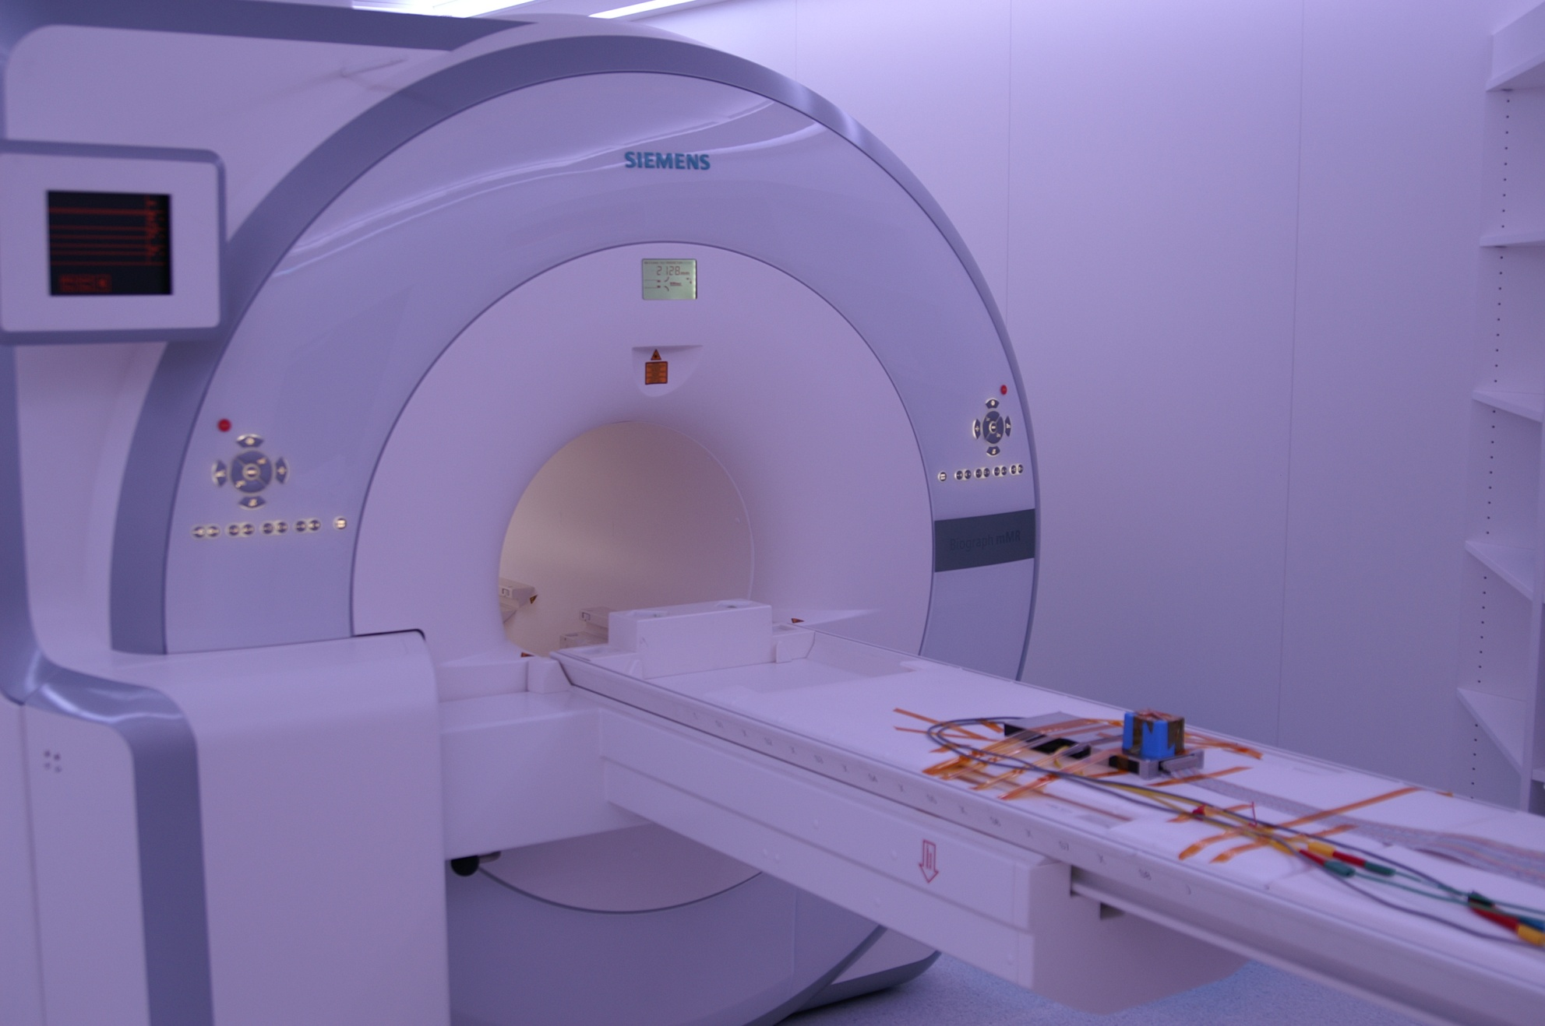
Siemens PET-MR
B= 3T
Operated with only static B field

Slide 5
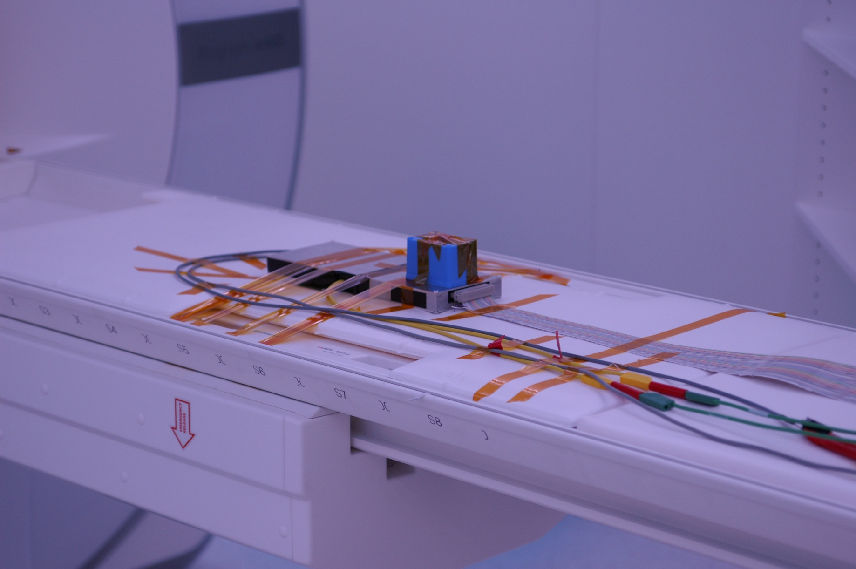
Patient …..
Cd¹⁰⁹
Hybrid board H 3.0.15

Slide 6
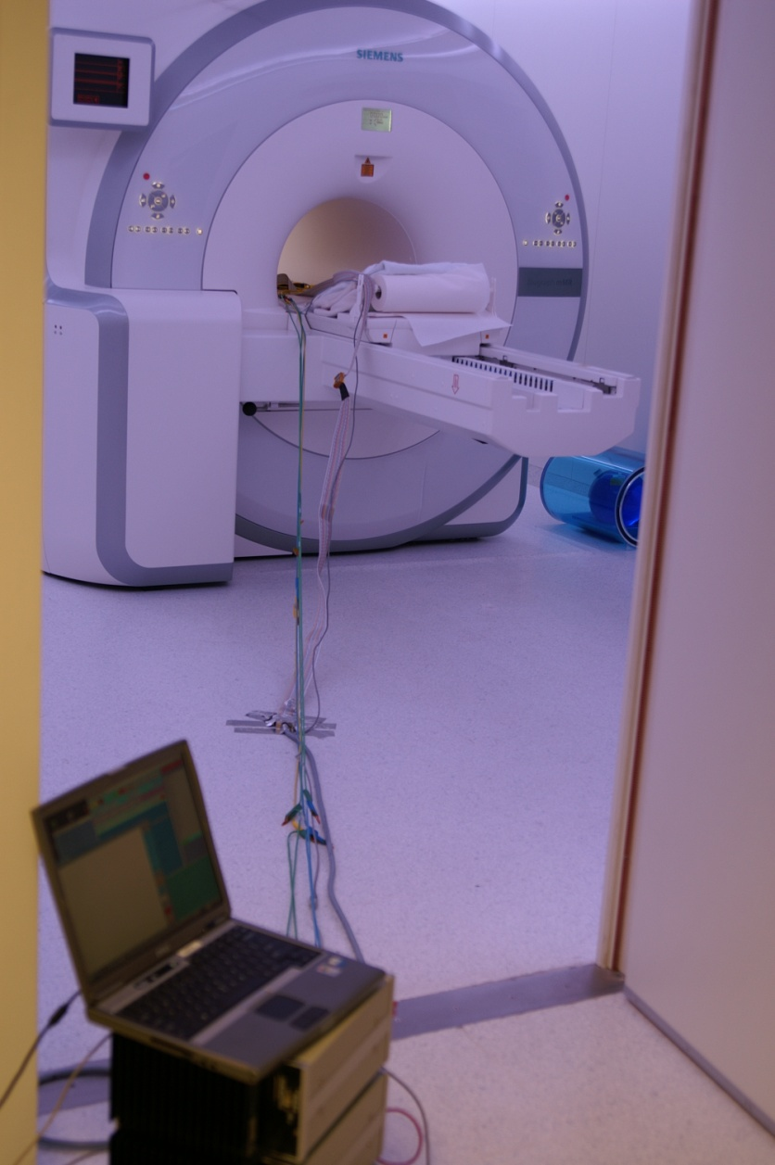
Diagnostic tool and operator …

Slide 7
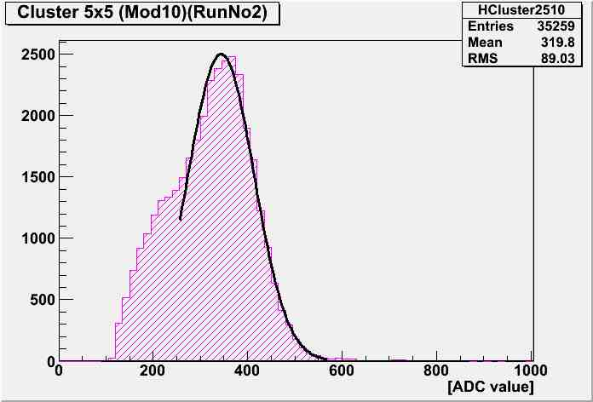
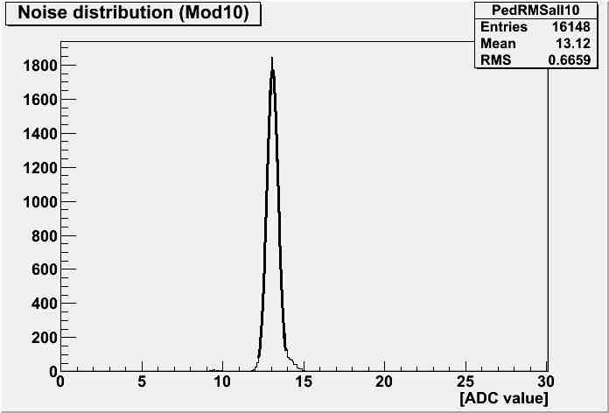
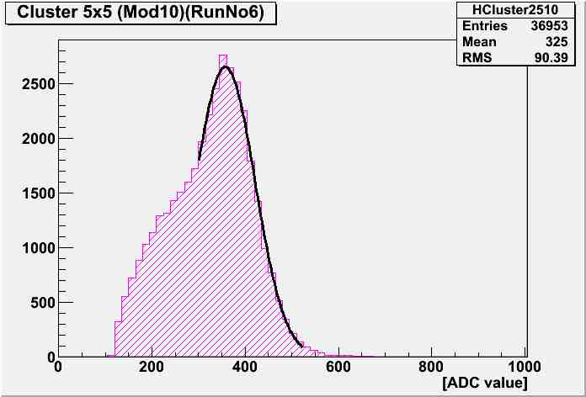
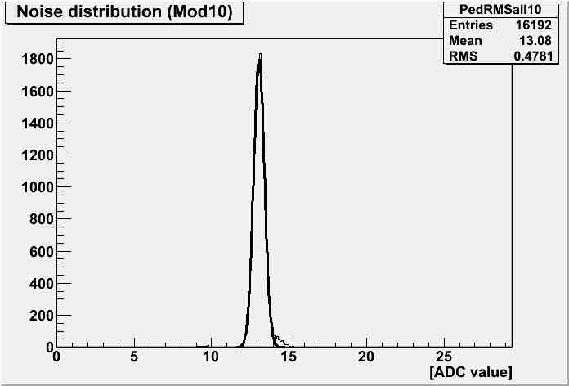
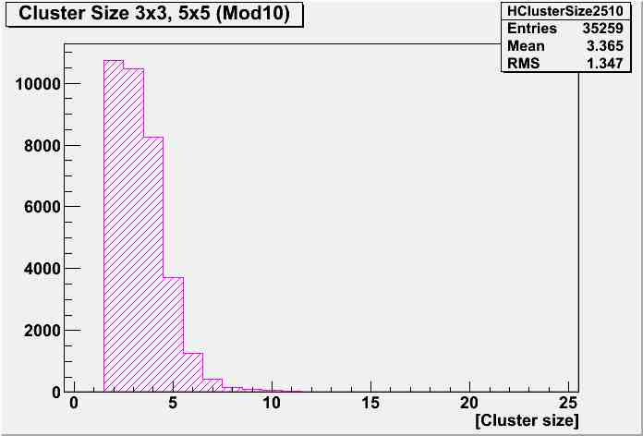
Preliminary results
Signal in 5x5 Cluster Noise Cluster size
B=3T
B=3T
B=3T
Mean 320
Mean 13.1
Mean 3.32
B=0T
B=0T
B=0T
Mean 325
Mean 13.1
Mean 3.36

Slide 8
Future tests …
We could use system again if we want. …

