Slide 1
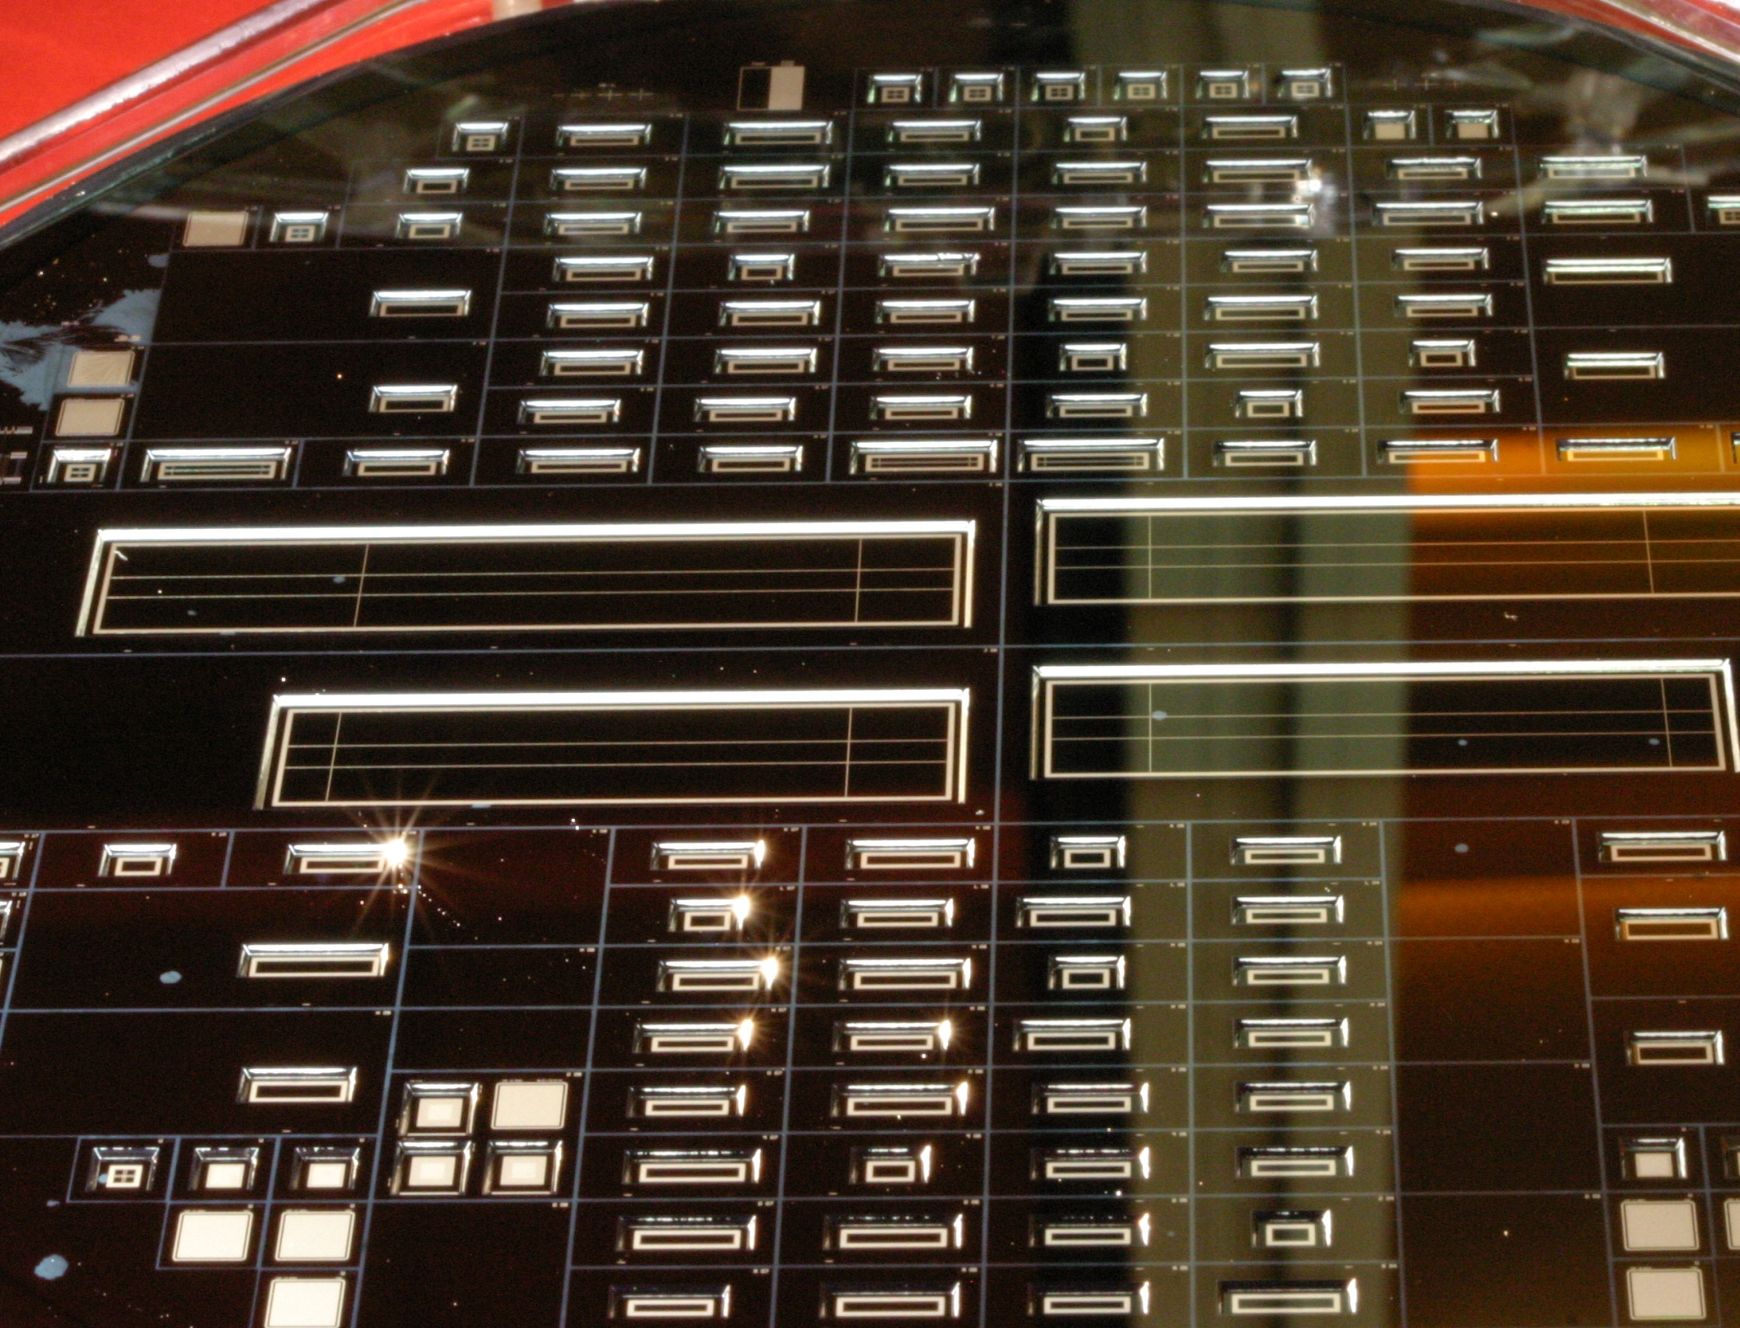
Technical Coordination
Schedule
Final Production
ASIC availability
Number of Wafers
Open issues
Odds and Ends (Action list, weekly report)
1

Slide 2
Schedule
When to start DEPFET production?
Original plan: September 2011 –
Criticized by referees: test with final electronics before production start
ASIC prototypes available: Nov 2011 (DCD, Switcher, Test_DHP?)
Can this be advanced ? No
Furthermore: SOI availability: needs to be resolved before June 2011
Processing should start latest ~ November 2011
Otherwise increasing risk to miss installation date

Slide 3
DEPFET processing
PXD6 Processing: Front Side:
16 Months -> 14 Months (delay due to problems with Tracit)
+ only few wafers
- 1 person 3days/week
- complex processing (variations, measurements)
PXD6.2: - >24 wafers (or more ?)
+ 2 persons (5 + 3 days/week)
+ no variants
Count with 14 months as well (for the first sub-batch to be ready)
+ copper (UBM ) (?)
+ back thinning (3 months)

Slide 4
Schedule
Processing starts: November 2011
Processing ready: End December 2012 (14 Months)
Thinning: Mid April 2013 (3 ½ Months – like PXD6)
Cut, test Mid June 2013 (2 ½ Months)
Start PXD assembly Nov 2013 (finished 1st May 2014)
4 ½ Months to produce 8 good ladders (16 modules)
Module/ladder Assembly
module: flip chip bonding of ASICs, caps 2 weeks (2)
tests 1 week (2)
kapton flex assembly 2 ½ days (2)
ladder joinig & test 1 week (1)
total 4 ½ weeks (1)
one ladder every two weeks:
=> 4 ½ + 7 x 2 weeks = 18 ½ weeks ~ 4 ½ months
after PXD assembly 2 months ‘buffer’ (for ‘tests’)
altogether 4 ½ months of contingency (but better to use it for
tests & commissioning)

Slide 5
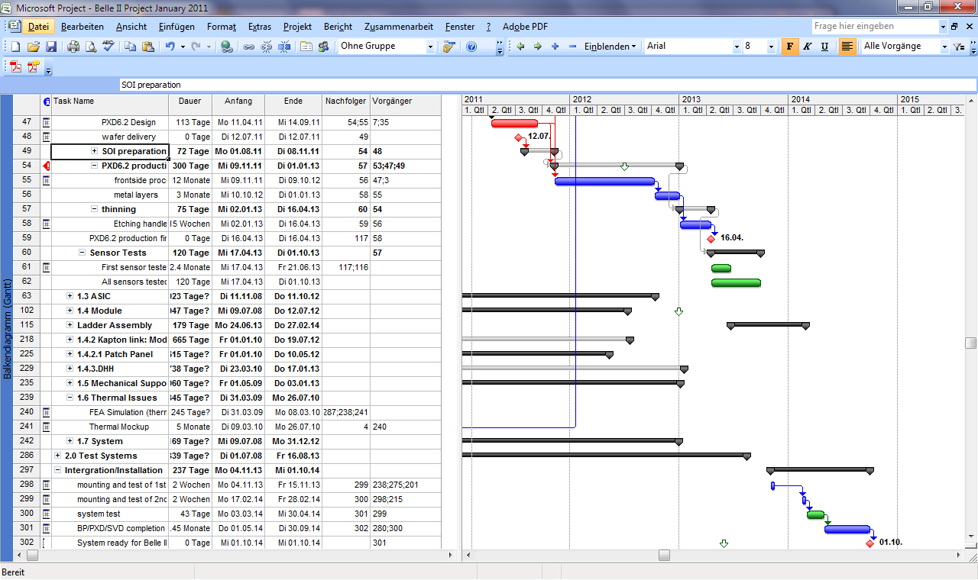
Schedule PXD6.2
2 ½ months between production end and assemble of first module
Use for tests (however: time for copper…)

Slide 6
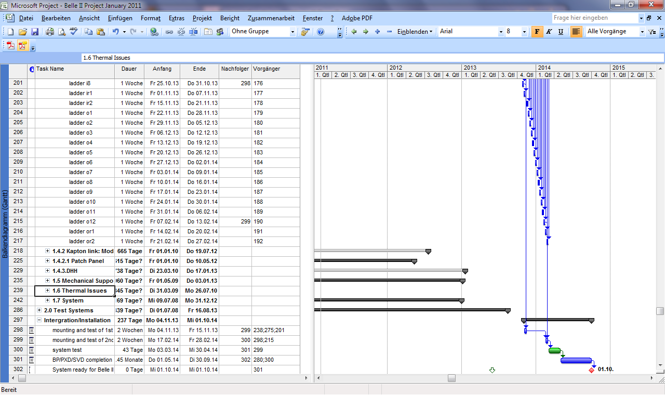
Schedule
Slow scenario:
Produce inner ladders, than outers
start inner/outer layer mounting when complete set of ladders is produced (ship together)
Speed up scenario: parallel (alternative), mount as they come: 3 months gained!

Slide 7
Commissioning
Could gain another ~ 6 months (less time to commission (emergancy)

Slide 8
Number of Wafers
Need: 16 inner layer modules
24 outer layer modules
Ratio: 2/3
Ratio: 3/4
Ratio: 2/5
Minimum yield 25%
incl. assembly (?)
24 wafers needed
18 inner
24 outer
May consider dependence of yield on area
y(outer) = y(inner) ^{4/3}
25% 16% => 32 wafers needed
16 inner
26 outer

Slide 9
Open Issues
Radiation hardness
nitride thickness
clear gate
Switcher. Reliability
DHP process: alternatives to IBM 90nm?
DHP/DCE algorithms need MC data
DCD: hope test chip will be a success
SOI: may just be in time…….(my largest worry)
CO2 cooling system(s): who does what where and when?

Slide 10
Action list
Gets more and more used (people need to be triggered from time to time)
Editor privileges can be granted on request

Slide 11
Odds and Ends
Weekly report:
please respond! (even if there is no news!)
Twiki:
needs clean up (remove dead wood)
Very useful (especially for newcomers) when up to date

Slide 12
Thanks!
Thanks to the Bonn group for hosting this workshop!
Next DEPFET workshop:
May 8-11, Ringberg Castle
Don’t miss the superKEKB groundbreaking ceremony!

