Slide 1
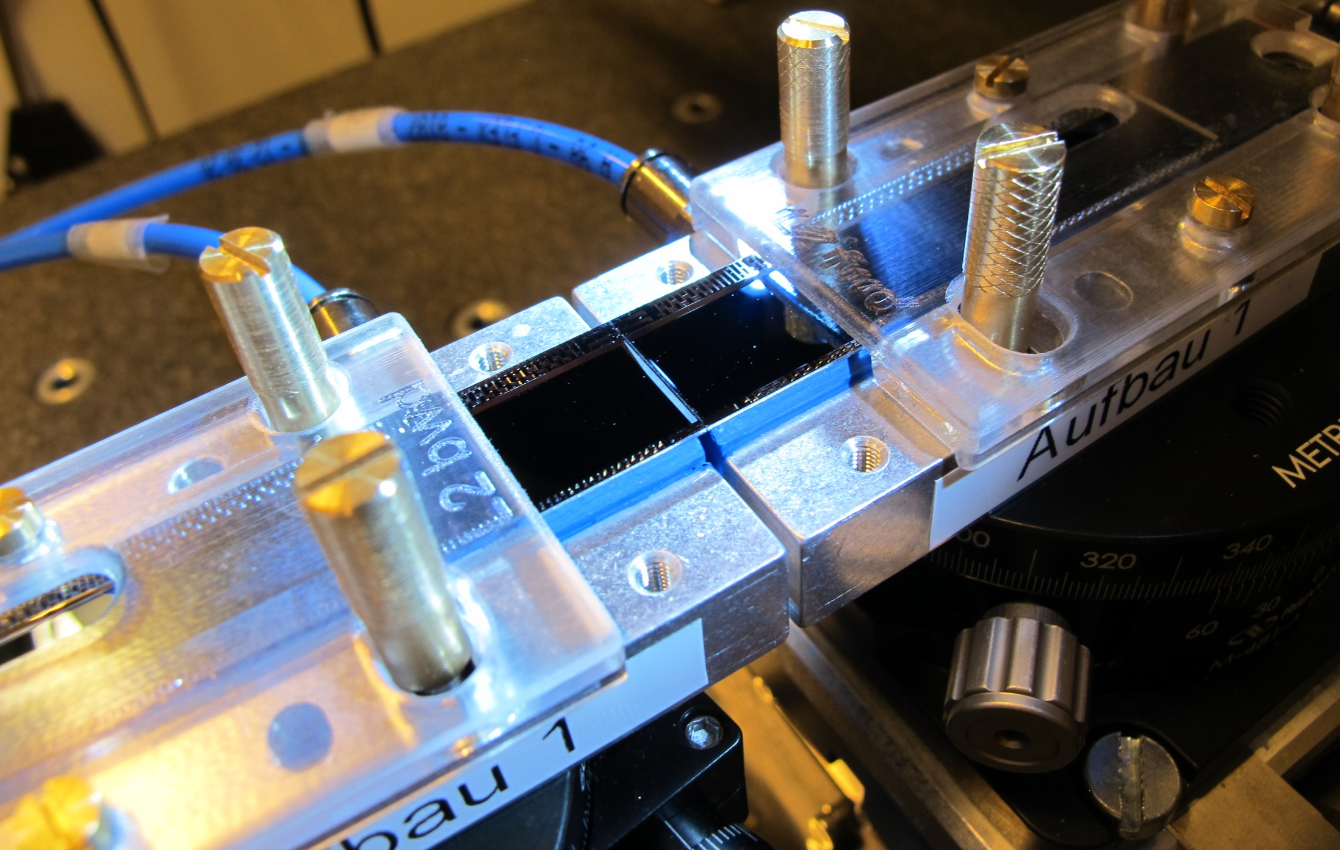
Ladder Assembly
All tools and jigs produced
Glue dispensing works
Pull tests ok
9 dummy ladders assembled

Slide 2
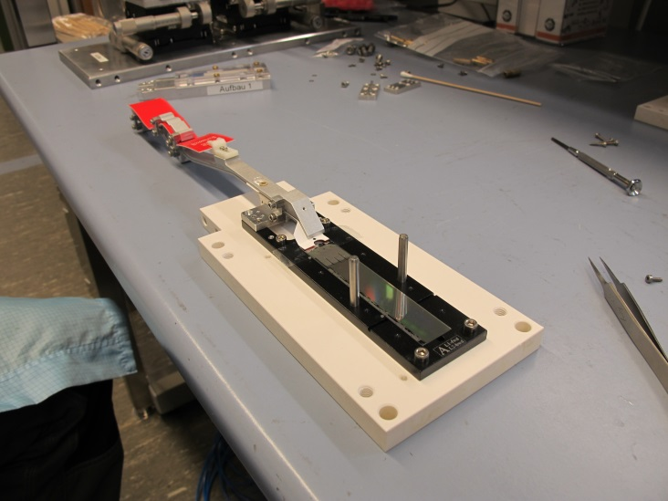
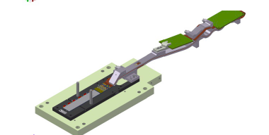
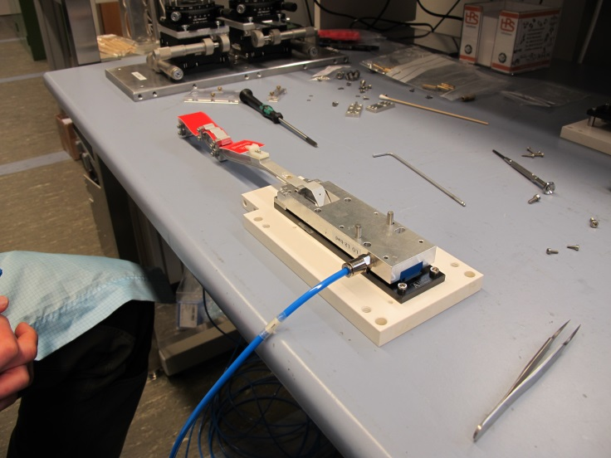
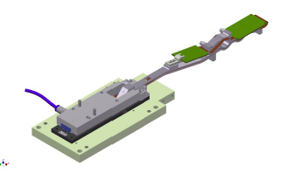
Transfer on vacuum jig
Modules arrive with kapton attached (tested)
Vacuum jig for turning and ladder gluing
Fits on top side (cut outs for switcher)
Mode from microporous plate (gentle vacuum on sensor top side)
Vacuum jig on sensor
Screw kapton jig to vacuum jig
Unscrew kapton jig from base jig

Slide 3
Accident
Made 18 transfers without problems…..
Demonstration to tech, coordinator: module cracked!
Reason: due to stiffness and misalignment of the dummy kapton modules lifted upwards from base jig
When the vacuum jig was lowered it did not push the module back, but broke it
Real kapton much softer and better aligned: this situation should not occure
Anyway: check and counteract if this happnes nevertheless
Vacuum Jig
Base Jig

Slide 4
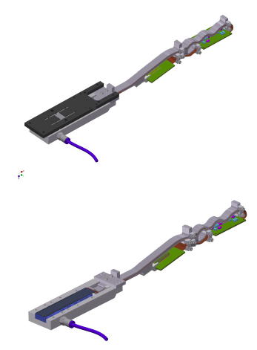
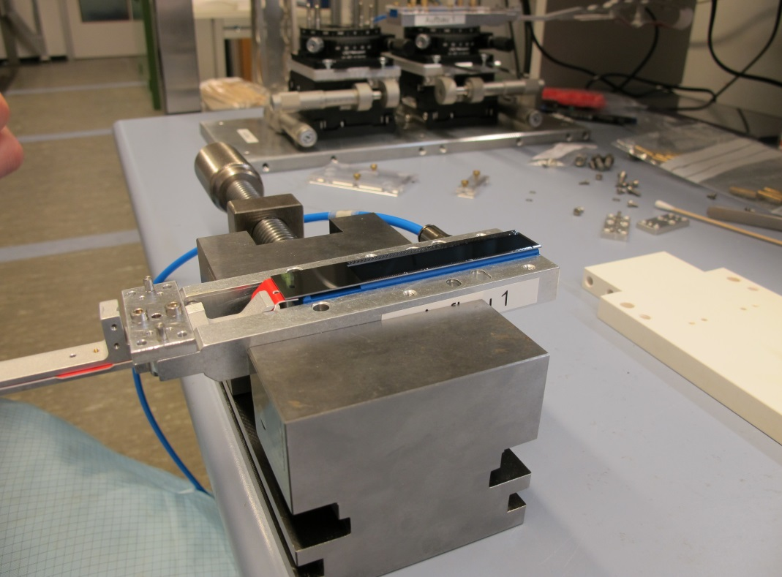
Remove base jig
Turn around and take off base jig

Slide 5
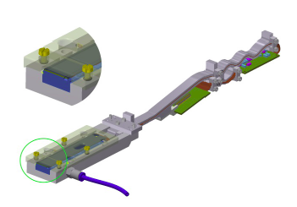
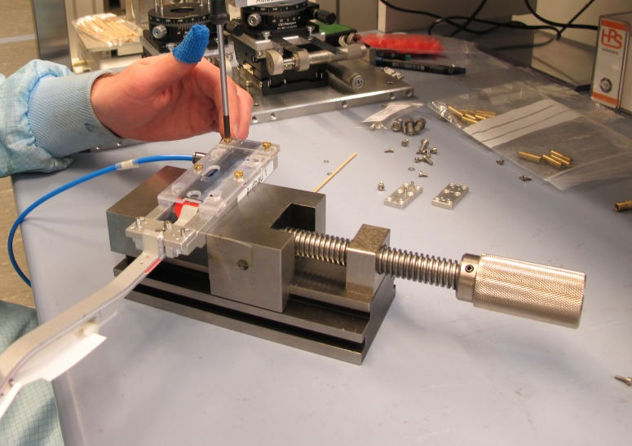
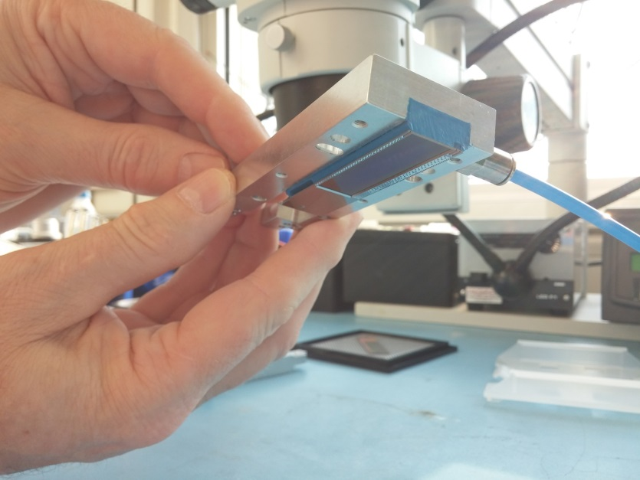
Prepare for glue dispensing
Add protective cover
to be sure: module is securely held by
Vacuum…

Slide 6
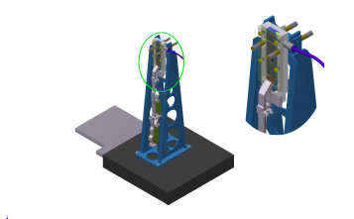
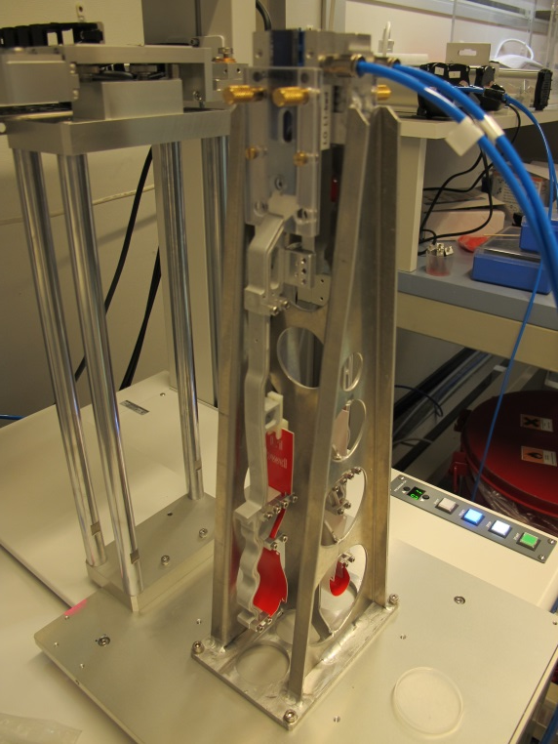
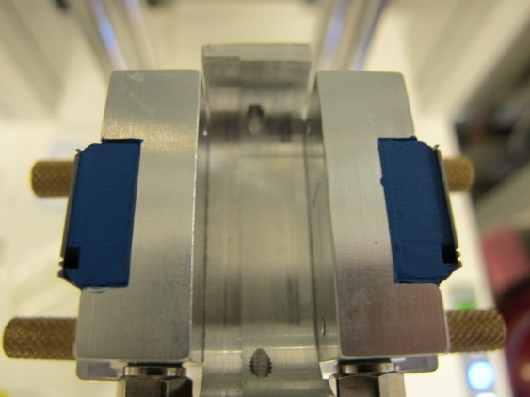
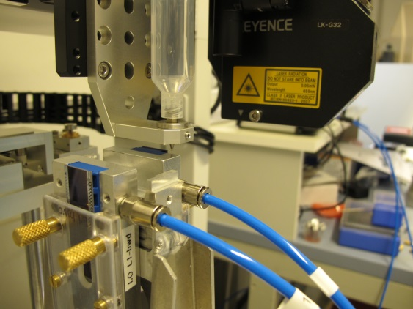
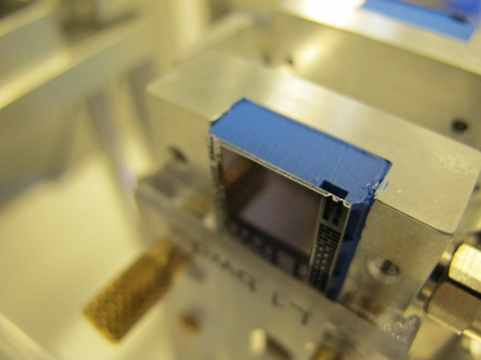
Mount on glue dispenser
2nd module is prepared the same way
Glue is automatically dispensed on both modules in one step

Slide 7
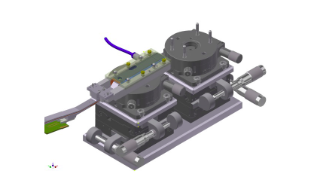
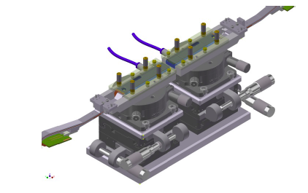
Place modules on alignment jig
bwd module 1st
fwd module 2nd

Slide 8
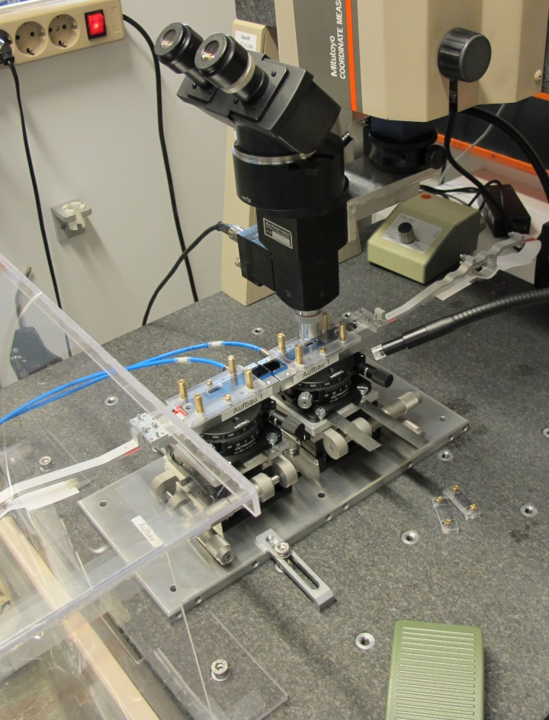
Align and glue together
Precision achieved:
10 µm over full length of ladder
Modules are pushed together to 30µm to ensure good contact and distribution of the glue.
Then they are driven apart to the nominal gap of 50µm

Slide 9
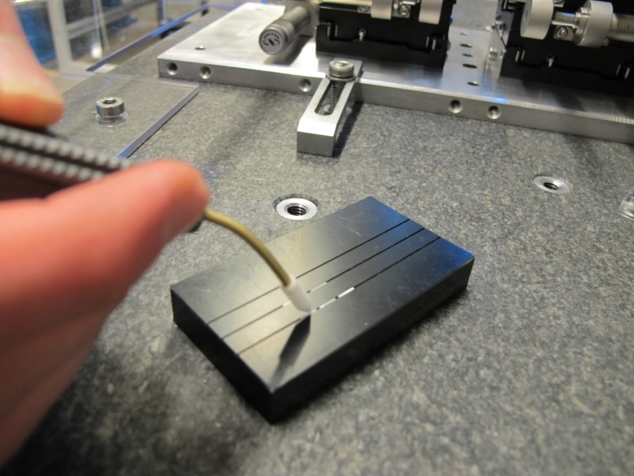
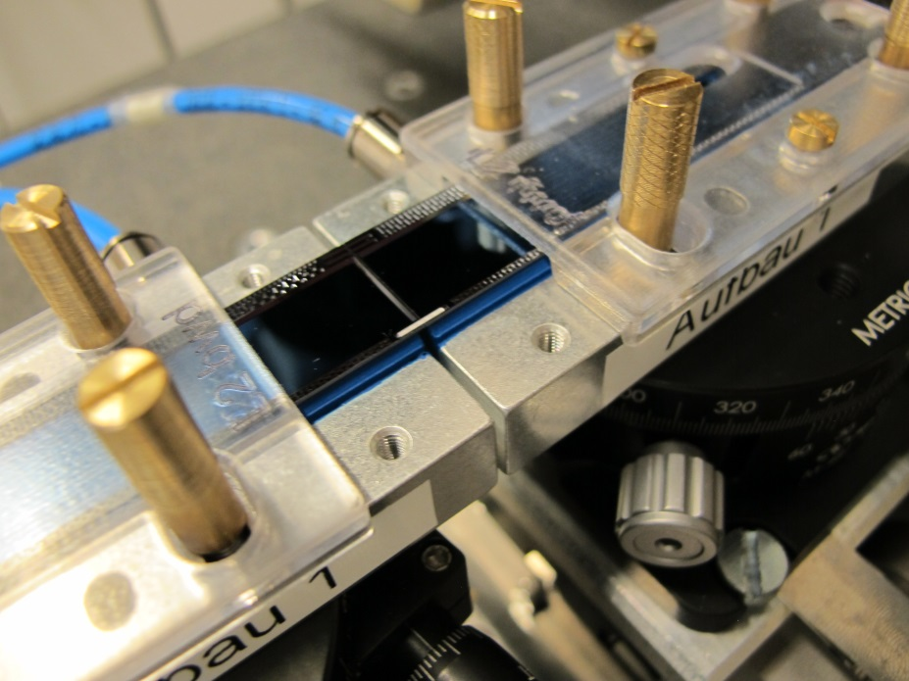
Add ceramic stiffeners
Stiffeners are handled with a vacuum tool
Glue is applied with a needle (works better than with a dispenser)

Slide 10
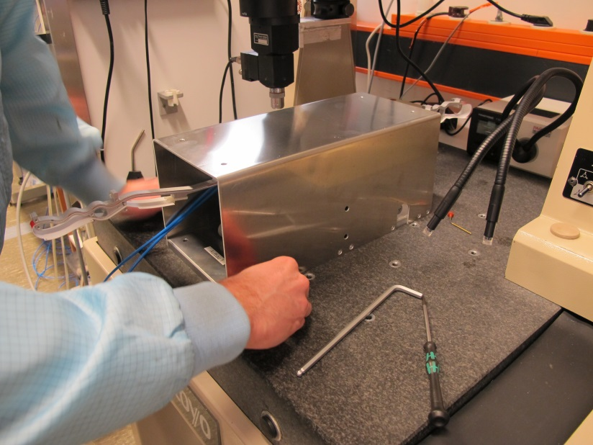
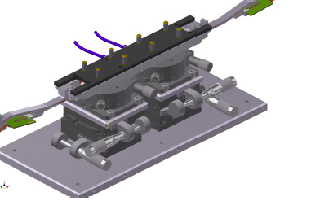
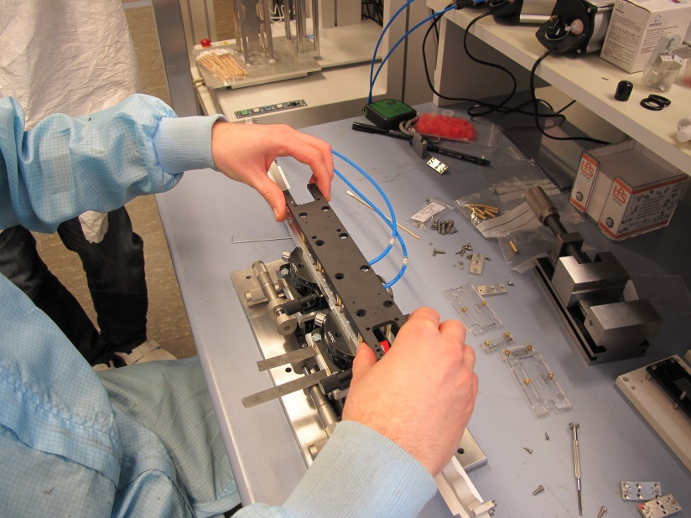
48h later….
For curing the ladder is covered and put apart
After curing ladder base jig is added

Slide 11
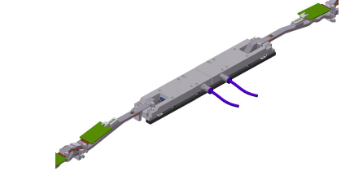
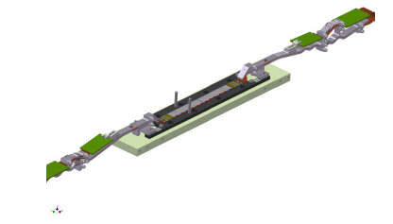
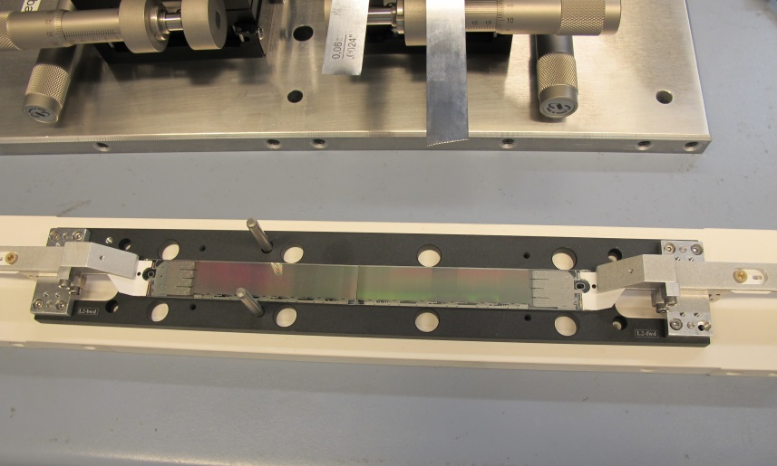
Remove vacuum jigs
Fix kapton jigs to ladder base jig
Unscrew vacuum jig
Remove ladder and turn over

Slide 12
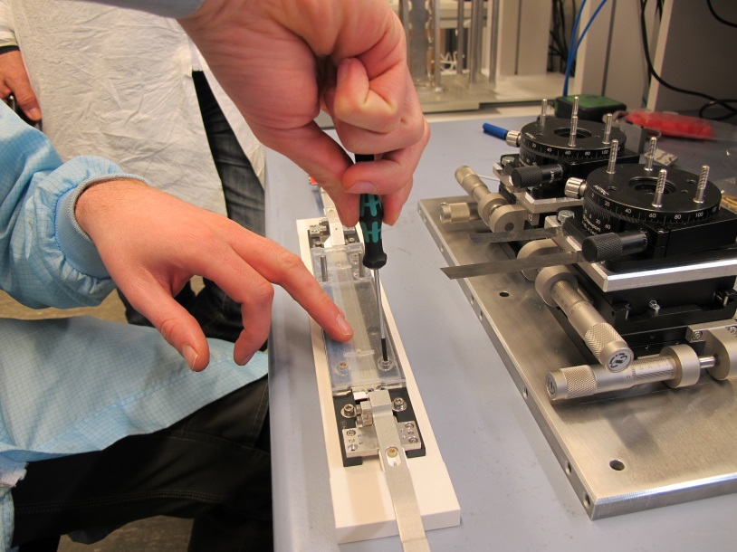
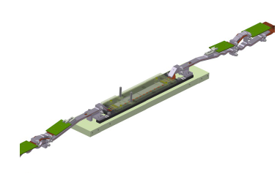
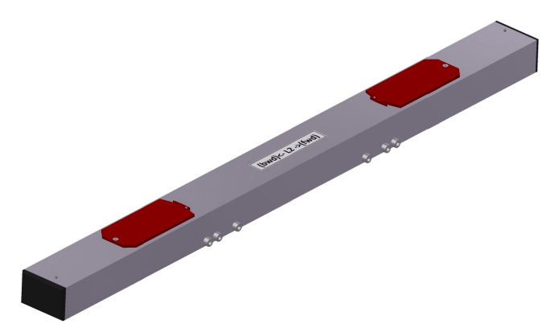
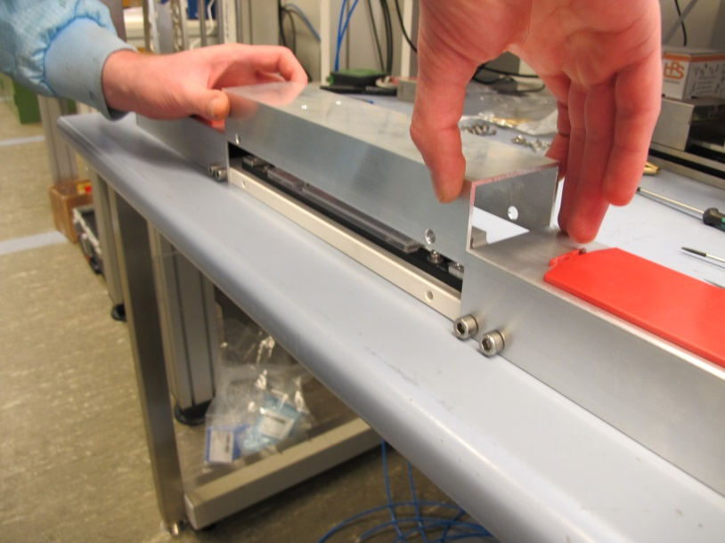
Protect and store
Add cover for sensors
Put in transport/storage box

Slide 13
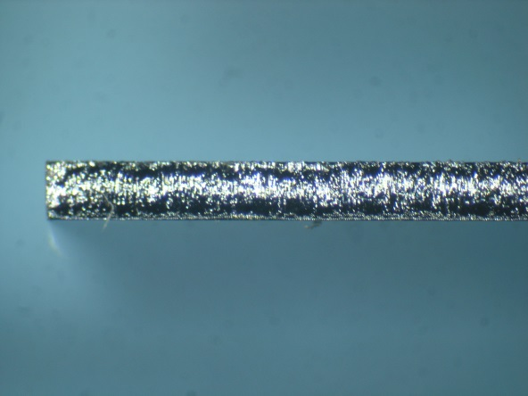
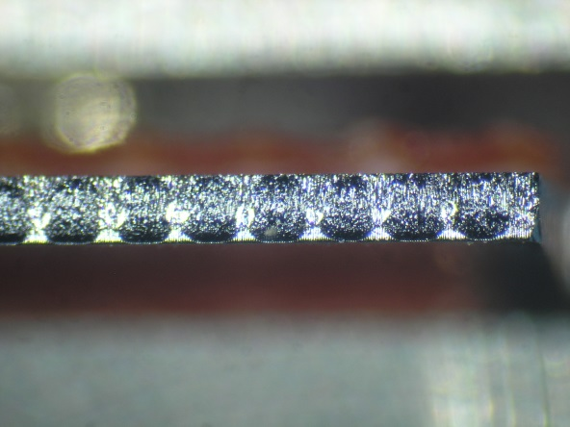
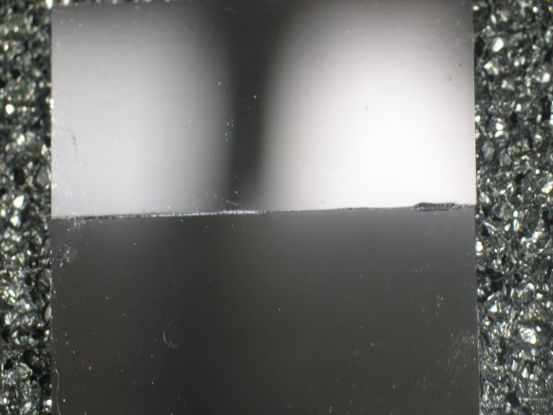
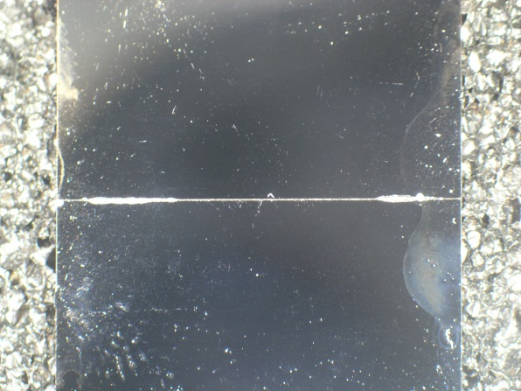
Gluing Tests
Musashi dispensor
Araldite 2011
200 Pa
5 mm/s (line)
Needle: 0.2 mm
Best results:
Line, broken at v-grooves
for stiffeners
Line dispensing
dots
First tests with manual alignment (no control of gap)
Some (very marginal) spill over (~100 µm width)
Second test series: no spill over

Slide 14
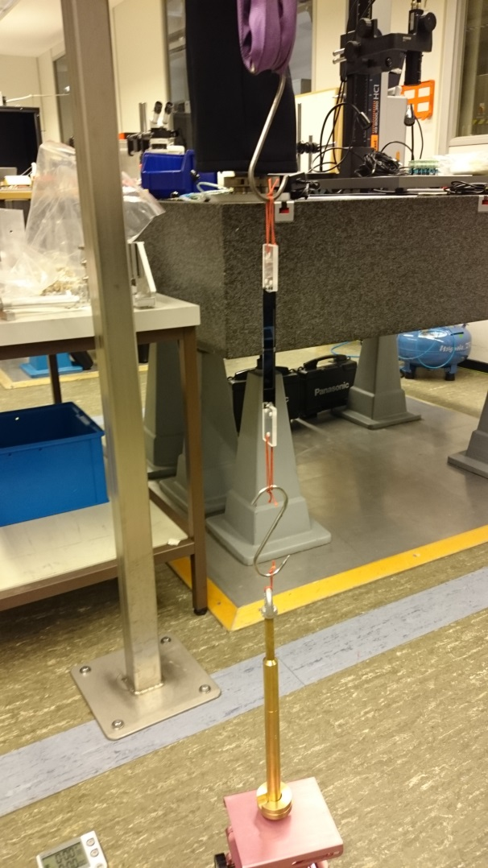
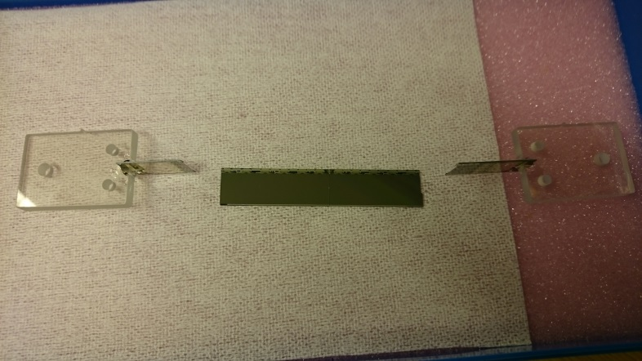
Pull Tests
Strip pattern: breaks at > 3 kg
Dot pattern weaker (~2 kg)
3 kg is considered sufficient (silicon breaks at ~3 kg)
Confirmed by pull test of 1st glued dummy ladder
=> 3.9 kg =>

Slide 15
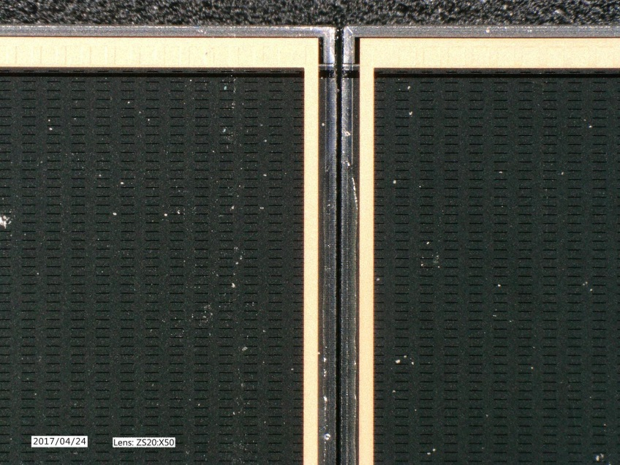
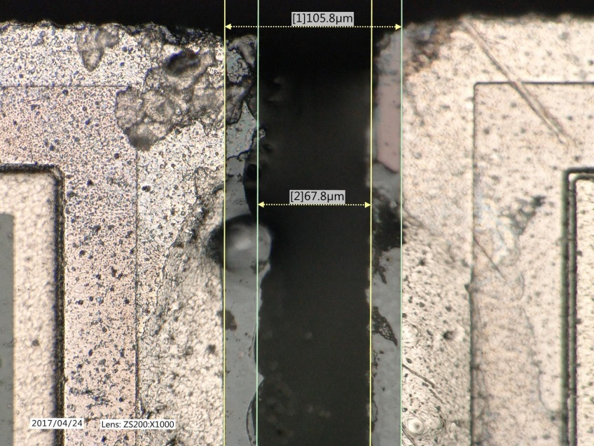
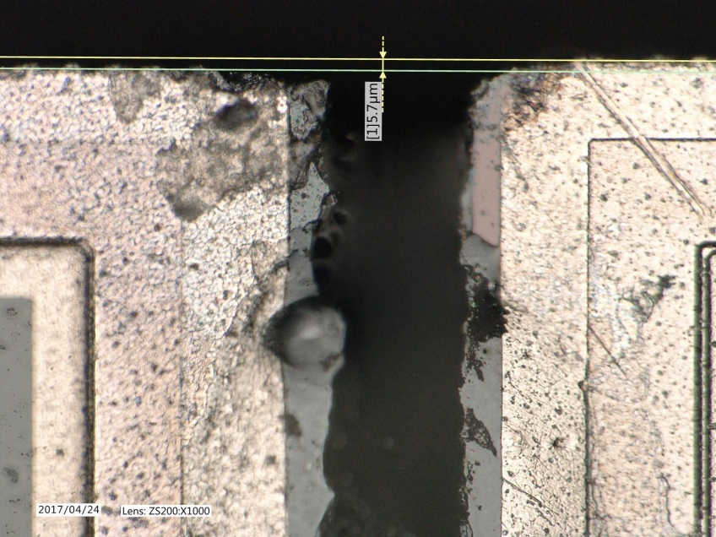
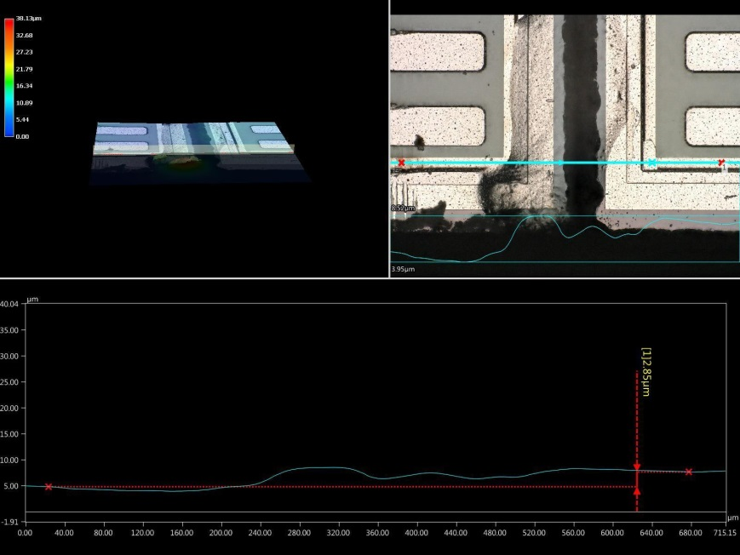
Protocol
Glue gap
Delta z
Delta x
Delta h

Slide 16
Statistics
Delta h
Glue gap
Ok after additional clamp
All in µm

Slide 17
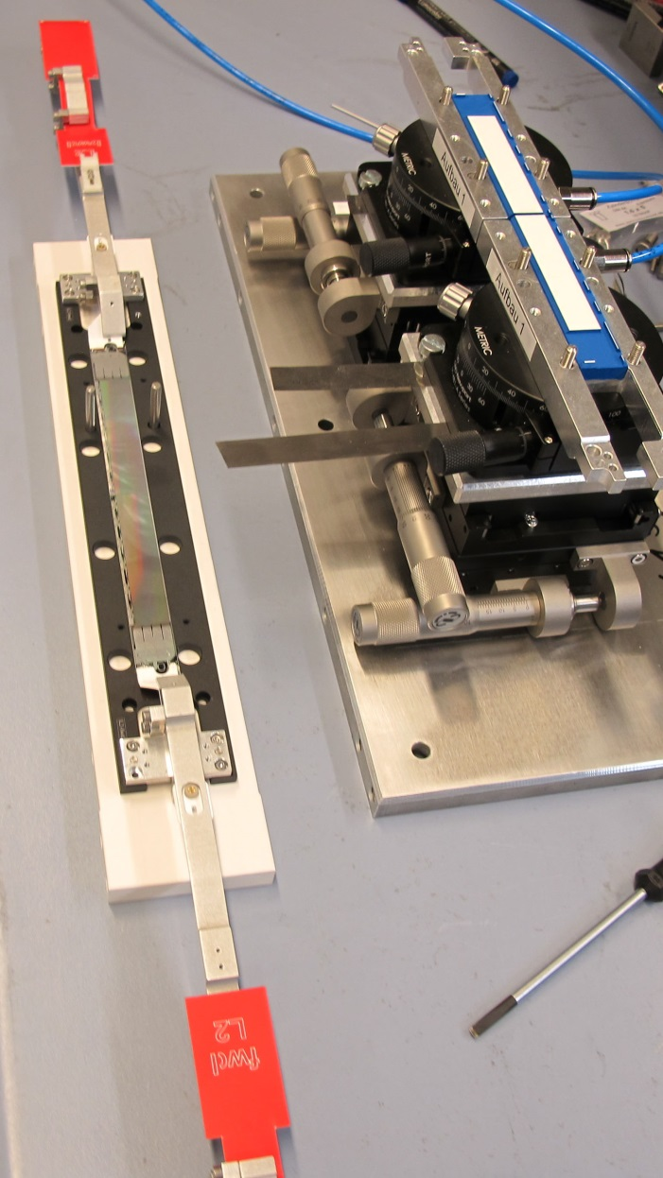
Summary
Module/Ladder assembly procedure defined.
Tooling is designed and produced.
All jigs are produced (for 80 modules & 40 ladders).
Gluing with automatic dispenser tested. Pull strength ok.
9 dummy ladders assembled
plain thinned silicon, plastic ‘kapton’
thinned silicon with copper, real kapton
Including ASIC dummies
Available: 5 outer ladders, 1 inner ladder
Assemble more realistic dummy ladders W31OF1, W30 OF1, xxxxxx
(partial) electronic test possible

