Slide 1
Status of BonnDAQ
Florian Lütticke
On behalf of the DEPFET Collaboration

Slide 2
Simplified Belle 2 DAQ
Full PXD Data
PXD ROI only
PXD
x 8
Data reduction
Module
DHE
ONSEN
Express Reco
Module
DHE
EVB
Module
DHE
DHC
Module
DHE
Module
DHE
Storage
DATCON
HLT
Strip detector (SVD)
Drift chamber (CDC)
Simplified
Calorimeter, PID, Muon/K_{L}
Data reduction using ROI selection: No full frames transmitted
Local calibration runs need full Belle2 DAQ

Slide 3
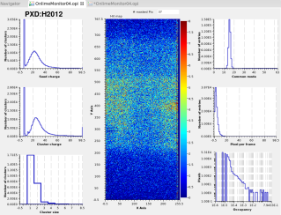
BonnDAQ in Belle II
Full PXD Data
PXD ROI only
PXD
x 8
Data reduction
Module
DHE
ONSEN
Express Reco
Module
DHE
EVB
Module
DHE
DHC
Module
DHE
Module
DHE
Storage
DATCON
HLT
Subset off full PXD events
BonnDAQ
Standalone DAQ running without HLT for
PXD Calibration data
PXD DQM on full data (no ROI)
Proven useful during 2016 and 2017 test beam
Currently: standard lab tool for measurements

Slide 4
Structure of BonnDAQ (05/2017)
Single DHE/DHC
Controlled over TCP
Writes (compressed) files
Live data distribution
Integrated statistics
Integrated logging
CMD Client(s)
Keyboard Command Decoder
TCP Command Server
BonnDAQ instance
Control
Statistics/ Health
Legend
DHE/DHC Receiver Thread
Buffer 1
Data Distribu-tion Server
Buffer 2
File Writer Thread
Thread
Socket
DHE
DHC
Compression thread pool
Compression thread pool
Compression thread pool
Data structure
File
Write/Control
Read/React
Error log file
Data listener(s)
Data File

Slide 5
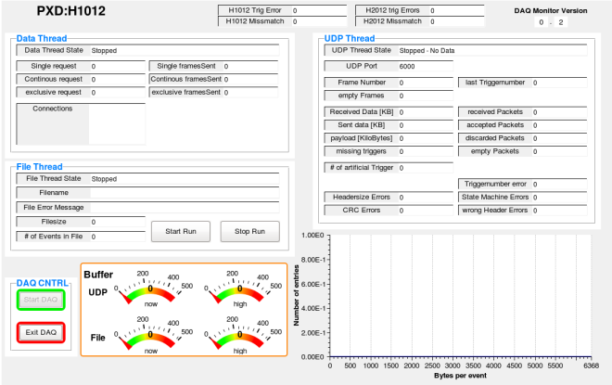
BonnDAQ: EPICS Integration status
DAQ Health module (python + CS-Studio)
Shows status of threads, filename, file size, connected clients (for live data), buffer fill status, error counts etc.
Creates EPICs server, requests DAQ status and publishes EPICS variables.
OPI display available
Used in 2016 and 2017
testbeam

Slide 6
BonnDAQ: EPICS Integration status
DQM display (python + CS-Studio)
Uses pyDepfetReader.TcpReader
Gets live data and calculates histogram
Creates EPICs server and publishes results
OPI display available
Used in 2016 and 2017 testbeam
~500 frames/sec
two PXD modules, single thread
~25 frames/sec for 40 modules
Currently standalone. Not integrated in histogram archiver
Currently available histograms:
Seed signal, cluster signal, cluster size, common mode, cluster per frame, hitmap, Occupancy (1D)

Slide 7
BonnDAQ at Phase 2 and Phase 3
Phase 2
2 DHCs
2 DHEs each
16 DHPs total
Using Gbit Ethernet: 200-250Hz for pedestals
Planned: Unified solution.
Fallback: One instance per DHC
Max 250 MB/sec: Good SSD required
Phase 3
8 DHCs
5 DHEs each
160 DHCs
Using Gbit Ethernet: 80-100Hz for pedestals
Unified solution. One program connecting to all DHCs
Max 1 GB/sec: Enterprise storage required

Slide 8
Reminder: Data estimates
Raw
Processed
Results and quality
Results only
Data per Scan
Reduction | None | Medium | Strong | Very Strong
Pedestal | 7.5 GB | 0.4 GB | 0.14 GB | 0.008 GB
Offset | 400 GB | 200 GB | 20 GB | 0.01 GB
Delays | 10 GB (0.1GB) | 0.01 GB | - | 0.0001 GB
ADC curve * | 80 GB (8 GB) | 0.8 GB | - | 0.01 GB
Data for Belle 2 lifetime
Reduction | None | Medium | Strong | Very Strong
Pedestal x 6000 | 45 TB | 2.4 TB | 0.84 TB | 0.048 TB
Offset x 400 | 160 TB | ~80 TB | 8 TB | 0.004 TB
Delays x 100 | 1 TB (0.01TB) | 0.001 TB | - | 0.00001 TB
ADC curve ** | 200 TB (20 TB) | 2 TB | - | 0.025 TB
BonnDAQ compression
* Single Setting, all ADCs
** Assuming 50 Scans during lifetime with RefIn/AmpLow, IPSource/IPSource2, 5 values for each setting (2 * 5 * 5 measurements), scan over all channels

Slide 9
Reminder: Cost estimates
Server:
8+1 1Gbit Ethernet for DHC and User
2 10Gbit Ethernet for Raid/User
2 * 12 Core CPU
8*8 GB RAM CPU
Est. price: 10K (24 Core, 3GHz, 64 GB RAM)
Fallback solution (Redundancy):
Powerful lab PC (800 Euro)
9 1Gbit Ethernet for DHC and User (400 Euro)
1 TB SSD (400 Euro)
<2000 Euro
Storage:
Discs: 50-60euro/TB
Depending on Size: 5-10K for server
~ 20K for 200TB
Not certain about the price
If only “small” storage: Single Server?

Slide 10
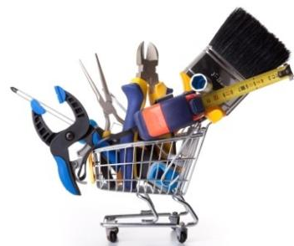
Things to be done
Buy Hardware
Tweak data format
Format ok for Phase 2, but needs some tweaks for Phase 3
Planned to be downwards compatible
(optional) reduce superfluous data
Performance tests and unit tests
PERSY: Lab version proven to work at 800Mbit
Currently writing DHC data generators
(worst case): Implement better UDP handling and/or memory management.
Integration in run control
Refine DQM Module
Integration in log server

Slide 11
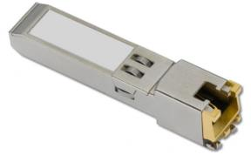
Open Questions
Connection to DHC (Current plan: Ethernet 1000Base-T)
Observed broken SFP Ethernet modules in DHE. Reason unknown
Use optical? If yes, upgrade to 10GBase-T?
Data selection for online monitoring
DHC sends every nth event: Could miss effects happening with same frequency
Random selection: No full detector events from BonnDAQ.
Phase 2: One or two DHCs?
Storage at KEK
Who to ask at KEK
for disc storage?
for access to tape backup?
Which histograms are needed?
Useful to have an „Error Interpreter“?

Slide 12
Conclusion
Progress on planing for BonnDAQ @ Belle II
Total data for optimization during lifetime < 200TB
We need to contact KEK computing soon…
Cost estimates: 10K (Server), 20K (Storage), 2K (Backup system), +X if we need our own data backup.
For users: Backup has information on data checks, log file format, command line parameters.

Slide 13
BACkup

Slide 14
BonnDAQ and pyDepfetReader Data checks
Check that frame sequence is correct:
UDP packets in large frames correctly ordered
DHP data encapsulated by DHE Start/End of event
DHE data encapsulated by DHC Start/End of event
DHE ID may not change within DHE data
Check packet size of non-data frames(14 byte DHE SOE is accepted, old bug…)
Checksums are verified (Some DHE bugs require to update checksums)
Trigger number are checked to be consecutive
Check that DHP ZP data starts with Row header
Check that only one frame type (Raw, ZS, Ghost) is received per event
Check size of DHP raw data is ok
Check that frame size in DHE/DHC End of event
Check DHP header
Redo (most) BonnDAQ checks and check BonnDAQ data format.
BonnDAQ
pyDepfetReader

Slide 15
BonnDAQ Commandline options
Change filename
Explicit filename given with --file
Automatic naming: Specify folder with --path, overwrite runnumber with --runnumber, change file prefix with --filePrefix
DEBUG options
--ignore-missing-trigger disables event number correction (i.e. inserting an empty event when event numbers are not consecutive)
--strict-checks disables all error correction mechanisms and logs all errors.
Multi DHE/DHC support
--inputport sets port where DAQ expects DHE/DHC data
--controlport sets port for remotecontrol
--dataport sets port where DAQ distributes live data

Slide 16
Logfile format
Log warning messages and the offending packets
At each start up a log file is created (/tmp/dhh_daq/daq_errors<number>.txt).
Log files contains header „DAQ Error Log Tue May 17 16:12:46 2016”
Logging is limited to 50 errors / 10 seconds if not in debug mode.
Error message with number of the offending packet “packet 40: This is a error”
Each line is a packet. Format:
Time, relative position to offending packet: Data
This is Packet 40
Packet 40 had an error
Last packet without error
packet 40: This is a error
…
16:12:46.402434, -2: 71 00 00 e6 5e 00 00 1c 45 00 00 30 5f 00 00 82 41 00 00 d0 04
16:12:46.402434, -1: 00 00 e6 5e 00 00 1c 45 00 00 30 5f 00 00 82 41 00 00 d0 04 00
16:12:46.402434, 0: 00 e6 5e 00 00 1c 45 00 00 30 5f 00 00 82 41 00 00 d0 04 00 00
16:12:46.403955, 1: e6 5e 00 00 1c 45 00 00 30 5f

Slide 17
BonnDAQ for Belle II
Suggested solution: Easy to control, one file for full PXD data
Needs work (and testing) for implementation
Needs powerful machine
CMD Client(s)
Other solution:
Just start existing
BonnDAQ 8 times
Keyboard Command Decoder
TCP Command Server
BonnDAQ instance
Control
Statistics/ Health
DHE/DHC Receiver Thread
Event building and sorting
Data Distribu-tion Server
File Writer Thread
DHE/DHC Receiver Thread
Buffer 1
Buffer 3
DHE/DHC Receiver Thread
Buffer 1
Buffer 2
Buffer 1
DHE/DHC
DHE/DHC
DHE/DHC
Compression thread pool
Compression thread pool
Compression thread pool
Error log file
Data listener(s)
Data File
Error log file
Error log file

Slide 18
Data Estimates for calibration
Pedestals:
Once per run, 3 runs/day, 200 days/year, 10 years: 6000 pedestals during lifetime
100 (1000?) Frames: 760MB (7.5GB) for pedestals
Total: 4 TB (40 TB)
Offsets
Once per Week, 40 weeks/year, 10 years: 400 Offset per lifetime
~32 (IPDAC) * 4(OFFSET) * 4(?) * 100 Frames: 100-400 GB for Offsets
Total: 40-160 TB
Delays
Once a month, 10 months/year, 10 years: 100 delays per lifetime
5 frames * 16 * 16 settings: 10 GB
Total: 1 TB
DCD transfer curves
Once per 2 months, 10 months/year, 10 years: 50 measurements
80 GB for all ADC channels (2MB channel, 2000 points/channel, 256 values/point), one setting. (2 * 25 settings?)
Total: 4 TB (200 TB?)
Time estimates:
Pedestals: 1 min DAQ + 1 min calc + 2 min upload. 4 min
Offset: 5 sec DAQ/setting * 32*4*4 settings. 10-40 min + calc
Delays: 4 sec DAQ/setting * 16 *16 settings: 18 min + calc
DCD transfer curves: DHE current source
10 min (All settings, one channel/DCD)
55 min (one setting, all channel)
42h (full scan)
Other Scans
SubIn/Gate voltage: Optimize Gate voltage for switcher pairs and Sub In for DCDs. Can be included in offset, would increase the time by 16 when using 4 voltage values and 4 SubIn values Else: Separate Short SubIn VGateOn scan, before offset scan. Much faster, perhaps less pedestal compression
5-40TB over lifetime: 4-16 (GateOn) * 4-8 (DACSubIn)*100 Frames, 3-10min + calc
Pedestal verification/noisy pixle scan: 1 min DAQ, 1 min calc

Slide 19
Data Estimates cont’d
Live DQM data acquisition
DHP bandwidth: 160*1.6 Gbit/s * 8/10 = 204 Gbit/s
Assumes 3% at 30KHz - > realistic occupancy : 0.75%
Effective bandwidth 50 Gbit/s at 30 KHz
Event: ~ 200-300KByte
Target: 20 Mbit from each detector, 160 Mbit total
Factor 312 lower than 50Gbit
Keep every 256th or 512th event
100 Hz
Data rate:
20MB/s * 3600 s/h * 6.6h/runs* 3 runs/day = 1.3 TB/day
Total runtime (200 * 10 days): 2600 TB=2,5 PB
Data Reduction possibilities:
Keep only triggered elements (which HLT keeps)
Make more sparse with time
Use compression (reduction by ? <2 ?)
Up to 8Gbit total possible
Should we permanently save DQM data at all?
Probably not!

