Slide 1
New low-power DCD chip - DCDC
Ivan Peric, Roberto Blanco

Slide 2
Reticle
DCDI
DCDIII
DCDII
No logo
DCDIII
DCDC
DCDEI
DCDEII
DCDEC

Slide 3
DCDC
DCDC chip is based on capacitive SAR ADC
Front end is the same as for DCDB4.2
DCDC is fully compatible (pins, configuration, readout) with DCDB4.2
Several DAC settings are different (only three DAC settings needed for analog part of ADC)
No RefIn current consumption (used as threshold)
Radiation tolerant design
It was measured on probe station with PC22
Measurement frequency was between 100MHz and 320MHz
Analog power consumption 75mA (where DCDBv2 has 300mA)
Power consumption per chip about 350mW

Slide 4
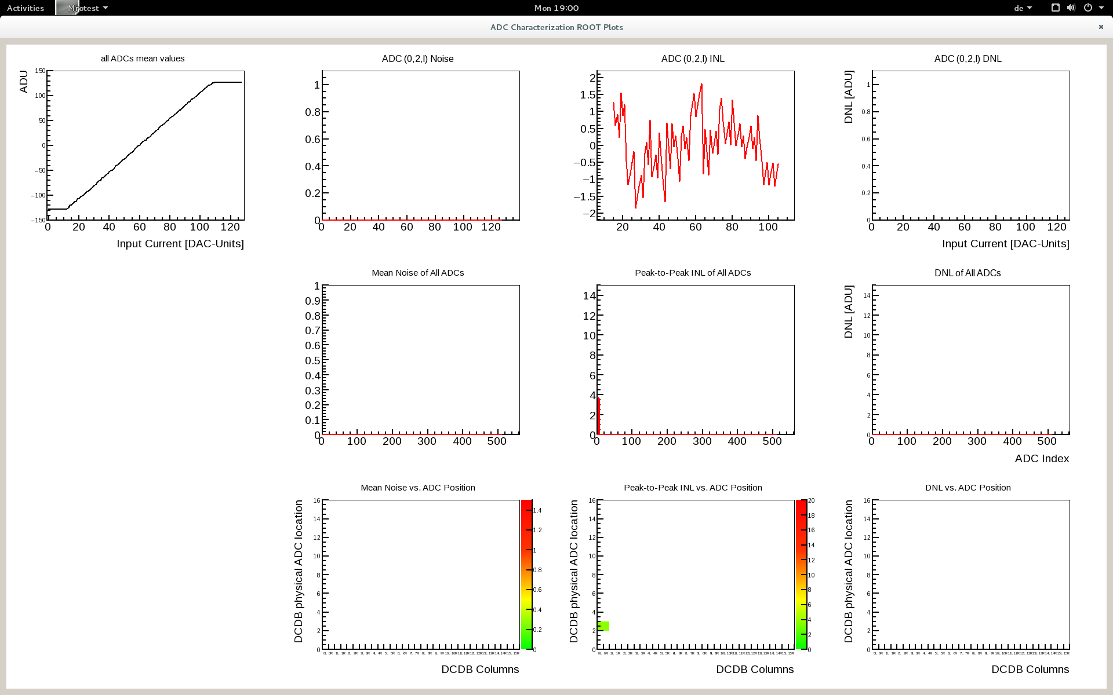
DCDC
Measurement with Heidelberg PC with SPARTAN FPGA – good linearity – 100MHz

Slide 5
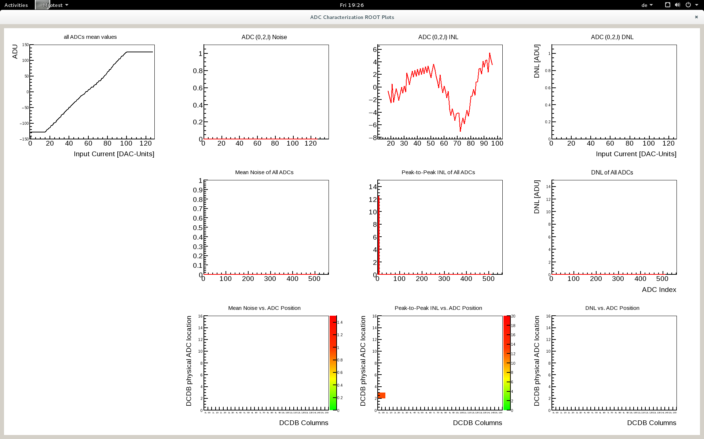
DCDC
Measurement with PTSL PC22 with faster NEXYS FPGA – 320MHz
Nonlinearity is probably caused by the contact problems – not an issue of DCD and speed
PC22 shows nonlinearities even at frequencies where Heidelberg PC makes nice linear ADC lines

Slide 6
Ain
DAC
K
?
D
Komparator

Slide 7
i=1
VDA=0
Vref
B(n-i) = 1
VDA+=Vref/2^{i}
VDA
Vin
Vin>VDA
nein
Zeit
B(n-i) = 0
B(n-i) = 1
VDA-=Vref/2^{i}
i = i +1

Slide 8
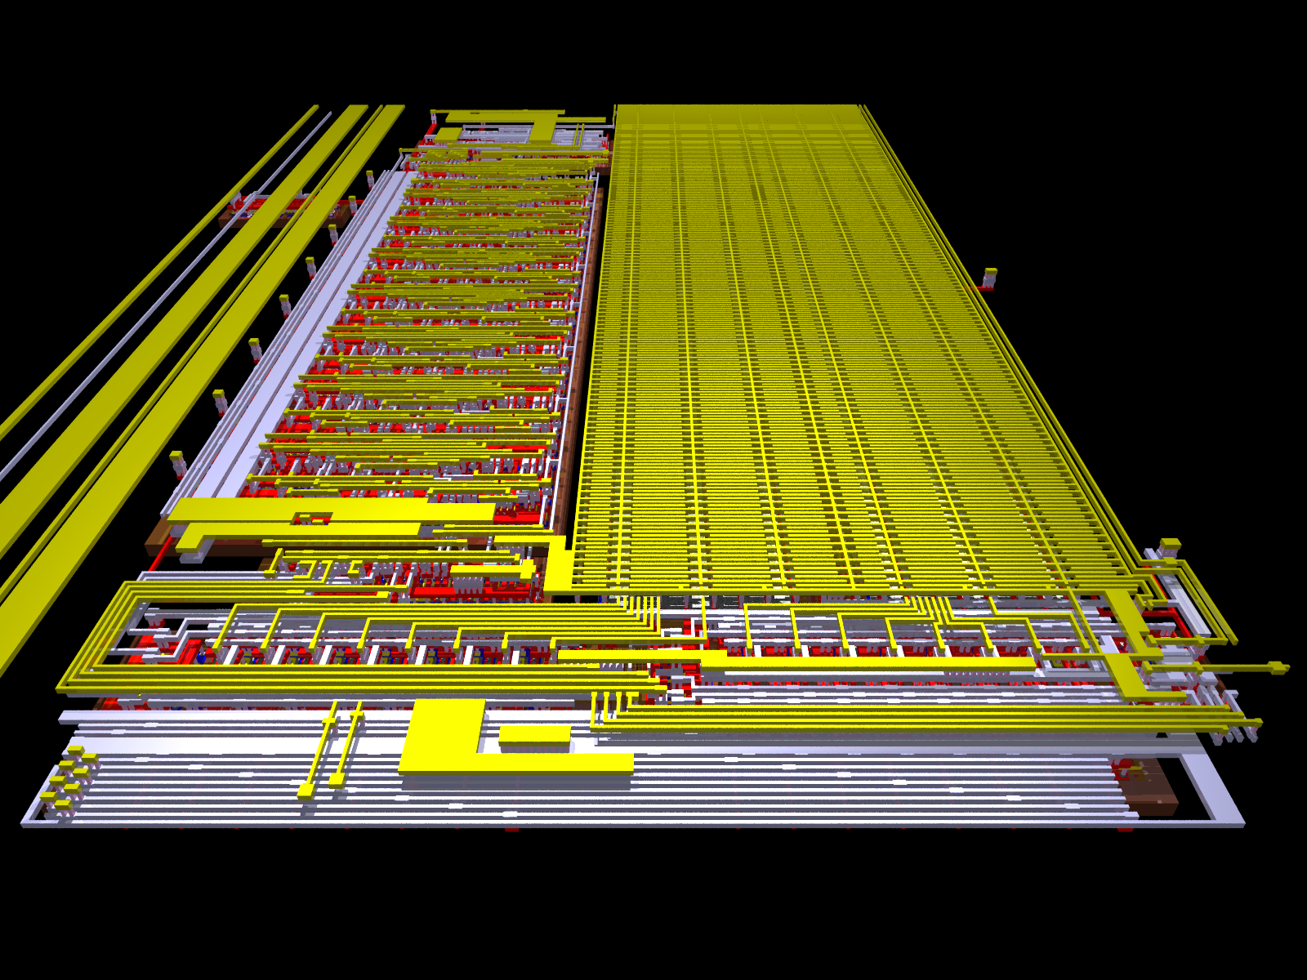

Slide 9
DCDC
New DCD chip based on capacitive SAR ADC was successfully tested at probe station at full speed
Front end is the same as for DCDB4.2
DCDC is fully compatible (pins, configuration, readout) with DCDB4.2
Several DAC settings are different (only three DAC settings needed for analog part of ADC)
No RefIn current consumption
Reduced power consumption by 500mW
Radiation tolerant design

