Slide 1
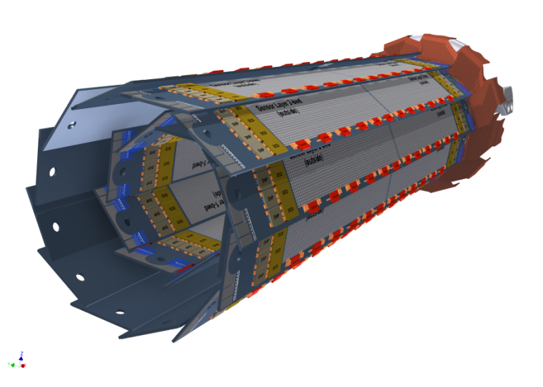
Gated Mode - System Aspects
Felix Müller on behalf of the Gated Mode crew (Christian Koffmane, Philipp Leitl, Luigi Li Gioi)
21st International Workshop on DEPFET Detectors and Applications
28th – 31th May 2017
Ringberg Castle

Slide 2
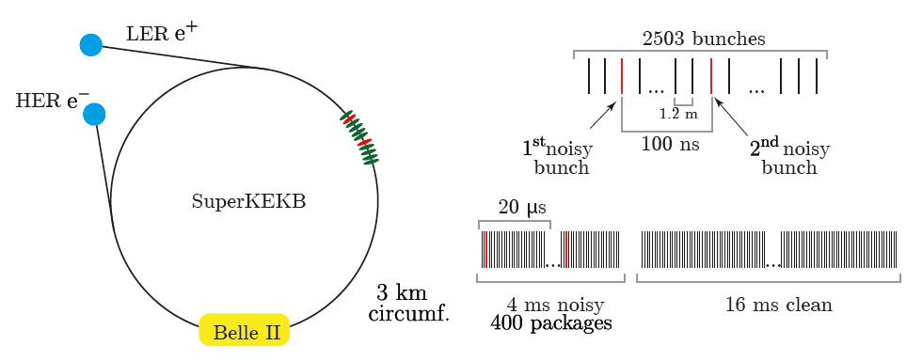
Gated Mode - Theory
KEKB
Continuous top-up injection with 50 Hz, i.e., every 20 ms
Bunch revolution time: 10 μs
Shield detector during passing of noisy bunches
Limit by other sub-detectors: 1 μs
BEAST Phase 2 will bring more information about damping time

Slide 3
Gated Mode
readout
direction
PXD sensitive area
Dead time:
1.4 µs – 1.9 µs
→ 14% of sensitive area
→ 19% of sensitive area
Gated Mode
20 µs
10 µs
Gated Mode
Dead time: Shielding of DEPFETs and Pedestal oscillations / relaxation

Slide 4
DHP – DCD – Switcher principle
gate changes every 8 clock cycles of GCK
DHP memory blocks
Switcher
Switcher | Signal | Pedestal | Offset
gate 1
128bit to Switcher
from
DCD
<, >
threshold
to
DCD
512
gate i
normal
gate i+1
gate i+2
gate 192
spare until
gate 256
VETO
512

Slide 5
DHP – DCD – Switcher principle for GM
gate changes every 8 clock cycles of GCK
Switcher | Signal | Pedestal | Offset
gate i
GM
Normal sequence
gate i+k+1
gate i+1
gate i+k
Switcher sequence

Slide 6
Gated Mode
Apply Clear On voltage at all DEPFET pixels
Switch Off the DEPFET
192 Switcher outputs in total
Four groups to (de)-activate the Gated Mode, each Switcher has 4 groups:
Each Switcher (de)-activate the Gated Mode for 8 gates simultaneously

Slide 7
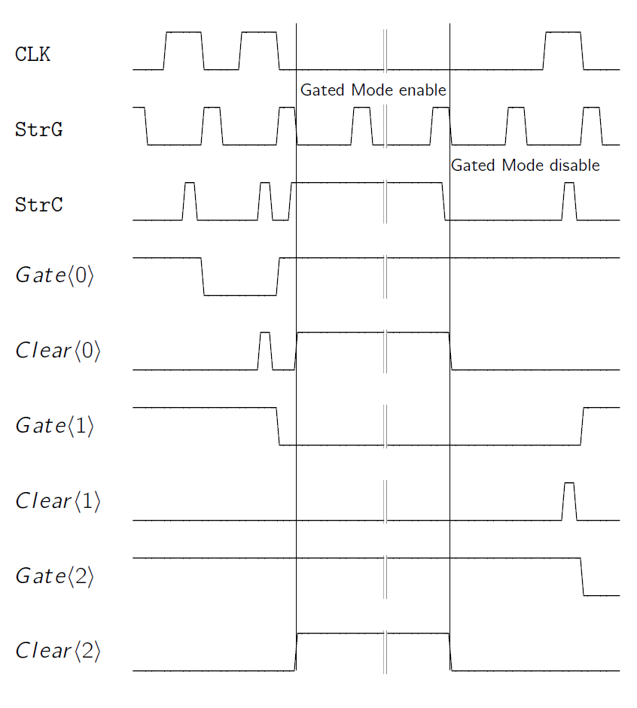
Gated Mode w/o readout
Stop Readout
During gating there is no readout
Continue readout after gating
need to be in sync with offsets, pedestals and machine => Fast clocking

Slide 8
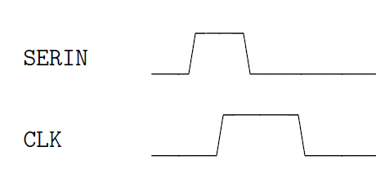
Gated Mode w/o readout
“Missing next frame” (Missing all frames during the damping time of noisy bunches (which prevent the sampling of the SerIn signal)) problem
Switcher requires high clock for SerIn
Fast clocking to get in sync

Slide 9
Gated Mode w/o readout
Advantages:
Can ramp up/down the Switcher groups with steps of 7.56 ns
Adjust the length of activating the GM in steps of 3.26 ns
Fast (de)-activation: 20 ns in theory for (de)-activation, and (90 ns) 75 ns are measured
Disadvantage(s):
Missing “next frame” problem / Missing all frames during the damping time of noisy bunches (which prevent the sampling of the SerIn signal)
In addition: Pedestal oscillation, i.e., require extra time for relaxation of pedestals, ~ 1µs (must be measured again in more detail with newest generation of ASICs)
total time for GM: ~ 370 ns
total Gated Mode (enabling, gating, disabling, time to normal operation): 1.4 µs

Slide 10
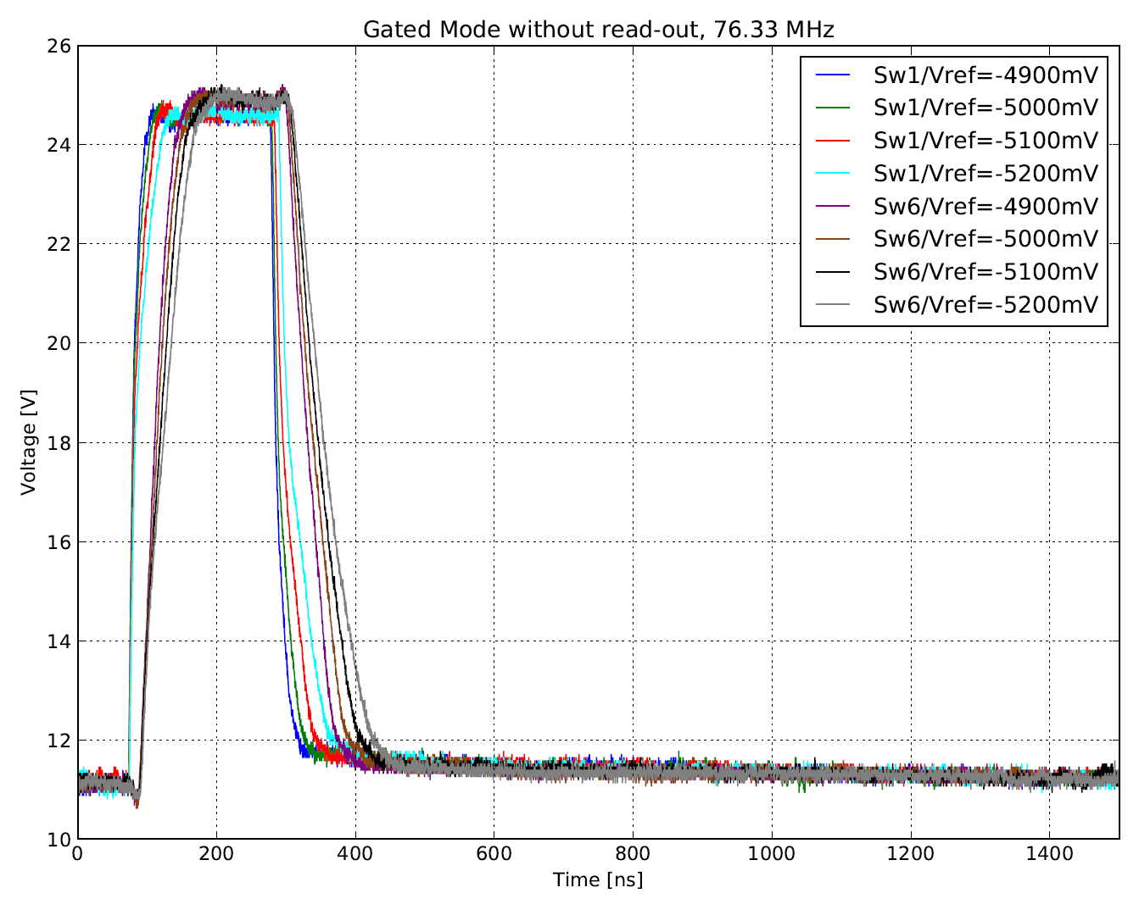
Gated Mode without readout
W37-IB
DHPT 1.1
DCDBv4.2
SWB18v2.1
Switcher substrate
voltage

Slide 11
Ideas to solve problems – pedestal oscillations
1) Stop GCK after switching back to normal mode for 1 μs
ensure synchronization with offsets and pedestals
Extend readout time from 20 μs to 22 μs
GCK
~1 μs
Gated Mode
Normal readout
Gated Mode
0 μs
20 μs
40 μs
60 μs
80 μs
Is it possible from DHE, DHP?

Slide 12
Ideas to solve problems – pedestal oscillations
Switcher | Signal | Pedestal | Offset
2) Running GCK, stop Switcher sequence
Extend Switcher Sequence with empty signals, i.e., stop continuous rolling shutter mode
out of sync with offsets
out of sync with pedestals (occupancy ↑ )
GM
Matrix readout
Pedestals memory
Does not work

Slide 13
FSYNC signal
DHP reads / writes data in the next memory line every 8 clock cycles
SerIn signal is stored in gate 190
Problem if the Gated Mode without readout is applied during gate 190
DHP memory
FSYNC
1
192
FSYNC resets all memory pointers
(Switcher sequence, offsets, pedestals)
After 1536 clock cycles (8*192)

Slide 14
Ideas to solve problems – “missing next frame”
3) Extend Switcher sequence and build SerIn and CLK after normal GM sequence
DHPT1.2 allows to decide whether the SerIn is used from normal switcher sequence or from Gated Mode switcher sequence: configuration via JTAG command
DHP memory
normal GM sequence
extended GM sequence:
SerIn and high Clock
Question: How fast can we write to JTAG that DHP should read SerIn from VETO Switcher Sequence?
extended GM sequence
DHE needs to sent the FSYNC more than 1536 clock cycles. Otherwise the memory pointer within the DHP is reset.
Does the DHE allow variable lengths of FSYNC for one frame?
At least two fixed lengths?

Slide 15
Ideas to solve problems – “missing next frame”
3) Extend Switcher sequence and build SerIn and CLK after normal GM sequence
Keep in sync with pedestals, offsets
Out of sync with machine – Problems?
Gated Mode
SerIn
Normal readout
Gated Mode
0 μs
20 μs
40 μs
60 μs
80 μs

Slide 16
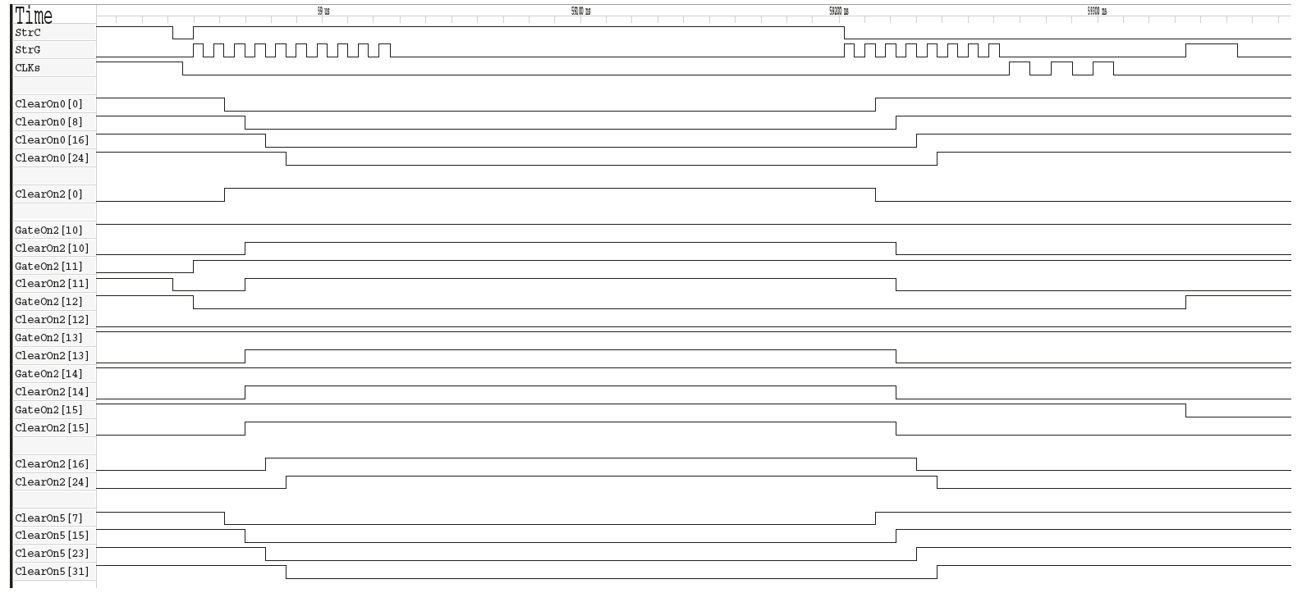
Gated Mode with readout
Continue readout during Gated Mode
Cannot read DEPFET values due to pedestal oscillations
Need 315 ns for (de)-activation in theory (20 ns for GM without readout)
Measured 330 ns / 335 ns for (de)-activation in practice
Adjust shielding time in steps of 105 ns (3.27 ns for GM without readout)

Slide 17
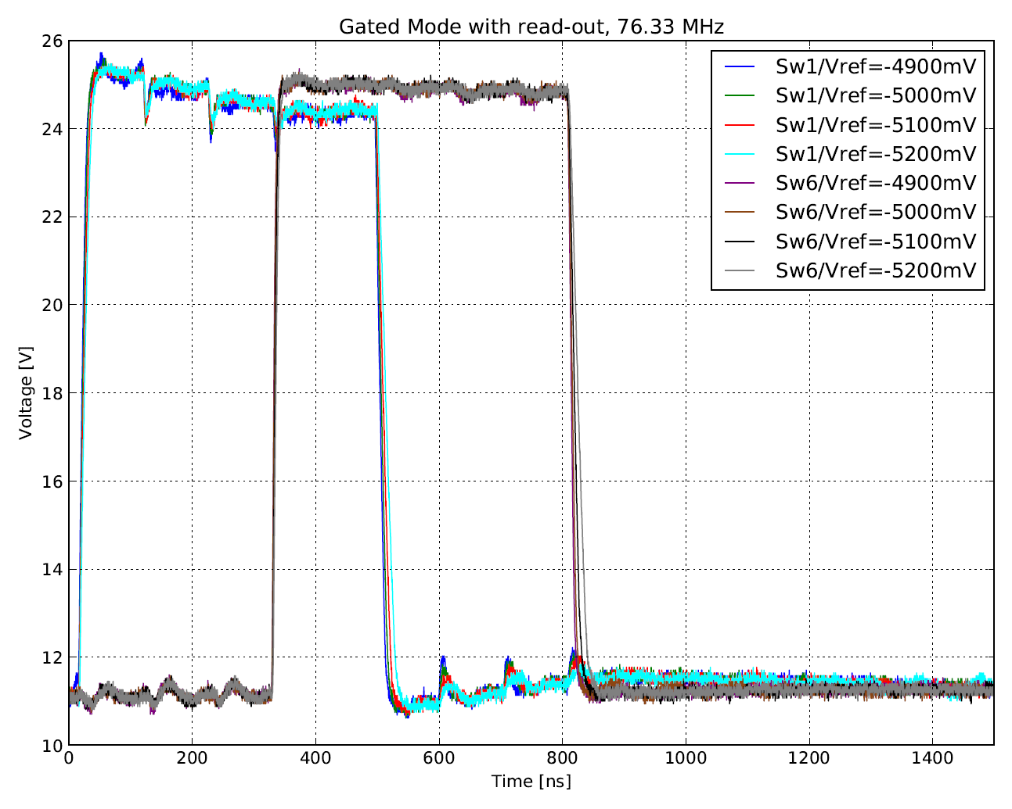
Gated Mode with readout
W37-IB
Group 1
Group 2
Group 3
Group 4
DHPT 1.1
DCDBv4.2
SWB18v2.1
Switcher substrate
voltage
Group 4
Group 3
Group 2
Group 1

Slide 18
Gated Mode – 2 Possibilities
Measurements on W37-IB (PXD9-7 with SWB18v2.1)
Gated Mode with readout (GM w/ RO):
needs 315 ns in theory (330 ns measured) to enable the GM, i.e., to shield all pixels
needs 315 ns in theory (335 ns measured) to disable the GM, i.e., to switch to normal operation
can apply the GM for all pixels in steps of 105 ns
total time for GM: ~ 870 ns
additionally, the read-out of the pedestals currents after the GM show oscillations (increased spread), which take ~ 1µs (must be measured again in more detail)
total Gated Mode (enabling, gating, disabling, time to normal operation): 1.6 µs – 1.9µs
Gated Mode without readout (GM w/o RO):
needs 20 ns in theory (75 ns measured) to enable the GM, i.e., to shield all pixels
needs 20 ns in theory (90 ns measured) to disable the GM, i.e., to switch to normal operation
can apply the GM for all pixels in steps of 3.27 ns
total time for GM: ~ 370 ns
additional pedestals currents after the GM : ~1 µs (must be measured again in more detail)
total Gated Mode (enabling, gating, disabling, time to normal operation): 1.4 µs

Slide 19
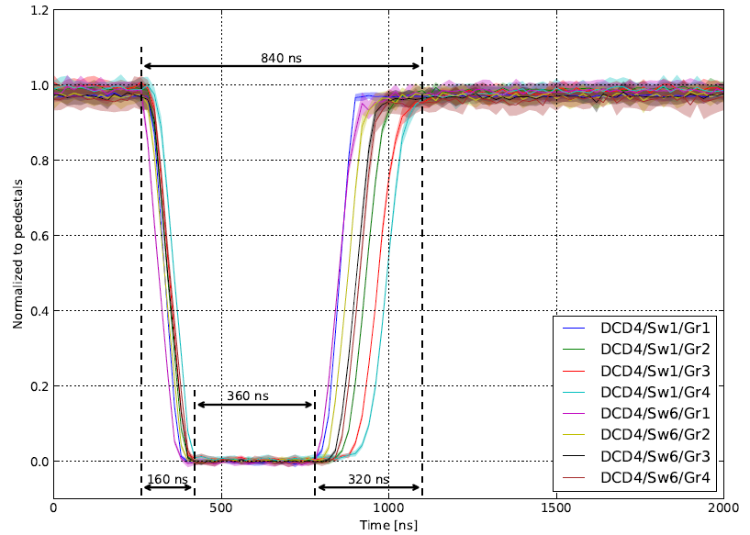
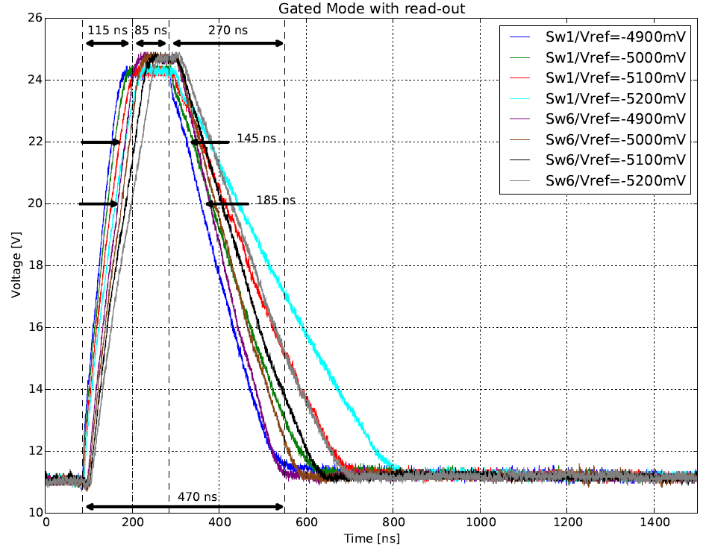
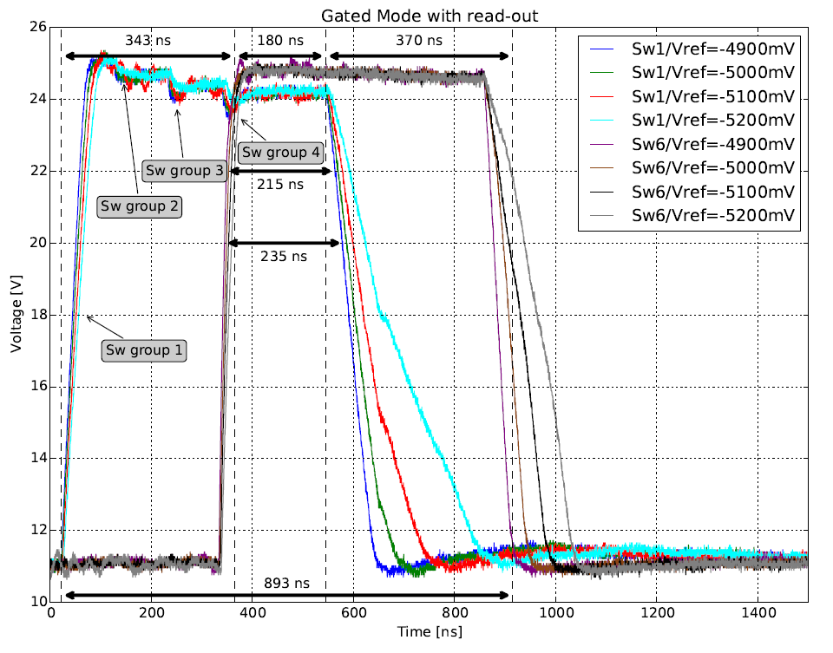
Layout change – PXD9-7
Reduced ohmic resistance from Switcher Substrate net
PXD9-6: 55 Ω for Switcher 1, 172 Ω for Switcher 6
PXD9-7: 10 Ω for Switcher 1, 27 Ω for Switcher 6
W31-OF1
DHPT 1.1
DCDBv4.2
SWB18v2.0

Slide 20
Layout change – PXD9-7
Reduced ohmic resistance from Switcher Substrate net
PXD9-6: 55 Ω for Switcher 1, 172 Ω for Switcher 6
PXD9-7: 10 Ω for Switcher 1, 27 Ω for Switcher 6
W31-OF1
DHPT 1.1
DCDBv4.2
SWB18v2.0

Slide 21
Summary and Outlook
Gated Mode without readout is faster but there is the “missing next frames” problem
Ideas to shift frame, increase frame time – need to consider system aspects from DHE/DHP
Need to measure pedestal oscillation time
Testing procedures for GM mass testing to be evaluated if needed?
Wait after “mass testing”
Is it better to use GM w/o RO and lose in 1.6% of the cases the 4 ms (200 frames) with gating time of 1.4 µs OR
is it better to use GM w/ RO, do not lose consecutive frames but with a gating time of 1.9 µs (preliminary)
⇒ Planned: Effect of the PXD Gated Mode on Physics should be evaluated
Gated Mode w/o RO | Gated Mode w/ RO
(De)activation 90 ns Adjustment of gating time in steps of 3.27 ns Total time for GM 370 ns + pedestal oscillations | De(activation) needs 335 ns Adjustment of gating time in steps of 105 ns Total time for GM 870 ns + pedestal oscillations

Slide 22
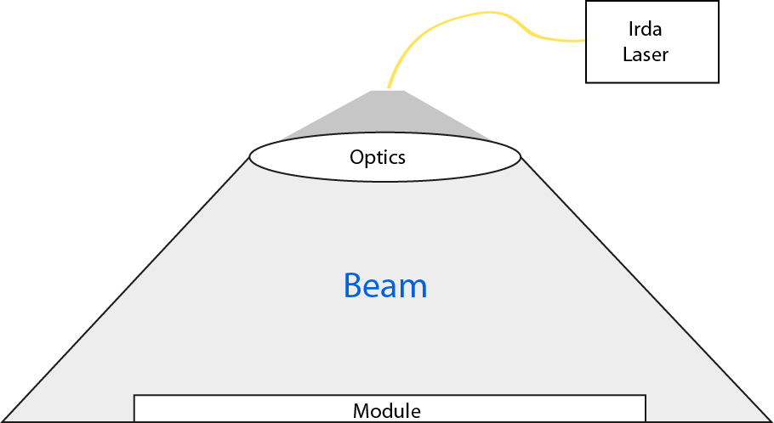
Radioactive Source and Laser setup
Infrared Laser (980 nm) to cover entire module area
Needs to be installed (Laser safety 3B)
LED setup to study clear efficiencies and gated mode operation, not in pixel scan, no laser setup

Slide 23
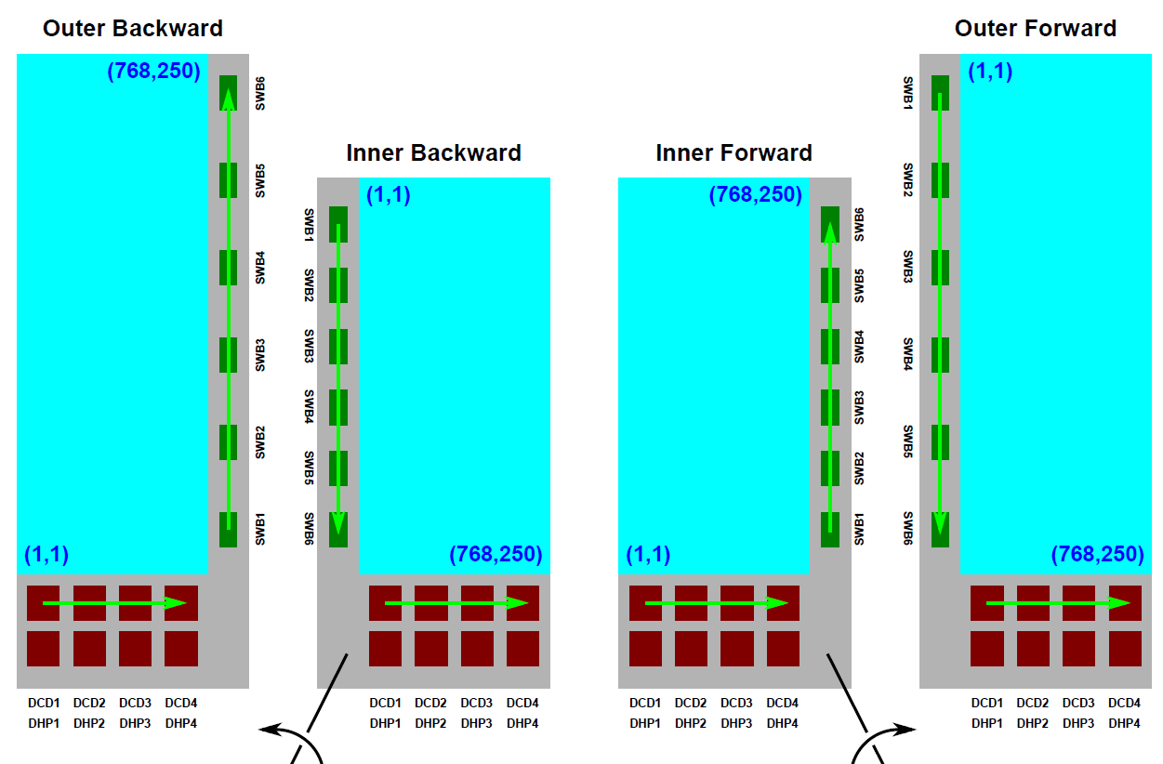
Readout directions (1)
L2 BWD
Arrows depict the readout direction
L2 FWD
L1 BWD
L1 FWD

Slide 24
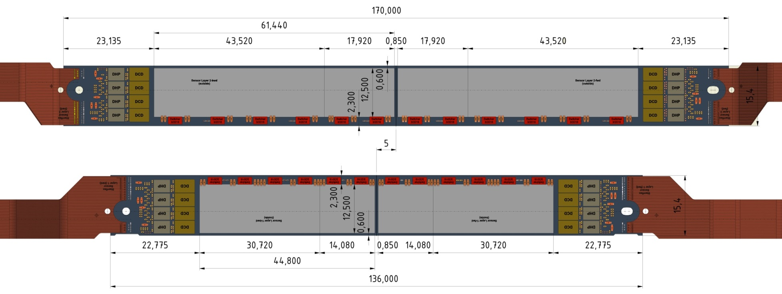
Readout directions (2)
Backward
Forward
Arrows depict the readout direction

Slide 25
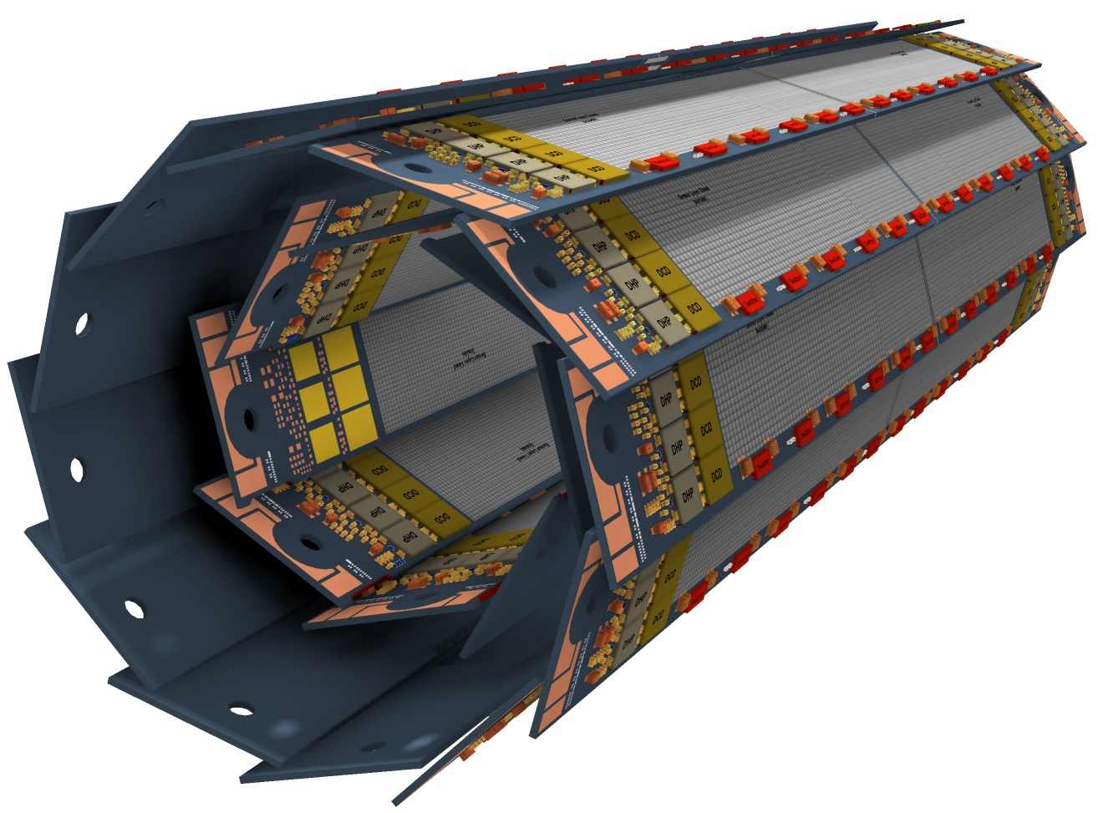
PXD Arrangement
Arrows depict the readout direction

