Slide 1
GREST
- Multistorage DEPFET Devices -

Slide 2
Getting Ready for the European Solar Telescope
Notes:
A venture for the development of new technologies for the application at EST

Slide 3
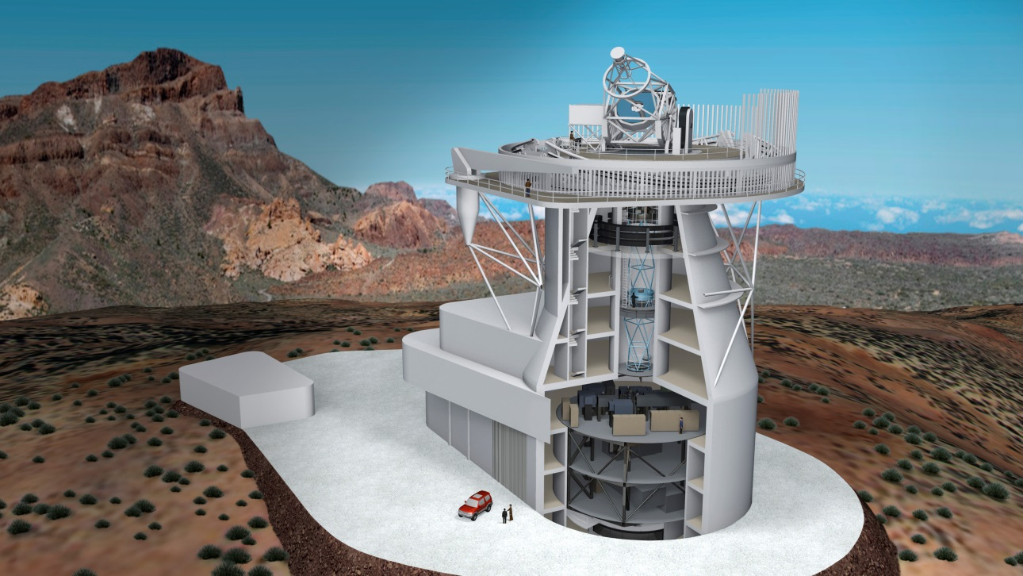
GREST
EST:
Notes:
- largest solar telescope in europe
- multiple exchangeable instruments
- located on the canary islands
- start of construction ~2020
start of operation ~2027
our contribution here will be a high precision polarimetric camera

Slide 4
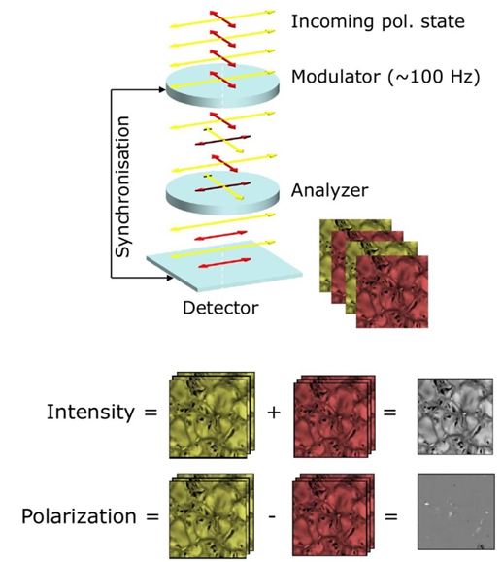
GREST
Notes:
Through Modulator and Analyzer, the polarisation at a given point in time is encoded as intensity variation. By detecting the intensity variation for 4 different polarization states, the complete polarization information can be retrieved.
For standard sensors Modulation and Frame rate are coupled.

Slide 5
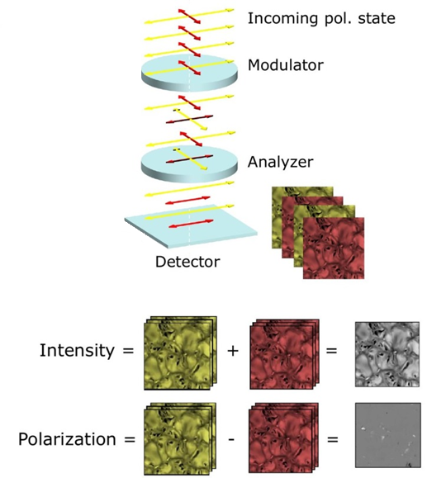
GREST
Modulation ~ 10 kHz
Frame-Rate ~ 400 Hz
Notes:
We intend to built a sensor that is capable to decouple modulation frequency and frame rate.
How are we going to do that?

Slide 6
DEPFET Principle

Slide 7
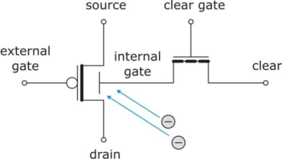
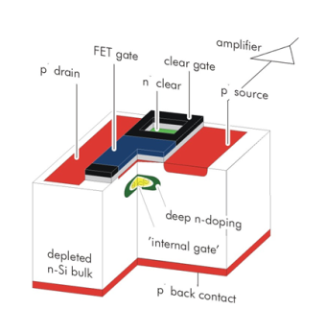
DEPFET
intrinsic amplification
low noise
backside illumination
100% fill-factor
intrinsic amplification
low noise
backside illumination
100% fill-factor

Slide 8
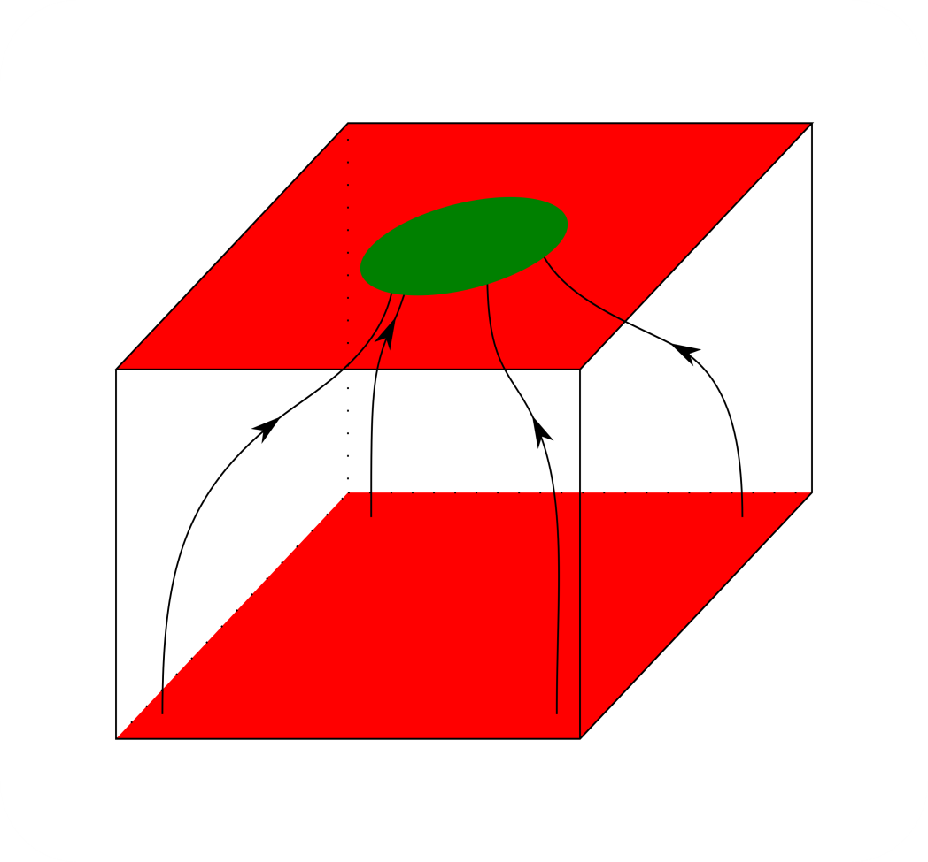
DEPFET
intrinsic amplification
low noise
backside illumination
100% fill-factor

Slide 9
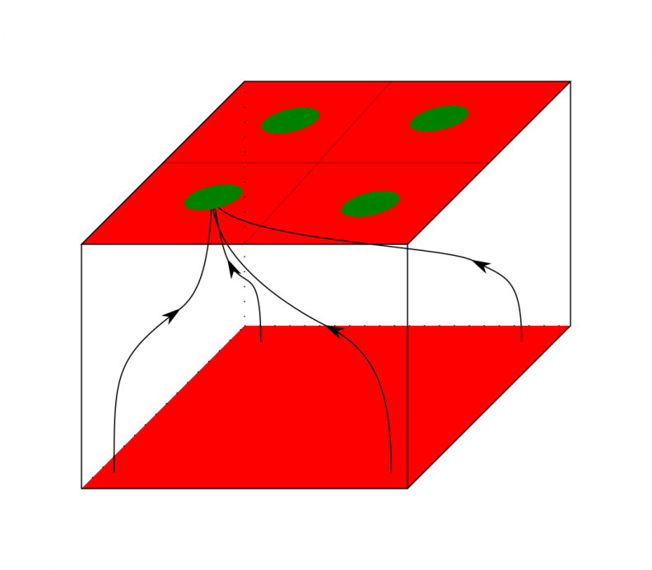
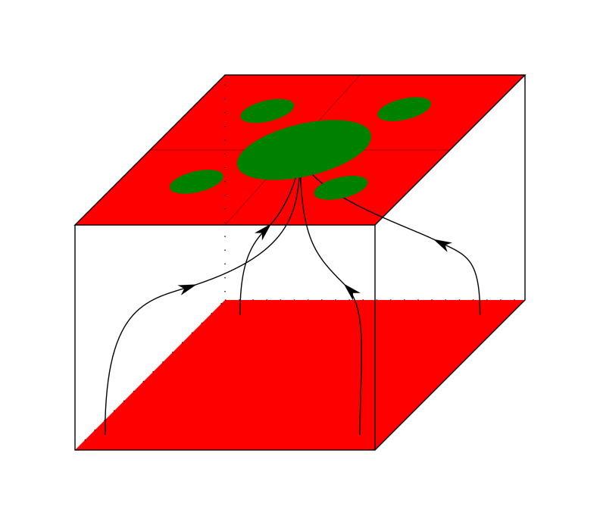
Quadropix
Central Anode
Notes:
We have two concepts for the proposed polarimetric sensor
the Quadropix DEPFET
and the Central Anode DEPFET

Slide 10
Simulations - Quadropix

Slide 11
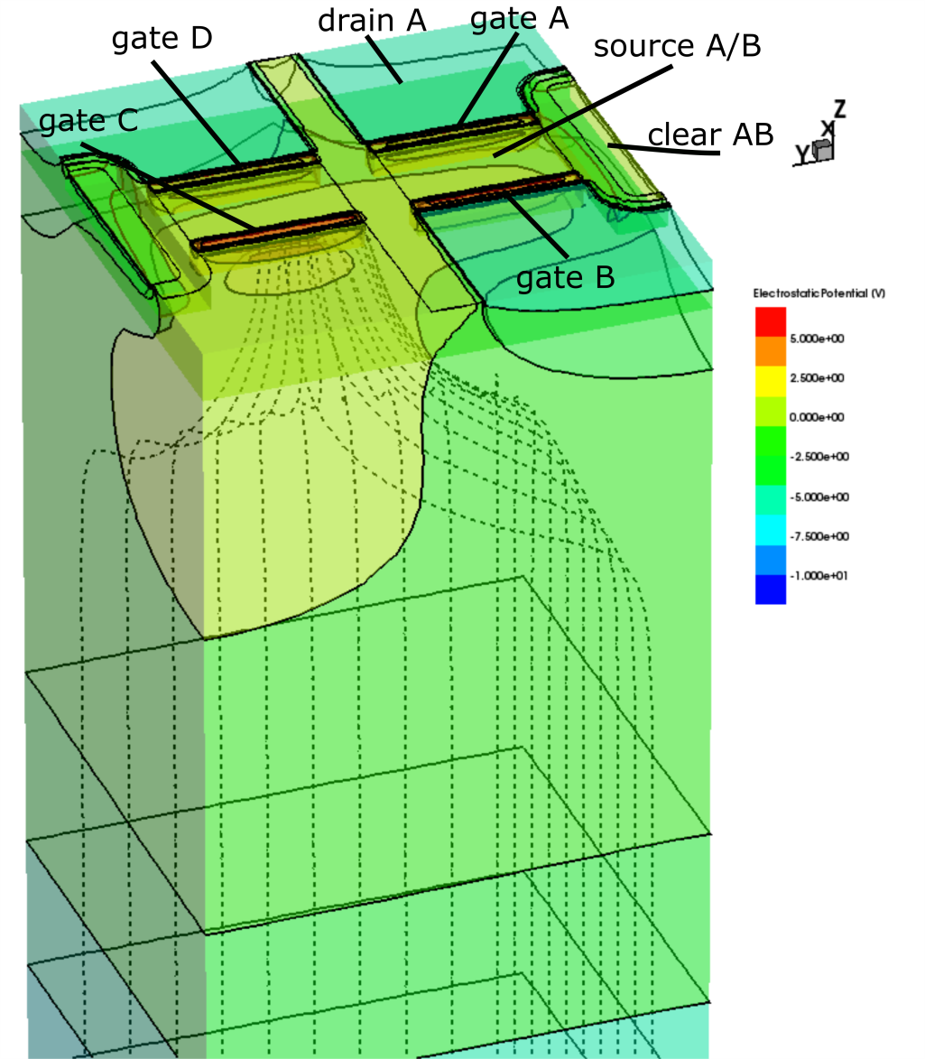
Simulations - Quadropix
Notes:
First a bit more explanation about the functional principle of the devices
so in principle we have 4 DEPFET subpixel per superpixel
voltages applied to the drain control the collection of charge

Slide 12
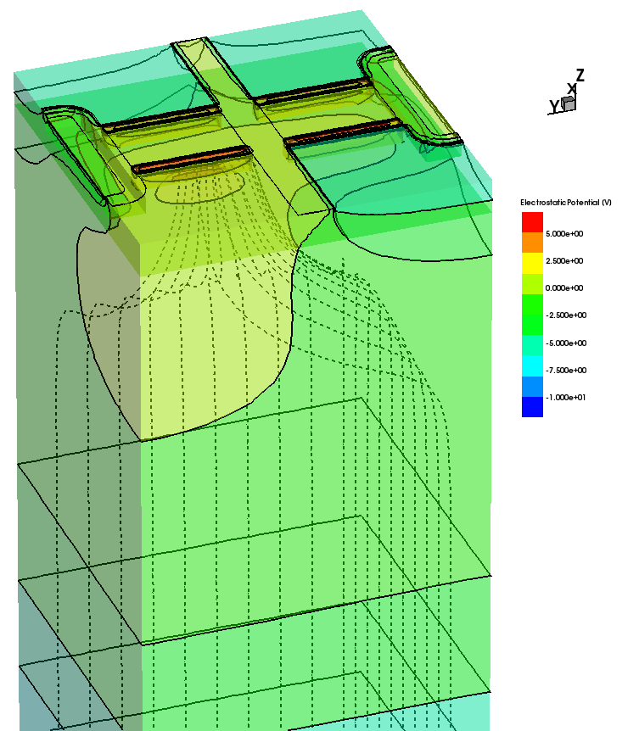
Simulations - Quadropix
A
D
B
C
Notes:
lets reduce the names and only go with the subpixels

Slide 13
Simulations - Quadropix
- Selectability
- Charge Spreading
A
D
B
C
Notes:
: How much charge is
collected in the insensitive subpixels?
How does the signal collected within a pixel change with respect to photon incident position and device state?

Slide 14
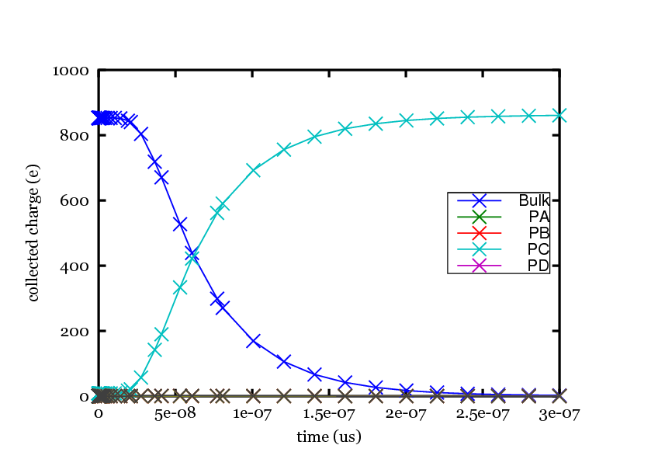
Simulations - Quadropix
- Selectability
A
D
B
C
Vback=-73V
s

Slide 15
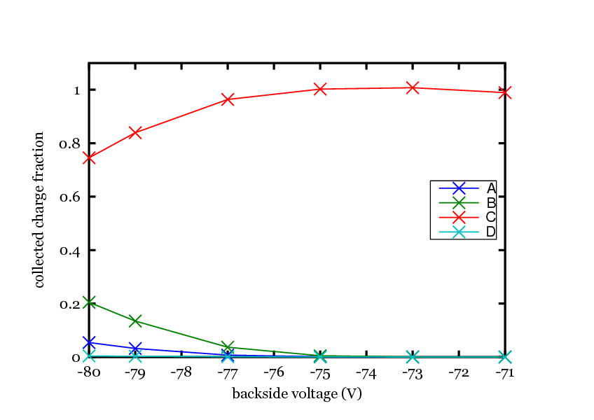
Simulations - Quadropix
- Selectability
A
D
B
C
operation window for backside voltage
Notes:
an optimization through adaption of geometry and implants is possible

Slide 16
Simulations - Quadropix
- Selectability
- Charge Spreading
A
D
B
C

Slide 17
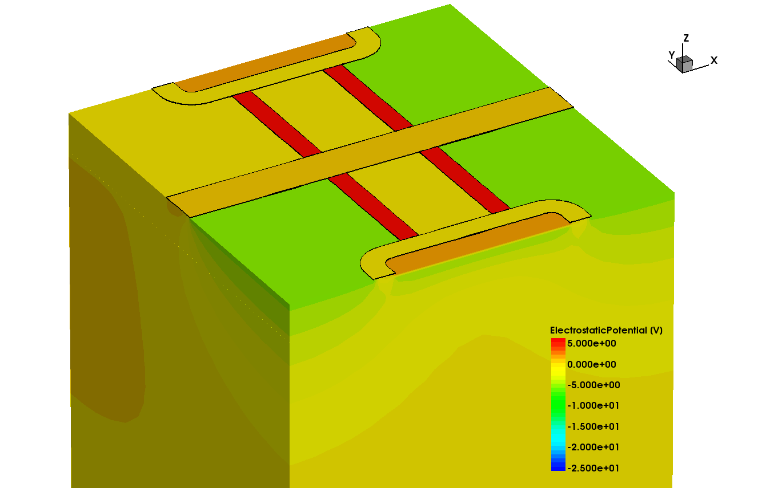
Simulations - Quadropix
- Charge Spreading
D
C
A
B

Slide 18
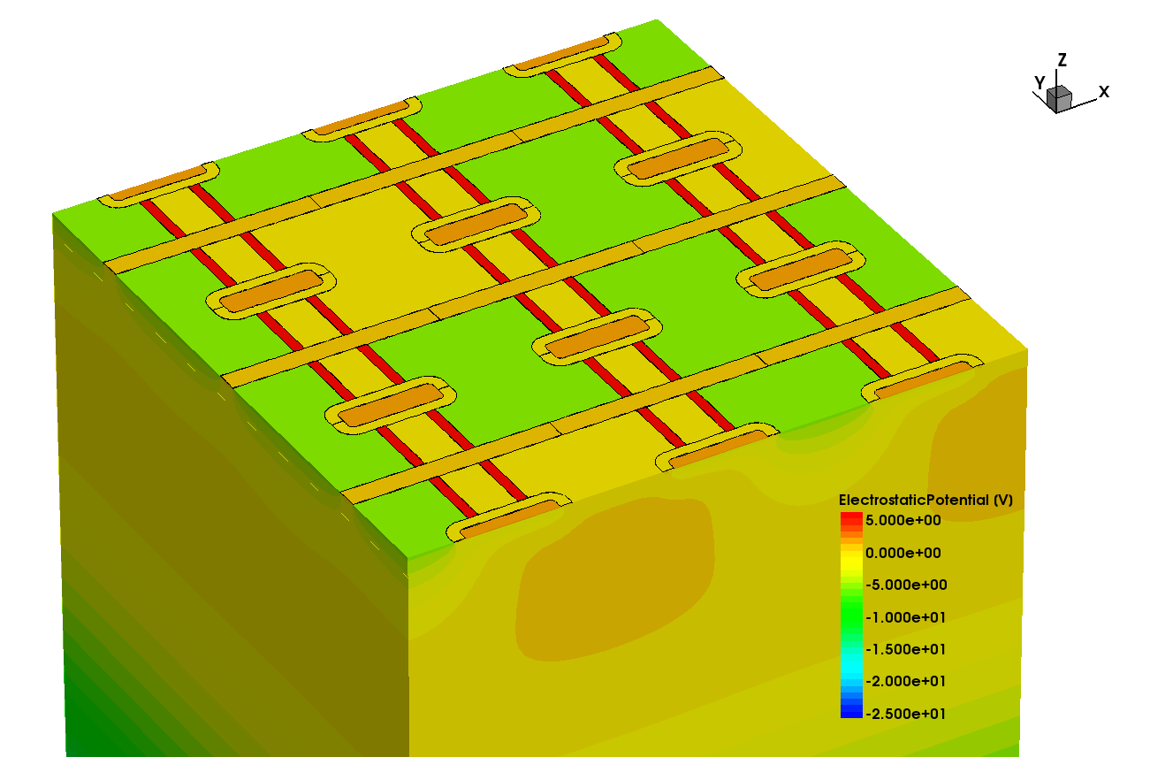
Simulations - Quadropix
3x3 Array
D
C
A
B

Slide 19
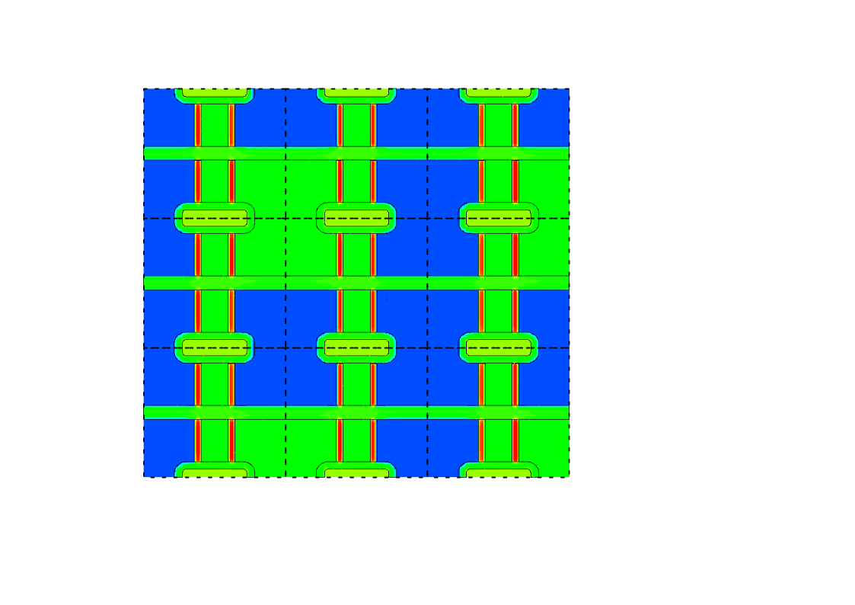
Simulations - Quadropix
3x3 Array
0/3
3/3
Gate
Drain
0/2
Source
C
D
Clear
B
A
0/1
0/0
1/0
2/0
3/0

Slide 20
Simulations - Quadropix
3x3 Array
0/3
3/3
Charge Injection Area
0/2
0/1
0/0
1/0
2/0
3/0
Alexander Bähr, MPG Halbleiterlabor

Slide 21
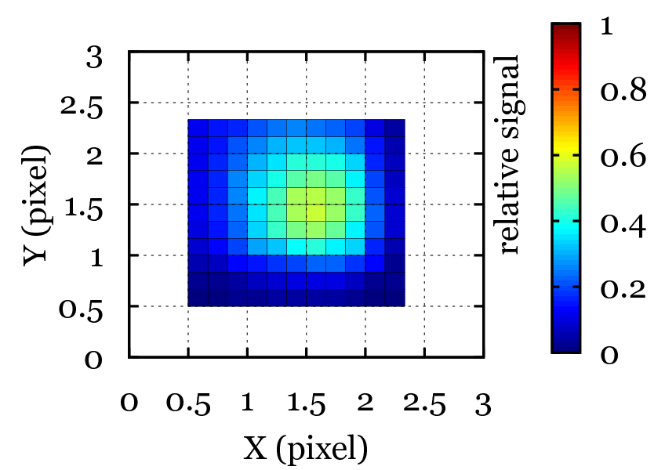
Simulations - Quadropix
0/3
3/3
CSF for Pixel 2/2
0/2
0/1
0/0
1/0
2/0
3/0
Notes:
PSF asymmetric
blurred into direction of positive Drain
the effects on polarimetric capabilities are yet to be evaluated

Slide 22
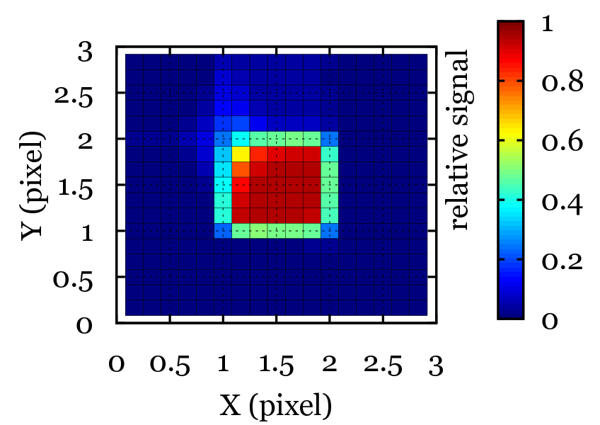
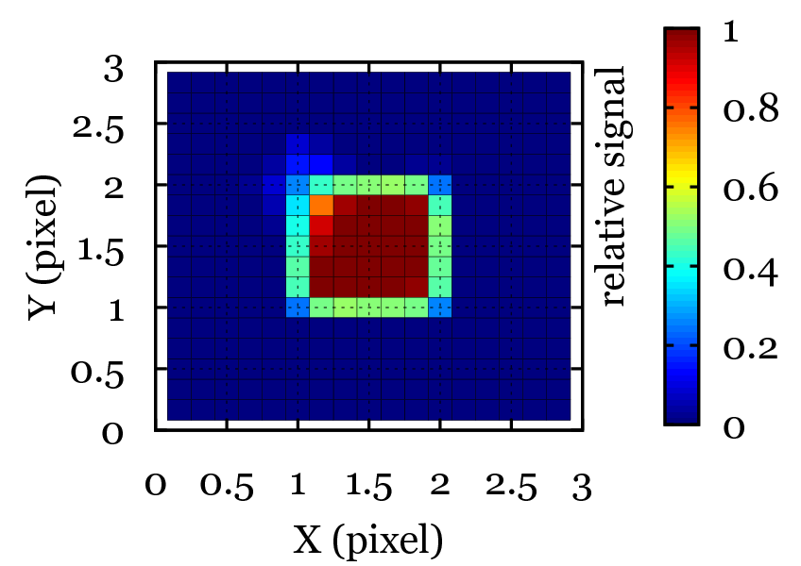
Simulations - Quadropix
standard (450 µm bulk)
thin (50 µm bulk)
thin (50 µm bulk)
+ focussing implant
Notes:
assymetry reduces for thinner material

Slide 23
Quadropix
Central Anode
Notes:
We have two concepts for the proposed polarimetric sensor
the Quadropix DEPFET
and the Central Anode DEPFET

Slide 24
Simulations – Central Anode

Slide 25
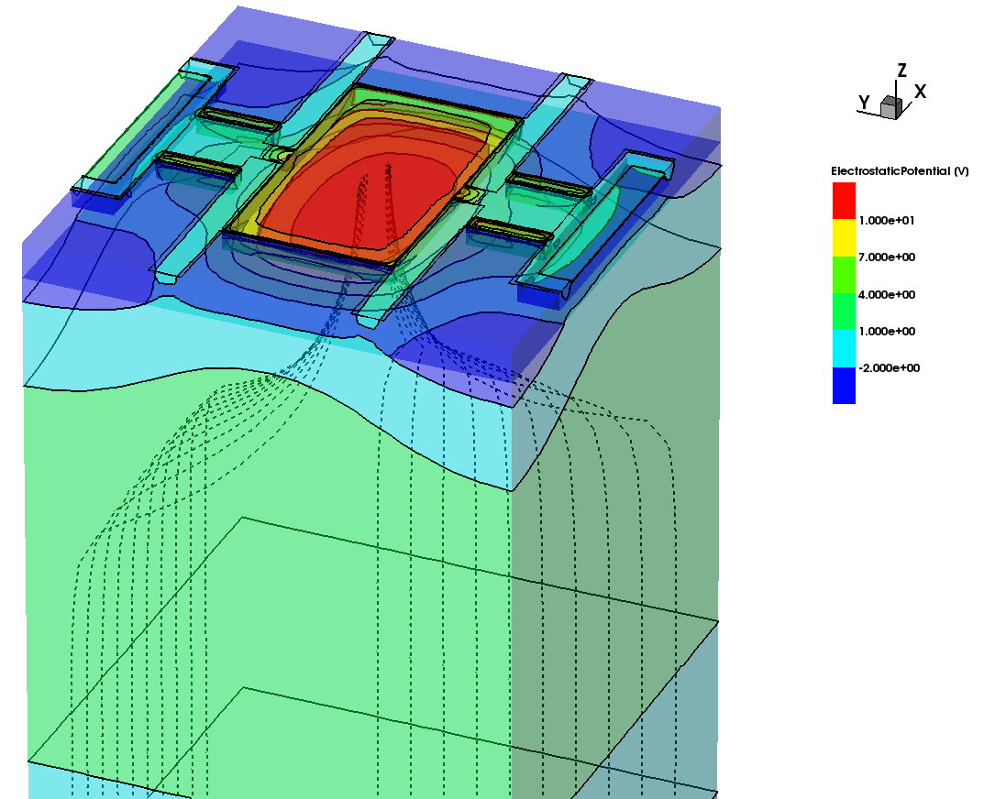
Simulations – Central Anode
D
A
CA
C
B
Notes:
Central Anode device 80x80µm²
Bulk thickness = 350µm
Analytical Gaussian profiles
to approximate implants

Slide 26
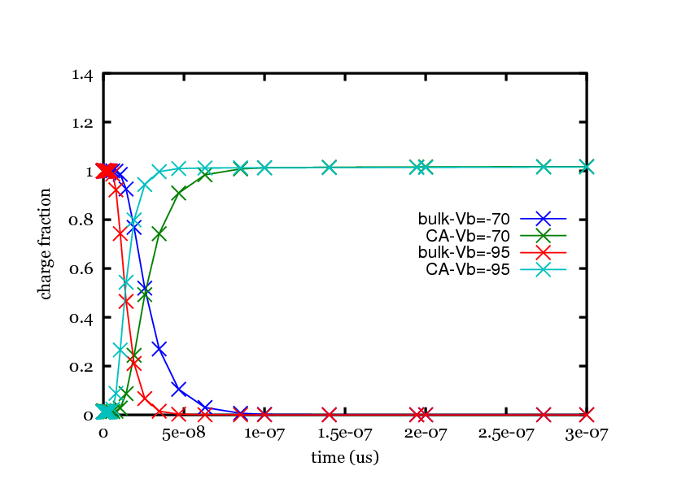
Simulations – Central Anode
Central Anode device
Charge collection for Vback=-70V and -95V
D
A
CA
C
B
s
Notes:
80x80µm²
Bulk thickness = 350µm
Analytical Gaussian profiles
to approximate implants

Slide 27
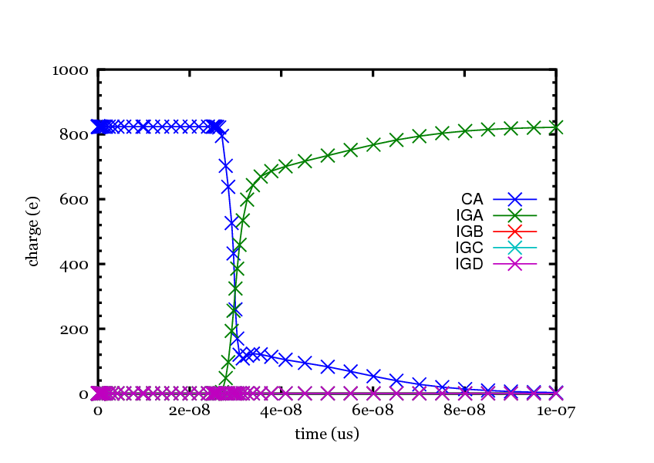
Simulations – Central Anode
Central Anode device
Charge transfer for Vdrain=-3 and Vsep=-3
D
A
CA
C
B
s

Slide 28
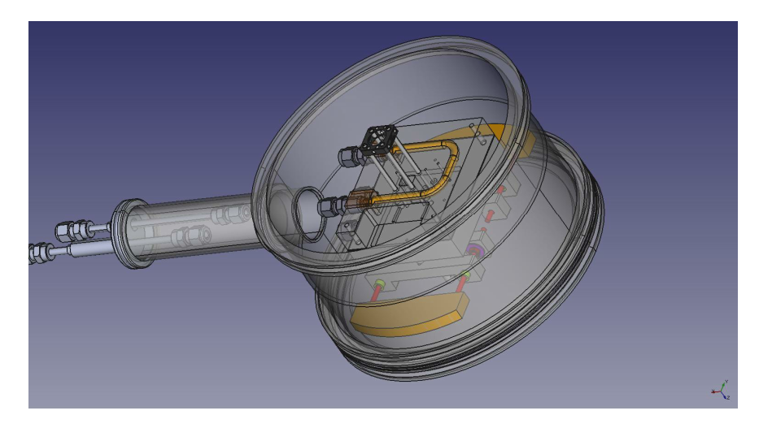
Measurement Setup
mechanical design
B

Slide 29
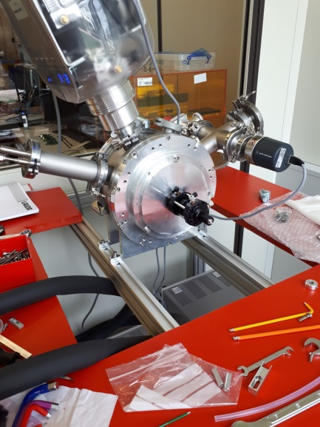
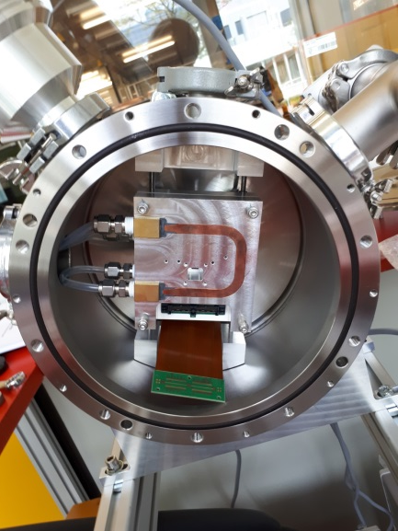
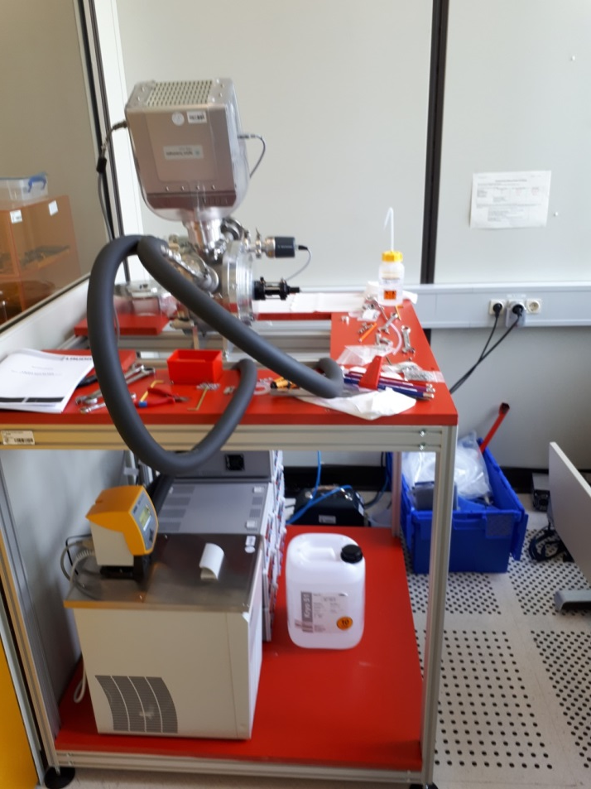
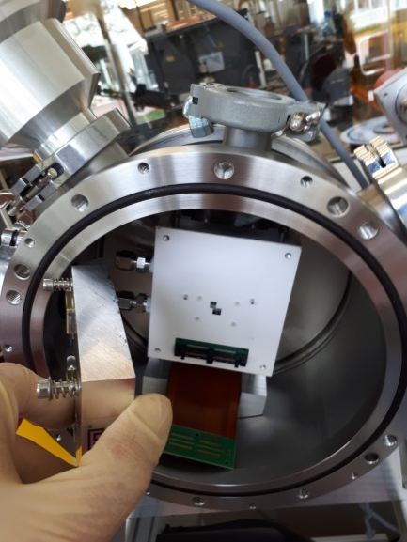
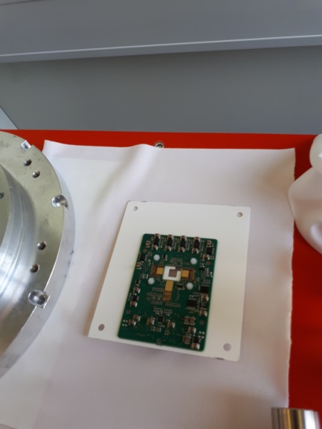
Measurement Setup
B

Slide 30
Outlook
measurements (and comparision to simulations)
smaller pixel size?
more storage regions?
Notes:
Feasability Study

Slide 31
Thanks for your attention
B

