Slide 1

21st International Workshop on DEPFET Detectors and Applications
28th – 31th May 2017
Ringberg Castle

Slide 2




Status DHPT 1.2b
Leonard Germic, B. Paschen, F. Lütticke,
T. Hemperek, C. Marinas, H. Krüger
and Norbert Wermes
21st International Workshop on DEPFET Detectors and Applications
28th – 31th May 2017
Ringberg Castle

Slide 3
Status DHPT 1.2b
200 chips tested (2 Wafers) – yield 97%
  6 not working
    3/6 no jtag response
    2/6 memory errors
    1/6 low power consumption (not responding)
Temperature sensor
  Script is ready
    Used for Hybrid 5 and PXD-EMCM2
  Read out is limited by DHE software
    Number of JTAG clock cycles is 2.5M instead of 120k
    Cycles send in bursts of 655 and Period of 5ms → overall time ~20s

Slide 4
Script - Temp Sensor
if __name__ == "__main__":
‘’’ Here you have to load the conig.ini
‘’’
irefTrim = config.getint("param","iref_trimming")
nbits = config.getint("param","nbits")
gain = config.getint("param","gain")
rp = config.getint("param","vrp")
params = [irefTrim, nbits, gain, rp]
sensor = UBTEMP(dhePrefix=dhe, asicpair=asicpair, params=params, verbose=False)
print sensor.updateTemperature()

Slide 5
DHPT - Signal Integrity
PXD9-EMCM2 modules
Leonard Germic, B. Paschen, F. Lütticke,
T. Hemperek, C. Marinas, H. Krüger
and Norbert Wermes
21st International Workshop on DEPFET Detectors and Applications
28th – 31th May 2017
Ringberg Castle

Slide 6
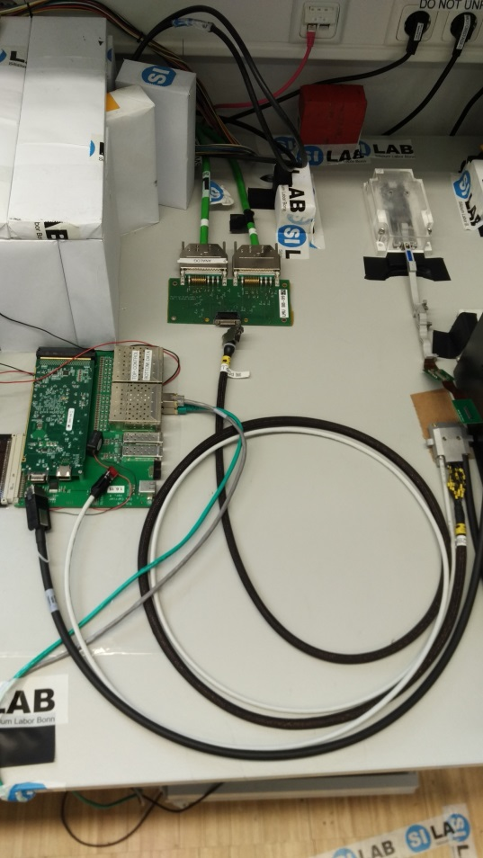
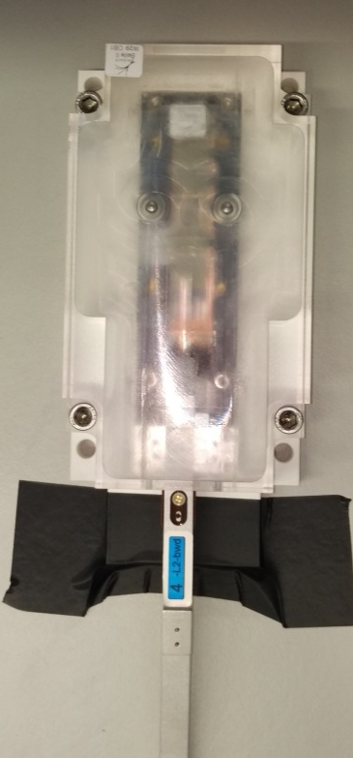
Test Setup
One Infiniband connector
Kapton + 2m Infiniband
PXD9-EMCM2
W29-OB1
DHE
Kapton
PP
Ethernet
2m Infiniband

Slide 7
Test Setup
PXD9-EMCM2
W29-OB1
Transmissionline Kapton + Infiniband | PDPP_L2BWD-04 | PDPP_L2BWD-03
AWG | 24 | 28
Diameter [mm] [%] | 0.511 100% | 0.321 63%
Cross section [mm²] [%] | 0.205 100% | 0.081 40%
Vendor | Madison | Meritec
DHE
Kapton
PP
Ethernet
2m Infiniband

Slide 8
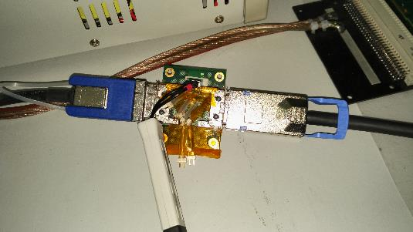
Test Setup
Three Infiniband connectors
Kapton + 2m Infiniband + 1m Infiniband
PXD9-EMCM2
W29-OB1
DHE
Kapton
1m
Infiniband
PP
HS
Probing
Ethernet
2m Infiniband

Slide 9

Test Setup
Three Infiniband connector
Kapton + 2m Infiniband + 1m Infiniband
PXD9-EMCM2
W29-OB1
DHE
Kapton
1m
Infiniband
PP
HS
Probing
Ethernet
2m Infiniband

Slide 10
Test Setup
For proper operation AC coupling capacitors have been exchanged by 0Ω bridges (GCK, Trigger)
Only DHP1 has been probed
PXD9-EMCM2
W29-OB1
DHE
Kapton
1m
Infiniband
PP
HS
Probing
Ethernet
2m Infiniband

Slide 11
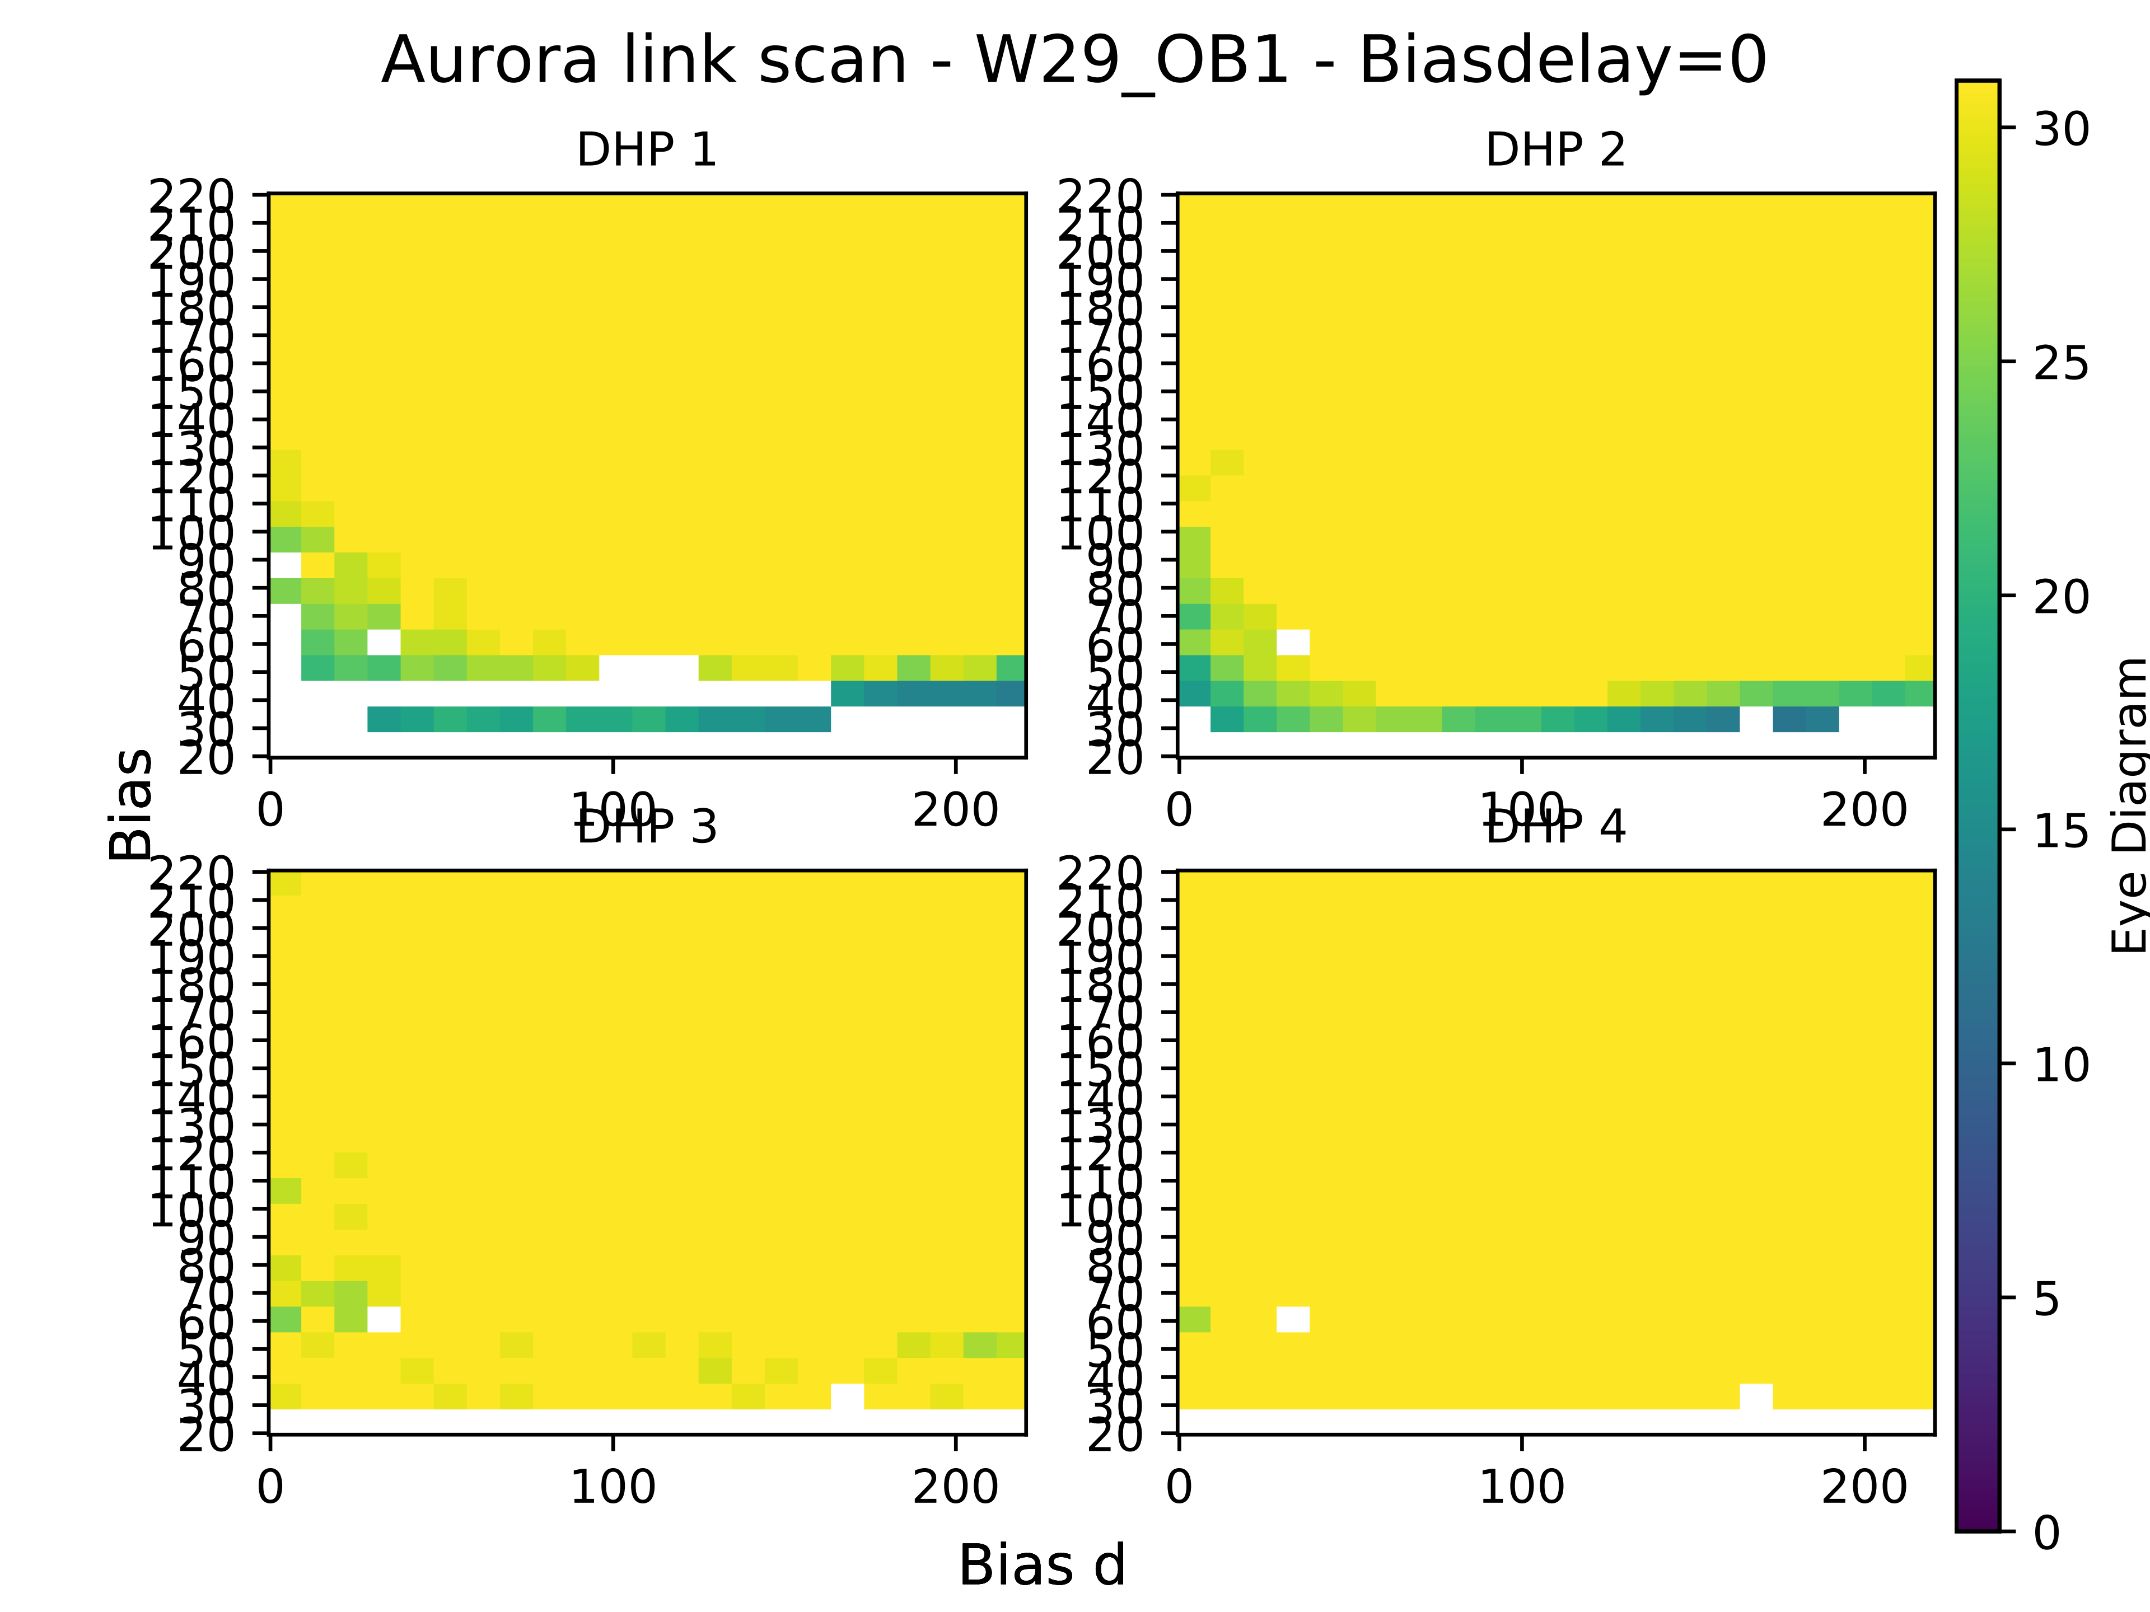
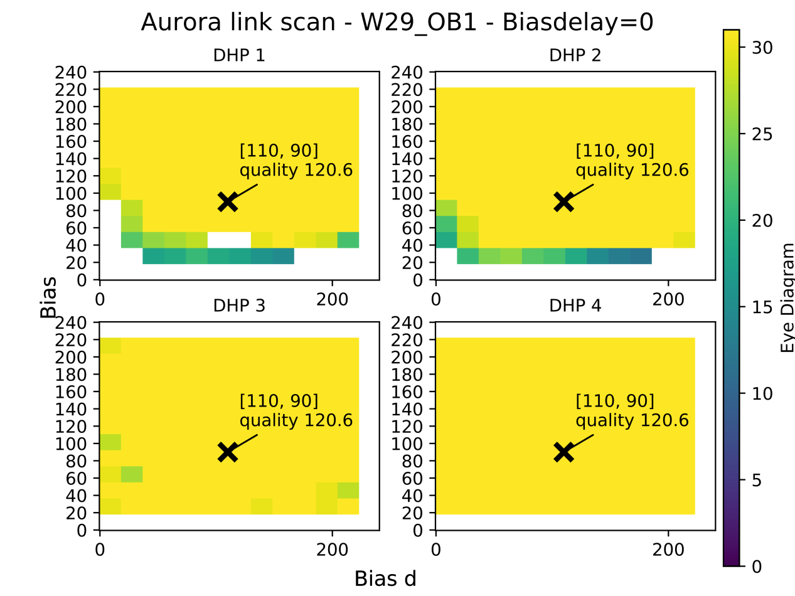
Signal Integrity measurements
Signal Integrity measurements on PXD9-EMCM2 (W29-OB1)
  AWG24, HS link scan 0.1s
200mV
Eye diagram
100mV
0mV

Slide 12
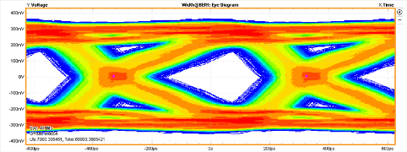
Signal Integrity measurements
Signal Integrity measurements on PXD9-EMCM2 (W29-OB1)
  AWG24, HS link scan 0.1s
  Opening ~ 220mV @ t=0ps (nominal)
  Why Asymmetry ?
  Why large Jitter content ?
200mV
Eye diagram
100mV
0mV

Slide 13
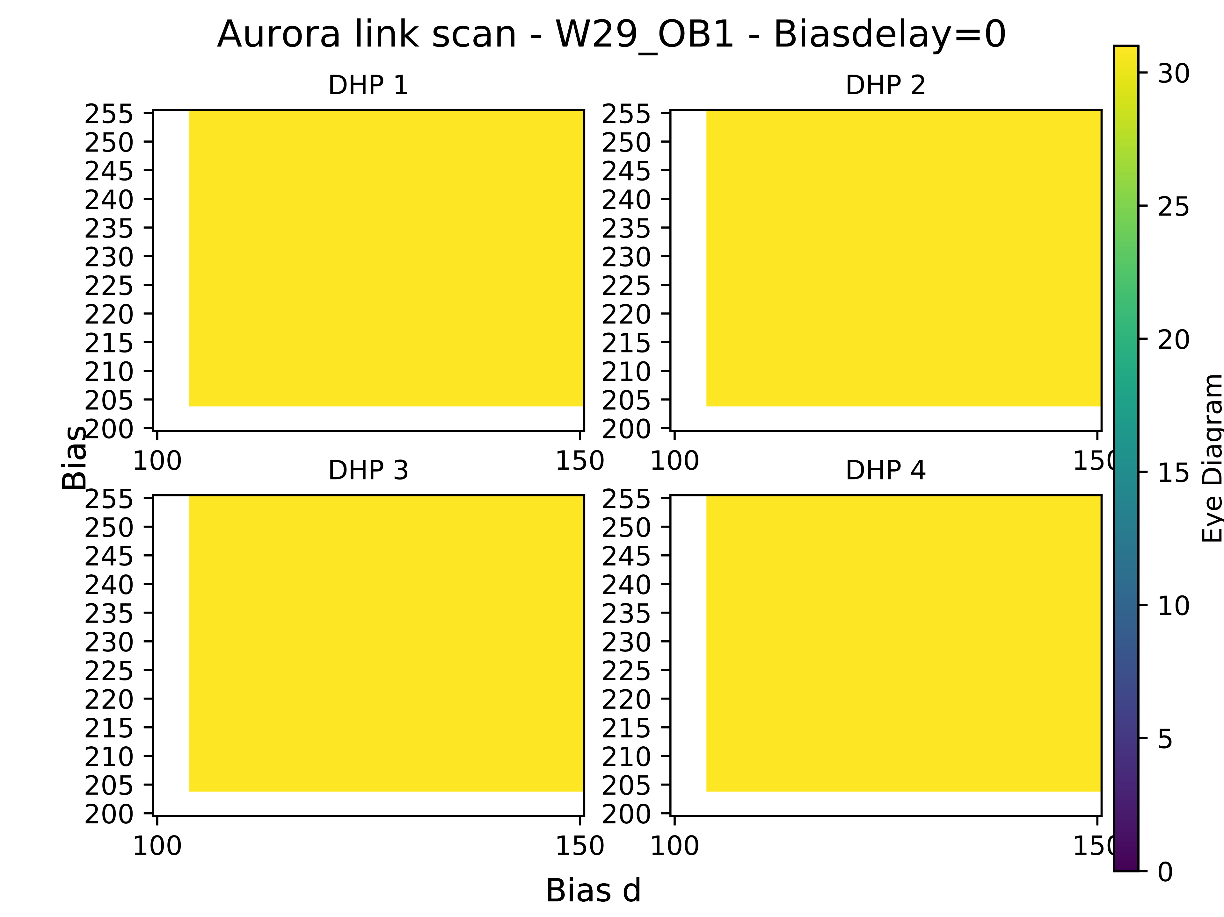
Signal Integrity measurements
Signal Integrity measurements on PXD9-EMCM2 (W29-OB1)
  AWG24, HS link scan 5min
200mV
B, bd dly=0 | Vertical Opening [mV] stdDev 10mv | Jitter Deter. [ps] stdDev 2ps | Jitter Rand. [ps] stdDev 0.5ps
200,100 | 225 | 263 | 24
200,150 | 232 | 234 | 21
255,100 | 225 | 268 | 21
255,150 | 228 | 224 | 18
225,125 | 233 | 238 | 20
100mV
0mV

Slide 14
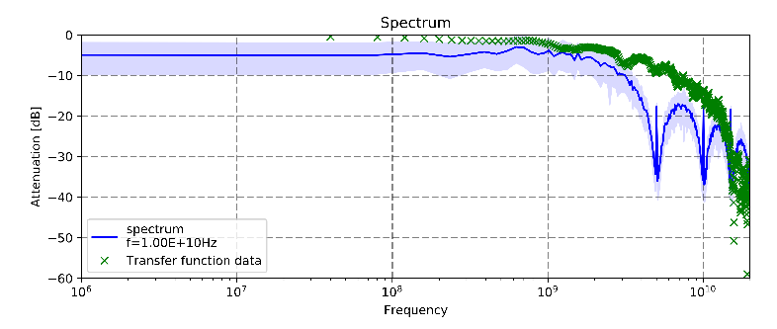
Signal Integrity Simulation Examples
One cause of Data Dependent Jitter (included in deterministic jitter)
  Inter-symbol interference
            Data rate
            1e10 Hz

Slide 15
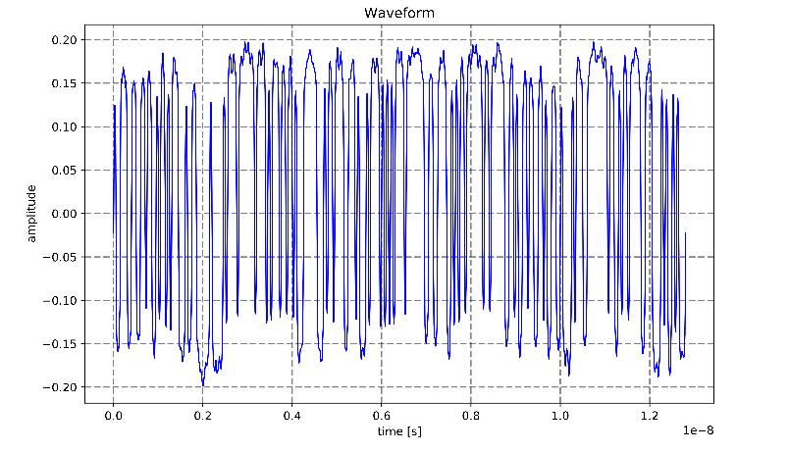
Signal Integrity Simulation Examples
One cause of Data Dependent Jitter (included in deterministic jitter)
  Inter-symbol interference

Slide 16
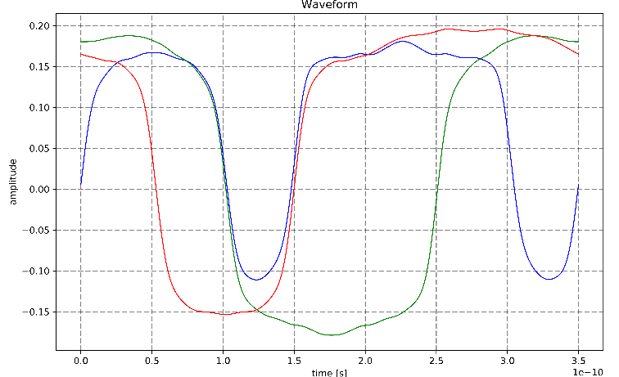
Signal Integrity Simulation Examples
One cause of Data Dependent Jitter (included in deterministic jitter)
  Inter-symbol interference
Zero crossing

Slide 17
Signal Integrity Simulation Examples
One cause of Data Dependent Jitter (included in deterministic jitter)
  Inter-symbol interference (ISI)
Cure ISI with limiting bandwidth (low frequency suppression)
  8b/10b encoding (max. 4/5bits of equal value)
    Example Simulation:
Jitter Deter. [ps] 7 bit LFSR | Jitter Deter. [ps] Data 8b/10b
~260 | ~180

Slide 18
Signal Integrity Simulation Examples
One cause of Data Dependent Jitter (included in deterministic jitter)
  Inter-symbol interference (ISI)
Cure ISI with limiting bandwidth (low frequency suppression)
  8b/10b encoding (max. 4/5bits of equal value)
    Example Simulation:
Additional cause: Asymmetric edges (rise and fall times)
Jitter Deter. [ps] 7 bit LFSR | Jitter Deter. [ps] Data 8b/10b
~260 | ~180

Slide 19
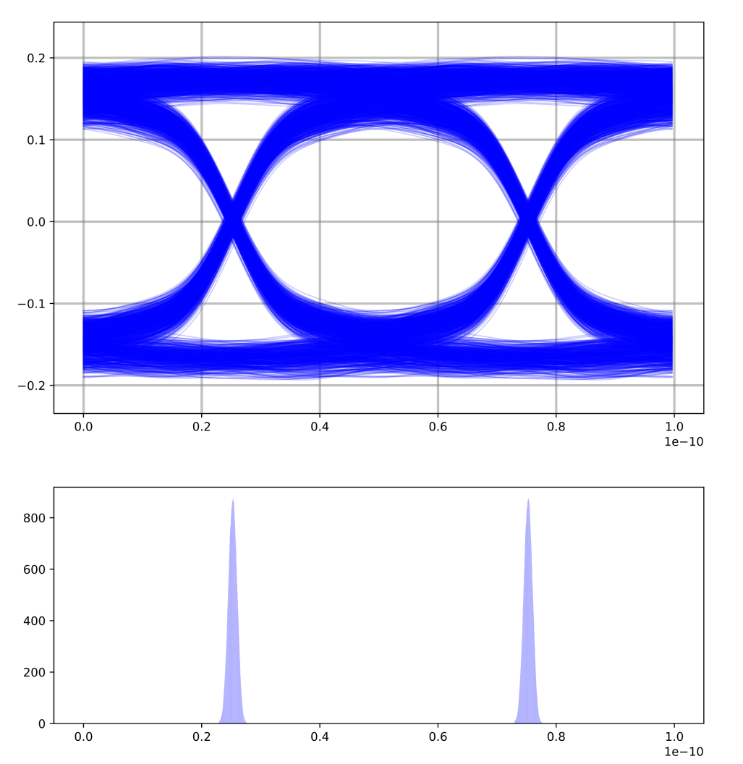
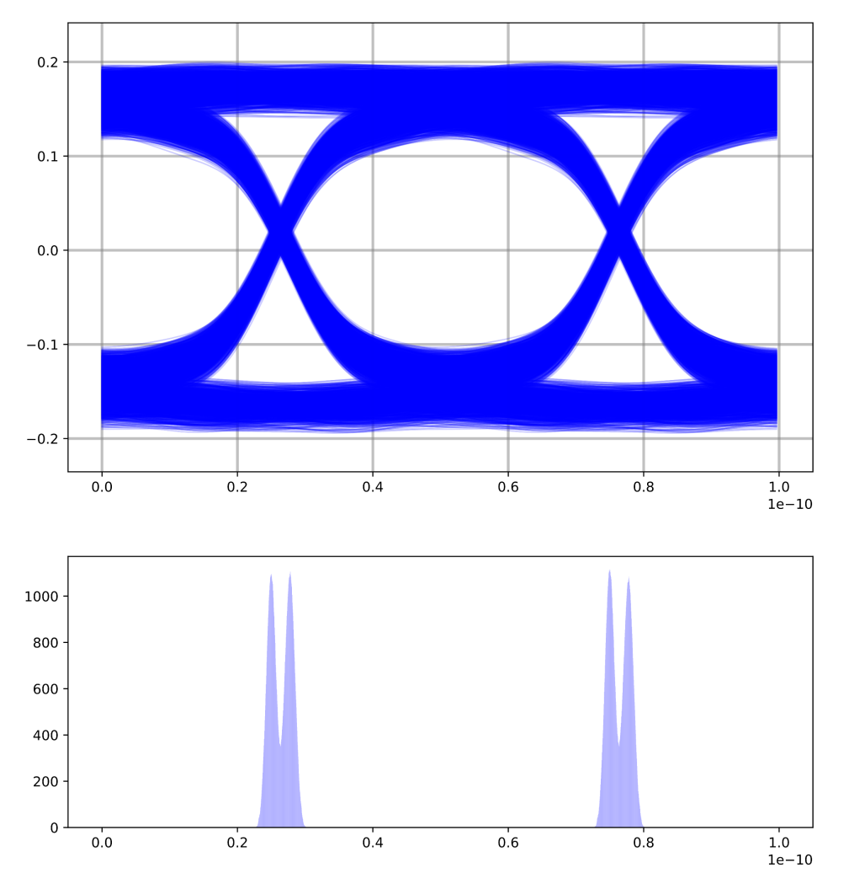
Signal Integrity Simulation Examples
One cause of asymmetric edges (included in deterministic jitter)
symmetric
Region of
histograming
asymmetric
Region of
histograming

Slide 20
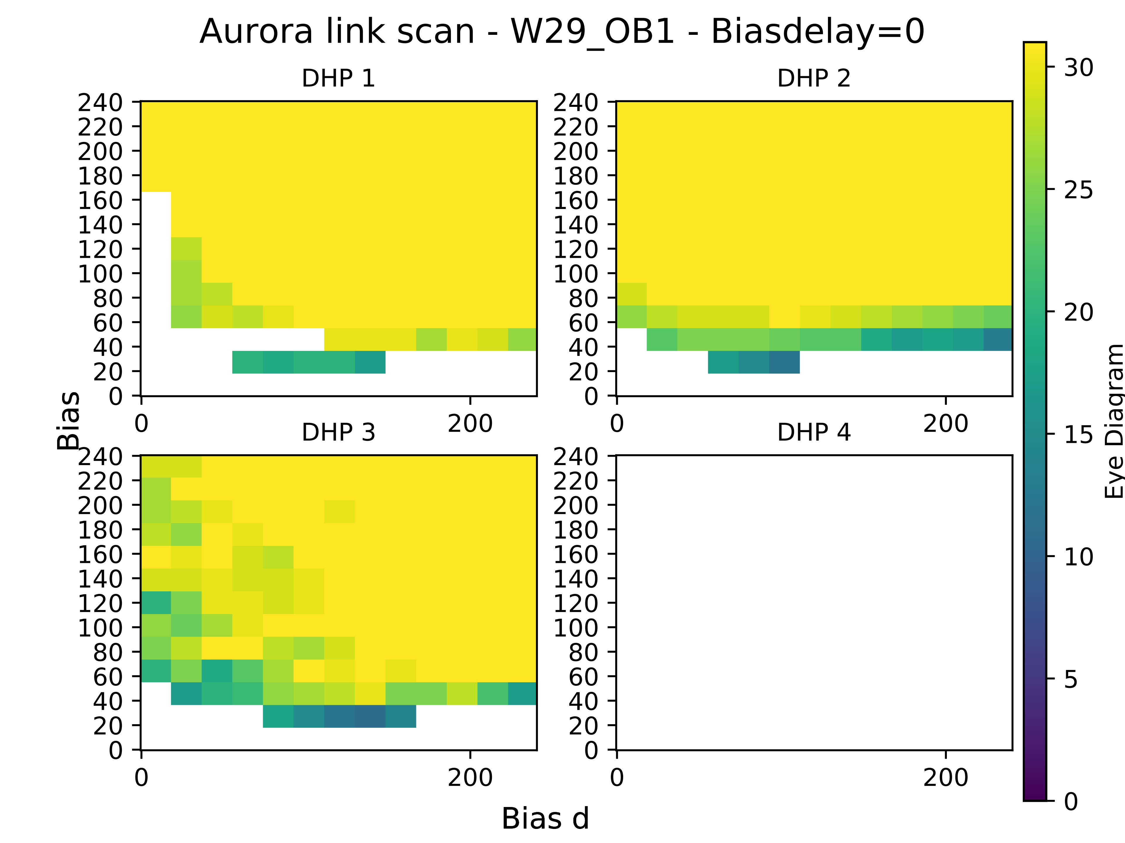
Signal Integrity measurements
AWG 24 fast scan 0.1s vs AWG 28 fast scan 0.1s
200mV
200mV
100mV
100mV
Broken
On PP
0mV
0mV
B, bd dly=0 | Vertical Opening [mV] | Jitter Deter. [ps] | Jitter Rand. [ps]
200,100 | 225 | 263 | 24
200,150 | 232 | 234 | 21
255,100 | 225 | 268 | 21
255,150 | 228 | 224 | 18
225,125 | 233 | 238 | 20
B, bd dly=0 | Vertical Opening [mV] | Jitter Deter. [ps] | Jitter Rand. [ps]
200,100 | 174 | 358 | 20
200,150 | 182 | 315 | 21
255,100 | 171 | 309 | 21
255,150 | 184 | 326 | 20
225,125 | 184 | 339 | 21

Slide 21
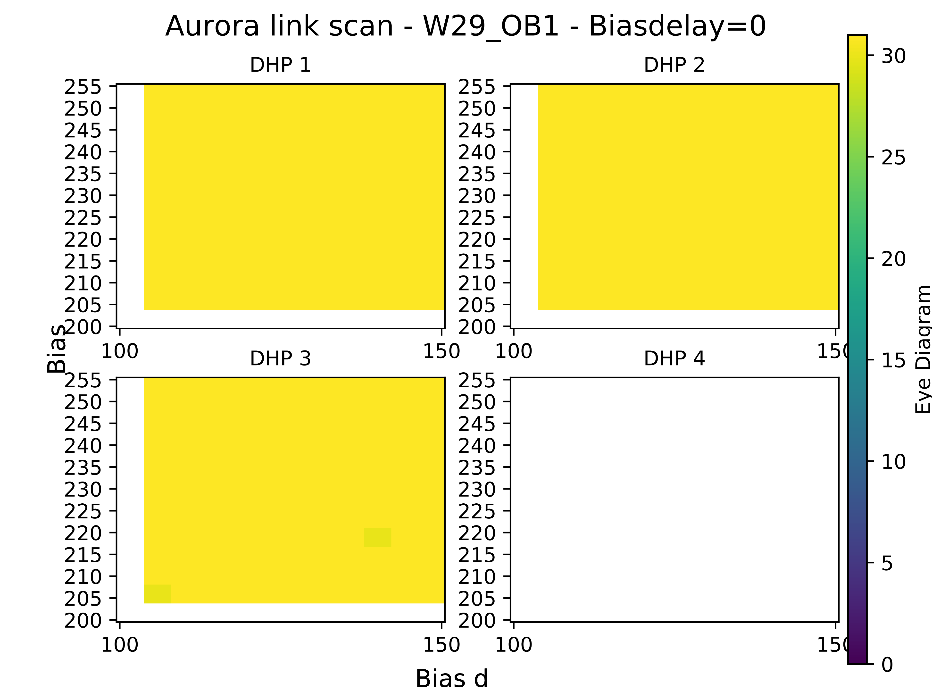
Signal Integrity measurements
AWG 24 stability scan 5min vs AWG 28 stability scan 5min
200mV
200mV
100mV
100mV
Broken
On PP
0mV
0mV
B, bd dly=0 | Vertical Opening [mV] | Jitter Deter. [ps] | Jitter Rand. [ps]
200,100 | 225 | 263 | 24
200,150 | 232 | 234 | 21
255,100 | 225 | 268 | 21
255,150 | 228 | 224 | 18
225,125 | 233 | 238 | 20
B, bd dly=0 | Vertical Opening [mV] | Jitter Deter. [ps] | Jitter Rand. [ps]
200,100 | 174 | 358 | 20
200,150 | 182 | 315 | 21
255,100 | 171 | 309 | 21
255,150 | 184 | 326 | 20
225,125 | 184 | 339 | 21

Slide 22
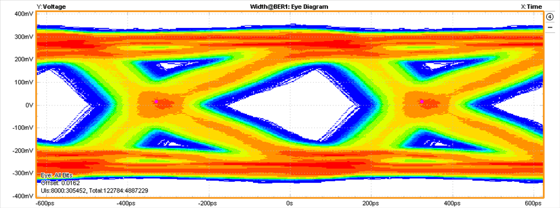
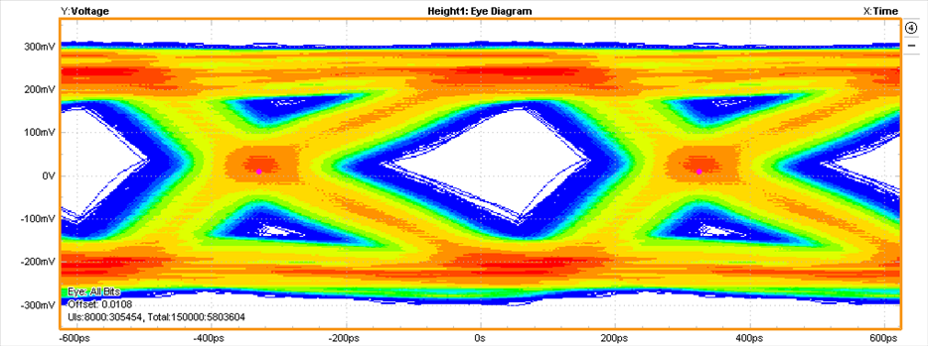
Signal Integrity measurements
AWG24 opt. eye vs AWG 28 opt. eye
B, bd dly=0 | Vertical Opening [mV] | Jitter Deter. [ps] | Jitter Rand. [ps]
200,100 | 225 | 263 | 24
200,150 | 232 | 234 | 21
255,100 | 225 | 268 | 21
255,150 | 228 | 224 | 18
225,125 Optimal | 233 | 238 | 20
B, bd dly=0 | Vertical Opening [mV] | Jitter Deter. [ps] | Jitter Rand. [ps]
200,100 | 174 | 358 | 20
200,150 | 182 | 315 | 21
255,100 | 171 | 309 | 21
255,150 | 184 | 326 | 20
225,125 | 184 | 339 | 21
255,255 optimal | 200 | 273 | 20

Slide 23
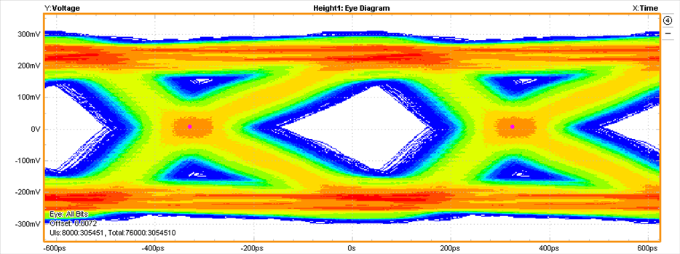
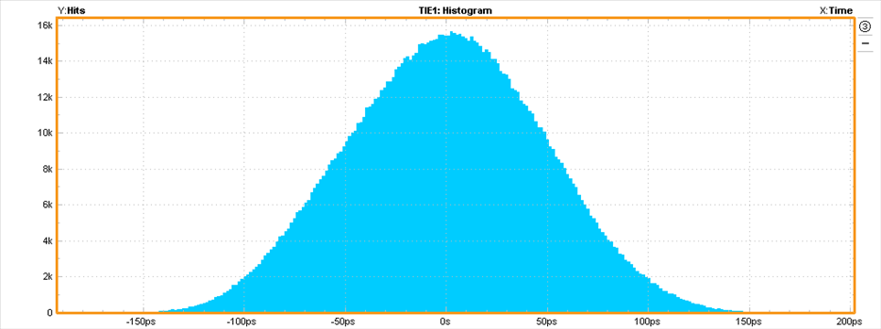
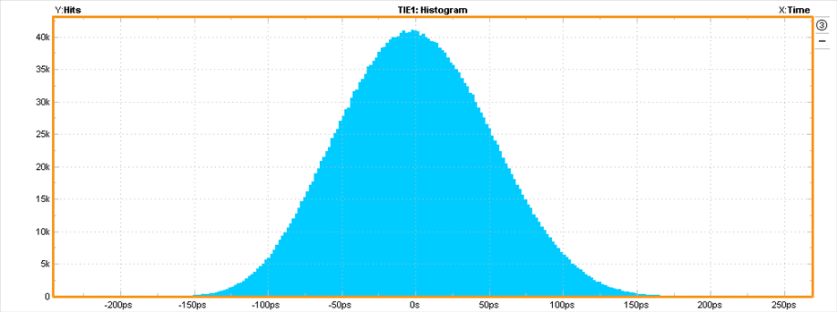
Signal Integrity measurements
AWG 28 7bit LFSR vs AWG 28 8b/10b
200 mV, DJ 273ps 220mV, DJ 240ps

Slide 24
Summary
We conclude…
Eye opening of PDPP_L2BWD-03 (AWG 24) ~ 230mV
compared to
Eye opening of PDPP_L2BWD-04 (AWG 28) ~ 200mV
High jitter though
  Further investigation needed

Slide 25
Summary
What have we learned so far?
Signal integrity highly depends on system
  Hybrid 5 (Infiniband only) vs EMCM2 (Kapton+PP+Infiniband)
  Impedance discontinuities has a high impact
  → Quality control of PP (soldering, etc.)
Additional optimization
  Understanding the source of jitter (GCK, DHPT PLL, …)
  Bit Error Rate for region of interest
    HS link scan does not give sufficient information
  Increase statistics
    Probe all DHP HS links
    Test multiple PP assemblies

Slide 26
Thank you

Slide 27
Backup

Slide 28
Mass production - What is tested?
Sanity check
  Power consumption, visual inspection (mechanical damage)
Internal chip functionality: DHP digital logic
  JTAG registers (programmability of DHP)
  Memory qualification (SRAM testing)
    Raw data mem., Offset data mem. And Sw data mem.
  Digital logic:
      Data processing
        Common mode (CM) correction
        Test data with simulated CM
      Trigger zero-suppressed data
Interchip communication: DHP<->DCD, DHP->Switcher and DHP<->DHE
  I/O en-/disabling
  Data transmission;
  DHP->DCD, DHP<-DCD, DHP->Switcher and DHP->DHE, DHP<-DHE
    Test pattern generation and r/w by FPGA based system
    Signal integrity, i.e. Bit Error Rate
germic@physik.uni-bonn.de
28
Notes:
28

Slide 29
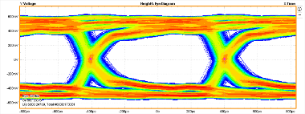
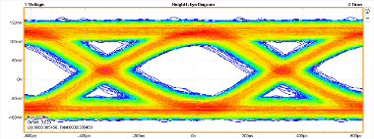
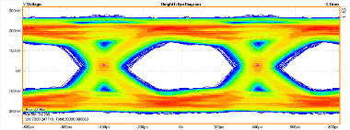
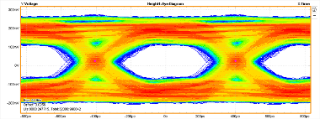
(6 connectors)
(4 connectors)
DHE<->BB==Probe<->Hyb5
1m 1m
Bias 255
Biasd 0
Biasdly 0
opening ~ 656mV
DHE<->BB<->Probe<->Hyb5
1m 1m 10m
DHE<->BB==Probe<->Hyb5
1m 10m
Bias 65
Biasd 255
Biasdly 0
opening ~ 117mV
Bias 120
Biasd 255
Biasdly 0
opening ~ 285mV
DHE<->BB==Probe<->Hyb5
1m 15m
Bias 120
Biasd 255
Biasdly 0
opening ~ 172mV

