Slide 1
Leo Stodolsky
80th anniversary
Cryodetectors
At the MPI and the TUM
Since 1985
Franz v. Feilitzsch, Raimund Straus

Slide 2
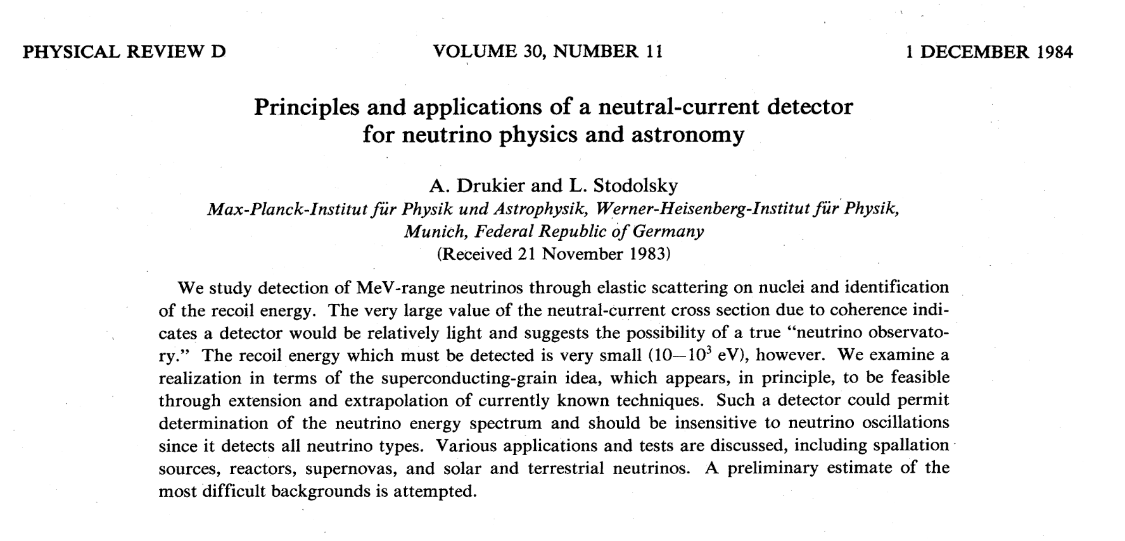

Slide 3
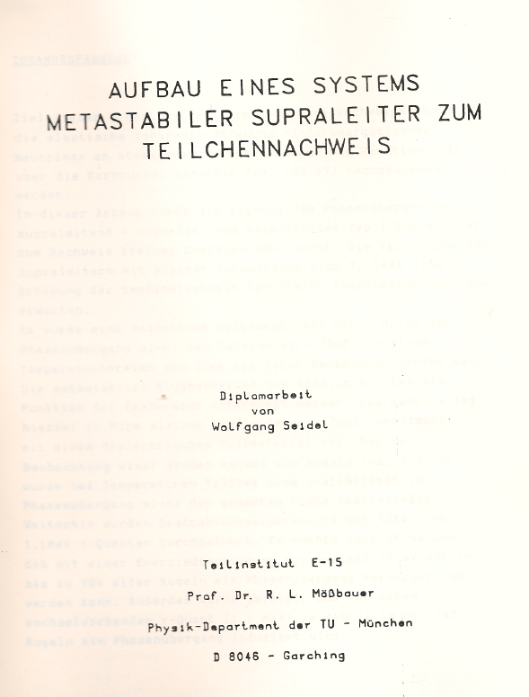

Slide 4
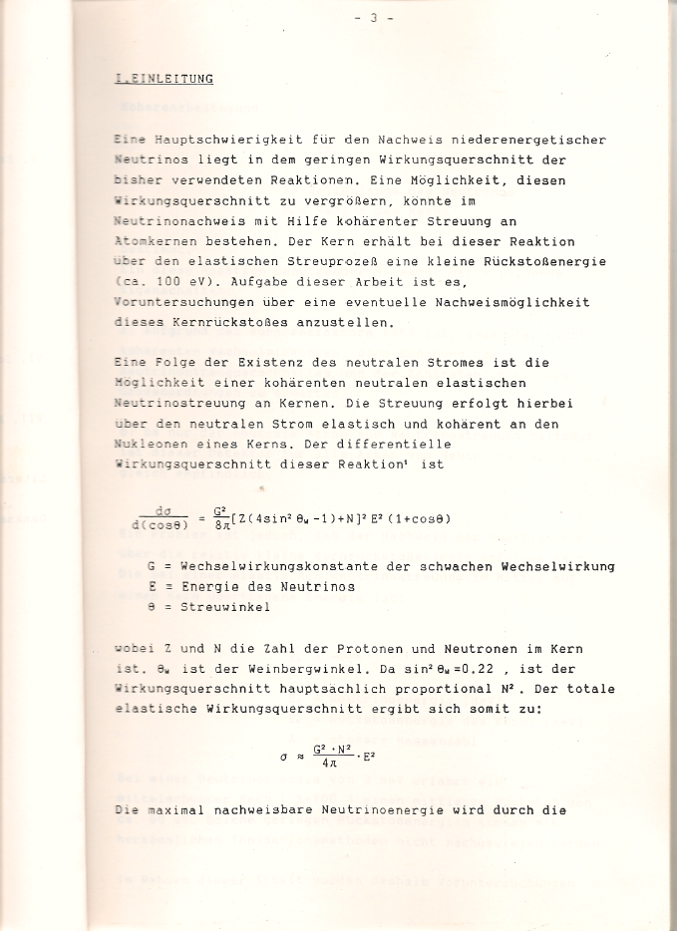
Total crossection
For coherent NC scattering

Slide 5
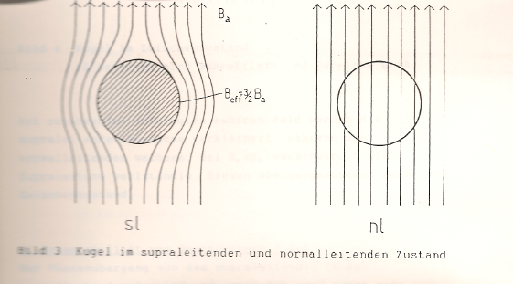

Slide 6
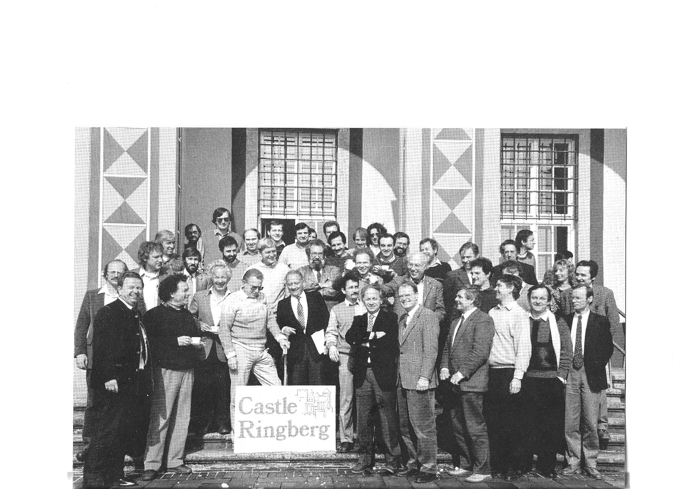
LTD 1 Ringberg Castel 1987

Slide 7
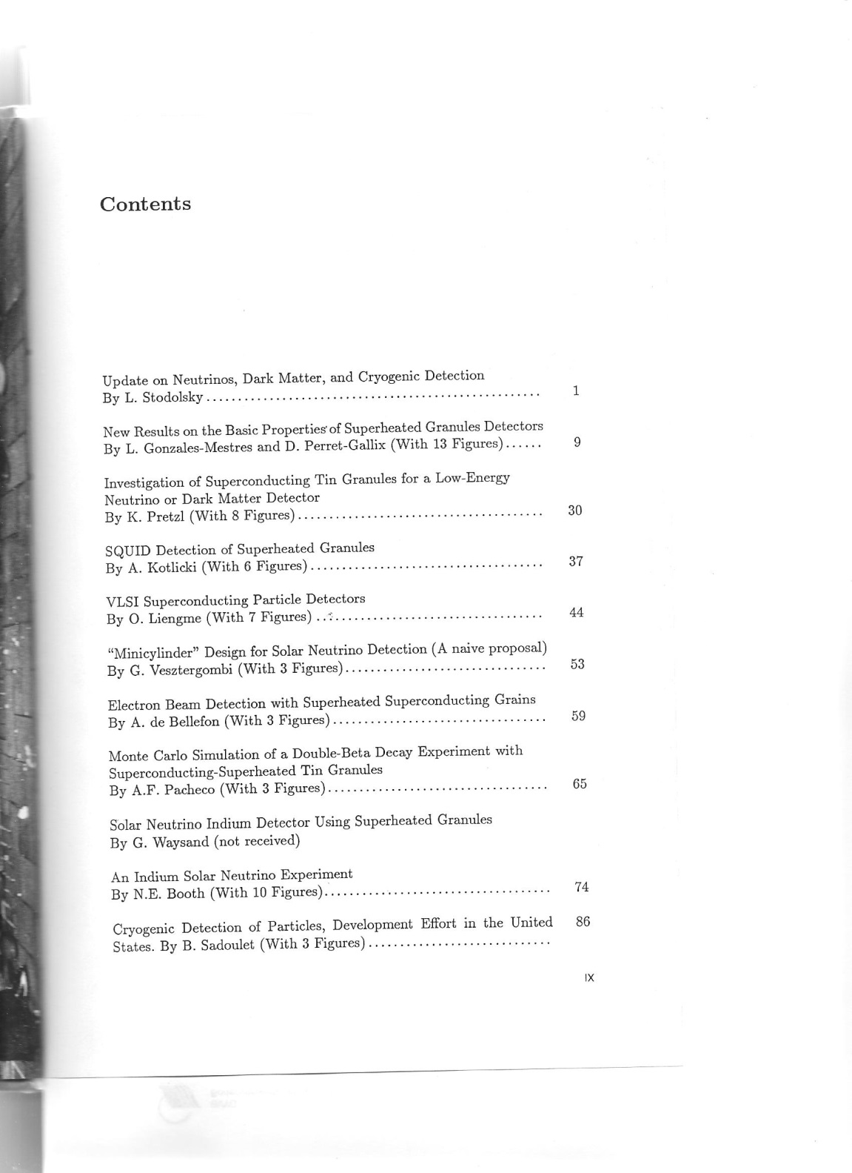
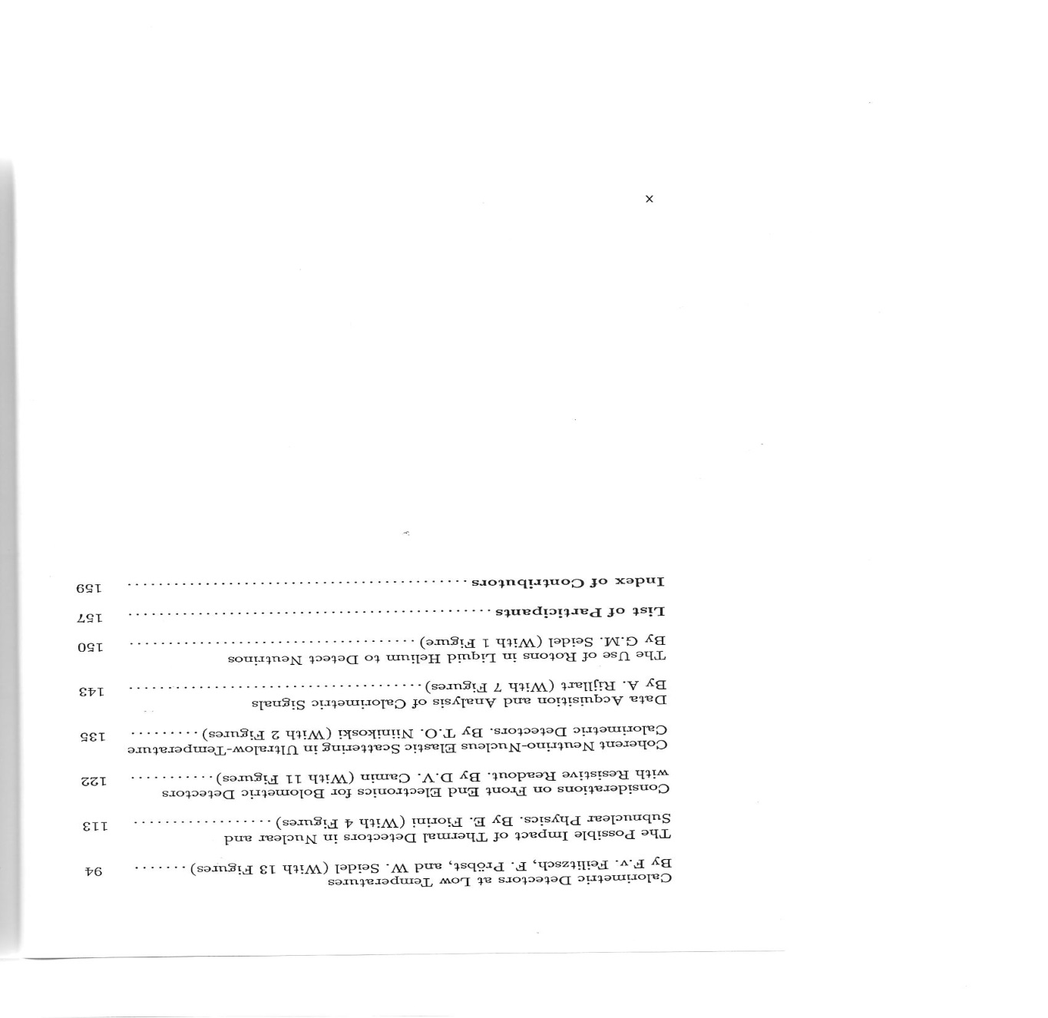

Slide 8
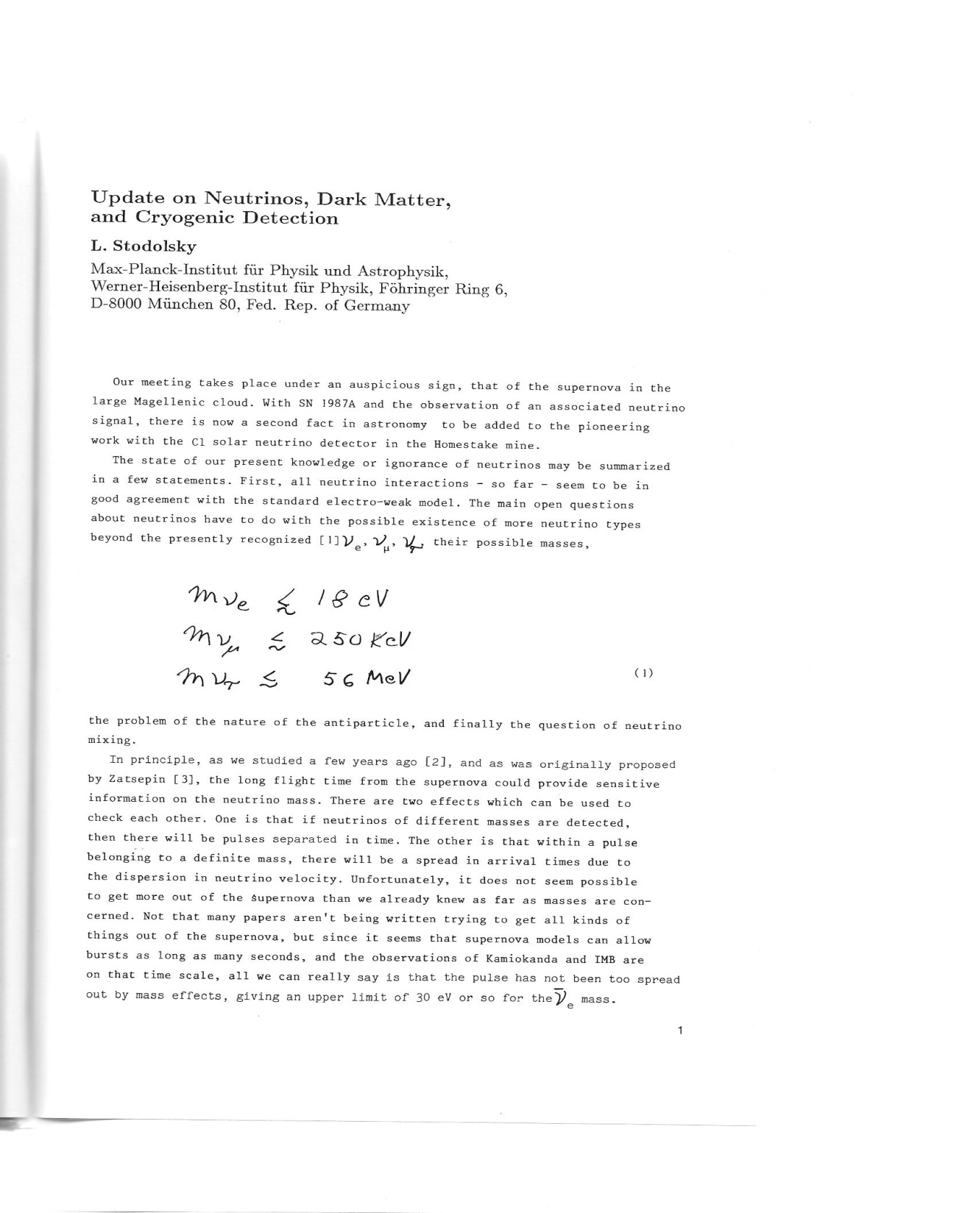
Supernova 1987a
V- signal detected

Slide 9
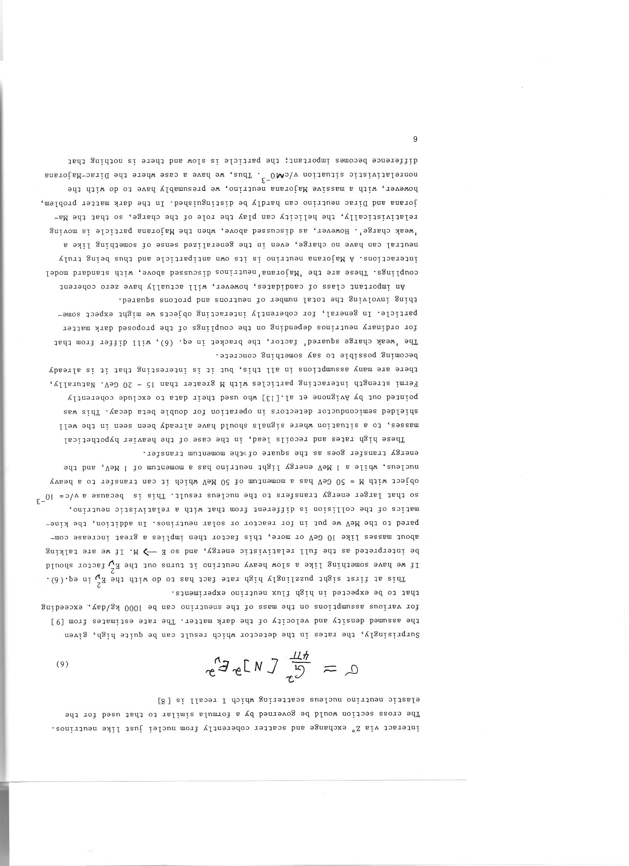
Coheren neutrino,-
dark matter
Scattering and detection

Slide 10
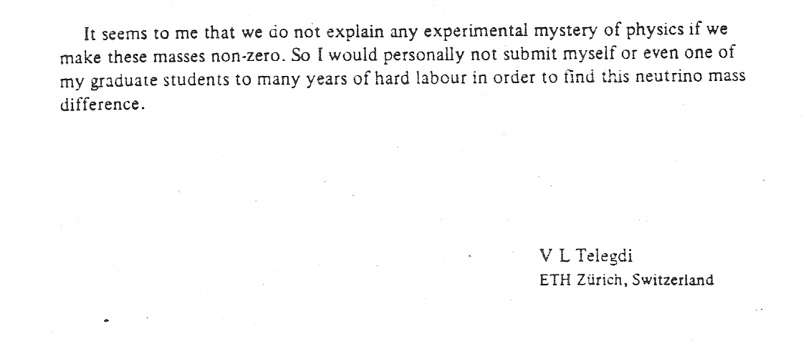
There were different opinions
Letter of Telgdi to R. Mößbauer
1978

Slide 11
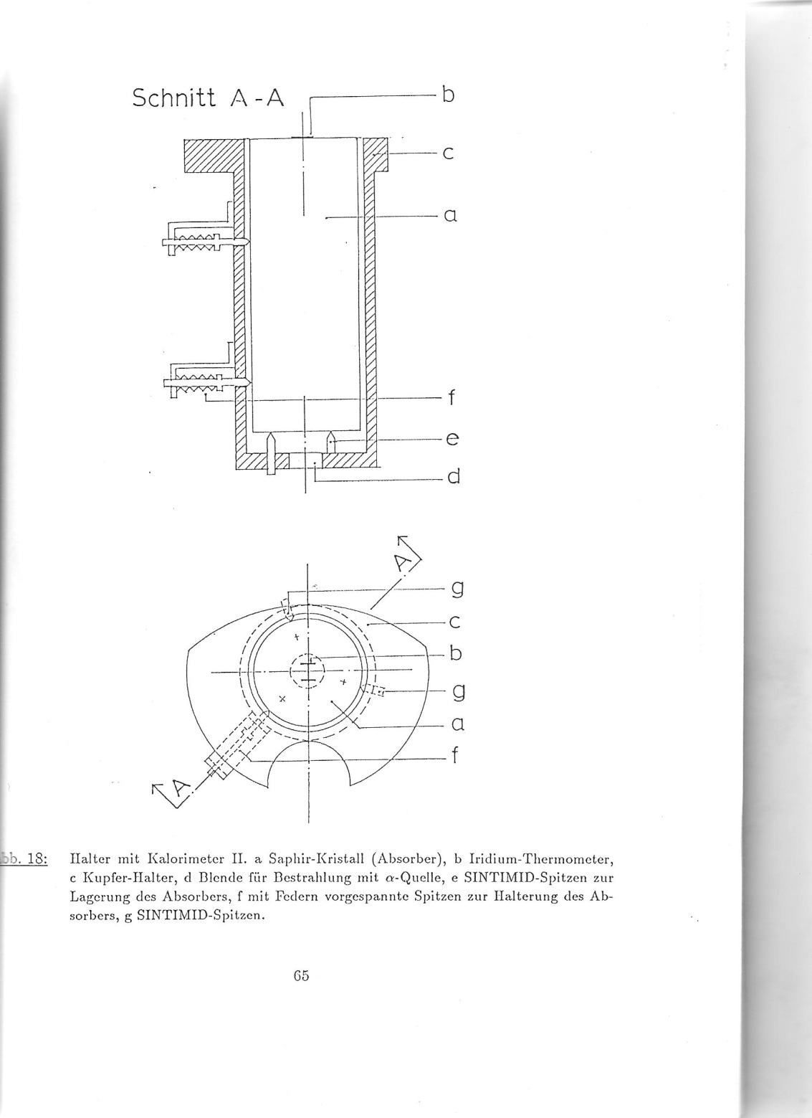
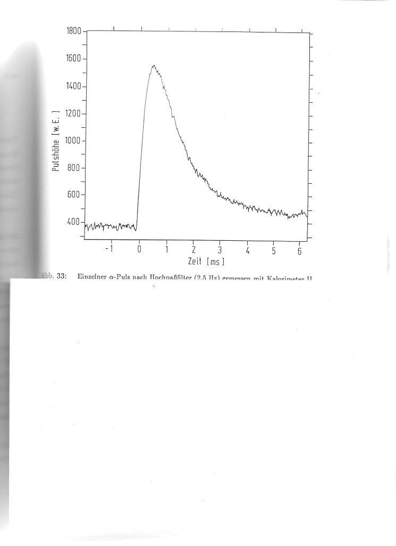
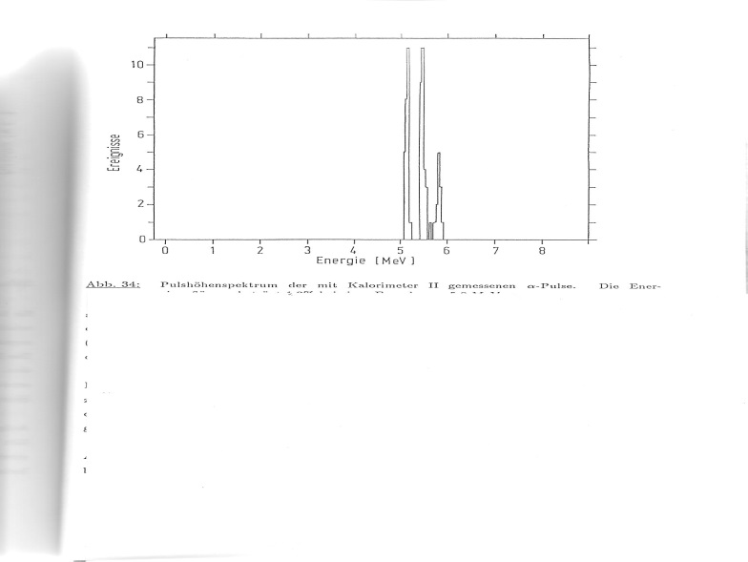
280g Al2O3 detector Dr Arb. W. Seidel
largest cryodet at the time
Test of energy flow and linearity

Slide 12
Al2O3 single crystal was optinized for low mass dark matter wimp´s
Very strong claims from reputated theorists were against low mass weakly interacting DM due to Z mass limits .
Decission for CRESST dark matter detector with CaWO4 single crystals
Many more developments for cryo detectors world wide
Low energy x- ray detection:
for cosmic rays , solid state physics, material analysis
ßß ov -decay search
More than 25 years later
Low mass WIMP´s again
fashionable !
and coherent v-scattering detectable ?

Slide 13
CRESST 3 detector design
Optimized for low energy threshold !
again Low mass wimps

Slide 14
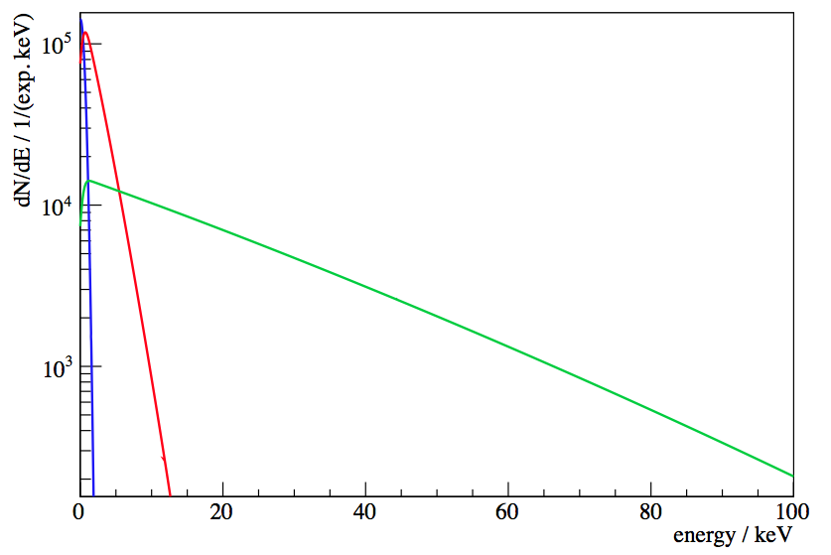
Potential of Cryogenic Detectors
Why are cryogenic detectors particularly sensitive to low-mass WIMPs ?
Ge
Low energy threshold
100 GeV/c²
10 GeV/c²
1 GeV/c²
lower WIMP mass

Slide 15
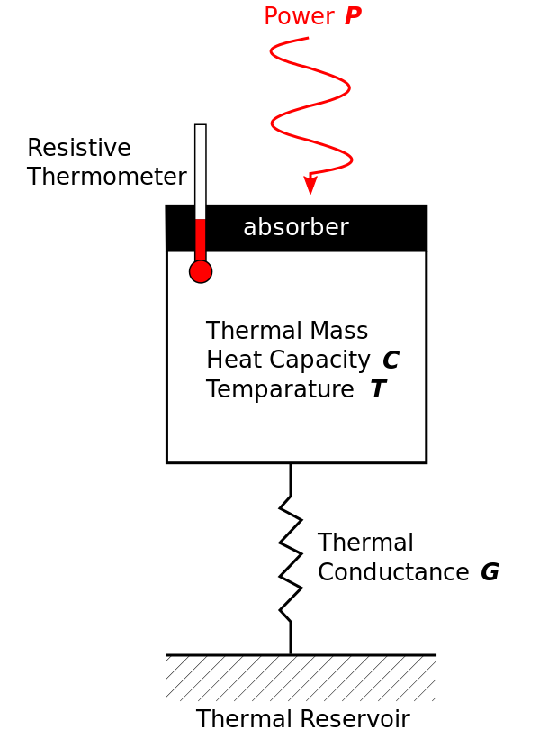
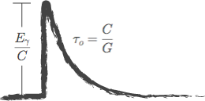
Cryogenic Detector
Thermometer response:
energy E
Calorimeter
Direct measurement of total deposited energy!

Slide 16
Cryogenic Detector
Irreducible thermal fluctuations:
Need:
Low temperature
Low heat capacity
energy E
Operation at mK:
Temperature increase from particles interactions can be measured!
( 1keV → μK )

Slide 17
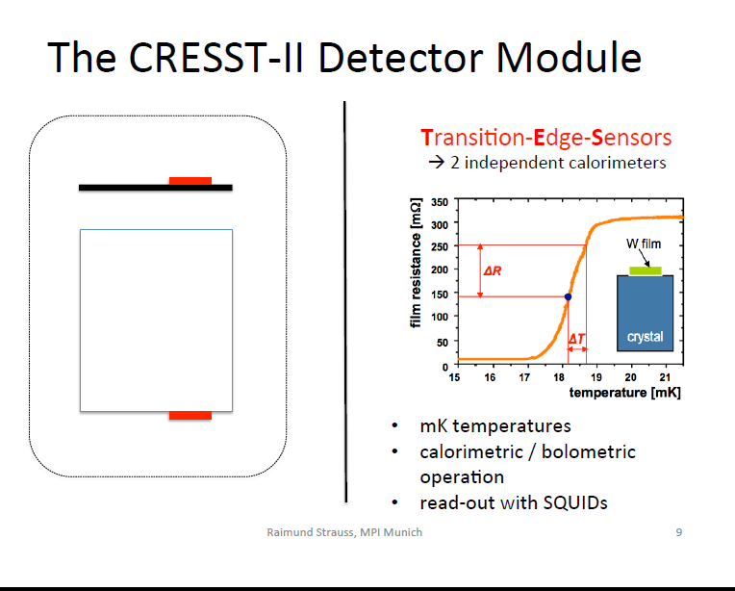

Slide 18
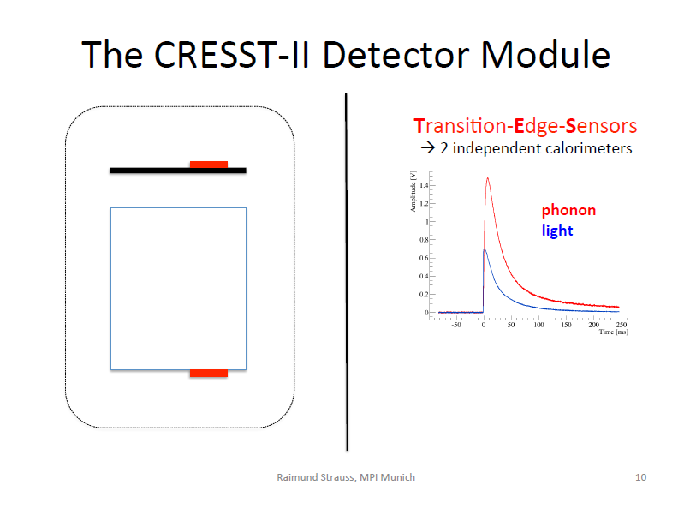
Light
detector
Phonon
detector
F. Probst

Slide 19
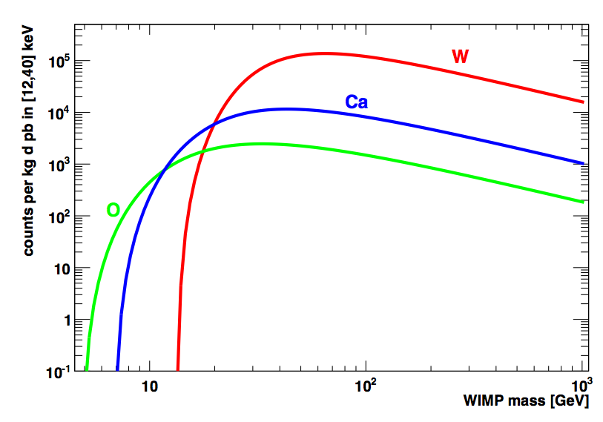
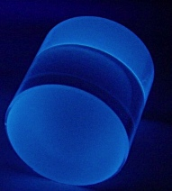
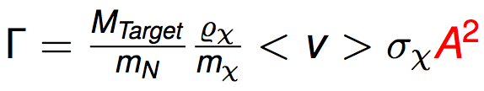
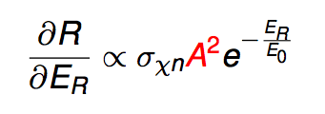
CRESST – Multi-Element Target
Example:
CaWO₄ target
Threshold: 12keV
Cross-section: 1pb

Slide 20
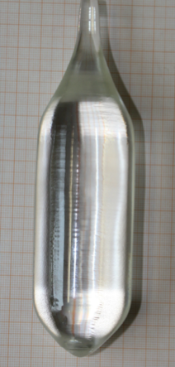
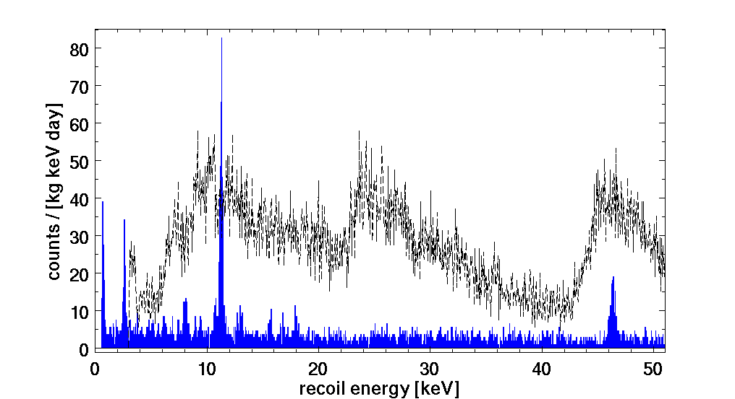
Radiopurity of CaWO₄ Crystals
CaWO₄-crystal production at TU Munich
Unprecedented radiopurity (by factor 2-10)
A. Erb et al., CrystEngComm 15(2013)12
raw ingot of m≈1kg
Average rate:
~3.5 counts / [kg keV day]
Excellent resolution:
𝜎 ≈ 90eV
Threshold:
E_{th} ≈ 603eV
(Nuclear-recoil energy directly measured!)
¹⁷⁹Ta L1(EC)
commercial crystal
TUM-40
²²⁷Ac
²¹⁰Pb

Slide 21
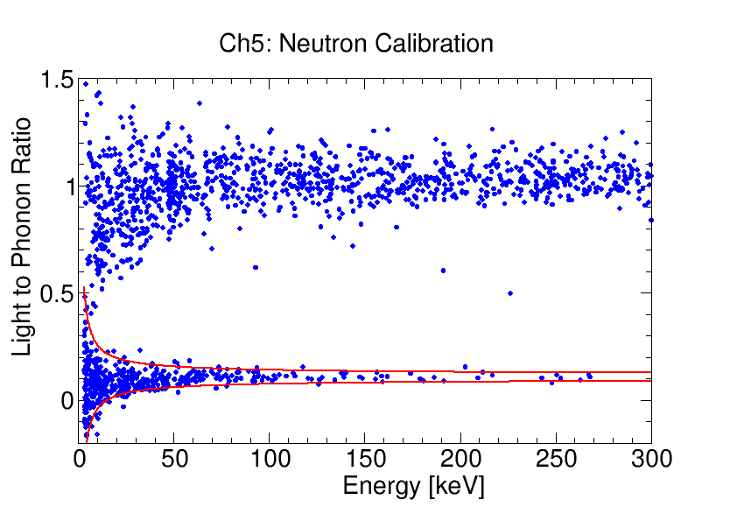
Phonon-Light Technique
light
phonon
e⁻/γ
light yield
neutrons
phonon
Reduced light output for highly-ionizing particles Quenching

Slide 22
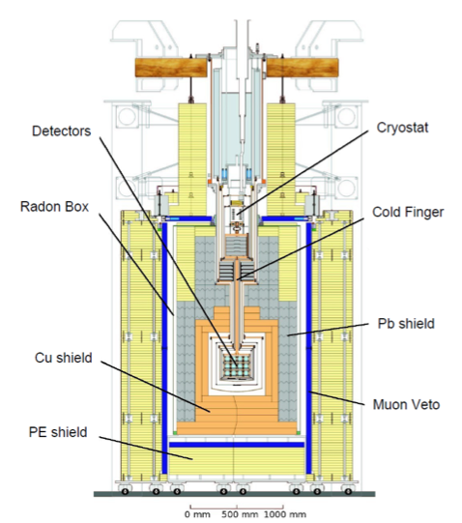
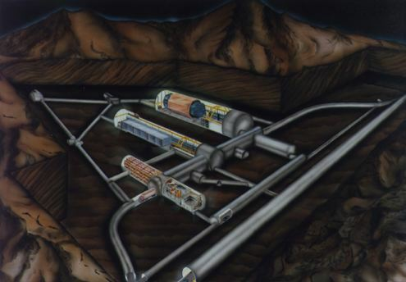
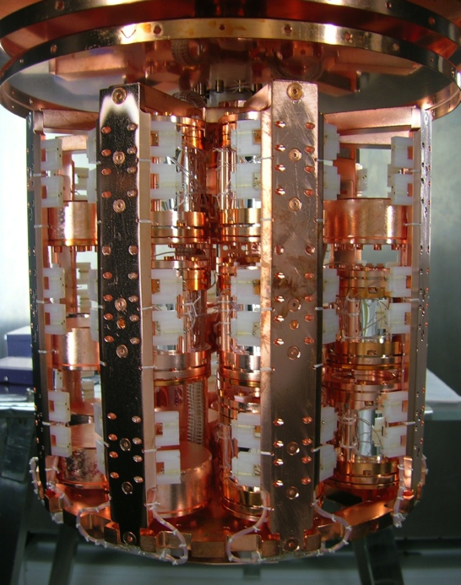
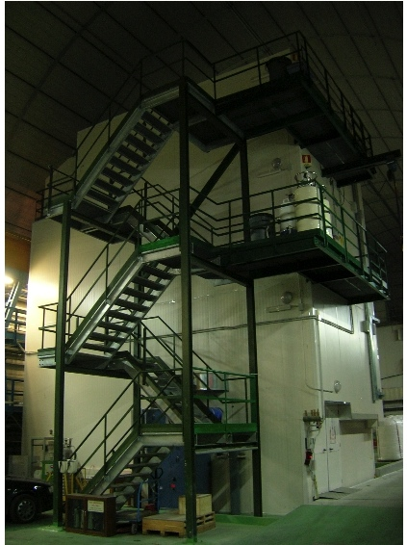
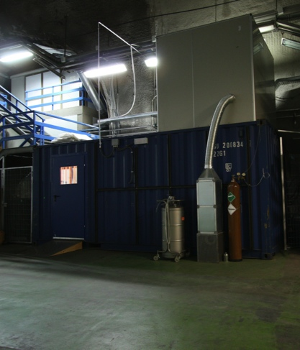
The CRESST Experiment
Cryogenic Rare Event Search with Superconducting Thermometers
LNGS
Detector “Carousel”
up to 33 individual CRESST modules
CRESST
sala A
CRESST-Testcryostat
truck tunnel

Slide 23
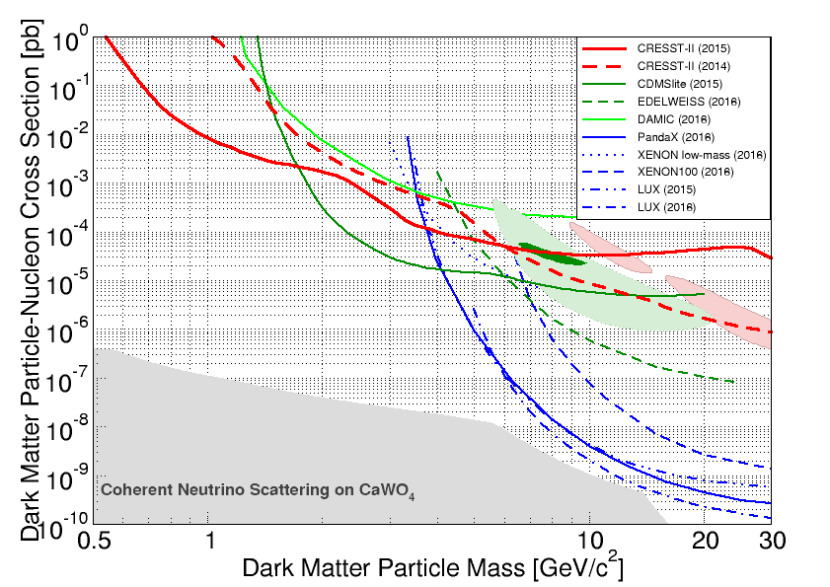
Current Status of Direct Dark Matter Searches
Cryogenic
experiments
Liquid Xe
experiments
Notes:
Limitplot – überblendung von currently best limits

Slide 24
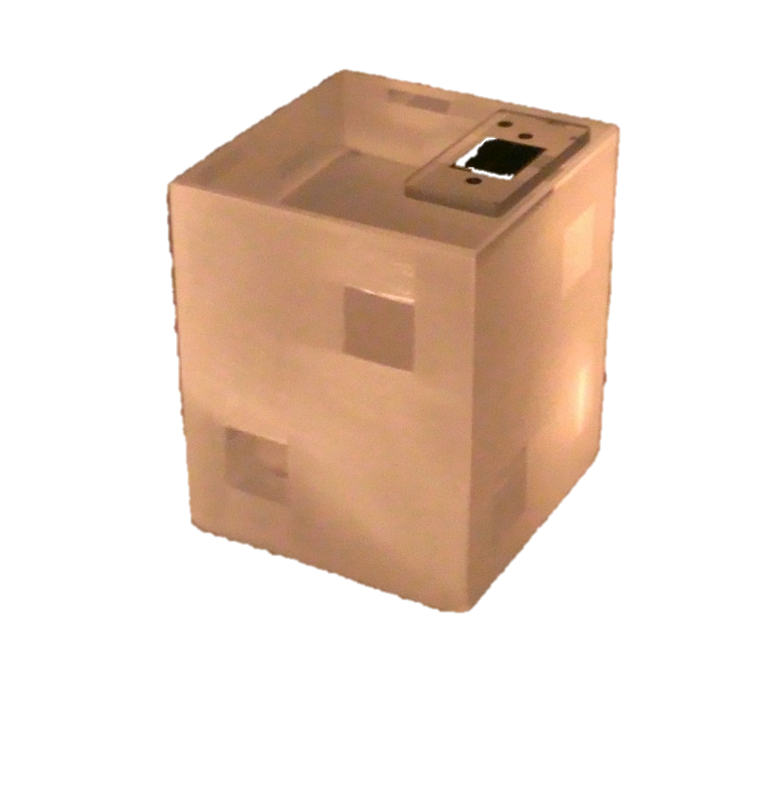
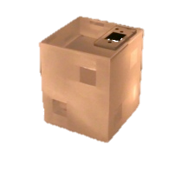
CRESST-III: Low-Mass Dark Matter Search
Straight-forward approach: CRESST-III Phase 1
Status quo
m = 250g
V = 32x32x40 mm³
Scale down size by factor 10
m=24g
Phonon threshold: E_{th} ≲ 500eV improvement by a factor of 5-10
Light-detector res.: 𝜎 ≈ 5 eV improvement by a factor of 2
F. Pröbst

Slide 25
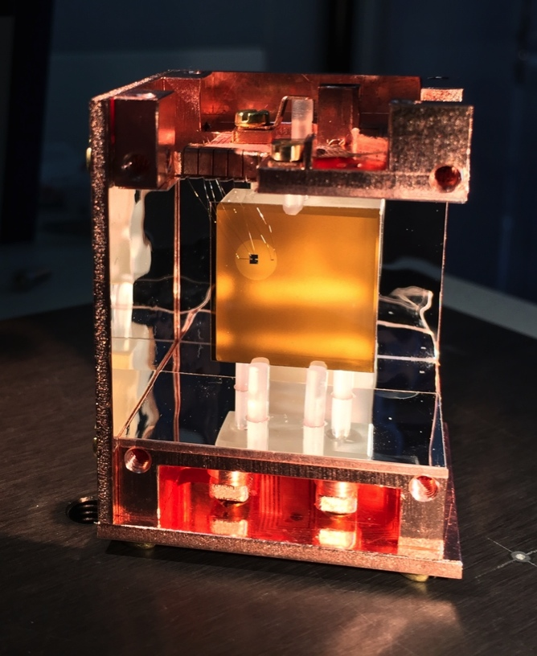
CRESST-III Detector Prototype
Notes:
To be tested next week

Slide 26
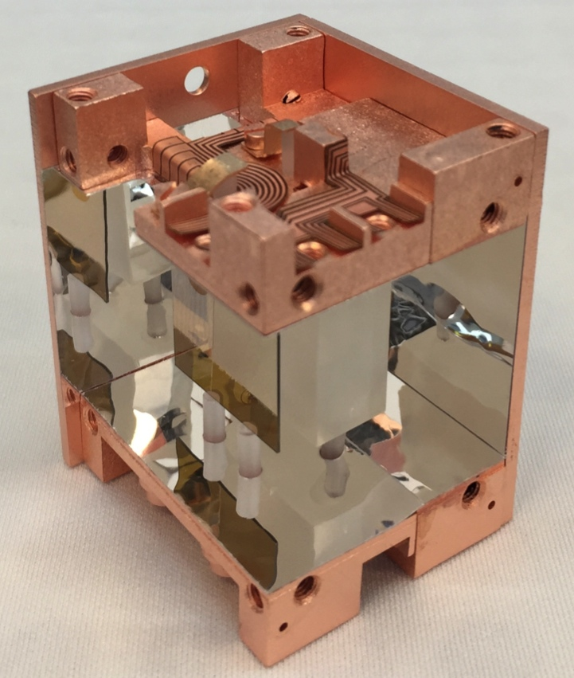
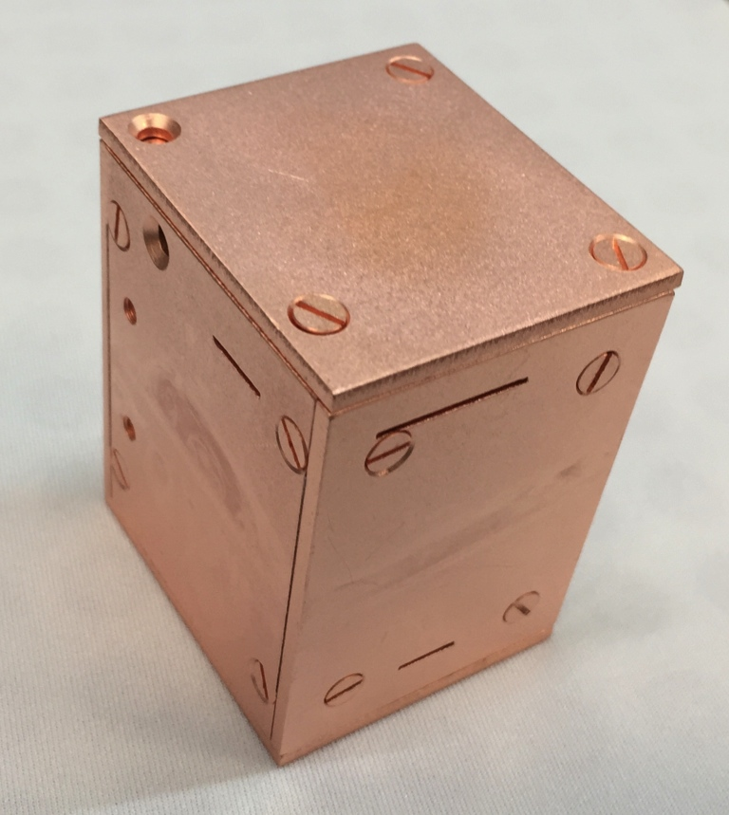
Assembly of CRESST-III Modules
New dedicated cleanroom for CRESST-III at MPI Munich
10 module assembled for CRESST-III phase 1

Slide 27
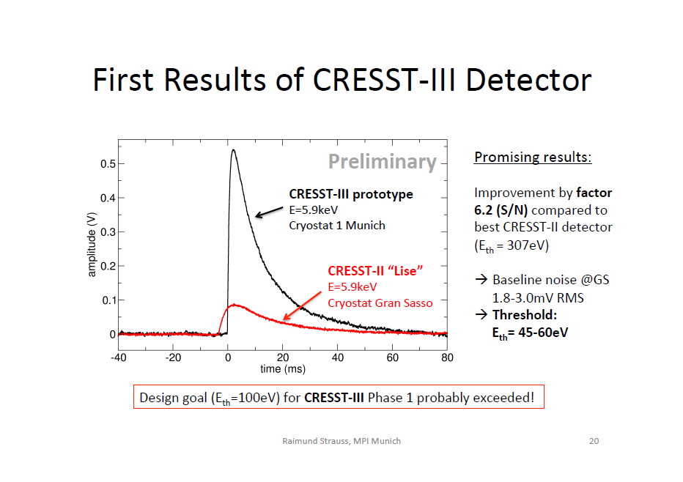

Slide 28
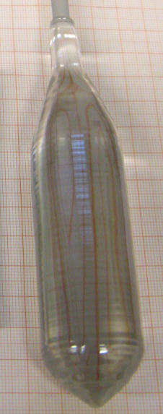

Recent Exciting Progress at TUM
First steps in chemical purification of CaCO₃ powder:
Measurements indicate purification
  Th contamination decreased by factor 2-7
  U contamination decreased by factor 15-35
Crystal growth successful
Two new crystals implemented in CRESST-III phase 1 !
Raw ingot enough for 3-4 CRESST-III detectors
work by H.H. Trinh Thi, A. Münster, A. Erb
30mm

Slide 29
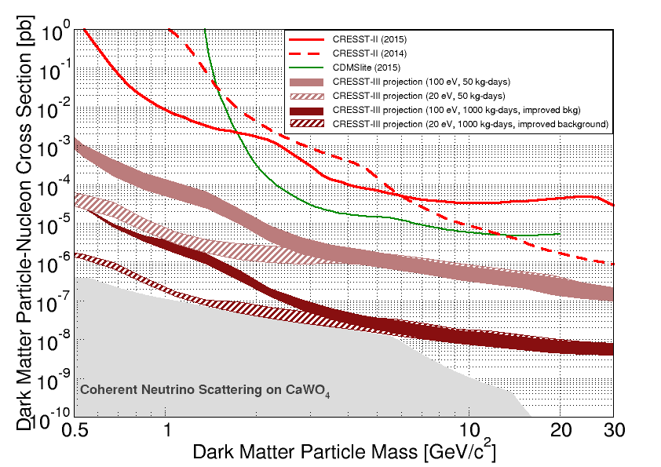
CRESST-III Phase 2
CRESST-II Phase 2
CRESST-III Phase 2 projection
100 x 24g detectors of improved quality operated for 2 years ≈ 1000 kg-days (net)

Slide 30
Summary
CRESST technology ideal for low-mass DM search
  Lowest thresholds in the field
  Nuclear-recoil energy scale precisely known
  Background discrimination down to low energies
  Efficient rejection of surface backgrounds
  Multi-element target
CRESST-II probed new region of parameter space for DM particle masses below 3GeV/c²
  CRESST-III has unique potential for low-mass DM search
  Threshold of <100eV reached with CRESST-III detectors
  new technology to reject holder-related events
  TUM crystals of improved quality in operation!
Publication of first CRESST-III data planned for Aug 2017
Notes:
Multi element target

Slide 31
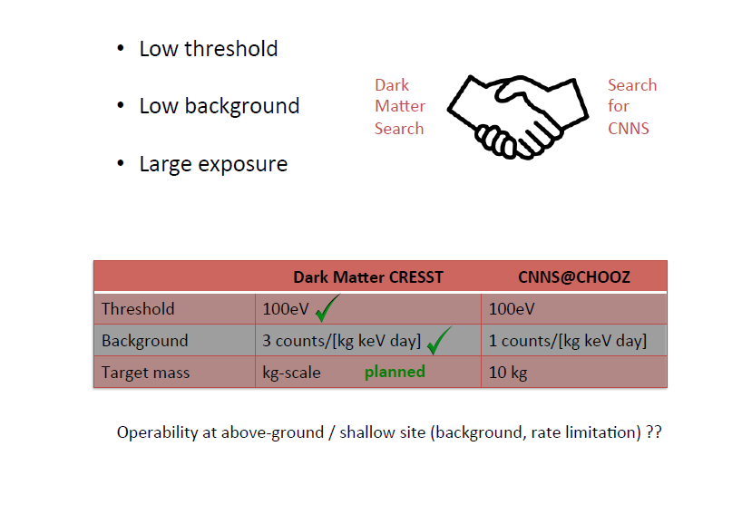

Slide 32
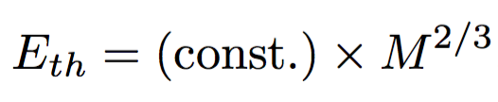
Gram-scale cryogenic calorimeters
outer cryogenic veto against external backgrounds
inner cryogenic veto against
surface backgrounds
We derived a simple scaling law:
(5x5x5)mm³ crystal cubes
CaWO₄: 0.8 g
Al₂O₃: 0.5 g
Threshold: 1-10eV regime
Goals:
Low threshold
Fiducialisation
Above-ground operation
→ „Fiducial-volume“ cryogenic detector

Slide 33
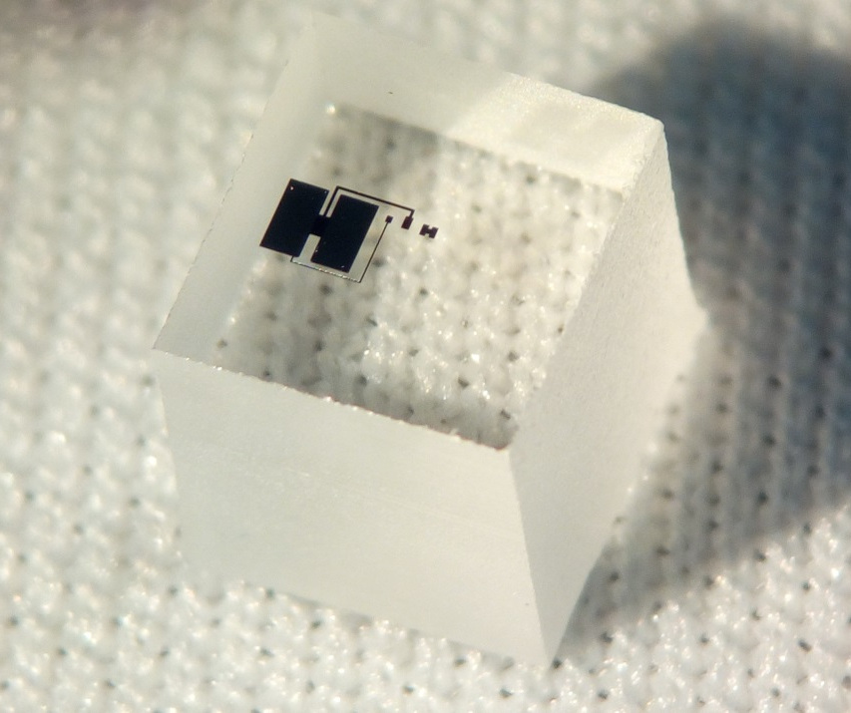
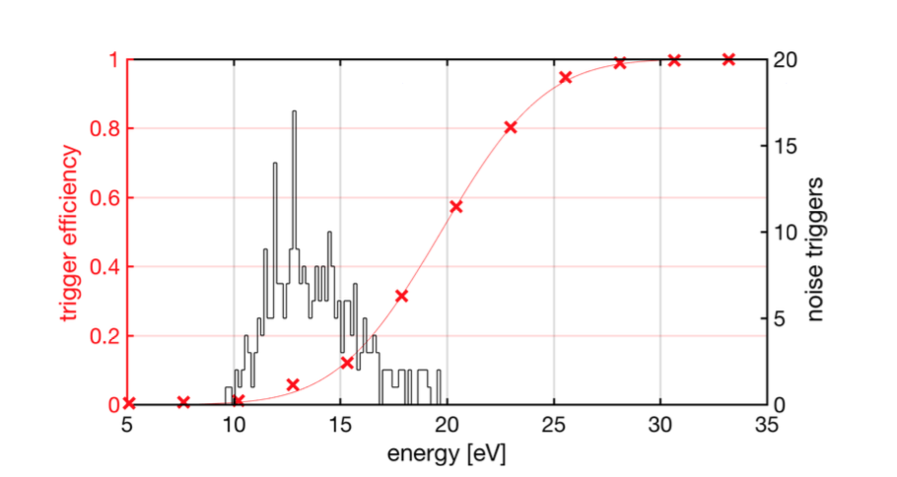
0.5g Sapphire Prototype
Picture: M. Mancuso
Transition-edge-sensor
Sapphire crystal 0.5g
Measurement at MPI
Noise traces
Measured efficiency
5mm
Energy threshold: E_{th} = (19.7 +- 0.1) eV

Slide 34
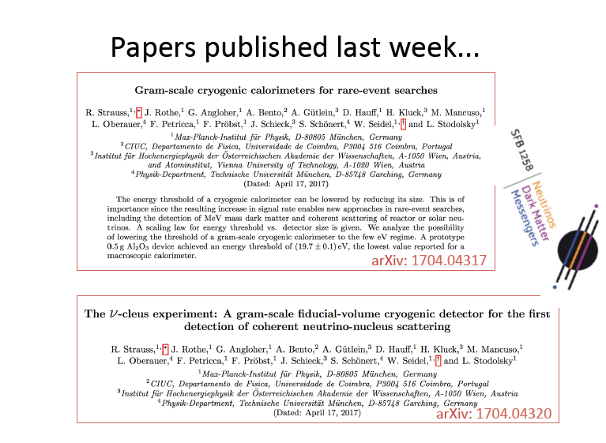

Slide 35
New approaches in rare-event search
CaWO₄
40m to 4GW reactor
Measured background levels
above ground
CaWO₄ intrinsic

Slide 36
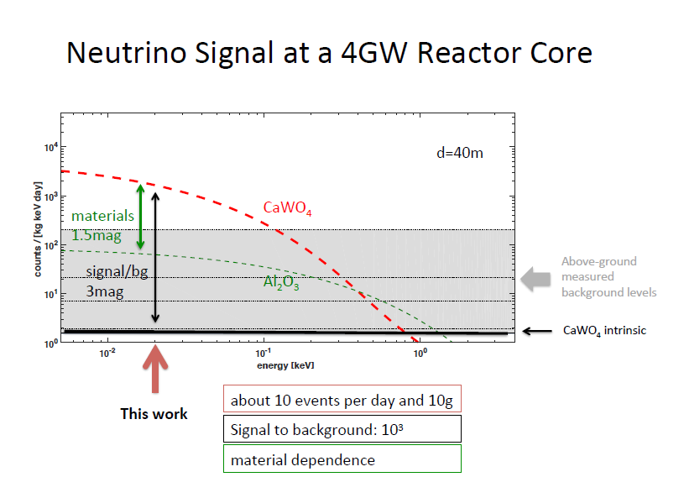

Slide 37
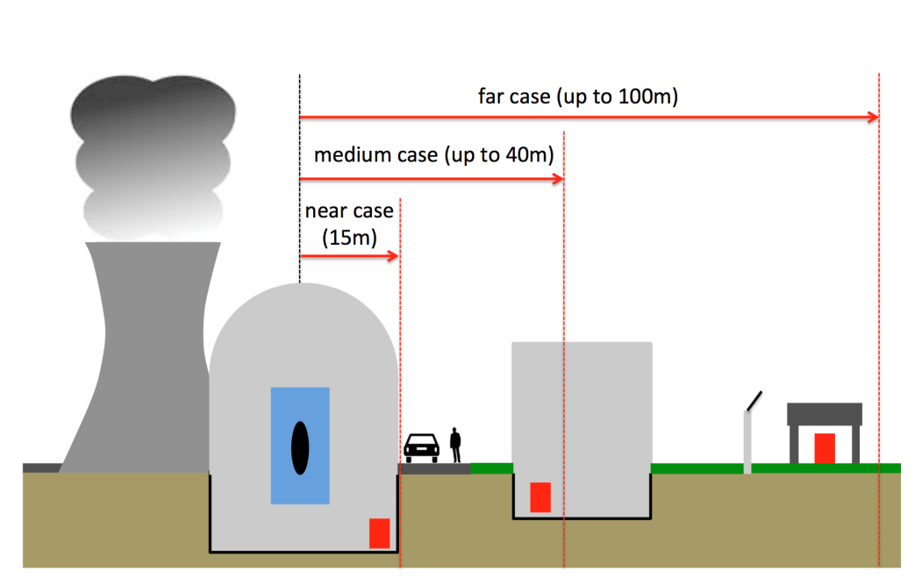
Study of 3 different sites
Medium case (40m)
Straight forward in terms of:
experimental site
signal rate
background level
→ Discovery within 2 weeks

Slide 38
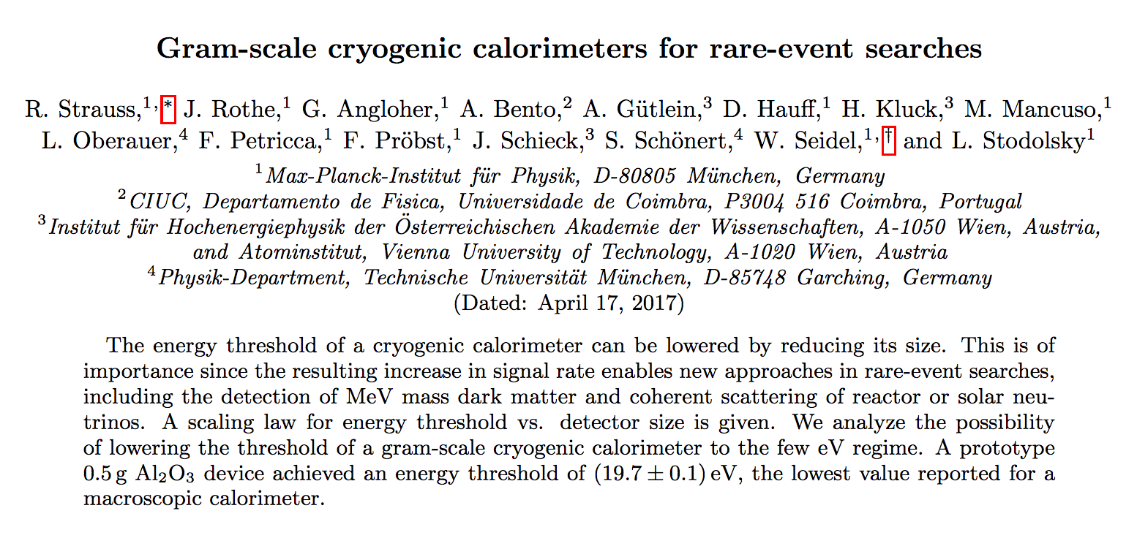
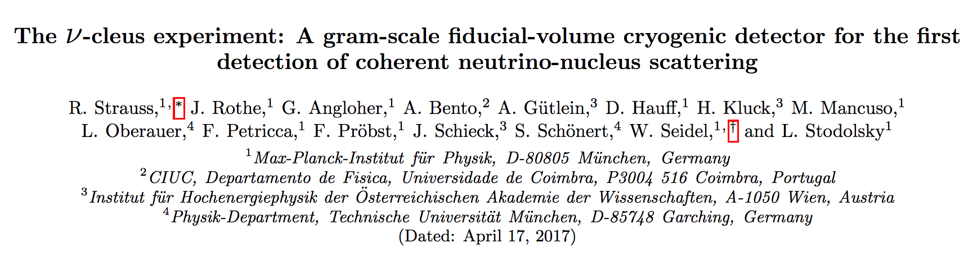
arXiv: 1704.04317
arXiv: 1704.04317
arXiv: 1704.04320

