Slide 1


POLARISED eP AND eA PHYSICS
Status, future and opportunities
E.C. Aschenauer
arXiv:1602.03922
arXiv: 1212.1701

Slide 2
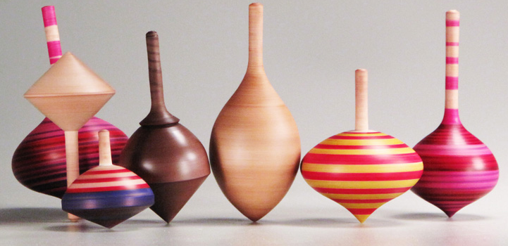
SPIN: Fundamental quantum Number
Remember:
x-distribution of PDF provides insight to intrinsic properties
vs. dynamic QCD effects
To separate interaction dependent phenomena from intrinsic properties
UNIVERSALITY
different complementary probes are needed ep ← → pp
SPIN is one of the fundamental properties of matter
all elementary particles, but the Higgs carry spin
Studying Spin revealed many surprises in physics
→ proton anomalous magnetic moment → substructure
cannot be explained by a static picture
of the proton
Proton Spin:
It is more than the number ½ ! It is the interplay between
the intrinsic properties and interactions of quarks and gluons
If we do not understand the proton spin in QCD,
we do not fully understand QCD !
need polarized colliders to have full access
to the proton dynamics

Slide 3
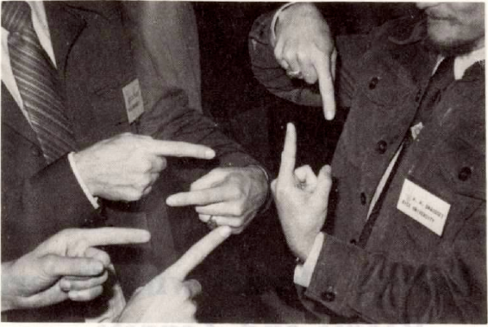
How and What do we measure

Slide 4


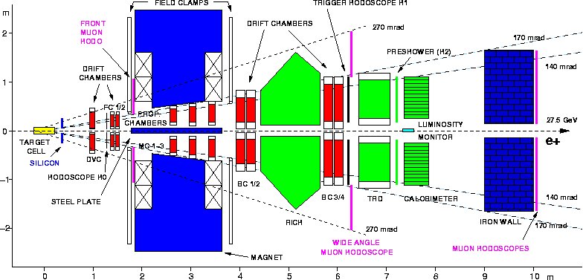
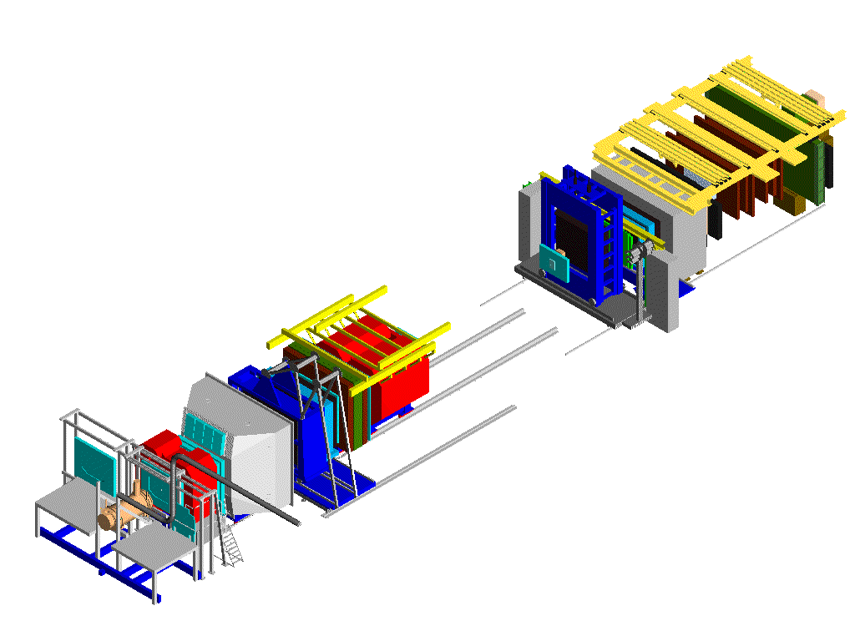
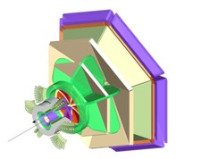

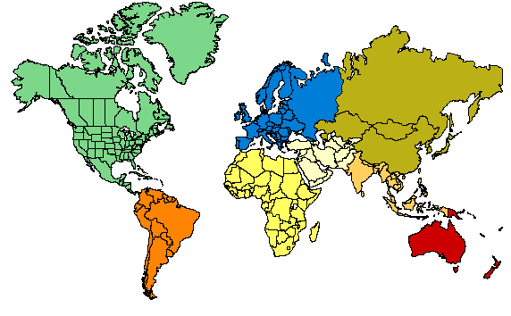

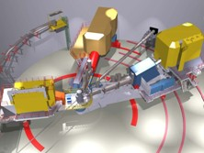

The contemporary “spin” experiments
Trigger-hodoscopes
Hall A
Hall B
μ Filter
ECal & HCal
50 m
SM2
Two high-resolution spectrometers
& large installations
RICH
Large acceptance spect. electron/photon beams
SM1
MWPC
Beam: 27.5 GeV e±; <50>% polarization
Target: polarized gas targets H, D, <85%> He³ <50%> polarization
unpolarised gas targets H₂ to Xenon
Lumi: pol: 5x10³¹ cm⁻²/s⁻¹; unpol: 3x10³²⁻³³ cm⁻²/s⁻¹
Data taking finished June 2007
Beam: ≤12 GeV e⁻; 85% polarization
Target: polarized targets 3He, 6LiD, NH3
several unpolarised targets
Hall-D: for spectroscopy 9GeV tagged polarised photons & a 4π detector
Hall C
Straws
⁶LiD Target
Gems
Drift chambers
160 GeV μ
Micromegas
Beam: 160 GeV μ: 80% polarization
Target: ⁶LiD: 50% polarization (2002-2006)
NH₃: 80% polarisation (2007)
Lumi: 5x10³² cm⁻²s⁻¹
2010 & 2011: longitudinal and transverse NH₃
SciFi
Silicon
Super high momentum spectrometer,
high luminosity and forward angles

Slide 5
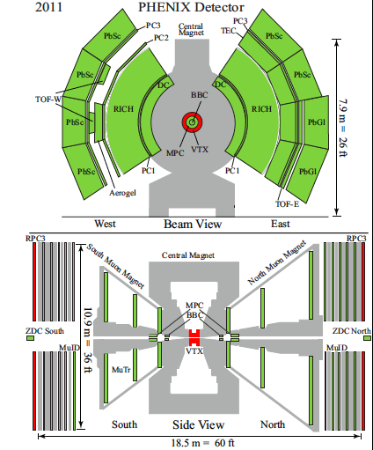
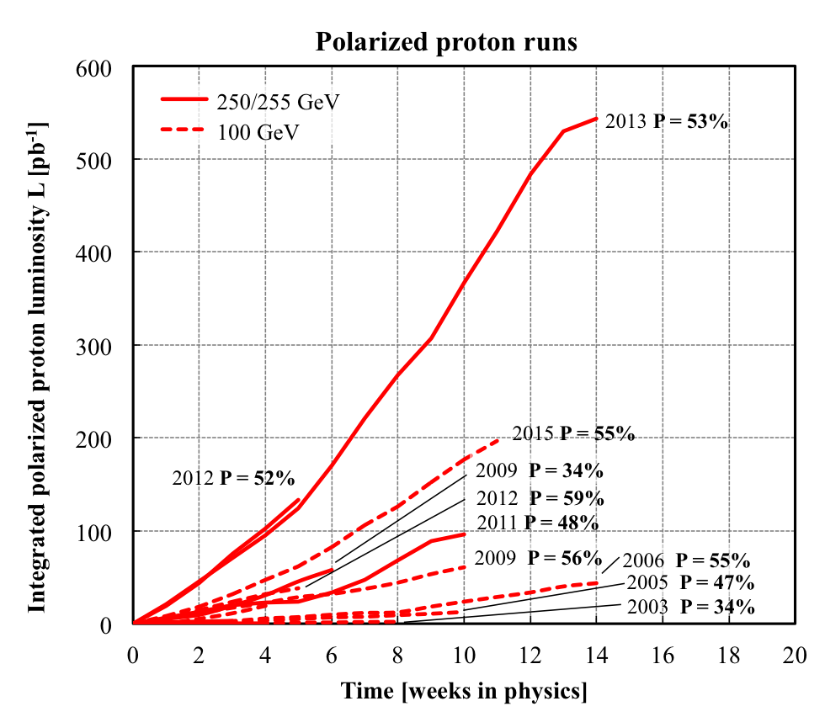
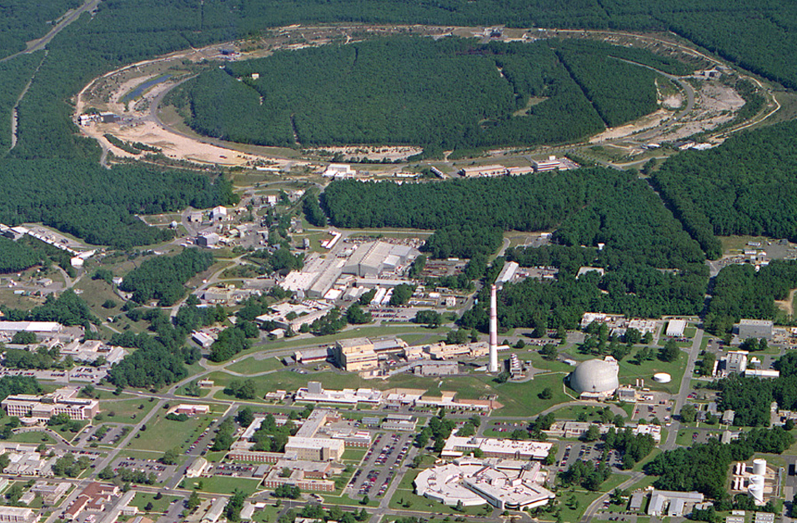
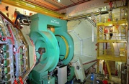
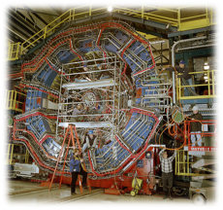
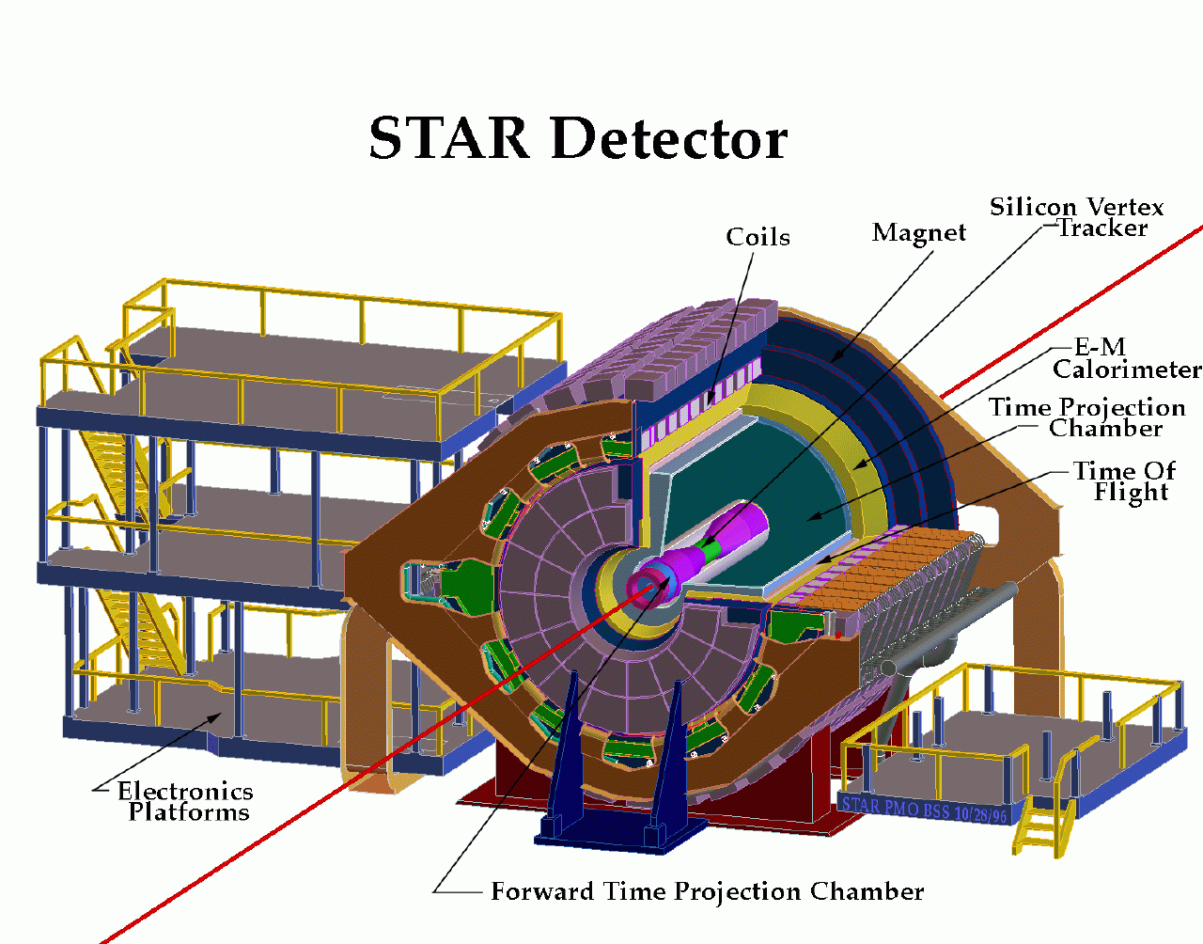

RHIC@BNL Today
eLens
Jet/C-Polarimeters
CeC
RHIC
PHENIX
small mid-rapitity
-0.35 < η < 0.35
forward μ-arms
RF
Beams: √s=<500 GeV pp; 50-60% polarization
Lumi: ~60 pb⁻¹/week
STAR
large rapidity
-1 < η < 4
multipurpose
LINAC
EBIS
Booster
NSRL
STAR
AGS
What do we collide ?
p
Polarized protons
24-255 GeV
Tandems
Light ions (d,Si,Cu)
Heavy ions (Au,U)
5-100 GeV/u

Slide 6
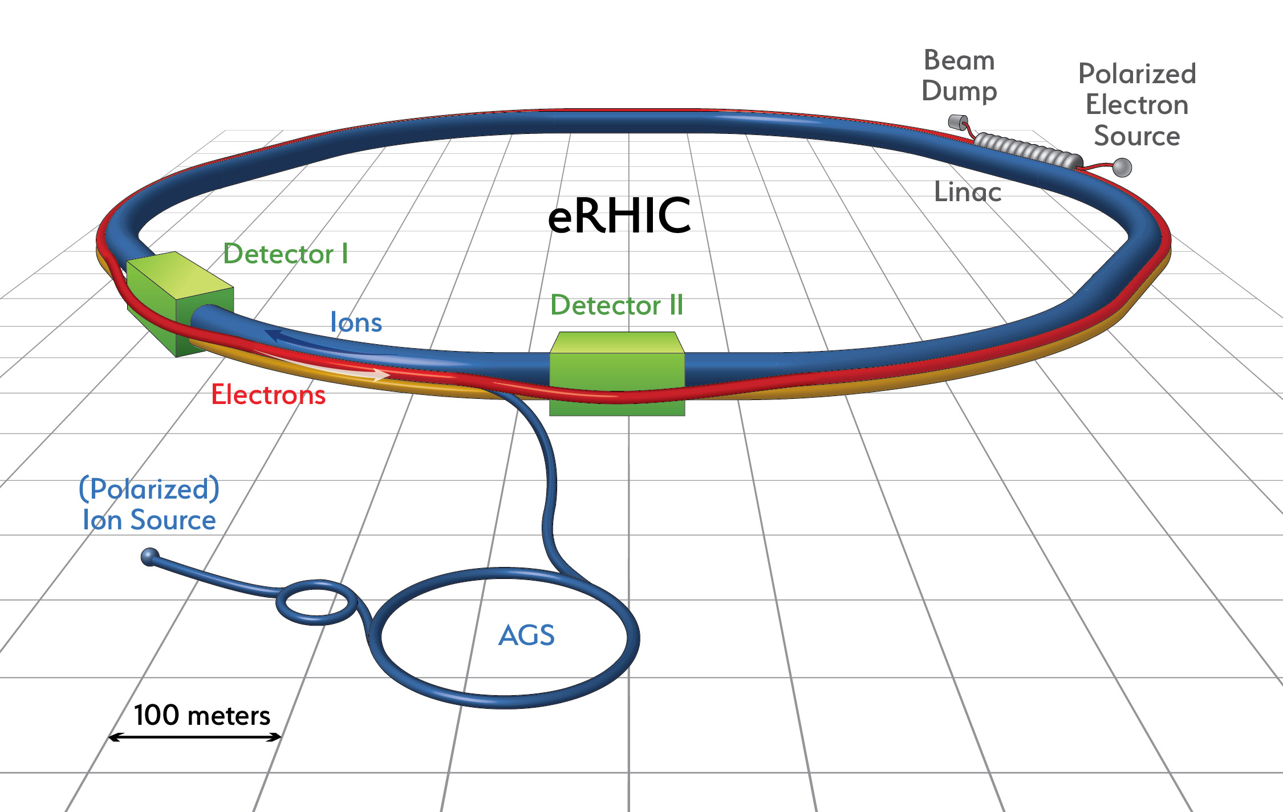
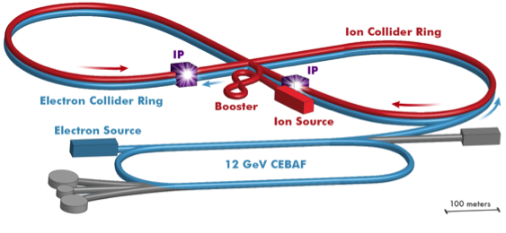
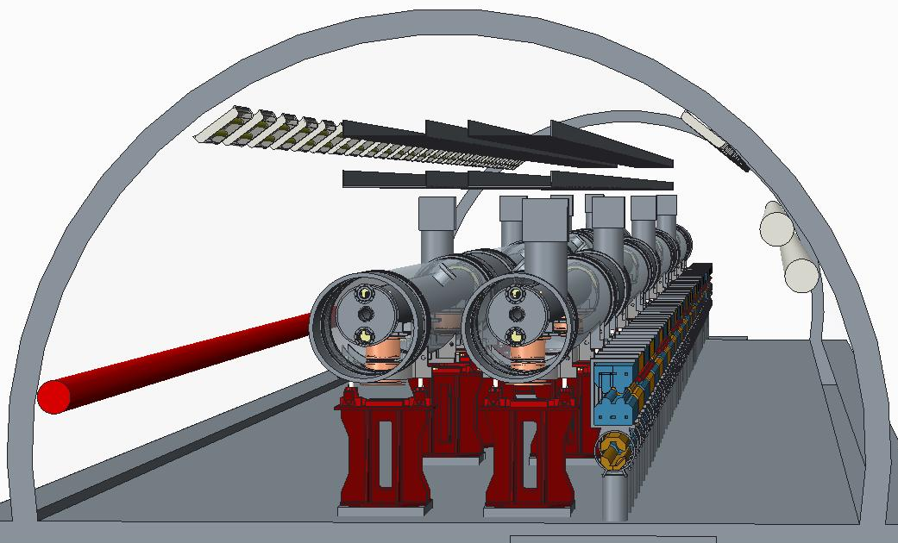
EIC Machine Designs
eRHIC
JLEIC
no civil construction
major hadron
machine upgrade
install hadron cooling

Slide 7
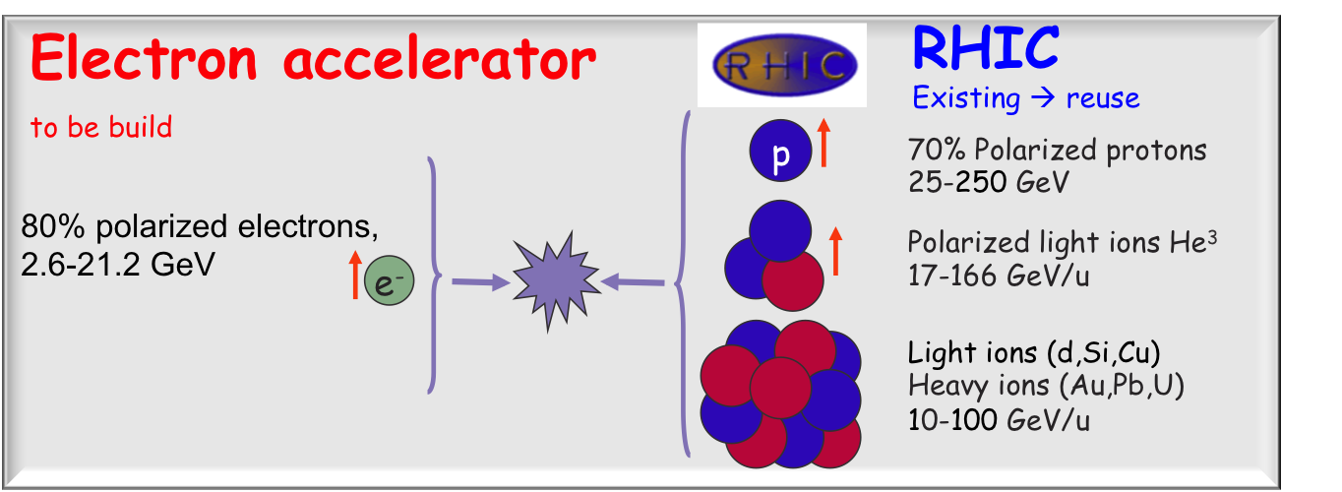
EIC Machine Designs
eRHIC
JLEIC
arXiv:1409.1633
arXiv:1504.07961
Both machine designs built on existing machines
Linac - Ring
Ring- Ring
reuse Cebaf as full energy lepton injector
electron: 3-10 GeV
protons: 20-100 GeV
ions: 8-40 GeV/u for Pb
polarised ions: p, d, 3He, possibly Li
Polarisation for both beams: > 70%
full √s range available from beginning
→ staging in luminosity
Luminosity 10³³ to 10³⁴ cm⁻²s⁻¹
→ staging center-of-mass energy
Both machines utilize crossing angles
10 mrad 50 mrad
→ need for Crab cavities
Bunch frequency: 9.4 MHz
Bunch frequency: 476 MHz
159 MHz@√s=63GeV
Both designs take great care to have maximal to full acceptance for scattered protons from diffractive reactions, breakup neutrons and spectator tagging
2 interaction regions

Slide 8
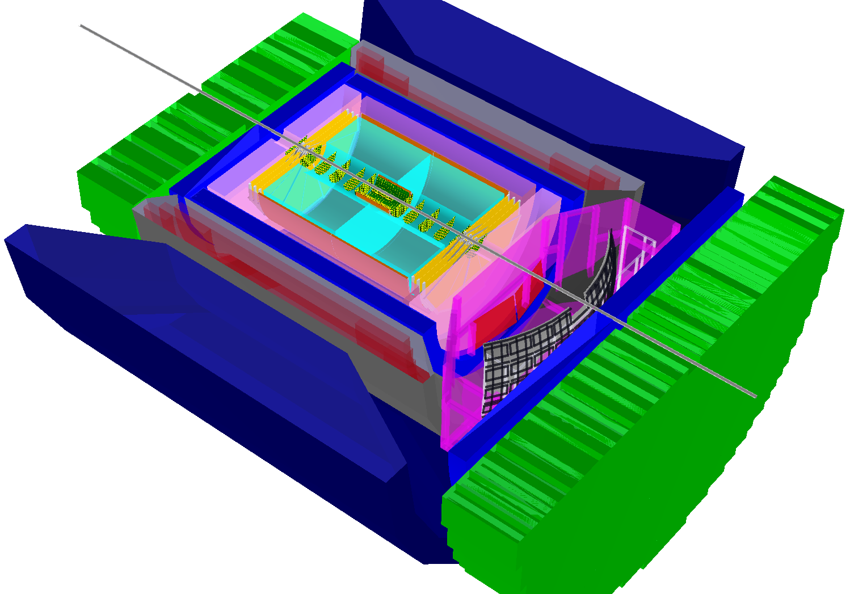
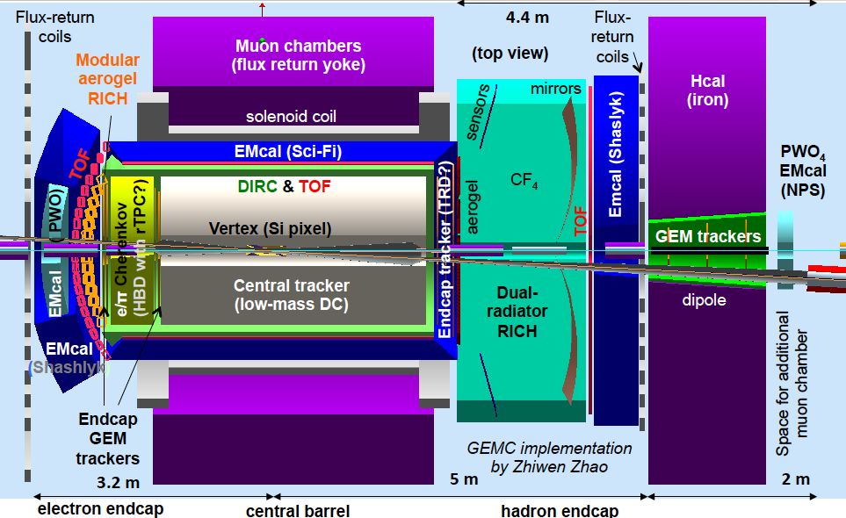
EIC Detector Concepts
eRHIC
JLEIC
BeAST
hadronic calorimeters
e/m calorimeters
RICH detectors
Overall detector requirements:
large acceptance: -4.5 ≲ η ≲ 4.5
high precision low mass tracking
equal coverage of tracking and EM-calorimetry
high performance PID to separate π, K, p on track level
high control on systematic effects
active EIC Detector R&D
  https://wiki.bnl.gov/conferences/index.php/EIC_R%25D
TPC
GEM trackers
silicon trackers
magnet yoke
Micromegas barrel
3T solenoid cryostat
Current emphasis on the design of a multipurpose detector
Both (eRHIC & JLEIC) IR-designs integrate
auxiliary detectors from the beginning:
→ critical for physics program and to control systematics
luminosity monitors
large acceptance for diffractive proton detection and neutrons from nuclear breakup
electron & hadron polarimetry
low Q²-tagger

Slide 9
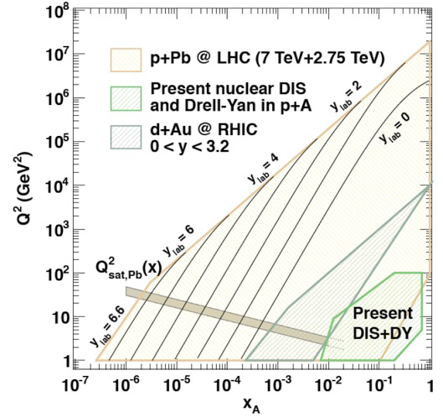
x-Q² Coverage for Different facilities
pp / ep
pA / eA
EIC
EIC √s=141 GeV y < 0.95
EIC √s=45 GeV y > 0.01

Slide 10

What composes the Spin of the Proton
L_{g}
Σ_{q}Δq
Σ_{q}L_{q}
??
ΔG
The Holy Grail
The Spin Sum Rule
total
quark
spin
gluon
spin
angular
momentum
“Helicity sum rule”
Can quarks and gluons explain all the spin?
→ what is the role of gluons?
→ what is the role of sea quarks?
How much orbital angular momentum is needed?

Slide 11
The different contributions
Needs to have both beams polarized
versus
Stat. Uncertainty:
N: number of of a specific final state product

Slide 12
present vs EIC kinematic coverage
likewise for Q²
EIC extends x coverage
by ~2 decades

Slide 13
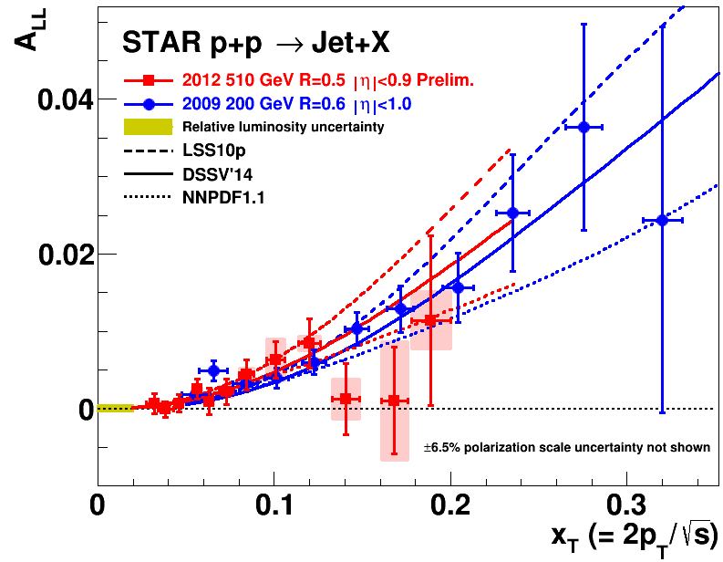
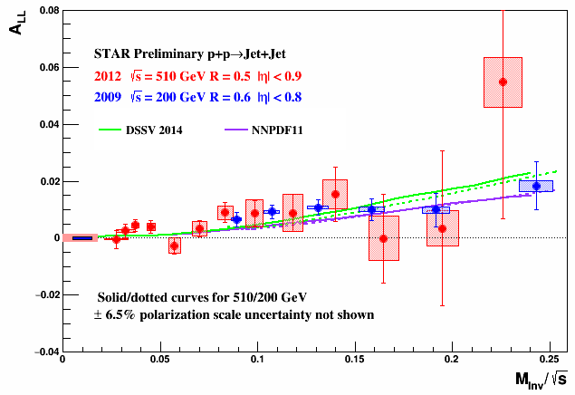
What We Know right now: ΔG
DIS:
DIS +
RHIC ≤2009
Data till 2009 included
in fits:
DIS +
RHIC ≤2015
arXiv:1404.4293
First time a significant
non-zero Δg(x)
all data till 2015
factor 2 reduced
uncertainties
at x ~ 10⁻³
RHIC:

Slide 14
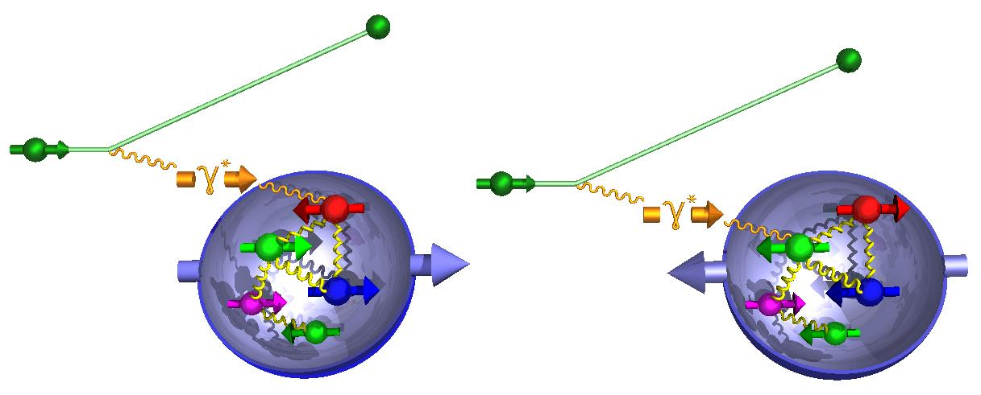
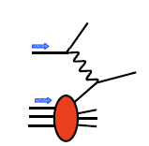
g₁^{p} the way to find the Spin
M.Stratmann, R. Sassot, ECA: arXiv:1206.6014 & 1509.06489
unseen precision and x-Q² coverage
cross section:
-
g₁ ~
pQCD scaling violations

Slide 15
Where does the Spin of the proton hide
total
quark
spin
“Helicity sum rule:”
gluon
spin
angular
momentum
1/2 -
-
orbital angular
momentum
Gluon
Quarks
=

Slide 16

Where does the Spin of the proton hide
total
quark
spin
“Helicity sum rule:”
gluon
spin
angular
momentum
After EIC:
spin puzzle will be solved

Slide 17
Polarized QUARKs

Slide 18
Why is separating quark flavors important?
nuclear structure is encoded in parton distibution functions
understand dynamics of the quark-antiquark fluctuations
flavor asymmetry in the light quark sea in the proton
unpolarized: ubar ≠ dbar → caused by non-pertubative effects
polarized case ?
shape of polarized sea-quark PDFs critical for quark contribution to spin
Region constrained by data:

Slide 19
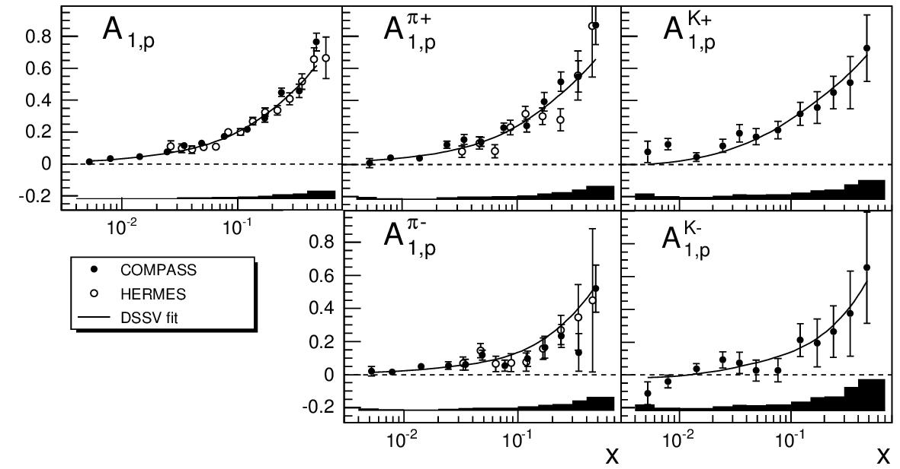
Data from Deep Inelastic scattering
Correlation between detected hadron and struck q_{f}
“Flavor – Separation”
Inclusive DIS:
Semi-inclusive DIS:
incl.
π⁺
K⁺
Polarised Quark Densities:
u-quarks polarised in the
spin direction of the proton
d-quarks polarised opposite
to the spin direction of
the proton
sea-quarks still pretty
unknown
PLB 693 (2010) 227–235
π –
K⁻

Slide 20
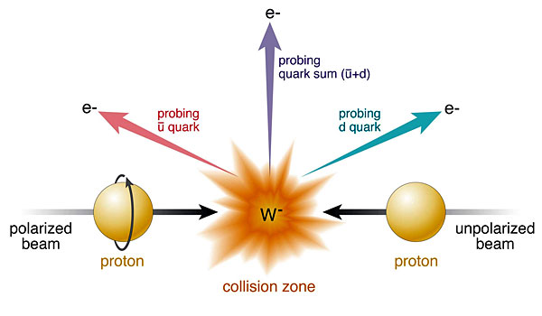
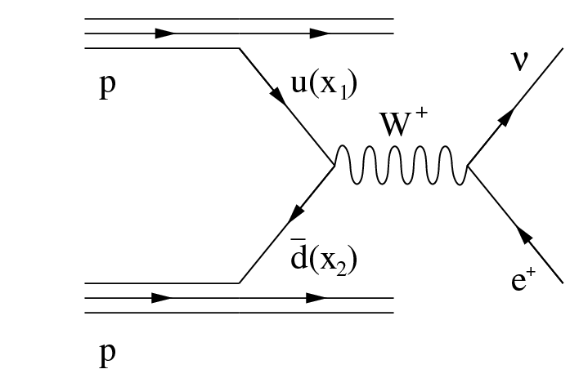
The golden channel: W Production
Complementary to SIDIS:
very high Q²-scale 6400 GeV²
extremely clean theoretically
No Fragmentation function
stringent test on theory approach
for SIDIS
UNIVERSALITY of PDFs
Ws naturally separate quark flavors
rapidity: sea vs. valence quarks
Ws are maximally parity violating
→ Ws couple only to one parton helicity

Slide 21
If the run-13 data are fully analyzed
Run-13 reduced uncertainties
by factor 2
RHIC/STAR W±-data will be a
strong constraint for
and

Slide 22

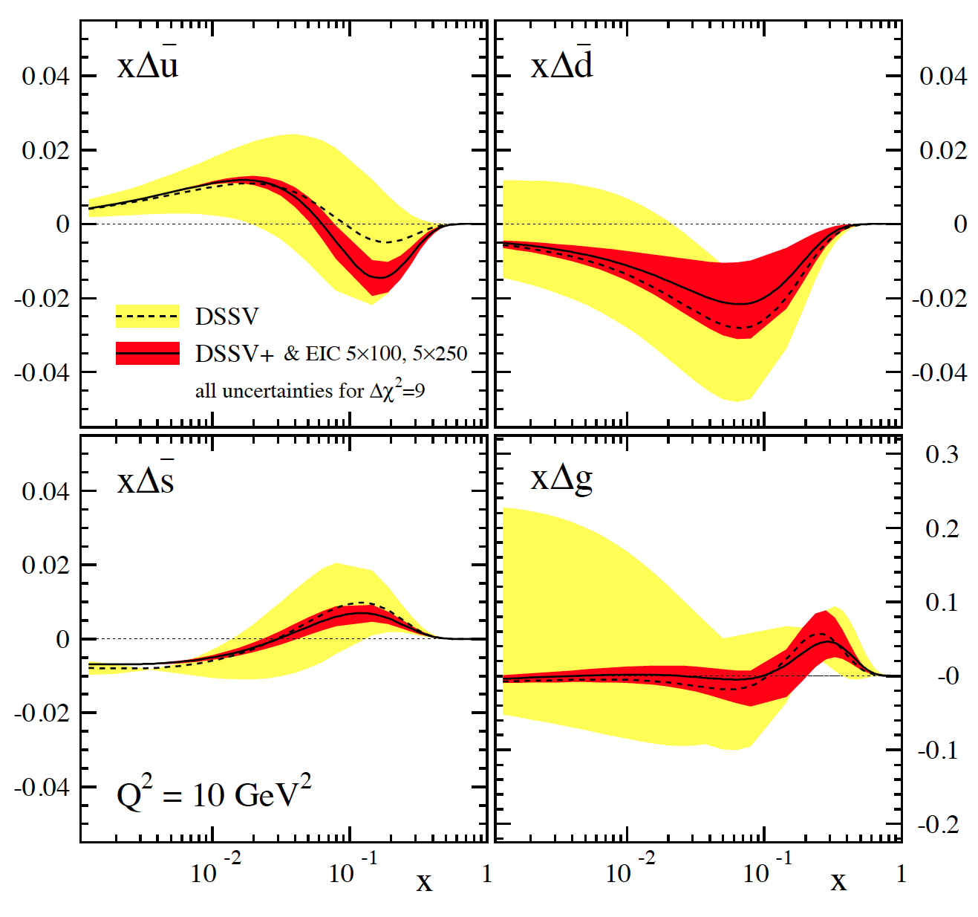
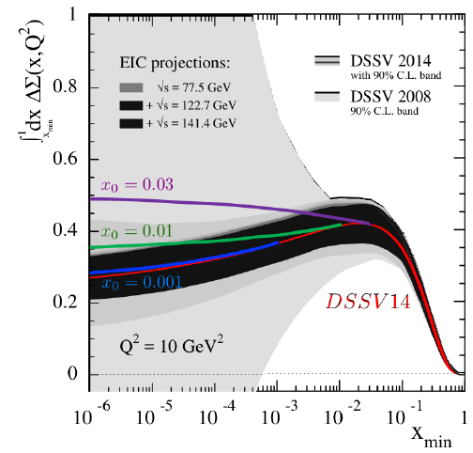
EIC: impact on helicity PDFs
DIS scaling violations crucial to constrain Δg
SIDIS data provide detailed flavor separation of quark sea
only data till x>10⁻³ included
∫Δq dx needs also the data
with √s = 140 GeV
→ same for ∫Δg dx
2008
BFKL: Low-x evolution
unpolarised quarks: α_{s}ln1/x
polarised quarks: α_{s}ln²1/x
Quark helicity at small x receives strong
double-logarithmic enhancement through
the evolution near a polarized Wilson line
What about gluons? → Saturation
arXiv:1505.01176, arXiv:1511.06737
arXiv:1610.06197, arXiv:1610.06188
arXiv:1703.05809

Slide 23
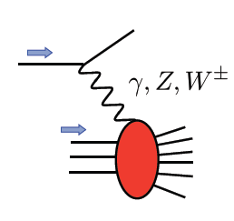
Polarized EW PHYSICS
ν
e
W^{+/-}
Complementary to SIDIS:
very high Q2-scale
extremely clean theoretically
No Fragmentation function
best way to measure at very high x
QCD
fit

Slide 24


Quantum tomography of the nucleons & Nuclei
Join the real
3D experience !!
TMDs
GPDs
2D+1 picture in momentum space 2D+1 picture in coordinate space
transverse momentum dependent PDFs generalized parton distributions
  → exclusive reaction
Quarks
unpolarised polarised
Spin as vehicle to do tomography of the nucleon
What is the dynamic structure of the proton and nuclei
2D+1 picture in momentum and coordinate space
Visualize color interactions in QCD
collective phenomena and correlations in fragmentation
New physics aspects due to confined motion

Slide 25
Transverse momentum structure of nuclei → TMDs
Needs (un)polarised hadron-beam and high luminosity

Slide 26
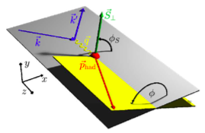
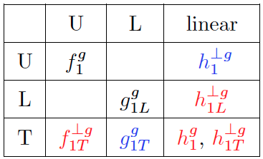
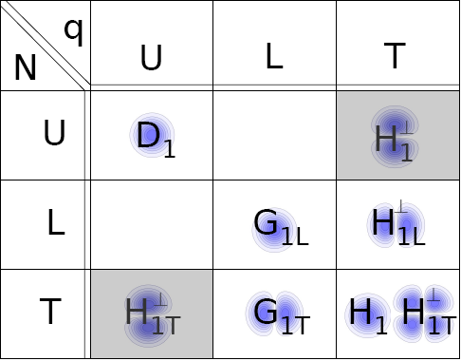
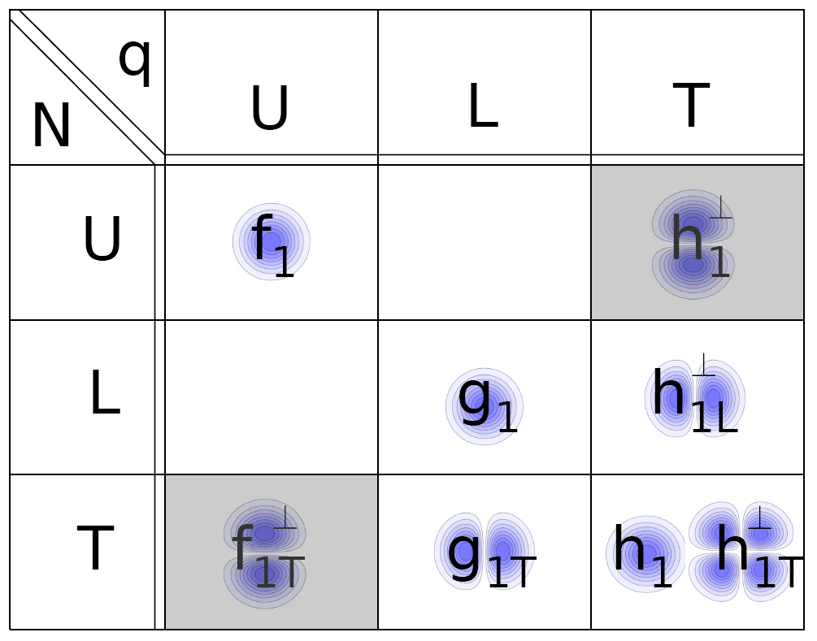
transverse momentum dependent PDFs & FFs
What is the dynamic structure of the proton and nuclei
2D+1 picture in momentum space
Visualize color interactions in QCD
collective phenomena and correlations in fragmentation
New physics due to confined motion
Features:
Need to test universality for TMDs ep ←→ pp
observable:
azimuthal modulations of 6-fold
differential SIDIS cross section
very different evolution then collinear PDFs
pertubative & non-pertubative contributions
slew of different TMDs can be defined
Leading Twist g-TMDs
Leading Twist TMD FF
g
N
Leading Twist q-TMDs

Slide 27
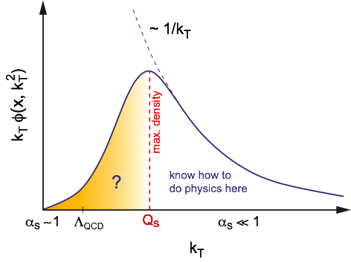
Why should we care about TMDs
provide a way to image the nucleus / nuclei in transverse and longitudinal
momentum space (2+1d)
provide access to spin-orbit correlations
provide constrains to quark-gluon-quark correlations in the proton and in
fragmentation
possible explanation for the breaking of DY Lam-Tung relation
1st Mellin Moment of transversity → tensor “charge”
  tensor charge not directly accessible in
  low-energy footprint of new physics at higher scales ?
  neutron β decay → high precision δq → 3-5 TeV bound for BSM scale
un-integrated gluon density g(x,Q²,k_{T}) important for physics at small x
→ CGC
→ many applications at LHC, i.e. Higgs production
shows emerges of a scale Qs
where gluon density saturates

Slide 28
TMD kinematic PLAN
Till today TMDs come only from fixed target low scale, high x measurements
need to establish concept at high √s and different x
→ polarised pp at RHIC

Slide 29

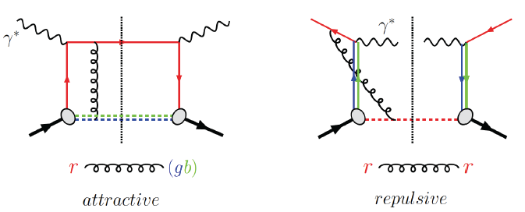
Visualize Color interactions in QCD
poster child
TMD:
correlation of nucleon’s transverse spin
with the kT of an unpolarized quark
measures spin-orbit correlations
link to parton orbital motion (through models)
reveals non-trivial aspects of QCD color gauge invariance
Sivers function
modulation
Measure non-universality of sivers-function
DIS:
γq-scattering
attractive FSI
pp:
qqbar-anhilation
repulsive ISI
QCD:
Critical test of factorization in QCD
no sign change
→ need to rethink QCD factorization
Sivers_{DIS} = - (Sivers_{DY} or Sivers_{W} or Sivers_{Z0})

Slide 30
Siver’s Sign Change: A_{N}^{W} First Results
Results based on 2011 25 pb⁻¹ transversely polarised 500 GeV data
→ published in PRL and PRL Editor pick
y and p_{t} for fully reconstructed Ws
→ through recoil method used at Fermi-Lab and LHC
Asymmetry favors Sivers fct. sign change and small evolution

Slide 31
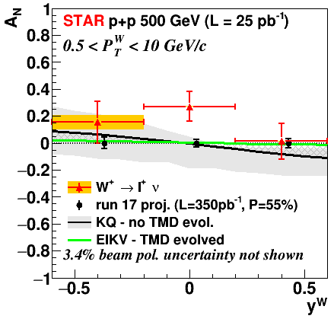
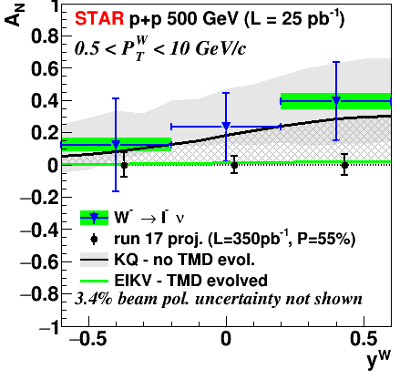
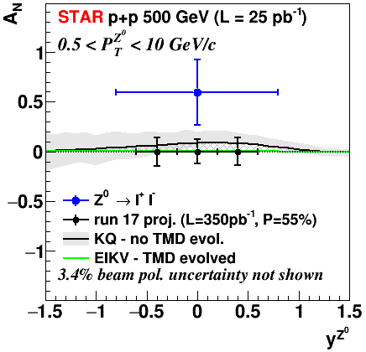
Sivers Fct. in RUN-17
2017 Running conditions:
transversely polarized p+p at 510 GeV → ∫Ldt = 350 pb⁻¹ (14 x 2011 ∫Ldt)
only STAR operational & dynamic β* through out the fill
  smoothed lumi-decay during fills
  reduced pileup effects in TPC → high W reconstruction efficiency
Will provide data to constrain:
TMD evolution combined with A_{N} DY
sea-quark Sivers fct → y-dependence
test Sivers-TMD sign-change

Slide 32
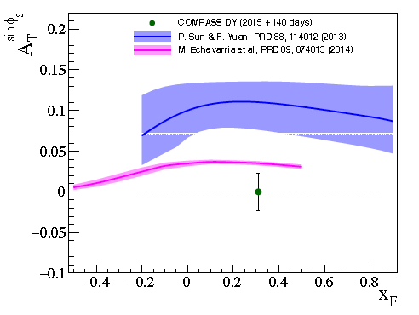
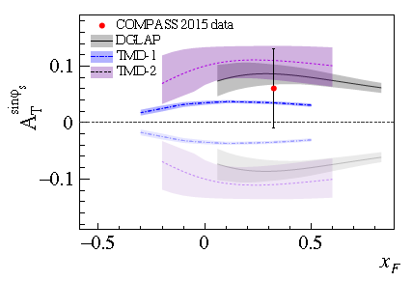
Compass: First result for A_{N} for DY
DY through pion beam on polarized LiH3 target
Mass-region: 4 < Mμμ < 9 GeV
same x-Q² regions as COMPASS SIDIS data
Complementary to STAR e+e- DY in polarized pp
DY Proposal:
http://wwwcompass.cern.ch/compass/proposal/compass-II_proposal/compass-II_proposal.pdf
δA_{UT}^{sinφs} in 2 years: 0.0142
2015+2018
COMPASS DY Paper arXiv:1704.00488
Run-15: δA_{UT}^{sinφs} = 0.07

Slide 33
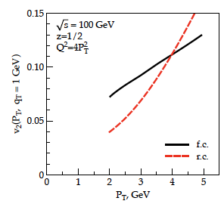
TMDs and “QGP” in small systems
Collective flow signatures
seen even in the smallest
systems and at the lowest
RHIC energies
Phys. Rev. C 95 (2017) 034910
TMD formalism in DIS predicts a distribution for linearly polarized gluons in an unpolarized target. This is reflected in cos(2φ) asymmetries in dijet production
Study azimuthal anisotropy as a function of the rapidity dis-balance of the jets
Process sensitive to unpolarized and linearly polarized gluon distribution
Phys.Rev. D94 (2016) no.1, 014030
Phys.Rev.Lett. 115 (2015) no.25,252301
Phys.Rev. D91 (2015) no.7, 074006
Phys.Lett. B743 (2015) 134-137

Slide 34


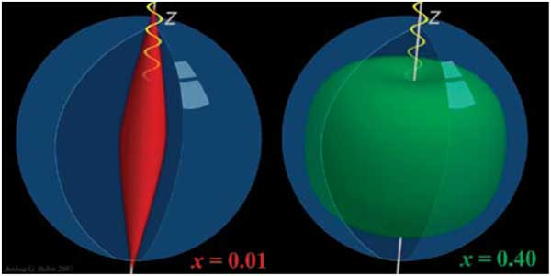
Generalized Parton Distributions (GPDs)
or
high luminosity is critical
polarised beams are
needed

Slide 35
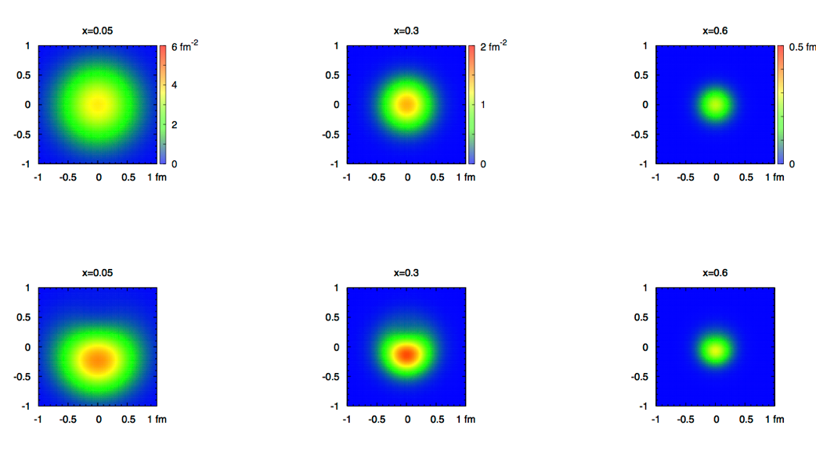
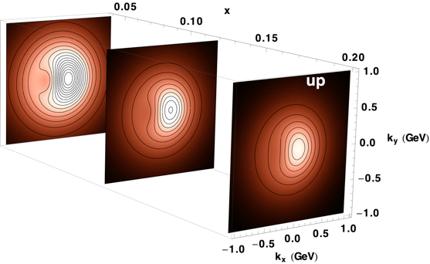
2+1 dimensional Imaging of Quarks & Gluons
Wigner function
W(x,b_{T},k_{T})
Momentum
space
Coordinate
space
∫d²b_{T}
∫ d²k_{T}
f(x,k_{T})
f(x,b_{T})
Quarks
Quarks
Spin-dependent 3D momentum space
images from semi-inclusive scattering
Spin-dependent 2+1D coordinate space images from exclusive scattering
down quark
x

Slide 36
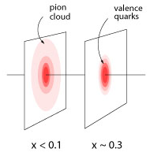
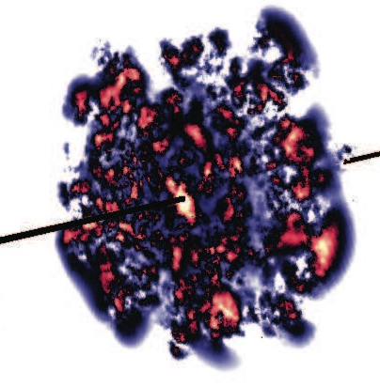
What does a proton look like with increasing energy?
One of several possible scenarios: a pion cloud model
A parton core in the proton gets increasingly surrounded
by a meson cloud with decreasing x
large impact on gluon and sea-quark observables
What would we see:
pairs (sea quarks) generated at small(ish)-x are predicted to be unpolarized
gluons generated from sea quarks are unpolarized
needed:
  high precision measurement of flavor separated polarized quark and gluon distributions as functions of x
  high precision spatial imaging: Gluon radius ~ sea-quark radius
What happens in the gluon dominated small-x regime?
  possible scenario: lumpy glue
EIC explores the dynamical spatial structure of hadrons
Notes:
we changed the old slide as the models discussed have been outdated, and this model allows to show a connection between 3 EIC physics pillars,,the spin structure, imaging and saturation

Slide 37
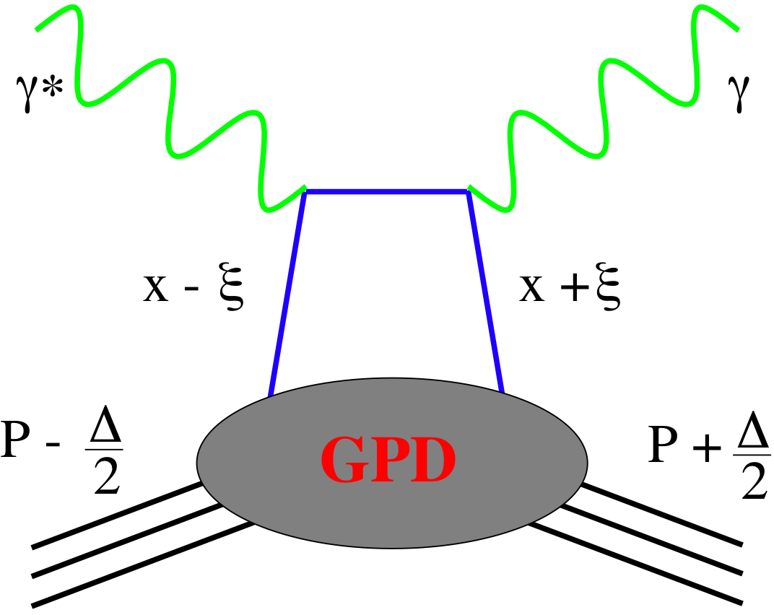
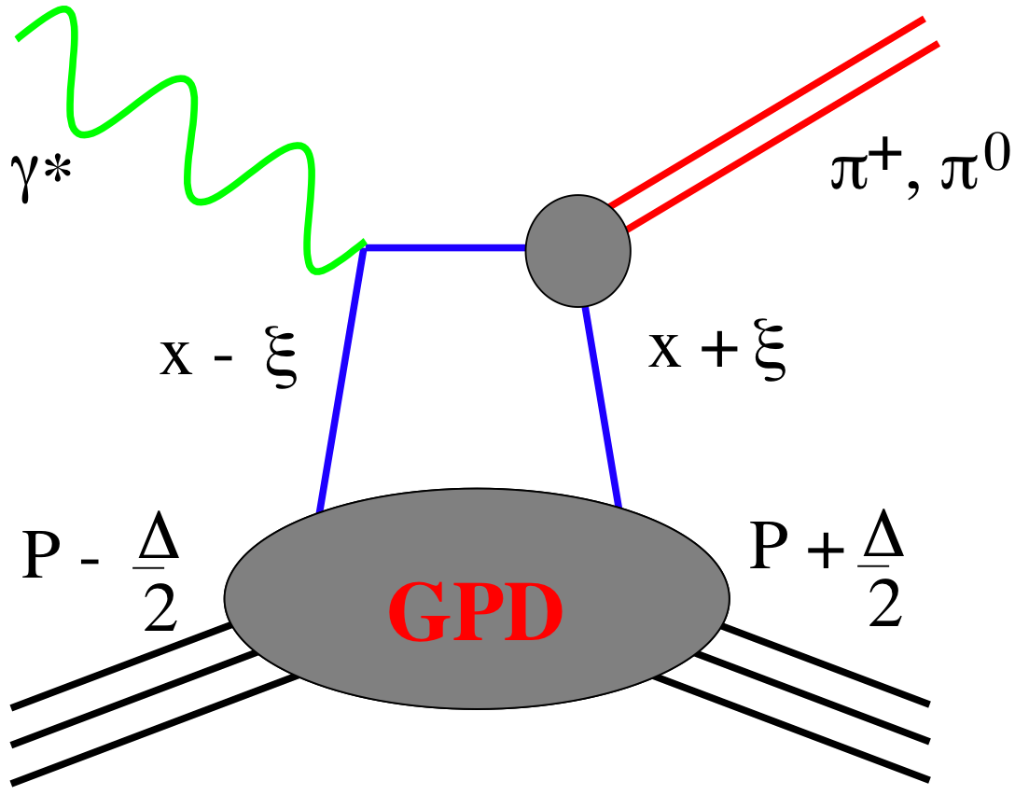
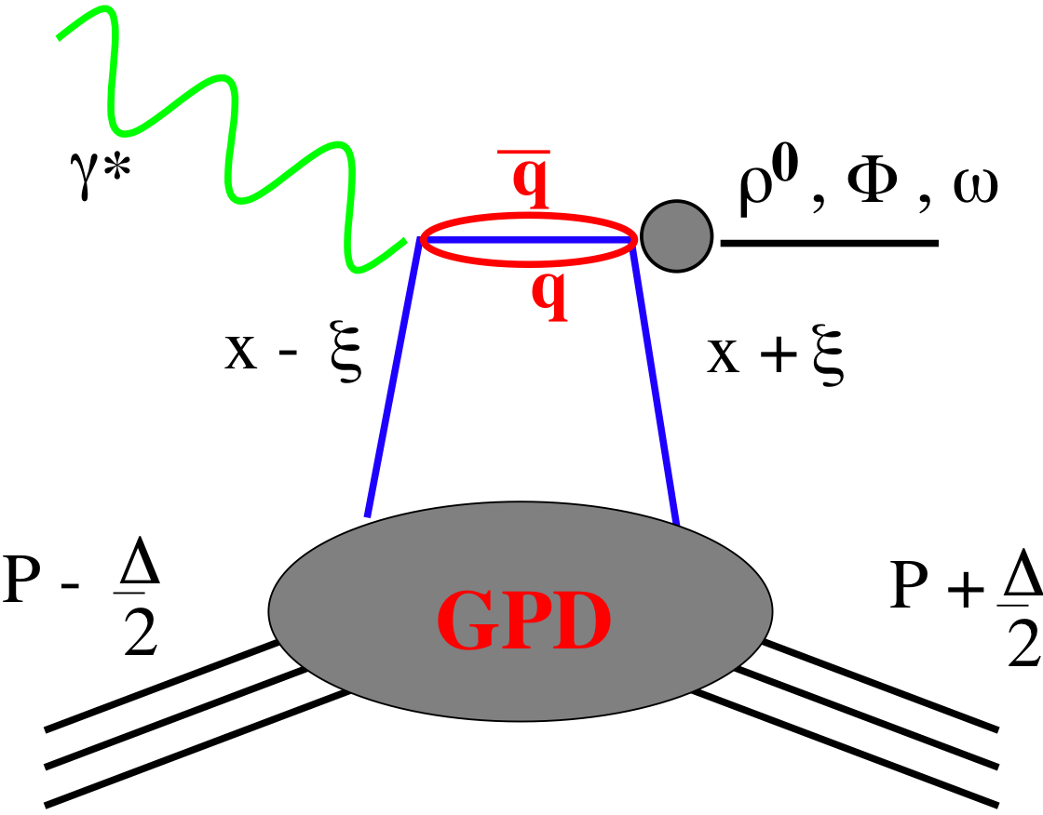
SMALL GPD Primer
Generalized Parton Distribution Functions:
→ the way to 2d spatial imaging of the proton as fct. of x and Q²
→ access the orbital angular momentum L_{q}
Spin-Sum-Rule in PRF:
responsible for orbital angular momentum
How are GPDs characterized?
unpolarized polarized
conserve nucleon helicity
flip nucleon helicity
not accessible in DIS
quantum numbers of final state select different GPDs
DVCS
pseudo-scaler mesons
vector mesons

Slide 38

Deeply Virtual Compton Scattering at EIC
e’
γ
e
Golden Channel: Deeply Virtual Compton scattering
Observable: cross section as function of x, Q² and t
A_{UT}, A_{LU}, A_{UL}, A_{C} as fct. of x, Q² and t
γ_{L}*
(Q²)
x+ξ
x-ξ
~
~
→ spatial distribution of quarks through Fourier transform of
dσ/dt(x,Q²)
Gluon Distribution: through scaling violation of
dσ/dt(x,Q²) needs large lever in Q² at fixed x
H, H, E, E (x,ξ,t)
p’
p
t
D. Mueller, K. KumerickiS. Fazio, and ECA arXiv:1304.0077
pion cloud
effects seen
at high b_{T}
Fourier
Transform

Slide 39

Proton structure important for QGP in small systems
Collective phenomena seen in pA collisions, i.e. ATLAS 1409.792
H. Mäntysaari & B. Schenke
arXiv:1607.01711
In a hydro-picture (used in AA)
fluctuations in the proton are
crucial to understand the seen
pA@LHC behaviors
Mapping spatial gluon structure of the proton in x and Q²
through excl. J/Ψ production
Examples of proton density
profiles at x ~ 10⁻³
Study
coherent
and
incoherent
J/Ψ prod.
Notes:
make simpler

Slide 40


eRHIC: Spatial Gluon Distribution from dσ/dt
1950-60: Measurement of charge (proton) distribution in nuclei
Ongoing: Measurement of neutron distribution in nuclei
EIC ⇒ Gluon distribution in nuclei
Diffractive vector meson production:
e + Au → e′ + Au′ + J/ψ, φ, ρ
Method:
Fourier Transform
Diffractive vector meson production:
possible Source distribution with b_{T}^{g} = 2 GeV⁻²
e + Au → e′ + Au′ + J/ψ, φ, ρ
Momentum transfer t = |pAu-pAu′|² conjugate to bT
  Hot topic:
      Lumpiness?
      Just Wood-Saxon+nucleon g(b_{T})
      coherent part probes “shape of black disc”
      incoherent part (large t)
      sensitive to “lumpiness” of the source
      (fluctuations, hot spots, ...)
PRC 87 (2013) 024913
Converges to input F(b) rapidly: |t| < 0.1 almost enough
Recover accurately any input distribution used in model used to generate pseudo-data (here Wood-Saxon)
  Systematic measurement requires ∫Ldt >> 1 fb⁻¹/A
  dσ/dt: diffractive pattern known from wave optics
  φ sensitive to saturation effects, smaller J/ψ shows no effect
  J/ψ perfectly suited to extract source distribution
Notes:
spin-dependent gluon distribution

Slide 41






Summary and outlook
ΔG
Σ_{q}L_{q}
L_{g}
Σ_{q}Δq
Σ_{q}L_{q}
δq
δq
Σ_{q}Δq
ΔG
L_{g}
Polarized Beams are critical:
spin the ideal tool to study how a complex many-body system such as the proton arises from the vacuum structure of QCD
Many new results which pave the way to resolve the mystery about the origin of the spin of the proton
Start to get first data to get tomographic pictures of the proton

Slide 42
Summary and outlook
What an VHEep could do:
VHEep √s is to high for studying helicity sum-rule → A_{LL} ≾ 10⁻⁶
For TMDs and GPDs proton beam polarization is critical
  but there are important unpolarised measurements, which reveal a lot
  about nucleon structure
  → need high lumi → EIC: ∫Ldt=10 fb⁻¹
LHeC CDR has physics worked out which is enabled by lepton polarisation only
  EW-physics, i.e. left-right handed Ws
Personal Note: I would not give up on electron polarisation
  could be critical to study physics like lepton substructure ←→ proton
  anomalous magnetic moment

Slide 43


Slide 44

Glossary of p+p collisions
q(x₁)
Hard Scattering Process
produced
particles,
π,K,p,γ,e
jets
g(x₂)
q(x₁), g(x₂): Parton distribution functions (PDF) (no polarisation effects)
→ a measure of the number of partons of different type in a
proton
Δq(x₁), Δg(x₂): polarised parton distribution functions
describe the difference of how many partons have their spin
aligned with the proton or anti-aligned
x₁, x₂: fraction of the proton momentum carried by a parton
Q²: the energy transfer in the hard scattering of the partons

Slide 45
Glossary of p+p & e+p collisions
hadron-hadron:
lepton-hadron:
q(x₁)
Hard Scattering
Process
g(x₂)
X
Pro’s:
direct access to gluons
RHIC collider → wider kinematics reach
Con’s:
no direct access to parton kinematics
Pro’s:
direct access to parton kinematics
Con’s:
no direct access to gluons
all polarised DIS experiments are fixed target
→ limited kinematics reach
q(x₁), g(x₂): Parton distribution functions (PDF) (no polarisation effects)
→ a measure of the number of partons of different type in a proton
Δq(x₁), Δg(x₂): polarised parton distribution functions
describe the difference of how many partons have their spin
aligned with the proton or anti-aligned
x₁, x₂: fraction of the proton momentum carried by a parton
Q²: the energy transfer in the hard scattering of the partons

Slide 46




Jet-Cross Sections
√s=200 GeV inclusive jets
√s=200 GeV Di-jets
√s=500 GeV Di-jets
Data compared to NLO pQCD calculations:
Inclusive jet and di-jet cross section results in
p+p collisions are consistent with NLO pQCD calculations
after Had+UE corrections

Slide 47






π⁰-Cross Sections
√s=62 GeV (PRD79, 012003)
√s=200 GeV (PRD76, 051106)
√s=500 GeV (Preliminary)
PRL 97, 152302
arXiv: 1309.1800
Data compared to NLO pQCD calculations:
√s=62 GeV calculations may need inclusion of NLL (effects of threshold logarithms)
√s=200 and 500 GeV: NLO agrees with data within ~30%
good agreement also for η>1
Input to qcd fits of gluon fragmentation functions → DSS

Slide 48




Q² dependence
high Q²
very fast evolution
in RHIC kinematics
medium Q²
low Q²

Slide 49





DY@STAR For 500 GeV
Kinematics:
DY e+e- in 2.5 < η < 4.0 4.0 GeV < M_{e+e-} < 9.0 GeV
Add a postshower to the preshower & the FMS
will be able to measure A_{N} DY
2.5 < η < 4.0
Design follows successful
Preshower design
→ 3 layers of u, x, y with
SiPM readout
After analysis 2.5 < η < 4.0
:
With TMD Evolution
No TMD Evolution
Run-17 ∫L_{del}=400 pb⁻¹
A_{N} for DY to +/- 0.008

Slide 50






Complementary Channel
STAR FMS-PreShower:
3 layer preshower in front of the FMS,
distinguish photons, electrons/positrons
and charged hadrons → installed for RUN-15
2015
2017
A_{N} for direct photon production:
sensitive to sign change, but in TWIST-3 formalism
not sensitive to TMD evolution
no sensitivity to sea-quarks; mainly u_{v} and d_{v} at high x
collinear objects but more complicated evolutions than DGLAP
indirect constraint on Sivers fct.
Not a replacement for A_{N}(W^{+/-}, Z⁰, DY) measurement
but an important complementary piece in the puzzle

Slide 51



Beyond form factors and PDFs
Generalized Parton Distributions
X. Ji, D. Mueller, A. Radyushkin (1994-1997)
Proton form factors, transverse charge & current densities
Structure functions,
quark longitudinal
momentum & helicity
distributions
Correlated quark momentum
and helicity distributions in
transverse space - GPDs

Slide 52
Disentangle different GPDs
Vary electron and proton beam spin directions:
electron
beam
longitudinal
polarised
proton
beam
transverse
polarised
proton
beam
longitudinal
polarised
Δσ_{UT}
beam target

Slide 53

What can we learn
Model of a quark GPD
x
down valence quark
b_{T} (fm)
b_{T} decreasing as a function of x
x
EIC
Valence (high x) quarks at the center → small b_{T}
Sea (small x) quarks
at the périphérie → high b_{T} ?
GLUONS ???

Slide 54
What will we learn about 2d+1 structure of the proton
GPD H and E as function of t, x and Q²
GPD H and E 1d+1
arXiv:1304.0077
A global fit over all pseudo data was done, based on the GPDs-based model:
[K. Kumerički, D Müller, K. Passek-Kumerički 2007]
Known values q(x), g(x) are assumed for H^{q}, H^{g} (at ξ=0, t=0 forward limits E^{q}, E^{g} are unknown)
Excellent reconstruction of H^{sea}, H^{sea} and good reconstruction of H^{g} (from dσ/dt)
GPD H and E 2d+1 structure for sea-quarks and gluons

Slide 55
GPD H^{g}: J/ψ
To improve imaging on gluons
add J/ψ observables
cross section
A_{UT}
…..
Fourier
Transform

