Slide 1
PULSARS & MAGIC
Giovanni Ceribella IMPRS Young Scientists Workshop 2017 - Ringberg Schloss

Slide 2
OUTLINE
Pulsars
Neutron Stars and emission models
The Crab pulsar
Magic
Imaging Atmospheric Cherenkov Telescopes
Main components of MAGIC
Some examples of atmospheric showers
The Sum-Trigger
Preliminary results
Future perspectives

Slide 3
PULSARS

Slide 4
NEUTRON STARS
Extreme environment:
Ultradense matter
Strong magnetic fields
Vast plasma magnetosphere
General relativity
Particle accelerators
Physics mostly unsolved:
Composition
Nucleons, strange matter, quarks…
How does matter behave inside them?
Superfluid, –conductive, equation of state,…
How do they accelerate particles and produce radiation?

Slide 5
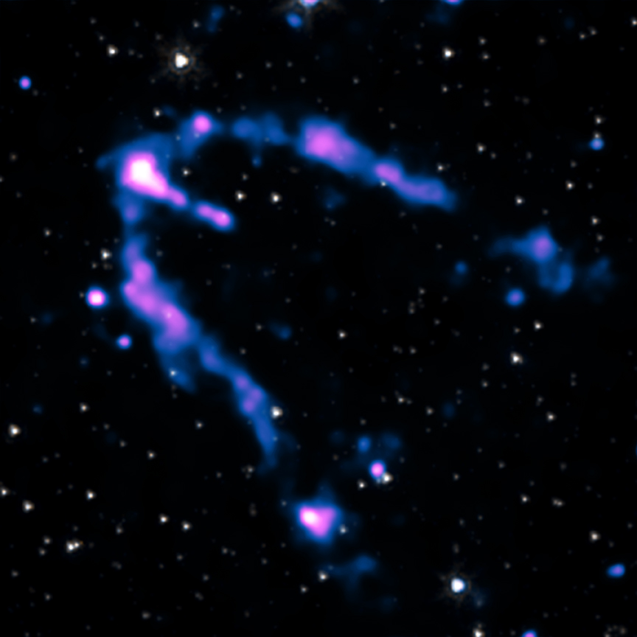
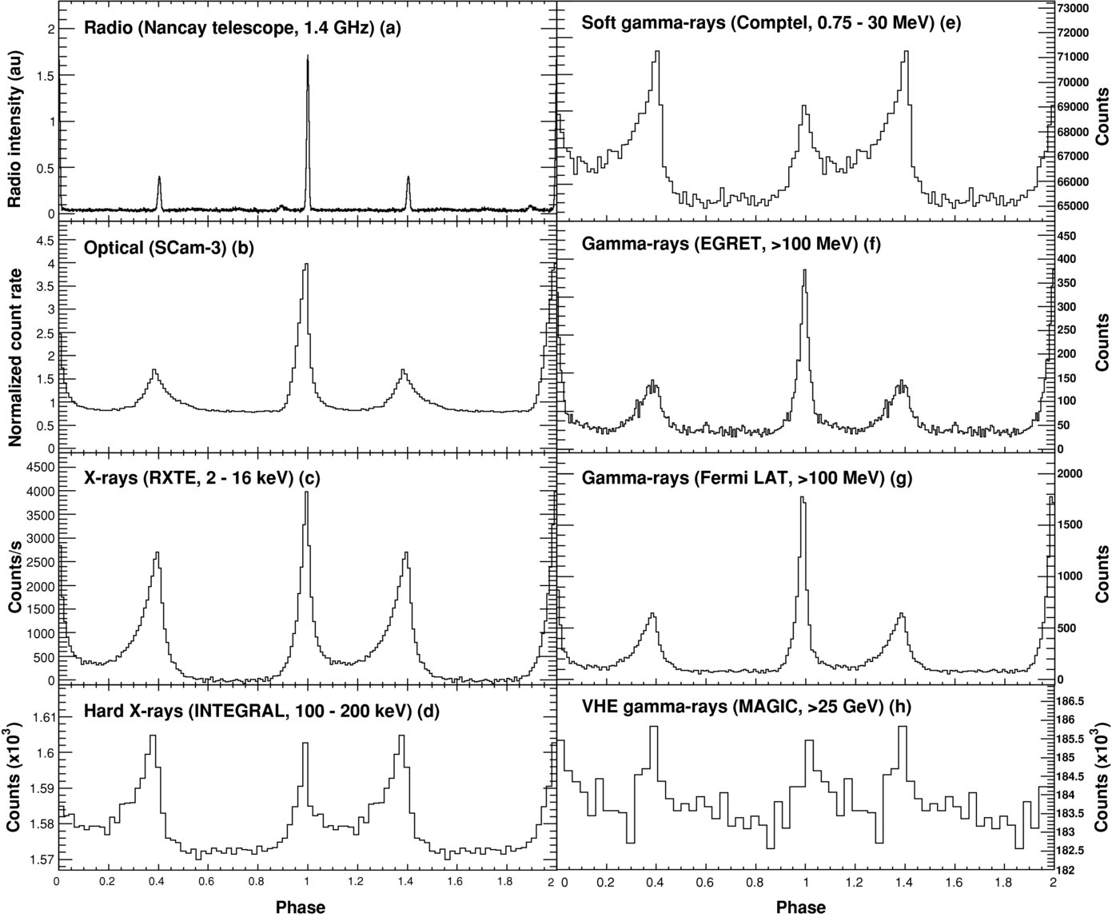
PULSARS
Detectable neutron stars
Mostly in radio band
Some binaries
Some VIS / X / γ pulsars
VELA
X-ray images from NASA/CXC/SAO
GEMINGA
CRAB

Slide 6
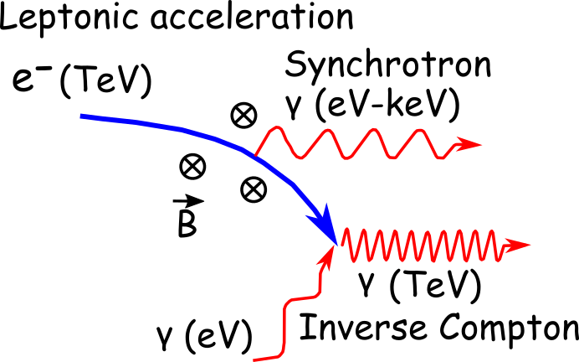
EMISSION MODELS
Kuiper et al., A&A 378, 918-935 [3]
MAGIC, Science 322:5905 [1]

Slide 7
EMISSION MODELS (VHE)
pulsar wind
Main emission models:
Polar gap
Outer gap
Wind model
… but they all disagree with the observations!
Adapted from K. Hirotani, [4]

Slide 8
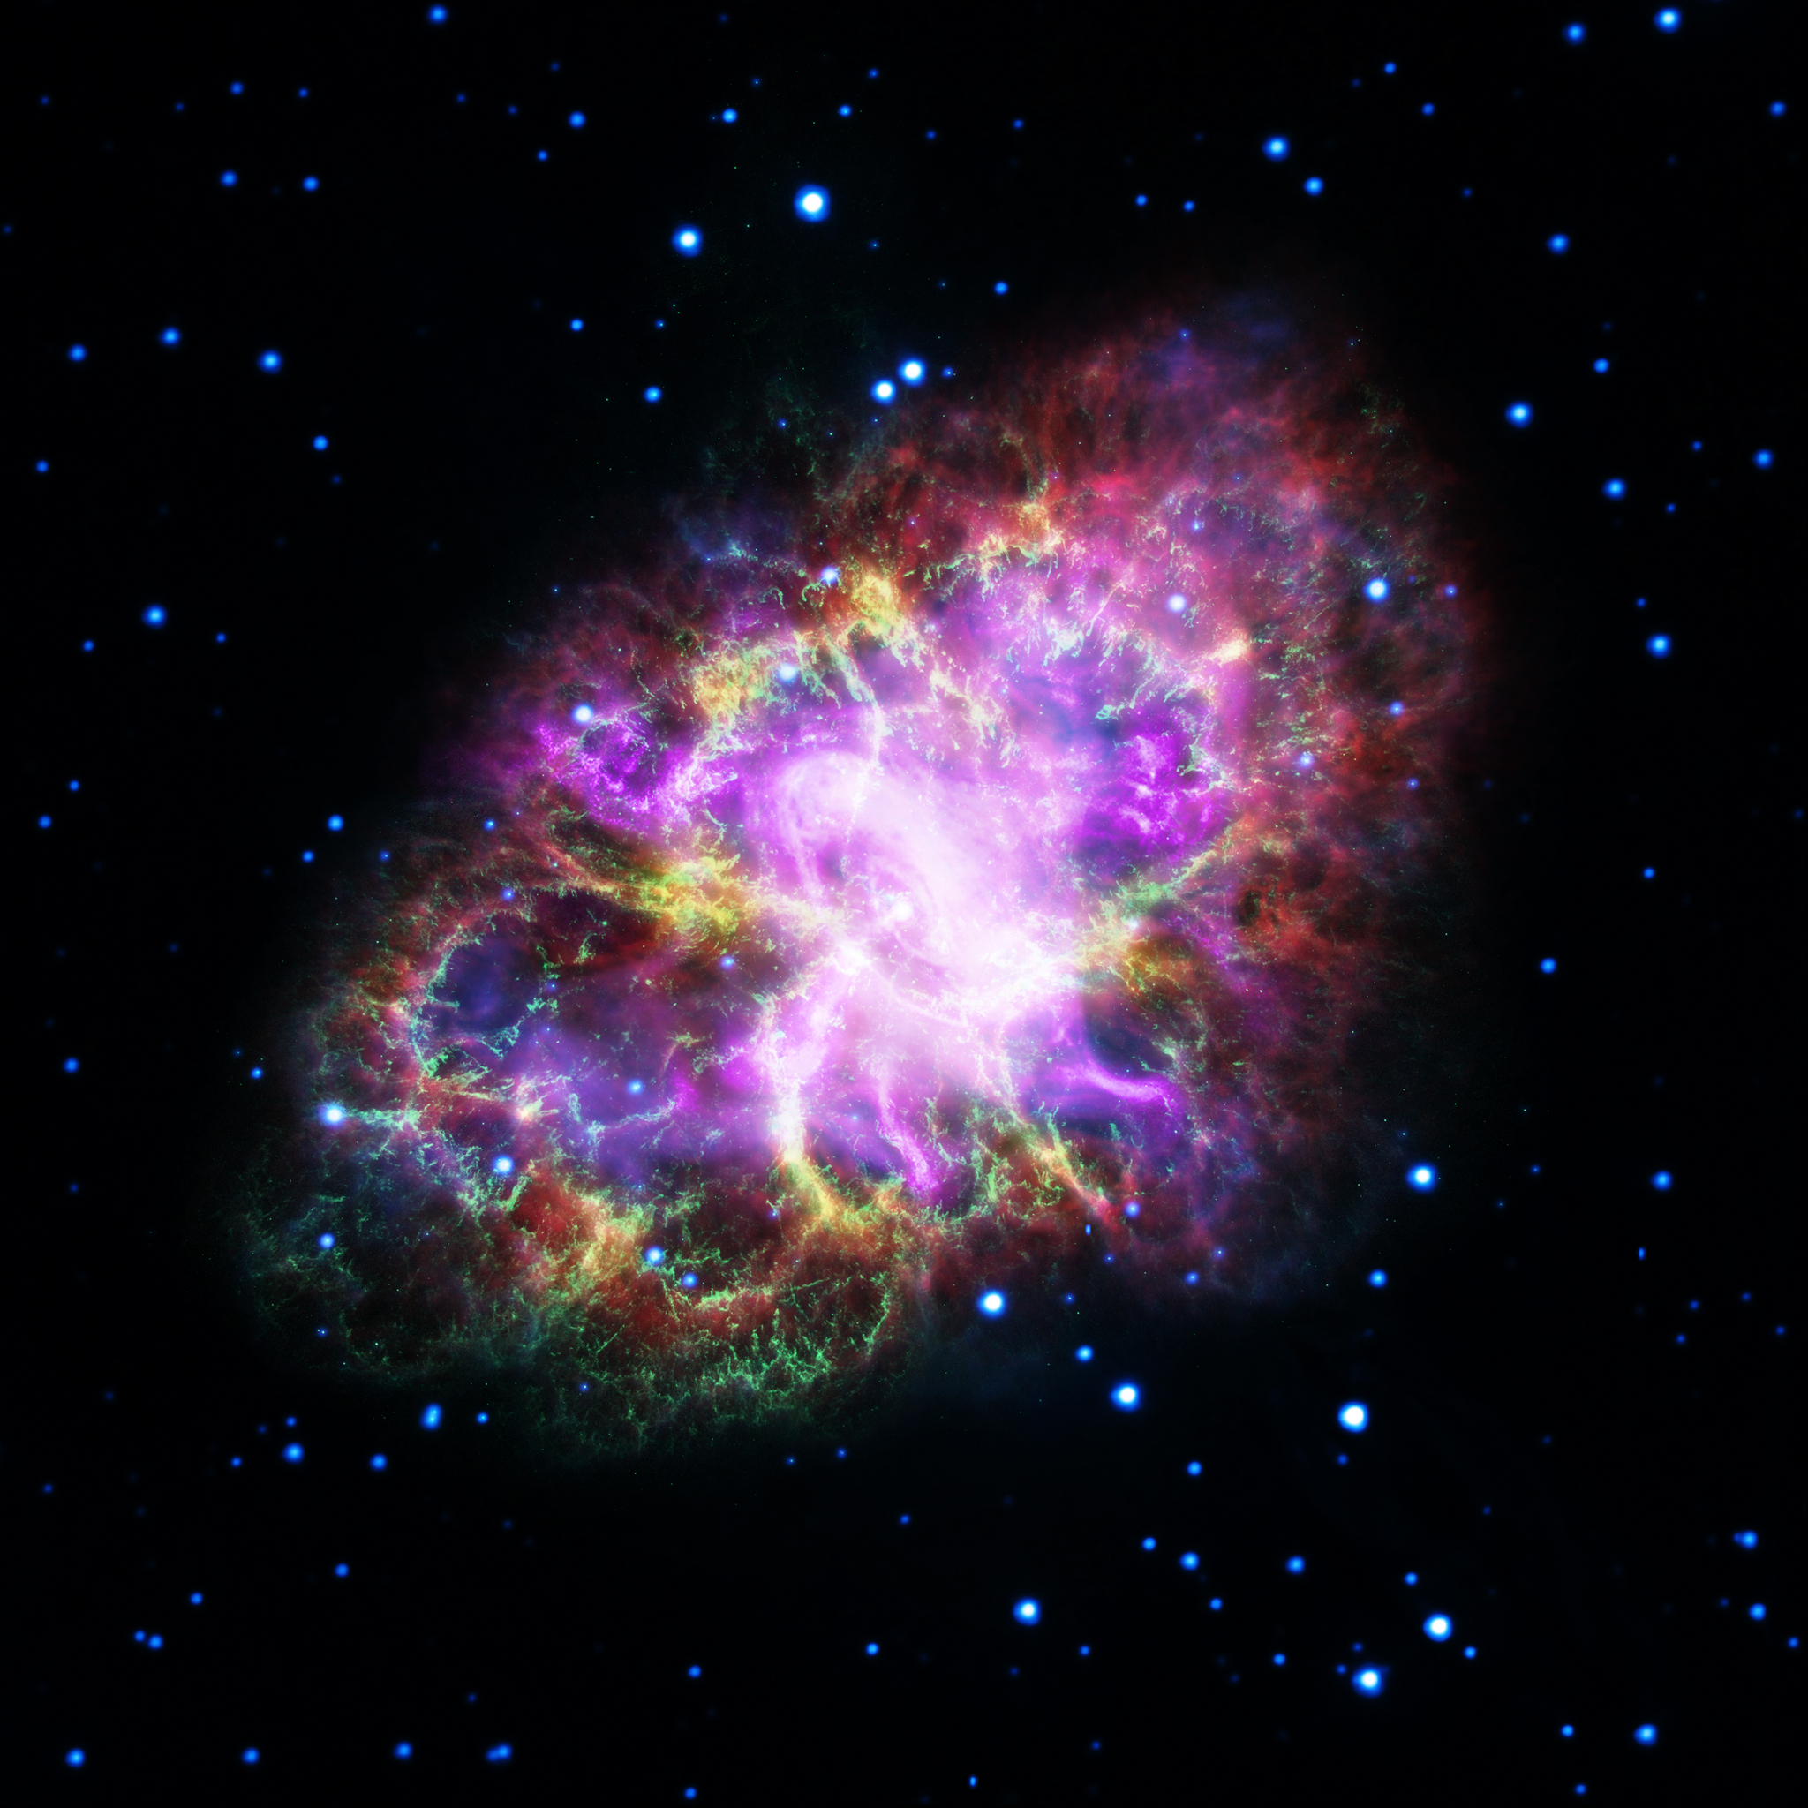
THE CRAB
Young pulsar associated with a Supernova Remnant nebula
Nebula: among the strongest very high energy (VHE) sources of the sky!!
Visible from radio up to TeV energies
One of the best studied objects ever, but…
…many problems still to be solved:
Acceleration mechanism?
Emission zone?
How can it produce TeV?
From G. Dubner, arXiv:1704.02968

Slide 9
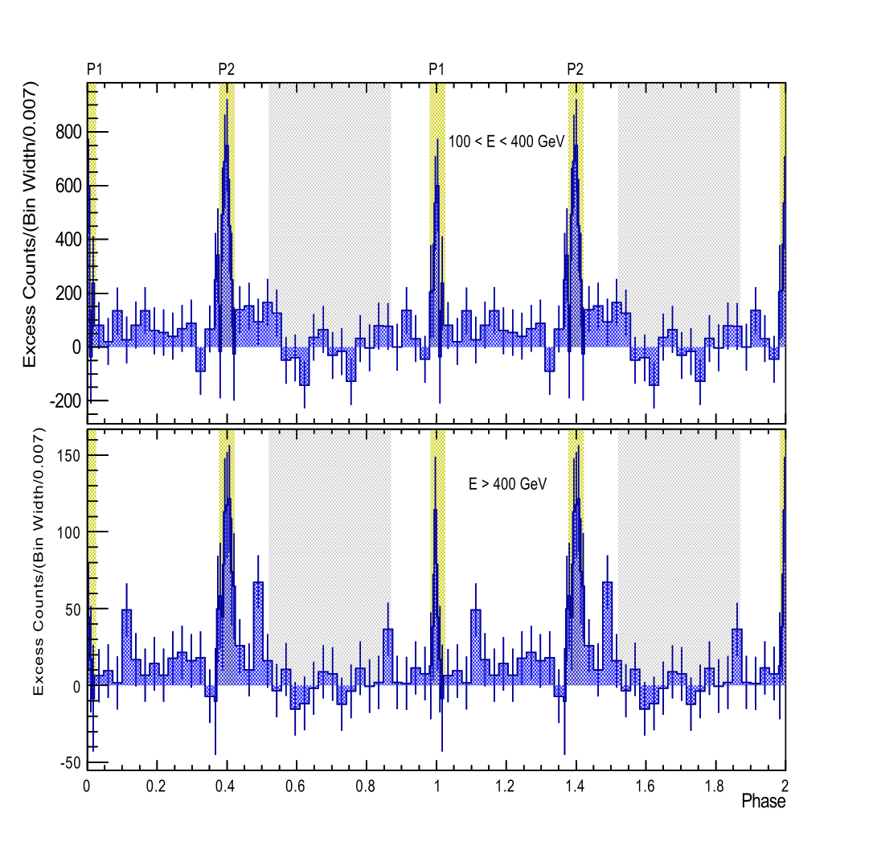
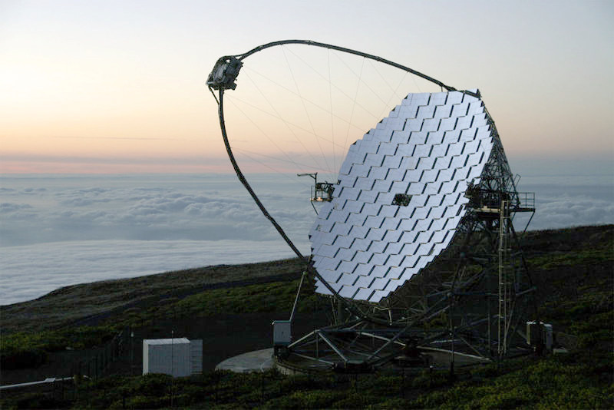
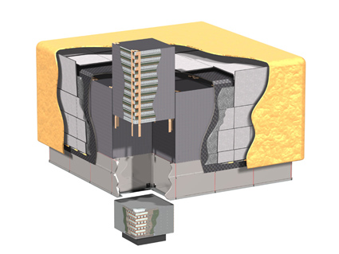
THE CRAB
SPECTRUM
PHASEOGRAM
1
2
2
1
MAGIC, A&A 585, A133 [2]
Sharp pulsed emission with hard spectrum (rules out models!).
Curvature radiation up to few GeV (unfeasible at TeV).
Inverse Compton at TeV energies?

Slide 10
PULSARS AT VHE
Observations already put in tension current emission models.
Precise studies can give more constraints and help developing a more consistent picture of the pulsar magnetosphere:
Temporal variability?
Pulse shape / intensity ratio?
Spectral variabilities?
Time delay with other wavelengths?
Interesting also for other exotic possibilities…
Lorentz invariance violation?

Slide 11
MAGIC

Slide 12
CHERENKOV TELESCOPES
Name of the game: Use the Atmosphere as a particle detector
Atmospheric particle cascades initiated by gamma or cosmic ray.
Cherenkov radiation by charged particles.
Large telescopes and photomultiplier tubes to focus and detect the Cherenkov light.
Credit: CTA Consortium

Slide 13
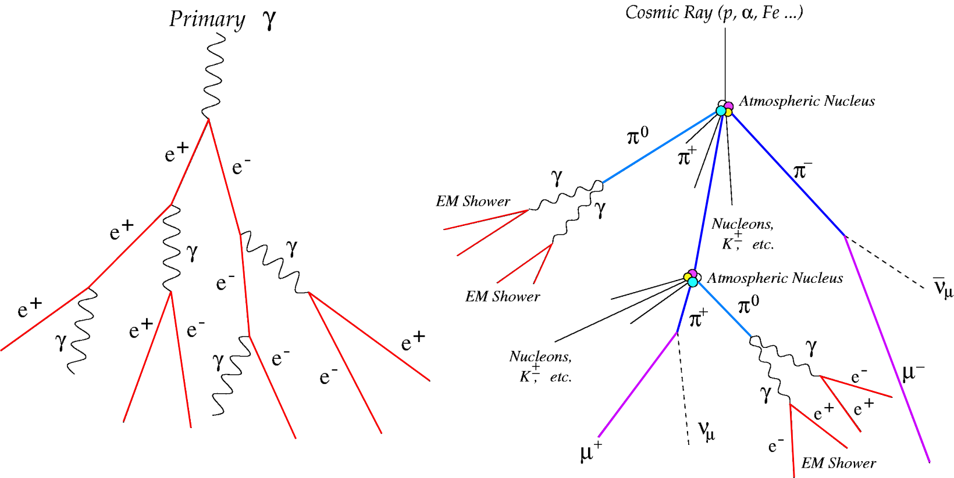
ATMOSPHERIC SHOWERS
PRIMARY PARTICLE INITIATES SHOWER
CHERENKOV LIGHT
EM showers → e⁺e⁻ pairs only.
Hadronic showers → jets, pairs, pions,…
Neutral pion π⁰ decays in γγ → EM subshower!
Charged pions π± decay in μν → muon rings!

Slide 14
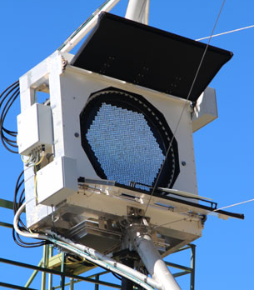
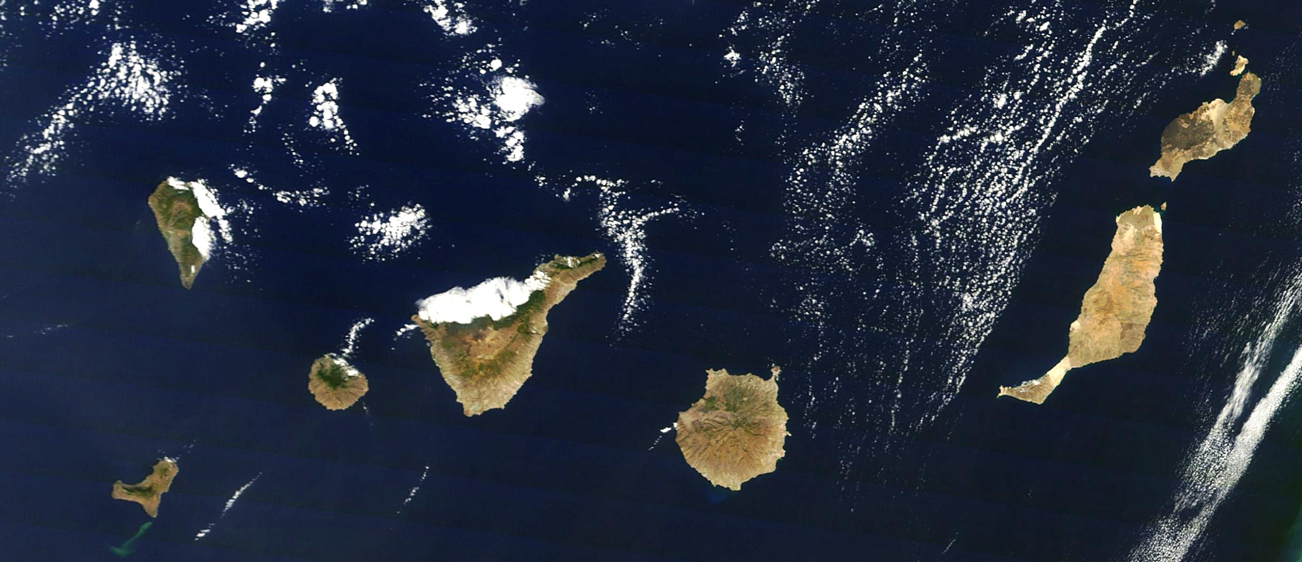
MAGIC TELESCOPES
Ø 17 m actively steered segmented mirrors.
MAGIC Camera:
1039 low-gain PMTs
Hexagonal geometry
Field of view of 3,5°
Pulse-width: 2,5 ns
Optical fibers to Counting House
Readout:
Analog memory sampling at 1.64 GHz (width 640 ns)

Slide 15
SHOWER IMAGES
After charge calibration and integration → shower image
Fit with an ellipse and get the Hillas parameters:
Length and width of the shower
Charge content (size)
Time gradient
Two telescopes → stereo reconstruction:
Direction of primary particle
Impact parameter
Parameters → physical quantities:
Primary species (γ / h)
Energy of particle
See also Kazuma’s talk on Machine Learning and energy reconstruction!

Slide 16
GAMMA MC SHOWER

Slide 17
HADRONIC SHOWER
HAPPY

Slide 18
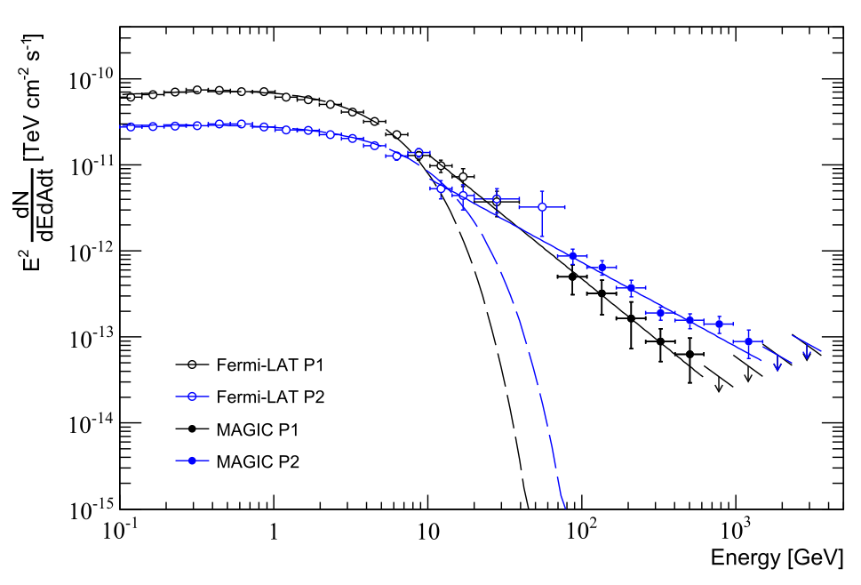
MAGIC SENSITIVITY
MAGIC peak sensitivity: 200 GeV – 2 TeV
But pulsar emission is much softer!
Need to improve sensitivity at lower energies…

Slide 19
FUTURE PERSPECTIVES

Slide 20
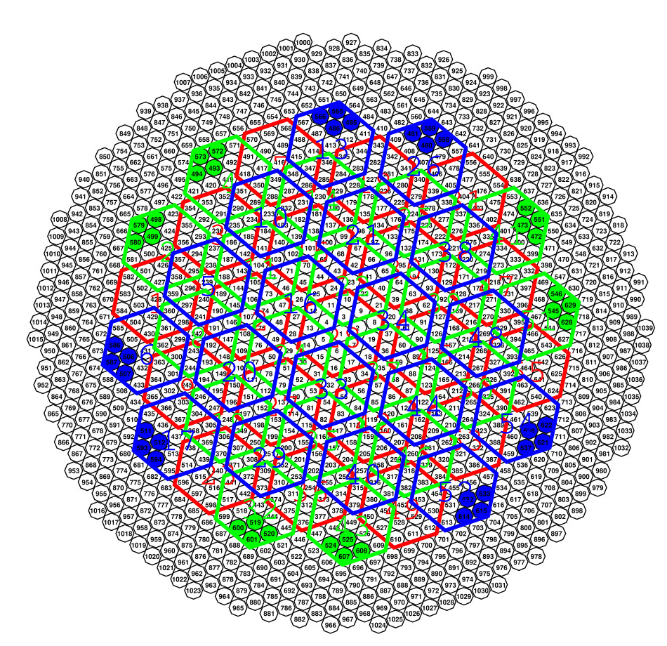
THE SUM-TRIGGER
Tuning MAGIC for Pulsars
Pulsars have soft spectra:
Faint shower images
Low S/N ratio (night sky background)
Dedicated trigger for lower energy showers:
Analog stacking of PMT signals
Discriminator threshold on the summed signal
However…
More affected by all sources of noise
Requires a careful dedicated analysis
Finally (almost) in stable operation!
Macrocell: analog sum of 19 next PMTs.

Slide 21
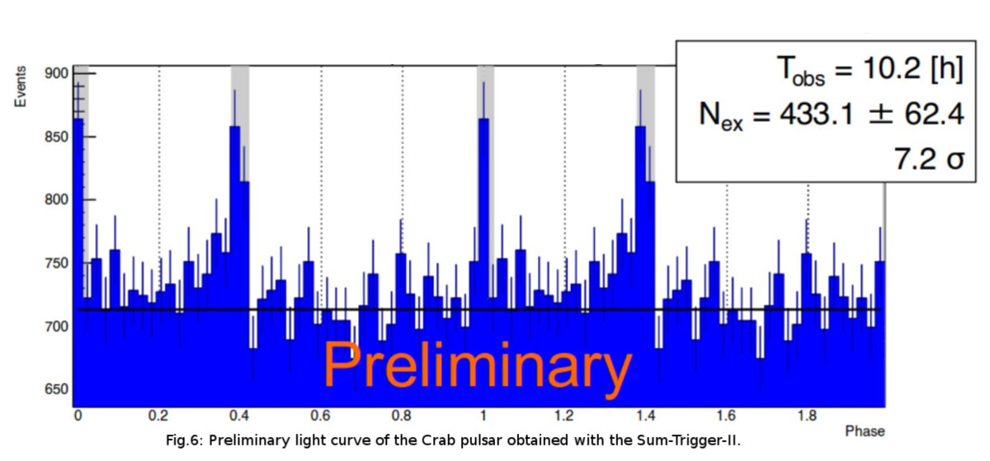
FIRST RESULTS
From M. Lopez, ICRC 2015 [8]
Old test (2015) on the Crab with the Sum-Trigger:
Detection efficiency improves by a factor of 2!
The energy threshold goes down to ~50GeV! Filled the gap between HE and VHE bands!
Since then the situation has further improved…

Slide 22
NEXT FUTURE
Improved statistics for low-energy detection:
Possibility to probe variability of the Crab:
Time / Pulse shape variability
Check for variations in the spectrum?
Linked with Nebula?
Potential new VHE pulsars discovery!
Not only pulsars: the hunt for Gamma Ray Bursts continues…
…STAY TUNED!

Slide 23
REFERENCES
MAGIC Collaboration, Observation of Pulsed γ-Rays Above 25 GeV from the Crab Pulsar with MAGIC, Science Vol. 322, Issue 5905, pp. 1221-1224, XI.2008
MAGIC Collaboration, Teraelectronvolt pulsed emission from the Crab Pulsar detected by MAGIC, A&A Vol. 385, A133, I.2016
Kuiper et al., The Crab pulsar in the 0.75-30 MeV range as seen by CGRO COMPTEL, A&A Vol. 378, IX.2001
K. Hirotani, What Pulsar High-Energy Emission Model Survives?, in “High-Energy Emission from Pulsars and their Systems: Proceedings of the First Session of the Sant Cugat Forum on Astrophysics”, Springer-Verlag 2001
Hinton et al., Teraelectronvolt Astronomy, Annual Review of Astronomy and Astrophysics Vol. 47:523-565, IX.2009
MAGIC Collaboration, The major upgrade of the MAGIC telescopes, Part I: The hardware improvements and the commissioning of the system, Astroparticle Physics Vol. 72, I.2016
MAGIC Collaboration, The major upgrade of the MAGIC telescopes, Part II: The major upgrade of the MAGIC telescopes, Part II: A performance study using observations of the Crab Nebula, Astroparticle Physics Vol. 72, I.2016
Rodriguez Garcia et al., Status of the new Sum-Trigger system for the MAGIC telescopes, in Proceedings of 33th International Cosmic Ray Conference (ICRC 2013), VII.2013
Dazzi et al., Performance studies of the new stereoscopic Sum-Trigger-II of MAGIC after one year of operation, in Proceedings of 34th International Cosmic Ray Conference (ICRC 2015), VIII.2015
Abdo et al., Fermi Large Area Telescope observations of the Crab Pulsar and Nebula, ApJ Vol. 708:2, XII.2009

Slide 24
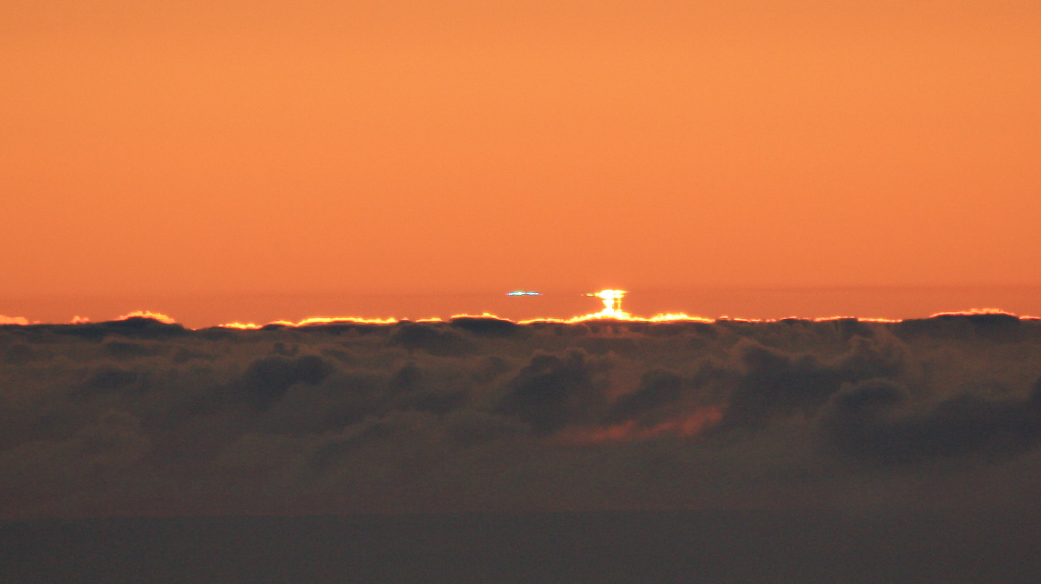
QUESTIONS?

Slide 25
THE SUM-TRIGGGER

