Slide 1



AWAKE Experiment at CERN.
Project Review
Mikhail Martyanov (Max-Planck Institute for Physics) on behalf of AWAKE Collaboration
Max Plank Institute for Physics, Munich, December 18-19, 2017

Slide 2
What is AWAKE?
AWAKE = Advanced WAKefield Experiment
Proton-driven Plasma Wakefield Acceleration Experiment
Aiming to accelerate electrons to high energy (GeV-TeV)
At CERN site with SPS proton bunches
AWAKE Structure:
Spokesperson: Allen Caldwell (MPP)
Deputy Spokesperson: Matthew Wing (UCL)
Technical Coordinator: Edda Gschwendtner (CERN)
Physics and Experiment Coordinator: Patric Muggli (MPP)
Simulation Coordinator: Konstantin Lotov (BINP)
Some useful links:
AWAKE web-page: http://awake.web.cern.ch/awake/
AWAKE INDICO web-page: http://indico.cern.ch/category/4278/
AWAKE Design Report: http://cds.cern.ch/record/1537318

Slide 3
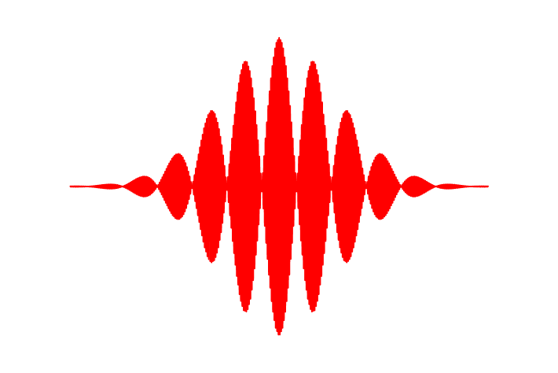
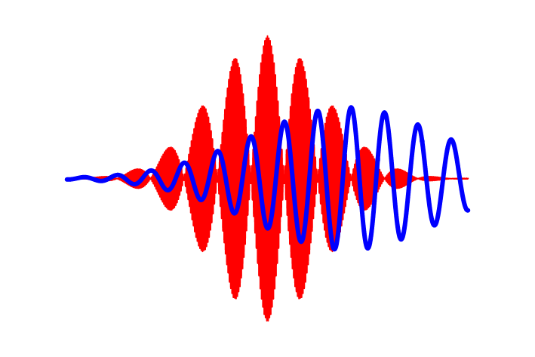

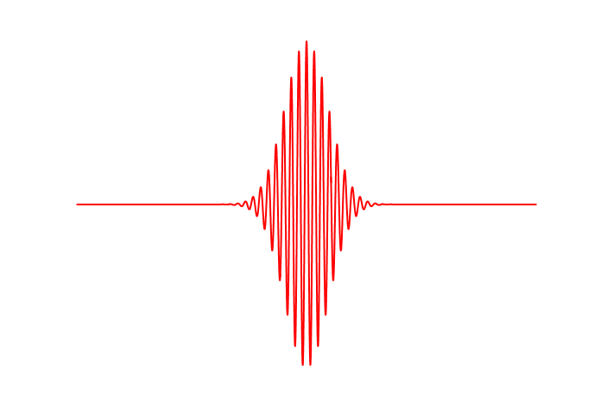
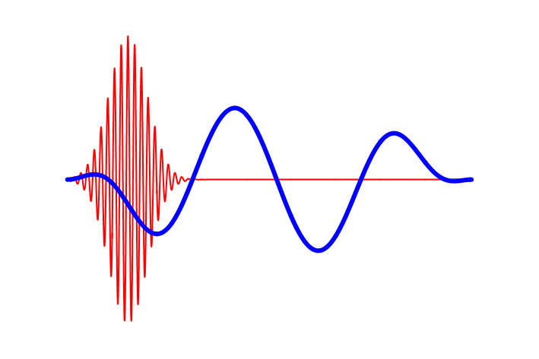
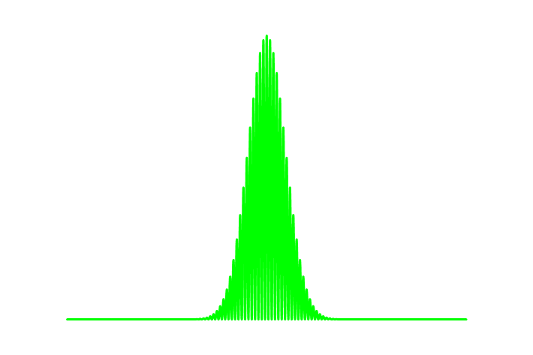
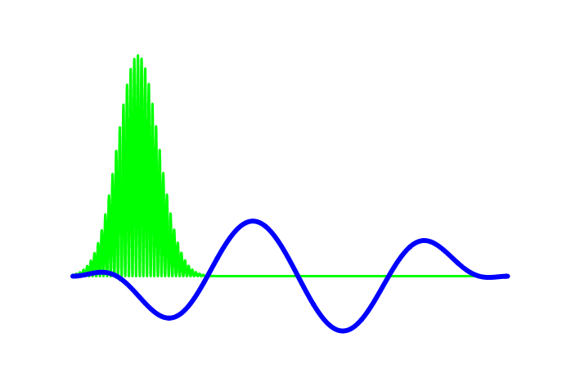
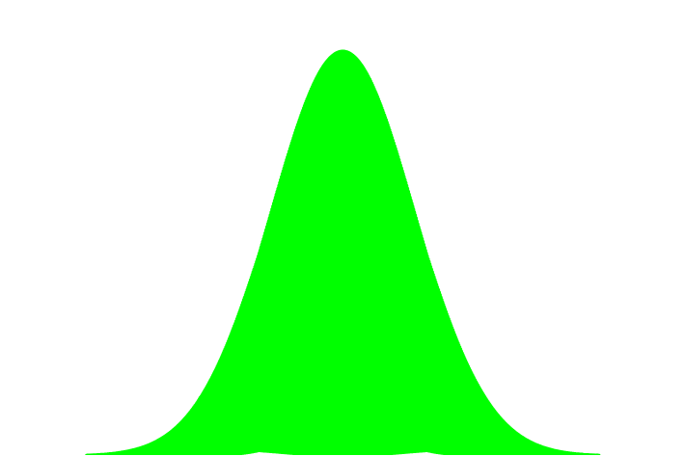
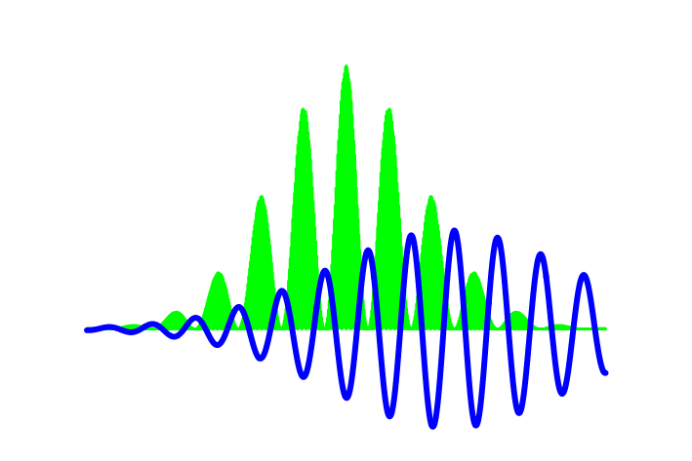
The Zoo of Plasma Wake-field Accelerators
… started from pioneer paper “Laser Electron Accelerator” by T.Tajima and J.Dawson
Phys. Rev. Lett. 43, 267 – Published 23 July 1979
Laser Beat-Wave WFA (~1 ns)
Two frequencies laser pulse (pulse train)
Self-Modulated Laser WFA (~1 ns)
Raman forward scattering instability in a long laser pulse
Laser WFA (~0.1 ps)
Short intense laser pulse
~ 1ps proton bunch
does not exist !
Particle Bunch WFA
Short intense particle bunch
Self-Modulated Particle Bunch WFA
Long bunch experience transverse self-modulation instability
~1ns
Scope of AWAKE proof-of-principle experiment

Slide 4
AWAKE at CERN

Slide 5
AWAKE Baseline Parameters
Plasma | Rb plasma density | 10¹⁴ ÷ 10¹⁵ cm⁻³ 7⋅(10⁻³ ÷ 10⁻²) mBar at 500°K
 | Expected gradient | 1 ÷ 3 GV/m
 | Uniformity | <0.1%
 | Length | 10 meters
Proton bunch | Energy | 400 GeV → 64 nJ/p⁺ → 19.2 kJ/bunch
 | Charge | 3⋅10¹¹ particles → 48 nC
 | Length, σ_{z} | 12 cm → 400 ps
 | Radius, σ_{r} | 200 μm
Electron bunch | Energy | 20 MeV → 3.2 pJ/e⁻ → 4 mJ/bunch
 | Charge | 1.25⋅10⁹ particles → 200 pC
 | Length, σ_{z} | 0.25 cm → 8 ps
 | Radius, σ_{r} | 200 μm
Laser | Energy | up to 450 mJ
 | Pulse duration | 120 fs
 | Beam size at Rb vapor (focused from 40m) | a few mm
 | Focused intensity | > 50 TW/cm2

Slide 6
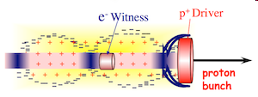
Seeded Self Modulation (SSM)
Short proton bunch driver
No SSM
e⁻
Space charge of drive beam displaces plasma electrons.
Plasma ions exert restoring force.
-
-
-
-
-
-
-
-
-
-
-
-
-
-
-
-
-
-
-
-
-
-
-
-
-
-
-
-
-
-
-
-
-
-
-
-
-
-
-
-
-
-
-
Long proton bunch driver
SSM develops
-
-
-
-
-
-
-
-
-
-
-
-
-
-
-
-
-
-
-
-
-
-
-
-
-
-
-
-
-
₊
₊
₊
₊
₊
₊
-
₊
₊
₊
₊
₊
₊
₊
₊
₊
₊
₊
₊
₊
₊
₊
₊
₊
₊
-
e⁻
-
-
-
₊
₊
₊
₊
-
-
-
-
-
-
₊
₊
₊
₊
₊
₊
₊
₊
₊
₊
₊
₊
₊
₊
-
-
₊
₊
₊
₊
₊
-
₊
₊
₊
₊
₊
-
-
₊
-
₊
₊
₊
₊
₊
-
₊
₊
₊
₊
₊
-
₊
₊
₊
₊
₊
₊
₊
₊
₊
₊
₊
₊
₊
₊
-
-
₊
₊
₊
₊
₊
-
-
-
-
-
-
-
-
-
-
-
proton
bunch
-
-
-
-
-
-
-
-
-
-
-
-
-
-
-
-
-
-
-
-
-
-
-
-
-
-
-
-
-
-
-
-
-
-
-
-
-
-
-
-
-
-
-
-
-
-
-
-
-
-
E_{z}

Slide 7
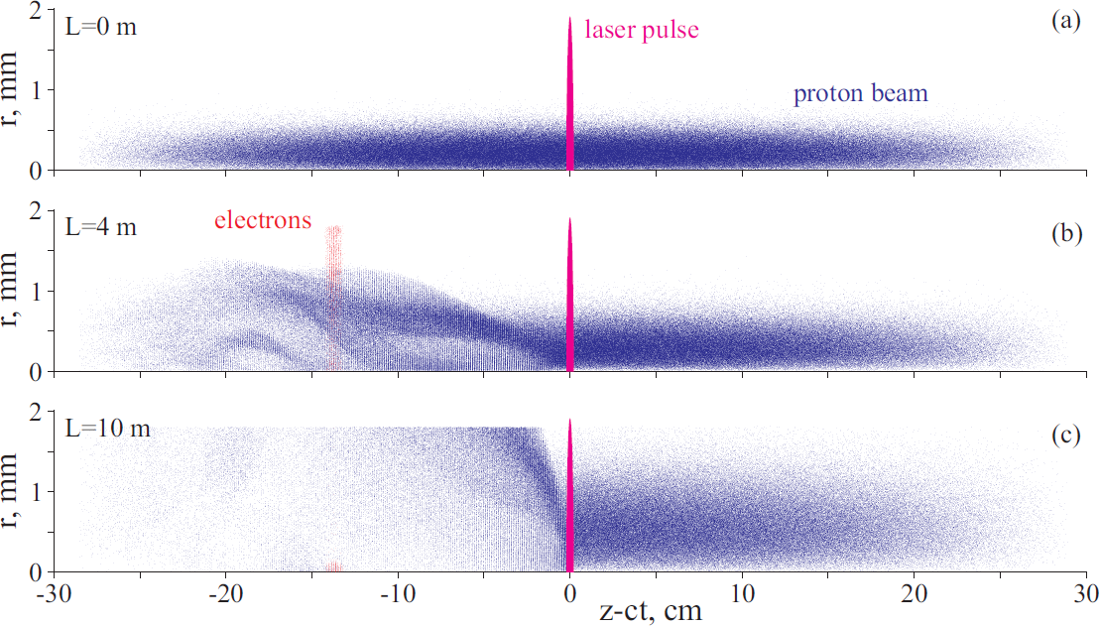
AWAKE Physics: Principle
Ionization front is co-propagating with a short laser pulse and creates Seeded Self Modulation (SSM)
τ_{laser} ~ 100 fs << τ_{wake} ~ 3 ps
100% Rb plasma
100% Rb vapor
Ionization front
witness e⁻ are injected
Picture taken from AWAKE CDR, CERN 2013
~100 periods behind
witness e⁻ are accelerated and focused

Slide 8
AWAKE Physics: Principle
Ionization front is co-propagating with a short laser pulse and creates Seeded Self Modulation (SSM)
τ_{laser} ~ 100 fs << τ_{wake} ~ 3 ps
Zoom in
Zoom
100% Rb plasma
100% Rb vapor
Ionization front
witness e⁻ are injected
Picture taken from AWAKE CDR, CERN 2013
~100 periods behind
witness e⁻ are accelerated and focused

Slide 9
AWAKE Experiment at CERN
Phase 1:
Understand the physics of seeded self-modulation processes in plasma ➔ started Q4 2016
Phase 2:
Probe the accelerating wakefields with externally injected electrons ➔ started Q4 2017
We had a very sucessful AWAKE programm during 2015 - 2017!
- Building an experiment from 2015.
- First SSM at the second day of run in 2016!
- Proven SSM phase stability in 2017.
J.Moody (MPP)
M.Huether (MPP)
A.Bachmann (MPP)
V.Fedosseev (CERN)
M.Wing (UCL)
F.Keebly (UCL)
S.Doebert (CERN)
K.Pepitone (CERN)
P.Muggli (MPP)
E.Oz (MPP)
F.Braunmueller (MPP)
F.Basch (MPP)
M.Martyanov (MPP)
K.Rieger (MPP)
F.Braunmueller (MPP)
Laser
RF gun
Laser
dump
e⁻ spectrometer
e⁻
p⁺ diagnostics
OTR / CTR
SSM
Acceleration
Proton
beam
dump
SPS p⁺
10m Rb plasma
2-screen halo
diagnostics
Streak-camera
M. Turner (CERN)
Reference laser marker to a streak-camera
to Heterodyne setup
through a waveguide

Slide 10
Beam Diagnostics overview
Rb-cell diagnostics (white light interferometry, T-sensors etc.)
Laser line diagnostics and alignment (CCD’s, energy, ACF etc.)
p⁺ diagnostics:
Standard (BCT, BPM’s, luminescent / OTR screens)
Two-screen halo diagnostics
Visible OTR, 2 streak cameras – SSM visualization
Microwave CTR – SSM frequency measurement
e⁻ diagnostics :
Standard (BCT, BPM’s, screens)
Large wide-band spectrometer (20 MeV to 3 GeV)

Slide 11
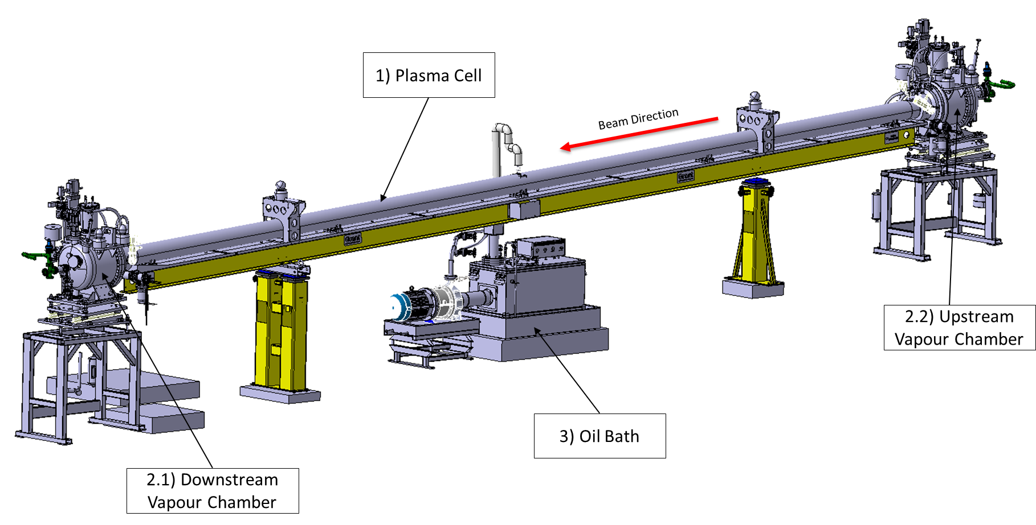

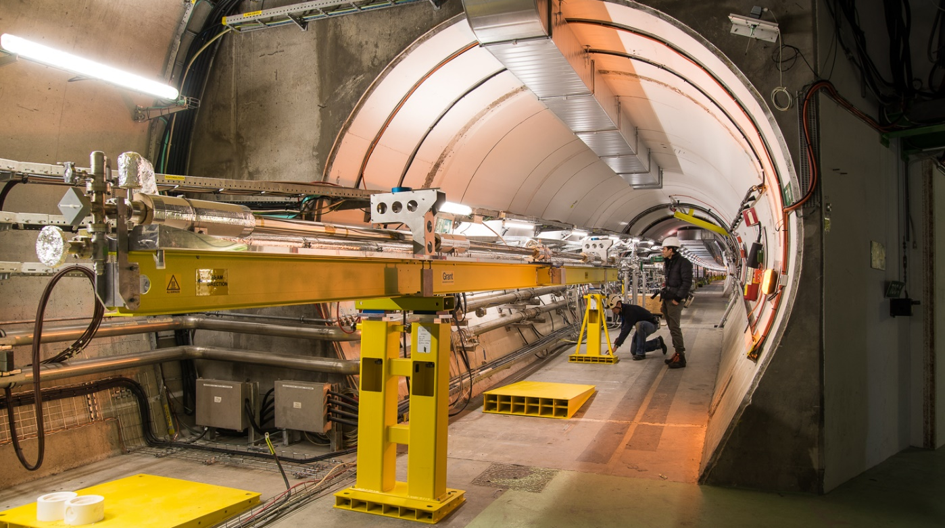
Key Component : Rb vapour cell
Rb vapour / plasma source and Ti:Sa ionizing laser – major contribution of MPP
P.Muggli (MPP)
E.Oz (MPP)
F.Braunmueller (MPP)
10 meter long heated oil bath
to provide Δn/n~0.1% uniformity

Slide 12
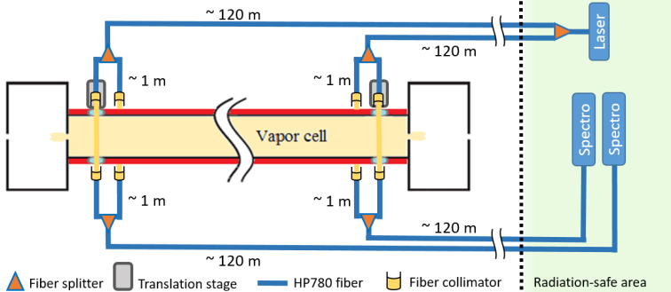
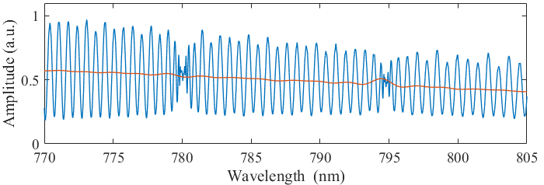
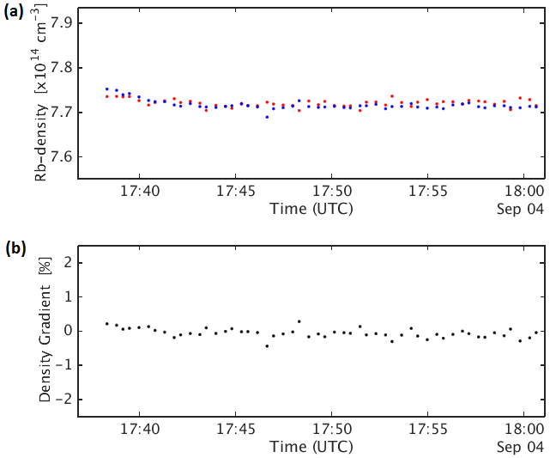
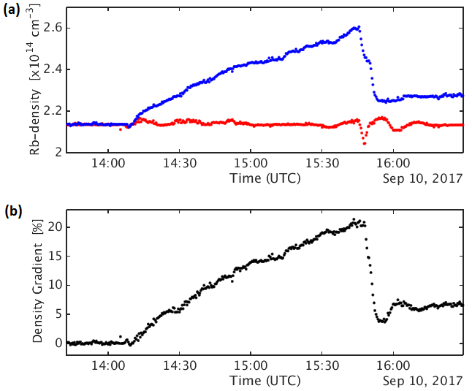
Rb vapour cell : density diagnostics
Measure at both vapor cell ends with 0.1 to 0.4 % precision for gradient determination
Use Mach-Zehnder interferometer and white light interferometer
F.Batsch (MPP)
Stable density and gradient:
Gradient scan:

Slide 13
Two-Screen p⁺ Halo Diagnostics
The aim of the diagnostic – to measure the defocused part of a proton bunch (halo)
Each screen port has 2-CCD optical system and a mask to hide a core of the beam
Screen 1
Screen 2
8 m
M.Turner (CERN)

Slide 14

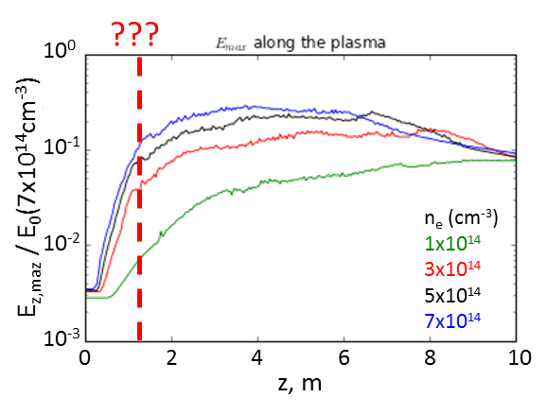
Two-Screen p⁺ Halo Diagnostics
p⁺ are defocused by the transverse wakefield (SSM) form a halo
Focused p⁺ form a tighter core
Estimate of the transverse wake-field amplitude (integral)
Information about saturation length?
Preliminary !!!
Screen 1
8 m
Screen 2
Longitudinal electric field E_{z}
evolution along plasma cell
Plasma OFF
Plasma ON
Rb plasma
Courtesy of M.Turner (CERN)

Slide 15
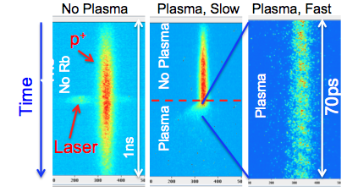
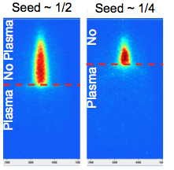
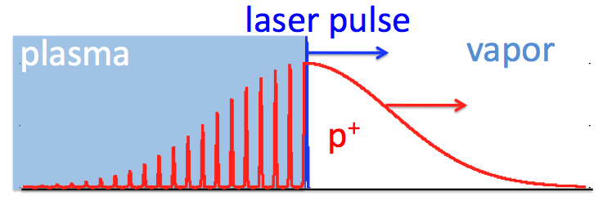
OTR Diagnostics: SSM
The aim is to get time resolved picture of SSM
Timing at the ps scale
Effect starts at laser timing => seeding of SSM
Density modulation at the 10ps-scale visible
Preliminary !!!
OTR light in visible band
Streak camera Images
Zoom in
N_{p+} = 3 ⋅ 10¹¹ (long)
n_{Rb} = 3.7⋅10¹⁴cm⁻³
f_{mod} ~ 164GHz
1ns
200ps
1ns
p⁺ are symmetrically defocused by SSM
K. Rieger (MPP)

Slide 16
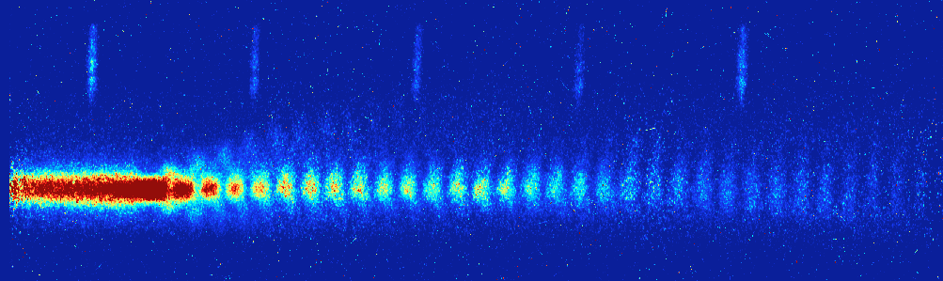
OTR Diagnostics: SSM
Micro-bunches present over long time scale ~σ_{t} from the seed
“Stitching” demonstrates reproducibility of the µ-bunch process against bunch parameters variations (N = 2⋅10¹¹ ± 5%, σ_{t} = 220 ± 10 ps)
Phase stability was proved, it is essential for e⁻ external injection !
Preliminary !!!
Streak camera images stitched together with the help of the reference marker laser line
“Ionizing”
Laser
Pulse
Marker
Laser
Pulse
Marker
Laser
Pulse
Marker
Laser
Pulse
Marker
Laser
Pulse
P. Muggli (MPP)
F. Batsch (MPP)
50 ps
50 ps
50 ps
50 ps
200ps
31 Bunches
Front
Defocused p⁺
σ_{t} ~ 200 ps

Slide 17
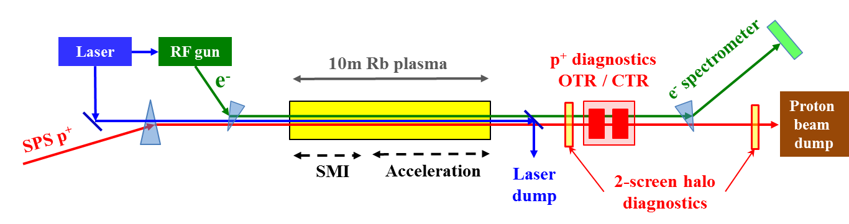
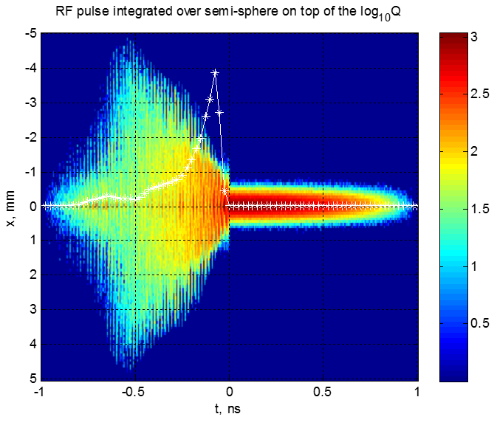
Coherent Transition Radiation (CTR )
The aims of CTR diagnostics are:
To measure a relative or absolute CTR signal strength
To measure a carrier frequency of CTR signal or its harmonics
To show that it is close to an expected plasma frequency
With our AWAKE parameters we expect f_{CTR} = 90 - 290 GHz
“Golden” figure would look like this
measured CTR frequency
Rb density

Slide 18
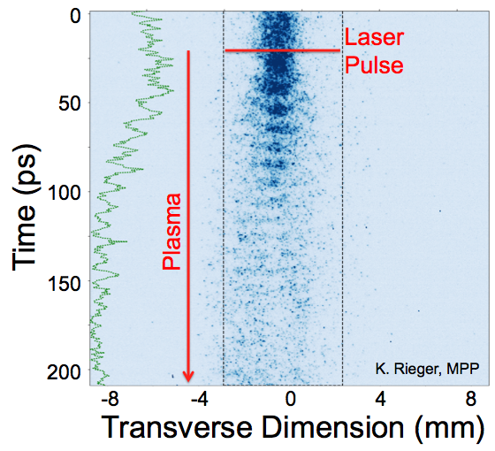
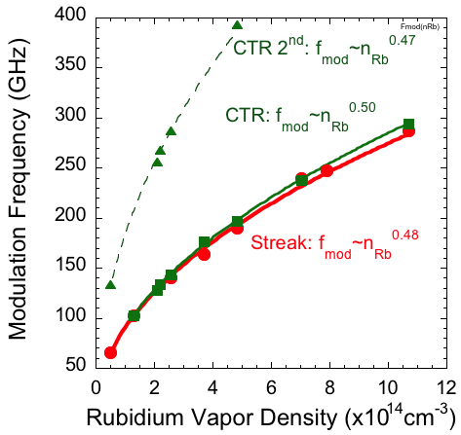
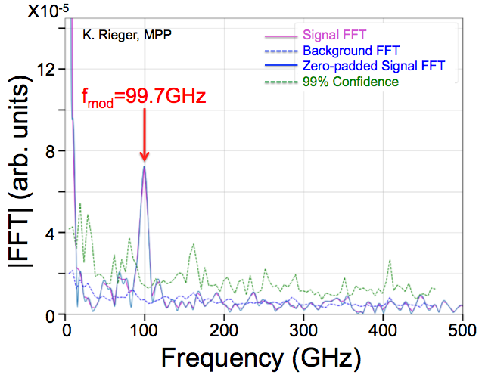
CTR Diagnostics: SSM frequency
At full Rb ionization we expect f_{mod} = f_{pe} ~ (n_{Rb} )^{-0.5}
CTR signal detected also at harmonics (power not calibrated)
Modulation of p⁺ is nonlinear, proven by presence of CTR harmonics
Preliminary !!!
Heterodyne CTR and streak camera FFT
FFT
K.Rieger (MPP), F.Braunmueller (MPP)

Slide 19
Summary
Year 2017 was very successful for AWAKE experimental program!
We observed a stable Seeded Self Modulation of a proton bunch
Proven stability of a modulation phase w.r.t. an ionizing laser
We observed defocused protons with the halo measurement
FFT of an OTR streak camera image gives a frequency peak in agreement with an expected plasma frequency assuming full Rb ionization
Measured CTR carrier frequency is in agreement with a frequency of OTR streak camera FFT and with a plasma frequency calculated from Rb density.
Electron line has been recently commissioned
We anticipate year 2018 to be exciting with an electron acceleration!

Slide 20
Thank you!

