Slide 1
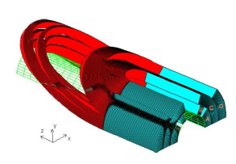
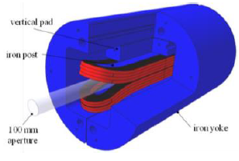
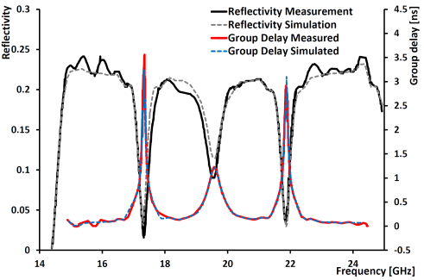
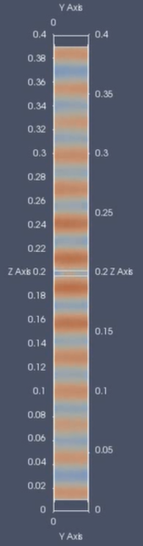
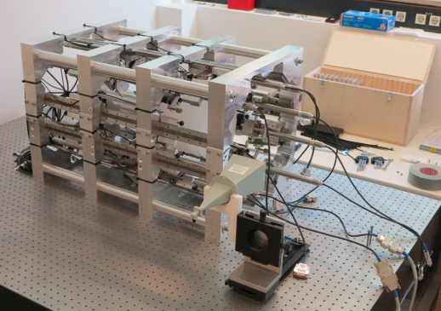
MADMAX: A new Road to
Axion Dark Matter Detection
OUTLINE:
MADMAX collaboration
The magnet
First results from seed setup
20 disc setup
Simulations
Outlook

Slide 2
MADMAX @ MPP

Slide 3
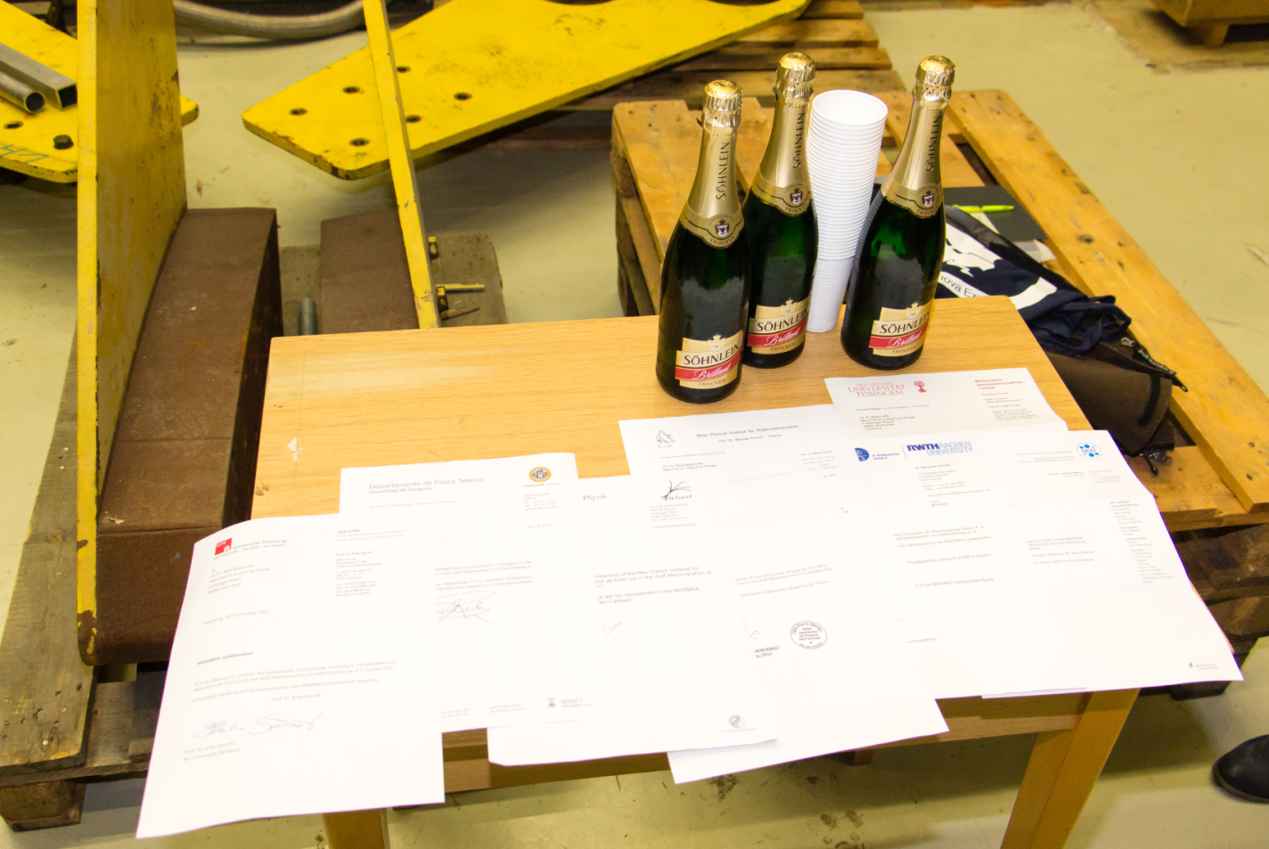
MADMAX
MAgnetized Disc and Mirror Axion eXperiment
Collaboration forming on 18th Oct. 2017

Slide 4
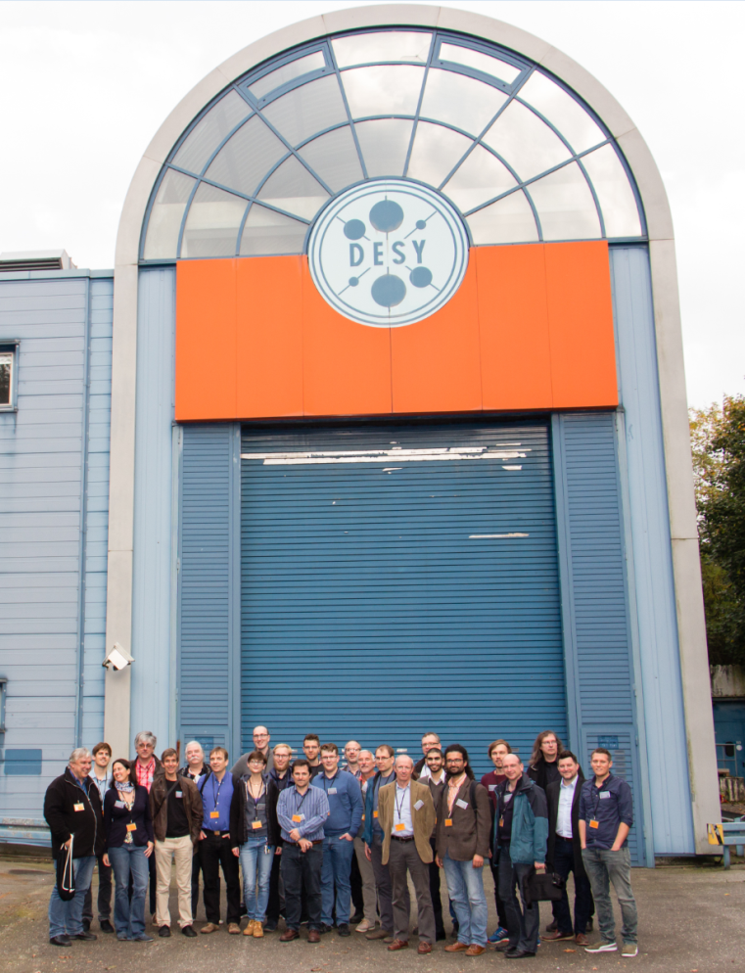
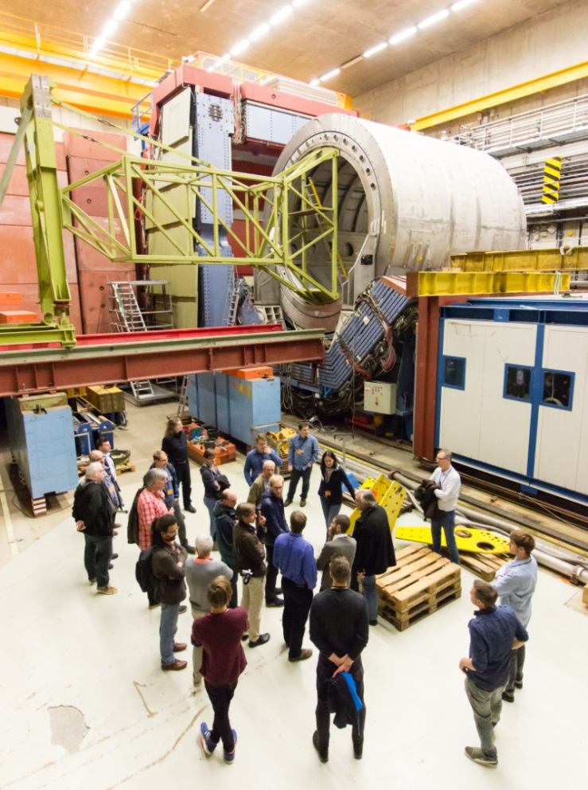
MADMAX
MAgnetized Disc and Mirror Axion eXperiment
Collaboration forming on 18th Oct. 2017

Slide 5
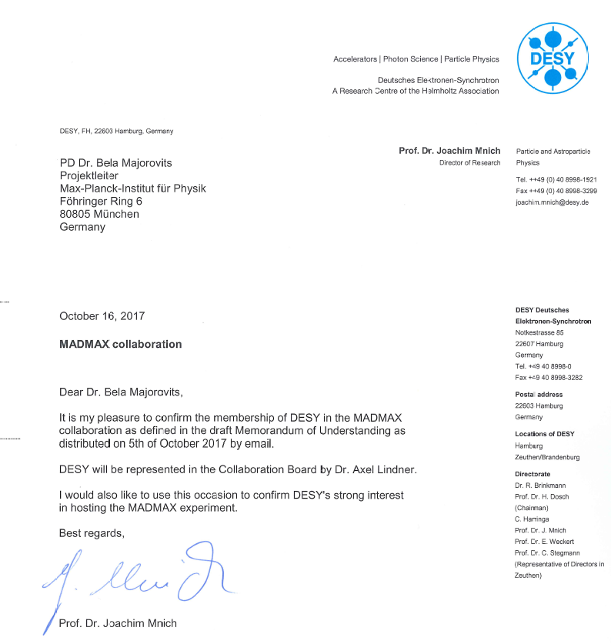
MADMAX:DESY as site!

Slide 6
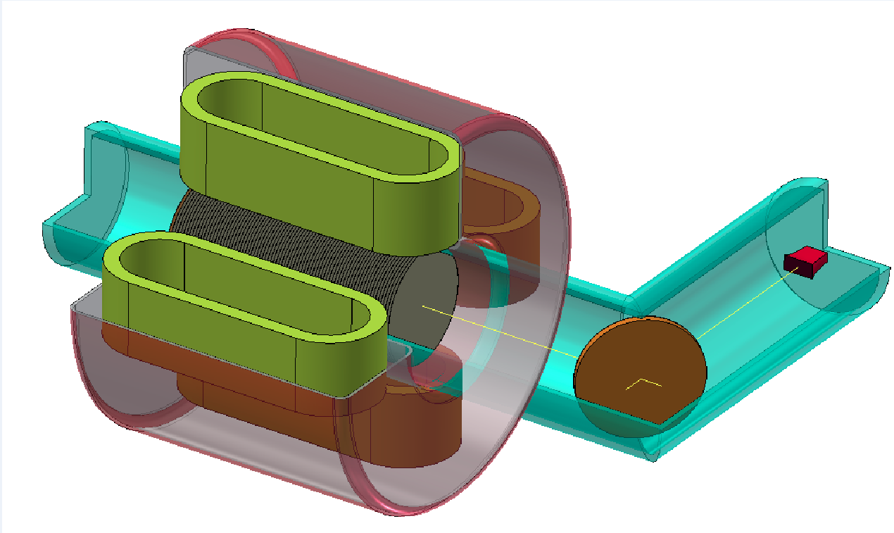
MADMAX
MAgnetized Disc and Mirror Axion eXperiment
~2m
Mirror
10 T dipole magnet
Horn antenna
(+ receiver)
80 adjustable dielectric discs
⊘: ~1m
Separate cryogenic volume
Parabolic Mirror

Slide 7

MADMAX Magnet
B²·A ≳100 T²m² over 2m
100 T²m² dipole magnet:
first ever
→ Design Study
→ Prototype
→ Full scale magnet
Innovation partnership: First in MPG
Tedious 16 months EU tendering process: Aug. 2016 – Dec 2017
Two innovation partners:
CEA-IRFU Saclay
Bilfinger Babcock Noell, Würzburg
One tender for whole magnet project!

Slide 8
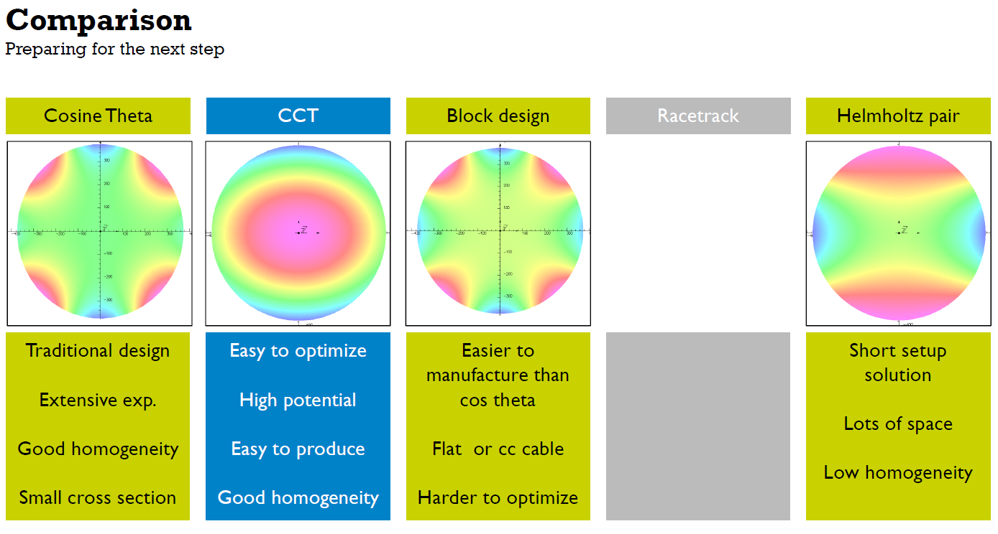
MADMAX Magnet
Design studies: investigate options

Slide 9
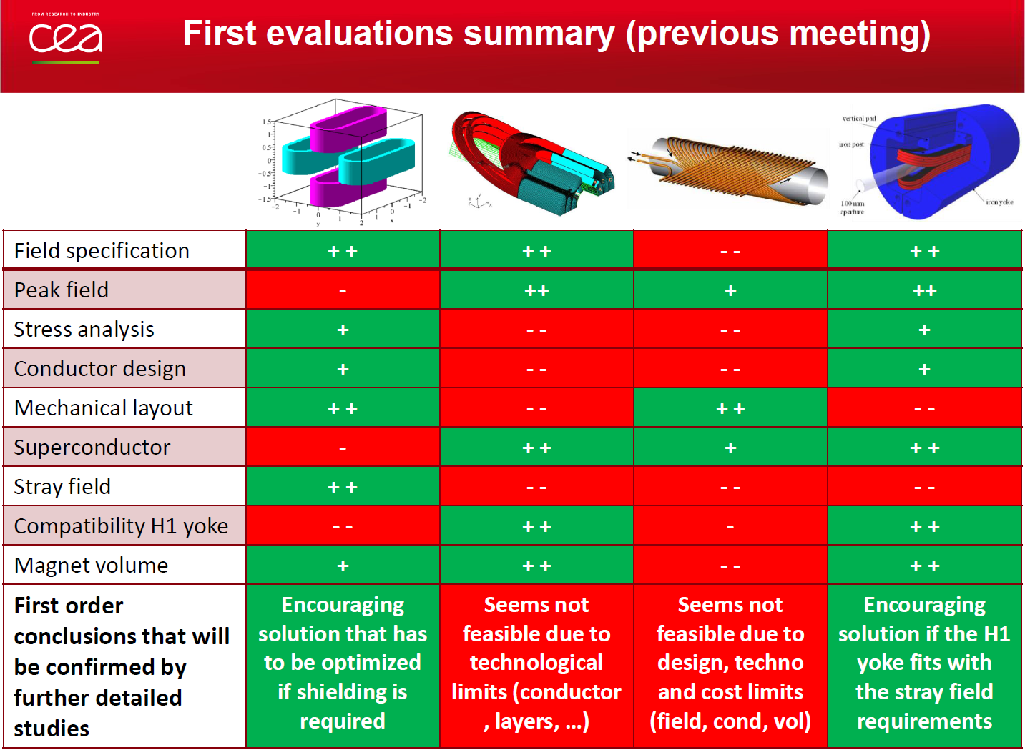
MADMAX Magnet
Design studies: investigate options

Slide 10
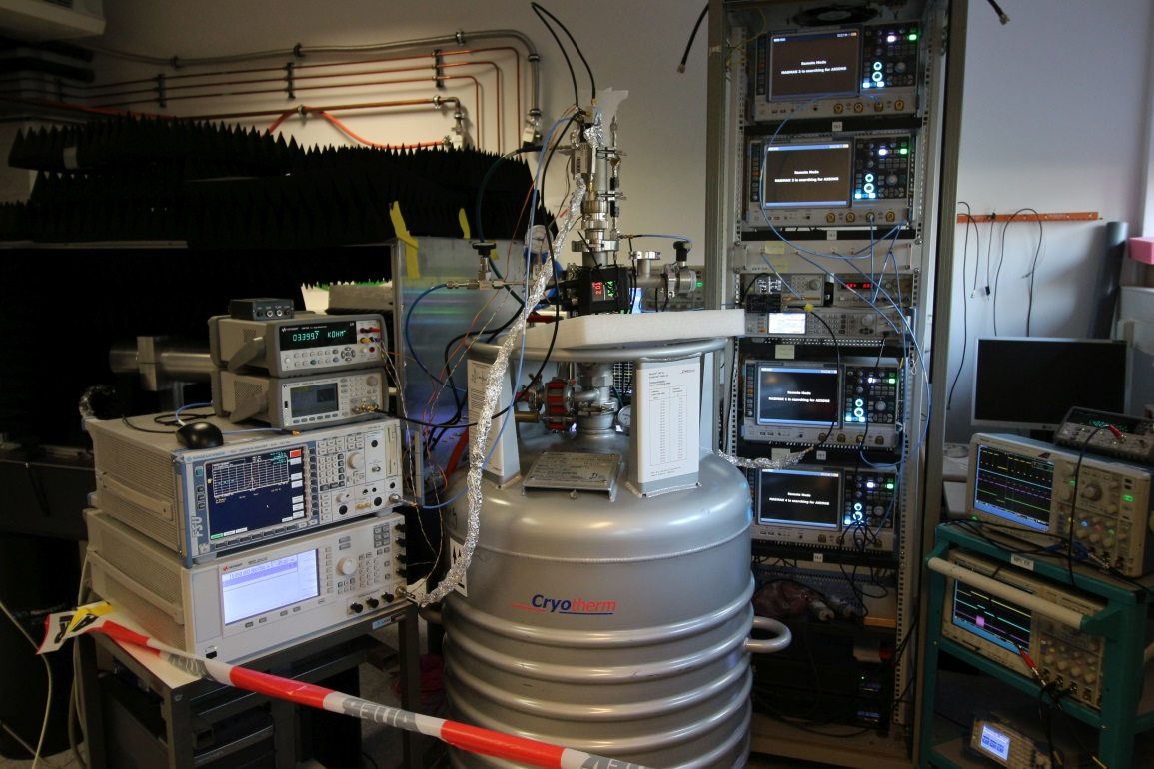
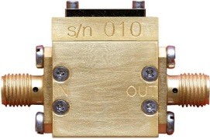
MADMAX Receiver
Heterodyne detection:
Signal analyzer
(4 samplers, 1.4% dead time)
Front end mixers and amps
Fake axion
LHe bath
→ 4K T_{He} + 5.5K T_{Amp}
= 9.5K T_{Sys}

Slide 11
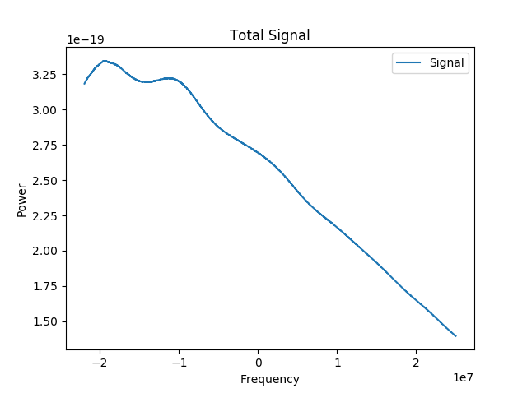
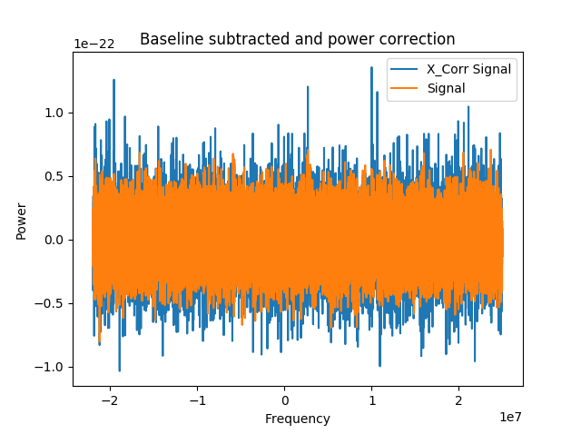
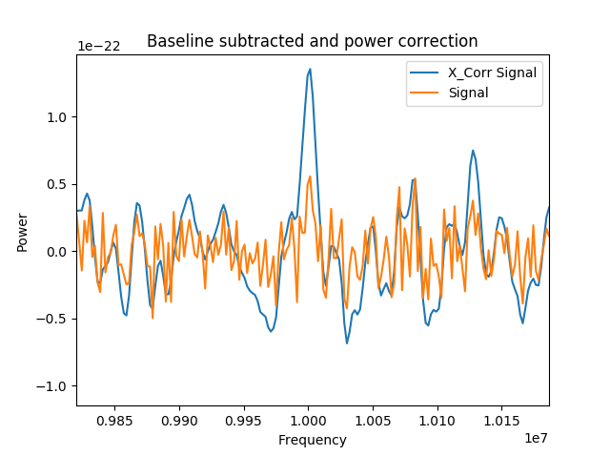
MADMAX Receiver: 1st measurements
Low noise preamp:
Inject fake 18GHz axion signal with 10⁻²² W power
Measurement for 28 hours (integrate signal):
Receiver at LHe temp.
Cross correlation analysis (8kHz Lorentz shaped)
found ~5σ signal succesfully
For 1 week measurement:
Sensitivity at the level of ~ few 10⁻²³ W

Slide 12

MADMAX Receiver: 1st measurements
Low noise preamp:
  s: Signal
  T: Testfunction
  (Lorentz, Gauss, …)
Inject fake 18GHz axion signal with 10⁻²² W power
Measurement for 28 hours (integrate signal):
Receiver at LHe temp.
Cross correlation analysis (8kHz Lorentz shaped)
found ~5σ signal succesfully
For 1 week measurement:
Sensitivity at the level of ~ few 10⁻²³ W

Slide 13
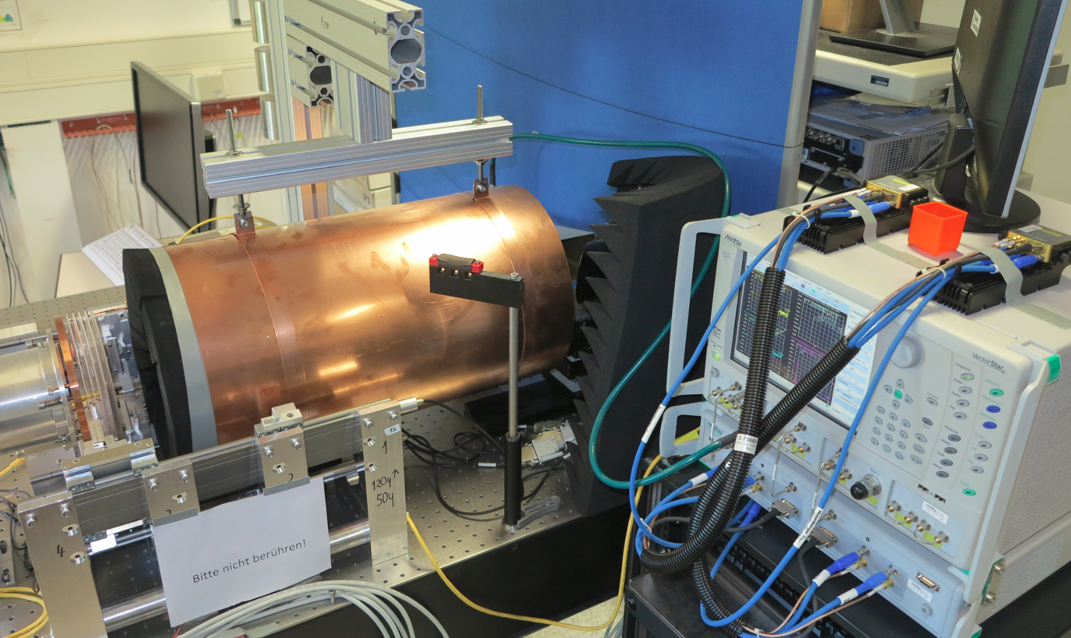

MADMAX Booster: Proof of Principle
Removable copper mirror
Reflectivity measurement:
Dielectric discs
(Saphire)
„Ab-sorber“
Horn antenna
Mirror

Slide 14

MADMAX Booster: proof of principle
Reflectivity measurement:

Slide 15
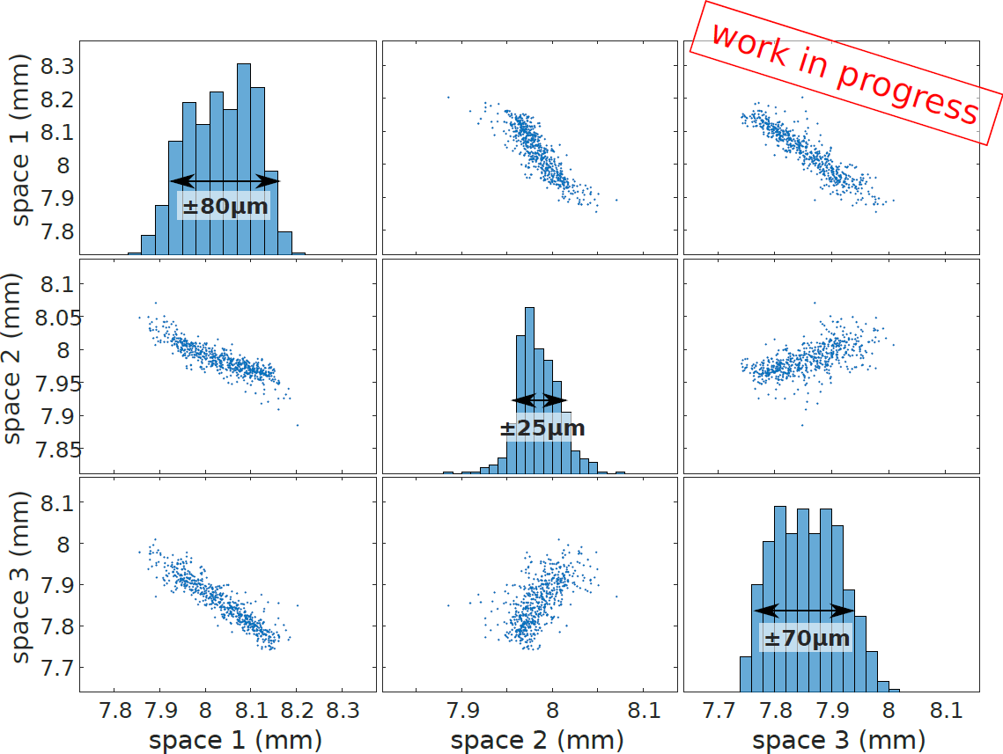
MADMAX Booster: proof of principle
Position reproducibility:

Slide 16

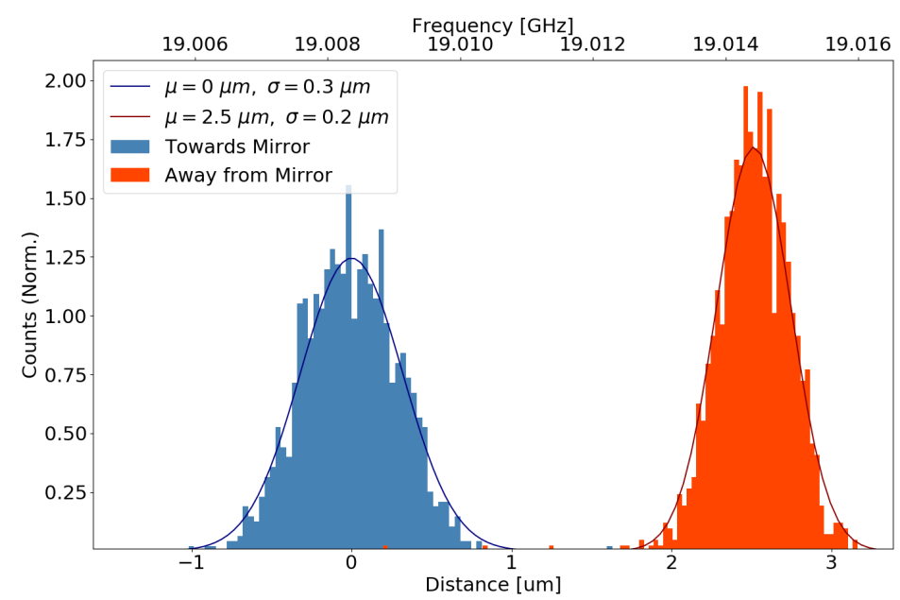
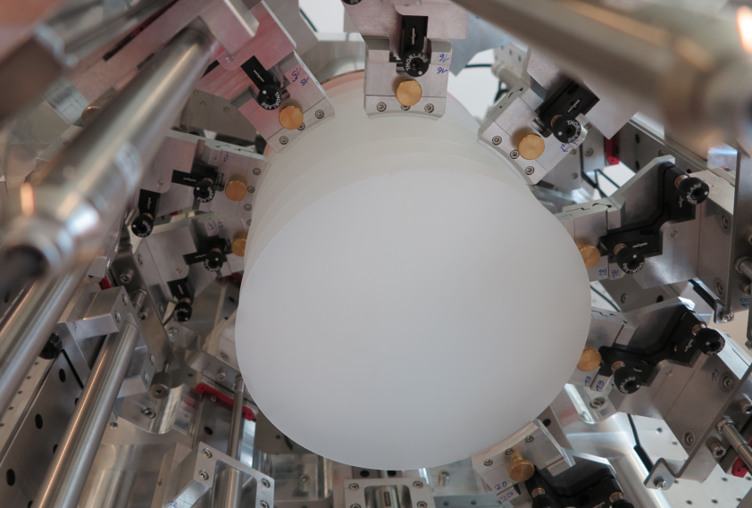
MADMAX Booster: proof of principle
20 disc setup:
Now available:
Reflectivity measurements with up to 20 discs
First results:
Reproducibility of positioning without algorithm: ~ µm

Slide 17
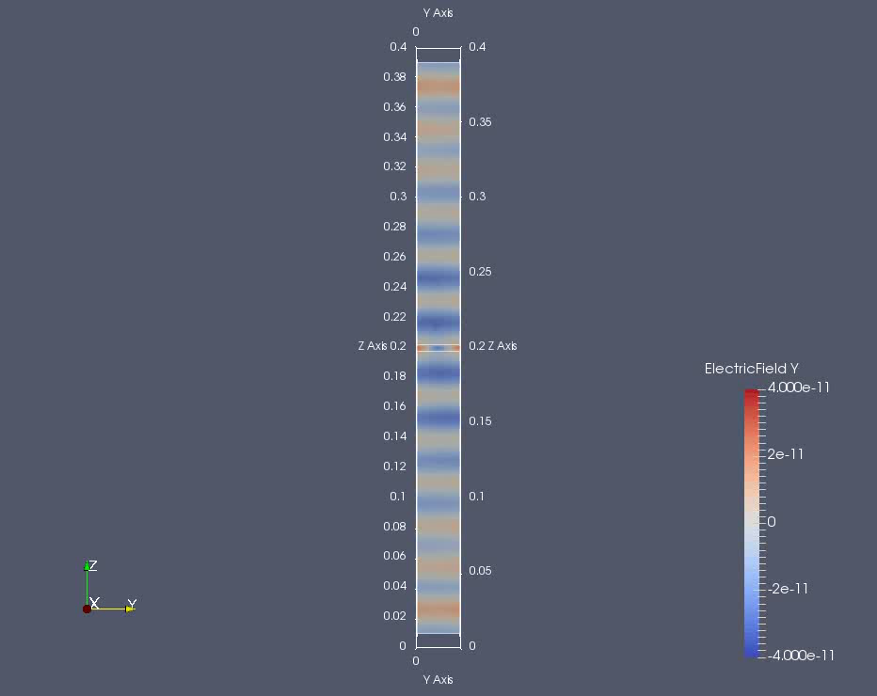
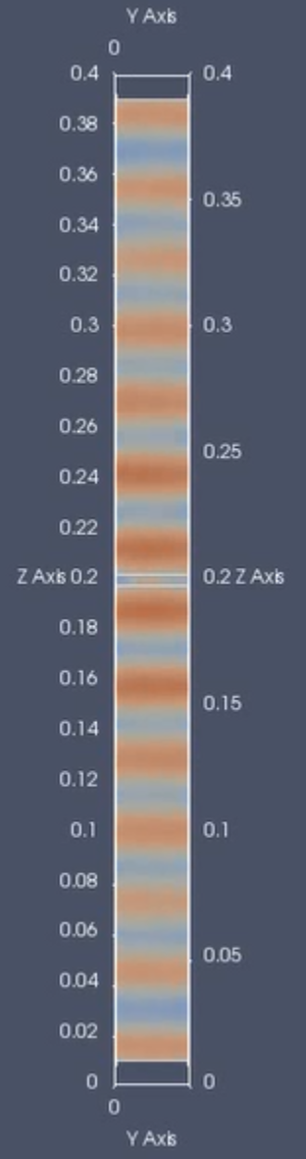
MADMAX 3D simulations
using ELMER
So far: boost factor vs. reflectivity correlation
known only from 1D calculations
Need 3D simulation for “arbitrary geometries”
Test for non symmetric
effects from
Geometries
Losses in materials
Tilting of discs
Surface roughness
…

Slide 18
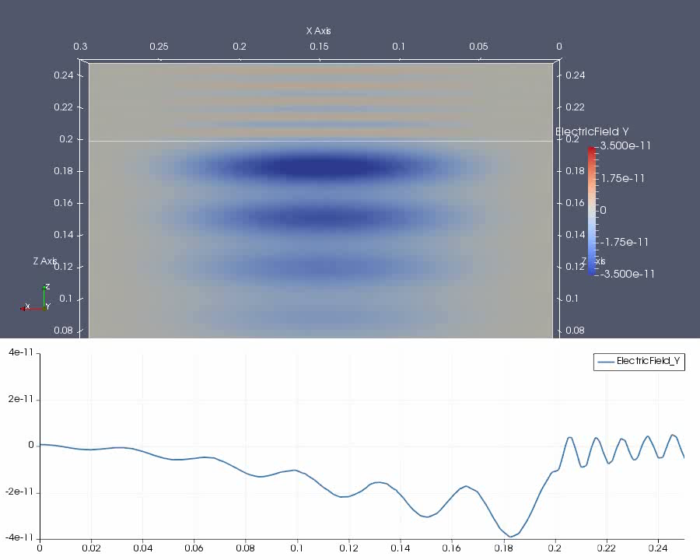

Slide 19
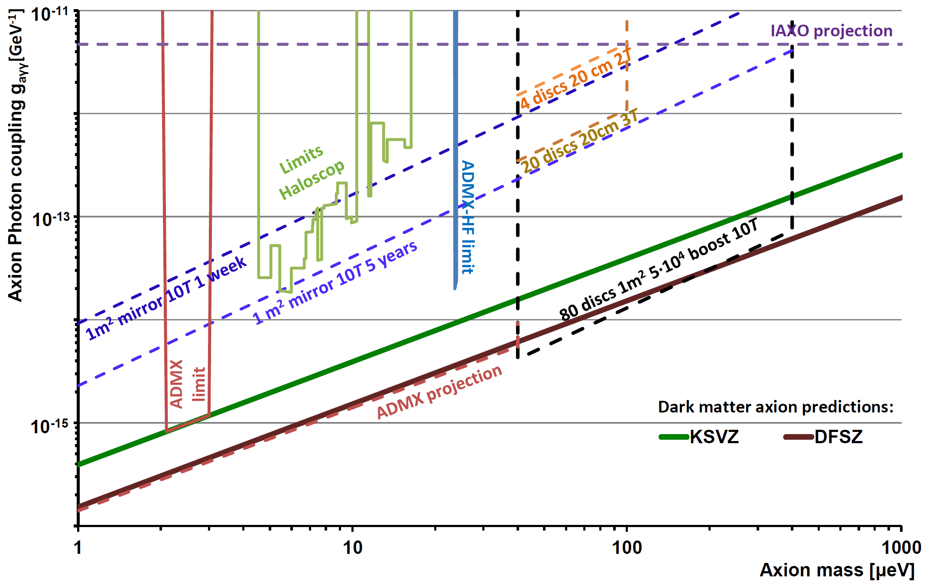
OUTLOOK:
Sensitivty for QCD dark matter axions with A=1m², B||=10T, T_{sys}= 8K, β²=5·10⁴

Slide 20
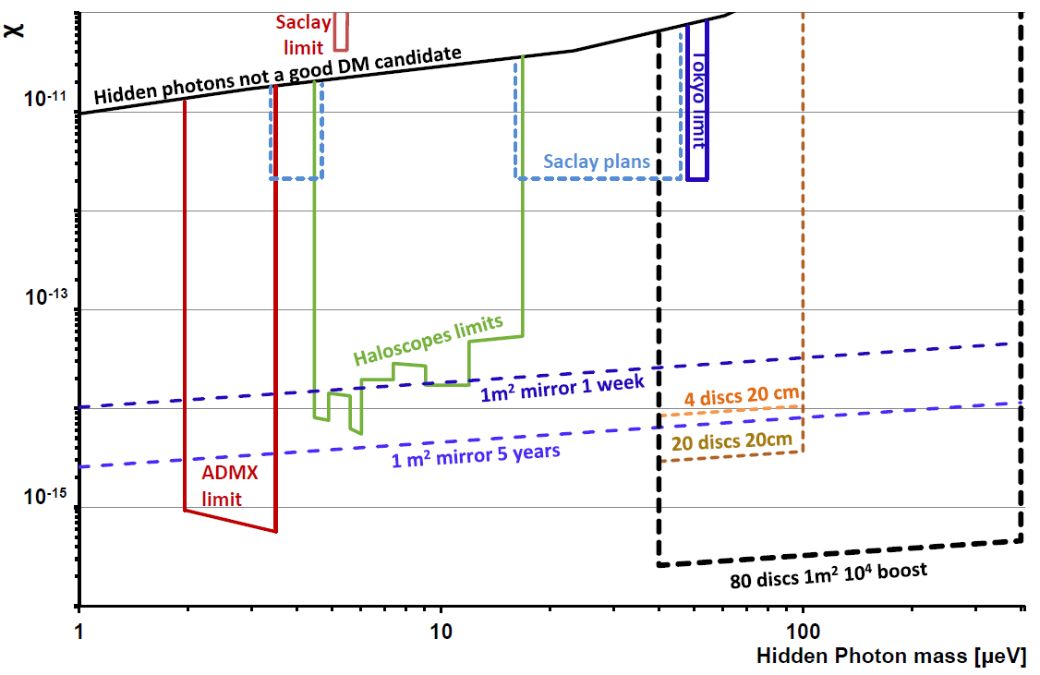
OUTLOOK:
Sensitivty for hidden photons with A=1m², T_{sys}= 8K, β²=5·10⁴
tan δ ≲ 10⁻⁴ (???)

Slide 21




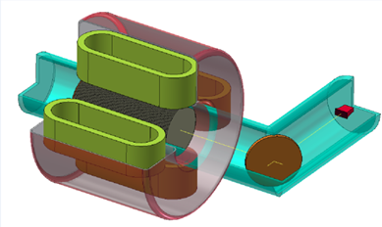
OUTLOOK:
Collaboration officially founded
DESY wants to host MADMX
Magnet innovation partnership with
Bilfinger Babcock Noell
CEA IRFU
First results from proof of principle setup promising
20 disc proof of principle setup available
Started 3D simulations
Goal: Build prototype until 2021
→ first physics results

Slide 22
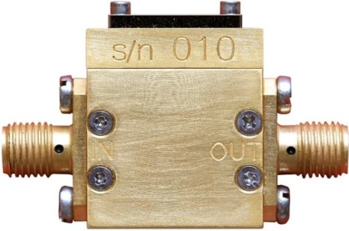
First measurements:
Low noise preamp:
InP HEMT preamplifier from LowNoiseFactory
Frequency range: 6-20 GHz
detector noise: T~7K (measured, quick and dirty)
T_{ds}~ 6K (data sheet)
22

Slide 23
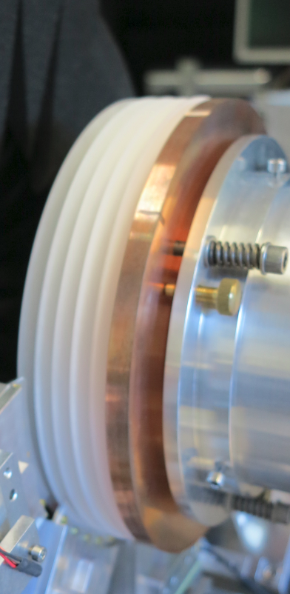
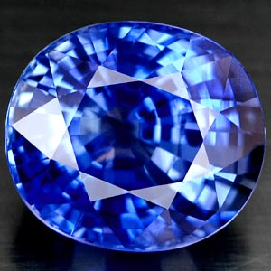
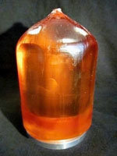
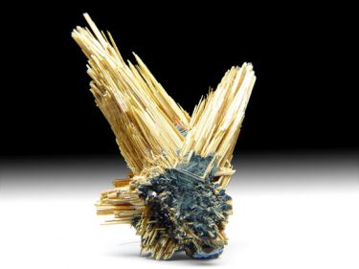



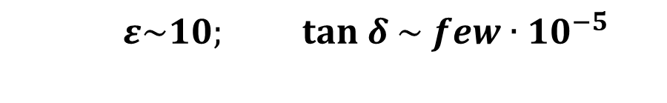
MADMAX Booster: Dielectric plates
Chose dielectric material:
  High dielectric constant $ε$ (for large boost & conversion)
  Low loss → low tan δ (reduce photon losses)
  Stable
  Cheap
  → Sapphire (Al₂O₃) @ 300K, 10 GHz:
$ε\sim 10; tan δ \sim { few∙10}^{−5}$
  → Lanthanide Aluminate (LaAlO₃) @ 77K
$ε\sim 24; tan δ\sim {3∙10}^{−5}$
  → Titanium dioxide – Rutil (TiO₂)
$ε\sim 100; tan δ\sim$0.001(?)

