Slide 1
Searching for axions with
a dielectric haloscope:
MPP Project Review 2021
Dagmar Kreikemeyer
Dec 13th 2021

Slide 2
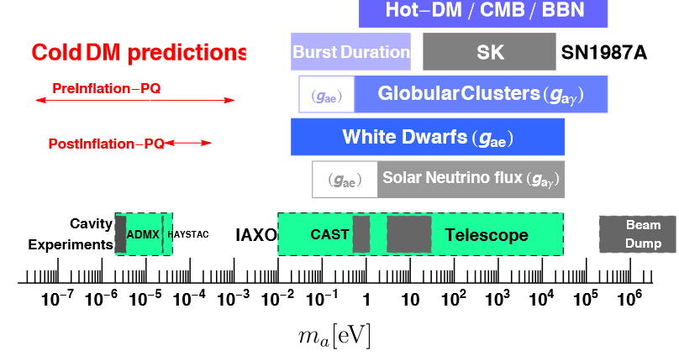
MADMAX
Looking for the Axion
Axion is a hypothetical particle conceived to explain the strong CP problem.
Axions → very low mass, do not emit or absorb light. Excellent candidate for cold dark matter.
Primakoff effect: axions couple to photons in the presence of a strong magnetic field.
The MADMAX experiment → search for axion dark matter in the range from 40 μeV to 400 μeV.

Slide 3
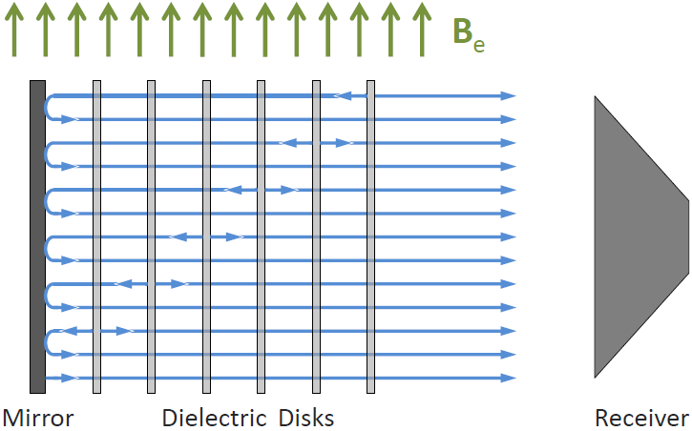
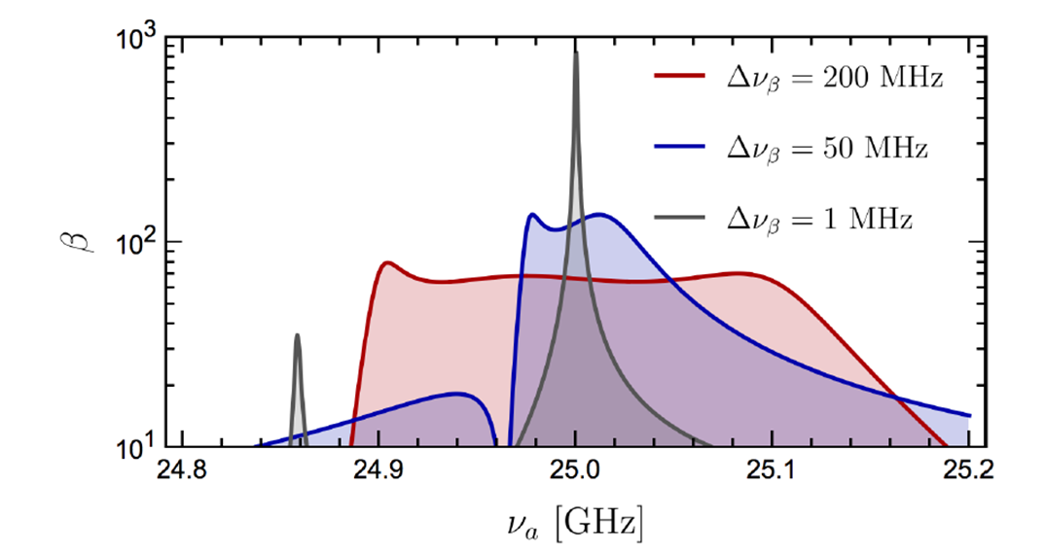
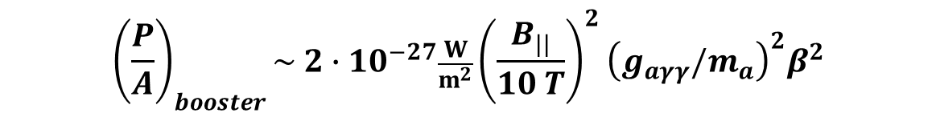
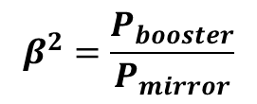
MADMAX: A dielectric haloscope
Boost of axion to photon conversion
Constructive interference of coherent photon emission at dielectric layers
+ resonant enhancement
MADMAX PRL118 (2017) 091801
Output power P of the dielectric haloscope per unit area A is:
The power boost factor
$${\left(\frac{P}{A}\right)}_{booster}\sim 2∙{10}^{−27}\frac{W}{m^{2}}{\left(\frac{B_{||}}{10 T}\right)}^{2}{\left(g_{aγγ}{/m}_{a}\right)}^{2}β^{2}$$
$$β^{2}=\frac{P_{booster}}{P_{mirror}}$$

Slide 4
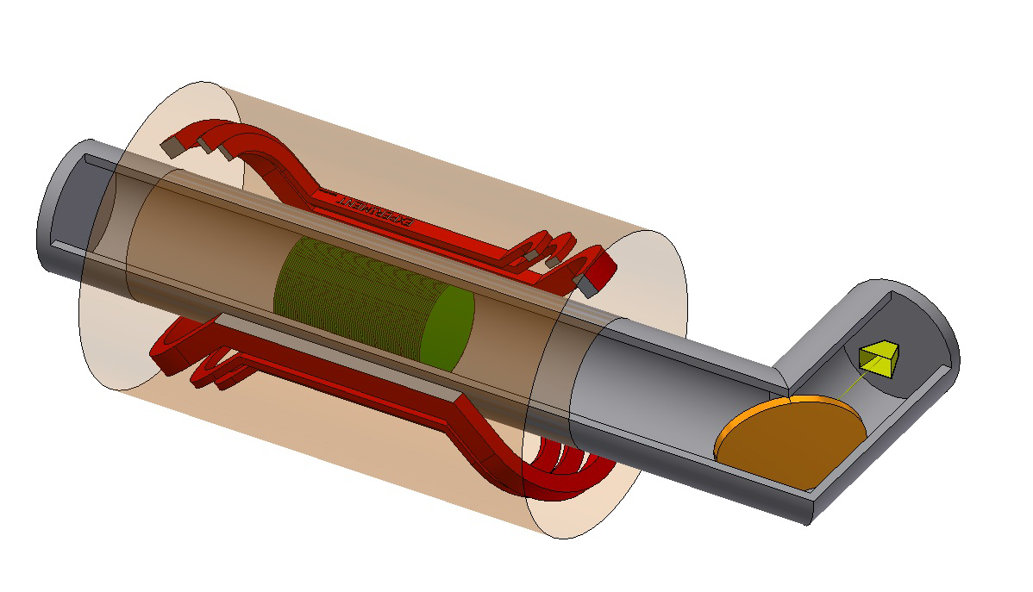
MADMAX: the final setup
9T - 1.35m warm bore
Dipole magnet
4 K Cryostat
Low noise detector
Antenna
Mirror
~80 x 1m²
dielectric disks
Focusing mirror

Slide 5
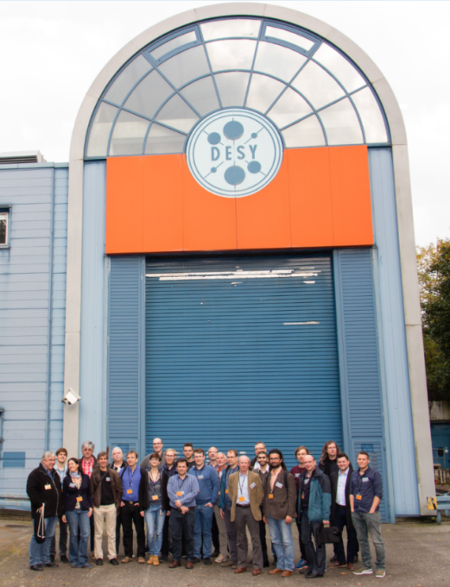
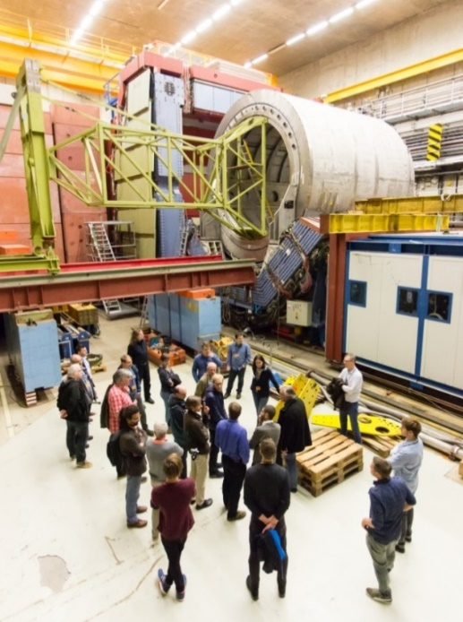
MADMAX collaboration
MAgnetized Disk and Mirror Axion eXperiment
Collaboration formed on 18th Oct. 2017
MPP → lead institute

Slide 6
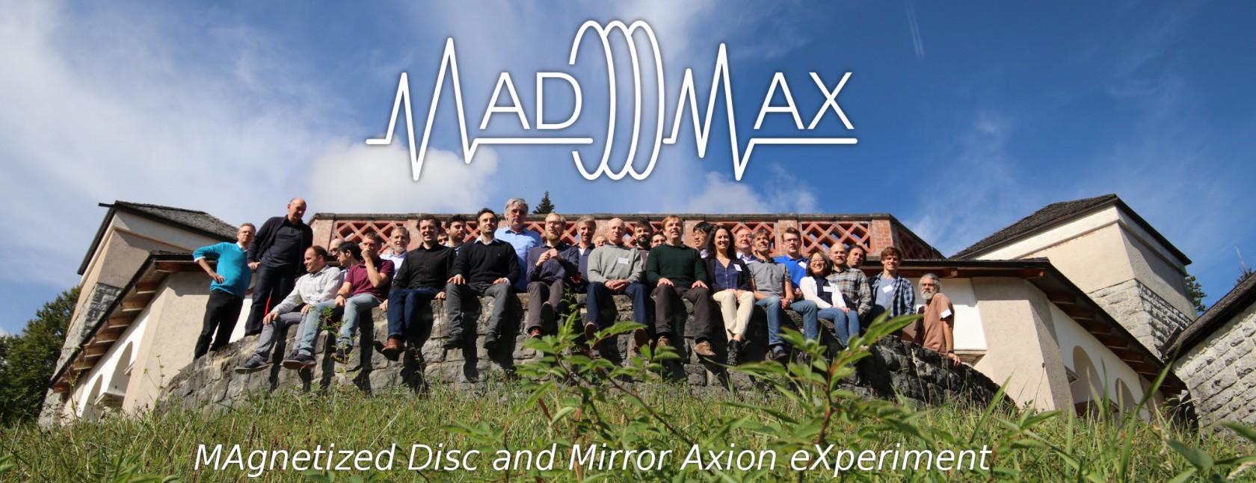
MADMAX Group at MPP
Director | Allen Caldwell
Project leaders | Béla Majorovits (Spokesperson) Olaf Reimann
Scientists | Georg Raffelt Frank Steffen
Engineering | Chris Gooch Armen Hambarzumjan David Kittlinger Alexander Sedlak Derek Strom
PostDocs | Anton Ivanov Dagmar Kreikemeyer Chang Lee
PhD Students | Johannes Diehl Lolian Shtembari
Master Student | Georg Monninger
Interns | Jeonghyun Seo Jiyoon Sun
Former members:
Xiaoyue Li → TRIUMF
Stefan Knirck → FermiLab
Big thanks to:
Electronics workshop
Mechanical workshop
Tasks: RF understanding, booster design, prototype(s) design, qualifying piezo motors, supervising magnet design, data analysis concept

Slide 7
MADMAX magnet

Slide 8
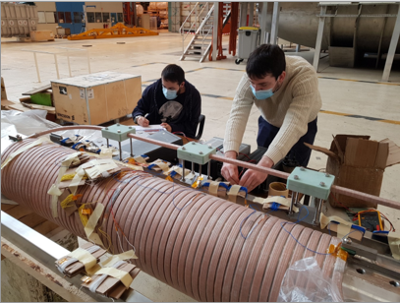
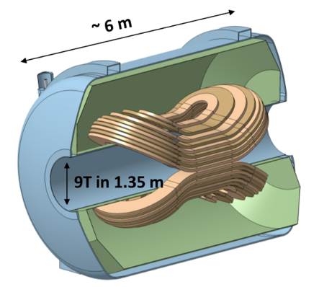
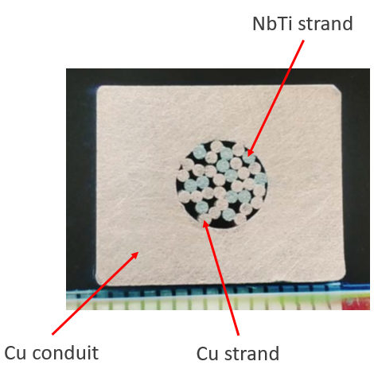

MADMAX Magnet
Magnet Design (work in progress) by CEA-Saclay & Bilfinger-Noell
Dipole Magnet
B > 9 T, Warm bore 1.35 m, I = 23.5 kA, stored energy ~500MJ
FOM : 80-100 T²m²
Status: design and R&D phase
Quench propagation velocity tests with new conductor at CEA-Saclay, France
New conductor:
CICC with Cu profile
16 mm
13 mm
$$φ 6.3 mm$$
Quench propagation speed ~10m/s ; detection < 1s
(within specifications - very successful results!)

Slide 9
MADMAX Magnet
Magnet Design (work in progress) by CEA-Saclay & Bilfinger-Noell
Dipole Magnet
B > 9 T, Warm bore 1.35 m, I = 23.5 kA, , stored energy ~500MJ
FOM : 80-100 T²m²
Status: design and R&D phase
New conductor:
CICC with Cu profile
16 mm
Next in 2022:
Further conductor R&D
Continue analysis of the quench tests data
Design of the smallest coil
→ Magnet Prototype
13 mm
$$φ 6.3 mm$$

Slide 10
Piezoelectric motors

Slide 11
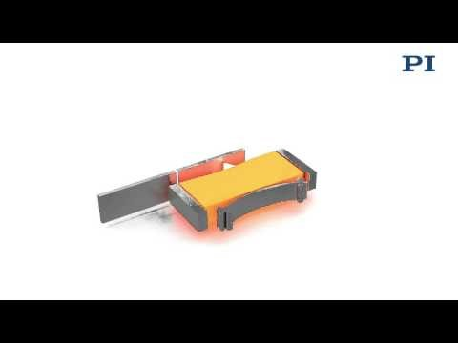
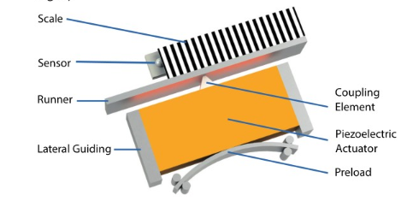
Piezo Drive Actuator
Piezo motors → move and position dielectric disks
Very precise (positioning accuracy +10 μm)
Self-locking
Vacuum compatible
Compact
Working principle:
Taken from Physik Instrumente GmbH & Co. KG

Slide 12
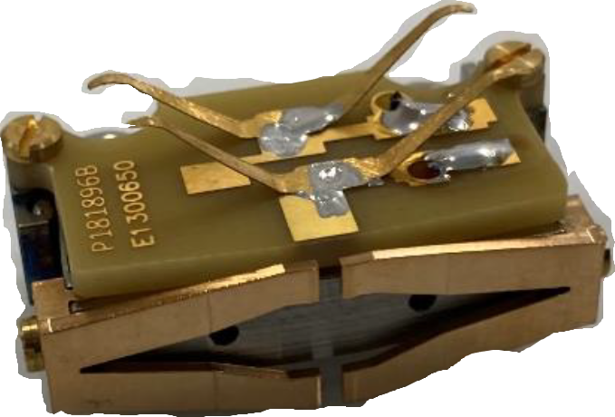
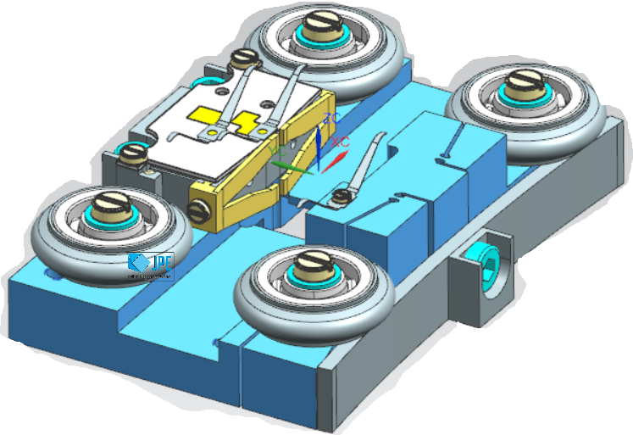
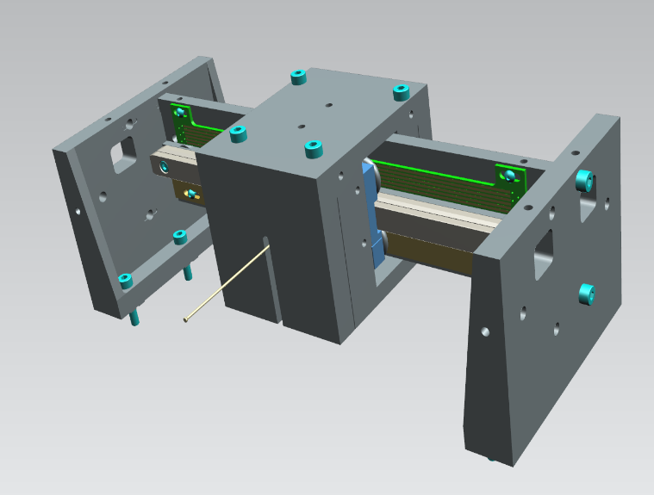
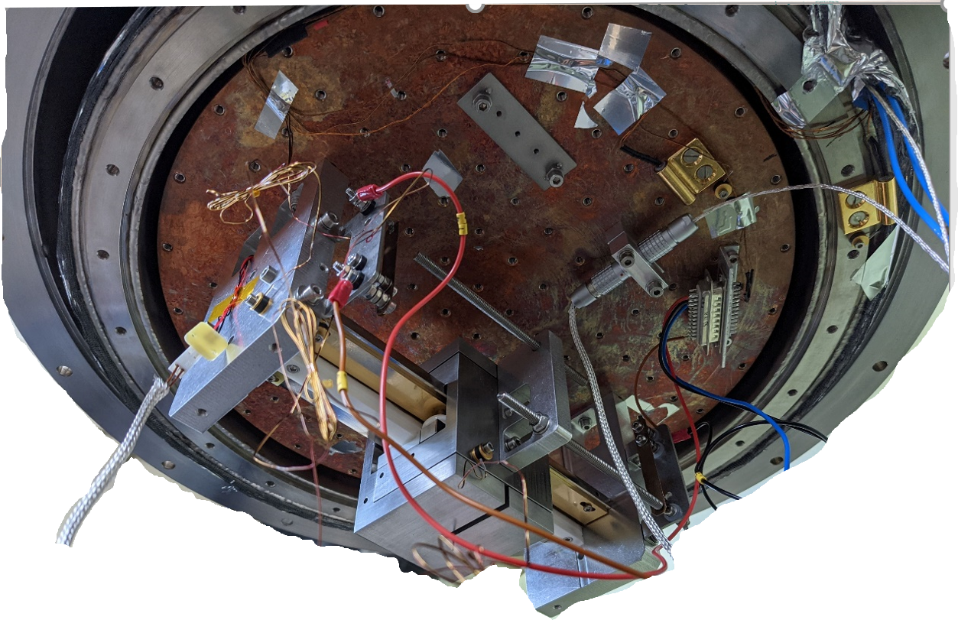
First Piezo Drive Unit
Challenges:
Operation at cryogenic temperatures and in B-field
Reliable design (240 motors to move 80 disks)
Friction wear, lifetime
Verifiy feasibility at 4.2 K and in a B-field
4
1 – motor carriage
2 – weight
3 – ceramic rail
4 – PCB
5 – cooling strip
6 – side plates
6
2
6
3
1
5
Supplied by : https://www.jpe-innovations.com/

Slide 13
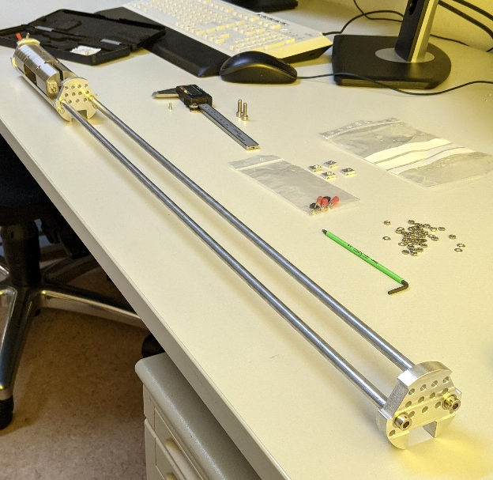
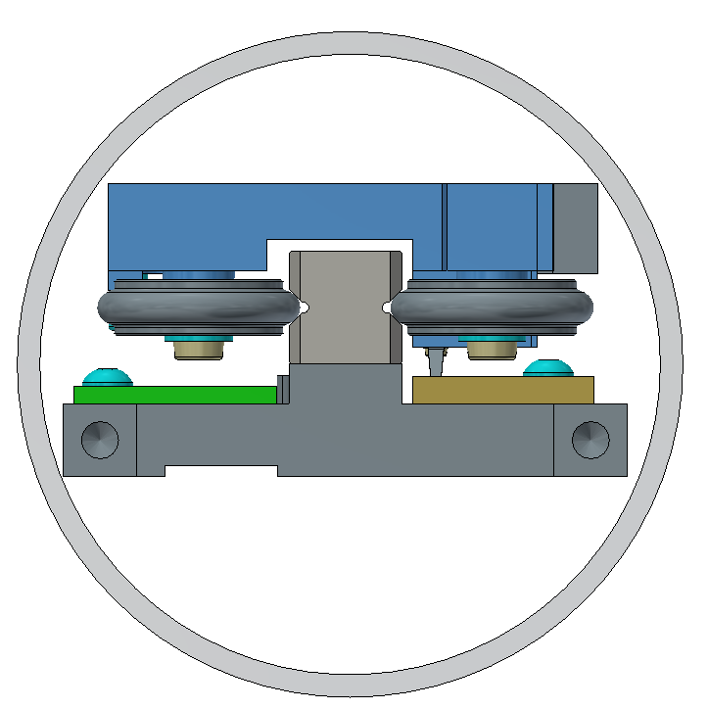
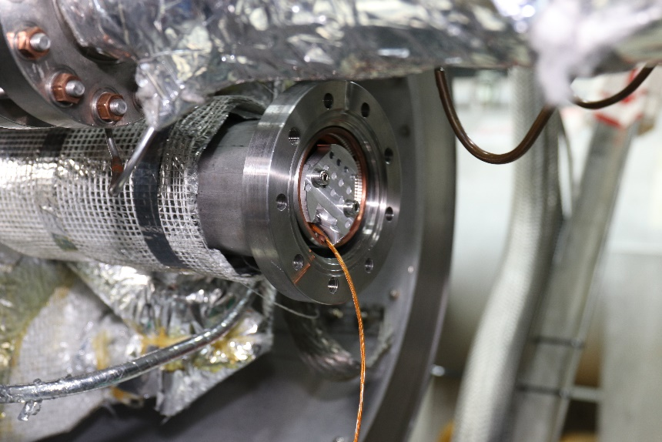
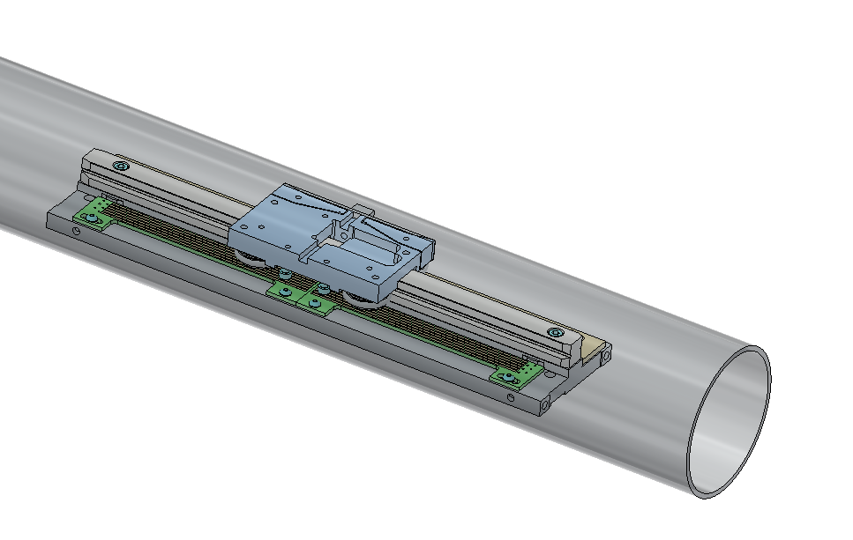
Piezo motors at 4.2 K in a B-field
ALPS Magnet DESY
55 mm diameter bore
5.6 T; 4.2 K
Tests pending →
Winter/Spring 2022
Design done by D. Kittlinger

Slide 14
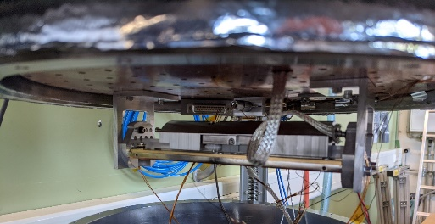
Piezo motors at 4.2 K
First tests → no laser interferometer
Using end switches → measure time → motor speed
Speed within specifications (specs:v > 0.1 mm/s).
Temperature of the motor after 80 minutes of operation is stable at ~9 K (with help of a copper braid).

Slide 15
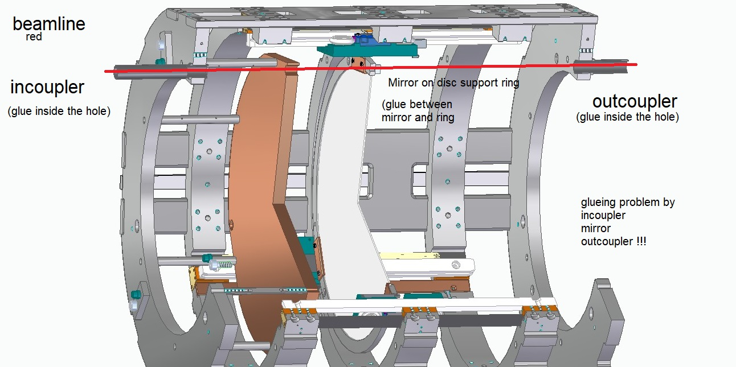
Mechanics Prototype: Project 200
  Goals: verifiy feasibility of 3 piezo motors moving one disk along a 200 mm rail at cryogenic temperatures in a vacuum volume. Study the temperature distribution along the hardware. First tests with absolute position interferometer.
3
4
5
6
1
1- Cu mirror (fix position)
2- Sapphire disk (adjustable position)
3- P200 backbone structure
4- (3x)piezo motors
5- interferometer incoupler
6- interferometer outcoupler
300 mm
2
530 mm
Weight < 20 kg

Slide 16
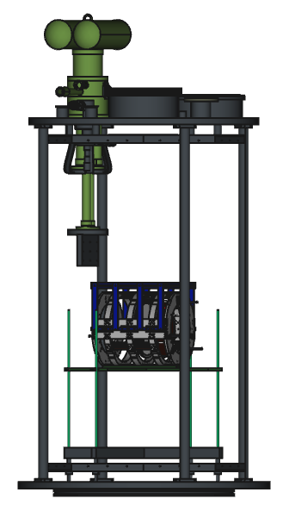
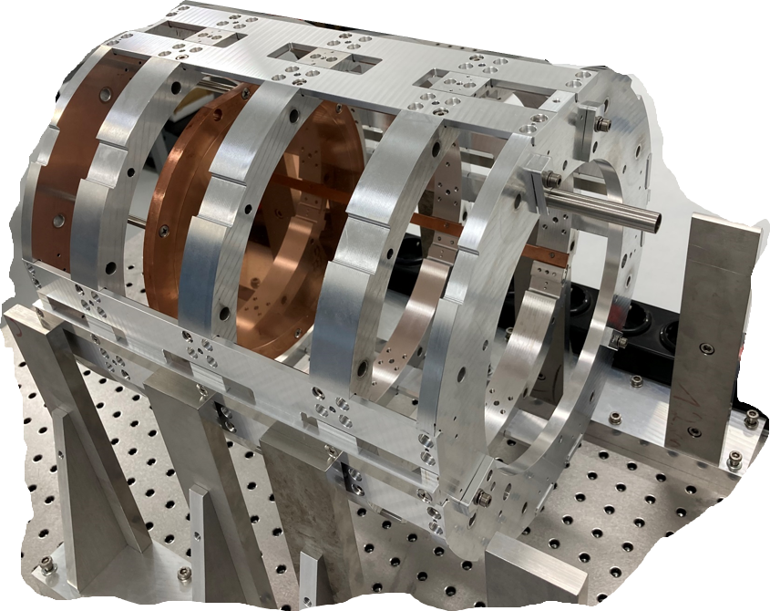
Project 200 in LHE at CERN
Status:
P200 assembled at UHH
First measurements using laser interferometer
Tests in RT → Dec‘21/Jan’22
Tests in CERN Cryostat:
  1st run → Feb, March 2022
  2nd run → Fall 2022
Tests at room temperature
(in Hamburg)
Parameters to be checked:
Stepsize
Positioning accuracy (spec: +/- 10 μm)
Tilt of the disk
Reproducibility
Drift (after 1s, 10 s, 10 min,…)
Different functionalities, e.g., step-and-settle
Tests at 4.2 K (CERN)
Parameters to be checked:
Repeat RT measurements
Temperature investigation

Slide 17
Booster/RF Group

Slide 18
Booster-Development
Goals of the booster development
  Understanding physics of the booster
    Axion-photon conversion
    Signal propagation (moding, mode crossings, losses, …)
    (Thermal) background
  Improve sensitivity
    Background reduction
    Loss reduction
    Receiver coupling
  Understanding mechanical/electrical issues
    Uncertainty in geometry (tilts, mispositioning, …)
    Uncertainty of dielectric constant, tan δ, …
    Optimal positioning
    …

Slide 19
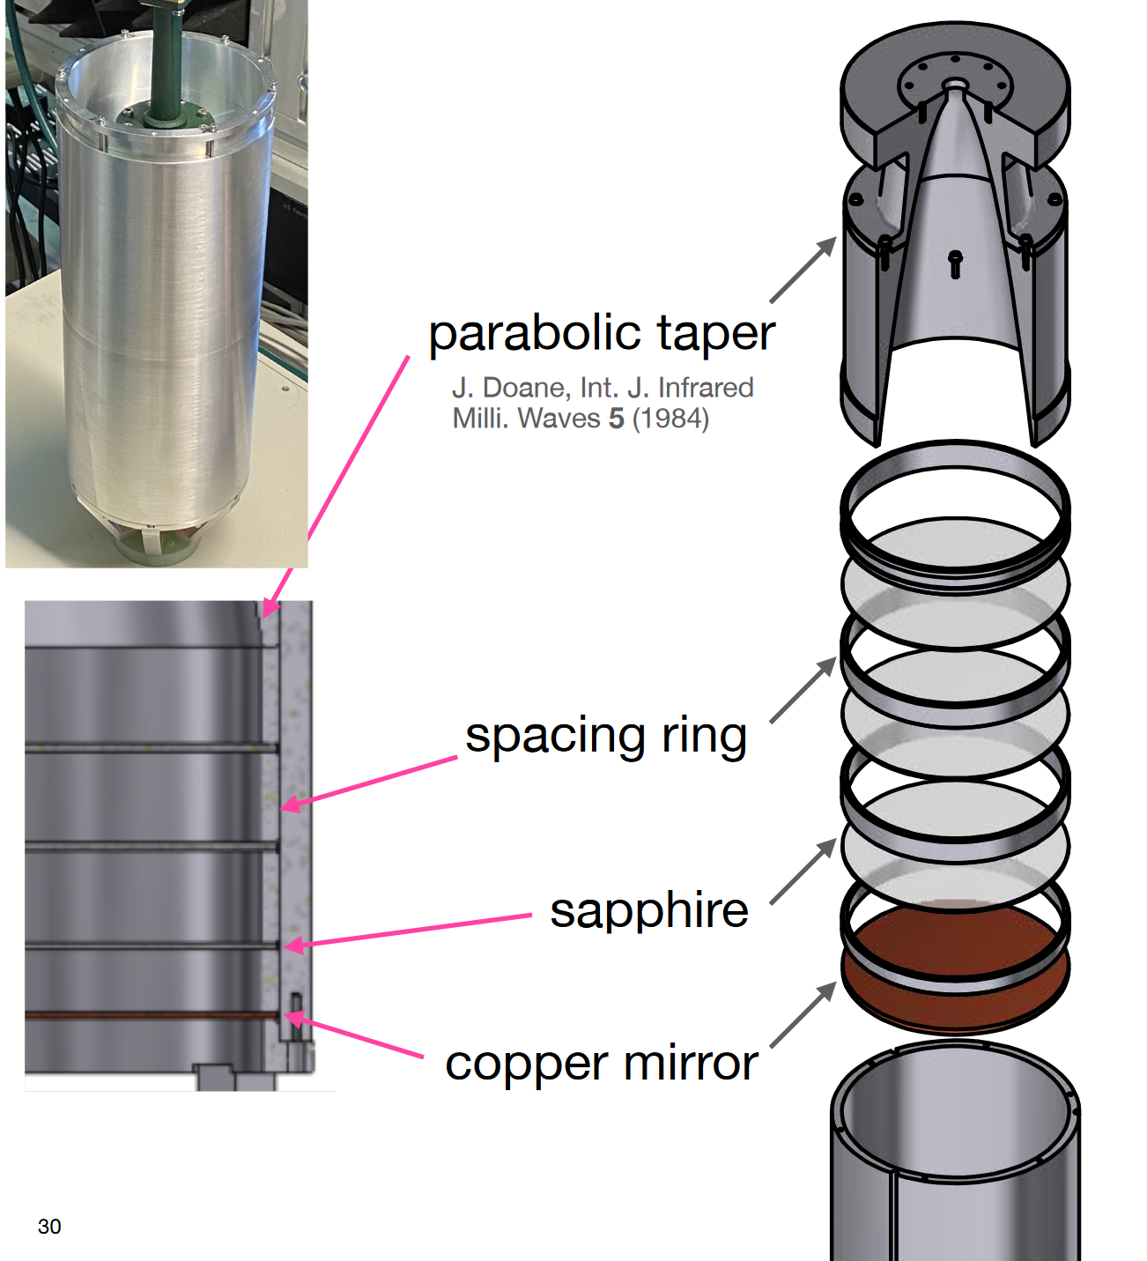
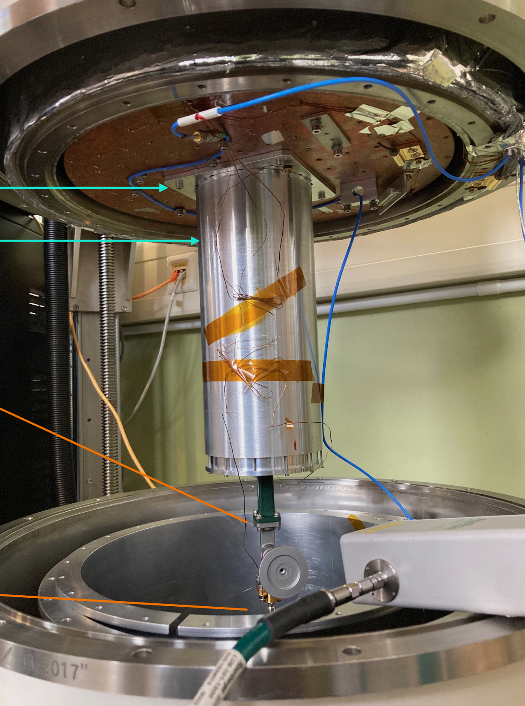
100mm Closed Booster (CB100)
Design and development of a closed booster
  Properties
    100mm inner diameter
    3 sapphire disks in resonant configuration (Boost β²~2000)
    Receiver coupling via taper
    Designed for 4K operation and 0.5T magnetic field
  Goals
    Reduction of radiation losses to understand other loss mechanisms (mirror loss, wave propagation, mode losses, …)
    Learning about stability, reproducibility, …
    Prove the idea of possible coherent background suppression and boost peak detection using thermal background
    (Maybe ALPS measurement at 4K and 0.5T) at MPP

Slide 20
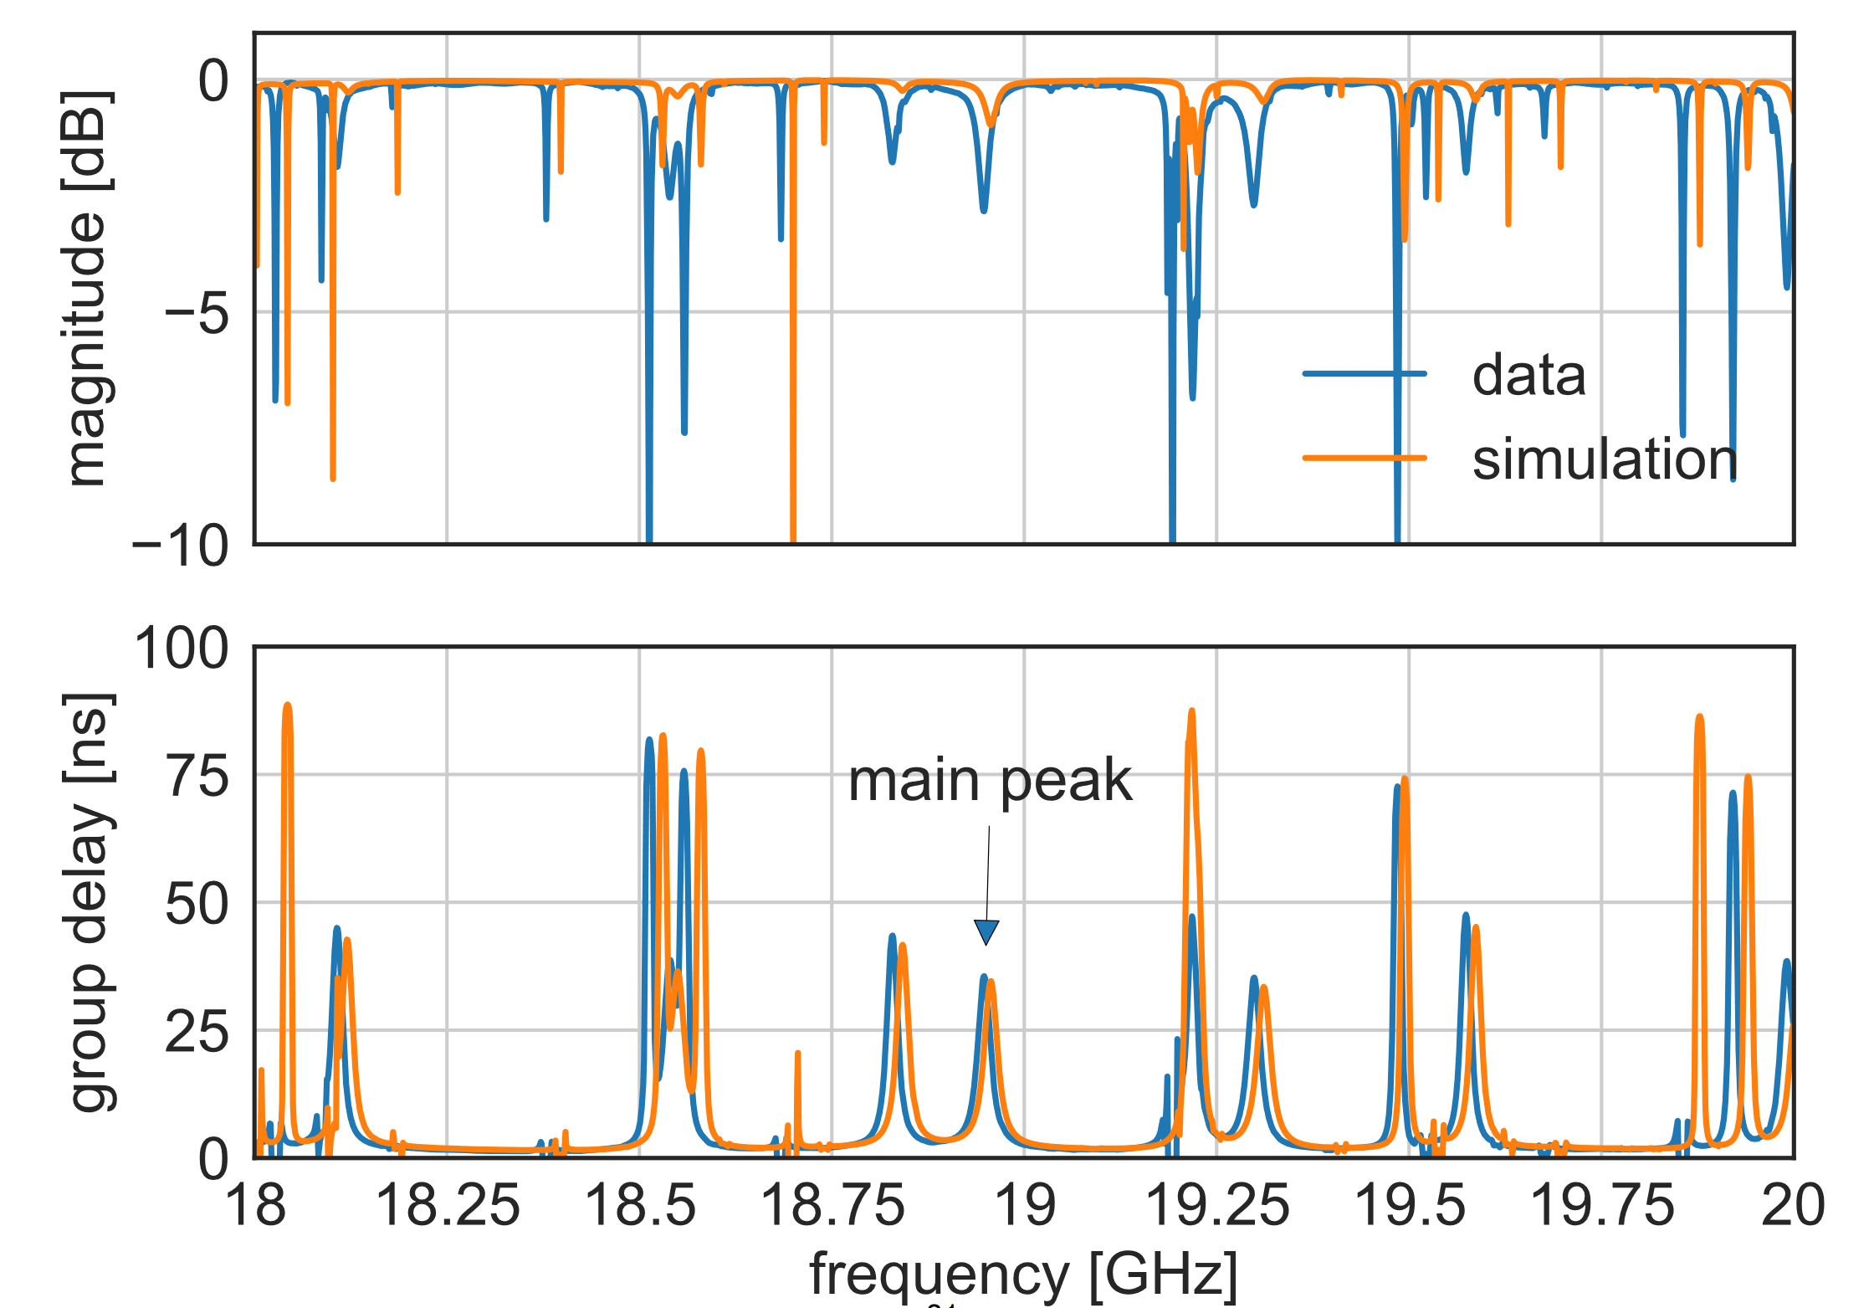
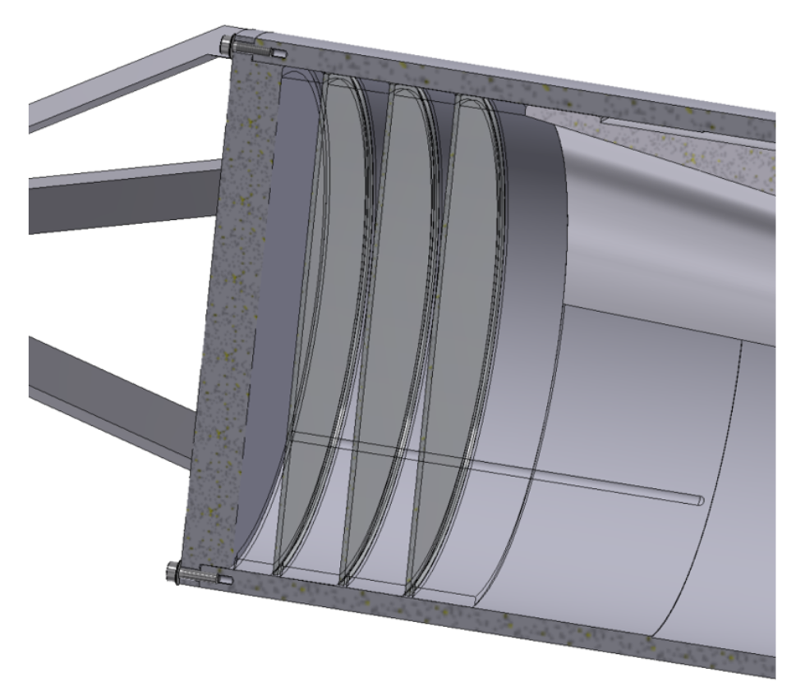
100mm Closed Booster (CB100)
Results from room temperature measurement:
  Agreement between simulation and reality is OK
  (considering the mechanical uncertainties)
  Boost peak loss is slightly higher because of remaining transverse radiation (current) at sapphire disks rim

Slide 21
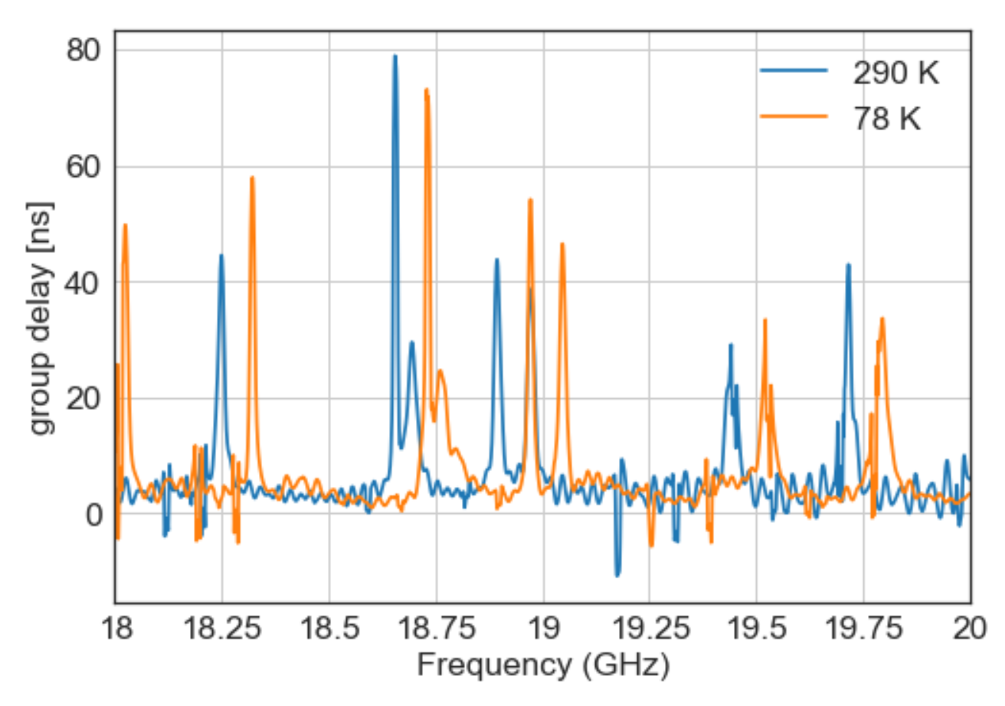
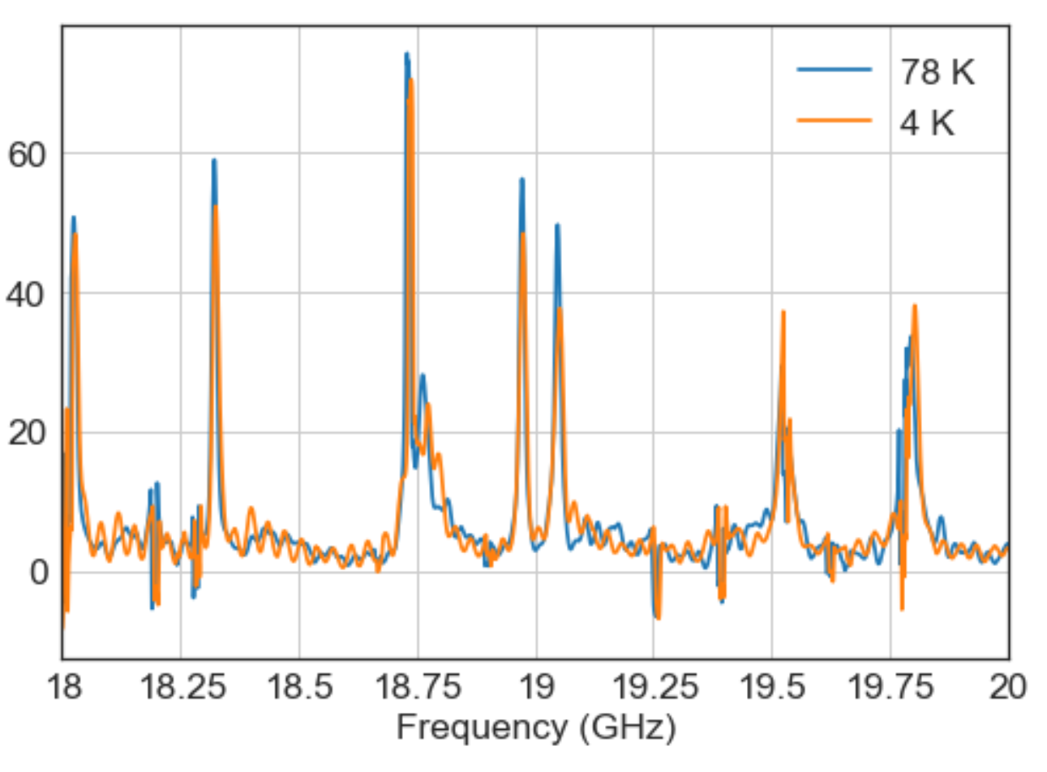
100mm Closed Booster (CB100)
Results from cryo measurement:
  Boost peak and mode crossings shift as expected
  Stable at 4K (even after LHe refill)
  System stable enough for long term measurement (ALPS search?)
Group delay:
From RT (290K) to LNT (78K)
Group delay:
From LNT (78K) to LHeT (4K)
Boost peak

Slide 22
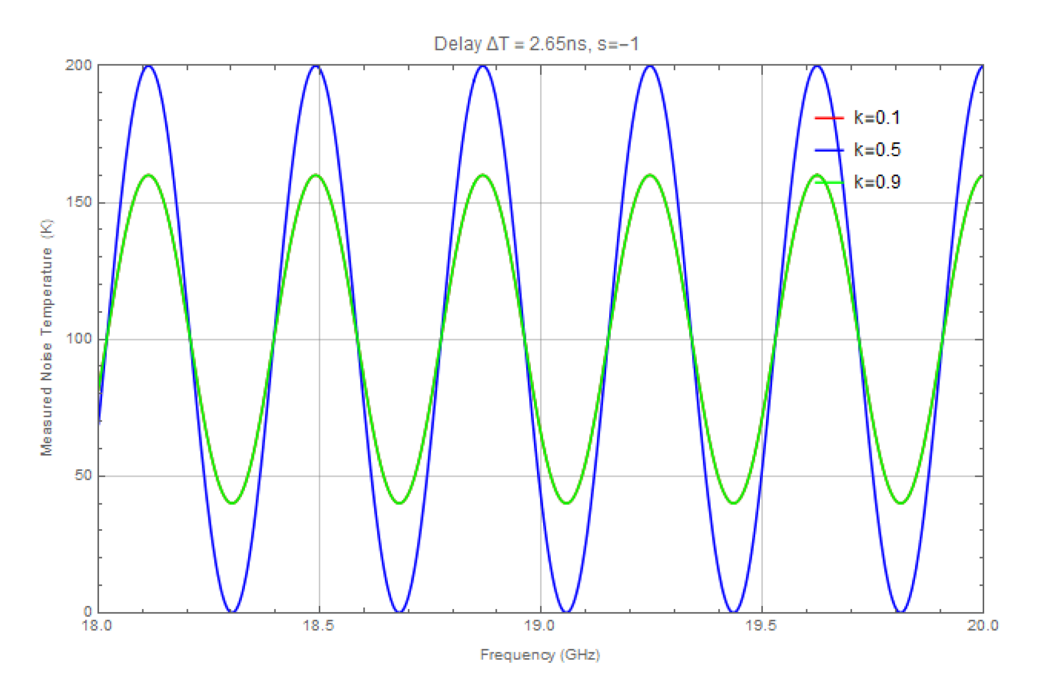
100mm Closed Booster (CB100)
Coherent suppression of thermal noise:
  Band limited black body radiation tends to be coherent
  Black body power spectral density for a detector in front of a metal mirror
  → constructive or destructive interference as function of frequency

Slide 23
100mm Closed Booster (CB100)
Coherent suppression of thermal noise:
  Situation in booster a little bit more complicated
  but can be predicted
    Change in noise temperature at boost peak
    Can be adjusted for minimum noise
Measurement with receiver:
  Reduction is possible
  Consistent with reflection (S₁₁)
  Improved sensitivity
  (~ factor 2)
  Can be used for noise reduction
  in MadMax

Slide 24
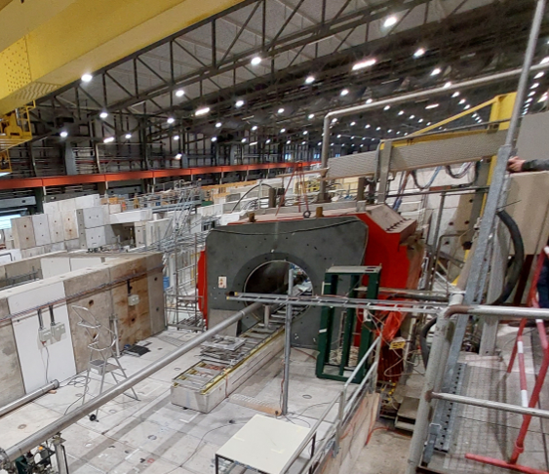
RF measurements at CERN
First measurements at
MORPURGO Magnet – CERN
B = 1.6 T
2022
EMC Test
(Electromagnetic compatibility)
2023
CB200 → (maybe) 1st physics run
P200 → mechanics tests in a B-field

Slide 25
MADMAX
MAgnetized Disk and Mirror Axion eXperiment
Conclusions:
Magnet
  New conductor succesfully tested
  Quench velocity propagation within specs
Piezoelectric motors
  Motors tested at 4.2 K.
  Motor speed at 4.2 K > 100 μm/s (within specs)
  Tests in B-Field and P200 planned in Q1 2022
Booster
  Simulation and data agree
  Tests at 4.2 K stable
  Method to reduce thermal noise demonstrated
MORPURGO Magnet (CERN)
  First RF measurements already in 2022.
Thank you for your attention!

