Slide 1
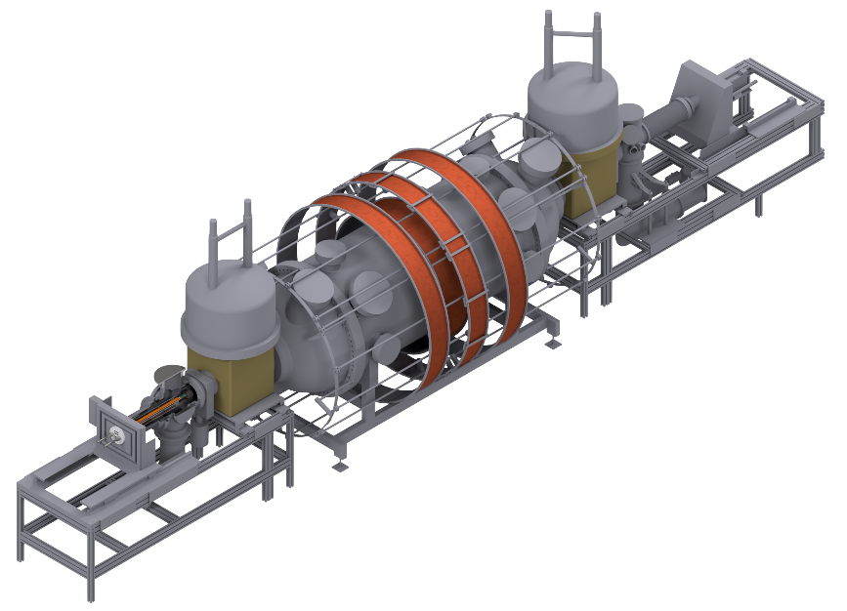

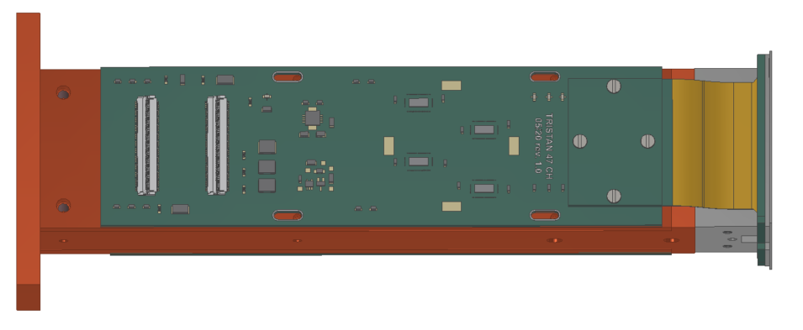
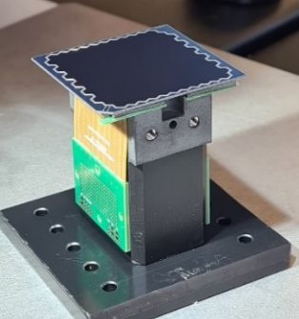




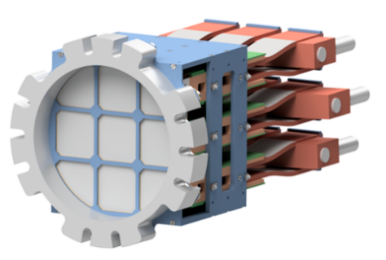
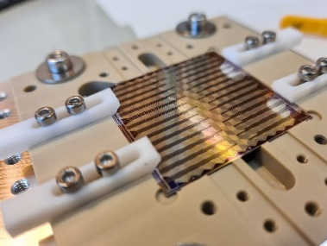
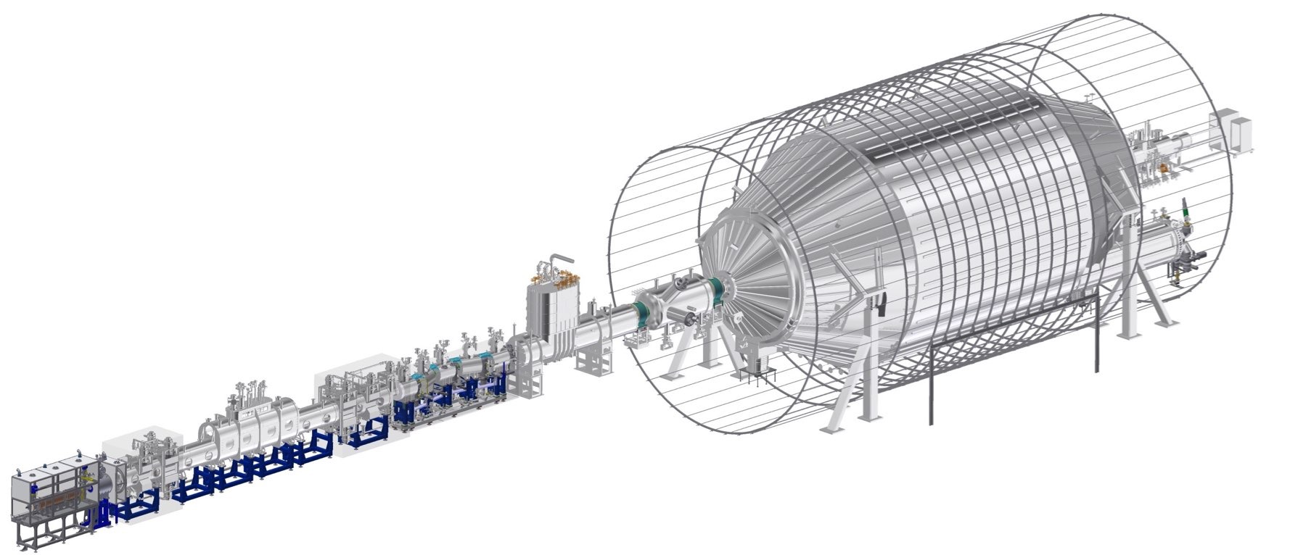
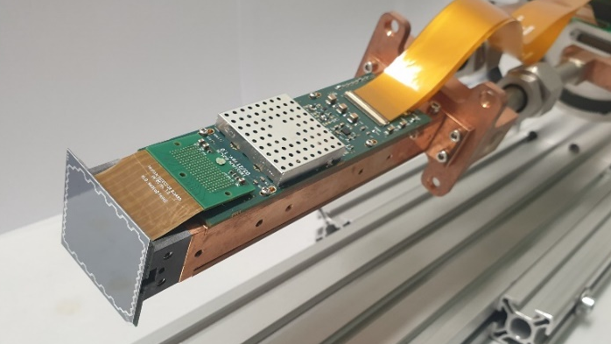
Development of a Silicon Drift Detector Array to Search for keV-scale Sterile Neutrinos with the KATRIN Experiment
Detector not to scale!

Slide 2
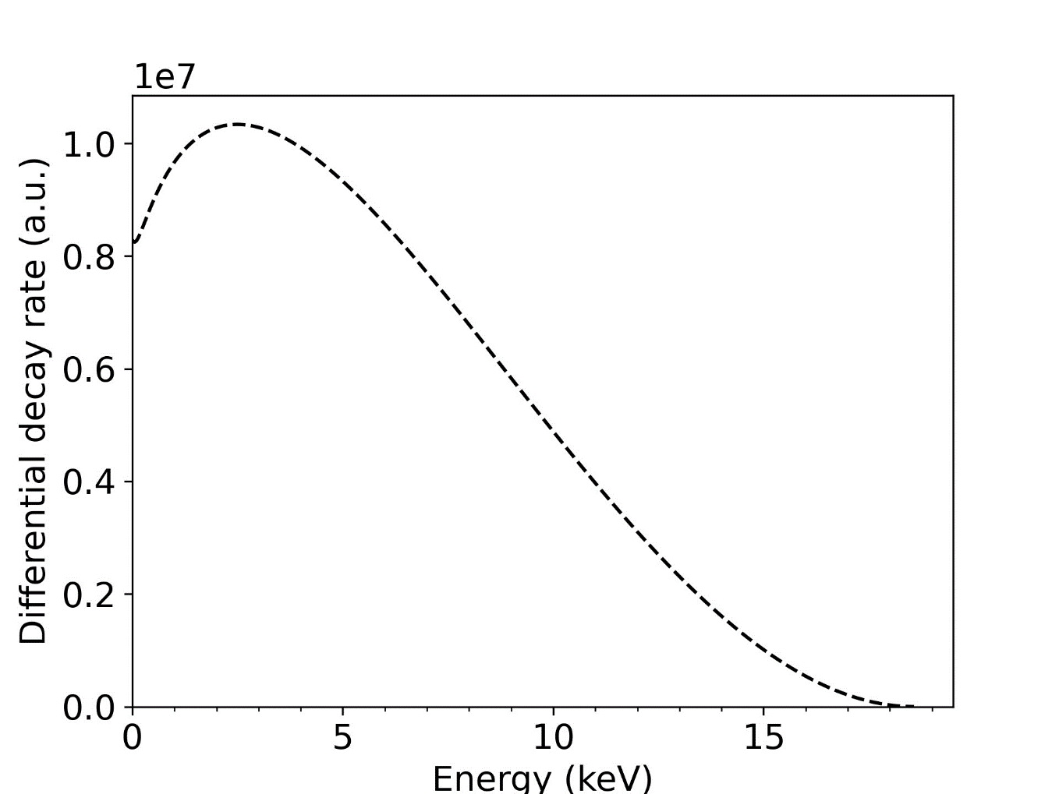
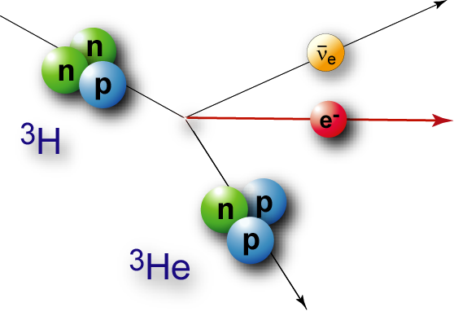
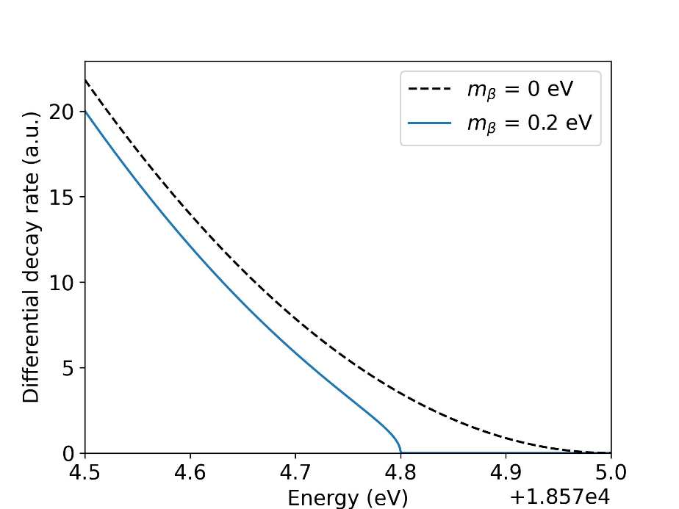


Tritium and Neutrinos
$β$-decay of tritium
Maximal electron energy
reduced by neutrino mass
$$m_{β}$$

Slide 3


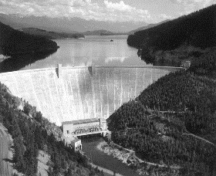
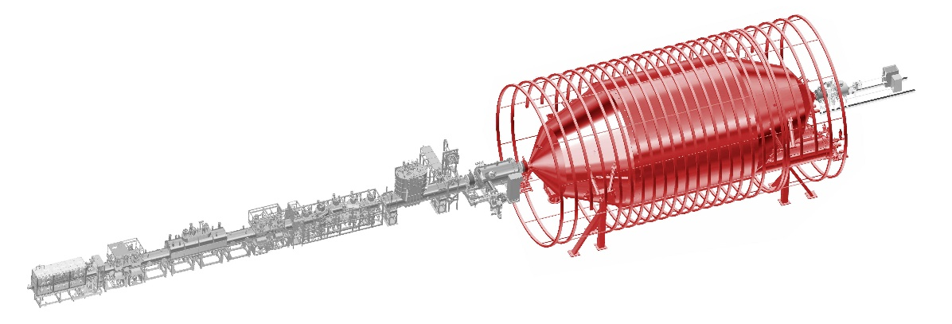

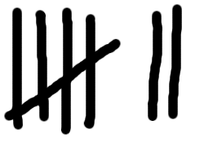


Neutrino Mass Measurement
Integral measurement (MAC-E)
@ endpoint
Effective neutrino mass
$m_{β}^{2}=\sum_{i=1}^{3}{{\left|U_{ei}\right|}^{2}}m_{ν_{i}}^{2}$
$m_{β}<0.8$ eV (90% CL)
retarding
potential
1 e/s
e⁻
MAC-E spectrometer
$${10}^{11} Bq$$
KATRIN Collab. Nat. Phys. 18, 160–166 (2022)

Slide 4
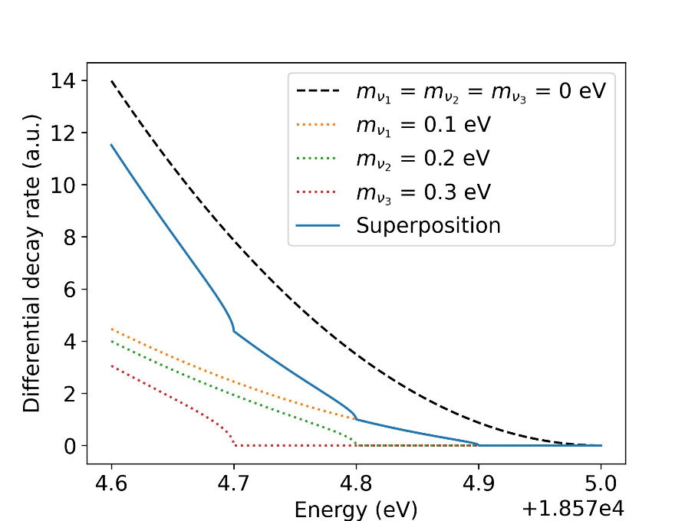





Neutrino Mass Measurement
Integral measurement (MAC-E)
@ endpoint
Effective neutrino mass
$m_{β}^{2}=\sum_{i=1}^{3}{{\left|U_{ei}\right|}^{2}}m_{ν_{i}}^{2}$
$m_{β}<0.8$ eV (90% CL)
retarding
potential
1 e/s
e⁻
MAC-E spectrometer
$${10}^{11} Bq$$
$$ν_{1}(m_{1})$$
$$ν_{e}$$
$$ν_{3}(m_{3})$$
$$ν_{2}(m_{2})$$
KATRIN Collab. Nat. Phys. 18, 160–166 (2022)

Slide 5
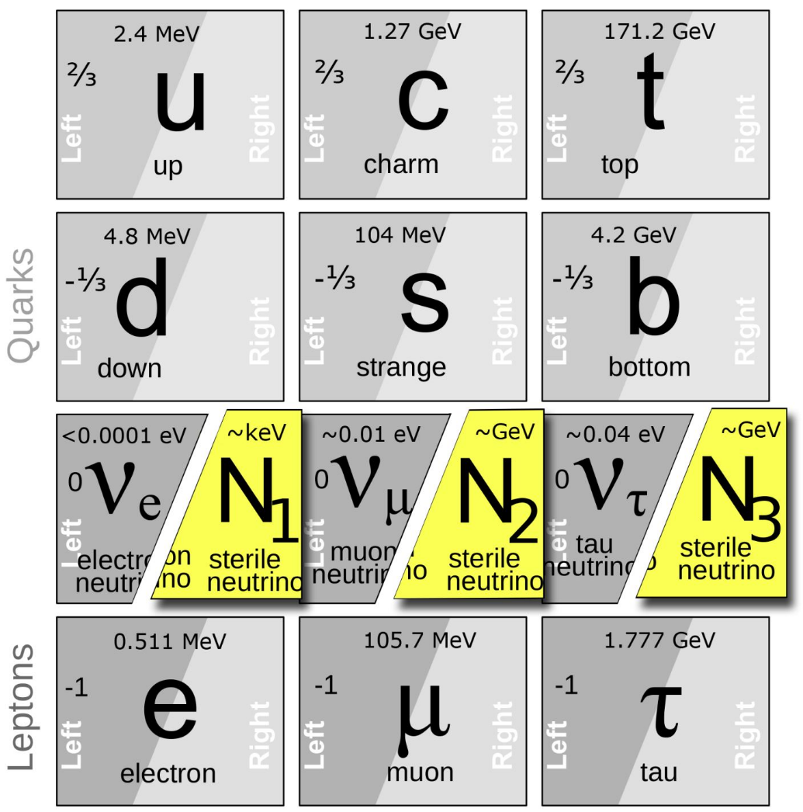
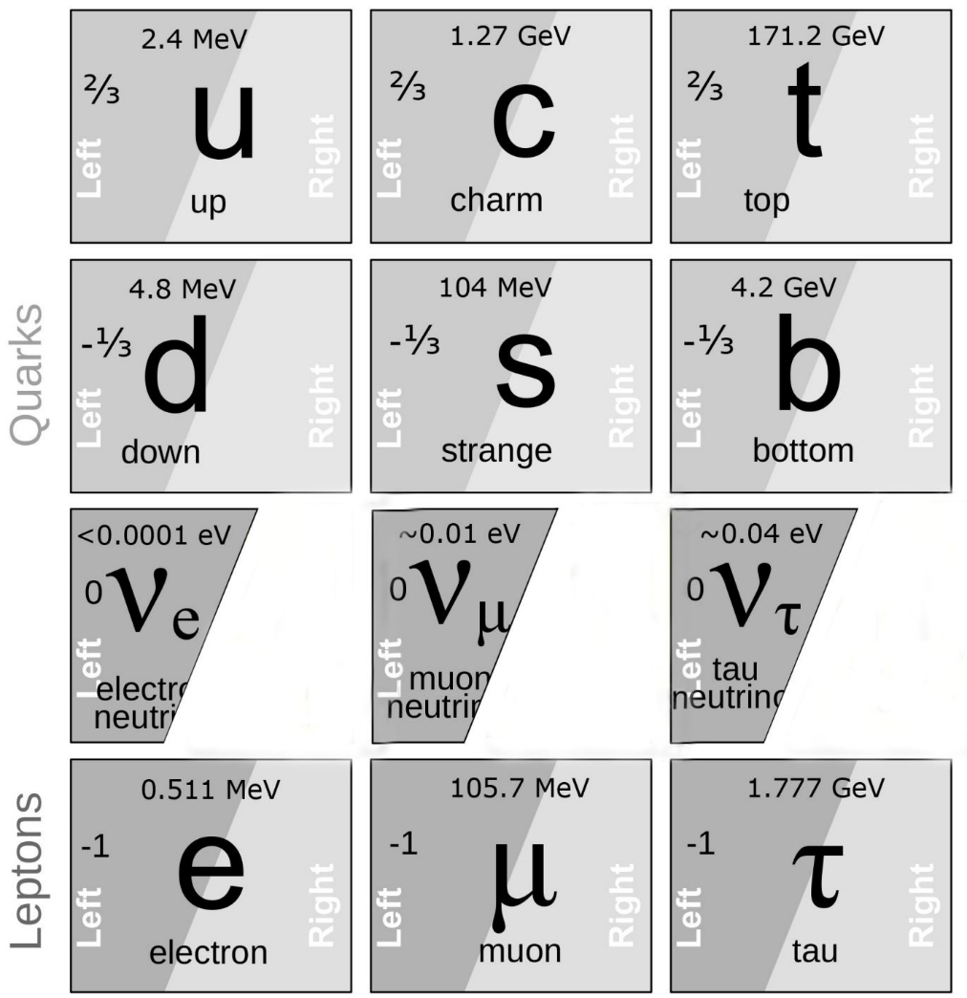









What are sterile Neutrinos?
Neutrinos are only left-handed
Right-handed neutrinos are a minimal extension to SM
No weak interaction -> sterile
Additional mass eigenstates
$$ν_{1}(m_{1})$$
$$ν_{3}(m_{3})$$
$$ν_{1}(m_{1})$$
$$ν_{2}(m_{2})$$
$$ν_{3}(m_{3})$$
$$ν_{e}$$
$$ν_{4}(m_{4})$$
$$ν_{s}$$
$$ν_{2}(m_{2})$$
$$ν_{4}(m_{4})$$
    keV sterile -> dark matter candidate

Slide 6
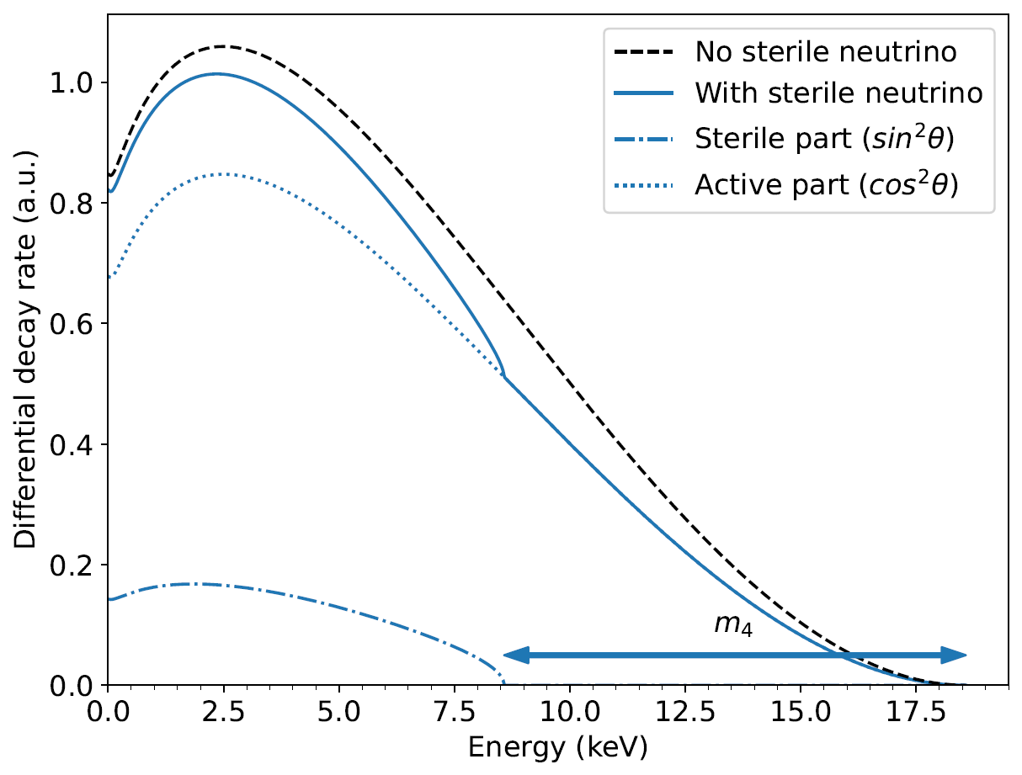

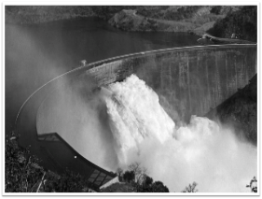
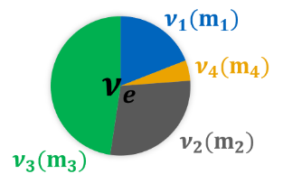



Beta Decay also Sensitive to keV Sterile Neutrinos
$$\frac{dΓ}{dE}= \cos^{2}{\text{θ}}\frac{dΓ}{dE}\left(m_{β}\right)+ sin²{\text{θ}}\frac{dΓ}{dE}\left(m_{4}\right)$$
Tiny kink-like imprint in $β$-decay
High rates required
Installation planned after $ν$-mass campaign completed end of 2025
10⁸ e/s
Kink-like signature
Detector not to scale!
TRISTAN Project = high precision electron spectroscopy detector upgrade for the KATRIN experiment

Slide 7
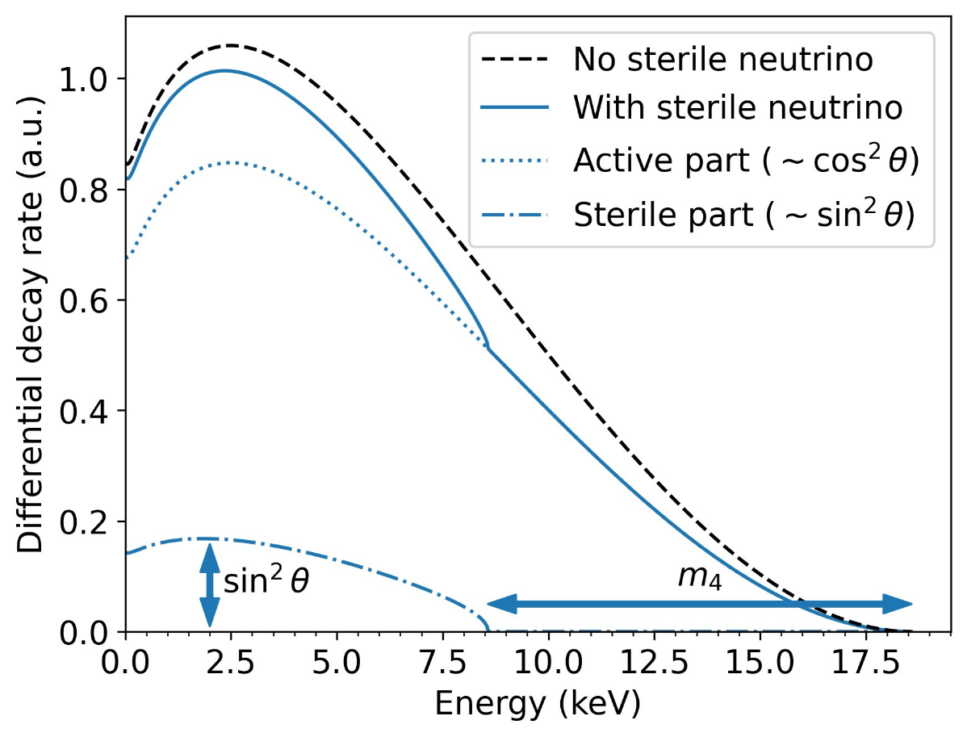


Beta Decay also Sensitive to keV Sterile Neutrinos
$$\frac{dΓ}{dE}= \cos^{2}{\text{θ}}\frac{dΓ}{dE}\left(m_{β}\right)+ sin²{\text{θ}}\frac{dΓ}{dE}\left(m_{4}\right)$$
Spectral distortion in $β$-decay
10⁸ e/s
Kink-like signature

Slide 8
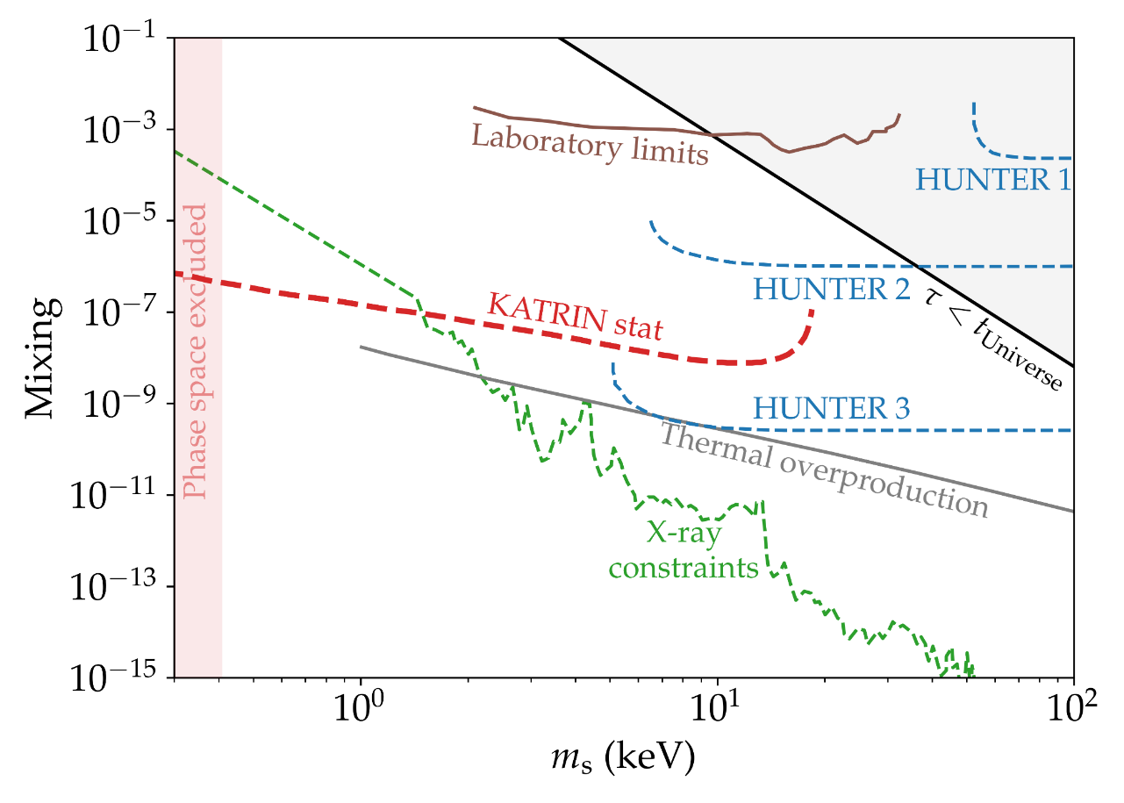


Beta Decay also Sensitive to keV Sterile Neutrinos
$$\frac{dΓ}{dE}= \cos^{2}{\text{θ}}\frac{dΓ}{dE}\left(m_{β}\right)+ sin²{\text{θ}}\frac{dΓ}{dE}\left(m_{4}\right)$$
Spectral distortion in $β$-decay
High rates required
$$(sin²{\text{θ}})$$

Slide 9

Beta Decay also Sensitive to keV Sterile Neutrinos
$$\frac{dΓ}{dE}= \cos^{2}{\text{θ}}\frac{dΓ}{dE}\left(m_{β}\right)+ sin²{\text{θ}}\frac{dΓ}{dE}\left(m_{4}\right)$$
Spectral distortion in $β$-decay
High rates required
Installation planned after $ν$-mass campaign completed end of 2025
10⁸ e/s
Kink-like signature
Detector not to scale!
TRISTAN SDD = high precision electron spectroscopy detector upgrade for the KATRIN experiment

Slide 10
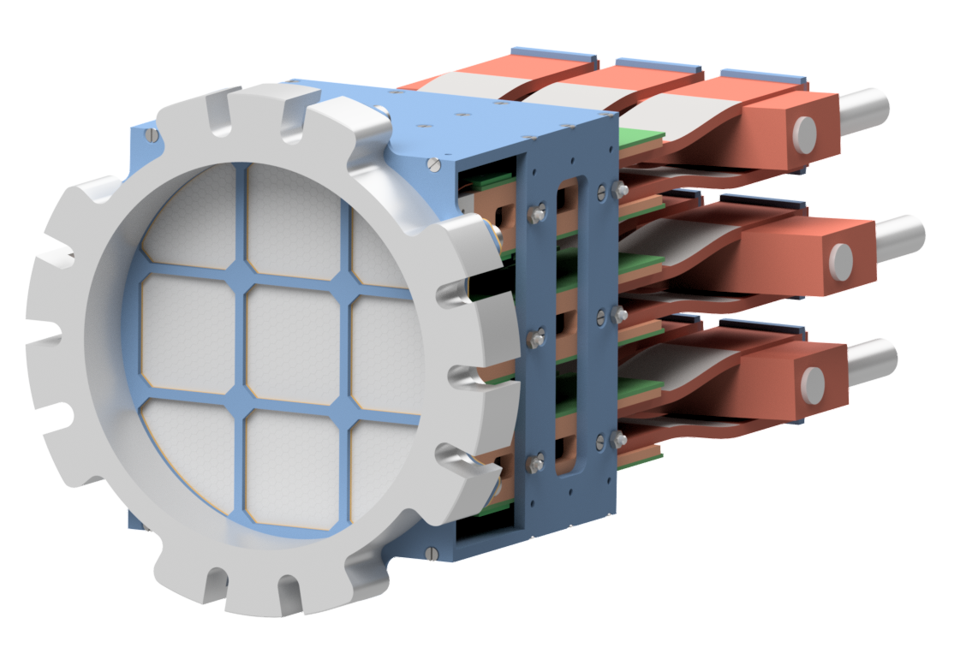


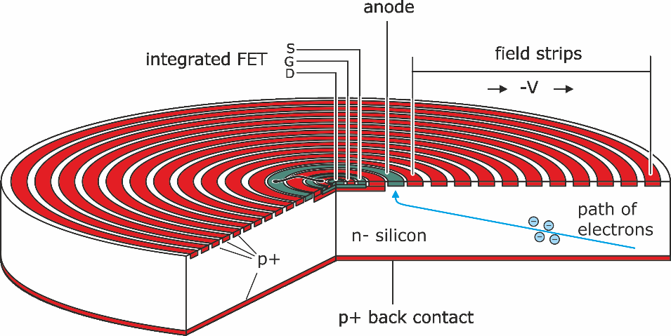

Challenges for TRISTAN Detector System
High rates $𝒪({10}^{8} \text{e}\text{/}\text{s}$)
  1000 pixels (100 kcps per pixel)
  Flux-tube Ø 20 cm -> Ø 3mm pixel
Differential measurement
  Energy resolution < 300 eV (@20 keV)
Low energy threshold < 2 keV
  Thin entrance window (< 100 nm)
    Silicon Drift Detector (SDD)

Slide 11
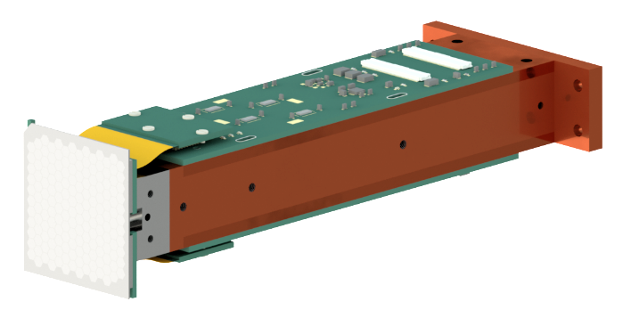


Challenges for TRISTAN Detector System
High rates $𝒪({10}^{8} \text{e}\text{/}\text{s}$)
  1000 pixels (100 kcps per pixel)
  Flux-tube Ø 20 cm -> Ø 3mm pixel
Differential measurement
  Energy resolution < 300 eV (@20 keV)
Low energy threshold < 2 keV
  Thin entrance window (< 100 nm)
    Silicon Drift Detector (SDD)
    9 modules with each 166 pixels
40 mm

Slide 12
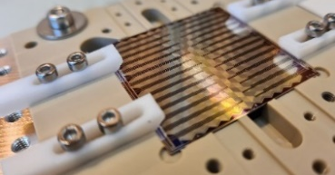
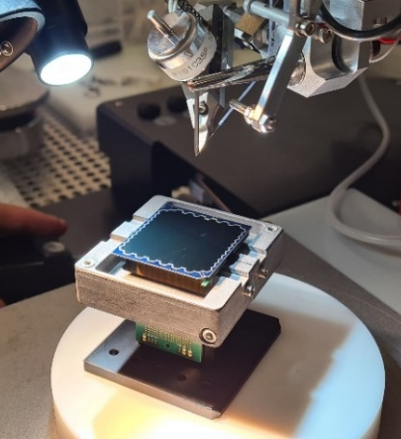
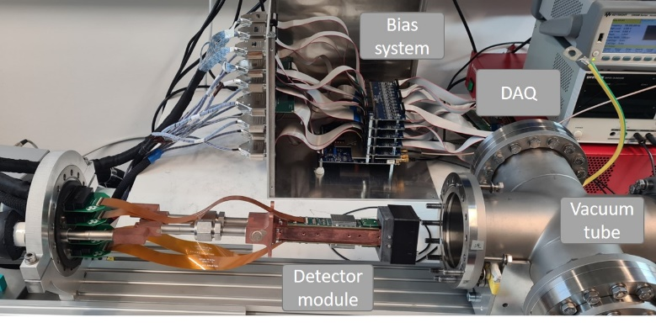


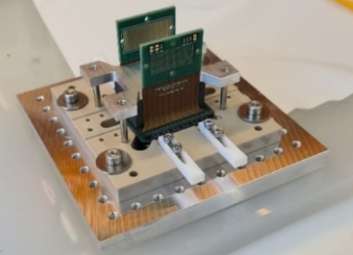

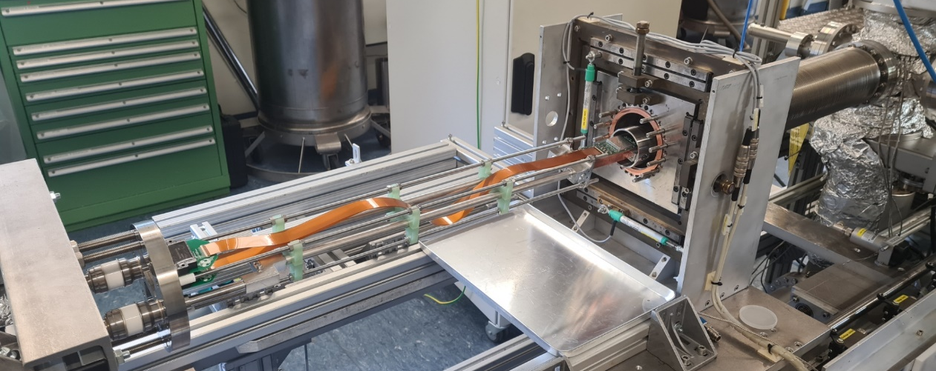
Development of the first TRISTAN Detector Module
Assembly Procedure
Commissioning Tests
Realistic Environment
Characterization with X-Rays in ‘perfect lab’ conditions
Testing the module in ‘Mini-KATRIN’ (MoS) with electrons
How to assemble the detector module?

Slide 13
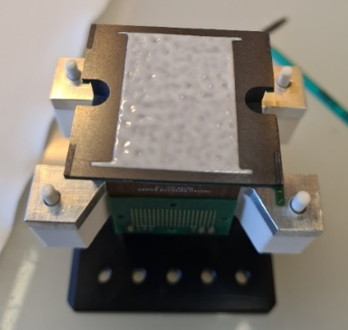

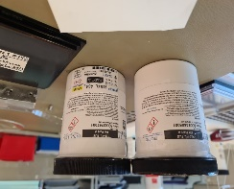
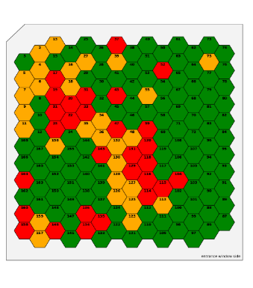
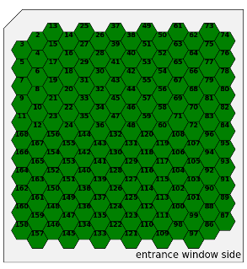

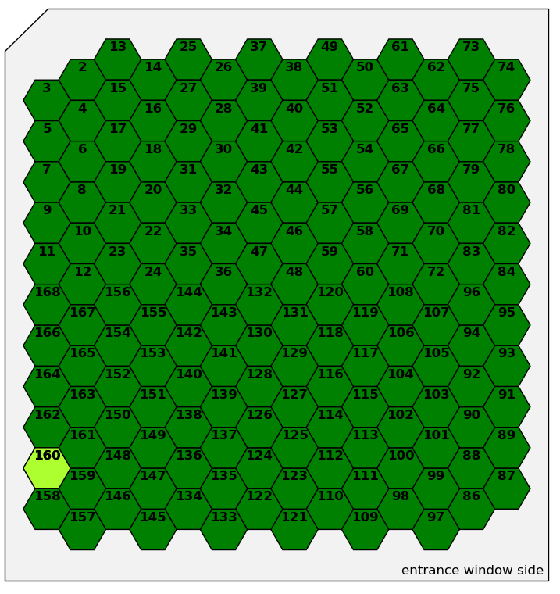
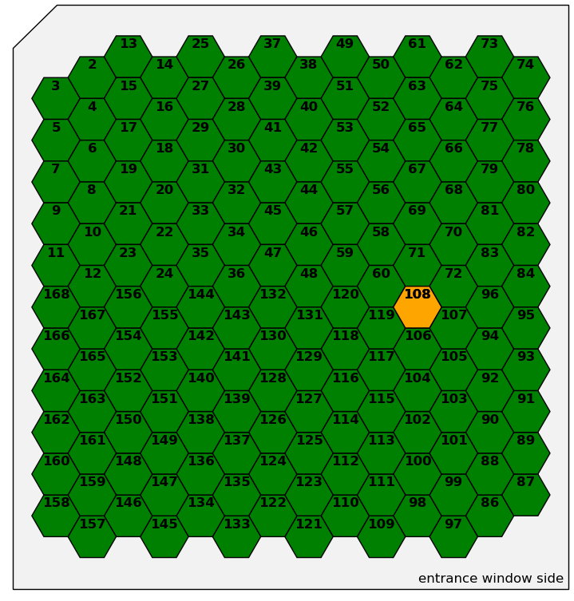
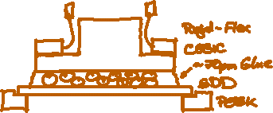
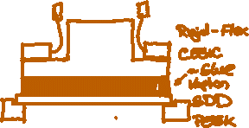
Critical Assembly Step – Gluing SDD to Cesic
SDD is glued to Cesic heat exchange
  Same thermal expansion as silicon (SDD)
First attempts less than 70% yield
  Investigations to locate issue
  Swapping to glue without spacer pills
S0-166-1 (D.Va)
S0-166-2 (Mercy)
S0-166-3(Echo)
S0-166-4 (Winston)
Gluing procedure works (>99% yield) ☺
Daniel Siegmann
13
Notes:
13

Slide 14
Development of the first TRISTAN Detector Module
Assembly Procedure
Commissioning Tests
Realistic Environment
ü
Characterization with X-Rays in ‘perfect lab’ conditions
Testing the module in ‘Mini-KATRIN’ (MoS) with electrons
How to assemble the detector module?

Slide 15


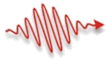
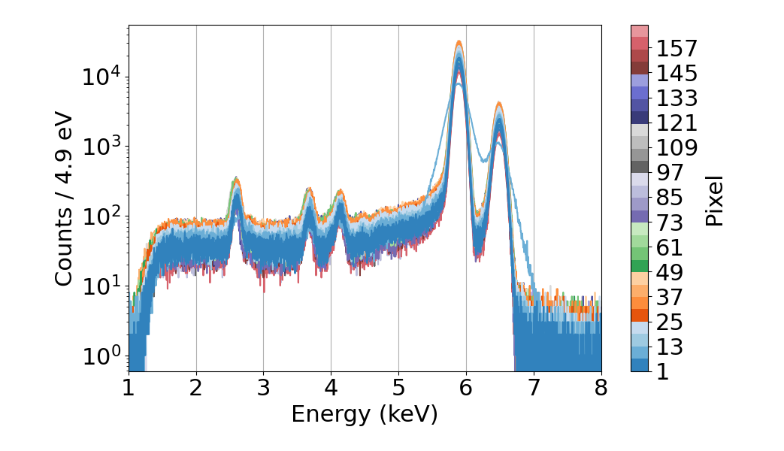
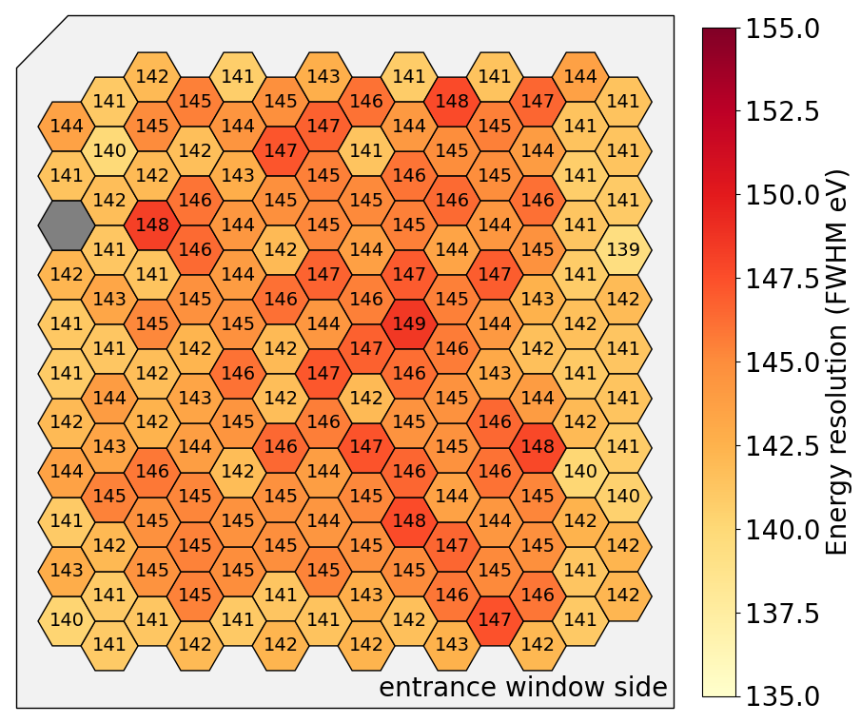
Characterization TRISTAN Module (Winston)
Detector installed in test setup @ MPP
  Optimized detector settings
  Pixel 7 has a loose contact
Investigated with X-ray source (⁵⁵Fe)
Energy resolution (FWHM)
X-ray @ 5.9 keV
ü

Slide 16
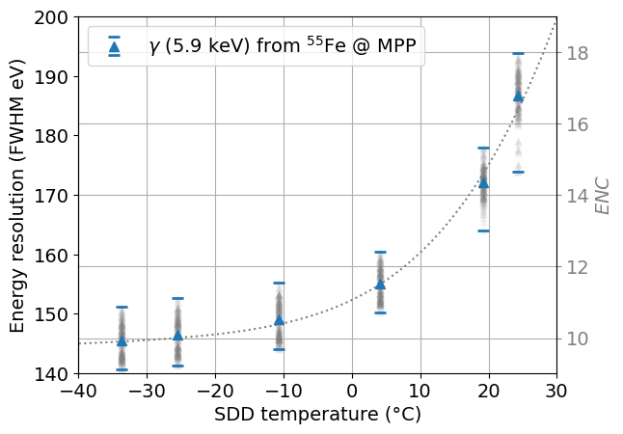
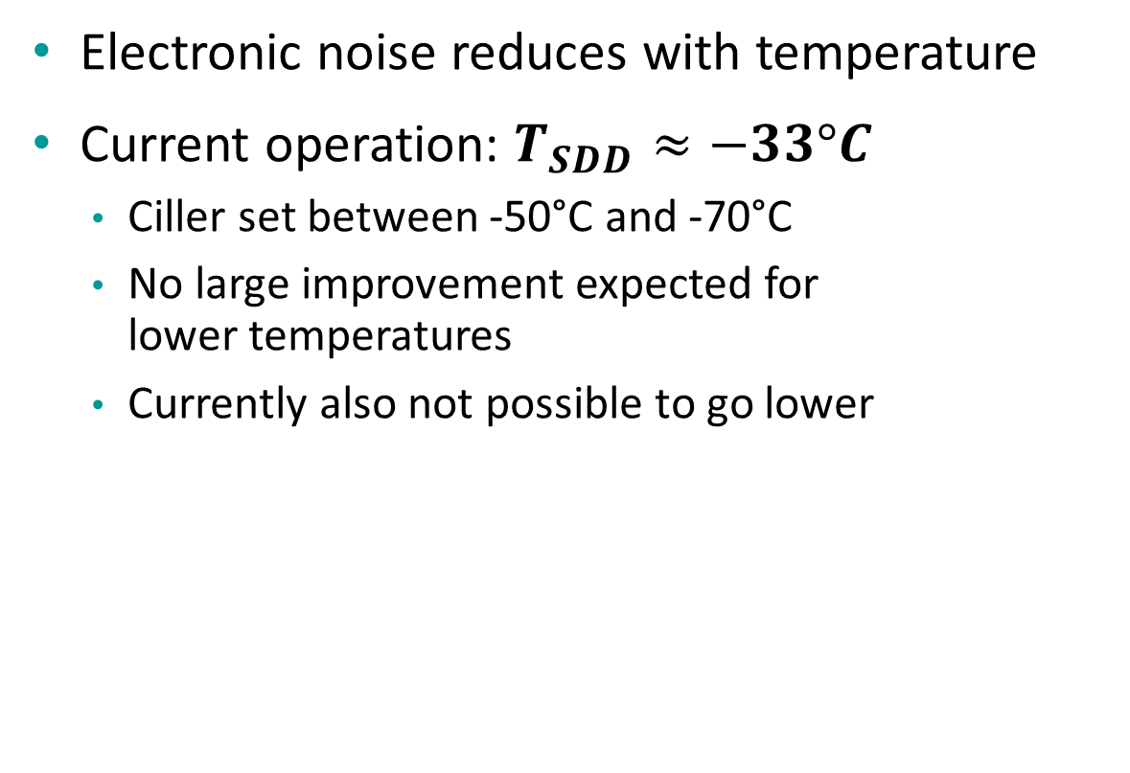
Operation Temperature for Detector Module
Electronic noise reduces with temperature
Current operation: $T_{SDD}≈−33°C$
  Ciller set between -50°C and -70°C
  No large improvement expected for
  lower temperatures
  Currently also not possible to go lower
Current operation point
Target temperature for detector modules roughly -30°C @ SDD

Slide 17
Development of the first TRISTAN Detector Module
Assembly Procedure
Commissioning Tests
Realistic Environment
ü
ü
Characterization with X-Rays in ‘perfect lab’ conditions
Testing the module in ‘Mini-KATRIN’ (MoS) with electrons
How to assemble the detector module?

Slide 18



TRISTAN Module in Monitor-Spectrometer
Detector not to scale!
e⁻
Testing in KATRIN-like conditions
  Vacuum compatibility
  Magnetic compatibility
  Cabling and interconnections
  Understanding electronic noise
  Experience with KATRIN framework
${}_{}^{55}{Fe}$ source for commissioning
retarding
potential
Daniel Siegmann
18
Notes:
18

Slide 19





Commissioning with X-Ray Source
C. Bruch
Successful installation end of 2022
Measured ${}_{}^{55}{Fe}$ spectrum inside MoS
‘Detector response’
X-ray @ 5.9 keV
Detector functional and comparable X-ray performance

Slide 20



TRISTAN Module in Monitor-Spectrometer
Detector not to scale!
e⁻
Testing in KATRIN-like conditions
  Vacuum compatibility
  Magnetic compatibility
  Cabling and interconnections
  Understanding electronic noise
  Experience with KATRIN framework
${}_{}^{55}{Fe}$ source for commissioning
Mono-energetic electron
  ${}_{}^{83m}{Kr}$ source: 7 keV to 32 keV
  Accelerated electrons from wall
retarding
potential
${}_{}^{83m}{Kr}$ source
Daniel Siegmann
20
Notes:
20

Slide 21



Measurements with Electrons
${}_{}^{83m}{Kr}$ source used with retarding potential
Detector compliant with MAC-E filter
Overall good performance, but …..
‘Detector response’
e⁻

Slide 22


Inhomogeneity in Energy Resolution for Electrons
Electron @ 18 keV
Electron @ 31 keV
e⁻
e⁻
30 eV

Slide 23
Inhomogeneity in Energy Resolution for Electrons
Electron @ 18 keV
Electron @ 31 keV
Various tests exclude MoS as cause of inhomogeneity
  Excluded environment, e.g. light, electronic noise, angle of electrons …
e⁻
e⁻
30 eV
Effect must be related to the SDD chip

Slide 24



Effect of the Entrance Window
Fraction of charge/signal is lost in entrance window

Slide 25


Effect of the Entrance Window
Fraction of charge/signal is lost in entrance window
$$e^{−}$$
$$e^{−}$$
Inhomogeneity caused by ticker entrance window
Chip homogeneity expected to be better
Entrance window
Sensitive area

Slide 26

Development of the first TRISTAN Detector Module
Assembly Procedure
Commissioning Tests
Realistic Environment
ü
ü
Characterization with electrons in ‘perfect lab’ conditions
Testing the module in ‘Mini-KATRIN’ (MoS) with electrons
How to assemble the detector module?

Slide 27





Cleaning the Detector Surface
Baseline @ 5 keV
Electron gun @ 5 keV
Additional cleaning of detector
  Isopropanol & Acetone
Improved detector on most regions
  Worsened energy resolution in one spot
Cleaning
Cleaned @ 5keV

Slide 28


Cleaning the Detector Surface
Baseline @ 5 keV
Electron gun @ 5 keV
Additional cleaning of detector
  Isopropanol & Acetone
Improved detector on most regions
  Worsened energy resolution in one spot
  Corresponds to waver center
  Seen in 2 independent detectors
Cleaned @ 5keV
Substance on the surface causes inhomogeneity
Can be cleaned away ☺

Slide 29


Off-Center Detector Measurements
S0-166-4 @ 5keV
S0-166-6 @ 5keV
Chips from the off-center of the waver very homogeneous
Can be used for the final detector assembly

Slide 30



Energy resolution for X-Rays and Electrons
FWHM for X-ray follow Fano statistics
FWHM for electrons in good region
  Entrance window effects visible
  Approx. 40 to 50 eV higher than X-ray
${}_{}^{83m}{Kr}$ electron slightly larger
  Additional scattering in source
  Mimics entrance window effect
Electron data only in ‘clean region’
${\overline{FWHM}}_{20 keV }^{e^{−}}=267eV$

Slide 31



Towards the TRISTAN Detector System
ü
TRISTAN Module
166 Pixels Detector
Commissioning successful
Fulfills requirements
TRISTAN Detector (Phase 1)
9 x 166 Pixels $≈$ 1000 Pixels
Integration after completion of $ν$-mass measurement (2025)
More than scaling
up the detector
Detector chamber
High density electronics
…

Slide 32



































C. Forstner
D. Siegmann
T. Houdy
C. Bruch
S. Lichter
D. Hinz
M. Carminati
M. Kandler
P. Lechner
A. Gavin
S. Mertens
L. Gisotti
A. Nava
F. Edzards
C. Fiorini
M. Steidl
P. Voigt
M. Descher
M. Gugiatti
L. Wunderl
D. Manfrin
... and many more!
P. King
J. Wolf
D. Spreng
D. Mießner
K. Urban
A. Onillon

Slide 33


Back-Up

Slide 34


Slide 35


Noise Curve for Detector Module
Electronic noise MPP & MoS
Very compatible in both setups for short shaping times
Slightly higher noise for MoS
at higher shaping times
  Looks like increased leakage current
  (but detector was colder)
  Probably light coming from not
  perfectly light tight view port
Detector electronic noise almost not effected by nosier MAC-E environment of MOS

