Slide 1
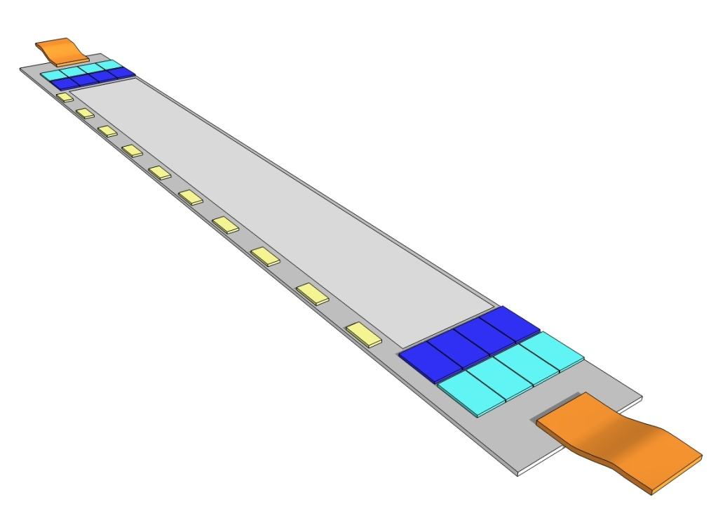

On-Module Interconnection and CNM Projects
No thinning in this talk :
PXD6-1 is finished: thinned and contacted from the back!
Next challenge: interconnection on the module
  Multi Chip Module on (partially thinned) Silicon substrate
    Metal system on the substrate
    interconnect between ASICs and Sensor
    Interconnect to the rest of the world → following talks
Next step: Fully functional electrical Module (everything but the DEPFET)
update on thinning
    samples for thermal mock-ups
    preparations for PXD6 thinning
on module interconnection (3rd metal layer)
→ CNM Project
→ Cu Process at HLL

Slide 2
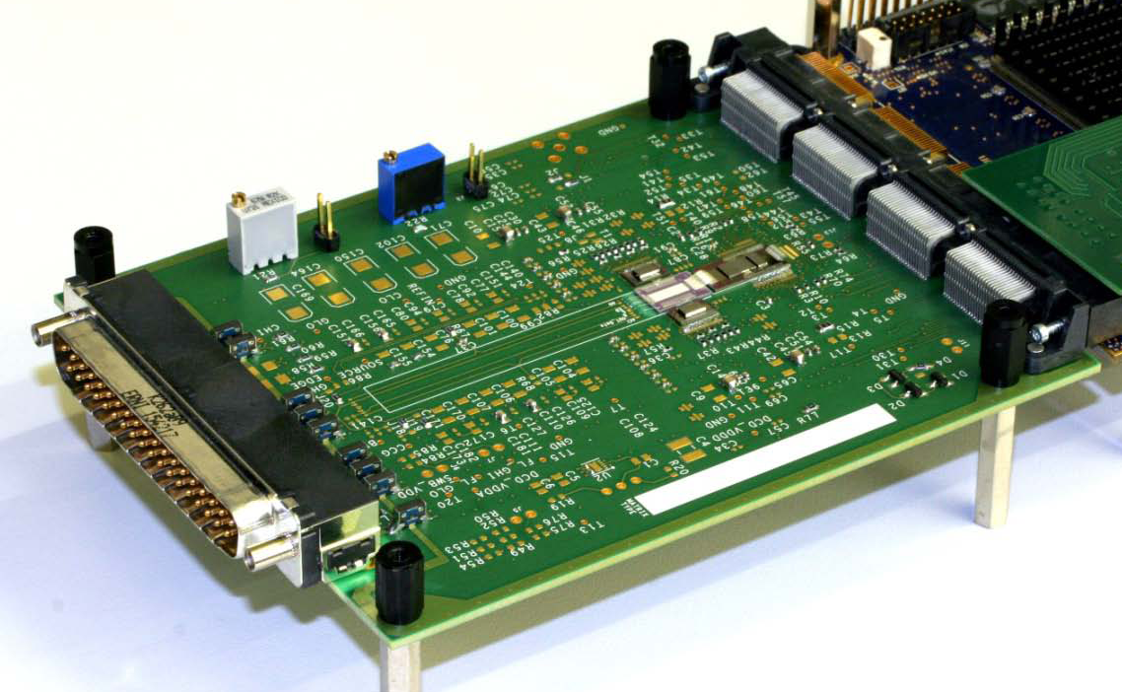
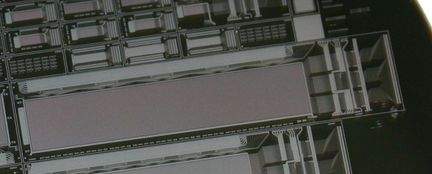
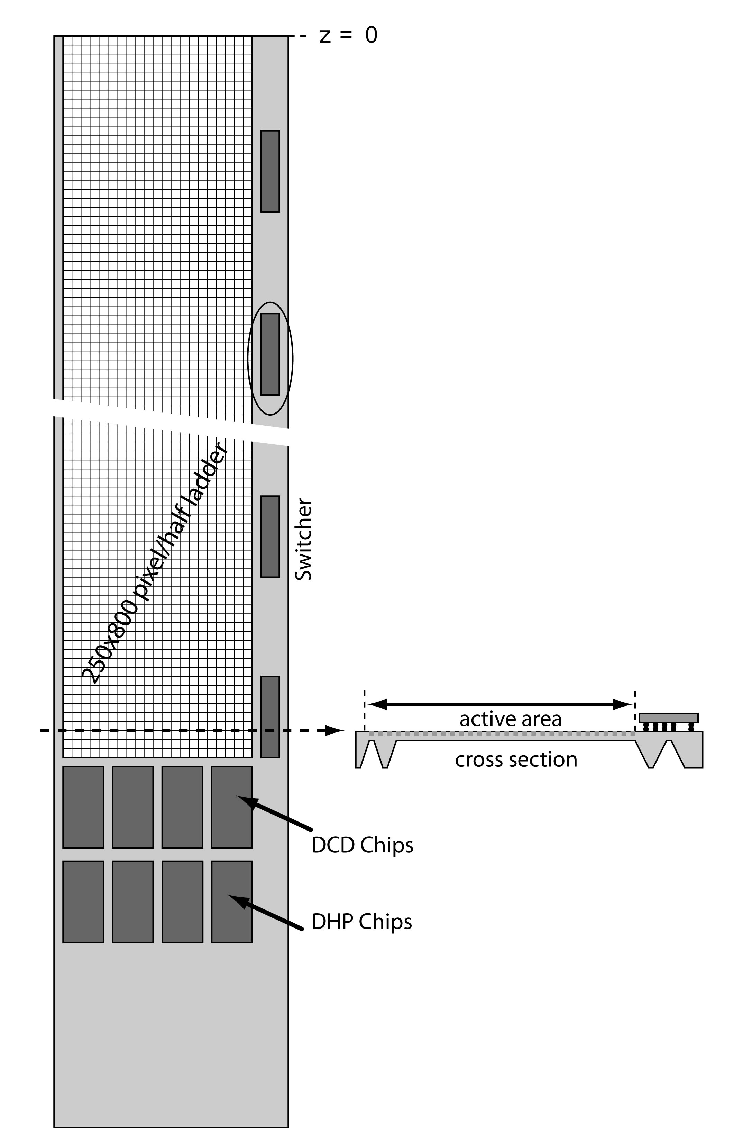
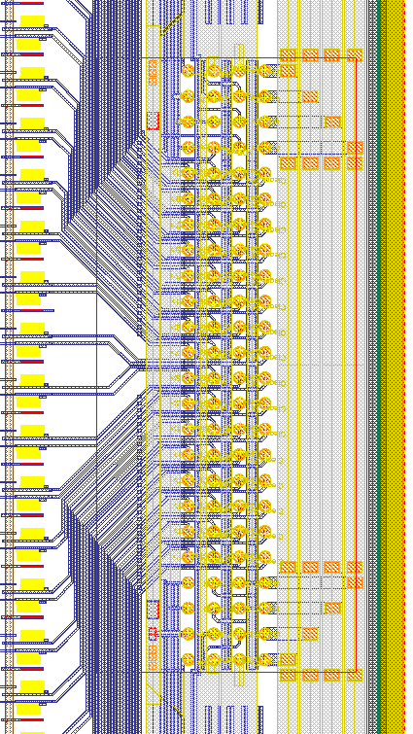
Towards a real ladder
Transition from test systems to integrated modules
1.) PCB for the various matrices ….. “hybrids”
2.) first bump bonded chip on PXD6 matrices
-: 2 metal layers, not the final geometry, 3rd metal later
-: need still support PCB for I/O
-: not perforated balcony, Au studs as UBM
3.) Belle-II PXD Module (two modules form a ladder)
-: three metal layers, Cu as LM
-: 4 DCD, 4 DHP, 6 Switchers → ~3000 bonds/module
-: Cu as UBM, bumps partly on thinned perforated frame
-: passive components soldered (or glued to) substrate
-: I/O and power over Kapton cable

Slide 3
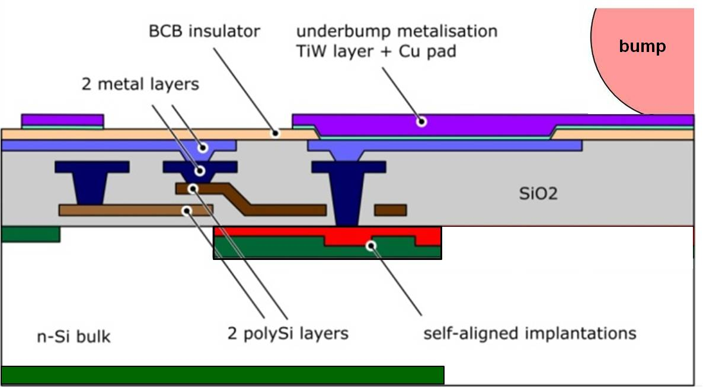
Metal system on the Module
update on thinning
    samples for thermal mock-ups
    preparations for PXD6 thinning
on module interconnection (3rd metal layer)
→ CNM Project
→ Cu Process at HLL
Not to scale

Slide 4
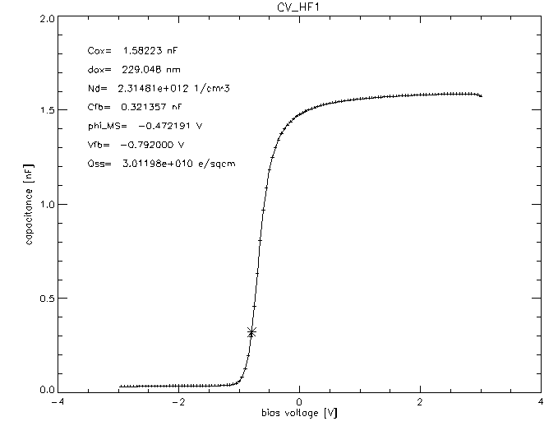
Back-end Status
Development and qualification of the 3rd metal started 2009 with CNM
2009: Ti:W and Copper sputtering, through mask ep-Cu on test diodes
→ Cu is compatible with low leakage current and high MOS quality
2010: Production of metal samples (Al and Cu) for both ASICs and Sensors. The ASICs are bumped
with PbSn (37/63)
update on thinning
    samples for thermal mock-ups
    preparations for PXD6 thinning
on module interconnection (3rd metal layer)
→ CNM Project
→ Cu Process at HLL

Slide 5
CNM Project 2010
-: project is divided in three parts:
I. provide “sensor” samples with two metal layers (Al and Cu)
II. ASIC dummies (DCDB and SwitcherB) with eutectic PbSn bumps
III. Bump bonding of ASIC dummies to “Sensor”
-: work sharing:
HLL:
→ mask design
→ provide passivated Al samples of both, the Sensor and the ASIC wafers on
std. material
CNM:
→ Cu electro-plating of the sensor wafer
→ bumping of the ASIC wafer
→ dicing of the wafers and bump bonding of the ASCIs to the sensor substrate
-: time line: finish in the first quarter of 2011

Slide 6
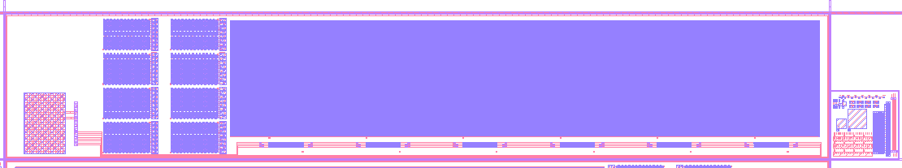
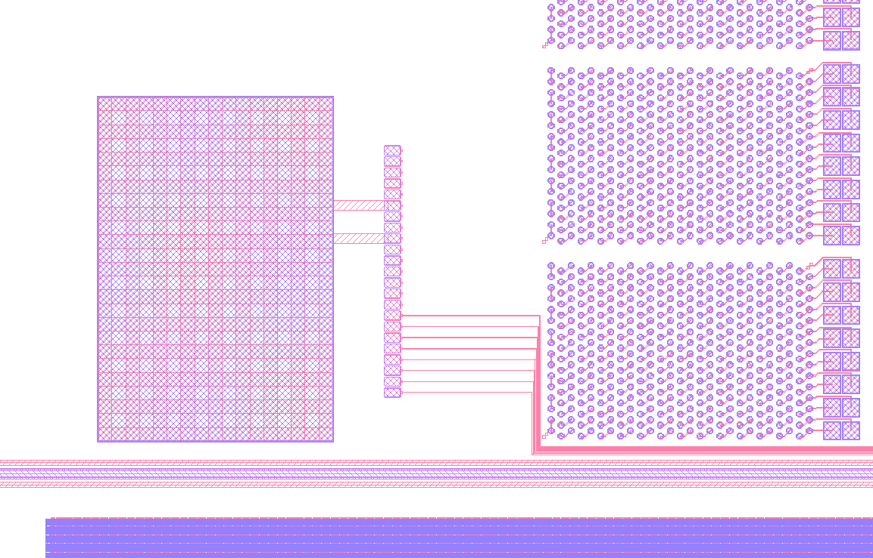
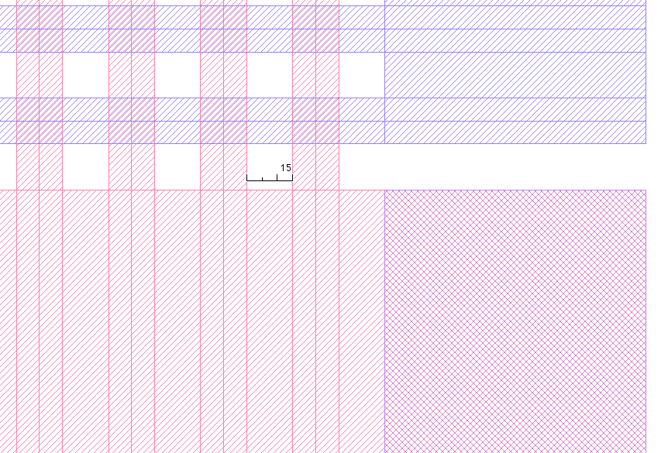
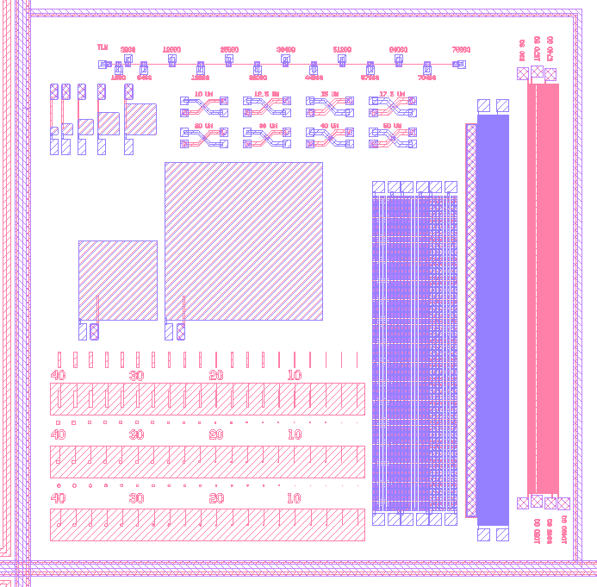
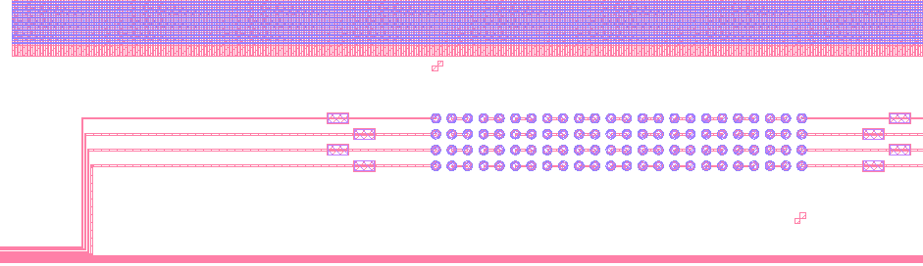
Devices on the “sensor wafer”

Slide 7
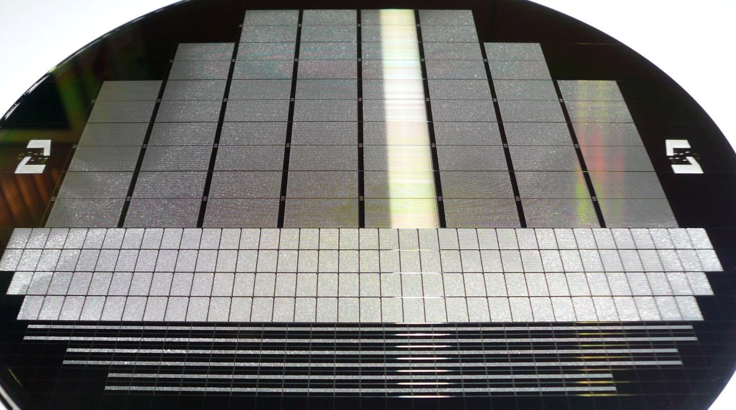
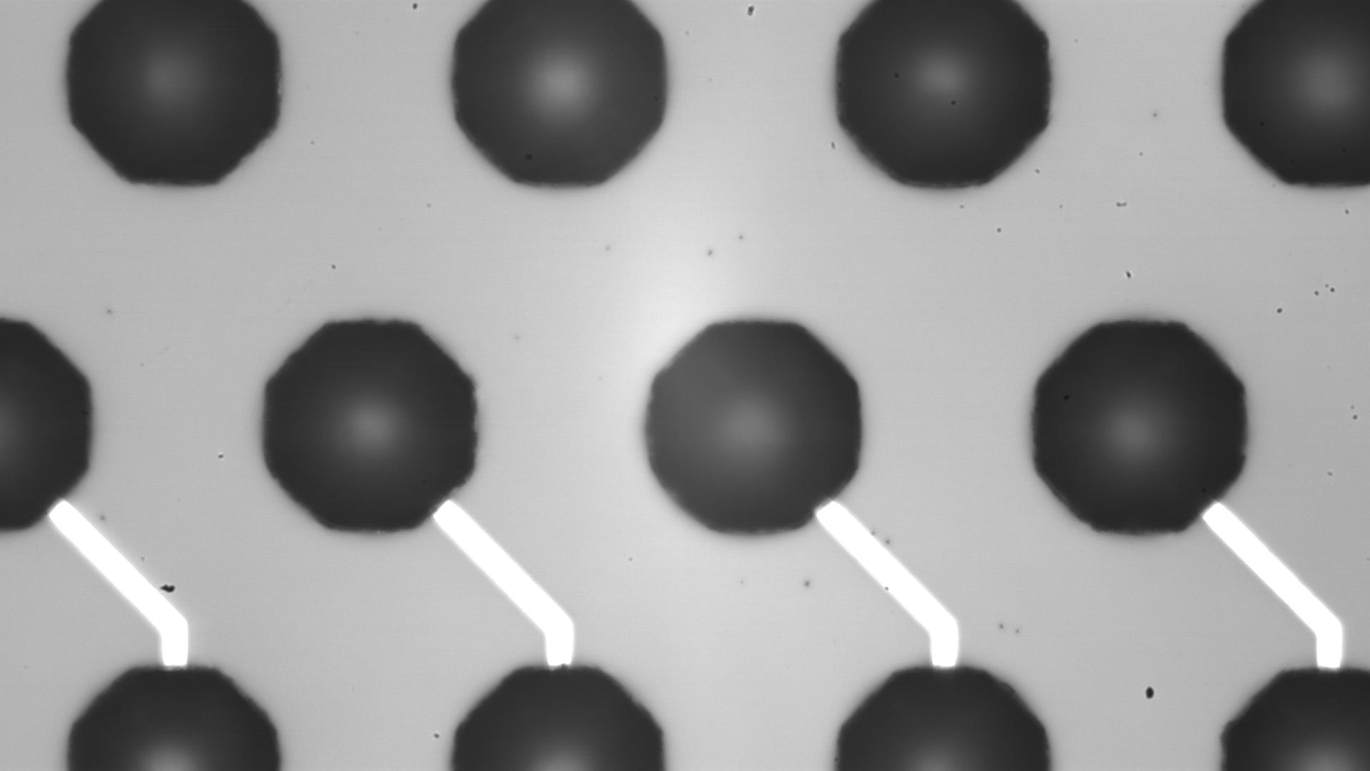
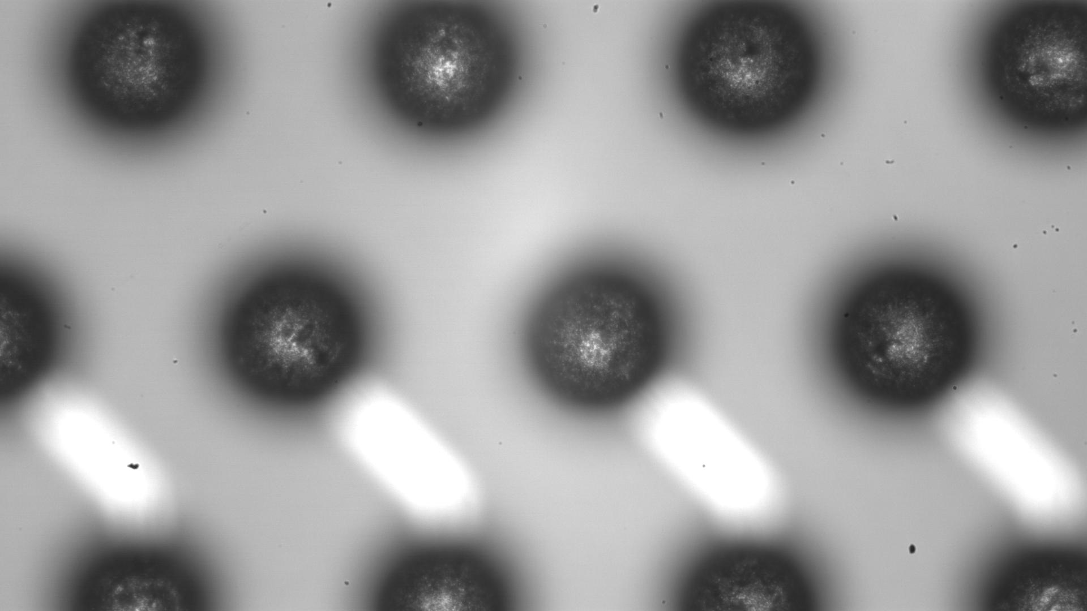
CNM Project 2010
Status:
-: 4 Sensor wafers finished, 2 with Cu LM and 2 with PbSn LM
-: 6 ASIC Wafers bumped
-: latest news (last week): all wafers scheduled for dicing
Next Step: flip chip DCD and Switchers to Sensor substrate → check procedure, yield …

Slide 8
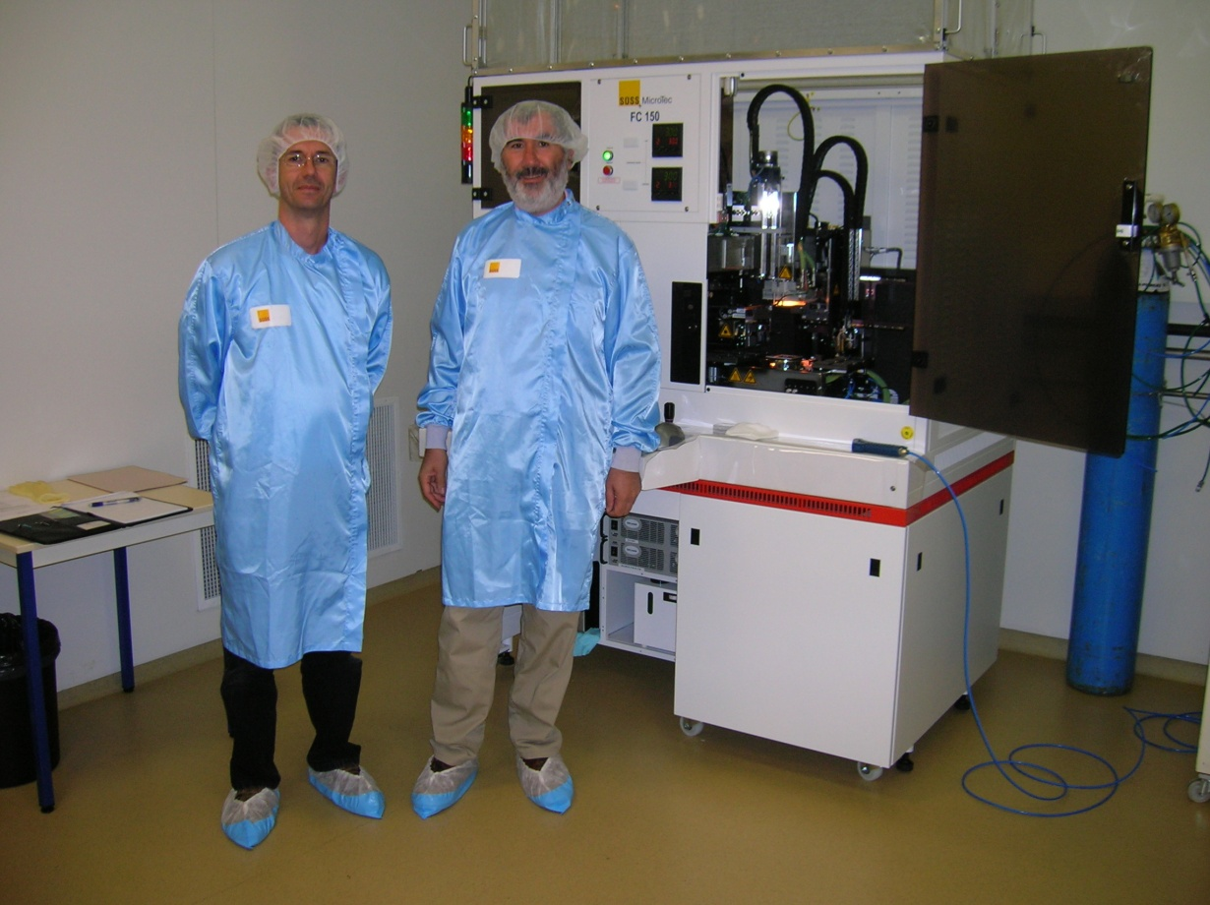
CNM Project 2010
Enric (CNM) and Mokhtar (IFAE) in front of “their” FC150

Slide 9
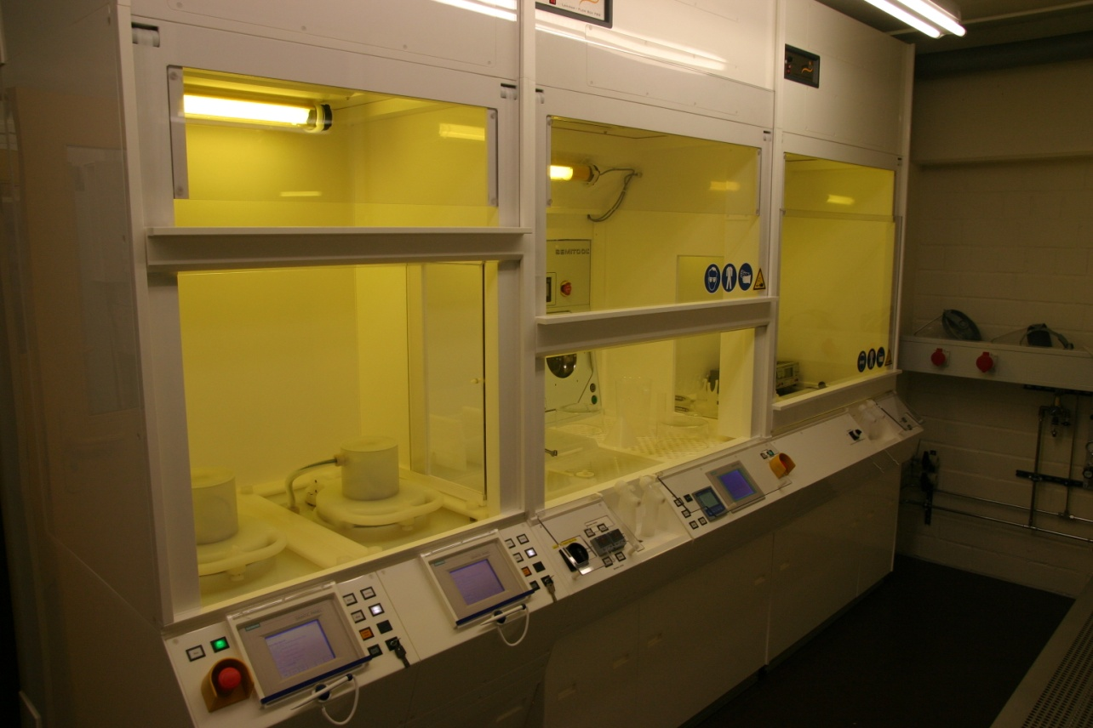
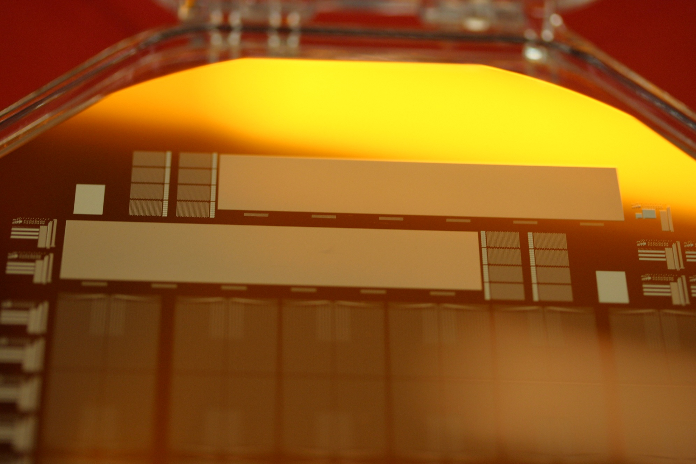
Cu back-end at HLL
The UBM and 3rd metal layer are essential parts of
the DEPFET production, done after thinning
and need to be installed at the HLL → done 2010

Slide 10
Intermediate summary
-: the Cu metal system (BCB – Ti:W – Cu) seems to be compatible with our process
-: more tests concerning the BCB isolator will be done on the next Cu-wafers produced
at the HLL.
-: CNM produced bumped ASIC dummies an is looking forward to bump bonding
these chips to sensor dummies. This will give us hopefully the answer to the
question, whether we can really solder reliably to Cu pads. We could also practice
the attachment of Hans’ kapton test samples to these modules.
We are ready to do the next step:
→ design and assembly of an electrically functional module (half ladder)

Slide 11
The plan … just a starting point…
-: The goal is to build the first fully functional MCM on Silicon → everything but the DEPFET
-: 3 Metal system with the ILD as close as possible to the final module
-: ASICs: SwitcherB, DCDB, DHP 0.2
-: Off-Module interconnect as close as possible to final (Kapton..)
-: place all necessary passives
-: Geometry: outer layer module, 106-011113.idw with wide kapton layout
→ need at least one iteration between electrical, mechanical and thermal WG to define
the exact geometry
-: the sensitive region will be free for test structures , bypass pads, test pads for the swticher
channels, load capacitors and resistors even as space for a pxd6 matrix.
First brain storming meeting was held in December in Mannheim with participants from
Mannheim, Bonn, and Munich (LMU and MPI) and the outcome is placed as a working document
on our wiki pages.

Slide 12
Actions (very rough…)
1. Draw schematic and first layout in consultation with the chip designers: Uni Heidelberg
2. Re-iterate with mechanical and thermal WG
3. Design test structures and schemes for the “sensitive region”: HLL, Heidelberg, Bonn
3. Schedule double-metal run at HLL, prepare Cu layer deposition: HLL
4. Prepare the ASICs (bumping etc…): Bonn, Heidelberg
is there a way to get bumped IBM and UMC Dummies?
5. Prepare and qualify bumping: CNM
6. Assembly at CNM

Slide 13
Summary
It is important to start the development of the module assembly procedure in parallel
to the next production.
With the achievements of the past years we are ready start the design and construction
of a real electrically functional module. Even without the final DHP, it would be
an extremely important milestone on the path to a MCM with thin DEPFETs.
The three-metal system is technologically challenging, as is the bump bonding to
Cu landing pads. A parallel development of this technology, independent of the
DEPFET production is necessary to safe time.
CNM in Barcelona is interested to do the bump-bonding in our collaboration. They have
already some experience and the necessary equipment. More details about CNM
and their facilities will be presented at Ringberg by Enric and/or Mokthar.

Slide 14
Backup slides follow

Slide 15
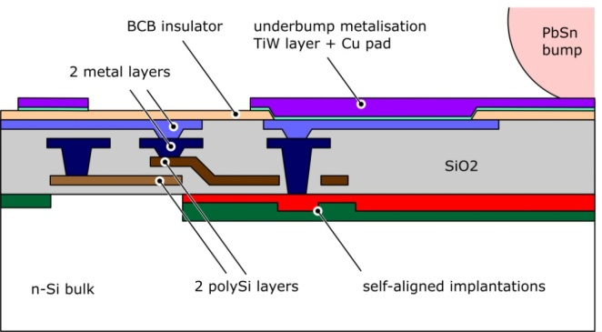

Module and On-Module Interconnection
bump

