Slide 1
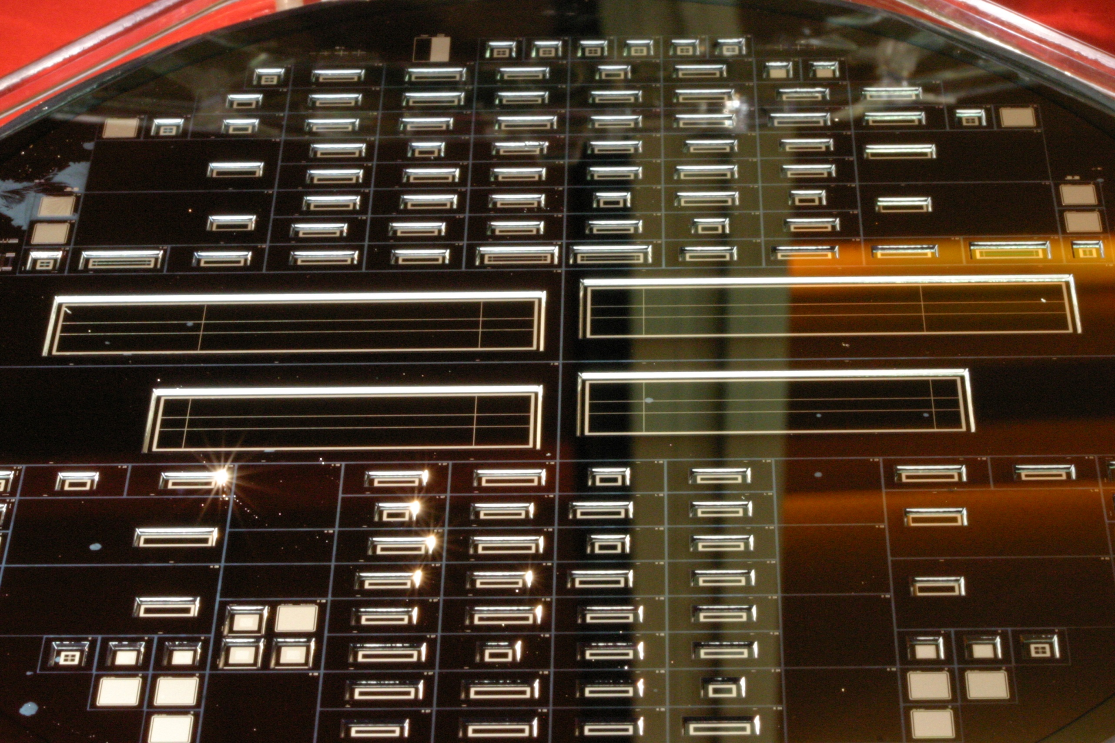
Testing PXD6 - testing plans
Jelena Ninkovic for the HLL team

Slide 2
Measurements on the first wafers with full DEPFET + THINNING
technology !!!!

Slide 3
PXD6 Batch 1 wafers
L1 - lithography dummy but has some of the implantations
S1, W02 – hot wafers with ZMI=600nm
W21 – hot wafer with ZMI=1000nm and Plasma etching of Polysilicon
W11 – Reference wafer (not SOI material)
Some parts of the wafer have 100nm thinner Oxide then the rest of the wafer

Slide 4
IR microphotographs
Small matrices
Al lines on n-side through the thick handle and top wafer
Al lines on p-side
Edge of the opening window on the p-side
Al lines on n-side through the thin top wafer

Slide 5
IR microphotographs
Half ladders

Slide 6
PXD6 Batch 1
8 (6+2) SOI wafers + 2 reference wafers
3SOI + 1 Ref in the first iteration +1 LithoDummy
128x16 matrices for wire bonding 128x8 matrices for wire bonding 85 standard 8 of them on thin oxide 6 ILC (128x128) 2 of them on thin oxide – (2 best DUTs from TB2009)
Mini matrices (9 of which 2 on thin oxide)
single DEPFETs (24 pairs with varied channel and clear gate geometry)
Some special test structures

Slide 7
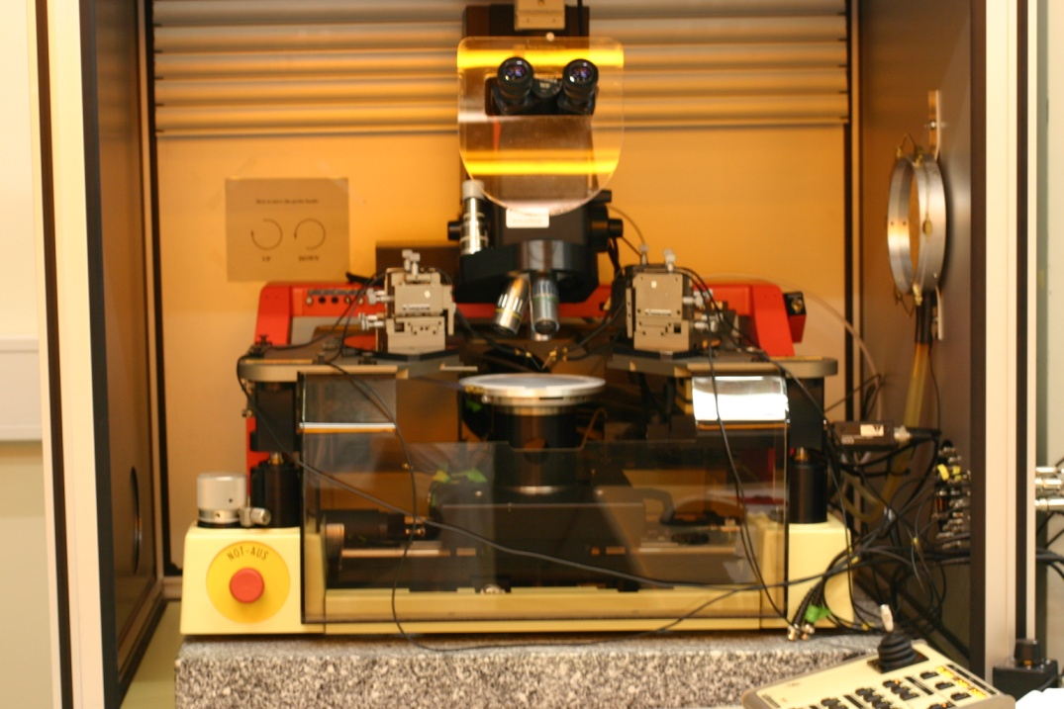
Testing system
Wafer level
Semiautomatic wafer probing
SUSS PA150 Semiautomatic Probe System
embedded into Keithley 4200
Semiconductor parameterization system

Slide 8
Depletion voltage
Spread on different wafers
10-15V

Slide 9
Back side diodes on SOI material
n+
p+
200nm Oxide
Al
Handle wafer

Slide 10
Back side diodes

Slide 11
Back-side biasing
Al
p+
n+
p+
Al
Handle wafer
Simplified backside processing
No wire-bonds on thin Si

Slide 12
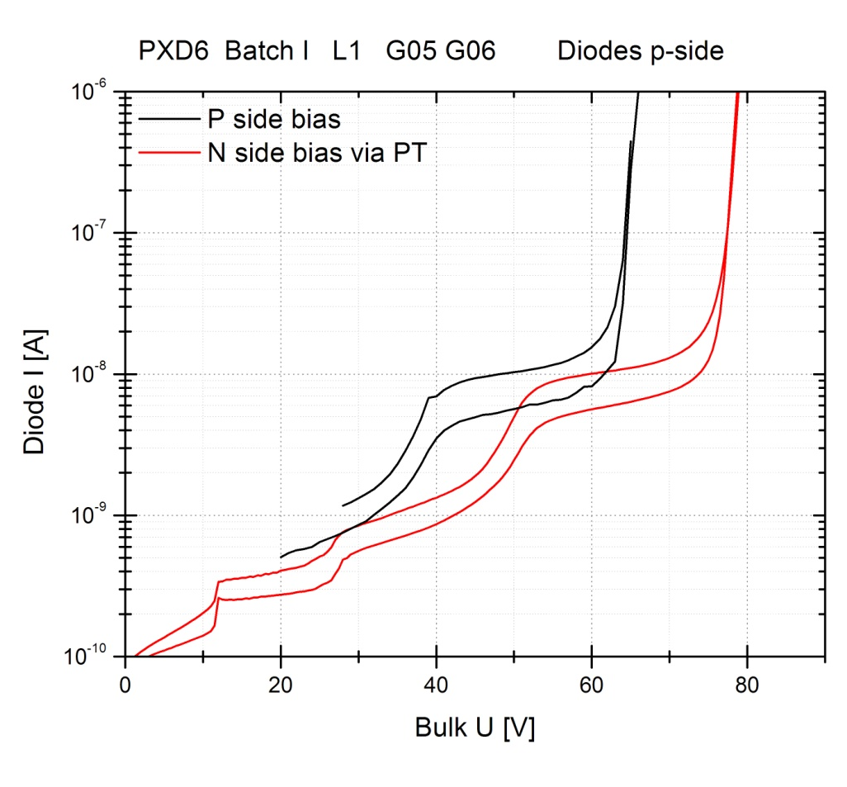
Back side biasing

Slide 13
Breakdowns of dielectrics
Wafer | Poly1 – Poly2 | Al 1- Al2 | P2 – Al1
L1 | -25V +35V | -150V >200V | -20V +120V
W02 | -30V +40V | -125V +135V | -25V +130V
W21 | -25V +35V | -150V +125V | -25V +50V
➔ Safe operation within the nominal voltage ranges

Slide 14
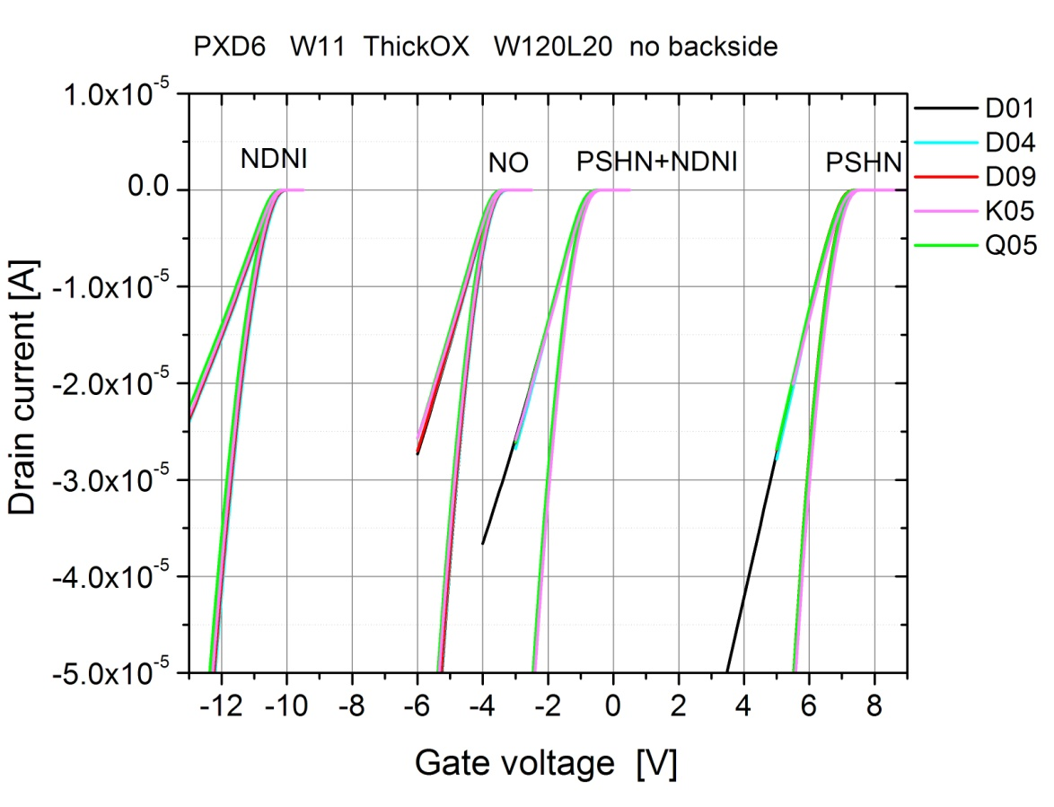
Transistors
High homogeneity over the wafer surface
DEPFET like transistors nicely match the threshold voltage around 0V

Slide 15
Transistors

Slide 16
Transistors
Flat position

Slide 17
Transistors

Slide 18
Transistors – Internal gate potential

Slide 19
Testing plans
Static measurements - Wafer level measurements:
Special test devices – qualification of the production quality
Leakage currents
Depletion voltage
Threshold voltage of DEPFET
Threshold voltage of Clear
Break down voltages of oxides : Poly1 - Poly2 & Al1 - Al2 & Poly2 – Al2
Contact resistance
Sheet resistance
CV on Caps
Bulk to Bulk contact
Matrices pretesting – selection of matrices for further testing
Leakage current of the back diode
Clear vs. Source
Gate vs. Source
Clear Gate vs. Gate
Some representative sample of IV curves

Slide 20
