Slide 1
Data Handling Processor Status/Plans
Tomasz Hemperek

Slide 2
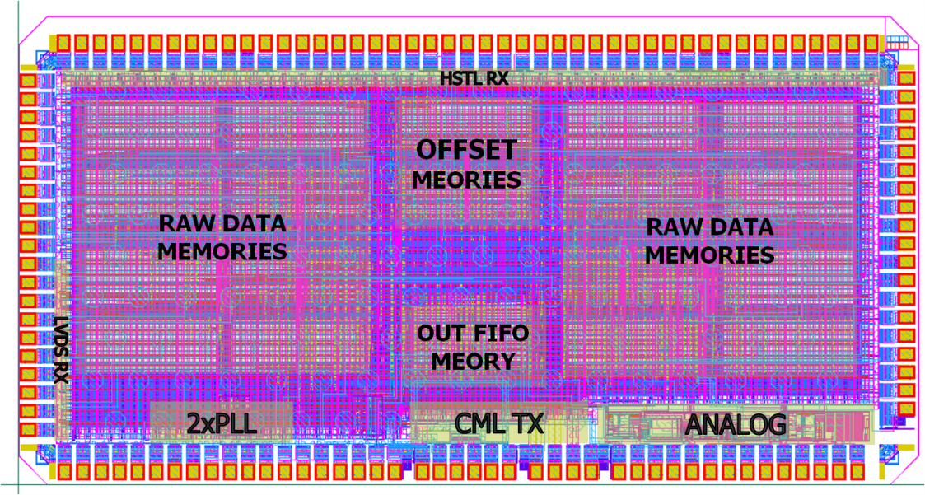
DHP 0.1

Slide 3
DHP 0.1 - Status
Working:
LVDS Input
HSTL like Input
Slow control (JTAG)
Memories read/write
Input readout
Patter generator
DAC
Band Gap
Processing (*need DCD)
High Speed TX testing
To Do:
DCD communication and synchronization
More Processing
Radiation test

Slide 4
DhpTxTest Chip
Design ready: December 2010 - MPW canceled
Resubmission: February 2011 - MPW canceled

Slide 5
DHP 0.2 - Changes
Fixes
Input routing
signed/unsigned convention
PRBS
Digital improvements/changes
Fix to static pedestal
Pedestal during acquisition update – JTAG
Improved common mode correction
Common mode readback
…
New combined PLL+Ser+TX
New I/O cells
Improved DACs/ADC

Slide 6
DHP 0.2 - Processing
DHP 0.1
DHP 0.2

Slide 7
DHP 0.2 - Data Processing
1024 rows buffer for data and for pedestals and offsets
8 bit static pedestal subtraction
2 pass common mode correction (signal rejection)

Slide 8
DHP 0.2 - Interface
LVDS TX
Rail-to-Rail LVDS RX
+ Custom Area I/O Pads

Slide 9
DHP 0.2 – PLL+Ser+TX
Integrated PLL, Serializer and CML TX
Separate power domain

Slide 10
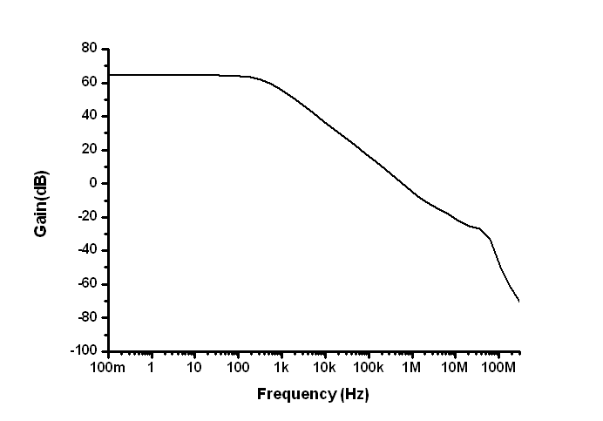
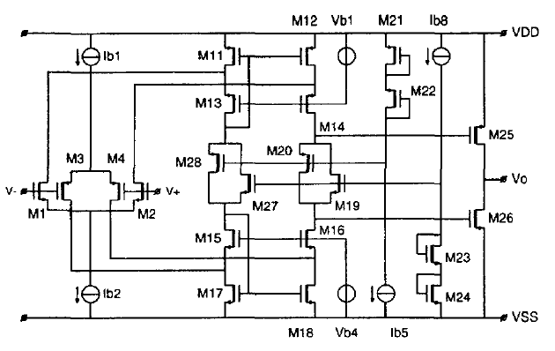
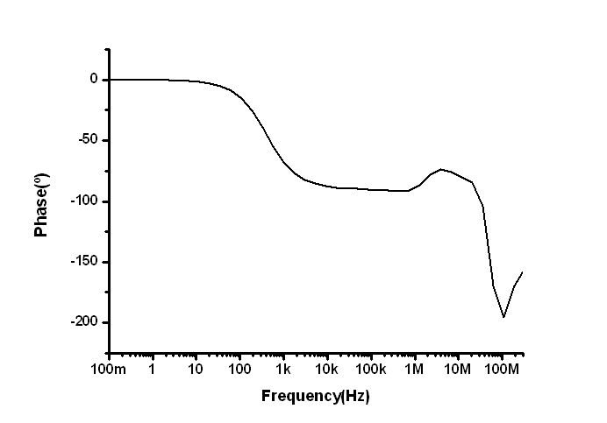
8-bits DAC redesign
DHP 0.1 tests showed that the 8-bits DAC and 10-bits ADC had to be redesigned in order to have a rail-to-rail output.
8-bits DAC has been redesigned (schematic level).
New op-amp with Avo=64 dB, PM=88.46º and a rail-to-rail output range.
R. Hogervorst, et. al.,”A Compact Power-Efficient 3 V CMOS Rail-to-Rail Input/Output Operational Amplifier for VLSI Cell Libraries”, JSCC, vol. 29, no. 12, pp. 1505-1513, Dec. 1994.

Slide 11
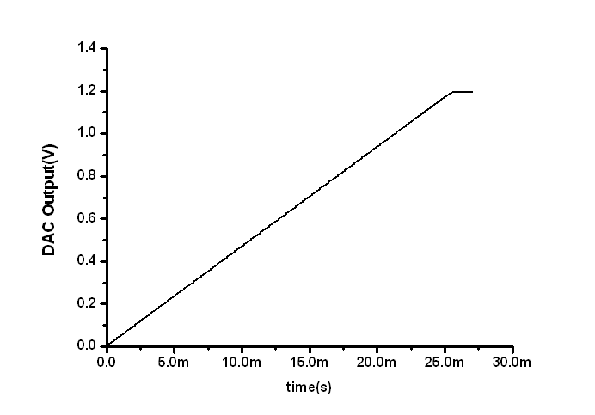
8-bits DAC redesign
Rail to rail 8-bits DAC
Dynamic response

Slide 12
DHP 0.2 Timetable
 | February | March | April | May
Digital Design
Verification
Implementation
Analog Designs
Sign-off
Want to be ready for May 2011 Submission

