Slide 1
SOI for Belle II PXD
-: top and handle wafer delivered by MPI
-: pre-processing of top wafer at MPI
-: engineered BSOI wafers prepared externally
-: DSP, ≈ 420 µm overall thickness, 75 µm top layer
update on thinning
samples for thermal mock-ups
preparations for PXD6 thinning
on module interconnection (3rd metal layer)
→ CNM Project
→ Cu Process at HLL
Siltronic, FZ, DSP, <100>, t=450µm, 300-500Ω.cm, Phosphorous
230 nm thermal oxide
structured Boron implant, through BOX, 90 keV, 5e14 - 1e15 cm-2
alignment marks in BOX: 60nm step
hydrophilic bond
top layer: 75 µm
≈420 µm
DSP
Siltronic, FZ, DSP, <100>, t≈450µm
after bonding, grinding and double sided polishing

Slide 2
Production chain
Raw wafer supply → pre-processing → SOI → DEPFET process → thinning, dicing, mounting..
external
HLL and collaboration
Key Process Modules for (thick) SOI production:
1/ Wafer bonding → Somewhat special due to our implanted back side
2/ Edge treatment of the top wafer
3/ grinding and polishing
Standard for SOI Wafer production
History:
-: first tests started ~2002 with MPI Halle: bonding there, rest at Sico → publication 2004
-: imperfect bonding, Sico closed it’s service → look for industrial partners
-: Tracit (spin-off from Leti) produced excellent SOI for the tests of the following years, after some trials
-: Soitec (another spin-of from Leti) bought Tracit, and Soitec became market leader for SOI wafers
-: Material for PXD6 done at Soitec (on their smaller R&D line) → results were acceptable
-: start to look for a second source already 2007/08 (Icemos, Belfast) → Simpl SOI
-: Spring 2010: Soitec told us that they will not continue the processing of our SOI on their line!

Slide 3
To make a long story short ….
We contacted all known and (less well known) SOI supplier all over the world:
-: Icemos, SQI, Yamaka, Okmetic, Virgina Semiconductor, Simgui, MEMC, Ultrasil …
and a number of wafer broker: ABC, Siegert, …
Result: most of them could not guarantee the quality or ..
..the “best” answer I got was from Virginia Semiconductor:
What’s left?
1. Icemos, Belfast
pro: they showed that they can bond with
reasonable yield so far (~60%)
con: edge trimming, cleanliness, reliability
2. VTT, Helsinki
pro: claim that they can do everything, cooperation with Okmetic
con: non, no experience so far, first tests to start soon
3. “UPS”: separate the tasks and find experts for the process modules
bonding: Icemos , Belfast or EVG, Austria
edge trimming and grind: Disco, Munich
polish and clean: Rockwood , close to Marseille
pro: better process insight and control (esp. EVG), con: complicated ….

Slide 4
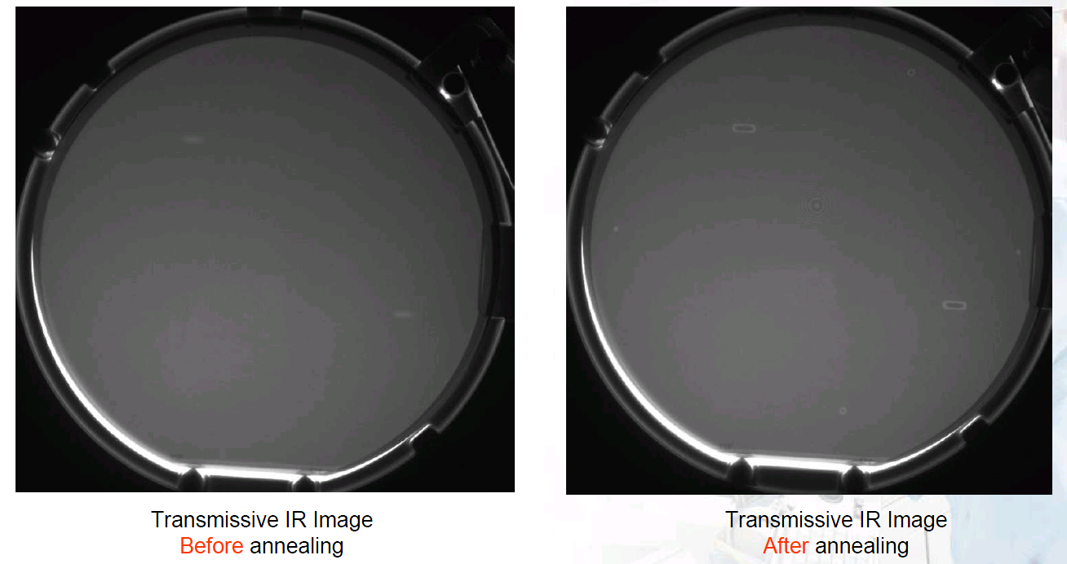
What are the specs?
I Bonding:
→ voids after annealing, Soitec said: 0 voids bigger than 0.5 mm
Bonding at EVG: few, but large bonds after annealing → better surface treatment before bonding
Icemos claims that they can fulfill the 0-void requirement, we have to check that

Slide 5
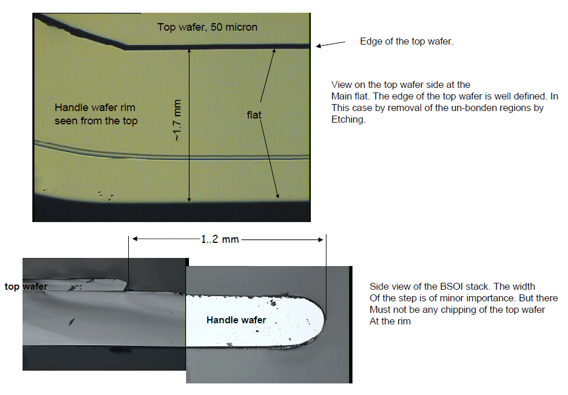
What are the specs?
II Edge trimming : → no edge chipping of the top wafer after grinding

Slide 6
What are the specs?
II Edge trimming : Icemos

Slide 7
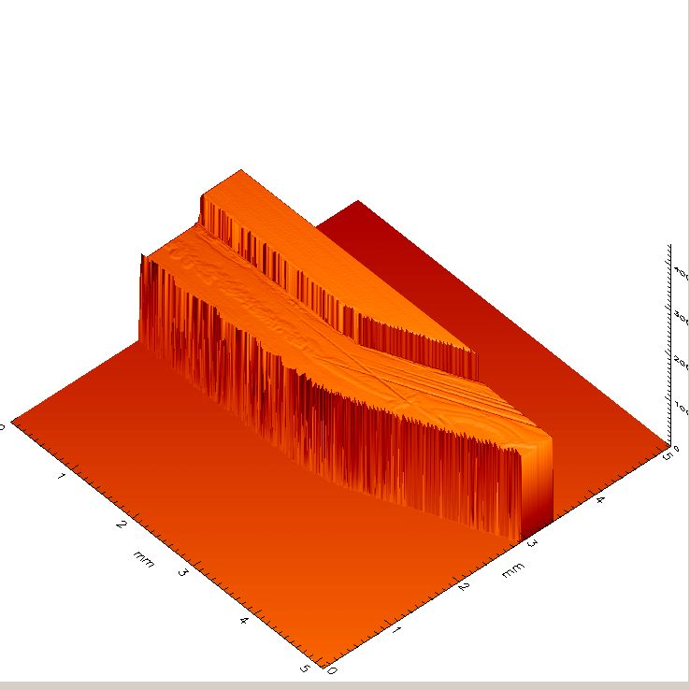
What are the specs?
II Edge trimming : Disco
-: Very nice edges!
-: But groove in the handle Wafer from the top → acceptable?

Slide 8
What are the specs?
III Polishing and cleaning:
-: Mirror polished surface, double sided
-: Surface roughness ~0.1nm
-: no metal contaminations (< 5e10 at/cm2)
-: low particle count on surface (< 50 part bigger than 0.2 µm)
→ Icemos can’t do it, also Disco is not good enough → Tests at Rockwood ongoing, expect results
end of February
Surface of two different batches of Icemos: Belle II and Simpl wafers

Slide 9
In Summary
-: The supplier of SOI wafers for Belle II are not yet qualified
-: There are three options left:
-: improve quality of Icemos
-: hope that VTT is not having this problems with bonding, edge trim., polish and clean
-: follow up the “UPS” line and qualify the various specialists for the individual processes
-: Time line and actions:
-: expect edge trimmed Belle II Wafers (Icemos) back from Disco next week
-: expect results from Rockwood end of February, if good, clean these Belle II wafers
-: technical meeting with Icemos 24.02. in Belfast
-: prepare wafers for more test runs:
-: 1st run at VTT
-: 2nd run at Icemos with improved process
-: possibly another bonding run at EVG (tbd)
-: Plan and prepare fast test run in R&D Lab@HLL: Diodes and MOSFETs on
-: VTT wafers
-: wafers from the “UPS” line: Icemos – Disco – Rockwood
-: This will take us easily to June, depending on when the VTT wafers will be available
-: Assuming 12 weeks lead time for the SOI wafers (VTT or “UPS”), we need to order the wafers
around July to have them in Sept.!! (ignoring all possible problems and summer break in the fabs.)

Slide 10
SOI for Belle II PXD
Backup slides follow

Slide 11
The Soitec Issue…
March 26: after pre-processing at HLL 30+30 HLL wafers sent to Soitec for bonding and thinning
May 25: SOI Wafers back at HLL
-: 22 “prime” grade
-: 7 downgraded wafers with some scratches and TTV>2micron
Incoming inspection:
-: some scratches seen even on “prime” wafers, handle side in general more affected
-: one larger scratch seen almost all of the top wafers
-: contamination level of top wafer “acceptable”!
→ start of processing at HLL
-: first oxidation
-: lithography with transfer of the alignment marks from BOX to handle wafer
Issue seen during back side photo resist coating:
-: pyramidal pits on the back side,
~20 micron lateral dim., ~ 15 micron deep
-: caused by:
1. pin holes in the screening oxide during front
side thinning
2. Due to a misunderstanding, the handle wafer
was not ground back and polished
Stack is still ~485 micron thick!

Slide 12
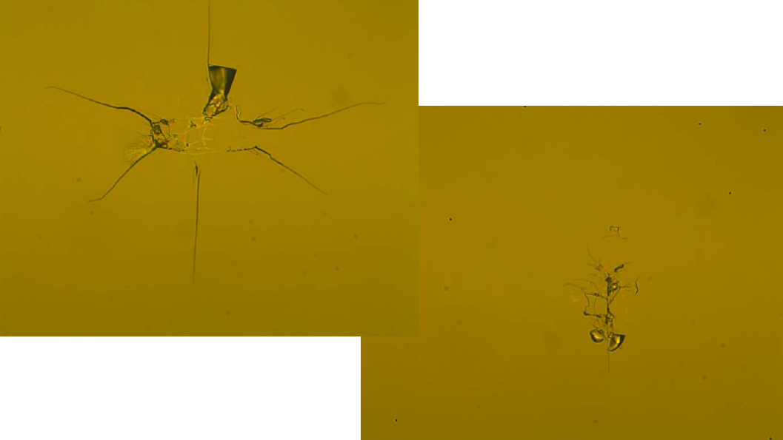
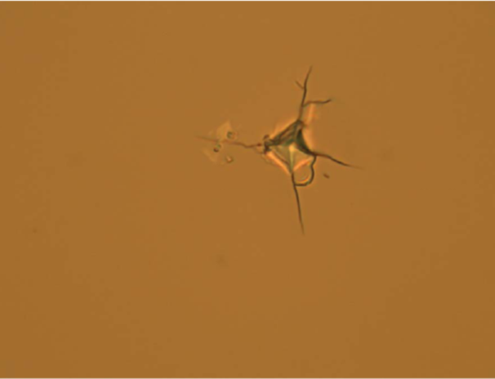
Crystal damage after re-work
Top wafer side
handle wafer side
Damages in the order of 10 um
in lateral dimension

