Slide 1
Mesurement of the H → $γγ$and H → ZZ* → 4𝑙 cross-sections in 𝒑𝒑 collisions at $\sqrt{s}=13.6 TeV$ WITH THE ATLAS DETECTOR
By Sajena hamdi
Proseminar presentation on dec 9th

Slide 2
overview
Detector Setup and refreshing knowledge
Fiducial region
Seletion criteria and event selection
Fit procedure and modelling
Results of fiducial and total cross-section
Conclusion

Slide 3
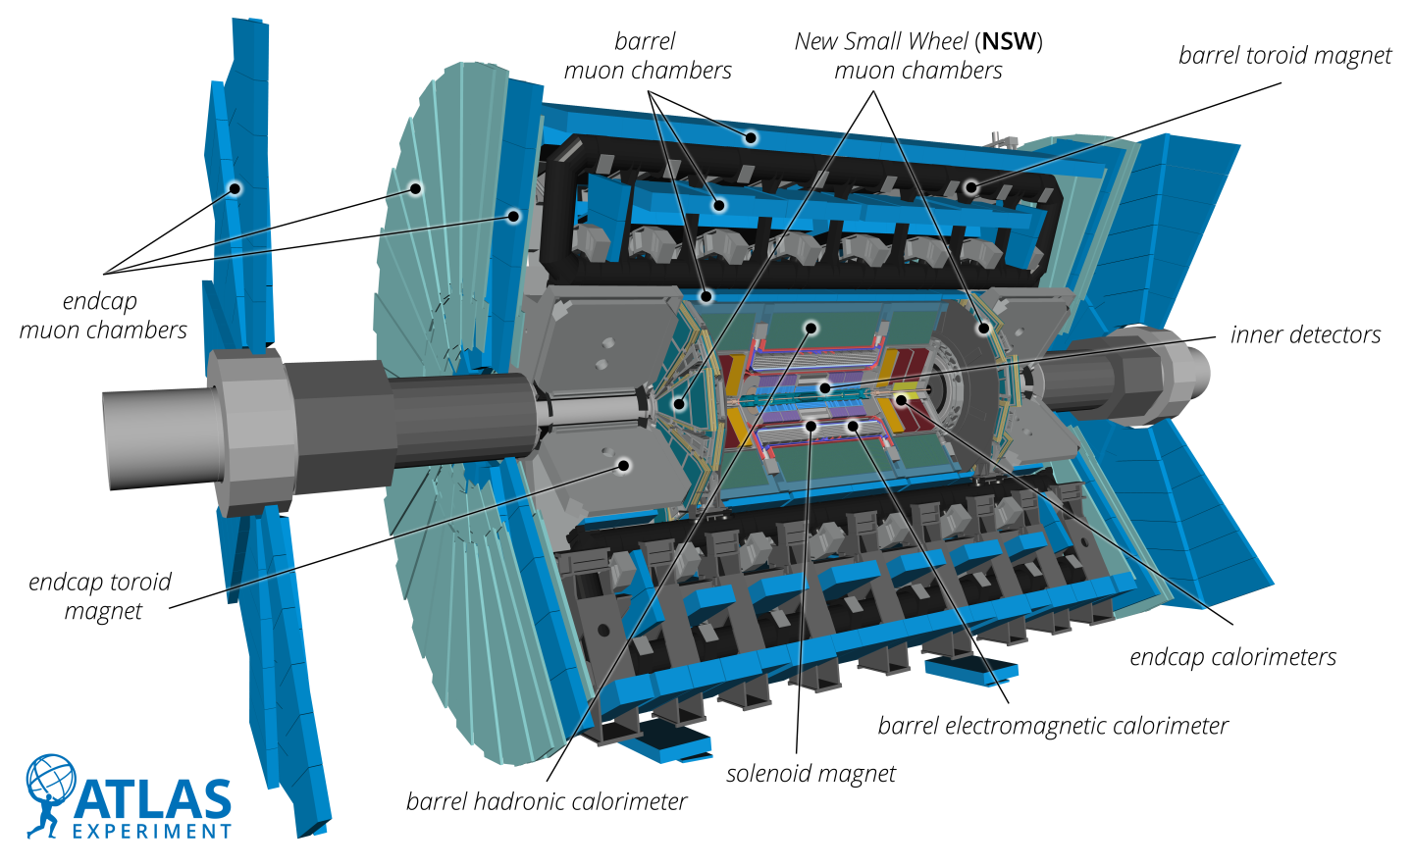
Atlas Detector setup
Consists of inner tracking detector(ID), EM and hadron calorimeters for energy measurement and muon spectrometer(MS)
Two-level trigger system:
Hardware trigger (accepted event rate below 100kHz)
Software trigger (accepted event rate 3kHz)

Slide 4
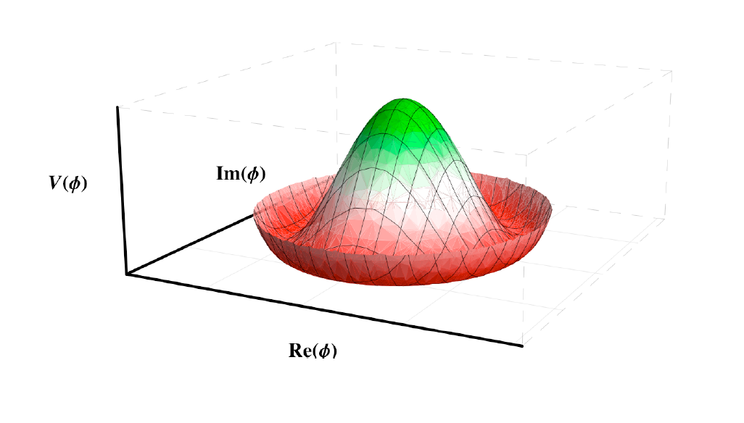
Higgs boson intro
complex higgs field can be written as two complex scalars: $\left({φ^{+} \atop φ^{−}}\right)$ with $φ^{+}$ and $φ^{−}$being complex fields
Spontanious symmetry breaking:
Higgs field $φ$ with potential:
For $λ>0$ and${ μ}^{2}<0$new minimum at vacuum expectancy value:
Three goldstone bosons get absorbed by $W^{+}$, $W^{−}$ and $Z^{0}$
$V\left(φ\right)=μ^{2}φ^{2}+λ$ $φ^{4}$
$$φ_{0}=v=\sqrt{\frac{−μ^{2}}{2λ}}$$

Slide 5
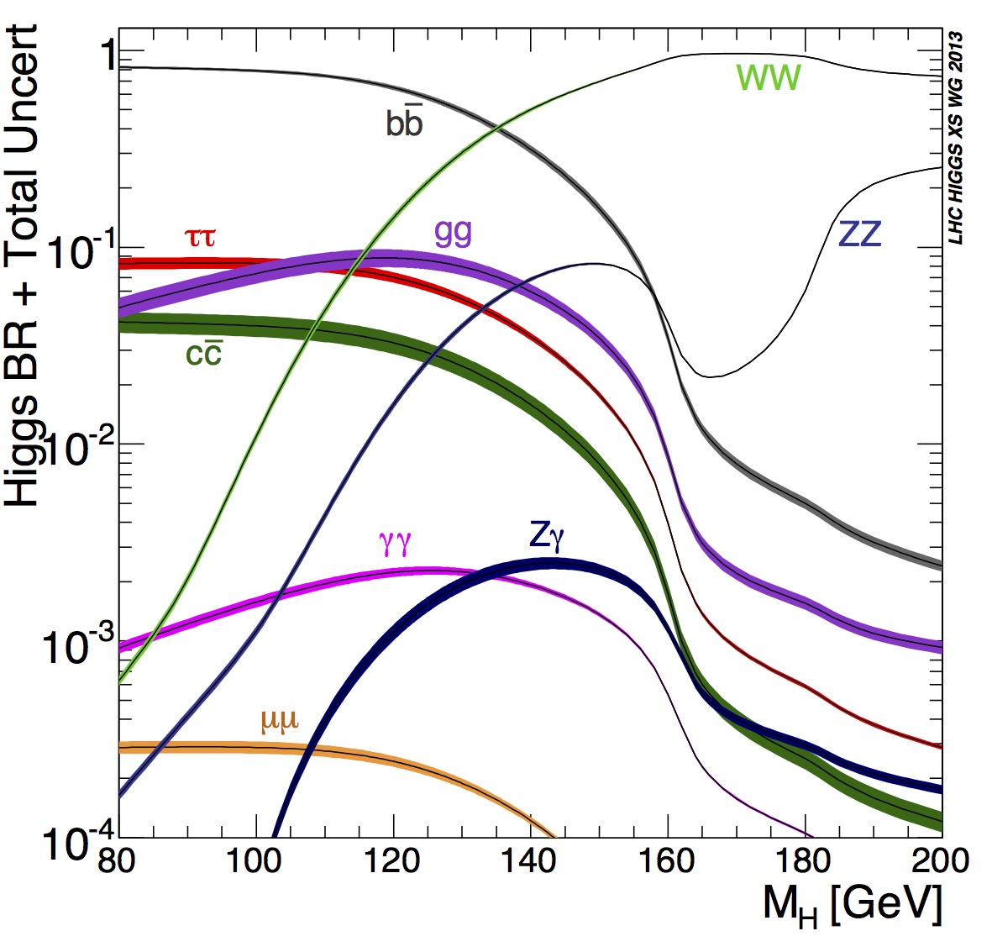
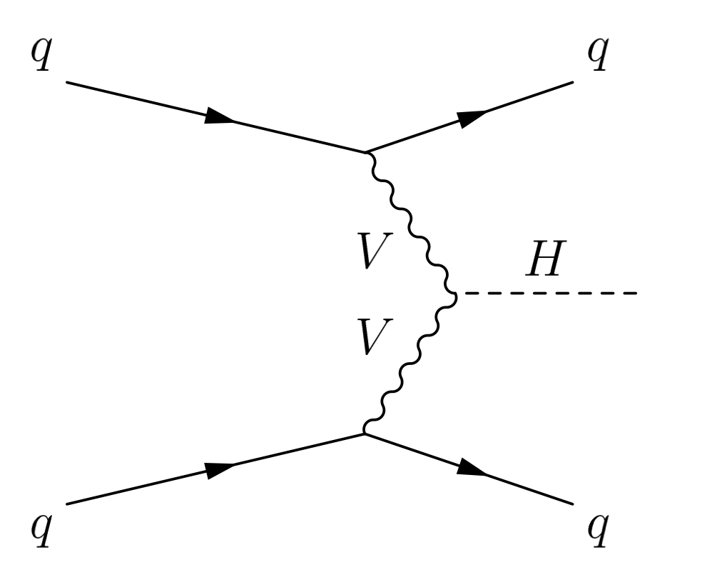
Higgs production and decay modes
Gluon-gluon fusion
Simulated with Monte Carlo generator with Next-to-order accuracy
Vektor-boson fusion
Simulated with NLO accuracy
Other important production modes at LHC:
Production with a vector boson
Top- or bottom-quark pairs

Slide 6
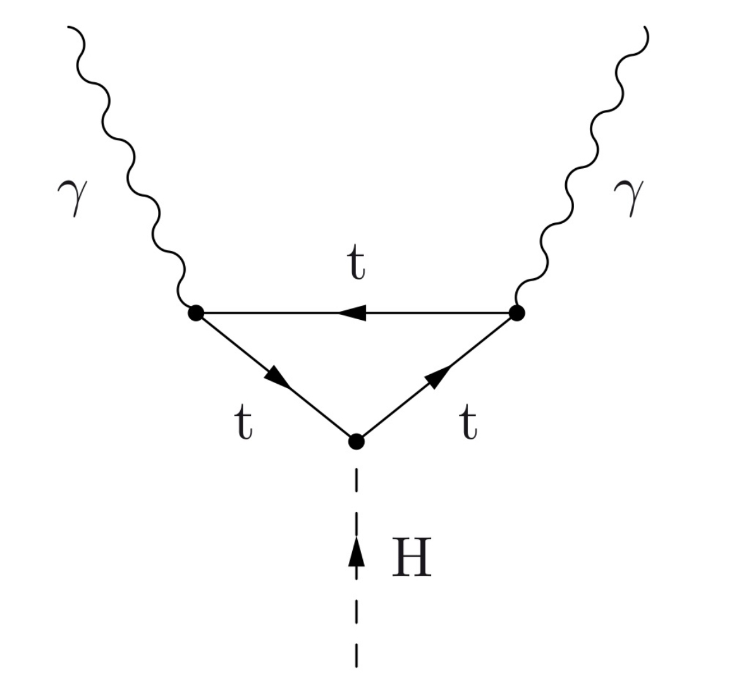
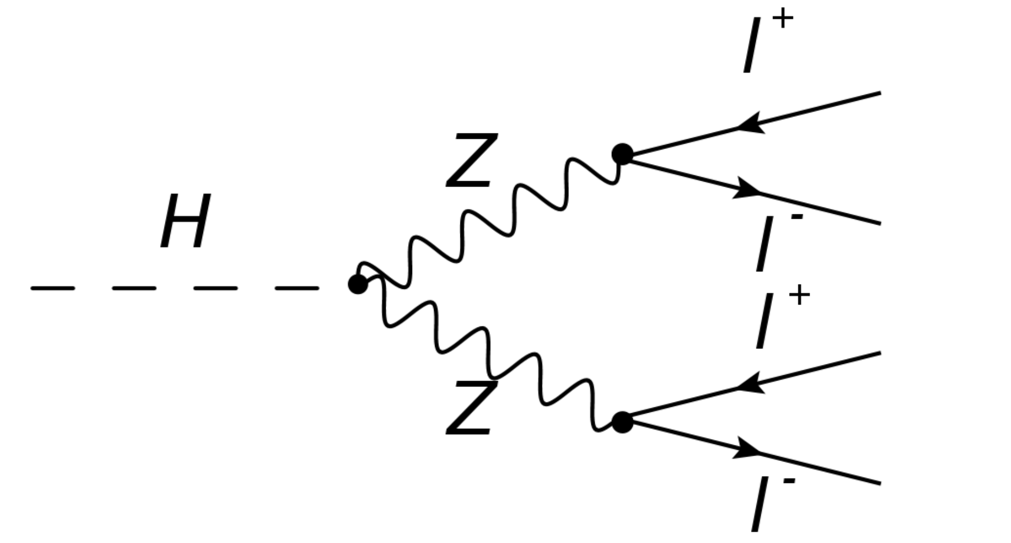
Decay channels
Decay channels
H →$γγ$
H →𝛾𝛾
H → ZZ* → 4𝑙
Run 3 atlas data Integrated luminosity: 31.4 ${fb}^{−1}$
Events that satisfy single- or di-photon triggers are used
*
Integrated luminosity: 29.0 ${fb}^{−1}$
Single-, di- or trilepton trigger events used

Slide 7
Fiducial region
Phase space: where measurements are made, closely matching the detector selection
reduced model dependence & more accurate cross-section measurements
Acceptance is defined by fraction of events passing fiducial selection
Fiducial phase space
Detector measuring range
Total phase space
extrapolating to full space: correction for predicted SM decay branching ratios neccecary

Slide 8
Fit procedure
Cross-section measured via analytic fit to mass spectrum
Background distribution from parameters of analytic function
Correction factor $C_{F}:$ takes detector effects into account
Signal yield $N_{S}$ parameterised: $N_{S}$ = ${\text{σ}}_{fid}$ $×$ $ℒ × C_{F}$
Fiducial cross-section: ${\text{σ}}_{fid}$ = ${\text{σ}}_{tot }× ℬ ×$ $𝒜$
$$C_{F}= \frac{events selected at detector level}{Total number of signal events}$$
$$𝒜= \frac{events passing particle level selection}{Total number of signal events}$$

Slide 9
Photon recunstruction and identification
Photon recunstruction by identifying energy depositions in EM calorimeter
Photons are classified as unconverted and converted
Loose and tight selection criteria (shower shapes and isolations)

Slide 10
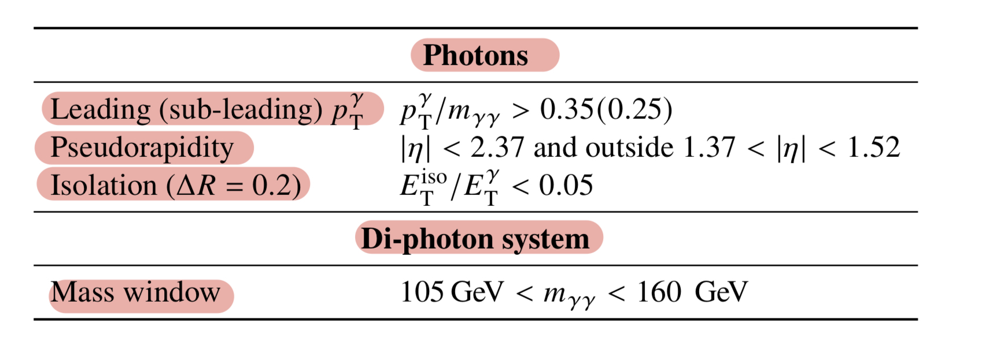
Selection criteria and primary vertex choice
Selection criteria
Primary vertex choice
A neural network algorithm selects the primary vertex, efficiency ~71%, improving $m_{γγ}$ resolution.

Slide 11
H → ZZ* → 4𝑙 : Lepton reconstruction and identification
electrons | muons
Reconstructed from energy clusters in EM calorimeter,matched to tracks in ID | Reconstructed using the MS, matched to tracks from ID
Identified using likelihood-based discriminants. Efficiencies: 85%–90%. | Identified with a loose criterion,efficiency exceeds 98%.

Slide 12
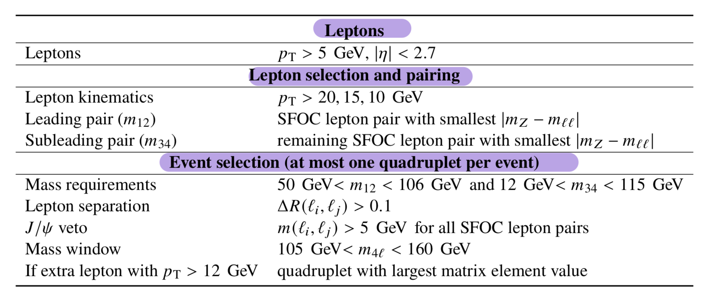
Pairing criteria and other requirements
Pairing Criteria
Same-flavor, opposite-charge (SFOC) lepton pairs are selected
Leading and subleading pairs

Slide 13
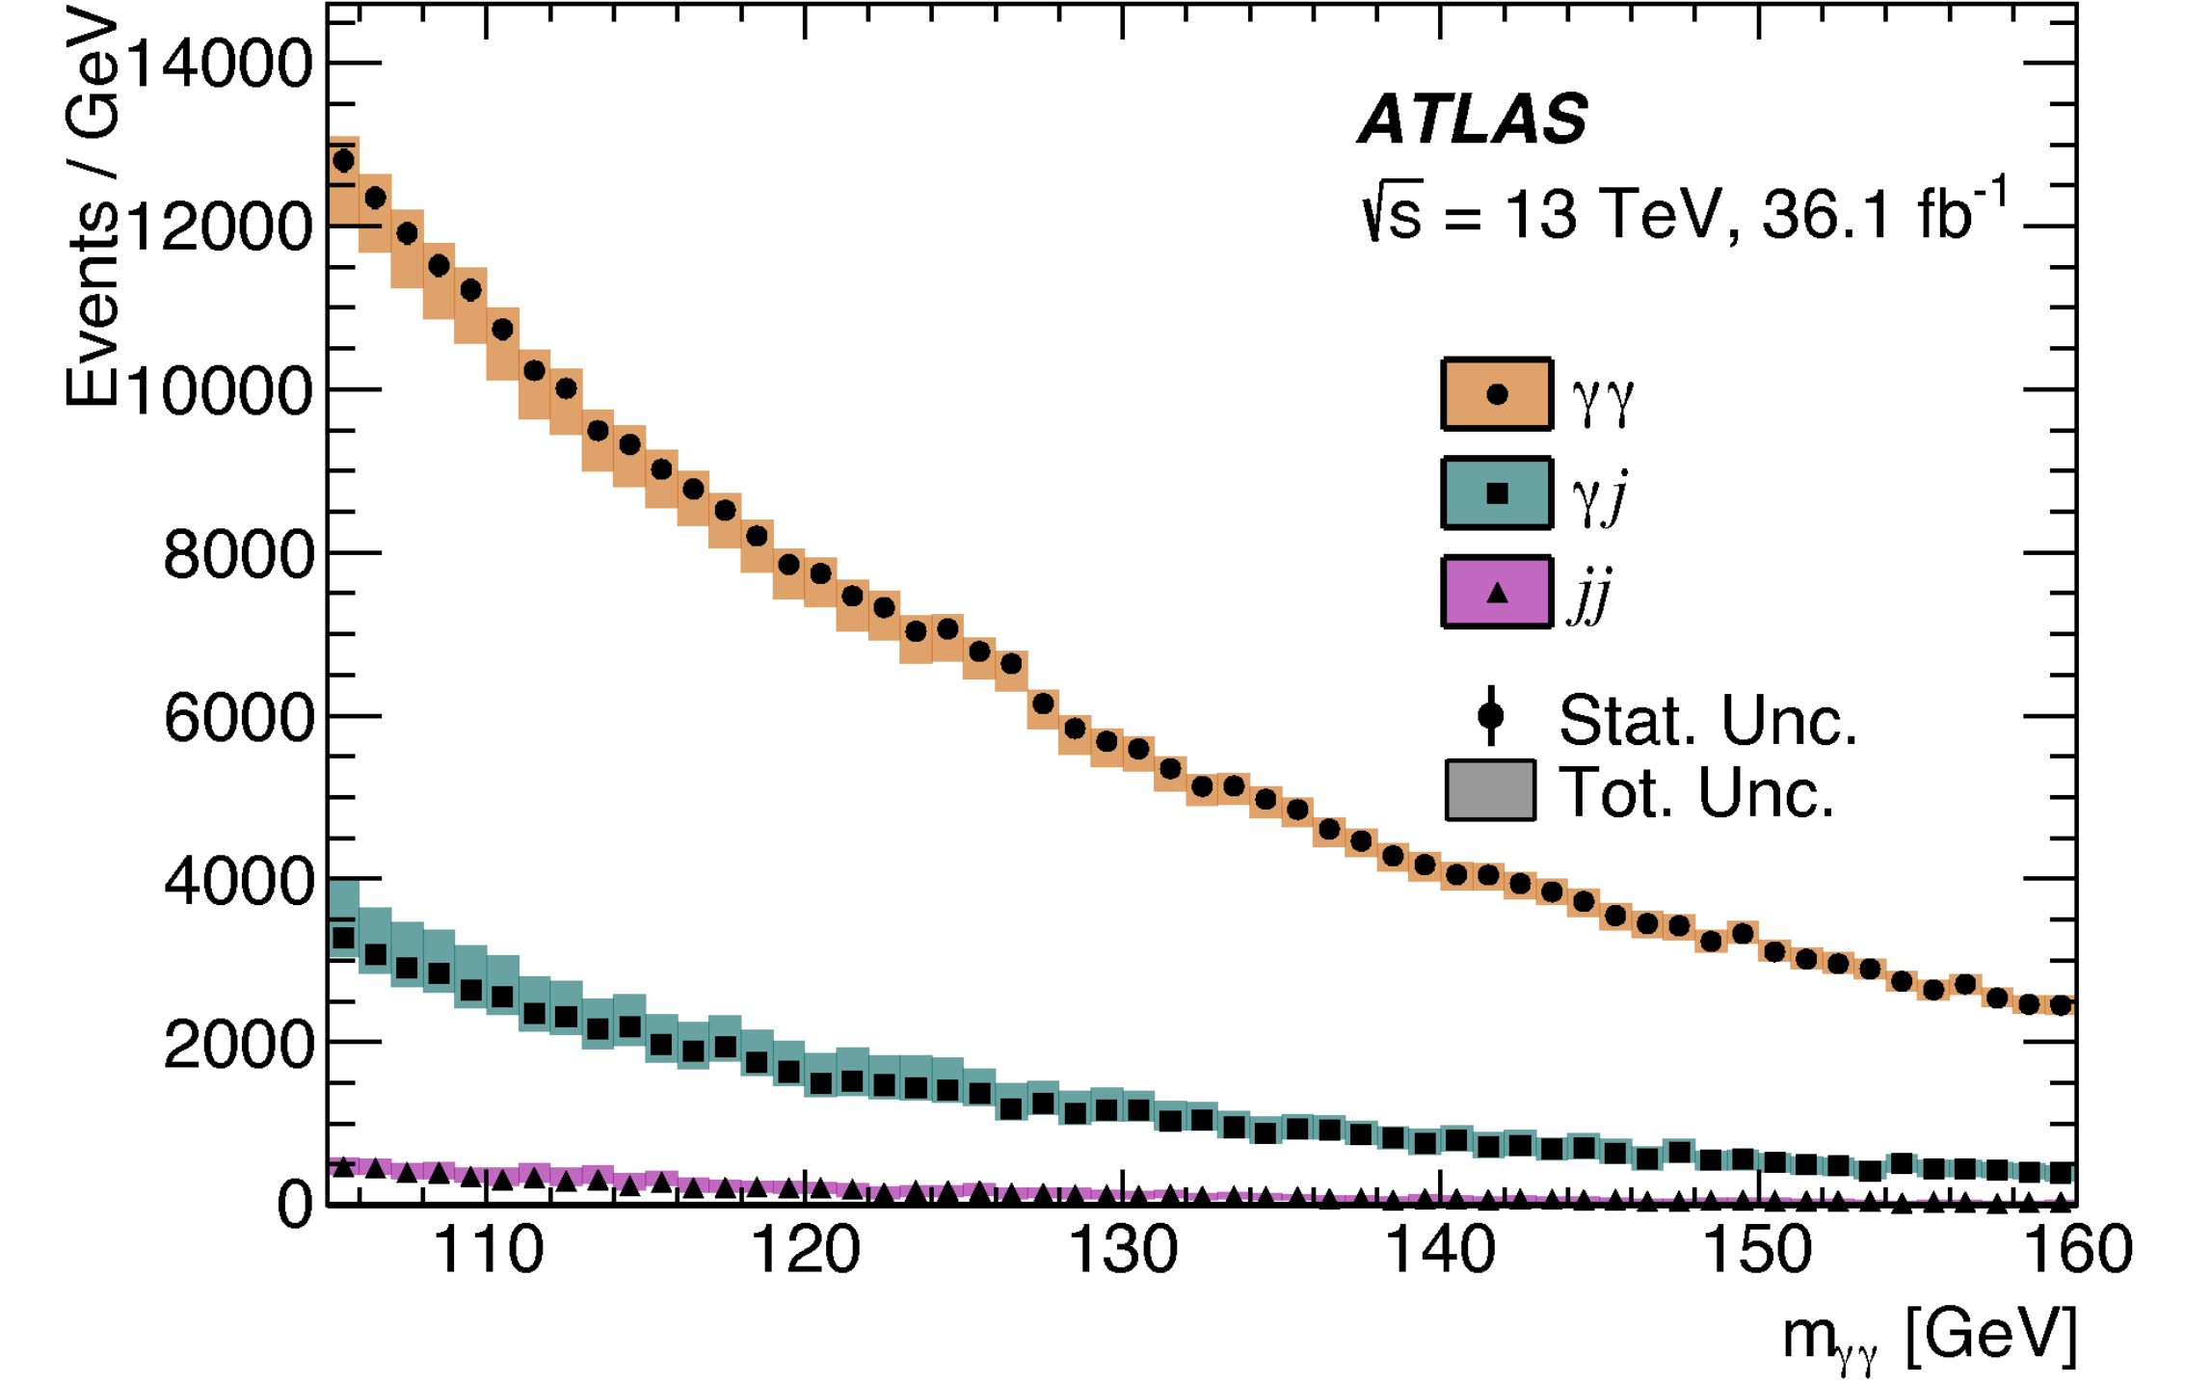
Signal and background modelling of H → $γγ$
Signal modelling:
Double sided crystal ball function
Parameters (mean, width) determined from simulaion & fixed during fit
Background modelling:
Main sources: non-resonnt diphoton production and jet photon misidentification
Data-driven Spurious signal method used

Slide 14
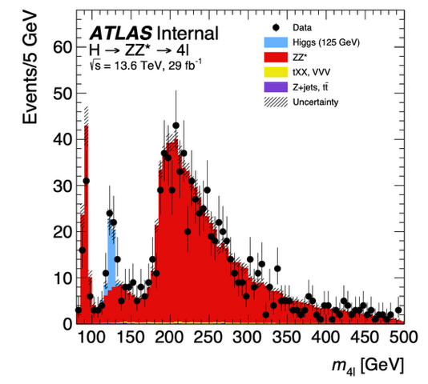
Signal and background modelling of H → ZZ* → 4𝑙
ZZ* continuum background:
Dominant background from non-resonant q$\overline{q}$→ZZ* processes
Gluon-induced ZZ*
Modelled using templates from simulation, scaled to data control regions
Model Dependence:
Theoretical uncertainties impact the fit
Variation in PDFs and QCD scales used to evaluate these dependencies

Slide 15
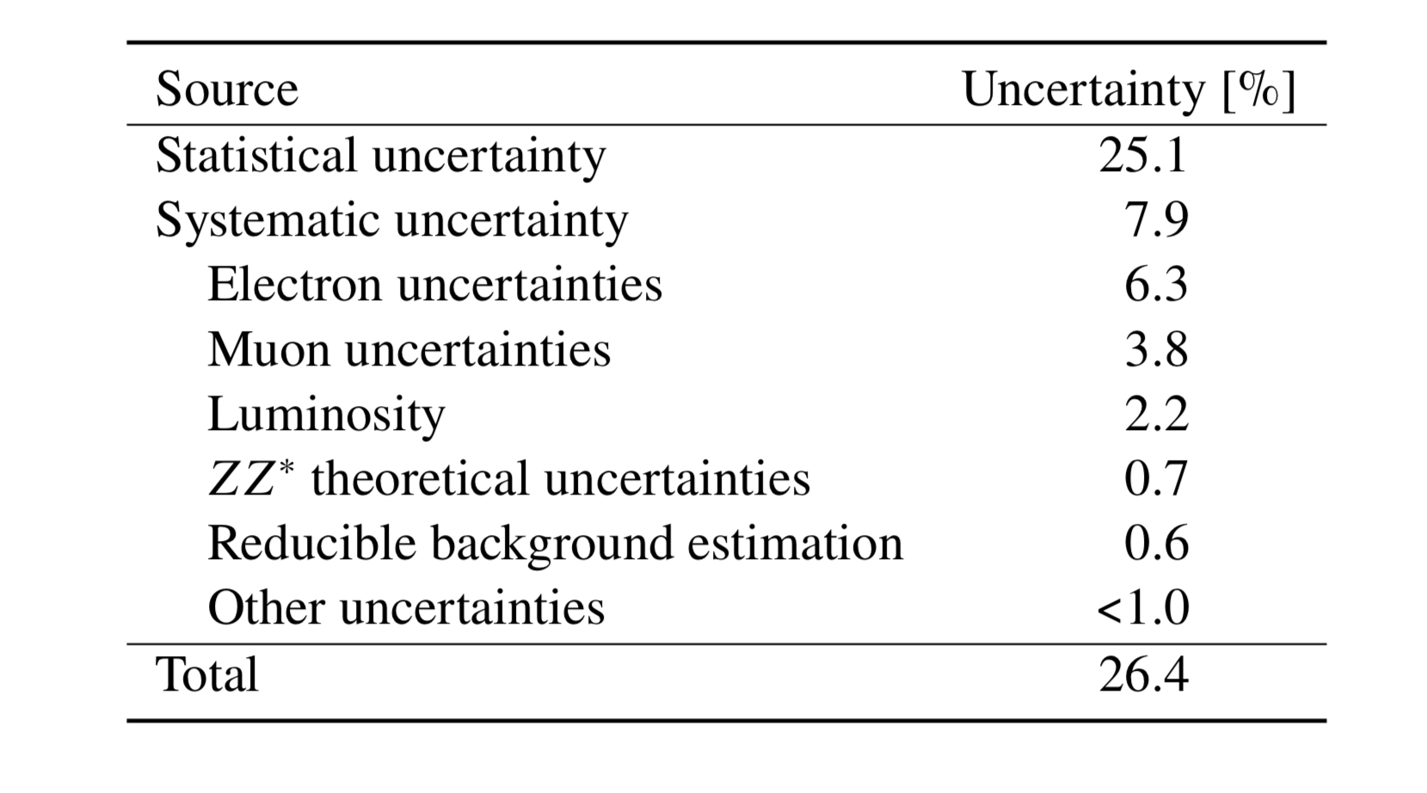
Uncertainty breakdown
For fiducial H → $γγ$ cross-section measurement
For fiducial H → ZZ* → 4𝑙 cross-section measurement

Slide 16
Results of fiducial cross-section measurements for H → $γγ$
fiducial cross-section: ${\text{σ}}_{fid}$ = 76 ± 11 (stat.) +9 (syst.) fb
SM prediction: ${\text{σ}}_{fid,SM}$ = 67.6 ± 3.7 fb.

Slide 17
Results of fiducial cross-section measurements for H → ZZ* → 4𝑙
fiducial cross-section:${\text{σ}}_{fid}$ = 2.80 ± 0.70 (stat.) ± 0.21 (syst.) fb
SM prediction: ${\text{σ}}_{fid,SM}$ = 3.67 ± 0.19 fb.

Slide 18
Results for total cross-section
The total Higgs boson production cross-section at $\sqrt{s}$ = 13.6 TeV :
H → $γγ$: σ(pp → H) = ${67}_{−11}^{+12}$pb.
H → ZZ* → 4l: σ(pp → H) = 46 ± 12 pb.
likelihood combination of the two channels :
σ(pp → H) = 58.2 ± 8.7 pb
All results are consistent with the Standard Model (SM) prediction: σ(pp →H)SM = 59.9 ± 2.6 pb

Slide 19
Conclusion and outlook
Conclusion:
fiducial cross-sections are consistent with SM predictions
Total cross-sections align with theoretical expectations
Statistical uncertainties dominate over systematical uncertainties
These measurements contribute to refining the understanding of the Higgs boson properties
Outlook:
Differential cross-section (hopefully next year)
More Data

Slide 20
Thank you for your attention
Sajena Hamdi
Q&A

Slide 21
sources
https://arxiv.org/pdf/2306.11379
Rest of the sources plus sources for pictures!!!!!

Slide 22
extras
More plots
All feynmann of production and decay

