Slide 1
Search for leptoquarks decaying into the $bτ$ final state in pp collisions at $\sqrt{s}=13 TeV$ with the ATLAS detector
Maria Leibelt
Technical University of Munich
Physics at the Large Hadron Collider
Student Seminar Presentation
13.01.2025

Slide 2
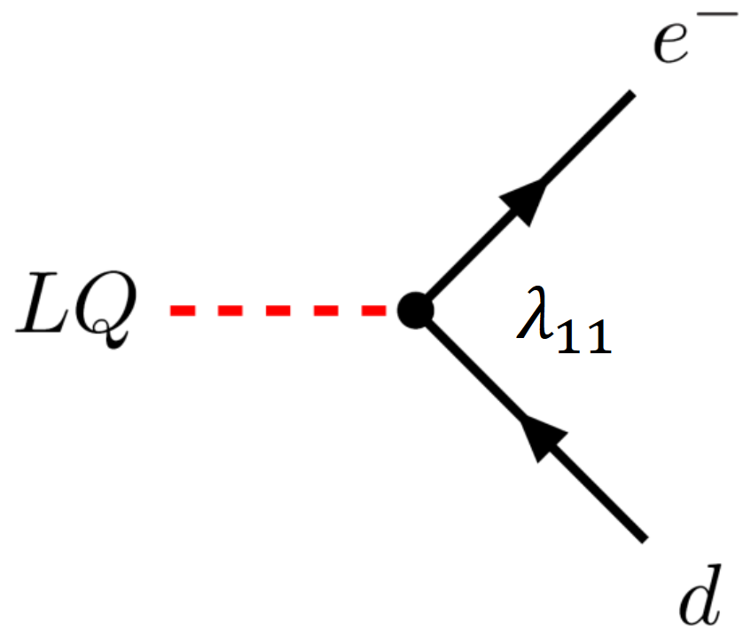
Leptoquarks (LQs)
Leptoquarks
Couple simultaneously to leptons and quarks
Carry color and electric charge
Possible charge: $\frac{1}{3}, \frac{2}{3}, \frac{4}{3}, \frac{5}{3}$
Carry lepton and baryon quantum number
Spin: 0 (scalar LQs), 1 (vector LQs)
Decay into lepton-quark pair
Hints to LQs:
Predicted by Grand Unified Theories
Could explain lepton flavor violation in B decays

Slide 3
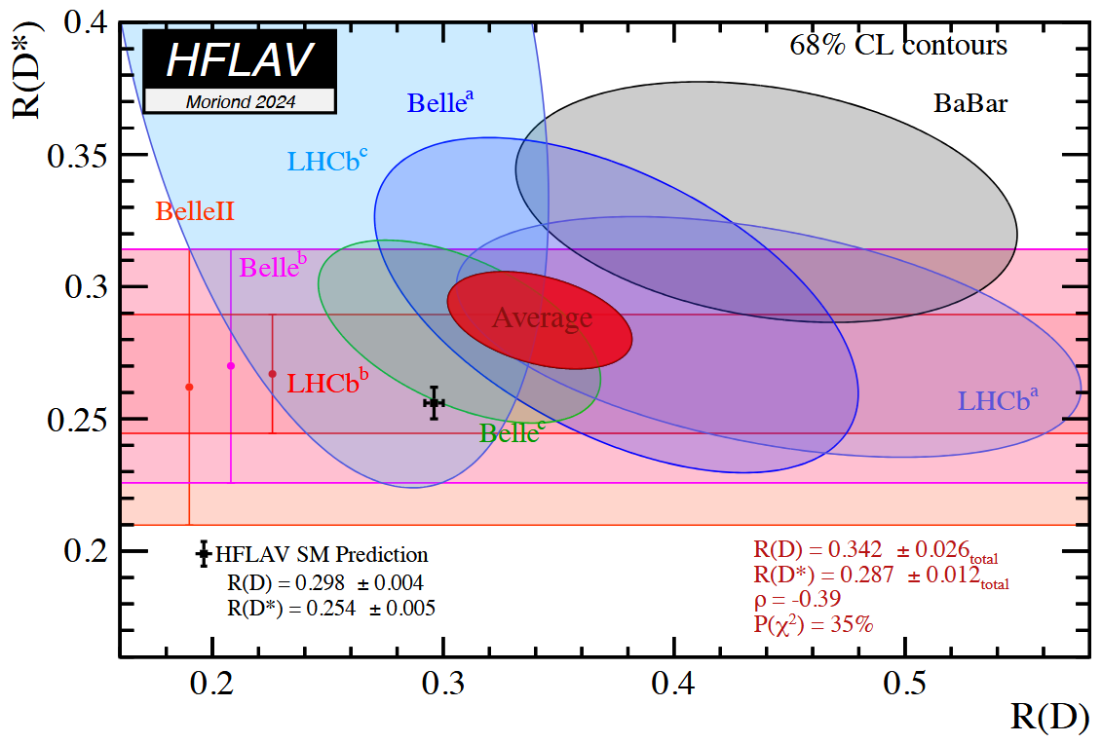
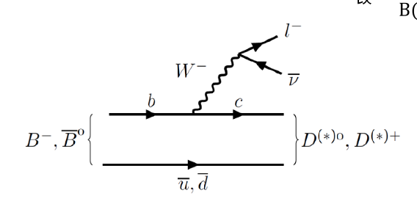
Lepton Flavor Violation
Leptoquarks
Experimental hints towards lepton flavor violation in B decays (global average: $3.2σ$ deviation)
$R\left(D^{\left(∗\right)}\right)=\frac{B\left(B→D^{\left(∗\right)}τν_{τ}\right)}{B\left(B→D^{\left(∗\right)}lν_{l}\right)}$
theory

Slide 4
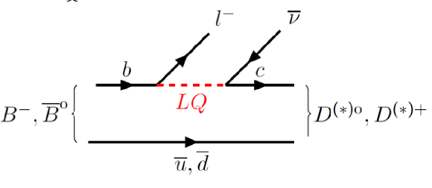
Lepton Flavor Violation
Leptoquarks
Experimental hints towards lepton flavor violation in B decays (global average: $3.2σ$ deviation)
$R\left(D^{\left(∗\right)}\right)=\frac{B\left(B→D^{\left(∗\right)}τν_{τ}\right)}{B\left(B→D^{\left(∗\right)}lν_{l}\right)}$
Possible explanation: Leptoquark couples stronger to the $τ$

Slide 5
Scalar vs. Vector Leptoquarks
Leptoquarks
Scalar Leptoquarks:
Can be “simply” added to the Standard Model (SM)
Addition of Yukawa terms to the Lagrangian of the SM
Vector Leptoquarks:
Introduction of a new gauge interaction
Require a bigger symmetry group
Theories predict more heavy-mass particles (coloron: $g^{′}$, heavy “Z”: $Z^{′}$)
Two main different scenarios, depending on the strength of the coupling:
Minimal Coupling (simplest interaction between a field and a gauge field)
Yang-Mills (considers more complicated dynamics)

Slide 6
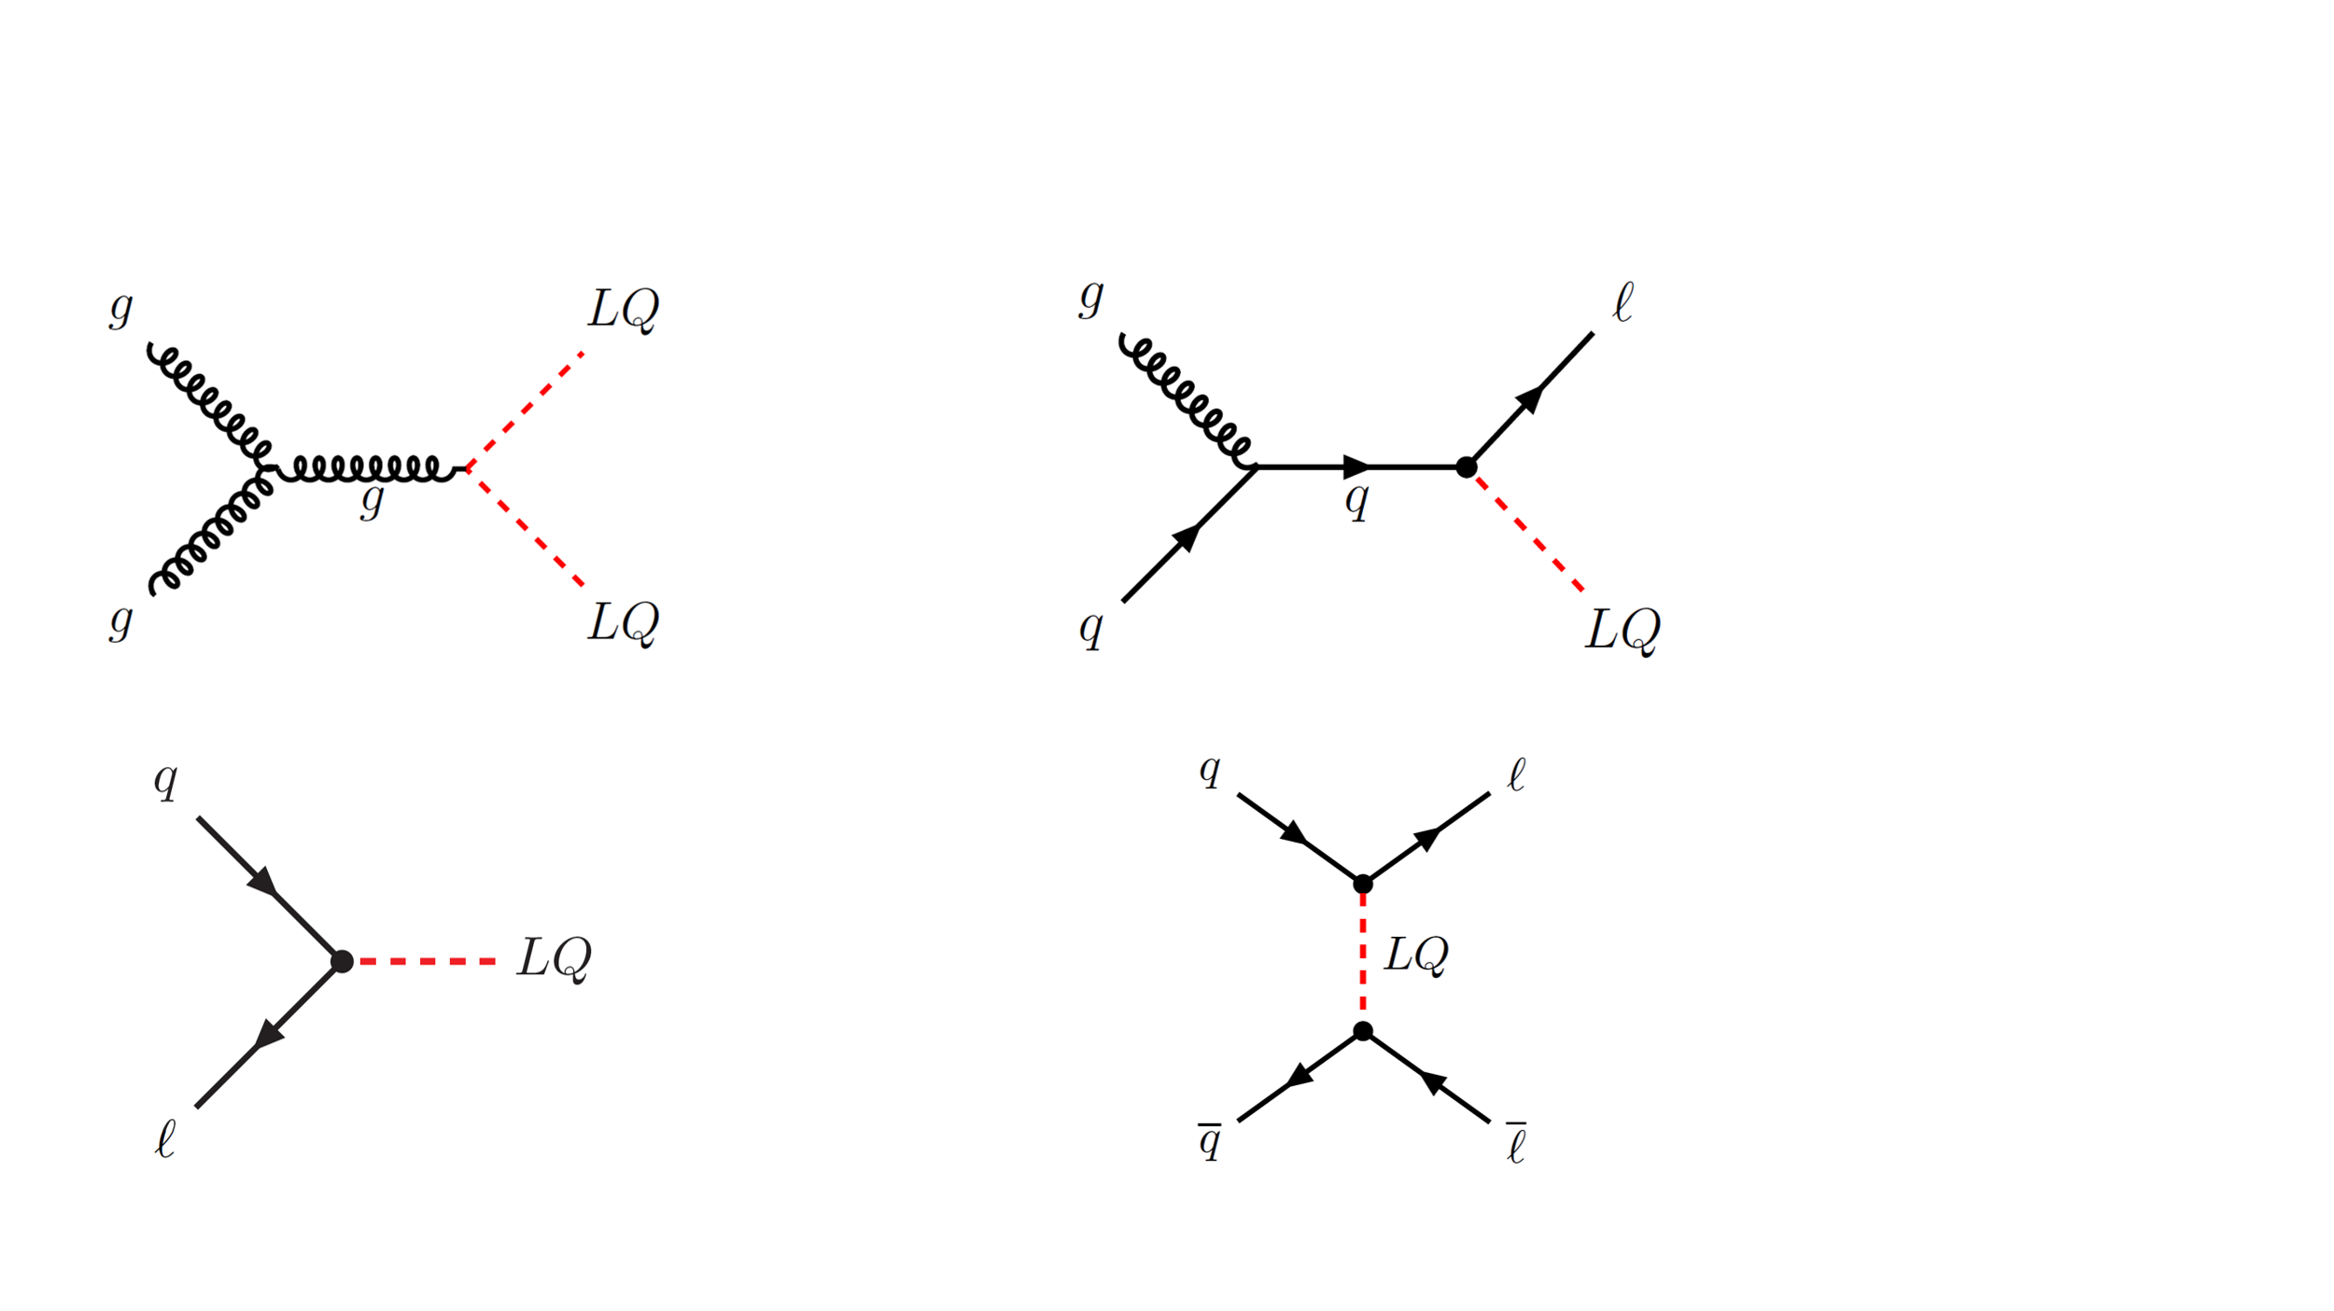
Production Modes
Leptoquarks
Pair Production
Single Production
Resonant Production
Drell-Yan Production

Slide 7
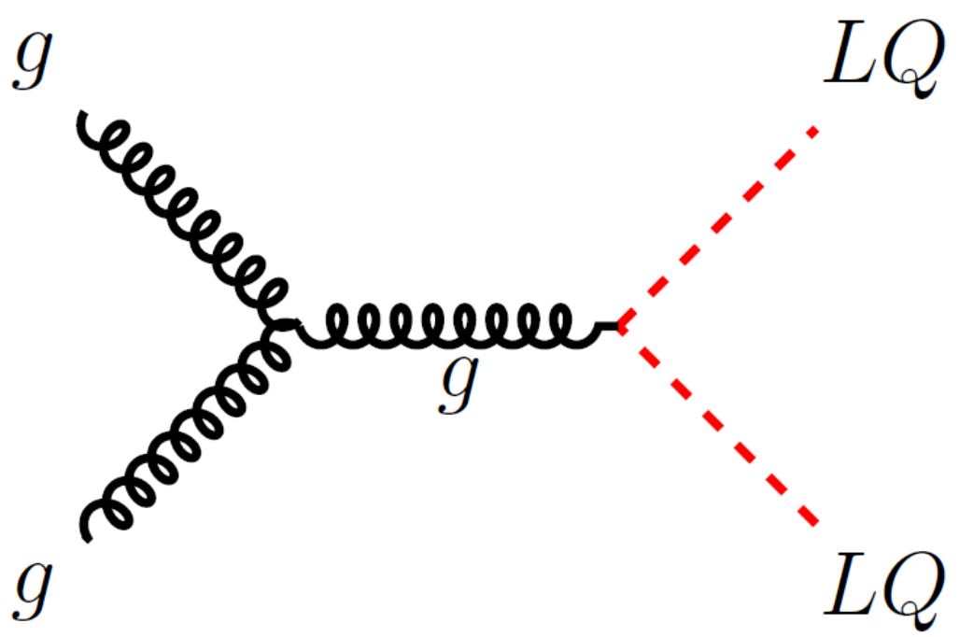
Pair Production
Leptoquarks
$$g_{s}$$
$$g_{s}$$
Only dependent on strong coupling $g_{s}$
Only new parameter beyond the Standard Model: leptoquark mass $m_{LQ}$
Final state: two lepton-quark (jet) pairs

Slide 8
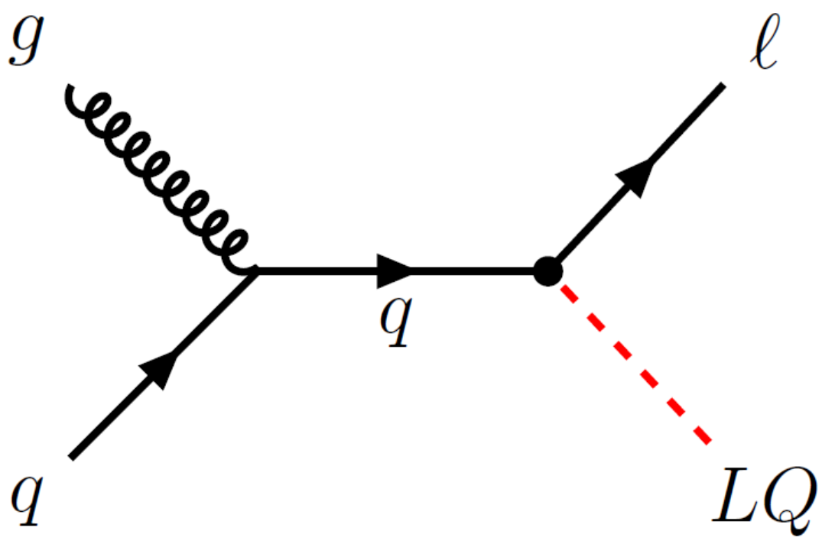
Single Production
Leptoquarks
$$g_{s}$$
$$λ$$
Contains one production vertex with LQ-to-fermion coupling $λ$
Final state: one lepton-jet pair from the LQ decay and an additional lepton

Slide 9
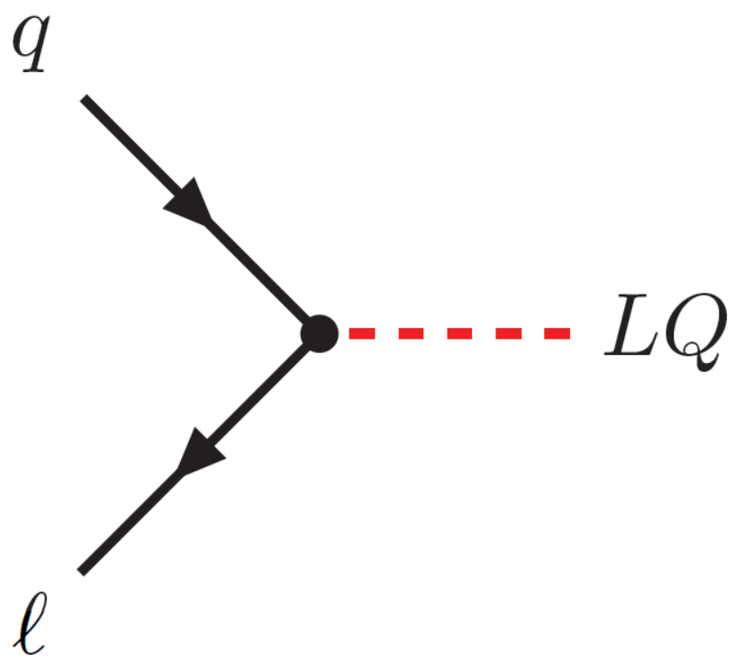
Resonant Production
Leptoquarks
$$λ$$
$$l$$
$$\overline{l}$$
$$q$$
Needs lepton from proton (quantum fluctuation)
Contains one production vertex with LQ-to-fermion coupling $λ$
Final state: one lepton-jet pair from the LQ decay
$$p$$

Slide 10
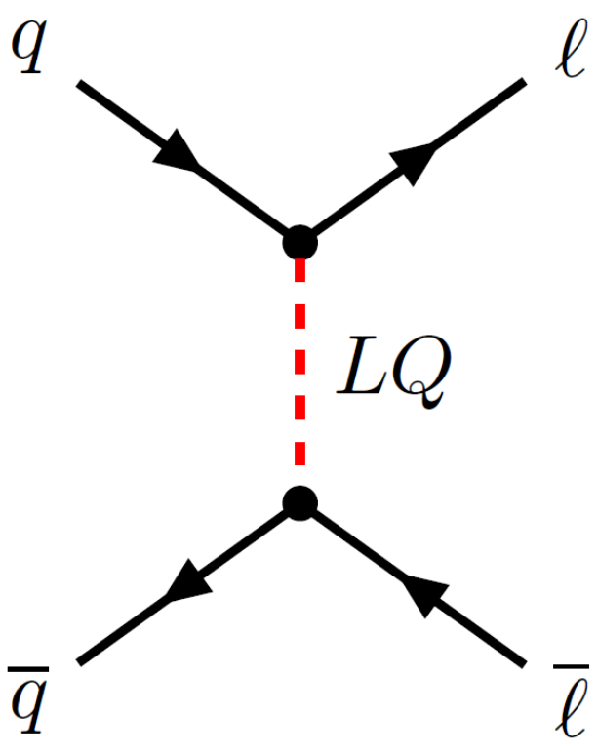
Drell-Yan Production
Leptoquarks
$$λ$$
$$λ$$
Contains two production vertices with LQ-to-fermion coupling $λ$
Final state: two leptons

Slide 11
Focus of the Paper
Focus
Decay of leptoquarks in the $bτ$ final state
Motivated by $R\left(D^{\left(∗\right)}\right)$anomaly
ATLAS Run 2 measurements $\left(\sqrt{s}=13 TeV\right)$
Pair production, single production and Drell-Yan production

Slide 12
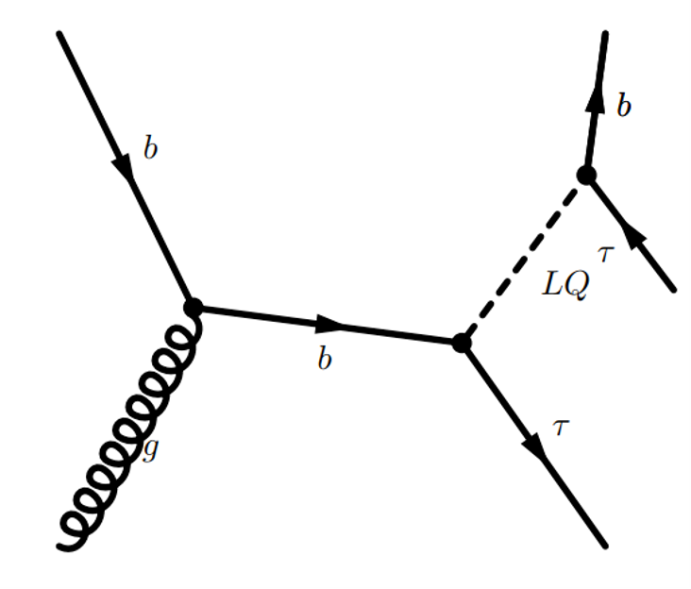
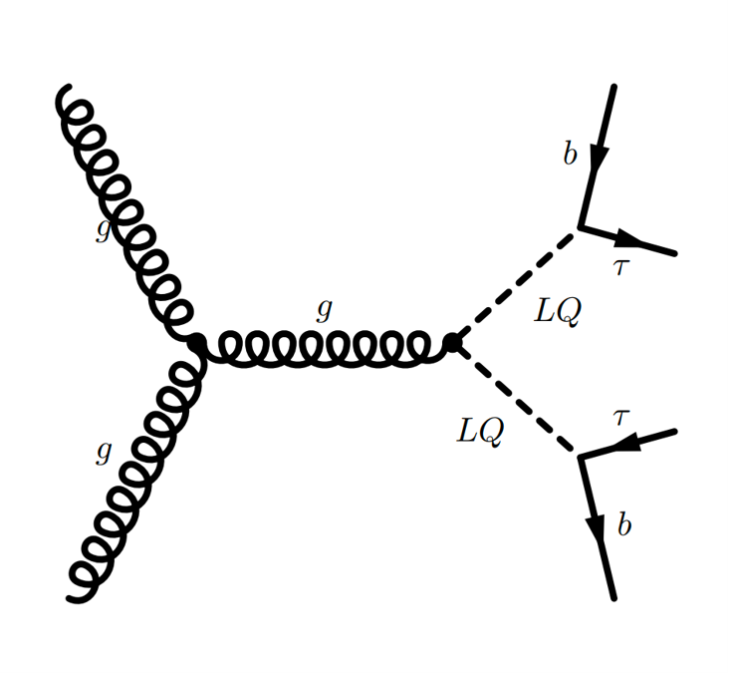
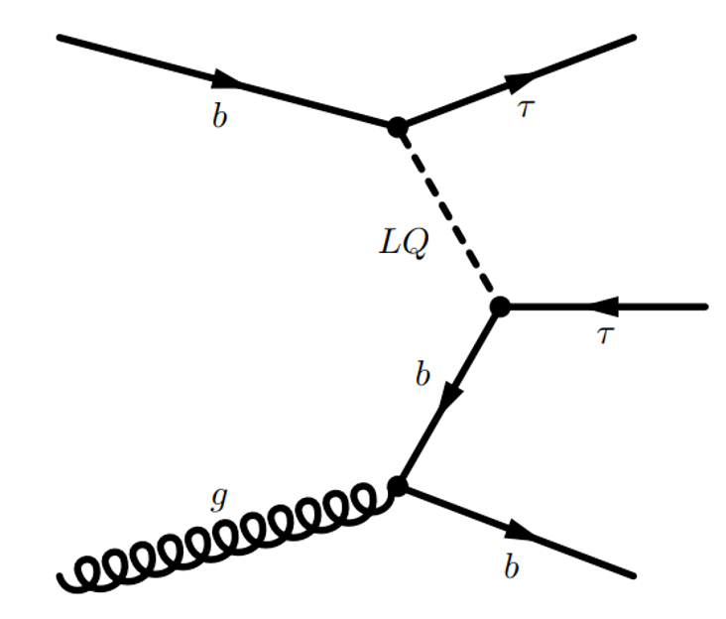
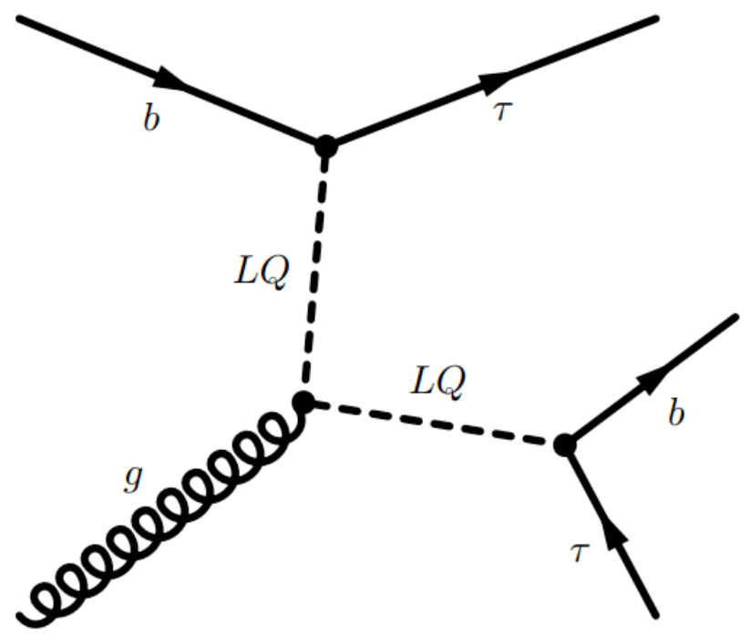
Focus of the Paper
Focus
Pair Production
Drell-Yan Production
Single Production

Slide 13
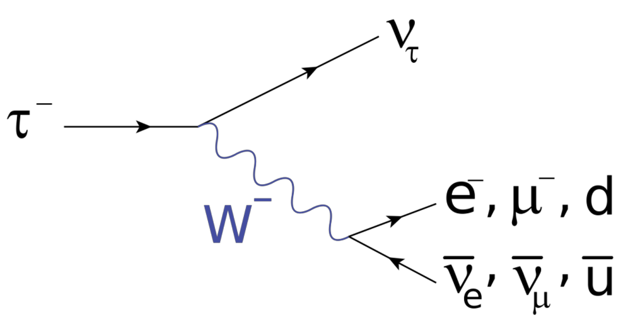
Focus of the Paper
Focus
Decay of leptoquarks in the $bτ$ final state
Motivated by $R\left(D^{\left(∗\right)}\right)$anomaly
ATLAS Run 2 measurements $\left(\sqrt{s}=13 TeV\right)$
Pair production, single production and Drell-Yan production
Analysis signature: 2x jets (one must contain a b-hadron) and 2x $τ$-leptons
$τ$-decays:
Channels: ${τ_{had}τ}_{lep}(≈46\%), τ_{had}τ_{had}(≈42\%)$
$$τ_{had}^{−}$$
$$64.8\%$$
$$τ_{lep}^{−}$$
$$35.2\%$$

Slide 14
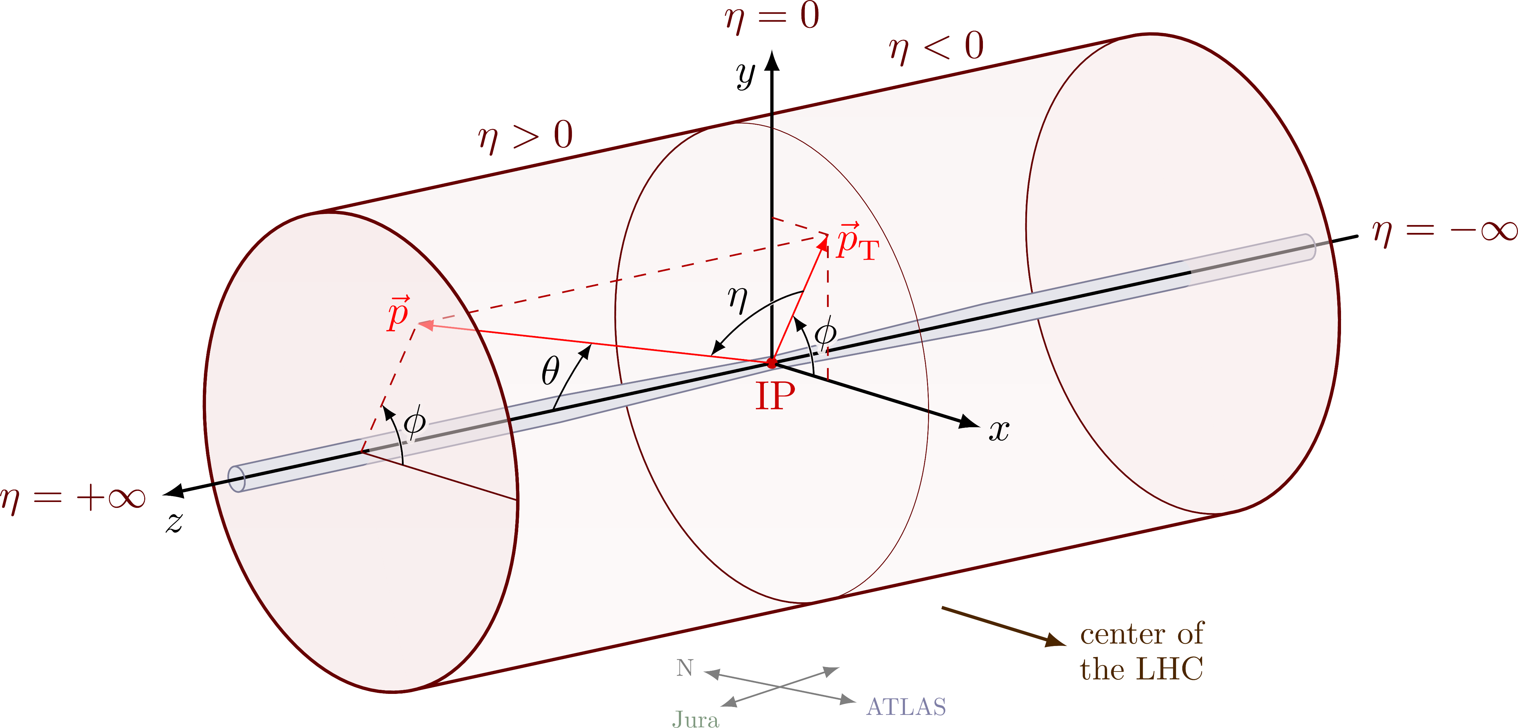
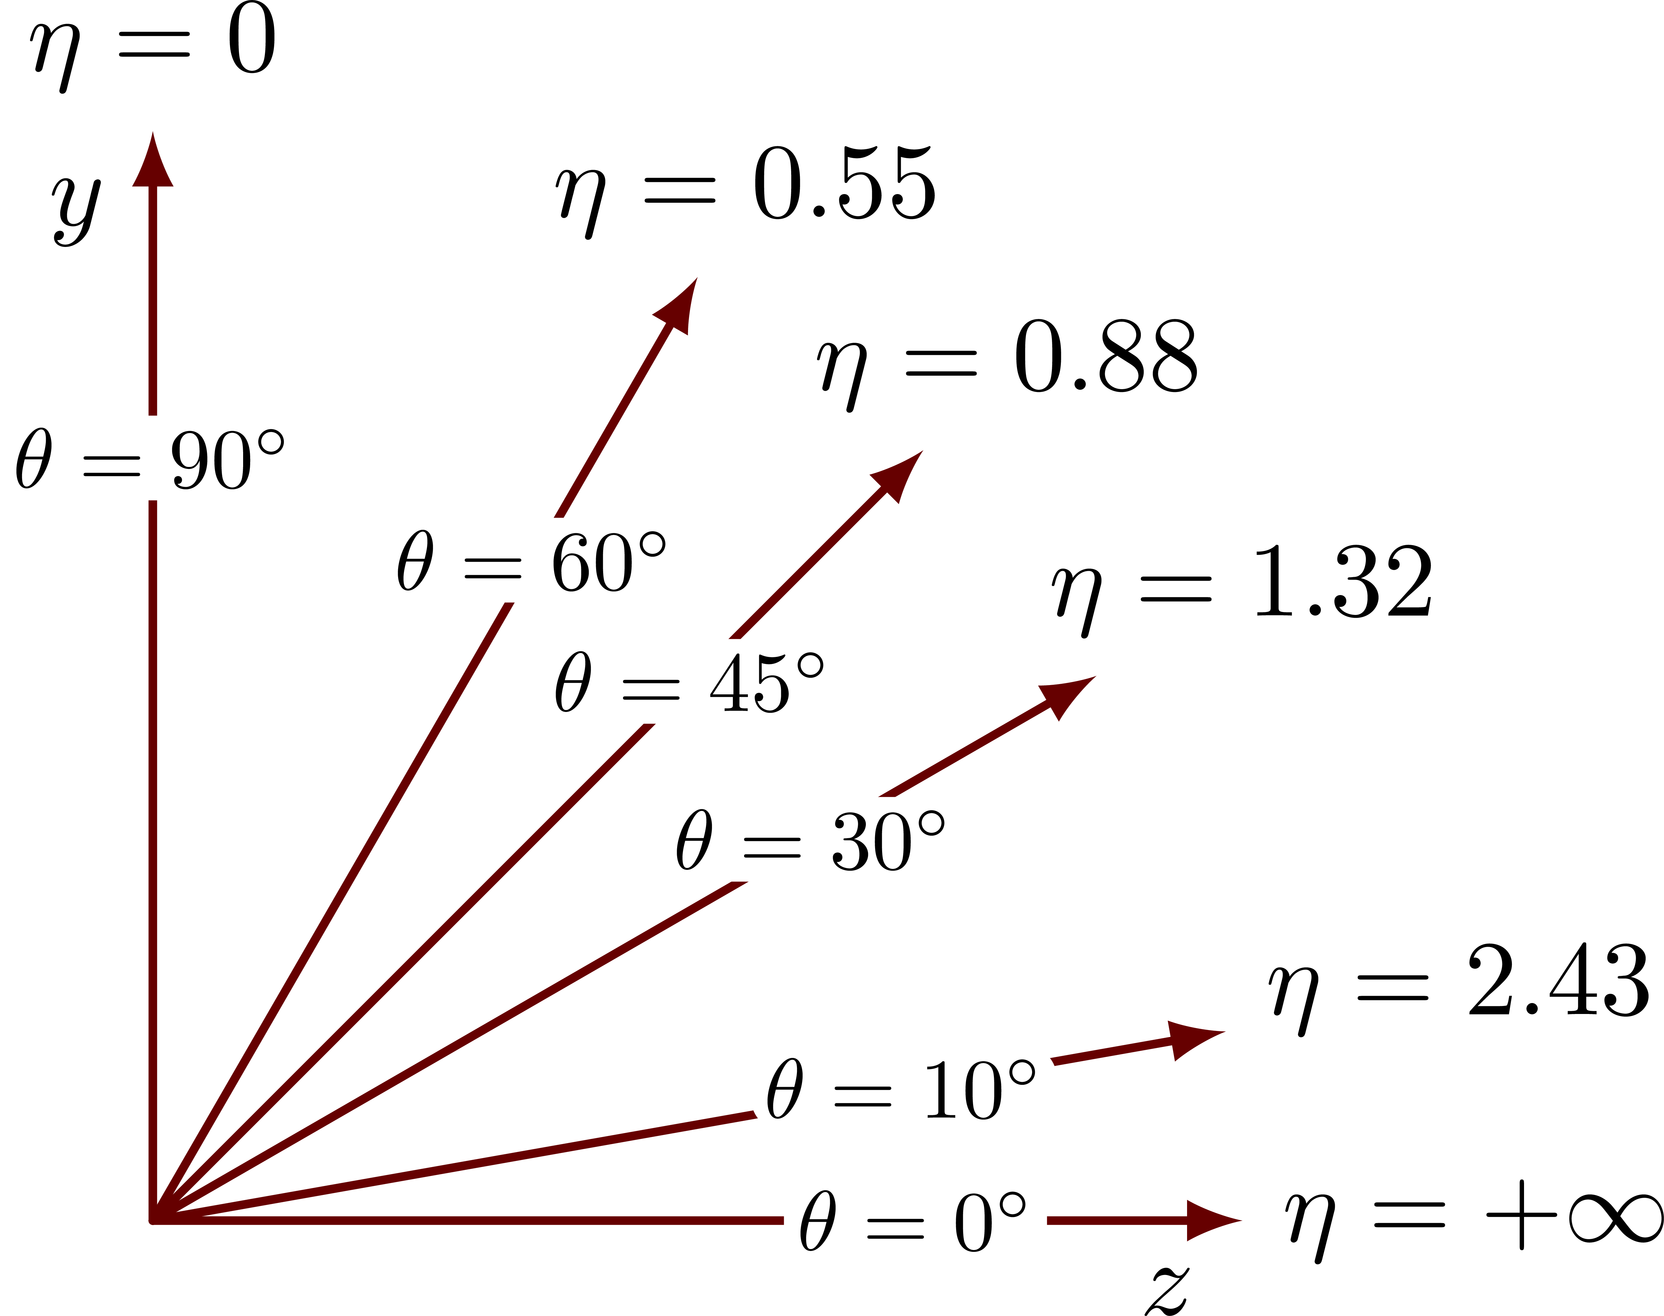
Object Reconstruction and Identification
Object Reconstruction and Identification
Jets:
Reconstructed with a particle-flow algorithm
Combines energy deposits in the calorimeter with ID tracks (anti-$k_{t}$ algorithm)
$R=0.4$
$\left|η\right|<2.5$
b-jets: DL1r b-tagging algorithm
$$R≥ΔR=\sqrt{{\left(Δη\right)}^{2}+{\left(Δφ\right)}^{2}}$$

Slide 15
Object Reconstruction and Identification
Object Reconstruction and Identification
$τ$:
Categorize $τ$ in $τ_{lep}$ and $τ_{had}$
$τ_{lep}$ decays into two neutrinos and a lepton
Reconstruct only the lepton
$τ_{had}$ decays contain a neutrino and visible decay products ($τ_{had,vis}$)
Reconstruct the jets by the anti-$k_{t}$ algorithm
$R=0.4$
$\left|η\right|<2.5$
Recurrent neural network identification algorithm separates $τ_{had,vis}$ candidates produced by
hadronic $τ$-lepton decays $→$ keep
jets initiated by quarks or gluons $→$ reject

Slide 16
Control Region (CR)
Background Modeling in the Signal Region
Validation Region (VR)
Check the consistency of the background modeling
Signal Region (SR)
Region most sensitive to the expected signal Criteria are chosen to maximize the signal-to-background ratio

Slide 17
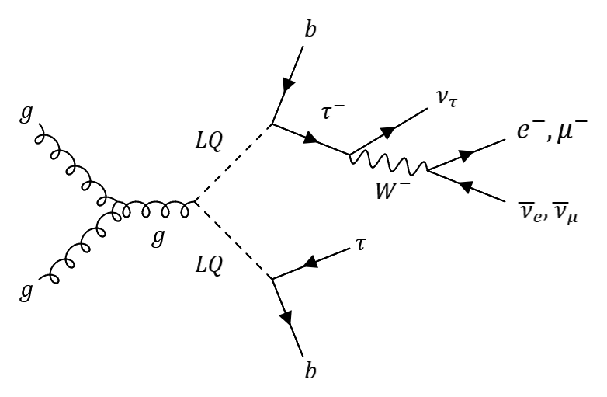
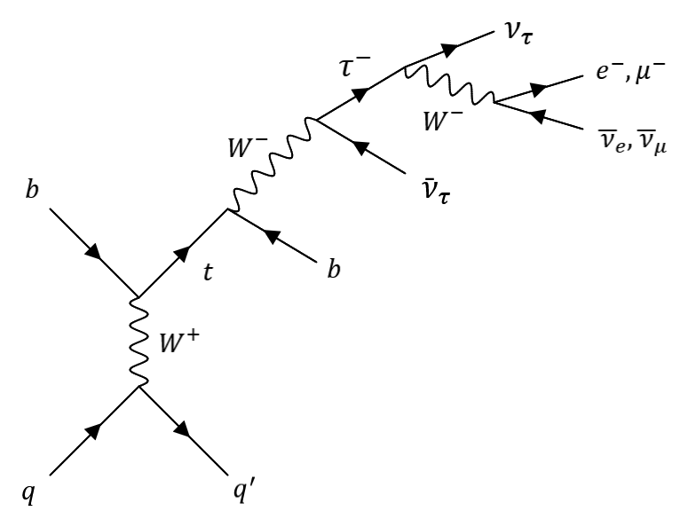
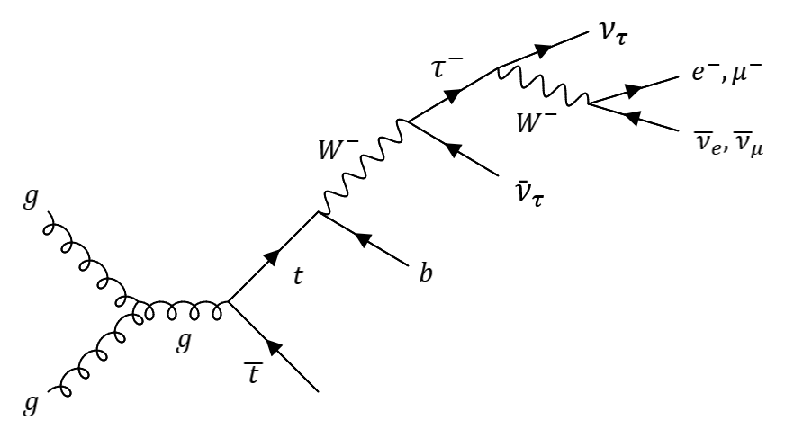
Event Selection
Event Selection
$$p_{T}$$
$$e^{−}/μ^{−}$$
Jet
$τ_{lep}τ_{had}$ channel:
Selected by single-lepton triggers
Events must contain at least one $τ_{had}$ candidate and exactly one $e^{−}$ or one $μ^{−}$
$\left|η\right|<2.3$
$Δφ\left(l,E_{T}^{miss}\right)<1.5$
Reduce $t\overline{t}$ and single top events
$$p_{T,miss}$$
$$p_{T}$$
$$e^{−}/μ^{−}$$
Jet
$$LQ$$
$$t$$
$$t$$
$$p_{T,miss}$$
$$\overline{t}$$

Slide 18
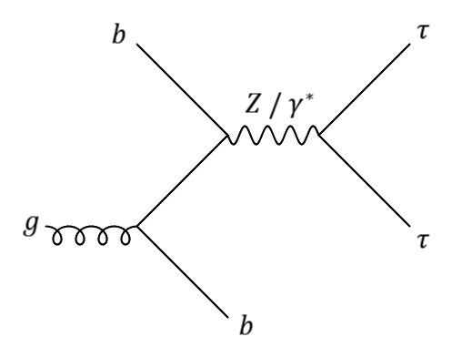
Event Selection
Event Selection
$τ_{had}τ_{had}$ channel:
Selected by a single $τ_{had}$ trigger
Events must contain at least two $τ_{had}$ candidates
Leading $τ_{had}$ candidate in $p_{T}$ must be matched to the trigger within $ΔR=0.2$
For both channels:
$τ_{had}/τ_{lep}$ and $τ_{had}$ must have opposite electric charges
At least one b-tagged jet
$m_{vis}\left(l,τ_{had}\right)$ or $m_{vis}\left(τ_{had},τ_{had}\right)>100 GeV$
Reduce Z/$γ^{∗}→ττ$ background $\left(m_{Z}=90 GeV\right)$
$S_{T}>300 GeV$
$S_{T}>300 GeV$

Slide 19
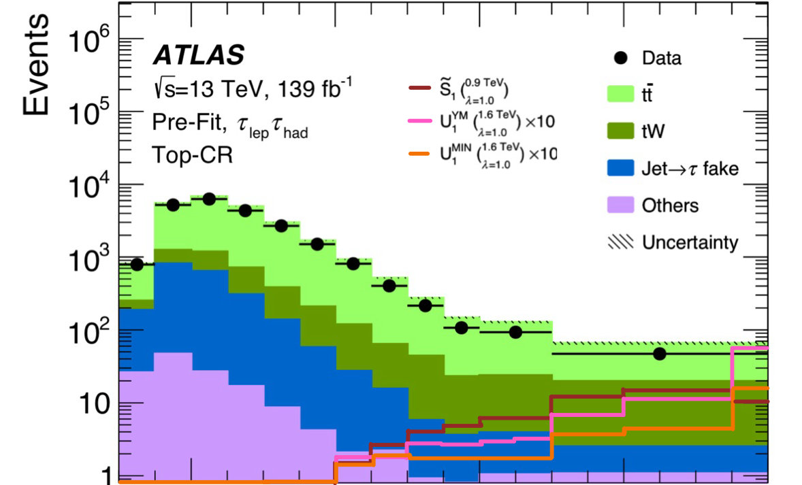
Event Selection
Event Selection
$S_{T}>300 GeV$
$S_{T}=p_{T}\left(τ_{had}\right)+p_{T}(τ_{had}/τ_{lep}$)$+p_{T}(\text{leading} \text{b}\text{−}\text{jet})$
$$300 GeV$$

Slide 20
Signal Region
Event Selection
Take the cuts from event selection
Devide the $τ_{lep}τ_{had}$ and the $τ_{had}τ_{had}$ channel into:
High b-jet $p_{T}$ region $→p_{T,leading}>200 GeV$
Low b-jet $p_{T}$ region $→p_{T,leading}<200 GeV$ (targets especially Drell-Yan Production)
4 signal regions

Slide 21
Background Estimation
Background Estimation
$τ_{lep}τ_{had}$ channel:
Dominant background: $t\overline{t}$ and single top-quark events
Can produce $τ$-leptons, or jets that get misidentified as $τ_{had}$
Estimated by simulation
Control regions:
Top$→$ Derive top correction
$$τ$$
$$τ$$
$$τ$$
$$τ$$
$$→τ$$
$$→τ$$
$$SF_{Top}\left(S_{T}\right)$$
$$SF_{Top}\left(S_{T}\right)$$

Slide 22
Background Estimation
Background Estimation
$τ_{lep}τ_{had}$ channel:
Dominant background: $t\overline{t}$ and single top-quark events
Can produce $τ$-leptons, or jets that get misidentified as $τ_{had}$
Estimated by simulation
Control regions:
Top$→$ top correction scale factor
Multijet $→$ lepton fake factor
Z+heavy flavor jets $→$ ZHF scale factor
Validation region:
High b-jet $p_{T}$
Low b-jet $p_{T}$

Slide 23
Background Estimation
Background Estimation
$τ_{had}τ_{had}$ channel:
Dominant background: top-quark events and$Z/γ^{∗}→τ_{had}τ_{had}$
Estimated by simulation
Apply the same Top and Z+heavy flavor jets correction as for the $τ_{lep}τ_{had}$ channel
Control regions$:$
First $τ_{had}$ $→$ $τ_{had,vis,1}$ fake-factor
Second $τ_{had}→$ Apply $τ_{had,vis,1}$ fake-factor $→$ $τ_{had,vis,2}$ fake-factor
Validation regions:
$τ_{had,vis}$ $→$ $τ_{had}$ modelling check
Z+ light flavor jets $→$ Check if correction would have been needed (→No)

Slide 24
Results
Results
Apply systematic uncertainties (experimental & modeling)
Too high uncertainties for Drell-Yan Production $→$ no Results
Only high b-jet $p_{T}$ Region
Benchmark model:
$U_{1}$: Vector LQs in the Yang-Mills $\left(U_{1}^{YM}\right)$ or Minimal coupling $\left(U_{1}^{MIN}\right)$ scenarios
${\tilde{S}}_{1}$: Scalar LQs
Consider $λ$ between $0.5$ and $2.5$
Fit data with likelihood function $ℒ(μ,$ $θ$) under background only hypothesis:
$ℒ$is a product of poisson distribution of each $S_{T}$ bin and (mostly) gaussian constraint terms of $θ$
$θ$ …nuisance parameters
$μ$ …signal strength (parameter of interest)
$μ=0:$ data is consistent with no leptoquark signal (background only)

Slide 25
Results
Results
Apply systematic uncertainties (experimental & modeling)
Only high b-jet $p_{T}$ Region $→$ does not include Drell-Yan Production
Benchmark model:
$U_{1}$: Vector LQs in the Yang-Mills $\left(U_{1}^{YM}\right)$ or Minimal coupling $\left(U_{1}^{MIN}\right)$ scenarios
${\tilde{S}}_{1}$: Scalar LQs
Consider $λ$ between $0.5$ and $2.5$
Fit data with likelihood function $ℒ(μ,$ $θ$) under background only hypothesis:
$ℒ$is a product of poisson distributions for each event observed in different $S_{T}$ bins
$θ$ …nuisance parameters
$μ$ …signal strength
$μ=0:$ data is consistent with no leptoquark signal (background only)
Example: Prediction of $0.1$ events from leptoquark production in a given mass range
If fit gives $μ≈5$ $→$ observed signal is $5$ times stronger than the benchmark prediction
If fit gives $μ≈0.5$ $→$ observed signal is half as strong as the benchmark prediction

Slide 26
Results
Results
Calculate profile likelihood ratio:
$Λ\left(μ\right)=\frac{ℒ\left(μ,\hat{\hat{θ}}\right)}{ℒ\left(\hat{μ},{\hat{θ}}_{ }\right)}$
evaluate how well a specific value of $μ$fits the data relative to the best fit
Construct test statistic ${\tilde{q}}_{μ}=−2ln⁡(Λ)$
Check background only hypothesis
Derive discovery significance from test statistic for the no-signal scenario ${\tilde{q}}_{μ}=0$
best possible fit for a fixed $μ$
best possible fit

Slide 27
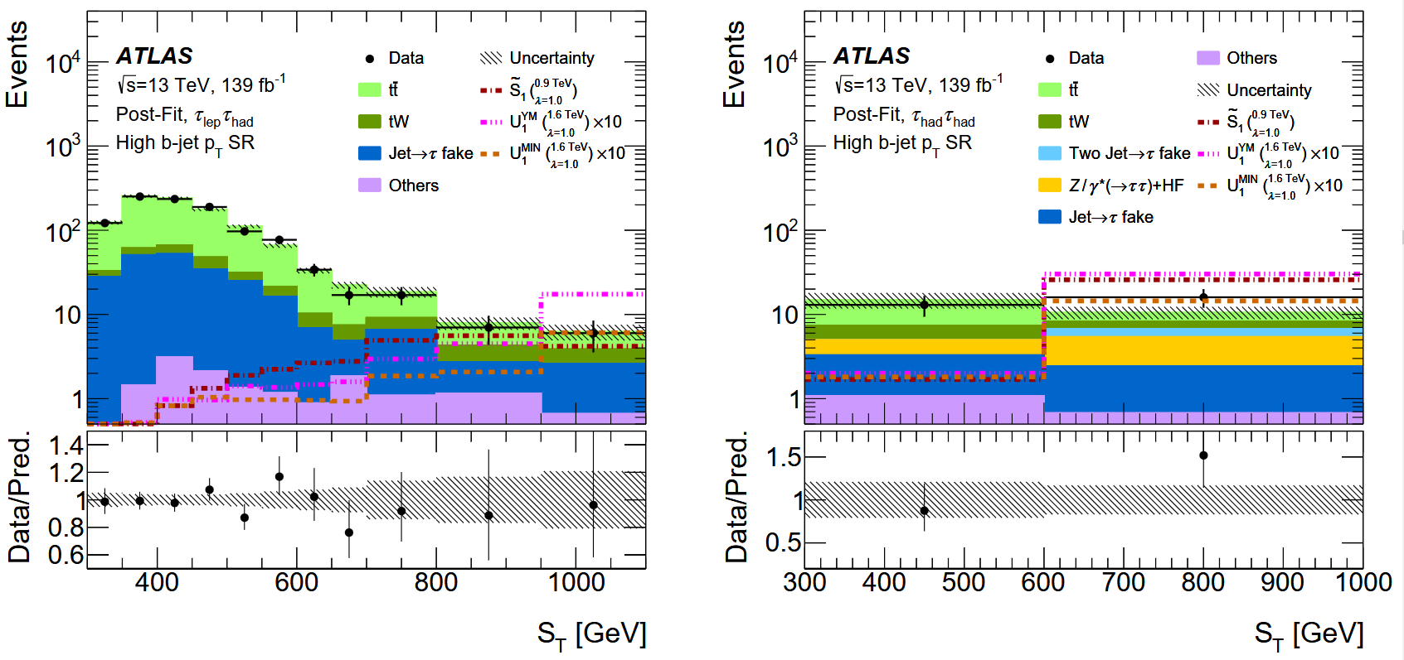
Results
Results
Good agreement with data
No significant excess above Standard Model prediction!

Slide 28
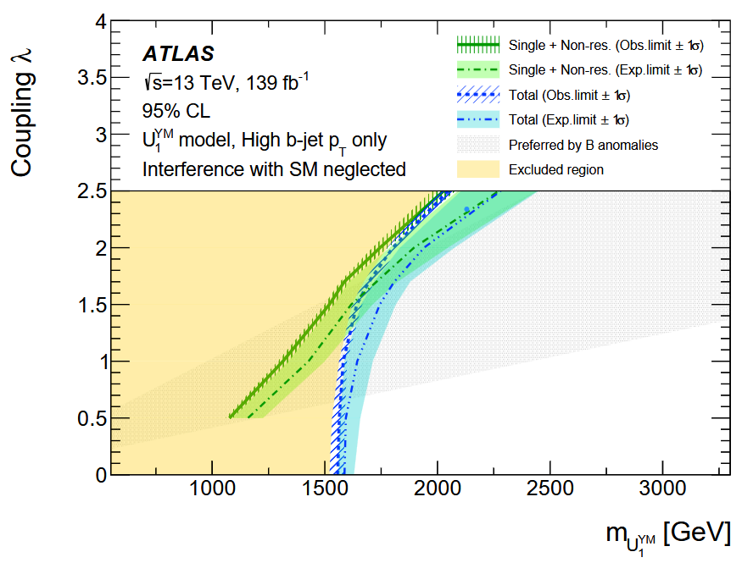
Results
Results
Observed (expected) leptoquark mass limits in TeV:
$σ_{signal,obs}∝\frac{(LQ−couplin{g)}^{2}}{m_{LQ}^{2}}$
Single production: $λ^{ }$
Pair production: $−$
Yang-Mills
 | $λ=1.0$ | $λ=1.7$ | $λ=2.5$
YM | $1.58 (1.64)$ | $1.70 (1.81)$ | $2.05 (2.28)$
MIN | $1.35 (1.44)$ | $1.52 (1.63)$ | $1.99 (2.26)$
${\tilde{S}}_{1}$ | $1.28 (1.37)$ | $1.38 (1.49)$ | $1.53 (1.67)$
Include pair production
significant amount of pair production

Slide 29
Wrap-up
Leptoquarks couple simultaneously to leptons and quarks
Spin: 0 (scalar LQs) or 1 (vector LQs)
Decay into lepton-quark pair
Production modes: pair production, single production, resonant production, Drell-Yan production
Focus paper:
Decay of leptoquarks in the $bτ$ final state
ATLAS Run 2 measurements $\left(\sqrt{s}=13 TeV\right)$
Analysis steps:
Object Reconstruction and Identification (jet and $τ$)
Event selection (signal region)
Background estimation (control and validation region)

Slide 30
Wrap-up
Results:
$U_{1}$: Vector LQs in the Yang-Mills $\left(U_{1}^{YM}\right)$ or Minimal coupling $\left(U_{1}^{MIN}\right)$ scenarios
${\tilde{S}}_{1}$: Scalar LQs
No significant excess Standard Model prediction
Exclude leptoquark mass region
Yang-Mills

Slide 31
Search for leptoquarks decaying into the $bτ$ final state in pp collisions at $\sqrt{s}=13 TeV$ with the ATLAS detector

Slide 32
Backup

Slide 33
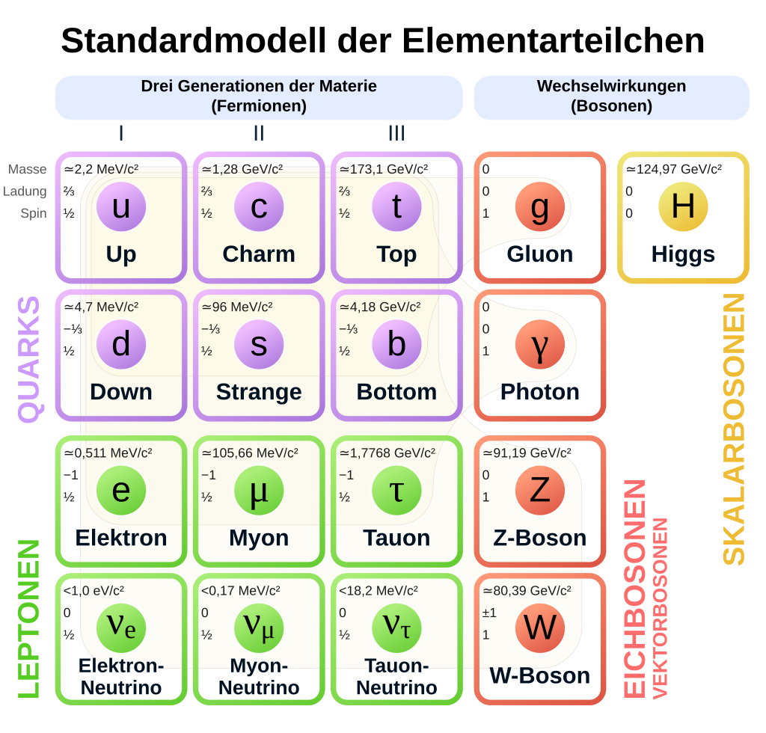

Slide 35
Correction Factors
$τ_{lep}τ_{had}:$
$$SF_{Top}\left(S_{T}\right)$$

Slide 37
Correction Factors
$τ_{had}τ_{had}:$

Slide 38
Signal Region

Slide 39
Control and Validation Region

Slide 40
Likelihood function
Poisson
Gaussian$→$systematic uncertainties

