Slide 1
Version 3.0
CO₂ Cooling of PXD Endflange:
Results from Karlsruhe
Stefan Heindl Belle II PXD Cooling Meeting, Karlsruhe, 13.01.2011

Slide 2
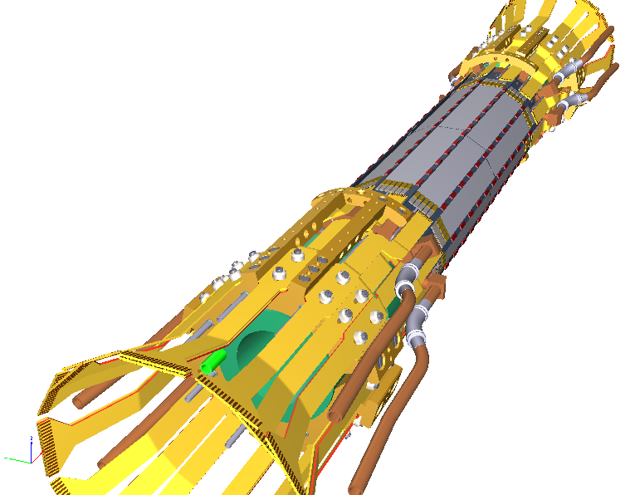
Overview
Open CO₂ system in Karlsruhe
First results
Heat load dummies
Results with heat load
Closed CO₂ system at CERN
Air cooling test setup
Schedule
Summary
Belle II PXD (by MPI)

Slide 3
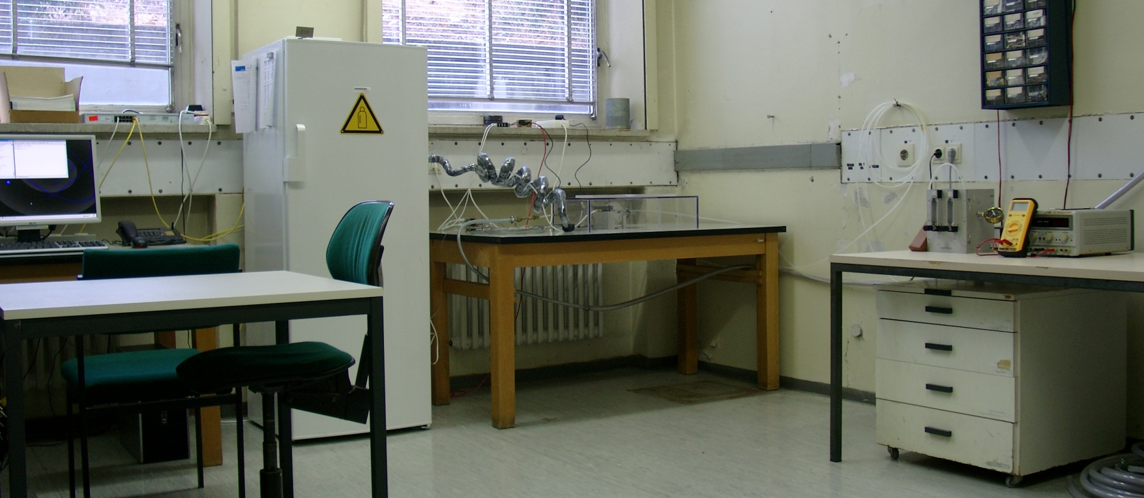
1. Open CO2 system in Karlsruhe
Built for CMS Tracker Upgrade
Now used for Belle II PXD cooling tests
Manual operation → limited runtime
readout PC
1. CO2 bottle
2. endflange
3. flow control

Slide 4
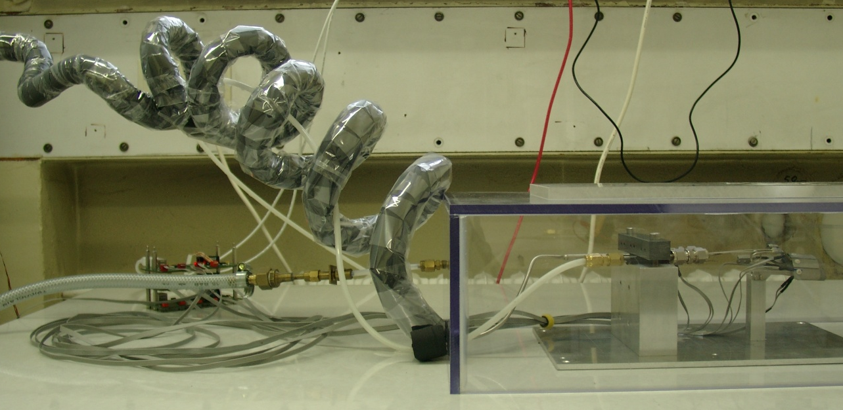
1. Open CO2 system in Karlsruhe
components of the system:
Armaflex insulation
steel tube
dry air
2. endflange prototype in air-flushed box to prevent condensation, Pt1000 for temperature readout
1. CO2 bottle with pressure regulator, precooled to -32°C (saves CO2)
Pt1000

Slide 5
1. Open CO2 system in Karlsruhe
components of the system (cont‘d):
outlet (window)
from flange
3. electric heater (temp. controlled) to prevent liquid CO2 from reaching the gas flow meters
3. gas flow meters (combined) and pressure gauge for controlling operating values

Slide 6
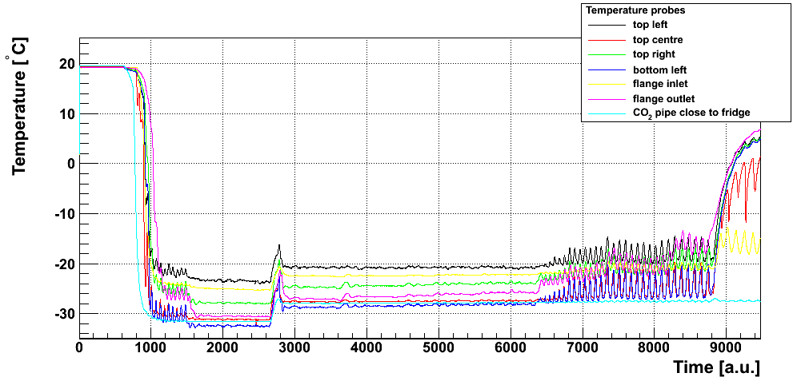
2. First results
no heat load attached
system is working as expected (max. pressure: 15 bar)
on flange
cooling down (3 min)
dryout test (reducing flow)
start pressure: 10 bar
higher pressure: 13 bar → higher temperature

Slide 7
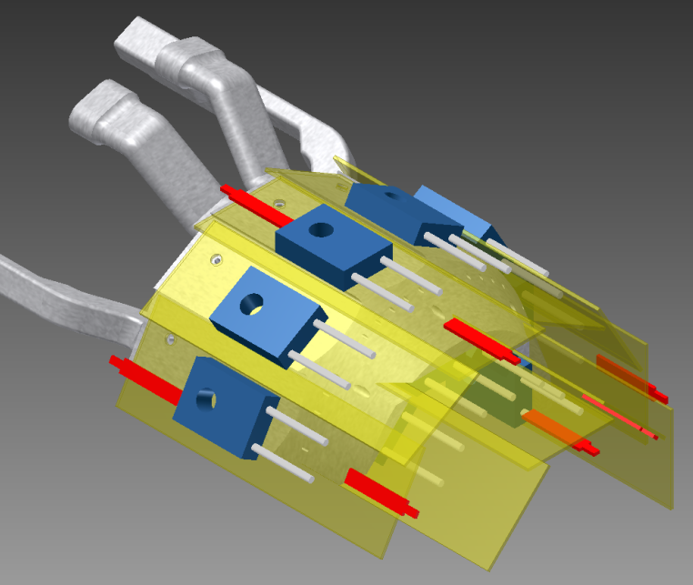
3. Heat load dummies
silicon pieces made by HLL (length: 46 mm)
resistor (max. power: 20 W)
screwed to flange (with heat transfer compound)
Pt1000 for temperature monitoring
drawing of the fully equipped flange (Pt1000 shown in red)
first dummies on flange to check positioning

Slide 8
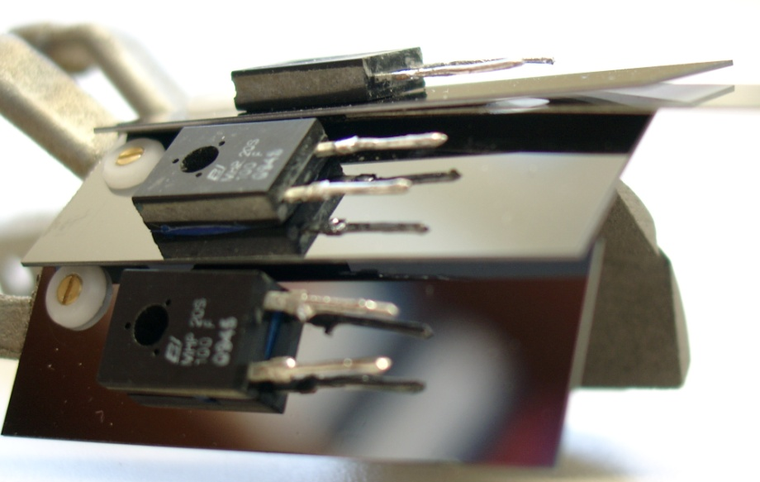
3. Heat load dummies
problems during check: surface of flange not flat, screw threads not perpendicular
solution: polish surfaces by hand → OK for testing
not suitable for production version
250 µm metal sheet!
screw
silicon dummy
flange surface

Slide 9
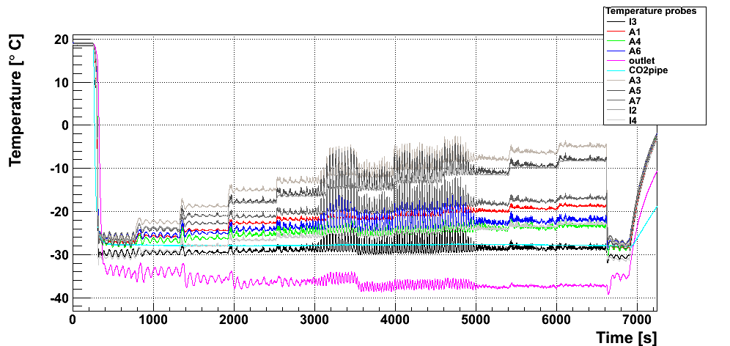
4. Results with heat load
First heat load test in December:
spikes related to leaky connection
temperature difference (@ 100 W): about 19°C
Power loads: (in Watts)
80
90
100
110
120
70
60
40
20
0

Slide 10
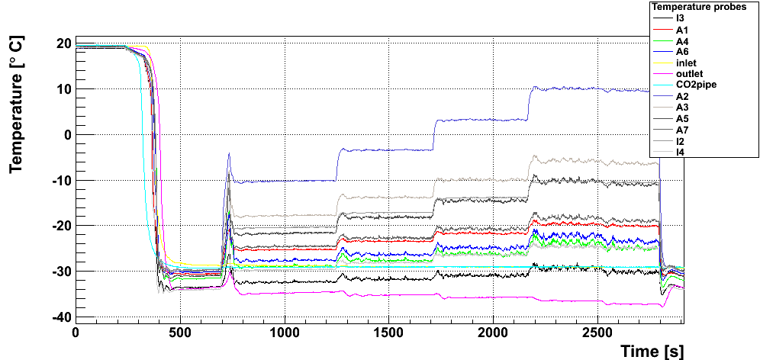
4. Results with heat load
Second test in January: leaky connection fixed
temperature difference (@ 100 W): about 20°C
Power loads: (in Watts)
120
100
80
60
0
outlet gets colder?!?

Slide 11
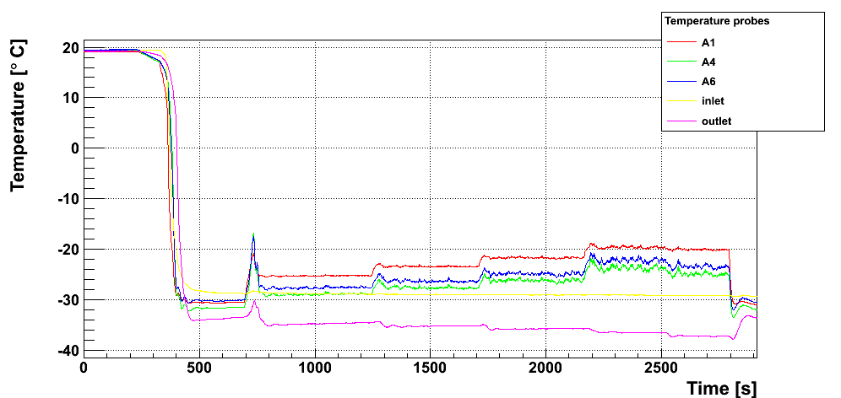
4. Results with heat load
now: closer look at different areas of flange
1. connection side:
all probes are within a range of 5°C
Power loads: (in Watts)
60
80
100
120
connection
0
A1
A4
A6

Slide 12
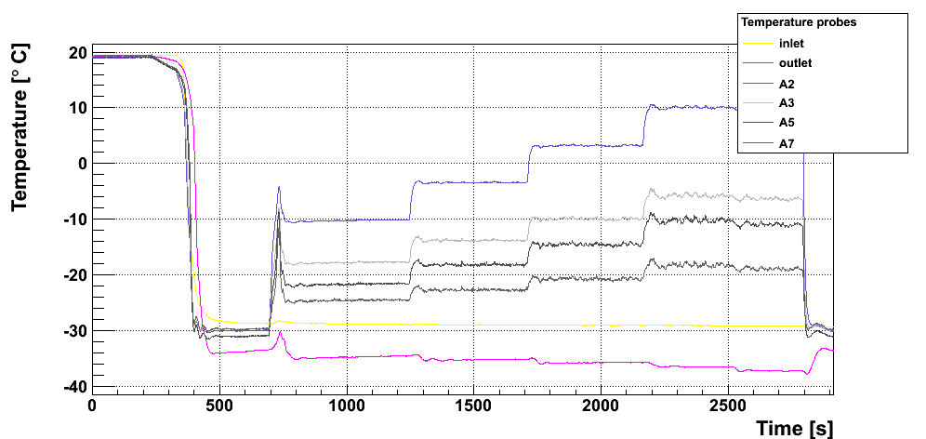
4. Results with heat load
2. front side:
much larger deviation of 24°C
probe A2: bad contact (without A2: 11°C)
120
Power loads: (in Watts)
100
80
60
0
A3
A2
A5
front
A7

Slide 13
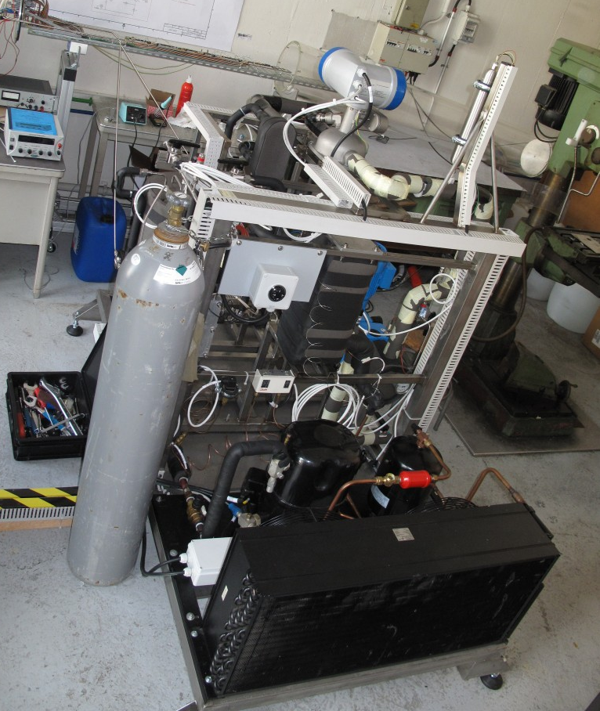
5. Closed CO2 system at CERN
Closed CO2 system built by the group of Hans Postema, also for CMS Upgrade testing
Finished in July 2010
Available to IEKP Karlsruhe for tests, slot booked for February 2011
Similar system supposed to be used for cooling of Belle II PXD and SVD
(CERN)

Slide 14
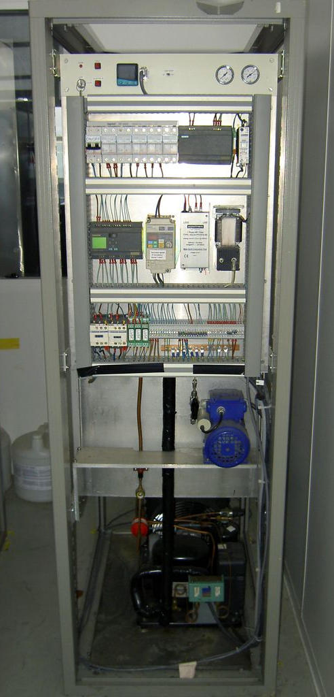
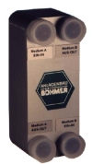
6. Air cooling test setup
purpose-built cooling plant for CMS Tracker petal testing: - made by University of Louvain, Belgium - mono-phase, using FC-77 - over pressure system, P = 2.8 bar - 350 W @ -20°C
heat exchanger: designed to our specifications
Anlagenbau Böhmer
PXD air volume: ~60 litres
(0,05 bar)
(0,01 bar)
180x60x80 cm

Slide 15
7. Schedule
Open CO2 system: - final results available for DEPFET meeting in Bonn
Air cooling test: - check proposed method of cold air supply
Closed CO2 system: - time slot booked for February 2011 - try to cool flange for a longer time - check stability of temperature control - become familiar with closed system and its components

Slide 16
8. Summary
Results with heat load look promising
Deviations related to mechanical problems
Final analysis available for Bonn meeting
Visit CERN in February to use closed system
Similar system is foreseen to be used by Belle II PXD and SVD subdetectors
Definition of future cooling work packages (today)

Slide 17
Thank you…

