Slide 1
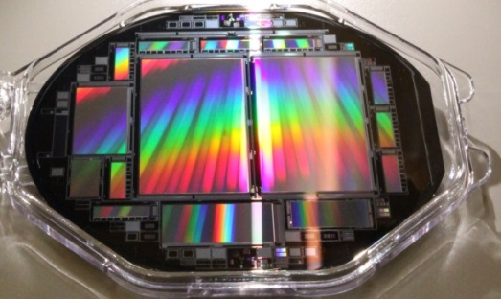
Welcome
Jelena Ninković

Slide 2
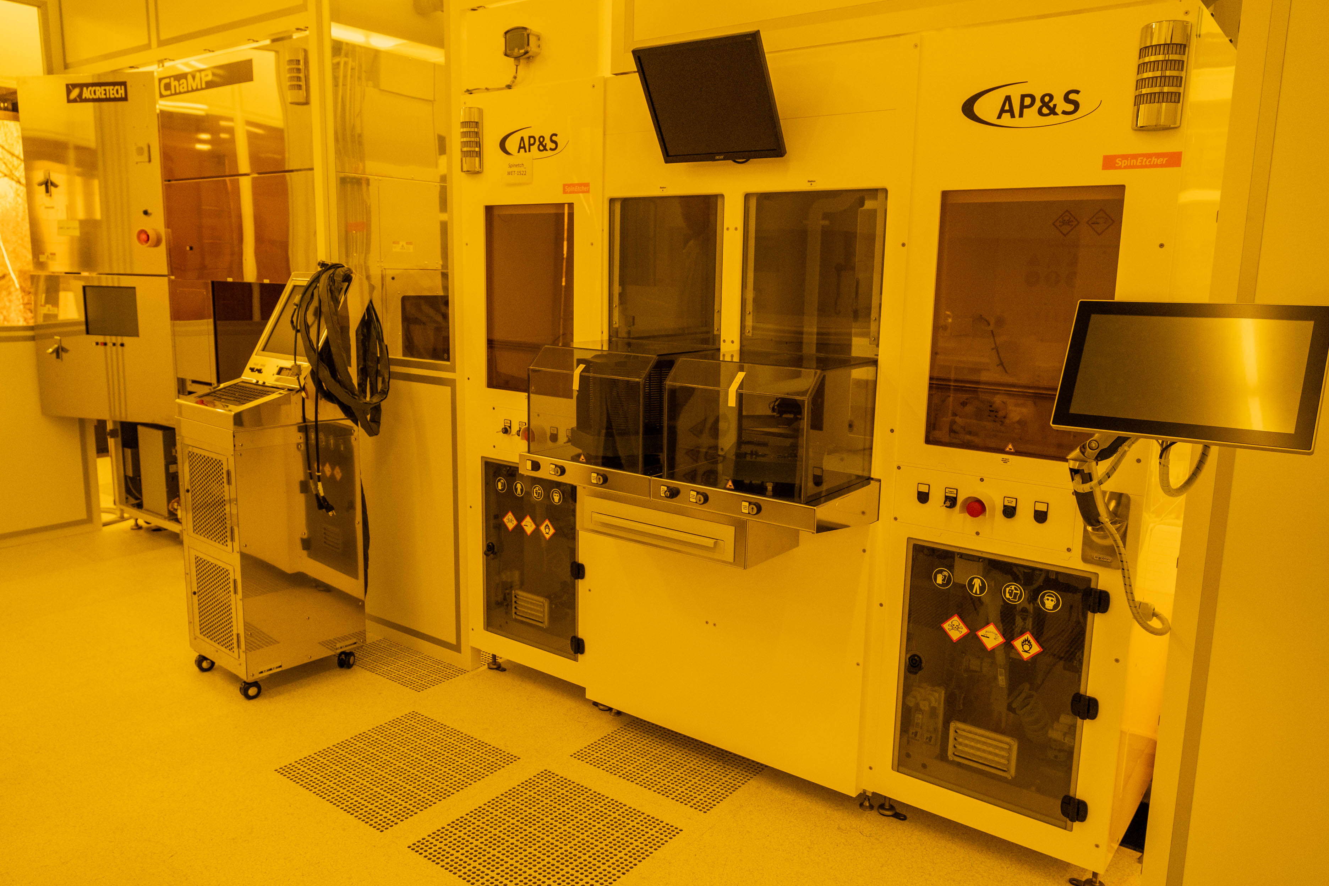
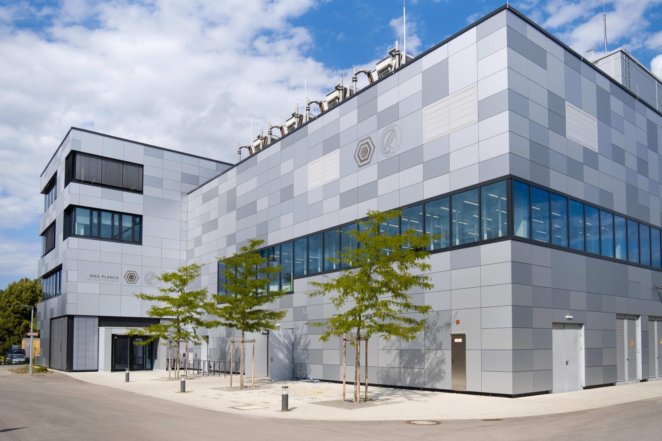
2024 … we moved
Clean room
1000m² → 1500m²
Silicon radiation sensors + quantum sensing

Slide 3
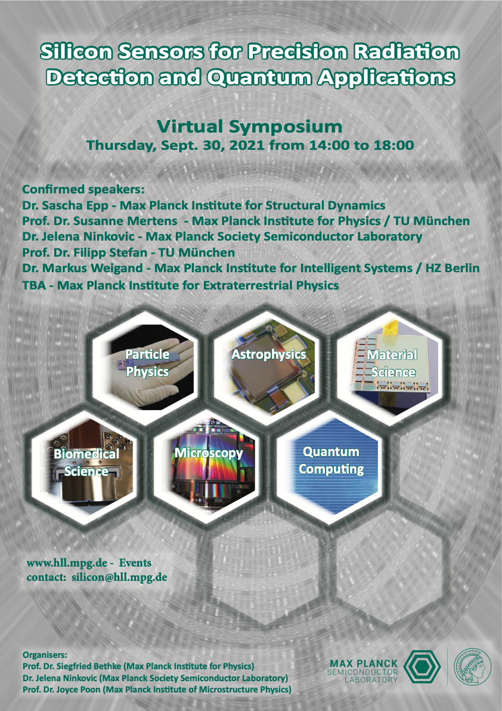
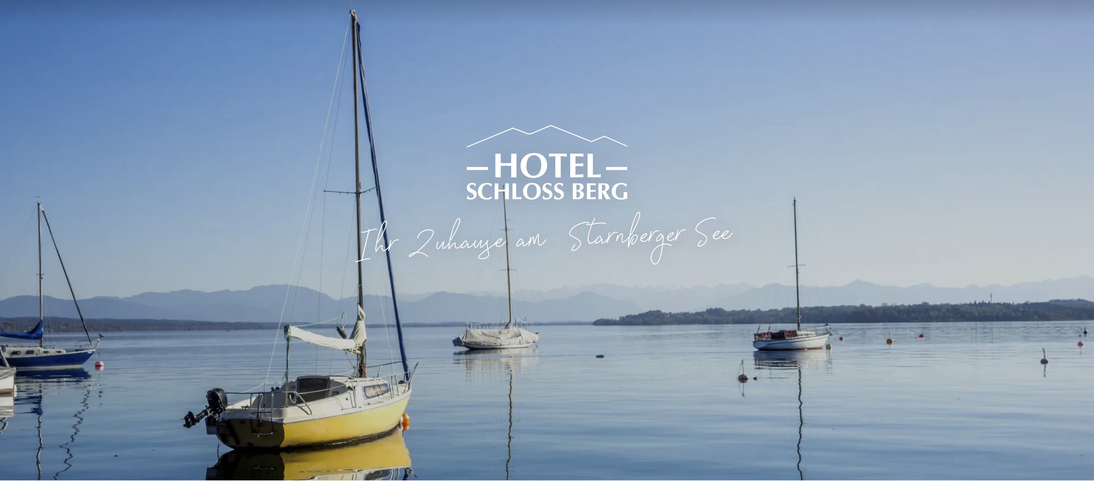
2nd Workshop on Silicon Sensors for Radiation Detection and Quantum Applications
Monday: DEPFET applications
Tuesday: pnCCDs, SDDs, LGADs applications
Wednesday: Quantum applications
In person 2.5 days

Slide 4
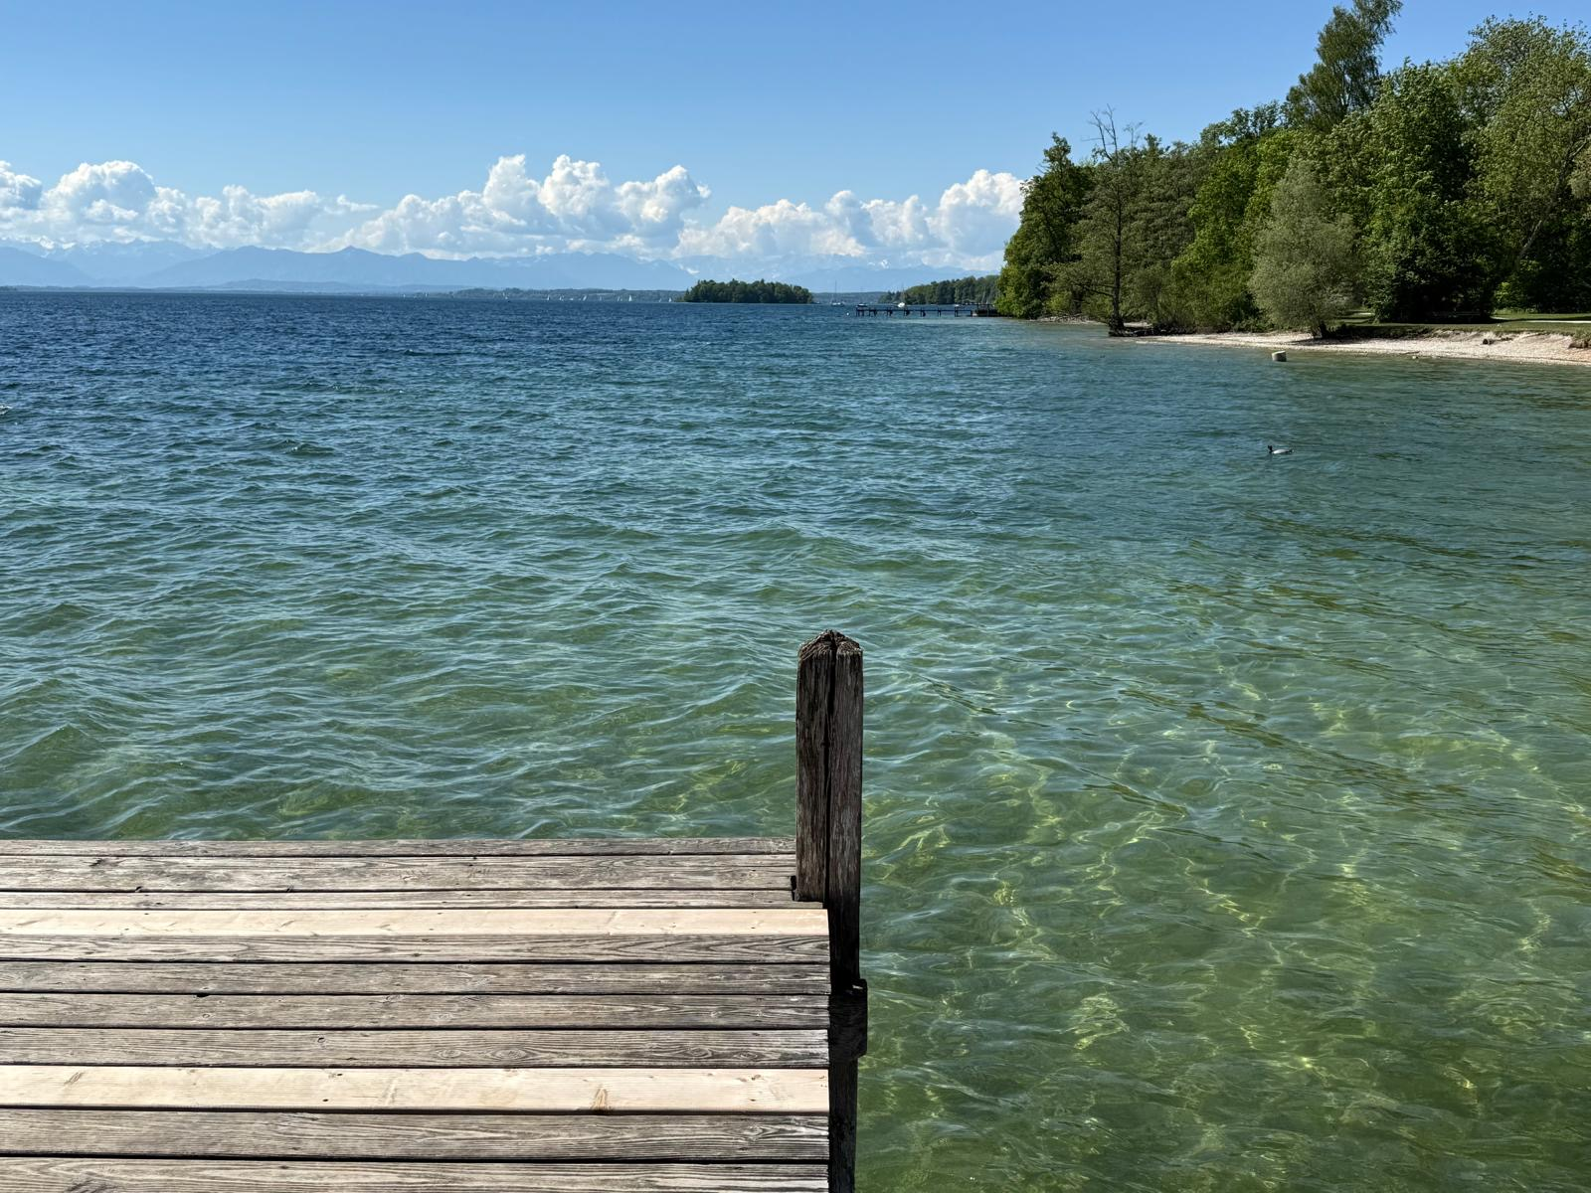
Organizational things
Lunches and dinners will be served here at the hotel
Great thanks to Laci and Anne for organizing everything
Weather

