Slide 1
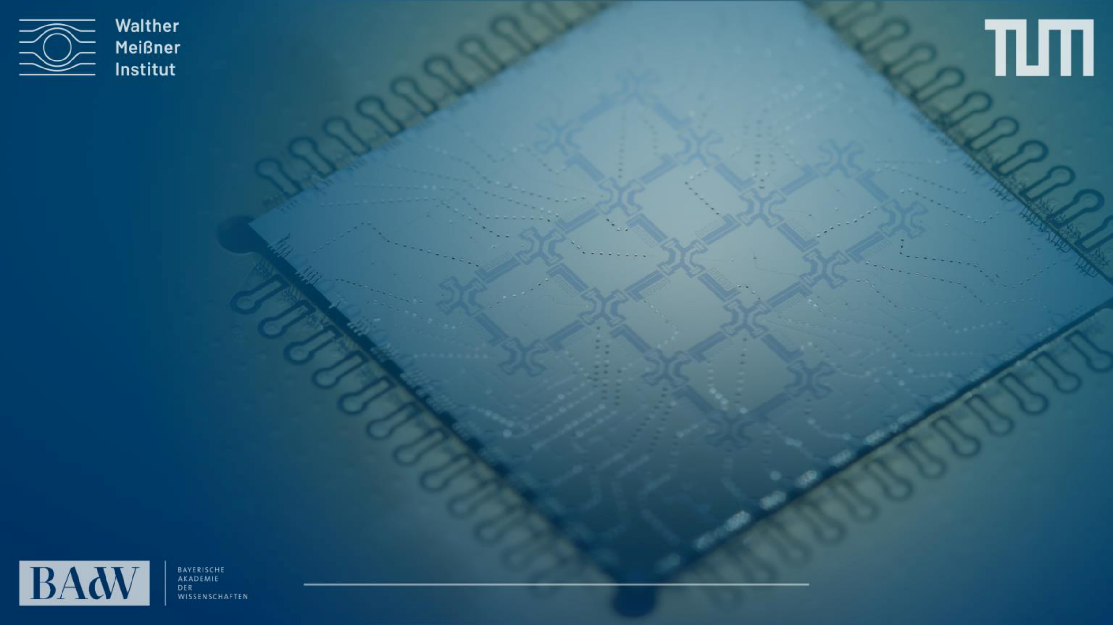
Superconducting Quantum computers
Technical University of Munich, TUM school of Natural Sciences
Walther-Meißner-Institute, Germany
Leon.Koch@wmi.badw.de
2nd Workshop on Silicon Sensors, Berg

Slide 2
- ein Übersichtstalk zu “euren” qubits allgemein und einen etwas fokussierteren in Richtung Technologie
First introduce super conducting qubits
Then go into how to fabricate them and what are future challenges
Talk should be 45 min long

Slide 3
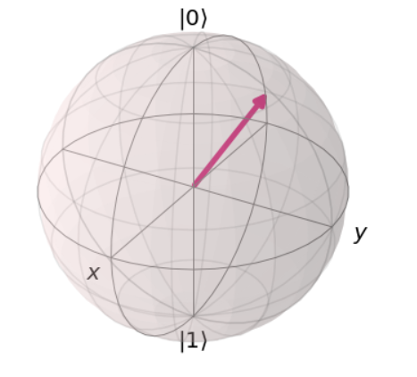
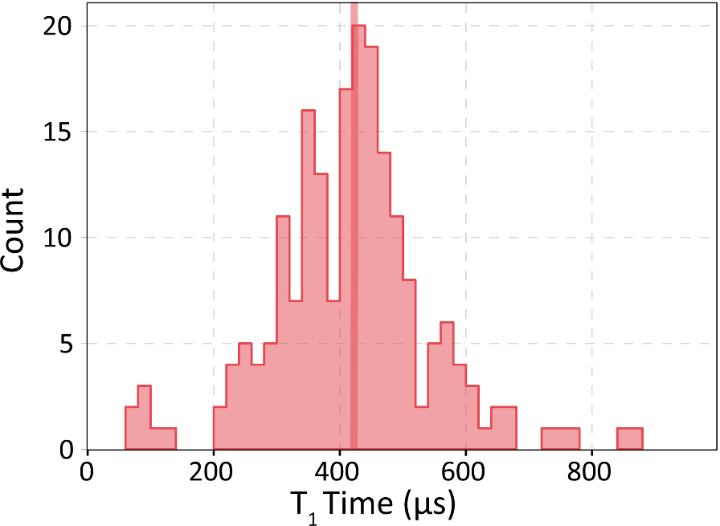
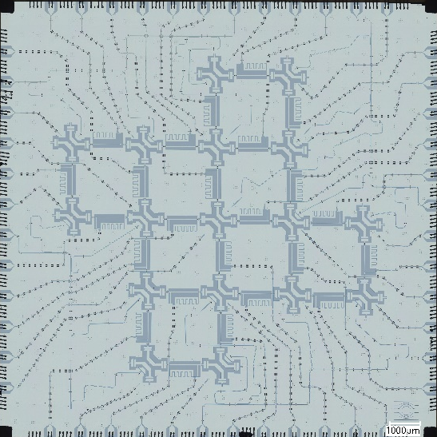
Overview
Part I
Part II
Part III
Superconducting qubit
Quality
Scaling

Slide 4
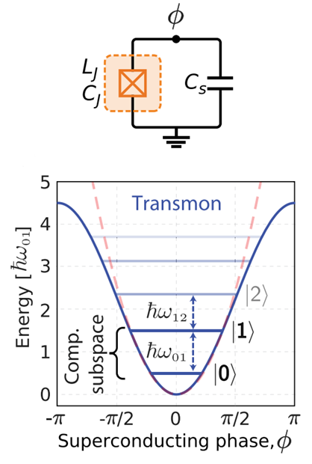
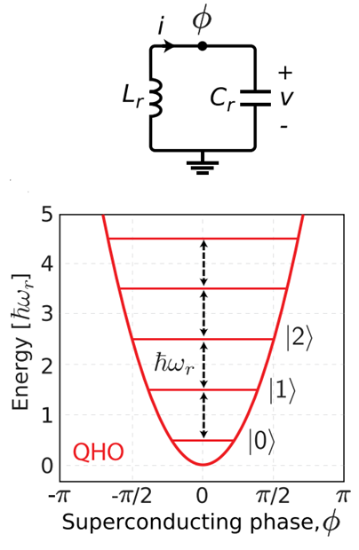
Quantum harmonic oscillators and transmon qubits
LC circuit with quadratic potential
Equal energy spacing unwanted
Introduce non linear inductivity
Josephson junction is key ingredient to form two level system
Qubit is a quantum mechanical two level system
Notes:
Lets have a look at the bulding block that we use for computation the (qubits) and what these qubits are
Qubit = quantum mechanical TLS: quantum dots, trapped ions, photons, neutral atoms and superconducting circuits (artificial atoms) which is what I’m working with
One of the most promising approaches
In principle similar to something that we all know LC circuit
Can not address states individually => need anharmonicity => like a non linear inductor instead of the coil => Josephson junction
Transmon at the moment most widely used qubit

Slide 5
Microscope image of qubit chip
200 nm
1 mm
Notes:
Make a picture of only a single transmon

Slide 6

The Josephson junction
Superconductor-Insulator- Superconductor trilayer (SIS)
Aluminum
Oxide
Aluminum
Aluminum
Substrate
200 nm
Notes:
Lets talk a bit more about what a josephson junction is
Nothing magic in fact quite simple
Trilayer of metal insulator metal
Insulator acts as thin tunnel barrier the superconducting charge carriers can tunnel thorugh
If one calculates properties precisely on finds non linear inductance term (4th order
now we know that a qubit is almost like an LC circuitbut with a josephson junction instead of a coil
Lets compare its properties to a classical bit

Slide 7
The Josephson junction
Superconductor-Insulator- Superconductor trilayer (SIS)
For qubits typically Al-AlO-Al
AlO builds tunnelbarrier (1.8 nm)
non-linear inductance
Aluminum
Oxide
Aluminum
Aluminum
Substrate
Notes:
Lets talk a bit more about what a josephson junction is
Nothing magic in fact quite simple
Trilayer of metal insulator metal
Insulator acts as thin tunnel barrier the superconducting charge carriers can tunnel thorugh
If one calculates properties precisely on finds non linear inductance term (4th order
now we know that a qubit is almost like an LC circuitbut with a josephson junction instead of a coil
Lets compare its properties to a classical bit

Slide 8
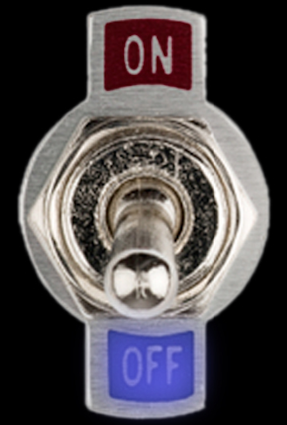
Bit vs. Qubit - Superposition
Classical Bit
Quantum Bit (Qubit)
Combinations of 0 and 1
imagine a point on a (Bloch-)Sphere
0 or 1
Notes:
now we know that a qubit is almost like an LC circuit but with a josephson junction instead of a coil as inductive element
Lets compare its properties to a classical bit
Classical bit like a switch can be either in on or off 0 or 1
Qubit imagine like a sphere state represented by a point on this sphere / vector
Has some probability to be in 0 or 1 and a phase deoted by phi in the picture
If its not exatly at the poles then its in superposition which is what we mean if we say it can be in 0 and 1 at the same time
One bit bit or qubit is a bit boring and useless lets add another one

Slide 9
Bit vs. Qubit - Entanglement
2 Classical Bits
2 Quantum Bits (Qubits)
Each switch position can be described independently
qubits are no longer independent, measurement of one qubit has influence on all qubits
“Spooky action at a distance” – Albert Einstein
Notes:
One bit bit or qubit is a bit boring and useless lets add another one
So far so good what happens if we add another bit or qubit
Can also bring them into an combined state which is mathematically not just the sum of the individual states of the single qubits
Do something that we call entanglement
N-qubit state is not just sum of individual states of qubits
4 basis states with 4 probabilities (exponential scaling of states we can be in with our qubits) what people call state space or hilbertspace of the system

Slide 10
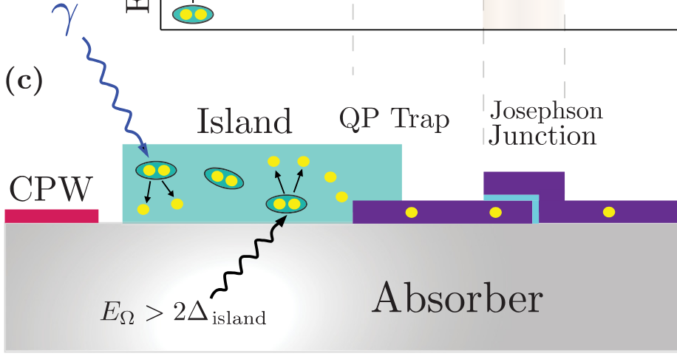
Superconducting Qubits as sensors
Qubits are sensitive to single quasi particles
  exploit as meV phonon sensor
Can be used to detect single THz photons
Easy signal readout
Low thermal noise (mK environment)
Low noise amplifiers (quantum limited)
Qubit can be coupled to other systems and used for sensitive readout
Fink et al. PRA 22.5 (2024)

Slide 11
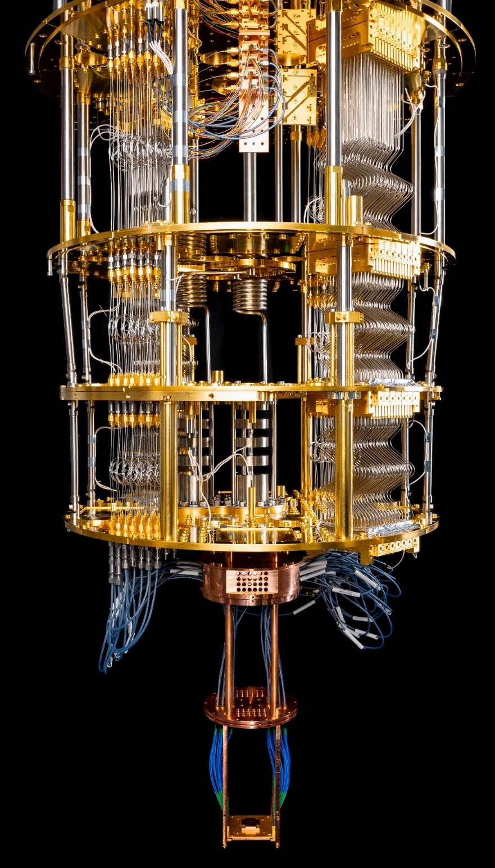
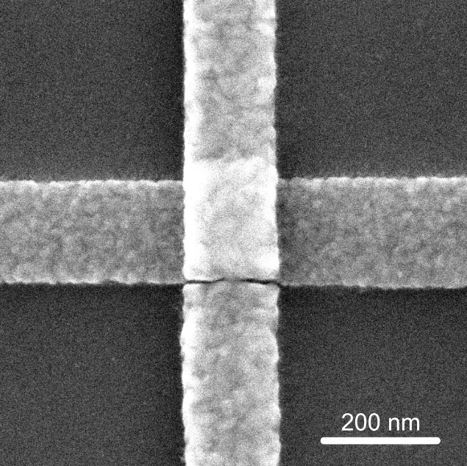
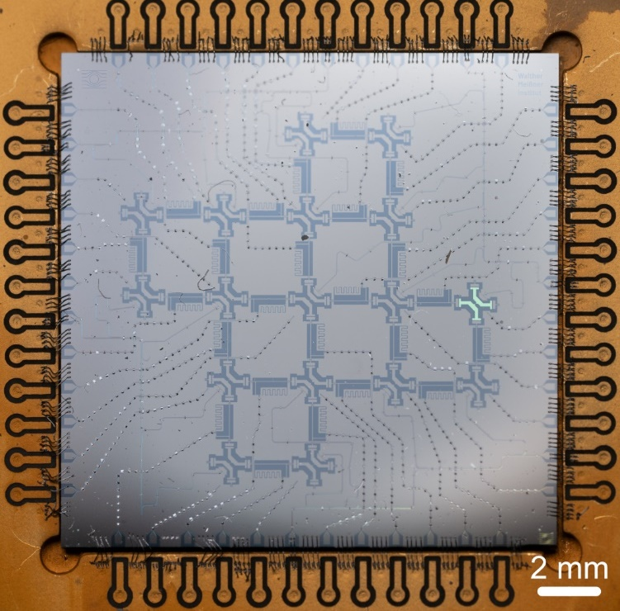
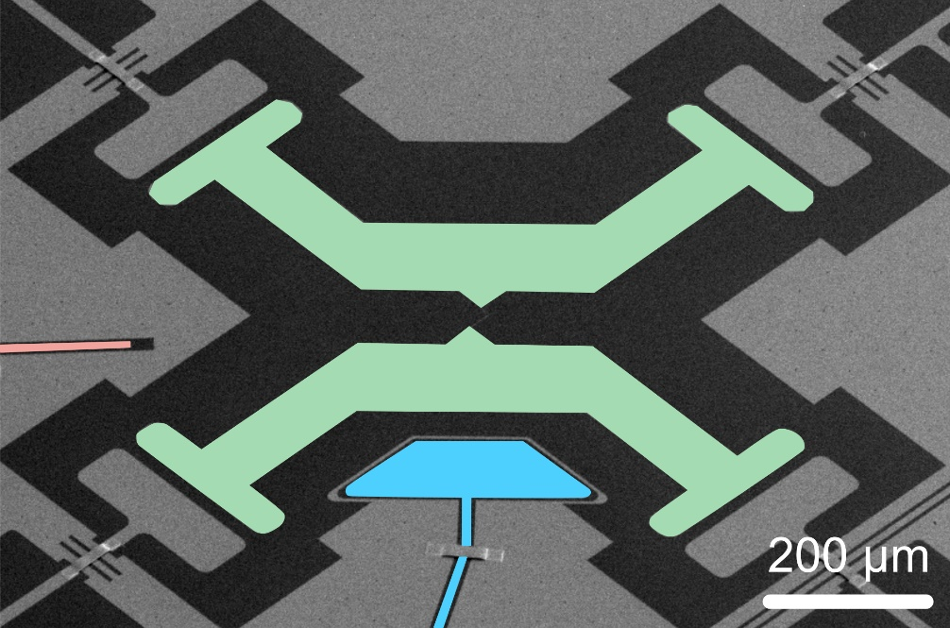
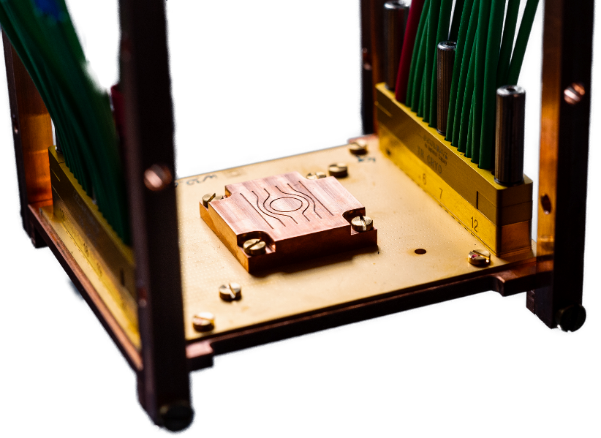

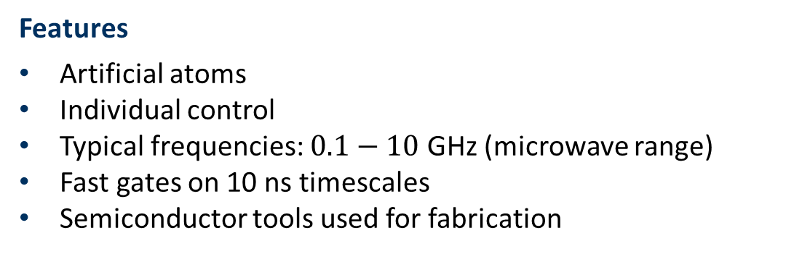
Supraleitende Quantencomputer
Features
Artificial atoms
Individual control
Typical frequencies: $0.1−10$ GHz (microwave range)
Fast gates on 10 ns timescales
Semiconductor tools used for fabrication

Slide 12
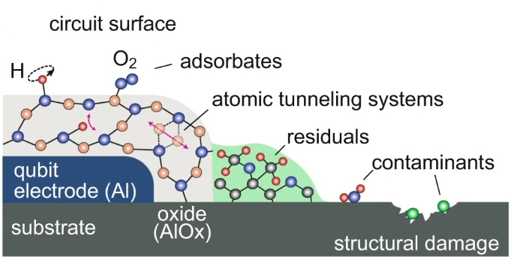
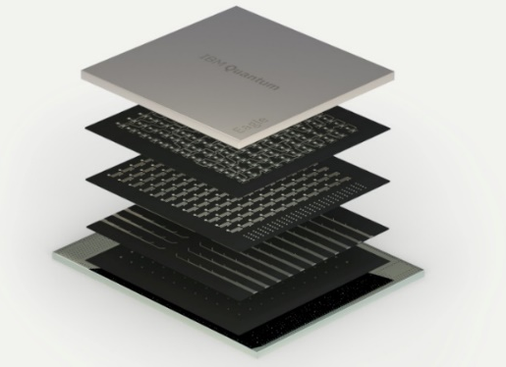
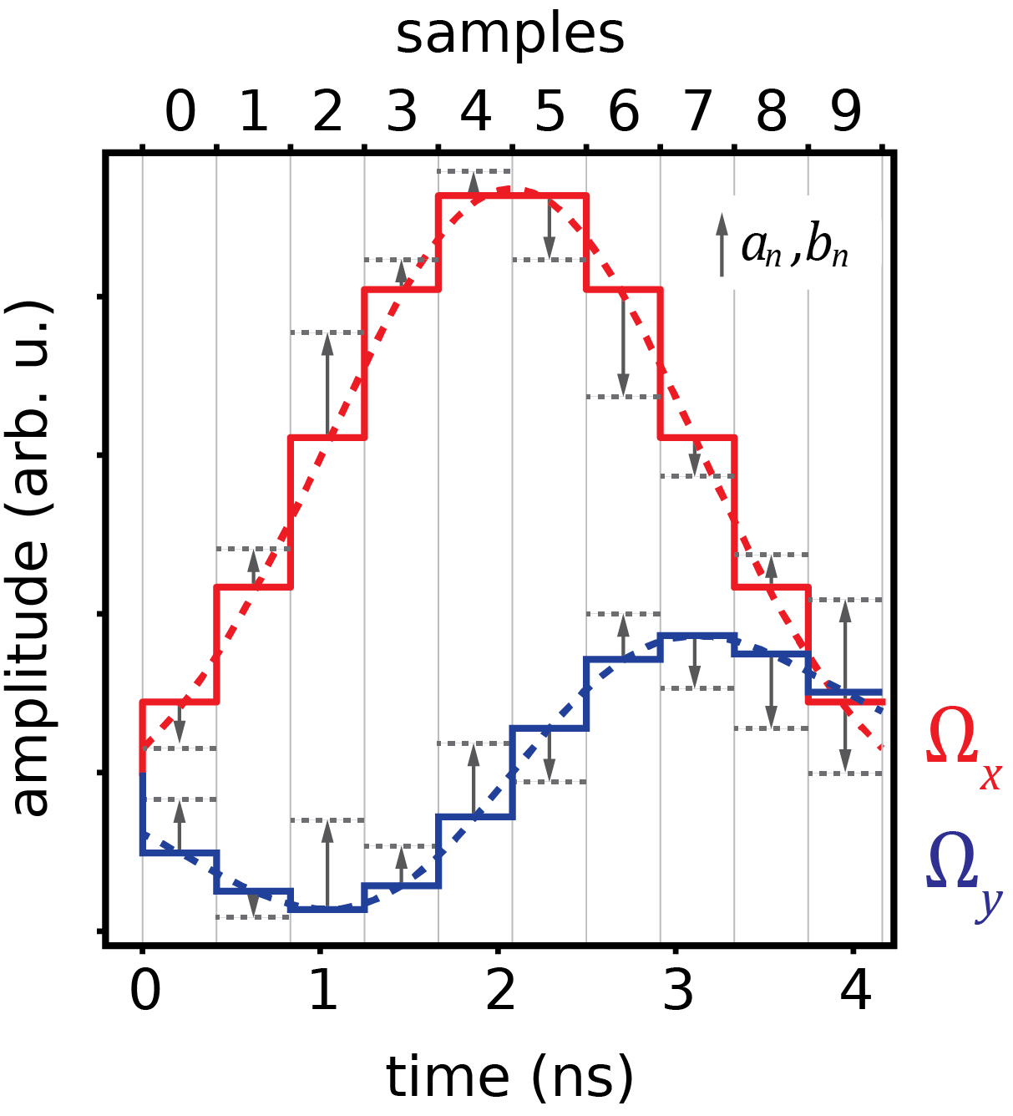
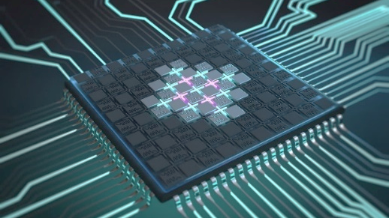
Challenges ahead (hardware centric)
Quality:
identification of loss channels and noise sources
(two-level fluctuators, quasi-particles and ionizing radiation, B-field fluctuations), mitigation (by design, by choice of materials, by fabrication), high fidelity
Number of qubits:
cross-coupling and cross-talk, uniformity & reproducibility, scalable control, I/O, qubit size, thermal budget, connectivity, cryogenic electronics
Speed and control:
fast coherence limited gates, pulse optimization, benchmarking sequences,
multi-qubit operations & extended gate sets
System stability and connectivity:
automated calibration & bring-up, run-time environment,
characterization & verification, quantum/classical integration,
(cryogenic) electronics
Eagle quantum processor, IBM
Lisenfeld, Jürgen, et al. "Electric field spectroscopy of material defects in transmon qubits." npj Quantum Information 5.1 (2019); Eagle quantum processor, IBM

Slide 13
Part II
Part I
Part II
Part III
Superconducting qubit
Quality
Scaling

Slide 14
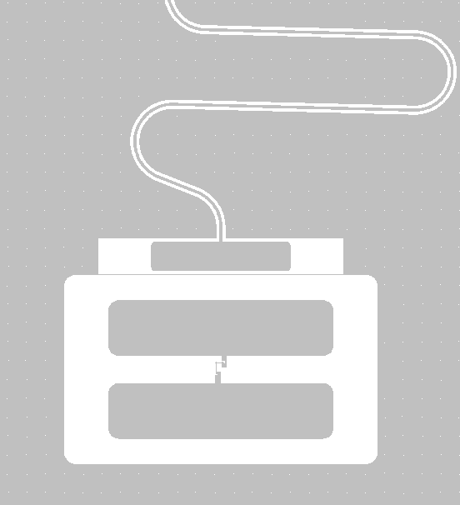
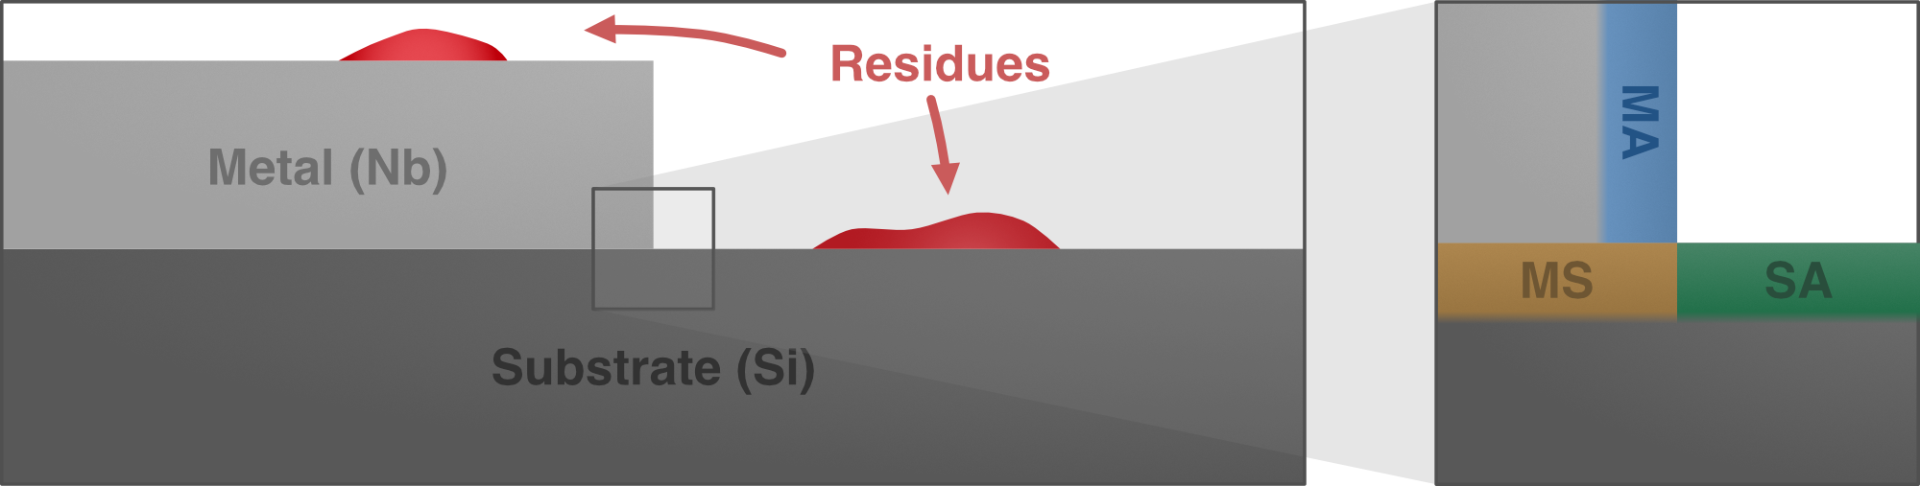
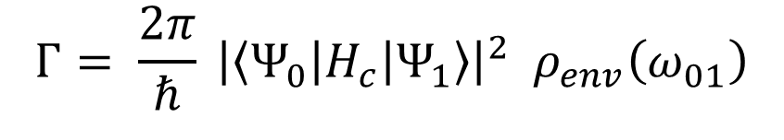
Fermi`s golden rule
$$Γ= \frac{2π}{ℏ} {\left|\left\langle Ψ_{0}\left|H_{c}\right|Ψ_{1}\right\rangle \right|}^{2} ρ_{env}\left(ω_{01}\right)$$
Decay rate $Γ$ can be influenced by the coupling strength (design)
and by the noise spectral density (fabrication)
J. M. Martinis et al., Phys. Rev. Lett. 95, 21 (2005); J. Gao et al., Appl. Phys. Lett. 92,15 (2008); J. Lisenfeld et al., Nat. comm. 6.1 (2015); G. Calusine et al., Appl. Phys. Lett. 112, 06 (2018); C. Müller et al., Rep. Prog. Phys. 82, 12 (2019); J. Biznárová arXiv: 2310.06797; M. Bal arXiv: 2304.13257
Notes:
Lets start with Fermis golden rule which describes the decay rate between two quantum states that are coupled to a noise source. In order to lower this decay rate we can eigther decrease the coupling stregth by design
Second knob noise spectral density. That can be influenced by fabrication
In order to improve the noise spectral density one needs to eliminate loss channels. For sc qubits this means that one need to minimize the amount of TLS by cleaning procedures. Since TLSs are mainly hosted at the interfaces these are the areas of interest
Especially at interfaces (MA, SA) host many TLS. They couple to electric fiels qubit and exchange energy with it=> which in turn leads to decay of qubit from exited to ground state
Talk about bulk being crystal
Statements a few word on the main message of this slide

Slide 15
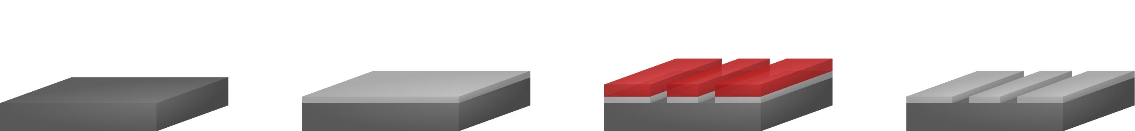


Fabrication steps
Coplanar waveguide resonator fabrication steps
Ground plane fabrication
Cleaned Si (100) substrate (10 to 20$kΩcm$)
DC magnetron sputtering 150 nm niobium
Spin coating, resist exposure (DLW)
Pattern transfer via RIE ($SF_{6}$chemistry)
Notes:
Participation ratios of our resonators (compared to other resonators?

Slide 16
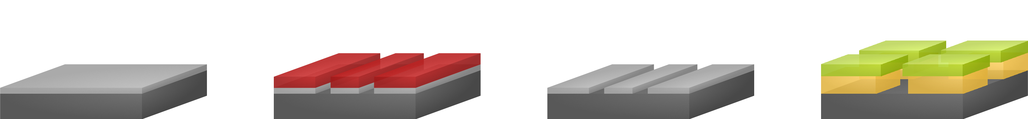


Fabrication steps
Qubit fabrication steps
Ground plane fabrication
Josephson junction fabrication
Cleaned Si (100) substrate (10 to 20$kΩcm$)
Bilayer resist system CSAR and PMMA
DC magnetron sputtering 150 nm niobium
Spin coating, resist exposure (DLW)
Pattern transfer via RIE ($SF_{6}$chemistry)
Resist removal
Post process cleaning

Slide 17
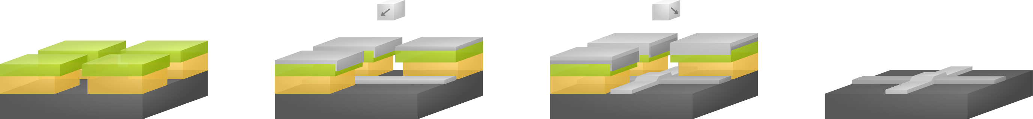

Qubit fabrication steps
Ground plane fabrication
Josephson junction fabrication
Cleaned Si (100) substrate (10 to 20$kΩcm$)
Bilayer resist system
Bilayer resist system CSAR and PMMA
DC magnetron sputtering 150 nm niobium
Al Evaporation and dynamic oxidation
Spin coating, resist exposure (DLW)
90° rotation and evaporation of second layer
Pattern transfer via RIE ($SF_{6}$chemistry)
Resist stripping and metal liftoff
Resist removal
Repetition of electron beam process for bandaging using Ar-ion milling
Post process cleaning
Notes:
Add details resitst thickness
Add ebeam and DLW

Slide 18
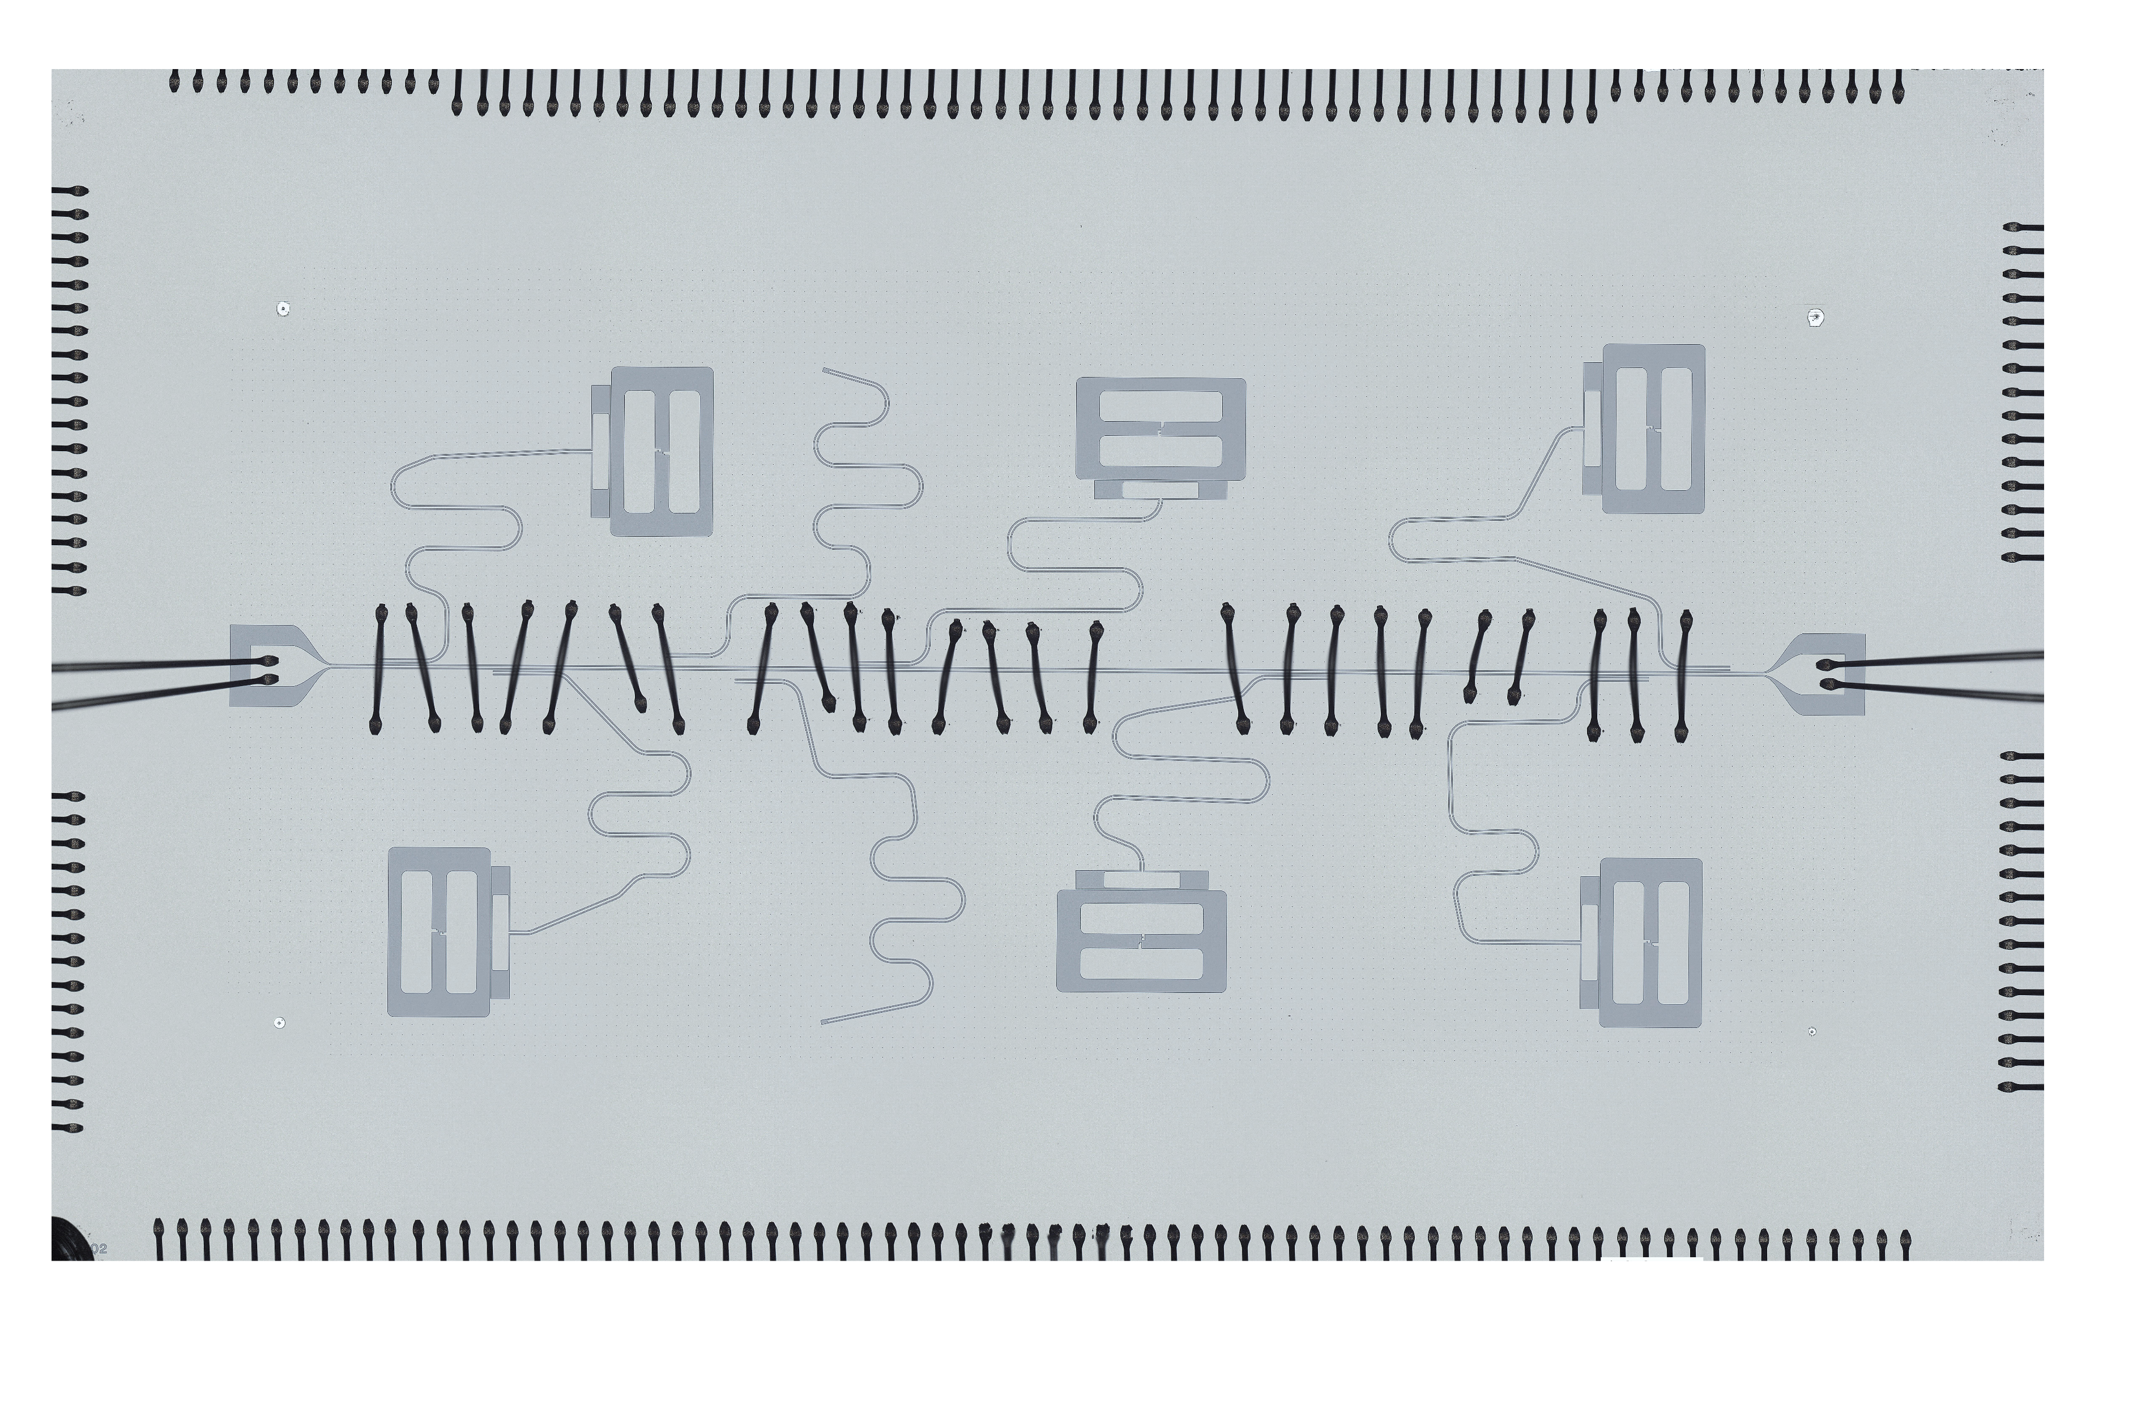
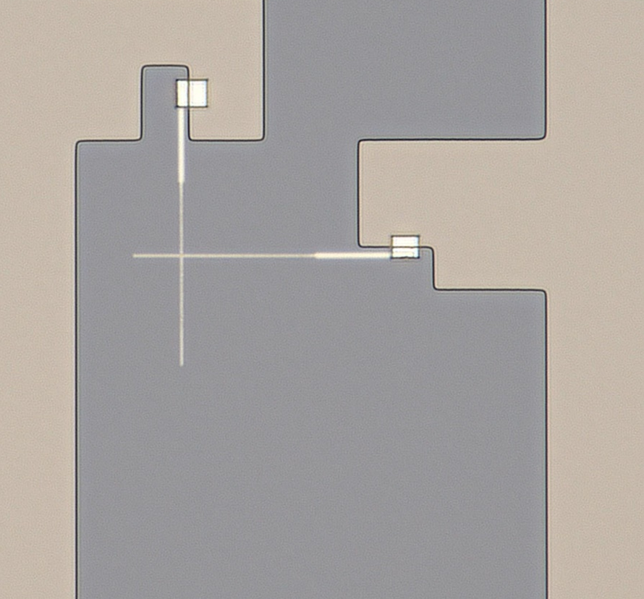
Microscope image of qubit chip
200 nm
10 µm
1 mm
Notes:
Moderately sized transmon
qubit

Slide 19
Part III
Part I
Part II
Part III
Superconducting qubit
Quality
Scaling

Slide 20
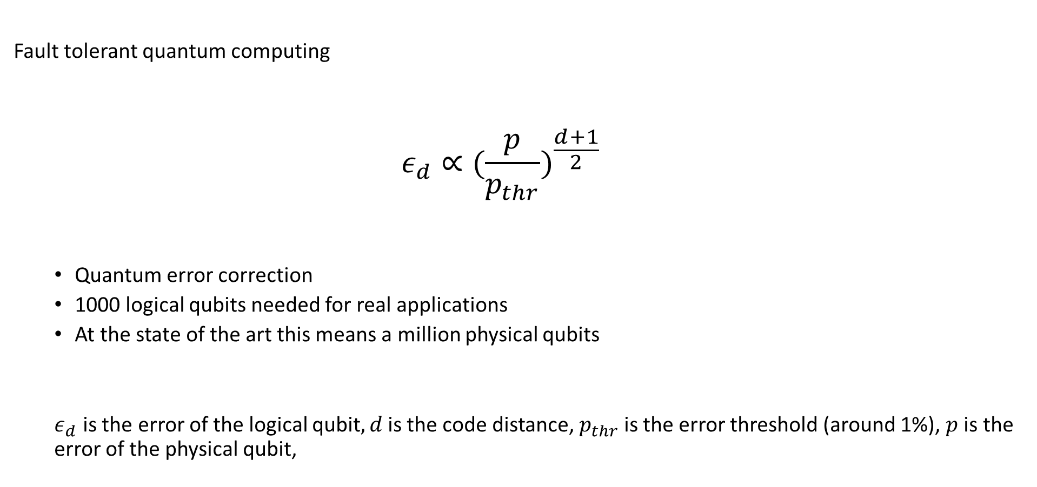
The Goal
Fault tolerant quantum computing
  $$ε_{d}∝({\frac{p}{p_{thr}})}^{\frac{d+1}{2}}$$
  Quantum error correction
  1000 logical qubits needed for real applications
  At the state of the art this means a million physical qubits
  $ε_{d}$is the error of the logical qubit$, d$ is the code distance, $p_{thr}$ is the error threshold (around 1%), $p$ is the error of the physical qubit,
Dennis, Eric, et al. "Topological quantum memory." Journal of Mathematical Physics 43.9 (2002)
Google Quantum AI. " Suppressing quantum errors by scaling a surface code logical qubit ". Nature 614 (2023)

Slide 21
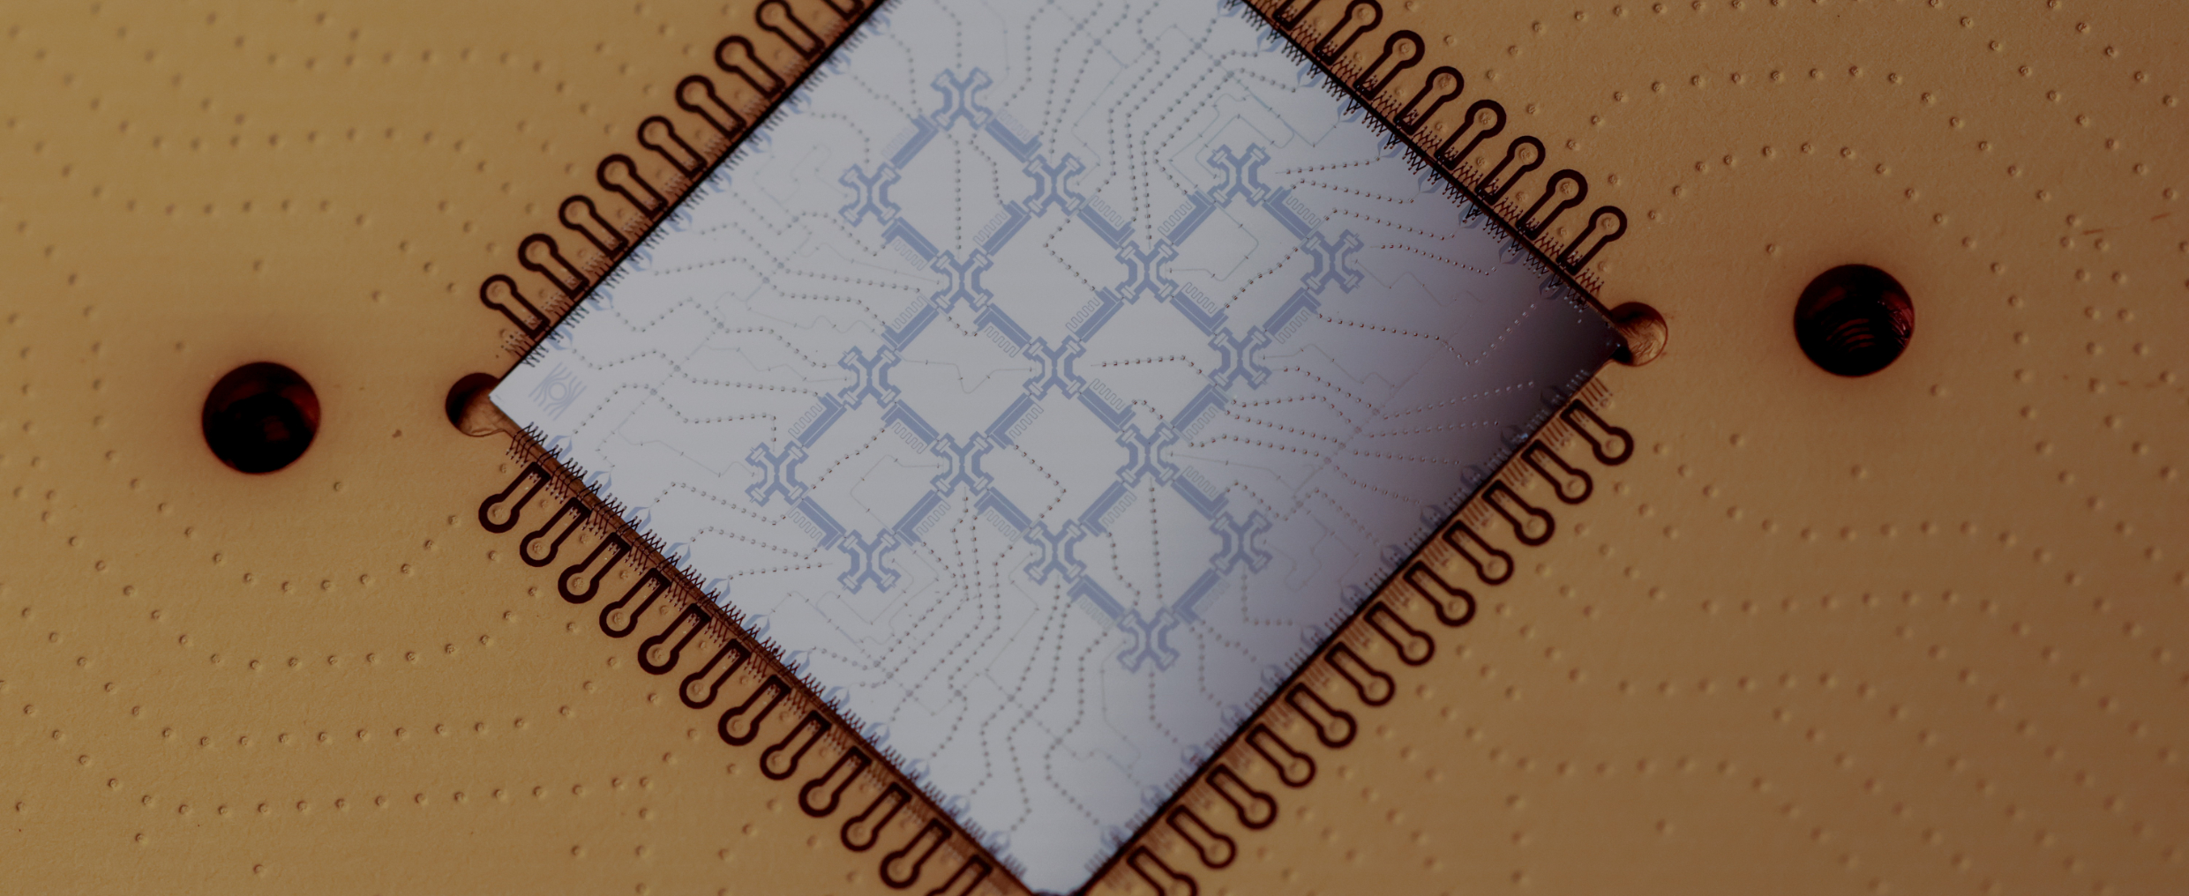
Chip architecture

Slide 22
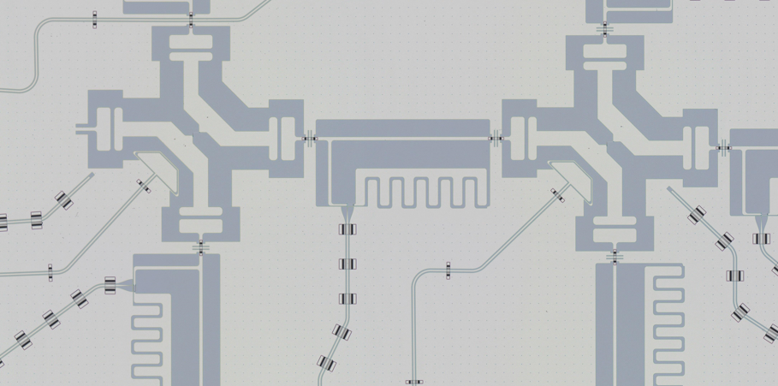
Chip architecture
Qubit
Tunable coupler
Drive line
Flux line
Readout line

Slide 23
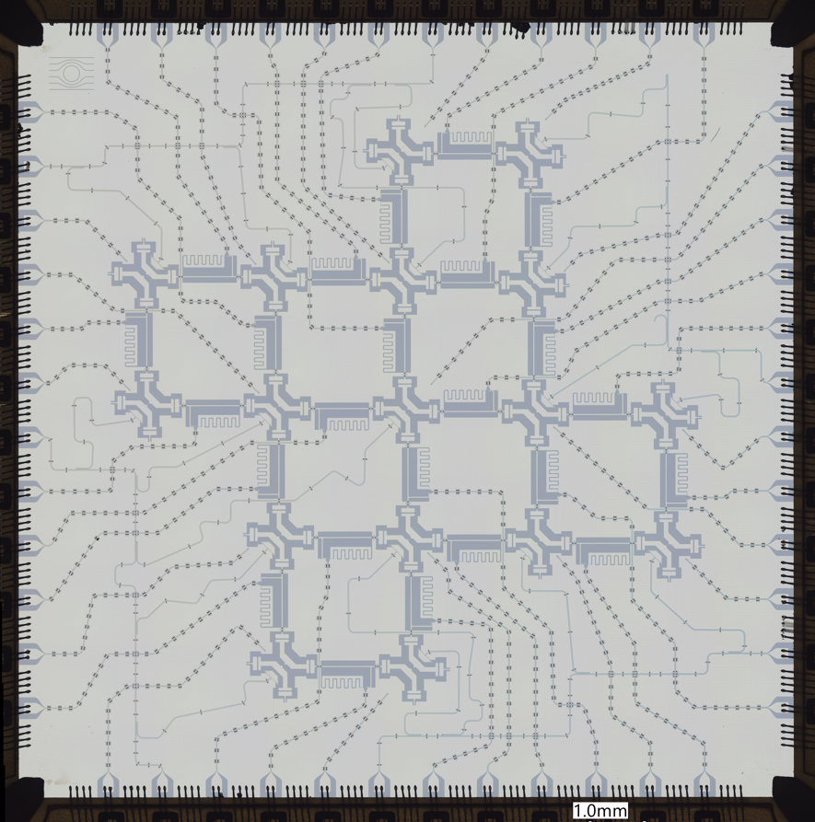
Chip architecture
17 qubits
48 lines needed
On average 2.8 lines per physical qubit

Slide 24
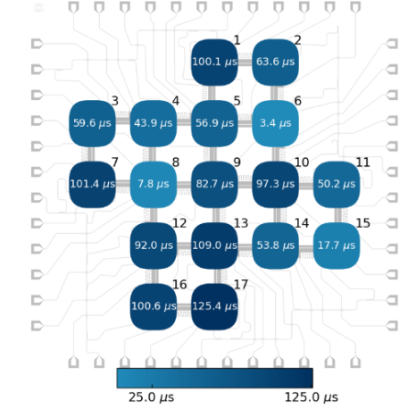
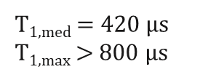



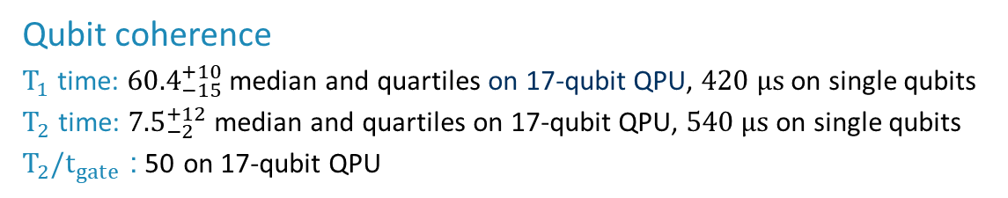

Quality – Status quo
  Qubit coherence
  $T_{1}$ time: ${60.4}_{−15}^{+10}$ median and quartiles on 17-qubit QPU, $420 μs$ on single qubits
  $T_{2}$ time: ${7.5}_{−2}^{+12}$ median and quartiles on 17-qubit QPU, $540 μs$ on single qubits
  $T_{2}/t_{gate}$: 50 on 17-qubit QPU
17-qubit QPU
Single qubits
17-Q QPU
Dedicated QPU
Google Willow
$T_{1}$times
60.4 µs
420 µs
68 µs
$T_{2}$times
7.5 µs
540 µs
89 µs
$$T_{2}/t_{gate}$$
50
> 5000
> 2100
T_{1,med} = 420 µs
T_{1,max} $>$ 800 µs
$$T_{1,med}=60.4 µs$$
Among world‘s best
https://quantumai.google/static/site-assets/downloads/willow-spec-sheet.pdf

Slide 25
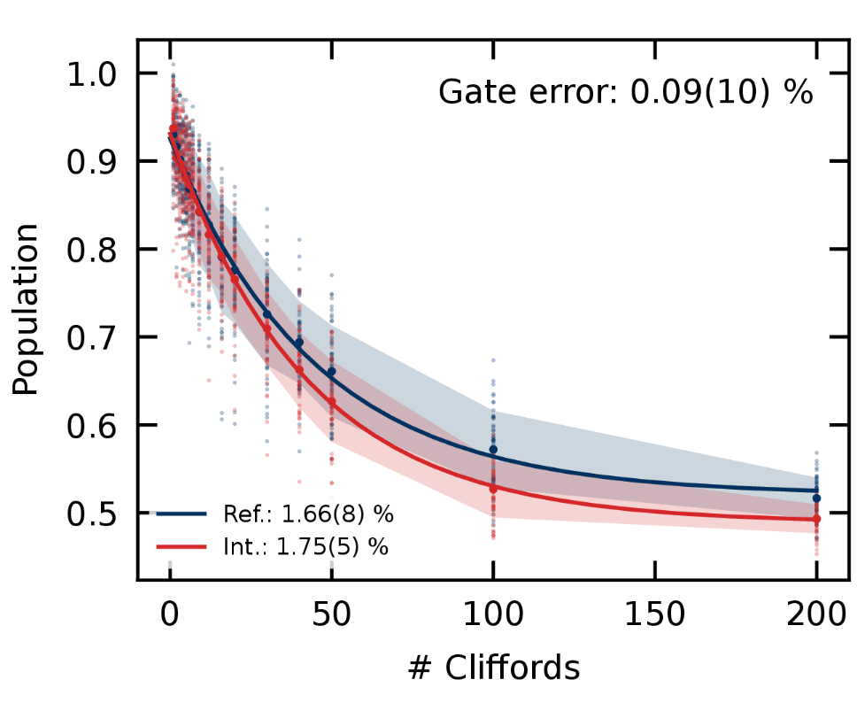
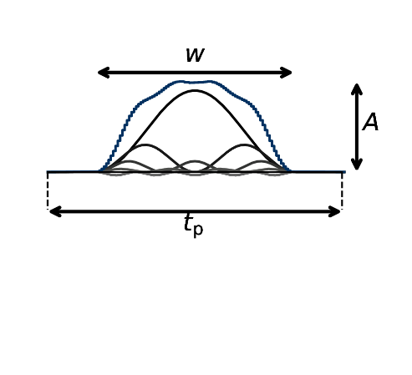
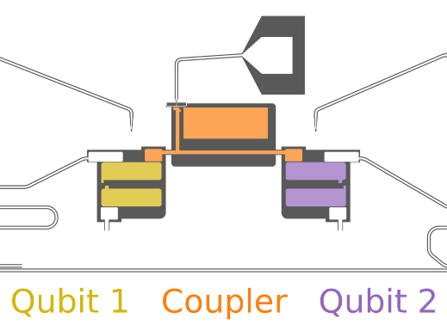



Quality – Status quo
  2-qubit gates
  Gate set: SU(2) and controlled-Z gate on 17-qubit QPU; CZ and iSWAP on 6-qubit QPU
  Gate fidelities: 99.48 % / 97.7 % median single-/two- qubit gate (RB); 99.95 % / 99.9 % on dedicated devices
17-Q QPU
Dedicated QPU
Google Willow
Adiabatic gate with closed-loop optimization
$T_{1}$times
60.4 µs
420 µs
68 µs
$T_{2}$times
7.5 µs
540 µs
89 µs
$$T_{2}/t_{gate}$$
50
> 5000
> 2100
1|2-Qu. Gate fid.
99.5 | 97.8 %
99.95 | 99.9 %
99.96|99.86 %
  Internationally leading two-qubit gate fidelities of
  $99.9\%$ will be implemented on next-gen 17-Qubit
Glaser, Niklas J, "Controlled-controlled-phase gates for superconducting qubits mediated by a shared tunable coupler." Physical Review Applied 19.4 (2023)
https://quantumai.google/static/site-assets/downloads/willow-spec-sheet.pdf

Slide 26
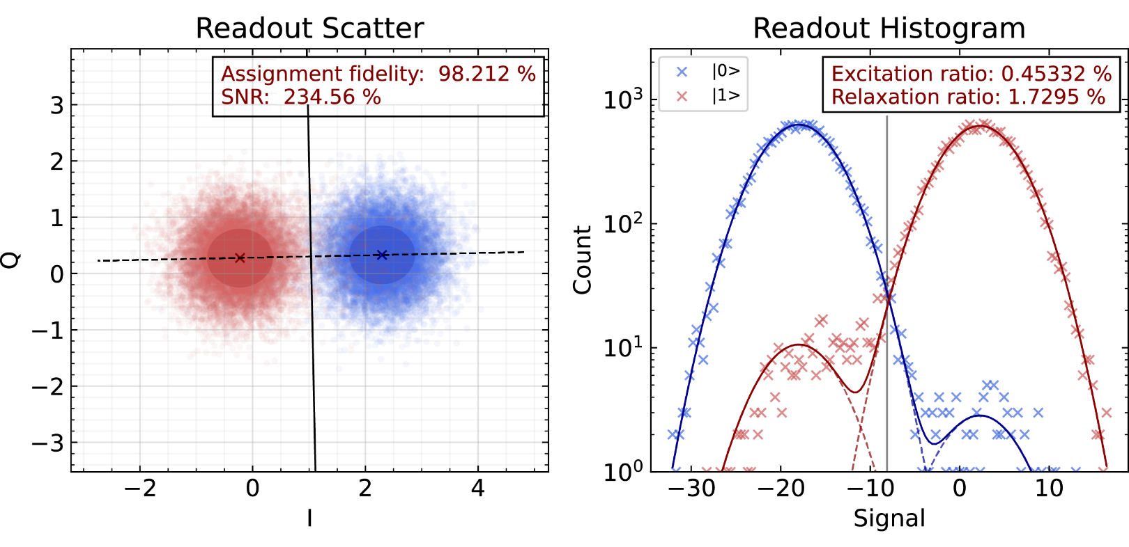


Quality – Status quo
  Readout
  Fidelity: Above 90 % on 17-qubit QPU (multiplexed); up to 98 %, improvements ongoing
17-Q QPU
Dedicated QPU
Google Willow
Readout
$T_{1}$times
60.4 µs
420 µs
68 µs
$T_{2}$times
7.5 µs
540 µs
89 µs
$$T_{2}/t_{gate}$$
50
> 5000
> 2100
1|2-Qu. Gate fid.
99.5 | 97.8 %
99.95 | 99.9 %
99.96|99.86 %
Readout fid.
> 90 %
> 98 %
> 99.33 %
$$Connectivity$$
4-way
2-way
4-way
$$\# Qubits$$
17
1-2
105
  Multiplexed readout for 5 qubits demonstrated
  (limited by individual fidelities)
  Parametric amplifiers and Purcell-filters in development
  Transfer to large chips in progress
https://quantumai.google/static/site-assets/downloads/willow-spec-sheet.pdf

Slide 27
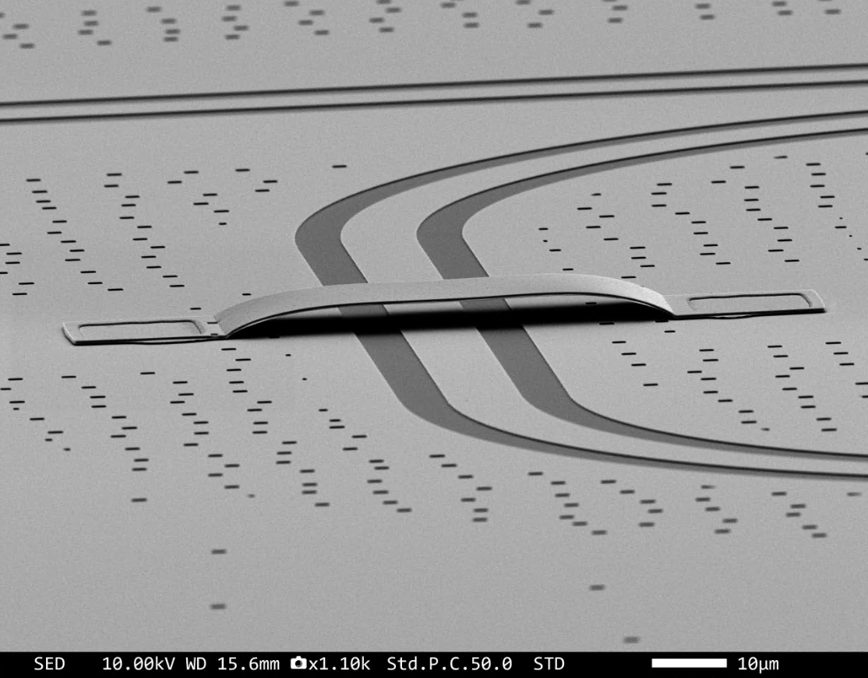
Scaling up to 100 qubits
Scaling up the number of qubits requires additional technology and precision
Air bridges allow crossing of lines

Slide 28
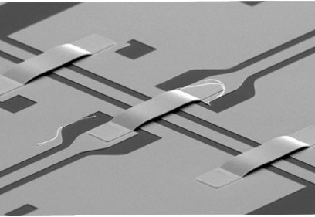
Scaling up to 100 qubits
Scaling up the number of qubits requires additional technology and precision
Air bridges allow crossing of lines

Slide 29
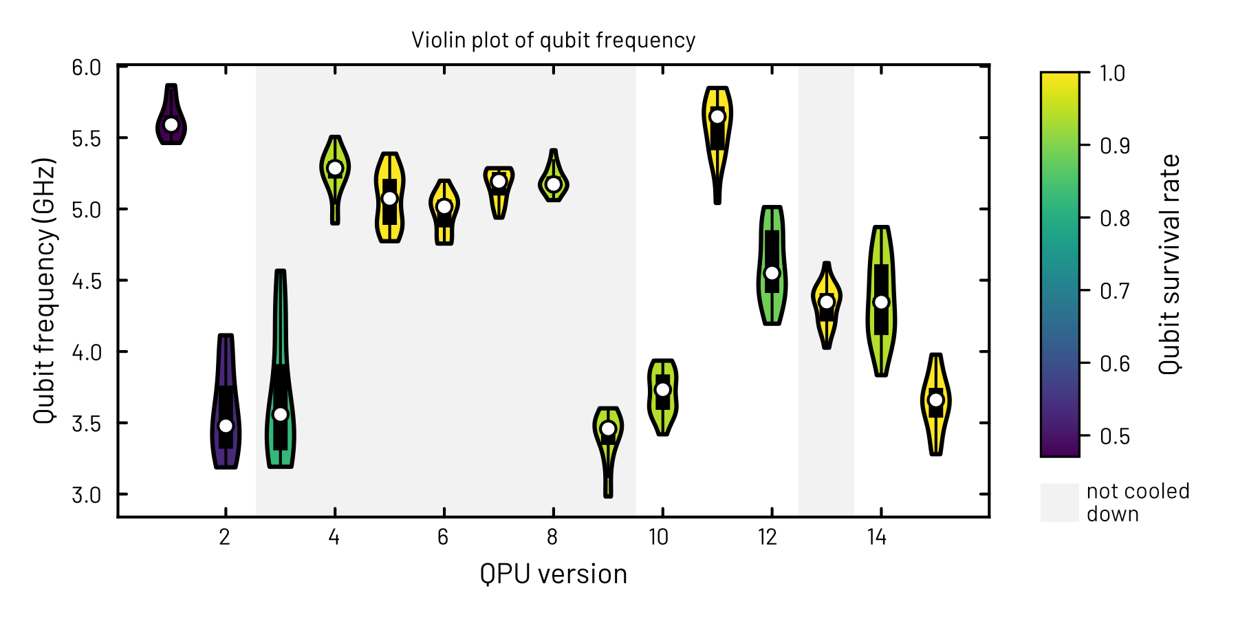
Scaling up to 100 qubits
Scaling up the number of qubits requires additional technology and precision
Air bridges allow crossing of lines
Reproducibility in freq. targeting and coherence (outliers matter), yield

Slide 30
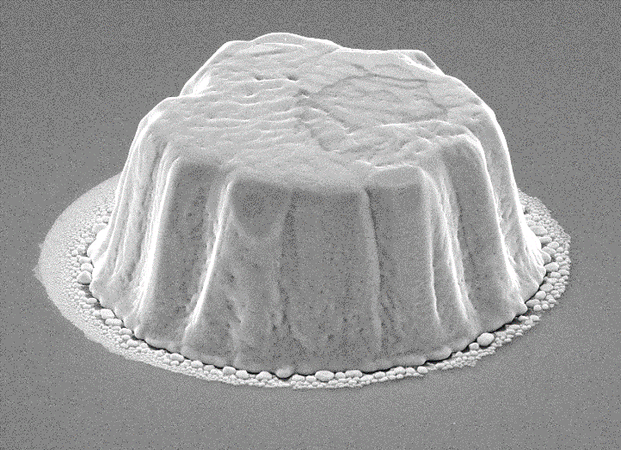
Scaling up to 100 qubits
Scaling up the number of qubits requires additional technology and precision
Air bridges allow crossing of lines
Reproducibility in freq. targeting and coherence (outliers matter), yield
Flip chip bonding for routing and against crosstalk
Low aspect ratio TSVs to break modes

Slide 31
Scaling up to 100 qubits
Scaling up the number of qubits requires additional technology and precision
Air bridges allow crossing of lines
Reproducibility in freq. targeting and coherence (outliers matter), yield
Flip chip bonding for routing and against crosstalk

Slide 32
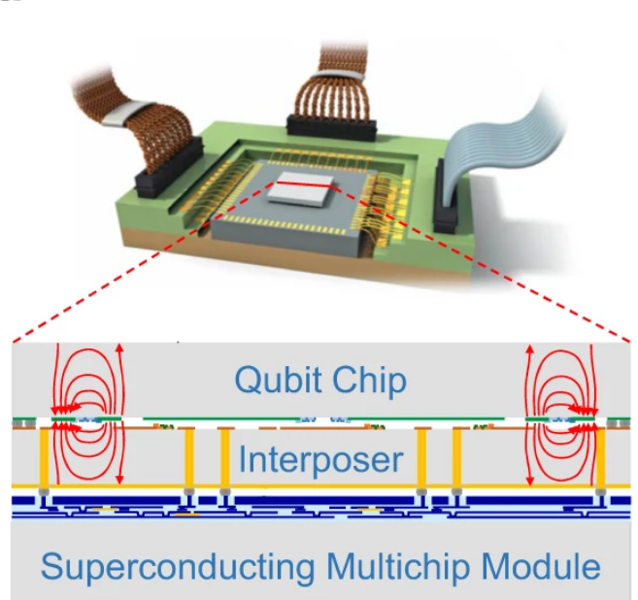
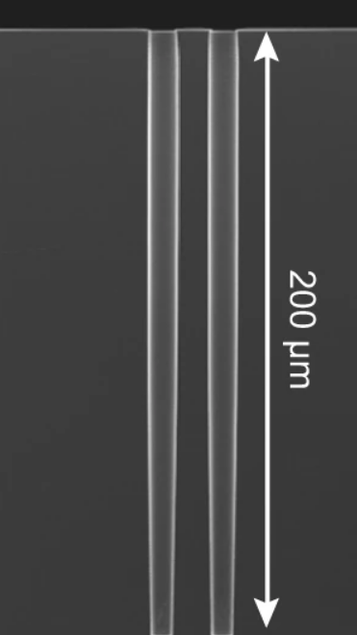
Scaling up to 1.000 qubits
High aspect ratio superconducting through substrate vias (TSVs)
Signal redistribution layers (RDLs)
High density coaxial lines (flex cables)
Advanced packaging depending on yield several qubit chips bonded to one interposer
Yost, Donna-Ruth W., et al. "Solid-state qubits integrated with superconducting through-silicon vias." npj Quantum Information 6.1 (2020)

Slide 33
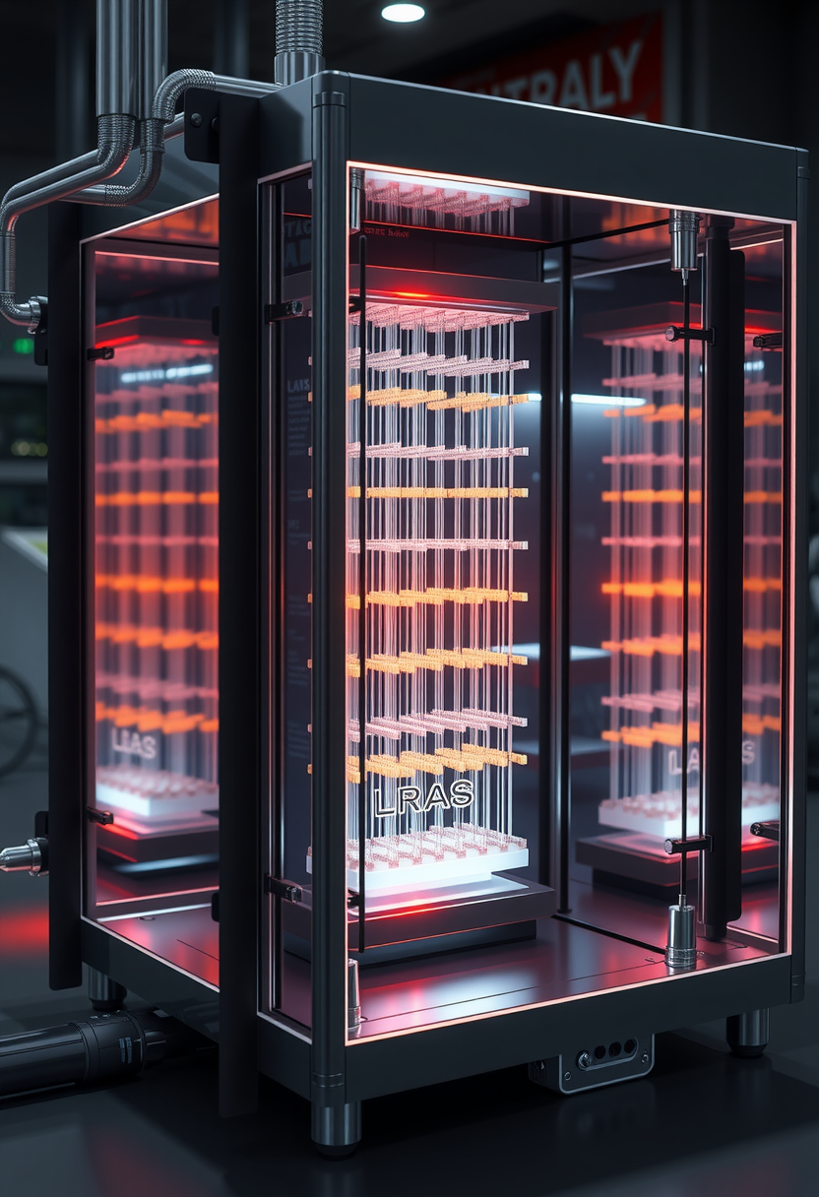
Scaling up to over 10.000 qubits
Cross talk might become a leading error source (due to line density)
Thermal and space budget is limited
  Cryogenic CMOS control electronics on different stages
Microwave inter chip couplers above 10.000 qubits
(Optical) inter fridge couplers above 100.000 qubits
Additional tuning knobs like TLS tuning
Circuit level scaling challenges (verification, testing, debugging)
Fault tolerant QC generated by Dall-E 3
Mohseni, Masoud, et al. "How to Build a Quantum Supercomputer: Scaling from Hundreds to Millions of Qubits." arXiv preprint arXiv:2411.10406 (2024)

Slide 34
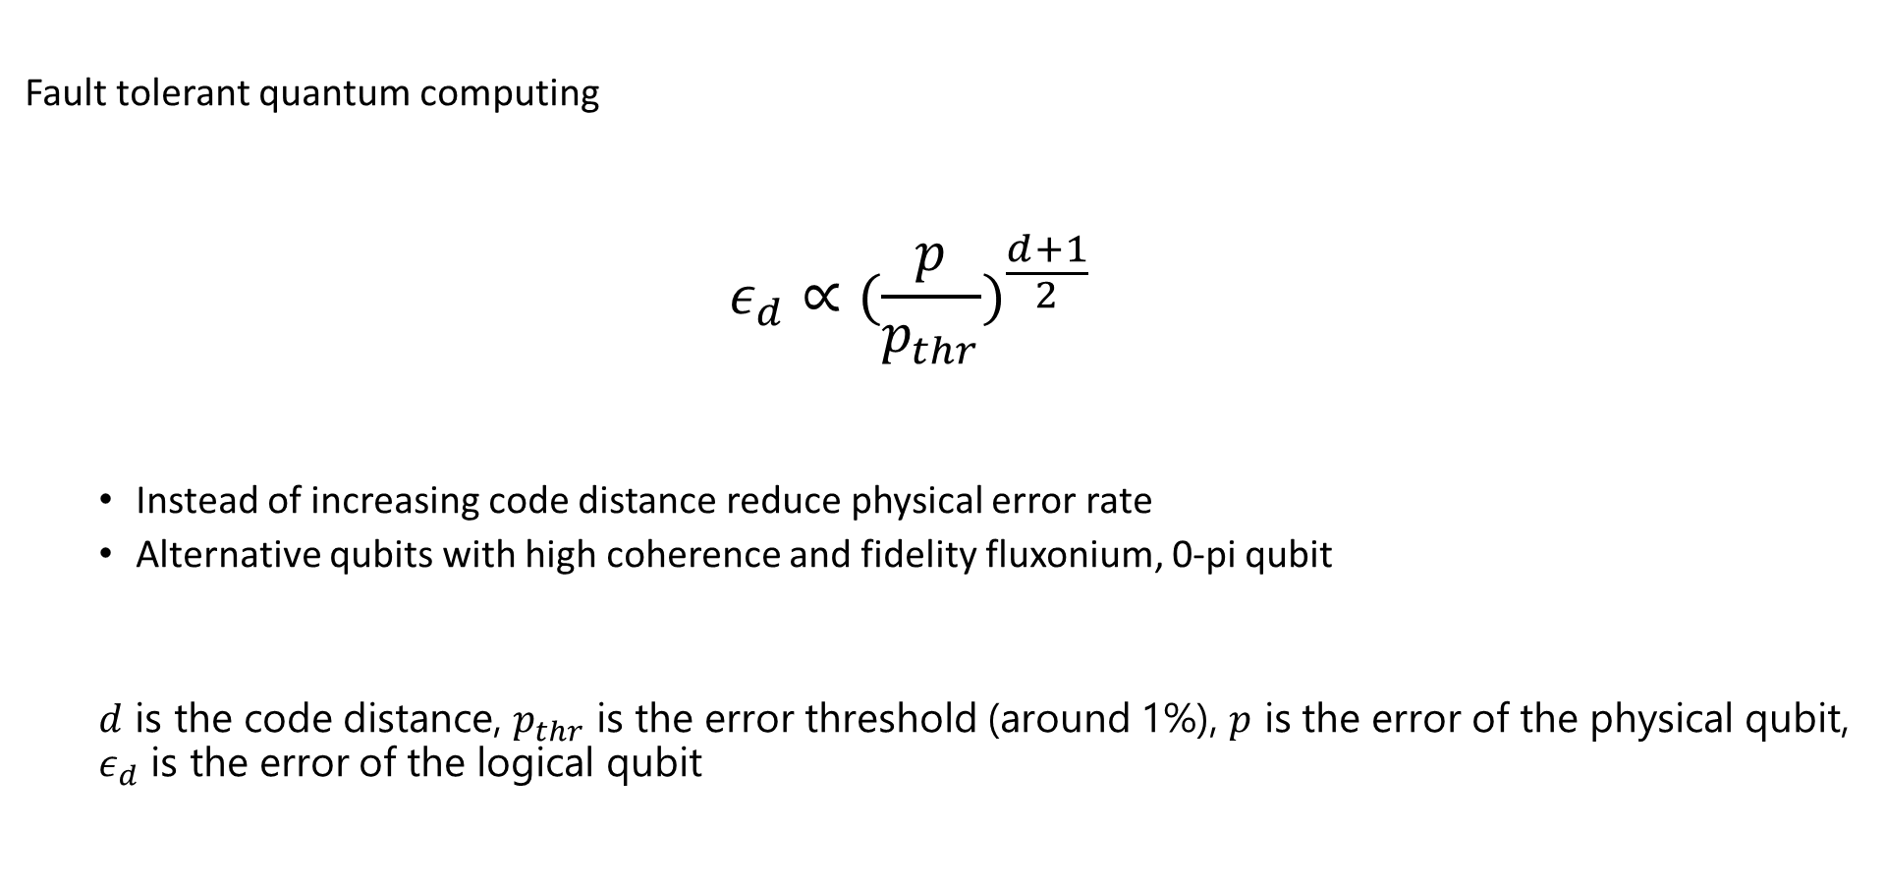
The Goal – from a different angle
Fault tolerant quantum computing
  $$ε_{d}∝({\frac{p}{p_{thr}})}^{\frac{d+1}{2}}$$
  Instead of increasing code distance reduce physical error rate
  Alternative qubits with high coherence and fidelity fluxonium, 0-pi qubit
  $d$ is the code distance, $p_{thr}$ is the error threshold (around 1%), $p$ is the error of the physical qubit, $ε_{d}$ is the error of the logical qubit

Slide 35
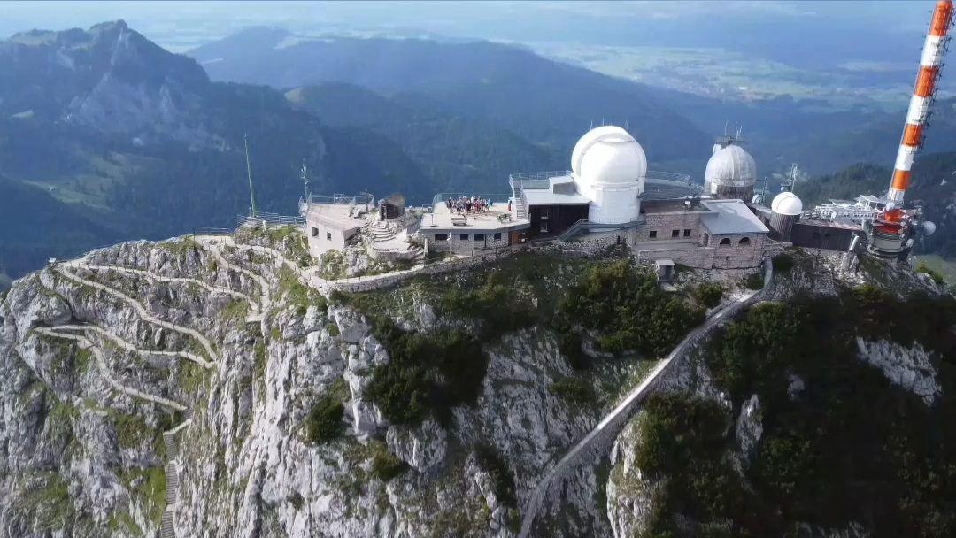









Thank you for your attention
Stefan Filipp
Nicolas Arlt
Vera Bader
Daniil Bazulin
Niklas Bruckmoser
David Bunch
Julian Englhardt
Julius Feigl
Noelia Fernandez
Niklas Glaser
Christian Gnandt
Longxiang Huang
Gerhard Huber
Fabian Jochum
Kevin Kiener
Martin Knudsen
Leon Koch
Vincent Koch
Gleb Krylov
Benedikt Lezius
Klaus Liegener
Florian Maier
Frederik Pfeiffer
Léa Richard
Joao Romeiro
Federico Roy
Lasse Södergren
Saya Schöbe
Johannes Schirk
Christian Schneider
Malay Singh
Agata Skoczylas
Ivan Tsitsilin
Lucia Valor
Lukas Vetter
Florian Wallner
Rui Wang
Max Werninghaus
Jan Wozniak
Emily Wright

