Slide 1
Quantum Technologies From the physics lab towards real world applications
Markus Mohr
Deutsches Zentrum für Luft- und Raumfahrt (DLR)
Institut für Quantentechnologien, Ulm

Slide 2
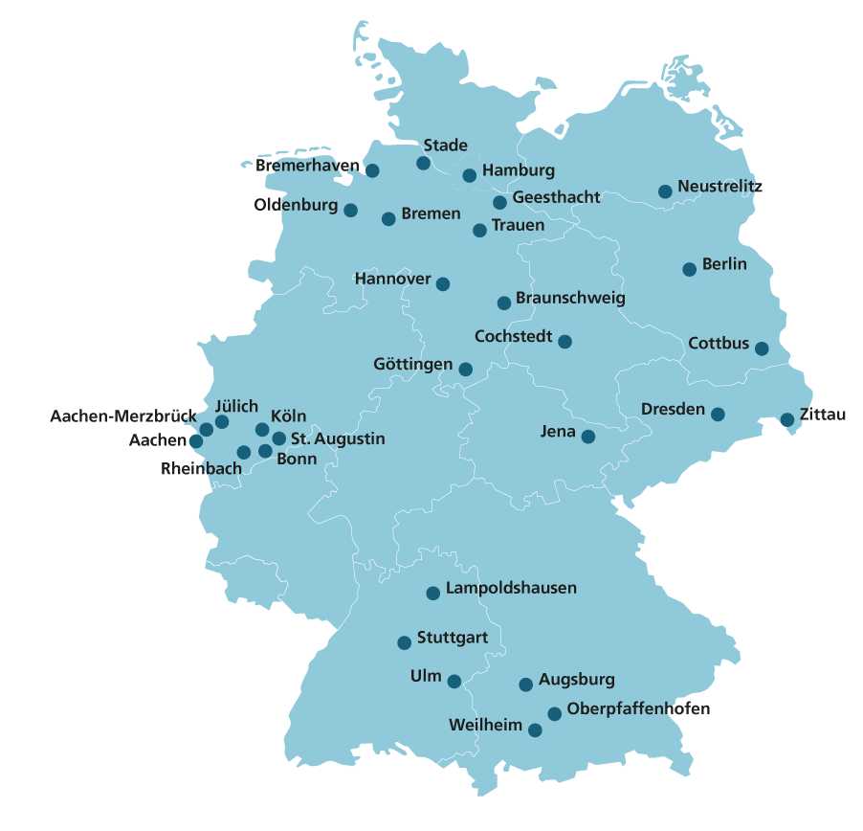
DLR
55 Institutes and Facilities at 30 locations
4 foreign offices
More than 10.000 employees
In Ulm
Institute for Quantum Technologies
Institute for AI-Safety and Security
Institute for Engineering Thermodynamics
Notes:
Brüssel, Paris, Tokio und Washington D.C.

Slide 3
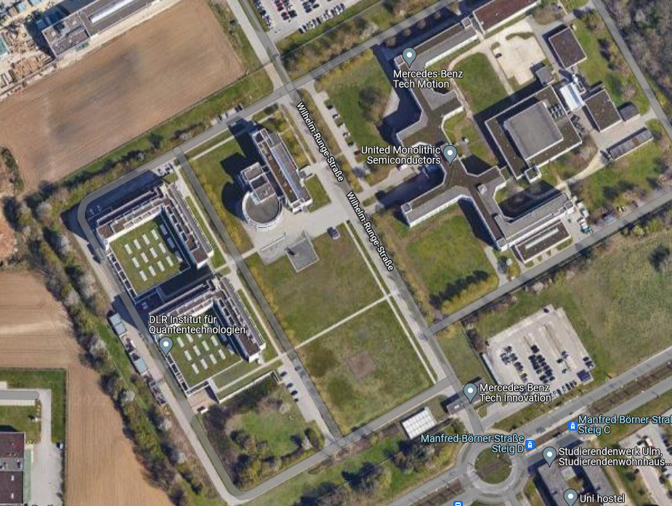
Institute for Quantum Technologies
Institute Statistics / Facts
Institute for Quantum Technologies
Approximately 100 employees
Approximately 15 PhD students
Seven divisions
2 Cleanrooms
>400 sqm new lab space
Other DLR Institutes
Quantum Computing Initiative
4-6 start-ups
Institute for Engineering Thermodynamics
Institute for Artificial Intelligence

Slide 4
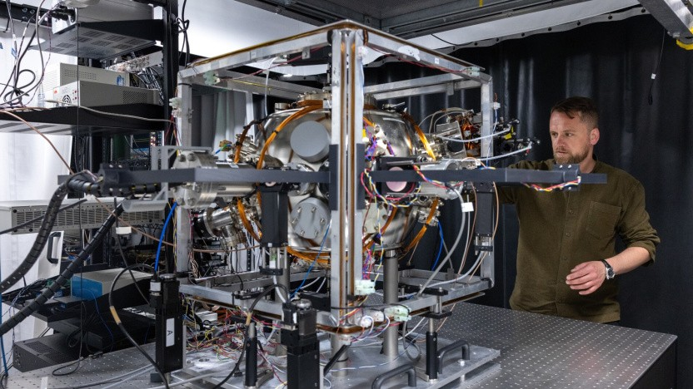
Quantum Technologies
Quantum Technologies offer exciting applications
secure communication
precise sensing (e.g. magnetic fields, gravity)
quantum computing
precise timing (e.g. atomic clocks)
Room filling experiments
Example: Accelerometer (British Royal Navy)
There is a big need for integration and miniaturization of quantum technologies
Ist GPS bald überflüssig und die Quanten-Navigationssysteme kommen? (golem.de)

Slide 5
Infrastructure
Bildquelle hier angeben

Slide 6
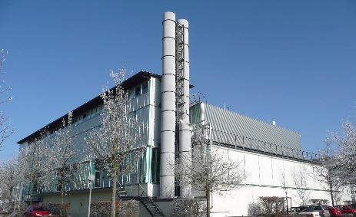
Microfabrication Cleanroom QT Ulm / Ulm University
Facility:
>500m² cleanroom lab space with ISO class 5 and better particle density
Shared with and operated by University Ulm
100 and 150mm substrate equipment
Technology Focus:
Diamond processing for NVs
Bonding technology for µ-scale UHV vacuum systems
Photonic components for µ-scale quantum systems
Rb Encapsulation
Lithography
Deposition
Etching
Packaging and Interconncetion
Analytics
Laser-Lithography
PECVD
Wet Etching
Wire Bonding
Laser Microscopy
E-Beam-Lithography
Sputtering Deposition
DRIE
Flip-Chip-Bonding
Electrical Characterization
Photo-Lithography
(with Mask)
Vapor Deposition
RIE
Anodic Bonding
Optical Characterization
Electroplating
IBE
Wafer Bonding
SEM
Mechanical Processing
3D Printing PEEK
Thinfilm reflectometer
ALD
CAIBE
Polishing
Focused Ion Implanter
ALE
Mikrooptics
2 Photon printer
AFM
Wafer Dicer
Focused Ion Implanter
Mircowave Reactor
3D Printing PA / PP
Ozon Treatment
In procurement

Slide 7
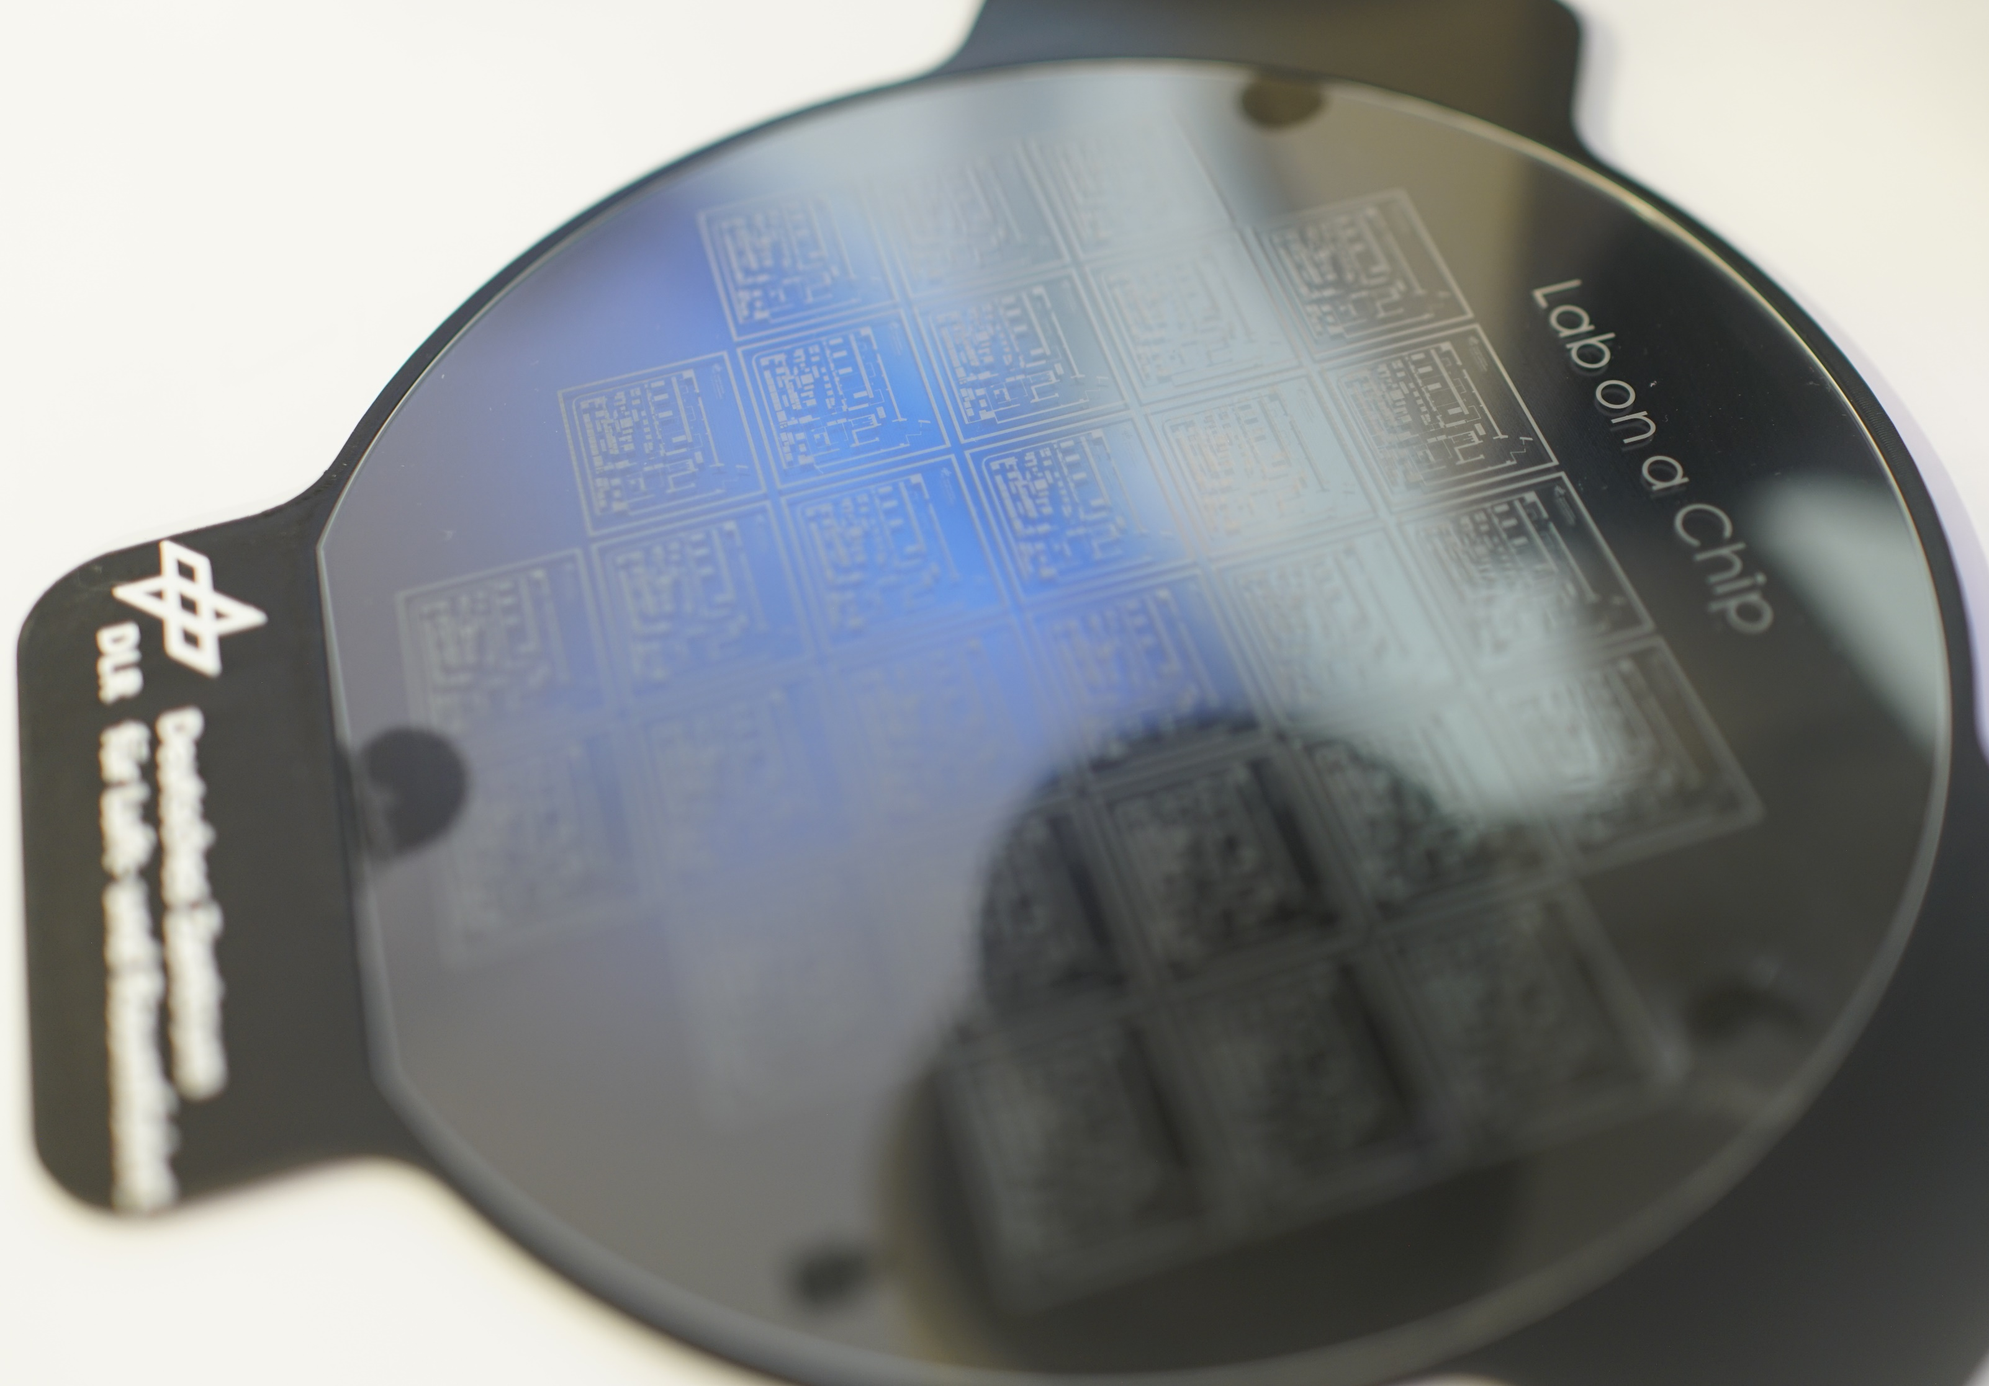
Microfabrication QC-I Cleanroom in Hamburg
Processes completely on 150 mm wafers
Deposition
Magnetron sputtering
E-Beam PVD
PECVD
Electroplating
Structuring
RIE
DRIE
IBE
XeF₂ gas phase etching
SLE
Plasma ashing
Wet processing
Cleaning
Etching (acids, bases)
Lithography
Mask Aligner
Laserlithography
Spin coating, bake, development
Assembly + Packaging
Dicing
CMP
Die mounting
Wire bonding
Metrology / Characterization
SEM/FIB/EDX
Tactile profilometry
Optical profilometry
Lightmicroscopy
Confocal laser scanning microscopy
Waferprober
Cryo probe station
Reflectometry
White light interferometry

Slide 8
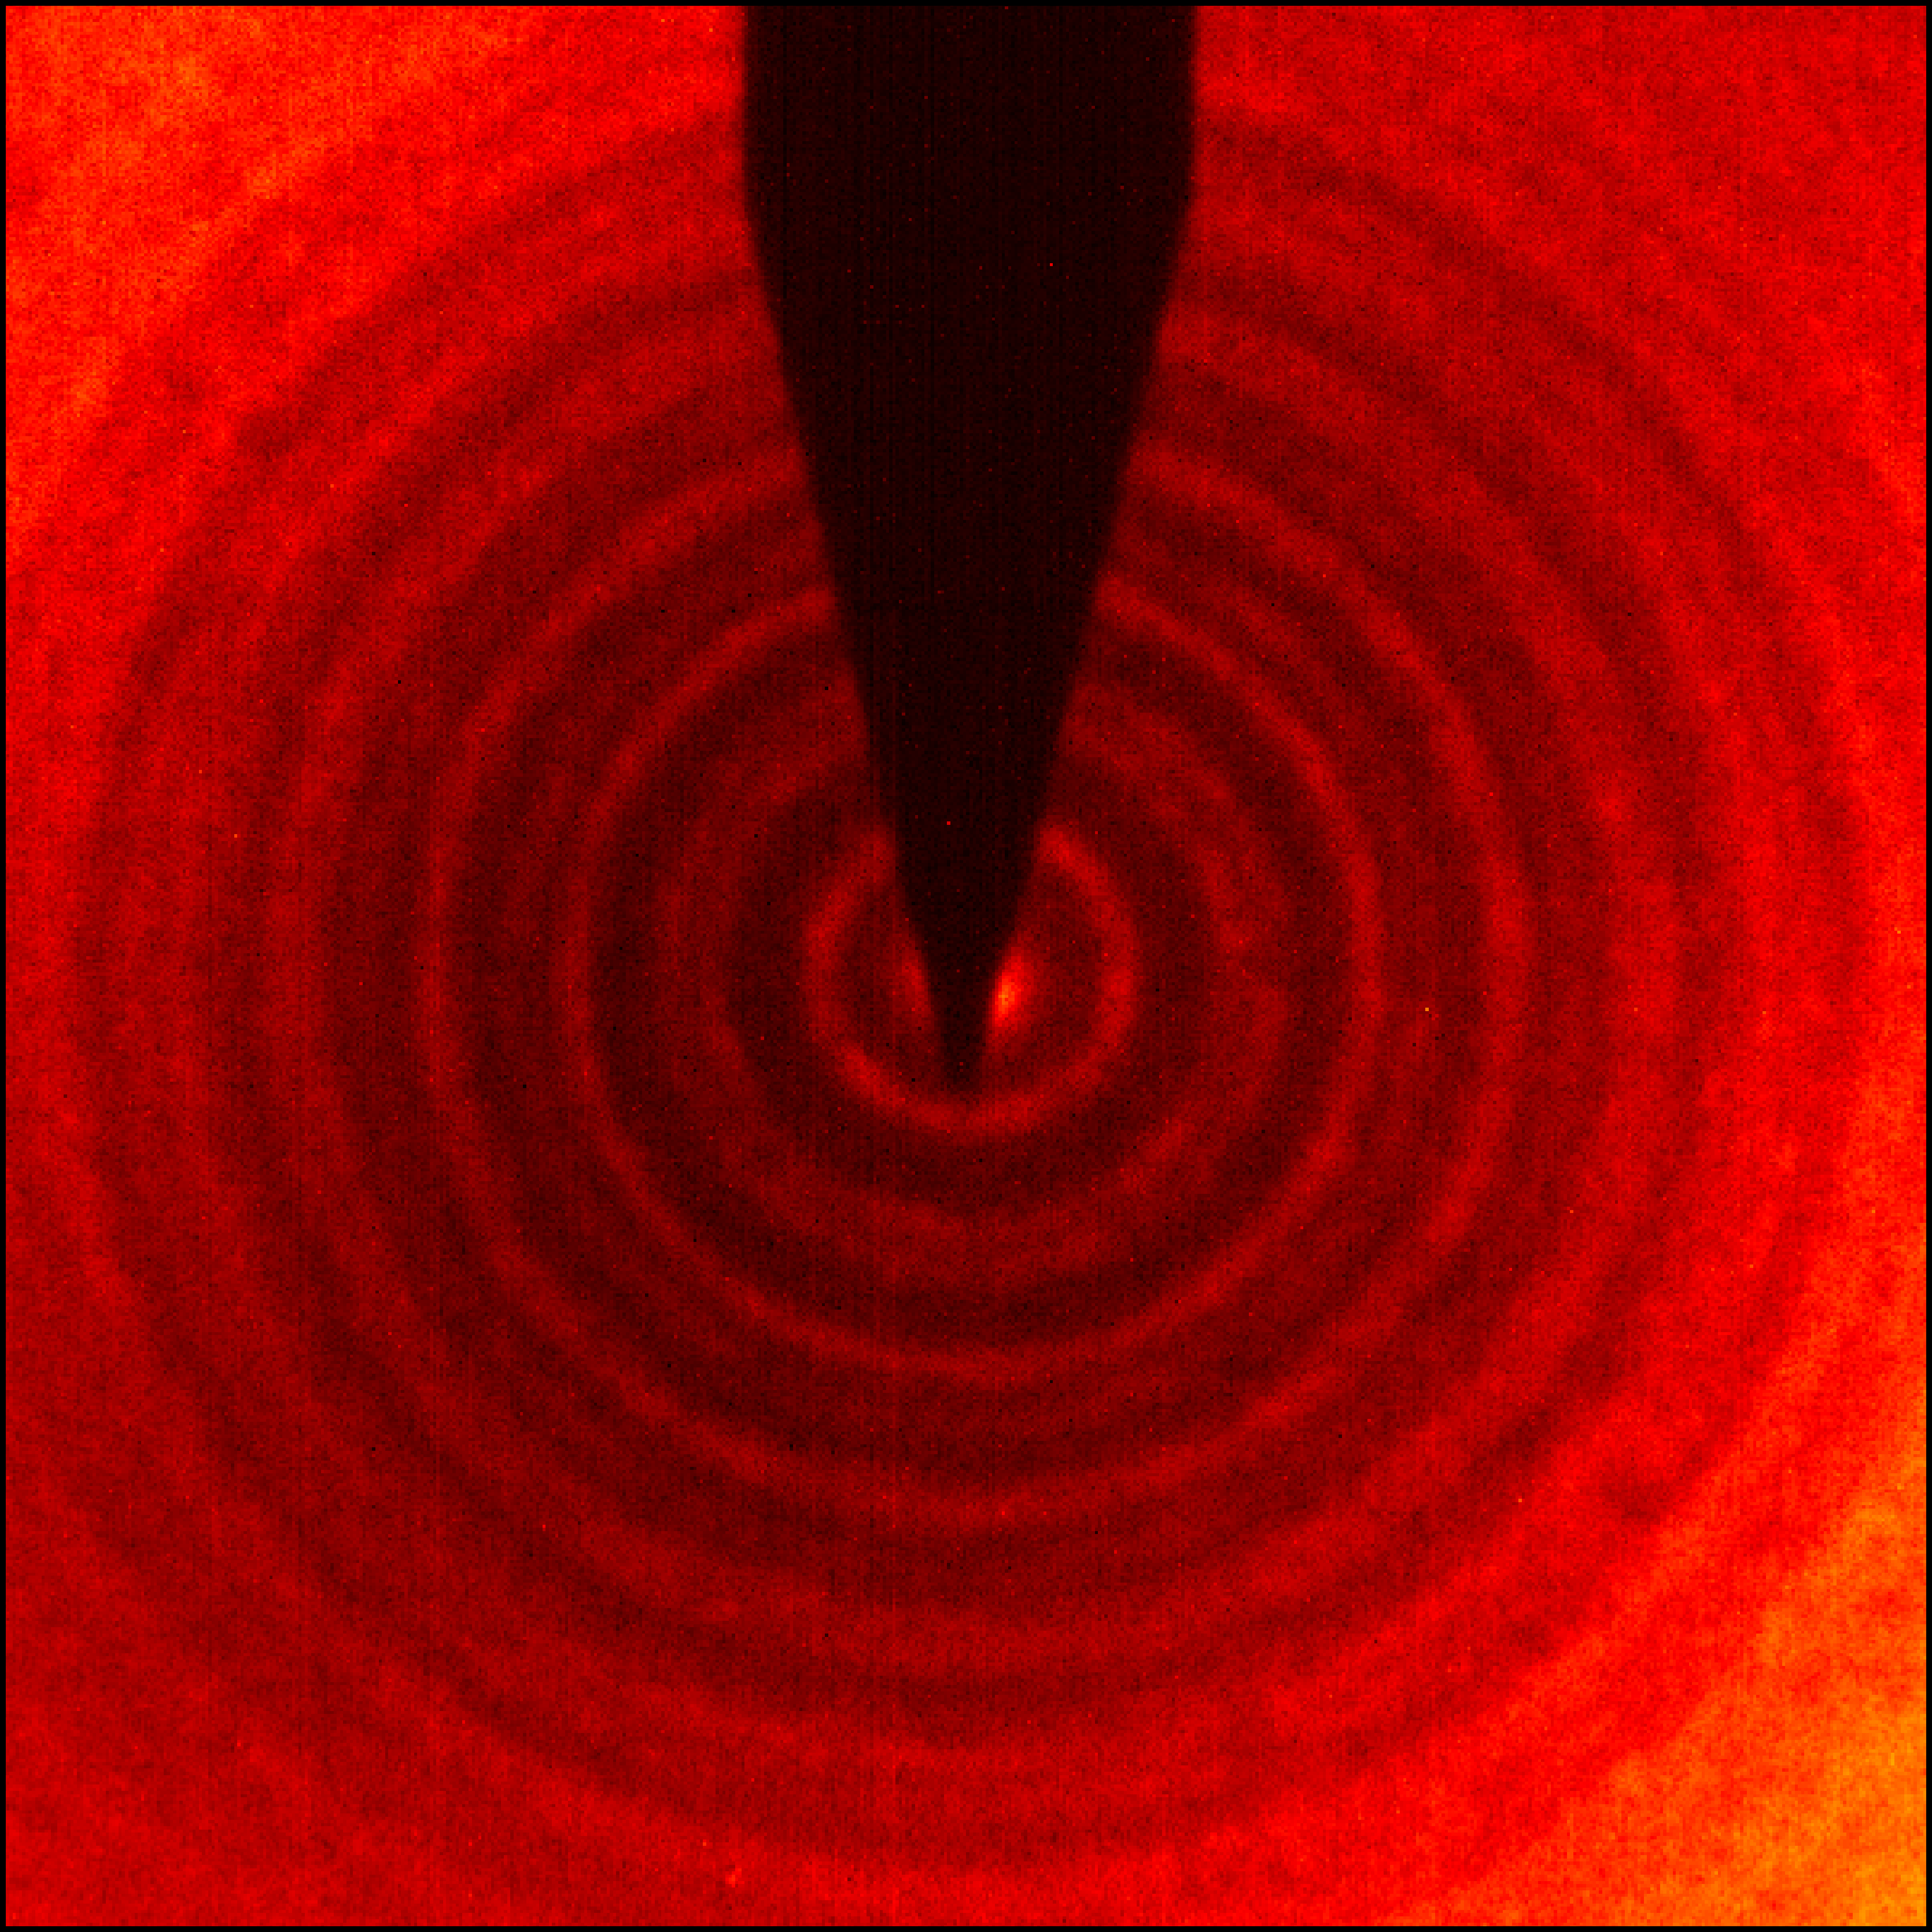
Nanophysics

Slide 9
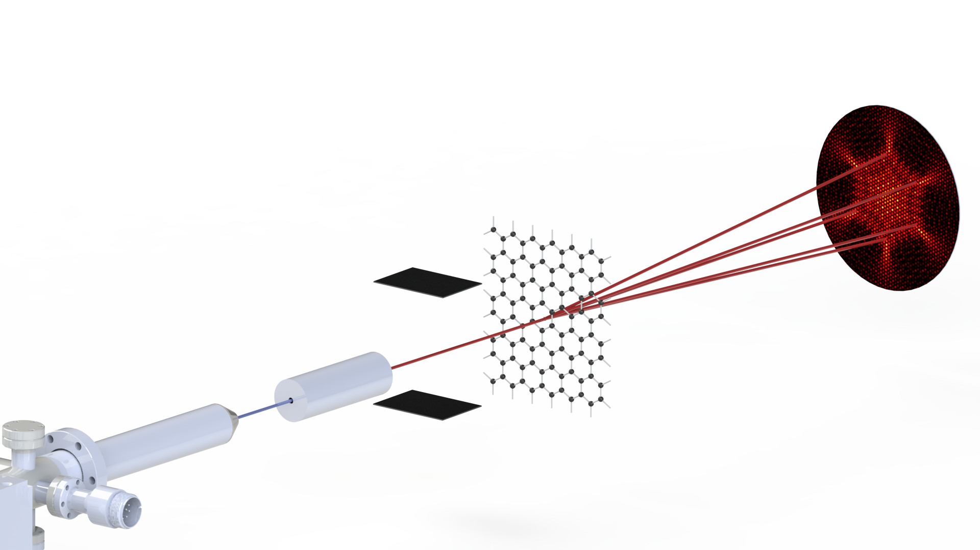
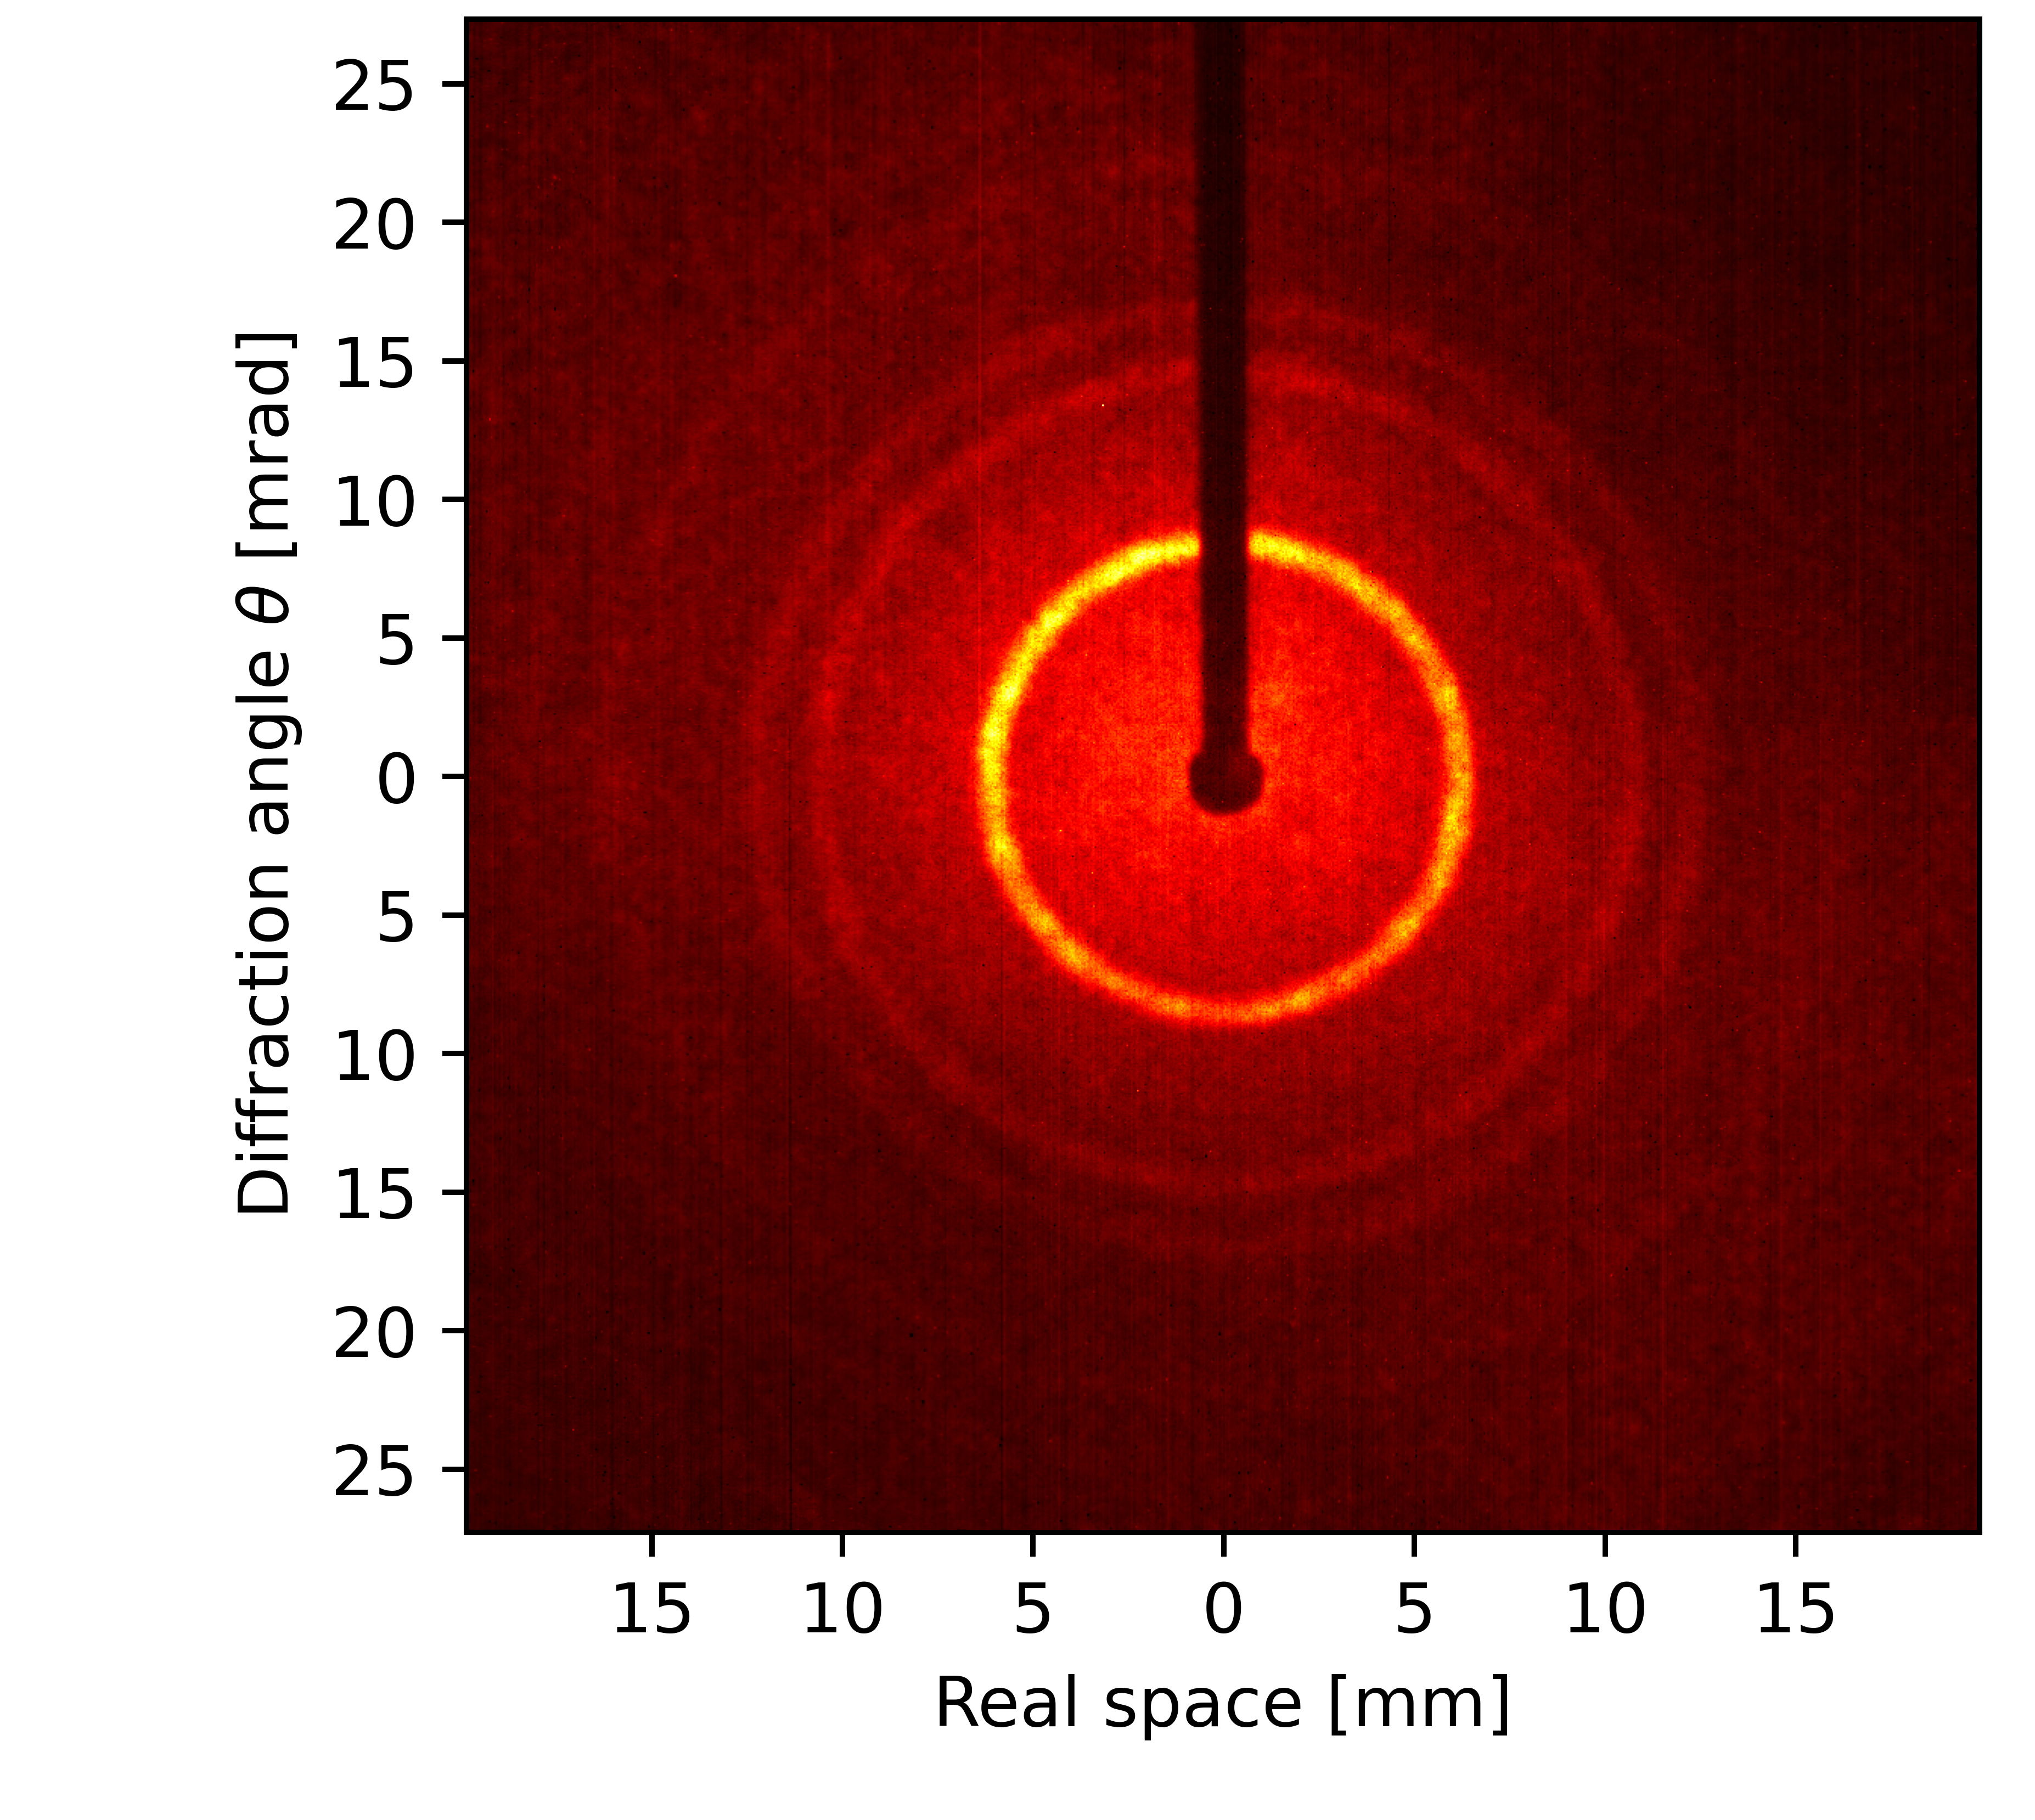
Diffracting atoms through materials
Radiation damage is a severe limitation in the study of materials, especially biological samples, in electron microscopy.
To solve this issue, we pioneer a table-top experiment that replaces the electron in a TEM by a neutral atom.
We present the world’s first diffraction of atoms through a material, single-layer graphene
helium
This technology has possible implications for biology, astrophysics, and material research.
hydrogen

Slide 10
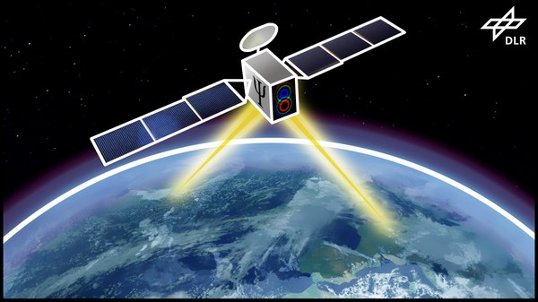
Quantum Communication

Slide 11
Communication Application Quantum Memory
Conventional communication
Transmission of a Key via Quantum States e.g. amplitude and phase of a photon (Quantum Key Distribution)
Fiber based difficult – too much absorption (max. ~ 170 km) → via satelite
Storage of a quantum state for later retrieval without destroying the quantum state
Any listener on the channel is „measuring“, destroying the quantum state
Bob
Bob
$$\left|ψ\right\rangle$$
Quantum communication
Alice
$$\left|ψ\right\rangle$$

Slide 12
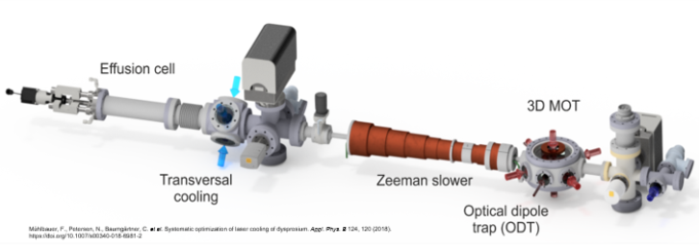
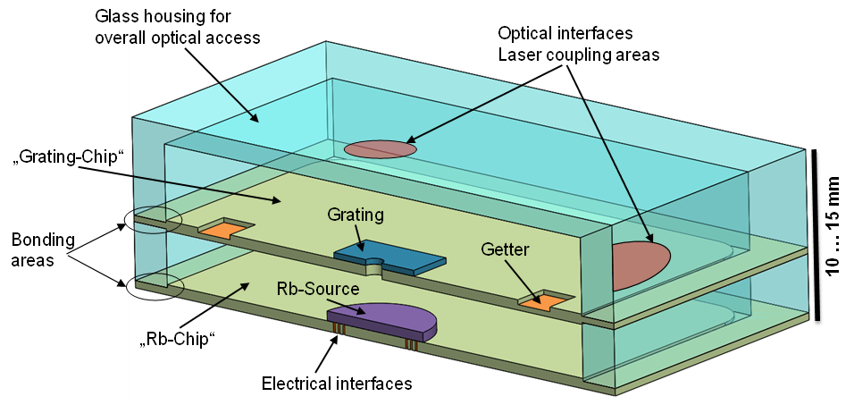
Communication Application Quantum Memory
Cold Rb atom gas based quantum memory
Development of miniaturized system components
Miniaturized Rubidium source
Grating chip for cooling lasers
Miniaturized Vacuum Cells
Getter materials for vacuum
Current lab experiments:
Goal:

Slide 13
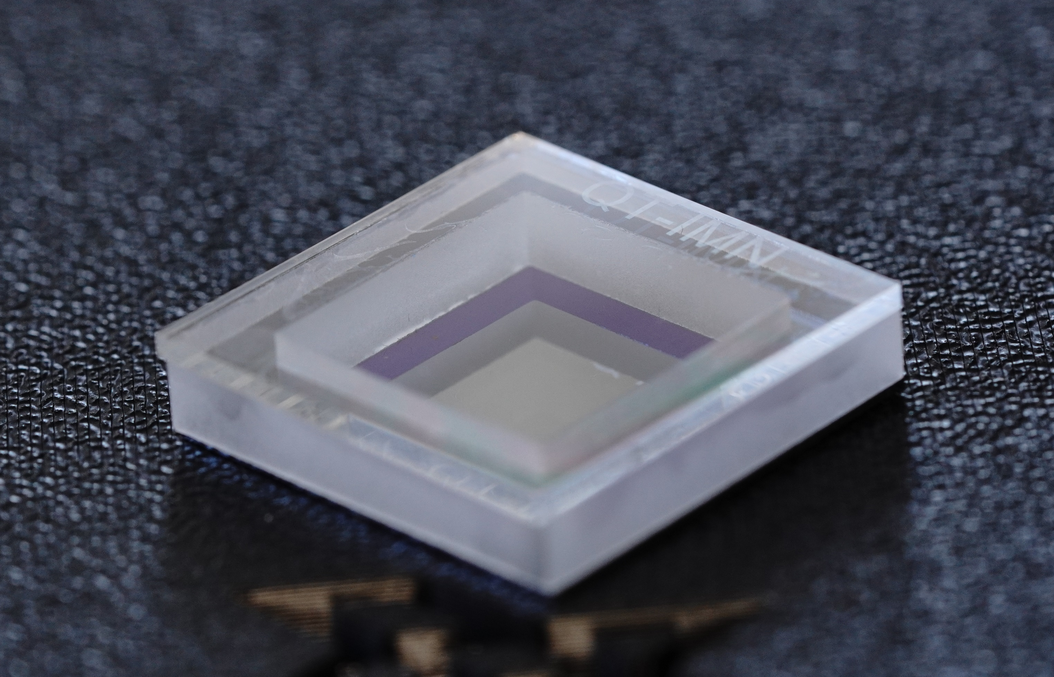
Communication Application Quantum Memory
In-house development and fabrication of miniaturized components on chip level
Chip-scale atom source for controlled Rb release
Grating-chip for efficient cooling light steering
Sealing technology for integration in glass cells

Slide 14
Quantum Sensing

Slide 15
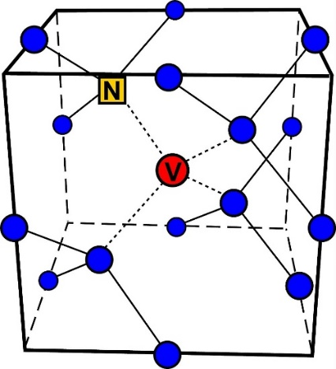
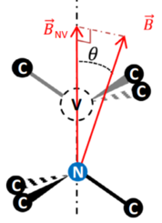
Quantum Sensing / Quantum Computing Diamond NV-center based technology
NV-Center in Diamond: a defect complex
Nitrogen atom next to a Vacancy
Zeeman splitting = 2 γ_{NV} B_{NV}

Slide 16
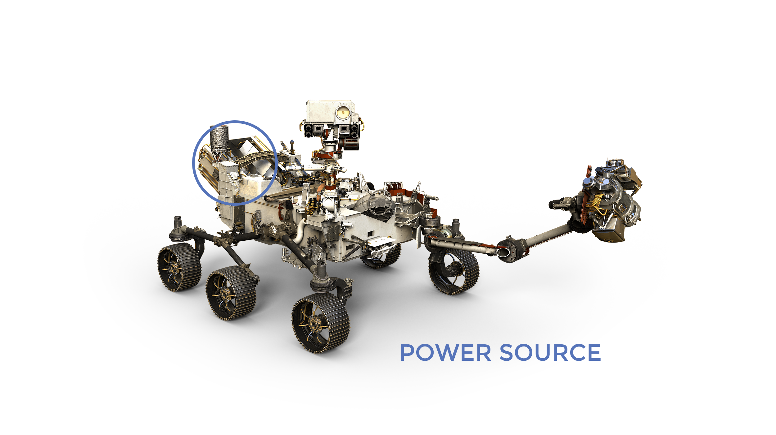
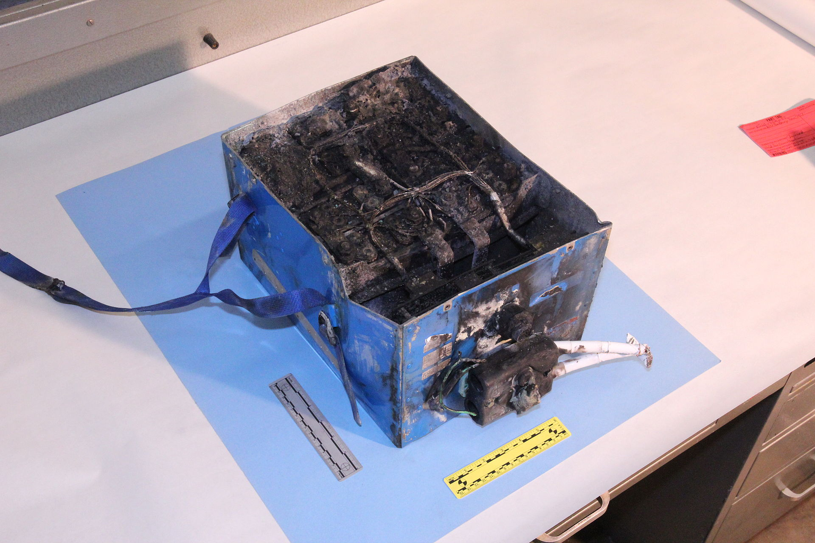
Quantum Sensing Diamond NV-center based technology
Safe, reliable, durable batteries required in space
Degradation of battery is limiting life-time and mission-duration
Degradation of batteries can become dangerous
Degradation mechanisms are complex (multiscale chemical/physical processes)
Monitoring of battery state is important (SoC = „state of charge“, SoH = „state of health“)
Defective Li-Ion Battery from Boeing 787

Slide 17
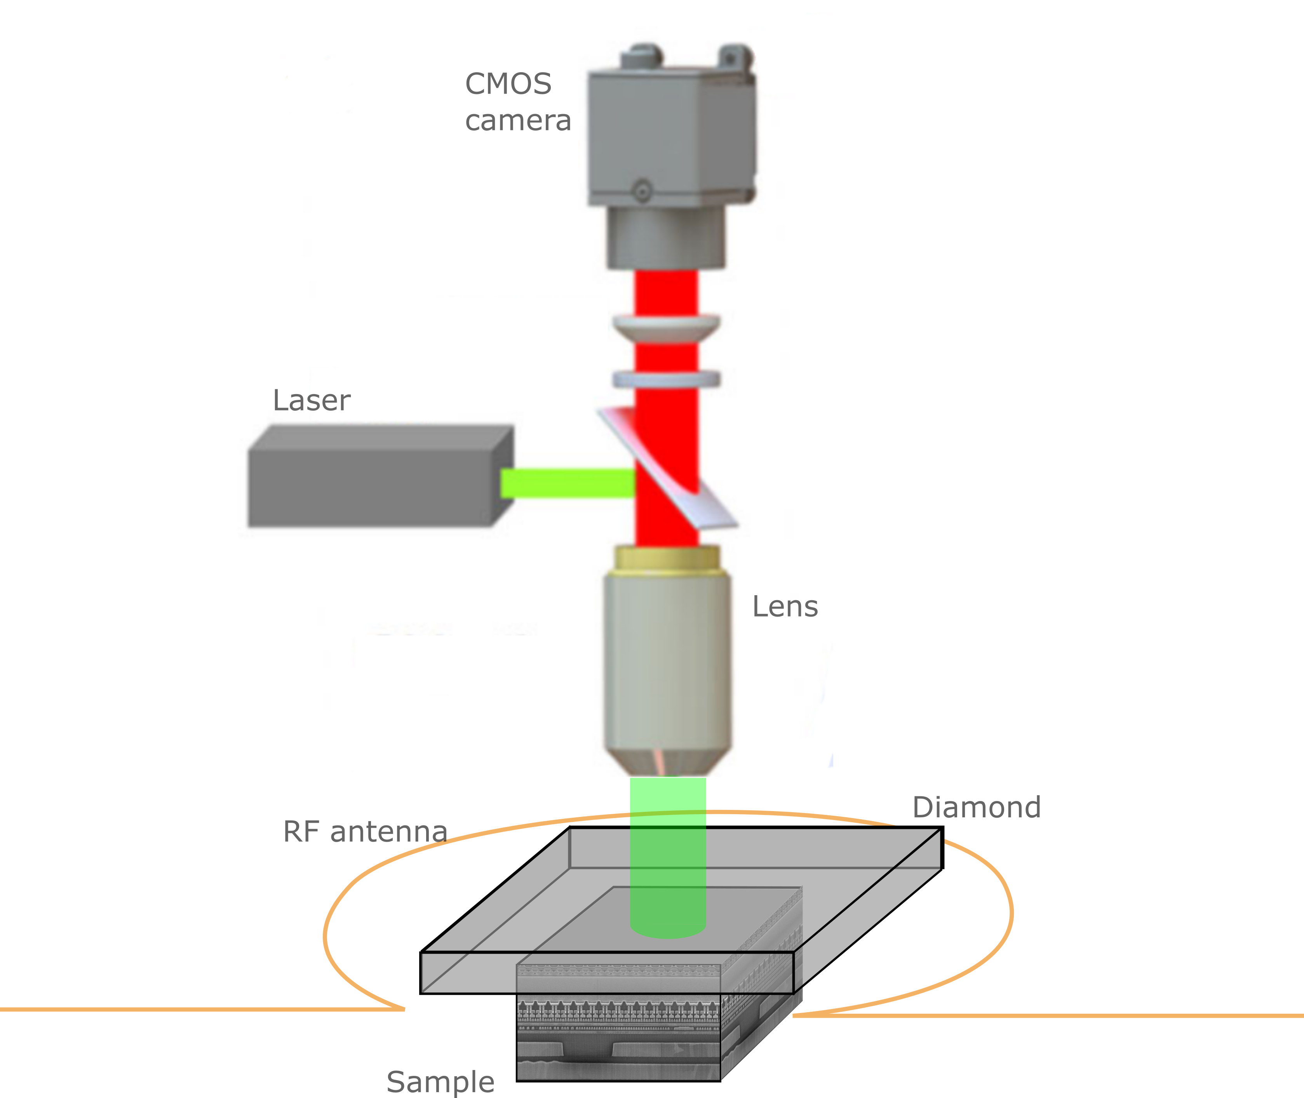
Quantum Sensing Diamond NV-center based technology
~400 µm
$$\vec{B}$$
$$\vec{j }$$
$$μ_{0}\vec{j }=\vec{∇}×\vec{B}$$
~400 µm
Time; RF Frequency
Fluorescence intensity (a.u.)
RF Frequency

Slide 18
Quantum computing

Slide 19
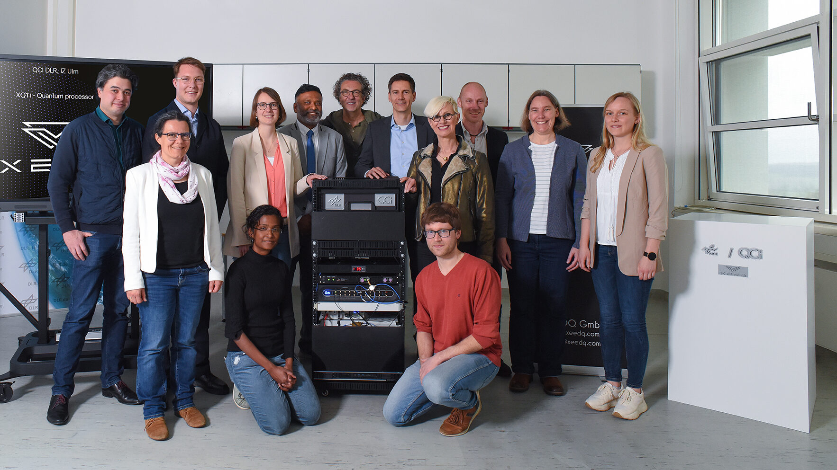
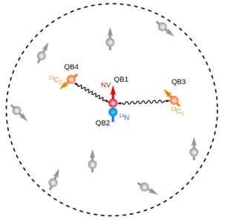
Quantum Computing Enabling Technologies – NV-center based technology
4-Qubit-system XQi1 based on NV-Centers in diamond
Working Principle:
1 x NV-electron spin is coupled to 2 x C13 nuclear spins, and 1x N14 nuclear spin
May 2023

Slide 20
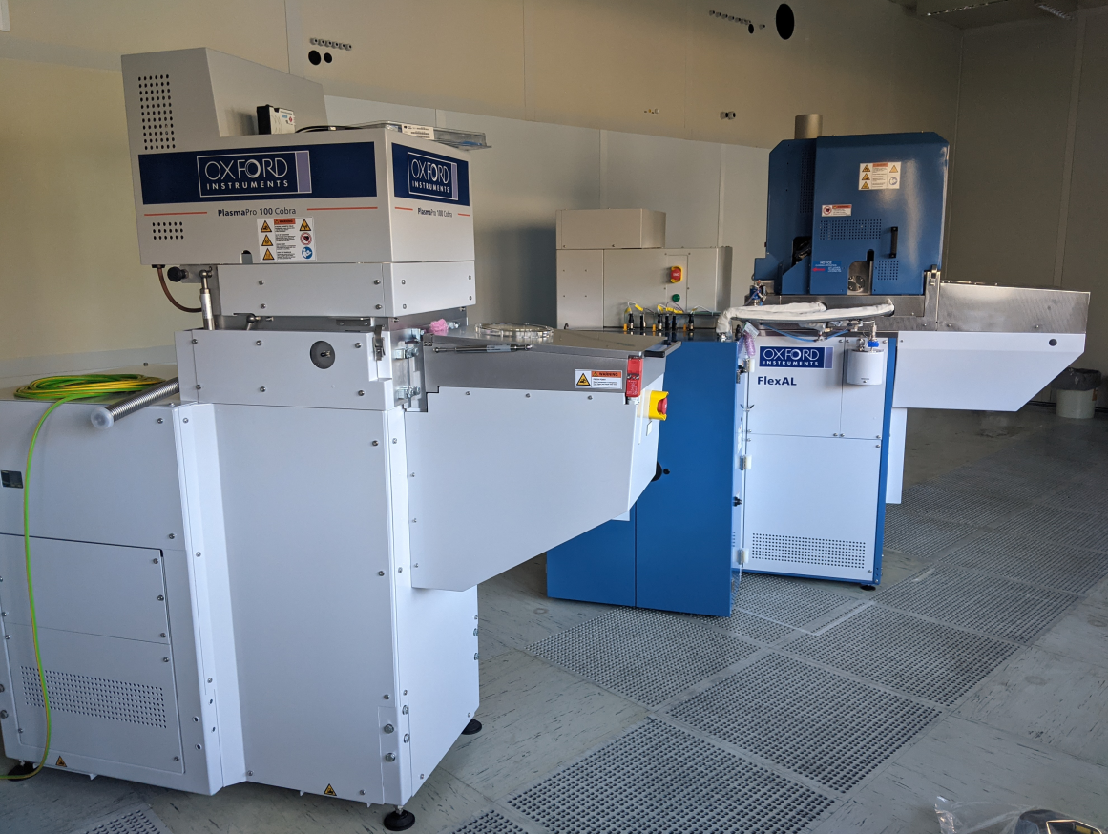
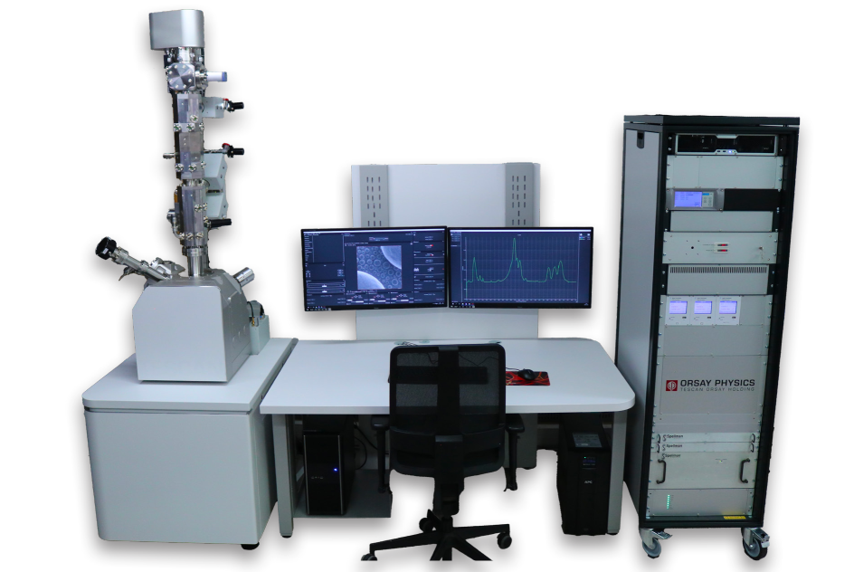
Quantum Computing Enabling Technologies – NV-center based technology
Establishing a process technology for atomic resolution etching and deposition, as well as for implantation at nanoscale resolution

Slide 21
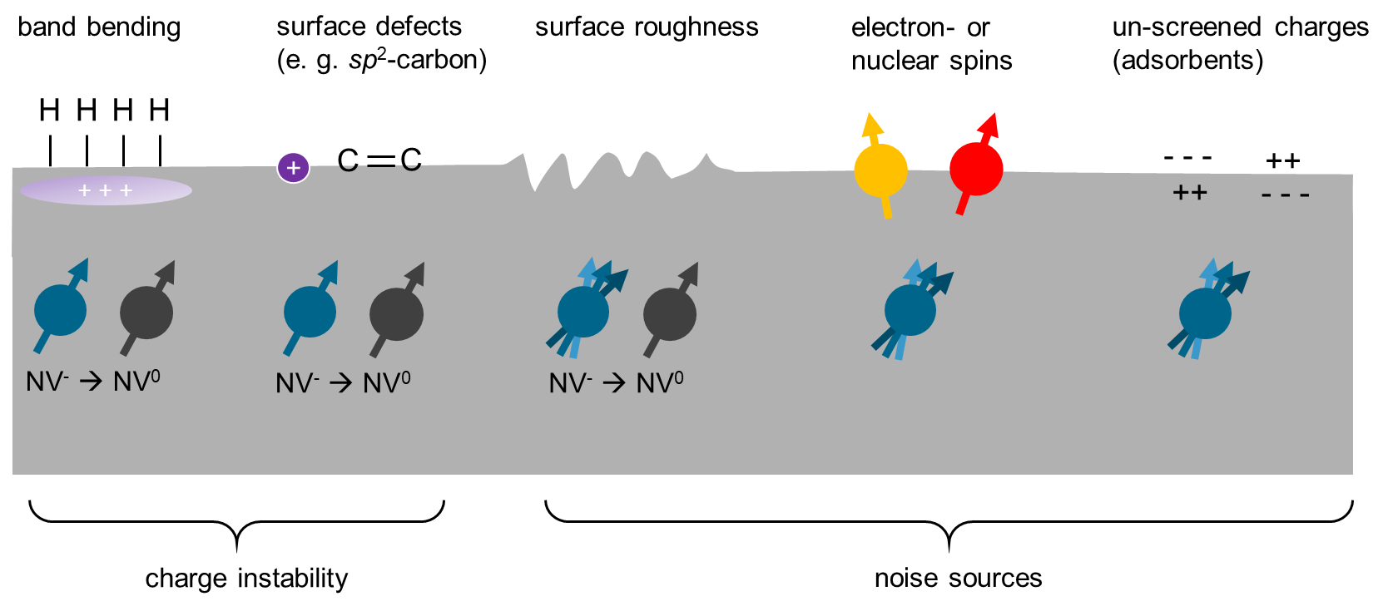
Quantum Computing Enabling Technologies – NV-center based technology
Process development for increasing coherence time of shallow NV-centers → at atomic resolution: Atomic Layer Etching, Atomic Layer Deposition
Surface cleaning
Surface termination
Surface structuring
Integration
Microwave antenna
Marker structures
Process compatibility

Slide 22
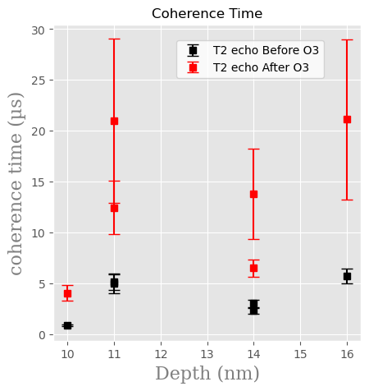
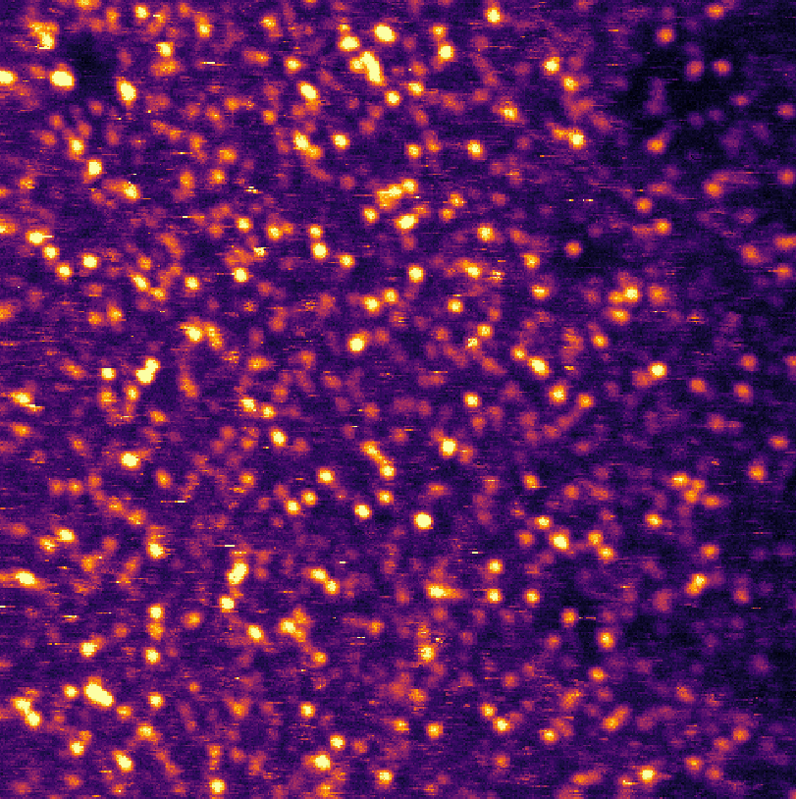
Quantum Computing Enabling Technologies – NV-center based technology
C 1s
sp³C
Reference
Ozone O₃
Chemical changes of surface can explain observed changes of NV-performance
→ Increase of T2 (~ 4 x)
Before Ozone After Ozone
sp²C
5 µm
→ Increase of yield (~ 3 x)

Slide 23
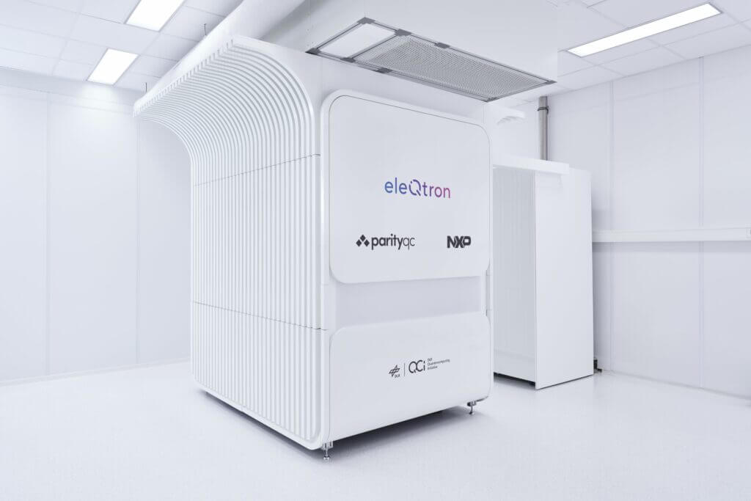
Quantum Computing Enabling Technologies – Ion-trap based technology
10-Qubit-system QSEA1 based on ion-traps
Coupling of trapped ions in a magnetic field gradient (MAGIC)

Slide 24
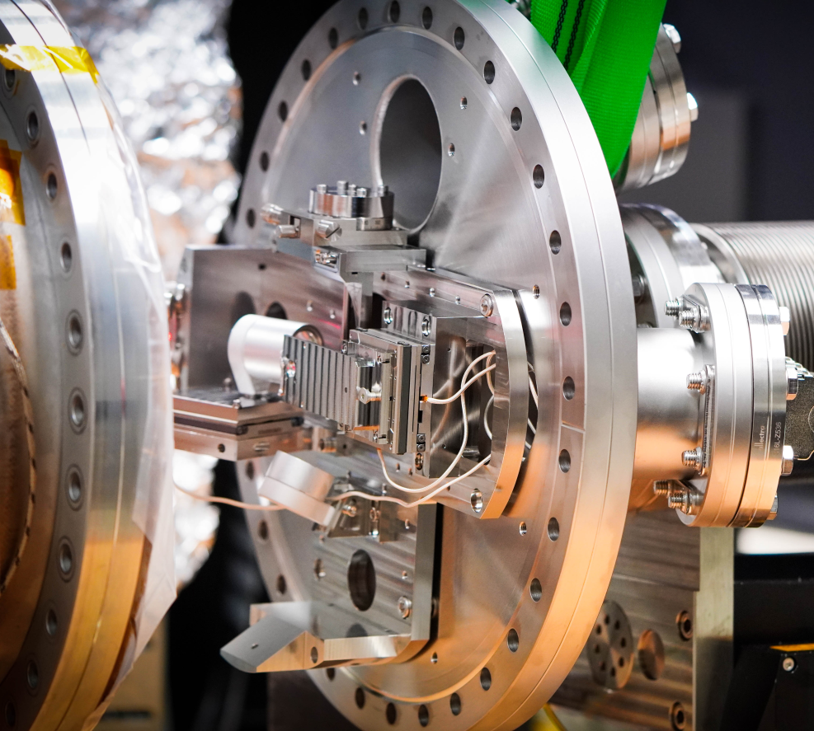
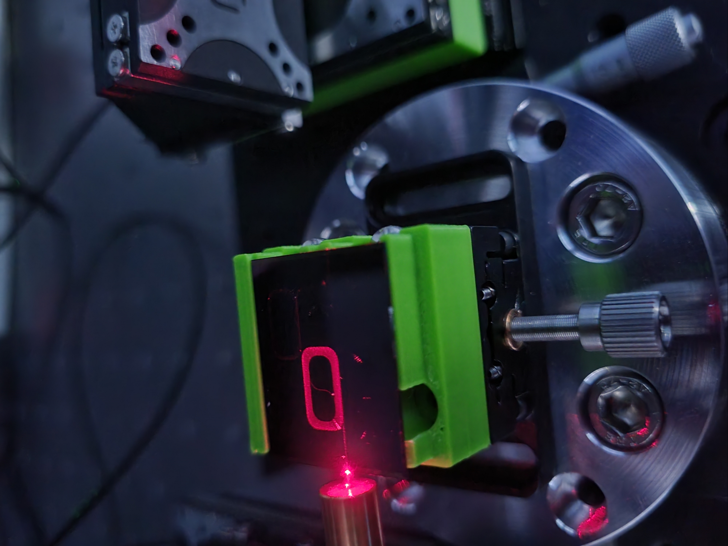
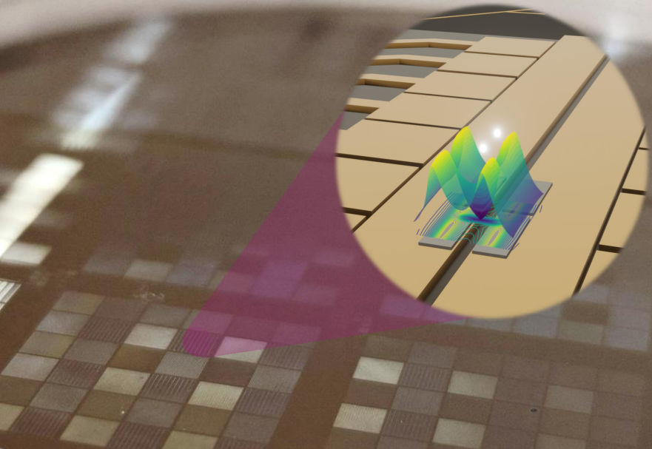
Quantum Computing Enabling Technologies – Ion-trap based technology
Miniaturized Ablation Atom Source
Photonic Integration
Micromagnetic Structures

Slide 25
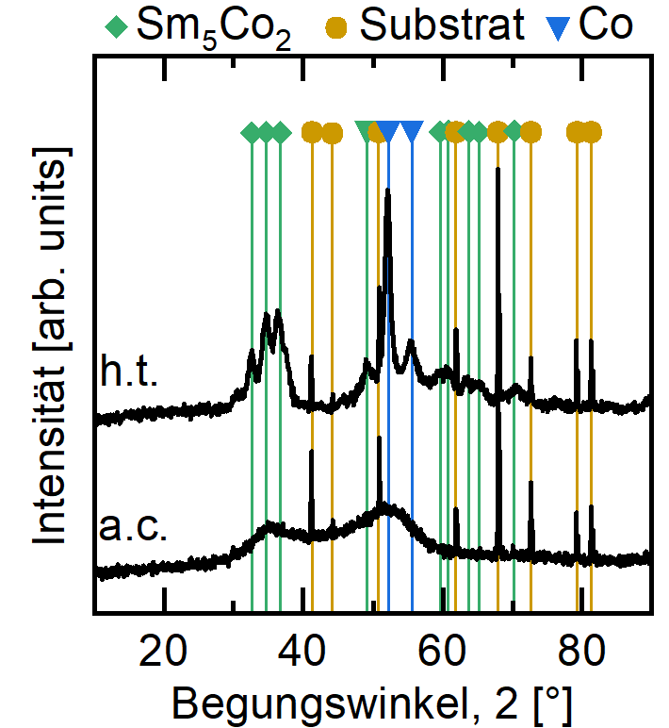
Quantum Computing Enabling Technologies – Ion-trap based technology
Aim: Microstructured hardmagnetic structures on the ion-trap chip
XRD on Si
SEM on Glas
Sputter deposition of SmCo films on Si
Wet chemical structuring
Sputtering at room temperature → amorphous
Sm₅Co₂ and Co crystallites after annealing

Slide 26
Conclusion
Quantum technologies require miniaturization
Need for new processes, special demands on process and compatibilities
Special requirements on processing equipment (e.g. atomic resolution, implantation with nm-resolution)
Need for materials research, integration of uncommon materials (magnetic materials, optical materials, diamond, …)
Different technologies, different wavelengths (in communication, sensing, computing)

