Slide 1
Soft X-ray Detection with JUNGFRAU and LGAD Sensors
Viktoria Hinger^{1,*}, Anna Bergamaschi¹, Ashish Bisht², Maurizio Boscardin², Maria Carulla¹,
Matteo Centis Vignali², Roberto Dinapoli¹, Nuno Duarte³, Khalil Ferjaoui¹, Francesco Ficorella², Erik Fröjdh¹, Viveka Gautam¹, Dominic Greiffenberg¹, Omar Hammad Ali², Julian Heymes¹,
Loïc Le Guyader³, Shuqi Li¹, Vadym Kedych¹, Carlos Lopez-Cuenca¹, Davide Mezza¹, Konstantinos Moustakas¹, Aldo Mozzanica¹, Jonathan Mulvey¹, Eugenio Paris¹,
Giovanni Paternoster², Kirsty A. Paton¹, Marco Ramilli³, Elia Razzoli¹, Sabina Ronchin²,
Andreas Scherz³, Justine Schlappa³, Bernd Schmitt¹, Patrick Sieberer¹, Saverio Silletta¹,
Elisabeth Skoropata¹, Monica Turcato ³, Hiroki Ueda¹, Xiangyu Xie¹, Jiaguo Zhang¹
¹ Paul Scherrer Institut, ² Fondazione Bruno Kessler, ³ European XFEL GmBH
* viktoria.hinger@psi.ch
2nd Workshop on Silicon Sensors for Radiation Detection and Quantum Applications Lake Starnberg, 13 May 2025

Slide 2
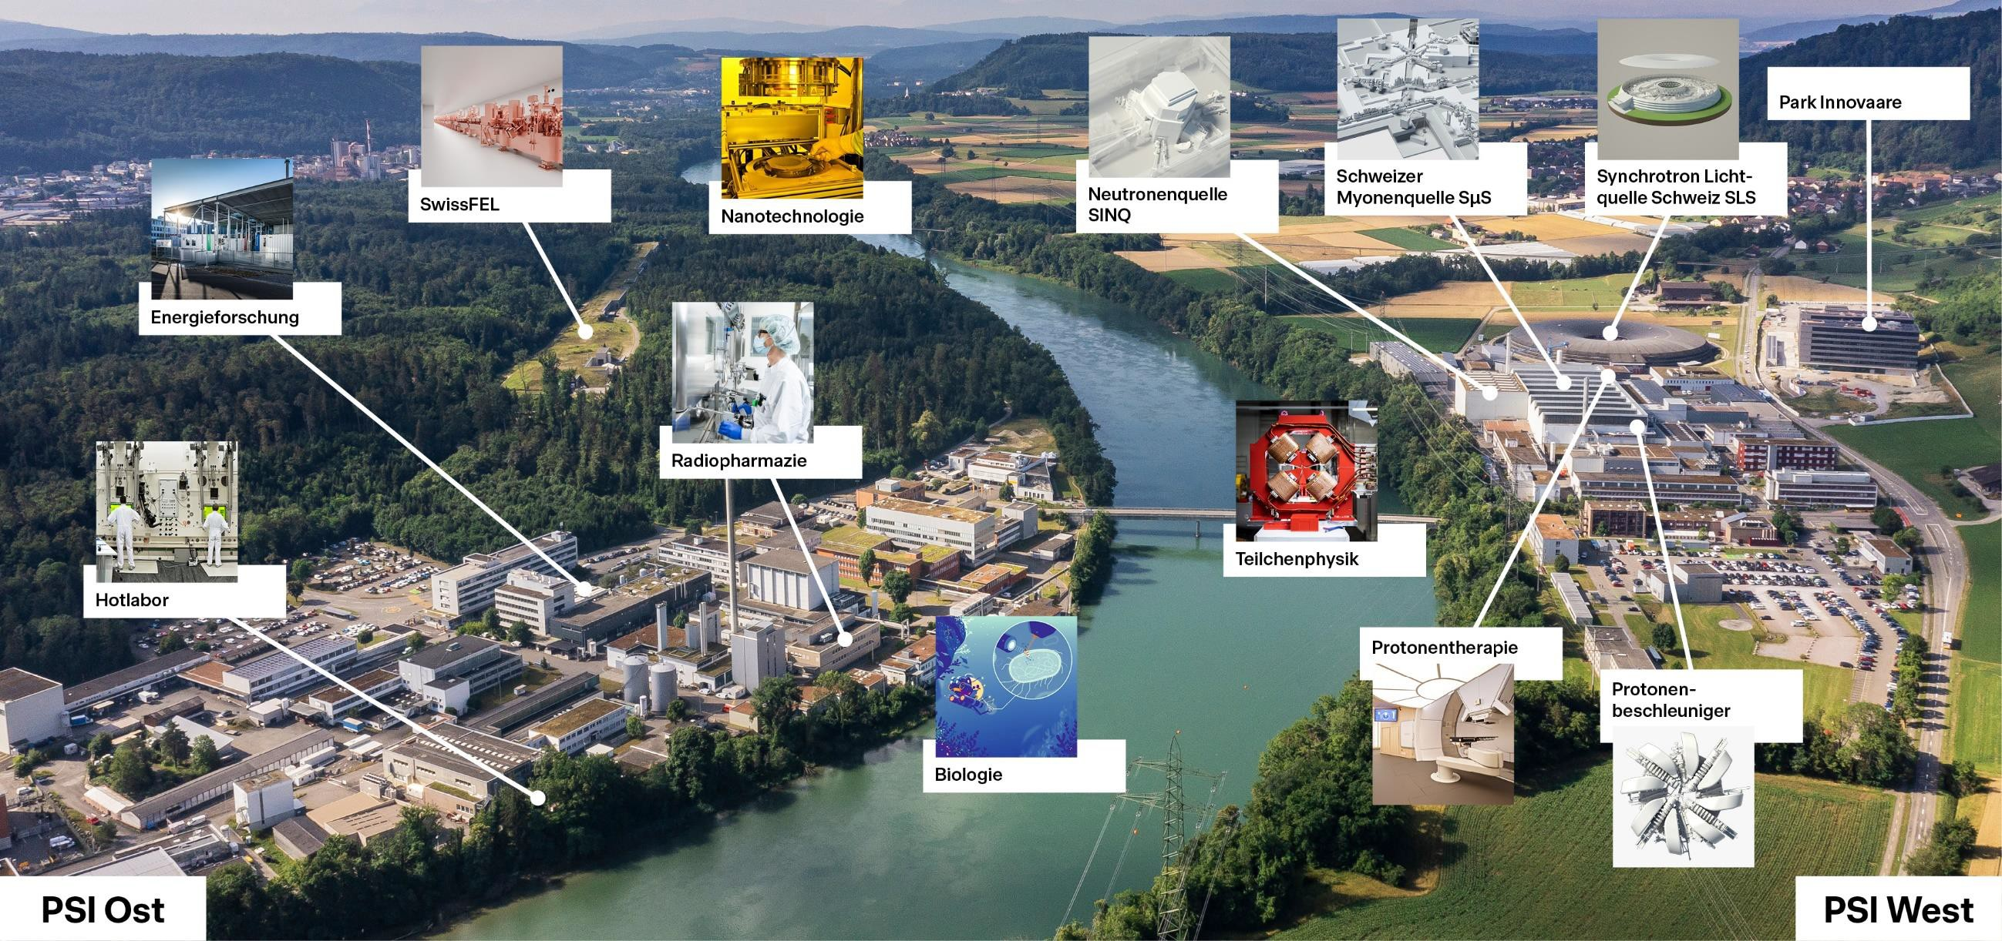
Paul Scherrer Institute
Neutron Source
SINQ
Swiss Myon Source
SµS
Swiss Light
Source (SLS)
SwissFEL
Nanotechnology
Energy Research
Radiopharmacy
Particle Physics
Proton Therapy
Proton
Accelerator
Biology
PSI East

Slide 3
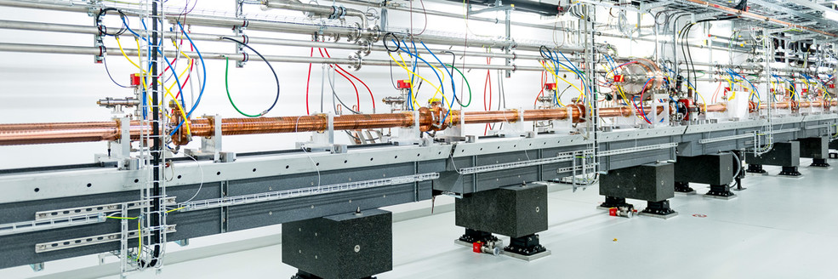
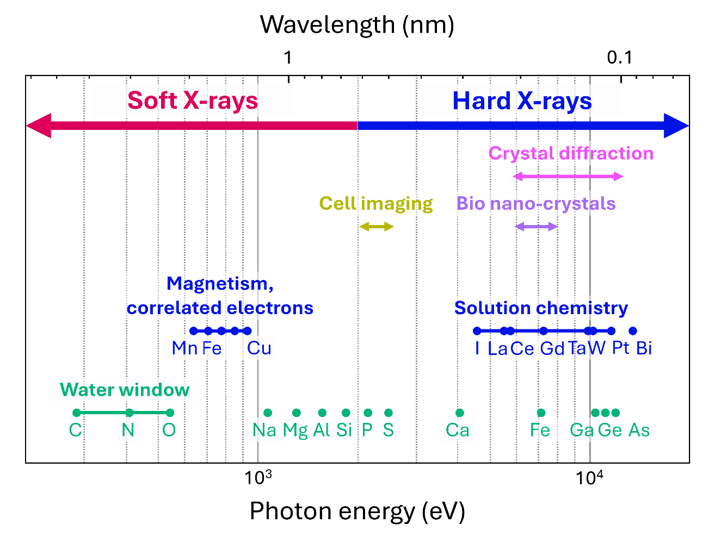
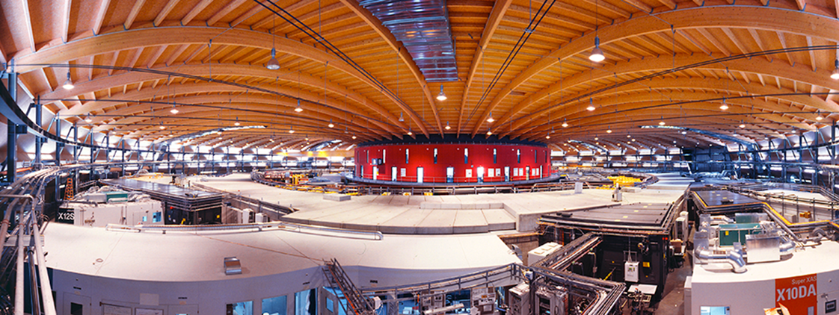
Photon Science at PSI
Swiss Free Electron Laser (SwissFEL)
Swiss Light Source (SLS)

Slide 4

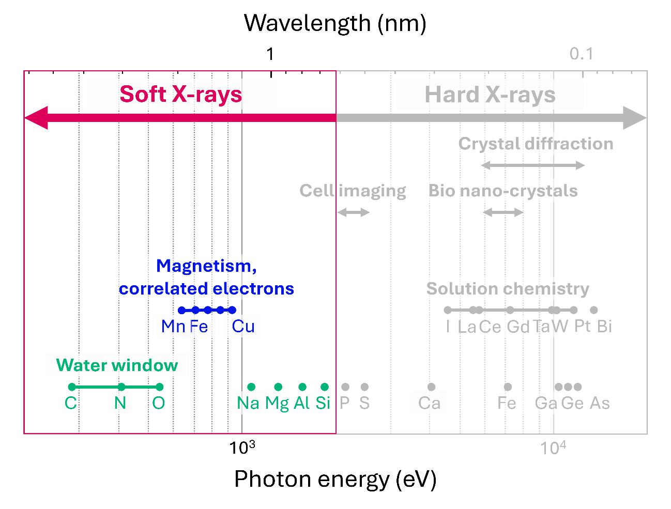


Photon Science with Soft X-rays
L-edges of many important metals
  Mn, Fe, Cu …
  Quantum materials
  Spintronics
  Superconductors …
“Water window” and light elements
  C and O K-edges (282 – 543 eV), Na, Mg, …
  Biological samples
  Catalysis
  Chemistry …
Resonant imaging and spectroscopy
e.g. Resonant Inelastic X-ray Scattering (RIXS)

Slide 5
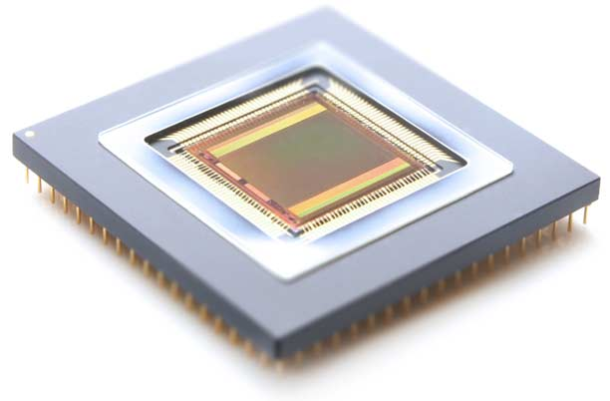
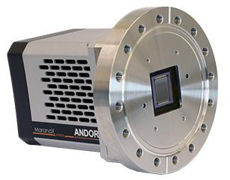
Problems of Soft X-ray Detectors: Area and Speed
Commercial soft X-ray detectors
Readout speed ~ 1 Hz
Area ~ 2 × 2 cm²
Charge Coupled Device (CCD)
Readout speed ~ 70 Hz
Area ~ 4 × 4 cm²
CMOS image sensor

Slide 6
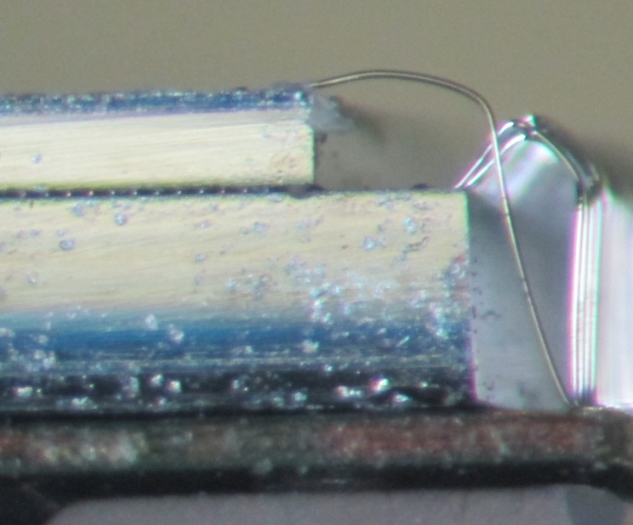



Hybrid Detectors are a Viable Solution
X-ray
Advantages
High frame rate (≥ 2 kHz)
Large dynamic range (120 MeV charge integrating, “unlimited” for photon counters)
Large, customizable area (4 × 8 cm² single module, tileable)
We can use different sensors to accommodate different X-ray energies
    e.g., HighZ materials for > 20 keV photons
  We can optimize sensor and chip separately!
High voltage to sensor
$e^{−}$
-
-
-
-
+
$$E$$
+
$h^{+}$
Sensor
+
+
Indium bumps
Chip controls
Readout electronics
To data acquisition system

Slide 7
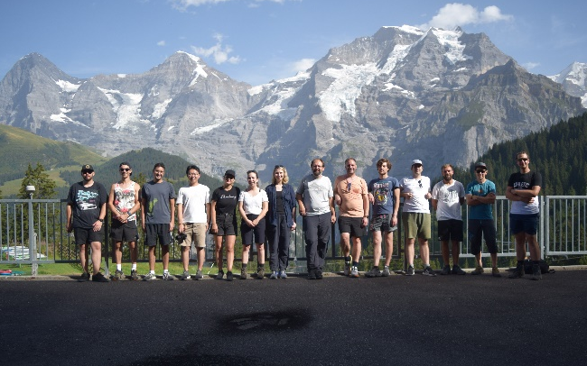
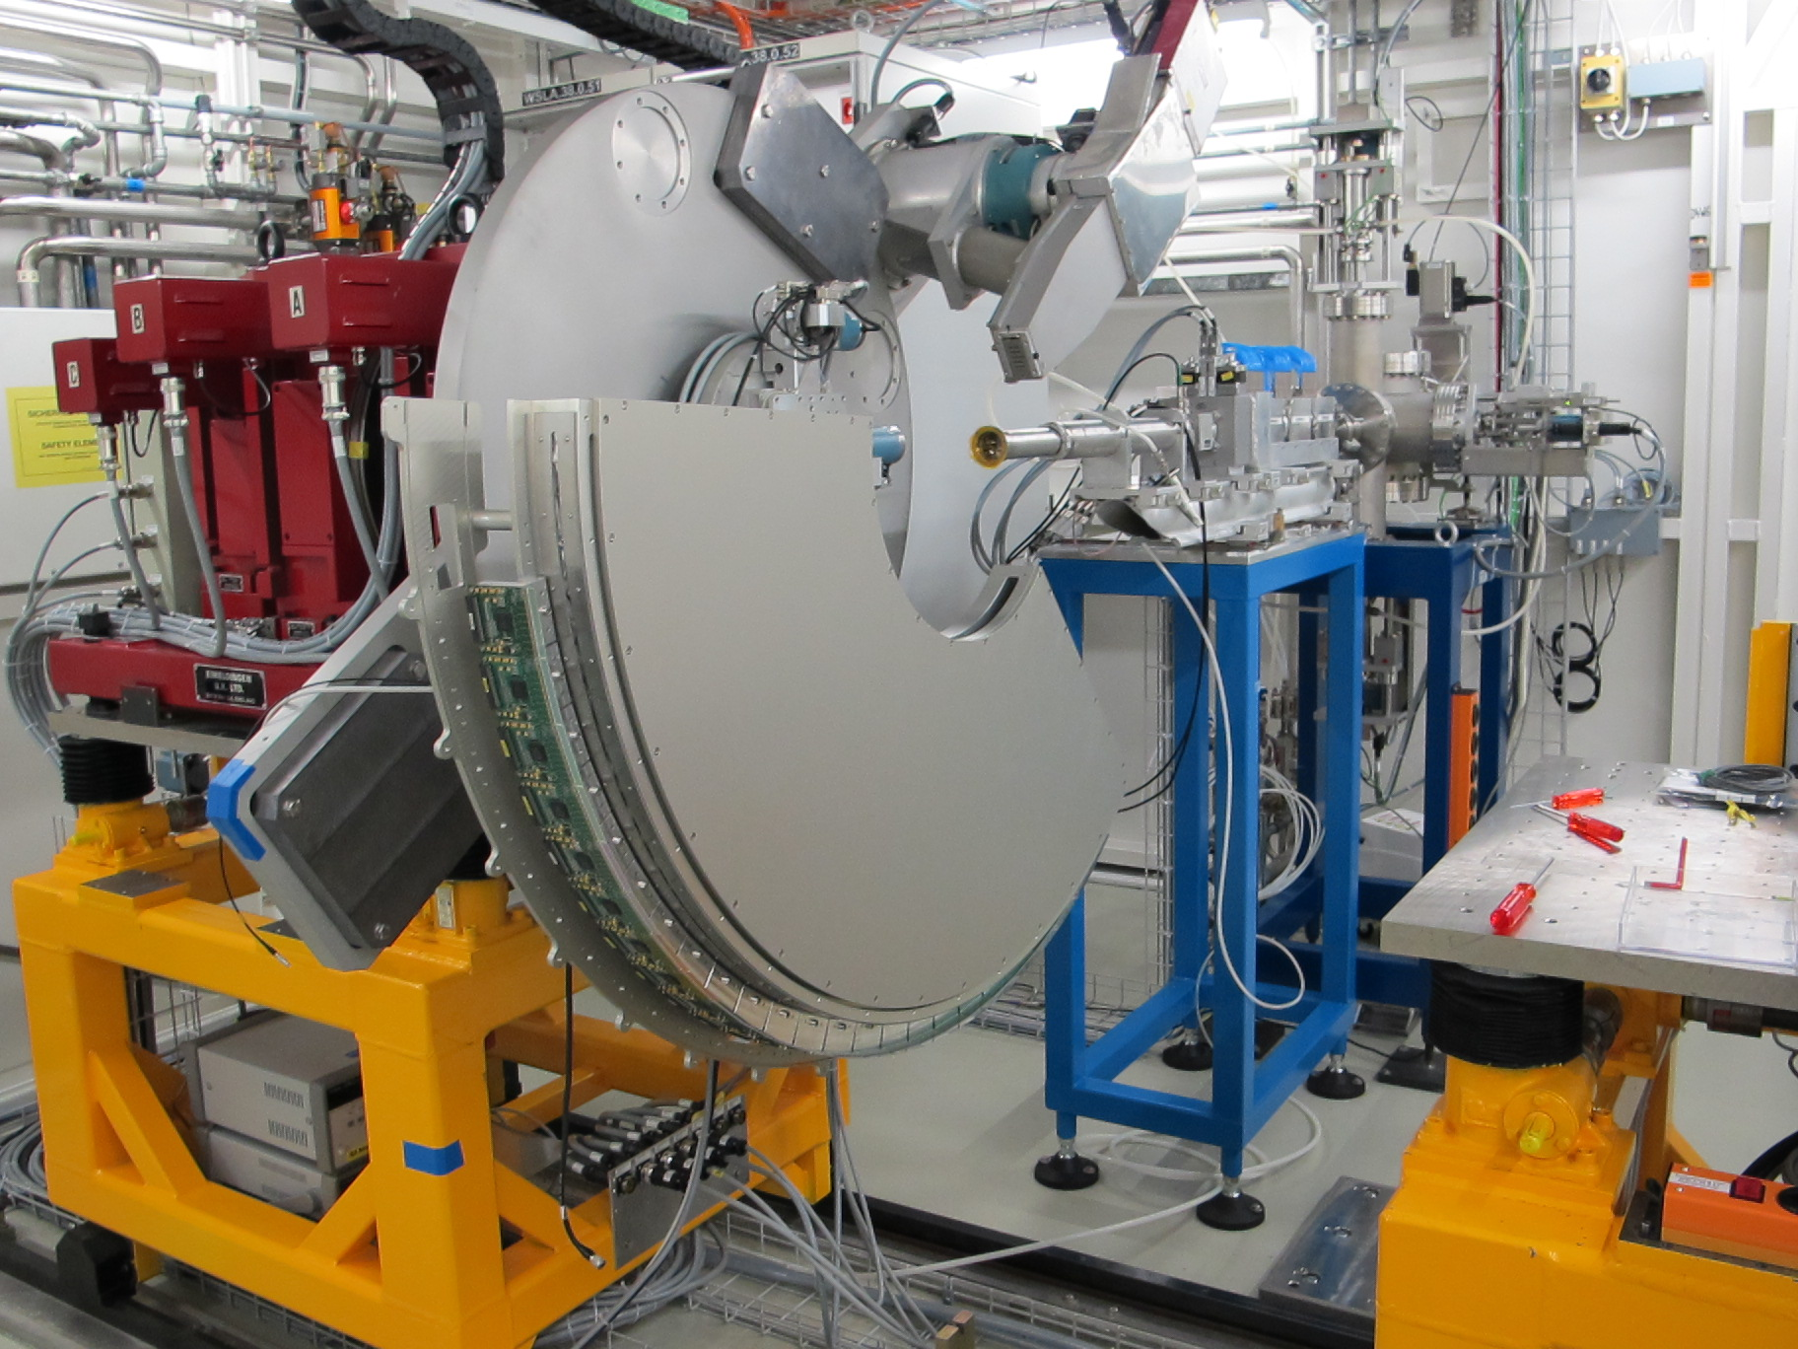
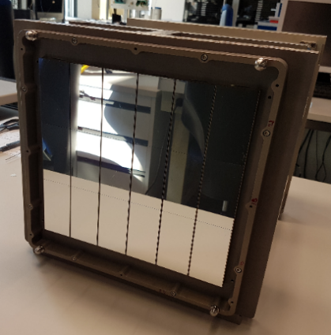
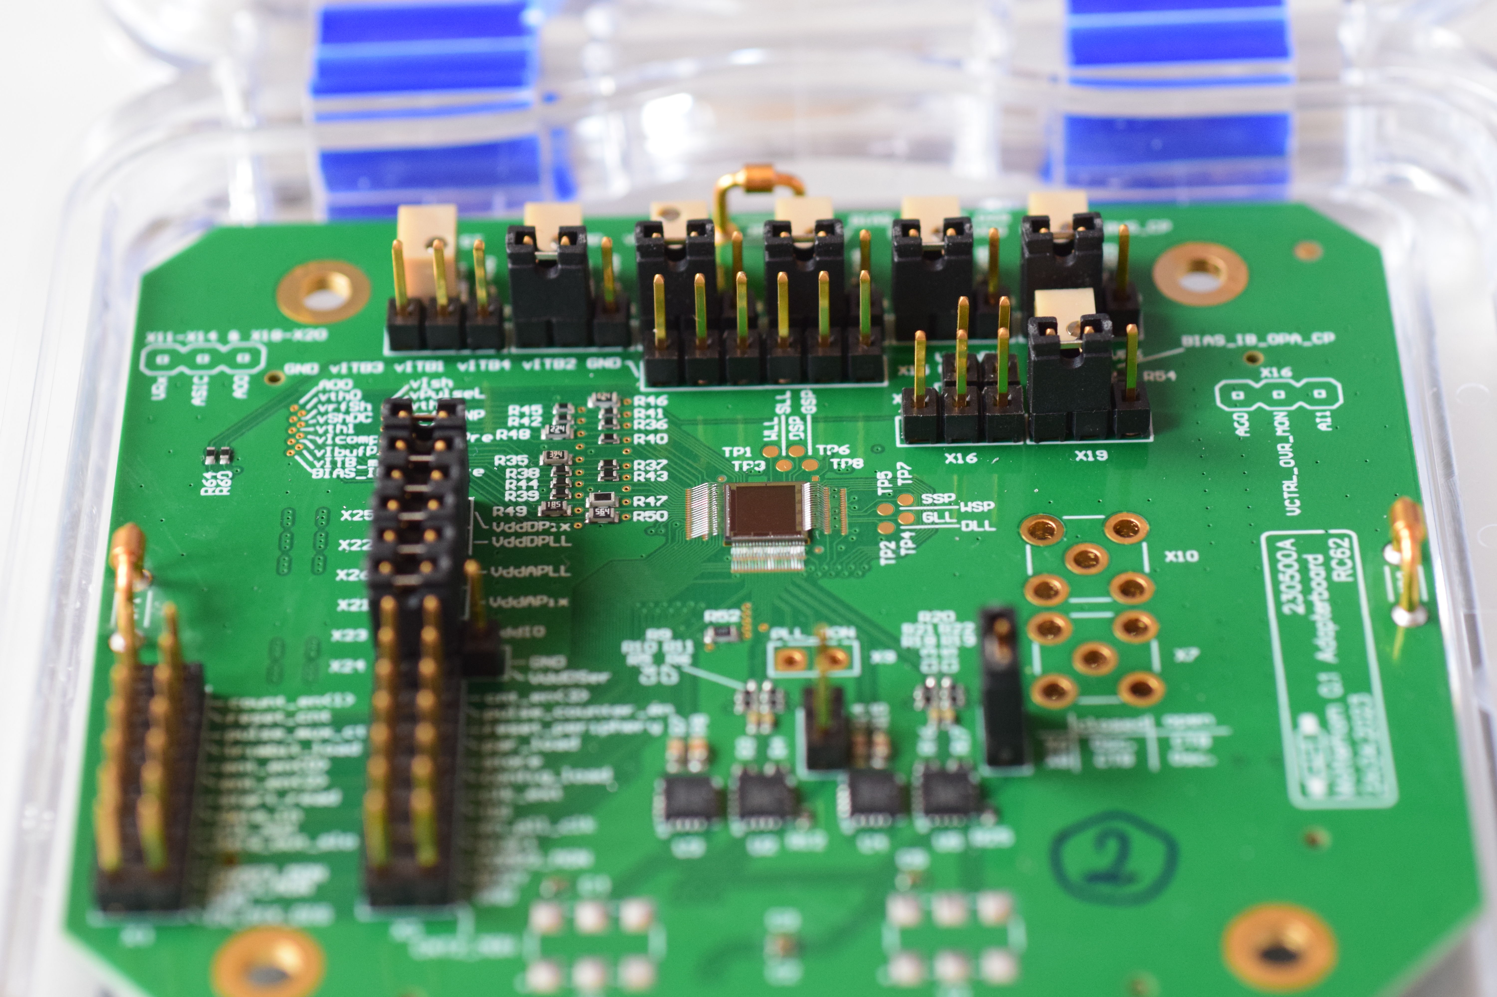
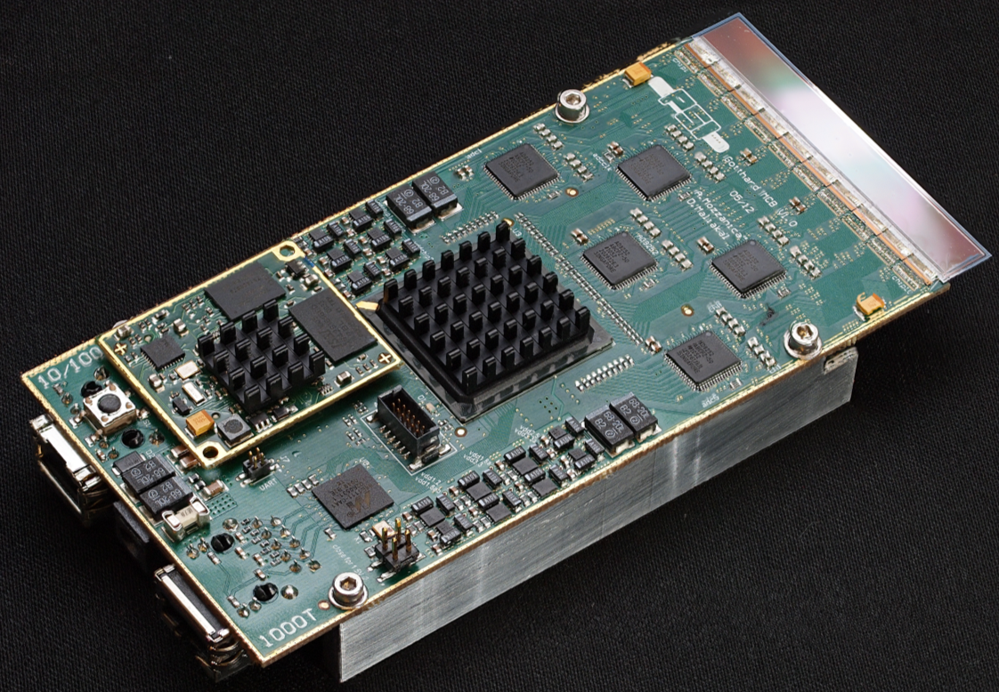
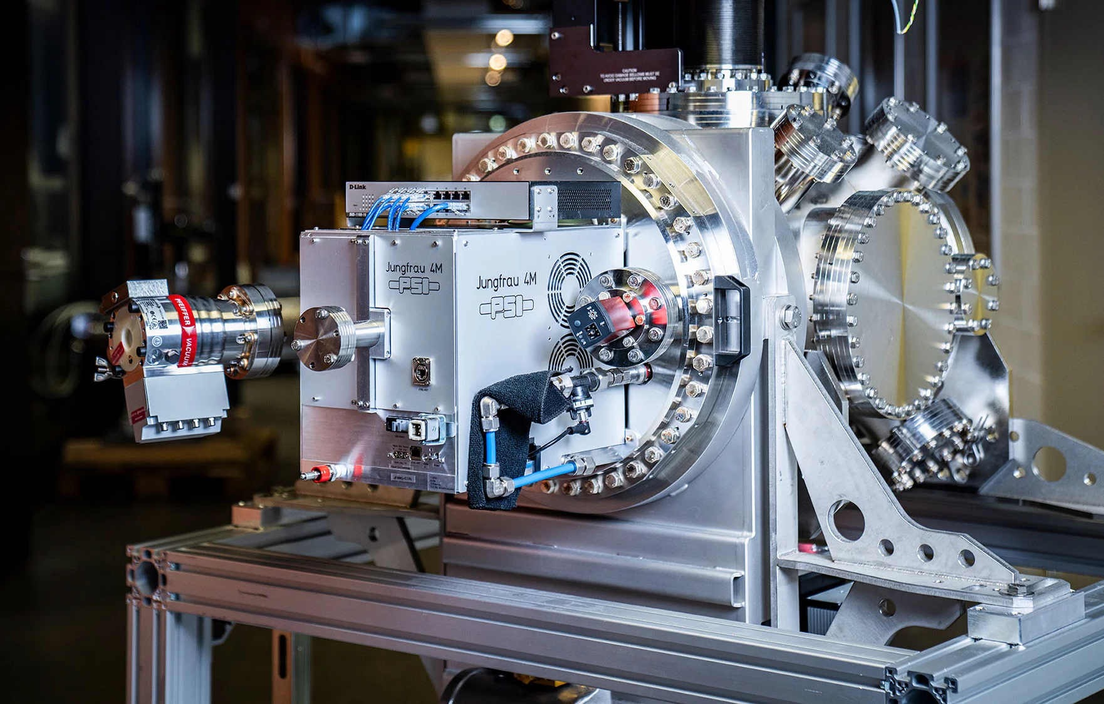
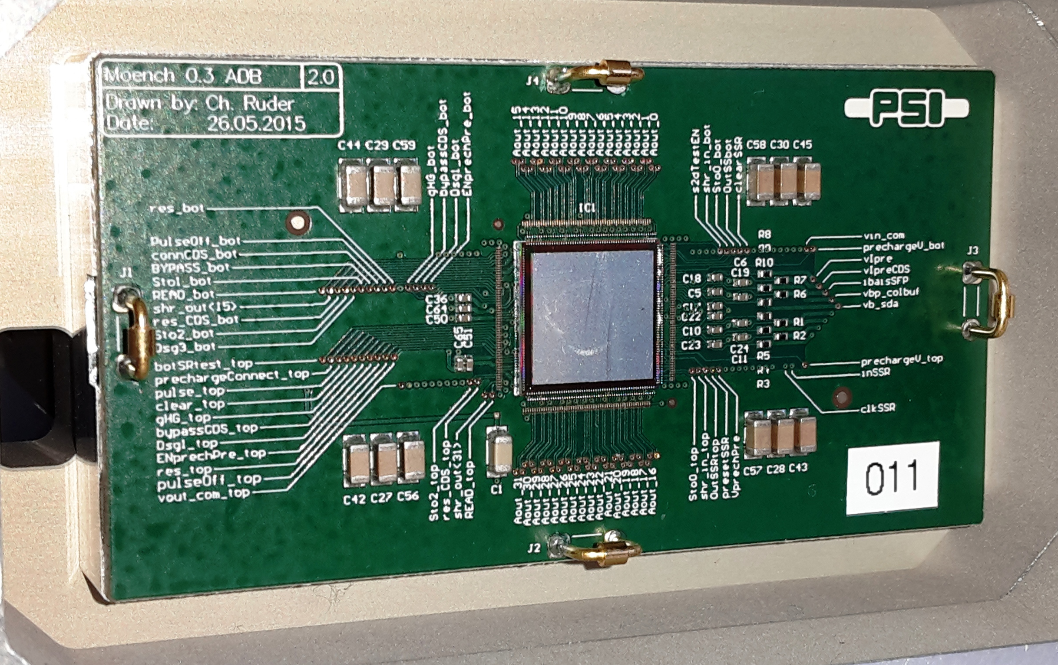
Detector Portfolio at PSI
 | Microstrip 1D | Pixel 2D
 | 25/50 µm pitch | 75 µm pitch | 25 µm pitch
Single photon counting
Charge integrating
MATTERHORN
MYTHEN
EIGER
GOTTHARD
JUNGFRAU
MÖNCH

Slide 8
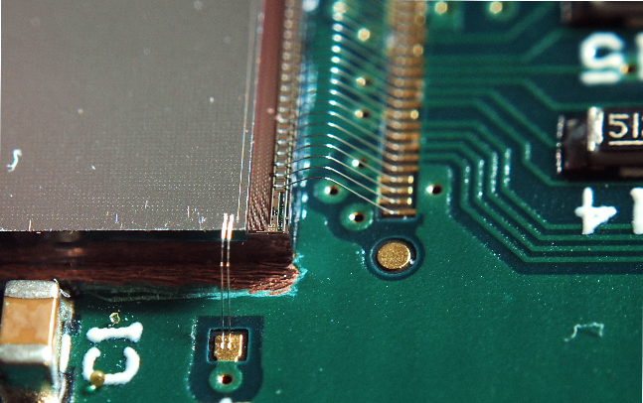

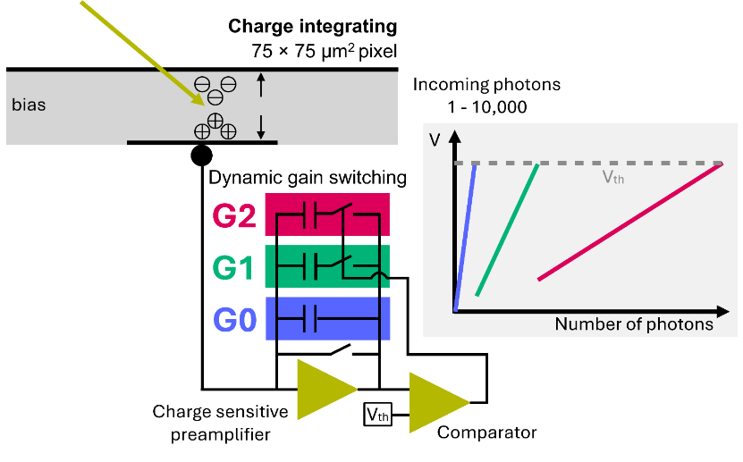
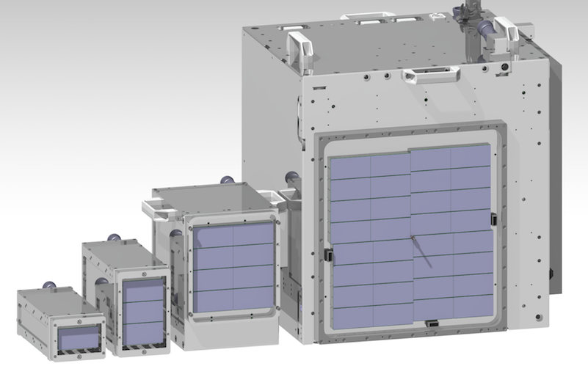
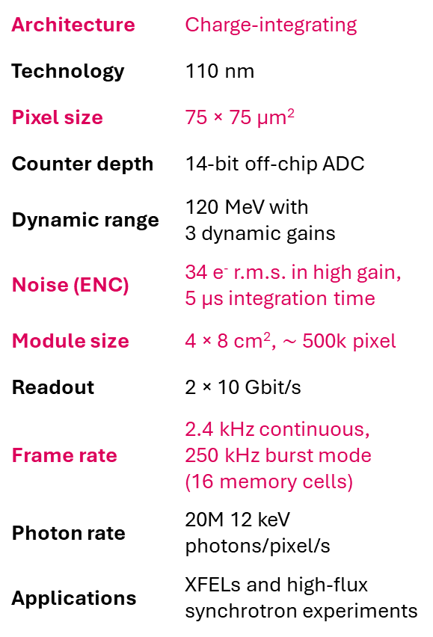
JUNGFRAU – Low Noise, High Dynamic Range
Architecture | Charge-integrating
Technology | 110 nm
Pixel size | 75 × 75 µm²
Counter depth | 14-bit off-chip ADC
Dynamic range | 120 MeV with 3 dynamic gains
Noise (ENC) | 34 e⁻ r.m.s. in high gain, 5 µs integration time
Module size | 4 × 8 cm², $\sim$500k pixel
Readout | 2 × 10 Gbit/s
Frame rate | 2.4 kHz continuous, 250 kHz burst mode (16 memory cells)
Photon rate | 20M 12 keV photons/pixel/s
Applications | XFELs and high-flux synchrotron experiments

Slide 9
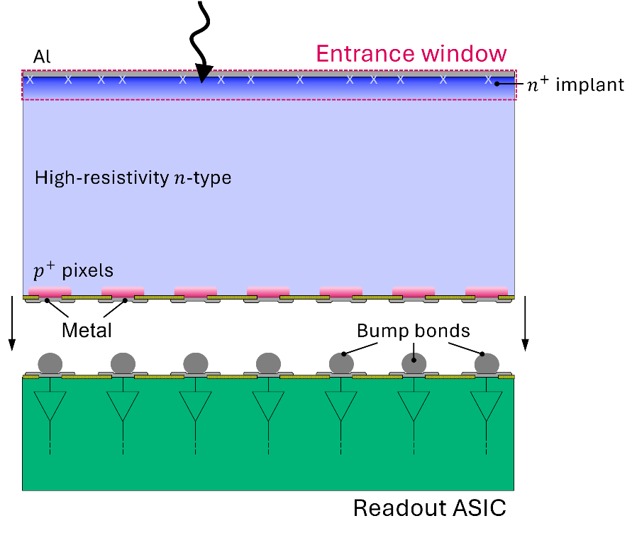
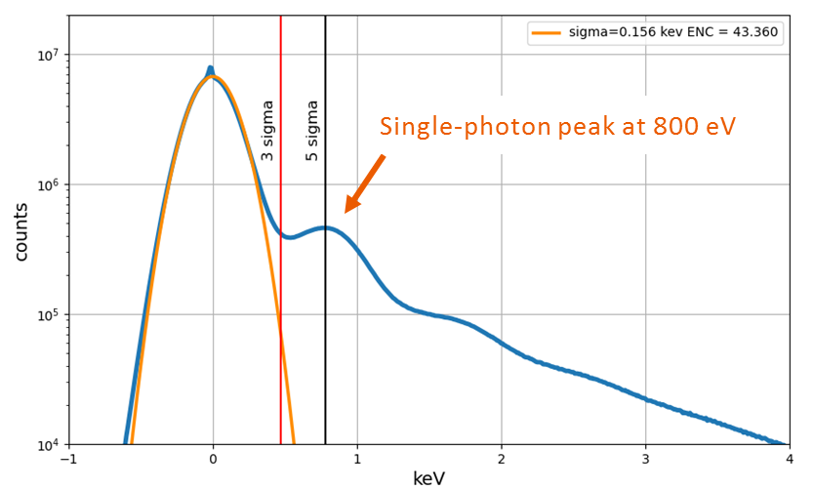
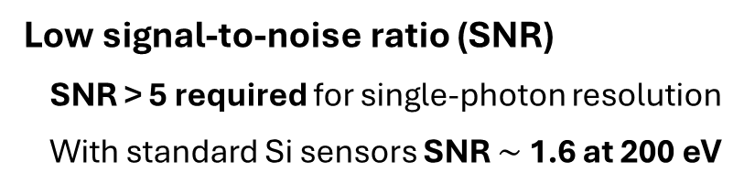
Limitations of Hybrid Detectors in the Soft X-ray Range
Low quantum efficiency (QE)
Recombination in the n⁺ layer and at the Si/Al interface
Absorption in the surface layers
Low signal-to-noise ratio (SNR)
SNR > 5 required for single-photon resolution
With standard Si sensors SNR $\sim$ 1.6 at 200 eV
V. Hinger et al. 2022 JINST 17 C09027
Single-photon peak at 800 eV
with typical JUNGFRAU noise
Thin Entrance Window (TEW)
Reduce losses at the entrance window
Low Gain Avalanche Diode (LGAD)
Internal signal amplification

Slide 10


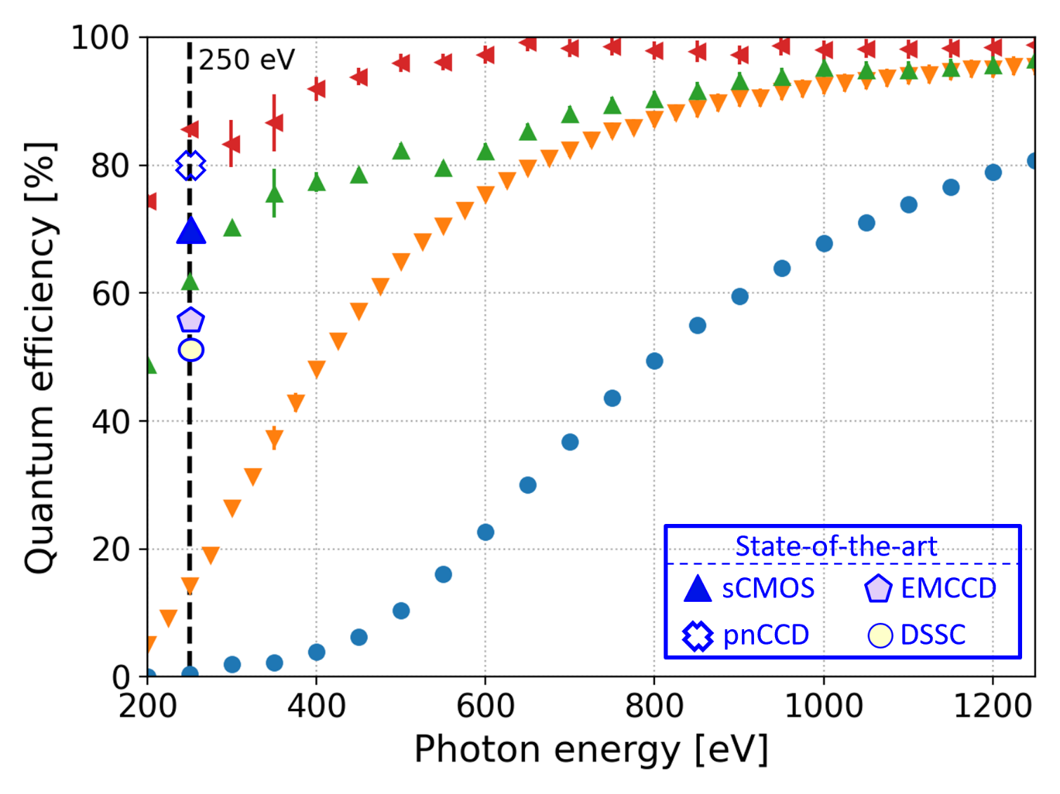
Thin Entrance Window (TEW) Technology
To improve quantum efficiency (QE)
M. Carulla et al. 2024 Sensors 24, 942
Optimized TEW
(thin passivation)
Optimized TEW (standard passivation)
Sensor with
shallow doping
Standard sensor

Slide 11
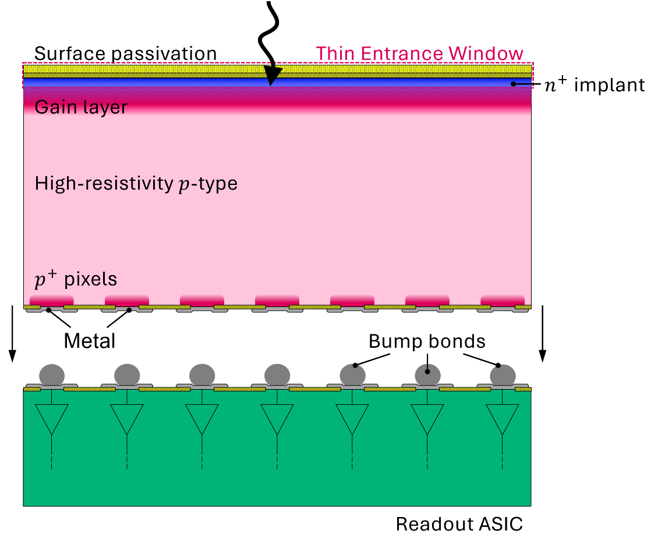
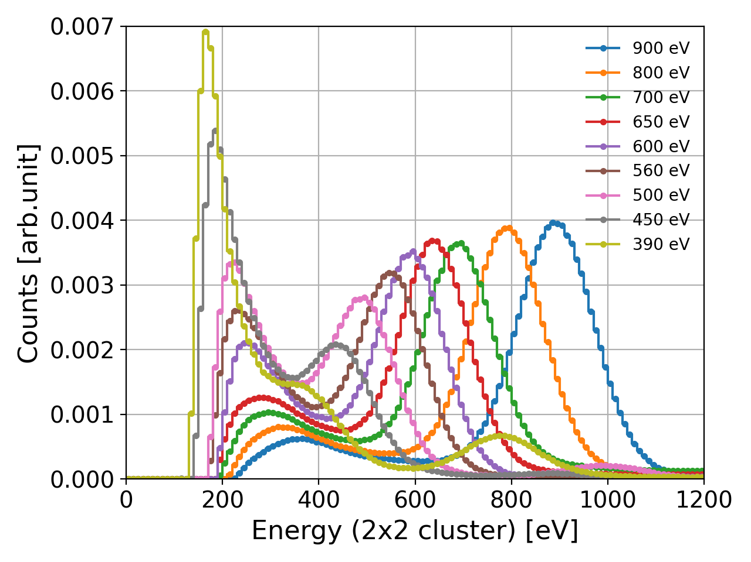
LGAD Sensors for Soft X-ray Detection
To improve signal-to-noise ratio (SNR)
Inverse design (iLGAD)
To achieve 100% fill factor
Soft X-ray detection capability
Measured at SLS SIM beamline with iLGAD bonded to MÖNCH (25 µm pixel)
900 eV
390 eV

Slide 12
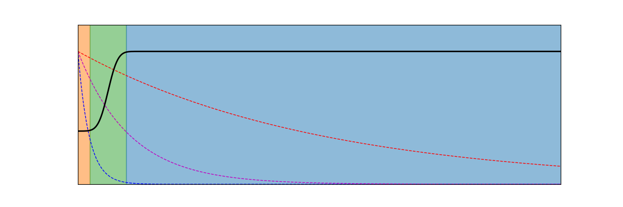
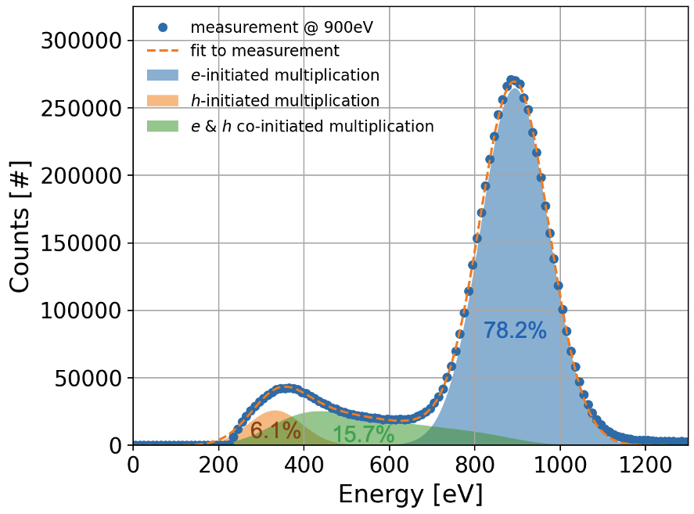
iLGAD Double-Peak Spectral Response
n+
gain layer
Soft X-ray detection capability
Measured at SLS SIM beamline with iLGAD bonded to MÖNCH (25 µm pixel)
gain
M_{e}
X-rays
attenuation
M_{h}
900 eV
250 eV
500 eV
absorption
before gain layer M_{h}
depth
absorption
beyond gain layer M_{e}
900 eV
900 eV
390 eV
Detector output [arb.unit]
Courtesy of Jiaguo Zhang

Slide 13
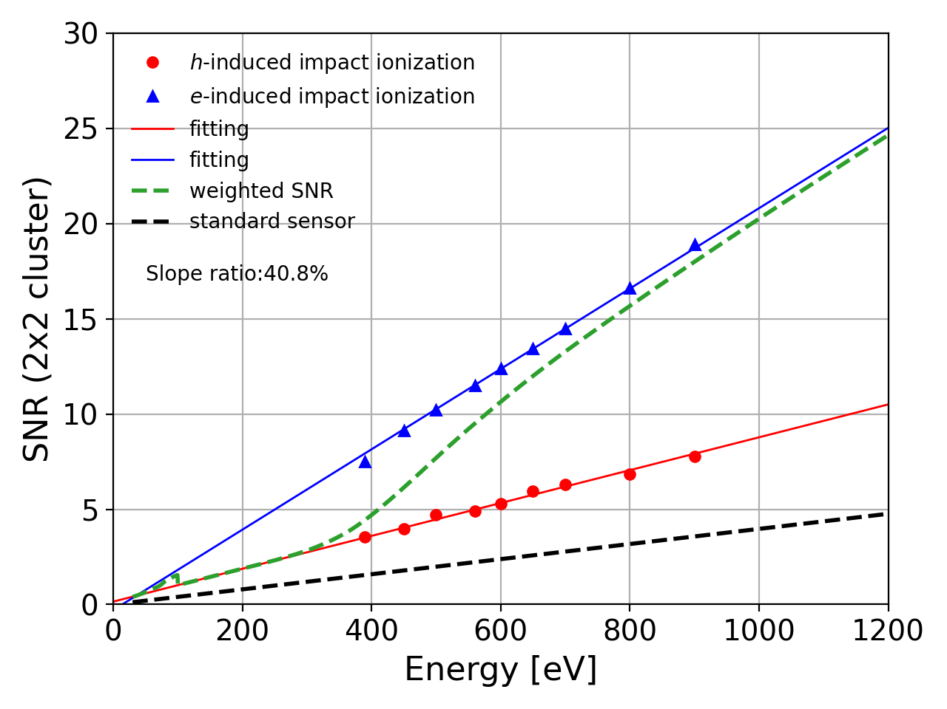
iLGAD Double-Peak Spectral Response
n+
gain layer
SNR > 5 for single photons down to 400 eV
To reach 200 eV the gain needs to be increased by at least a factor 2!
gain
M_{e}
X-rays
attenuation
M_{h}
900 eV
250 eV
500 eV
absorption
before gain layer M_{h}
depth
absorption
beyond gain layer M_{e}
900 eV
900 eV
390 eV
SNR iLGAD
absorption beyond gain layer
absorption before gain layer
SNR
standard
Si sensor
Detector output [arb.unit]
Courtesy of Jiaguo Zhang

Slide 14
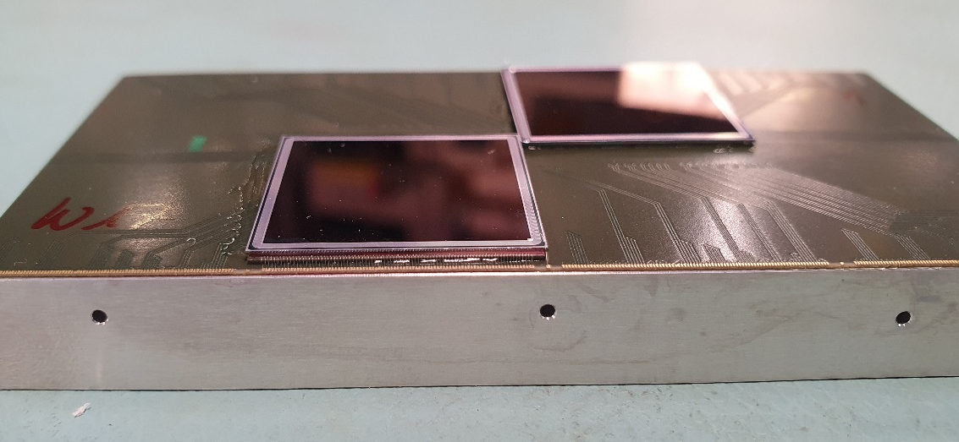
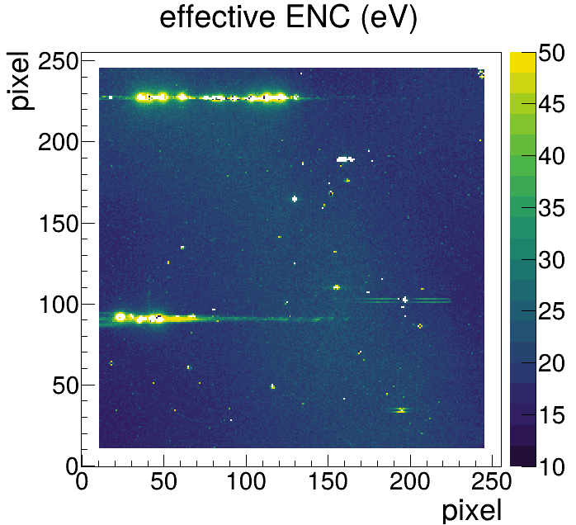
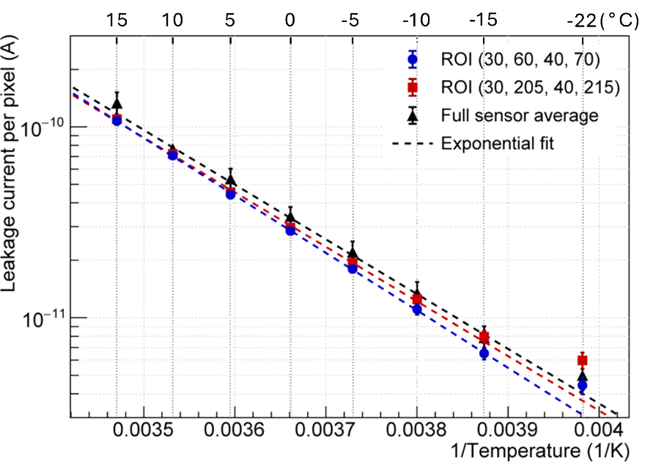
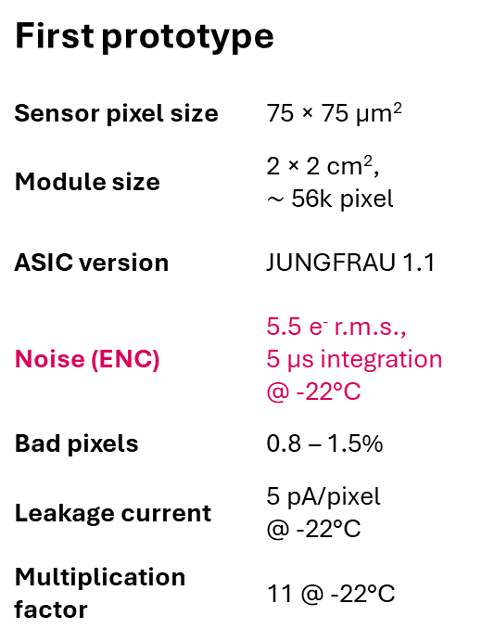
Combining JUNGFRAU with iLGAD Sensors
First prototype
Sensor pixel size | 75 × 75 µm²
Module size | 2 × 2 cm², $\sim$56k pixel
ASIC version | JUNGFRAU 1.1
Noise (ENC) | 5.5 e⁻ r.m.s., 5 µs integration @ -22°C
Bad pixels | 0.8 – 1.5%
Leakage current | 5 pA/pixel @ -22°C
Multiplication factor | 11 @ -22°C
V. Hinger et al. 2024 Front. Phys. 12

Slide 15
Our Target Application

Slide 16
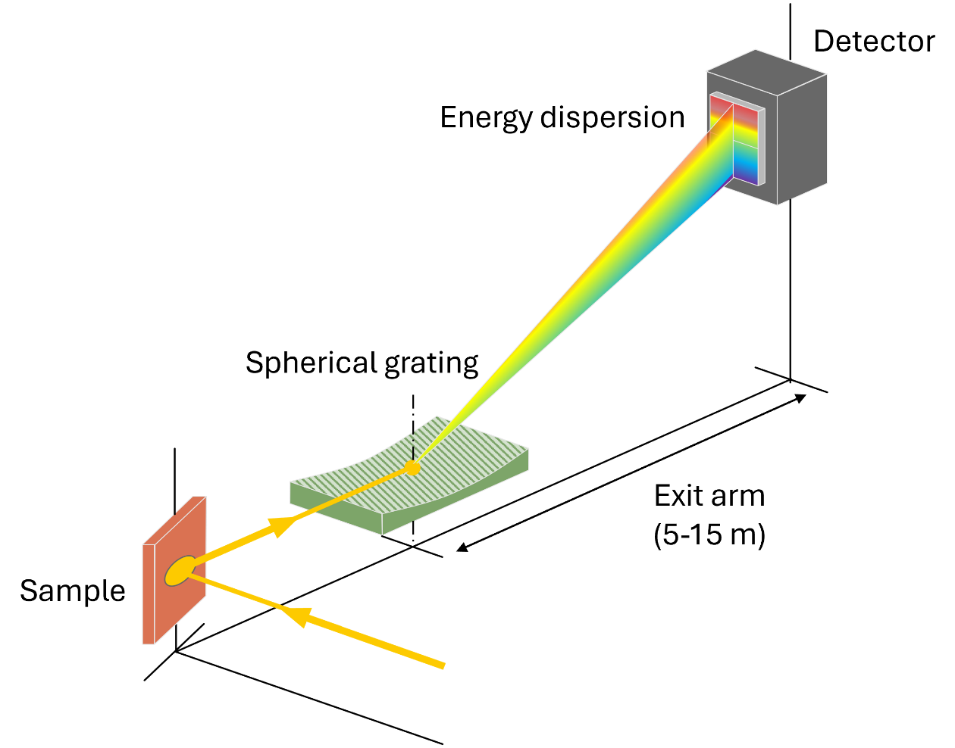
Resonant Inelastic X-ray Scattering (RIXS)
Scientific goal
Access very specific, complex electronic-structural information and dynamics
Charge, spin, orbital, and lattice excitations
Quantum materials: spintronics, superconductors
Method
Scan over electronic resonance
Measure transferred energy and momentum

Slide 17
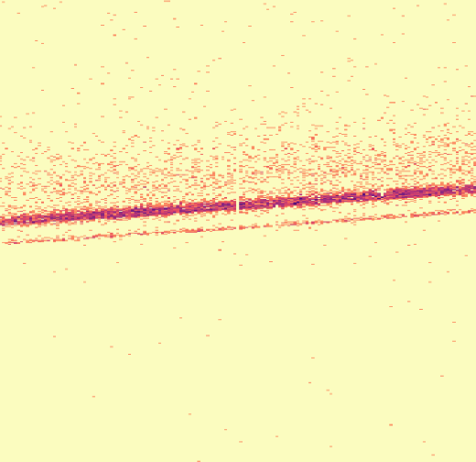
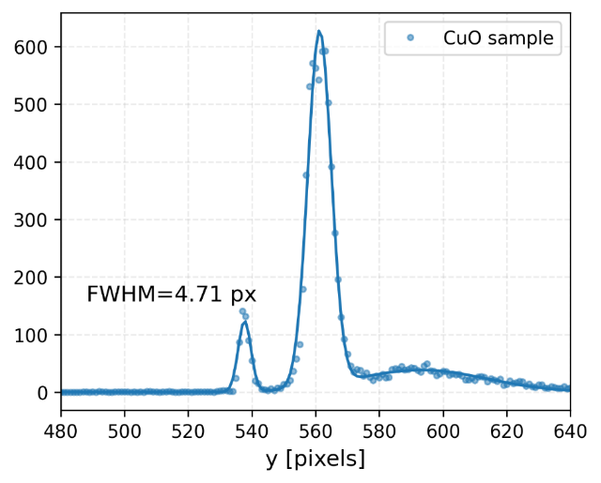
Resonant Inelastic X-ray Scattering (RIXS)
Scientific goal
Access very specific, complex electronic-structural information and dynamics
Charge, spin, orbital, and lattice excitations
Quantum materials: spintronics, superconductors
Method
Scan over electronic resonance
Measure transferred energy and momentum
Characteristics
Energy resolution ↔ spatial resolution
“Photon-hungry”
Single shot detection at high repetition rates
Multi-dimensional scans
Energy resolution
Elastic line
(930 eV)
Courtesy of Nuno Duarte
Statistics
Laser pump

Slide 18
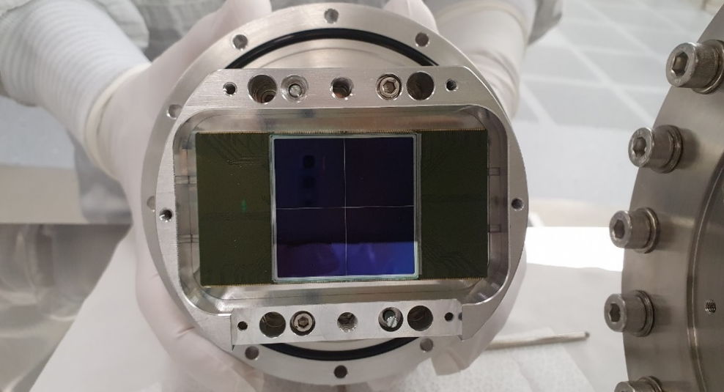
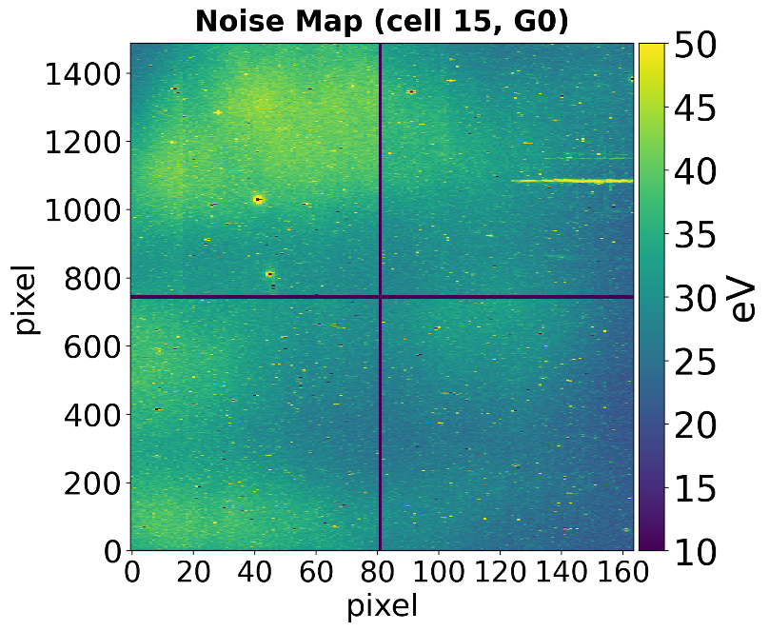
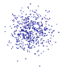
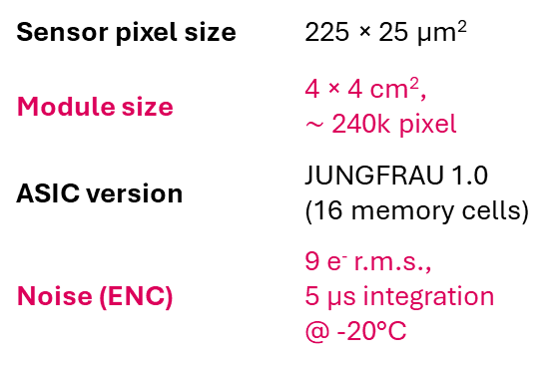
First JUNGFRAU for Soft X-ray RIXS
effective ENC (eV)
Sensor pixel size | 225 × 25 µm²
Module size | 4 × 4 cm², $\sim$240k pixel
ASIC version | JUNGFRAU 1.0 (16 memory cells)
Noise (ENC) | 9 e⁻ r.m.s., 5 µs integration @ -20°C
  Pixel pitch must be comparable to the spread of the charge cloud!
75 µm
X-ray photon
75 µm
Interpolation direction
Native pixel resolution
25 µm
  Sensor with rectangular pixels
Implant
Interpolated
Metal
225 µm

Slide 19
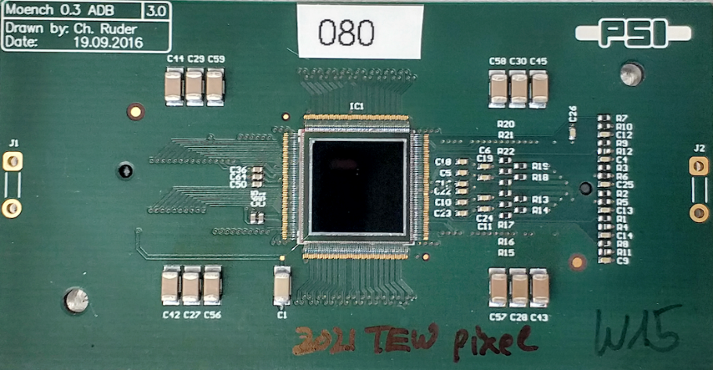
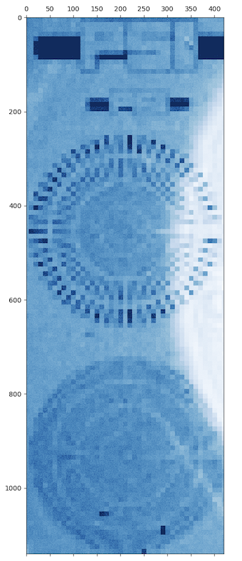
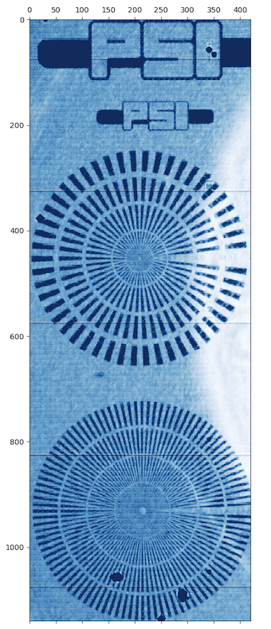

Using Charge Sharing to Perform Position Interpolation
To achieve high spatial resolution $\sim$ µm
25 µm pixels
1 cm
1 cm
2.5 µm bins
MÖNCH-iLGAD module (25 × 25 µm² pixels)
Measured at SLS POLLUX beamline
Photon energy: 500 eV
Estimated position resolution: 2.7 µm
Courtesy of Jiaguo Zhang

Slide 20

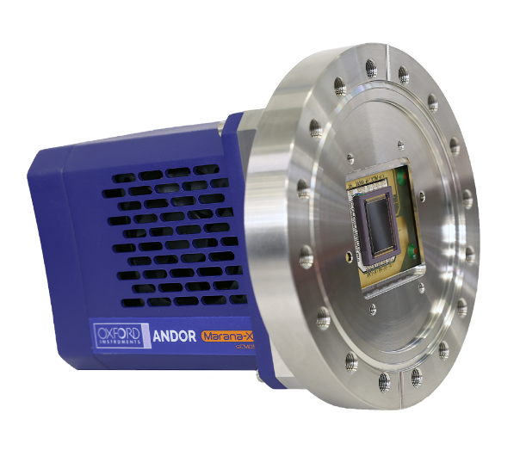
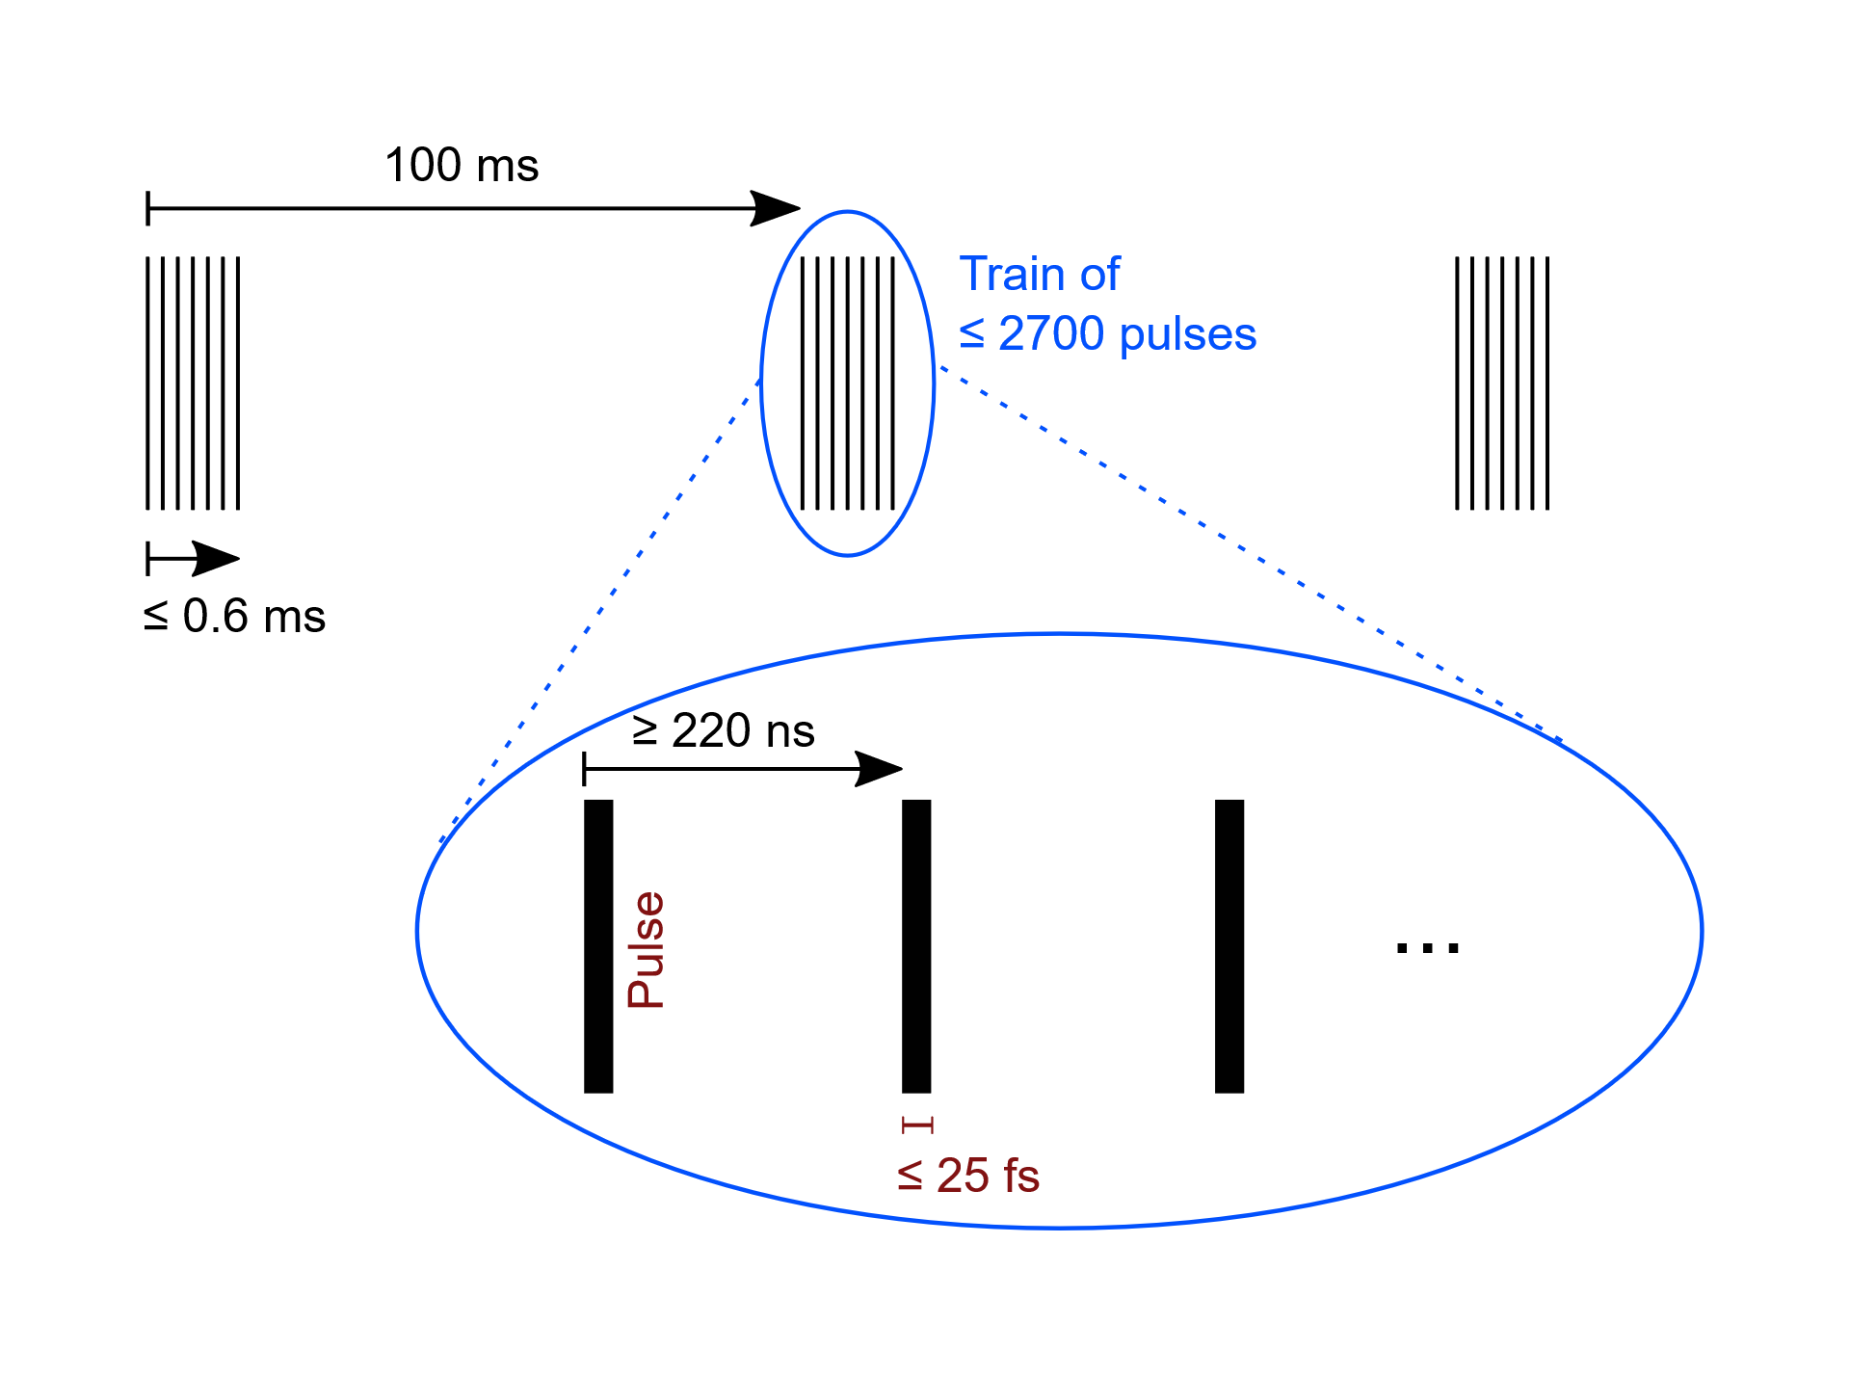

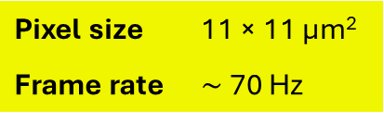
Test at European XFEL Heisenberg RIXS Spectrometer
Marana-X sCMOS
JUNGFRAU iLGAD
EuXFEL pulse structure
Pixel size | 11 × 11 µm²
Frame rate | $\sim$ 70 Hz
Pixel size | 25 × 225 µm²
Frame rate | 250 kHz burst
Exit arm ($\sim$ 5 m)

Slide 21
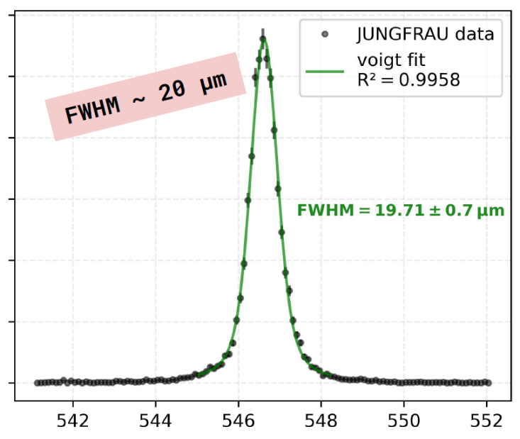
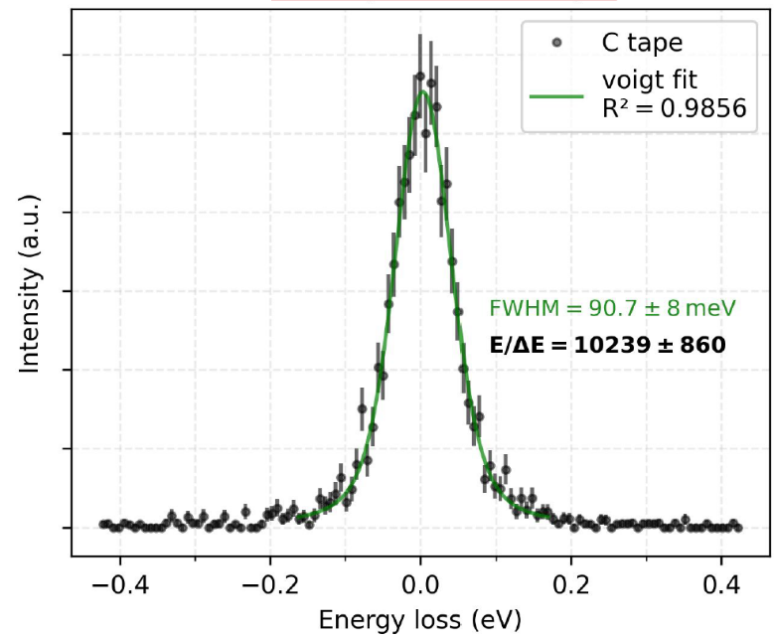
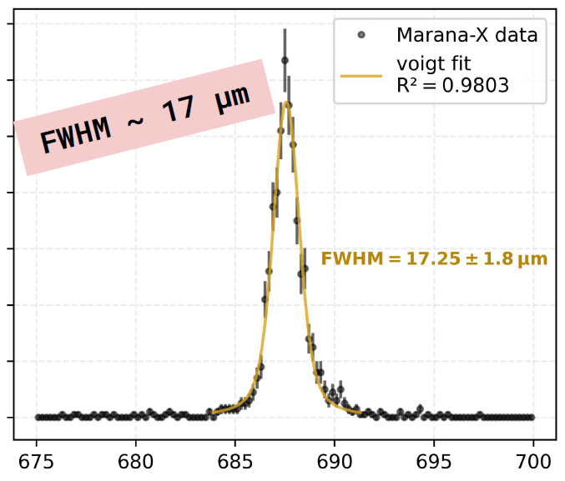
Test at European XFEL Heisenberg RIXS Spectrometer
Marana-X sCMOS
JUNGFRAU iLGAD
Elastic scattering on carbon tape
Pixel size | 11 × 11 µm²
Frame rate | $\sim$ 70 Hz
Pixel size | 25 × 225 µm²
Frame rate | 250 kHz burst
Marana-X
Exit arm ($\sim$ 5 m)
Courtesy of Nuno Duarte

Slide 22
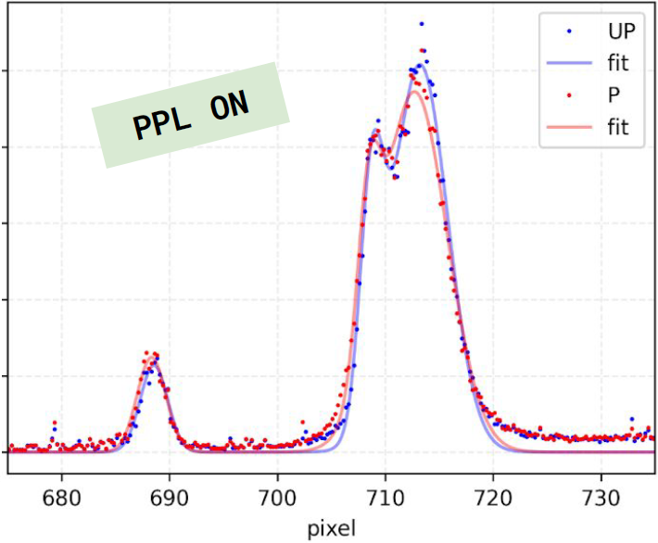
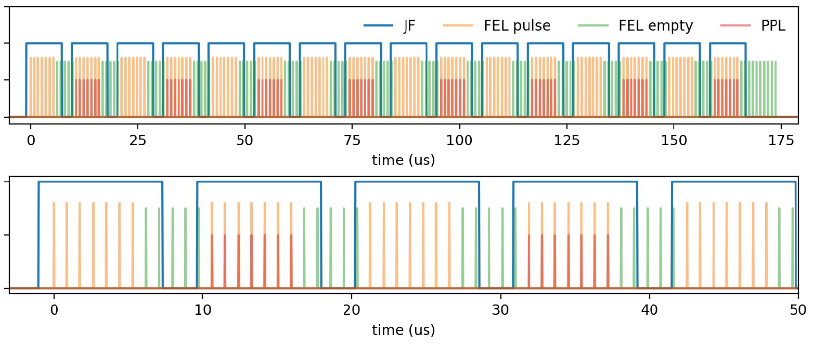
Test at European XFEL Heisenberg RIXS Spectrometer
First ever RIXS spectra alternating pumped (P), unpumped (UP) in a single pulse train (@ 930 eV)
Marana-X sCMOS
JUNGFRAU iLGAD
Pixel size | 11 × 11 µm²
Frame rate | $\sim$ 70 Hz
Pixel size | 25 × 225 µm²
Frame rate | 250 kHz burst
Exit arm ($\sim$ 5 m)

Slide 23



Test at European XFEL Heisenberg RIXS Spectrometer
Marana-X sCMOS
JUNGFRAU iLGAD
Decrease of photons emitted from sample within a train, affected by FEL intensity
Pixel size | 11 × 11 µm²
Frame rate | $\sim$ 70 Hz
Pixel size | 25 × 225 µm²
Frame rate | 250 kHz burst
Exit arm ($\sim$ 5 m)

Slide 24


Summary & Outlook
Detecting soft X-rays with JUNGFRAU and iLGAD sensors
Achievements
QE > 80% @ 250 eV with Thin Entrance Window
SNR > 5 for single photons down to 400 eV with iLGADs
First promising results at RIXS experiments
Current challenges
Efficiency at low photon energies and shallow incidence angles
Absorption depth dependent multiplication factor due to inverse LGAD design
Goals for the new iLGAD batch (available 2026)
$→$ Reduced oxide thickness
$→$ Increased gain
$→$ Shallower gain layer
4 cm
4 cm

Slide 25

Brief Advertisement: X-Ray Sensor Workshop Upcoming!
See you there!

Slide 26



Acknowledgements
Fondazione Bruno Kessler
Ashish Bisht, Maurizio Boscardin, Matteo Centis Vignali, Francesco Ficorella, Omar Hammad Ali, Giovanni Paternoster, Sabina Ronchin
European XFEL
Nuno Duarte, Loïc Le Guyader, Marco Ramilli, Andreas Scherz, Justine Schlappa, Monica Turcato
PSI Center for Photon Science Detector Group
Front: Roberto Dinapoli, Anna Bergamaschi, Shuqi Li, Dhanya Thattil, Jiaguo Zhang, Alice Mazzoleni, Viveka Gautam, Davide Mezza, Thomas King, Bernd Schmitt
Back: Konstantinos Moustakas, Christian Ruder, Vadym Kedych, Jonathan Mulvey, Martin Müller, Patrick Sieberer, Saverio Silletta, Khalil Ferajoui, Viktoria Hinger, Martin Brückner, Aldo Mozzanica, Erik Fröjdh, Maria Carulla, Julian Heymes, Xiangyu Xie, Carlos Lopez-Cuenca
Not on photo: Simon Ebner, Shqipe Hasanaj, Dominic Greiffenberg, Kirsty A. Paton
SwissFEL Furka
Eugenio Paris, Elia Razzoli, Elisabeth Skoropata, Hiroki Ueda

Slide 27
Backup

Slide 28

Thin Entrance Window Radiation Hardness
Diodes measured at SOLEIL synchrotron
Courtesy of Jiaguo Zhang

Slide 29
JUNGFRAU-iLGAD Effective Noise

Slide 30






Interpolating with Rectangular Pixels
X-ray photon
 | 0.97
 | 0.53
12 µm
$$η_{y}=0.65$$
$$y\left(η_{y}\right)= \int_{0}^{η_{y}}{H\left(η_{y}\right)dη_{y}}$$
Clustering to reconstruct photon hit
→ Attribute shared charge to central pixel
Eta function
→ Accounts for non-linear behaviour of charge sharing
→ From flat-field: construct histogram from charge fraction of each pixel
→ Integral gives the interpolation curve (lookup table)
$$η_{y}=\frac{Q_{top}}{Q_{bottom}+Q_{top}}$$

Slide 31




Validating the Position Resolution with 1-µm Size Beam
@ SLS Pollux beamline
$η$ distribution for different scan positions
75 µm
2.5 µm steps
1 keV
$$η=\frac{Q_{top}}{Q_{bottom}+Q_{top}}$$
75 µm
Interpolation direction
Estimated resolution
25 µm
∼ 2.7 µm
Implant
∼ 2.6 µm
∼ 2.3 µm
Metal
∼ 2.1 µm
∼ 2.2 µm
225 µm
∼ 2.3 µm
∼ 2.3 µm

Slide 32





Test at SwissFEL Furka
Preliminary
FWHM 62 µm
No interpolation,
no curvature correction
Elastic scattering off carbon tape
@ 932 eV
Grating chamber
Experimental chamber
# photons
Pixel Y
Pixel Y
Detector chamber
X-rays scattered from sample
Preliminary
Pixel X
Exit arm ($\sim$ 5 m)
Image rate aligned with SwissFEL (100 Hz) allows efficient jitter correction for time-resolved measurements
Good performance at Cu L-edge (~ 930 eV), but low efficiency at O K-edge (~ 530 eV) because of shallow incidence angle

Slide 33



Test at SwissFEL Furka
Hole peak
5$σ$ effective noise
Grating chamber
Experimental chamber
Not detected
Electron peak (500 eV)
Detector chamber
X-rays scattered from sample
Exit arm ($\sim$ 5 m)
Image rate aligned with SwissFEL (100 Hz) allows efficient jitter correction for time-resolved measurements
Good performance at Cu L-edge (~ 930 eV), but low efficiency at O K-edge (~ 530 eV) because of shallow incidence angle

Slide 34









Optimizations Planned with Upcoming iLGAD R&D Batch
Combined detection efficiency (500 eV photons, 30° angle) $\sim$ 10% (today)
Combined detection efficiency (500 eV photons, 30° angle) $\sim$ 10% (today) $→$ > 80% (new iLGAD batch)
@ 500 eV
5$σ$ (new batch)
Hole peak
5$σ$ effective noise (today)
Hole peak
Electron peak (500 eV)
Reduce oxide thickness
$→$Improve quantum efficiency
Reduce thickness of multiplication layer
$→$Improve M_{h}/M_{e}
Increase iLGAD gain
$→$Improve signal-to-noise ratio

