Slide 1
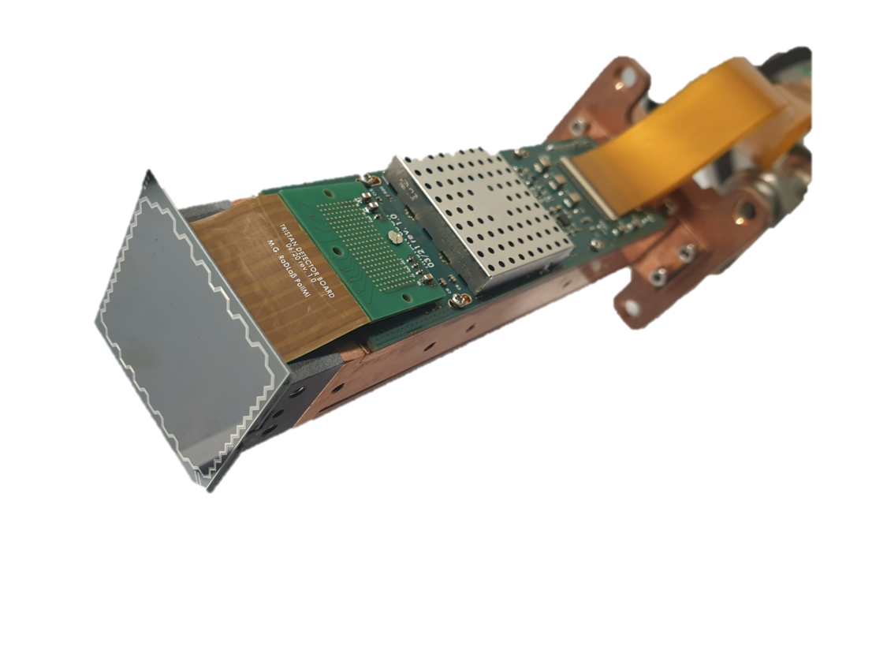
TRISTAN
A Silicon Drift Detector Array
for the Sterile Neutrino Search with KATRIN
2nd Workshop on Silicon Sensors for Radiation Detection and Quantum Applications
13.05.2025
Daniela Spreng and Christian Forstner
on behalf of the KATRIN collaboration
Notes:
https://indico.mpp.mpg.de/event/10919/
We are from the KATRIN collaboration and want to present you our TRISTAN detector, which is a silicon drift detector array for the sterile neutrino search with KATRIN. I will give you a short introduction about our physical motivation and the detector design and Christian will then take over and tell you more about all the characterization measurements we performed and the challenges we are still facing.

Slide 2
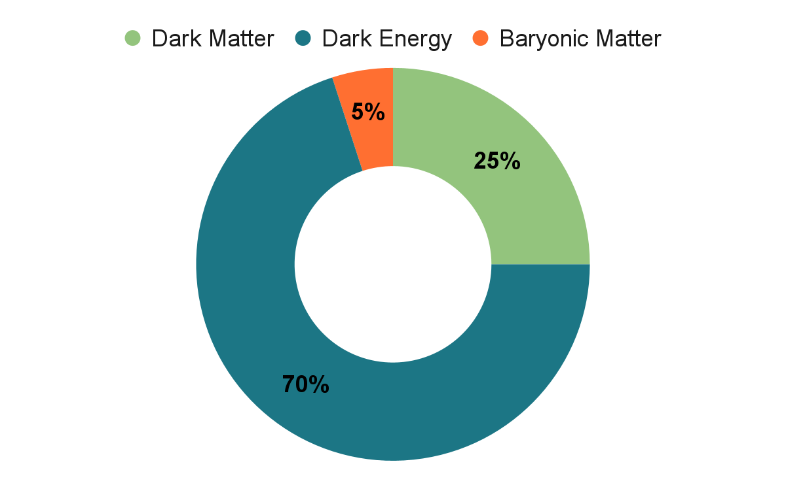
What is our Universe made of?
Motivation
KATRIN + TRISTAN
Detector Characterization
Future Challenges

Slide 3
Dark Matter Candidates
μeV
meV
eV
keV
MeV
GeV
TeV
Talk by Lucinda Schönfeld (IAXO)
This talk (TRISTAN)
Motivation
KATRIN + TRISTAN
Detector Characterization
Future Challenges

Slide 4
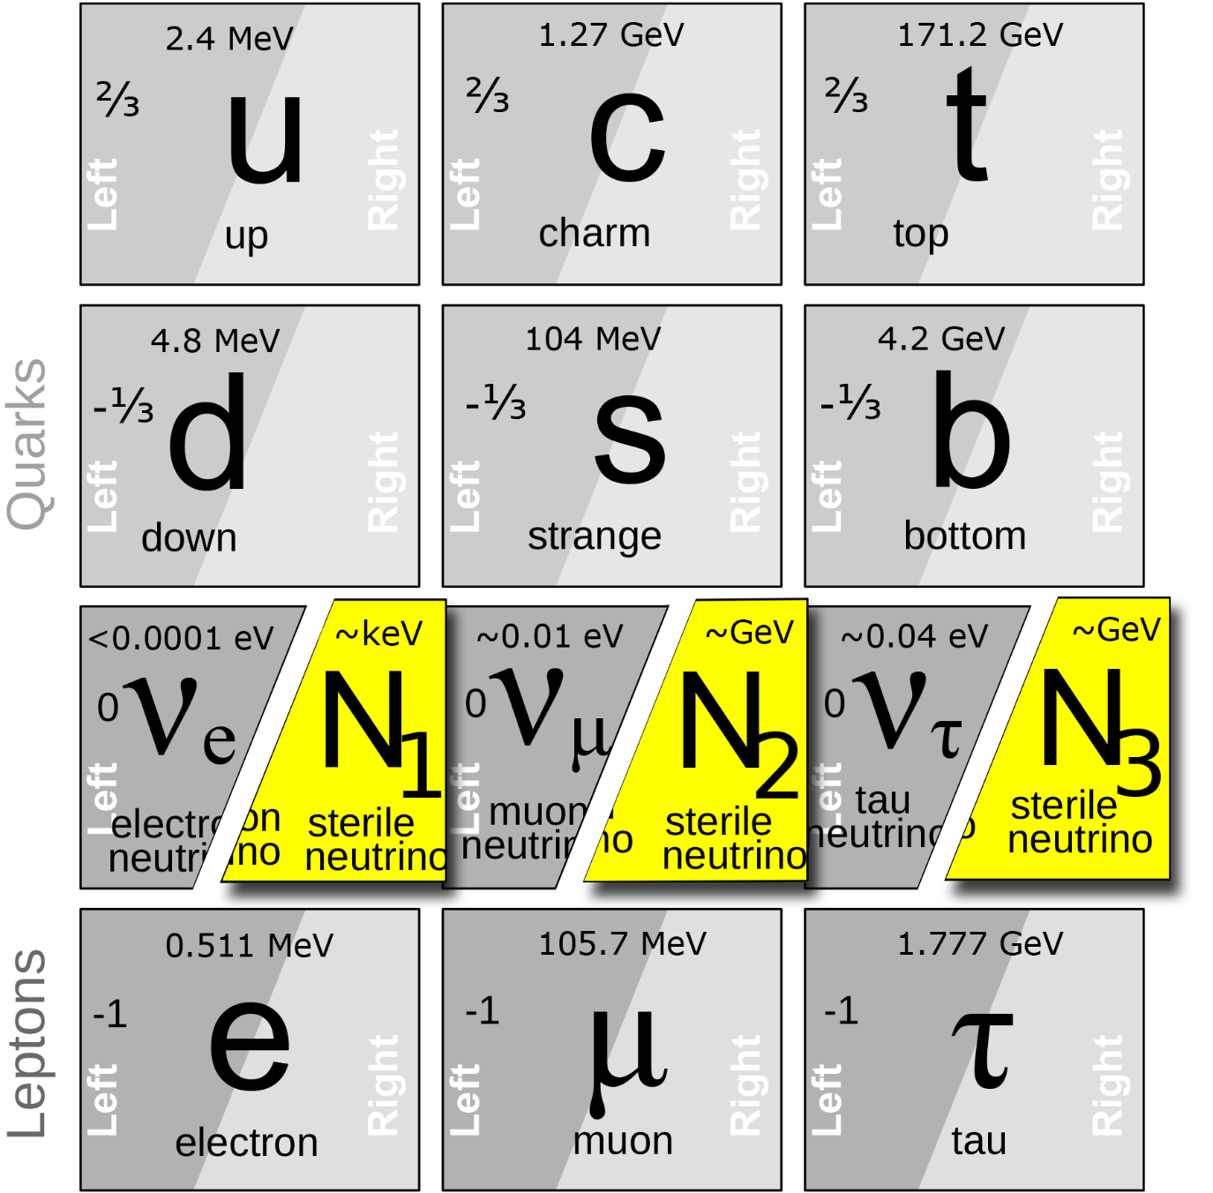
Sterile Neutrinos
Neutrino Minimal Standard Model
Only interaction via gravitational force and admixture to active neutrino flavours
No mass constraints
Dark Matter candidate (~keV)
T. Asaka, S. Blanchet and M. Shaposhnikov, Phys. Lett. B631:151-156 (2005)
Motivation
KATRIN + TRISTAN
Detector Characterization
Future Challenges
Notes:
Notes/reminders:
Standard Model introduced by Prof. Kiesling on Mo
Standard Model not complete (e.g. neutrinos have non-zero mass; known from neutrino oscillations; know only mass square differences)
Sterile neutrino as right-handed counterpart of the active neutrinos
While these sterile neutrinos do not necessarily couple to SM particles, they mix with the active neutrinos.
Most extensions of the original standard model involve one or more sterile neutrinos
Further open neutrino questions: Majorana particles (the particle and antiparticle are related and containing only two degrees of freedom)? CP violation (do neutrinos and anit-neutrinos oscillate differently)?
While these sterile neutrinos do not necessarily couple to SM particles, they mix with the active neutrinos in such a way that neutrino oscillation experiments might depend on more mixing parameters and more oscillation frequencies.
Sterile neutrinos, also known as singlet or right-handed neutrinos, are SU(2)xU(1)-singlet leptons.
They have no ordinary charged or neutral current weak interactions except those induced by mixing.
Most extensions of the original standard model involve one or more sterile neutrinos
model-dependent masses which can vary from zero to extremely large.
It could be warm or cold dark matter depending on the cosmological production mechanisms, e.g., produced by oscillations between active and sterile neutrinos.
In particular, warm or moderately cold dark matter could describe the low-scale structure observations better than cold dark matter candidates such as WIMPs or axions.
The keV neutrinos would not be absolutely stable, but could decay by mixing into a photon and light neutrino with a cosmologically-long lifetime.

Slide 5
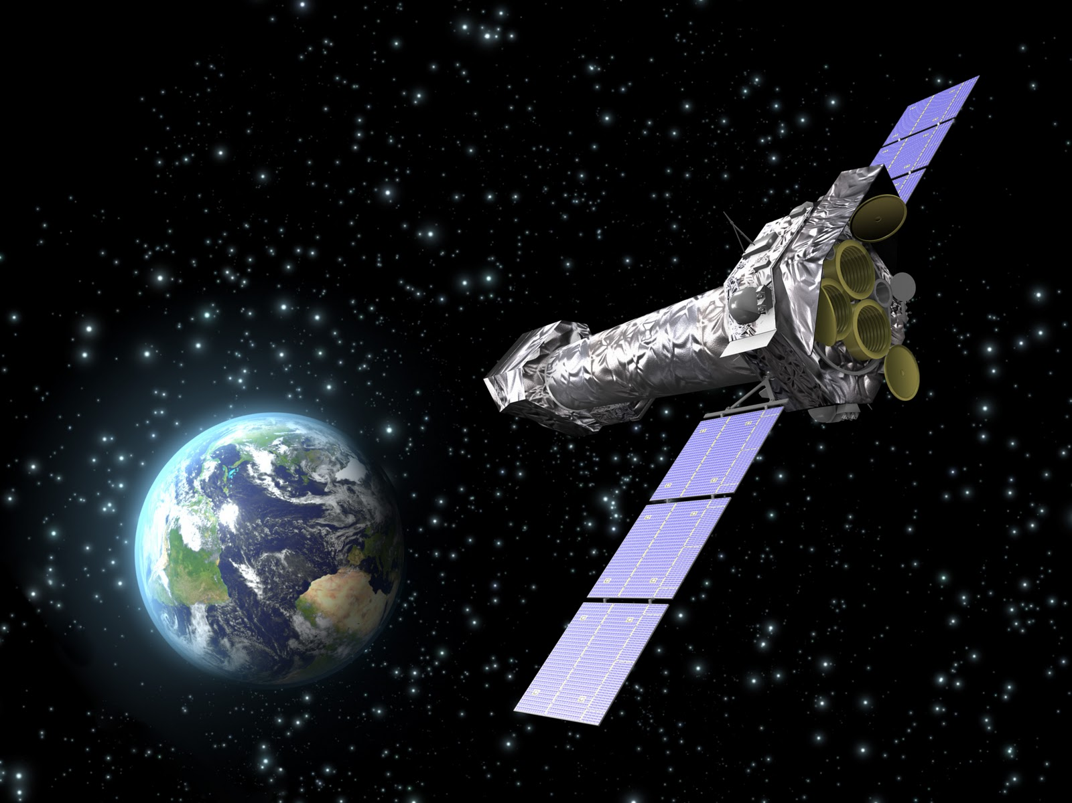
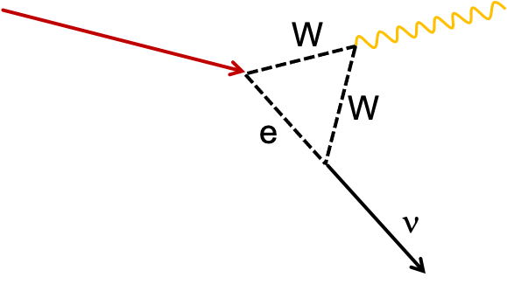
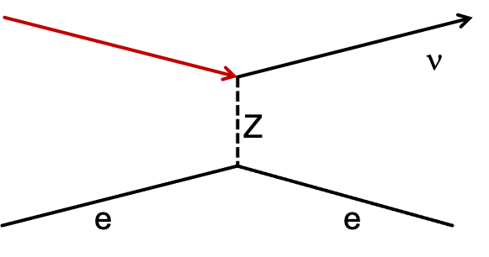
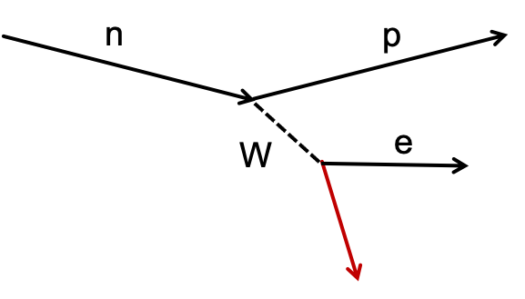
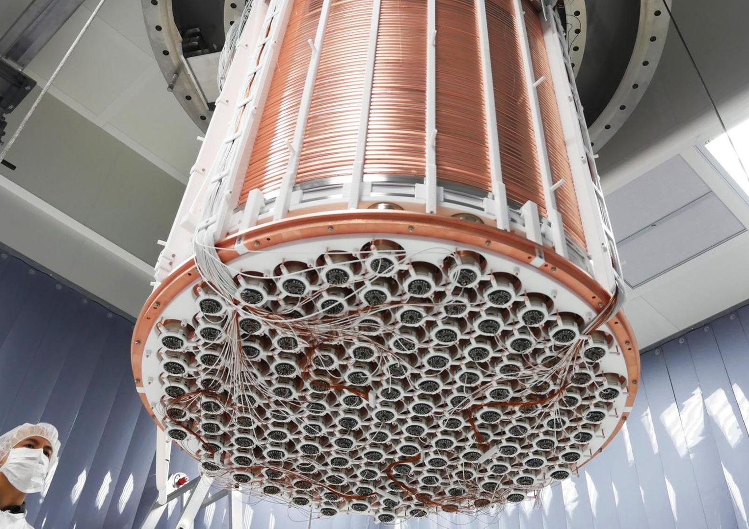
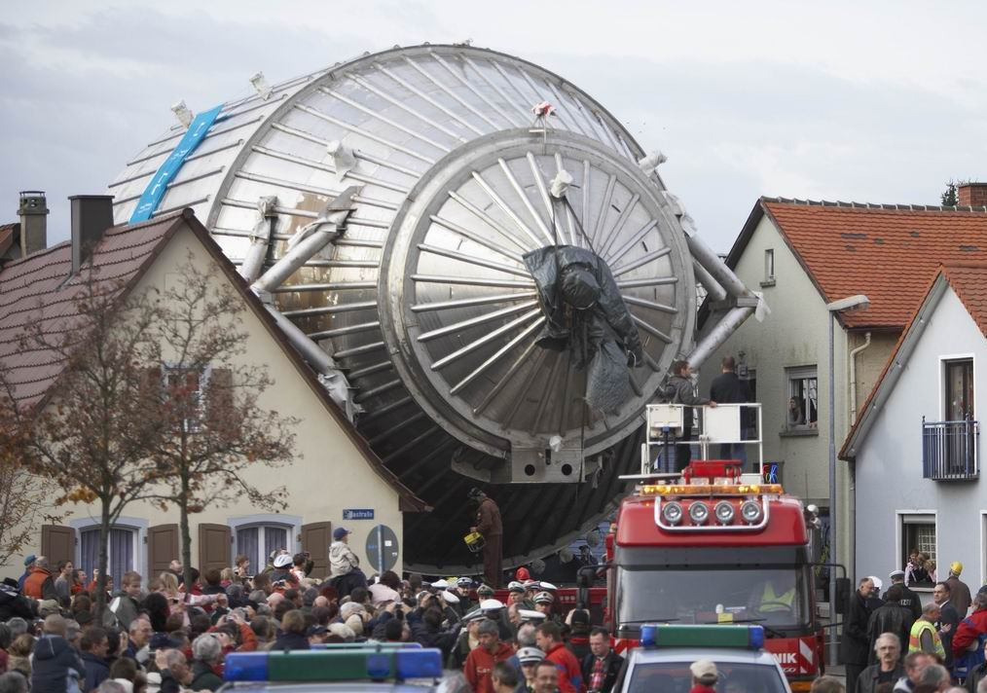
Experimental Searches
Indirect Detection
e.g. XMM Newton
ν₄
Direct Detection
e.g. DyNo, Xenon
ν₄
Production
e.g. KATRIN/ TRISTAN
ν₄
Motivation
KATRIN + TRISTAN
Detector Characterization
Future Challenges
Notes:
Notes/Additional Info:
There is some tentative evidence for a 3.5 keV X-ray line, which could possibly be due to a decaying sterile neutrino.

Slide 6
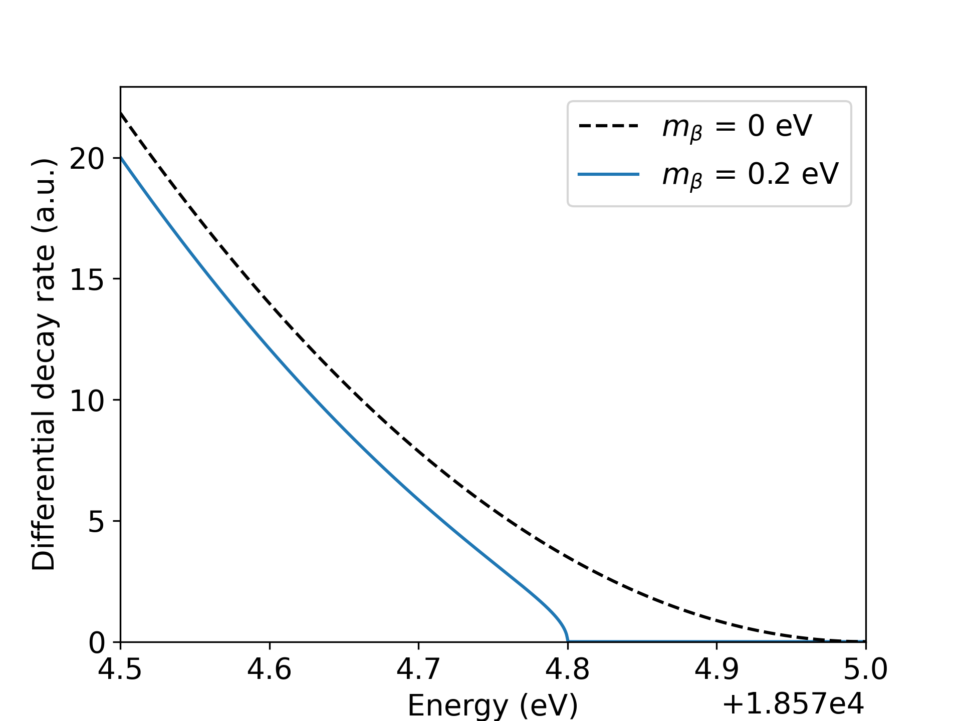
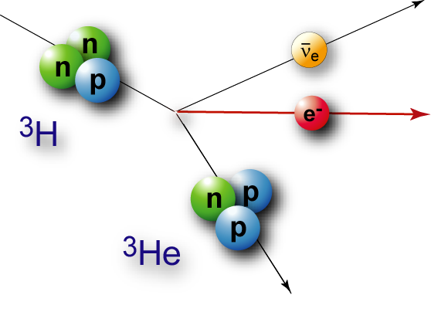
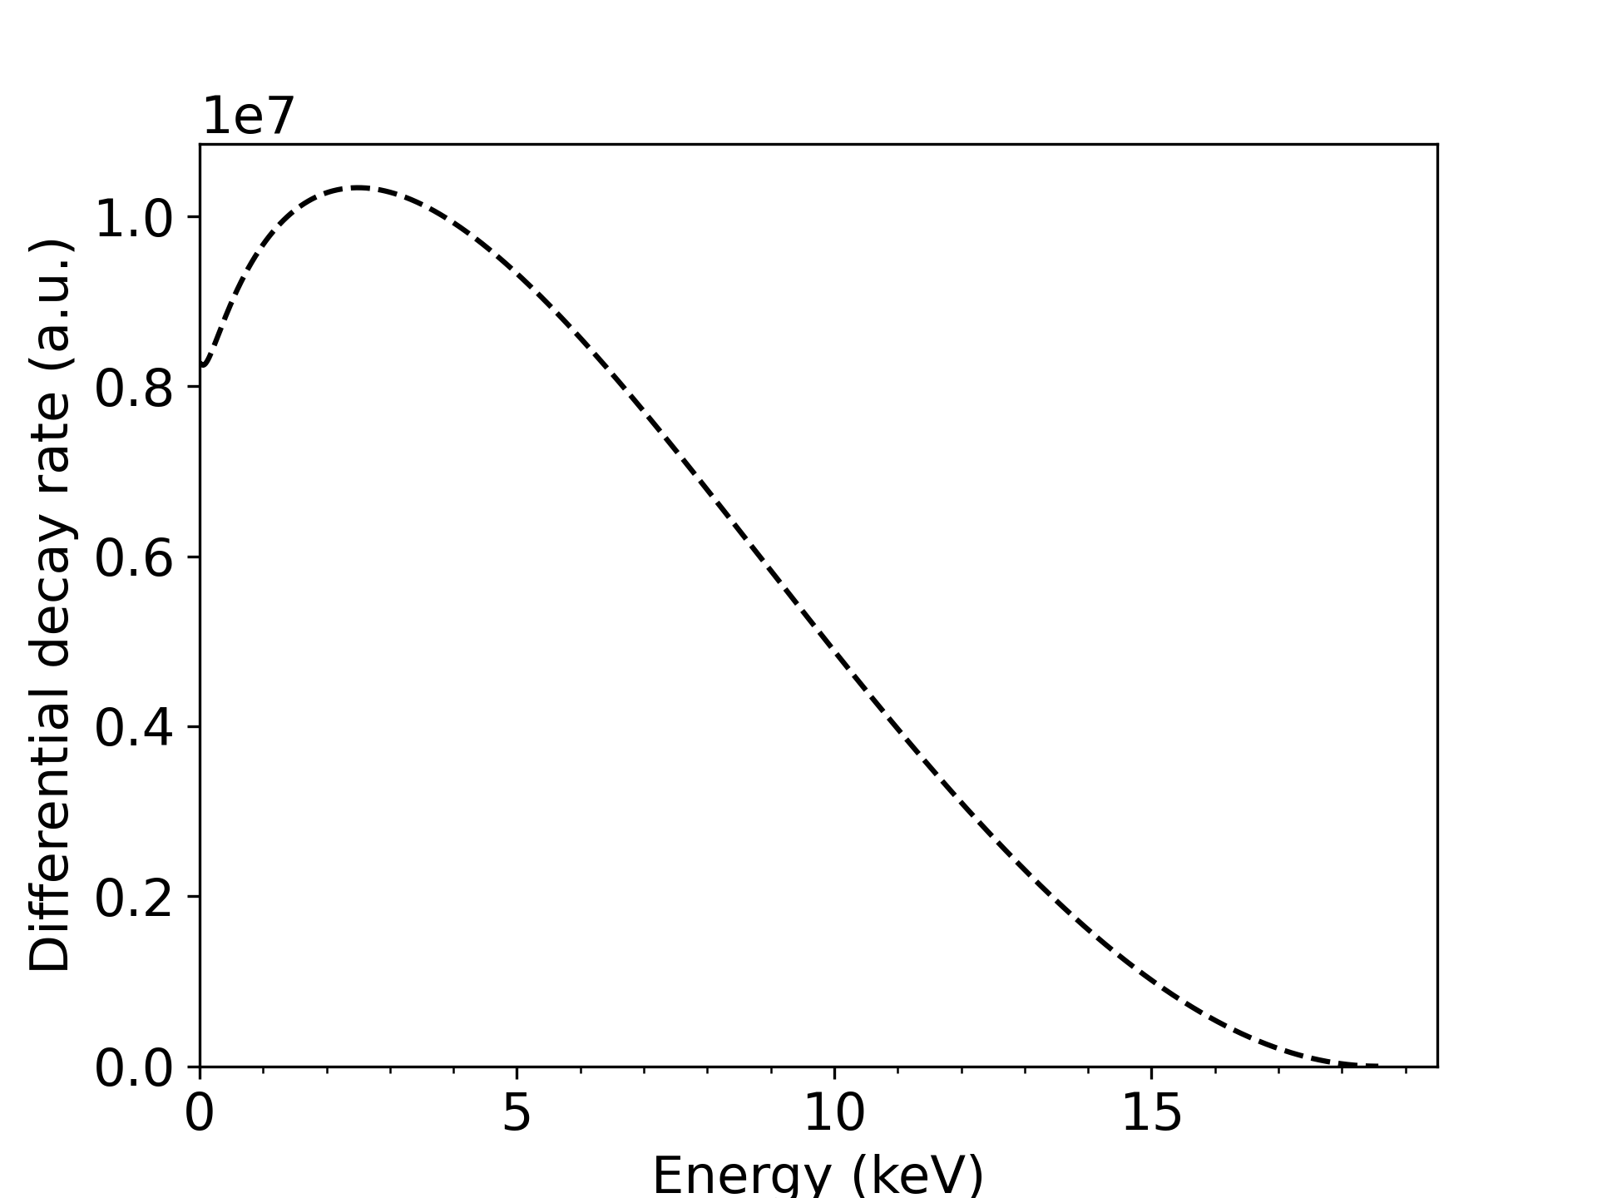
Tritium ß-decay
Signal of neutrino mass
Motivation
KATRIN + TRISTAN
Detector Characterization
Future Challenges
Notes:
Notes/Reminders:
As tritium beta-decay is a super-allowed decay the spectral shape is smooth and a precise theoretical description is possible.
Furthermore, the life time of tritium of 12.4 years is rather short allowing for high signal rates with comparably low source densities, which minimises
source related systematic effects.
Finally, with an endpoint energy of 18.6 keV, tritium beta-decay provides access to heavy neutrinos in a wide mass range

Slide 7
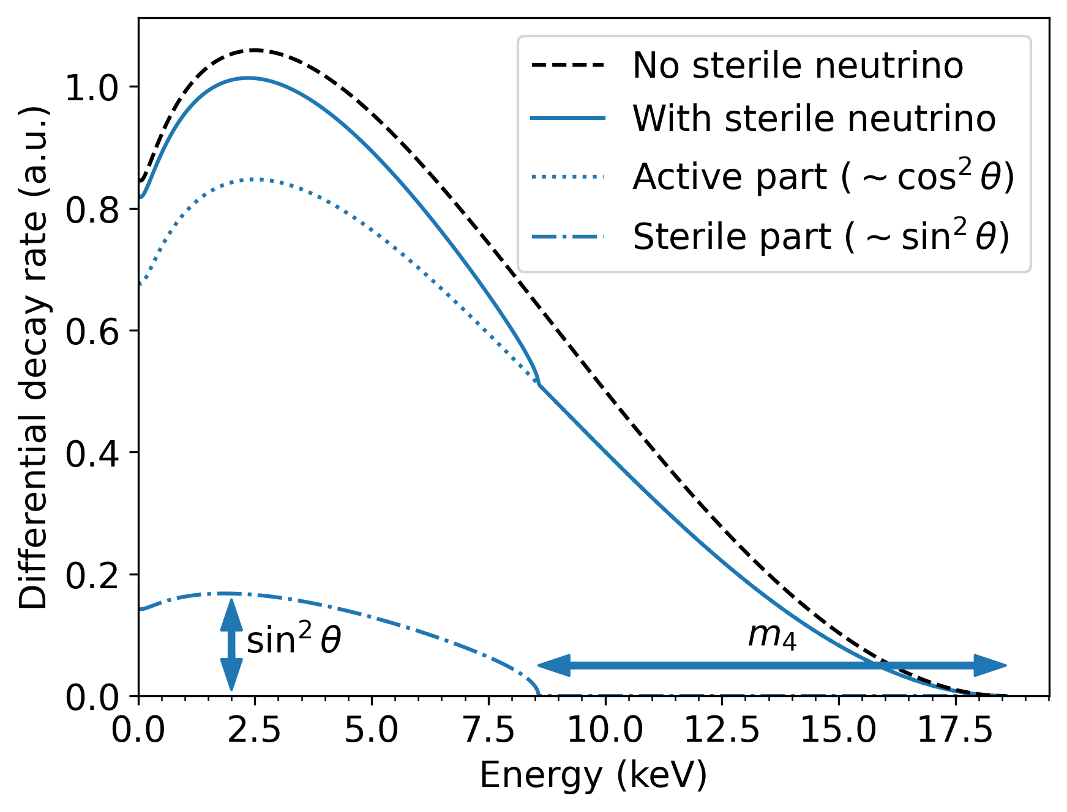
Imprint of sterile ν‘s on ß-spectrum
Heavy sterile
neutrino
Neutrino from
tritium β-decay
Light active
neutrinos
Motivation
KATRIN + TRISTAN
Detector Characterization
Future Challenges
Notes:
beta-decay spectrum is given as a weighted superposition of the spectra corresponding to each neutrino mass eigenstate m(i) the electron neutrino flavour is composed of.
As a result the sterile neutrino manifests itself as a characteristic kink-like signature and spectral distortion further away from the kinematic endpoint
Since the mass splittings between the three light neutrino mass eigenstates are so small, no current beta-decay experiment can resolve them → effective light neutrino mass

Slide 8
Imprint of sterile ν‘s on ß-spectrum
Problem: Tiny signature
→ Need high statistics
Heavy sterile
neutrino
Neutrino from
tritium β-decay
Light active
neutrinos
Motivation
KATRIN + TRISTAN
Detector Characterization
Future Challenges
Notes:
As a result the sterile neutrino manifests itself as a characteristic kink-like signature and spectral distortion further away from the kinematic endpoint

Slide 9
The world’s strongest tritium source
@ KATRIN
Susanne Mertens, ERC, 5/6/19

Slide 10
The world’s strongest tritium source
@ KATRIN
Experimental site: Karlsruhe Institute of Technology (KIT)
International Collaboration (150 members)
Main goal: Direct measurement of the neutrino mass with 0.3 eV sensitivity
Susanne Mertens, ERC, 5/6/19

Slide 11
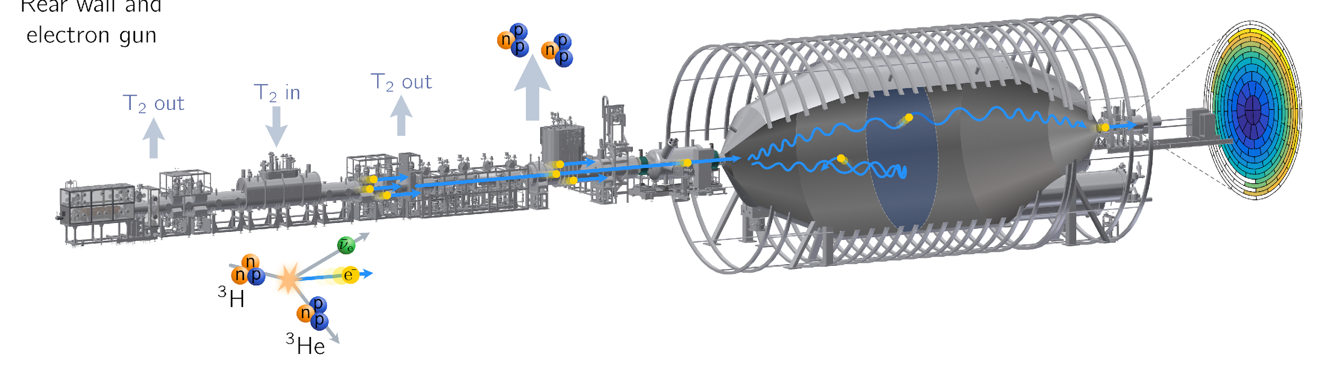
Working Principle
70 m
Motivation
KATRIN + TRISTAN
Detector Characterization
Future Challenges

Slide 12
Working Principle
Tritium source
100 μg of gaseous T₂
10¹¹ T₂ decays/s
70 m
Motivation
KATRIN + TRISTAN
Detector Characterization
Future Challenges

Slide 13
Working Principle
Tritium source
100 μg of gaseous T₂
10¹¹ T₂ decays/s
Transport section
Guidance of electrons
Removal of tritium
70 m
Motivation
KATRIN + TRISTAN
Detector Characterization
Future Challenges

Slide 14
Working Principle
Tritium source
100 μg of gaseous T₂
10¹¹ T₂ decays/s
Transport section
Guidance of electrons
Removal of tritium
Spectrometer
Electrostatic filter
MAC-E filter principle
70 m
Motivation
KATRIN + TRISTAN
Detector Characterization
Future Challenges

Slide 15
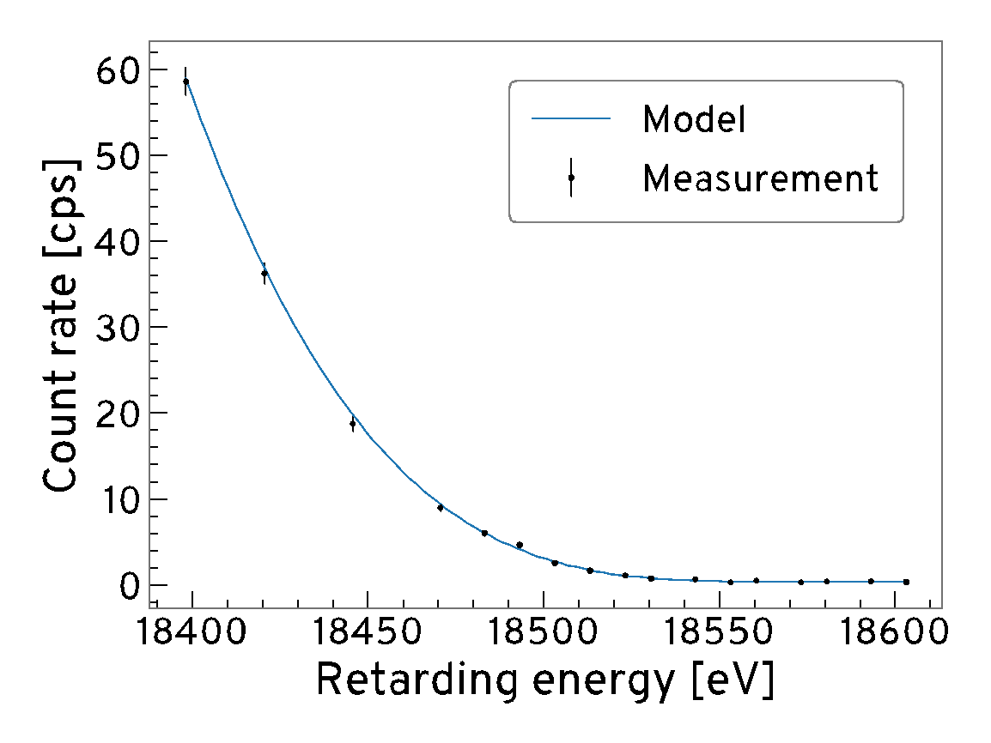
Working Principle
Tritium source
100 μg of gaseous T₂
10¹¹ T₂ decays/s
Transport section
Guidance of electrons
Removal of tritium
Spectrometer
Electrostatic filter
MAC-E filter principle
Detector
Counts electrons
Rate vs potential
70 m
Motivation
KATRIN + TRISTAN
Detector Characterization
Future Challenges

Slide 16
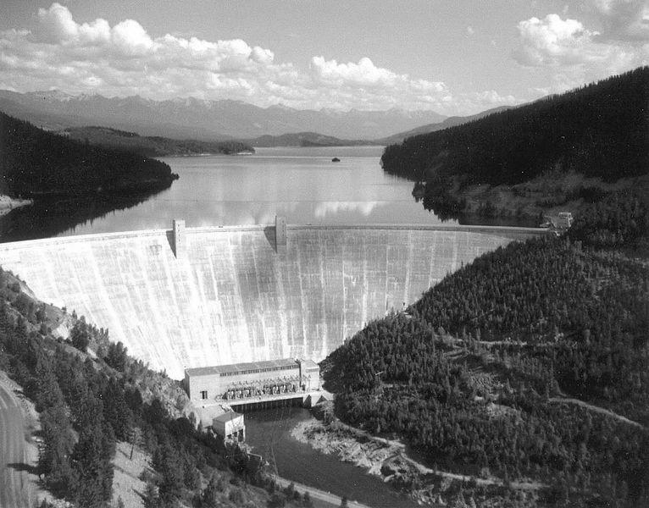
Extending KATRIN
10¹¹ decays/s
Motivation
KATRIN + TRISTAN
Detector Characterization
Future Challenges

Slide 17
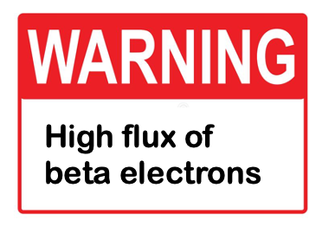
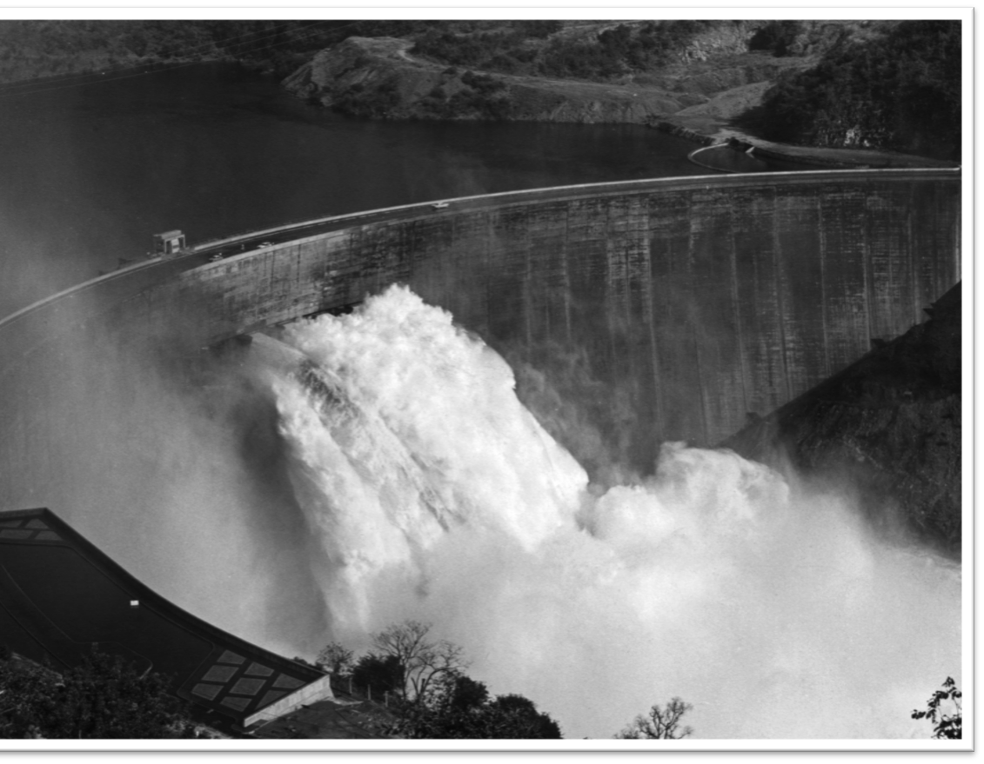
Extending KATRIN
10¹¹ decays/s
Motivation
KATRIN + TRISTAN
Detector Characterization
Future Challenges

Slide 18
A novel detector system
Mertens et al, Phys.Rev. D91 (2015) 4, 042005
Mertens et. al. JCAP 1502 (2015)
Tristan
Detector
10¹¹ decays/s
Motivation
KATRIN + TRISTAN
Detector Characterization
Future Challenges
Notes:
The novel idea of SENSE is to extend KATRIN to search for sterile neutrinos from the eV to keV range.
This means to extend the measurement interval from a region close to the endpoint to the entire tritium spectrum
In this new mode of operation a major technical challenge arises:
The tremendous source activity of 1011 decays per second will leads to signal rate of 1010 electron per second, comparable to rates at the LHC.
Consequently, a novel detector and read-out system. This design and production of this system is a major milestone of this research proposal.

Slide 19
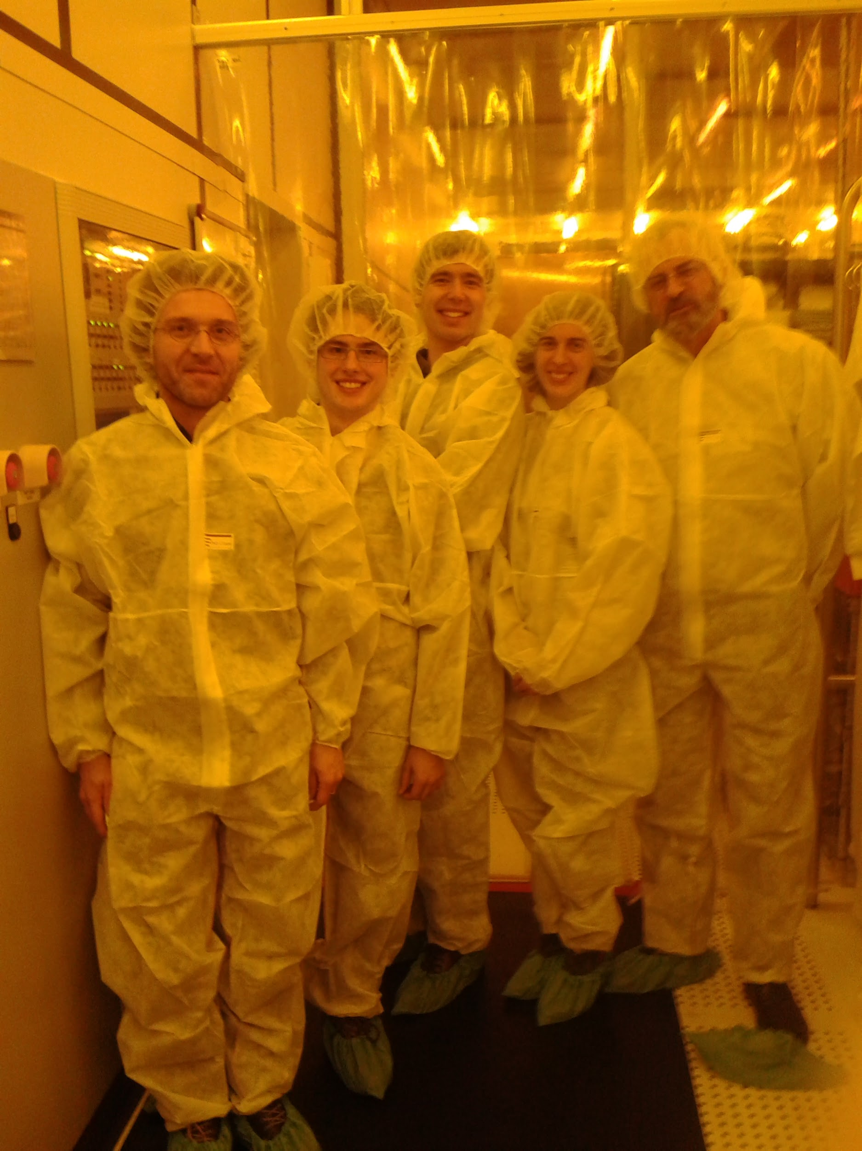
Detector Requirements
Our first visit to HLL in 2015
The detector needs to handle high rates
We need a good energy resolution, to resolve the kink
The detector needs to cover the full electron beam, without much dead area
Thierry, Kai, Marc, David, Susanne
Motivation
KATRIN + TRISTAN
Detector Characterization
Future Challenges

Slide 20
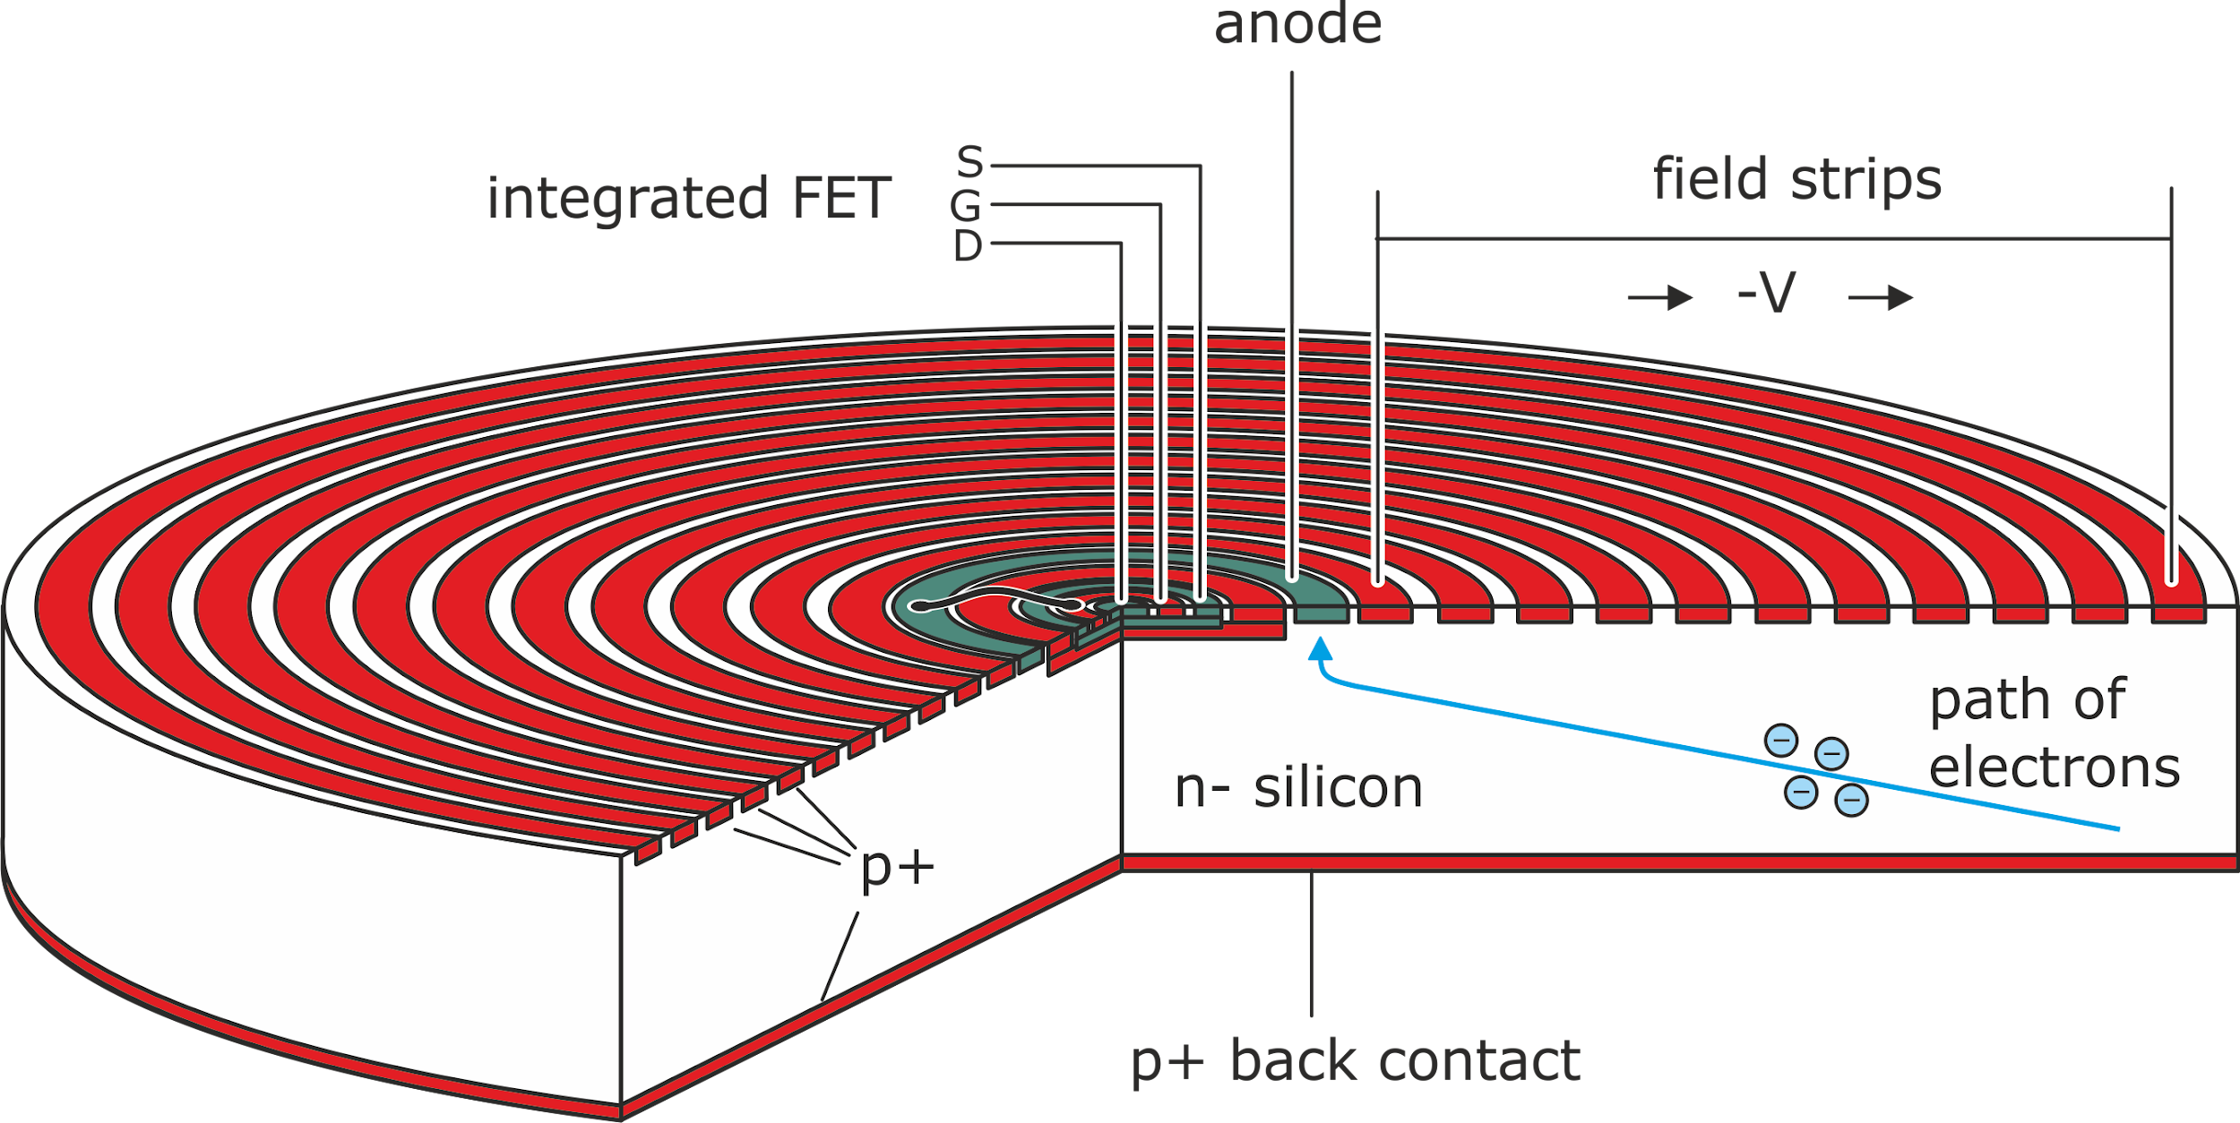
Silicon Drift Detector (SDD)
Peter Lechner (HLL)
12 cm
Small anode contact
Small detector capacitance → Low noise for high rates
Large detector area
Large area coverage, not too many pixels
Integrated amplification (nJFET)
Focal plane array
4 cm
4 cm
3 mm
S. Mertens et al., J. Phys. G46 (2019) S. Mertens et al., J. Phys. G48 (2020) M. Gugiatti et al., NIM-A 979 (2020) M. Biassoni et al., EPJ. Plus 136 (2021) P. King et al., JINST 16 T07007 (2021)
450 μm
Motivation
KATRIN + TRISTAN
Detector Characterization
Future Challenges
Notes:
Radial drift of charge-cloud to almost point-like anode
n-channel junction-gate field-effect transistor (JFET) 🡪 charge sensitive pre-amplifier
small capacitance at the level of few hundreds of fF
20 drift rings

Slide 21
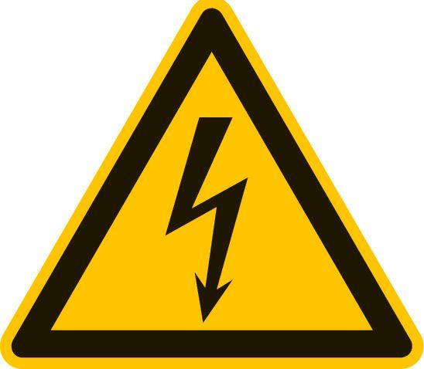
Challenges
> 1000 pixel SDD
9 modules (each 166 pixel)
Large pixel number
Focal plane configuration
Operation at high magnetic field and high vacuum
Ultra-precise beta spectroscopy
Motivation
KATRIN + TRISTAN
Detector Characterization
Future Challenges
Notes:
The novel idea of SENSE is to extend KATRIN to search for sterile neutrinos from the eV to keV range.
This means to extend the measurement interval from a region close to the endpoint to the entire tritium spectrum
In this new mode of operation a major technical challenge arises:
The tremendous source activity of 1011 decays per second will leads to signal rate of 1010 electron per second, comparable to rates at the LHC.
Consequently, a novel detector and read-out system. This design and production of this system is a major milestone of this research proposal.

Slide 22
Detector Module
ASIC board
Rigid flex PCB (signal and power lines)
Ettore ASICs
(below cap)
SDD operated at about -30°C
Electronics hidden beyond SDD
Modularity: Upscaling and maintenance
40 mm
38 mm
Copper cooling and holding structure
166 px SDD with integrated JFET
Silicon carbide (CeSiC)
cooling link
12 cm
Motivation
KATRIN + TRISTAN
Detector Characterization
Future Challenges
Notes:
external application-specific integrated circuit (ASIC), named ETTORE

Slide 23
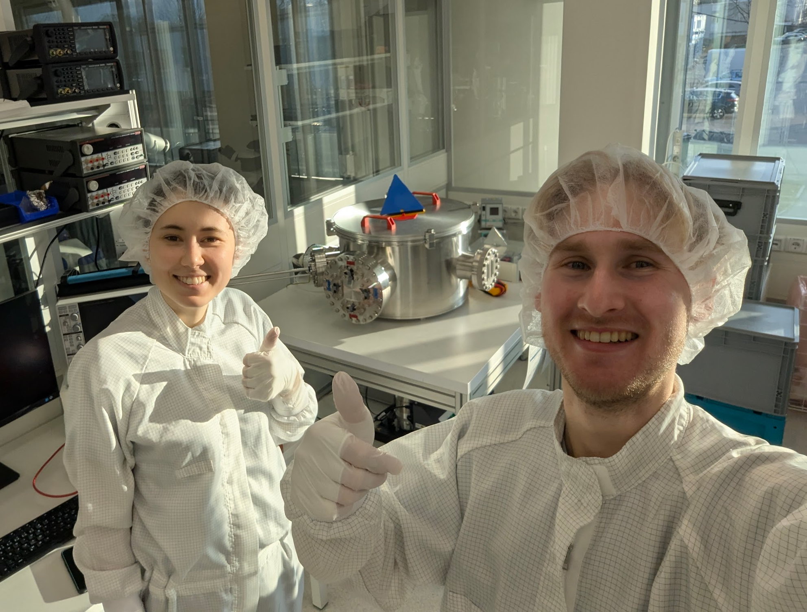
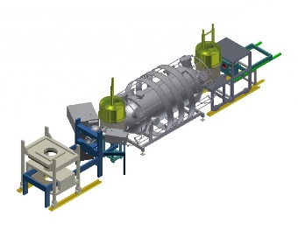
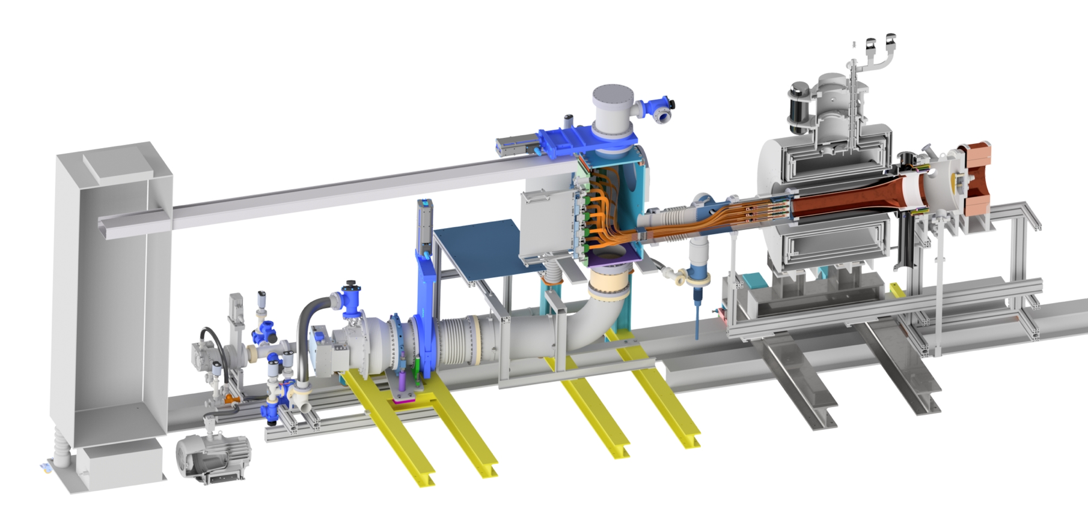
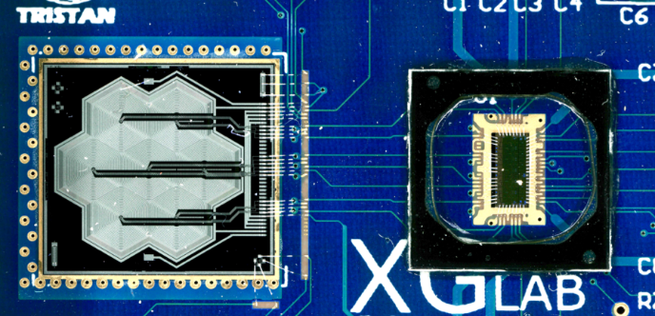
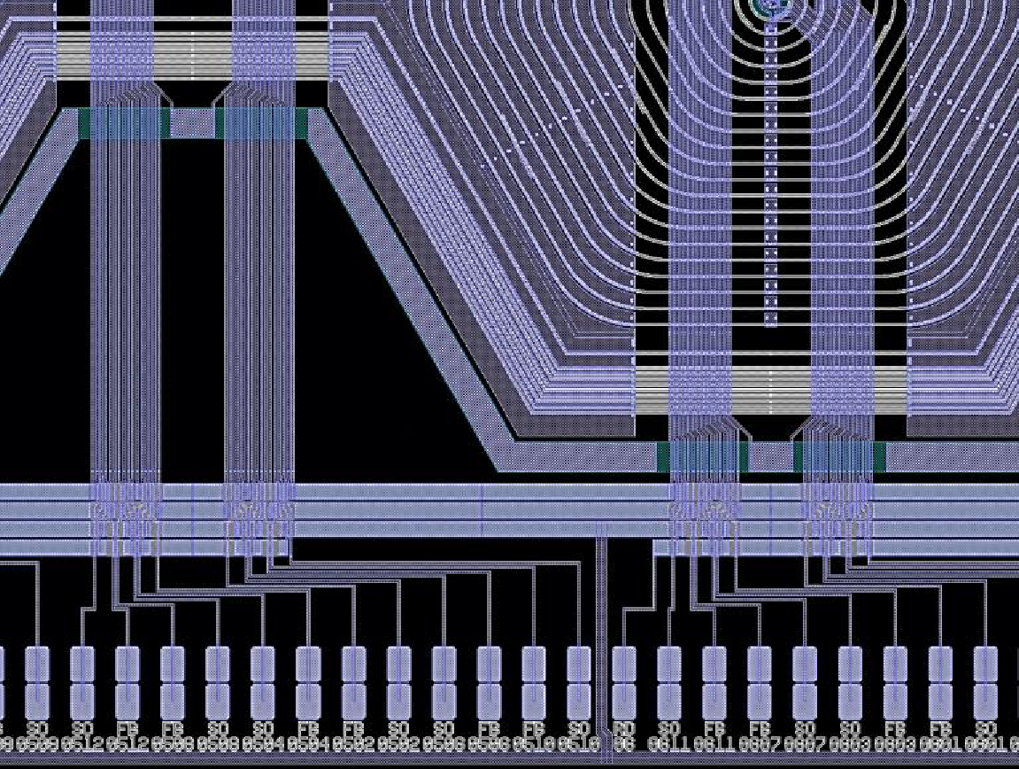
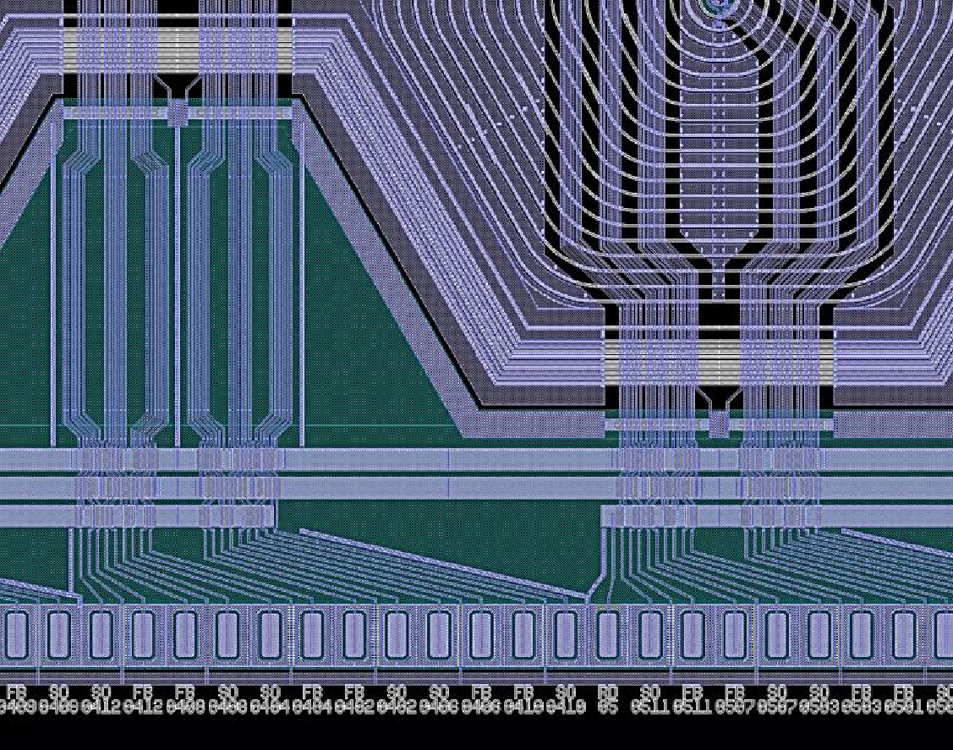
What happened so far …
Move of TRISTAN lab to HLL + start production of 12 more modules
Installation of 3 modules as tower in a KATRIN-like detector section
Very first prototype detector
7-pixel prototype detector with enhanced design
47-pixel prototype detector
166-pixel detector module
Operation in a KATRIN-like environment
First Idea
2013
…
05/17
…
01/20
…
02/21
…
07/21
…
09/22
…
11/24
…
02/25
…
Layout optimizations
Motivation
KATRIN + TRISTAN
Detector Characterization
Future Challenges
Notes:
Along this timeline, an extensive detector characterization program has been conducted since the delivery of the very first prototype detectors. And in the following, I want to show you some of the key investigations that have been performed by our colleagues, mostly students like us.

Slide 24
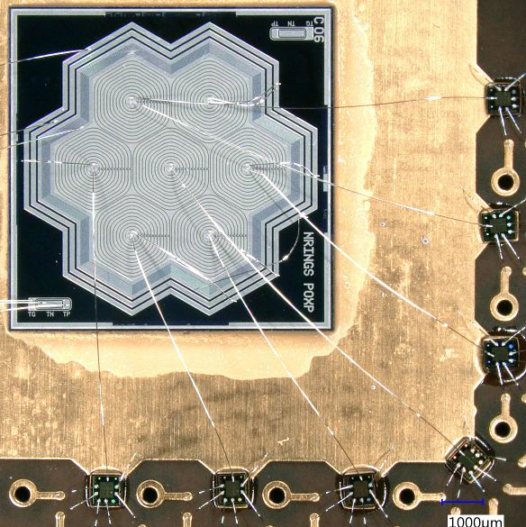
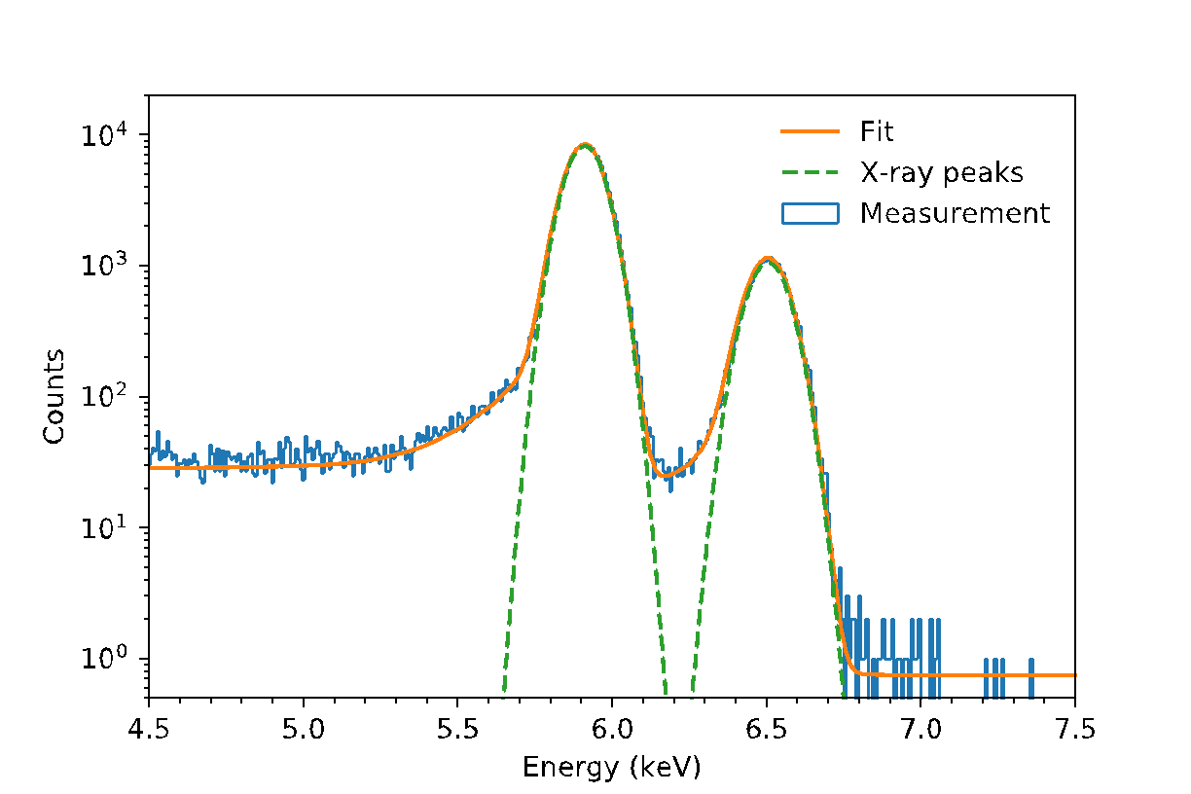
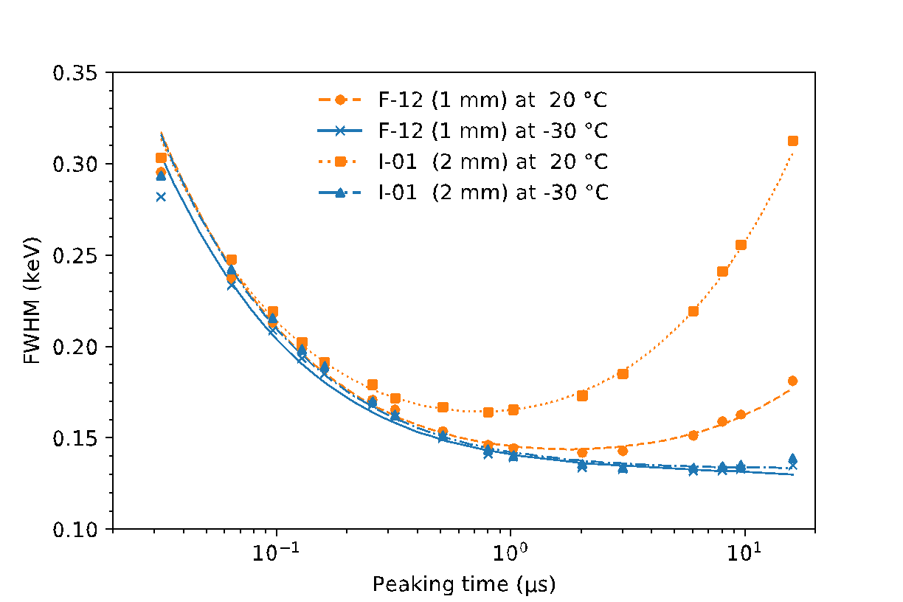
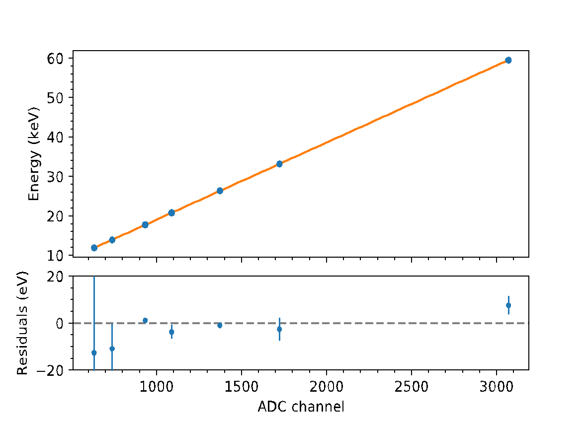
X-ray Characterization
Excellent performance demonstrated J. Phys. G46 (2019)
Energy resolution
Noise characteristics
Linearity
130 eV (FWHM) @ 6 keV
< 150 eV (FWHM), < 1μs shaping time
0.1% linearity over 60 keV range
Motivation
KATRIN + TRISTAN
Detector Characterization
Future Challenges
Notes:
When a new detector arrives in our hands, the first things we usually do are basic functionality tests with an X-ray source. For these tests, we use an 55Fe source as it has two clearly distinctive peaks at 6 and 6.5 keV as you can see here on the left. Starting with the prototype detectors, we have demonstrated an excellent performance in energy resolution of less than 130 eV FWHM at this 6 keV line. But since we have this high number of beta electrons, we have to set the shaping or peaking time of our event filter to values of only a few us. And there has to be a found a tradeoff between the noise coming from the detector and the readout electronics as this filter is sensitive to both. Combining this with cooling the detectors, as it reduces the number of thermally generated electron hole pairs, we still achieve an energy resolution of less than 150 eV at 6 keV. This plot here shows the comparison of detectors with different pixel diameters (1 and 2 mm) and we practically see no difference when the detectors are cooled. And furthermore, using another X-ray source, 241Am, we have obtained a very high linearity of less than 0.1 % over an energy range of 60 keV. And this has been shown is time-independent, so we can be sure to measure the correct energy over the measurement period and reduces the number of times we have to do calibration runs.

Slide 25
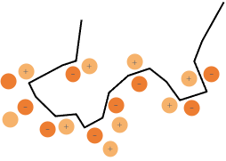
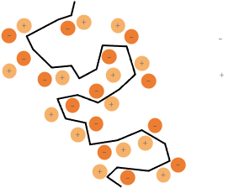
Electron Spectroscopy
X-ray
Electron
Electron
Electron
SiO₂
10 nm
Si 450 μm
sensitive volume
Energy loss in entrance window
Back-scattering
Charge sharing at pixel boundary
Pixel 1
Pixel 2
Motivation
KATRIN + TRISTAN
Detector Characterization
Future Challenges
Notes:
But since we don’t want to do X-ray but electron spectroscopy, we also have to know how the detector response to electrons looks like. Photons can enter the detector much deeper before interacting in the sensitive volume compared to electrons. Electrons start to deposit their energy already in the first few nm of the detector surface, the entrance window which is a very thin layer of silicon oxid, and this energy is lost as it is not collected at the readout electrode. Also, there is the chance for electrons to be back-scattered from the detector surface after depositing some energy and e.g. hit another pixel and be registered as an event as well. Speaking of other pixels: For neighboring pixels, there is the possibility that the created electrons can be shared across the boundary of these pixels. So depending on where the electron hit the pixel in the first place, some energy could be transferred to the next pixel.

Slide 26
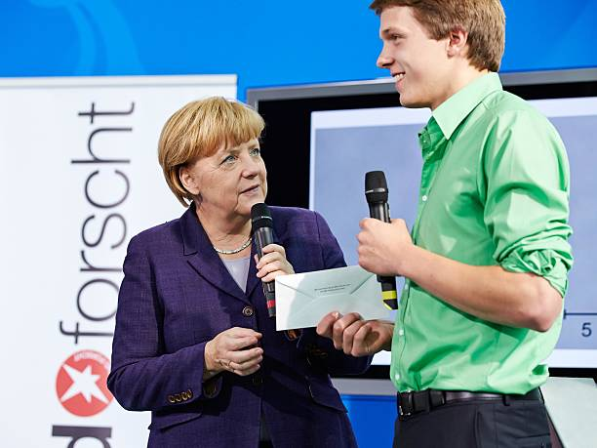
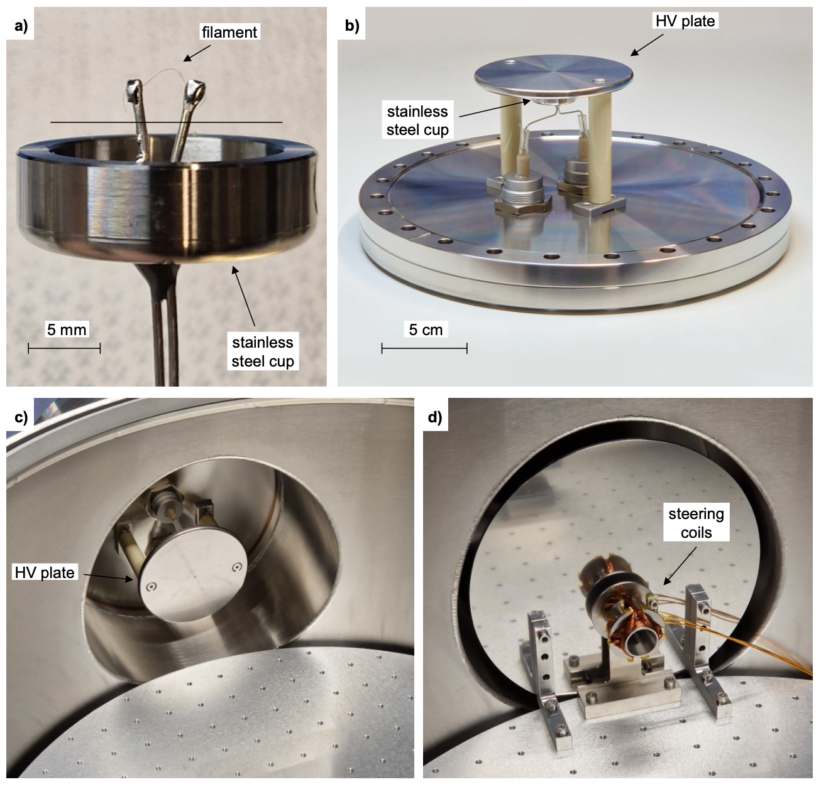
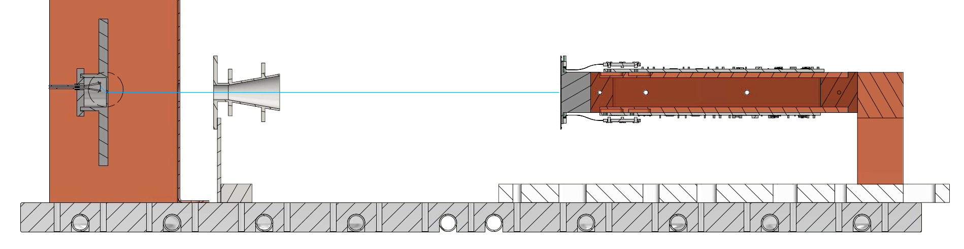
TRISTAN Hot Cathode (THC) E-gun
Mono-energetic electrons with kinetic energy up to 30 keV
Electron rates up to 100 kcps per pixel
Illumination of the area of one TRISTAN detector module (40 × 38 mm²)
K. Urban et al., JINST 19 P06004 (2024)
Motivation
KATRIN + TRISTAN
Detector Characterization
Future Challenges
Notes:
And to investigate all of this, Korbinian built an electron gun based on the concept of thermionic emission. A tantalum wire acts as filament and is heated to emit electrons. The stainless steel cup is connected to the HV plate which allows us to accelerate the electrons to up to 30 keV. The picture here shows the e-gun installed in our vacuum chamber and as it sits on the flange it is easy to maintain. So the electrons come out of this hole here in the center with a rate of up to 100 kcps/px and with the steering coils in front of it, we can deflect the electrons and illuminate our entire detector module.

Slide 27
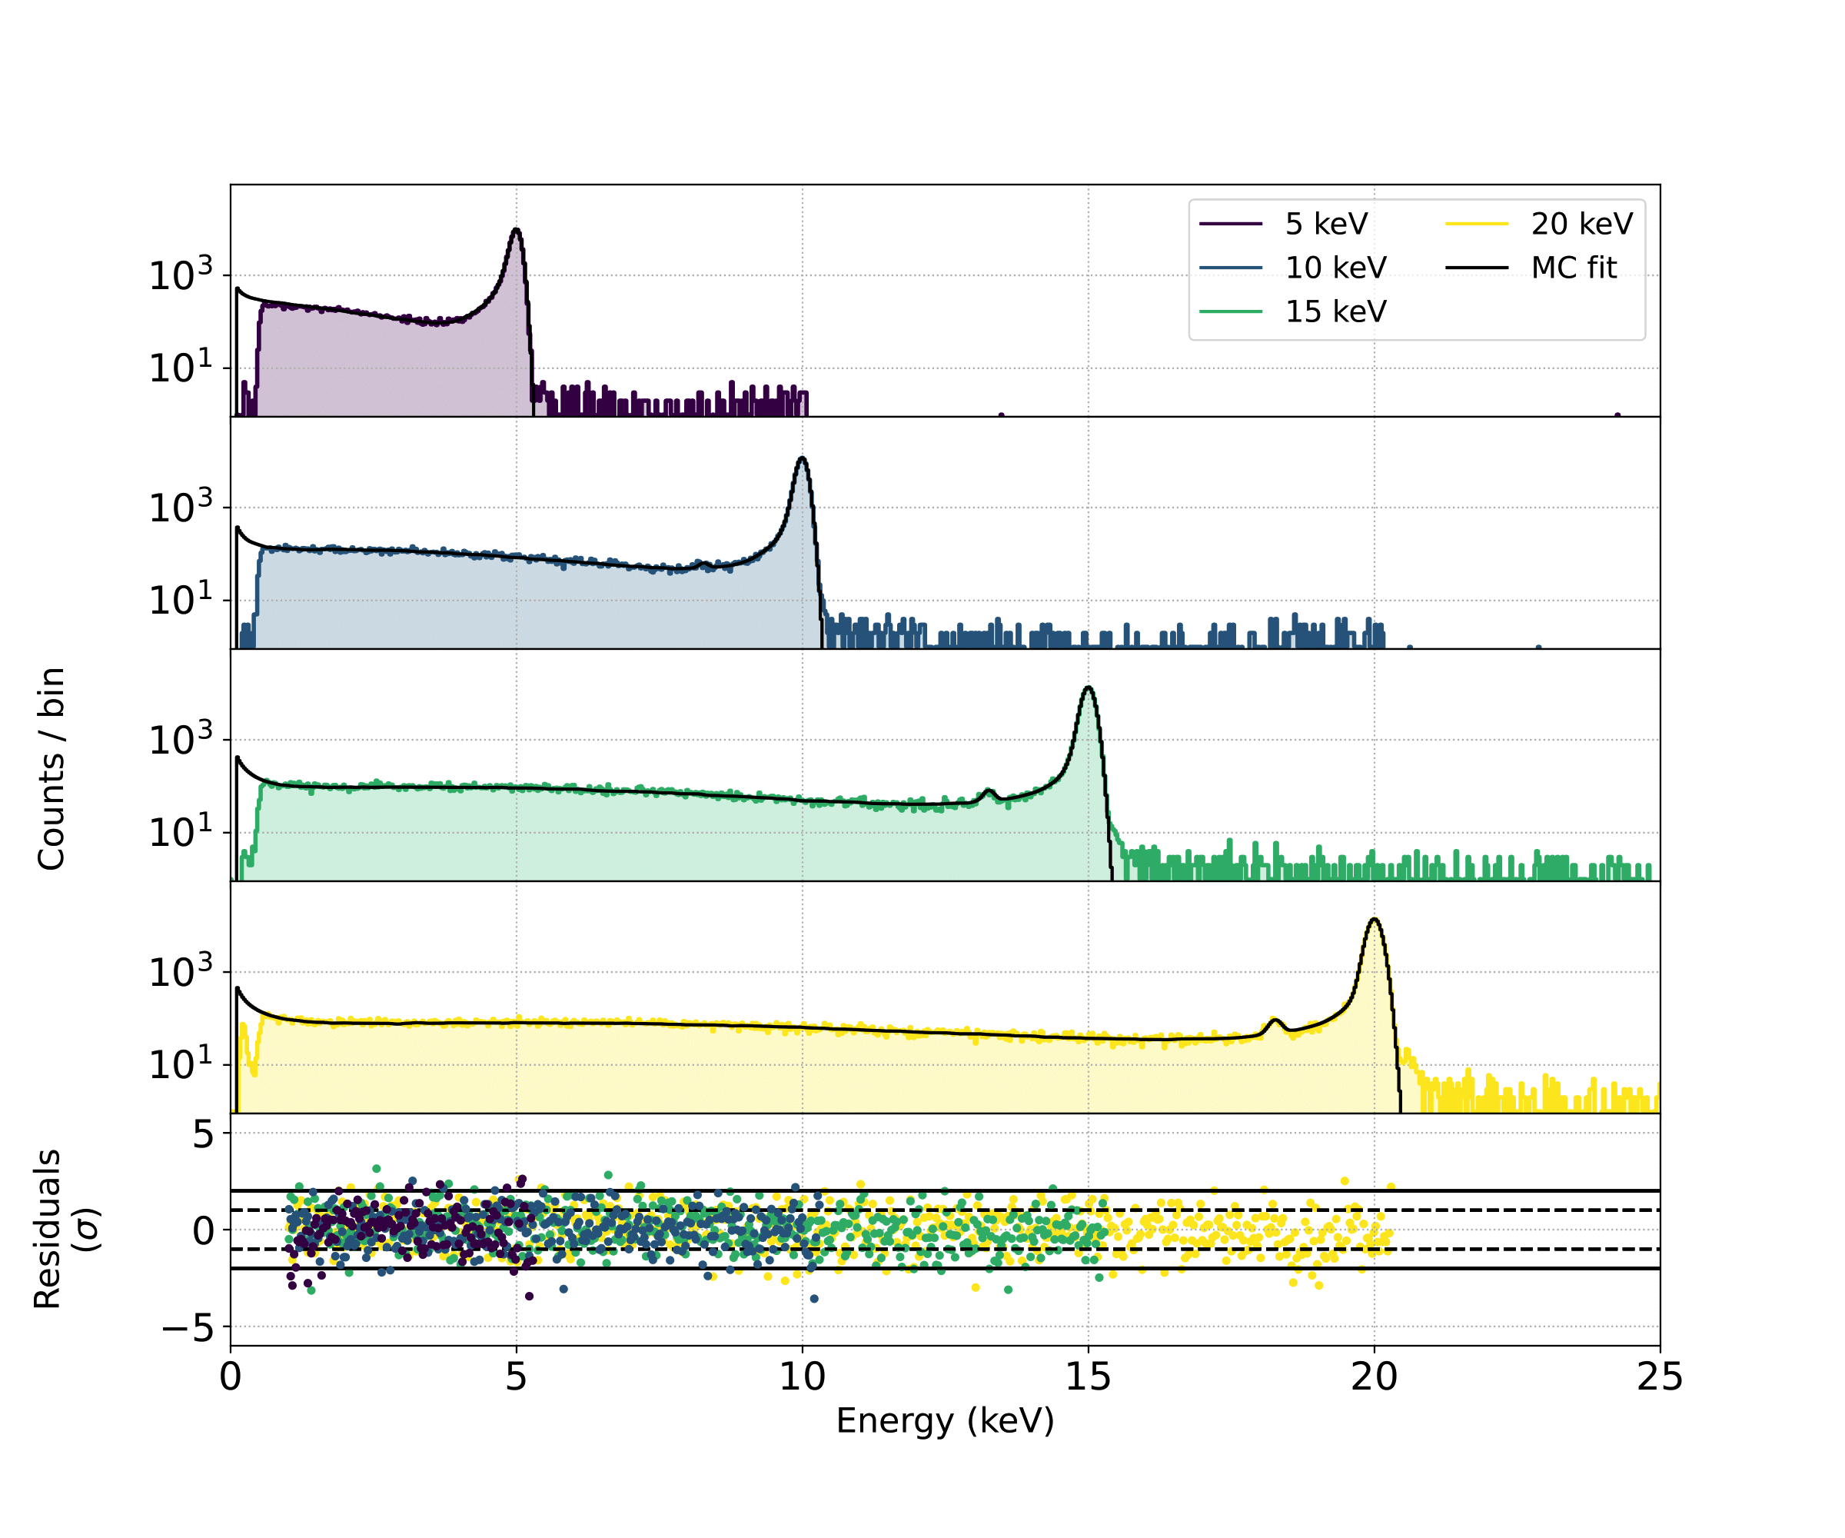
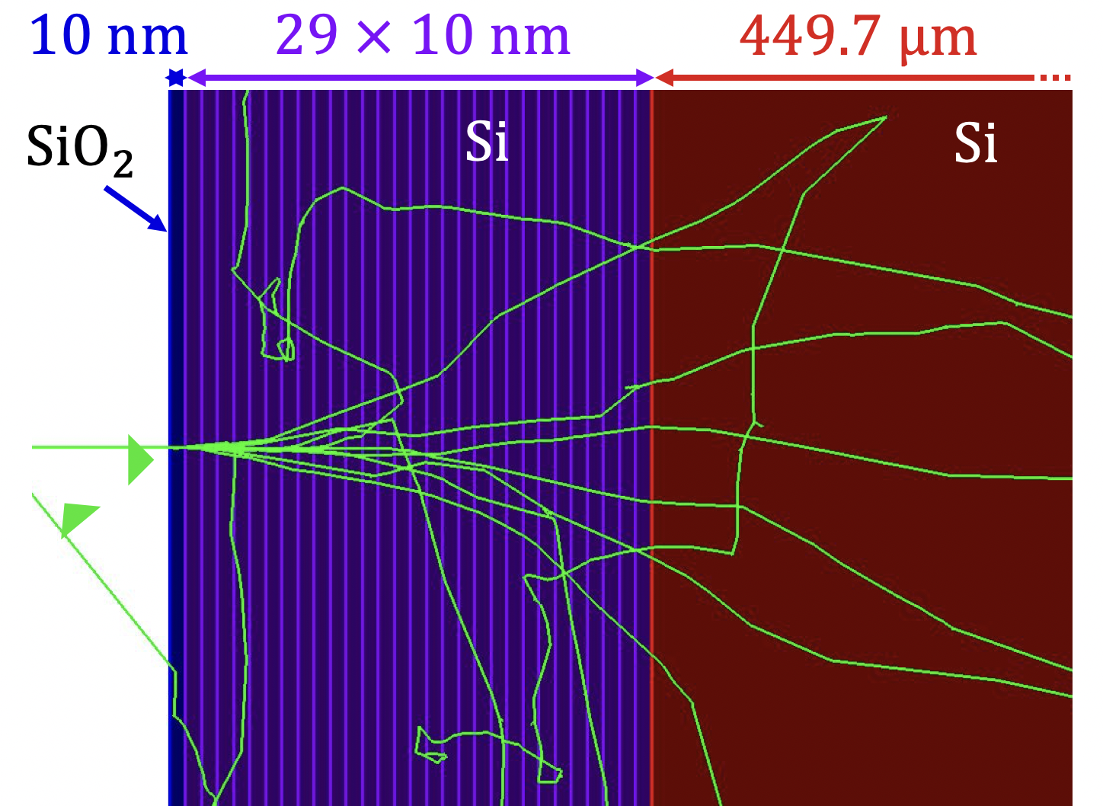
Electron Spectra
High statistic electron spectra
Good agreement of model with data
Backscattering
Pile-up
Si-escape peak
Entrance window + charge sharing
K. Urban et al., JINST 17 C09020 (2022)
A. Nava et al., NIM-A 1046, 167812 (2023)
Motivation
KATRIN + TRISTAN
Detector Characterization
Future Challenges
Notes:
And now, when we tune the energy between 5 and 20 keV as it was done here, we get the response to mono-energetic electrons. We can see here different effects, like the backscattering tail when only part of the total energy was deposited and the rest was carried away when the electron left the detector again. We also see DAQ effects like pile-up when two events couldn’t be resolved individually but were recorded as a single event with double the energy. With enough statistic, one can also recognize the silicon escape peak around 1.7 keV below the full energy peak as well as the energy loss in the entrance window and the charge sharing that lead to a asymmetric peak towards lower energies. When comparing the obtained data to the developed model that is based on Geant4 simulations, we see that there is relatively good agreement over the entire energy range.

Slide 28
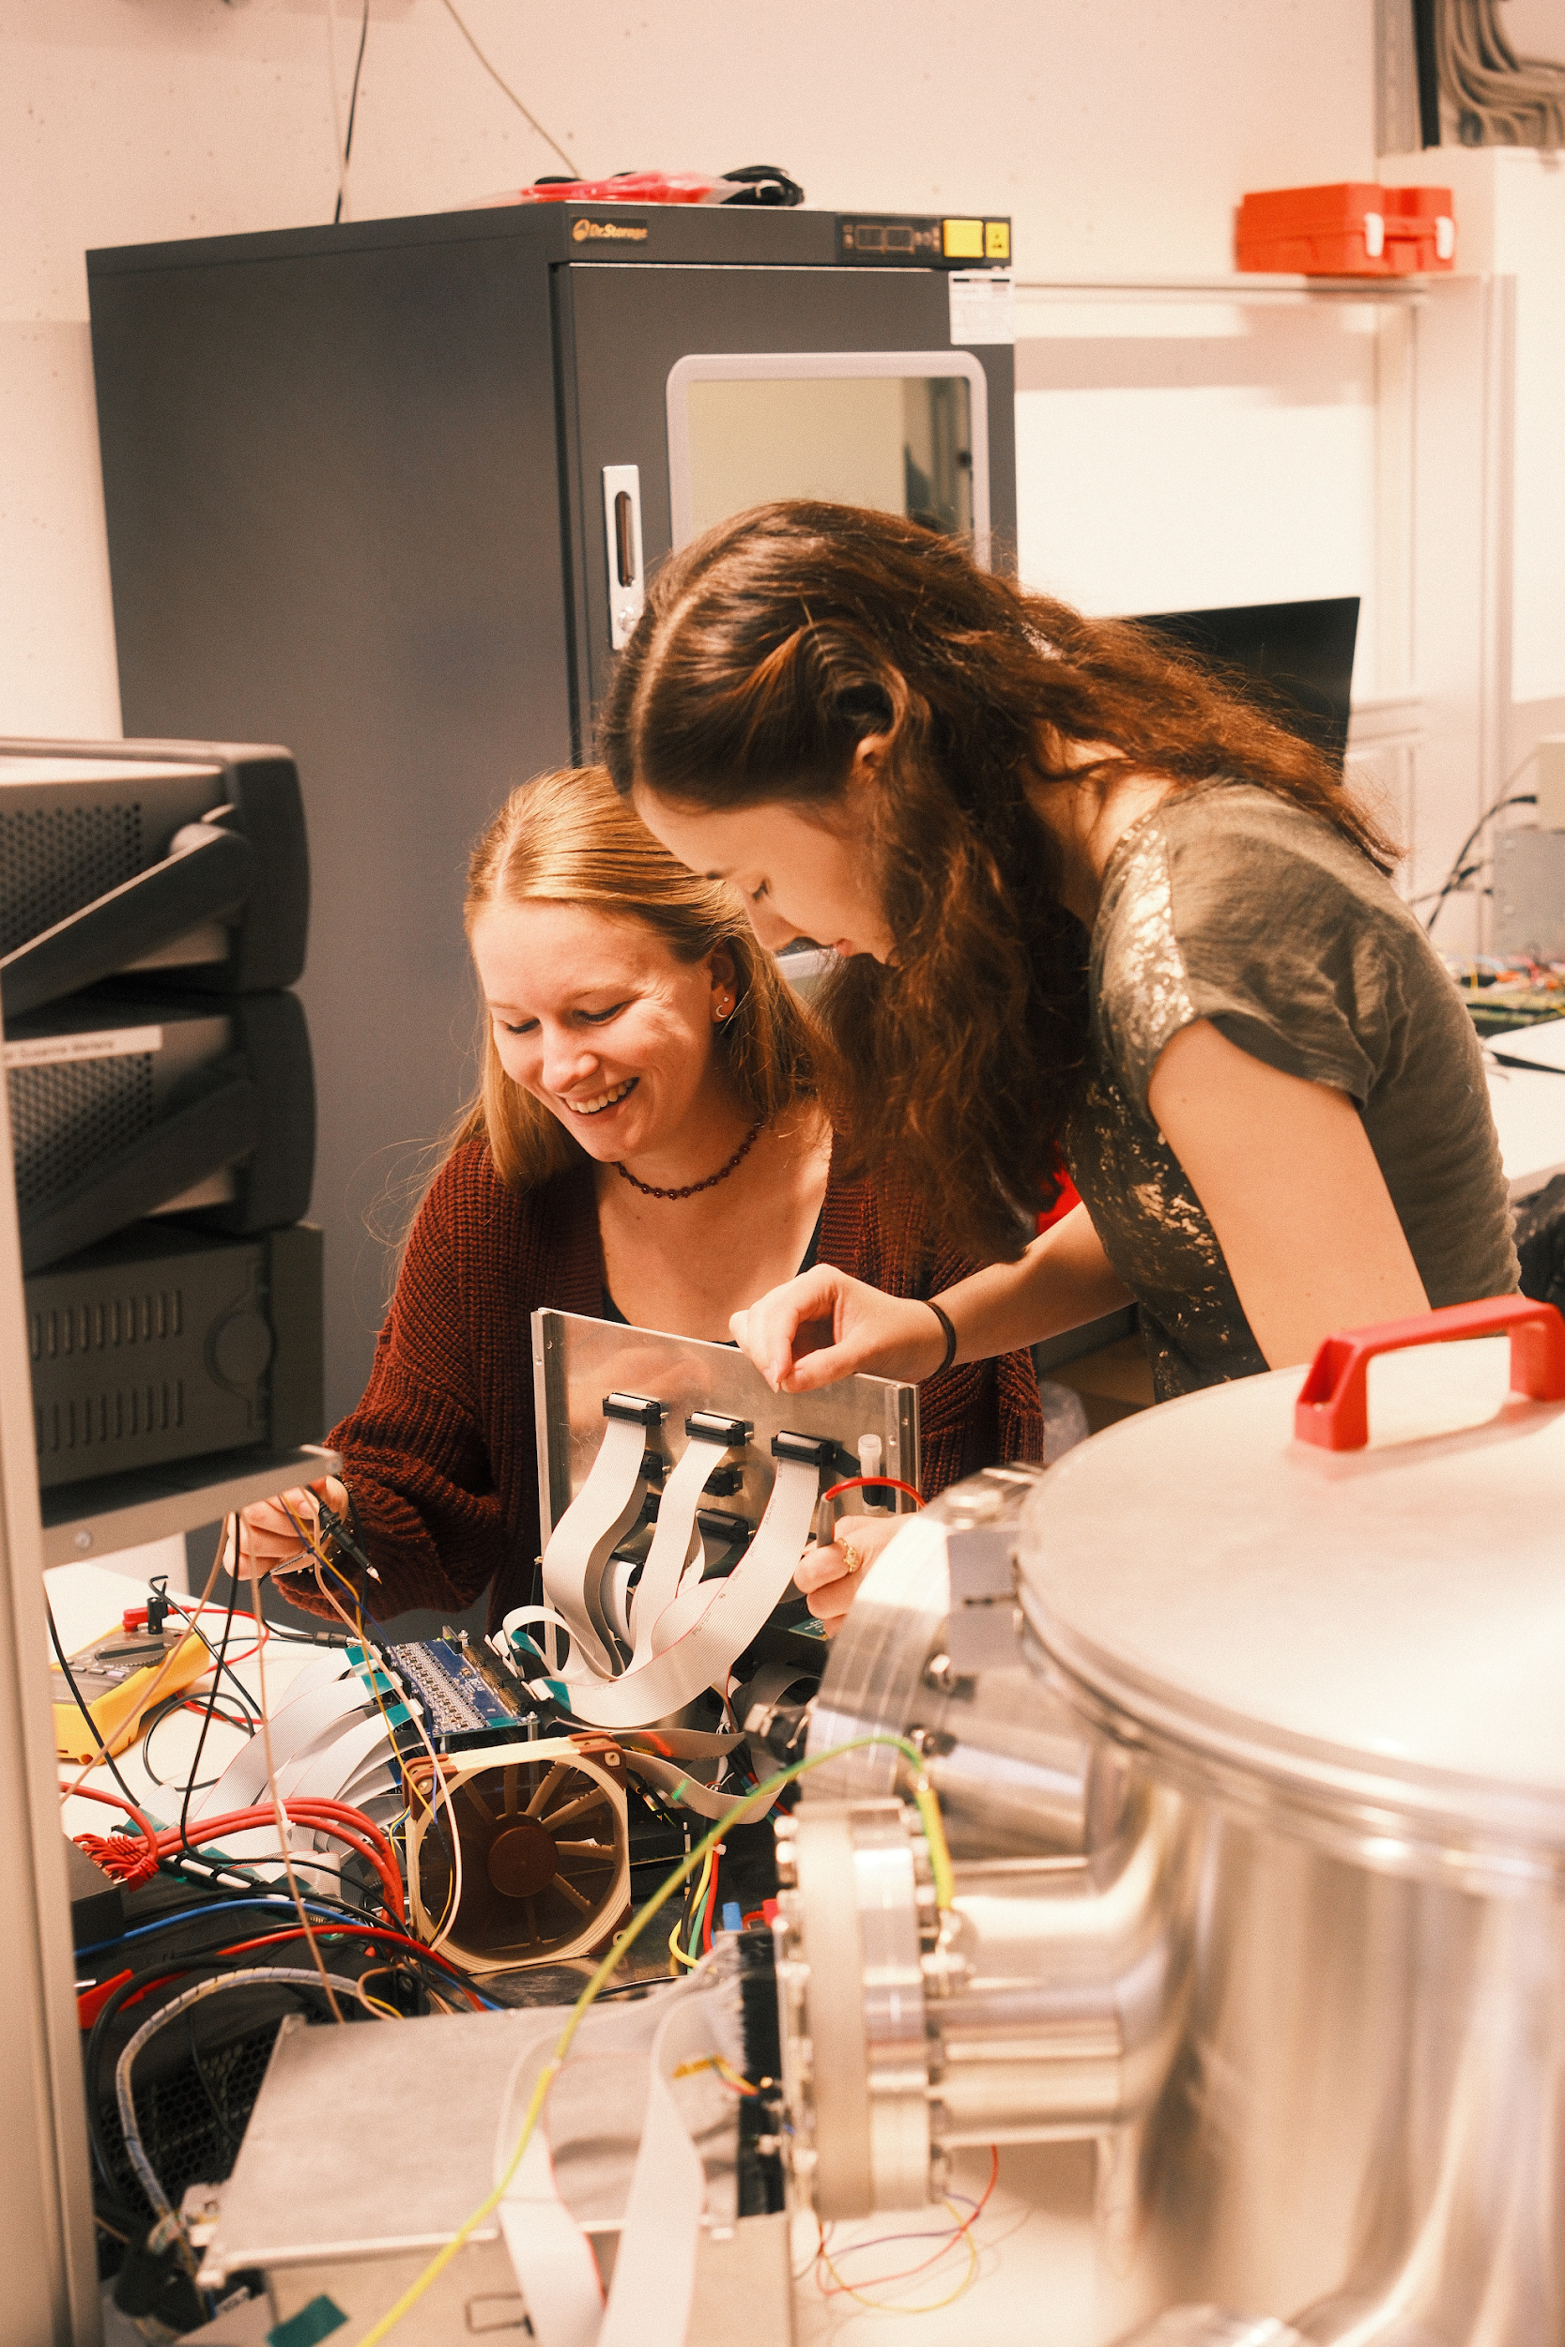
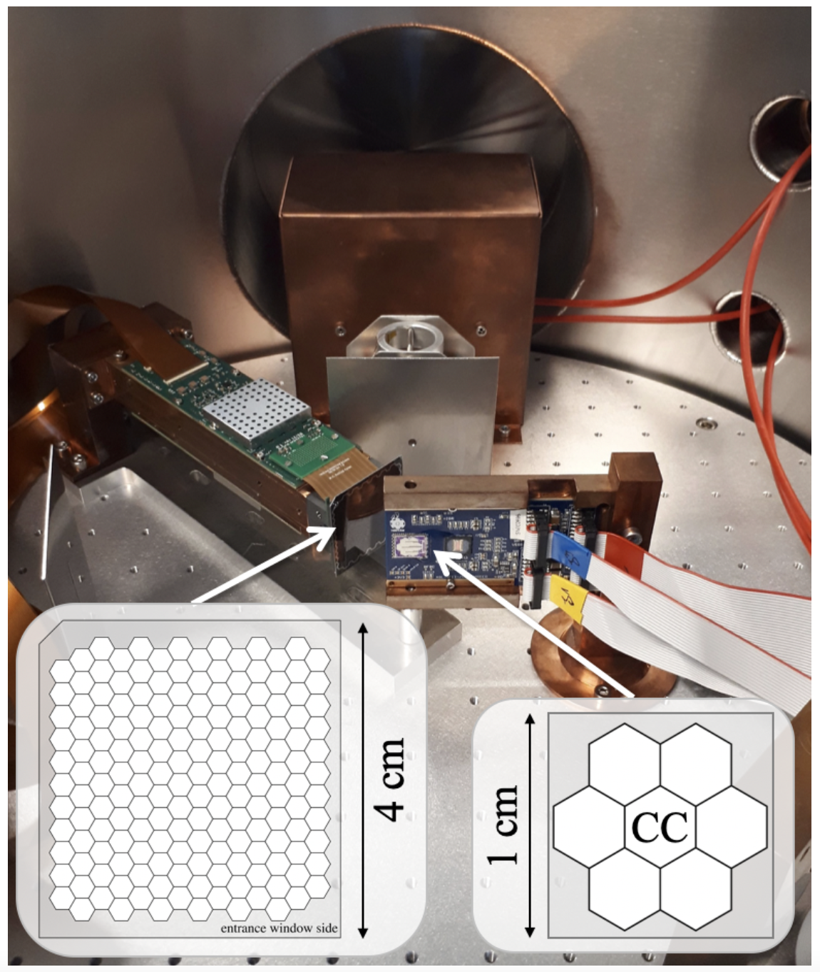
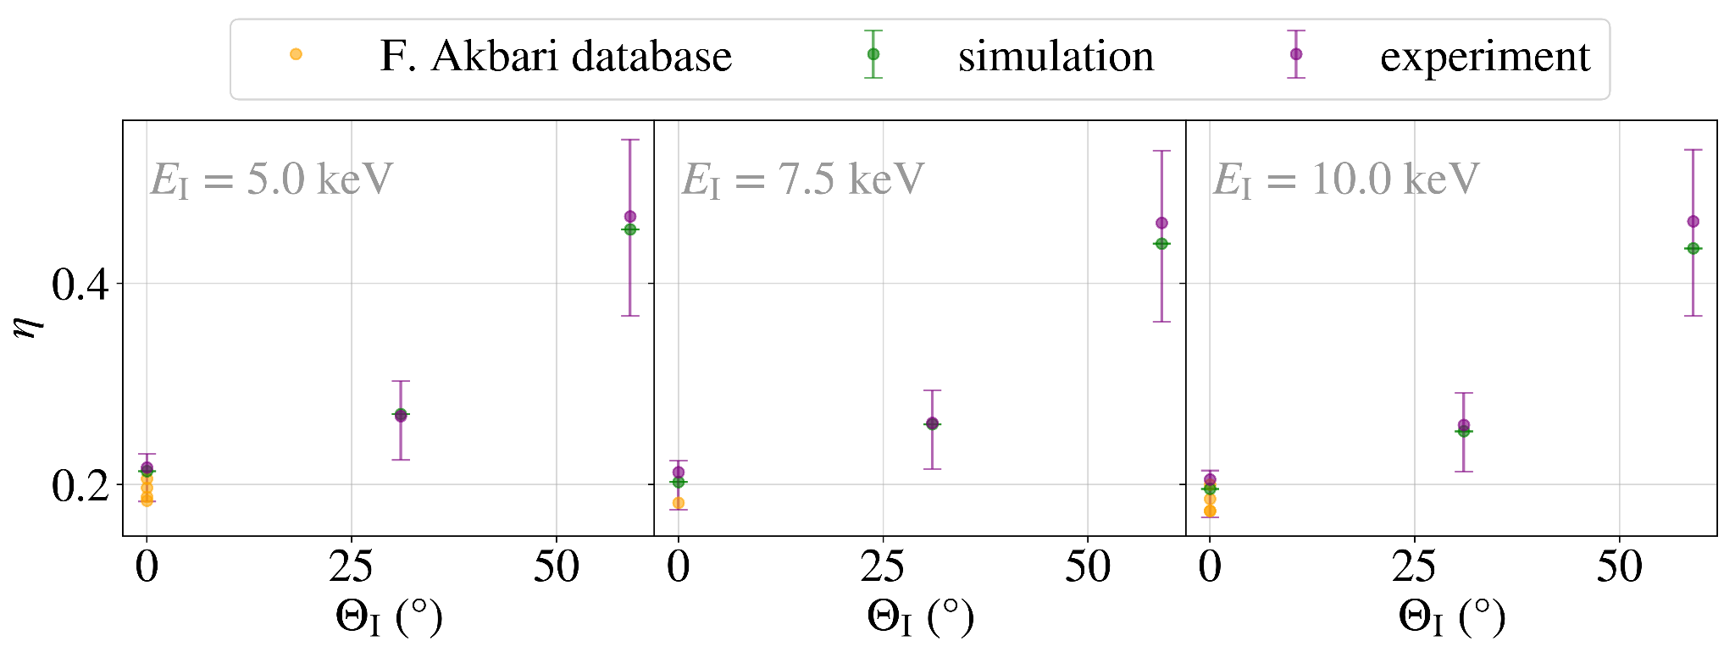
Backscattering
Measurement of backscattering coefficient with two detectors
Good agreement with simulations
D. Spreng et al., JINST 19 P12009 (2024)
Motivation
KATRIN + TRISTAN
Detector Characterization
Future Challenges
Notes:
Individual effects like the electron backscattering were studied in more detail by Daniela. For this, she installed two detectors in our vacuum chamber, a 7 pixel prototype and a 166 pixel detector module. With the electron gun, she illuminated the 7 pixel detector and the electrons that got backscattered from the detector surface were measured with the large detector module. With the variation of the electron energy and the incident angle under which the electrons hit the small detector, she could measure the back-scattering coefficient which tells us the fraction of electrons that were detected in the 166 pixel module after depositing some energy in the 7 pixel detector. And as one can see, the larger the angle under which the electrons hit the small detector, the more electrons get scattered back from its surface.

Slide 29
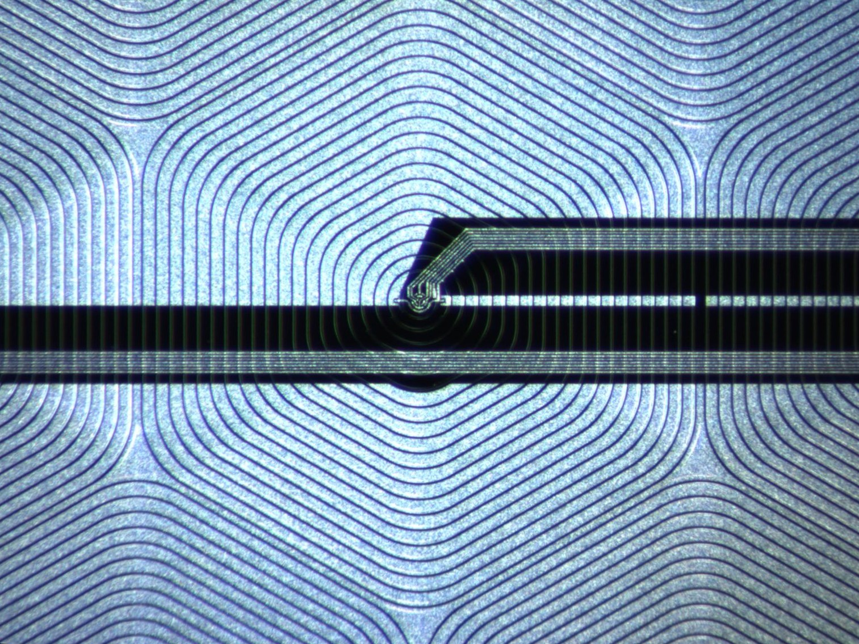
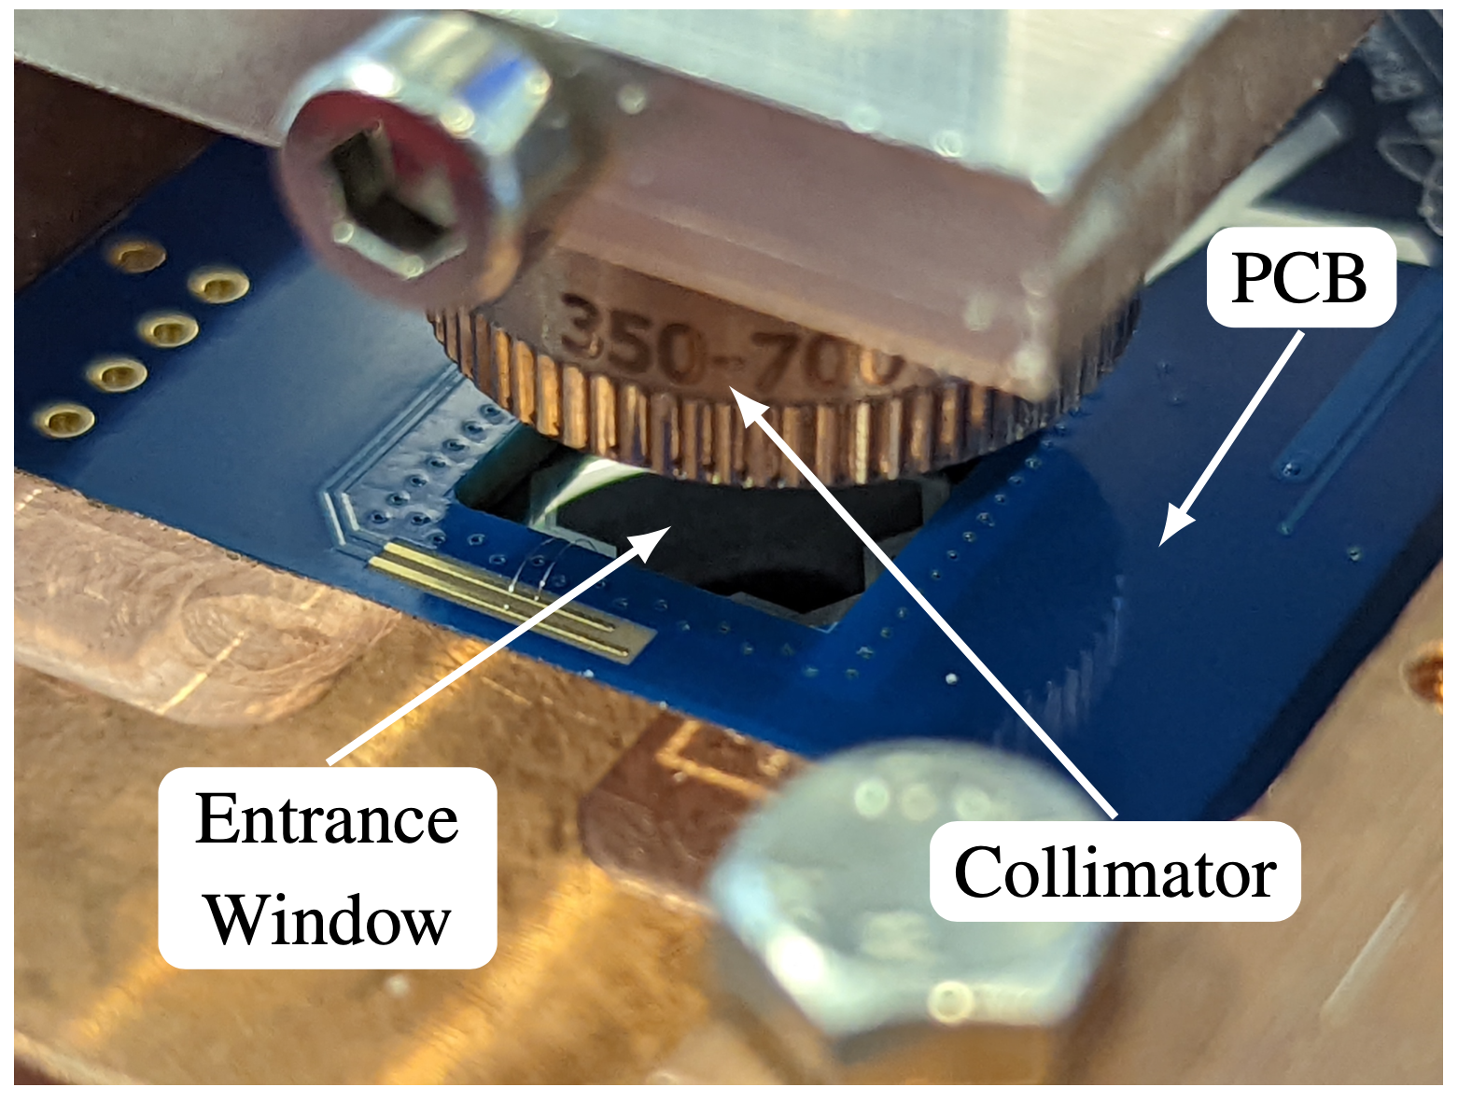
Pulsed Light Source
Laser or LED ( = 630nm)
Interaction in entrance window + small spot size + timing
+
-
+
+
-
+
-
+
-
+
-
+
-
+
-
-
+
-
+
-
+
-
+
-
+
-
+
+
-
+
-
+
-
-
+
+
-
-
-
+
-
X-ray detection
light detection
Motivation
KATRIN + TRISTAN
Detector Characterization
Future Challenges
Notes:
We also wanted to study how the detector signal behaves depending on where the electrons hit the pixel and of course how the charge-sharing between the pixels looks like.
But since focusing the electron beam to a spot size of only a few um is not that easy in a small setup like ours, we chose another route and went for a pulsed light source meaning a laser and an led. Compared to X-rays that interact with the material over a long track as shown here, the photons from our light source of around 630 nm, that’s in the near infrared regime, only have very little energy and so each photon can create an electron-hole pair on its own. This means, that the beam is highly focused and the cloud of created charges is quite small and compact. You can see here the setup with the collimator facing downwards mounted above the detector surface and the beam being focused on the entrance window. The nice thing about a pulsed light source is that one also knows when the light pulse was emitted, so we have the precise timing information on when the charges get created in the detector.

Slide 30
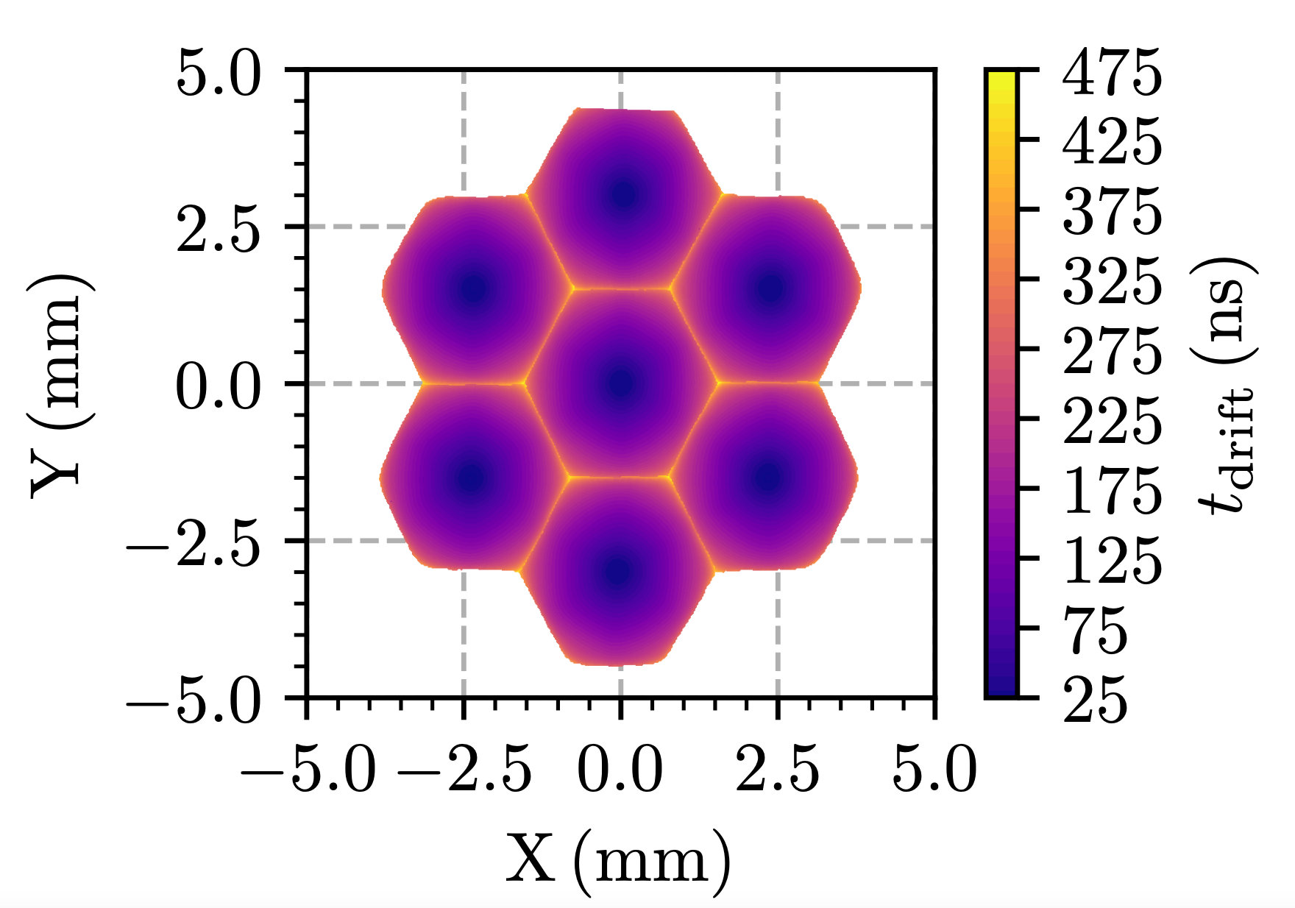
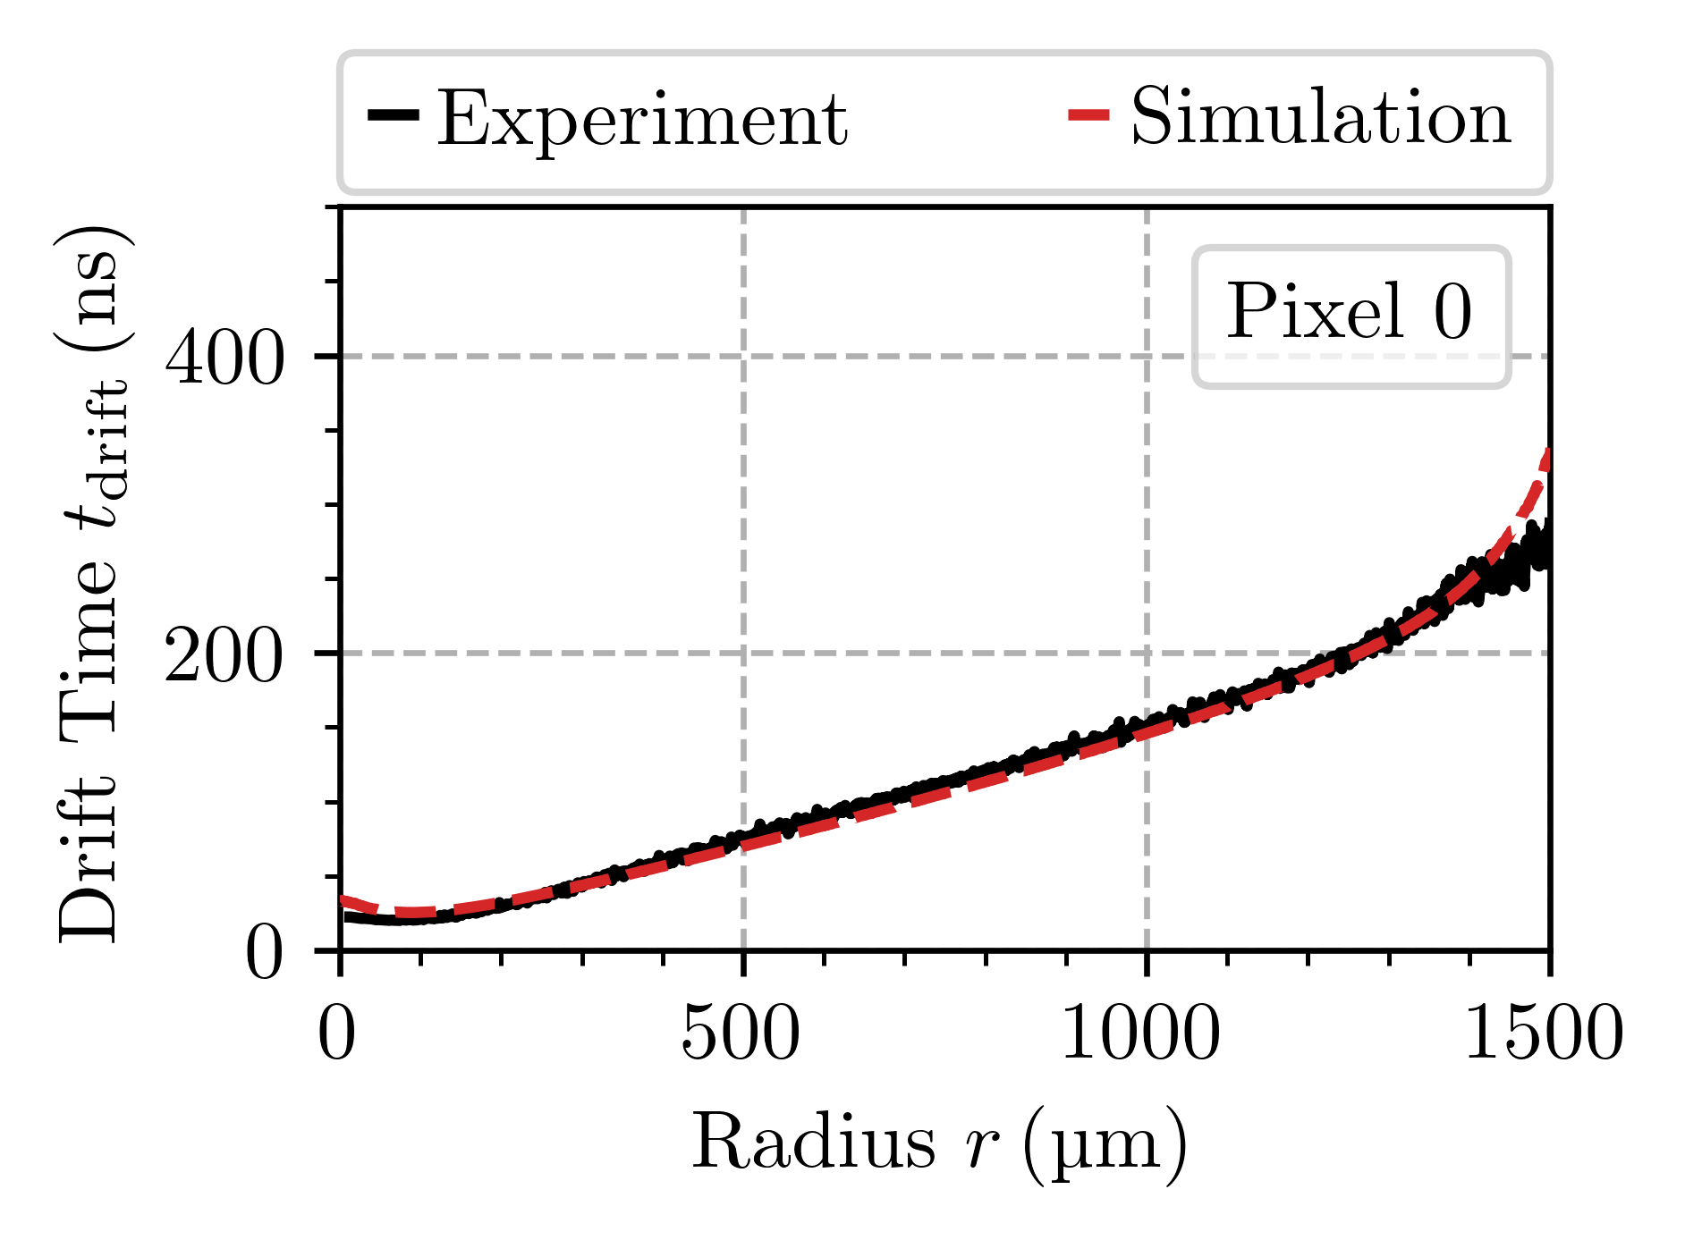
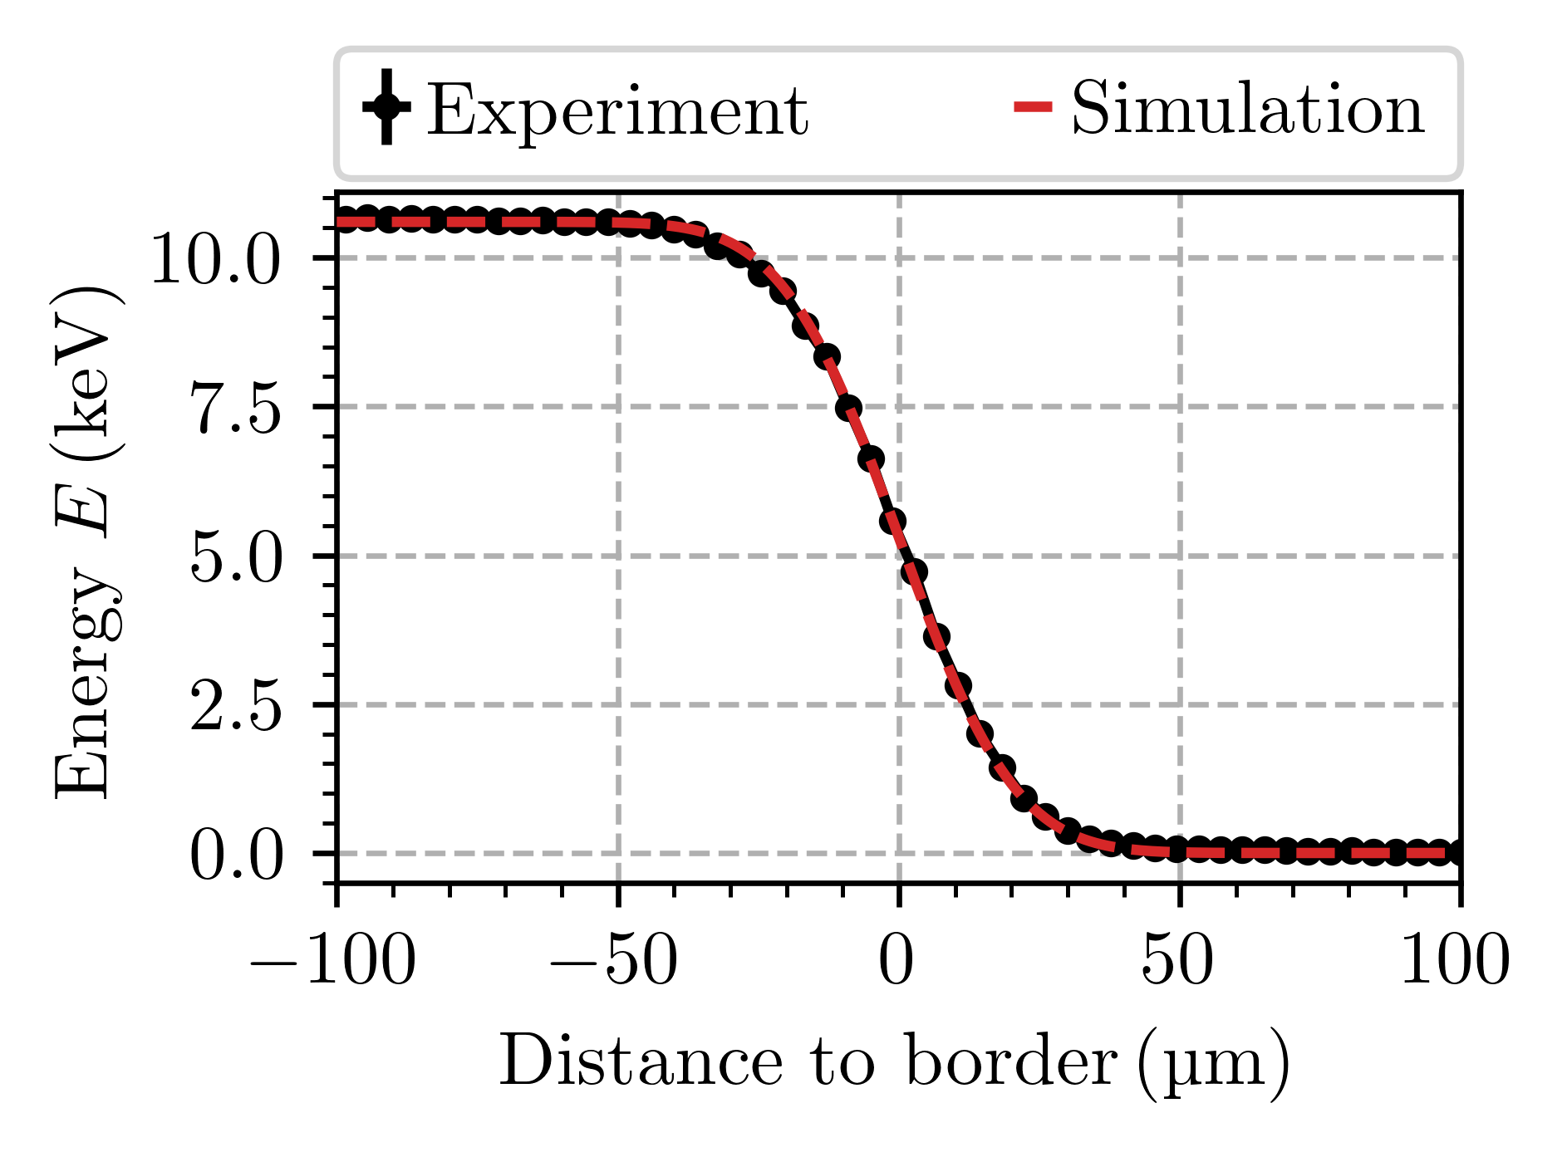
Pulsed Light Source
Good understanding of drift times (incl. diffusion and repulsion)
Good description of charge sharing
C. Forstner et al., arXiv:2409.08901 (2024)
Motivation
KATRIN + TRISTAN
Detector Characterization
Future Challenges
Notes:
And by this, we could investigate the drift of the electrons in the detector volume and behavior at the pixel boundaries.
On the top right, you can see a simulation of a charge cloud being generated exactly at border between two pixels. It is split in half and eventually the electrons are collected at the readout electrode of the respective pixel.
And with a systematic scan over the entire detector surface, we could extract the drift time of the charge cloud, that is the time it takes from being created by the light pulse to being collected, as a function of the pixel radius. And we see, that the experimental data matches quite well the simulation. Also the description of the charge sharing follows the data almost perfectly. The plot shows how much energy gets collected in left pixel depending on the distance to the pixel boundary. And as we get closer to the border from the left to the right, the pixel sees less of the total deposited energy but still something even if the charge cloud is created in the neighbouring one.

Slide 31
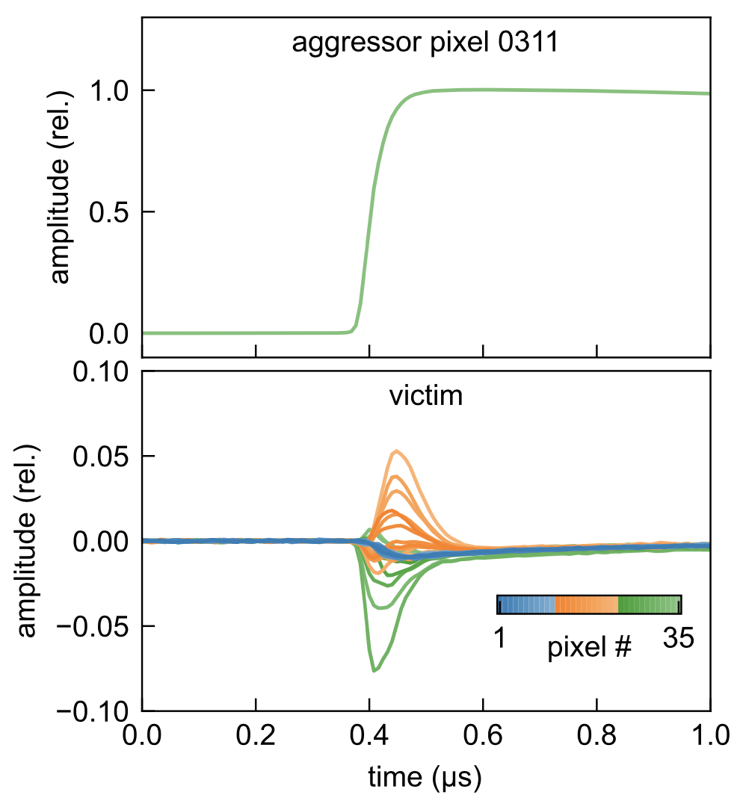
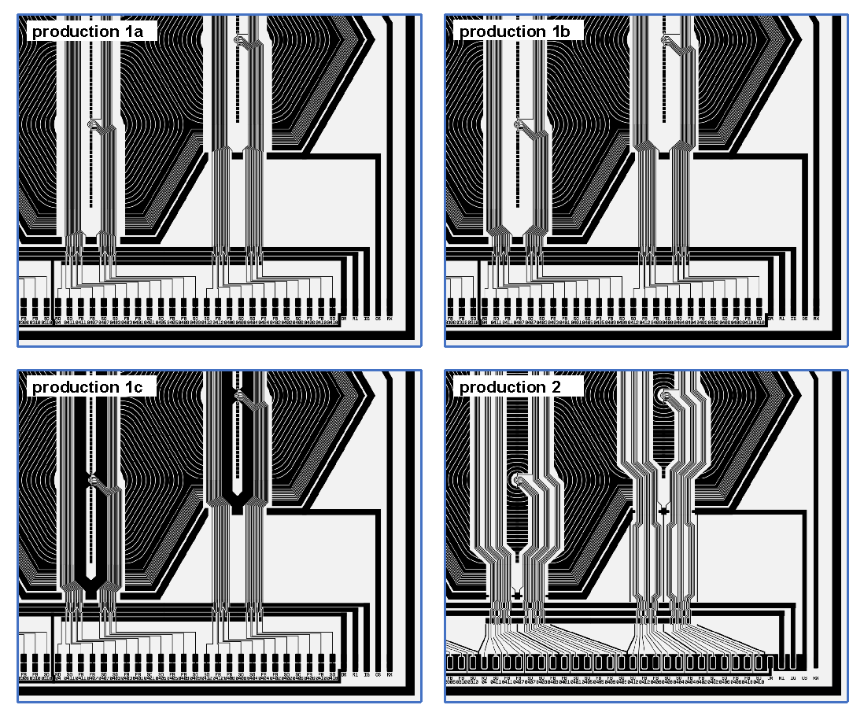
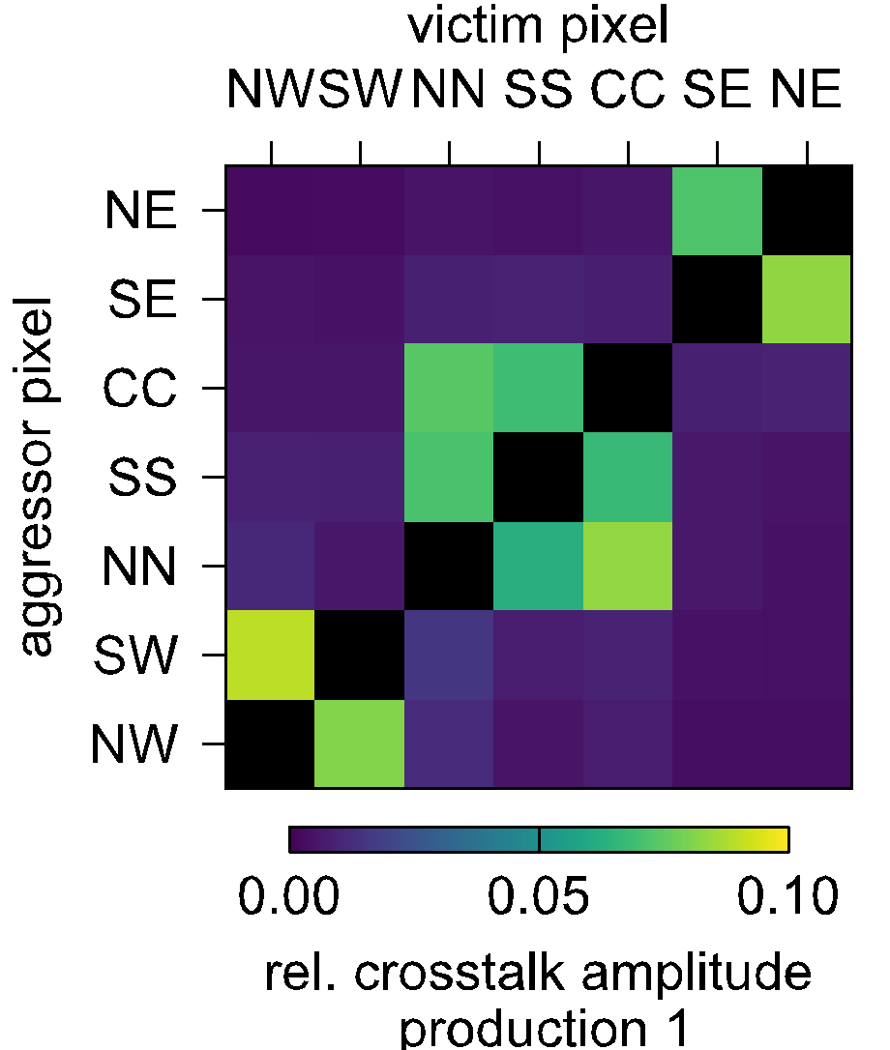
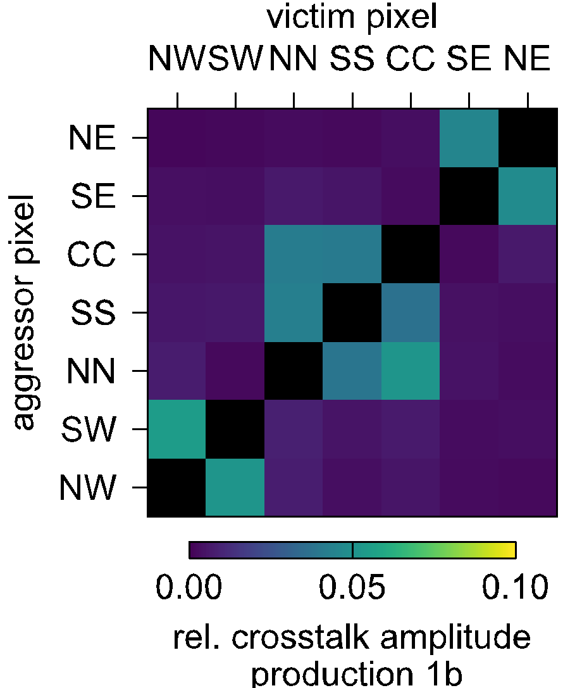
Crosstalk and Layout Modifications
Optimized trace layout to reduce x-talk between pixels
Significant reduction of cross-talk in final production
Lines more narrow and shifted,
additional grounding,
improved bond pad design
Motivation
KATRIN + TRISTAN
Detector Characterization
Future Challenges
Notes:
Another topic was the optimization of the routing layout on the detector chip to reduce the cross-talk between the traces as much as possible. To illustrate this, on the top right a regular signal of an event from the detector is shown. And on the bottom, one sees how this rising edge of the signal causes distortions in other pixels, both in positive as well as negative direction. We can quantify this by measuring the amplitude of the distortions and map it a crosstalk matrix that shows which pixel causes how much distortion on another one. And to minimize this effect, Peter has made modifications to the routing across the different productions.

Slide 32
Crosstalk and Layout Modifications
Optimized trace layout to reduce x-talk between pixels
Significant reduction of cross-talk in final production
Lines more narrow and shifted,
additional grounding,
improved bond pad design
Motivation
KATRIN + TRISTAN
Detector Characterization
Future Challenges
Notes:
You can see some pictures of the modifications that were made. In particular, the lines got more narrow and shifted, there is additional grounding, and at the bond pads region at the bottom edge of the chip was redesigned. And with each iteration, the crosstalk was reduced more and more, and for the final production we now only have a minimal amount left, that we can deal with.

Slide 33
Inner Guard Ring
!
Improved nJFET layout to eliminate charge loss
No more charge-losses observed
V_{IGR} = -15 V
V_{IGR} = -19 V
V_{IGR} = -23 V
M. Kandler, Master Thesis (2024)
Motivation
KATRIN + TRISTAN
Detector Characterization
Future Challenges
Notes:
Another layout optimization was the design of the integrated JFET in the center of each detector pixel that is surrounded by an inner guard ring electrode. This electrode prevents charge loss at the JFET by guiding them around it to the readout anode. On the bottom, you can see the impact of this inner guard ring as a function of its potential. And the more negative the applied voltage is, the more effective the ring is and eliminates charge loss completely.

Slide 34
Radiation Damage
Electron exposure expected from roughly one year of sterile neutrino search in < 10h
Saturation effect after an exposure of ~ 4 months of sterile neutrino search
Damage expected to remain stable
V. Wallner, Master Thesis (2024)
Motivation
KATRIN + TRISTAN
Detector Characterization
Future Challenges
Notes:
Now, let me quickly say some words on the future challenges that we might face with the TRISTAN detector when it is installed at KIT.
In her master thesis, Verena investigated if the electron exposure during the sterile neutrino search would lead to a degradation of the detector performance. Since the sterile neutrino search will take about a year, and she cannot wait that long, she decided to expose one half of the detector with electrons that are expected from 1 year measurement period but within only 10 hours. This should not affect the results but be kept in mind for the future. For the illuminated pixels she saw a significant change in the peak shape compared to the non-illuminated ones. The monoenergetic peak was broadened and shifted to lower energies. This hints towards damage in the silicon oxide transition layer that is between the well formed silicon di-oxide on the detector surface and the silicon bulk. After an exposure of about 4 months of sterile neutrino search, the changes due to the damage begin to saturate and are expected to remain stable over time. At the moment, we are thinking of having a burn-in phase before the start of the measurement runs so we could avoid to model a dependent change of the detector response.
Note: radiation damage topic mentioned/discussed in talk by Sascha Epp → laser annealing; IR laser heats detector volume (temperatures needed? max. temp for glue? scan how fast to avoid cracking due to thermal expansions etc.? how to scan over detector?); they illuminated from behind because there is aluminum in the front

Slide 35
Simultaneous Operation of multiple Detector Modules
^{83m}Kr spectrum
First successful operation of three detector modules with commercial system
Now: Development of custom read-out electronics
Early functional tests already in progress
Motivation
KATRIN + TRISTAN
Detector Characterization
Future Challenges
Notes:
And finally, as we want to operate not only 1 but 9 detector modules at the same time, the development of custom readout electronics has started and early functional tests are already in progress. You can see here a picture of one of the digitizer boards that will be mounted directly on the vacuum flange, but is here connected to a test box with a detector inside.
For the very first tests, where we operated 3 modules simultaneously we still used a commercial system to obtain a Kr spectrum that you can see here on the right, but that was quite the cable spaghetti.

Slide 36
Conclusion and Outlook
SDD technology will be used for high-statistic electron spectroscopy
TRISTAN detector will consist of ~1500 pixels → largest SDD focal plane array ever operated
Extensive detector characterization program
Proof of concept in Replica setup with three modules operated simultaneously
Production of final detector modules started → delivery to KIT expected end of 2025

Slide 37
Thanks for your attention!

Slide 38
Special thanks to everyone at HLL helping with the detector production and letting us characterize our detectors in their lab!
Peter Lechner
Laci Andricek
Danilo Mießner
Christopher Roth
and many more!

Slide 39
Backup

Slide 40
New KATRIN result
Science388 (2025)
DOI:10.1126/science.adq9592
Motivation
KATRIN + TRISTAN
Detector Characterization
Future Challenges
Notes:
Just one month ago the KATRIN collaboration released a new result, based on the first 5 measurement campaigns. You can see here the corresponding integral beta spectra, which we fit simultanously with our theoretical prediction. We obtain an excellent fit quality and a best fit at, slightly in the negative region. This translates then in a new upper limit of 0.45 eV, which is almost a factor of 2 improvmeent with respect to our previous data release.

Slide 41
Detector Section Setup
detector (3x3 166-px modules)
getter pumps
DAQ back-end
slow control units
feedthrough chamber (3600 lines) on HV
superconducting magnet (B < 4.5T)
DAQ cards
calibration chamber with air coils
UHV pumping system (p < 10⁻⁹ mbar w/o outgassing load)
cooling pipe (T > -70°C)
post acceleration electrode
Motivation
KATRIN + TRISTAN
Detector Characterization
Future Challenges

Slide 42
Detector Effects in Magnetic Field
Impact on charge collection and charge cloud motion
Spiral drift under the influence of the Lorentz force
Expectation: Increase of drift time and signal rise time
Motivation
KATRIN + TRISTAN
Detector Characterization
Future Challenges

Slide 43
Modelling and Analysis
Many systematic effects to be considered:
Background: surface radioimpurities, …
Tritium Source: density, distribution, …
Electromagnetic field design: electron trapping, (back-)scattering, (back-)reflection, …
Detector: resolution, dead layer, charge sharing, …
Read-out: pile-up, linearity, noise, …
Approaches to model the data:
Response matrices
Monte Carlo method
Neural Networks
Fränkle et al., 10.1016/j.astropartphys.2022.102686 (2022)
TRISTAN group, Conceptual Design Report: KATRIN with TRISTAN modules (2021)
M. Descher, PhD Thesis (2024)
L. Laschinger, Master Thesis (2024)
L. Fallböhmer, Master Thesis (2024)
Motivation
KATRIN + TRISTAN
Detector Characterization
Future Challenges
Notes:
A promising candidate is Rydberg atoms created from 𝛼-decays in the spectrometer walls by sputtering processes. Low-energy electrons are produced through ionization of those highly excited atoms in the magnetic flux volume. The energy of photons from the thermal radiation of the walls at room temperature is sufficient to ionize some of the Rydberg atoms.

Slide 44
2 m

