Slide 1
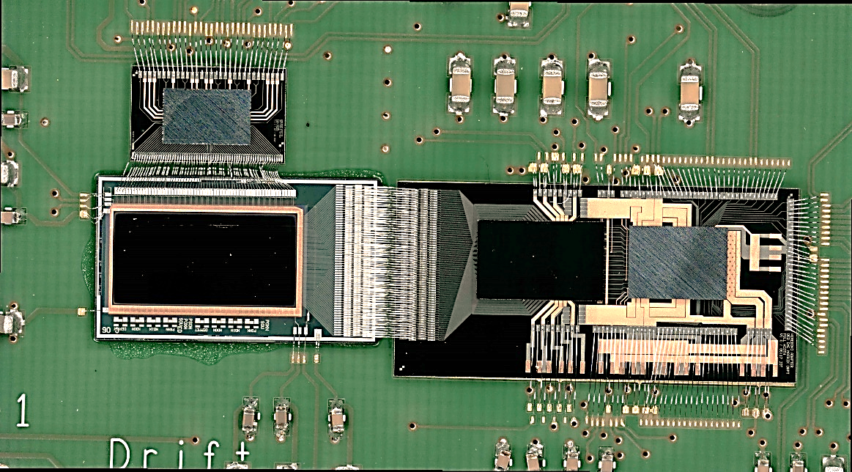
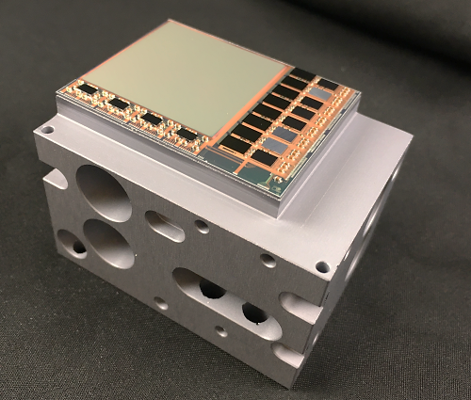
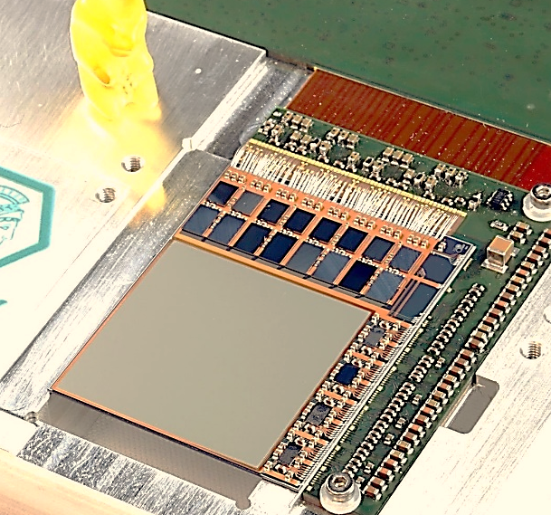
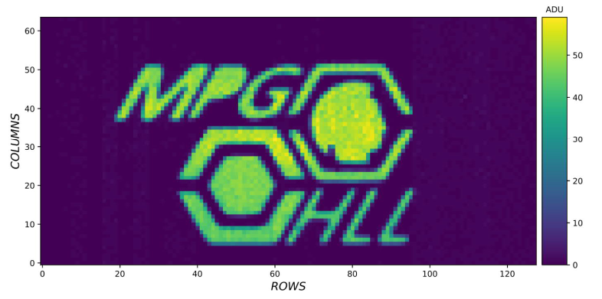
The EDET instrument
Concept and status
2nd Workshop on Silicon Sensors for Radiation Detection
and Quantum Applications
Berg, 12.05.2025

Slide 2
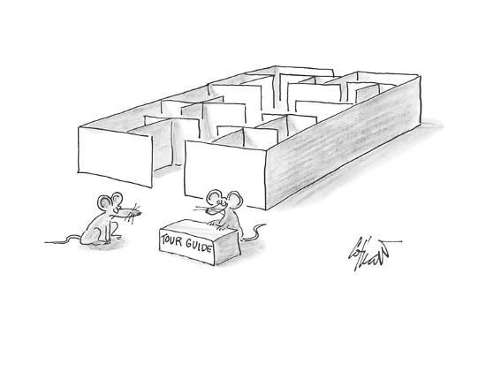
Contents
Concept of the EDET instrument
EDET detectors
The focal plane assembly
Quadrant modules
The EDET system
Status & outlook

Slide 3

EDET DH80K
1 MPixel direct hit electron detector with 80 kHz framerate
Applying the principle of stroboscopic imaging in the TEM world to enable measurements with extremely high time resolution
J. Treis, L. Andricek, M. Hensel, C. Koffmane, J. Ninkovic, M. Polovykh, M. Predikaka, E. Prinker, R. Richter, M. Rizwan, T. Selle, A. Vostrukhin
MPG Semiconductor Laboratory
S. Epp, D. Gitaric
MPSD Hamburg
I. Peric
KIT Karlsruhe
T. Hemperek, H. Krüger
Bonn University

Slide 4


Application
"Normal" imaging:
Continuous illumination w/ fixed intensity
Exposure "gated" by shutter
Exposure time defines image contrast
Tradeoff: Image contrast vs. motion blur vs. exposure time
"Stroboscopic" imaging:
Short, discrete illumination w/ high intensity („Flashbulb“)
Exposure „gated“ by pulse duration
Pulse intensity defines image contrast
Exposure time, image contrast and motion blur decoupled
In both cases the exposure time determines the impact of motion blur!

Slide 5
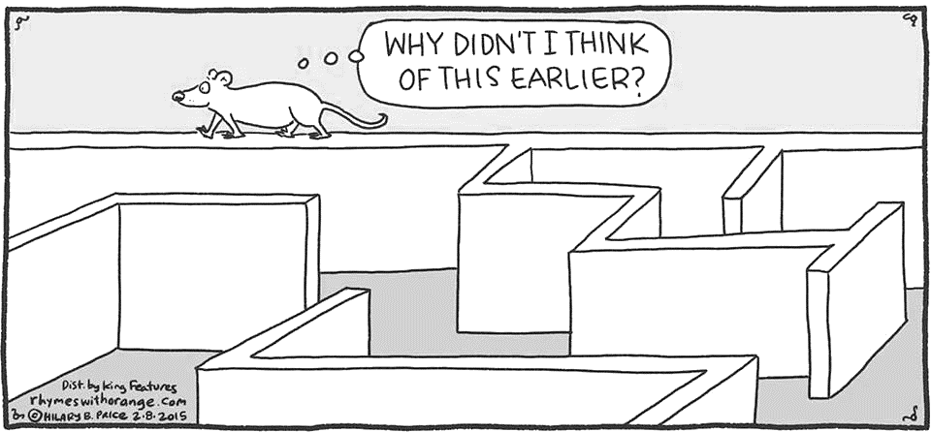
Application
Two ingredients:
What this talk is about
High-Intensity, short pulse length electron „flashbulb“ source for illumination
+
Large, real-space imaging device with high framerate and dynamic range

Slide 6

Requirements
Stroboscopic imaging in TEM world is challenging:
Fast imaging → Direct electron detection
Real space imaging → Large sensitive area
High intensity → High dynamic range
High contrast range → Signal compression in sensor
Direct electron detection → Thin substrate
High pulse frequency → High framerate
"Grey scale" image → No data reduction possible
Small volume → Extremely high integration density

Slide 7
Requirements
Dynamic range
  Single primary electron sensitivity
  Primary electron @ 300 keV on 50 µm Si
  → Distinguish 8k e- from noise
  50 (better 100) primaries per pixel to provide enough contrast
  → 800k signal electrons to be stored in pixel
Operation in vacuum:
  Small volume / extremely compact setup
  Cooling / thermal stabilization difficult
Multiple scattering:
  Thin sensitive detector substrate
  No support layer
  Highly efficient beam dump for traversing electons
  Advanced thermal support
Data rate
  Max. burst frequency 100 Hz ( 50 frames each)
  Digitization with 8 bit resolution
    Tile module data rate 1.28 GByte/s gross
    Total data rate ~ 6.4 GByte/s gross
    Data reduction / zero suppression difficult

Slide 8
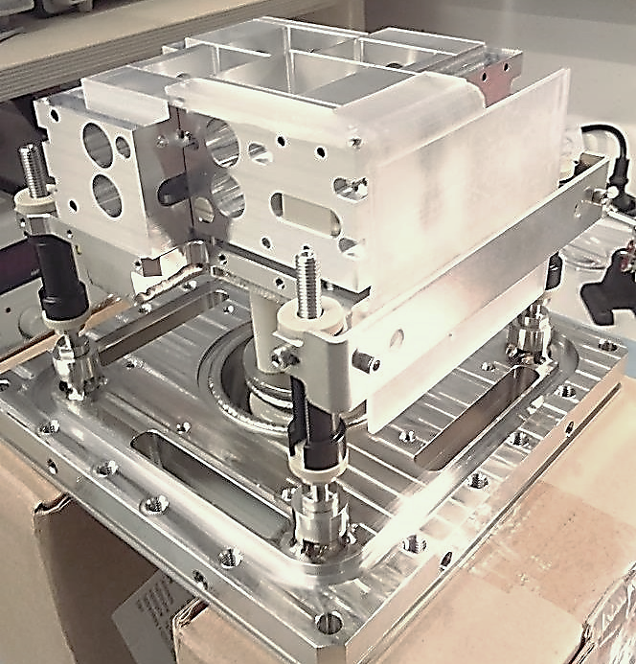

Focal plane assembly (FPA)
Focal plane
  Consists of four quadrant modules on a common baseplate / heatsink
  Must fit inside vacuum vessel
  Individual vacuum feedthrough for each module
  Vacuum compatible, non-magnetic materials

Slide 9
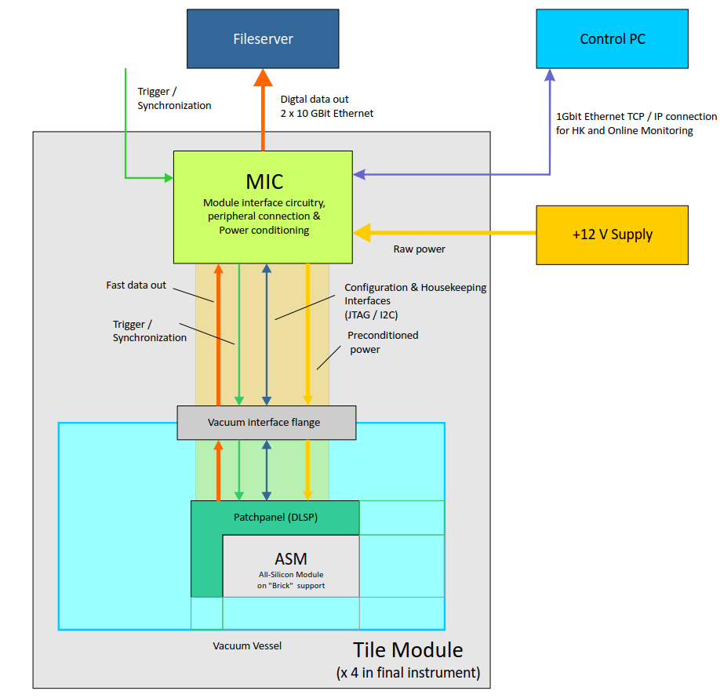
Module structure
Quadrant module
  Capable of stand-alone operation
  Individual supply and bias generators
  Individual control, sequencing and DAQ components
  Module operates either autonomously or synchronized with the other modules

Slide 10
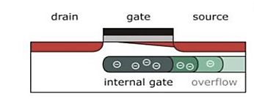
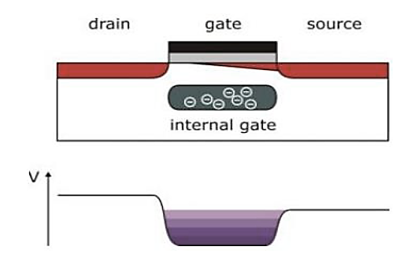
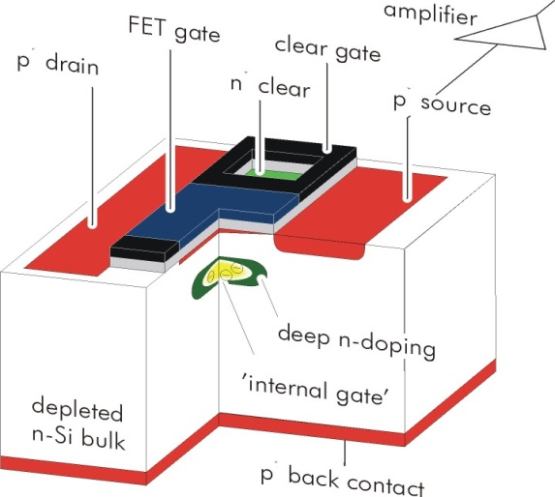


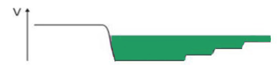
Pixel matrix
DEPFET integrated amplifier
p-channel FET on depleted n-bulk
Signal charge collected in potential minimum below FET channel
"Internal gate", low capacitance & noise
FET current modulation ≥ 300 pA/el.
Reset via clearFET
Charge storage
Readout on demand
Rolling shutter mode
EDET pixels:
Dynamic range problem
Implement signal compression in pixel
Overflow to source to tailor dynamic range

Slide 11
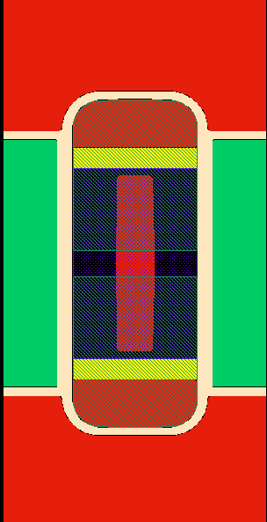
Pixel Matrix
Drift
DEPFET Gate
(ext + int)
EDET pixels:
Variant of the BELLE vertex detector pixel layout
AC coupled cleargate
Pixel „couples“ (North & South pixel sharing a (global) common source and both clear and cleargate contacts)
Drain contacts use for readout
Peripheral interconnects provide for common gate contact
Drain based current readout w/ individual drain contacts for couple partners
Organized in 512 topological rows of 512 couples per row embedded in drift grid
Drain
Cleargate
Clear
Source
contact
Overflow
regions
Each pair of rows shares common Gate and Clear contact
Electrical row w/ 2048 drain contacts
4- fold column parallel drain based current readout
Topological matrix size: 512 rows x 512 columns
Electrical matrix size: 128 rows x 2048 columns

Slide 12
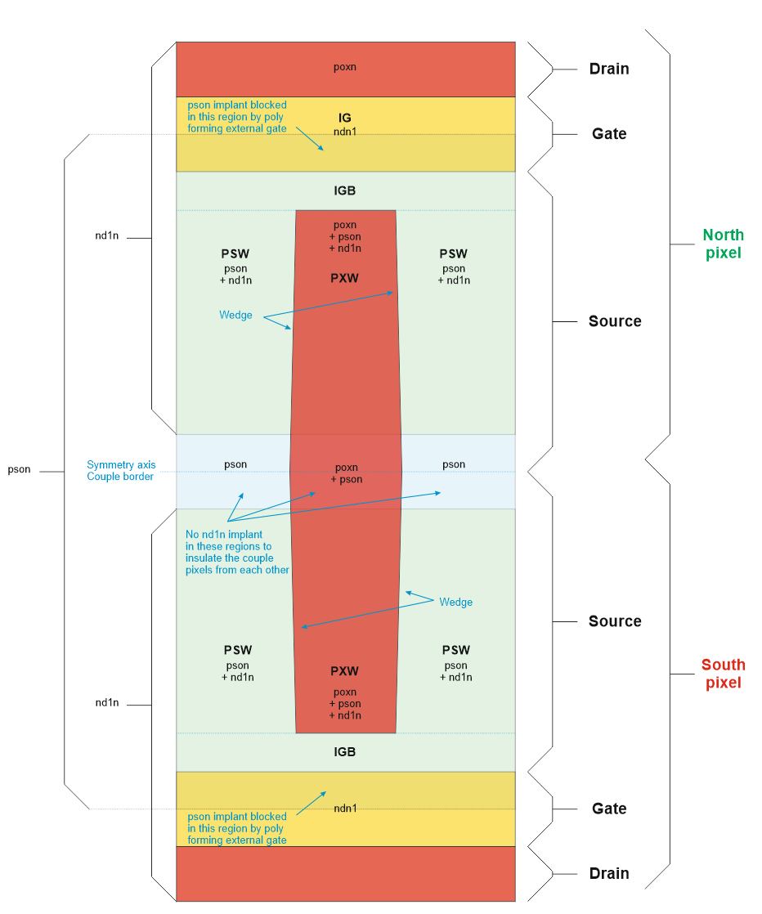
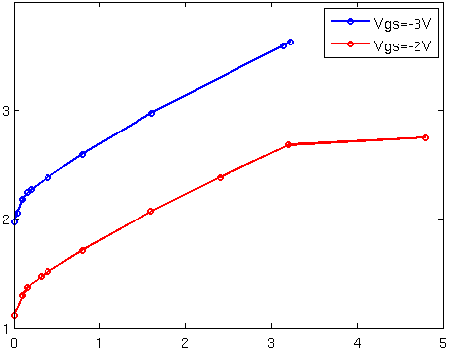
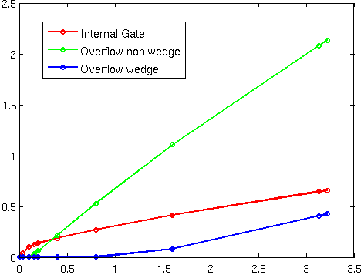
Pixel Matrix
Response curve (V_{DS} = -5 V)
Secondary
"Kink„?
Emission over CG barrier
Drain current (100 µA)
CHC limit
Primary OF "Kink"
Signal charge (Me⁻)
Charge distribution (VGS = -3 V, VDS = -5 V)
Couple spillover
OV1
Signal charge (Me⁻)
IG
OV2
Signal charge (Me⁻)

Slide 13
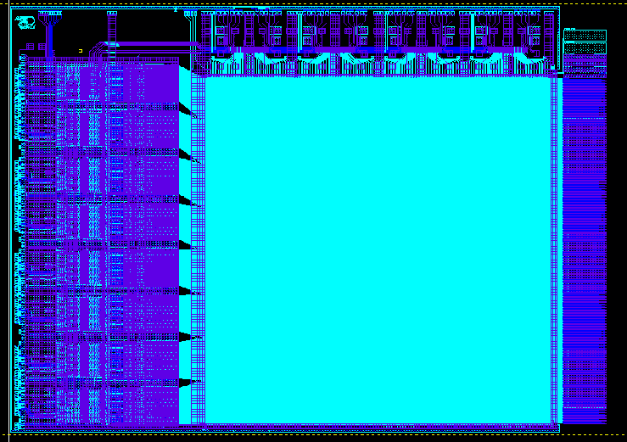
Detector All-SIlicon Module (ASM)
JTAG
DCD array
(EDET specific DCD-E)
Bias contacts
Bondpads for Switchers
DMC array
Switcher Bank
Test pads
(removed after
met. 1 testing)
Pixel array
30.7 x 30. 7 mm²
^{Thin material, 30 -50 µm}
Topological size: 512 x 512 pixels
Electrical size: 128 x 2048 pixels
Bondpads
for DCD / DMC
data & supplies
Chip size
~ 50 x 38 mm²

Slide 14
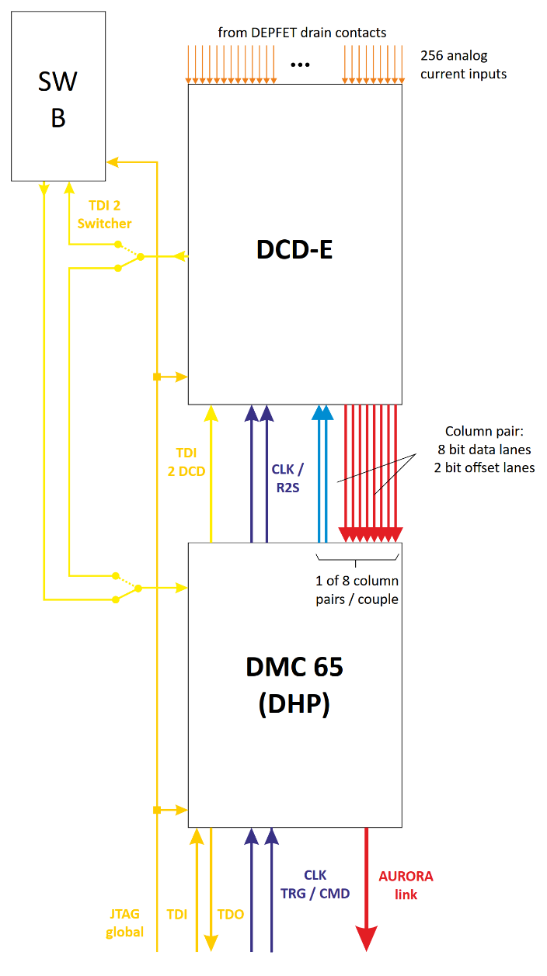
ASM Periphery
Direct Current Digitizer (DCD-E)
  UMC 130 nm technology
  256 channels read in parallel
  8 bit digitization, 100 ns conversion
  64 parallel data output links @ 320 MBit/s
100 ns x 128 (el.) rows = 12.8 µs (78.125 kHz)
Only for first couple
Advanced sequencing capabilities (windowing)
DEPFET Movie Chip 65 nm (DMC 65)
  TSMC 65 nm technology
  Data FIFO, serializer & pattern generator for all DCDs and Switchers
  Controlled by single TRG / CMD signal stream
  Fast data transfer to periphery using 1.6 GBit AURORA link
Switcher-B:
  AMS H18 HV technology
  Controller IC, 32 channels
  Each channel driving gate and clear lines of 4 ASM pixel matrix rows in parallel
  4 Switchers in total
Buffer memory for 50 frames
Front-end ASIC „couple“

Slide 15
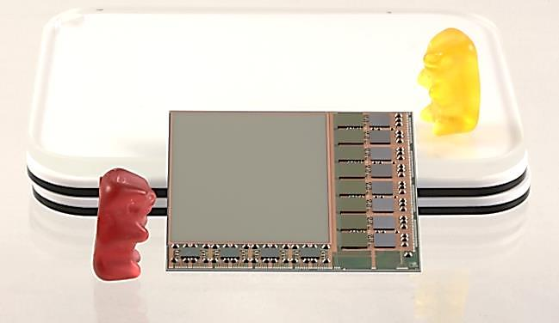
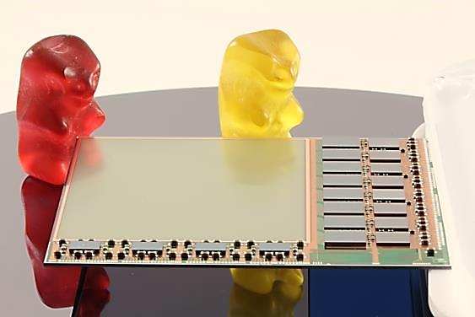
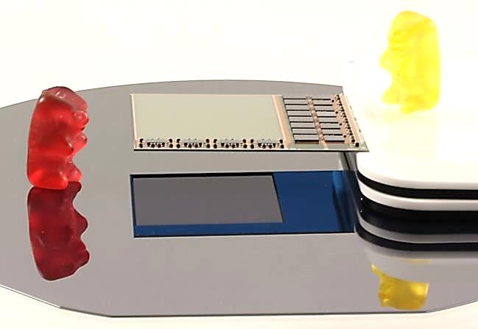
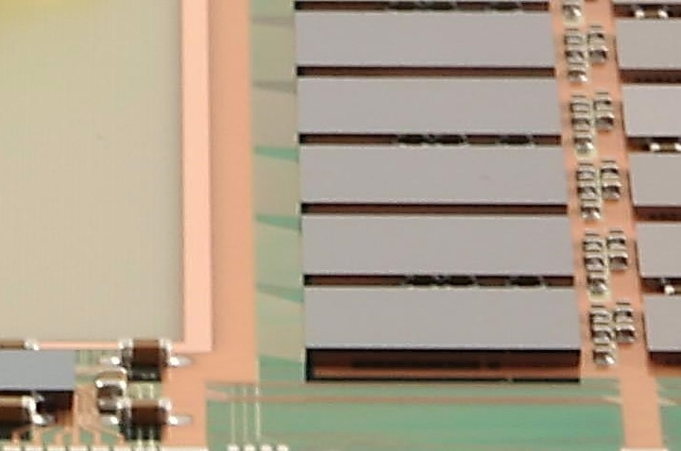
ASM

Slide 16
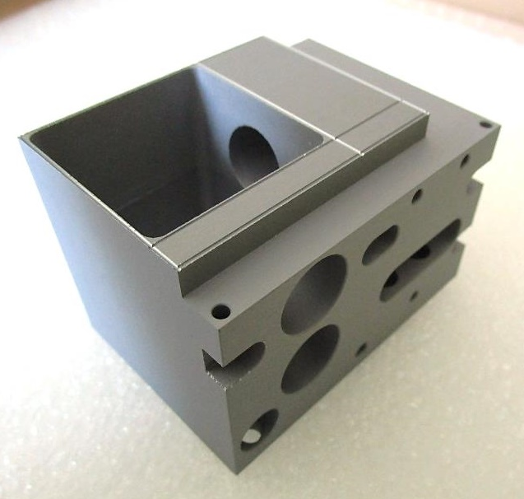
BRICK support
Beam dump
„Base Rigid Interface and Cooling linK“:
Mechanical support
Thermal interface
Beam dump
Venting holes
Cutouts for mounting fixtures

Slide 17
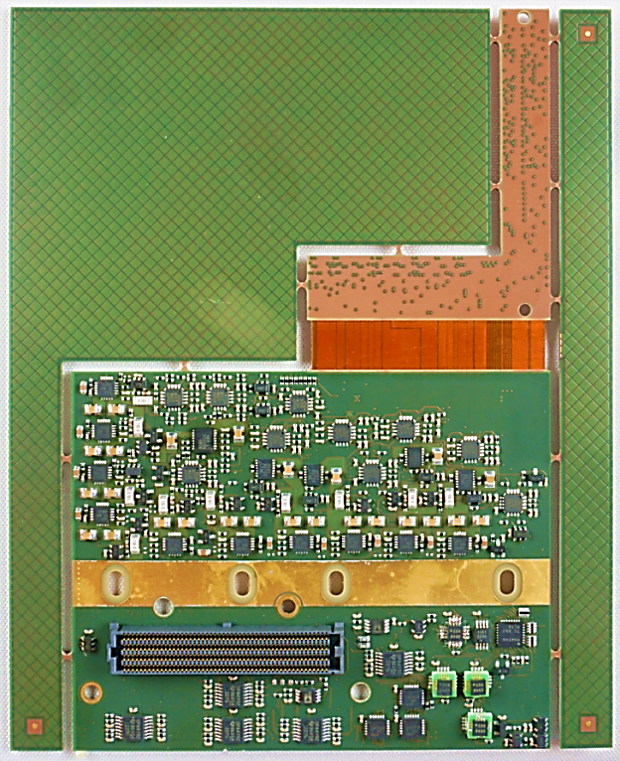
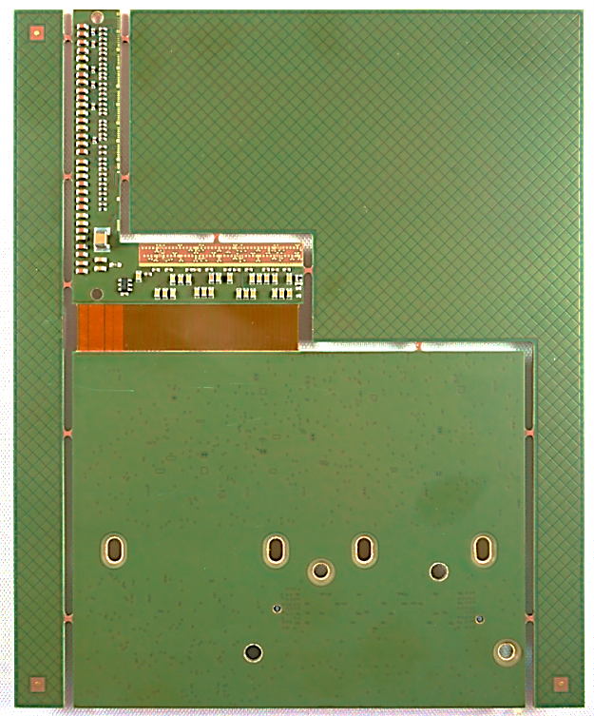
DLSP
„Double L-Shaped Patchpanel“:
Local power condinioning
HI and LO side sensing for ASIC voltages
Voltage feedback for ground level shift
Housekeeping
„Upper“ L
„Lower“ L
Flex part for 90° bend
Thermal interface
Connector to DLSP bracket of VIC

Slide 18
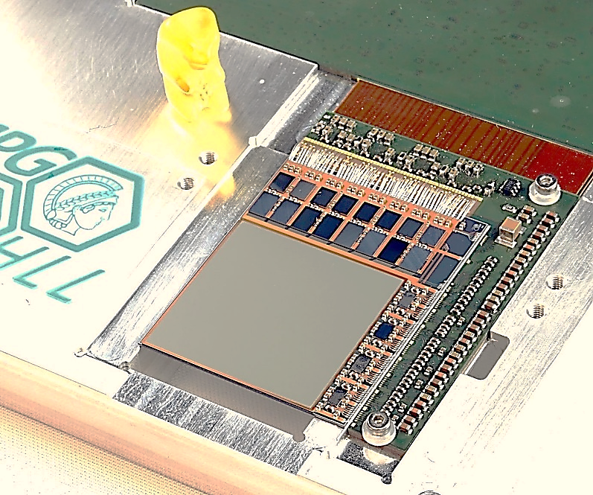
EMCM
„Electrical Multi-Chip Module“:
Electrical (and partially also mechanical) mockup of detector module
Test of circuitry and interconnectivity
„Dummy“ for development of system control and DAQ software

Slide 19
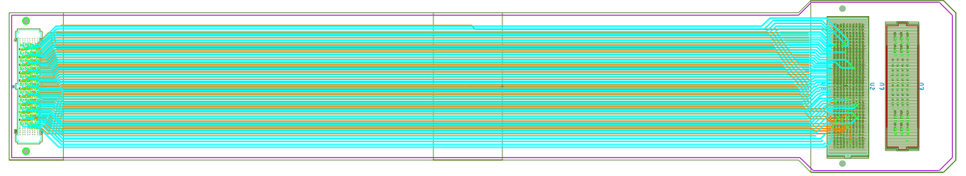
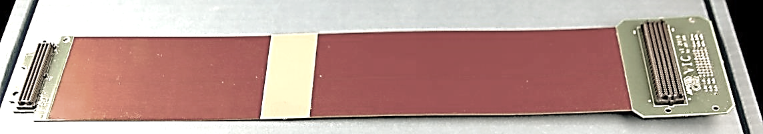
VIC
FR4 face for vacuum flange attachment
DLSP bracket
„Vacuum Interlink Circuit“
MIC bracket

Slide 20
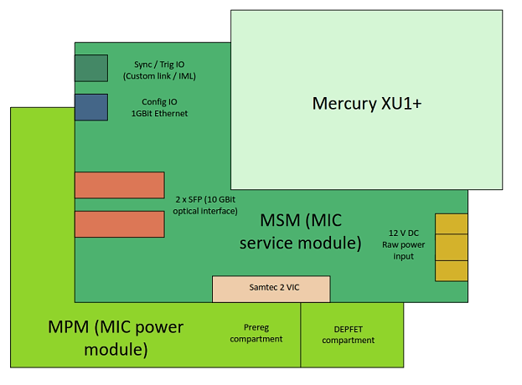
MIC
„Module Interface Circuit“:
Stack of 3 components:
  MSM
  MPM(S)
  MBM
Contains all necessary peripheral circuitry for standalone module operation
MSM bracket of VIC enters between MPM(S) and MSM
(MBM – MIC Brain Module)

Slide 21
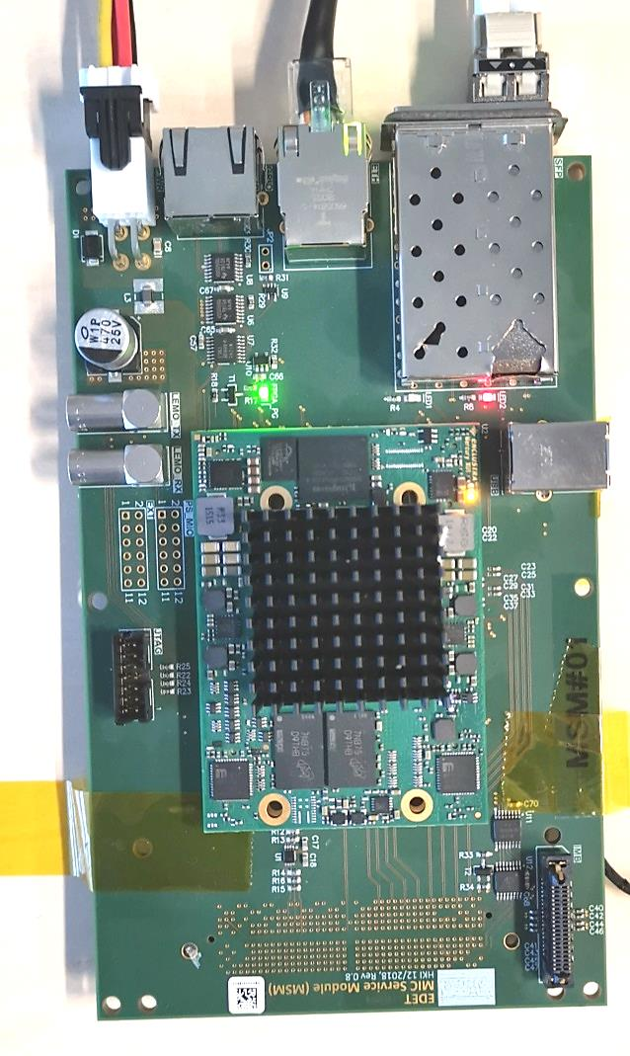
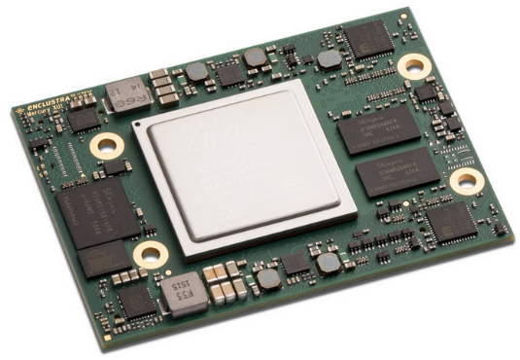
MSM / MBM
USB-C (unused)
IML connector
„MIC Brain Module“:
aka XU1
Commecially available unit with
  ZYNQ SoC
  Memory
  Peripheral PHYs
  Supply generators
Main system control component
„MIC Service Module“:
Support card hosting MBM and all peripheral connectors
Hub for connection of
SFP slots (10 GBit optical Ethernet)
FMC connector to MIC bracket of VIC (below)
GBit Ethernet (TCP/IP for Main com/CFG)
GPIO RJ45
Power supply connector
GPIO LEMOs
Mercury+ XU1 feat. ZYNQ Ultrascale SoC

Slide 22
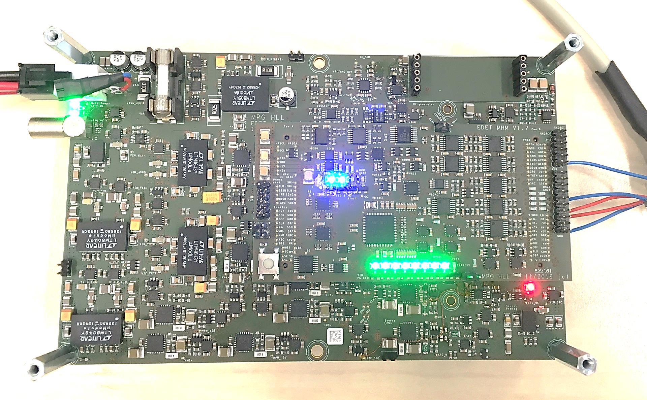
MPM(S) / MPM & MHM
(empty) slot for HV converter
Single 12 V power supply input
„MIC Power Module Stack“:
Generates all power for module and DLSP from single 12 V supply
Stack of two boards:
  MPM (MIC Power module) hosting all regulators and DC/DC converters
  MHM (MIC Housekeeping module) hosting all housekeeping functionality
MPM „light“ baseboard
MHM piggy back (MIC Housekeeping Module)

Slide 23
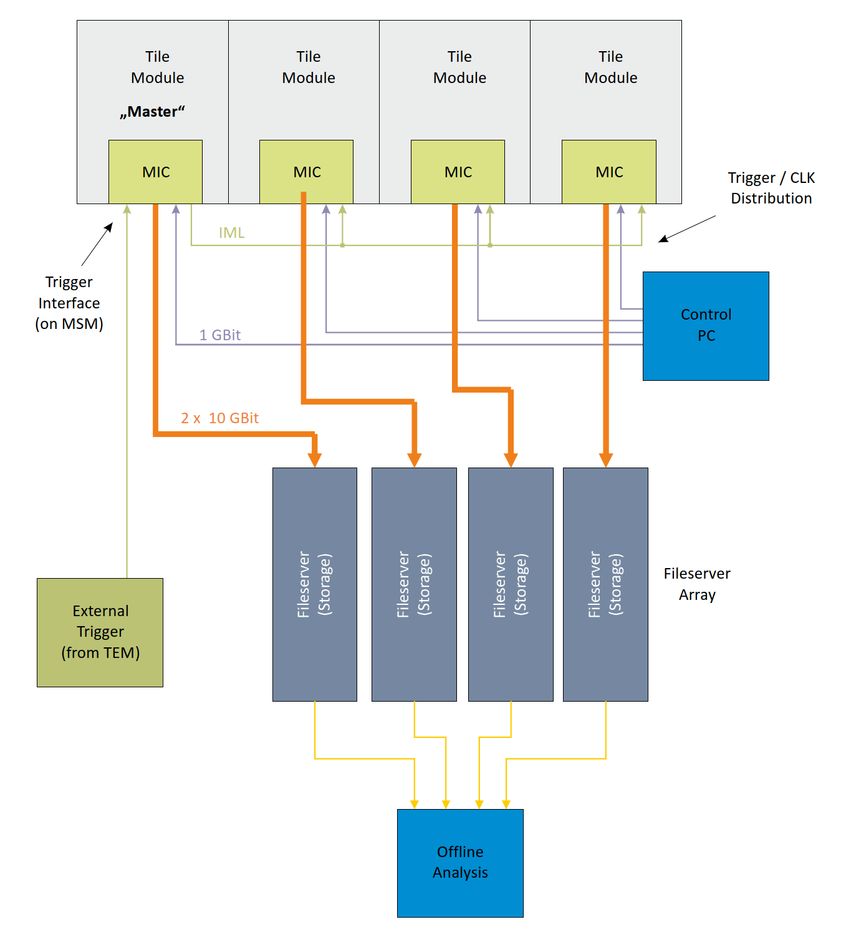
System structure
Full size focal plane assembly
4 independent modules working on standalone basis
Data volume demands individual DAQ servers
Controlled and configured by common control PC
Operation is coodinated by distributing TRG/CMD stream to all modules using dedicated firmware in „Master“ module
Pseudo Master-Slave star topology

Slide 24
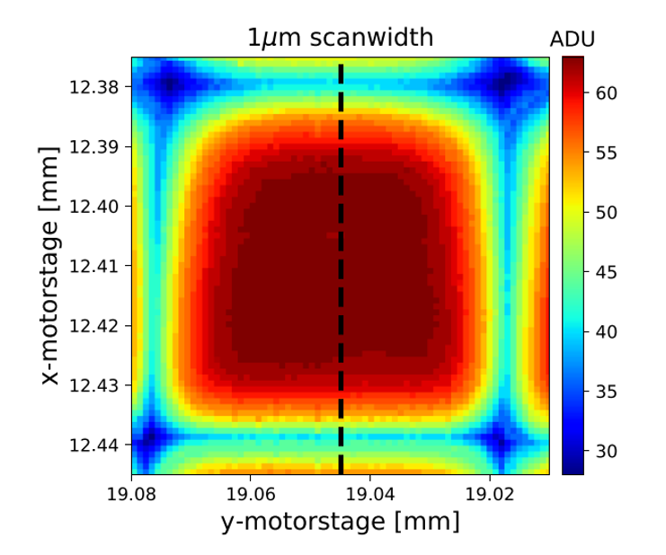
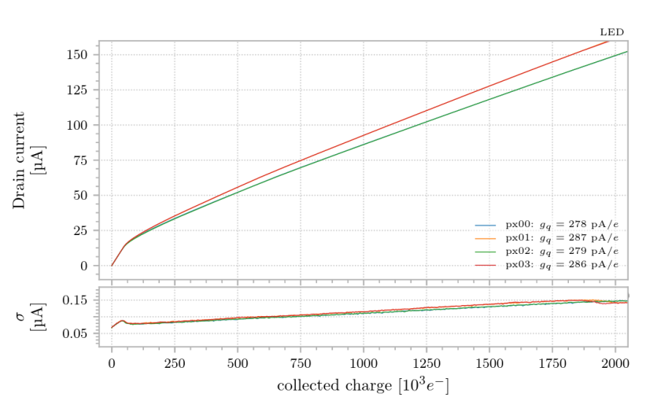
MEasurements

Slide 25
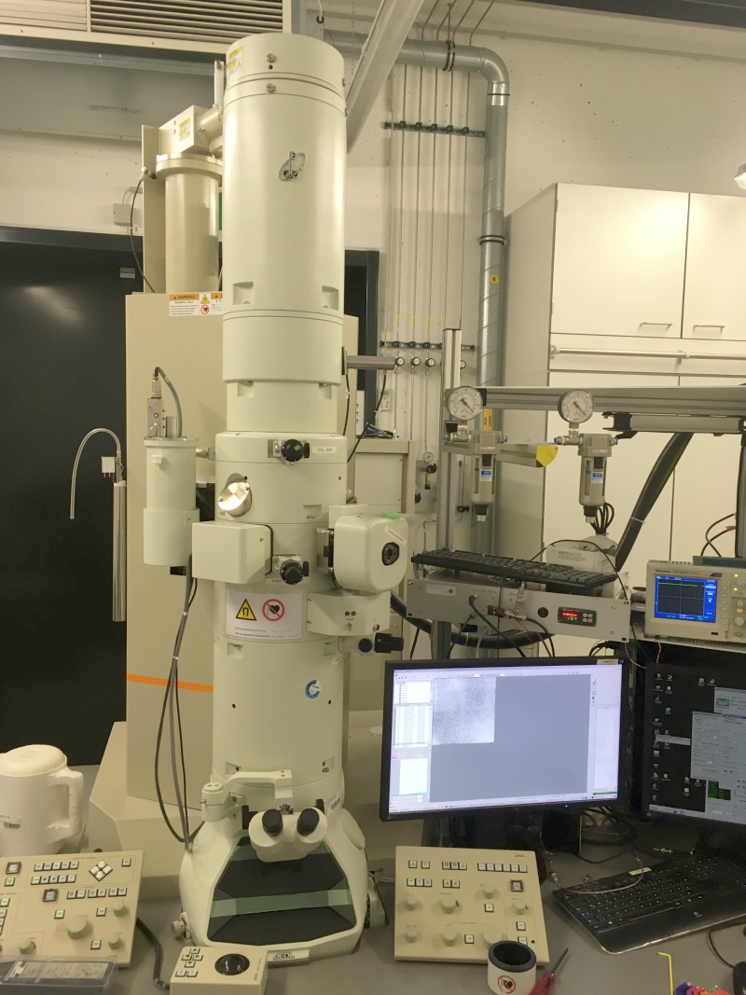
MEasurements at MPSD

Slide 26
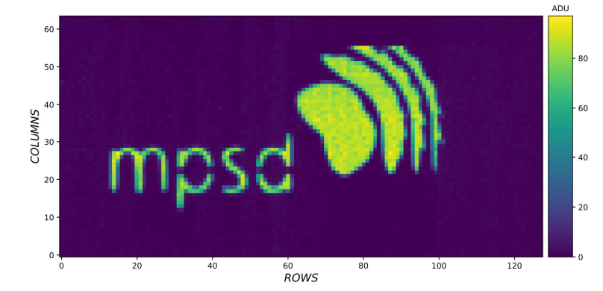
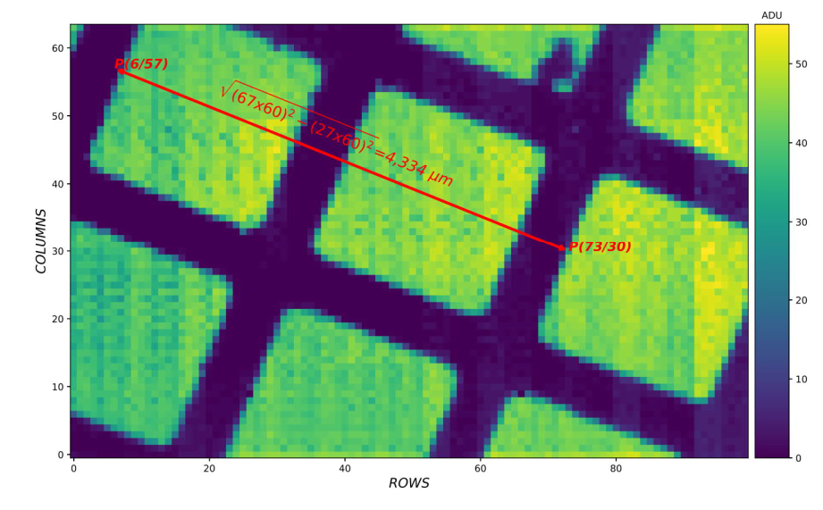
Measurements at MPSD
Logo images taken with a titanium shadow mask.
Calibration mesh with 25 um mesh period (19 um hole, 6 um line width).

Slide 27

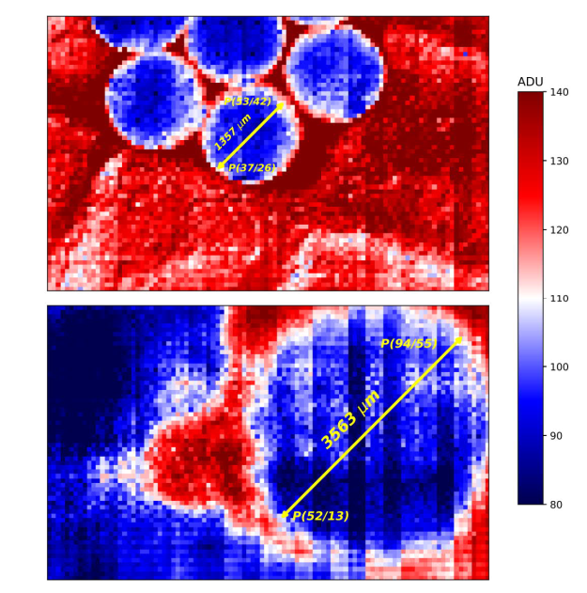
Measurements at MPSD
Images of 261 nm latex spheres for calibration purposes

Slide 28
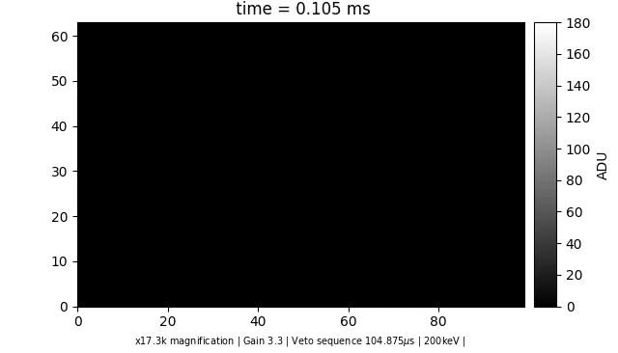

Measurements at MPSD
Electron induced growth of nanoparticle gold:
Framerate 10 kfps
Mesh-like structure is the alumina carrier of the liquid cell
Liquid cell contains chloroauric acid

Slide 29
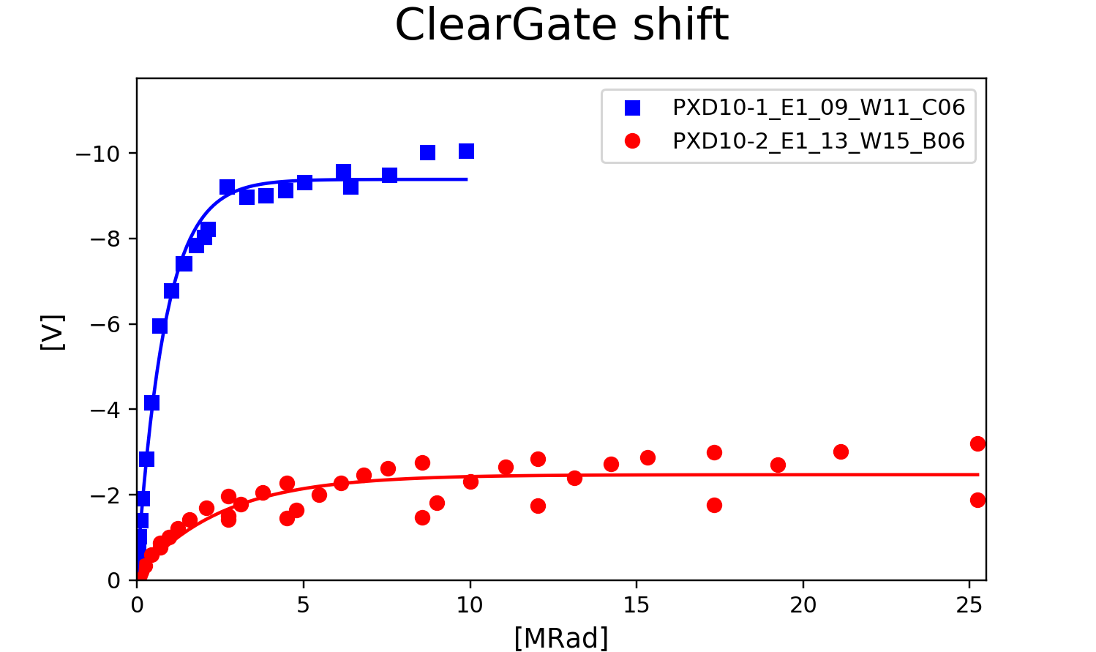
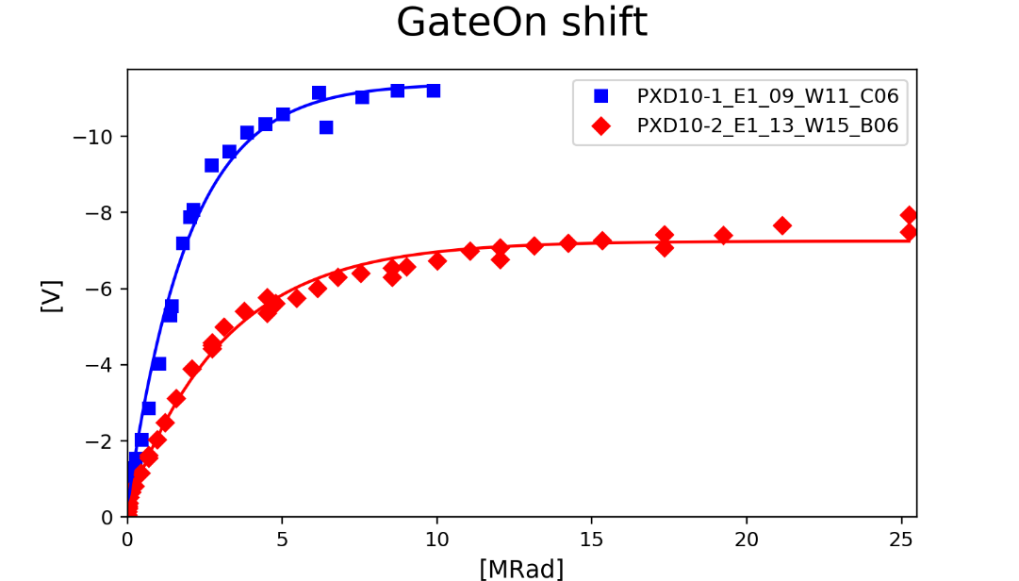
Measurements at MPSD
Overnight annealing
Radiation damage is a big issue for EDET:
Threshold voltage shift for both gate and cleargate during measurement (intensity depending)
Mitigation using voltage adaptions and offset DACs
Inhomogeneities can cause lack of CHC and even insensitive regions over matrix
Using TEM as representative radiation source and dosimeter
PXD-10-2: Technology pathfinder production
Very promising results compared to “standard” BELLE technology:
  Factor of ~ 2 lower shift for Gate
  Factor of ~ 3 for Cleargate

Slide 30

Measurements at MPSD
...nice proof-of-principle measurements, but:
Area of prototype too small for scientifically relevant measurements, in spite of the high framerate
No pulsed electron source yet (required to exploit full potential)
We need a working quadrant module for demonstration measurements and actual science!

Slide 31

Project status & Outlook

Slide 32

Status
Project status before relocation...
Preparations for large module operation were in advanced state
Sufficient stock of ASICs
Complete set of components for small number of large modules available
Some testing and calibration required
Fully populated ASMs (DHP and DMC) available
Next planned step was operation of DHP module with Probecard
Activities suspended due to relocation
...and since relocation...
Mainly focussing on conceptual and theoretical aspects (successful)
Technical problems in the new lab inhibit progress on hardware development
Prototype test setup operational, firmware development can resume
Calibration and Probecard setup were not yet recommissioned
Still no quadrant module operational

Slide 33

Outlook
In progress:
Firmware development of IML / Sequencer IP required to utilize enhanced sequencing capabilities of DMC (implementation)
Develoment and test of configuration data for advanced operation scenarios
Design of test setup to demonstrate sequencing capabilities
Next steps:
Start recomissioning of
  MPMS calibration setup
  Probecard setup for DHP / DMC modules
Prepare benchtop setup for quandrant module
Prepare vacuum setup for quadrant module
Calibration and test of MPMS modules
Qualification of DHP Quadrant modules
Qualification of DMC modules
At present, a reliable timeline cannot be given
Resource planning is difficult
Project needs to regain momentum

Slide 34

Questions?

