Slide 1
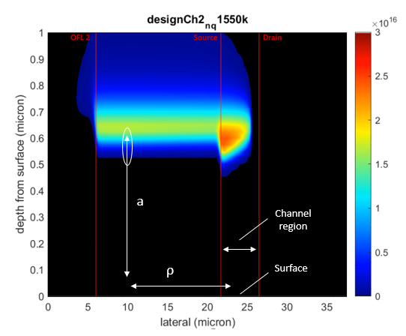
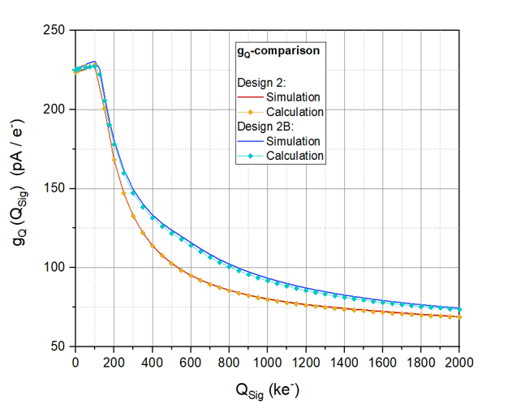
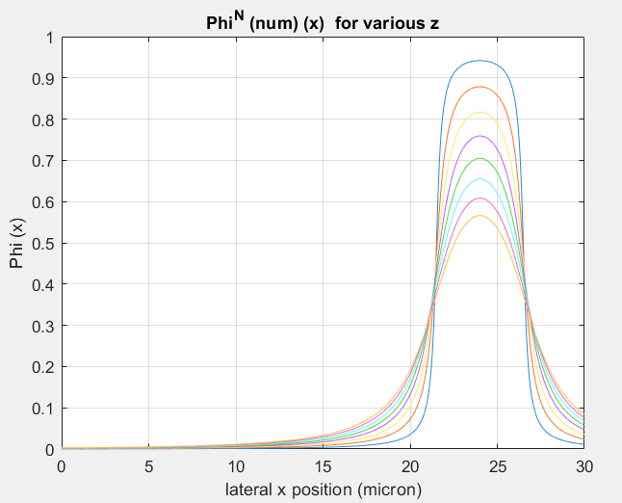
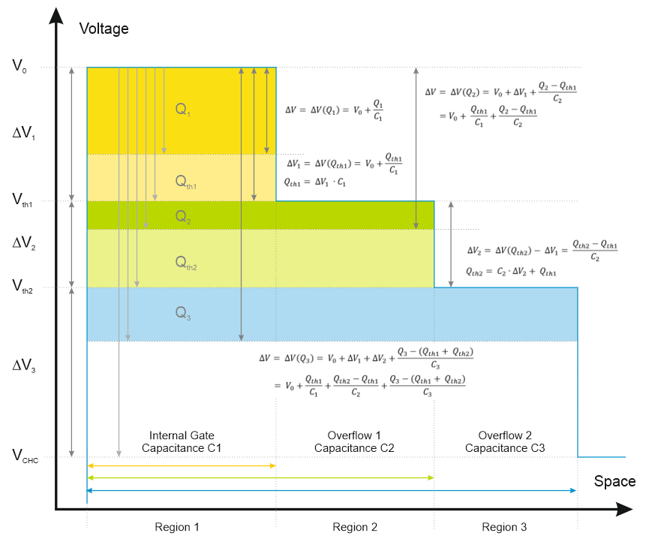
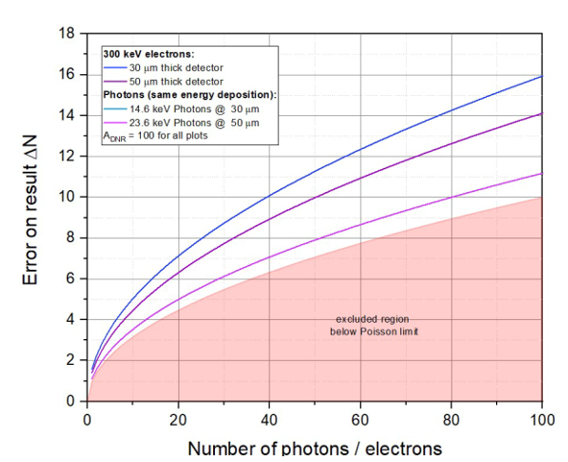
Nonlinear Amplification revisited Insights and modelling
2nd Workshop on Silicon Sensors for Radiation Detection
and Quantum Applications
Berg, 12.05.2025

Slide 2
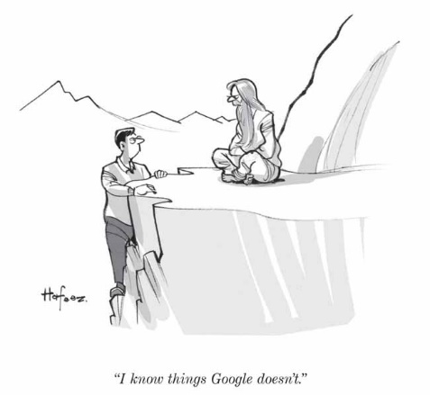
EDET DH80K
1 MPixel direct hit electron detector with 80 kHz framerate
Applying the principle of stroboscopic imaging in the TEM world to enable measurements with extremely high time resolution
J. Treis, L. Andricek, M. Hensel, C. Koffmane, J. Ninkovic, M. Polovykh, M. Predikaka, E. Prinker, R. Richter, M. Rizwan, T. Selle, A. Vostrukhin
MPG Semiconductor Laboratory
S. Epp, D. Gitaric
MPSD Hamburg
I. Peric
KIT Karlsruhe
T. Hemperek, H. Krüger
Bonn University

Slide 3
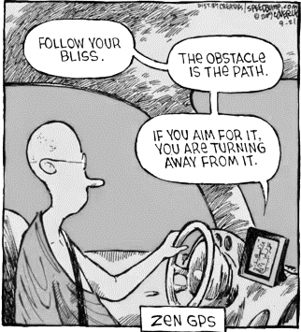
Contents
Nonlinear amplification – why?
Accuracy functions
The DEPFET and NLA
The many g_{q}-s of the DEPFET
Calculating DEPFET g_{q}
Summary & Outlook

Slide 4
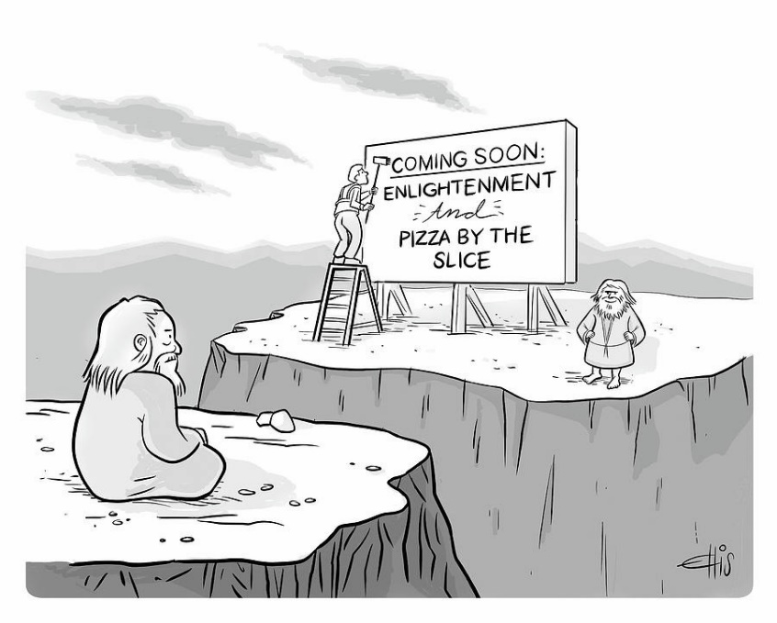
Requirements
Stroboscopic imaging in TEM world is challenging:
Fast imaging → Direct electron detection
Real space imaging → Large sensitive area
High intensity → High dynamic range
High contrast range → Signal compression in sensor
Direct electron detection → Thin substrate
High pulse frequency → High framerate
"Grey scale" image → No data reduction possible
Small volume → Extremely high integration density

Slide 5
Requirements
Translation:
System noise must be significantly lower than minimum signal amplitude $A_{out}\left(S_{Min}\right)>n∙σ$
Dynamic range
Single primary electron sensitivity
Primary electron @ 300 keV on 50 µm Si
→ Distinguish 8k e- from noise
50 (better 100) primaries per pixel to provide enough contrast
→ 800k signal electrons to be stored in pixel
Operation in vacuum:
Small volume / extremely compact setup
Cooling / thermal stabilization difficult
Multiple scattering:
Thin sensitive detector substrate
No support layer
Highly efficient beam dump for traversing electons
Advanced thermal support
Data rate
Max. burst frequency 100 Hz ( 50 frames each)
Digitization with 8 bit resolution
Tile module data rate 1.28 GByte/s gross
Total data rate ~ 6.4 GByte/s gross
Data reduction / zero suppression difficult
Translation:
Amplitude for maximum stimulus must be
smaller than or equal to maximum amplitude
$$A_{out}\left(S_{Max}\right)≤A_{Max}$$

Slide 6
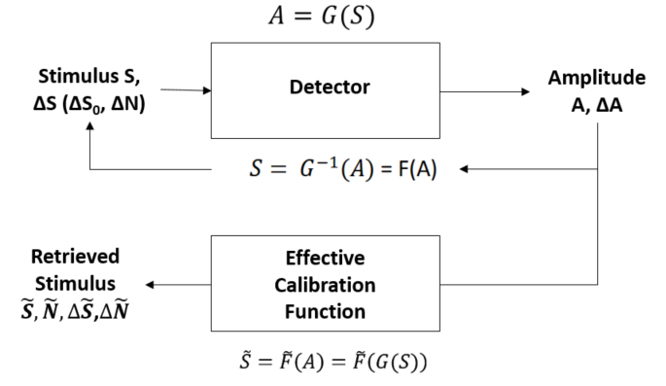
Accuracy function
Needed:
Model tool to investigate interdependence between:
Maximum input signal
Maximum output amplitude
Nature of signal
System gain
System noise
Noise threshold
Minimum detectable signal
... using some simplifications.
Accuracy function
Detector is black box converting a stimulus $S$into an amplitude $A(S)$
Stimulus has variations $(∆S,∆N)$ depending on its nature
Amplitude is limited ($A(S_{Max})≤A_{Max}$) and adds a (constant) noise contribution $∆A$
Stimulus can be recovered using an effective calibration function$\tilde{S}(A)$
Recovered stimulus $\tilde{S},\tilde{N}$ has variation $∆\tilde{N}, ∆\tilde{S}$
Accuracy function describes the error on the reconstructed stimulus as a function of the original stimulus:
$$∆\tilde{N}\left(A\left(N\right)\right),∆\tilde{S}\left(A\left(S\right)\right)$$

Slide 7
Accuracy function
Stimulus:
Total stimulus is sum of N individual quanta (electrons / photons):
Monoenergetic, varying around a common mean stimulus:
For counting applications:
is the signal to be retrieved.
Error given by Fano and „Landau“

Slide 8
Accuracy function
Finding:
Any unspecified gain function
Yields a generalized accuracy function
Offset, AKA
Pedestal, AKA
Black level ....
Needed:
First derivative of the inverse wrt. A
Partial derivatives wrt. S and N
„Valid“ gain function must be:
Invertible, continuous
Derivative of the inverse must exist
Must be (piecewise) differentiable with respect to S and N

Slide 9
Accuracy function
Example 1: Linear gain
Linear gain function „ansatz“:
Linear gain coefficient (from boundary conditions):
Accuracy function:
Using the amplifier dynamic range to noise ratio (A_{DNR}):

Slide 10
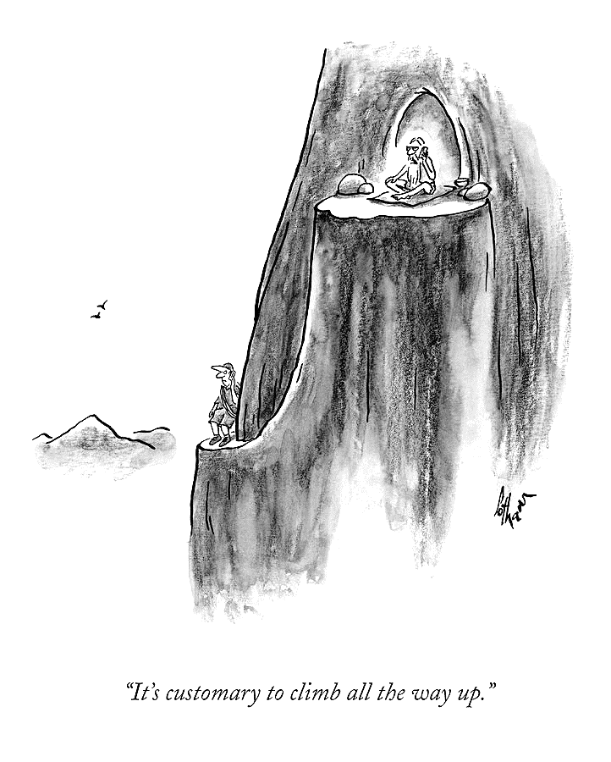
Accuracy function
Example 2: Semilinear gain
Semilinear gain function ansatz:
Semilinear gain coefficient (from boundary conditions):
Accuracy function:

Slide 11
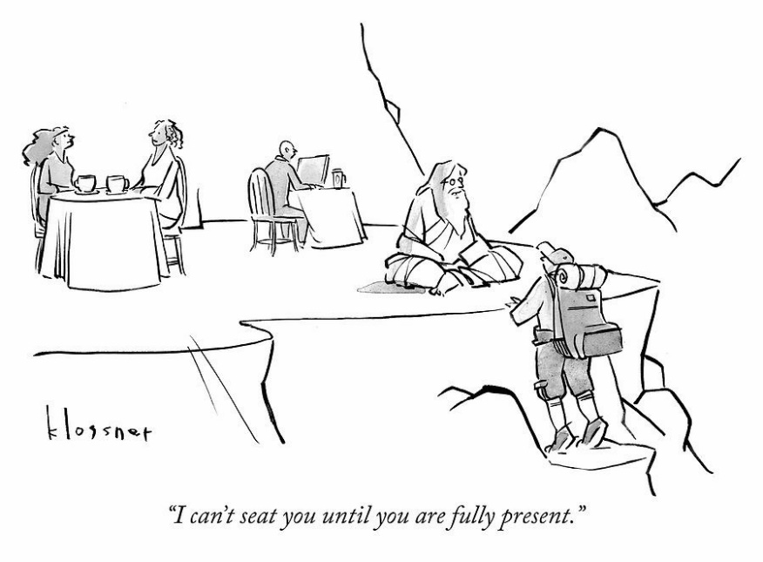
Accuracy function
Other quantities to be calculated:
Low energy limit $N_{Min}$ (minimum stimulus distinguishable from noise) with
Dynamic range:
Single quantum sensitivity limit
$n$: noise discrimination factor (application specific)

Slide 12
Accuracy function
 | Linear gain function | Semilinear gain function
Gain function
Gain coefficient
Effective calibration function
Accuracy function
Low energy limit
Dynamic range
Single quantum sensitivity limit
Dynamic range to noise ratio:
Note:
For most applications, it can be taken for granted that
$$\frac{A_{DNR}}{n}≫1$$

Slide 13
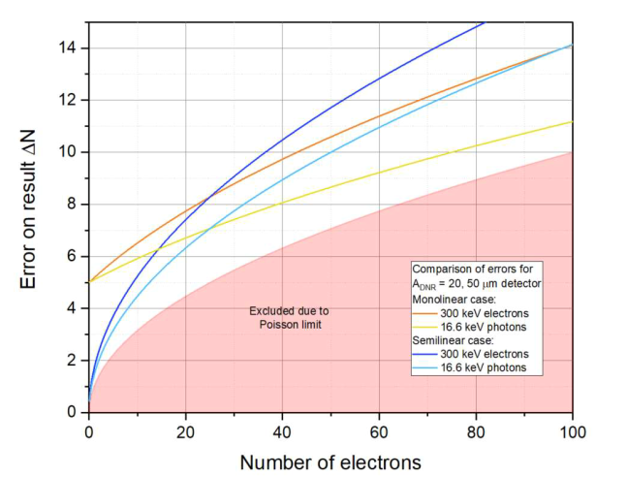
Accuracy function
Comparison:
Linear
gain function
Break-even at 25
Semilinear
gain function
Stimulus error
Error due to amplifier noise
This term also shows up in every gain function
Counting error (Poisson statistics)
$A_{DNR }$ scaling factor (ASF)
Break-even at
$${\left(\frac{N_{Max}}{N}\right)}^{2}=4∙\frac{N_{Max}}{N}$$
$$N=\frac{N_{Max}}{4}$$
For smaller $N$, the accuracy for the semilinear gain function is higher
For larger $N$, the accuracy for the linear gain function is higher
For $N→0$, the ASF for the linear GF stays constant, while the ASF for the semilinear GF drops to 0.

Slide 14
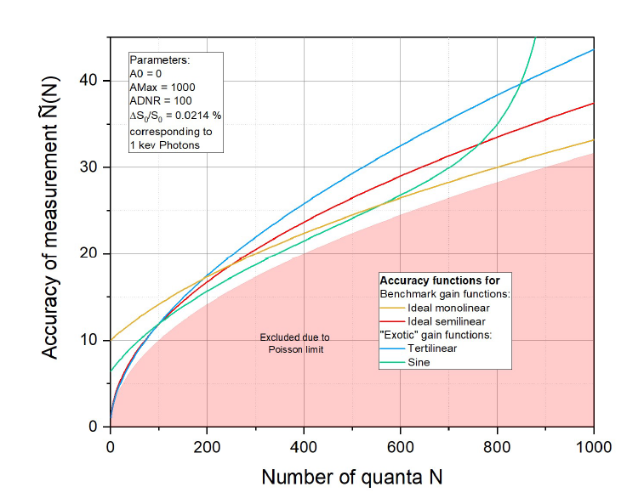
Accuracy function
„Tertilinear“: $\sqrt[3]{r∙S}$
„Sine “: $k∙\sin\left(\frac{π}{2}∙\frac{S}{S_{Max}}\right)$
Conclusion:
Choosing a gain function is about distributing output dynamic range to accuracy of retrieved stimulus
Zero-sum situation: Achieving high accuracy in one stimulus region yields lower accuracy in other regions
Accuracy function has Poisson error as built-in limitation
There is no „generic“, or optimal, gain function. It‘s all about user requirements and priorities.
Parameters:
Input stimulus and input stimulus „error“
Maximum requested stimulus
Minimum stimulus to be detected
Maximum output Amplitude
A_{DNR}

Slide 15
DEPFET and nonlinear amPlification

Slide 16
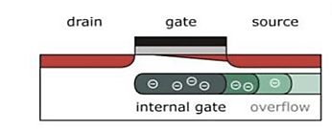
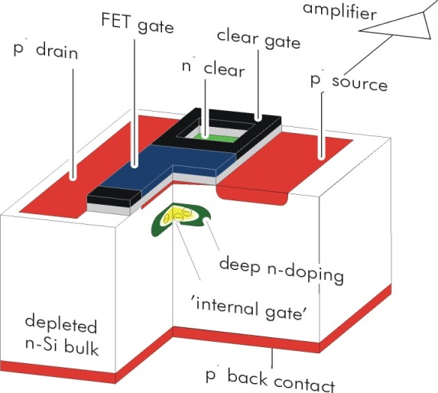
DEPFET and NLA
DEPFET integrated amplifier
p-channel FET on depleted n-bulk
Signal charge collected in potential minimum below FET channel
"Internal gate", low capacitance & noise
FET current modulation ≥ 300 pA/el.
Reset via clearFET
Charge storage
Readout on demand
Rolling shutter mode
EDET pixels:
Dynamic range problem
Implement signal compression in pixel
Overflow to source to tailor dynamic range

Slide 17
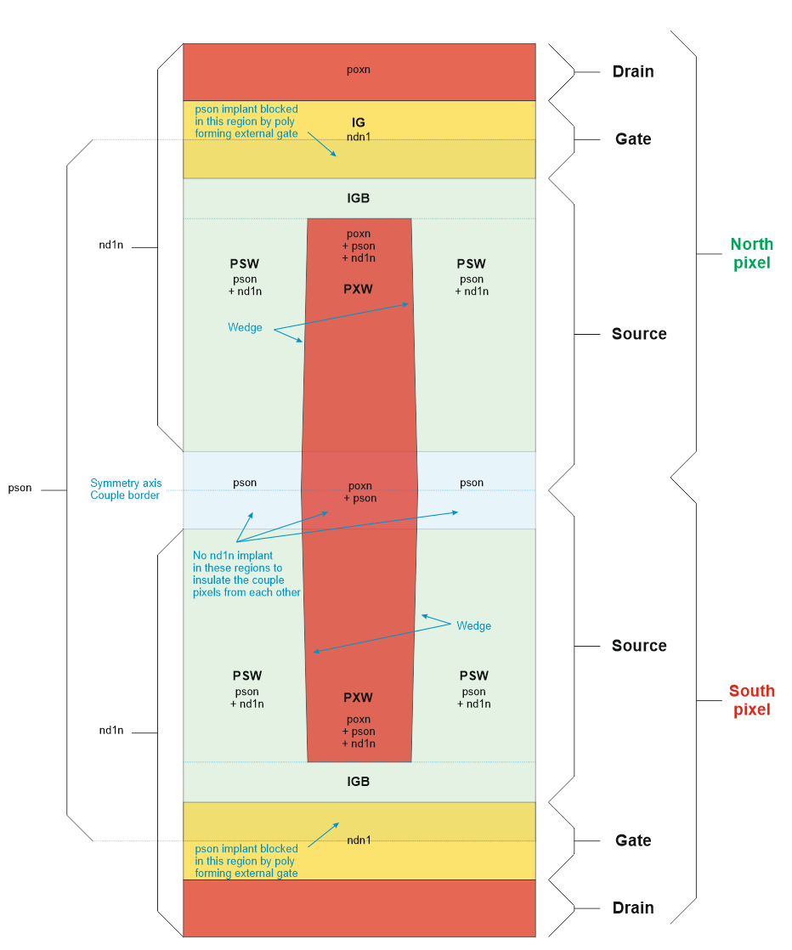
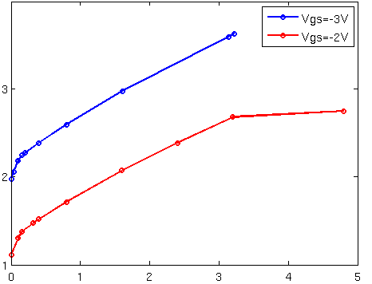
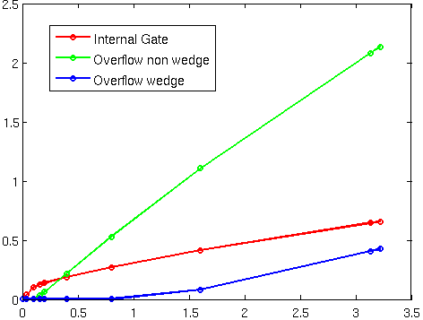
DEPFET and NLA
Response curve, or Charge-current (C2)-curve
Response curve (V_{DS} = -5 V)
Secondary
"Kink„?
Drain current (100 µA)
CHC limit
Primary OF "Kink"
Signal charge (Me⁻)
Charge distribution (VGS = -3 V, VDS = -5 V)
OV1
Signal charge (Me⁻)
OV2
Signal charge (Me⁻)

Slide 18
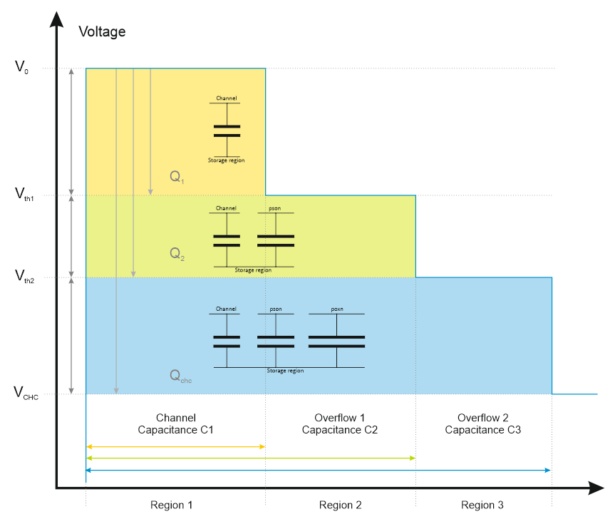
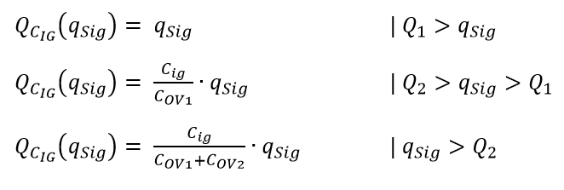
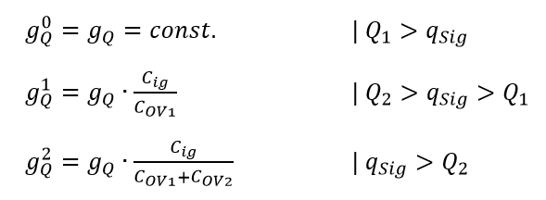
The many $g_{Q}s$ of the DEPFET
Simple voltage depending capacitive model w/ 3 zones
Constant „generic“ default $g_{Q}$ of IG
Only charge in „internal gate“ contributes to $I_{DS}$
Here, 3 steps in $g_{Q}\left(q_{sig}\right)$ can be expected!

Slide 19
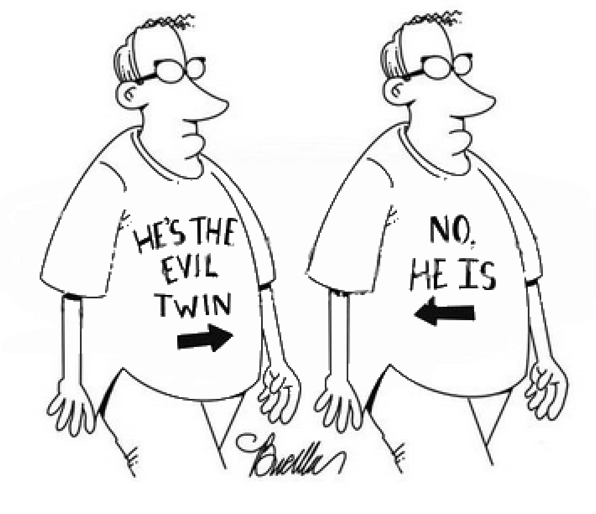
The many $g_{Q}s$ of the DEPFET
Common definition of $g_{Q}$
But behold the quantity
This quantity is also often used because of
Same dimension, but the quantities are identical only in small signal mode or for devices w/o NLA.
„Differential“ $g_{Q}\left(q_{sig}\right)$: (Local) slope of the C2-curve!
„Integral“ ${\overline{g}}_{Q}\left(q_{sig}\right)$: average slope for charge interval between $0$ and $q_{sig}$
May cause confusion if mistaken!

Slide 20
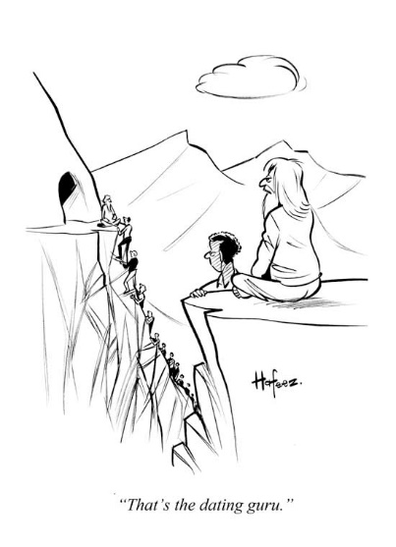
The many $g_{Q}s$ of the DEPFET
Differential $g_{Q}\left(q_{sig}\right)$ and integral ${\overline{g}}_{Q}\left(q_{sig}\right)$ can be converted into each other, as
and
Thus, the net C2-curves can be calculated by
or

Slide 21
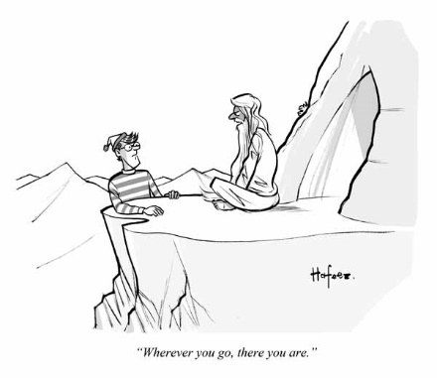
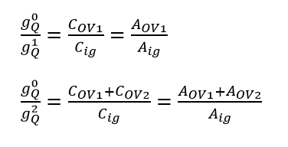
The many $g_{Q}s$ of the DEPFET
Because of
The ratio of the $g_{Q}\left(q_{sig}\right)$ is linked to the area ratios:
Already something, but model is too simple
Shortcomings of the model:
Gives ratios for $g_{Q}$s, not values
Overflow charge/voltage points are not given
Inductance effects are ignored
Need to use more sophisticated and fundamental approach

Slide 22
Calculting DEPFET $g_{Q}$
Approach:
Use actual space charge density in storage region (as simulated) to calculate both $g_{Q}\left(q_{sig}\right)$ and ${\overline{g}}_{Q}\left(q_{sig}\right)$
Modify and extrude (simulated) charge cloud to investigate different layouts
Later: Use (technology dependent) parametrization of charge in internal gate to model arbitrary layouts

Slide 23
Calculting DEPFET $g_{Q}$
Very generic model „transfers“ internal gate charge to the external gate to calculate ${\overline{g}}_{Q}$:
Conversion factor is the capacitance of external gate:
„Loss“ factor $f$ quantifies the fraction of the internal gate charge which is effective, i.e. „seen“, by the DEPFET channel
For the operation of the DEPFET in small signal mode (i.e. constant $g_{Q}$), a constant $f$ factor is assumed
For large charge quantities or devices with overflow regions, the factor $f$ has to be made a function of the charge:
The factor $f$ evolves from simple „loss factor“ to charge depending „influence effectivity factor“ (IEF)
How to calculate the IEF?

Slide 24
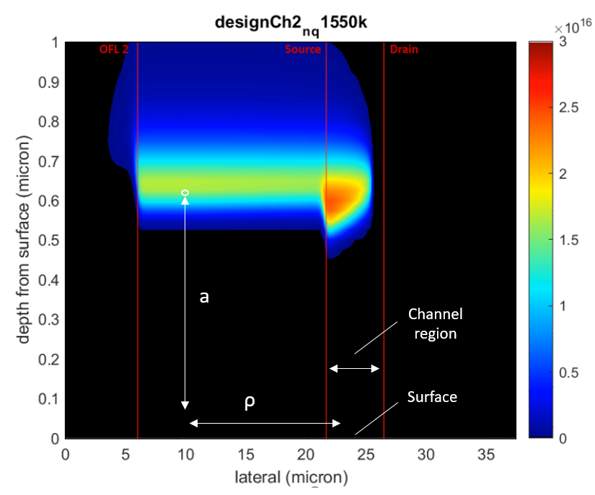
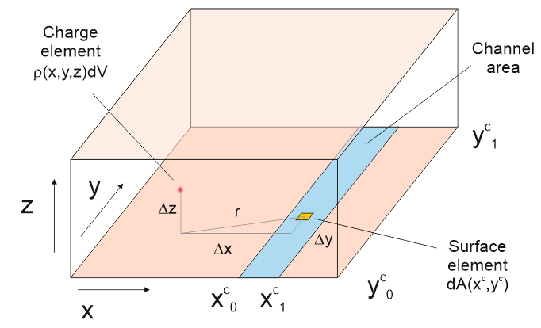
Calculting DEPFET $g_{Q}$
Calculate charge density at location of DEPFET channel as induced by charge in every voxel in the respective regions of the storage
Quotient of simulated charge vs. induced charge is inductance efficiency
Apply Shockley-Ramo Theorem to charge cloud in storage region
Step 1: Calculate the induced charge in the channel
Step 2: Calculate the IEF
Weighting potential of channel region

Slide 25
Calculting DEPFET $g_{Q}$
The weighting potential usually calculated numerically
Here, simplified (e.g. neglect influence of backside, surface „flat“ etc.) analytical solution is used
Corresponds to simple „mirror charge over conductive plate“ problem
Weighting potential
This yields a closed algebraic epression
Error estimation yields error in the 1% range for the thinnest detector values

Slide 26
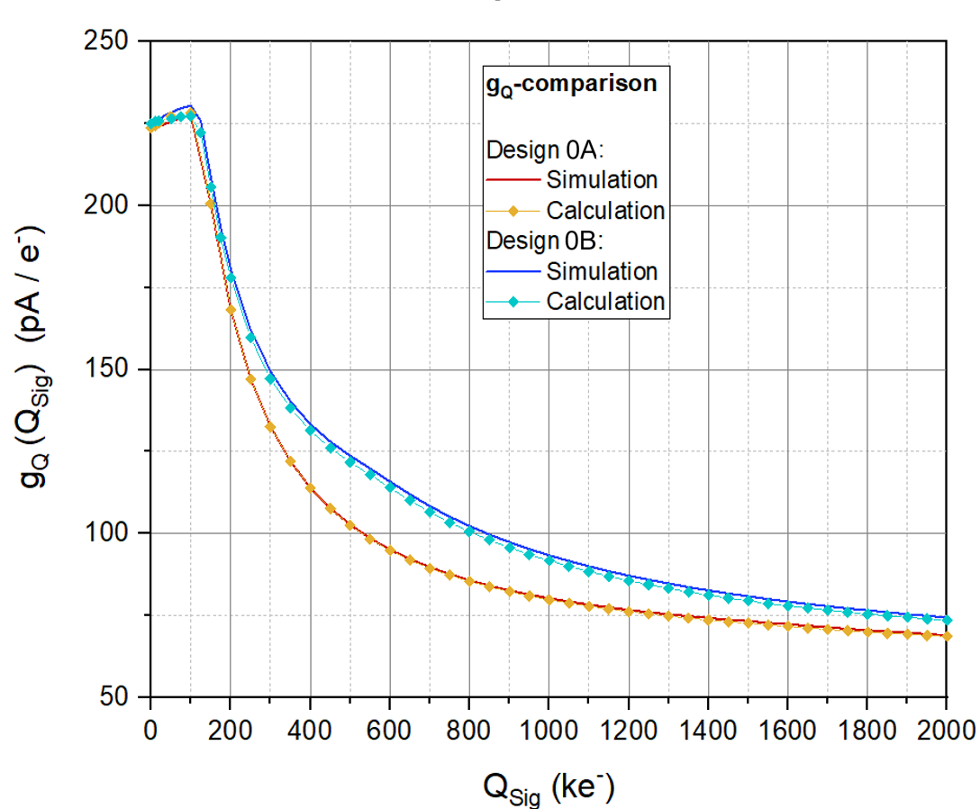
Calculting DEPFET $g_{Q}$
Very nice match with few parameters!
Compare model calulation with numerical simulations
Nice agreement
Few average parameters (mobility etc...)
Geometry parameters
Gate-Source voltage...
To a large degree, the g_{q} dependence seems to be an „electrostatic“ phenomenon

Slide 27
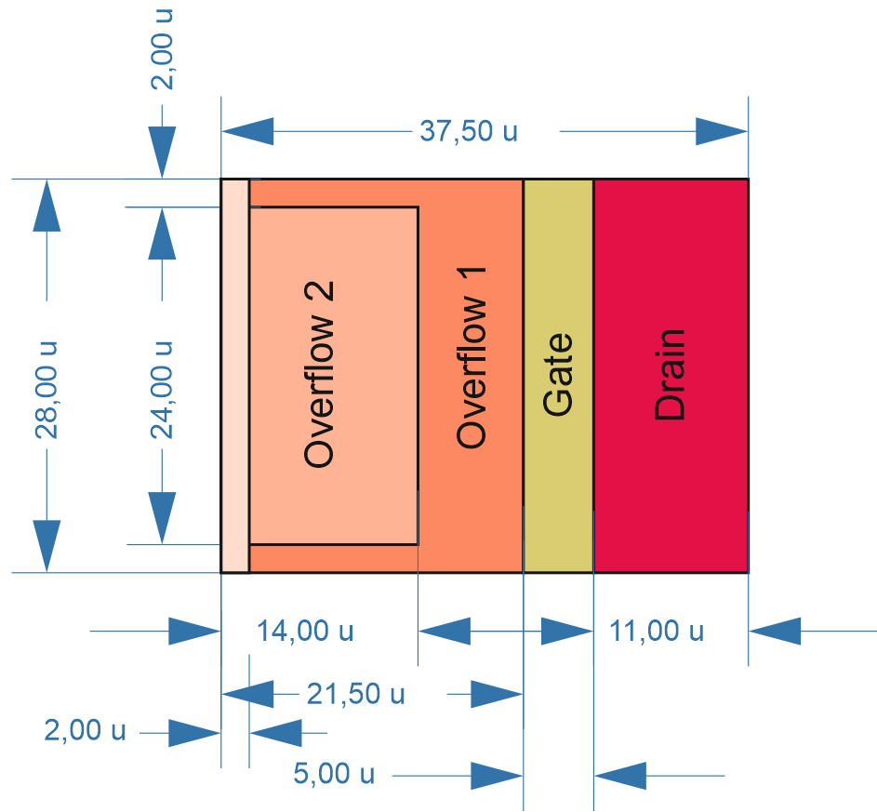
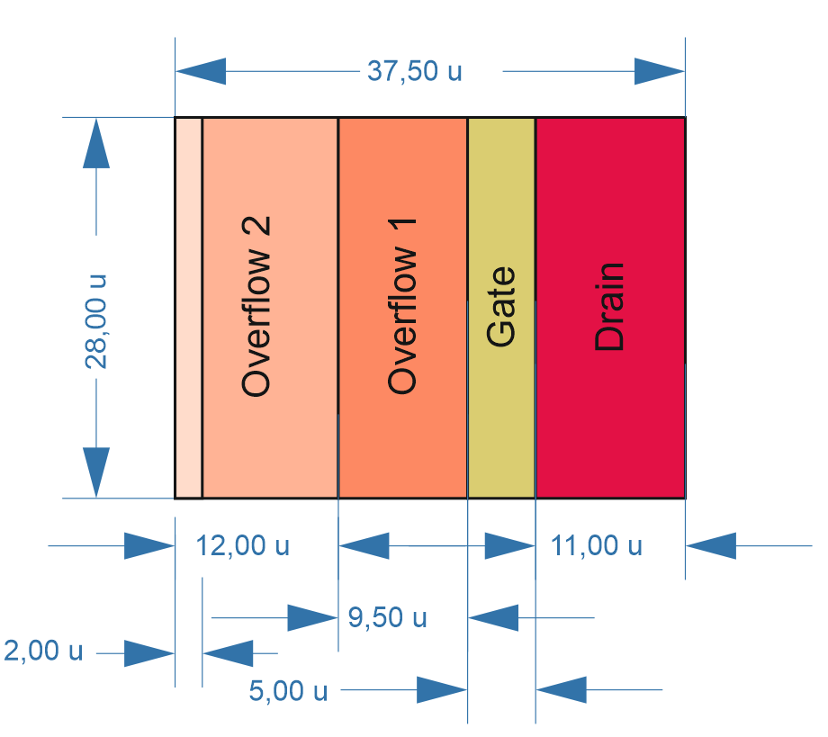
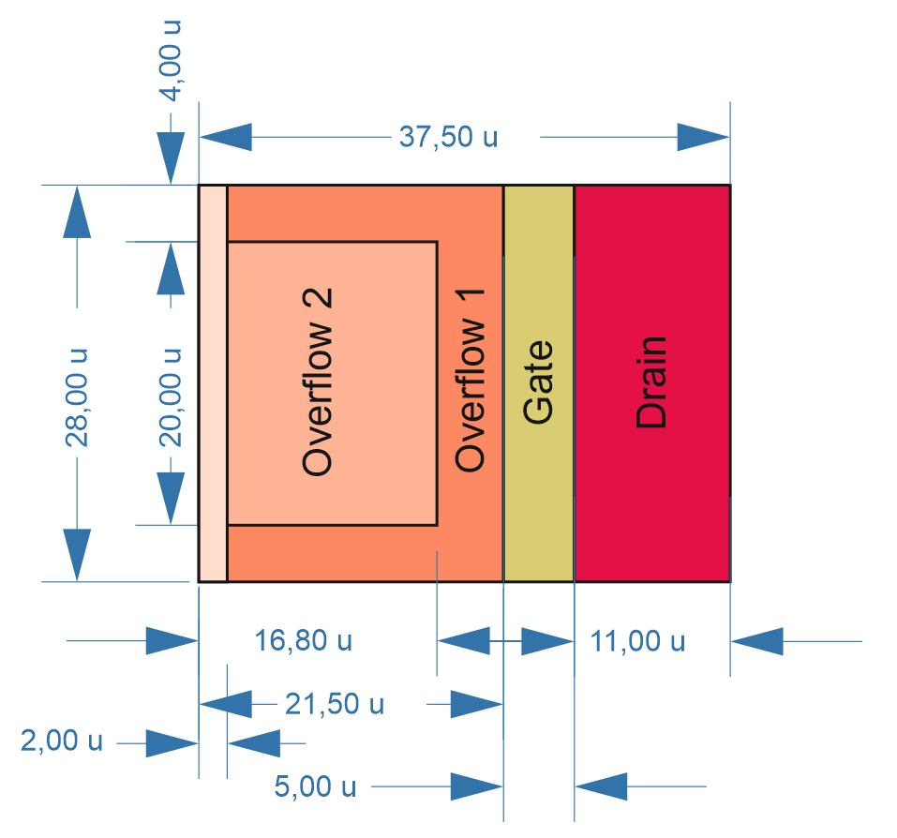
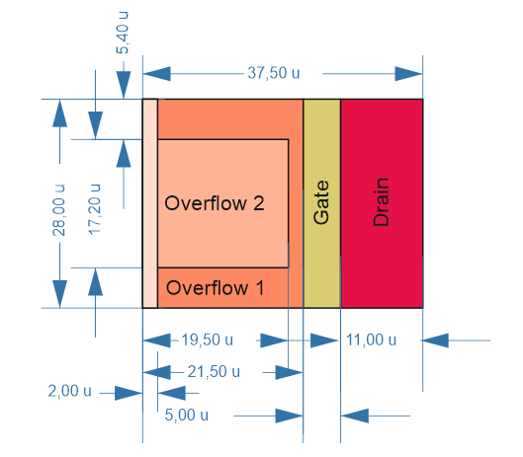
Calculting DEPFET $g_{Q}$
0B:
1:
Different designs based on extruded simulation results
Distance of overflow 2 to internal gate becomes smaller
Overflow 1 brim introduced
Area ratios between overflow 1 and overflow 2 regions are very similar
External gate position and charge distribution in internal gate are not modified
Interesting parameters:
Device capacitance values for the various regions
Overflow thresholds
g_{q} as a function of charge
2:
3:

Slide 28
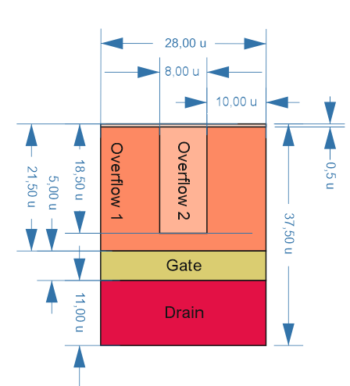
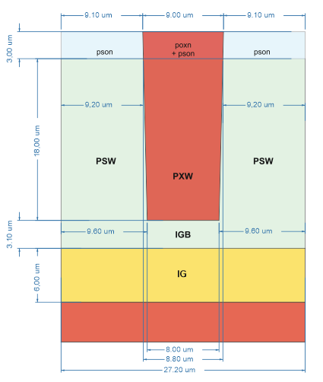
Calculting DEPFET $g_{Q}$
EDET pixel design:
Situation similar to case 3 in terms of Gate - OV1 gap
Much wider brim (9 -10 µm)
Area ratio changed wrt. reference design
Probably mismatch in gate width
Model:
Design:

Slide 29
Calculting DEPFET $g_{Q}$
Next step: Calculate Charge-current (C2)-curve

Slide 30
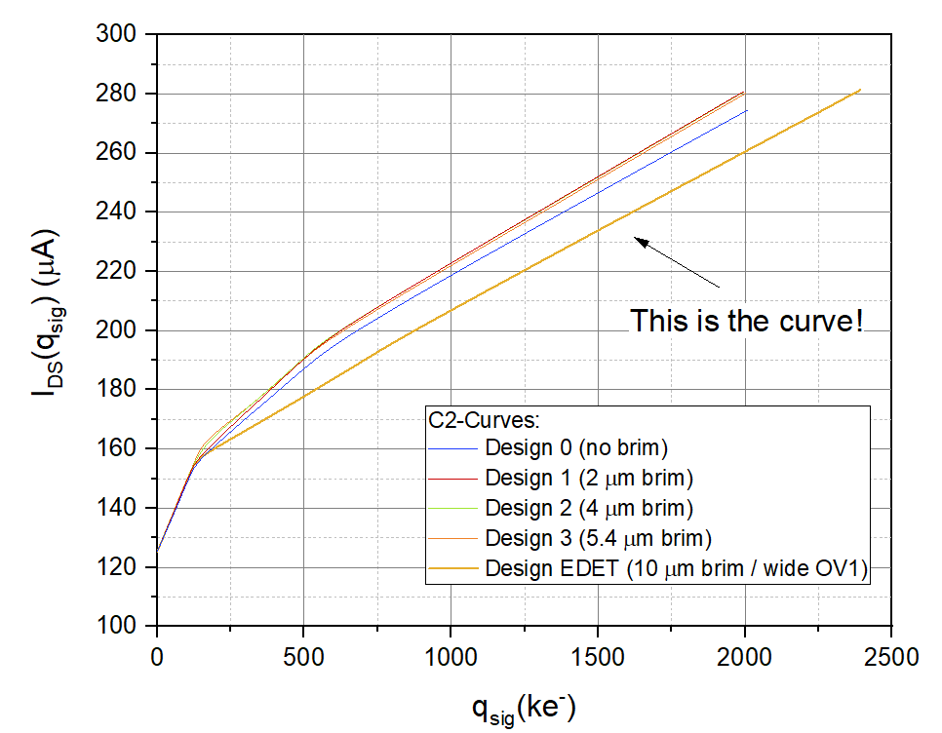
Calculting DEPFET $g_{Q}$
The ${\overline{g}}_{Q}\left(q_{sig}\right)$ can be used to calculate the C2-curves:
Charge-current (C2)-curve is experimentally relevant DEPFET characteristics
Gives overall current in the pixel as a function of the total signal charge in the pixel $I_{DS}(q_{sig})$
If the detector is properly calibrated, the C2 curve can be used to determine the verall signal charge.
„Total“ C2-curve and net C2-curve (w/o $I_{0}$)

Slide 31
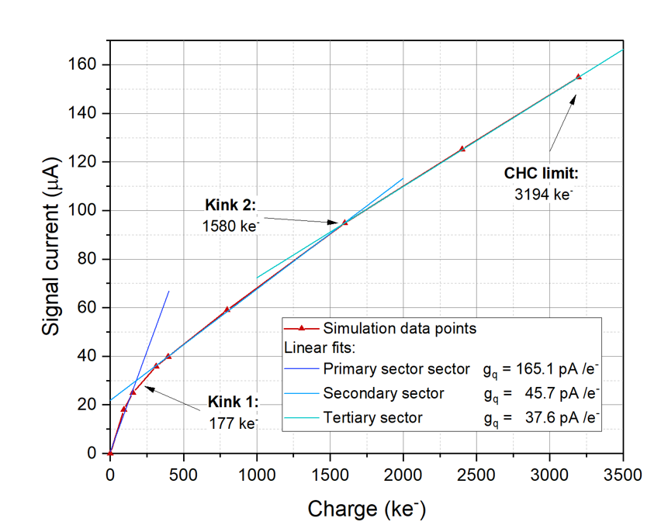
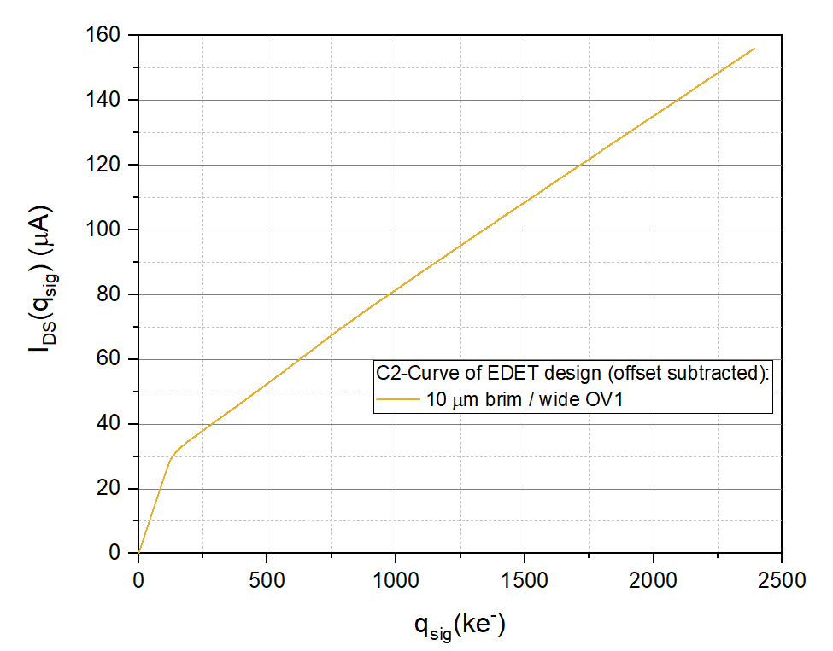
Calculting DEPFET $g_{Q}$
Net C2-curve of OSCAR simulation
Net C2-curve calculated for EDET-like design

Slide 32
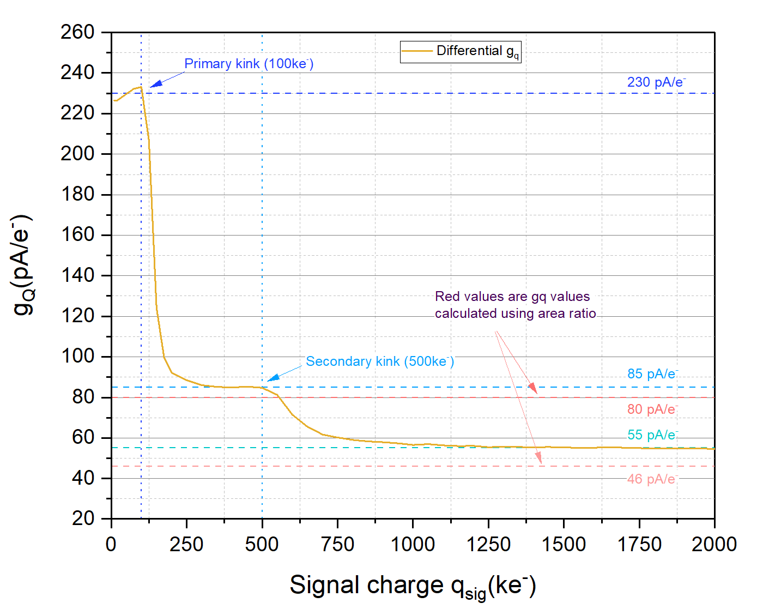
Calculting DEPFET $g_{Q}$
Because of
the $g_{Q}\left(q_{sig}\right)$ is linked to the capacitance!
Example: Design 0B
Steps reflect the activation of the various overflow regions
Kinks are (as expected) much more pronounced as in the integral $\tilde{g_{Q}}\left(q_{sig}\right)$ plot

Slide 33
Construction of Gain function for DEPFET
1st step: Define parameters
Input parameters: $N_{Max}$, $N_{Min}$, type of $S$
Choose gain function (may be linear interpolation)
Define „gain“ coefficient(s)
Determine required $A_{DNR}$
Fix kink points according to preference / requirement
2nd step: Convert gain function to layout
Input: Charge density function (simulated or parameterized) alongside activation threshold voltages
Calculate internal gate size according to required primary $g_{Q}$.
Set dimensions (if possible) such that threshold voltage meets requested first kink point
Set area of overflow 1 such, that secondary $g_{Q}$ requirement is met.
Caveats:
Many interdependencies,
Limited design options
Check if kink point requirement is met (variation here is difficult, if no modification fo technology possible)
Set area of overflow 2 such that tertiary gq requirement is met
Check, if $N_{Max}$ requirement is met

Slide 34
Summary
Accuracy functions are a useful tool for the prediction of performance of a detector system in terms of measurement accuracy
Can be used to define an optimum gain function for an application according to the respective requirements
Mainly useful for counting applications, significance for spectroscopy is limited
The Shockley-Ramo theorem can be used to predict the $g_{Q}$ to be expected for a given layout
Modelling method was developed and tested
Increases understanding of amplification mechanism in DEPFET
Helps to narrow down layout options prior to simulation for design optimized for a specific application
Insights gained are significant also for other DEPFET applications

Slide 35
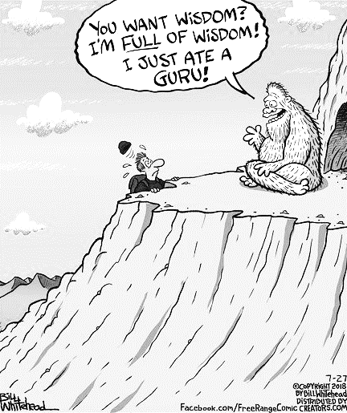
Outlook
Create parametrization for charge density function
Optimize design
Verify optimized designs by actual 3D-Simulation
Investigate and quantify effect of inductance on operational parameters for other DEPFET applications (RNDR, Inifinipix, Quadropix)
Use insights gained to study the amplification mechanism in the DEPFET channel in detail.
Learn about the effect of charge distribution in the channel on charge amplification
Optimized positioning of internal gate
Imporved performance

Slide 36
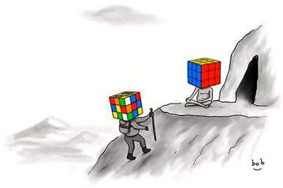
Questions?

