Slide 1
Fast Small Pixel -
The next Generation
(FSP TNG)

Slide 2
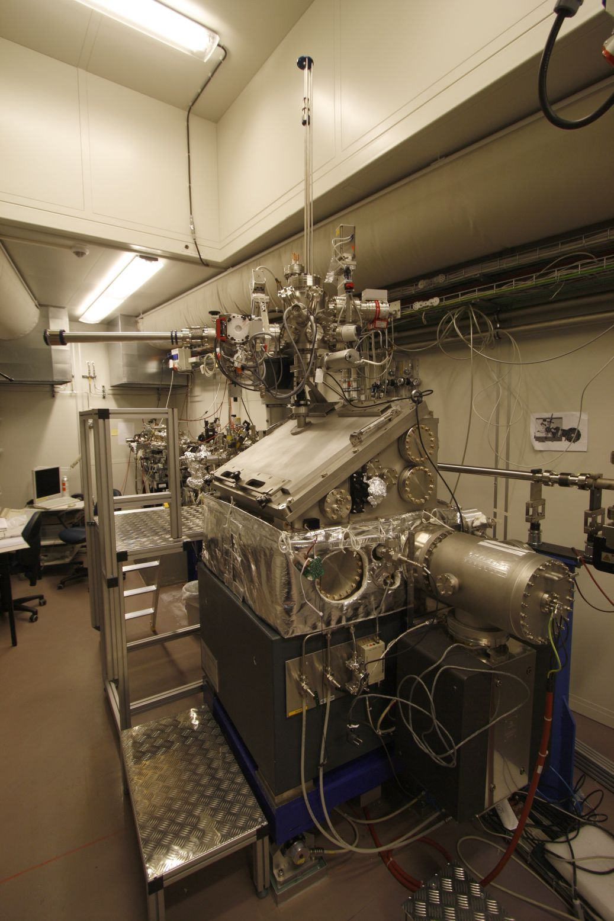
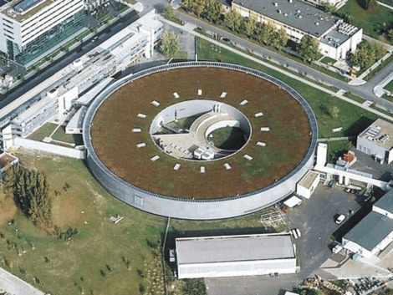
MAXYMUS/MYSTIIC @ Bessy II
BESSY II, Helmholtz-Zentrum, Berlin
*MAgnetic X-raY Microscope
with UHV Spectroscopy

Slide 3
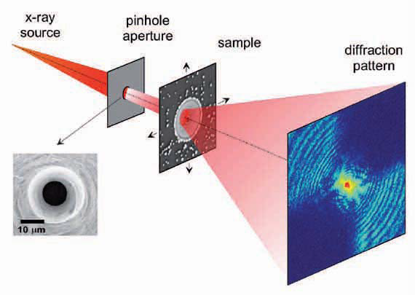
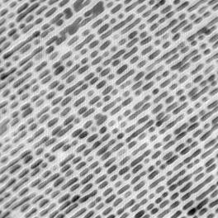
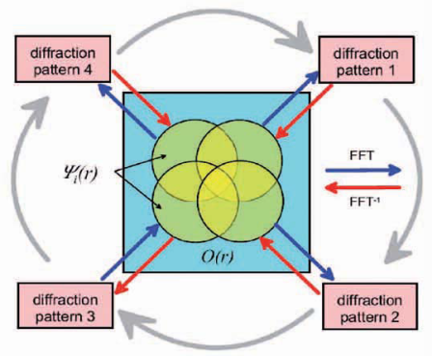
Ptychography
Ptychographic reconstrution of
commercial Fresnel Zone Plate
200 nm
5 nm half-pitch
resolution aperture limited
record n pictures
move sample in x and y
do this for m positions
reconstruct sample from m x n pictures

Slide 4
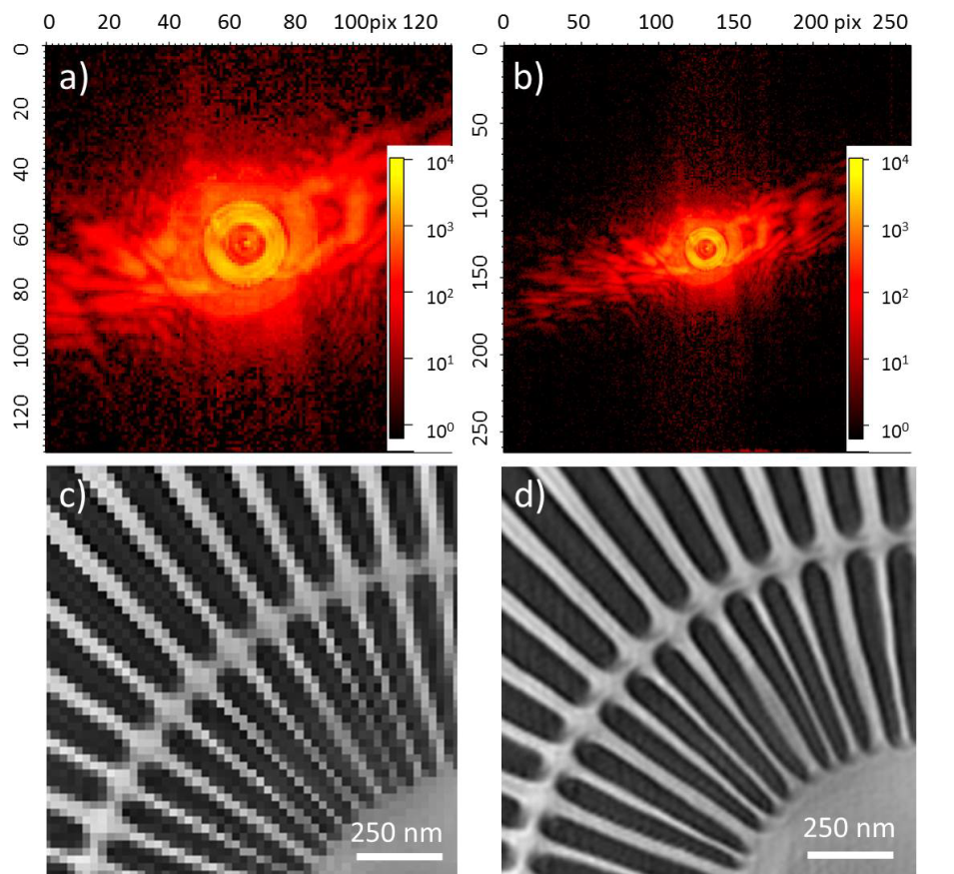
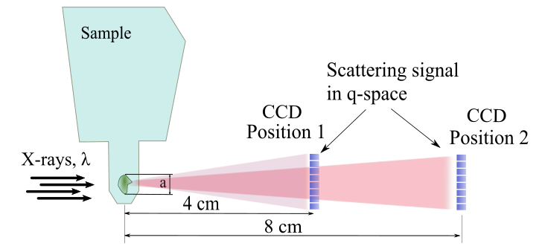
ptychography
Reconstractions with different NA
Numerical aperture (NA)

Slide 5
Concept

Slide 6
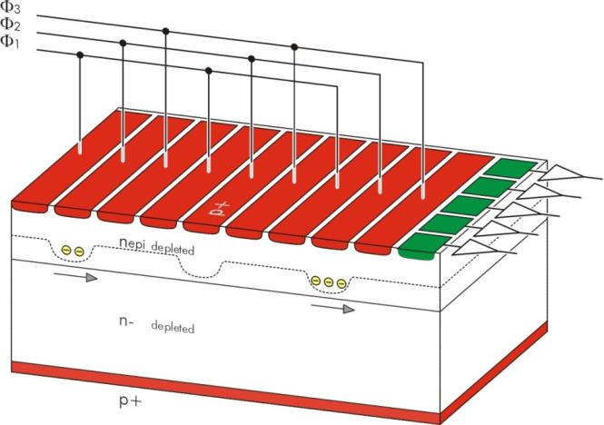
pnCCD
  definition of potential pockets by differently reverse-biased diodes
  charge transport by periodic clocking of shift registers
  column-parallel readout → high frame rate (5 msec @ 200 pixel)
  integrated 1st FET (1 / column) → low noise (2el. ENC)
  backside illuminated, fully depleted → high quantum efficiency
  format ~ cm² … wafer scale
  thickness 450 µm
  pixel size 36 … 150 µm
  Applications
    X-ray imaging & spectroscopy
    optical light imaging

Slide 7
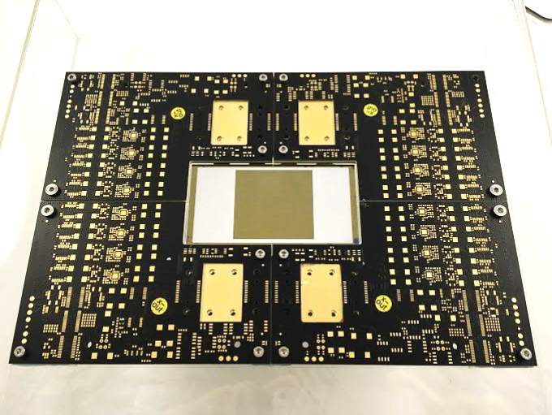
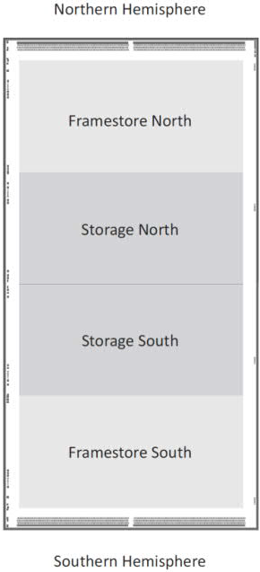
FSP TNG
(dummy) Sensor + Hybrid PCBs
build a camera around a
  1 MPix pnCCD
  36 x 36 µm² Pixels
  framestore area
  split frame readout
develop:
thermo-mechanics
electronics
soft-and firmware for operation

Slide 8
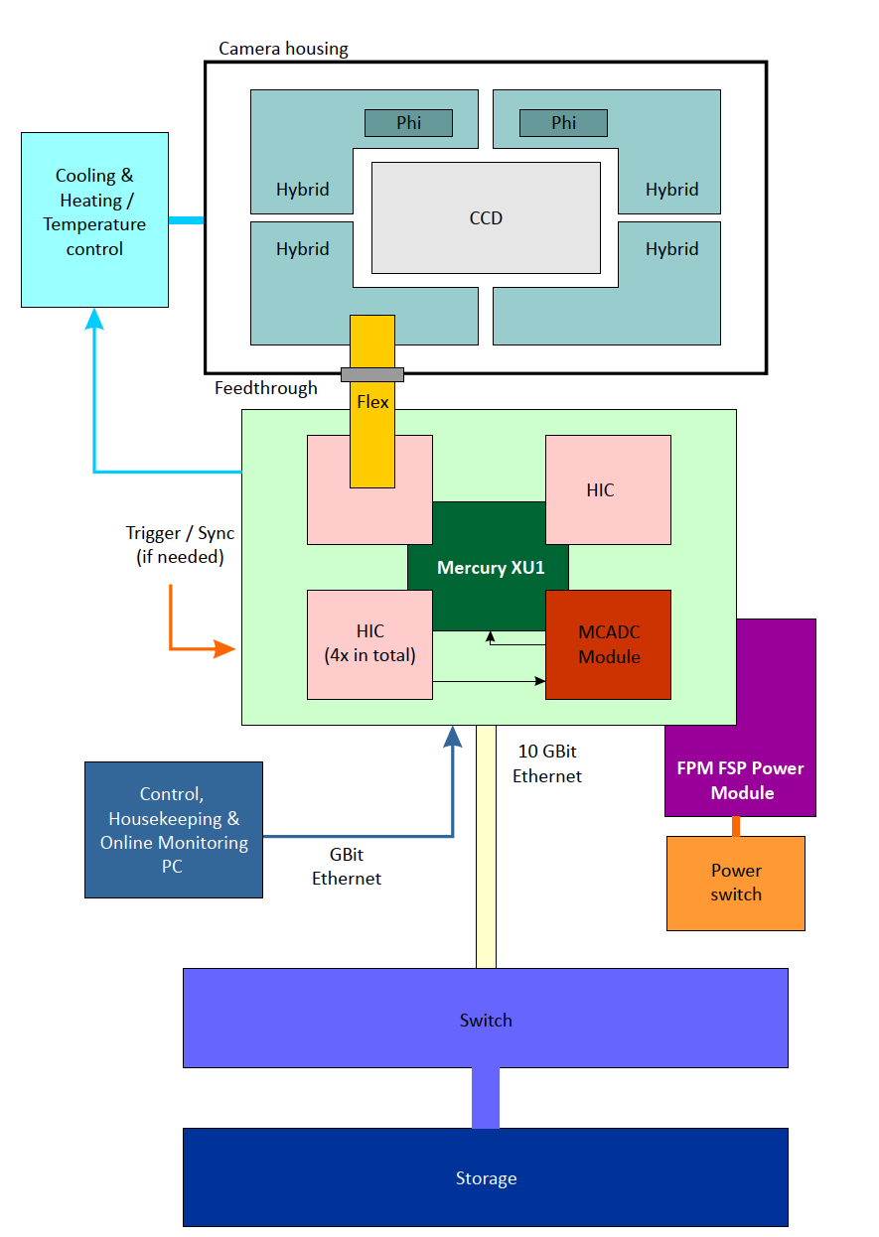
FSP TNG - concept
sensor + hybrids inside vacuum
IIC + mezanine cards outside vacuum
  Control over Mercury XU1
  1 GB – slow control from PC
  10 GB Ethernet – datatransfer XU1 to Storage

Slide 9
Mechanics

Slide 10
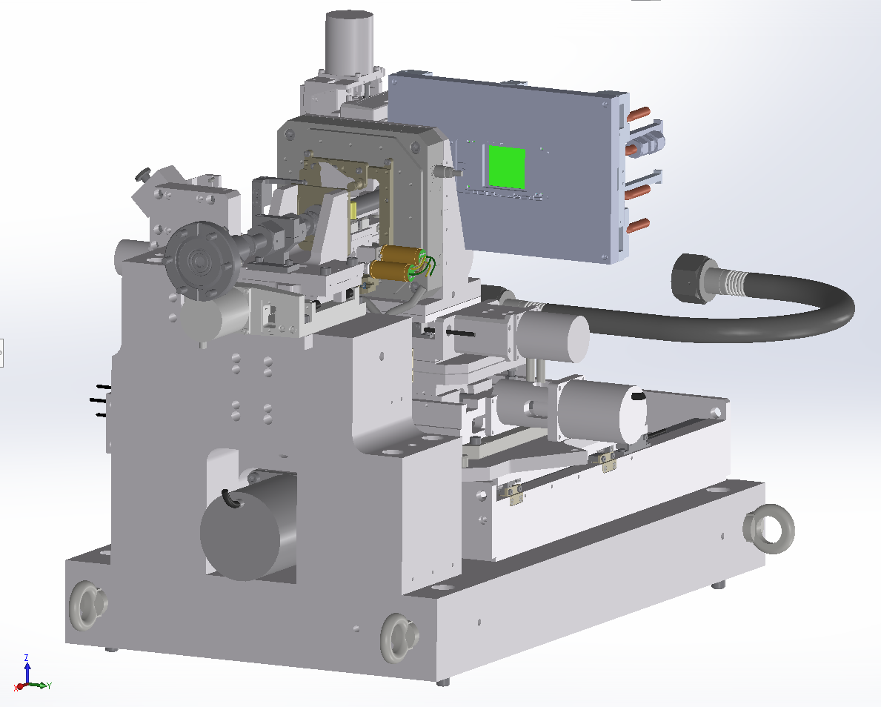
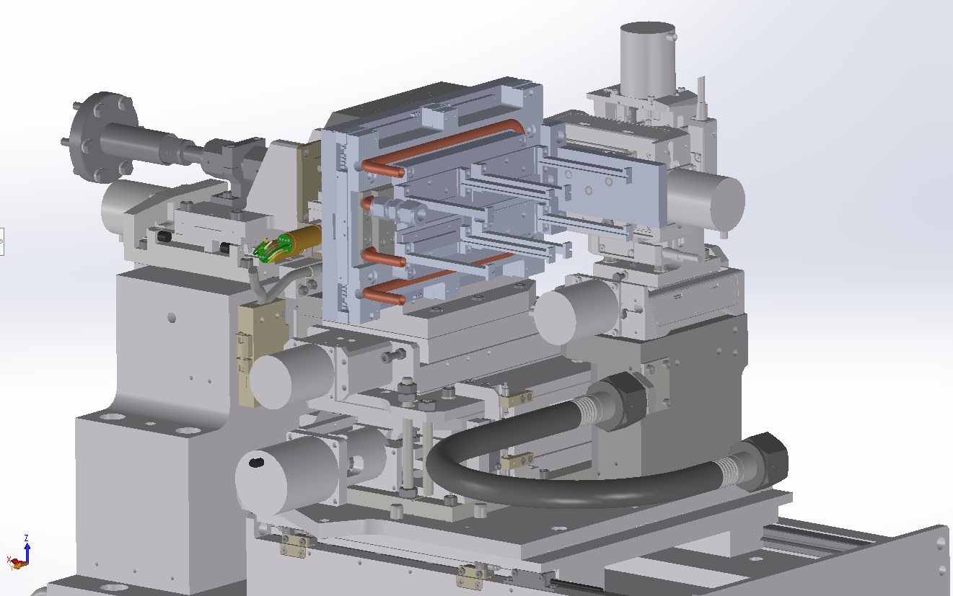
Mechanics – camera Head
camera head
water cooling
cable fixtures
MAXYMUS mechanics
xyz stage

Slide 11
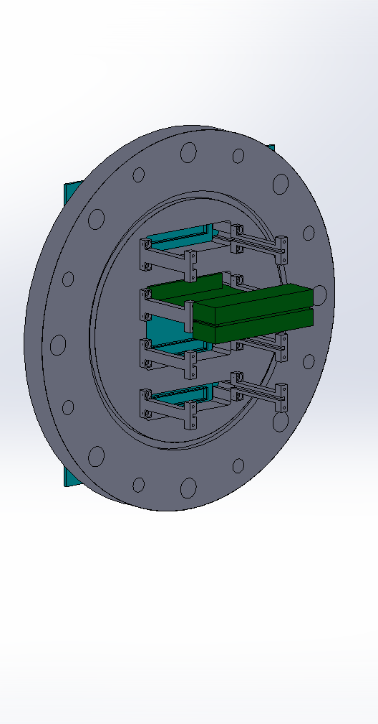
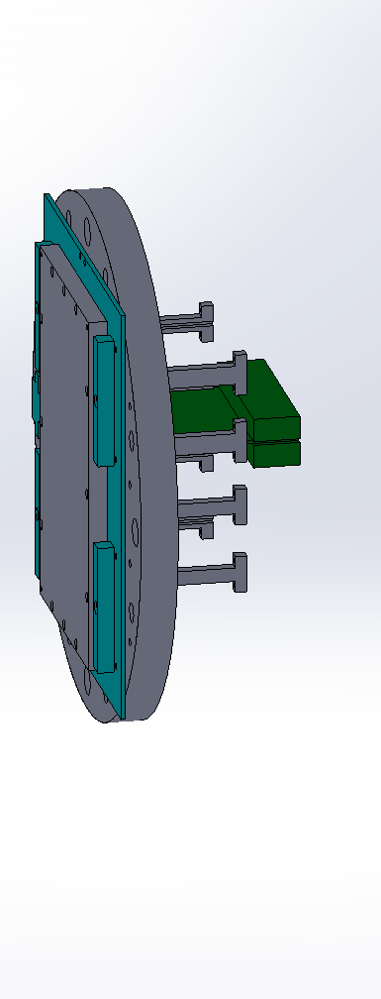
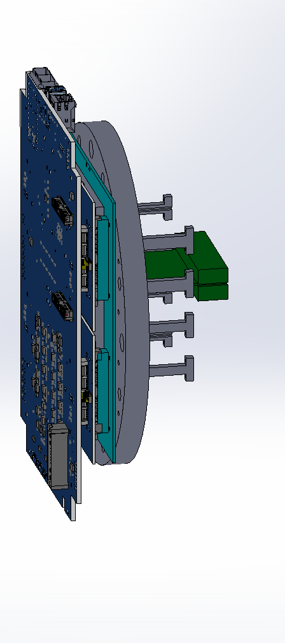
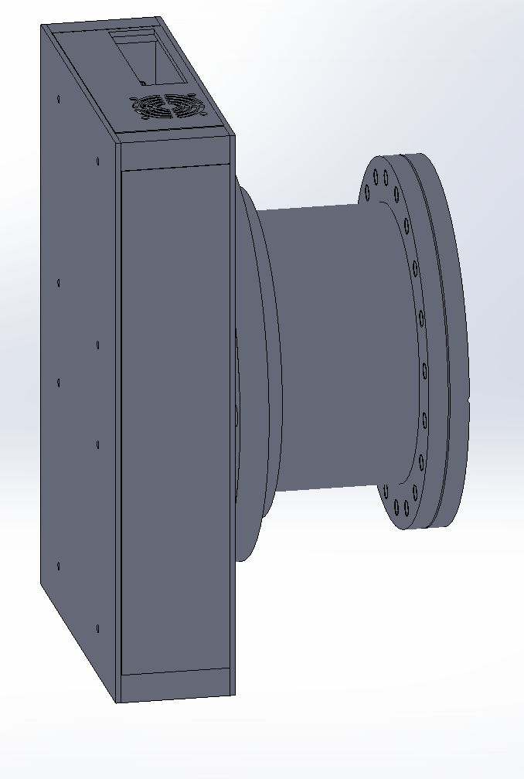
Vacuum FeedthrougH
vacuum flange (custom)
ISO-K to CF adapter
vacuum flange (iso-f)
Cable bracket (x4)
feedthrough pcb
IIC (Instrument Interface Card)
Al-Housing

Slide 12
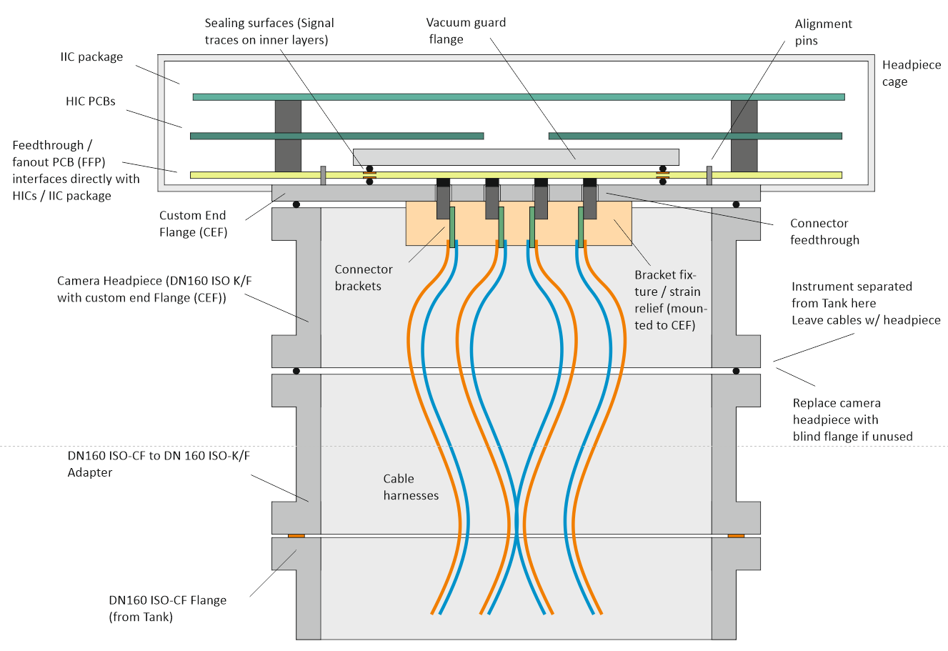
Vacuum FeedthrougH- cables
Concept: PCB clamped between 2 costum flanges
4 identical cables connecting to Camera Head

Slide 13
The „Brain“
Firmware

Slide 14
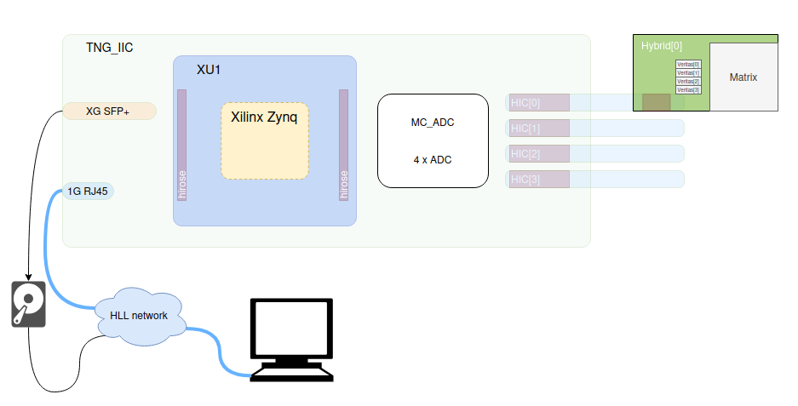
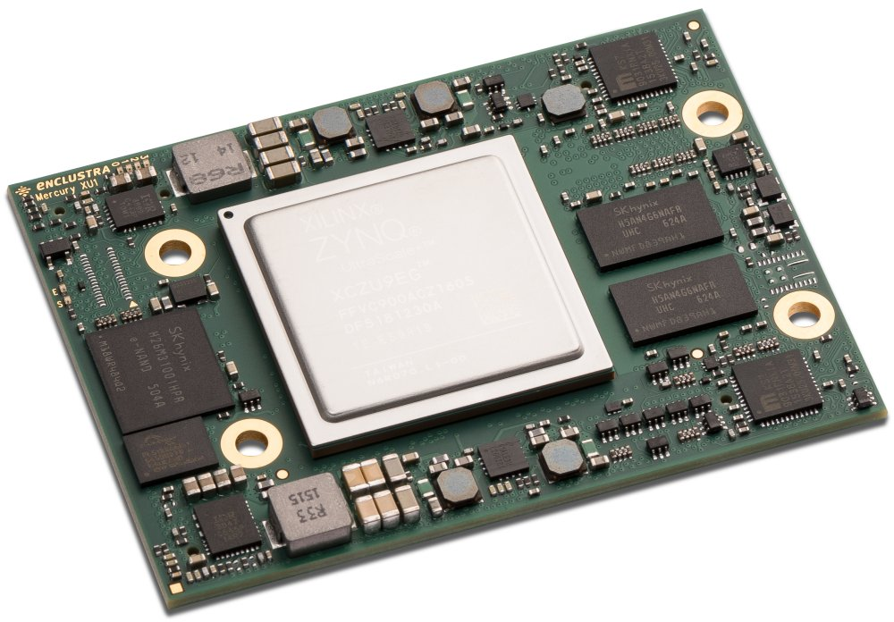
FSP TNG Firmware
Mercury XU1 SoC Board
XCILINX Zynq SoC

Slide 15
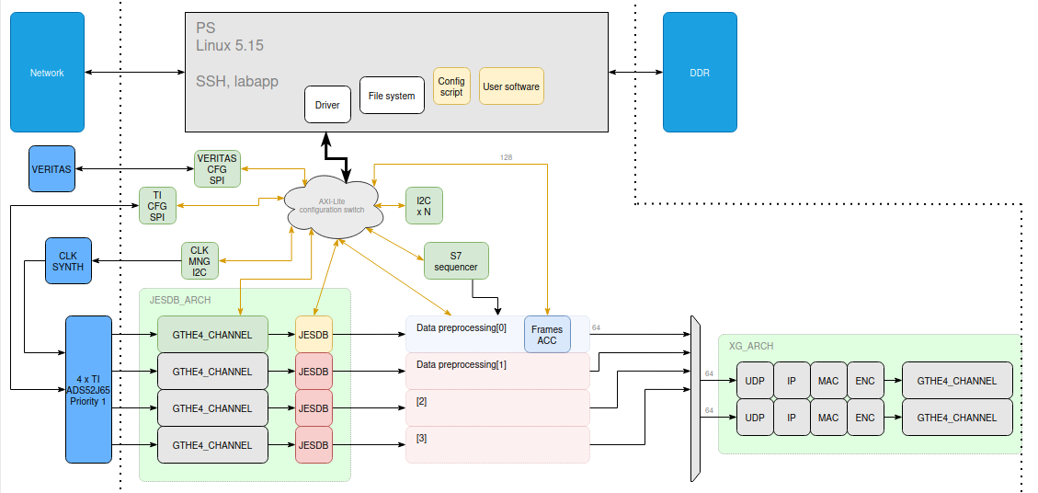
FSP TNG Firmware
divide tasks between
      processing system
        on-chip linux
        drivers for PL
        houskeeping software
      processing logic
        communication interfaces
        sequencer
        data reduction

Slide 16
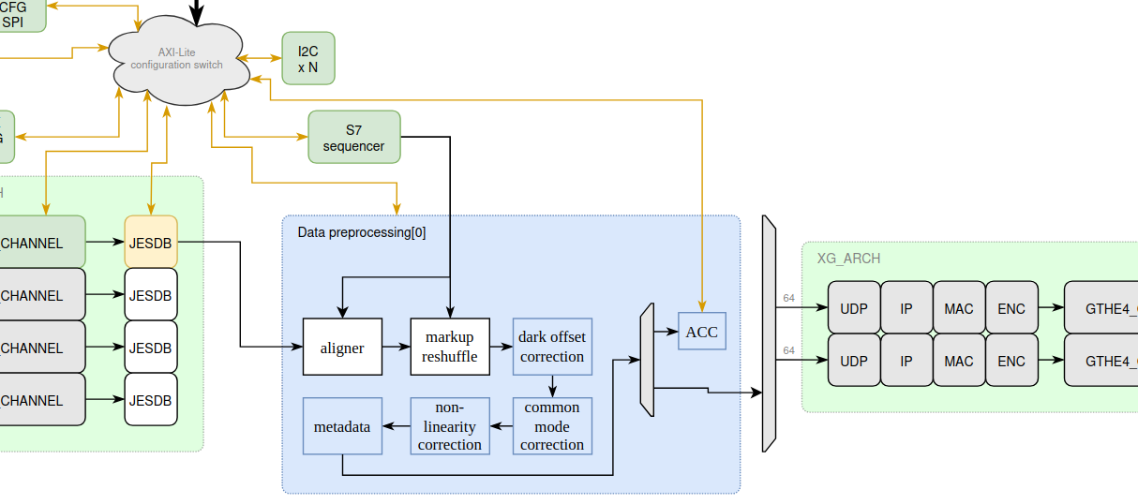
FSP TNG Firmware
accumulation of frames
for every (ptychography) position
stack multiple frames inside FPGA
send only accumulated data to storage
increase dynamic range
reduce data rate

Slide 17
Current state

Slide 18
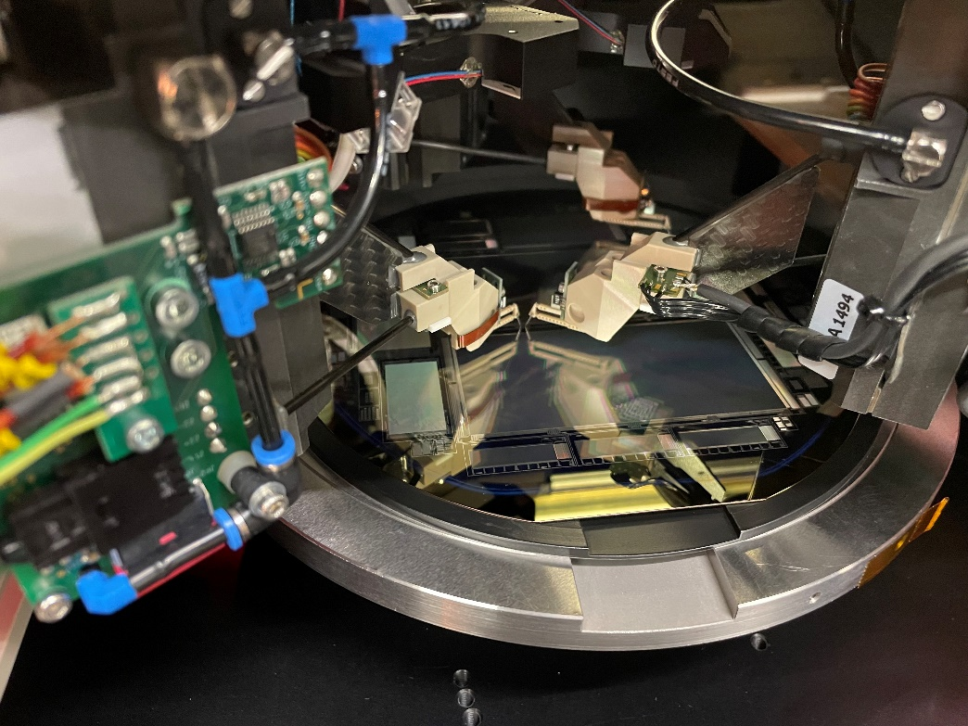
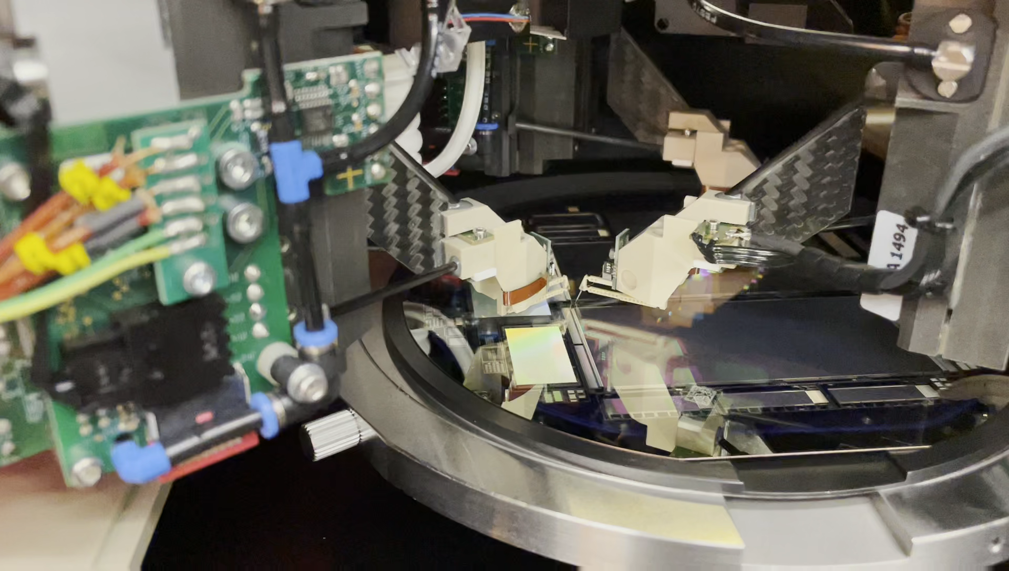
Hardware test
CCD test on ATG
Automated pre-test of CCDs
phi-registers, MOS, bulk tested against each other
9 devices tested (including dummies)
3 devices selected for further assembly

Slide 19
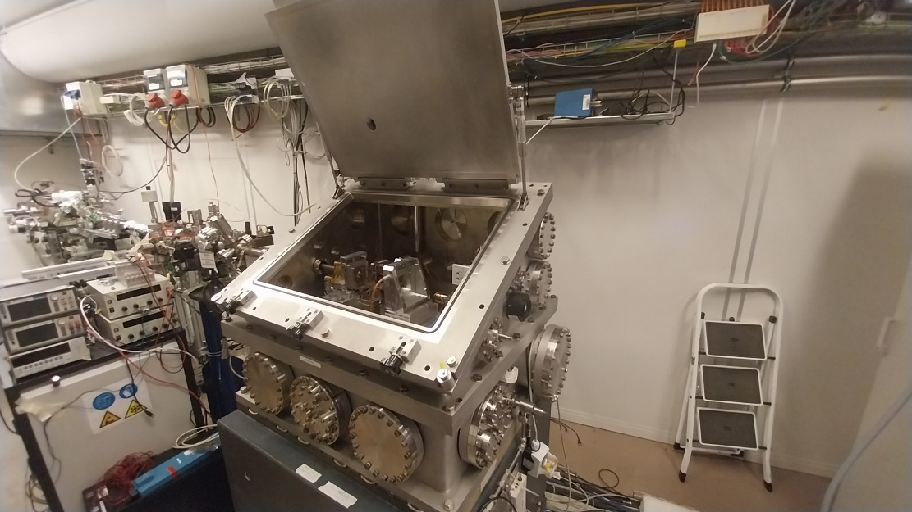
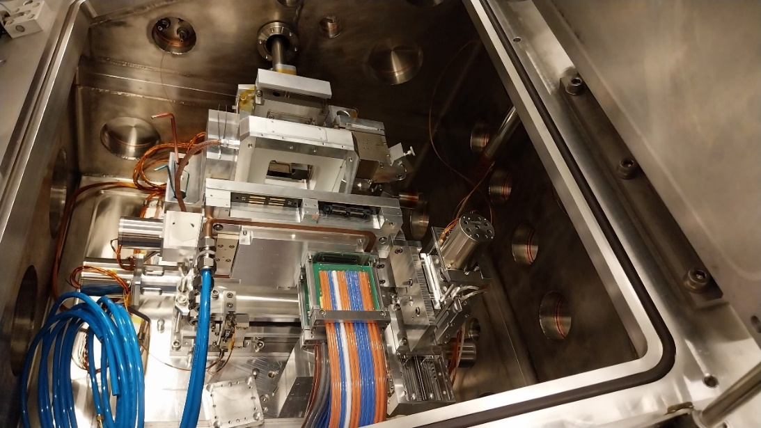
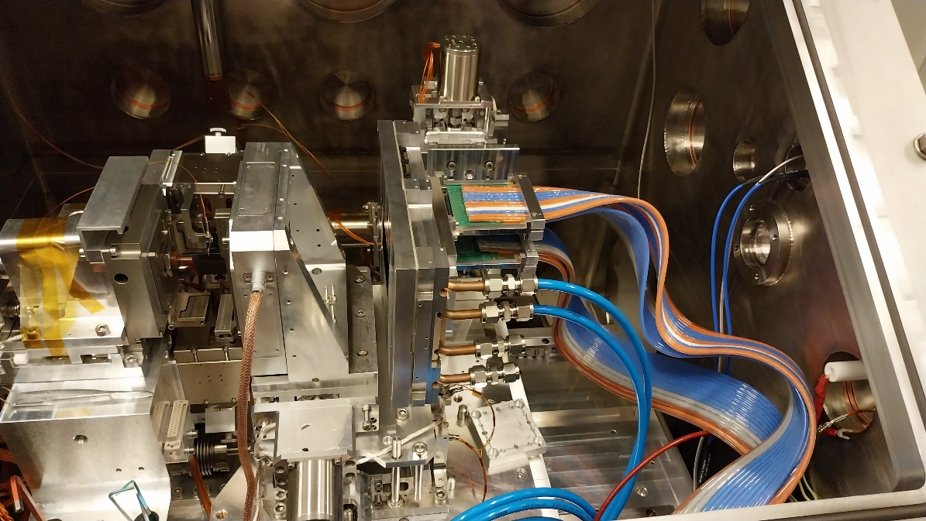
Mechanics check at Maxymus

Slide 20
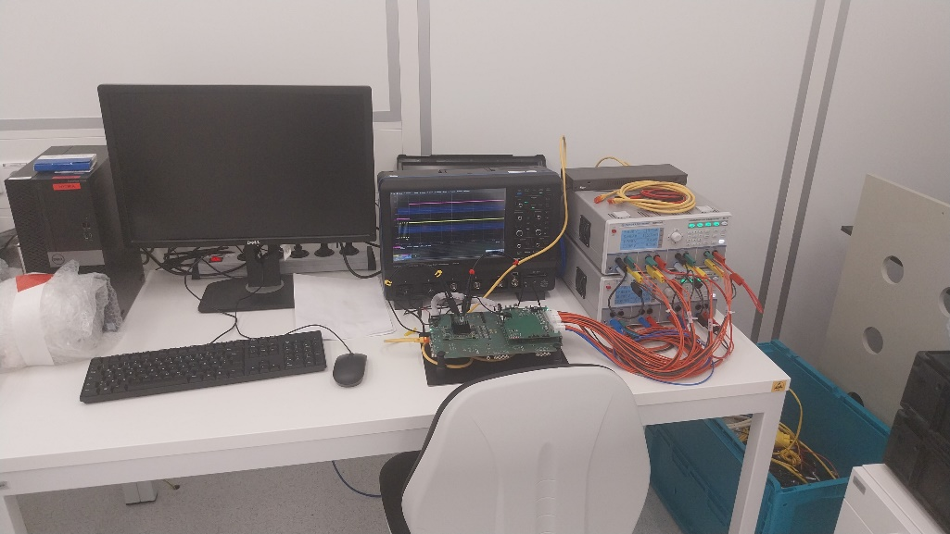
Electronics testing
Electronic components:
FPM tested
IIC 2 PCBs tested and calibrated 2 more populated
HIC 4 PCBs tested and calibrated
ADC card 2 cards under test
Phi driver several cards tested
Hybrids populated with ASICs - debugging and testing

Slide 21
Next steps
finish test of electronic components
assembly of camera head
glue pnCCD
mechanical assembly
bonding
test of system inside of vacuum chamber
first time combination of all components

Slide 22
Thanks for listening

