Slide 1
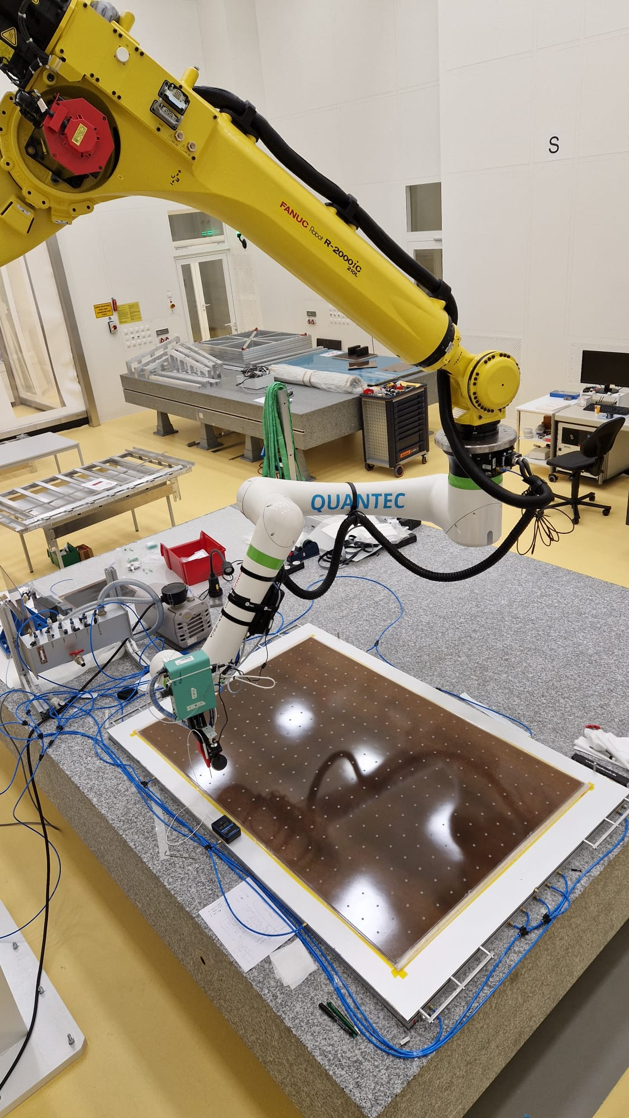
Quality assurance and quality control (QA/QC) of the production of thin-gap RPCs for the ATLAS phase 2 upgrade
Davide Costa
on behalf of the MPP ATLAS Muon Group
DPG-Frühjahrstagung 2025
Göttingen – 31st March - 4th April 2025

Slide 2
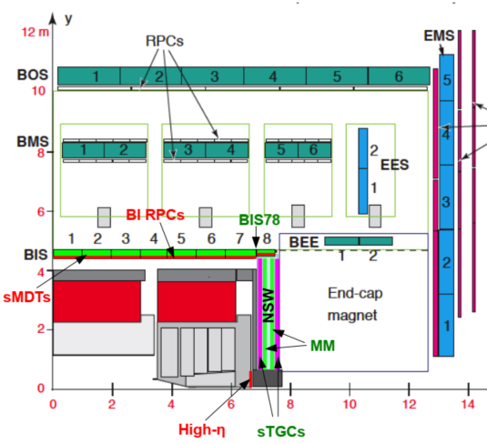
RPCs for the ATLAS Muon System Upgrade
1
Installation of ~1000 1mm-gap RPCs in the inner layer of the barrel to maximize the efficiency and geometrical acceptance of the muon trigger.
Challenges:
Very tight space constraints:
only 60 mm in radial space available for the system.
Higher rate capability:
make up for loss in efficiency of legacy RPC system.
Required longevity:
>10 years of operation at HL-LHC till 2040.
New production and certification facilities for ~300/1000 thin-gap RPCs have been established at MPI, with technology transfer to German industry partners.

Slide 3
New generation of ATLAS 1mm-gap RPCs
2
schematic drawing of RPC singlet
Electrode material:
phenolic high-pressure laminate (ρ_{V} = 10¹⁰ Ω × cm)
Gas mixture:
C₂H₂F₄ / iso-C₄H₁₀ / SF₆ (94.7 / 5 / 0.3)
Rate capability and longevity:
up to 1 kHz/cm² for 10 years of HL-LHC
Solutions:
Reduced bakelite thickness:
Less voltage loss in bakelite → improve the rate capability, larger induced signals.
Reduced gap size:
Less charge produced per event → improve longevity, rate capability.
New generation FE electronic:
Very low-noise and very sensitive front-end electronics to compensate the lost gas amplification.

Slide 4
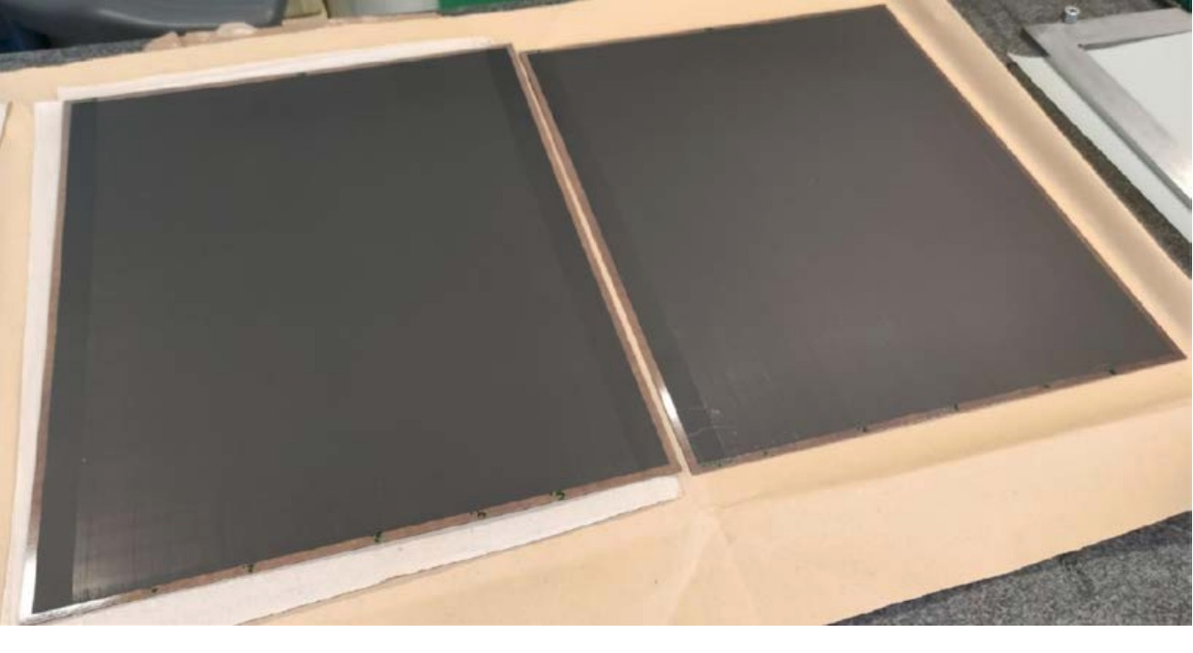
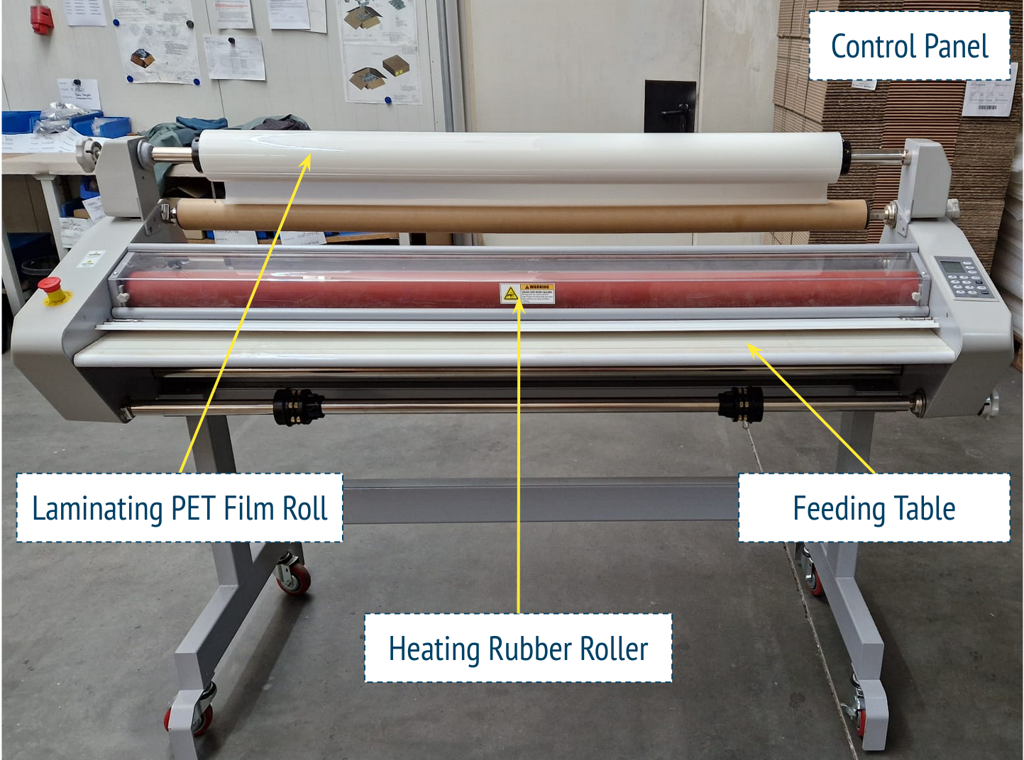
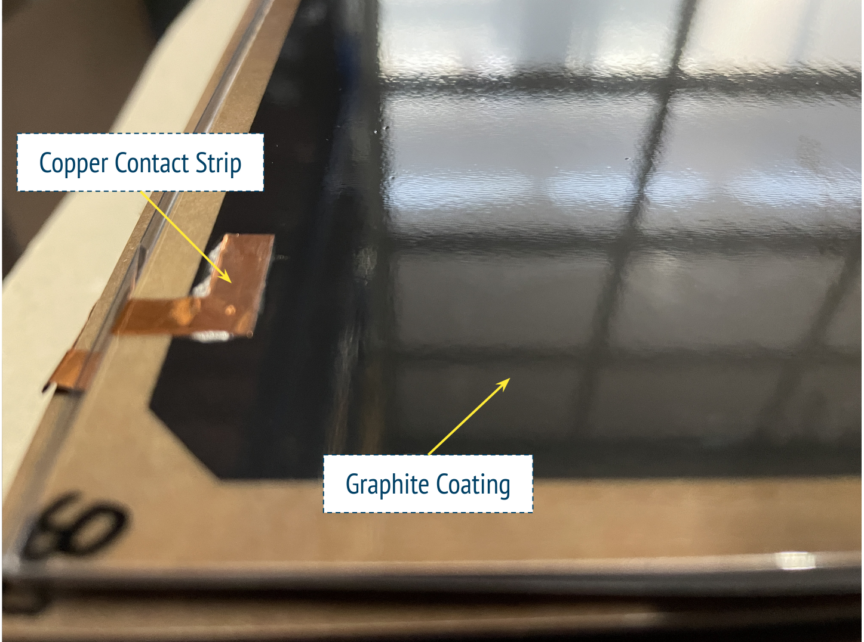
Assembly Procedure
3
The 1mm-gap RPCs production involve several stages:
Electrode production, installation of HV contacts, and lamination.
Gas gap production.
Gas pipe installation, edge sealing, sticker application.
Linseed oil coating.
graphite coating of the HPL electrodes
triple graphite layer edge
lower resistivity (<20 kΩ/◻) on edge to improve the high voltage distribution.
graphite coating
(ρ_{s} = 350 kΩ/◻)
laminating press machine
HPL electrode after lamination

Slide 5
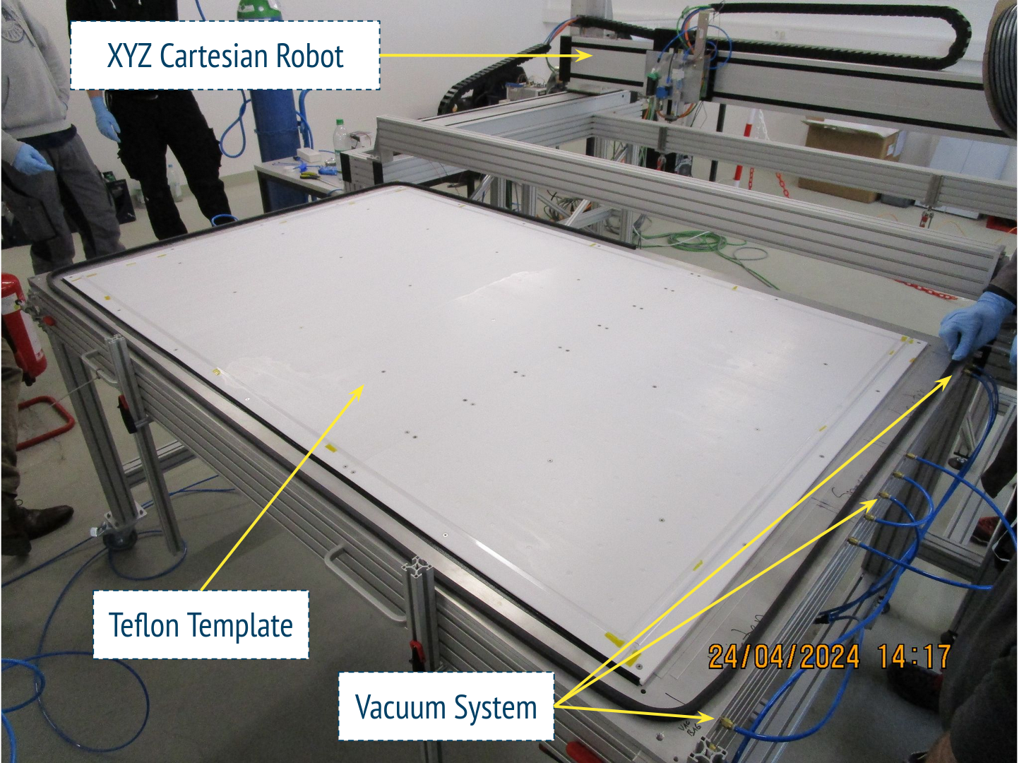
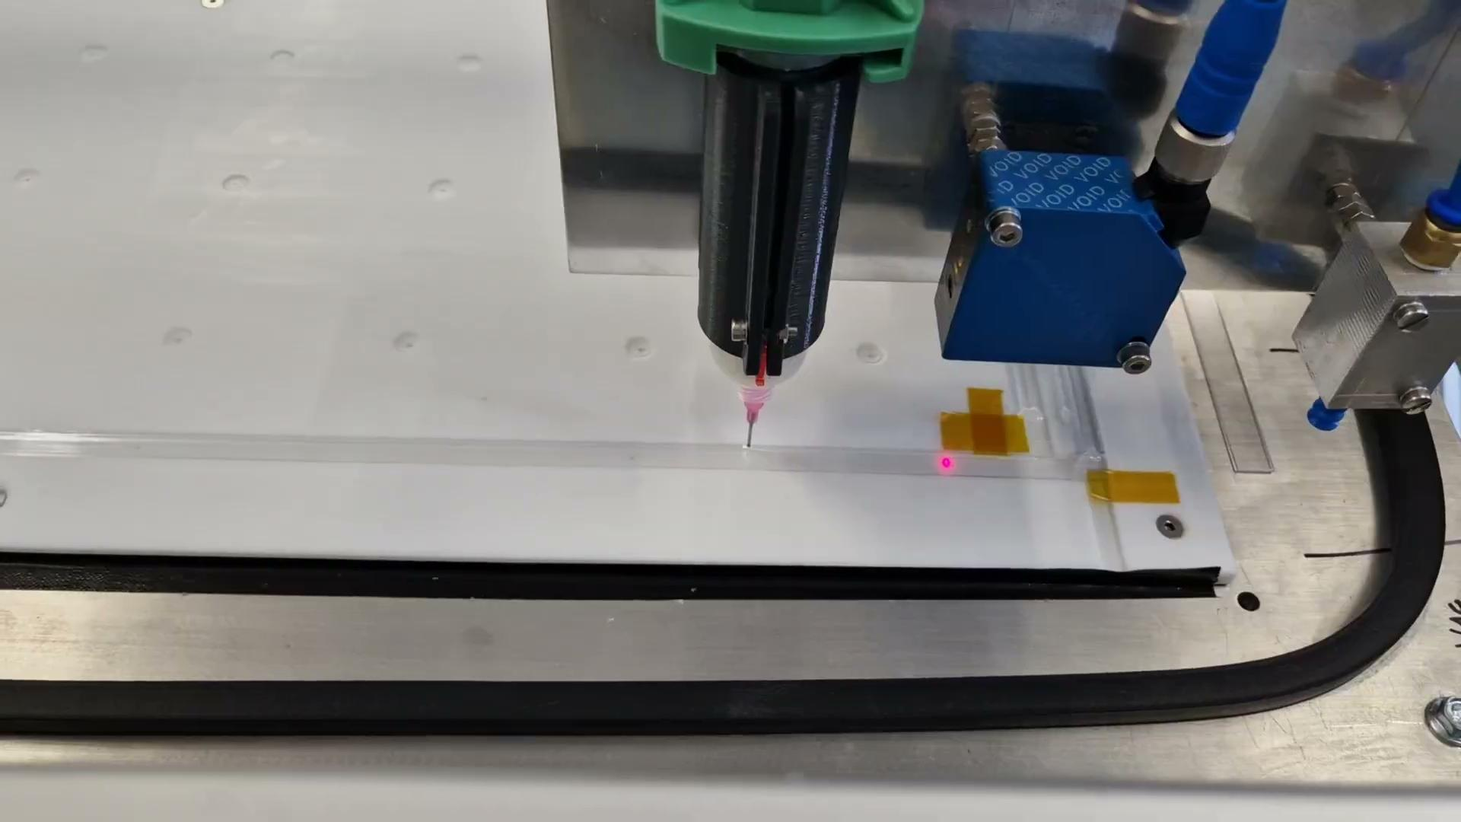
Assembly Procedure
4
The 1mm-gap RPCs production involve several stages:
Electrode production, installation of HV contacts, and lamination.
Gas gap production.
Gas pipe installation, edge sealing, sticker application.
Linseed oil coating.

Slide 6
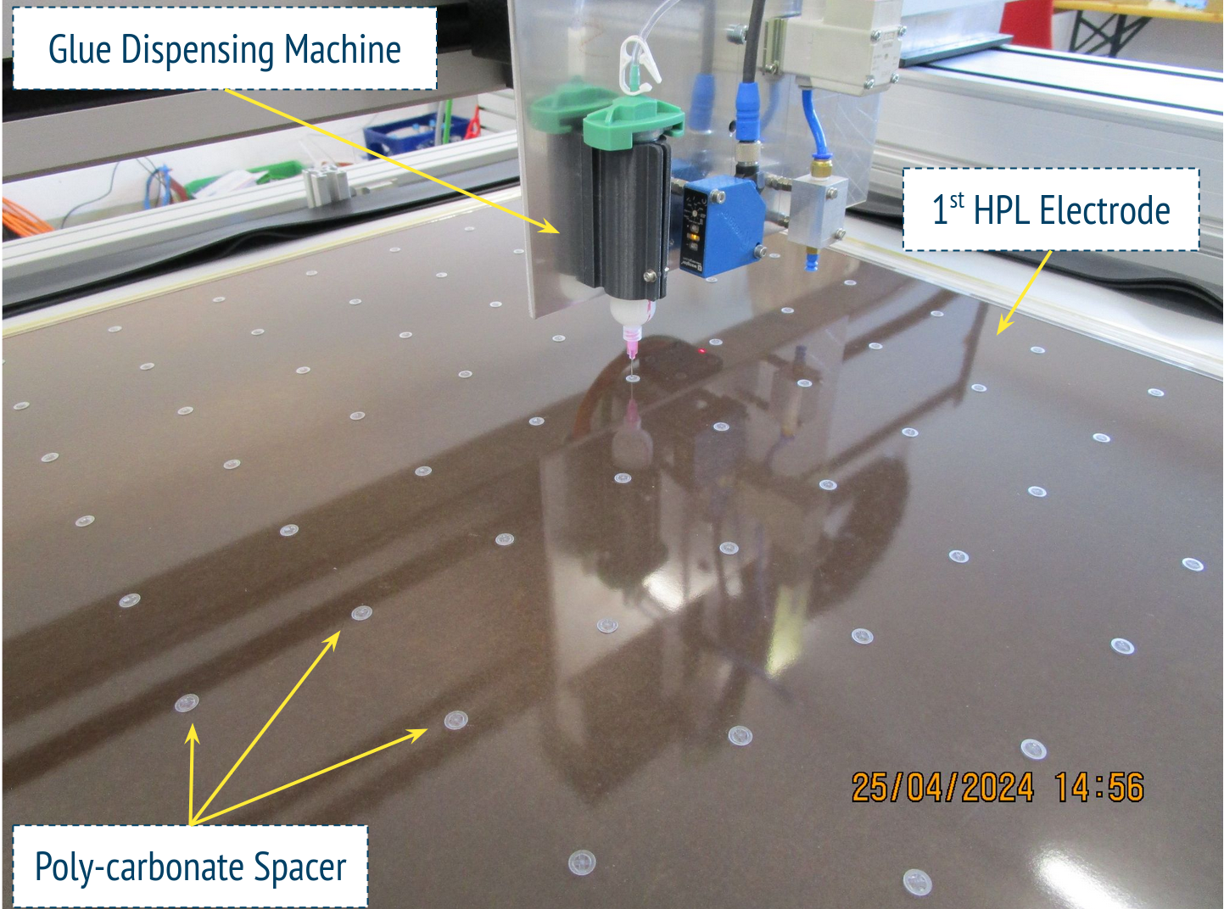
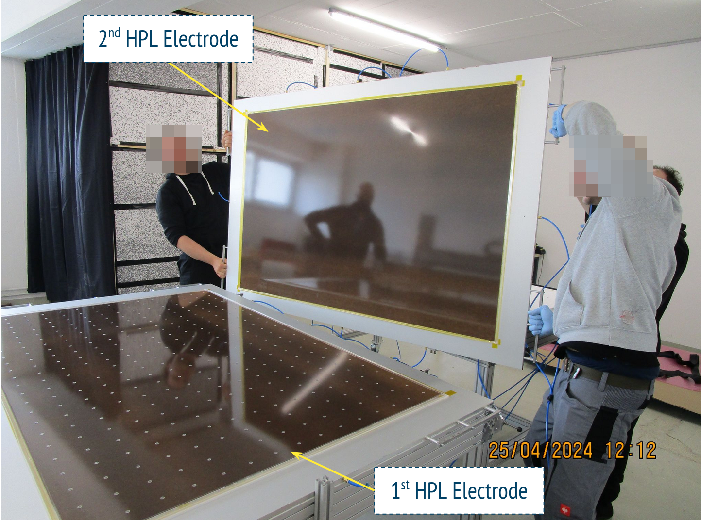
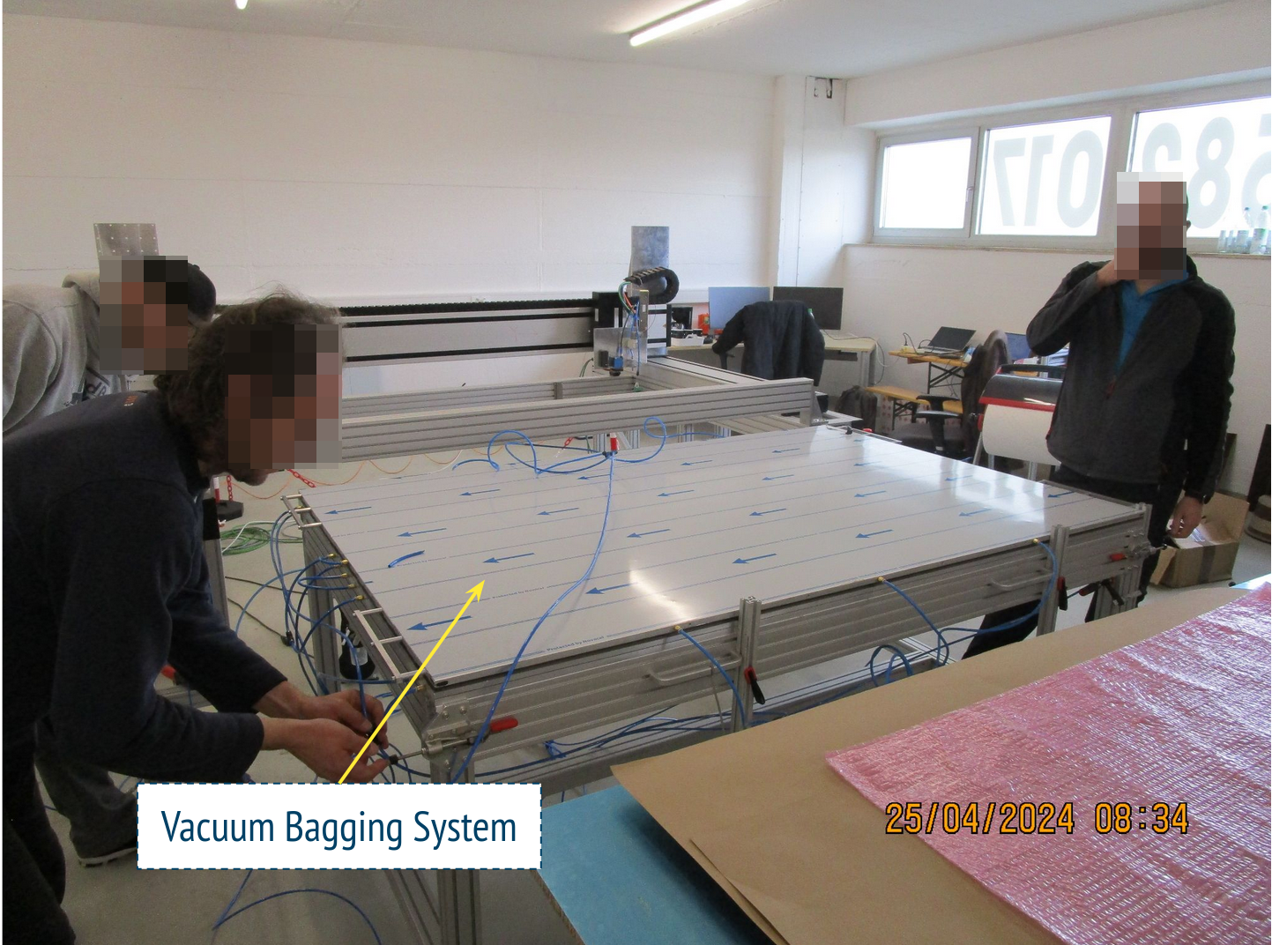
Assembly Procedure
5
The 1mm-gap RPCs production involve several stages:
Electrode production, installation of HV contacts, and lamination.
Gas gap production.
Gas pipe installation, edge sealing, sticker application.
Linseed oil coating.

Slide 7
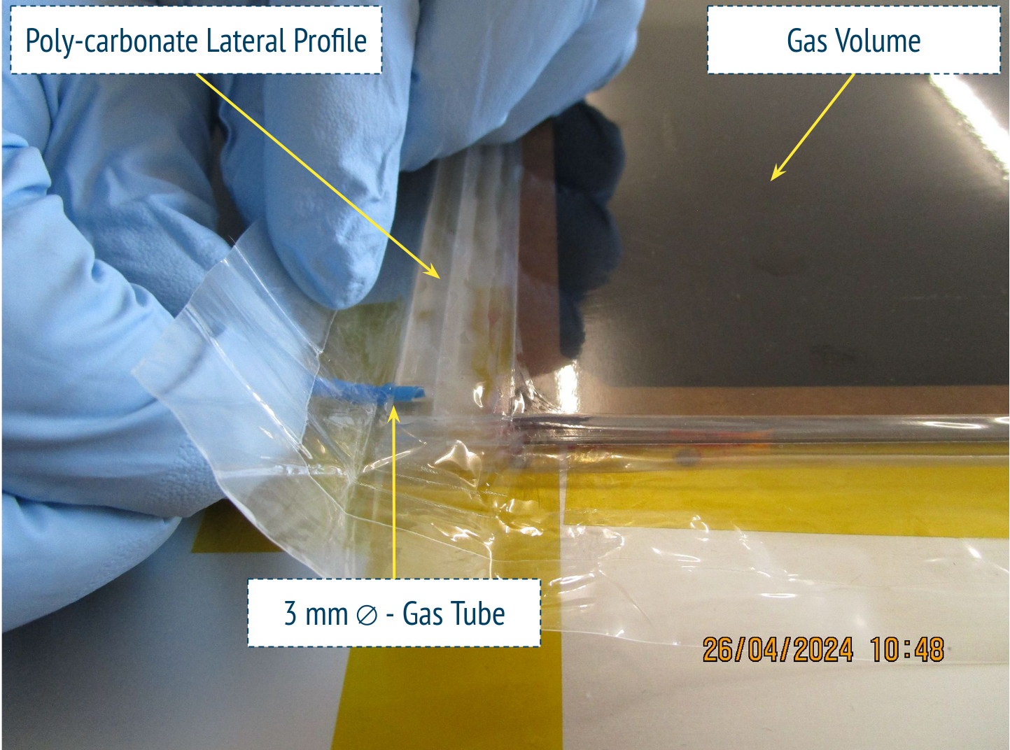
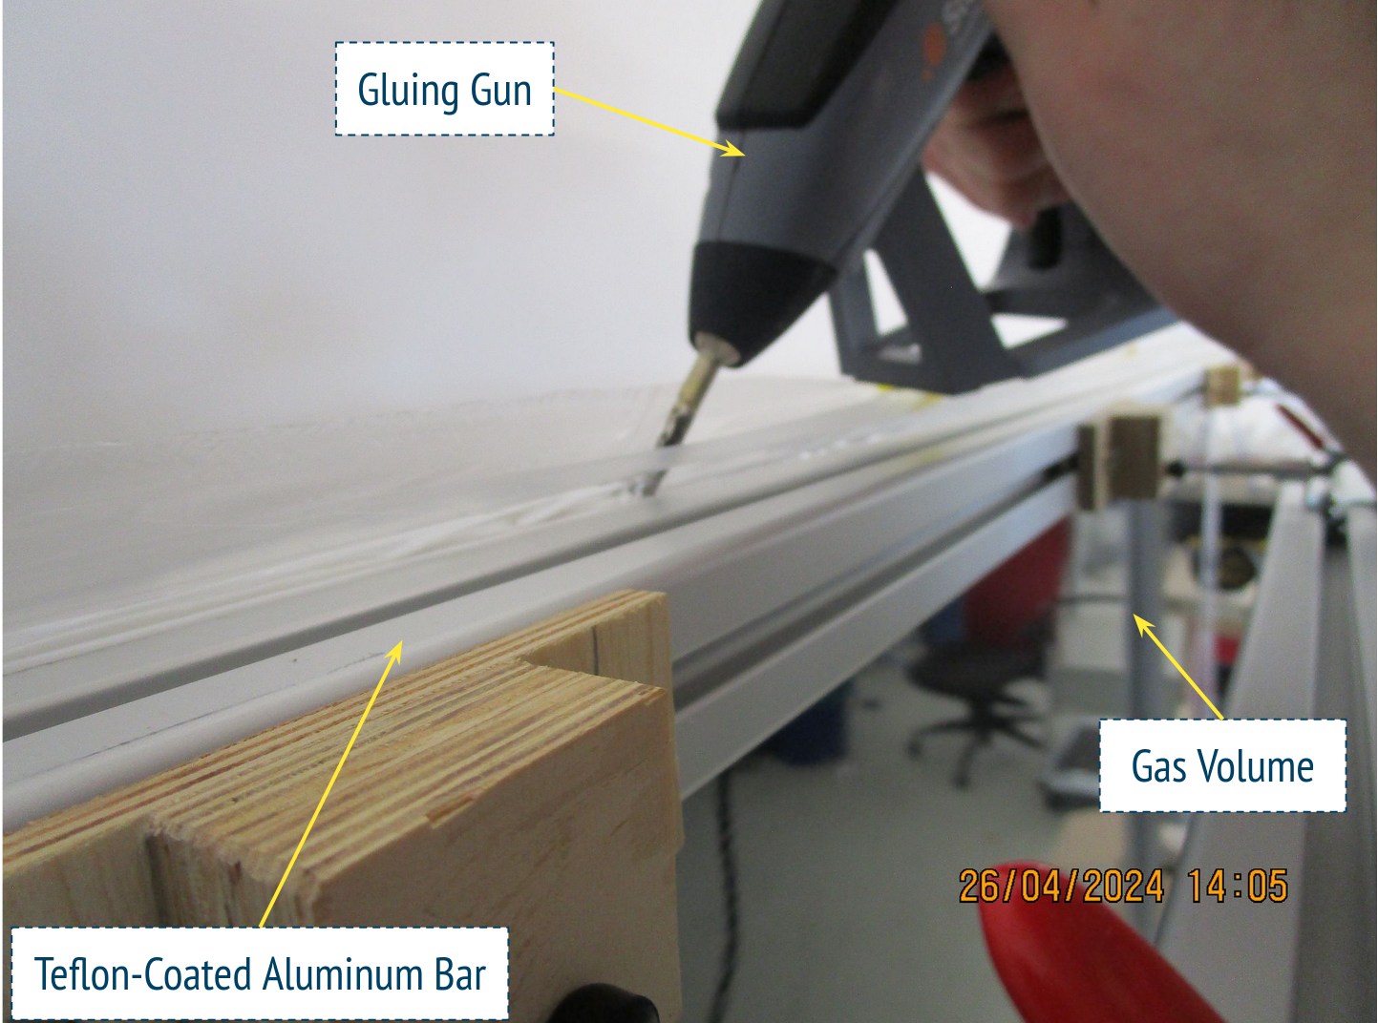
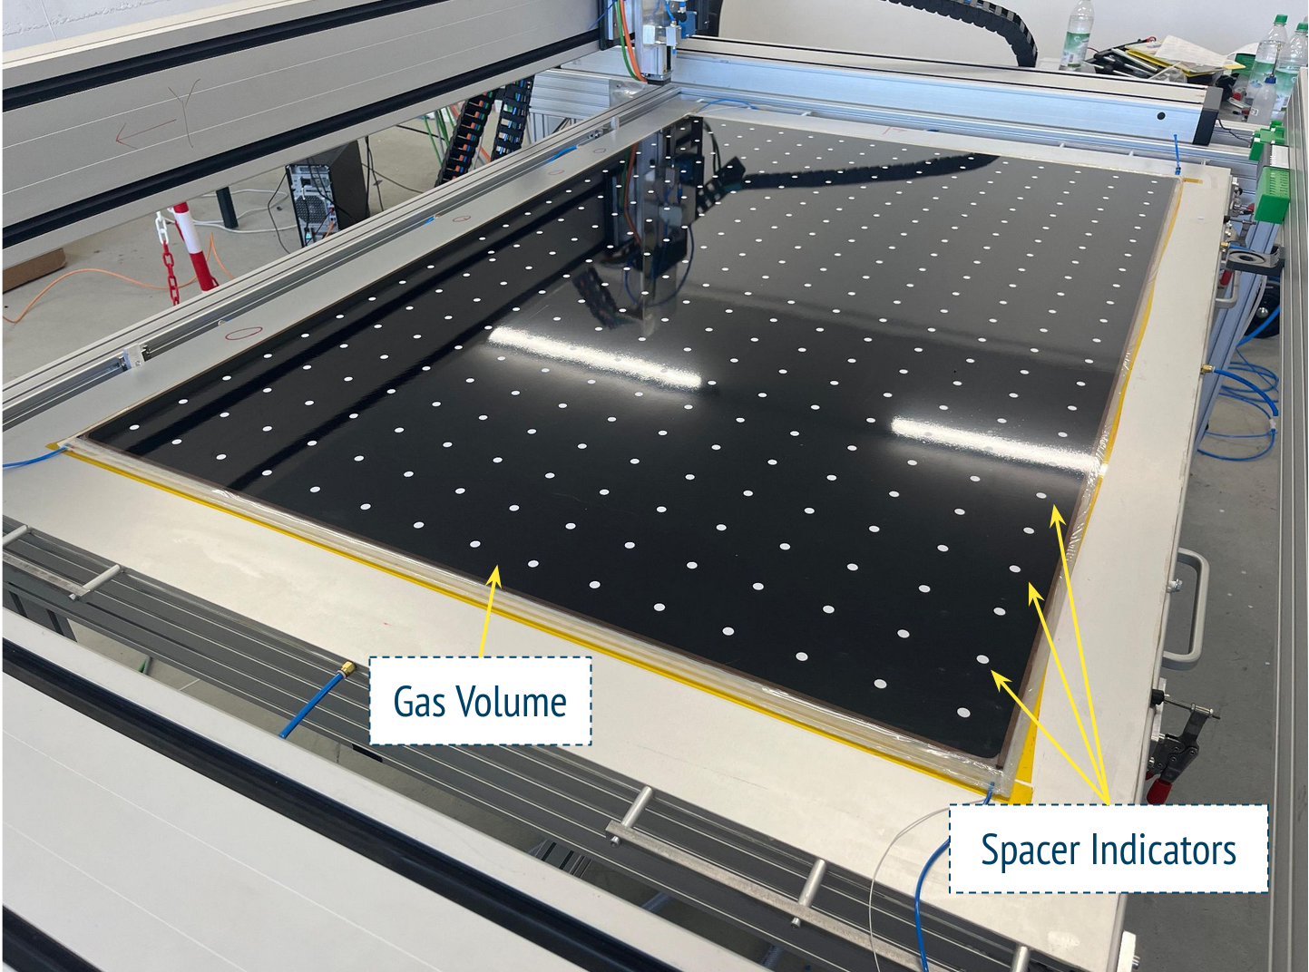
Assembly Procedure
6
The 1mm-gap RPCs production involve several stages:
Electrode production, installation of HV contacts, and lamination.
Gas gap production.
Gas pipe installation, edge sealing, sticker application.
Linseed oil coating.

Slide 8
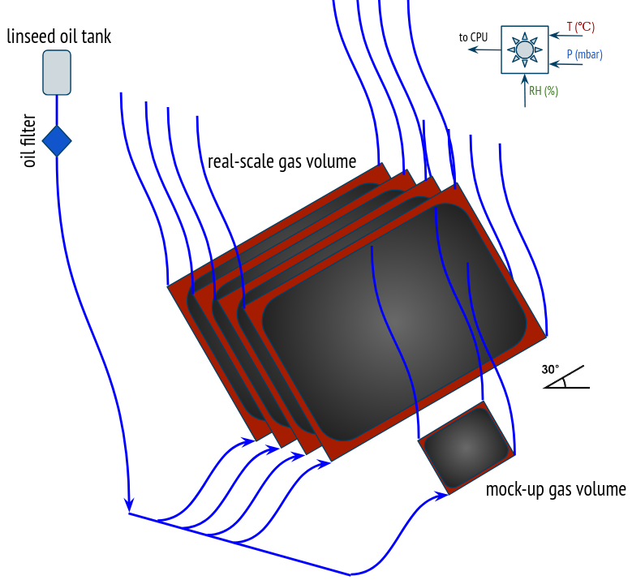
Assembly Procedure
7
The 1mm-gap RPCs production involve several stages:
Electrode production, installation of HV contacts, and lamination.
Gas gap production.
Gas pipe installation, edge sealing, sticker application.
Linseed oil coating.
schematic drawing of the oiling station

Slide 9
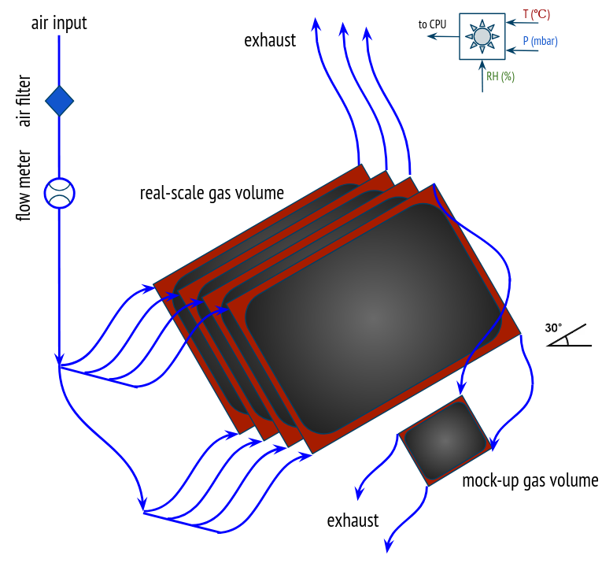
Assembly Procedure
8
The 1mm-gap RPCs production involve several stages:
Electrode production, installation of HV contacts, and lamination.
Gas gap production.
Gas pipe installation, edge sealing, sticker application.
Linseed oil coating.
The mock-up volume will later be opened to verify the quality of the coating (fully polymerised, uniform, clean)
schematic drawing of the polimerisation station

Slide 10
9
Quality Control Flowchart
Materials tests
An extensive Quality Assurance and Quality Control (QA/QC) program has been established to guarantee high quality and reliability of the gas volume production to meet the stringent requirements of ATLAS
rejected
rejected
rejected
production
FAIL
FAIL
FAIL
gas volume
Gas leak measurement
Mechanical rigidity test
hot melt glue application
sticker application
Overall dimension measurement
PASS
PASS
QC step 1
QC step 2
QC step 3
PASS
rejected
rejected
presence of linseed oil leaks
rejected
FAIL
FAIL
FAIL
oiling and polymerization
absence of linseed oil leaks
Linseed oil coating test
Leakage current measurement
I-V curve measurement
PASS
Monitoring / conditioning
PASS
PASS
PASS
FAIL
QC step 4
QC step 5
QC step 8
QC step 9

Slide 11
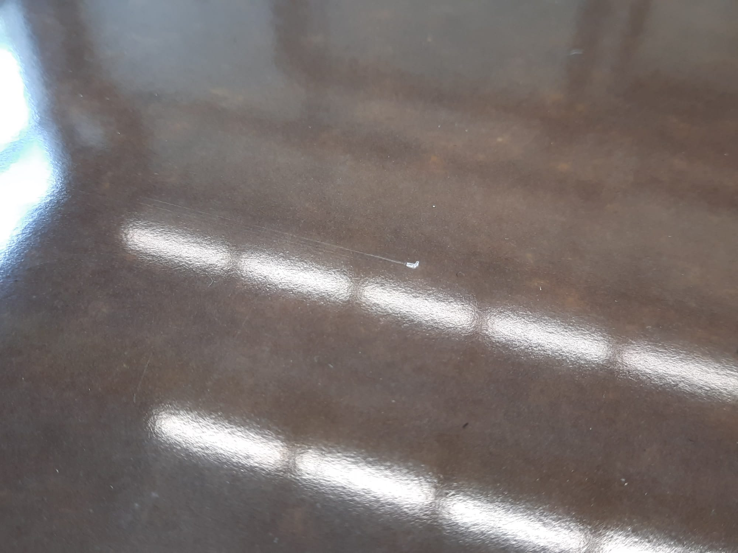
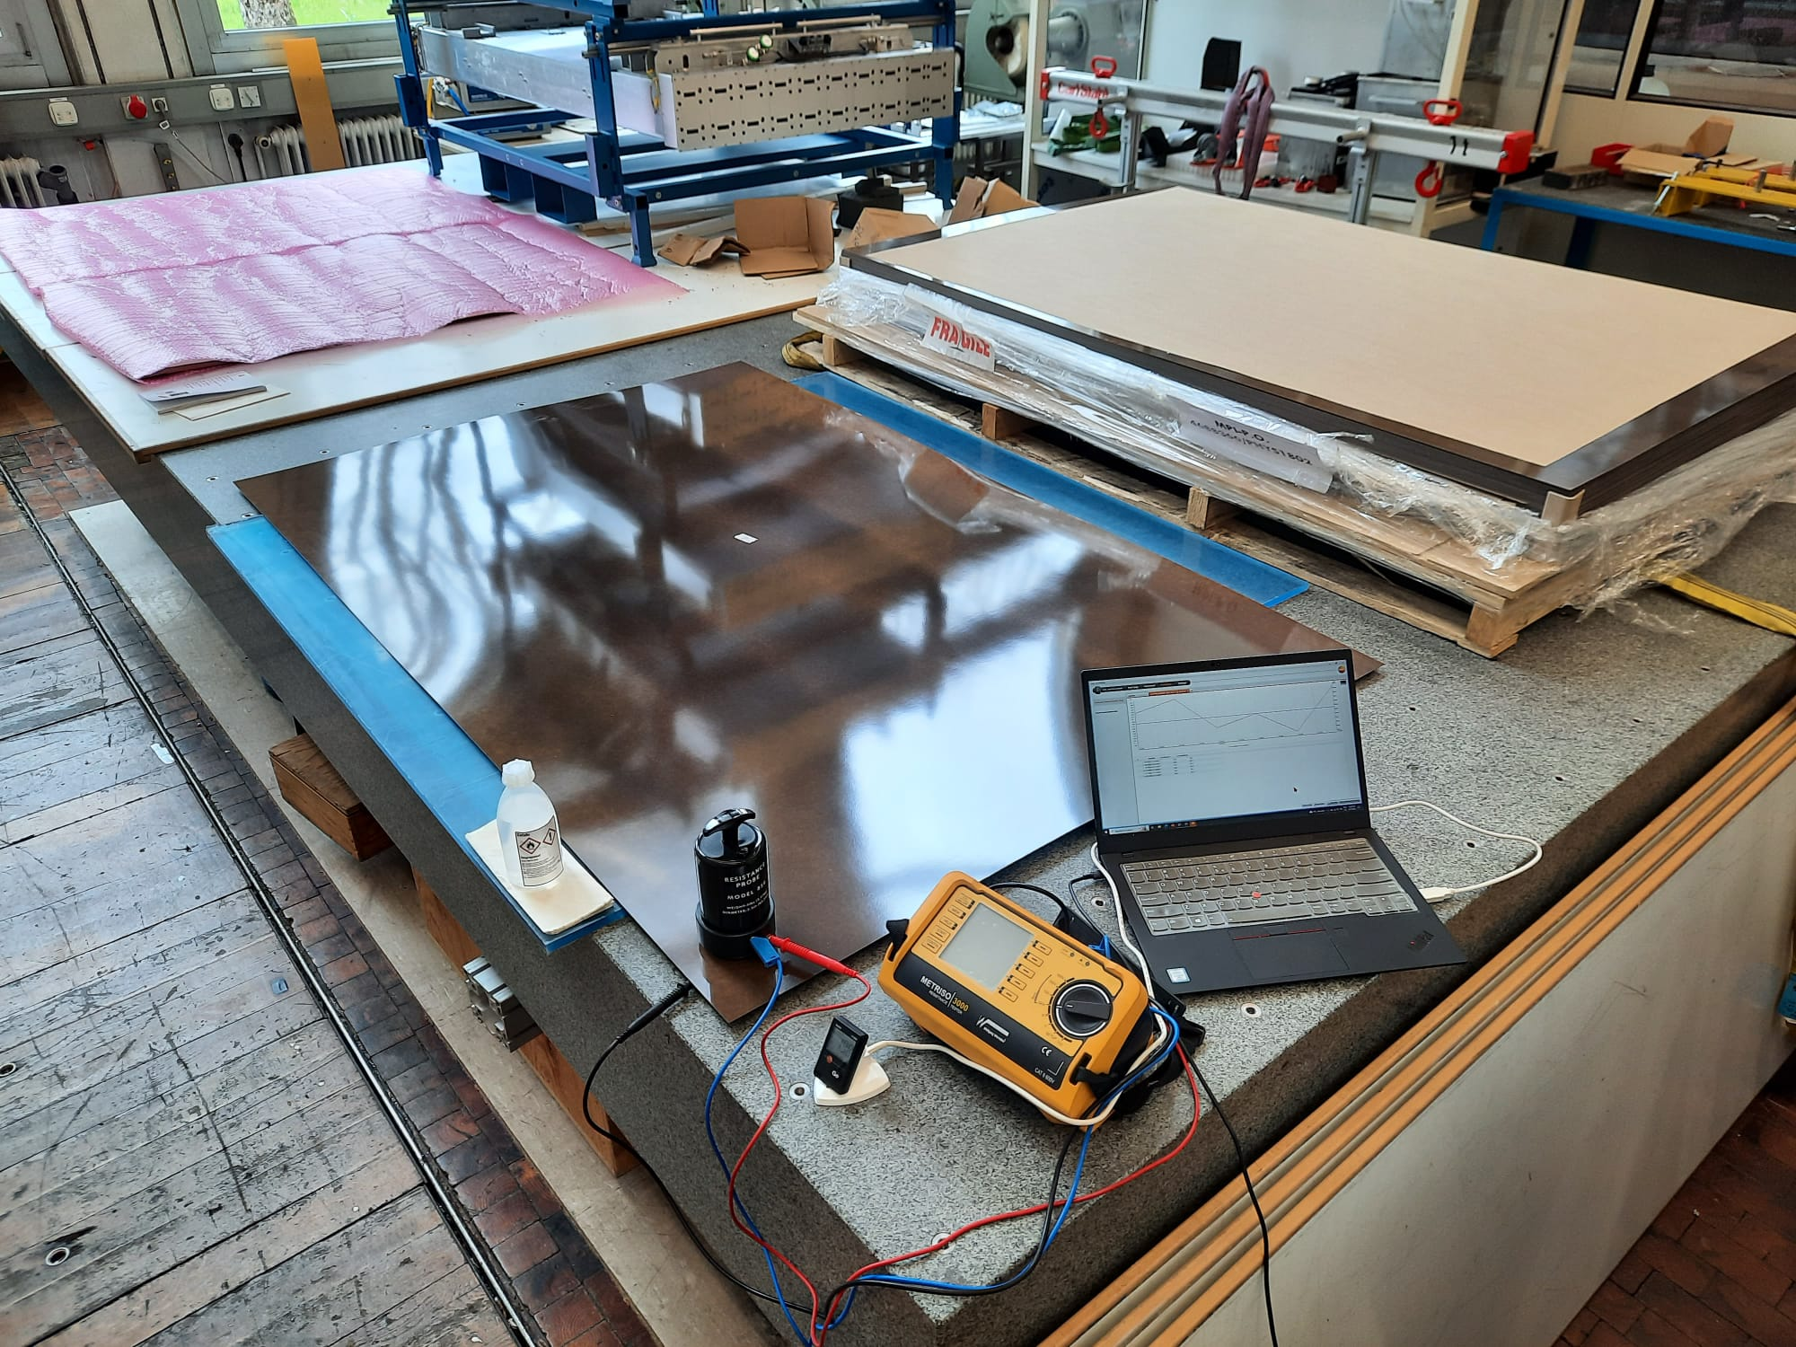
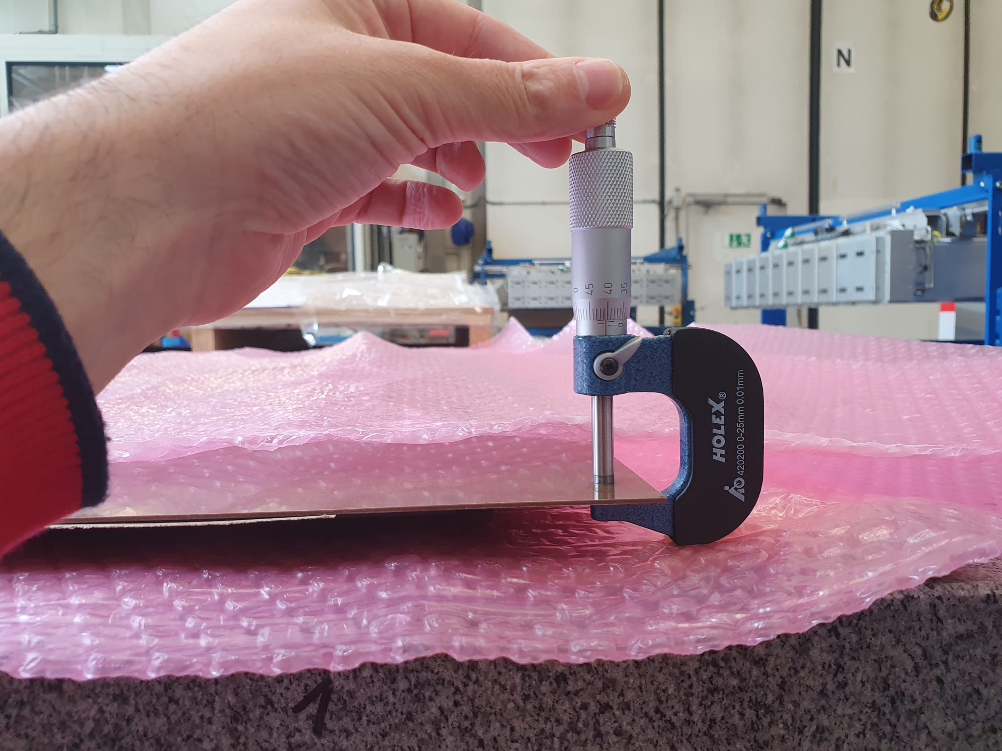
Materials Acceptance Tests
10
QA/QC step 1: HPL production test
Visual inspection of surface, volume resistivity meas., thickness meas.
QA/QC step 2: Electrode production test
Visual inspection and surface resistivity meas. of the graphite coating.
Test of absence of bubbles between the insulating PET foil and the graphite coating.
visual inspection
volume resistivity meas.
thickness meas.

Slide 12
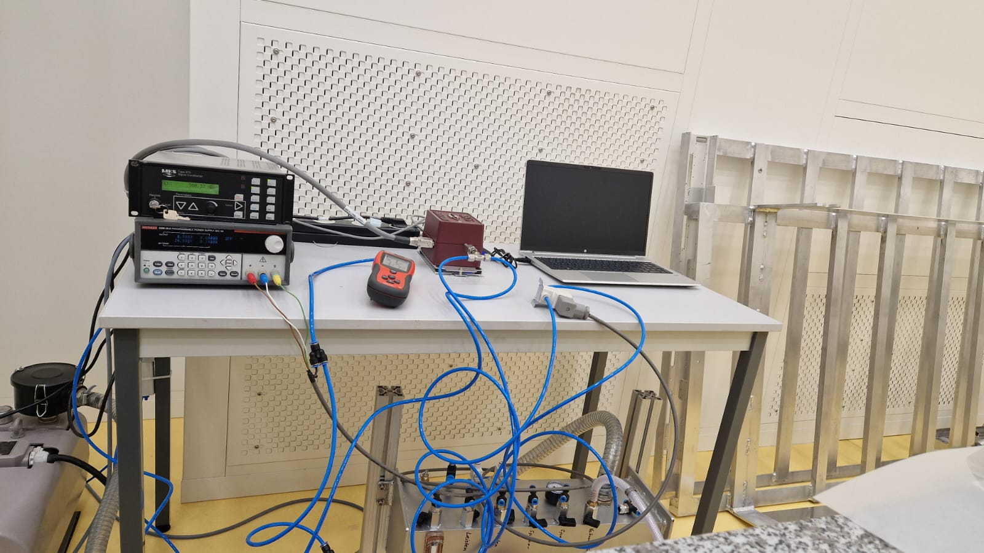
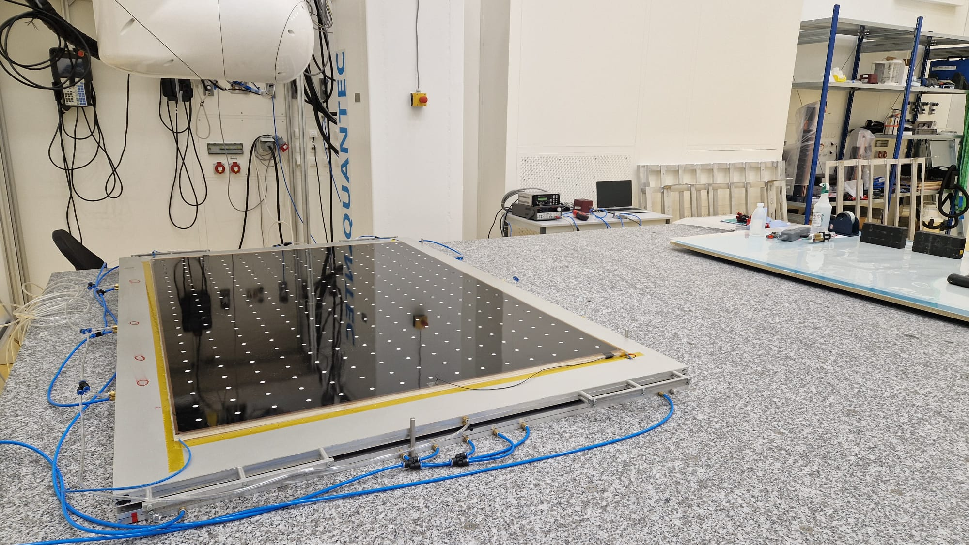
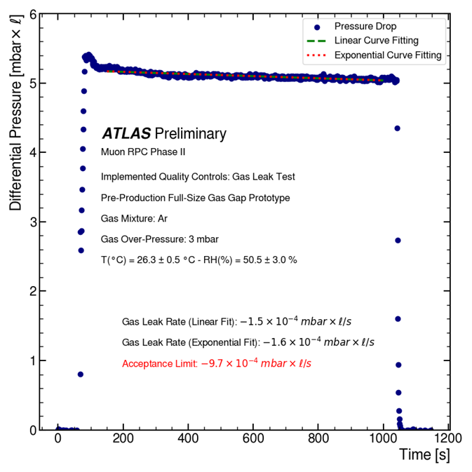
Gas leak measurement
11
Objective:
The combined leak rate of the gas volume and gas system is measured by monitoring the drop of internal pressure in order to ensure that gas tightness requirements are met.
Methodology:
Chamber is over-pressurized at 3 mbar (3x operating overpressure for ATLAS RPCs).
Monitor the drop over 10 minutes, using a precision pressure gauge.
Setup is completely automated, improving reliability and production efficiency.
The combined acceptance limit for the gas volume and system is a leak rate of $−9.7×{10}^{−4 }$mbar × l / s.

Slide 13
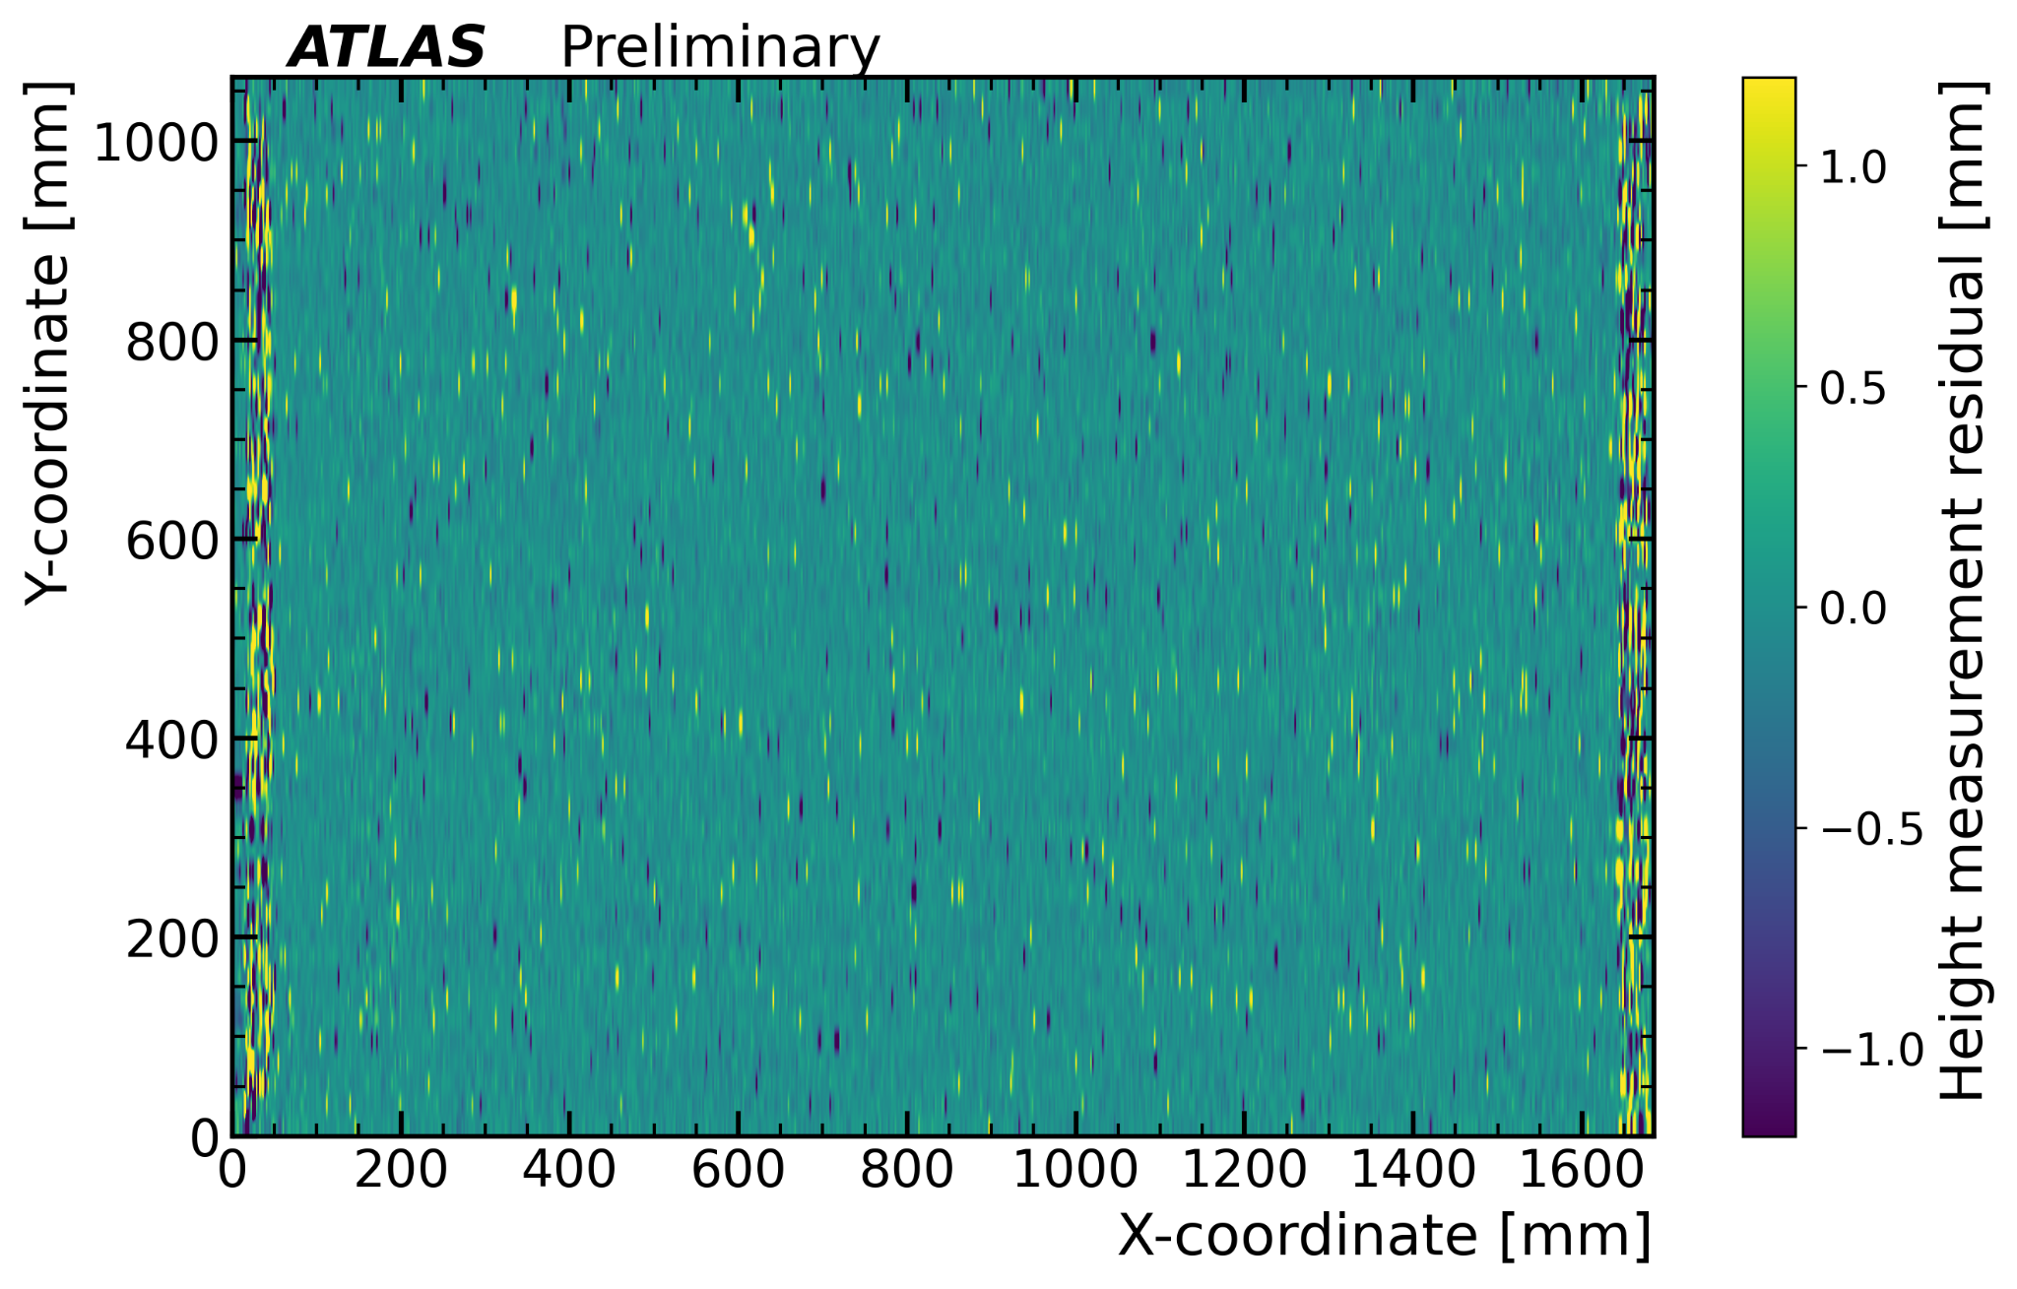
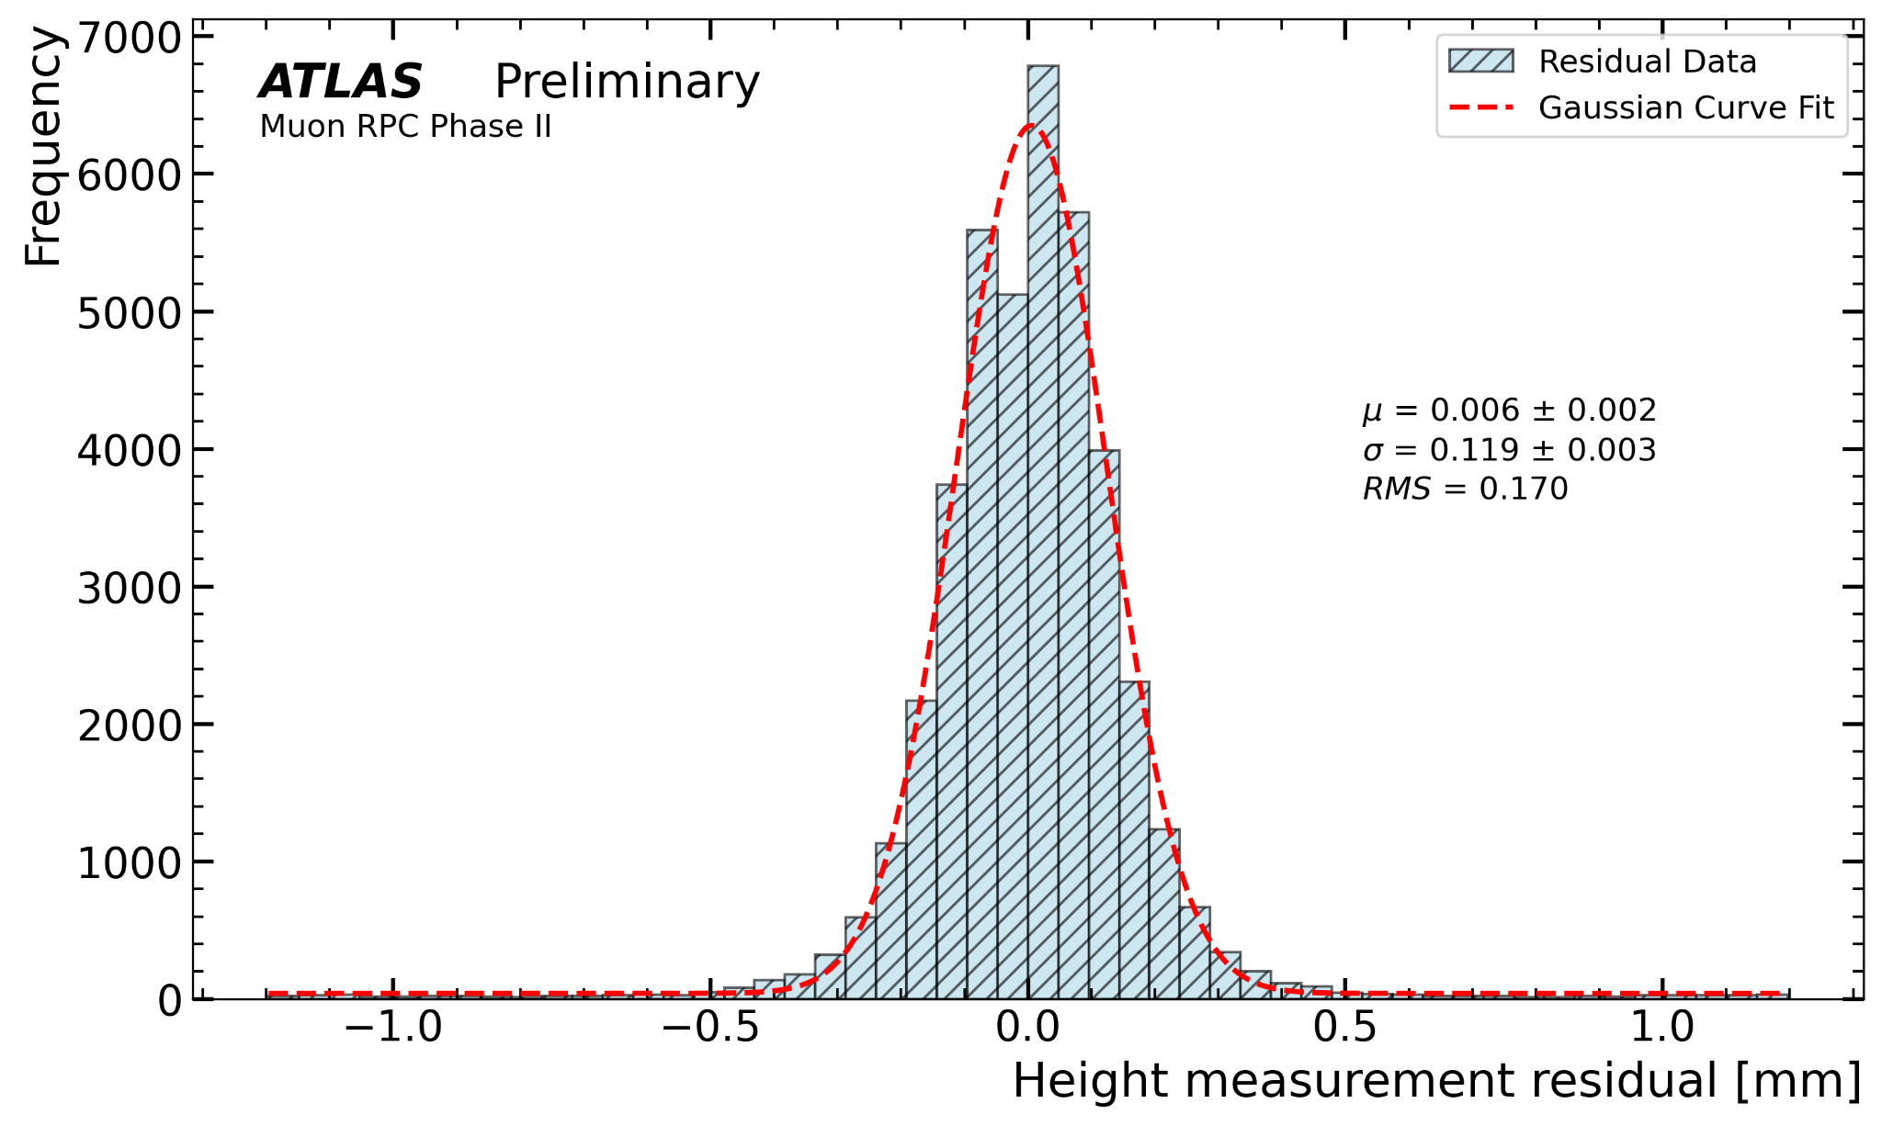
Gas Gap Mechanical Rigidity Test
12
Gas channels
Objective:
Ensure gas volume integrity by detecting popped-up spacers caused by insufficient adhesive bonding or improper handling during fabrication process.
Methodology:
Initial Test: A laser scan planarity test is conducted to assess the flatness of the gas volume at atmospheric pressure.
Pressurized Test: The gas volume is then pressurized to 3 mbar above atmospheric pressure, and the laser scan planarity test is repeated.
Analysis:
Residuals are calculated by comparing the laser scans at atmospheric and pressurized conditions to identify any discrepancies indicating popped-up spacers.

Slide 14
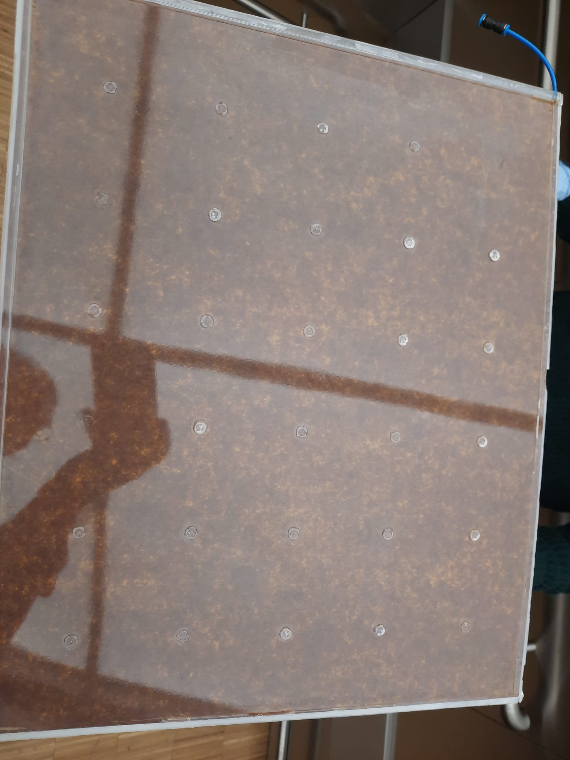
Mock-up gas volume opening
13
The mock-up is an accurate representation of the status of the full-scale volume, in terms of detector components, materials, and quality of the coating.
Expected visual inspection results:
The oil coating is applied uniformly across all surfaces.
The linseed oil has fully polymerized on both HPL plates.
Minimal dust / debris should be present in the coating.
Scratch resistance:
A 10 mm blade, held at 45°, applying 1 N of force, scrapes the coating for a length of 100 mm.
No oil residue should be left on the blade, and no damage should be visible on the coating.

Slide 15
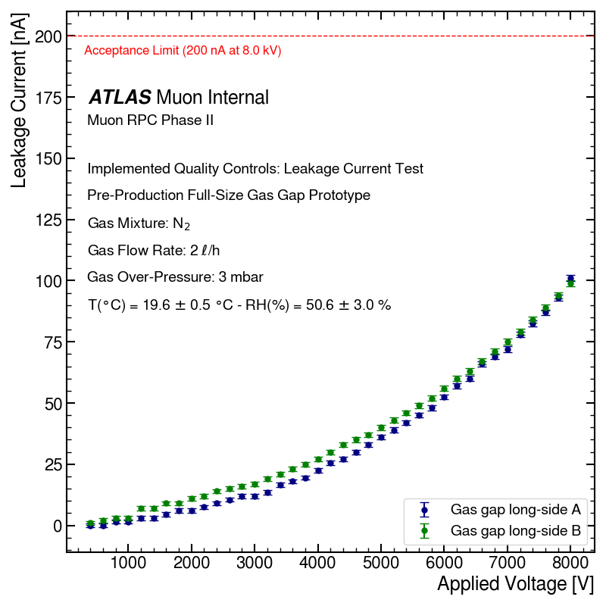
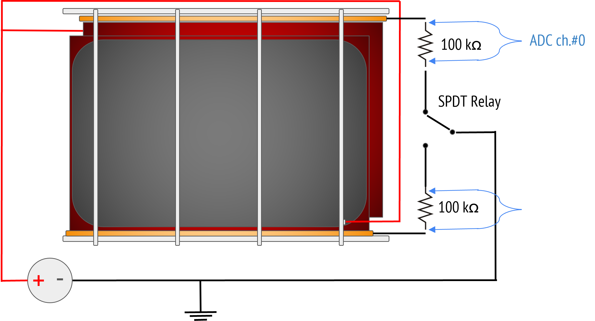
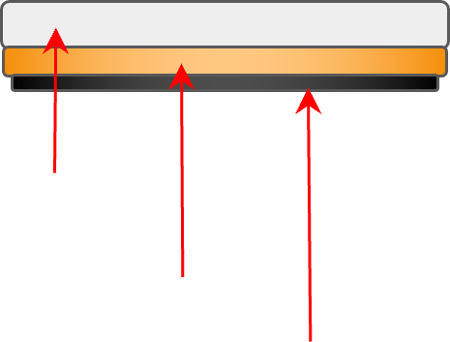
Leakage Current Measurement
14
Objective:
Measure the leakage current within the HPL electrodes of the gas volume to ensure proper insulation and minimal leakage.
Methodology:
The HPL electrodes are subjected to the same voltage. This allows us to perform the test in air
A copper-coated teflon bar, grounded through a 100 kΩ resistor, is brought into contact with the long side of the gas gap under test. The presence of a layer of conductive rubber ensures a good electrical contact across the whole length.
The leakage current is monitored through the voltage drop across the resistor.
Analysis:
The gas volume passes the test if the leakage current does not exceed 200nA at the maximum applied voltage of 8 kV on both HPL electrodes.
Teflon
Copper
Conductive Rubber
High Voltage Power Supply Module - CAEN Mod. R1470ET

Slide 16
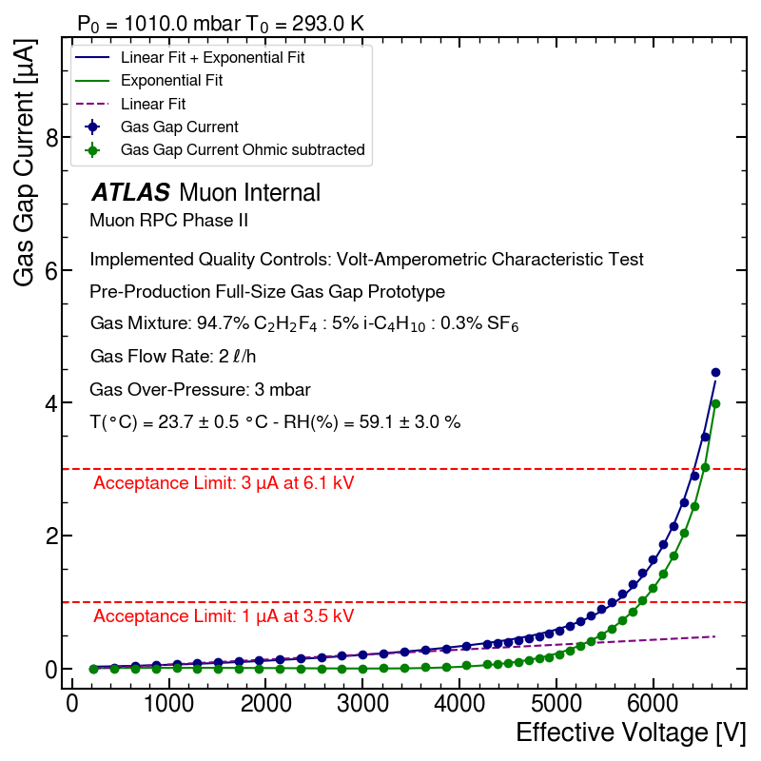
Volt-Amperometric Characteristic Test
15
Objective:
Characterize the gas volume by evaluating the current flow through the gas gap under different voltages with the standard ATLAS RPC gas mixture (94.7% C₂H₂F₄ : 5% i-C₄H₁₀ : 0.3% SF₆).
Methodology:
The voltage scan is conducted by gradually increasing the applied voltage in 200 V increments up to 4 kV, followed by 100 V increments up to 6.2 kV.
The current flowing through the gas gap is measured via a 100 kΩ resistor connected in series with the device.
The applied voltage V_{app} is rescaled to calculate the effective voltage V_{eff} using the equation: V_{eff} = V_{app} × (P₀ / P) × (T / T₀), where P₀=1010 mbar and T₀=293 K.
Analysis:
Acceptance Limits:
Maximum current of 3 µA at 6.1 kV after subtracting ohmic contribution.
Maximum current of 1 µA at 3.5 kV.
Ohmic contribution is determined using a linear fit in the range [0, 3] kV.

Slide 17
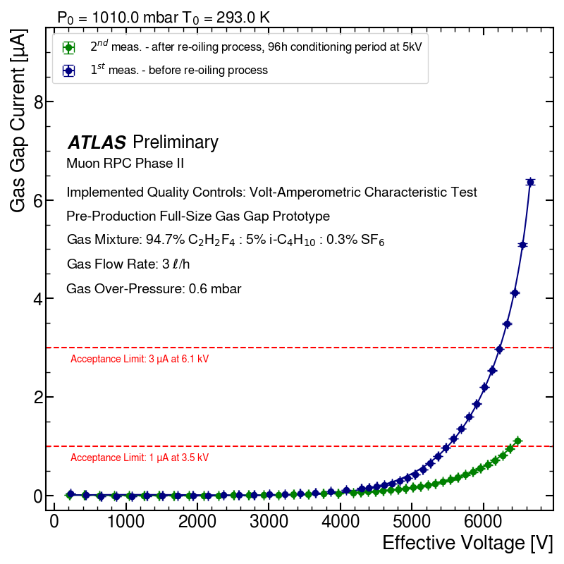
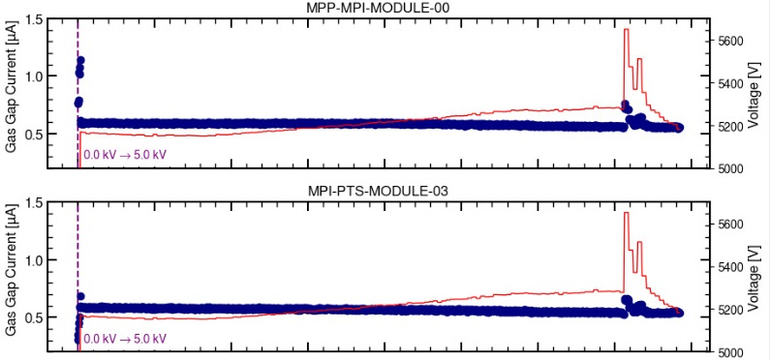
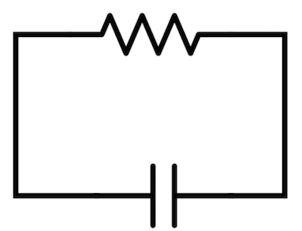
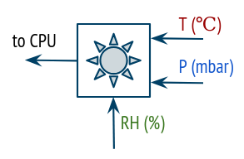
Long-Term Stability Test
16
Objective:
Ensure long-term gas volume stability by continuously monitoring the gas gap current over time with the standard ATLAS RPC gas mixture.
Methodology:
The gas gap current is continuously monitored over time at applied voltages of 5.0 kV, 5.4 kV, and 5.8 kV, with each conditioning step lasting 48 hours.
Real-time voltage correction to compensate for environmental parameters.
The volt-amperometric characteristic curves are measured at both the beginning and the end of the conditioning period.
ADC CH-1
Bosch BME 280 Sensor
HV PS CH-1
HV PS CH-2
HV PS CH-3

Slide 18
QA/QC summary
17
Materials tests
rejected
rejected
rejected
production
FAIL
FAIL
FAIL
gas volume
Gas leak measurement
Mechanical rigidity test
hot melt glue application
sticker application
Overall dimension measurement
PASS
PASS
QC step 1
QC step 2
QC step 3
PASS
rejected
rejected
presence of linseed oil leaks
rejected
FAIL
FAIL
FAIL
oiling and polymerization
absence of linseed oil leaks
Linseed oil coating test
Leakage current measurement
I-V curve measurement
PASS
Monitoring / conditioning
PASS
PASS
PASS
FAIL
QC step 4
QC step 5
QC step 8
QC step 9

Slide 19
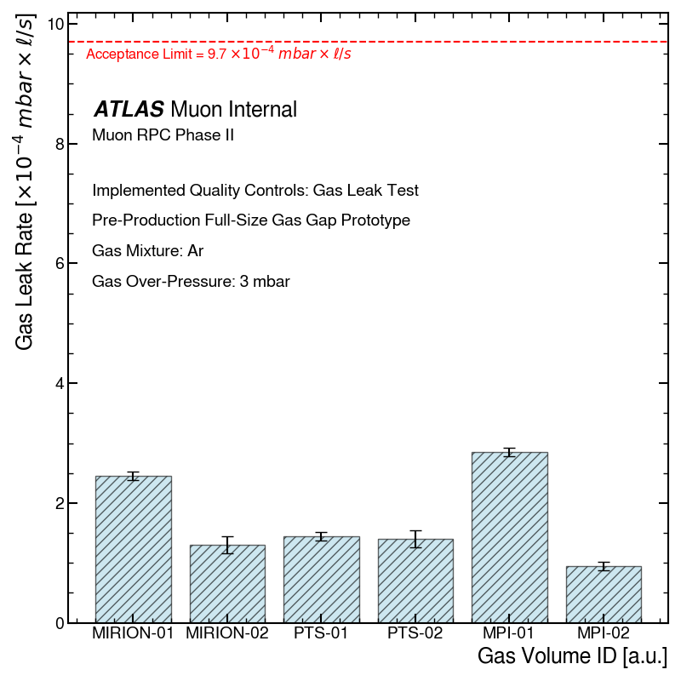
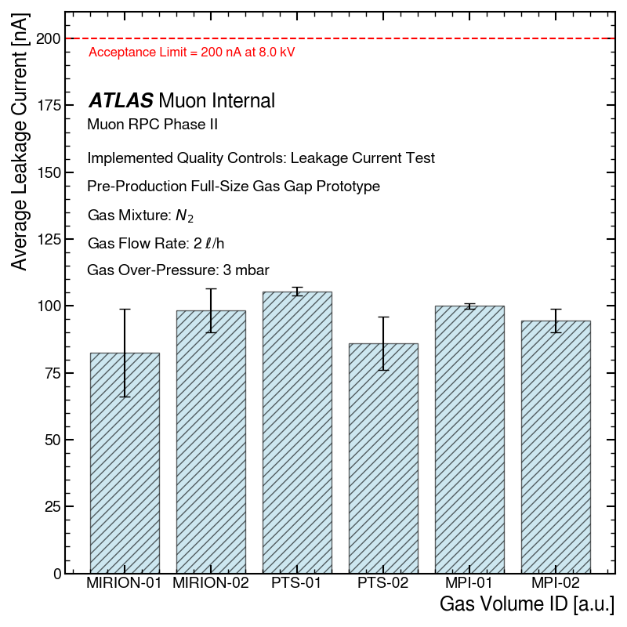
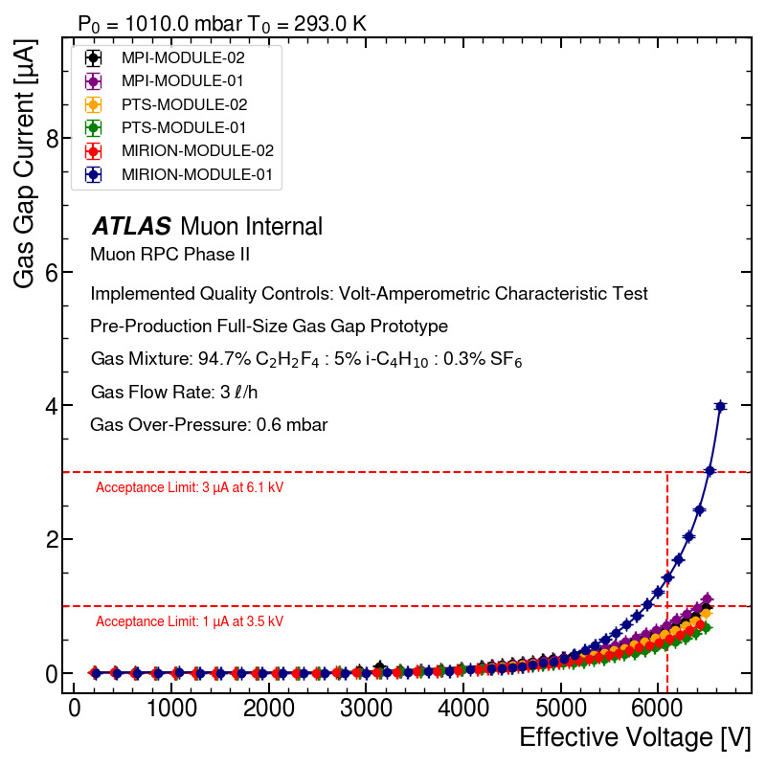
QA/QC results summary
18
To date, six real-scale RPC gas volume have been successfully assembled: two at MIRION, two at PTS, and two at MPI.
All real-scale gas volumes produced by MPI and German companies fully meet the stringent acceptance requirements.
QA/QC tests have been, where possible, automated, with plans to build independent test stands, fully integrated with the required equipment, on track to be completed before the start of production in the Summer of 2025.
A real-scale gas volume from each production site has been selected for final longevity certification at CERN.
Gas tightness measurement
Leakage current measurement
Volt-Amperometric characteristic test

Slide 20
Thank you for your attention

Slide 21
Extras

Slide 22
RPCs for the ATLAS Muon System Upgrade
Installation of ~1000 1mm-gap RPCs in the inner layer of the to maximize the efficiency and geometrical acceptance of the muon trigger.
Challenges:
Very tight space constraints:
only 60 mm in radial space available for the system.
Higher rate capability:
make up for loss in efficiency of legacy RPC system.
Required longevity:
>10 years of operation at HL-LHC till 2040.
efficiency drops due to the uninstrumented detector regions
The challenge is to build a new generation of 1mm-gap RPCs
with higher rate capability and longevity.

Slide 23
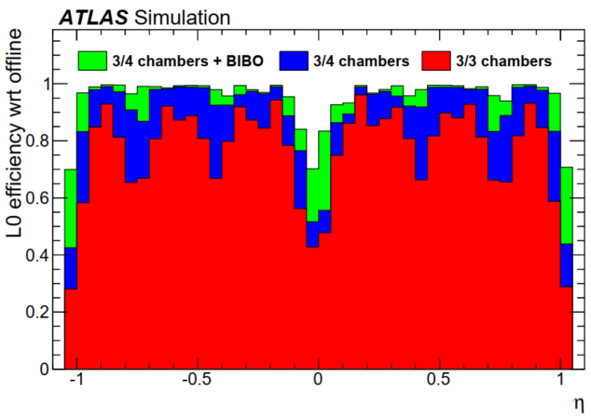
RPCs for the ATLAS Muon System Upgrade
Installation of ~1000 1mm-gap RPCs in the inner layer of the to maximize the efficiency and geometrical acceptance of the muon trigger.
Challenges:
Very tight space constraints:
only 60 mm in radial space available for the system.
Higher rate capability:
make up for loss in efficiency of legacy RPC system.
Required longevity:
>10 years of operation at HL-LHC till 2040.
The challenge is to build a new generation of 1mm-gap RPCs
with higher rate capability and longevity.

Slide 24
Establishing New RPC Production Facilities
The MPI team leads the industrialization of 1mm-gap RPC detector technology for the ATLAS Muon Spectrometer upgrade, preparing for the HL-LHC era and future collider projects.
~300/1000 RPCs required for the ATLAS Muon Spectrometer upgrade will be produced at the MPI in collaboration with industrial partners.
Successful technology transfer to industrial manufacturers has enabled large-scale RPC production that meets the stringent ATLAS standards.
Dedicated facilities for the construction and certification of 1mm-gap RPCs have been established at:

Slide 25
Quality Control Flowchart (pre-production)
rejected
rejected
presence of linseed oil leaks
gas leak repair
FAIL
FAIL
FAIL
FAIL
gas volume
gas leak measurement
mechanical rigidity test
oiling and polymerization
absence of linseed oil leaks
linseed oil coating test
hot melt glue application
PASS
PASS
PASS
QC step 1
QC step 2
QC step 3
mock-up gas volume
rejected
rejected
gas leak repair
rejected
rejected
FAIL
FAIL
FAIL
FAIL
FAIL
FAIL
overall dimension measurement
leakage current measurement
gas leak measurement
mechanical rigidity test
I-V curve measurement
PASS
Monitoring / conditioning
PASS
PASS
PASS
PASS
PASS
FAIL
QC step 4
QC step 5
QC step 6
QC step 7
QC step 8
QC step 9

Slide 26
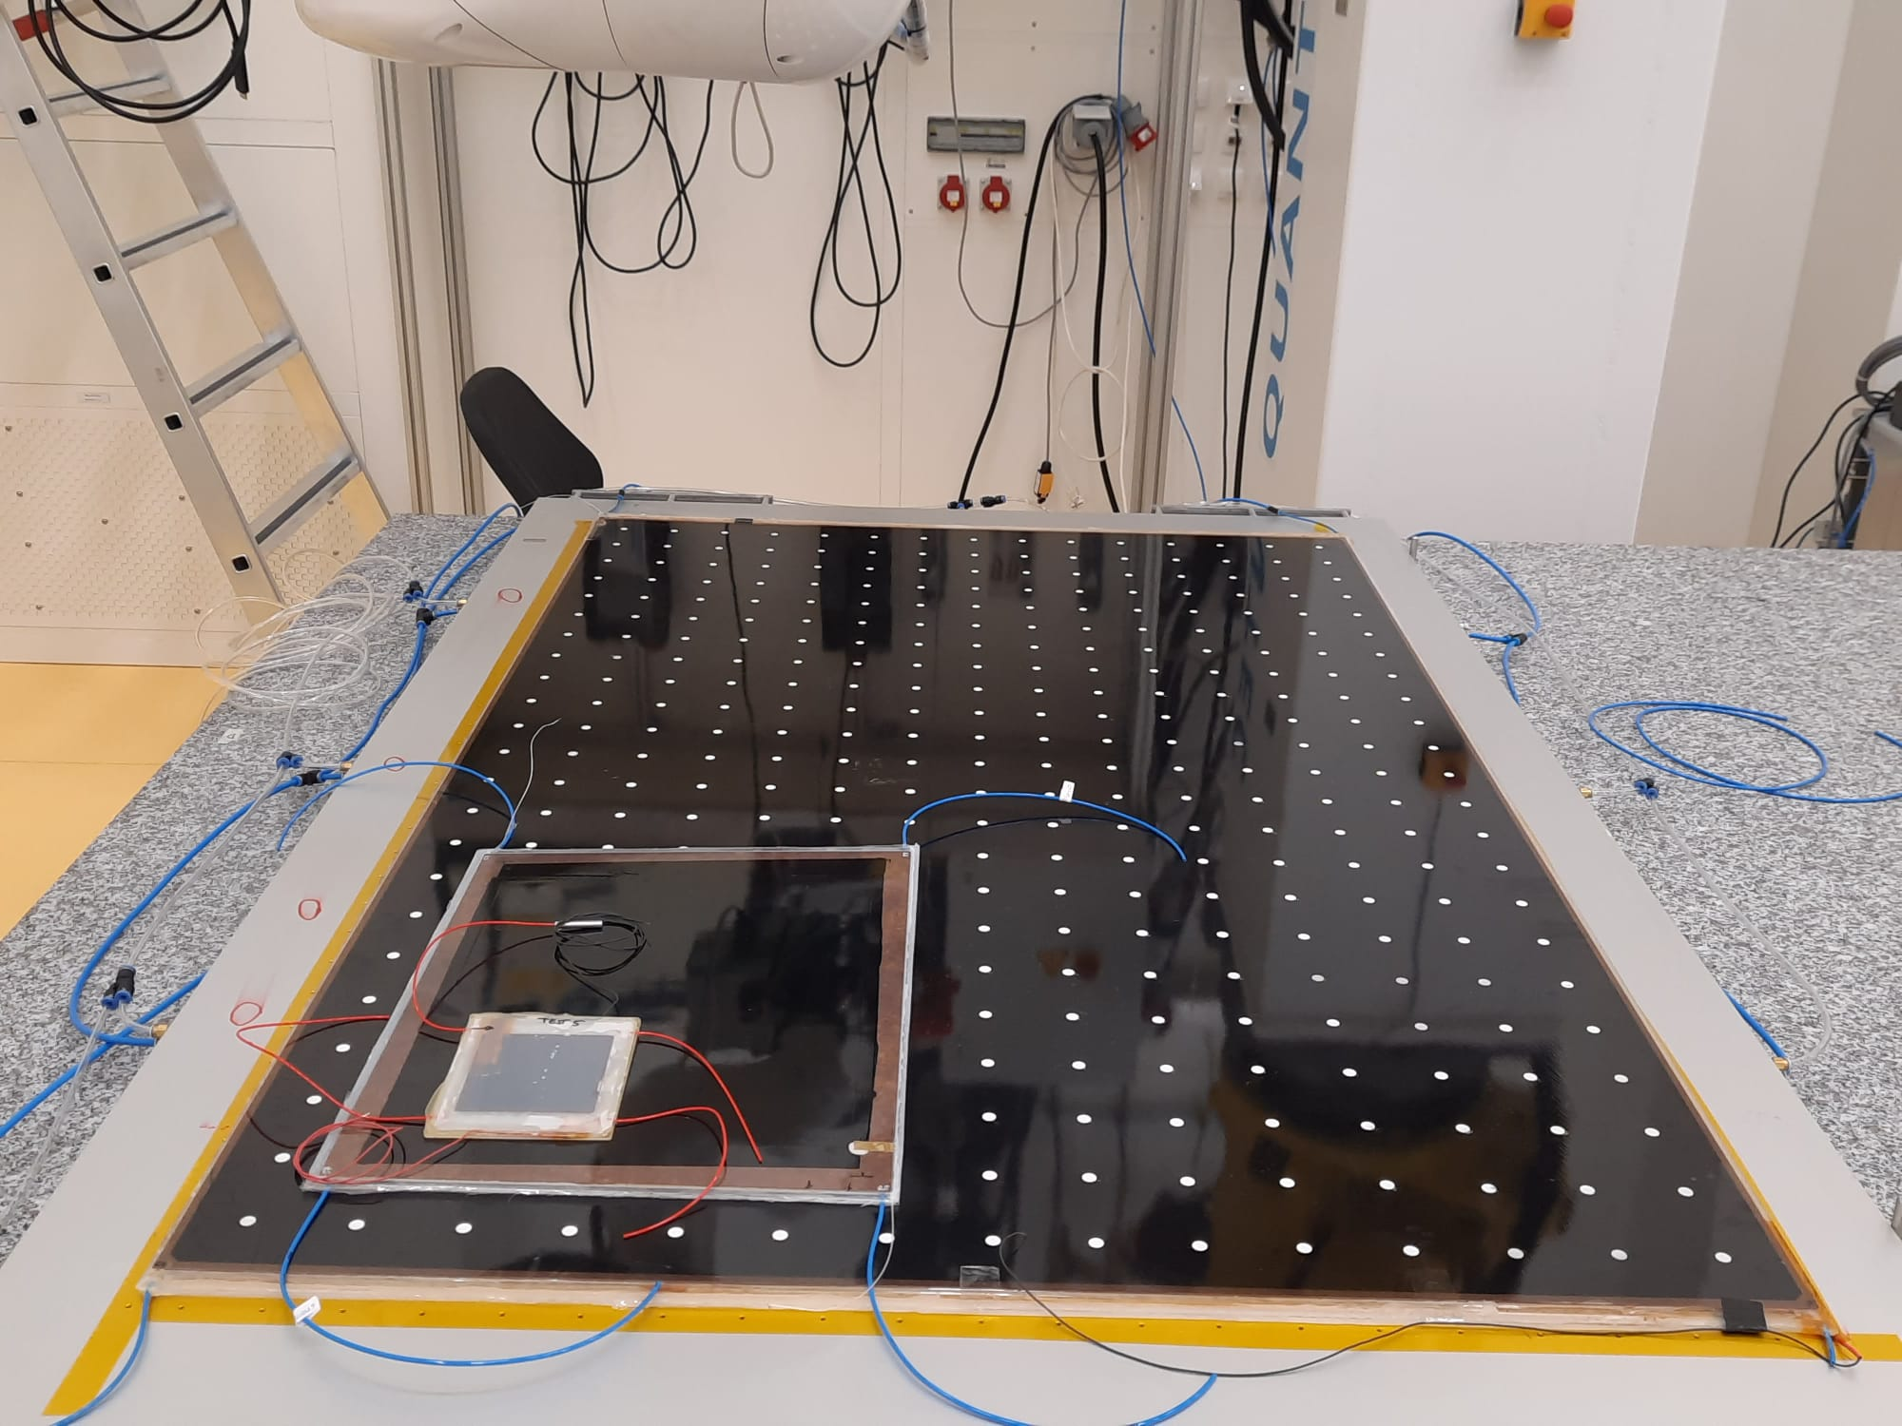
Long-Term Partnership with Industry
A fully established production site at MPI, enabling reliable and scalable manufacturing of PRC detectors in partnership with industry.
Multiple prototype iterations produced at MPI to validate and refine manufacturing steps.
Lessons learned integrated back into processes, ensuring robust and reliable production workflows.
Implementation of rigorous industrial-level quality assurance and control measures.
Extensive collaboration with industry to gradually mature production capabilities.
Deep understanding of RPC technology leading to improvements in detector design, prioritizing on reliable manufacturing, rigorous QA/QC, and backed by dedicated in-house engineering expertise.
2019 -2021
10 × 10 cm²
2022 -2023
50 × 40 cm²
2024 -2025
2 × 1 m²

Slide 27
Assembly Procedure
The 1mm-gap RPCs production involve several stages:
Production step 1: HPL electrode production
Graphite coating on surface of the HPL electrodes using a silk-screen technique in industry.
Mesh size: 90 threads/cm and drying process at 105 °C for 1h.
Installation of the high-voltage and ground contact.
Epoxy silver glue: E-Solder® 3025; curing time: 24-36 h at 25 °C.
Laminating of the insulating Polyethylene Terephthalate (PET) film onto the HPL electrodes.
Laminating Perfex gloss PET-EVA foil (190 µm PET + 80 µm EVA).
Roll lamination at 105 °C under pressure at ~3 m/min.
graphite coating of the HPL electrodes
triple graphite layer edge
lower resistivity (<20 kΩ/◻) on edge to improve the high voltage distribution.
graphite coating
(ρ_{s} = 350 kΩ/◻)
laminating press machine
HPL electrode after lamination

Slide 28
Assembly Procedure
Production step 2: Gas gap production
Component Preparation
Thoroughly cleaning of the polycarbonate spacers and lateral profiles with isopropanol.
Placing components onto a Teflon gluing jig, secured by a vacuum system during adhesive application
Adhesive Application
Using an automated gluing dispenser integrated with an X-Y-Z robot for precise epoxy glue¹ deposition.
Employing dynamic dispensing parameters to account for variations in epoxy glue viscosity over time.
Continuously monitoring room temperature and relative humidity to ensure consistent bonding quality.
¹ epoxy glue: 3M™ Scotch-Weld™ DP460 [LINK]

Slide 29
Assembly Procedure
Production step 2: Gas gap production
Adhesive Application
Applying epoxy glue on the polycarbonate parts already bonded to the first HPL electrode.
Electrode Placement
Carefully positioning and aligning the second HPL electrode on the first electrode to form the gas gap.
Vacuum Bagging
Installing the vacuum bagging system to ensure a secure and uniform hold during the epoxy curing process.
Curing Process
Curing the epoxy glue for 7 hours at 20–25 °C; maintaining a vacuum level of −200 mbar (i.e. ~ 100 N on each spacer).
step 2.6
step 2.7
step 2.8

Slide 30
Assembly Procedure
Production Step 2: Gas gap production
Gas Pipes Installation
Installing and gluing the 3 mm-diameter gas pipes into the polycarbonate lateral profile holes along the short edges.
Edge Sealing
Filling and sealing the long edges of the gas volume with the Ethylene Vinyl Acetate (EVA) hot-melt glue².
Spacer Indicators
Attaching 0.10 mm thick paper stickers on both gas gap surfaces to mark spacer positions.
Fully automated sticker application ensures accurate and consistent placement.
² EVA hot-melt glue: Technicoll® 9310 [LINK]
step 2.9
step 2.10
step 2.11

Slide 31
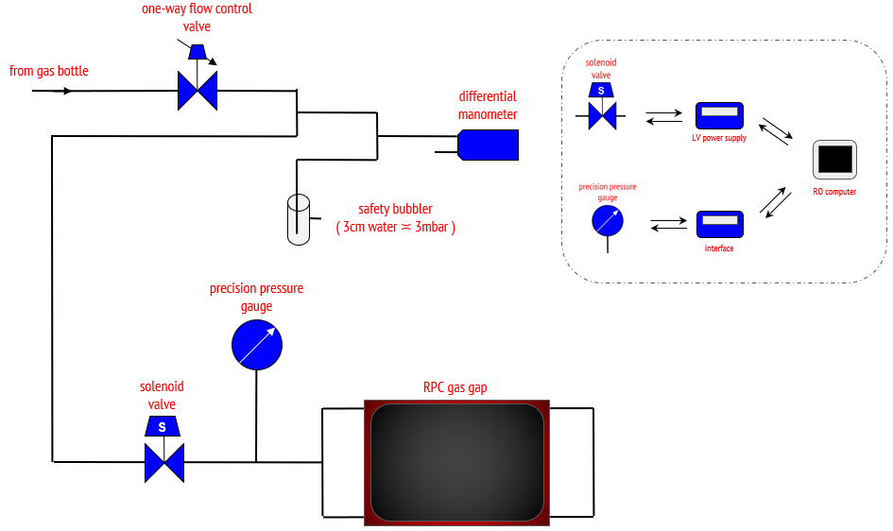
Gas leak measurement
Objective:
The combined leak rate of the gas volume and gas system is measured by monitoring the drop of internal pressure in order to ensure that gas tightness requirements are met.
Chamber is pressurized at 3 mbar overpressure (3x operating pressure for ATLAS RPCs).
Monitor the drop over 10 minutes, using a precision pressure gauge.
Setup is completely automated, in order to improve reliability and production efficiency.
Methodology:

Slide 32
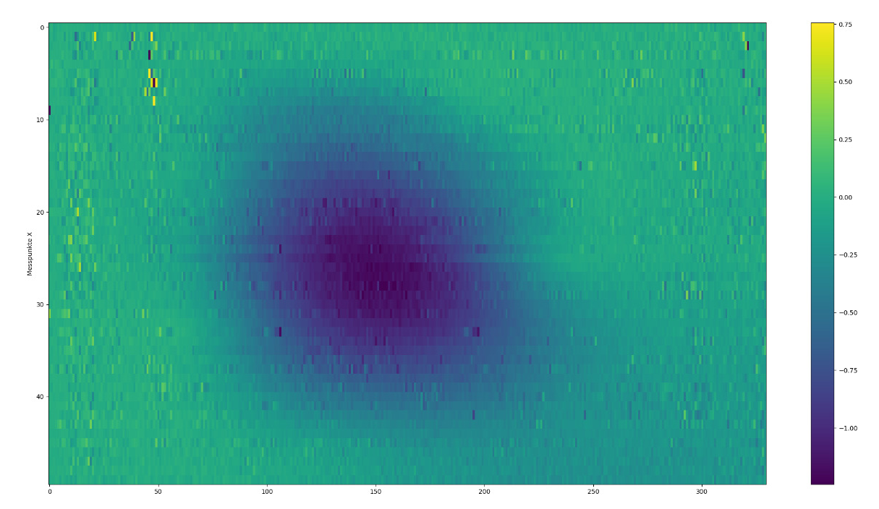
Gas Gap Mechanical Rigidity Test
Objective:
Ensure gas volume integrity by detecting popped-up spacers caused by insufficient adhesive bonding or improper handling during fabrication process.
Methodology:
Initial Test: A laser scan planarity test is conducted to assess the flatness of the gas volume at atmospheric pressure.
Pressurized Test: The gas volume is then pressurized to 3 mbar above atmospheric pressure, and the laser scan planarity test is repeated.
Analysis:
Residuals are calculated by comparing the laser scans at atmospheric and pressurized conditions to identify any discrepancies indicating popped-up spacers.

Slide 33
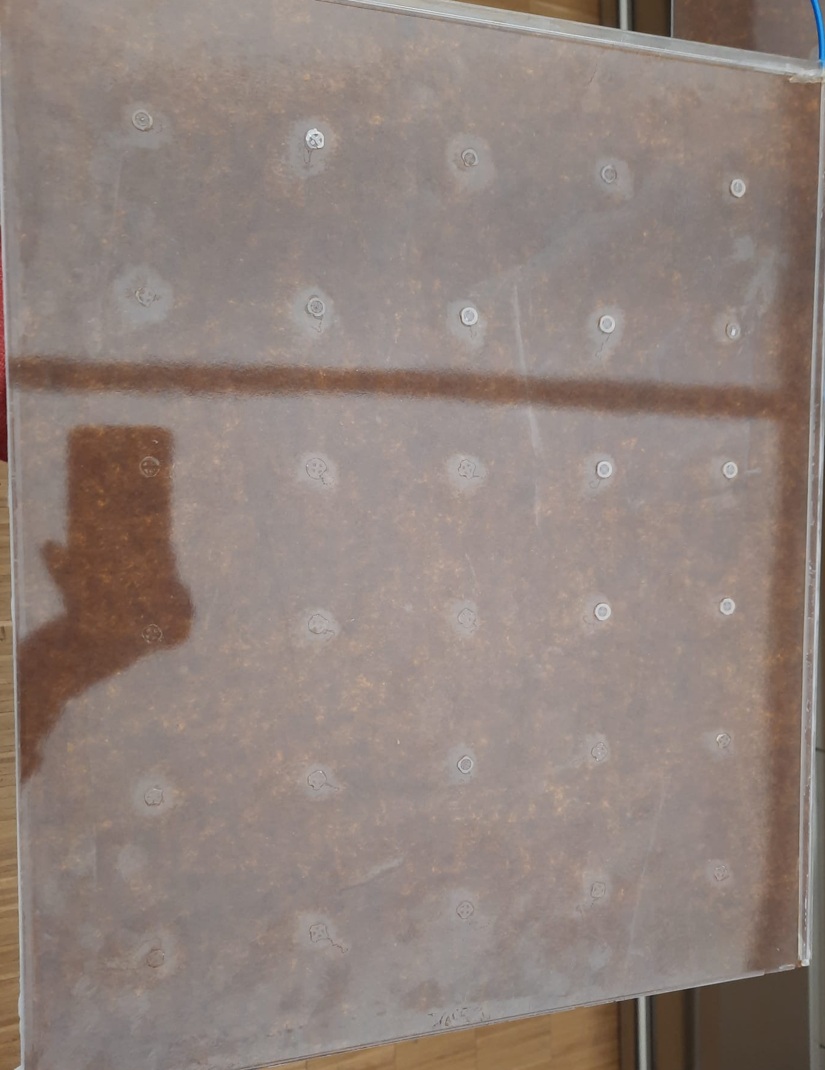
Mock-up gas volume opening
The mock-up is an accurate representation of the status of the full-scale volume, in terms of detector components, materials, and quality of the coating.
Expected visual inspection results:
The oil coating is applied uniformly across all surfaces.
The linseed oil has fully polymerized on both HPL plates.
Minimal dust / debris should be present in the coating.
Scratch resistance:
A 10 mm blade, held at 45°, applying 1 N of force, scrapes the coating for a length of 100 mm.
No oil residue should be left on the blade, and no damage should be visible on the coating.

Slide 34
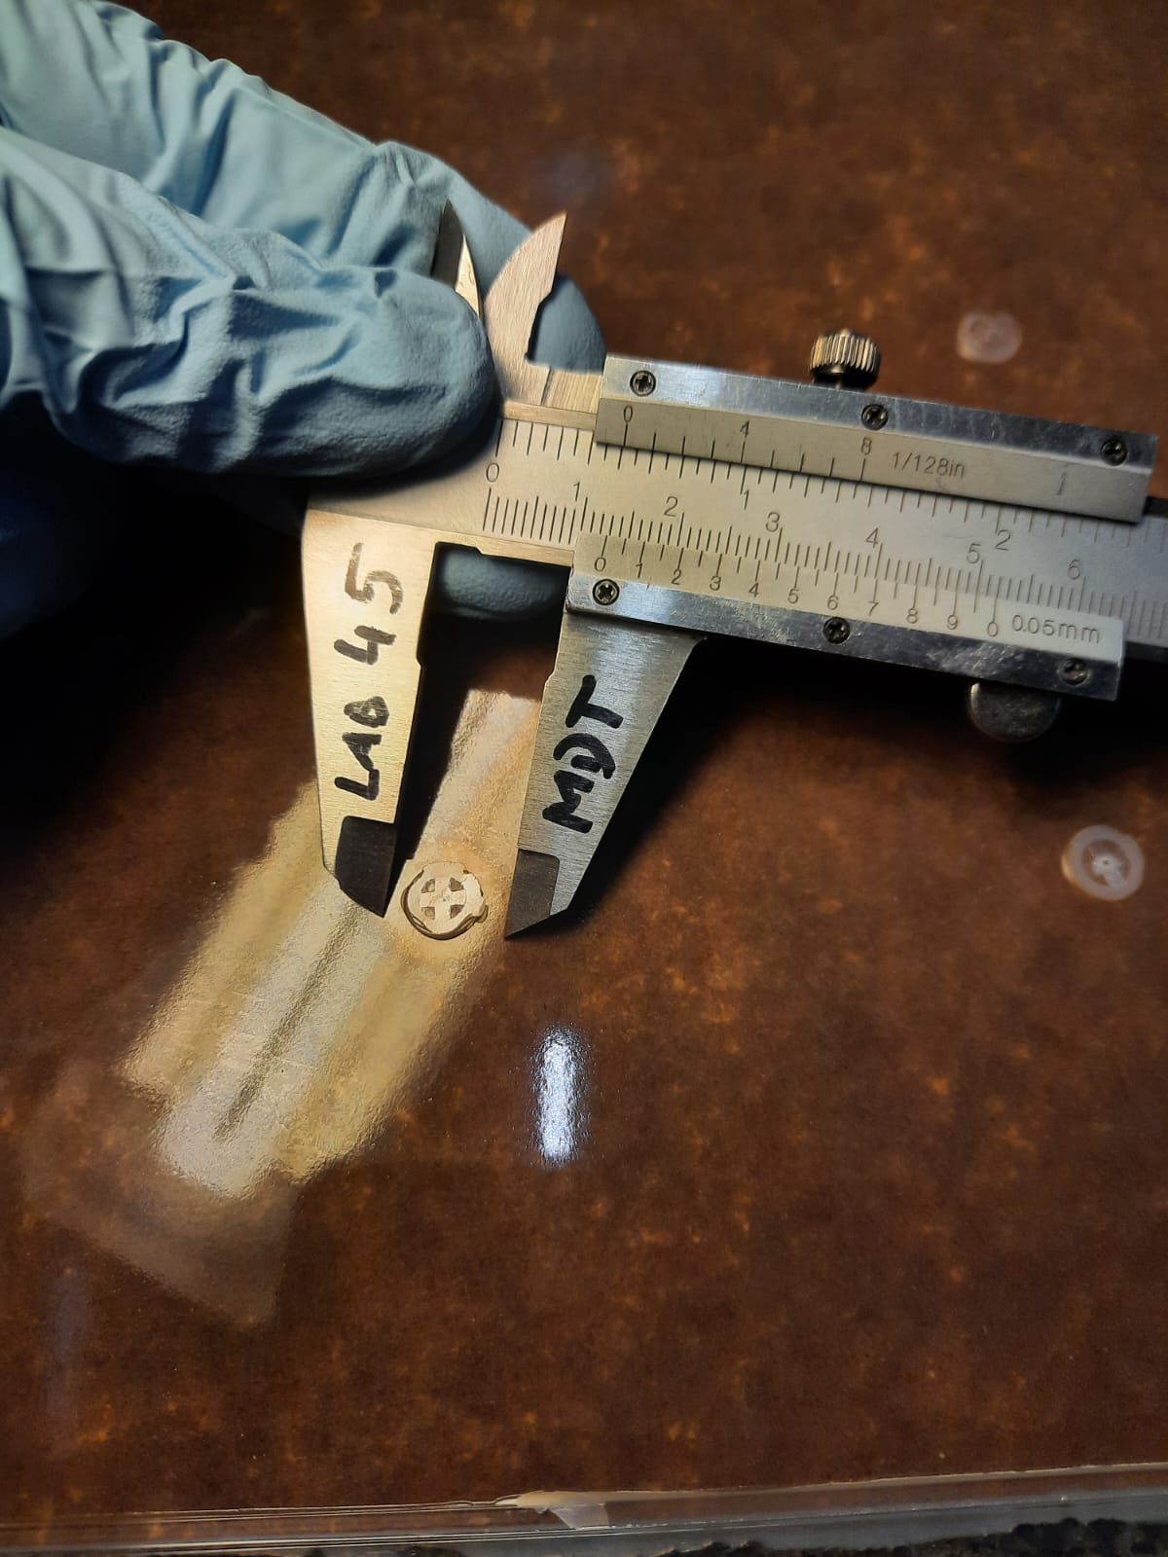
Mock-up gas volume opening
The mock-up is an accurate representation of the status of the full-scale volume, in terms of detector components, materials, and quality of the coating.
Expected visual inspection results:
The oil coating is applied uniformly across all surfaces.
The linseed oil has fully polymerized on both HPL plates.
Minimal dust / debris should be present in the coating.
Scratch resistance:
A 10 mm blade, held at 45°, applying 1 N of force, scrapes the coating for a length of 100 mm.
No oil residue should be left on the blade, and no damage should be visible on the coating.
Halos are commonly seen around spacers.

Slide 35
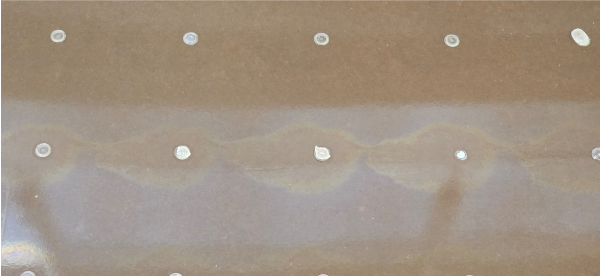
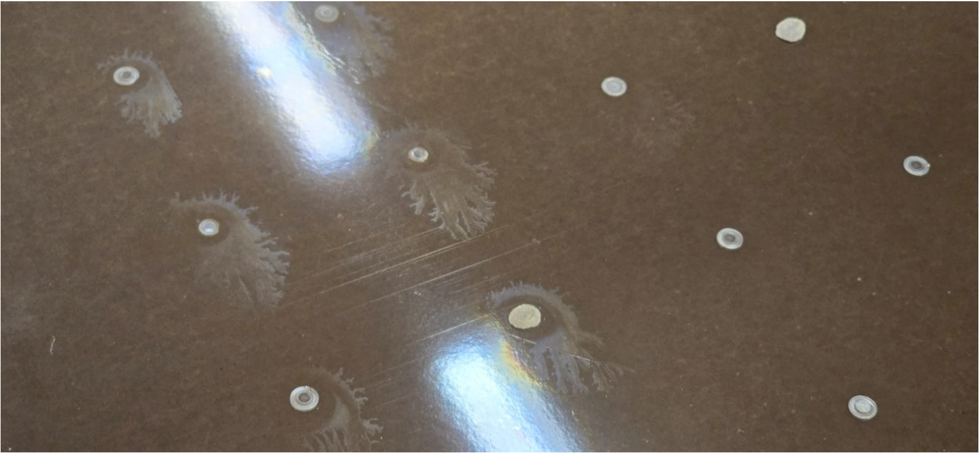
Mock-up gas volume opening
Hypothesis (R. Cardarelli): residue deposits from epoxy glue outgassing around the spacers interfere with the proper adhesion of the linseed oil layer.
Epoxy glue used at GTE company: Araldite® 2011.
Epoxy glue used at MPI and German companies: 3M™ Scotch-Weld™ DP 460.
The halos in gas gaps produced at MPI / German industrial partners are smaller, typically 1- 1.3 cm in diameter.
GTE real-size gas volume opening: L. Pontecorvo [LINK]
GTE gas volume
The 3M™ Scotch-Weld™ DP 460 used by MPI seems to have better outgassing properties.
Compositional analysis planned to study the causes behind the formation of halos.
GTE gas volume

Slide 36
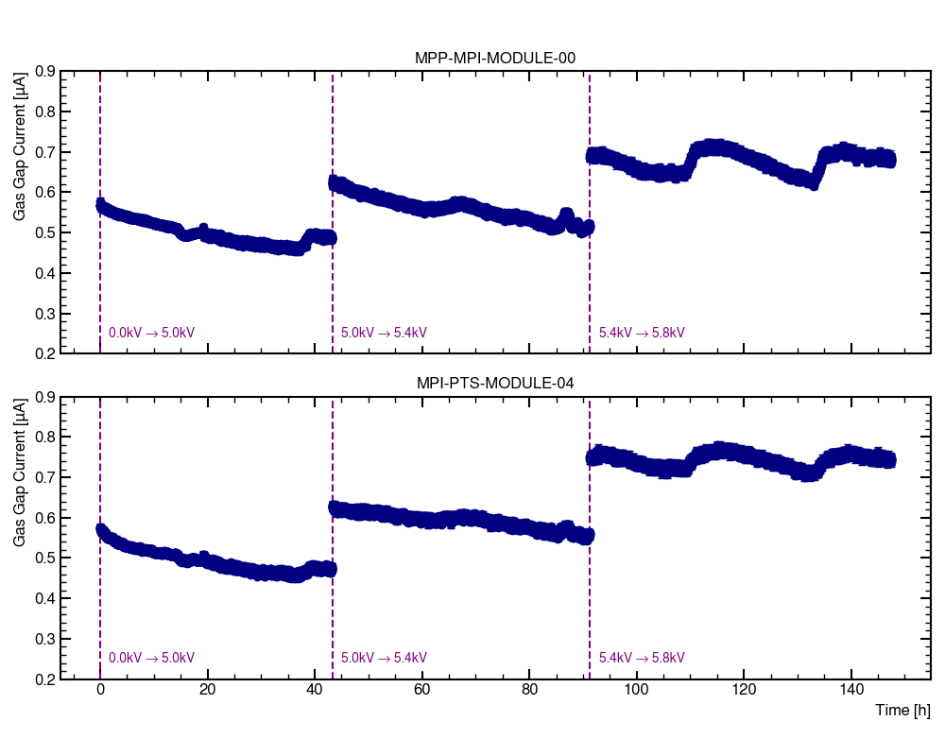
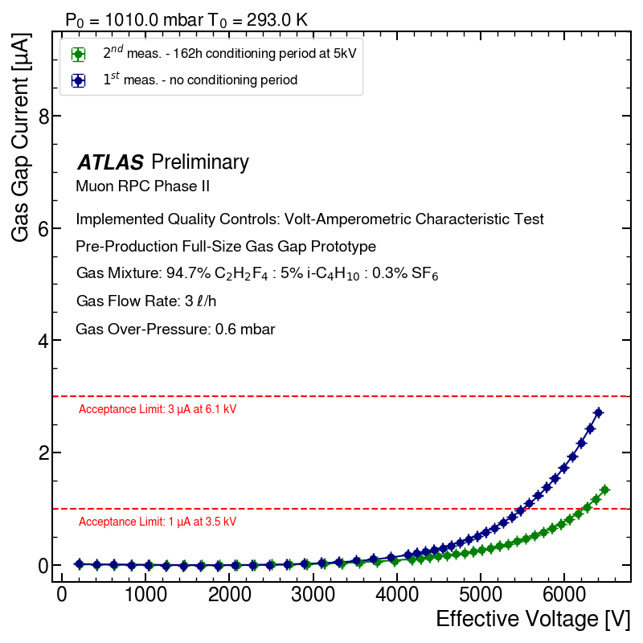
Long-Term Stability Test
Objective:
Ensure long-term gas volume stability by continuously monitoring the gas gap current over time with the standard ATLAS RPC gas mixture.
Methodology:
The gas gap current is continuously monitored over time at applied voltages of 5.0 kV, 5.4 kV, and 5.8 kV, with each conditioning step lasting 48 hours.
The volt-amperometric characteristic curves are measured at both the beginning and the end of the conditioning period.
ADC CH-1
Bosch BME 280 Sensor
HV PS CH-1
HV PS CH-2
HV PS CH-3

Slide 37
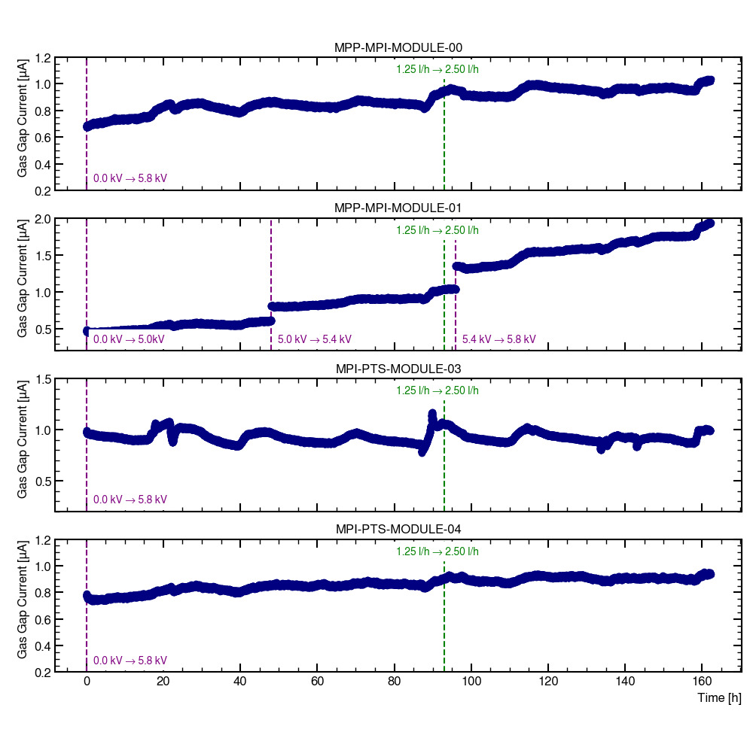
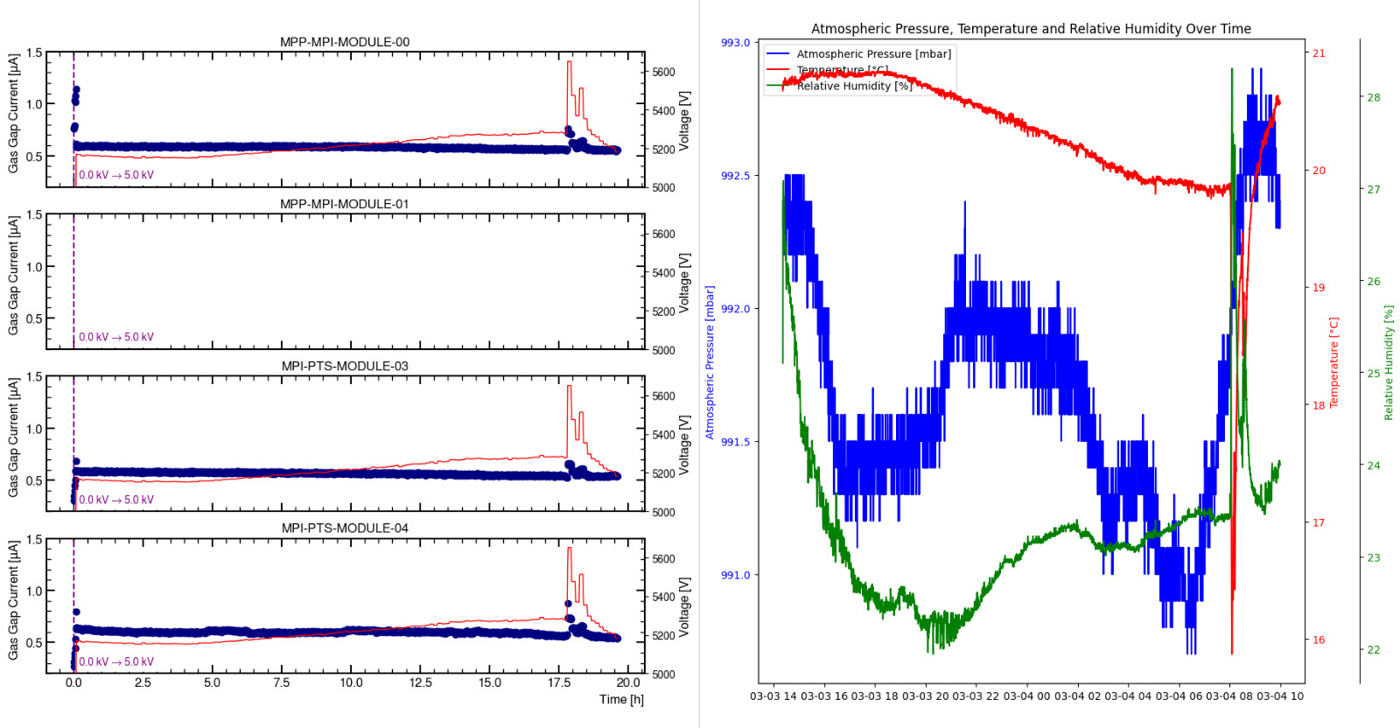
Long-Term Stability Test
Current in the gas gap is strongly dependent on environmental conditions.
A second-order correction [LINK] is applied every measurement cycle, to ensure that the effective (P-T corrected) voltage applied to the gas gap remains within 1% of the desired value.
Improper consideration for environmental parameters could make us reject a good gas gap.

Slide 38
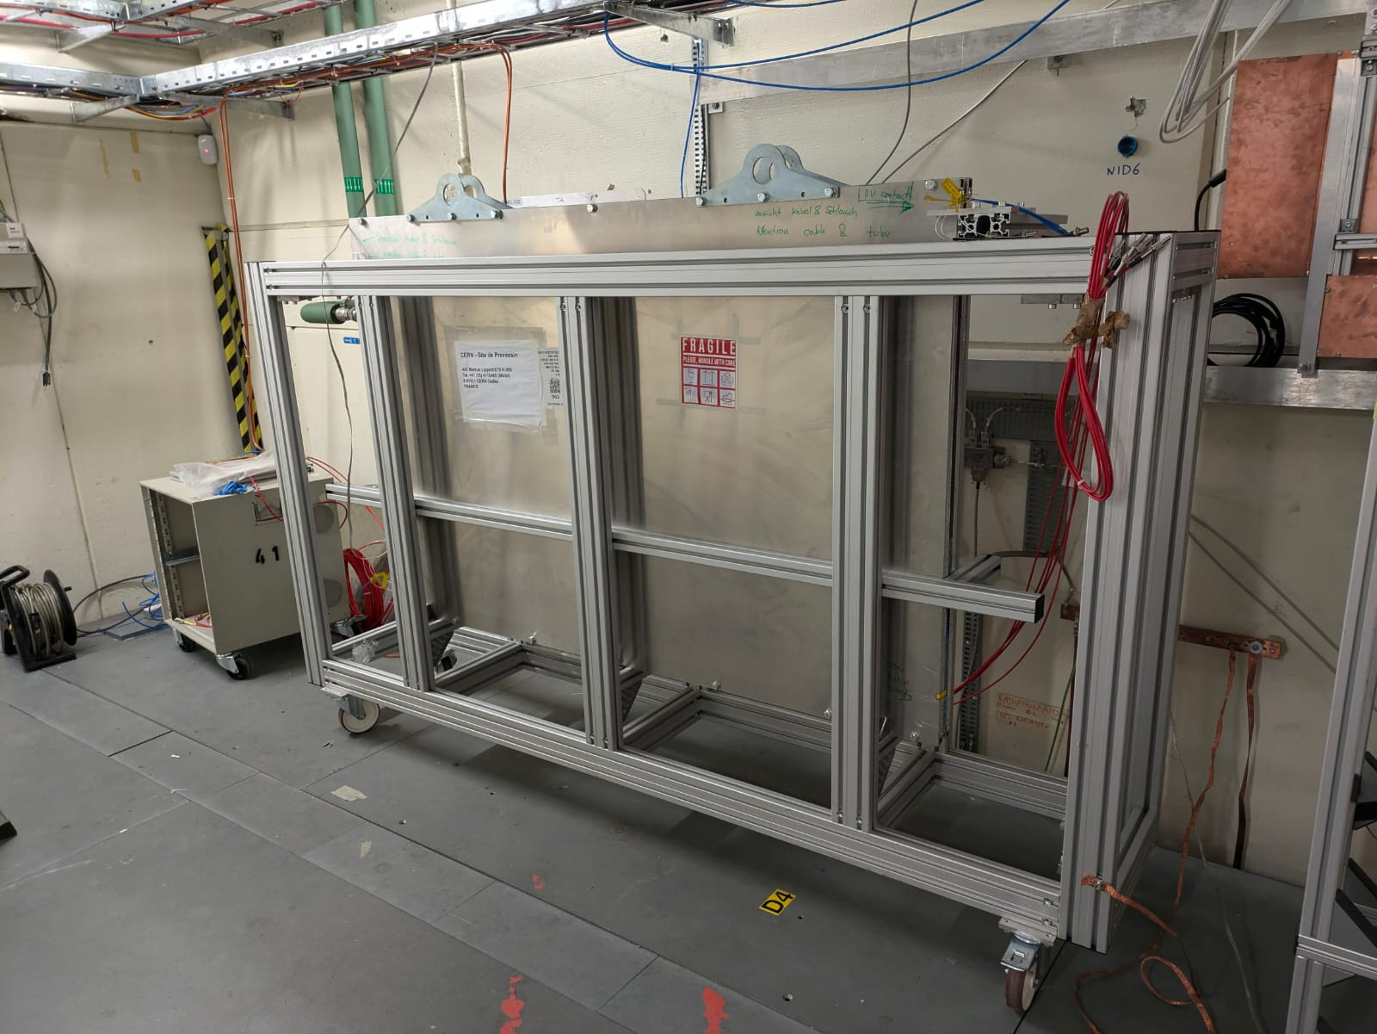
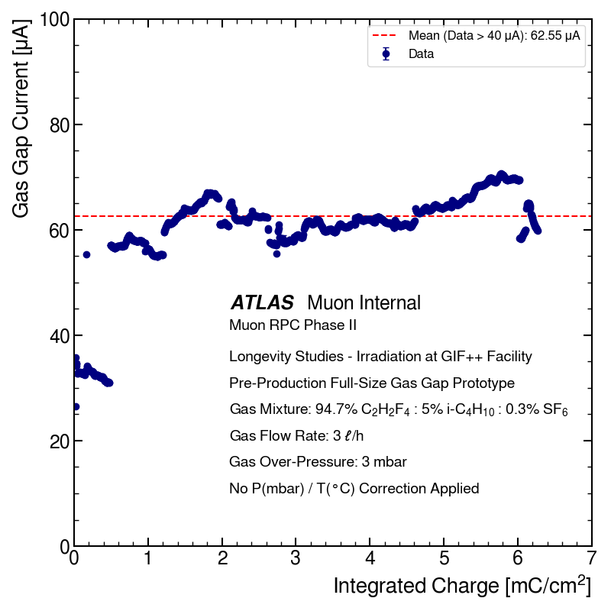
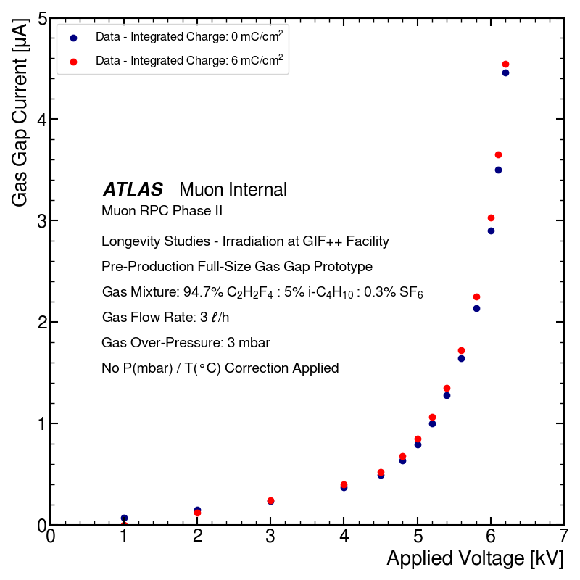
Final certification phase: Longevity Studies
1-year long-term irradiation of small- and full-scale RPCs at CERN GIF++ to validate components and production procedures.
real-scale RPCs under irradiation test at GIF++
gas gap current vs. integrated charge
Volt-Amperometric curve vs. integrated charge
Fluctuations within 6%
⬳
⬳
¹³⁷Cs
⬳
⬳
⬳
⬳
662 keV 𝛾 - photons
No aging effects observed up to 6 mC/cm² (2% of the RPC operating lifetime under HL-LHC conditions).
Studies on-going up to 285 mC/cm², corresponding to 10 years of HL-LHC operation with a safety factor of 3.

