Slide 1
Coffee to know - Purchasing & Reception
27/03/2023- Lisa Bock

Slide 2
Tasks in the area of purchasing - Reception
Contact person Central telephone
Information for visitors and issuing of visitor passes, access control
Receipt and dispatch of letters and parcels
Ordering and provision of office supplies
Acceptance and forwarding of delivery notes
Distribution of mail
Cash management Coffee
Key issue
EC card payment for guest house
Cleaning complaint book

Slide 3
Tasks in the area of purchasing
Processing of procurement processes
Invoice processing
Export control checks and customs matters
Temporary employment
Ongoing contracts for mobile telephony, maintenance of building systems, electricity, cleaning, security, etc.
Inventory
Cash desk

Slide 4
Processing of procurement processes
eProcurement
Advice on procurement procedures
Good to know:
What is checked for an EKW? (see procurement regulations)
Detailed procurement reason and WiBe available?
Is the cost centre; G/L account correct? Does an asset have to be created?
Has the correct authoriser been entered?
Are offers and enquiries complete and has sufficient competition been established?
Can the delivery date be met?
What type of procedure can be used to award the contract? (UVgO and VgV)
- Please come to us before a complicated or higher-priced purchase and we will discuss the best way to proceed!

Slide 5
Invoice processing
Goods receipt entry
Preliminary invoice entry
Processing of reminders
Good to know:
What do we need for fast invoice processing?
Delivery notes should always be signed and handed in immediately to Mrs Henning at reception
If no delivery note is available, please respond to e-mail enquiries from colleagues, otherwise no payment may be made
Is the cost centre; G/L account correct? Has the system been created correctly?
Have additional freight costs been charged? We may only approve up to 10% additional costs without further enquiry

Slide 6
Export control inspection and customs matters
Dispatches
Recruitment of persons from third countries
Publications
Business trips
Co-operations
Imports
Good to know:
What do we need for fast despatch?
Fill in the registration form as completely as possible and allow sufficient time, as there may be queries about the tariff classification
For the quickest possible examination of persons from third countries (only applies to persons who have been resident in EU001 for less than 5 years):
Please complete the checklist in full if possible
Name the area of responsibility, know-how to be imparted, devices and software used; the export agents can use this information to check
Imports: please also inform us of samples etc. that you receive without an order

Slide 7
Other tasks
Temporary employment
Current contracts
Inventory
Cash desk
Good to know:
Contracts for maintenance (e.g. building facilities) or electricity, laundry, etc.
Mobile phone contracts: always choose the cheapest phone and contract, everything else requires detailed justification
Inventory: must be carried out every 3 years; the cost centre manager is responsible for ensuring that all devices are correctly recorded (or scrapped etc.); therefore always affix an inventory label
Room inventory should be sufficient in future
- Cash desk opening hours: Wed and Thu, 8am-12pm; payment only against EKW and receipt

Slide 8
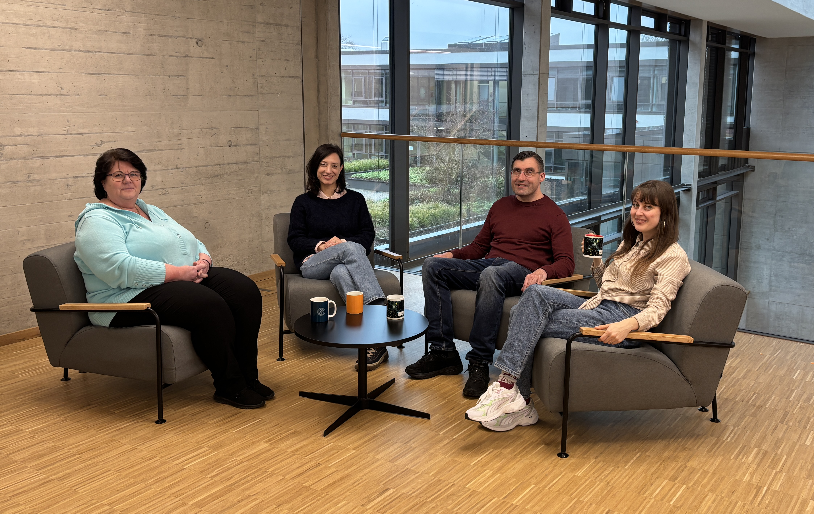
The team and the division of tasks
Katharina Henning
Reception and goods receiving
Processing
Serena Riccetti Supervision of the department Prof Zanderighi, Prof Kado, Prof Teshima and Prof Dvali
Processing
Uwe Lohmüller
Supervision of the semiconductor laboratory and
Supervision of the department by Prof Caldwell, Prof Henn, Prof Lüst
& the independent research groups
Head of department
Lisa Bock
Advice on complex and expensive procurement processes
Export control officer
Customs officer

Slide 9
Thank you very much for your attention If you have any questions, please contact us:
Max Planck Institute for Physics
Boltzmannstraße 8, 85748 Garching
Phone: +49 (0)89 32354-217
E-mail: einkauf@mpp.mpg.de

