Slide 1
Stepper motors to move the antenna
Update
Team:
Georg Obermüller
Chris Gooch
Dagmar Kreikemeyer
Dagmar Kreikemeyer
Summer Collaboration Meeting
Hamburg, July 3rd 2025

Slide 2
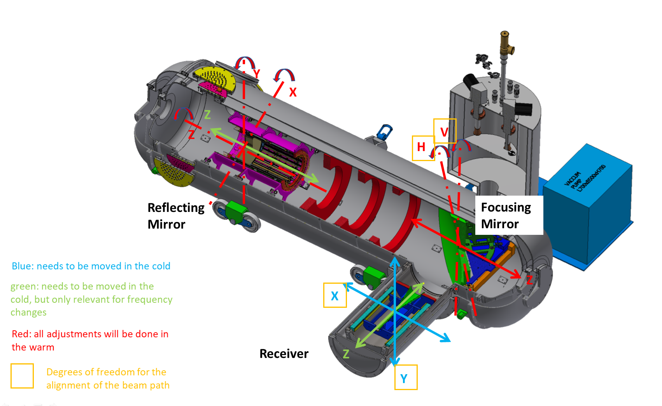
Introduction
What for: need to move the antenna in at least one, but possibly 3 degrees of freedom (x,y,z)
Antenna and receiver chain weighs approx. 20 kg
Phytron → stepper motors for cryo applications
No position encoder – just checking the speed
Ordered 4 extra motors + 1 tested already last year

Slide 3
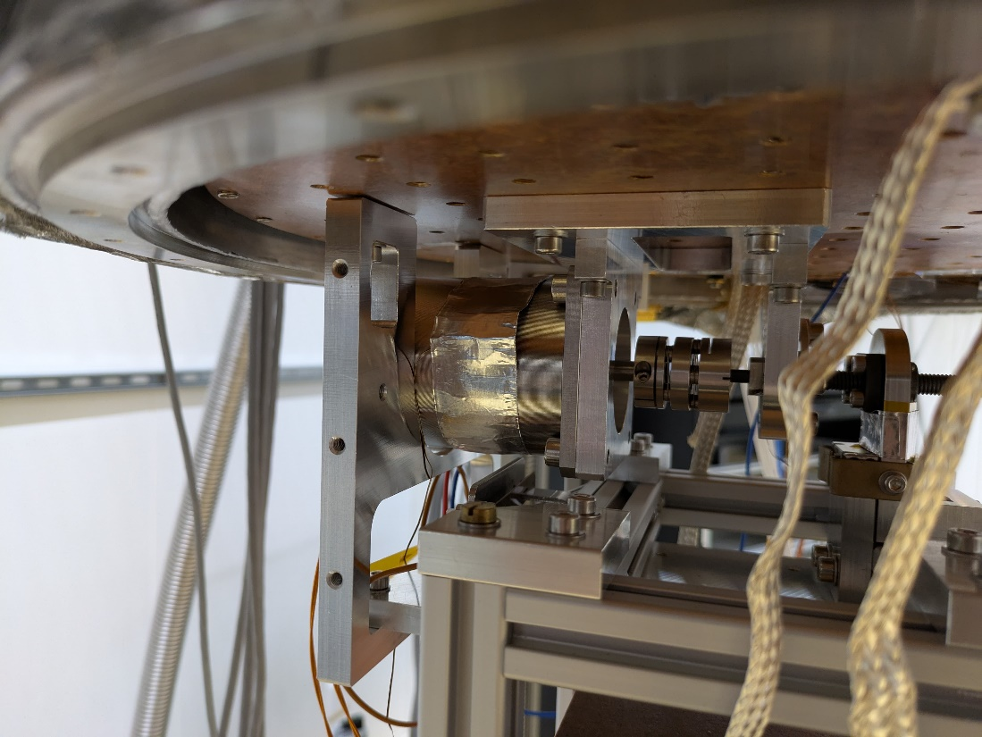
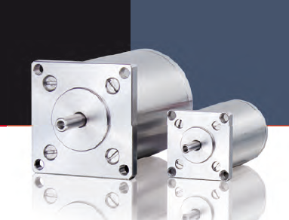
The motors
Motors from company Phytron
In-Vacuum 2-Phase-Hybrid-Stepmotor
Reference number:
  VSS 57.200.1,2-UHVC2-4Lp-X-R
Some parameters:
  Nominal current 1.2 A
  Max. operational voltage: 70 V_{DC}
  Resistance: 3.9 Ohm
  Inductivity : 11.6 Hm
  Original wire size 24 AWG
  Weight: 1 kg
  Holding torque: 840 mNm

Slide 4
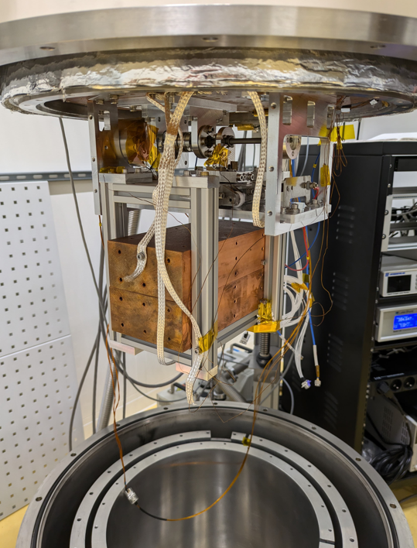
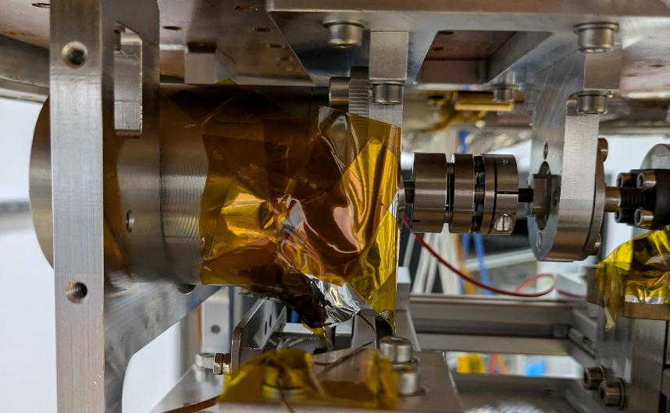
The setup
3
Motor
Spindle
Cold plate
Cryostat tanks
Thinner cables
3x Temp sensors
Cu blocks (~18 kg)
End-switches
1
2
6
8
6
7
Travel range ~42 mm
→ measure the travel time → convert it to speed
5
4

Slide 5
Activities
1st motor tested in summer 2024
4 extra motors received in spring 2025
  1 motor tested in June 2025 with 20 kg weight at 4 K
  1 motor tested in July 2025 without the weights at 4 K
  2 remaining motors will be tested without weight in the next weeks
When we have 3 motors tested at 4 K → use them to build the antenna/ motor structure → test at RT
      see Georg‘s presentation
New filter box will be tested with one of the (already tested) motors at 4 K with 20 kg weight
→ Results in next slides

Slide 6
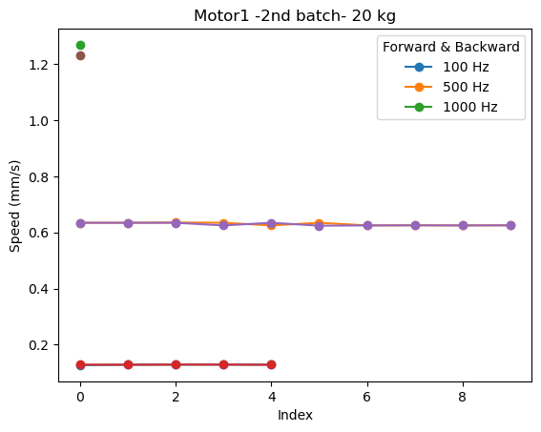
Motor performance: speed vs frequency
Test performed in June 2025
Lowest temperature (motor casing) - ~ 7 K
with 20 kg weight (similar as antenna)
Speed scales up with frequency, as expected
Similar results for both tested motors
Speed does not depend on travel direction

Slide 7
Motor performance: comparison 2024/2025 tests
Motor 1 – 1st batch (2024)

Slide 8
Motor performance: speed vs temperature
f = 500 Hz

Slide 9
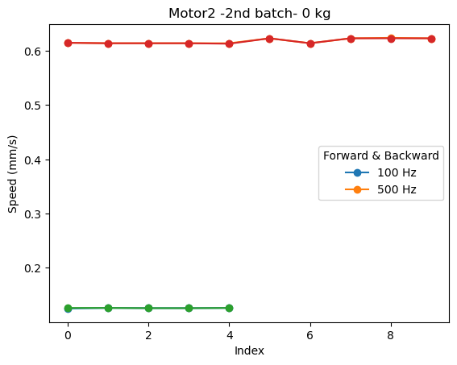
Motor 3 (2nd motor of 2nd batch)
Without weigths!
Same performance
without weights as well!

Slide 10
Timeline
Tests of motors # 4 and #5 at 4 K
July 2025
Q3 2025
Assembly and test of 3-axis motor structure
October 2025
Delivery of 3-axis motor structure to UHH
October 2025
Q4 2025
Tests of filter box with motor and weight at 4 K
Q4 2025
Installation of motor structure in RC at SHELL
    → (Depends on delivery of RC)
Q1 2026

Slide 11
Conclusions
Three motors (out of 5) have been tested at 4 K so far
Same performance for all motors (with and without weight)
Temperature has no influence on the speed of the motor
Motor warms up during operation (as expected)
Speed scales up with frequency (as expected)
3-axis motor structure for antenna-setup → currently on schedule
Thank yor for your attention!

Slide 12
Motor performance: speed vs frequency

Slide 13
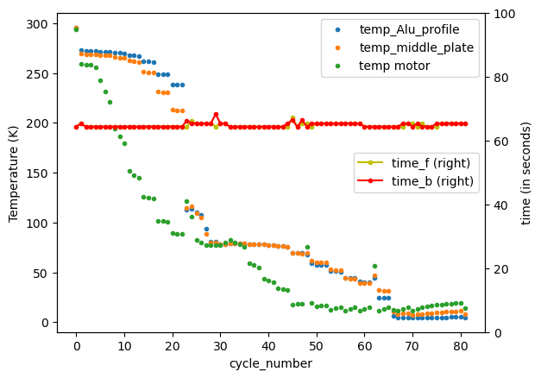
Temperature evolution temp vs cycles (not time!)
Right axis shows the moving time of the motor in the forward and backward direction
We only logged the temperature while operating the motor, that‘s why we don‘t have a graph „temp vs time“

