Slide 1
LMU München - Excellence Cluster Universe
UPDATE on Services and PS
Stefan Rummel

Slide 2
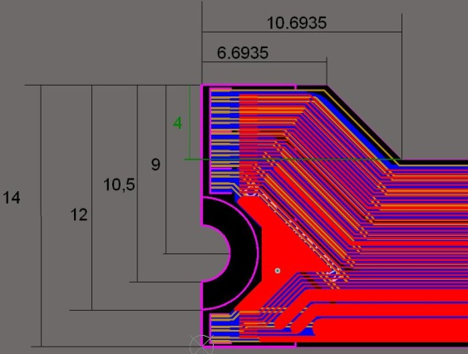
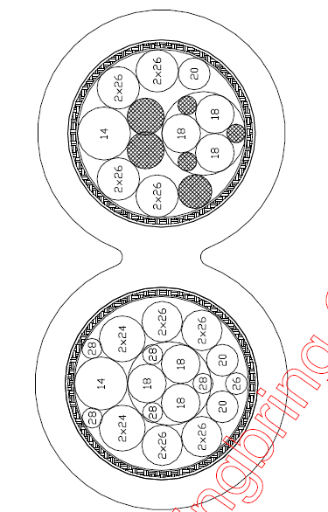
Services
Kapton-Flex development
Test production @ Taiyo submitted on 20.1.11
Flex length from 30cm to 50cm
Realistic designs including power & TML
Realistic design with washer
→ Testing of signal integrity and power distribution
New design for cable – incorporating:
Our findings regarding wire diameter → AWG14/18 instead of AWG12
Forward service space required to limit diameter
Radiation hard till 50MRad (according to company)
→Double cable with 14.5mm diameter each
Patch panel design assuming Vienna’s mounting concept
Space for PP seems to fit including decoupling on PP-level
Further design iteration necessary for KEK SVD-Layer 1 design
Stefan Rummel
2

Slide 3
PS Development – Organisation
Group from Krakow interested to join the PS development effort
Already started with hardware tests
Will look into Overvoltage protection / Hardware safety system
Firmware development together with TUM/Fortiss is ongoing
Collecting requirements on Firmware and PS-Slowcontrol interface
First preselection of microcontrollers done
Safety analysis of PS-system ongoing
Stefan Rummel
2

Slide 4
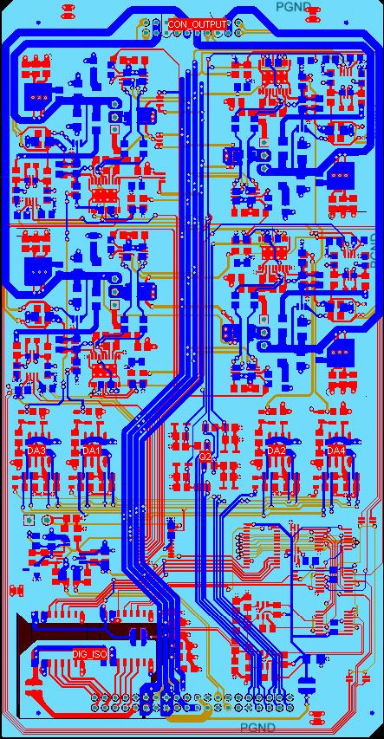
PS Development
Design of multichannel prototype finished – “Analog Prototype”
Digital interface via DAC-PCI card and ADC
Organized in 4 modules with 4 channels
Flexible design:
With/without remote sensing
Positive- or Negative Output, sink or source
Flexible over current protection
Monitoring of currents and voltages
Status outputs
Will allow to verify the analog building blocks and multi channel operation
Design of micro controller card for steering has started (“MCU-Card”)
Next steps / outlook
Finish MCU-Card
Integration of ADC/DAC into “Analog Prototype”
→ Full scale prototype till end of this year
Stefan Rummel
3

