Slide 1
CO₂ Cooling of PXD Endflange:
Results from Karlsruhe
T. Barvich, S. Heindl, Th. Müller, H.J. Simonis and Th. Weiler Belle II General Meeting (via EVO) 07.04.2011

Slide 2
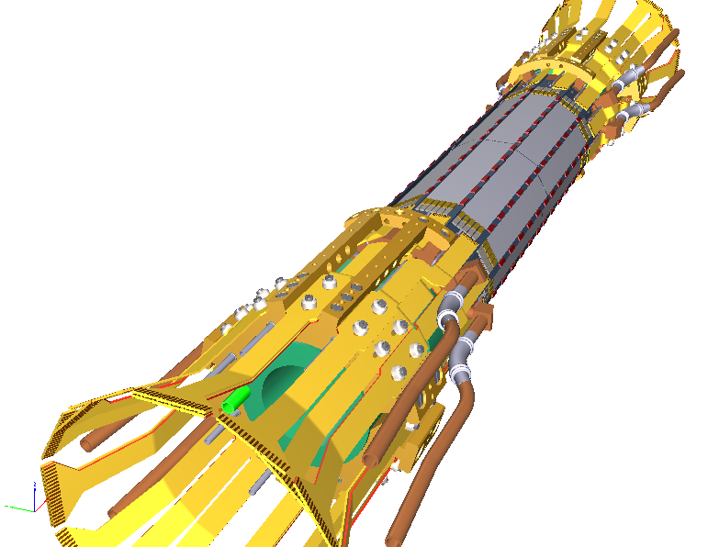
Overview
Three slides specially prepared:
Cooling tests in Karlsruhe
Results
Test at CERN
+ Backup Slides from Bonn DEPFET workshop
Belle II PXD (by MPI)

Slide 3
CO₂ Cooling Tests in Karlsruhe
Open CO₂ system
Endflange prototype (DLMS) from MPI
Silicon with resistors as module dummies
Several Pt1000s for temperature monitoring
Pt1000
Fully equipped flange in test setup
CO₂ bottle in freezer to save gas
Flow and pressure control

Slide 4
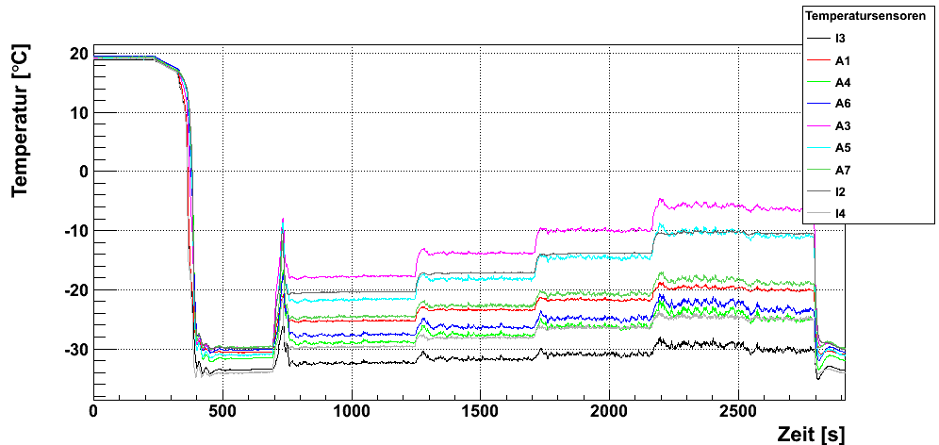
Results
Milestone: first proof of working cooling solution für Belle II PXD!
Temperature difference (@ 100 W): ca. 20°C
Target reached (stay below 0°C) and even 120 W possible
Power load: (in Watts)
Max. power for ¼ of PXD:
Temperature [°C]
100
120
60
80
Cooldown: 3 mins
0
Time [s]

Slide 5
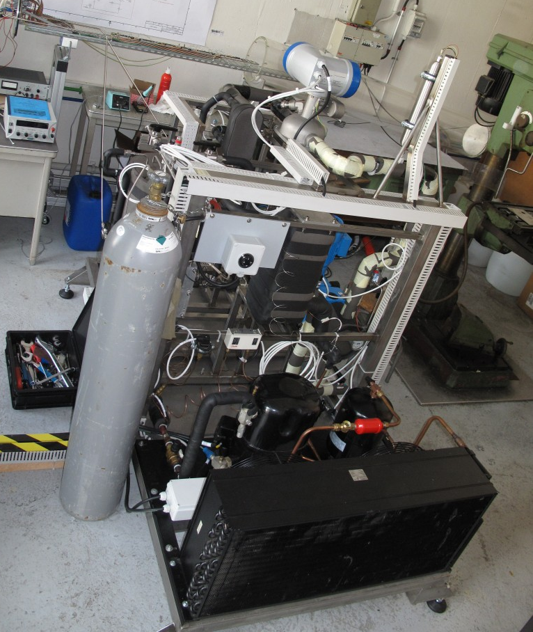
Closed CO₂ system at CERN
Closed CO₂ system built by the group of B. Verlaat and H. Postema
Based on experience with AMS and LHCb systems
Test same endflange prototype under „real“ operating conditions
Testing is currently underway (April 04 to April 08)
(CERN)

Slide 6
Backup Slides from Bonn
Unchanged!

Slide 7
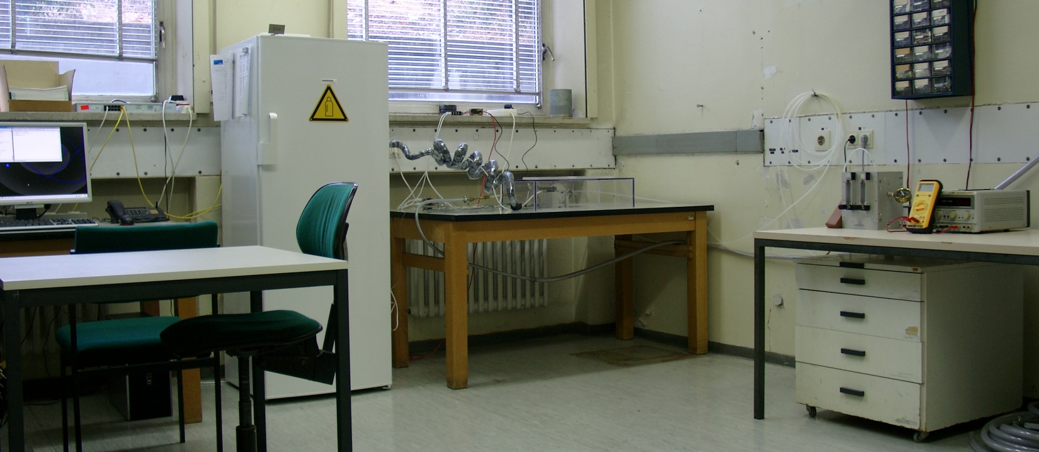
1. Open CO2 system in Karlsruhe
Built for CMS Tracker Upgrade
Now used for Belle II PXD cooling tests
Manual operation → limited runtime
readout PC
1. CO2 bottle
2. endflange
3. flow control

Slide 8
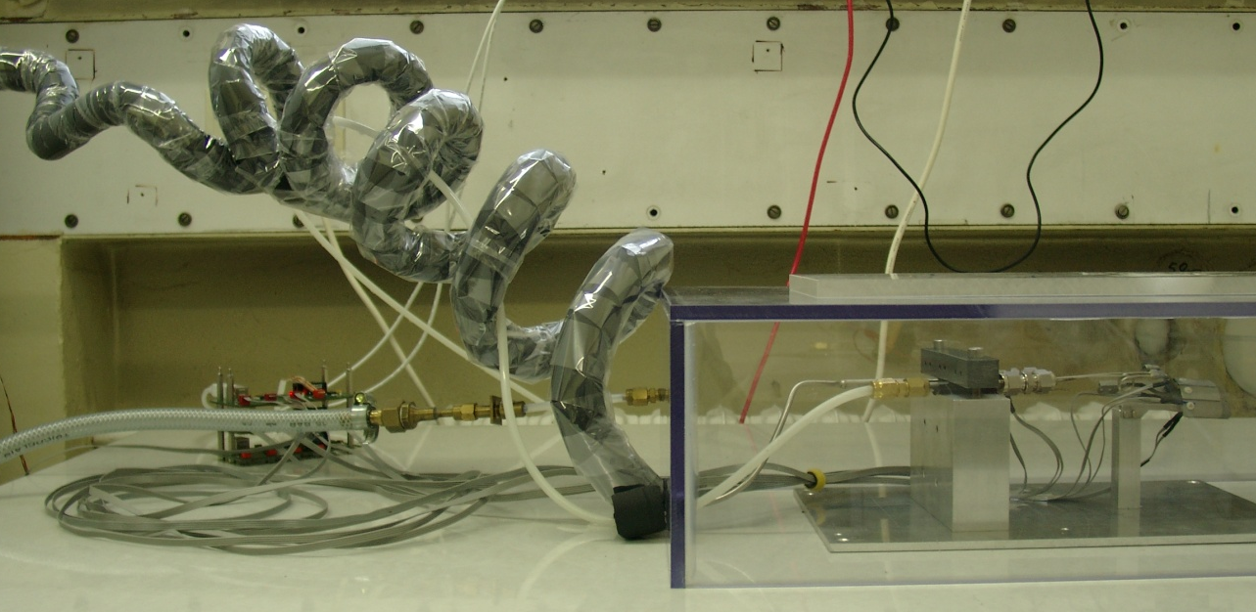
1. Open CO2 system in Karlsruhe
Components of the system:
Armaflex insulation
steel tube
dry air
1. CO2 bottle with pressure regulator, precooled to -32°C (saves CO2)
2. endflange prototype in air-flushed box to prevent condensation

Slide 9
1. Open CO2 system in Karlsruhe
Components of the system (cont‘d):
outlet (window)
from flange
3. electric heater (temp. controlled) to prevent liquid CO2 from reaching the gas flow meters
3. gas flow meters (combined) and pressure gauge for controlling operating values

Slide 10
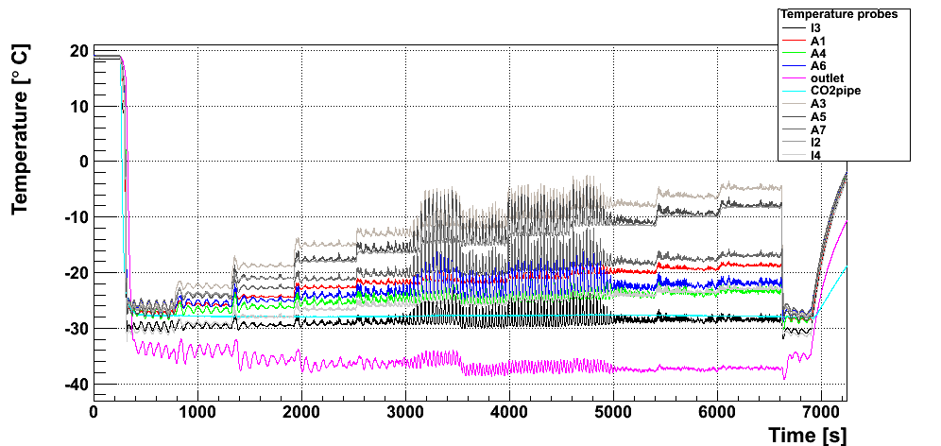
3. Results with heat load
First test in December:
Large oscillations related to leaky connection
Temperature difference (@ 100 W): about 19°C
Power loads: (in Watts)
80
90
100
110
120
70
60
40
20
0

Slide 11
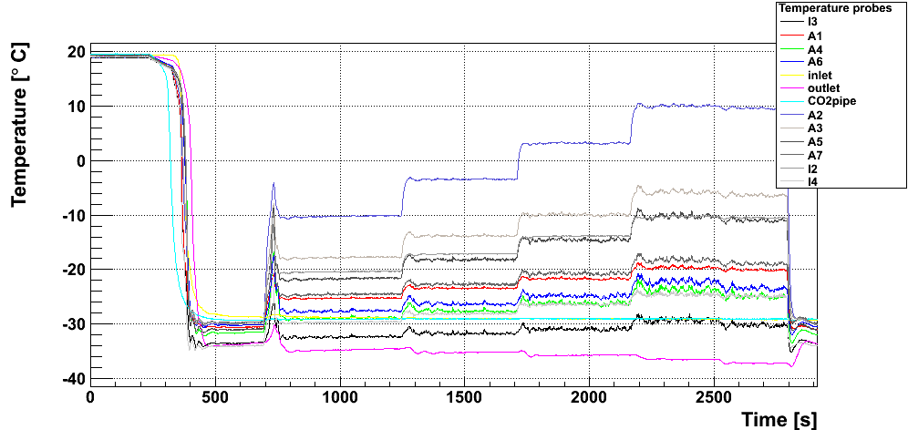
3. Results with heat load
Second test in January: leaky connection fixed
Temperature difference (@ 100 W): about 20°C
Remaining oscillations common to open CO2 systems
Power loads: (in Watts)
120
100
80
60
0

Slide 12
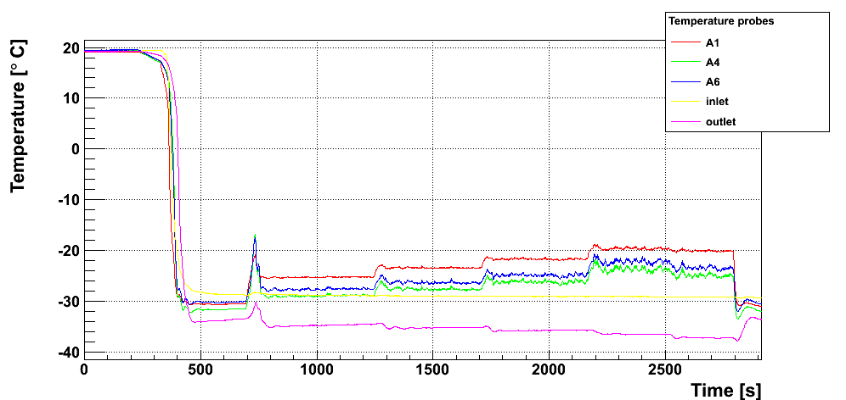
3. Results with heat load
now: closer look at different areas of flange
1. connection side:
all probes within a range of 5°C
Power loads: (in Watts)
connection
60
80
100
120
A1
0
A4
A6

Slide 13
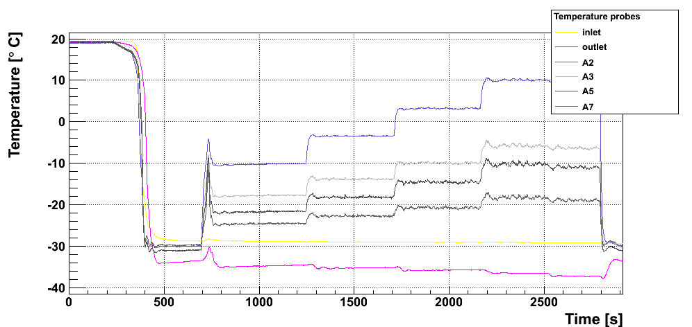
3. Results with heat load
2. front side:
much larger deviation of 24°C
probe A2: bad contact (without: 11°C)
Power loads: (in Watts)
120
100
80
60
0
A3
A2
A5
front
A7

Slide 14
4. Conclusion
Cooling and Mechanics workpackages have passed a milestone: first proof of working cooling solution for Belle II PXD!
Minor problems identified: quality of flange surfaces and threads needs to be improved in next iteration → even better results expected
Next steps: - test with closed CO2 system - how to get a working system for Belle II?

