Slide 1
The PXD Digitizer: Status and Plans
Peter Kvasnička
Institute of Particle and Nuclear Physics,
Charles University, Prague
DEPFET meeting 2011, Ringberg, 8 - 11 May 2011

Slide 2
The basf2 PXD and SVD simulation/reconstruction chain
 | PXD | SVD
Sensitive Detector (MCPart.→SimHits) | ☑ | ☑
Digitizer (SimHits→Digits) | ☑ | Gaussian-smear SimHits→Hits
Clusterizer (Digits →Hits) | ☑
RecoHit Producer (Hits->RecoHits) | ☑ | ☑
SpacePoint Producer (SimHits→SpacePts) | ☑ | ☑
All the data types are in place, together with their relations to the generating MCParticles
The main missing part is currently the full SVD digitizer.
Current status of the PXD digitizer will be the subject of this talk.

Slide 3
The PXD digitizer: Current status
The basf2 implementation of the ILC SiPxlDigi pixel digitizer processor is now in the basf2 svn.
Physics is mostly the same. Some features of the ILC digitizer were not implemented:
Bricked pixel structures, ganged pixels – of little interest at present
Benjamin Schwenker’s lateral diffusion code – a somewhat different implementation will be used to imbed this in basf2.
The organization of the code was changed:
The ILC digitizer was divided into PXDDigitizer and PXDClusterizer. The principal reason was that while the digitizer belongs to simulation chain, the clusterizer is part of reconstruction.
Some re-orgainzation of the code was necessary due to differences in programming philosophies between ILCsoft and basf2 (indices into StoreArrays in place of pointers, separate relation arrays in place of pointer arrays in data objects etc.)
The processing logic was simplified and the volume of code significantly decreased.
The code is being tested and debugged: The code now needs active usage time to discover errors and to verify that it is equivalent to the original ILC code. Thanks to Martin Ritter and Susanne.

Slide 4
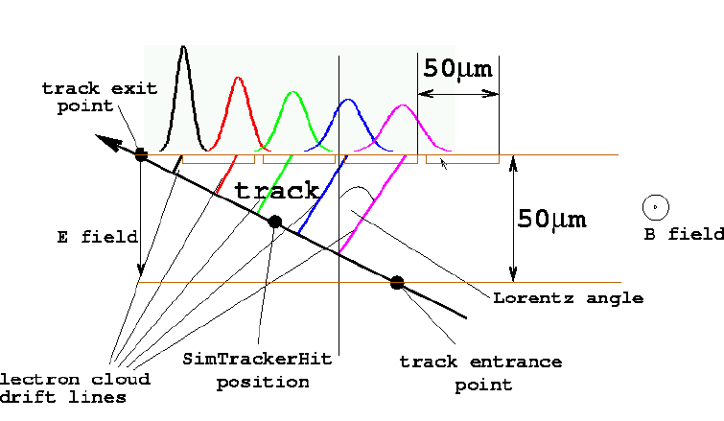
The PXD digitizer: What it does
For each simulated hit (PXDSimHit) obtained from Geant4
Track generation. The SimHits are created where Geant4 detects a passage of a particle through an active detector. The current philosophy is that SimHits are actually Geant4 steps with limited length, which are digitized.
Ionization. The track segment is divided into sub-segments (“ionization points”), whose charge is smeared according to the Landau distribution using the code borrowed from Geant4 (G4UniversalFluctuation) for more realistic simulation.
75 µm
SimHit position

Slide 5
The PXD digitizer: What it does (cont’d)
Production of digits. The ionization points are then drifted to the readout plane, Lorentz-shifted in the presence of a magnetic field and smeared by a Gaussian distribution to account for diffusion during the drift time.
Lateral diffusion. Finally, the total charge of an ionization point is split into carrier groups of ~100 electrons. For each carrier group, a random walk in the readout plane is sampled until the internal gate region of a pixel cell is reached. Still to be implemented: currently we only integrate charge into individual pixels.
Digitization. For each pixel electrode we now have a signal dependent on how many ionization points contributed.
Background and noise. The pixels are then populated by random electronic noise and background signal as appropriate.
Analog-To-Digital conversion: Analog signals are converted into digital values.

Slide 6
The PXD digitizer: What it does (cont’d)
Clustering: (PXDClusterizer): Clusters are formed from digits with charge exceeding seed threshold, non-zero charge (>zero-suppression threshold) digits are allowed at the border of the cluster.
Hit reconstruction. Hit position is estimated separately in each coordinate, by center-of-gravity for cluster projections of 1 or 2 pixels, and analog head-tail (approximate the cluster by a uniform charge distribution consistent with pixel signals) for larger clusters.
Output.
Digitizer: PXDDigits (data on sensor, cell and charge) and relations MCParticles-to-PXDDIgits
Clusterizer: PXDHits (data on sensor, position, positioin error, charge, charge error), relations MCParticles->Hits, relations PXDHits->PXDDigits (clusters)

Slide 7
Things to do
Physics:
Landau fluctuations: Tune the generation of Landau fluctuations by setting appropriate step lengths and production cuts.
Handling of photons has to be implemented properly.
Simulation of charge diffusion Implement Benjamin Schwenker’s code
Calculation of resolutions. Currently resolutions are estimated based on histograms acquired in calibration runs. A procedure using digit charge fluctuations would be much better.
Technical issues:
Several point regarding basf2 programming:
Handling of relations
Efficiency of implementation
On agenda of the Ljubljana workshop

Slide 8
Conclusions
PXD digitizer:
Mostly working: A full PXD digitizer/clusterizer code has been implemented, and is now being tested and verified
Some features have to be added
Lateral diffusion
Hit position errors
Basf2 PXD/SVD simulation:
SVD digitizer is now top priority
Must be in by the Ljubljana workshop

Slide 9
Thanks for your attention!

