Slide 1
Final Remarks
Great workshop !
In addition to the splendid weather
Nice progress in all fields
Thanks to speakers and convenors!
General remark:
the project is now in a transition from an R&D phase in
a production phase. There is still some R&D needed, which has now to be well focused on the final device
E.g. DEPFET PXD6 ready, the next production will be the final one
Close to final versions of DCDB and switcher are submitted.
This puts more load and responsibility on the work package responsibles.
We must intensify communication and coordination to ensure that all aspects of the detector are properly taken into account.

Slide 2
Items which came up during the workshop
Vertexing/Tracking performance:
Digitizer: Documentation/Reference Manual
Effect of digitization error (including Pedestal subtraction and CM
Background:
HER Touschek
Synchrotron radiation
inhomogeneity across module
ASICs:
Switcher: understand yield
DCD/Switcher development: ensure backwards compatibility,
fix footprints and basic parameters
Reverse direction, channel veto: do we need it?
DHP: which technology (TSMC 65nm/90nm)

Slide 3
New Items
Mechanics/Module
What happens if modules touch?
How to make space for wirebonds?
Kapton glueing (electrical contacts)
Flip Chipping/Assembly
Need module jig compatible with flip chip requirements
Prepare for ASIC testing (incuding thermal cycling?)
Test Systems
Organise (fast) hybrid production

Slide 4
New Items
Power/Slow Control
Grounding/Shielding study with ITA will start
Supply information to Fernando
Good opportunity to write/update documentation
Check Voltage table on Twiki
http://twiki.hll.mpg.de/twiki/bin/view/DepfetInternal/PowerSupplyScheme
Do we need a temperature monitor on the DEPFET ? How?
Anything missing? You name it!

Slide 5
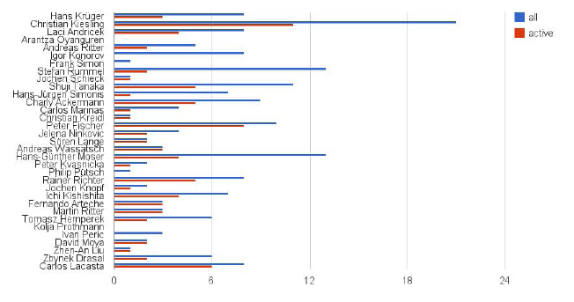
Action List
Please check it regularly!
If you want to edit the list yourself, ask me to set the priviledge
Is there an EXCEL/Googledocs experts how could provide a macro which
automatically mails reminders?

Slide 6
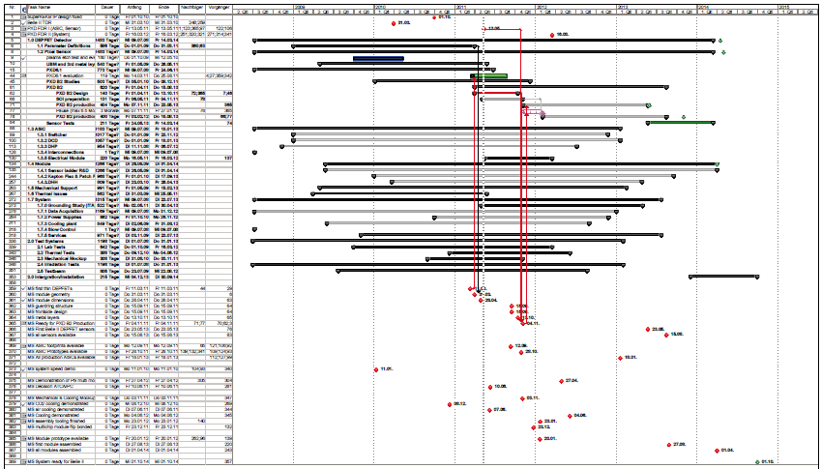
Schedule
http://twiki.hll.mpg.de/twiki/pub/DepfetInternal/SuperBelleProjectManagement/Belle_II_Project_March_2011.mpp
Not yet in: Slow control; R&D on interconnection

Slide 7
Schedule
Please check it and give me feedback
Since Bonn I got zero feedback!
“I have always found that plans are useless, but planning is indispensable.” - Dwight D. Eisenhower
In this sense:
Identify tasks which are on the critical path and need support
Check dependences and order of tasks
How can delays be absorbed?
Identify milestones
Clearly, some parts are guesswork but planning them helps to identify
possible bottlenecks
And: it is a great if you can tick off a task!

Slide 8
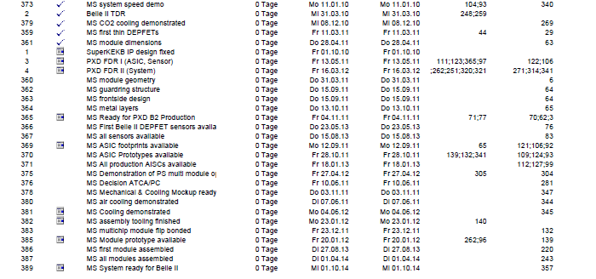
Milestones
http://twiki.hll.mpg.de/twiki/pub/DepfetInternal/SuperBelleProjectManagement/Meilensteine.pdf

Slide 9
Technical Board
The IB endorsed a proposal of the TC to create a technical board to assist
the TC:
Schedule: planning and monitoring
Definition and monitoring of Milestones
Supervision and coordination of work in the work packages
Maintain and monitor the Action List
Prepare technical decisions
Organize reviews before ‘final’ production releases
Organize technical documentation
Composition: work package convenors (+ invited experts if needed)
Meet face to fact in DEPFET workshops, otherwise by EVO (monthly)
Minutes will be public

Slide 10
Thank you!

