Slide 1
Dr.F. Arteche
EMC DEPFET Project:
A general overview

Slide 2
OUTLINE
1. Motivation
2. Main goals
3.WP description
  WP1: Grounding & shielding strategy
  WP2: Immunity issues of DEPFET
  WP3: Noise emissions of PS units
  WP4:Noise propagations issues
4. Schedule
5.Project management

Slide 3
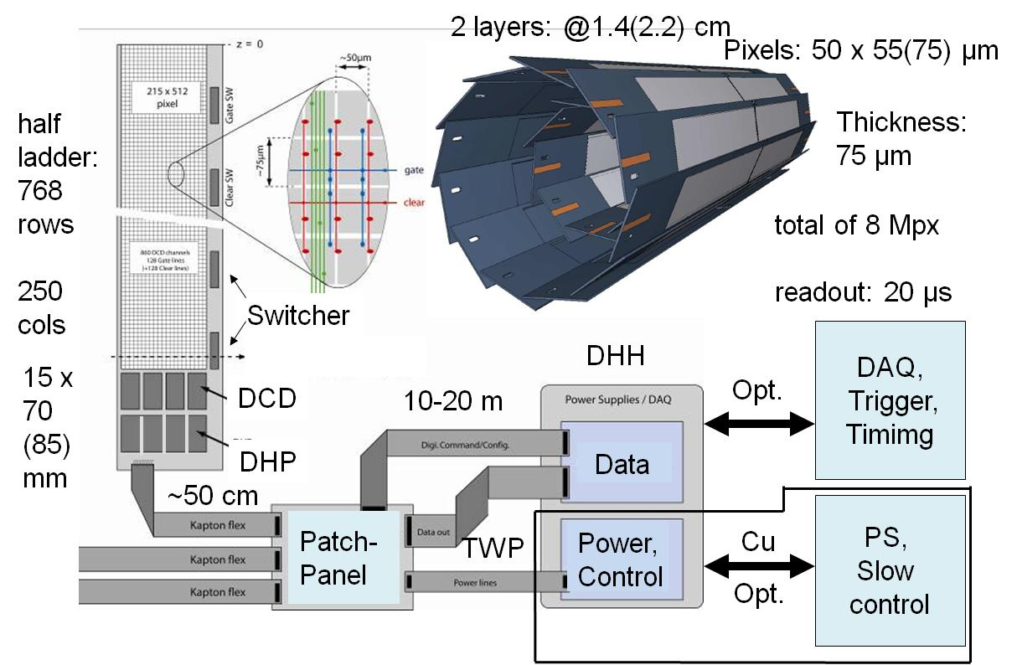
1. MOTIVATION
DEPFET detector is very complex
FEE (Sensor, DCD,DHP,DHH)
  It may be sensitive to EM noise
  It may radiates ( HF clocks and signals)
Power supplies
  It emits EM noise
Cable & connectors
  It may propagate EM noise inside/outside FEE area

Slide 4
1. MOTIVATION
Describing the electromagnetic (EM) environment of DEPFET detector is important to determine and solve problems related to
  Electromagnetic interference
  Grounding & Shielding
It will help to ensure the correct integration of the system in the Belle II experiment.
Experience gained in previous detectors showed that an EM analysis helps a lot during the design & commissioning stage of detectors
  It saves time and money
  It helps to conduct robust designs

Slide 5
2. MAIN GOAL
The goals of the proposed research project are to conduct studies and measurements to establish a map of:
  EM emissions and susceptibilities of sensitive electronics.
This map will be used to:
  To systematically approach the grounding design
  To quantify the immunity /emission of the electronic systems to integrate safely the DEPFET detector.
This is the first time that this kind of mapping will be implemented in a pixel detector
  Studies conducted previously in Tracker and calorimeters

Slide 6
3. WORKING PACKAGES
The project has been divided in four working packages
  WP1: Grounding and shielding strategy for DEPFET: Coordination & Policy
  WP2: Immunity issues of DEPFET FEE: Susceptibility curves of DEPFET system.
  WP 3: Noise emissions of PS units: FEE noise immunity and PS noise emission coordination
  WP4: Noise coupling path characterization between FEE and Power units: Noise propagation issues

Slide 7
3.1 WP1: Grounding strategy
It is focused on grounding and shielding aspects.
It plans to define:
  Safety grounding
  Signal or ground reference plane
  Grounding topologies
These issues will be used to verify:
  Electrical safety issues
  Identify possible ground loops
  Identify EMI sources
  Identify EMI victims

Slide 8
3.1 WP1: Grounding strategy
The main tasks of this WP are:
  T1.1: Definition of the base line for the grounding and shielding strategy for DEPFET.
    Coordination between mechanical and electrical engineering aspects
  T1.2: Coordination of DEPFET grounding policy with other sub-detectors.
    Important collaboration with Belle II
It will issue two versions of the grounding document
  First version: General issues – Main rules
    Some open questions
  Second version
    Final grounding – End of the project

Slide 9
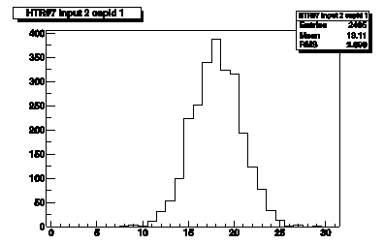
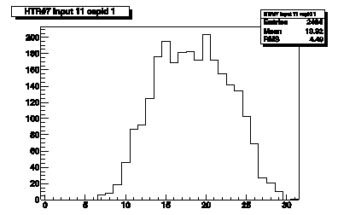

3.2 WP2: Immunity issues of DEPFET FEE
The main goal of this WP is to define the susceptibility level of DEPFET FEE to
  Radio frequency perturbation
  Transient perturbation.
A set of test will be performed in an EMC unit
  Immunity test to RF disturbances
  Transients immunity test
No
noise
Noise

Slide 10
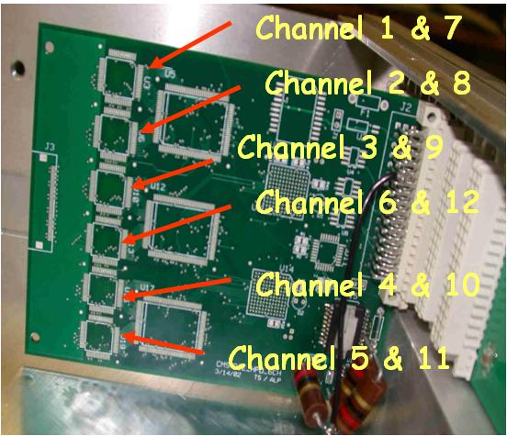
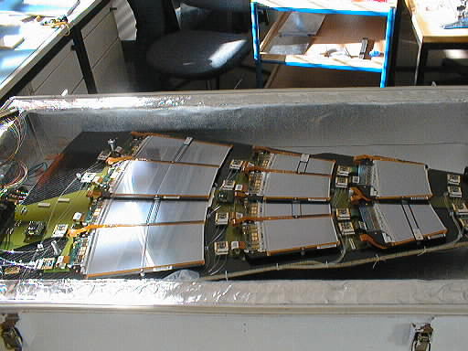
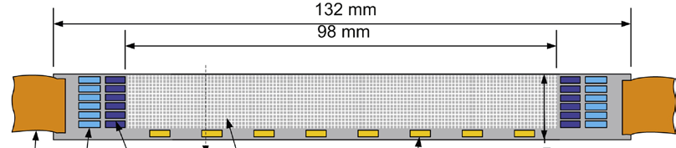
3.2 WP2: Immunity issues of DEPFET FEE
This EMC unit is defined by the minimum structure that may obtain good results to extrapolate results for the whole detector (same topology)
CMS HCAL:1RBX (12 chips-12 chanels)
CMS Tracker: 1Petal (50 chips-6000 chanels)
…¿¿DEPFET ??...
1 Module /half ?
Power supply
DAQ system..
Test set –up preparation complex

Slide 11
3.2 WP2: Immunity issues of DEPFET FEE
These tests allow quantifying the system sensitivity to conductive noise to define:
  The output noise level of power supplies,
  The magnitude of external EM fields
  Ground currents
The main tasks of this WP are:
  T2.1: Immunity noise currents.
  T2.2: Susceptibility curves characterization of DEPFET system to noise currents
  T2.3: Definition of key design issues such as filtering, grounding connection points, and shielding strategy to improve the immunity of DEPFET FEE.
    Evaluation of grounding and shielding topology.

Slide 12
3.3 WP3: Noise emissions of Power units
The main goal of this WP is to measure the noise emission level of the power supply units
It will help to define the compatible levels with the FEE.
These set of tests are complementary to those performed in WP2
The main task of this WP are :
  T3.1 Conducted noise test sep-up definition
    it should be complementary to immunity test
  T3.2 Conducted noise emission level definition for DEPFET system.
  T3.3 Filtering layout and connections.
It is required a prototype of the power units
  Special test set –up

Slide 13
3.4 WP4: Noise propagation issues.
The main goal of this WP is to define the key parameters and the configuration of the power distribution network to minimize the conducted noise.
These studies and analysis will be based on:
  Real tests
  Numerical models developed in MATLAB codes.
It will help to addresses the effect of power cables on the noise propagation and the impact that those cables have in the selection of:
  EMI filters for the FEE low-voltage input
  Conducted emission levels required for the power supplies.

Slide 14
3.4 WP4: Noise propagation issues.
The main tasks of this WP are :
  T4.1 Development of Multi-Transmission Line model for the DEPFET system power network based on MATLAB code.
  T4.2 Characterization of DEPFET power cables: L,C,R and G matrices measurement or simulation.
  T4.3 Characterization of CM & DM transfer function of DEPFET cables. Impact of filtering and grounding and shielding strategies.
A set of cable prototypes will be required
  An schematic may be enough

Slide 15
4. SCHEDULE
Kick-off: May 2011
WP milestones are flexible
  Depends on the DEPFET project
  WPs are quite independent
    Order may change
WP1 – Nov 2011
WP2 – Dec 2012
WP3 – April 2012
WP4 – April 2013

Slide 16
5.PROJECT MANAGEMENT
The project will be carried out by Electrical engineering group from Aragon Institute of Technology (ITA)
  Experienced people in EMC issues
Project coordinator
  Dr. Fernando Arteche
Test & analysis group
  C. Esteban & N. Dominguez
Simulation group
  I.Echeverria & M. Iglesias
VERY IMPORTAT
  Collaboration with DEPFET groups
    Test set –up preparation ( detector , PS, DAQ,..)
    Information

Slide 17
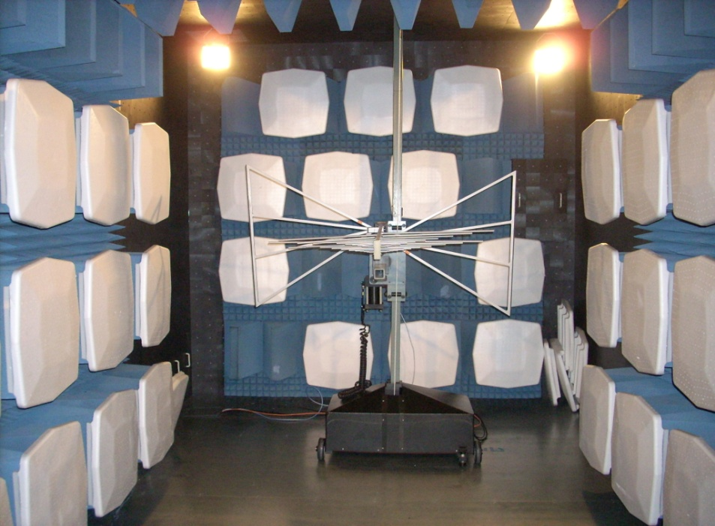
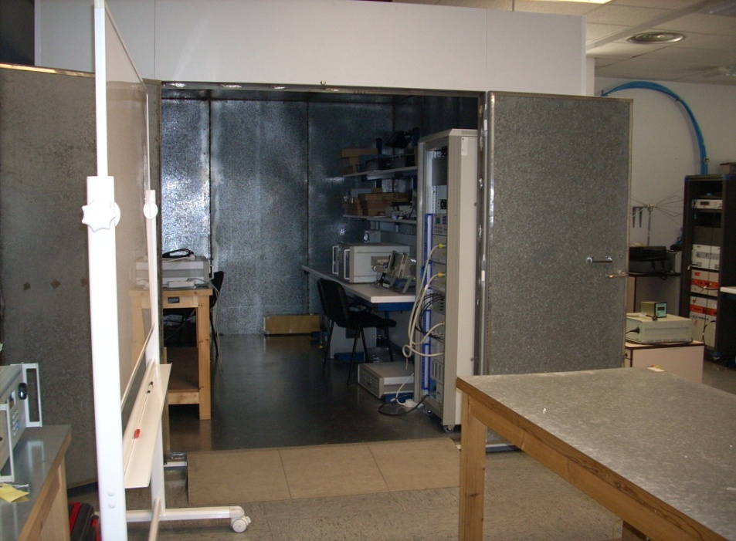
5.PROJECT MANAGEMENT
EMC- URE group
  10 persons + lab support
EMC - Facilities
  Faraday cage
  One semi-anechoic chamber
    3m & 10m
  Spectrum analyzers
  Current probes & Antennas
  Surge & Burst & ESD generators
  Amplifiers (kHz-GHz)
Electronic Lab - Facilities
  Boards designs
  Power supplies
  Programming controllers

