Slide 1
Testbeam setup in basf2
Tadeáš Bílka, Peter Kvasnička, Peter Kodyš, Jozef Kovaľ
Institute of Particle and Nuclear Physics,
Charles University, Prague
DEPFET meeting 2011, Ringberg, 8 - 11 May 2011

Slide 2
Overview
Why analyze testbeam data in basf2?
Current status
Some results
Plans
Conclusions

Slide 3
Why analyze testbeam data in basf2?
Testbeam analysis is a simple test case.
Verification and cross-checking tool
Testbeam data are easily simulated and analyzed with independent tools, which makes them a useful tool for verification of simulation and reconstruction steps.
For adjusting simulation/processing steps, it is a great advantage to process testbeam data in the same environment and using the same tools as in real Belle II simulation and analysis.
It is a good test of implementation of basf2 processing – any hard-wired dependencies on Belle II geometry easily show up.
Entry point to basf2.
Being a simple test case, it is a good starting point for familiarization with basf2. For example, it is a good exercise to create a testbeam geometry from scratch.
Basf2 is a good environment for testbeam analysis
Python steering, availability of geometry, ROOT output data, and framework support provide a comfortable environment for testbeam simulation and analysis.

Slide 4
Current status
Geometry of the 2009 DEPFET testbeam implemented . Geometry data (xml) and geometry creator allow to create geometry in basf2, without any modifications to the framework.
The data and code are available, and we will submit them to basf2 svn.
Demo results. We show some preliminary results to show that the implementation is working.

Slide 5
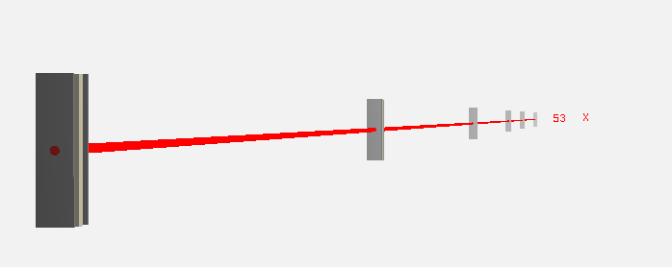
Results: Testbeam geometry
Testbeam geometry is in place.
Particle Gun
Test Beam Modules
0
1
2
3
4
5
x
-40 mm
0 mm
80 mm
198 mm
320 mm
404 mm
529 mm
0
1
2
3
4
5
y
x (beam direction)
z

Slide 6
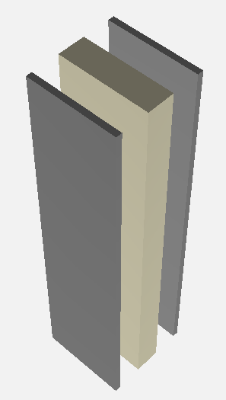
Results: Testbeam geometry
Testbeam geometry is in place.
1.5 mm
2 x 100μm Aluminium (Passive)
450μm PXD Silicon (Active)
10 mm
6 mm

Slide 7
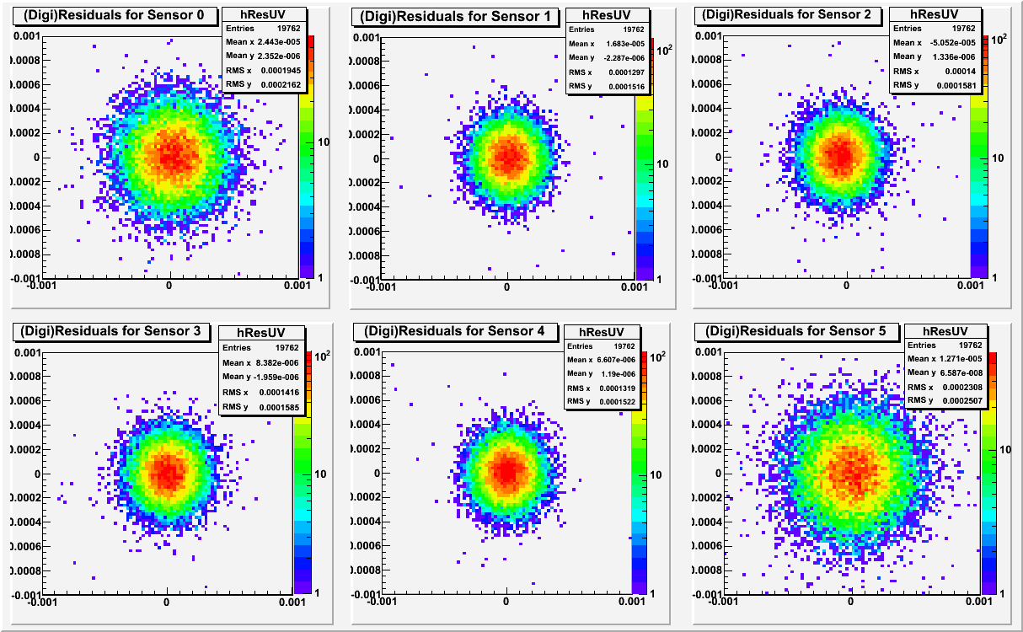
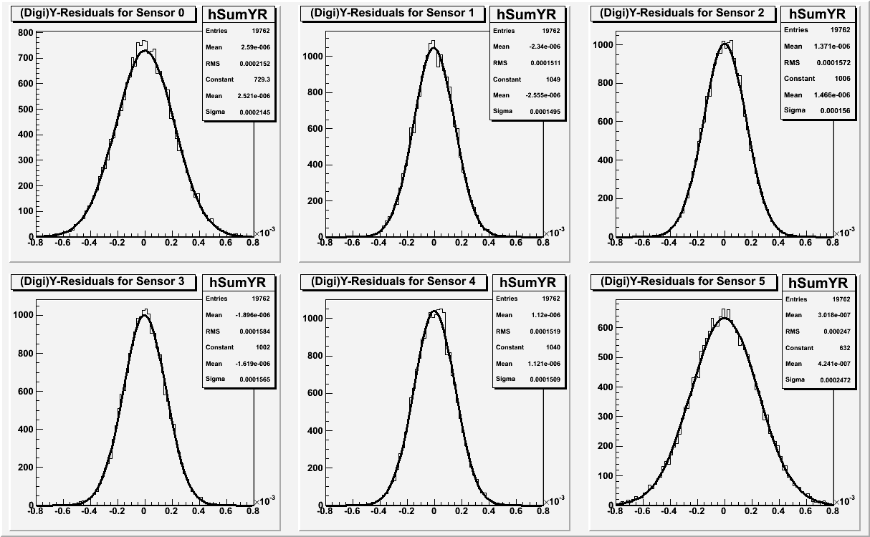
Results: Tracking
Simulattion of 20 000 120 GeV pions, Gaussian-smear digitizer, pre-set resolutions δu = 1.2 µm, δv = 1.0 µm, line fit.
Sensor | σ_{u} [μm] | Δσ_{u} [μm] | σ_{v} [μm] | Δσ_{v} [μm]
0 | 2,145 | 0,012 | 1,914 | 0,010
1 | 1,495 | 0,008 | 1,280 | 0,007
2 | 1,560 | 0,008 | 1,368 | 0,007
3 | 1,565 | 0,008 | 1,392 | 0,007
4 | 1,509 | 0,008 | 1,307 | 0,007
5 | 2,472 | 0,013 | 2,264 | 0,012

Slide 8
Results: Energy scan
Pions with energies from 20 to 80 GeV, line fits, u coordinate (pre-set resolution 1.2 µm)

Slide 9
Plans
Try to use pattern reco and genfit.
Simulate with full digitizer.
Compare with existing 2009 analyses.
Prepare for future testbeams.
Specific testbeam modules:
data readers,
calculation of pixel gains,
position bias,
? alignment
resolutions.

Slide 10
Conclusions
The 2009 DEPFET testbeam geometry was implemented in basf2
Its basic functionality was tested.
We want the code to become official part of basf2 distribution.
We go on to test the full digitizer, basf2 pattern reco / tracking and to develop specific testbeam modules.

Slide 11
Thanks for your attention!

