Slide 1
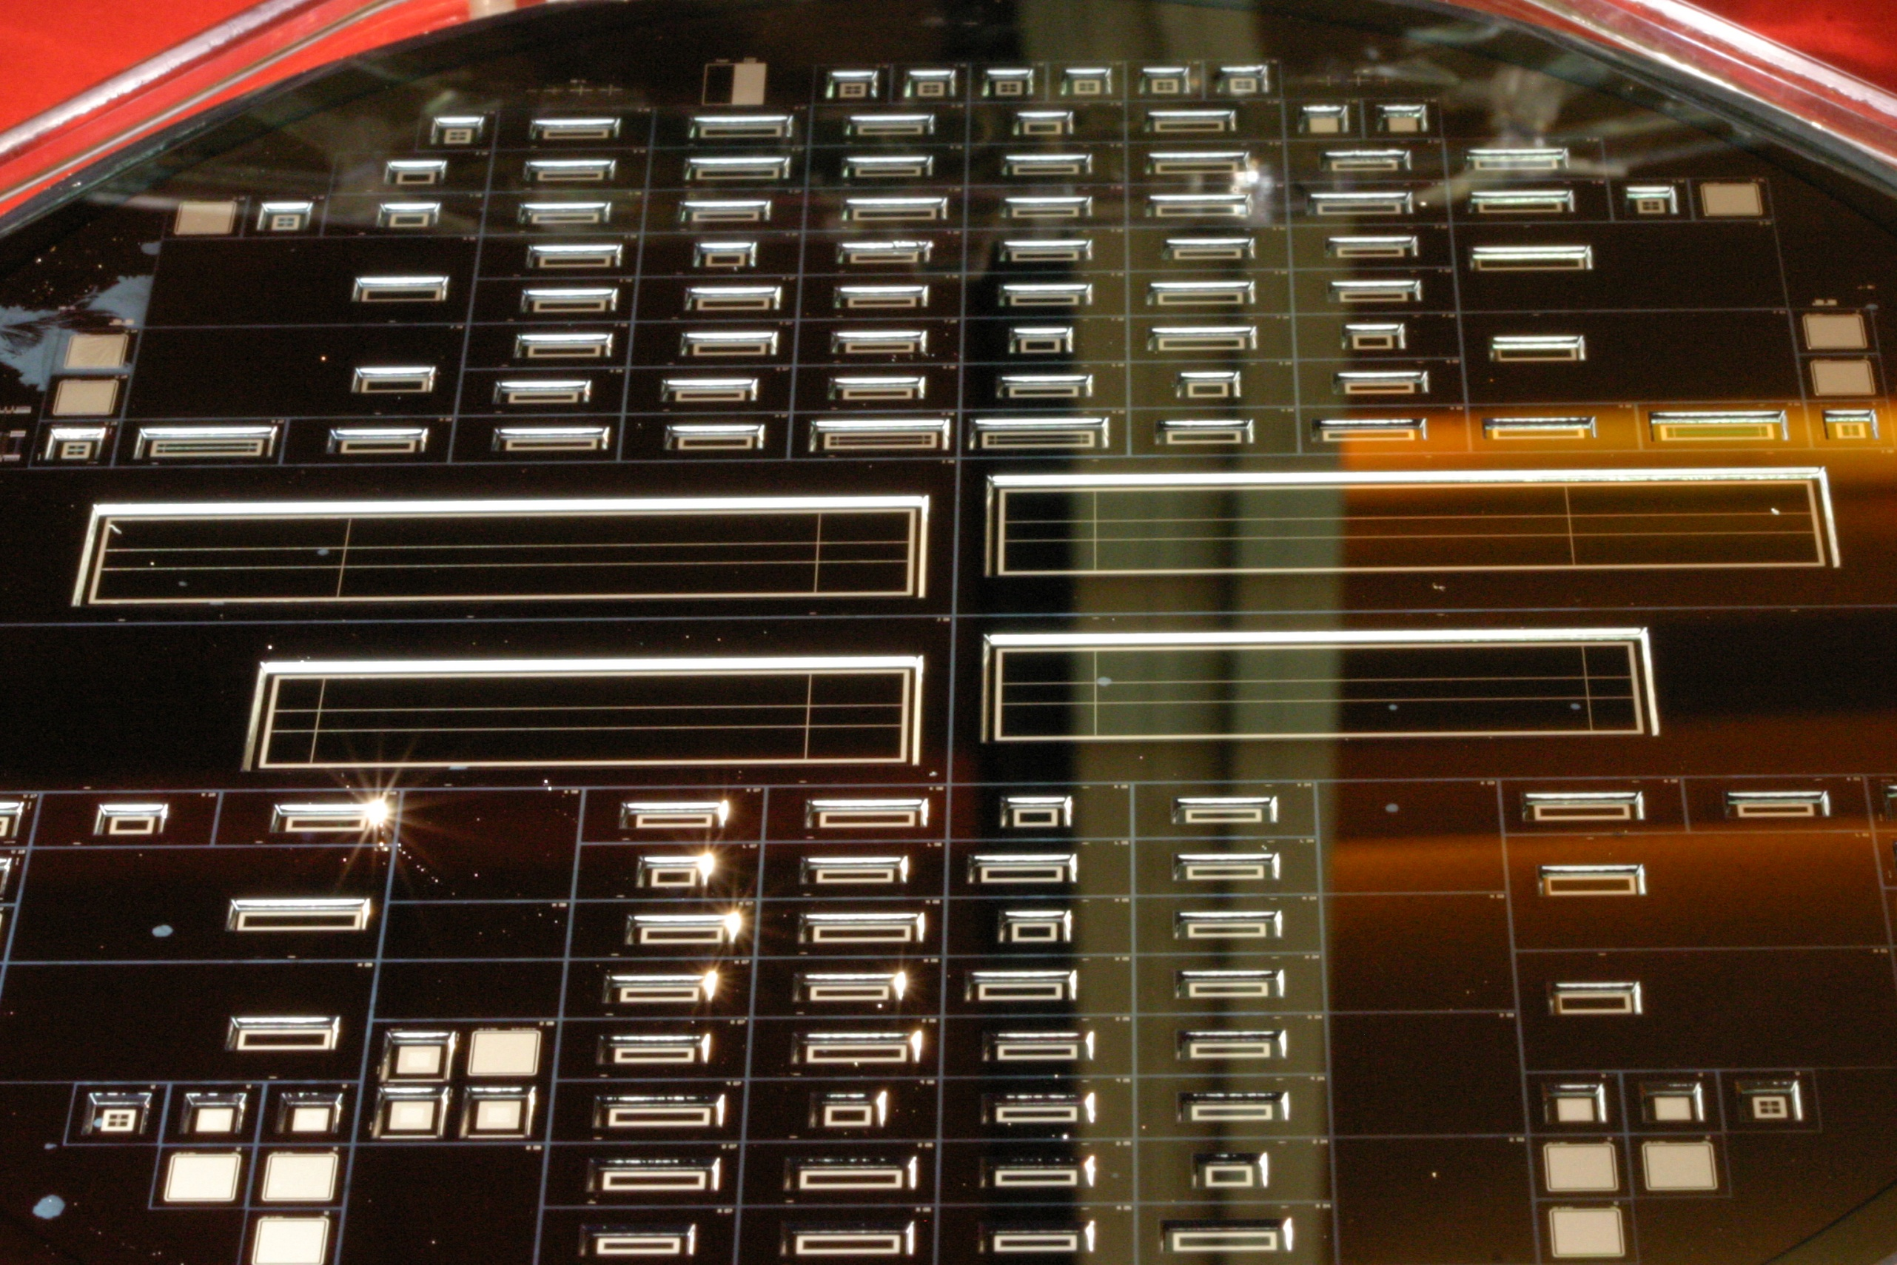
Testing PXD6 - summary and plans
Jelena Ninkovic for the HLL team

Slide 2
PXD6 Batch 1 wafers
  L1 - lithography dummy but has some of the implantations
S1, W02 – hot wafers with ZMI=600nm
W21 – hot wafer with ZMI=1000nm and Plasma etching of Polysilicon
W11 – Reference wafer (not SOI material)
  Some parts of the wafer have 100nm thinner Oxide then the rest of the wafer
  Non of the copies of ILC matrices passed pretests
  Significant number of small Belle designed matrices passed pretests

Slide 3
Back side diodes on SOI material
n+
Direct bonding on 50μm silicon without mechanical support works and no increase in the leakage current was observed
50μm
200nm
Oxide
p+
Al
Handle wafer

Slide 4
ILC vs. Belle in the testing differences
ILC (2 fold read out)
Belle (4 fold read out)
128 Drain connections 128
Gate connections 16
Physical columns 32
256 Physical rows 64
SW
Clear SW
Gate SW

Slide 5
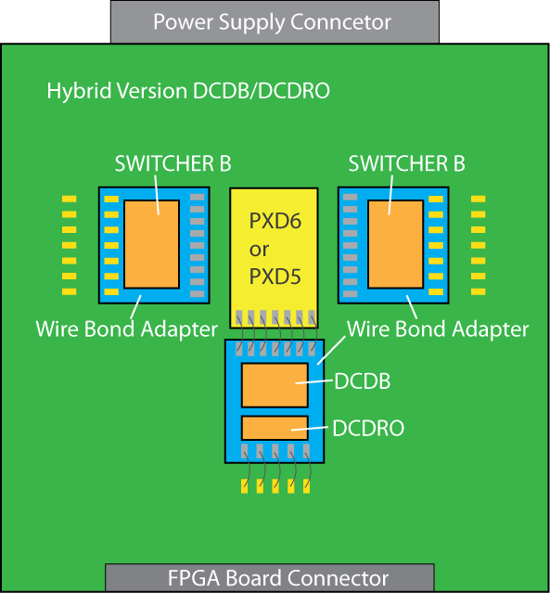
Hybrid 4.1
Statistics on the yield on
Hybrid 4.1 assembly
2.5 out of 14 adapters DCDB/DCDRO
SWB
All chips were taken into assembly without any precharacterisation !!!
Matrices are preselected

Slide 6
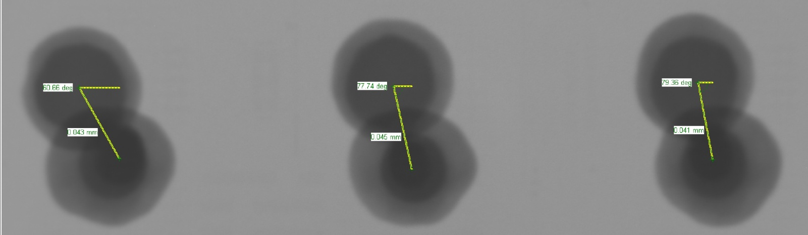
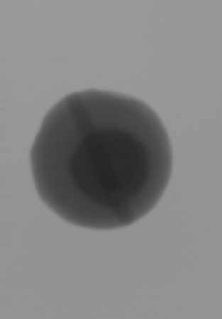
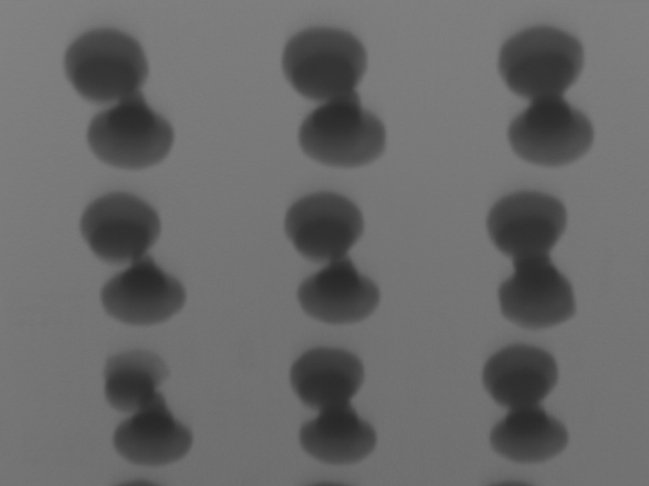
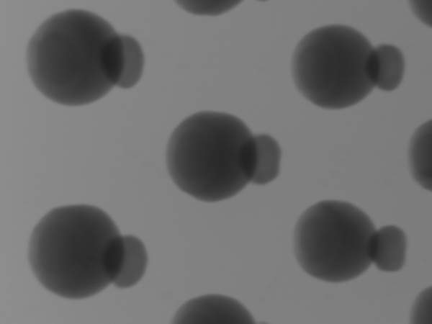
Yield of the chips on the adapters
DCDRO
DCDB
DCDRO
DCDB

Slide 7
Hybrid 4.1 plans
DCDB - characterization on chip level before flip chipping (Planned)
characterization after flip chipping (not yet planned)
optimization of ACDs parameters for functional chips before assembly
SWB - characterization on chip level before flip chipping (Planned)
characterization after flip chipping (not yet planned)
We will need this procedure also for the final Belle PXD assembly
Preparation of this will take additional time ….( 3-4 months ?)

Slide 8
MiMa
Will soon become nice tool ….
low noise
flexible system
But can be used only as multiple (48) single depfet setup for the 4-fold read out
3 setups exist : Prags, MPI-HLL, LMU

Slide 9
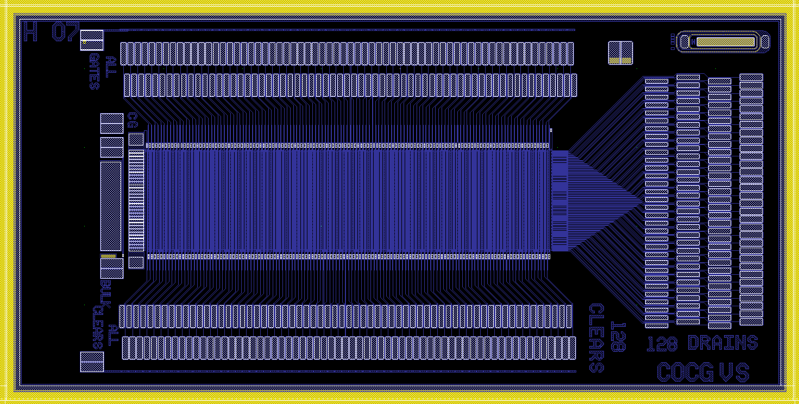
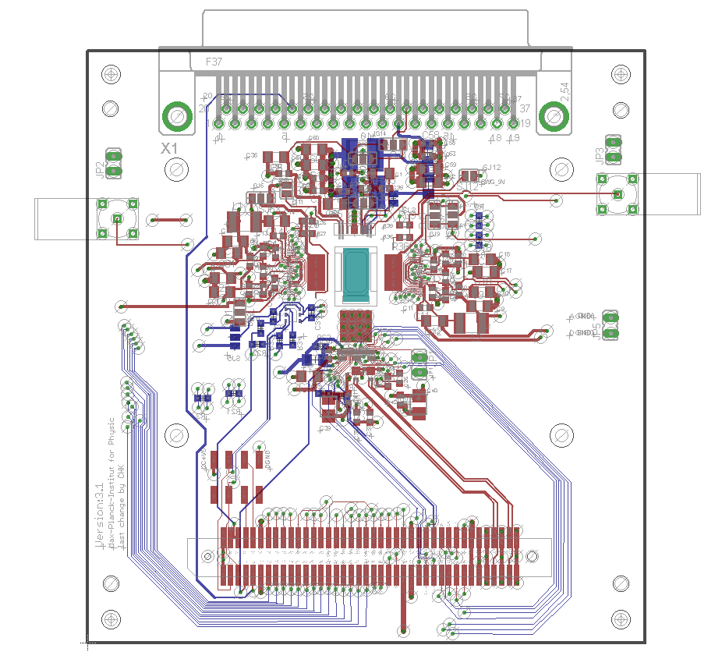
Hybrid 3.1 - S3B system (CURO + SW3)
PXD6 ILC Design can be used with Hybrid 3.1 (electrical identical with Hybrid 3.0
cut-out 4.3 x 9mm² instead of 5.3 x 10 mm²).
PXD6 Wafer:
  3 x ILC type (24 x 24 µm² - type used as DUT in TB2009)
  3 x ILC type VS (20 x 20 µm² - type as the best DUT TB2009)

Slide 10
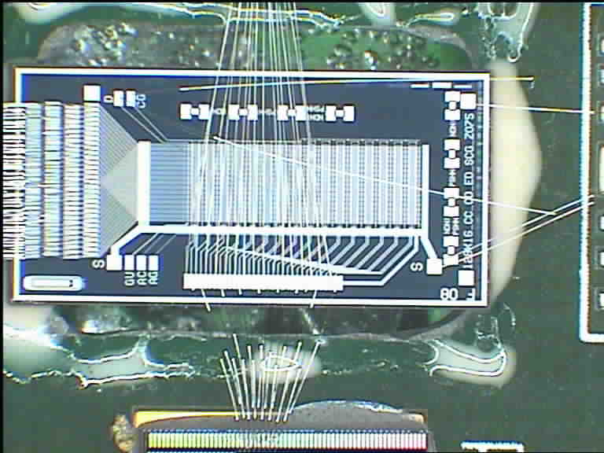
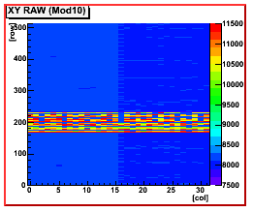
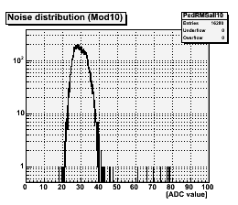
S3B system with Belle matrix
Prepared last Thursday
Matrix can be swithed ON/OFF
Reacts on light
DEPFET currents look ok
DAQ/Monitor was not ready for 4 fold read out
Hybrid is 2 times more noisy then usual
Further investigation is needed
One more hybrid of this kind will be prepared
within the coming week.

Slide 11
Dynamic measurements – Initial proposal
Decision made in Prague - to risky to use SAMTEC connectors better to prepare more hybrids each assembled with ASICs and Matrix

