Slide 1
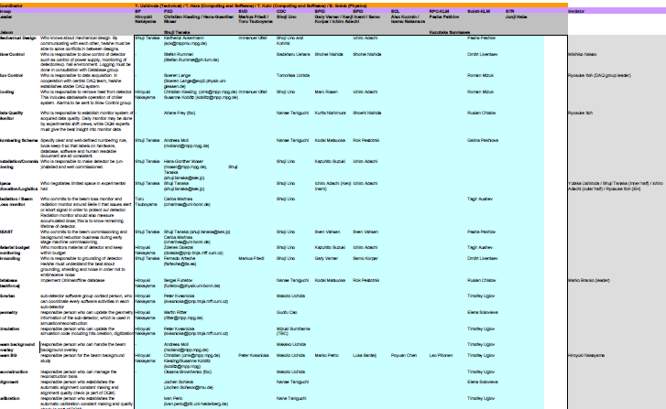
Contact Persons
Yutaka Ushiroda proposed to set up a matrix of responsible persons (contacts) for the various subdetector tasks.
He plans to have meetings of subsets of this matrix during B2GM meetings
A first draft of PXD contacts has been made and should be agreed upon
(not all positions are confirmed yet)

Slide 2
Part I
Group |  | PXD
Leader |  | Christian Kiesling / Hans-Guenther Moser
Liaison |  | Shuji Tanaka
Mechanical Design | Who knows about mechanical design. By communicating with each other, he/she must be able to solve conflicts in between designs. | Karlheinz Ackermann (ack@mppmu.mpg.de)
Slow Control | Who is responsible to slow control of detector such as control of power supply, monitoring of detector/exp. hall environment. Logging must be done in consultation with Database group. | Stefan Rummel (Stefan.Rummel@ph.tum.de)
Run Control | Who is responsible to data acquisition. In cooperation with central DAQ team, he/she establishes stable DAQ system. | Soeren Lange (Soeren.Lange@exp2.physik.uni-giessen.de)
Cooling | Who is responsible to remove heat from detector. This includes stable/safe operation of chiller system. Alarms to be sent to Slow Control group. | Christian Kiesling (cmk@mpp.mpg.de) Susanne Koblitz (koblitz@mpp.mpg.de)
Data Quality Monitor | Who is responsible to establish monitor system of acquired data quality. Daily monitor may be done by experimental shift crews, while DQM experts must give the best insight into monitor data. | Ariane Frey (tbc)
Numbering Scheme | Specify clear and well-defined numbering rule, book-keep it so that labels on hardware, database, software and human readable document are all consistent. | Andreas Moll (molland@mpp.mpg.de)
Installation/Commissioning | Who is responsible to make detector be (un-)installed and well commissioned. | Hans-Günther Moser (moser@mpp.mpg.de), Shuji Tanaka (shuji.tanaka@kek.jp)
Space allocation/Logistics | Who negotiates limited space in experimental hall. | Shuji Tanaka (shuji.tanaka@kek.jp)
Radiation / Beam Loss monitor | Who commits to the beam loss monitor and radiation monitor around Belle II that issues alert or abort signal in order to protect our detector. Radiation monitor should also measure accumulated dose; this is to know remaining lifetime of detector. | Carlos Marinas (cmarinas@uni-bonn.de)

Slide 3
Part II
BEAST | Who commits to the beam commissioning and background reduction business during early stage machine commissioning. | Shuji Tanaka (shuji.tanaka@kek.jp) Carlos Marinas (cmarinas@uni-bonn.de)
Material budget monitoring | Who monitors material of detector and keep within budget | Zdenek Dolezal (dolezal@ipnp.troja.mff.cuni.cz)
Grounding | Who is responsible to grounding of detector. He/she must understand the best about grounding, shielding and noise in order not to emit/receive noise. | Fernado Arteche (farteche@ita.es)
Database [taskforce] | Implement Online/offline database | Sergei Furletov (furletov@physik.uni-bonn.de)
librarian | sub-detector software group contact person, who can coordinate every software activities in each sub-detector | Peter Kvasnicka (kvasnicka@ipnp.troja.mff.cuni.cz)
geometry | responsible person who can update the geometry information of the sub-detector, which is used in simulation/reconstruction | Martin Ritter (ritter@mpp.mpg.de)
simulation | responsible person who can update the simulation code including hits creation, digitization | Peter Kvasnicka (kvasnicka@ipnp.troja.mff.cuni.cz)
beam background overlay | responsible person who can handle the beam background overlay | Andreas Moll (molland@mpp.mpg.de)
beam BG | responsible person for the beam background study | Christian Kiesling(cmk@mpp.mpg.de) Susanne Koblitz (koblitz@mpp.mpg)
reconstruction | responsible person who can manage the reconstruction tools | Oksana Brovchenko (tbc)
alignment | responsible person who establishes the automatic alignment constant making and alignment quality check (a part of DQM) | Jochen Schieck (Jochen.Schieck@lmu.de)
calibration | responsible person who establishes the automatic calibration constant making and quality check (a part of DQM) | Ivan Peric (ivan.peric@ziti.uni-heidelberg.de)

