Slide 1
Calorimetry of the Future & the T3B Experiment
Young Scientist Workshop – July 26th 2011
Christian Soldner
Max-Planck-Institute for Physics

Slide 2
Outline
Let’s try to design a future calorimeter
(for the future linear e+e- collider CLIC with 3TeV CM Energy)
Look for the Superlative:
Bigger?
More?
Faster?

Slide 3
State of the Art Technology (At lhc)

Slide 4
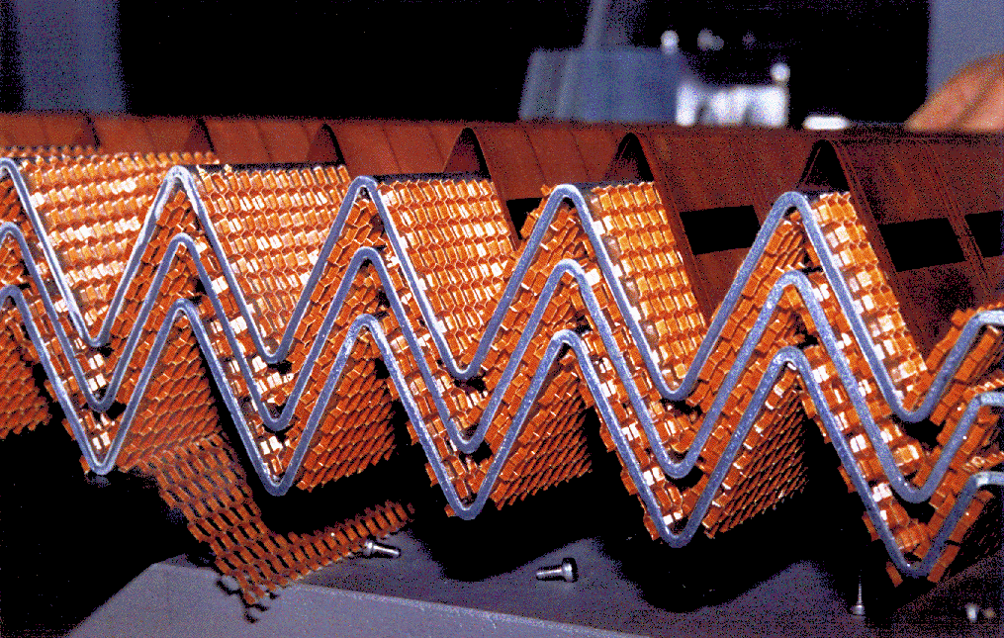
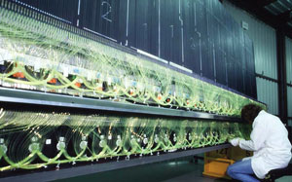
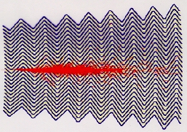
State of the Art Technology (Hadron Collider)
ATLAS: Readout:
ECAL: - Liquid Argon + Lead Absorber Plates → Cu/Kapton Electrode
HCAL: - Plastic Scintillator + Steel Absorber → Photo Multiplier Tubes
Calorimeters located outside of the Solenoid
$σ_{E}/E_{CAL}$
10%/$\sqrt{E}$
45%/$\sqrt{E}$
$$E_{JET}$$ | 45 GeV | 500 GeV
$$σ_{E}/E_{JET}$$ | 15% | 4%

Slide 5
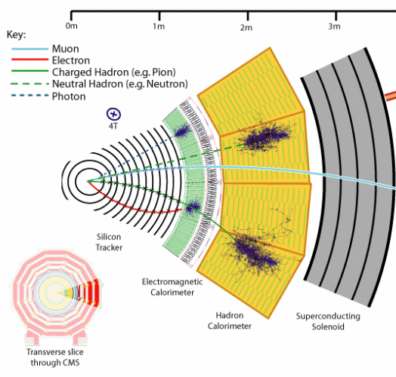
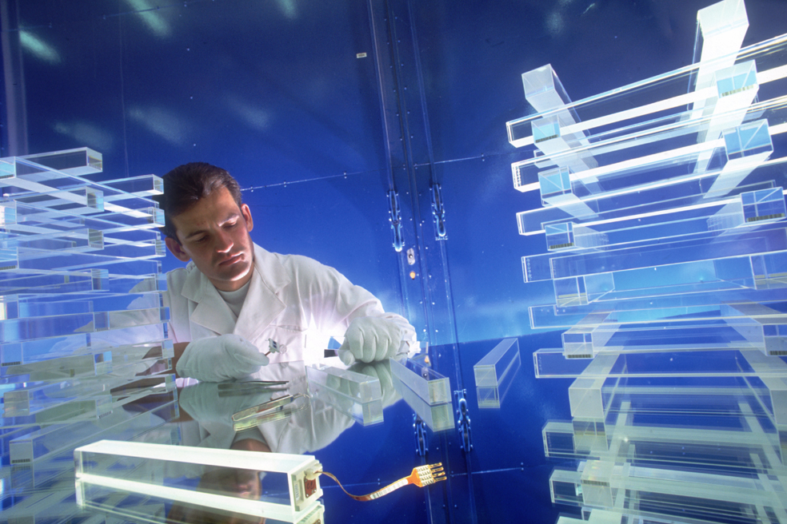
State of the Art Technology (Hadron Collider)
CMS: Readout:
Ecal: - Lead Tungstenate Crystals → Avalanche Photodiodes
HCAL: - Plastic Scintillator + Brass Absorber → Hybrid Photodiodes
Calorimeters located inside of the Solenoid
$σ_{E}/E_{CAL}$
3%/$\sqrt{E}$
100%/$\sqrt{E}$
$$E_{JET}$$ | 45 GeV | 500 GeV
$$σ_{E}/E_{JET}$$ | 19% or 12% | 5%

Slide 6
Design a Future Calorimeter (for a E+E- COLLIDEr)

Slide 7
Big?
Let’s look for Superlatives:
Why don’t we build the biggest Calorimeter in the world?
Compare: ATLAS: 12m in beam direction, 8m diameter
Look at what’s important:
Would be nice if we could find someone to pay for it at some point!
Hermitic → leakage deteriorates the jet energy measurement
→ needed to reconstruct missing E
ρ(CAL) determines size
Atlas: ~25 $X_{0}$, ~10 $λ_{I}$
→ Bigger is not better
What about “small”?
Compare: CMS: 2.95m in diameter
Advantage: CAL fits inside the solenoid → no dead material between trackers and CAL
But: most dense material to consider: Tungsten
→ let’s try that
Steel | Tungsten
~ 8 ${g/cm}^{3}$ | ~ 19 ${g/cm}^{3}$
~ 5-10 €/kg | ~ 100 €/kg

Slide 8
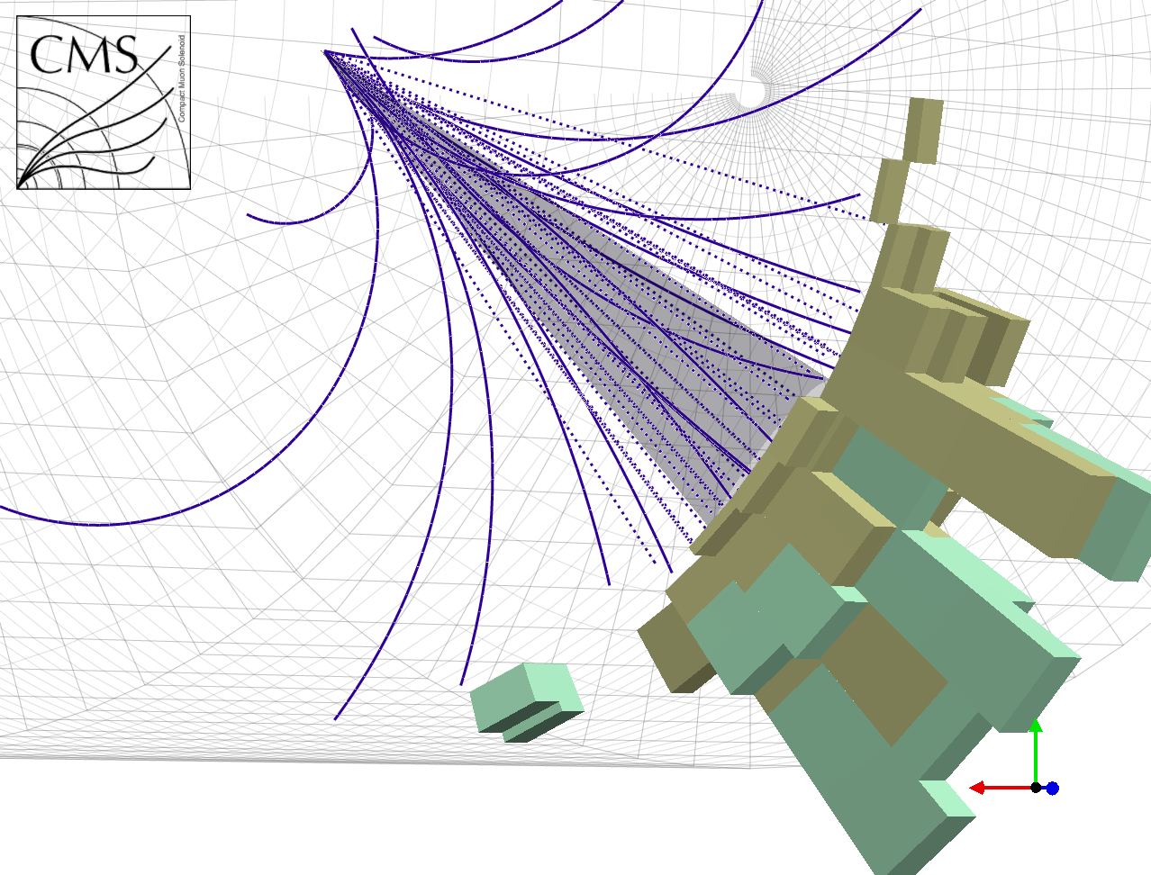
More?
How about millions of readout channels in the CAL?
Compare: ATLAS: ~10.000 in the Hcal (TileCal)
Energy depositions in Cal combined to towers
→ space requirements
→ cost efficiency
→ reduce no of readout channels (data transfer)

Slide 9
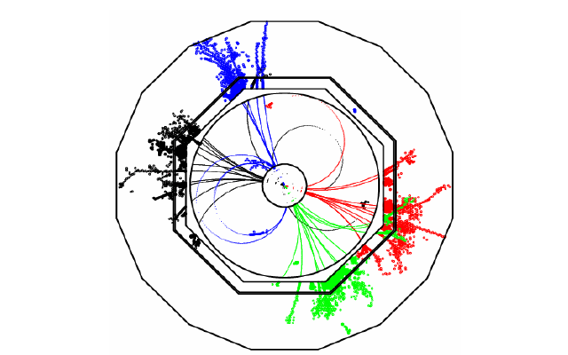
More?
How about millions of readout channels in the CAL?
Compare: ATLAS: ~10.000 in the Hcal (TileCal)
Energy depositions in Cal combined to towers
→ space requirements
→ cost efficiency
→ reduce no of readout channels (data transfer)
With say 8 million readout channels (HCAL):
Note: This just makes sense in the clean environment of a e+e- collider

Slide 10
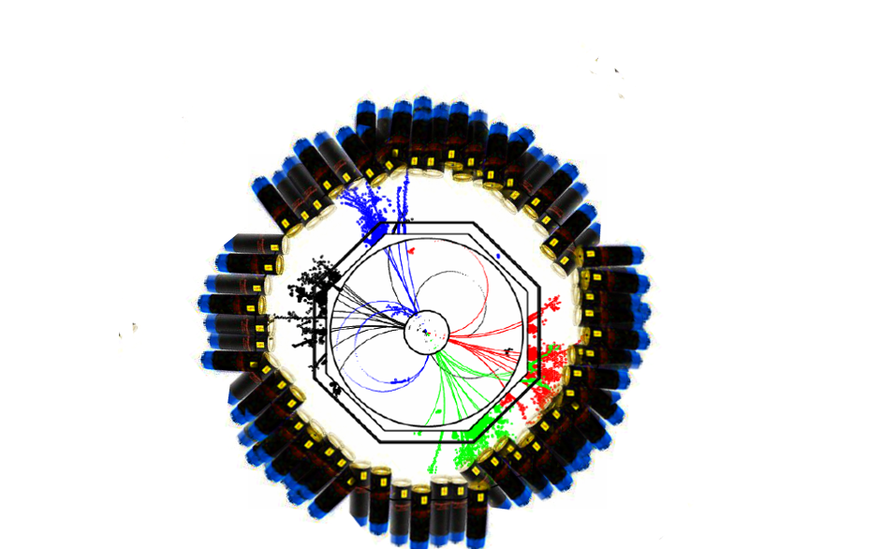
More?
How about millions of readout channels in the CAL?
Realize this with millions of PMTs? → hardly
Need to exploit
new technologies!
Use novel Silicon Photomultipliers:
Small
Insensitive to B-Fields
Low Voltage operation (~30-70V)
At last:
Photo Sensor, Scintillator Tile and Readout Electronics integrated in active layer
(other approaches: (Semi-)Digital HCAL…)

Slide 11
More?
How about millions of readout channels in the CAL?
Why did we want this again?
It certainly looks nice!
But main reason:
Try to build the best possible calorimeter
to minimize its usage
because calorimeters are bad.
Momentum measurement of tracking system better (for particles whose track is bent enough
~100GeV in case of ILD)
The Particle Flow Idea:
Reconstruct each particle in a jet in the subdetector which can provide the best energy measurement
Calorimeters need to categorize and assign energy depositions
Ultra fine segmentation and
Intelligent clustering algorithms necessary
 | Average Jet Composition(LEP)
Charged particles | 62%
Photons | 27%
Neutral Hadrons (long lived) | 10%

Slide 12
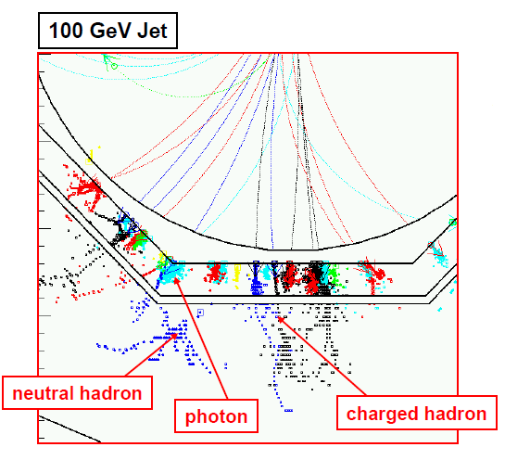
Particle Flow
Calorimeters need to categorize and assign energy depositions to incoming particles
ECAL → Photons HCAL → Neutral Hadrons
Unprecedented Jet Energy Resolution:
→ 3x better than LEP
2x better than
conventional
→ 5.2% using raw calo energy
$E_{JET}$ | $$σ_{E}/E_{JET}$$
45 GeV | 3.7%
100 GeV | 2.9%
180 GeV | 2.8%
250 GeV | 2.8%
375 GeV | 3.2%
500 GeV | 3.5%
For Jets >100GeV: JER dominated by confusion not by the Energy Res of Calorimeters!

Slide 13
Faster?
Could the calorimeter be so fast that we can observe the time development of e.g. hadronic showers?
Not directly.
Energy depositions cannot be sampled (like on an oscilloscope) → too much data
→ more later
But:
Equip every calorimeter channel with a TDC (Time to Digital Converter)
Assign a time stamp to every energy deposition
A next generation HCAL prototype is on the way equipped with such TDCs
(time resolution ~100ps)
The question is: Why should we care?

Slide 14
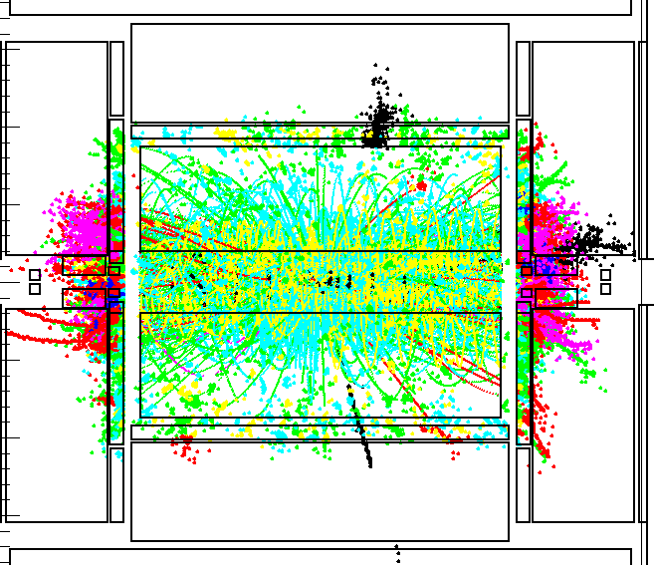
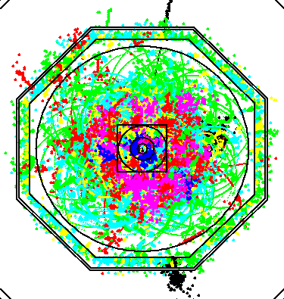
Faster?
1. Because of the design of CLIC
$$CLIC$$
CMS Energy | 3TeV
Bunch Separation | 0.5ns (25ns@LHC)
Bunch Train Length | 156ns
High rate background: γγ $→q\overline{q} →Jets$
Origin: Beam Focusing → Bremsstrahlung
Occurrence: ~13 particles/BX
Interesting Physics: << 1/Bunch Train
Clean environment of a e+e- collider?
→ Detector activity when integrating over half a bunch train
150 BXs (75 ns) in ILD-like detector
Time stamping can clean up the detector

Slide 15
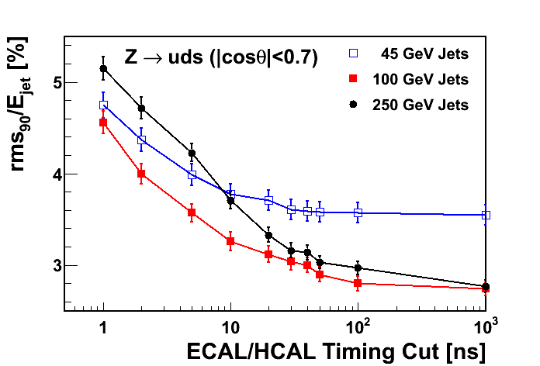
Faster?
2. Hadronic showers are not instantaneous
Process:
Heavy absorber nuclei get struck inelastically
Nucleus can be excited
Relaxation
emission of a late neutron / photon
Inelastic scattering within the active layers
Ignoring late energy depositions deteriorates the JER (like leakage)
Compromise necessary:
Good Jet Energy Resolution Efficient Background Rejection
Are those timing studies true?
→ Rely heavily on correctness of GEANT4 simulations (i.e. its physics lists)
Timing properties of hadronic showers in a tungsten calorimeter so far untested
This is where the Tungsten Timing TestBeam experiment (T3B) comes in!

Slide 16
T3B

Slide 17
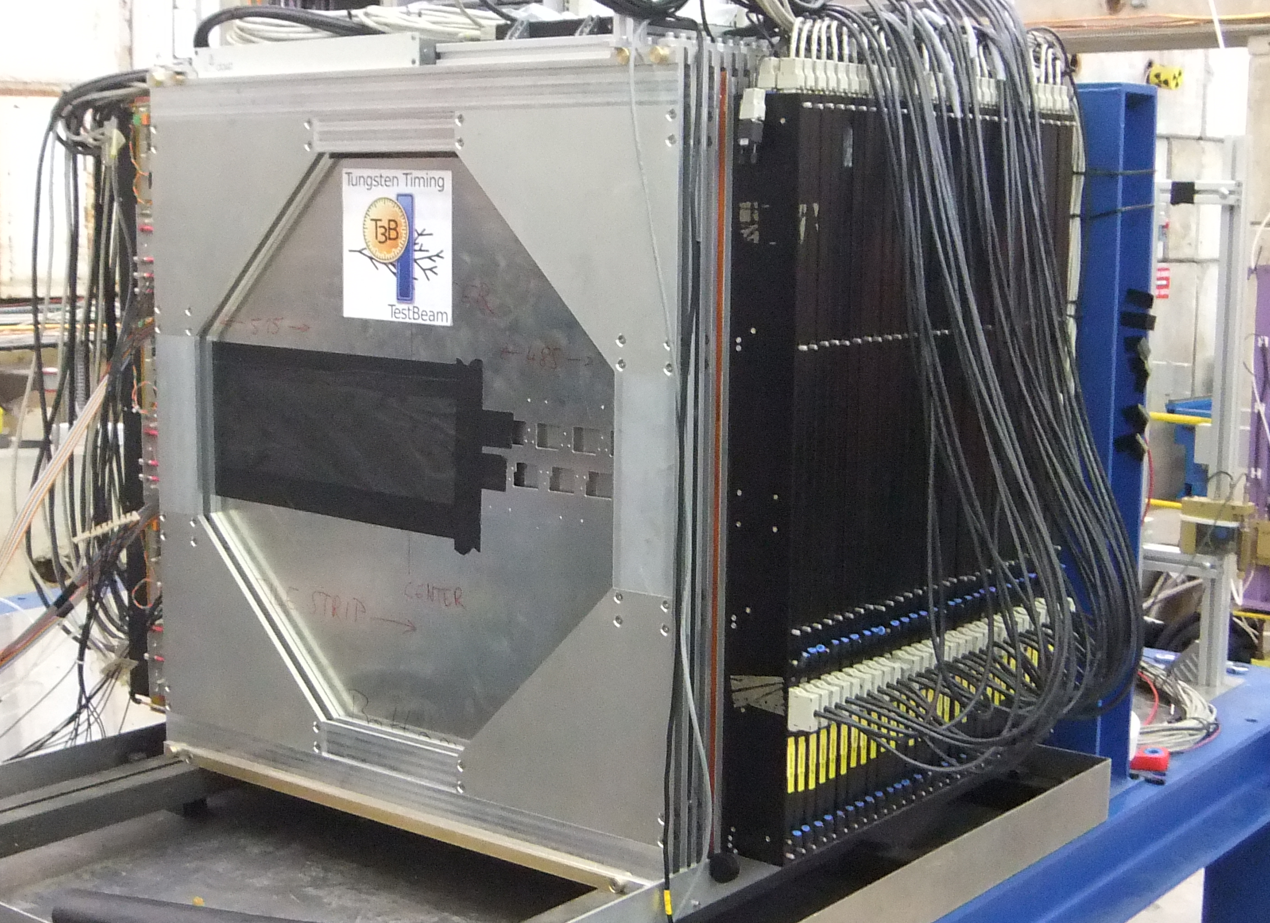
The T3B Experiment within the CALICE AHCAL
CALICE
(calorimeter for the linear collider experiment)
Prototype for a future highly granular HCAL
38 layers of scintillator and tungsten absorber
1x1x1$m^{3}$ with about 8000 channels and 5 $λ_{I}$
+ 3D reconstruction of hadronic shower shapes
- No timing information on the showers
Test Beams: PS 11/2011, SPS 7/2011
Particles: Hadrons from 10 to 300 GeV
CALICE AHCAL
T3B Layer
Shower Shape of a 300GeV pion Event

Slide 18
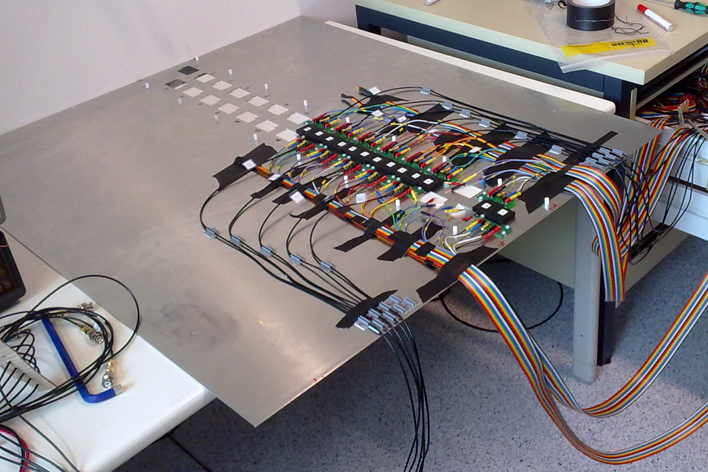
What is T3B?
What is T3B?
One layer of 15 scintillator tiles
Tile dimensions: 3 x 3 x 0.5 cm³
Light Readout by SiPMs
Data Acquisition: 4 fast USB Oscilloscopes
Setup optimized to observe the time development of hadron showers
3cm

Slide 19
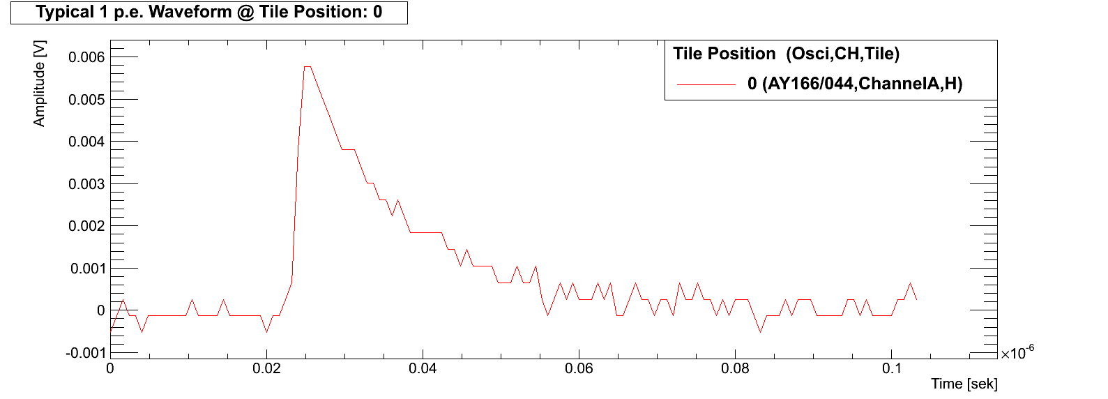
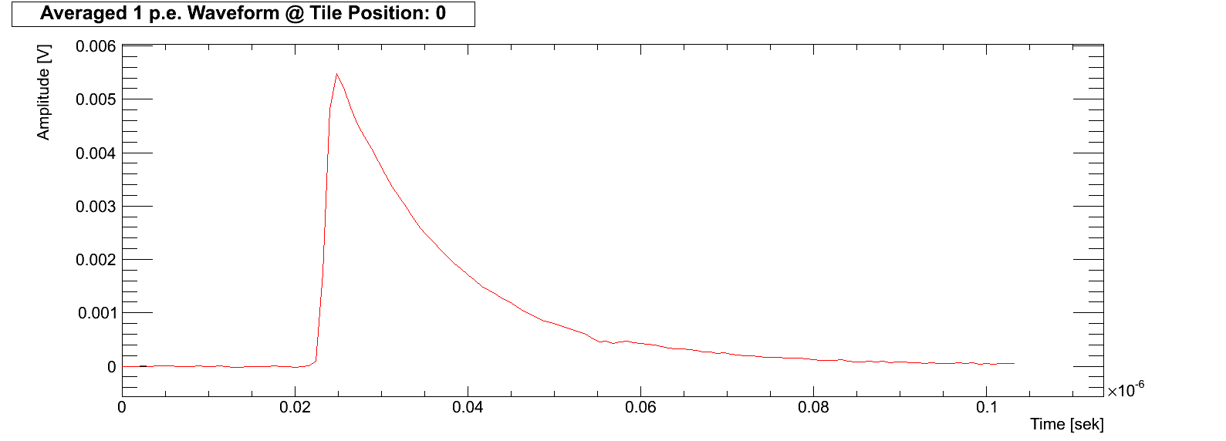
SiPMs
Typical waveform of 1 pixel firing
Average
1mm
Hamamatsu SiPM: 1600 pixels → each pixel can measure single photons
→ # fired pixels $\sim$ # measured Photons $\sim$ Energy deposition in Scintillator

Slide 20
Data Analysis
Waveform of Total
Acquisition window
T3B Waveforms:
Appearance of a typical event at one T3B channel → ${\text{π}}^{−}$@ 10GeV
High short energy deposition, followed by potential late Edeps

Slide 21
Novel Data Processing Method
Waveform Decomposition:
Iteratively substract 1 pixel waveform from the local maximum till nothing is left
Obtain time of energy deposition with sub-nanosecond precision
http://www.mpp.mpg.de/~soldner/WaveformDecomposition.gif

Slide 22
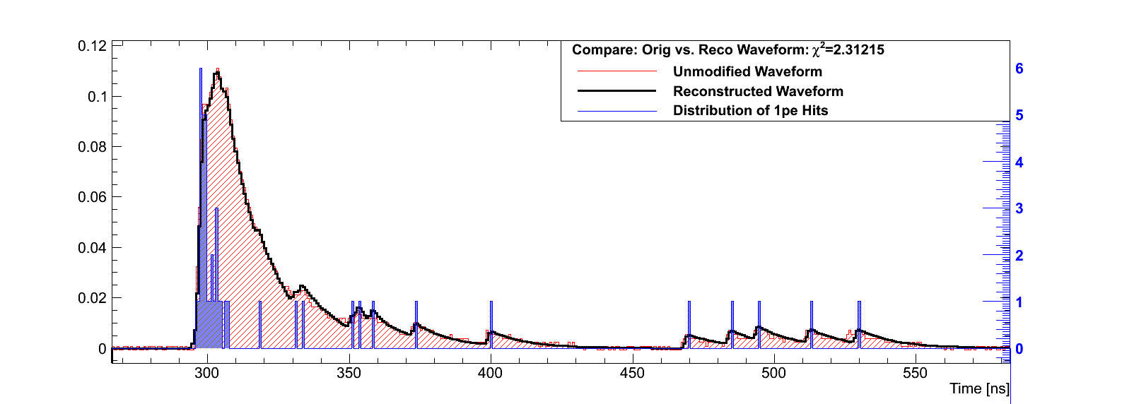
Data Analysis: Waveform Decomposition
Verify the success of the procedure:
Build up the original waveform from the 1p.e. hit histogram → good agreement

Slide 23
Data Analysis: Waveform Decomposition
Analysis of the time of first energy deposition within the tiles of the T3B layer for hadronic showers
The time of first hit is a good measure for the intrinsic time stamping possibilities in the calorimeter
Verify the success of the procedure:
Build up the original waveform from the 1p.e. hit histogram → good agreement

Slide 24
Results: Data vs. MC
First Robust Comparison of Data vs. MC with a timing key parameter:
Determine the mean time of first hit cell by cell
Note:
Beam axis through T3B tile 0
Tile 10 is 30cm from beam axis
Data very well reproduced with QGSP_BERT_HP
QGSP_BERT overestimates late contributions at large radii
First Data vs. MC comparison delivers valuable information:
→ The GEANT4 physics list QGSP_BERT (standard for ILC, LHC simulations) does not reproduce the timing properties of hadron showers correctly, but the High Precision extension does!

Slide 25
Summary

Slide 26
Summary
We saw how a calorimeter of the future could look like
Using the Particle Flow concept an unprecedented jet energy resolution of $\frac{σ_{E}}{E_{JET}}\sim 3−4\%$ is achievable
CALICE is a prototype of a highly granular calorimeter with 8000 channels
Testing if the performance requirements can be met
T3B is a new experiment testing the time development in hadronic showers
First results manifest that the standard GEANT4 physics list QGSP_BERT does not reproduce shower timing correctly
A high precision extension to the list is needed to fit the data
There is still a lot of potential in the taken test beam data → analysis ongoing

Slide 27
Backup

Slide 28
Summary
We presented preliminary results on the time structure of hadronic showers
Setup: Investigated π⁻ events at 10 GeV in the CALICE WHCAL at 3 lambda depth
using the T3B Timing Layer
In the presented analysis we used the time of first hit as key parameter for the time structure of hadronic showers
Data vs. MC comparison shows excellent agreement for QGSP_BERT_HP and large discrepancies for QGSP_BERT
More timing analyses from the T3B group will follow…

