Slide 1
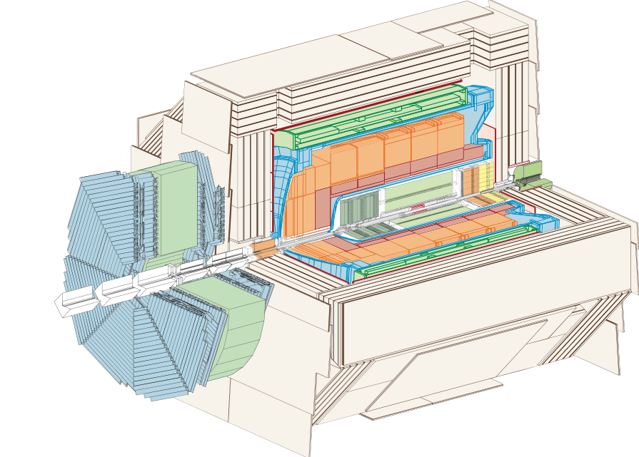
H1 Detector Upgrade Installation
HERA Luminosity Upgrade
2000-2001

Slide 2
H1 Detector Upgrade
HERA SC Magnet GO
HERA SC Magnet GG
H1 Central Upgrade Region

Slide 3
LAr Cryostat Upgrade Volume
Inner Cryostat Vessel
Interaction Point
Beamaxis

Slide 4
Central Tracking Installation
GO Magnet Support
CIP Chamber

Slide 5
GO Magnet Support
Integratet Tracking Detector
Carbon Structure
Hydraulic Moving System

Slide 6
CIP Installation into CJC
CIP
CJC

Slide 7
CJC - Central Jet Chamber
CJC 2
COP
COZ
CJC 1

Slide 8
H1 Detector in Service Position
FTD - Forward Tracking Detector

Slide 9
FTD Installation
Inner Cryostat Vessel
GO Support Pipe
FTI 2

Slide 10
Central Tracking Installation
GO Support
CJC

Slide 11
CTD Installtion
GO Support Pipe Fixation

Slide 12
GO Magnet and Central Beampipe
GO Magnet
Central Beampipe

Slide 13
GO Magnet and Central Beampipe
GO Magnet
Central Beampipe

Slide 14
GO Magnet / Central Beampipe installed

Slide 15
GO Magnet and Support A Installed
GO Magnet
Support A
LAr Cryostat

Slide 16
Central Beampipe Installed
CIP
Beampipe
CJC1

Slide 17
H1 Detector moves into Beam Position

Slide 18
FST – Forward Silicon Tracker Installation
FST

Slide 19
FST – Forward Silicon Tracker Installation
FST

Slide 20
FST – Forward Silicon Tracker installed
FST

Slide 21
CST - Central Silicon Tracker
Term Shield
CST

Slide 22
CST - Central Silicon Tracker
CST
Adapter Pipe

Slide 23
BST – Backward Silicon Tracker
BST

Slide 24
BST – Backward Silicon Tracker

Slide 25
Silicon Trackers ( Vertex ) installed
FST
CST
BST

Slide 26
Vacuum System completed
Bellow
Central Beampipe
GG Magnet

Slide 27
GG Magnet installed
GG Magnet

Slide 28
GG Magnet Supports
GG Magnet Support A
GG Magnet Support B
GG Magnet

Slide 29
BPC – Installation
BPC

Slide 30
BPC – Backward Proportional Chamber
BPC

Slide 31
BPC - Installed
BPC

Slide 32
EM Spacal Installation
EM Spacal

Slide 33
EM Spacal – Electromagnetic Spagetti Calorimeter
EM Spacal

Slide 34
EM Spacal installed
EM Spacal

Slide 35
EM Spacal installed
EM Spacal

Slide 36
HD Spacal Installation
HD Spacal

Slide 37
HD Spacal installed
HD Spacal

Slide 38
HD Spacal – Hadronic Spagetti Calorimeter
HD Spacal

Slide 39
Closeing Inner Detector Volume
Nitrogen Shield

Slide 40
H1 Detector Upgrade Installation completed
GO Magnet
GG Magnet
FST
CST
BST
CIP
BPC
GO Supporte
GG Magnet

Slide 41
Close North Shell
North Shell
GO Magnet

Slide 42
Close H1 Detector Iron Yoke
North Shell
South Shell
GO Magnet

