Slide 1
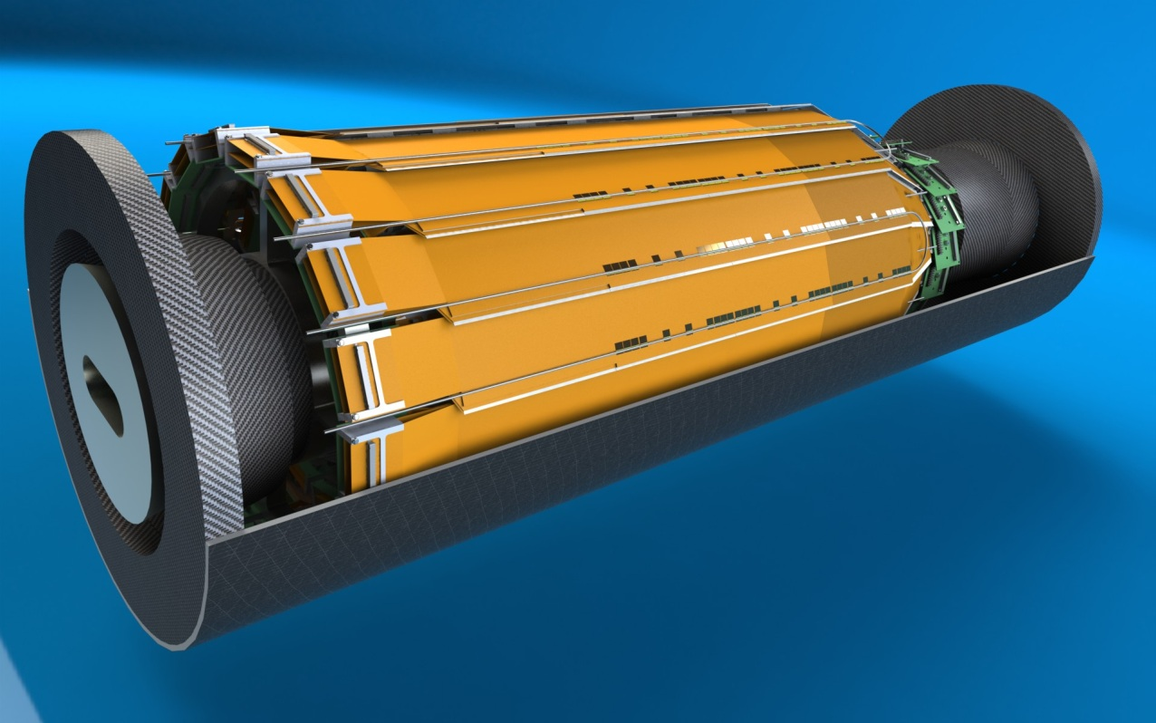
Belle II SVD/PXD Installation Procedure
Mockup Meeting Munich

Slide 2
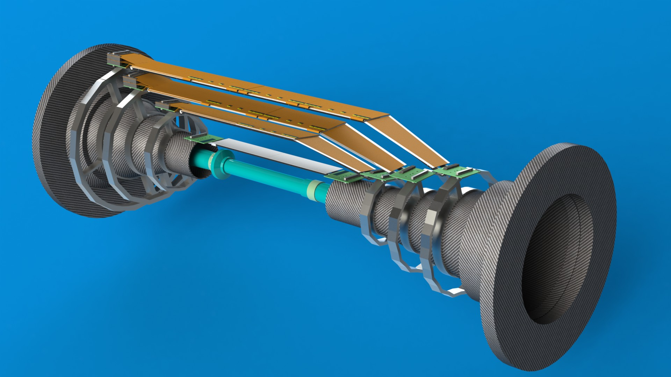
SVD Skeleton

Slide 3
Assembly Support Stand
QCS Decouple Ring
Beam Mask Support
Beam Masks
Crotch Piece
Beam Masks
Beam Pipe
The heavy metal masks are completed.

Slide 4
Patch Panel
Kapton
PXD
PXD is assembled to two halves in another stage and put together to the beam pipe. Cables and tubes will go to the slot in the masks.

Slide 5
SVD will be preassembled before joined with the BP-PXD assembly
SVD half shells will be attached from the side
SVD is also assembled in another stage. The forward and backward support cones are then fixed with the outer cover, made of CFRP.
Then they are put together around the beam pipe.

Slide 6
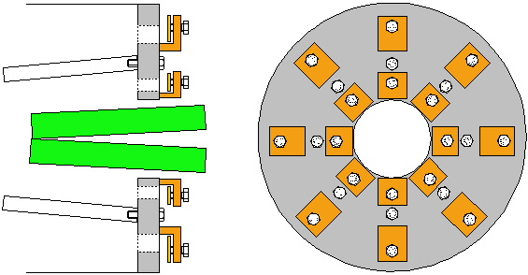
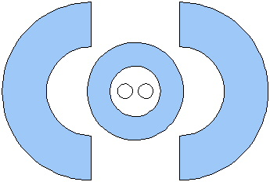
Endflange
Schematic draft
Constraint:
Acting as shielding BG
CDC connection
SVD connection
BP conection
Assembly work will be perform for SVD and BP in parallel
SVD flange
BP flange

Slide 7
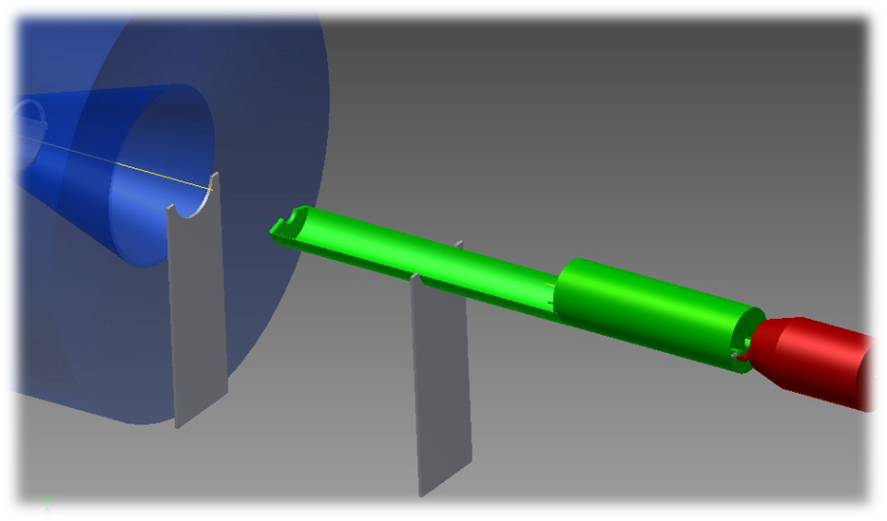
SVD has to be self-supporting. SVD is pushed in by the cryostat.
Cabling and tubing is pre-installed and routed along the QCSR and resting in the tray.
This procedure is proposed by KEK and will be tested with a mockup.
Tray
SVD
QCSR
cryostat
koike
Conceptual view

Slide 8
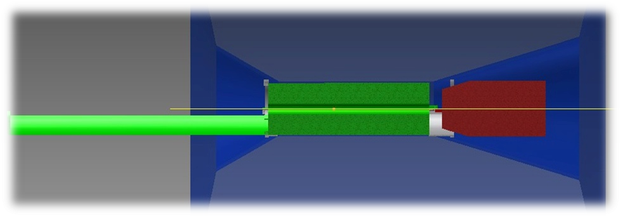
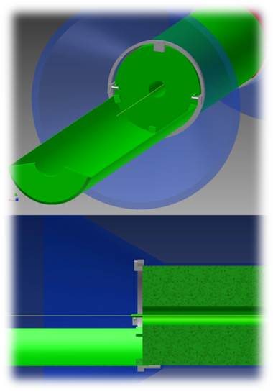
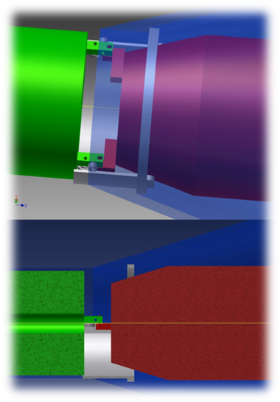
Side view
After move-in of the QCSR cryostat
koike
After the installation of SVD, this junction must be decoupled so that a shift of the cryostat after exciting every magnet does not interfere with the SVD.
This ring fixes the SVD
koike
koike

Slide 9
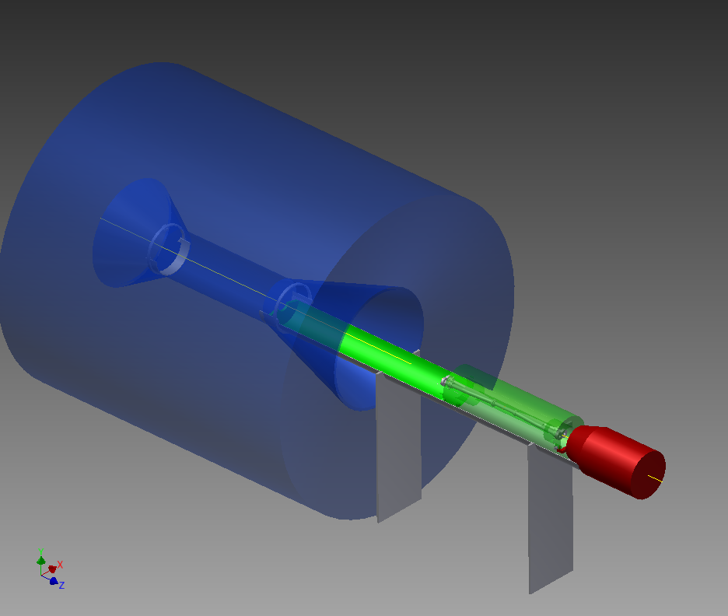
2.5m
Support point

