Slide 1

Ultra-thin fully depleted DEPFET active pixel sensors
DEPFETs at ILC and Belle II
Module Concept
results with 50µm thin DEPFETs

Slide 2
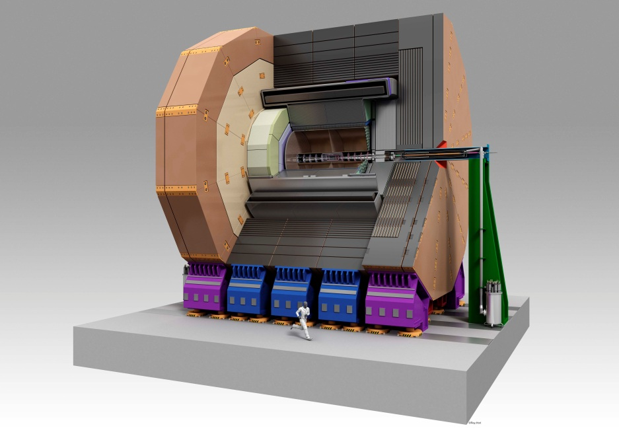



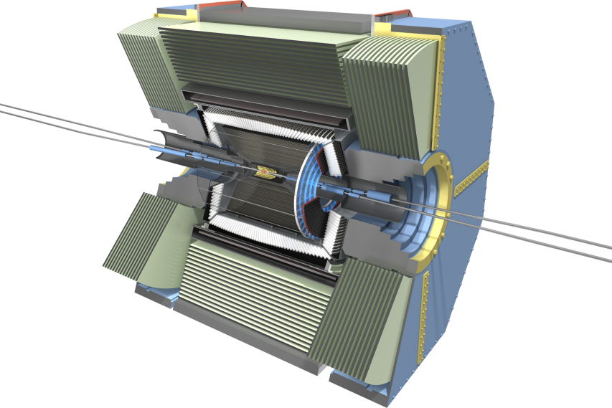
ILC VXD vs. SuperKEKB PXD (from a DEPFET point of view)
-: radii: 15, 26, 37, 48, 60 mm ……………………………………………………….
-: ladder length: 125mm(L0) and 250mm(L1-4) …………………………………
-: sensitive width: 11mm (L0), 15mm(L1), 22mm(L2-4) ……………………..
-: number of ladders: 10/11/12/16/20 → 130 sensors ………………………..
-: pixel size: ≈20 µm ……………………………………………………………………….
-: Row rate: ≈20 MHz ………………………………………………………………………
-: number of pixels: ≈800 Mpix …………………………………………………………
14, 22 mm
136 mm(L0) and 169mm(L1)
12.5mm (L0, L1)
8/12 → 40 sensors
50x50 µm² (L0) 50x75 µm² (L1)
≈10 MHz
≈8 Mpix
Minimal material in both application!!! (for sensor and support)

Slide 3
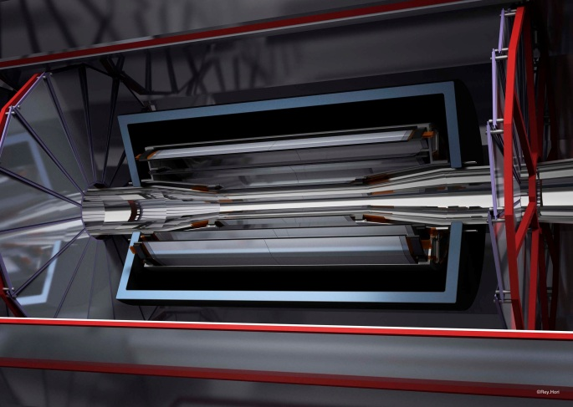
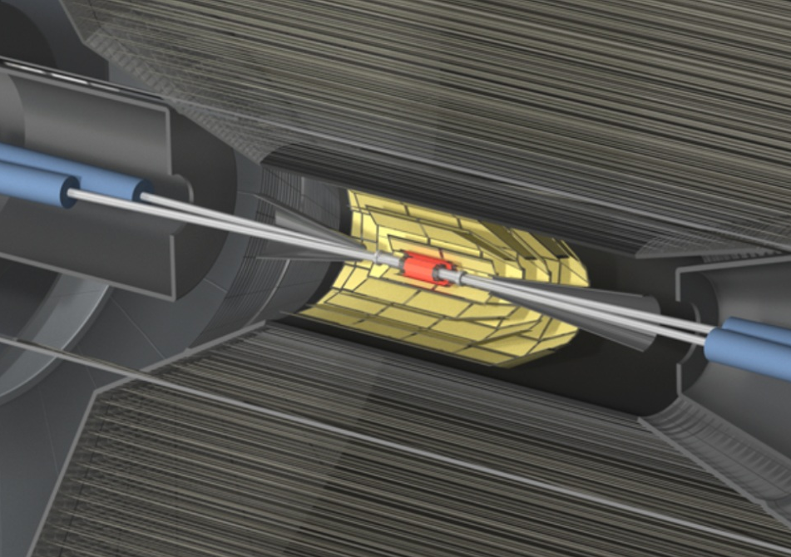
ILC VXD vs. SuperKEKB PXD (from a DEPFET point of view)
-: radii: 15, 26, 37, 48, 60 mm ……………………………………………………….
-: ladder length: 125mm(L0) and 250mm(L1-4) …………………………………
-: sensitive width: 11mm (L0), 15mm(L1), 22mm(L2-4) ……………………..
-: number of ladders: 10/11/12/16/20 → 130 sensors ………………………..
-: pixel size: ≈20 µm ……………………………………………………………………….
-: Row rate: ≈20 MHz ………………………………………………………………………
-: number of pixels: ≈800 Mpix …………………………………………………………
14, 22 mm
136 mm(L0) and 169mm(L1)
12.5mm (L0, L1)
8/12 → 40 sensors
50x50 µm² (L0) 50x75 µm² (L1)
≈10 MHz
≈8 Mpix
Minimal material in both application!!! (for sensor and support)

Slide 4
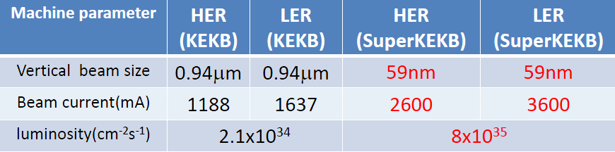
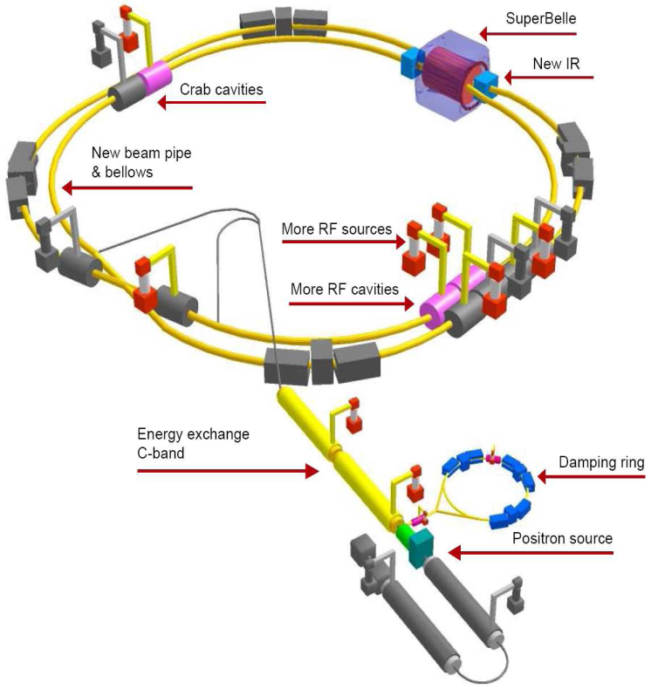
KEKB to SuperKEKB
-: e⁻/e⁺, 7 GeV & 4 GeV
-: E_{cm} at Y(4s) Resonance, (10.58 GeV)
-: goal L = 8x10³⁵ cm⁻²s⁻¹
Belle-II
Schedule and Milestones:
10/2014 ……………………. first beam
10/2014 – 05/2015 ……. beam commissioning
05/2015 – 09/2015 ……. shut down, sub-det install.
09/2015 – 11/2015 …….. det. commissioning
12/2015 ……………………. physics run
Smaller beam size & more current:
→ 40x higher luminosity
Higher Background: occupancy and rad. damage
-: QED background, intra-beam scatter., beam-gas, synchrotron

Slide 5
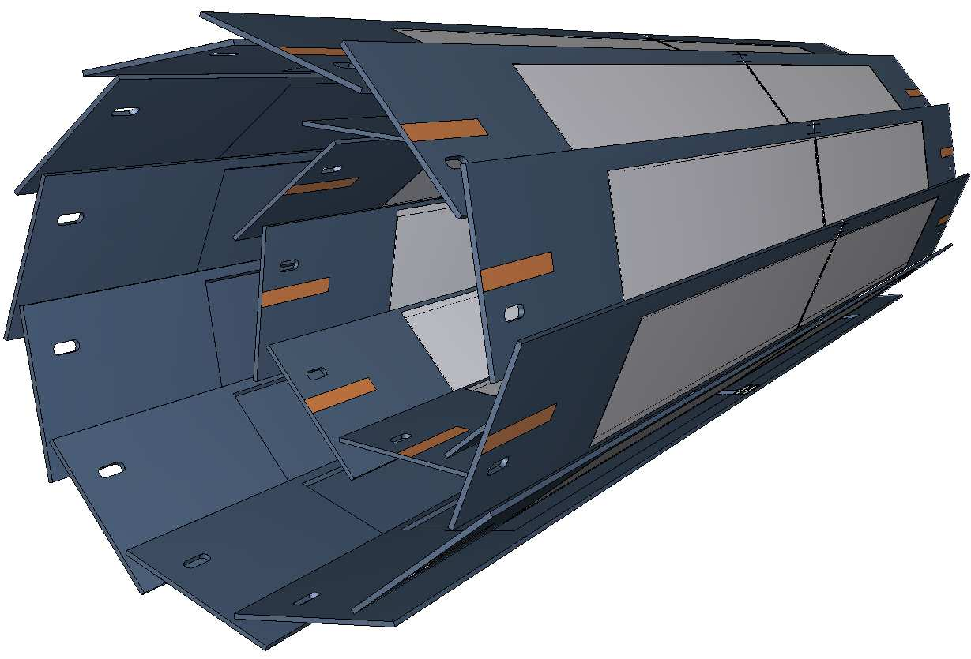
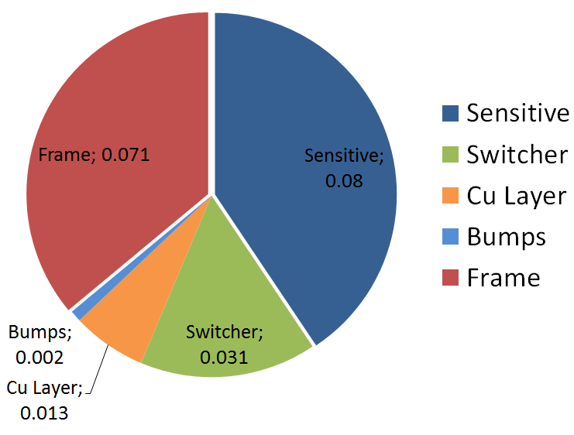
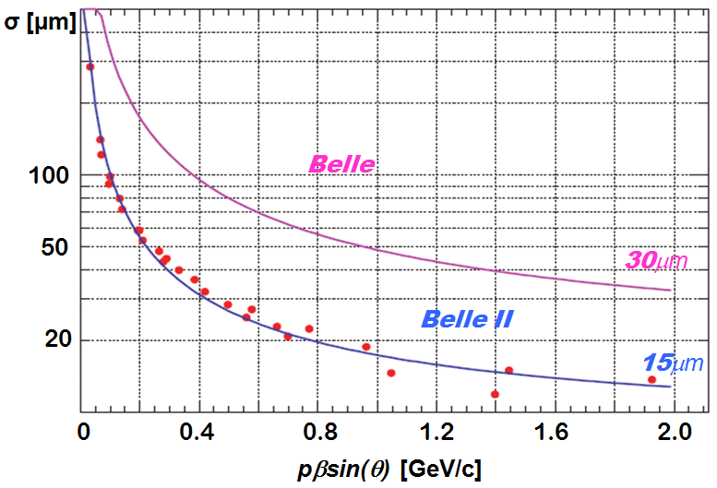
The DEPFET Belle-II PXD
→ 0.19 %X0 in total - Si contribution (0.15%)
Angular coverage 17°<θ < 155°
z vertex resolution significantly improved (PXD & SVD)
 | Inner layer | Outer layer
# ladders | 8 | 12
Sens. length | 90 mm | 123 mm
Radius | 1.4 cm | 2.2 cm
Pixel size | 50x50 µm² | 50x75 µm²
# pixels | 1600(z)x250(R-ɸ) | 1600(z)x250(R-ɸ)
Thickness | 75 µm | 75 µm
Frame/row rate | 50 kHz/10 MHz | 50 kHz/10 MHz

Slide 6
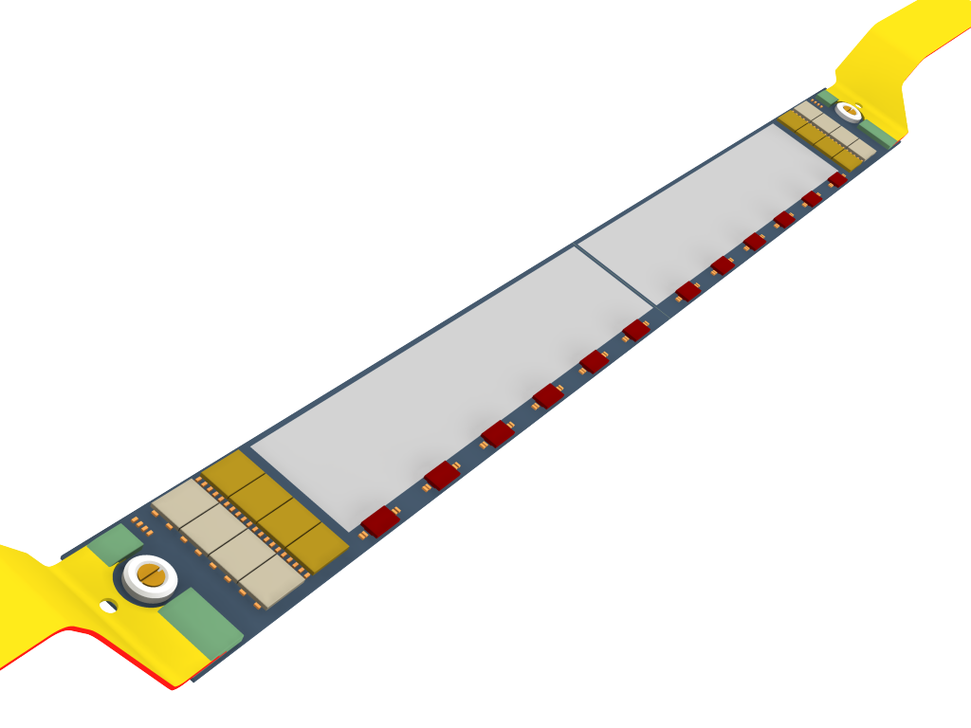
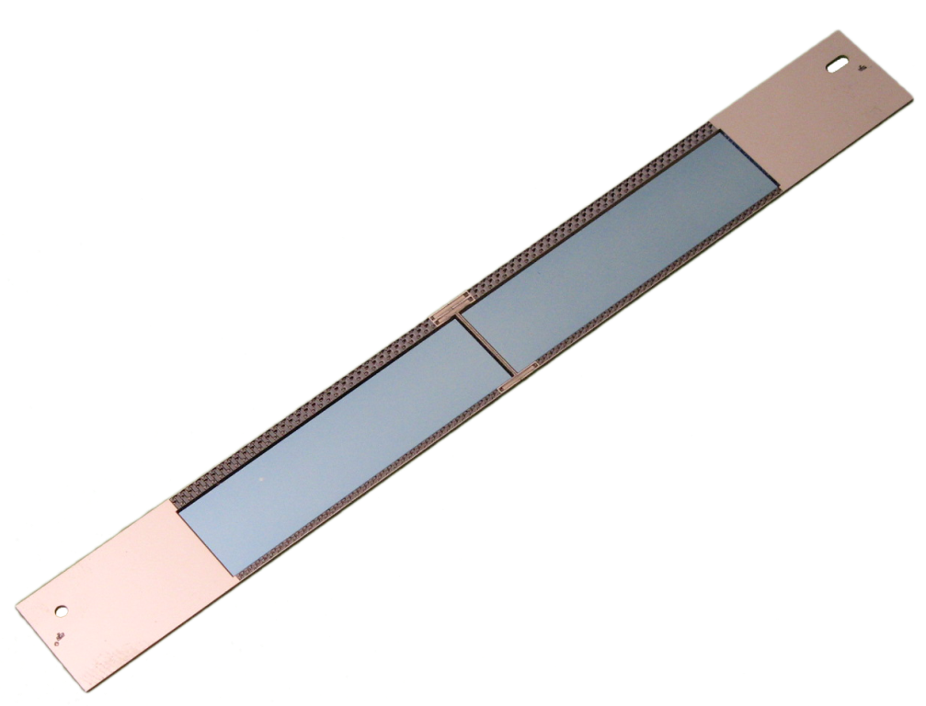
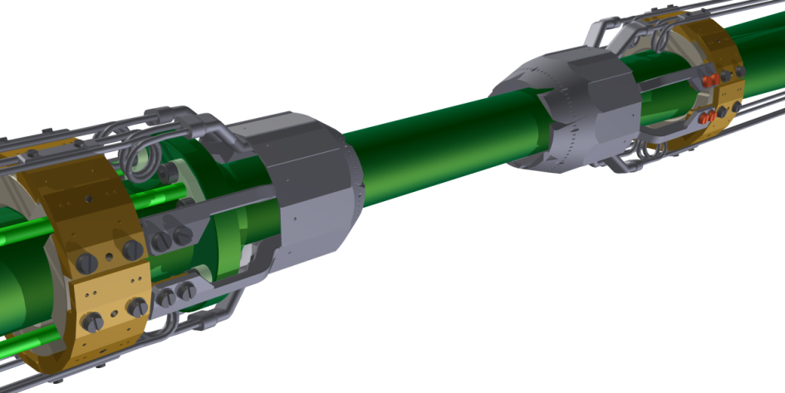
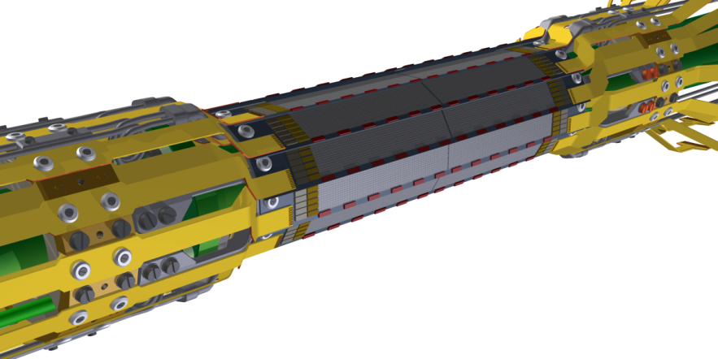
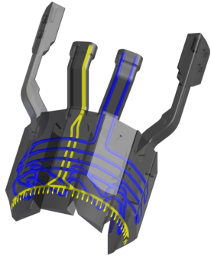
Self Supporting All-Silicon Module
3D Modell of Belle-II Ladder
Photo of thinned backside
end-flange with CO2 channels
and capillaries for air cooling
(RPT sinter process)

Slide 7

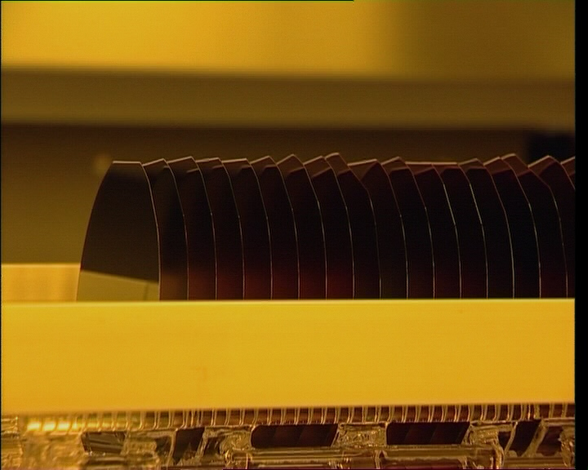
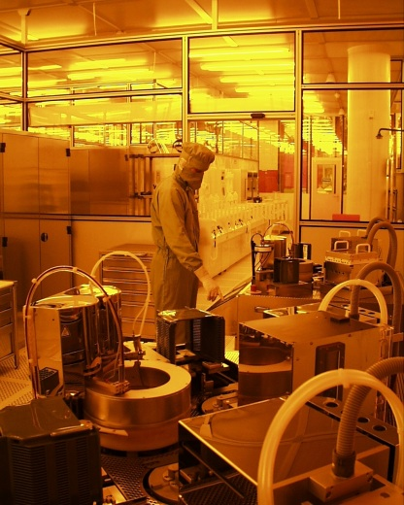
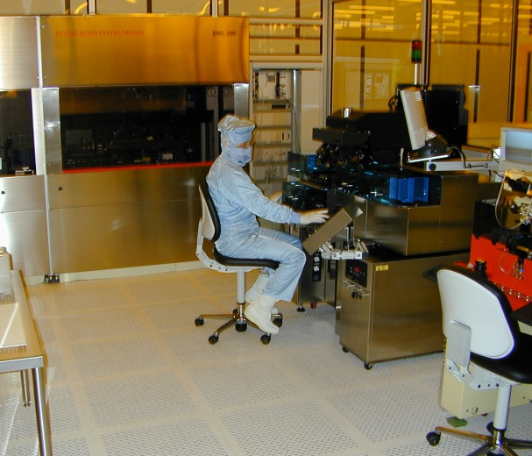
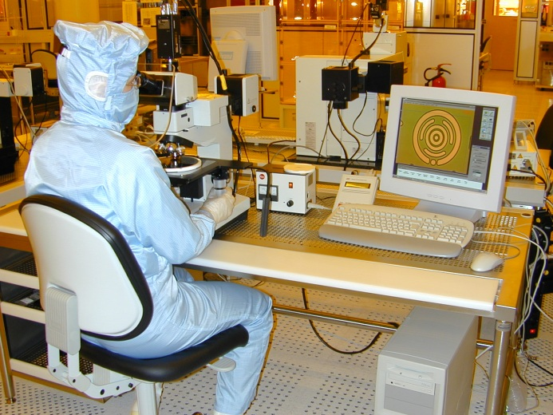
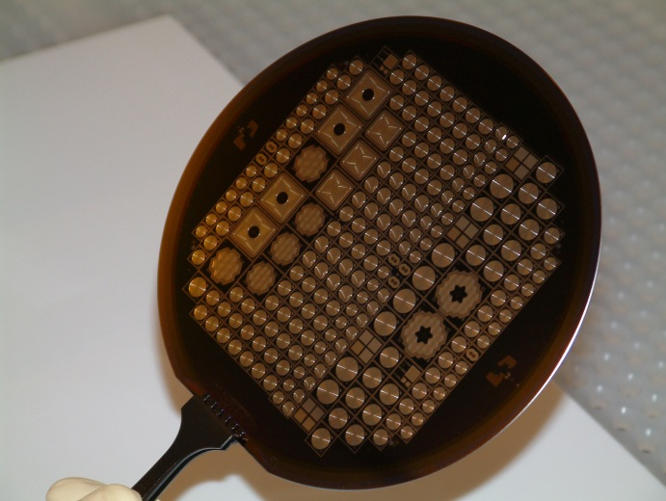
MPI Semiconductor Laboratory
MPI semiconductor lab
Munich-Neuperlach
800 m² clean room
class 100 … 1
15 cm Si process line
custom made,
non-standard equipment
clean room building
15 cm wafers in furnace boat
spin coater
mask aligner for photolithography
wafer inspection
processed wafer

Slide 8
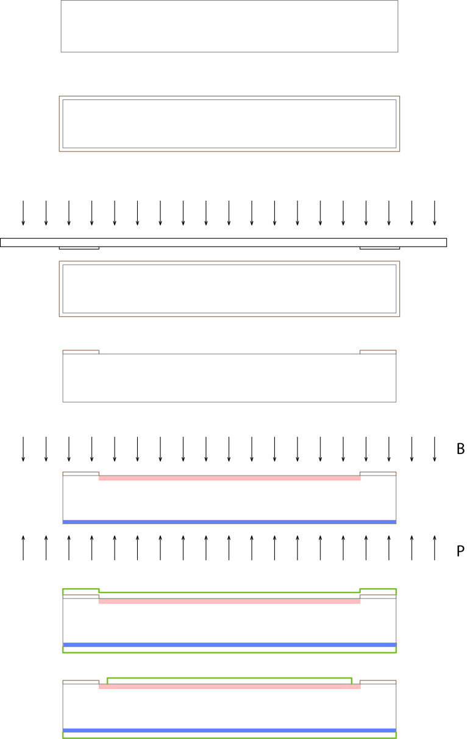
Semiconductor Processing
planar technology
J. Kemmer, 1983
  example: ‘simple’ diode process
    1 photolithographic step
    2 ion implantations
    1 etching step
    2 layer depositions
polished n-type wafer
oxidation
photolithography:
- UV illumination
- mask
- wafer coated with
photoresist
- photoresist
development
- oxide etching
boron & phosphorous
implantation
aluminum deposition
aluminum patterning

Slide 9
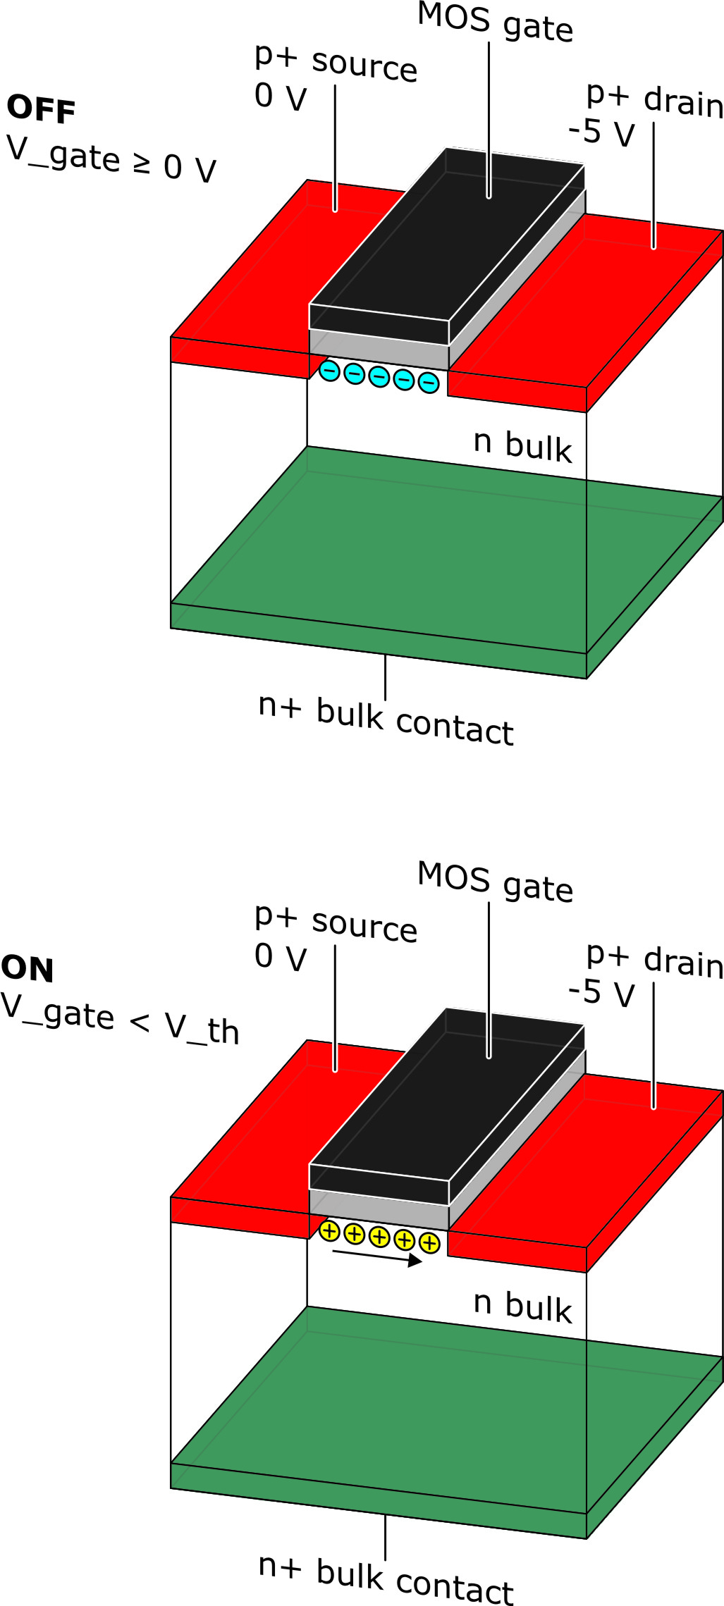
MOSFET (MOS field effect transistor)
MOSFET – basis of the DEPFET
  example: p-channel enhancement mode
  controllable resistor source - drain
    V_{gate} ≥ 0 V
   electron accumulation layer
   no current flow
    V_{gate} < V_{threshold}
   hole inversion layer
   hole current from source to drain
   current value adjustable by V_{gate}
  via inversion charge density

Slide 10
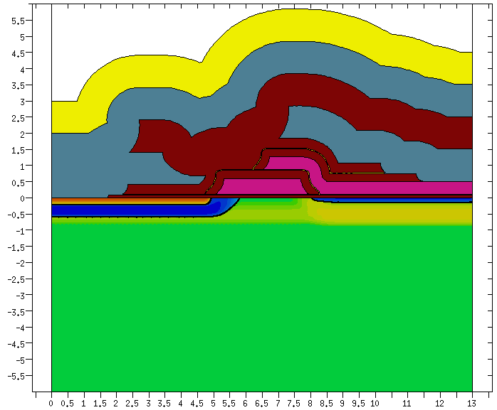
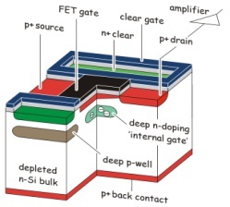
DEPFET Technology
planar technology
  example: DEPFET process
    20 photolithographic steps
    10 ion implantations
    8 etching steps
    9 layer deposition steps
    cycle time ≥ 1 year
passivation
SiO₂
Al
Poly
clearregion
cleargate
internal gate
DEPFET tech.

Slide 11
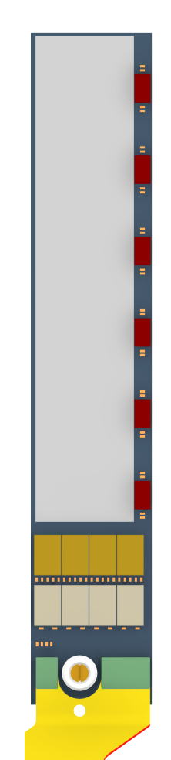
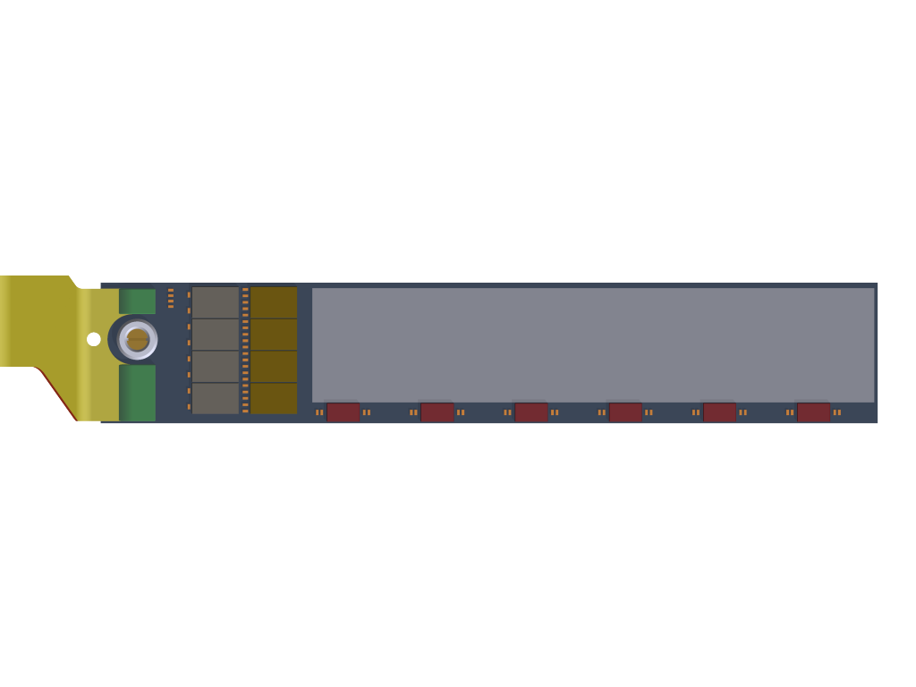
DEPFET and auxiliary ASICs
DEPFET Matrix
Switcher:
180nm HVCMOS AMS
Size 3.6 × 1.5 mm²
Gate and Clear Signal
DCD:
“Drain Current Digitizer”
UMC 180nm
f/e and ADC
DEPFET = depleted p-channel field effect transistor
Fully depleted sensitive volume
Charge collection in the “off” state, read out on demand
Modulation of the FET current by the charge in the internal gate
Clear contact to empty the internal gate
Low power dissipation
  DEPFETs ~ 1 W
  Switcher ~ 1 W
  DCD/DHP ~ 8 W on each ladder end
DHP:
“Data Handling Processor”
IBM 90nm → TSMC 65nm
Digital Control Chip
CO₂ cooling at end flange
gentle gas flow in sensitive region

Slide 12
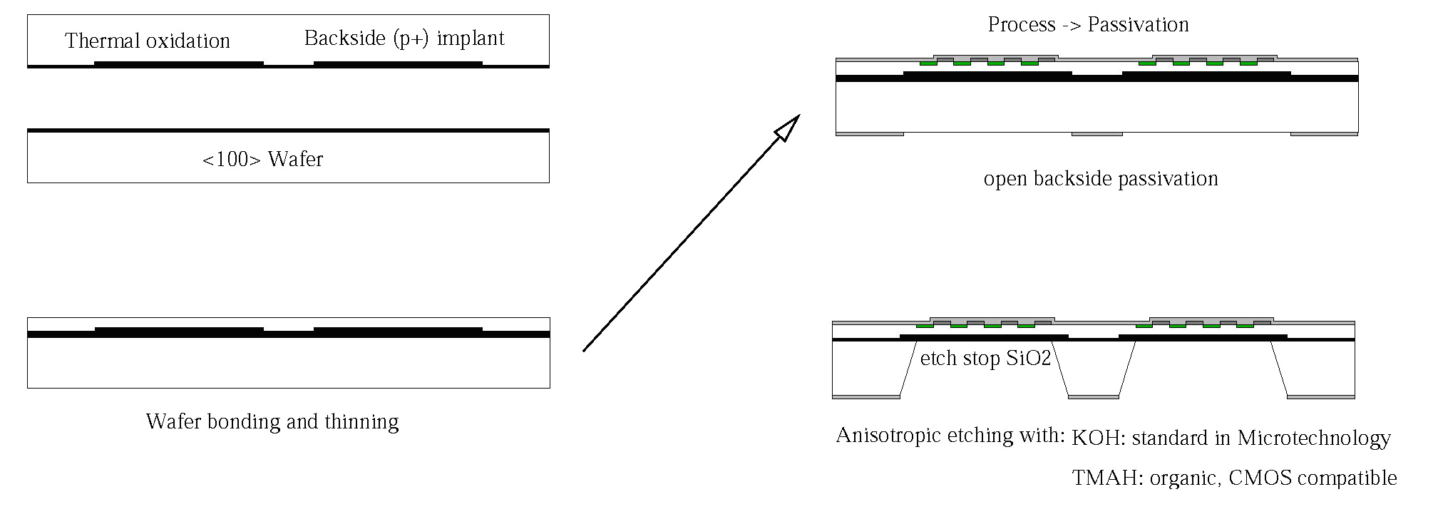
Processing Thin Detectors - The SOI Approach
a) oxidation and back side implant of top wafer
c) process ➔ passivation
Top Wafer
Handle <100> Wafer
open backside passivation
Custom made SOI Wafer
b) wafer bonding and grinding/polishing of top wafer
d) anisotropic deep etching opens "windows" in
handle wafer
The DEPFET thickness becomes a free parameter, adjustable to the needs of the experiment!
Key Process Modules:
-: Wafer Bonding and thinning of top layer (external)
-: Sensor fabrication on SOI
-: Etching of the Handle Wafer
-: Litho on extreme topographies

Slide 13
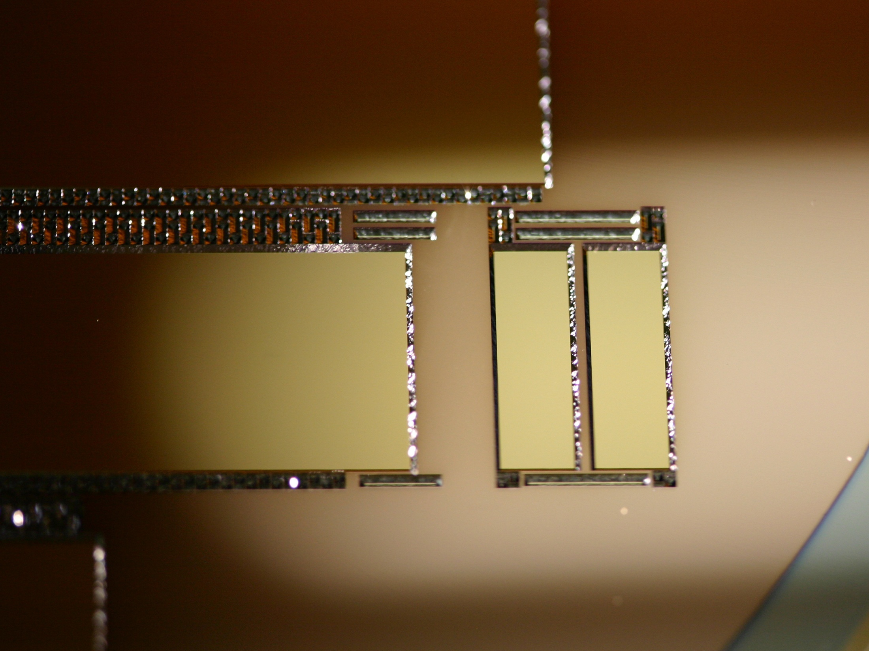
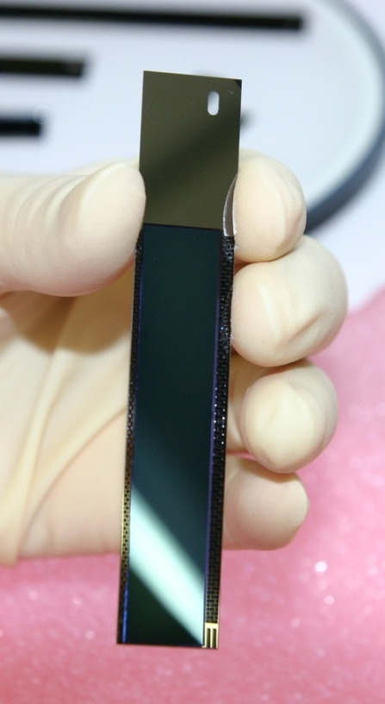
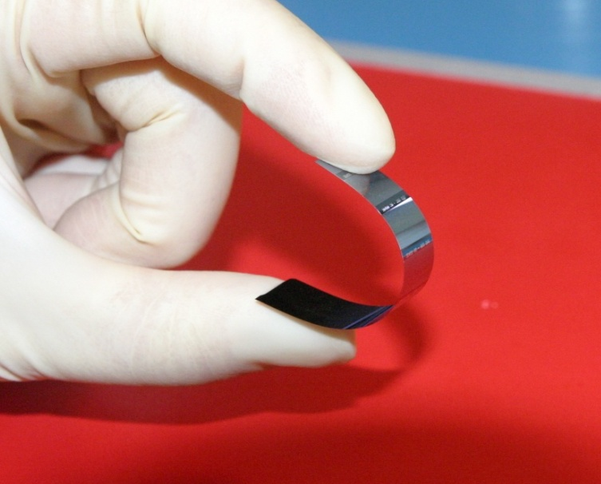
Integrated Silicon Frame

Slide 14
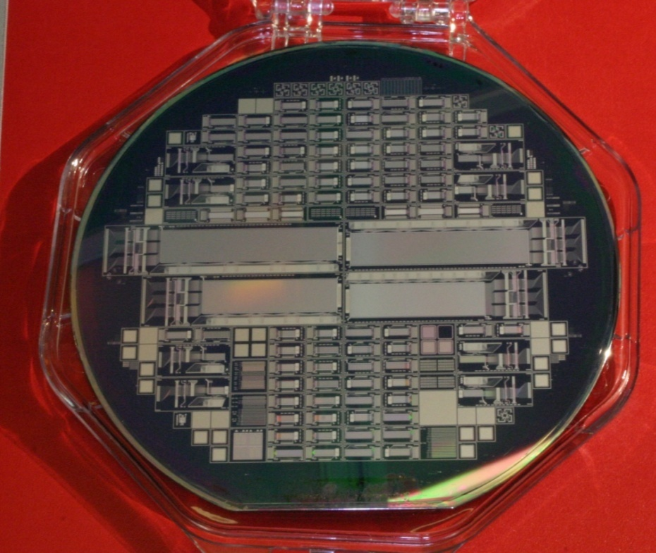
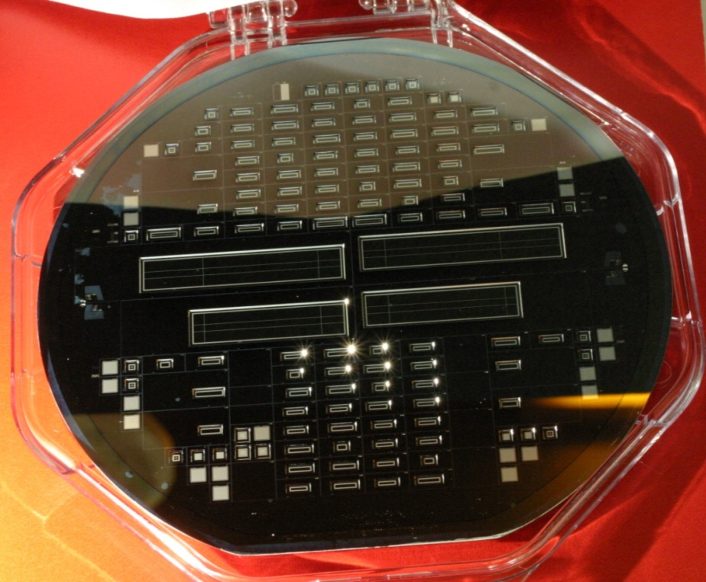
Thin DEPFET Prototyping for Belle II and ILC
-: SOI wafers (50 µm sensor layer)
+ reference wafers on std. 450µm material
-: 4 half-ladders for Belle II with the most
promising design options
-: About 100 test matrices in different design variations
(ILC design and Belle II design)
  -: pixel sizes from 20 µm to 200 µm
  -: shorter gate length
  -: improved clear structures
  -: various field shapes

Slide 15
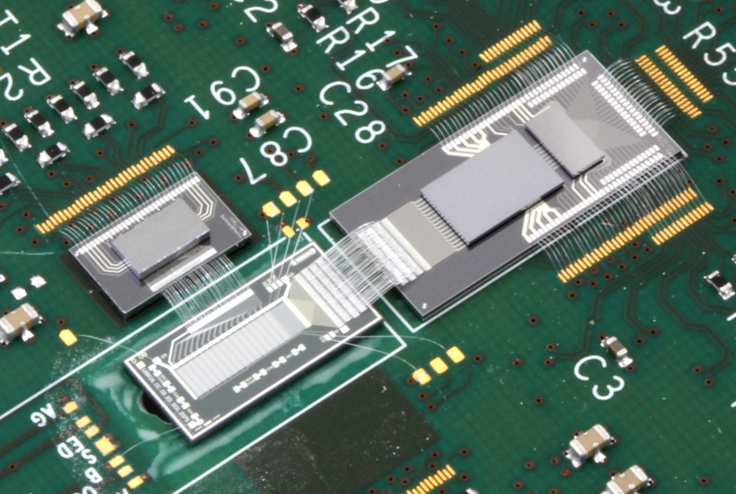
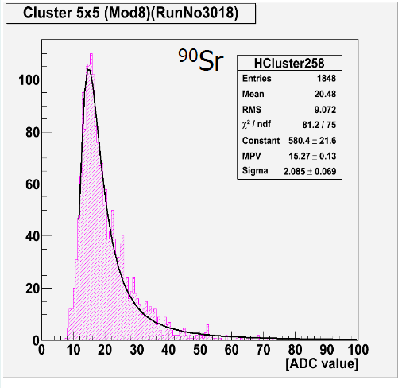
DEPFET/DCD-B Test System
Switcher-B
for Clear and Gate Control
DCD-B
Read-out Chip
DCD-RO
Line Driver and Buffer to FPGA
PXD6 Belle-II DEPFET Matrix 32x64 Pixels
L = 6 µm
Pixel Size 50 x 50 µm²
320 MHz DCD-B clock
→ 100 ns signal processing time per row
S/N=17 for Sr90 “mip”, settings not yet optimal ..

Slide 16
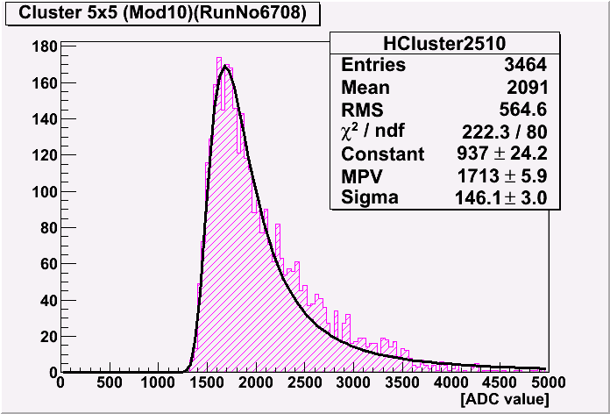
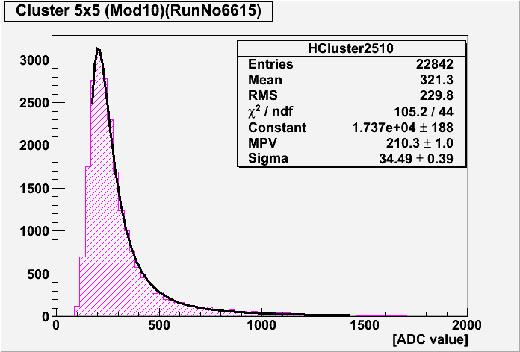
Signal Measurement – Sr90
2 DUTs: 32x64 pixels Belle II PXD design, L=6 µm, pixel size 50x75 µm², same design on front
  I : 450 µm standard FZ material
  II: 50 µm SOI
β source, ~2MeV end energy, close to mip
photons and LE e⁻ blocked by 4.3 mm plastic
external scintillator trigger below the sensor
t = 450 µm
S/N ≈ 171
from Cd109 we know: 1 ADU → 19.8 e⁻
Sr90 signal with 50µm: 210 ADU → 4164 e⁻
expect ~80e-/µm for a mip: ~4000 e⁻ for 50µm
signal(450µm) : signal(50µm): 8.2
t = 50 µm
S/N≈21

Slide 17
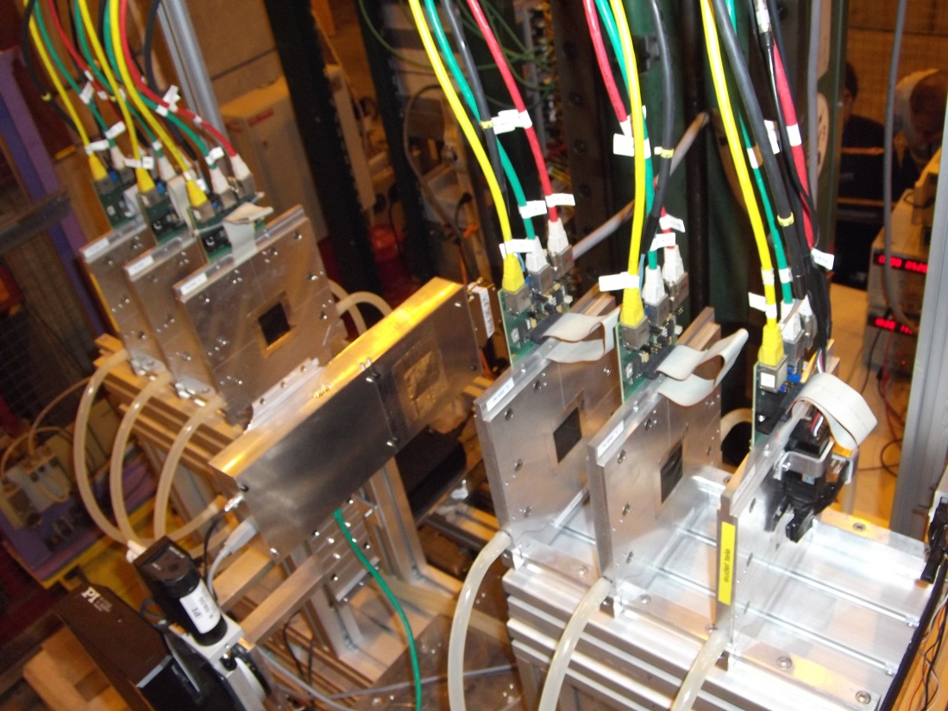
Thin DEPFET - Beam Test Oct. 2011
Beam Test 3-12 October at CERN SPS
: AIDA Telescope (1 µm pointing precision)
: 2 DUTs with 50µm thin DEPFET, 1 DUT with 450µm
: different pixel designs (S/N of 20 and 40)
: read out with 100MHz and 320MHz
: angle and voltage scans to optimize design parameters
: correlation between telescope tracks and DUT found

Slide 18
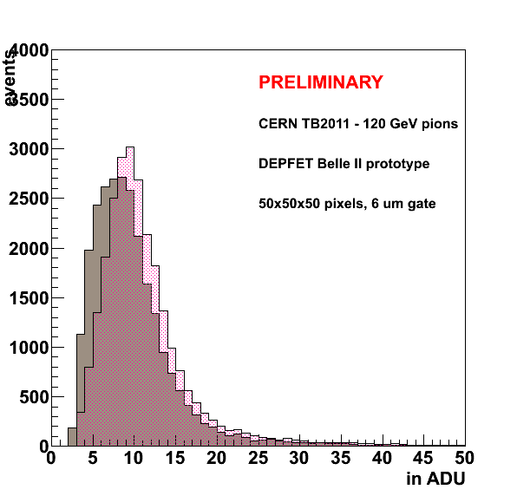
Signal – 120GeV Pions
Noise performance:
Common mode noise < 1 ADU
Intrinsic noise, after CM subtraction: 0.5 ADU
Noise measurement agrees with lab. tests
Preliminary result for most
probable signal on H4.1.04:
MPV ~ 10 ADU
S/N ratio ~ 20
(i.e. 40 in Belle-II)

Slide 19
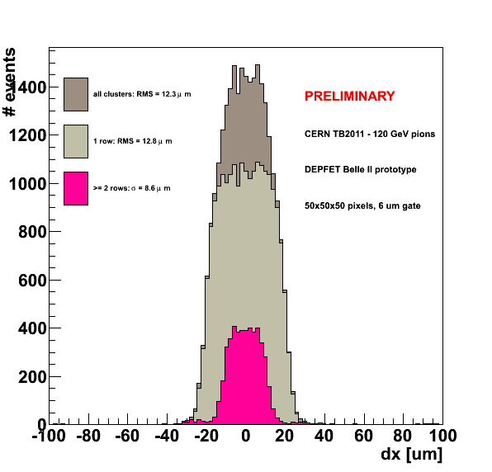
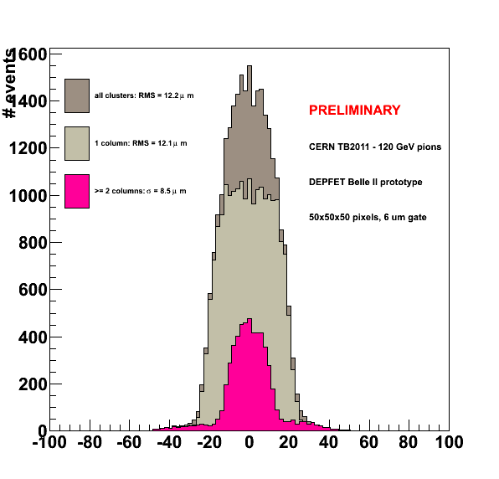
Spatial Resolution
Spatial resolution of module H4.1.04 in X(left) and Y(right)
dy [um]
Single-pixel cluster show expected “box” distribution from -25 to +25 μm,
  smearing by telescope resolution ~ 2-3 μm
  binary RMS = 50 μm / √12 = 14.4 μm
Multiple-pixel clusters are relatively rare under perpendicular incidence
Spatial resolution depends on incidence angle, S/N, clustering (esp. 0-suppression), bias voltage (scan under analysis)

Slide 20
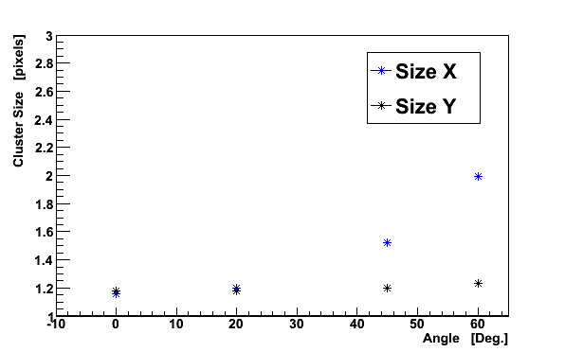
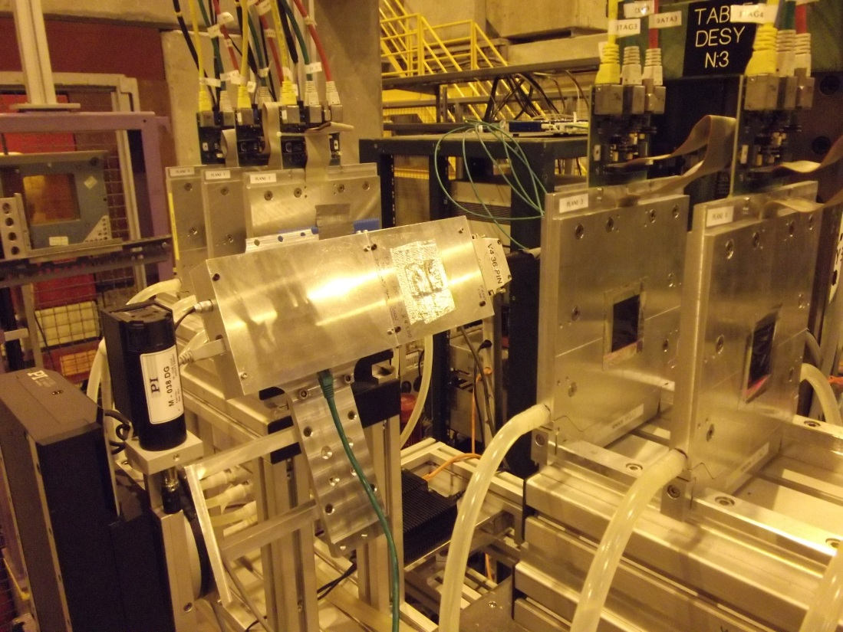
Angular Scan
Rotation around y-axis.
Charge sharing in X-direction increases

Slide 21
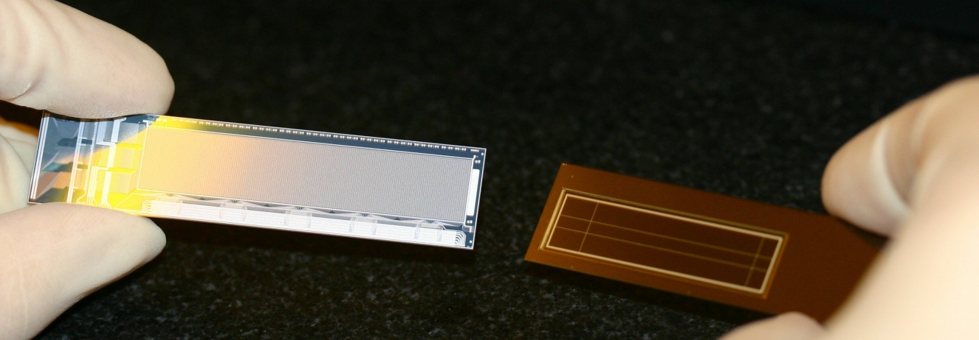
Summary
The DEPFET technology, including thinning and the module concept, initially developed for application at the ILC found it’s way into a high precision vertex detector at SuperKEKB.
The mechanical concept and the thermal management is adapted to the Belle II geometry, but engineered designs, techniques, technologies can and will be transferred to the barrel geometry at future linear collider.
A new read-out chip generation (DCD-B) has been designed and tested and shows the expected performance with the DEPFET.
First tests show that thin DEPFETs have the expected performance. A beam tests to measure the single point resolution of thin active pixel sensors was done and the data further analysis is ongoing.

Slide 22
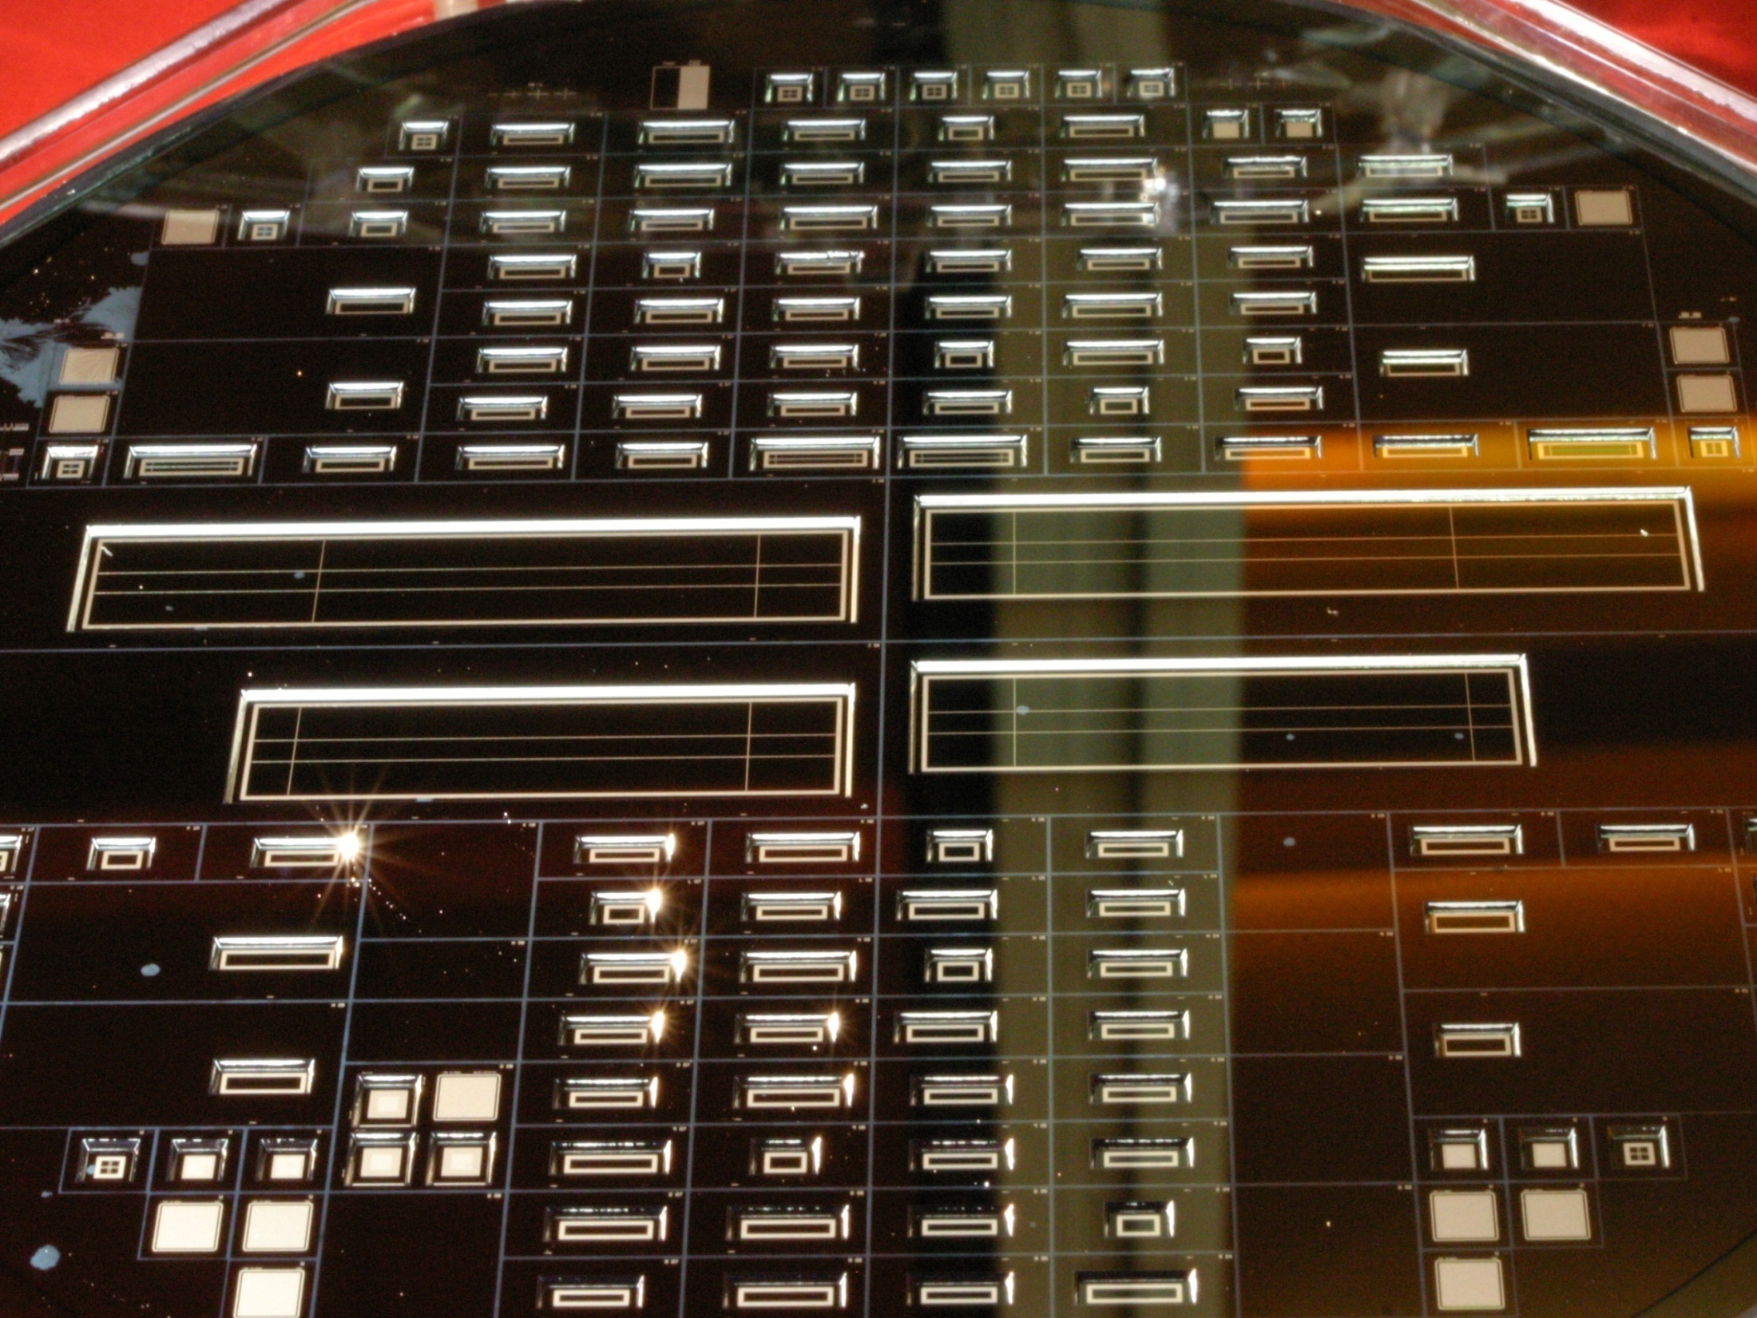
Thank you!

