Slide 1
MAGIC Astrophysics with Very High Energy Gamma Rays
Razmik Mirzoyan
for the MPI MAGIC Team
Max-Planck-Institute for Physics
Munich, Germany

Slide 2
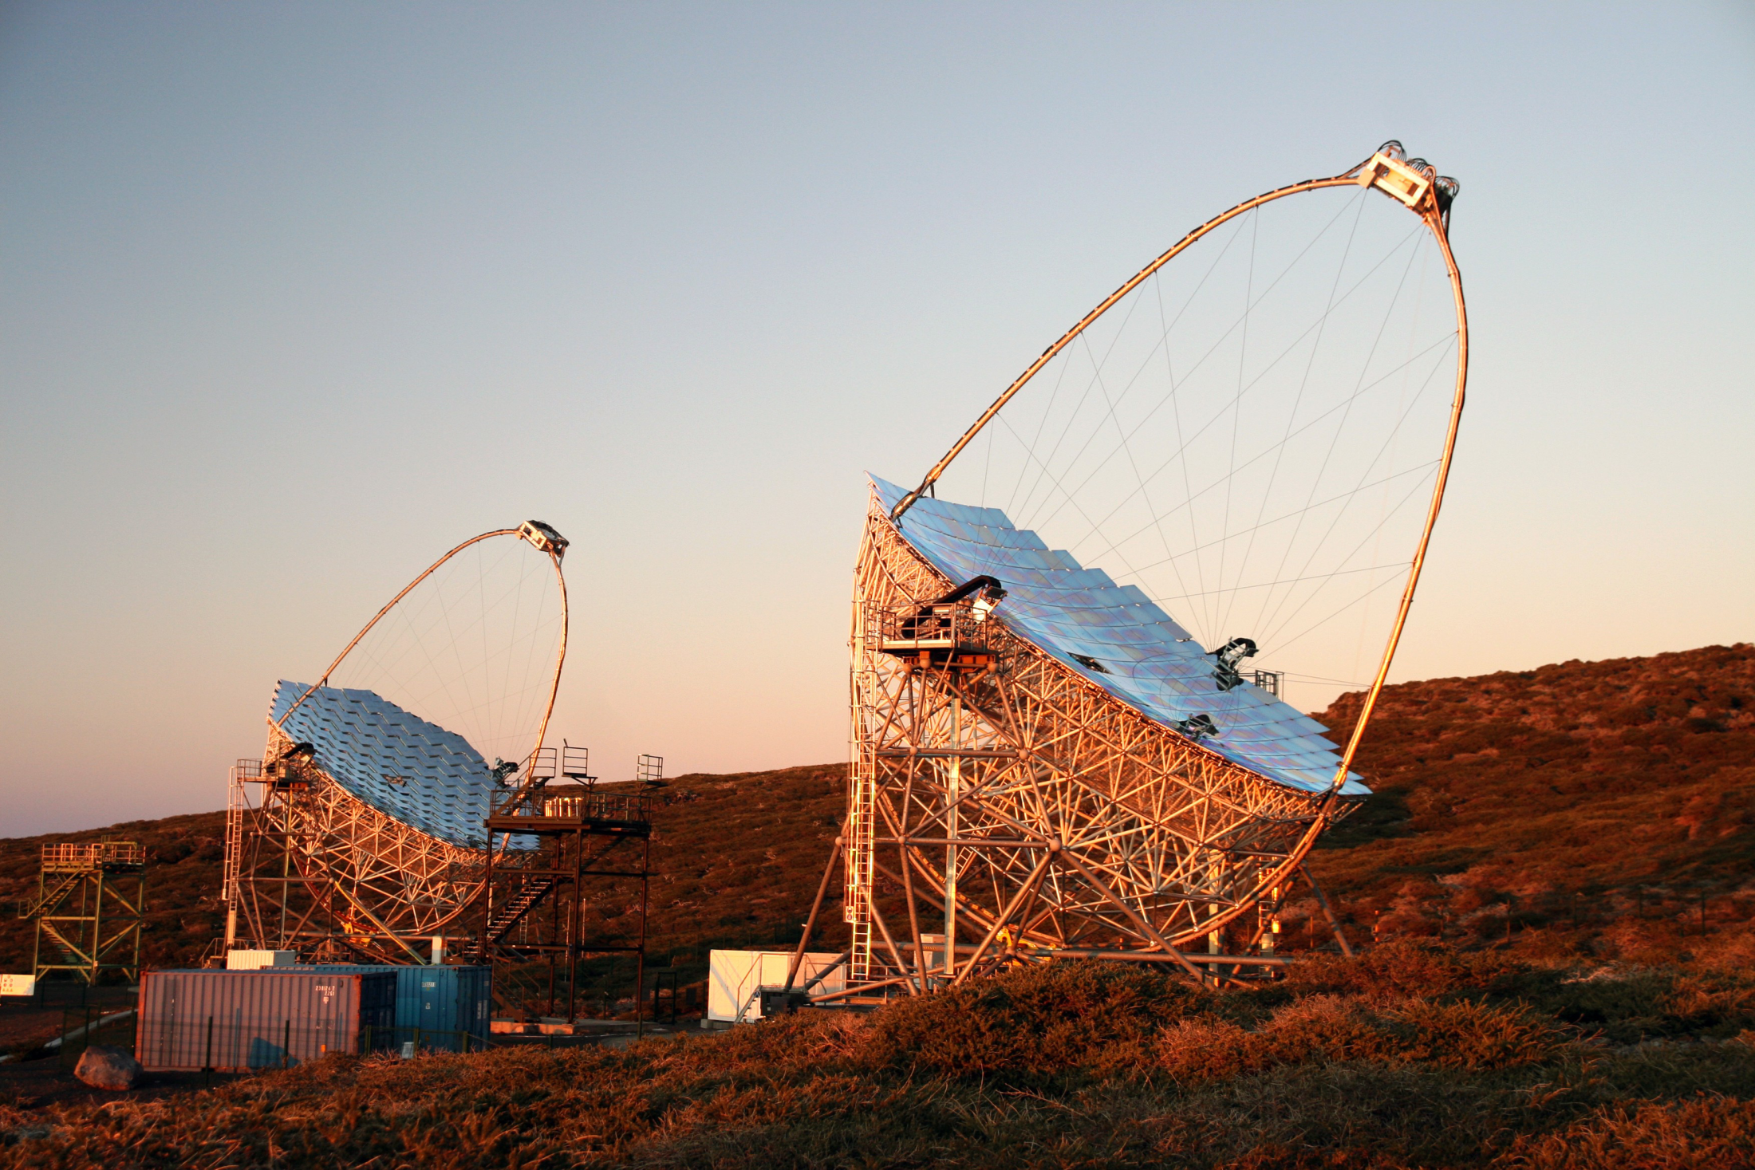

Slide 3
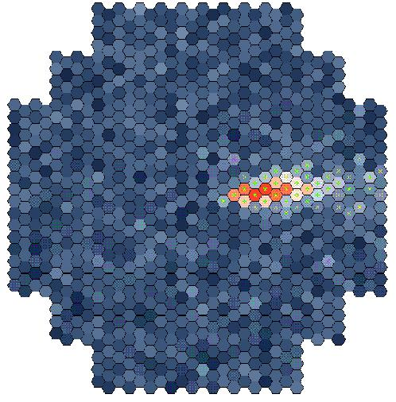
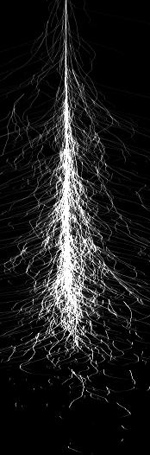
Detection of VHE γ radiation
Particle shower
Original photon
~ 10 km
~ 1º
Cherenkov light emission at ~ 1°
Detection area ≥ 5 x 10⁴ m²
for a single telescope
For large arrays detection area could be ≥ 1 km²
~ 120 m

Slide 4
Detection of VHE γ radiation
Particle shower
Original photon
~ 10 km
~ 1º
Cherenkov light emission at ~ 1°
Image intensity ~ shower E
Cross-point- shower axis impact
Image shapes ~ particle type
~ 120 m
Notes:
.

Slide 5
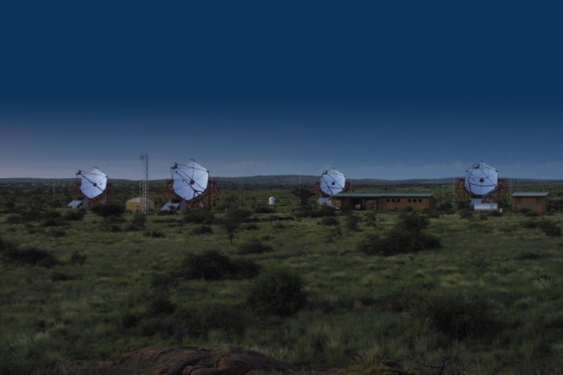

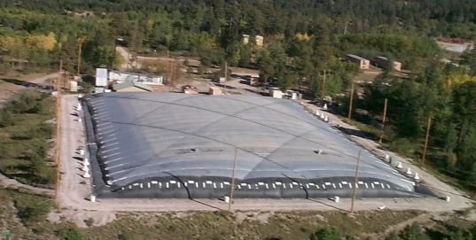
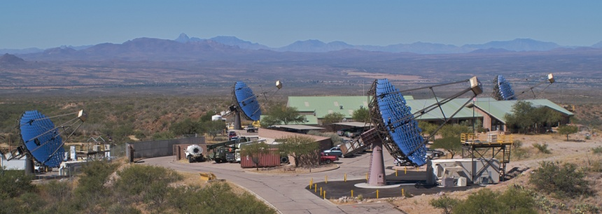
H.E.S.S., VERITAS & MAGIC
H.E.S.S.
MILAGRO
Parameters of VERITAS almost
matching those of H.E.S.S.
H.E.S.S. MAGIC
# telescopes 4 2
Field of view 5° 3.5°
Reflector diameter 12 m 17 m
Energy threshold 160 GeV 50 GeV (25 GeV – special trigger)
Sensitivity: 0.8 % Crab (25 h) 0.8 % Crab (50 h, E ≥ 260 GeV)

Slide 6
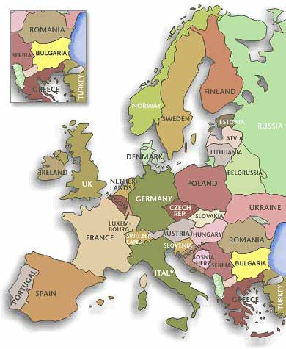
The MAGIC Collaboration
~160 Scientists from 9 countries
Bulgaria Sofia
Croatia Consortium
Finland Tuorla Observatory
Germany DESY, Dortmund
MPI Munich, Würzburg
Italy INFN Padova, INFN Siena
INFN Udine, INFN Como, INAF Rome
Poland INRNE Lodz
Spain U. Barcelona, UAB Barcelona
IEEC-CSIC Barcelona
IFAE Barcelona, IAA Granada
IAC Tenerife
U Compultense Madrid
Switzerland ETH
+ Japan (since last Thursday)

Slide 7
Young science, ground-based VHE γ-astrophysics: 20GeV – 100TeV
The 1st strong signal (9σ) reported by the Whipple team in
Arizona ~ @ 1TeV from the Crab Nebula in 1989
The 1st Extragalactic source (and the 2nd source at all)
Mkn-421 was reported by the Whipple team in 1992
No source for the next few years; initiated a serious discussion
in cosmic ray community if this is not a science of just 2 sources
Today, after ~ 22 years, 152 VHE gamma sources are reported
(report taken from http://tevcat.uchicago.edu/)

Slide 8
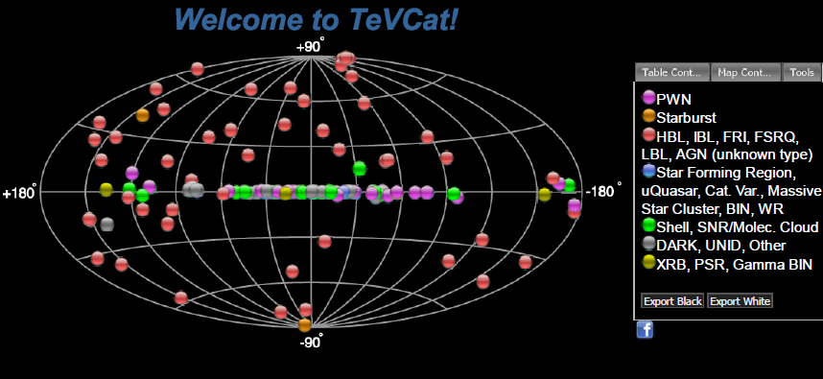
VHE γ Ray Sky Status (Last Update: yesterday):
# of sources discovered by H.E.S.S., MAGIC, VERITAS, Milagro, Cangaroo: 133
Also sources by Whipple, HEGRA, Durham, Crimea, Potchefstroom, Telescope Array
A total of 152 reported sources

Slide 9
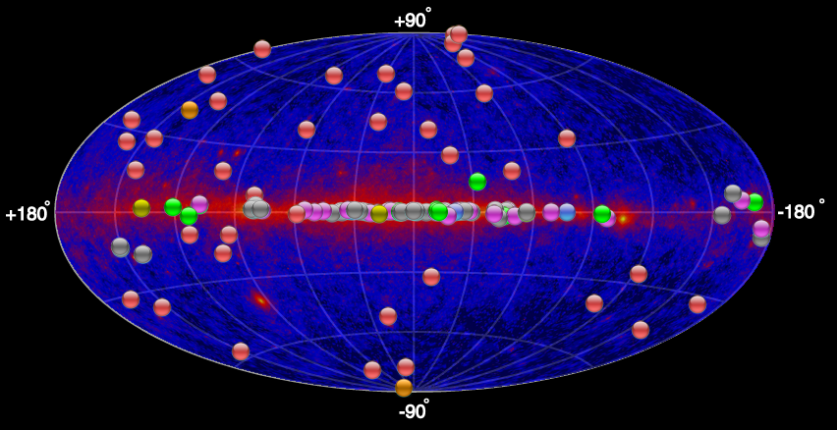
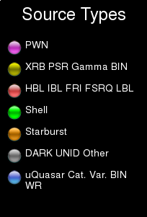
GeV - TeV γ-astrophysics
The FERMI satellite mission has revolutionized the > 100 MeV γ sky,
after 3.5 years of flight few thousand sources are reported

Slide 10
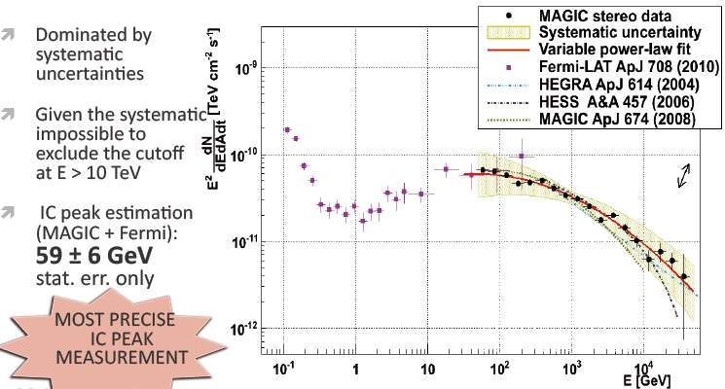
Crab Nebula with MAGIC: 50 GeV - 45 TeV
Observed Oct. 2009 – March 2011 for 48.7h; zenith angle 6.7°-50°

Slide 11
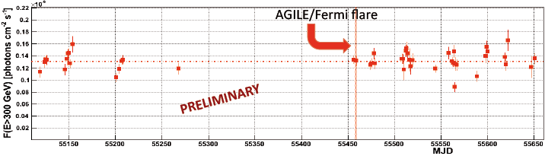
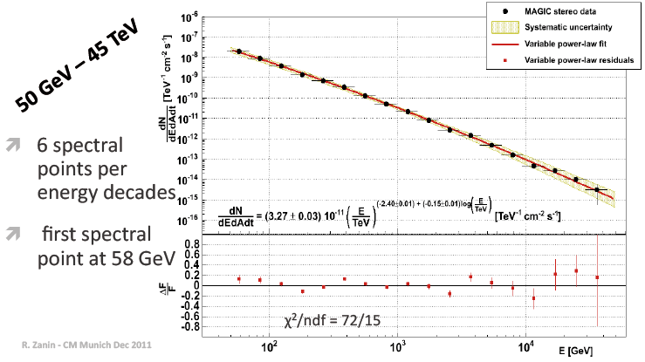
@ E ≥ 0.3 TeV no corellation with measured by AGILE/FERMI strong enhancement

Slide 12
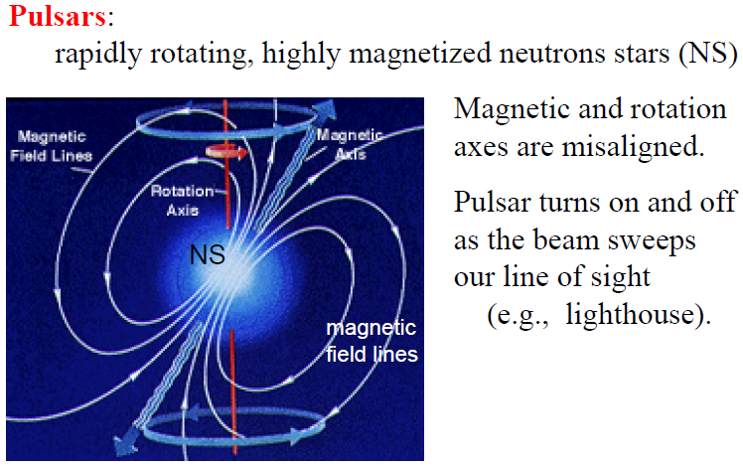
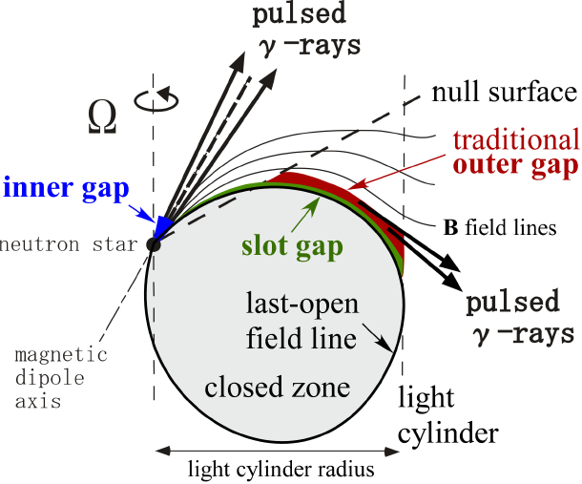
A pulsar
Hirotani

Slide 13
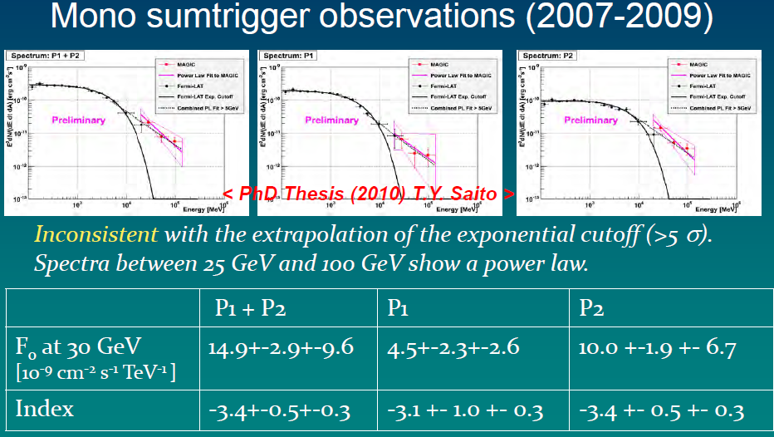
Crab pulsar mono observations

Slide 14
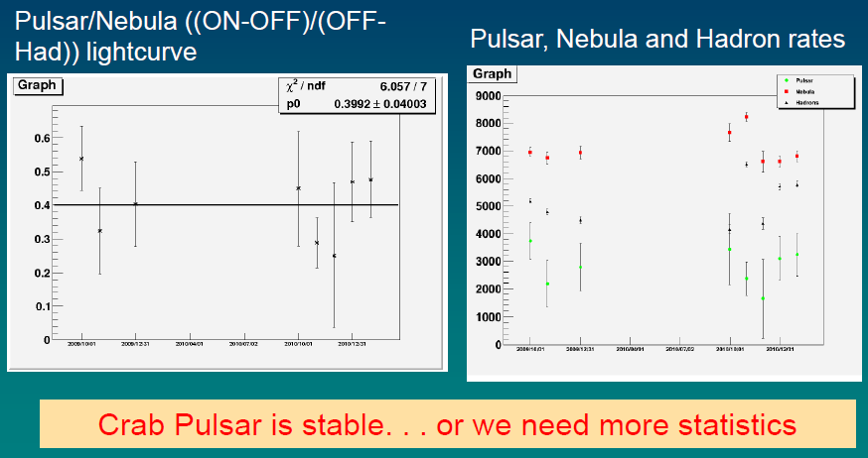
Crab pulsar variability

Slide 15
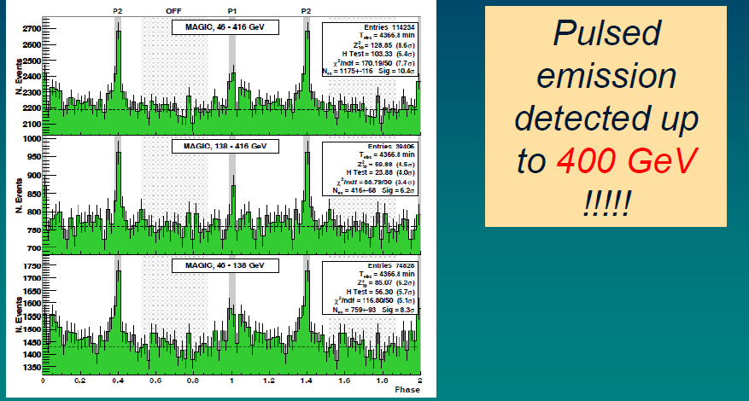
73h stereo data, Oct.2009 – Feb.2011

Slide 16
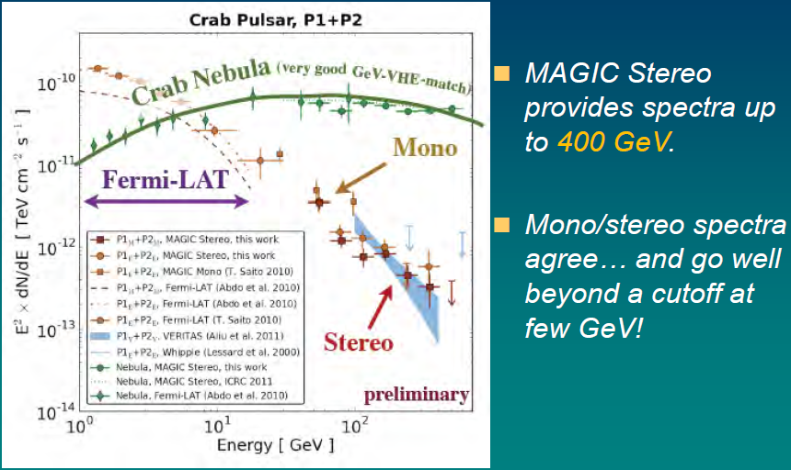
VHE spectrum of Crab Pulsar

Slide 17
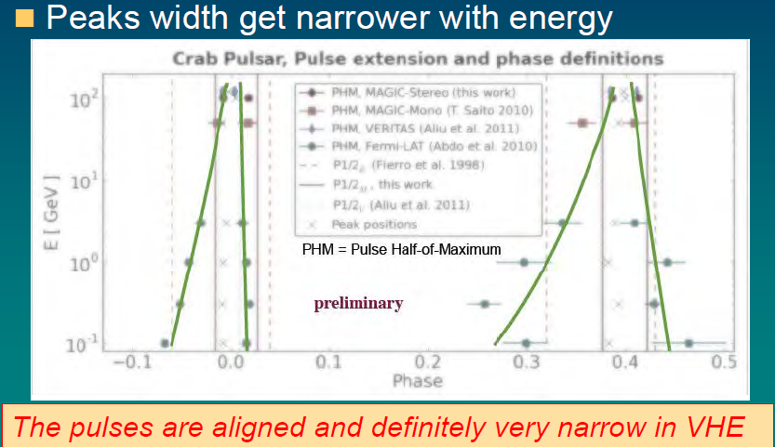
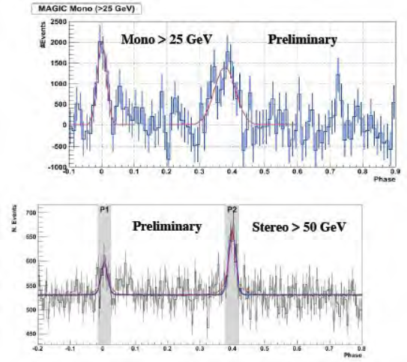
Pulsar pulse width dependence on energy

Slide 18
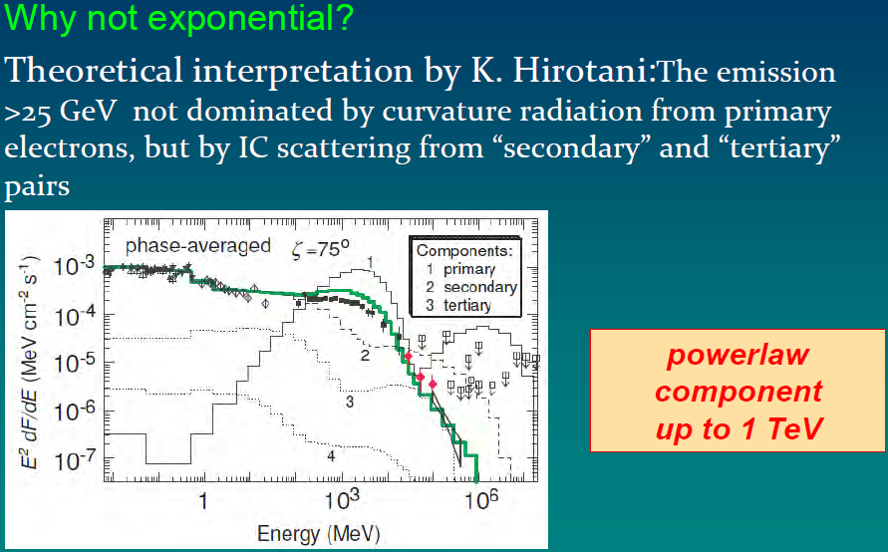
Why there is no exponential cut-off ?

Slide 19
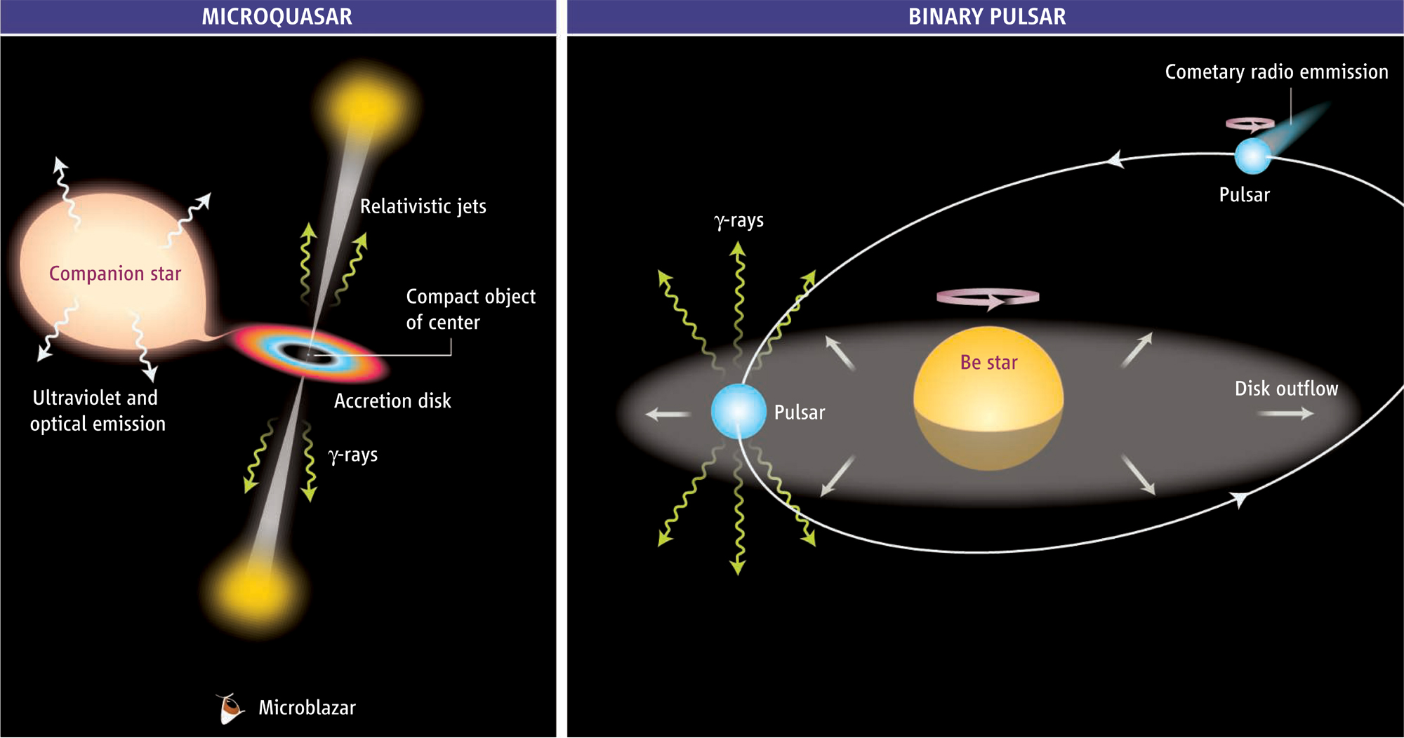
γ-ray emission from binaries
accretion powered
rotation powered
Mirabel 2006

Slide 20
The binary system LS I +61 303
Compact object still unknown
Periodic emission with orbital
period (P = 26.496 d)
Difficult to study for IACTs since period close
to Moon period
Periastron at phase 0.275
Eccentricity e = 0.55
Orbital parameters were modified during
VHE observations
Periastron
to observer

Slide 21
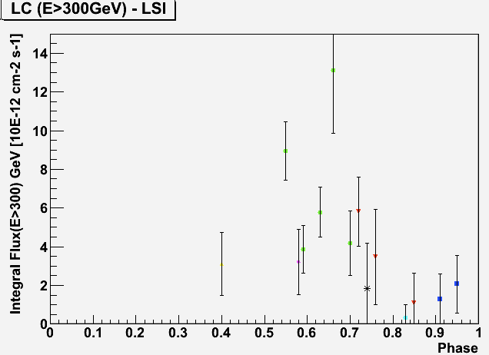
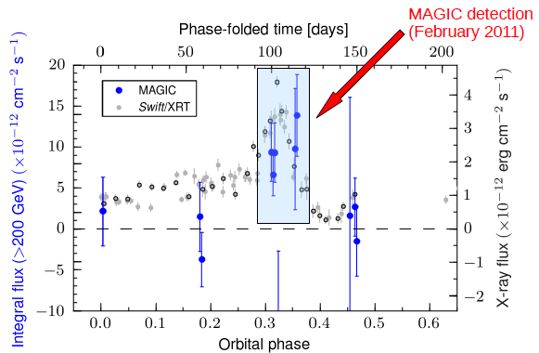
LS I +61 303 & HESS J0632+057 observations
27h data taken under partial moon illumination. Strong signal
HESS J0632+057

Slide 22
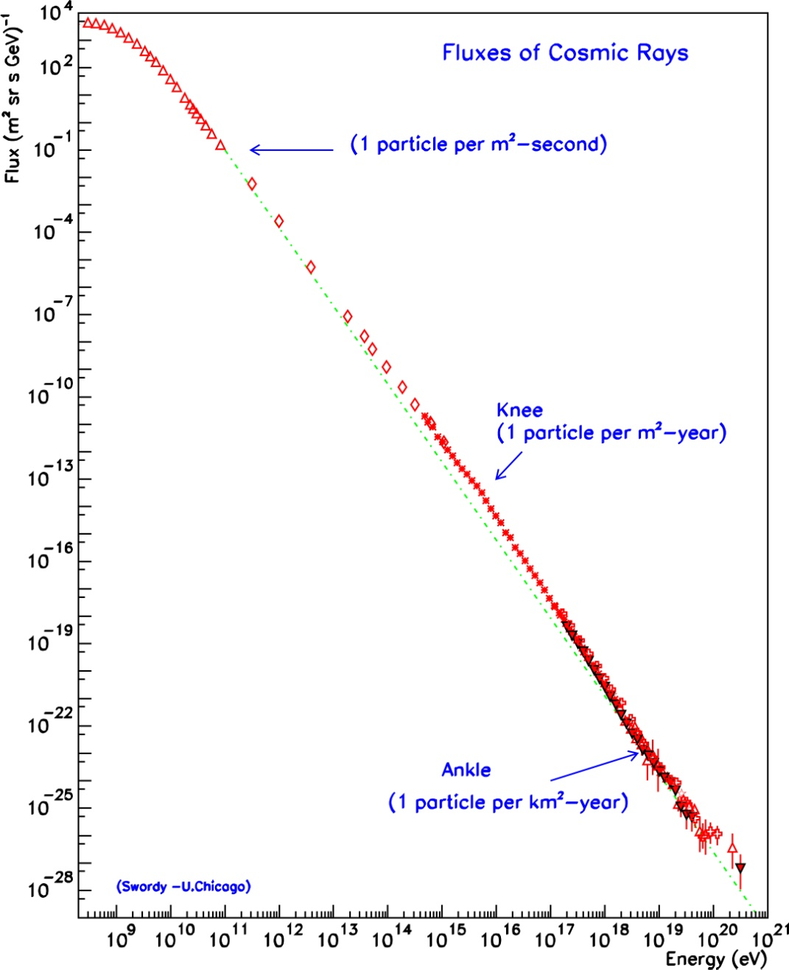
Origin of cosmic rays
Discovered in 1912 but their sources are not yet identified!
Which object(s) in our galaxy can
provide the right amount of CR?
galactic origin
Supernova remnants could
accelerate swept up particles in
their magnetic shock waves
extragalactic
origin
Signature: Hadronic generated Gamma-rays from SNRs

Slide 23
Very interesting galactic source: SNR W51
Infrared image of W51
SNR expanding into a complex
environment
Distance ~ 6 – 7 kpc
Age ~ 3x10⁴ years (Sedov – Phase)
Molecular clouds (CO – emission lines)
VHE protons probable
Enough target material
A bit too distant

Slide 24
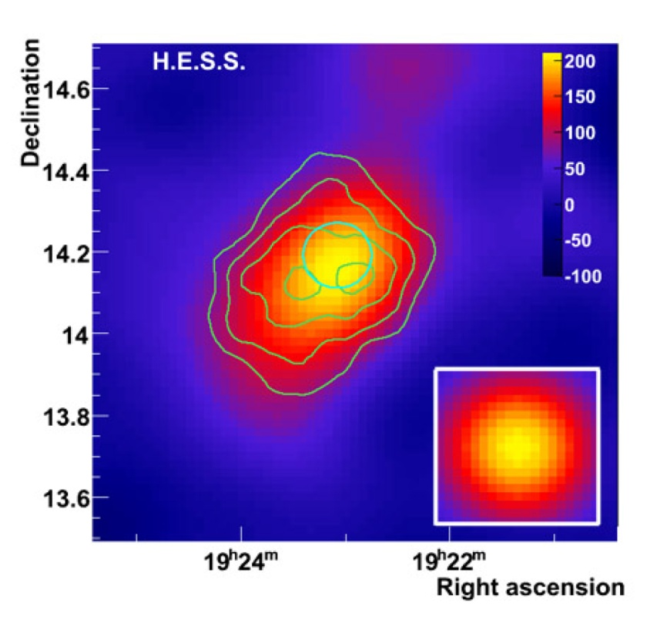
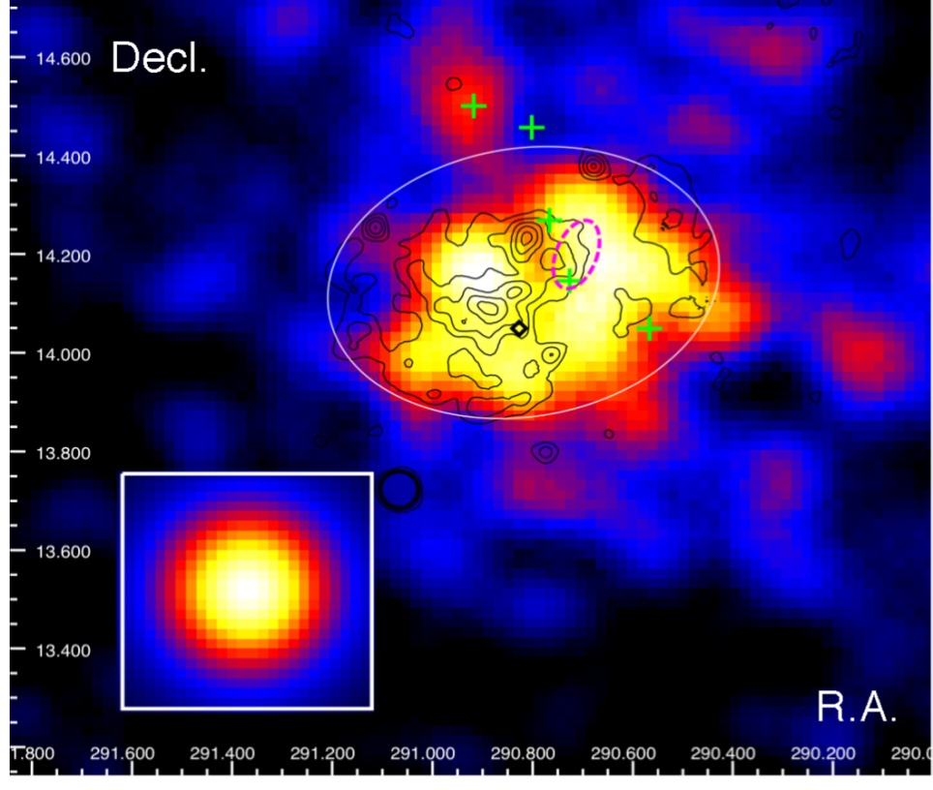
Supernova remnant: W51
2-10 GeV Photons detected by FERMI
0.22 deg extension
HESS reported detection
no spectrum
Flux E > 1 TeV ~ 3% Crab
FERMI E = 2-10 GeV
E > 800 GeV

Slide 25
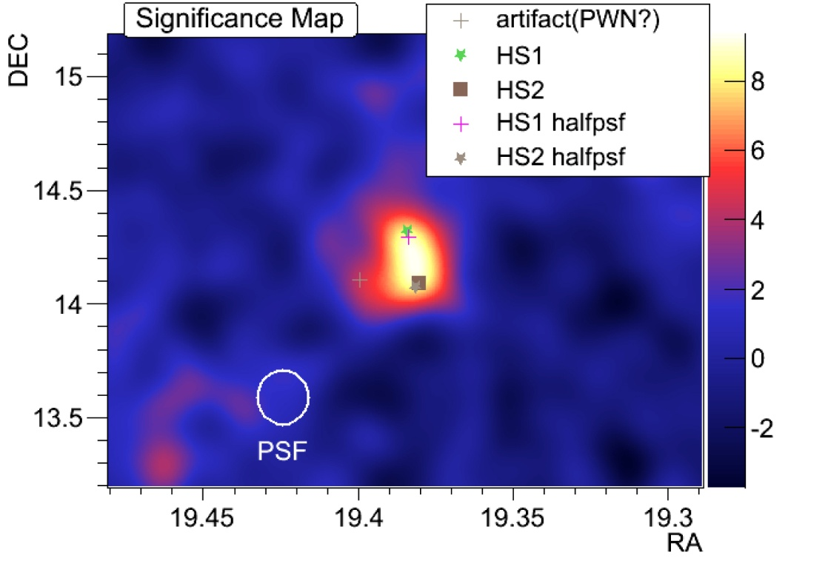
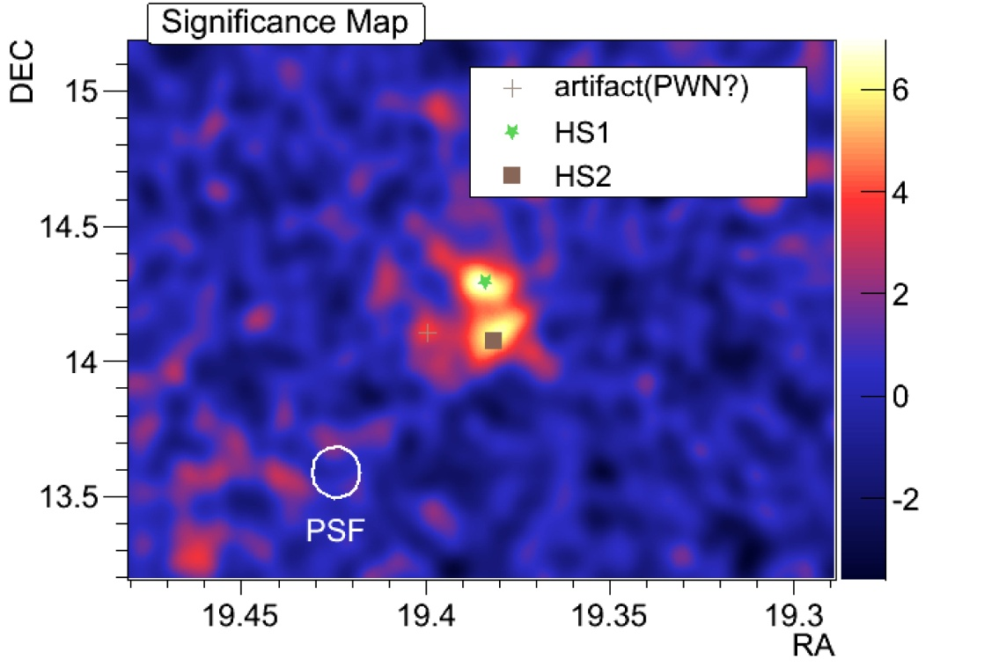
W51 as seen by MAGIC
MAGIC observations of W51 in 2010 : ~ 65h (selected good quality data: 31h)
Energy threshold of the sky-map analysis ~ 130 GeV
Preliminary
Preliminary
Morphology? Angular resolution is very good but further tests needed!

Slide 26
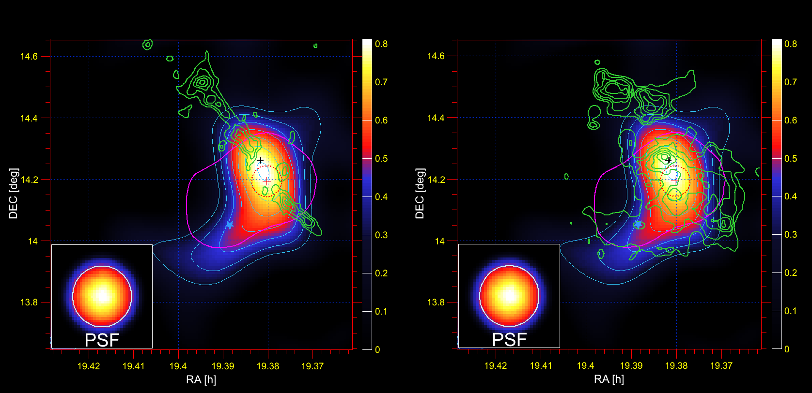
W51 as seen by MAGIC
Miniproposal for May-June 2011: 22h (eff.) added to the dataset.
Skymaps: 0.3 < E < 1 TeV

Slide 27
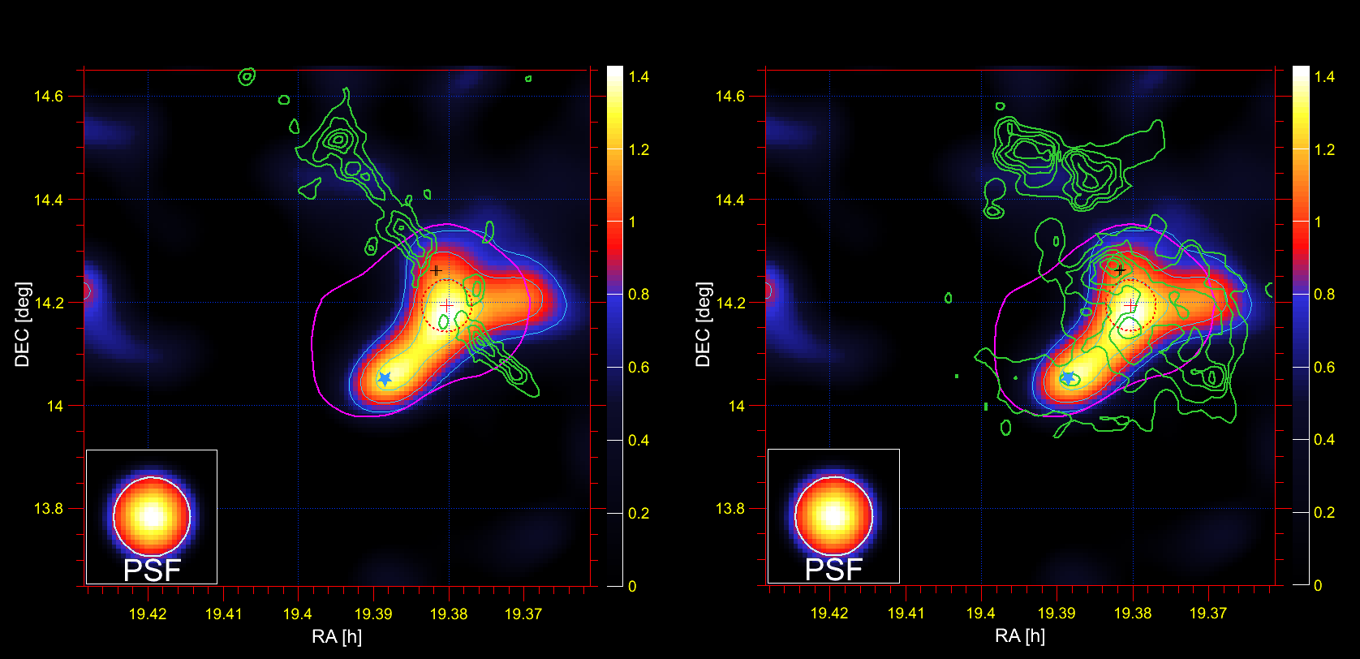
W51 as seen by MAGIC
Skymaps: E > 1 TeV

Slide 28
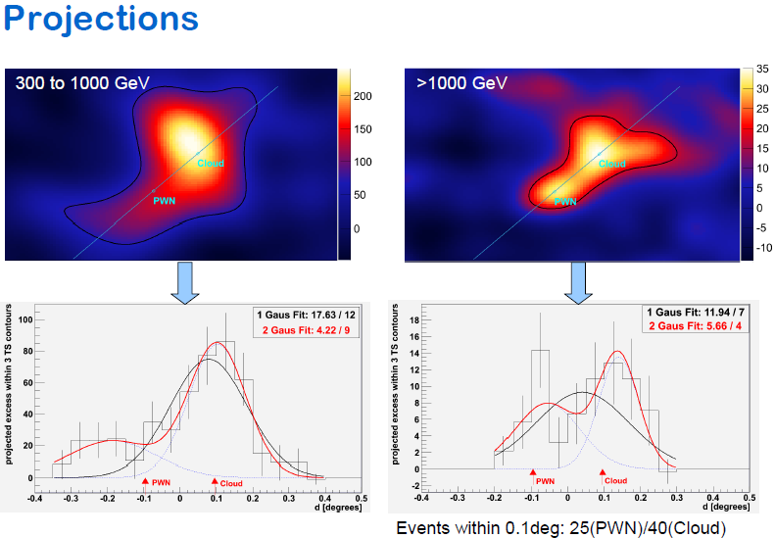

Slide 29
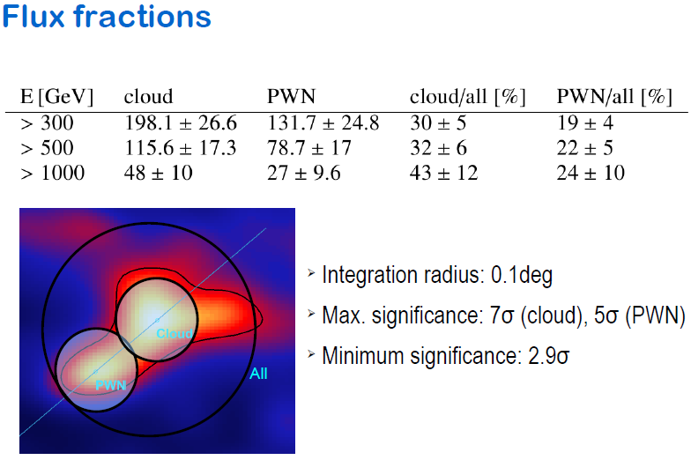

Slide 30
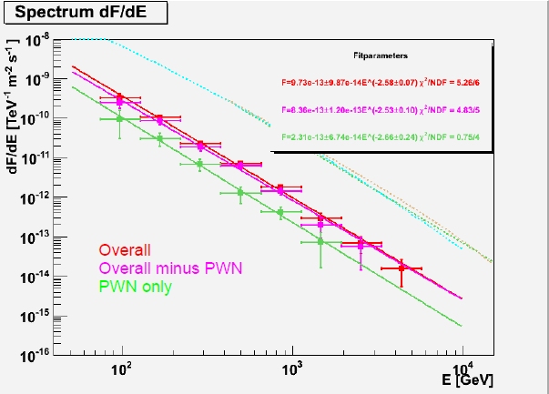
Extended source measured from 75GeV to 4.4TeV
The PWN alone is responsible only for ~20% of emission
The main emission comes from the region with molecular
material

Slide 31
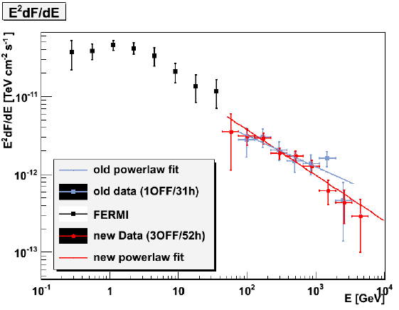
SED Old/New
Spectrum of the complete
extended source
MAGIC spectrum well
described by a power law
Preliminary
Candidate cosmic ray accelerator

Slide 32
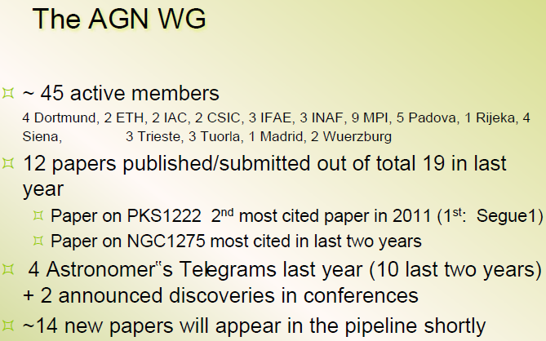
Few excerpts from the last weeks MAGIC meeting in MPI

Slide 33
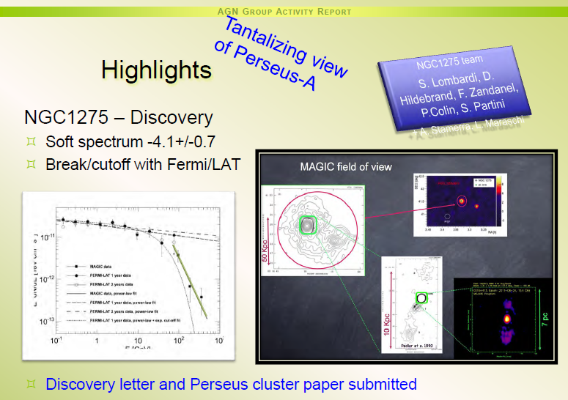
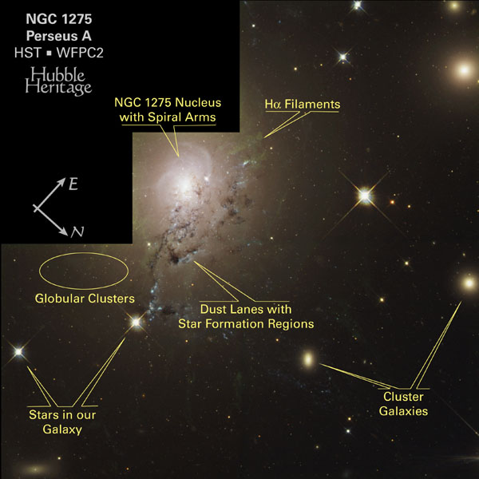
No signal above 400 GeV

Slide 34
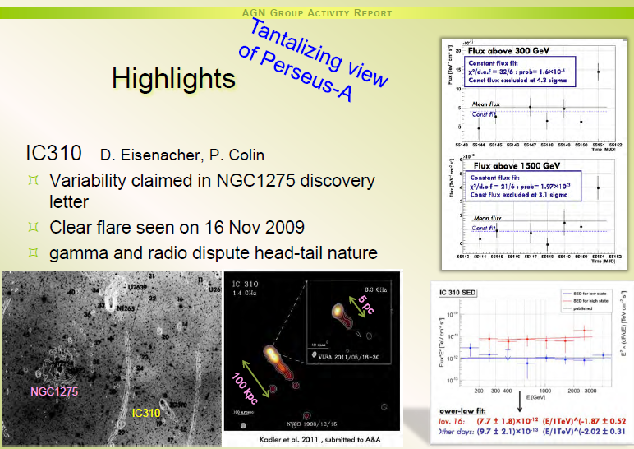
Radio galaxy in Perseus cluster @ 80 Mpc
Emission level: ~ 2.5 % Crab

Slide 35
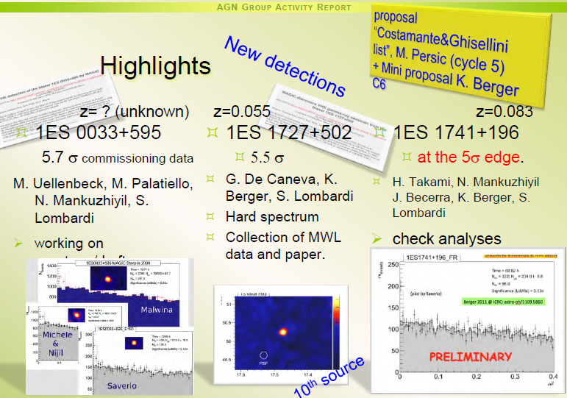

Slide 36
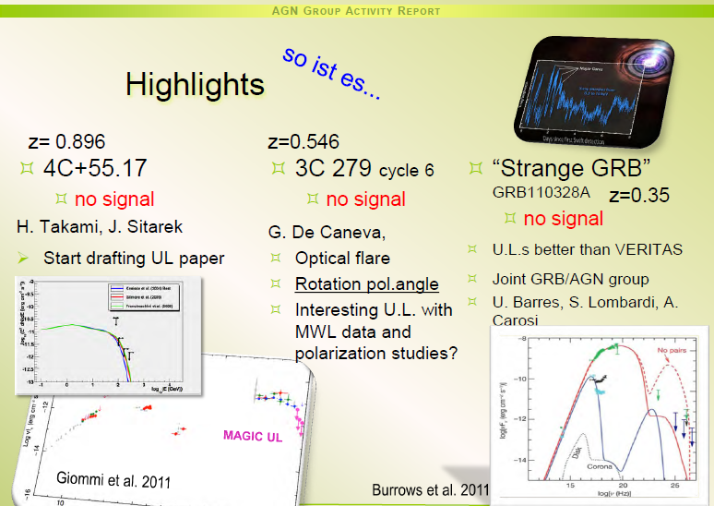

Slide 37
MAGIC Upgrade plans
MAGIC-I Upgrade camera work was completed in our institute. The camera was shipped to La Palma in spring 2011.
Both MAGIC telescopes were planned to obtain a new, same 2GSample/s readout based on DRS4 chips, mezanins produced in Pisa, Italy.
The above upgrades were planned to improve the sensitivity
Unforeseen problems related to the mechanics of the MAGIC-I popped up
While we were investigating the mechanical problems with the company MERO our collaboration entered the Upgrade scheme.
The array was stopped for 6 months.

Slide 38
MAGIC Upgrade plans
DRS4 installed in M-I in September, in M-II in December 2011. Today both the MAGIC-I with the old camera and the MAGIC-II telescopes are read out by using the DRS4 2GSample/s systems.
Currently M-I is on hold for one month for repairing a serious defect on lower mast. Our workshop is preparing an action in mid-January 2012.
After that the telescopes will operate till the 2nd stage of the Upgrade, planned for the late Spring 2012 (estimated duration ~ 5 weeks).
We anticipate a ~15% sensitivity improvement after the full Upgrade

Slide 39
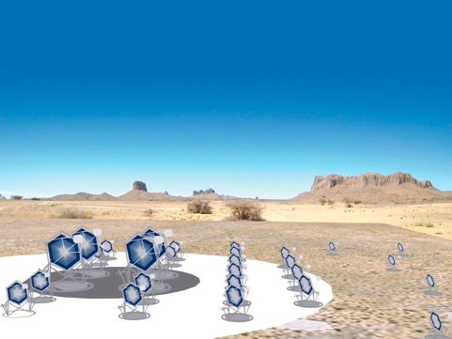
Cherenkov Telescope Array (CTA) Project
(see the CTA talk later)
The array is currently under
design and prototyping.
~ 100 telescopes of 3 different
sizes are planed to be built.
Sensitivity should be ~10
higher compared to current
mini-arrays, much weaker
sources could be measured

Slide 40
Conclusions-1
In 2010 MAGIC has reached a very good sensitivity, very comparable to H.E.S.S. and of VERITAS for energies above ~250 GeV
Below 200 GeV currently MAGIC is the only and the most sensitive instrument for energies down to 50 (25) GeV
Many extragalactic sources are discovered, several galactic sources are monitored, morphological studies reveal great, facsinating physics
Professional Sum-trigger Upgrade (MPI + Padova) for the next year for both telescopes is under production: M-C studies show this should allow us to measure pulsars and GRBs @ E ≥ 20GeV

Slide 41
Conclusions-2
The system of 2 MAGICs will be the best instrument for energies 20-200GeV at least for the next 5-7 years

Slide 42
Spare slides

Slide 43
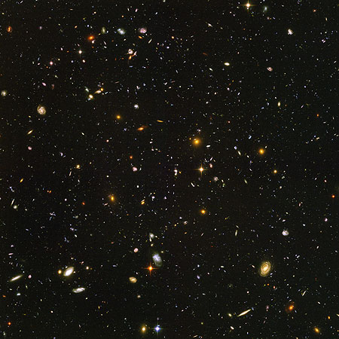
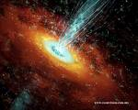
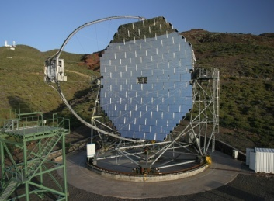
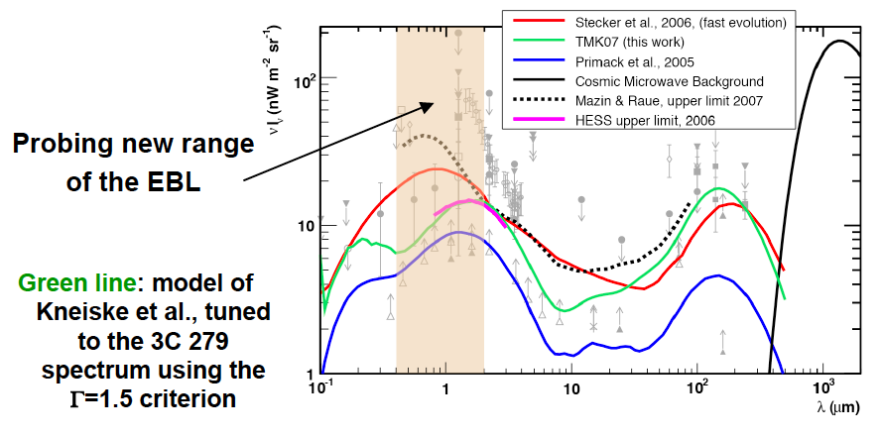
EBL studies
Extragalactic Background Light
blazar
IACT
γ_{VHE}
γ_{EBL}
e⁺
e⁻

Slide 44
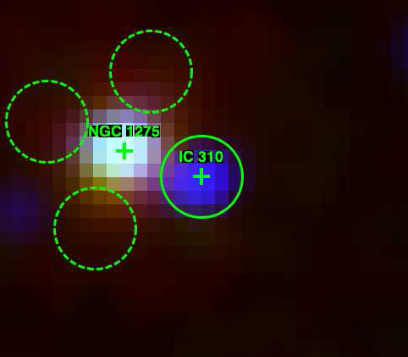
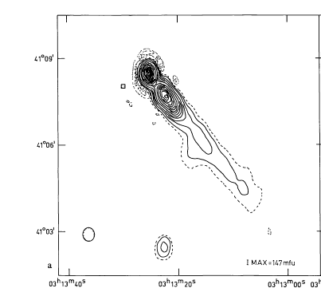
Radio Galaxy: IC 310
In Perseus cluster @ 80 Mpc
Emission level: ~ 2.5 % Crab
Detected by FERMI/LAT >100 GeV (2-days earlier than MAGIC)
Gammas could be produced as
  Close to central BH (like M87)
  Intercation of relativistic outflow with intra-cluster medium ?
  Source variable, but the detailed time behavior needs to be studied

Slide 45
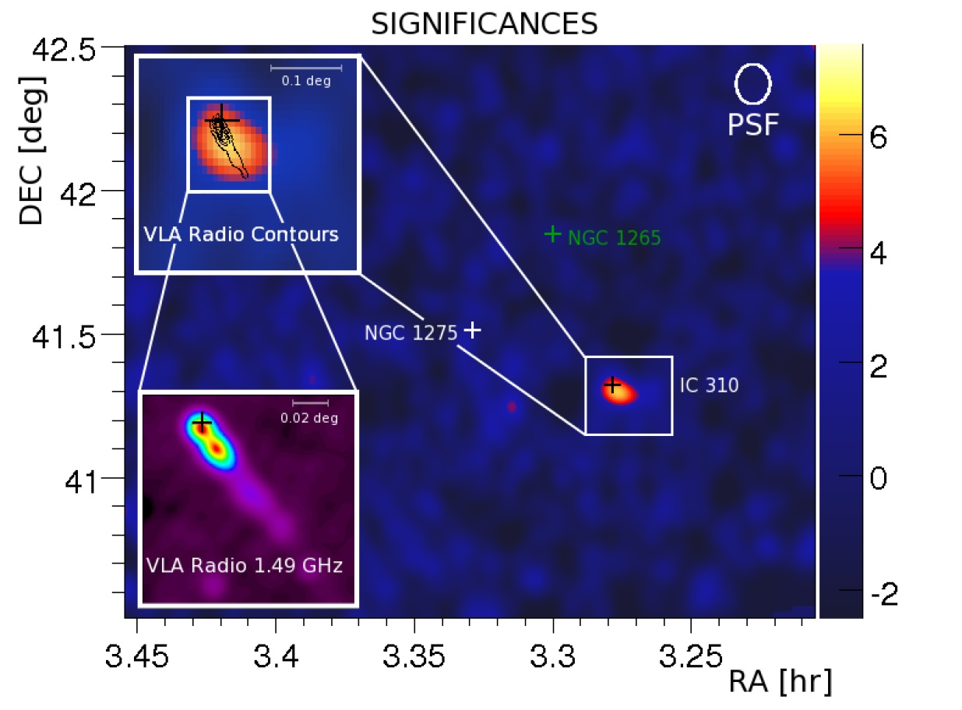

Radio Galaxy: IC 310
Discovery while observing
NGC 1275!
Very hard spectrum!

Slide 46


Dark Matter Search (indirect)
DM candidate source could be
Dwarf spheriodals Draco, Ursa Minor, Wilman 1, Boötes 1, Canis Major, Sagittarius Dwarf, .. (high light/mass ratio)
Galactic center
Globular clusters
Local group galaxies M32, M33
Clusters of galaxies: Perseus, ...
Though the estimated IACT sensitivity fails by few orders of magnitude for detecting the assumed type „classical“ DM, still it is a challenge to measure the candidates
Intermediate mass black holes in Milky Way

Slide 47

Gamma Ray Bursts and afterglow
Very interesting for studying the rapid variability of the most luminous objects in the Universe
Interesting for LIV studies
Could help in modeling the high-energy end of GRBs
Propagation and absorption effects could be studied
2 populations: < 1 sec. and few tens of seconds; even the latter need very fast reaction time
Also afterglow has a high chance
GRB050713A
The telescope started measuring in 27s
after the GCN signal arrived; no signal
Observed at T₀+4753s; z: 0.76;
GRB080430; T=16s; energy > 80 GeV
No detection, upper limit

Slide 48

New Discoveries
IC310 (J. Aleksić et al. (MAGIC Coll.), Astrophys. J. Lett. 2010 )
Two Radio Galaxies
NGC 1275 (ATel #2916, October 2010)
Flat Spectrum Radio Quasar
PKS 1222+216(4C +21.35)
(ATel #2684, June 2010)
High Frequency peaking BL Lac
B3 2247+381(ATel #2910, October 2010)
Unknown Fermi source
MAGIC J2001+435 (ATel #2753, July 2010)

Slide 49


Flat Spectrum Radio Quasar
PKS 1222 +216 (4C 21.35)
Discovered recently by MAGIC
z = 0.432 (after 3C279 2nd most distant (reliable z) measured source)
measured signal strength
~ 8.5σ in 0.5^{h}
Along with 3C279 and PKS 1510-089 this is the 3rd FSRQ
Variability time scale: ~ 10’
Short-time variability conflicts with external Compton model
FERMI & MAGIC data: 0.1 – 400 GeV

Slide 50

Optical trigger for Blazars
New discovery thanks to optical
trigger
Why only some AGN are optical
trigger able ?

Slide 51

IC310: 1st Head-Tail Galaxy in TeVs

Slide 52


Blazar modeling
MWL data is mandatory, best from radio till VHE gammas
The sources are highly variable, SED changes
Which model fits best, leptonic or hadronic , which types ?
It became usual to start a MWL with LAT, SWIFT, AGILE,
Chandra, XMM, RXTE, many other optical and radio telescopes
3C279

Slide 53

M87 – Giant Elliptical Radio Galaxy
Distance: 16.7 Mpc
Jet angle: 30° (in inner region
< 19°)
Black Hole: 6 x 10⁹ Solar mass
Giant outer lobs: 0.2° x 0.2°
High polarisation in radio
Superluminal motion
A very interesting „nearby laboratory“ for studying

Slide 54

M87 Plasma Jet
Highly structured jets with knots
(shocks ?) in Radio, optical, X-rays
Radio-optical similar polarisation (also X-rays ?)
Variability scale: weeks – years
Inner jet: superluminal motion ~ 2 x c (relativistic particles)
Jet can flare, from radio to X-rays

Slide 55


VHE Active Galactic Nuclei
I could count 27 HBL, 3 LBL, 4 IBL + 4 radio galaxies
The sources appear faster than their classification happens
~ 70 % are HBL (non-HBL could „catch“ mostly when flaring)
Due to EBL absorption, threshold and sensitivity issues mostly sources are observed < z=0.2
Distant blazars harden than expected (hint on low EBL-level)
Variability time scale ≥ 2 min.
Fossati 98

