Slide 1
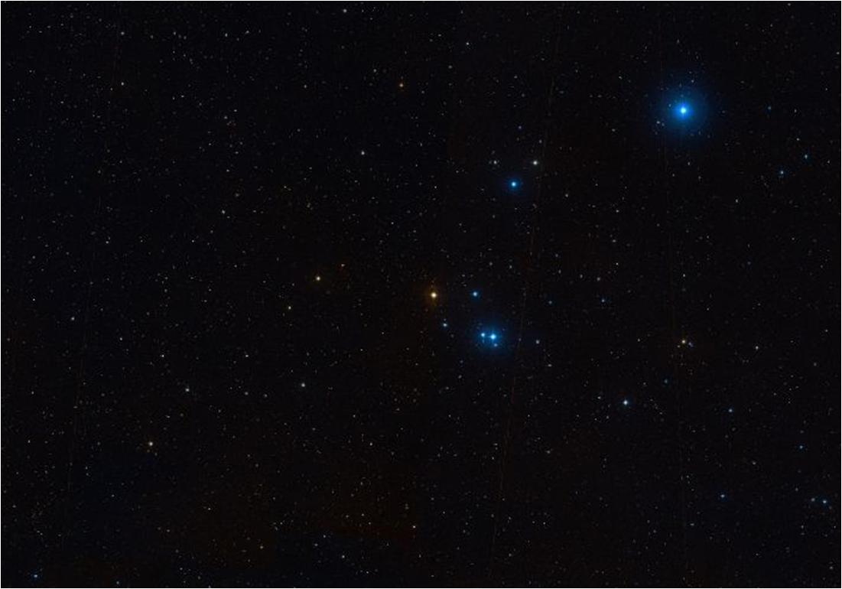


Detailed characterization and scientific interpretation of the broadband emission of Mrk421 during flaring activity in 2010
Max Planck Institute for Physics
The MAGIC Telescope
Ringberg Young Scientist Workshop 2012
ShangYu Sun
A. Boller, L. Fortson, N. Galante, D. Paneque and B. Steinke On behalf of the Fermi, MAGIC, VERITAS collaborations and the participants/groups of the MW campaign on Mrk421 in 2010, which include GASP-WEBT, F-GAMMA and many others
Notes:
Previous speaker; 2010 data

Slide 2
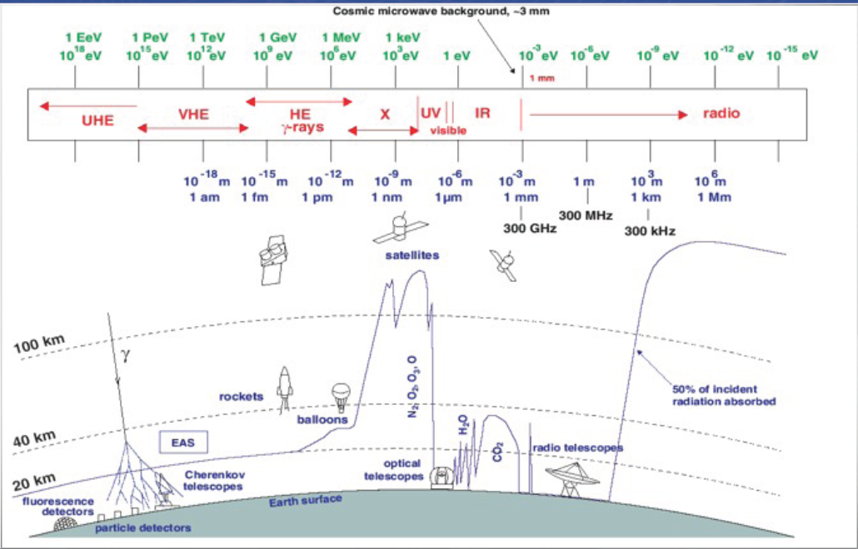
2010 Multi-wavelength Campaign for Mrk 421
MAGIC
VERITAS
Metsahovi
UMRAO
GLAST-AGILE Support Program
Goddard Robotic Telescope
New Mexico Skies
ROVOR
St.Petersburg ……
Notes:
MW intruments

Slide 3
2010 Multi-wavelength Campaign for Mrk 421
50TeV-
50GeV
300GeV-
300MeV
50keV-
300 eV
RXTE
MAXI
Swift
Fermi-LAT
MAGIC
VERITAS
Metsahovi
UMRAO
GLAST-AGILE Support Program
Goddard Robotic Telescope
New Mexico Skies
ROVOR
St.Petersburg …….
Notes:
MW intruments

Slide 4
MW Light-Curve Frequency-Bands
Wave band | instrument | flux unit | mean freq. Hz | low freq. Hz | high freq. Hz | low energy | high energy
VHE | MAGIC | count/cm^2/s |  | 4.84E+025 | 1.21E+028 | 200GeV
VHE | VERITAS | count/cm^2/s |  | 4.84E+025 | 1.21E+028 | 200GeV
GammaRays | Fermi | ph/cm2/s |  | 6.06E+022 | 6.06E+025 | 300MeV | 300GeV
XRays | RXTE/PCA | erg/cm2/s |  | 4.84E+017 | 2.42E+018 | 2.00keV | 10.0keV
Xrays | SWIFT/BAT | count/cm2/s |  | 3.63E+018 | 1.21E+019 | 15keV | 50keV
Xrays | SWIFT/XRT | erg/cm2/s |  | 4.84E+017 | 2.41E+018 | 2keV | 10keV
Xrays | SWIFT/XRT | erg/cm2/s |  | 7.25E+016 | 4.84E+017 | 0.3keV | 2keV
Xrays | RXTE/ASM | ph/s |  | 4.84E+017 | 2.41E+018 | 2keV | 10keV
XRays | MAXI | ph/s |  | 9.67E+017 | 2.41E+018 | 4keV | 10keV
UVW2 | SWIFT/UVOT | mJy | 1.60E+015 | 1.37E+015 | 1.93E+015
UVM2 | SWIFT/UVOT | mJy | 1.38E+015 | 1.24E+015 | 1.55E+015
UVW1 | SWIFT/UVOT | mJy | 1.19E+015 | 1.05E+015 | 1.37E+015
b | ROVOR | mJy | 6.81E+014 | 6.14E+014 | 7.66E+014
b | Bradford Robotic Telescope | mJy | 6.81E+014 | 6.14E+014 | 7.66E+014
v | New Mexico Skies | mJy | 5.45e14 | 5.04e14 | 5.92e14
v | ROVOR | mJy | 5.45e14 | 5.04e14 | 5.92e14
v | Bradford Robotic Telescope | mJy | 5.45e14 | 5.04e14 | 5.92e14
r | New Mexico Skies | mJy | 4.68E+014 | 4.20E+014 | 5.29E+014
r | ROVOR | mJy | 4.68e14 | 4.20e14 | 5.29e14
r | Bradford Robotic Telescope | mJy | 4.68e14 | 4.20e14 | 5.29e14
r | GLAST-AGILE Support Program | mJy | 4.68e14 | 4.20e14 | 5.29e14
r | Goddard Robotic Telescope | mJy | 4.68e14 | 4.20e14 | 5.29e14
r | Perkins | mJy | 4.68e14 | 4.20e14 | 5.29e14
r | Steward | mJy | 4.68e14 | 4.20e14 | 5.29e14
r | Crimean | mJy | 4.68e14 | 4.20e14 | 5.29e14
r | St.Petersburg | mJy | 4.68e14 | 4.20e14 | 5.29e14
I | ROVOR | mJy | 3.79e14 | 3.47e14 | 4.19e14
Radio | Metsahovi | Jy | 37GHz | 3.63E+010 | 3.87E+010 | 1.5e-4eV | 1.6e-4eV
Radio | UMRAO | Jy | 14GHz | 1.26E+010 | 1.64E+010 | 5.2e-5eV | 6.8e-5eV
Radio | UMRAO | Jy | 8GHz | 7.25E+009 | 8.70E+009 | 3.0e-5eV | 3.6-5eV
Notes:
Complete list of all the wave bands ~ 30 ;http://www.slac.stanford.edu/~dpaneque/MW_Mrk421_2010/Obs.html

Slide 5
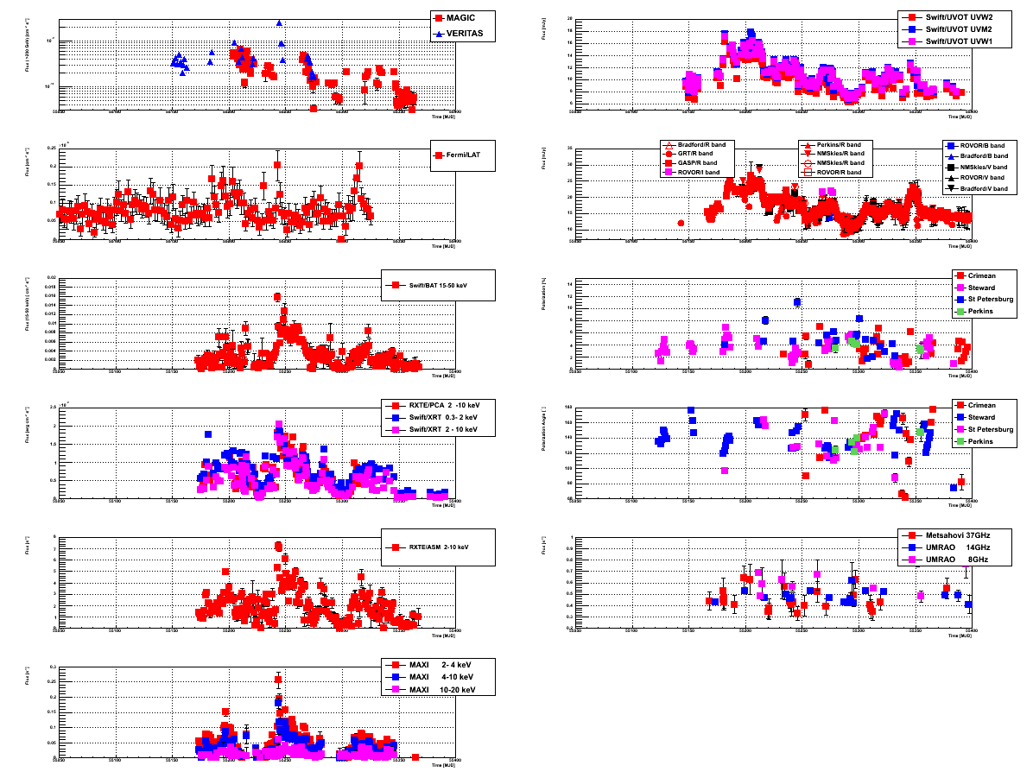
Mrk421 2010
MW light curves
VHE
UV
flux
time
GammaRays
Optical
XRays
Optical
XRays
Optical
XRays
Radio
XRays
Notes:
Axises; bands and correlation

Slide 6
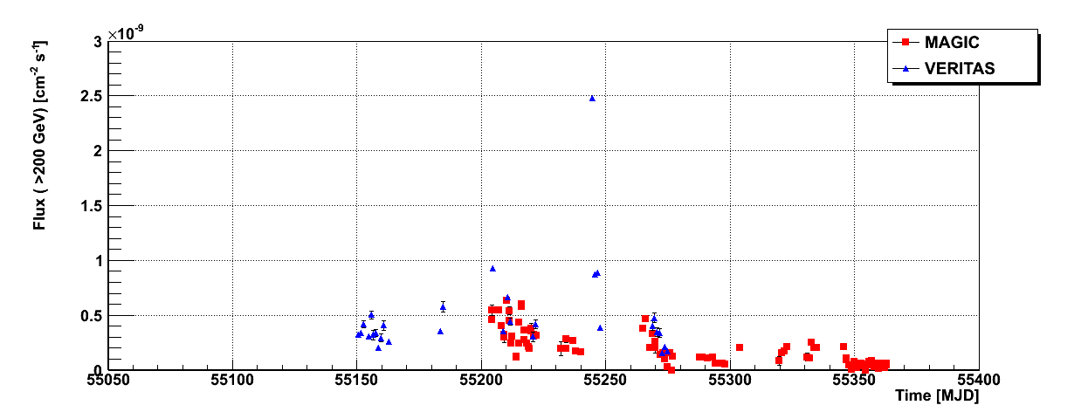
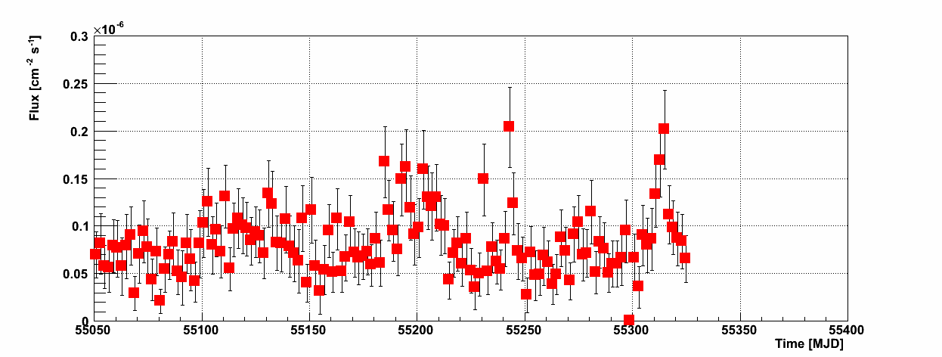
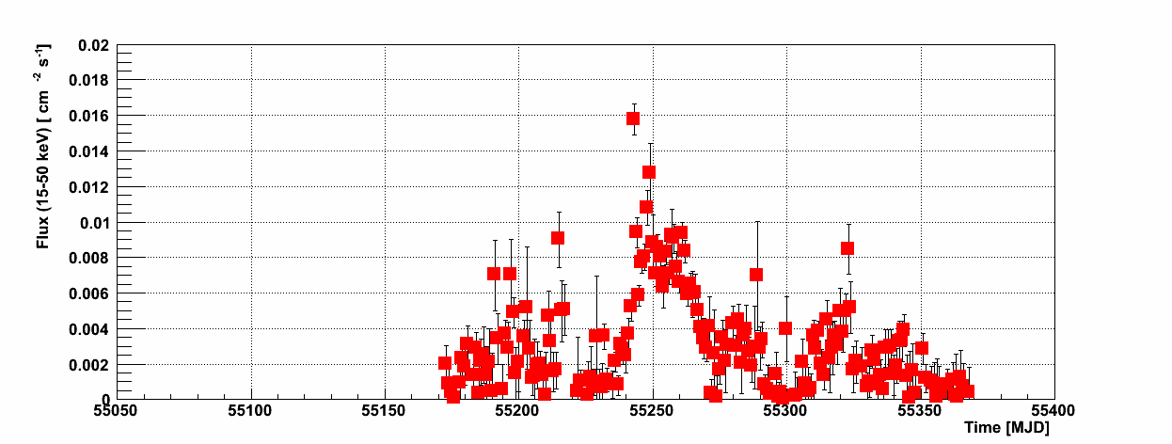
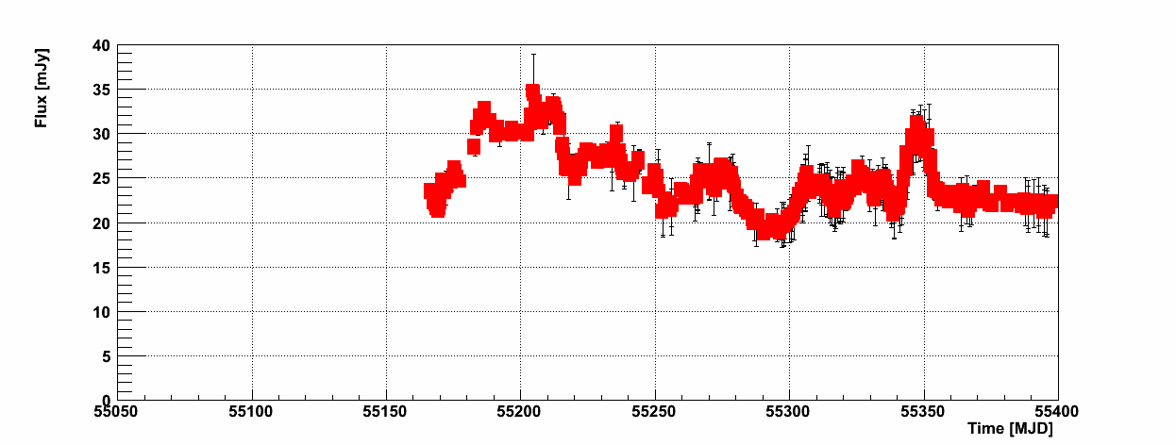
Mrk421 2010 Flares
VHE, HE, Xray, Optical light curves
2010 Jan Mar May
x1.e-9
high
high
MAGIC&VERITAS
200GeV~50TeV
Fermi
300MeV~300GeV
55197 55228 55256 55287 55317 55348
high
SWIFT/XRT
2-10keV
high
high
high
GASP
R band
Flares of different types ! !
Notes:
2 flares; 2 flavors

Slide 7
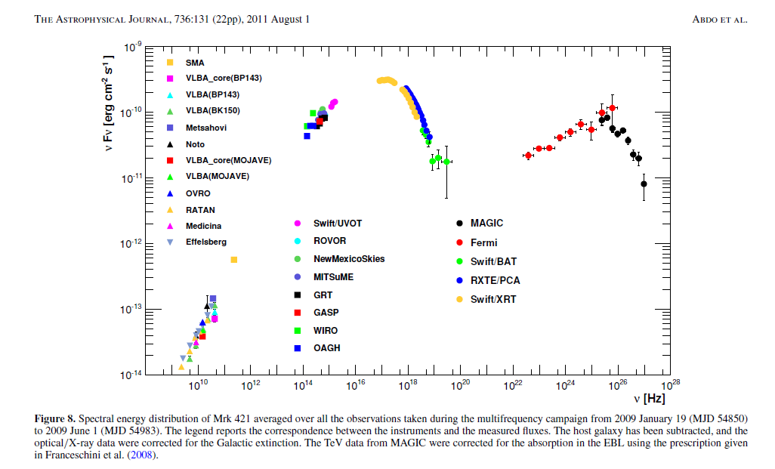
Mrk421 Broadband Spectral Energy Distribution
2009 data
ShangYu SUN
7

Slide 8
Mrk421 2010 MW Light Curve Variability
Variability: the quantity showing how much each light curve fluctuates
Variability
(S. Vaughan et al. Mon.Not.Roy.Astron.Soc.345:1271,2003)
Variance of Flux
Mean of error sq.
Mean of Flux
Notes:
Purpose; 3 terms; results(active and low)

Slide 9
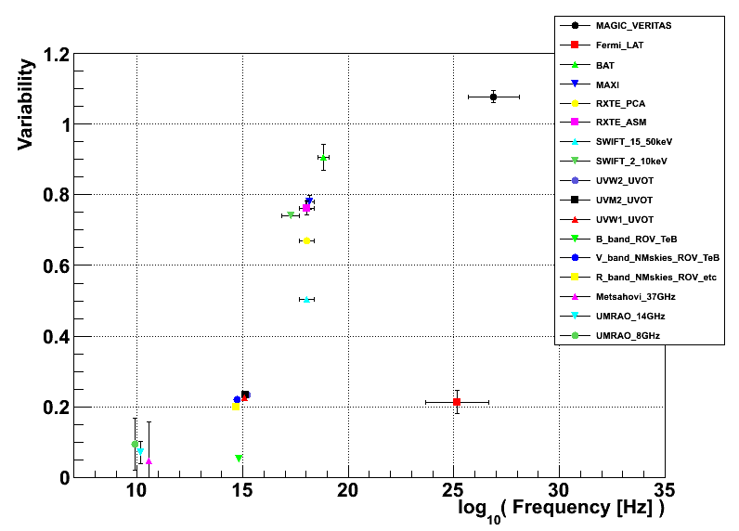
Mrk421 2010 MW Light Curve Variability
Variability: the quantity showing how much each light curve fluctuates
2009
2010
2_10keV
0.3_2keV
Nina Nowak
Opt 0.2 X 0.45 GeV 0.2 TeV 0.25
Opt 0.2 X 0.7 GeV 0.2 TeV 1.1
Notes:
Purpose; 3 terms; results(active and low)

Slide 10
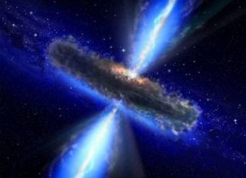
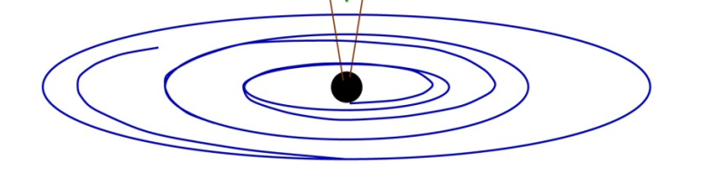
Describe Spectra with
One-Zone Synchrotron Self-Compton Model
An emission blob with:
Radius R
Magnetic field B
Doopler factor
Relativistic electrons
Using Hajime Takami ‘s SSC code
Monthly Notices of the Royal Astronomical Society,
Volume 413, Issue 3, pp. 1845-1851
Notes:
Jet-dominated emission; SSC model parameters

Slide 11
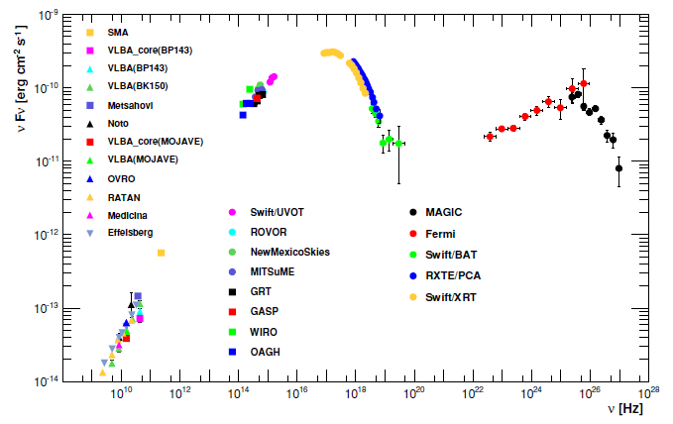

Describe Spectra with
One-Zone Synchrotron Self-Compton Model
synchrotron radiation
=>Xray
inverse Compton
=>GammaRay
Notes:
2 radiation mechanisms

Slide 12
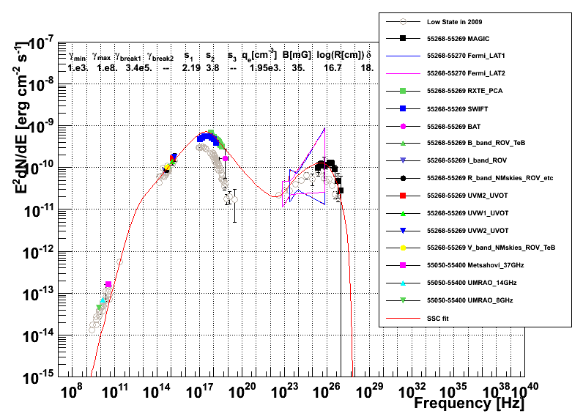
Mrk421 Broadband SED and SSC Modeling
Content of this plot:
1. 2009 average SED (low state )
2. 2010_03_14(high state) SED
3. one-zone one-break SSC fit
Fermi (two days)
SED
region of 68% confidence level
Notes:
Axises; 3 components; bands;
Fermi spectrum: because there are few photons detected by Fermi in a short time, they provide instead the region of 68% confidence level

Slide 13
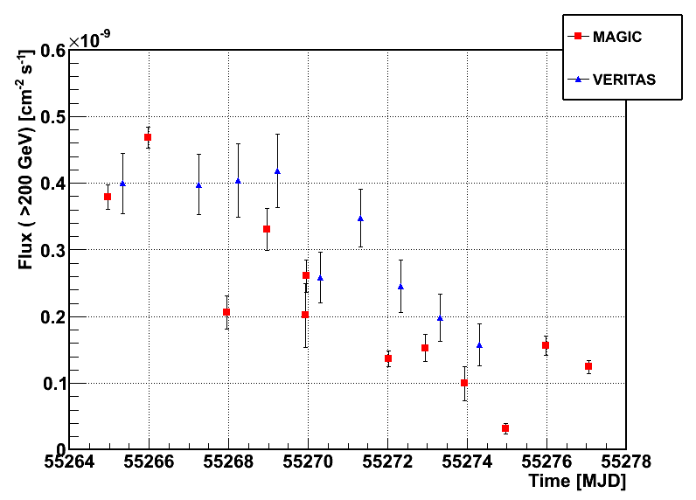
Mrk421 2010 March
Very High Energy Light Curve
March 10 12 14 16 18 20 22
• A decaying flare in Mrk 421 was observed by MAGIC and VERITAS in March (peak ~2 Crab). (Low state around 50% Crab)
• 10/03/2010 (55255) - 22/03/2010 (55267) ; MAGIC 11 nights (10~ 80 min obs.)
VERITAS 6 nights (~10 min obs.)
Crab
Next: unprecedented data for blazar study:
day-by-day broadband Mrk421 SEDs in flaring activity
Notes:
Lc->spectrum day by day

Slide 14
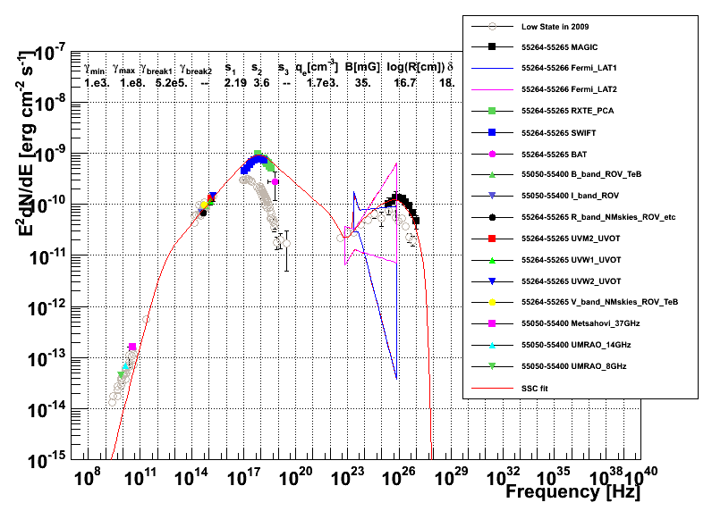
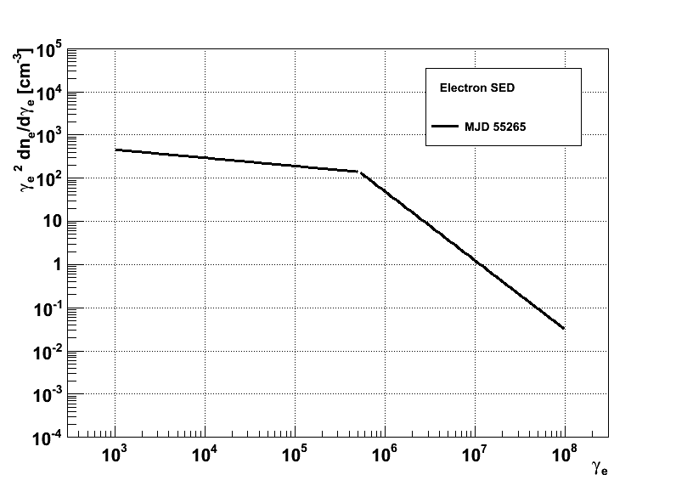
Mrk421 MW 2010_03_10 (55265)
Electron
Energy
Spectrum
Notes:
Evolution of SED

Slide 15
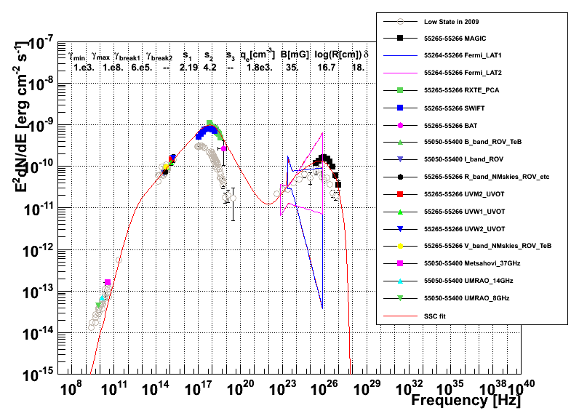
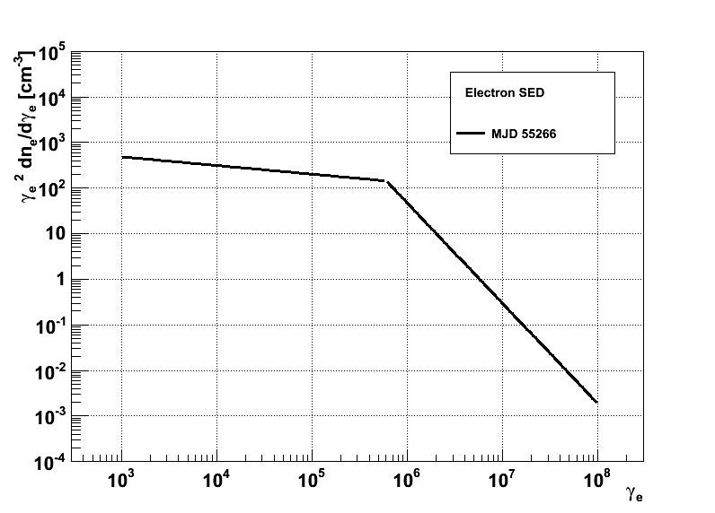
Mrk421 MW 2010_03_11 (55266)
Notes:
Fermi spectrum: because there are few photons detected by Fermi in a short time, they provide instead the region of 68% confidence level

Slide 16
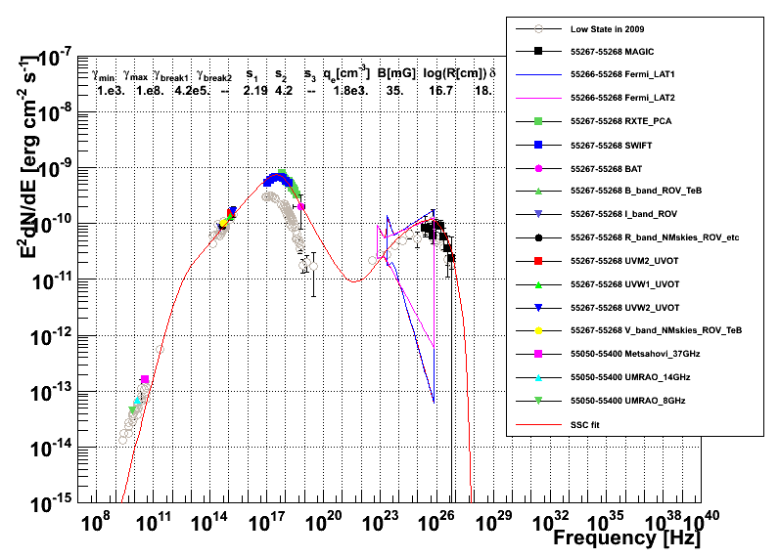
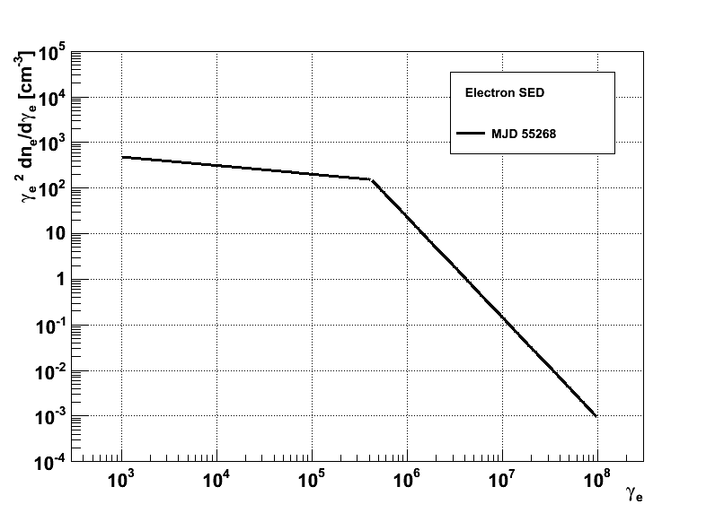
Mrk421 MW 2010_03_13 (55268)
Notes:
Fermi spectrum: because there are few photons detected by Fermi in a short time, they provide instead the region of 68% confidence level

Slide 17
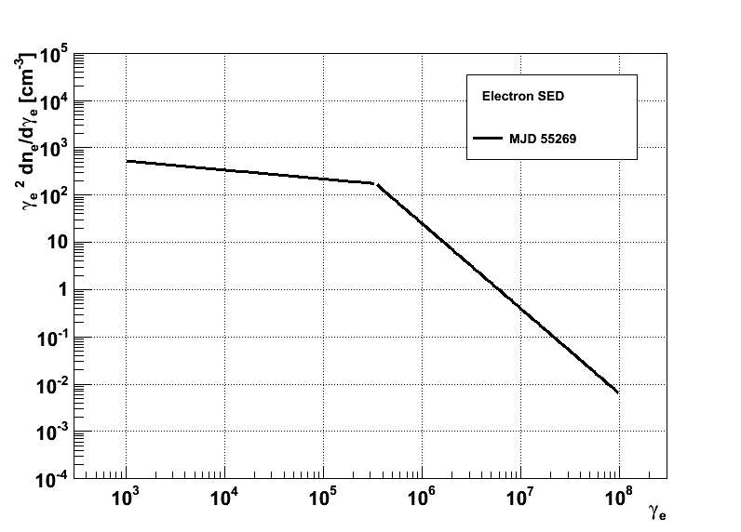
Mrk421 MW 2010_03_14 (55269)
Notes:
Fermi spectrum: because there are few photons detected by Fermi in a short time, they provide instead the region of 68% confidence level

Slide 18
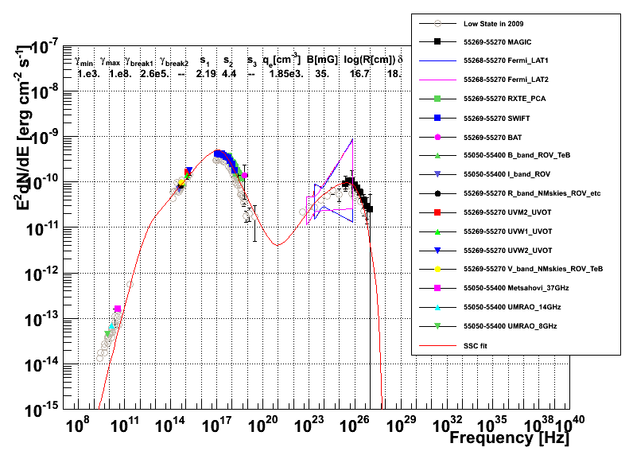
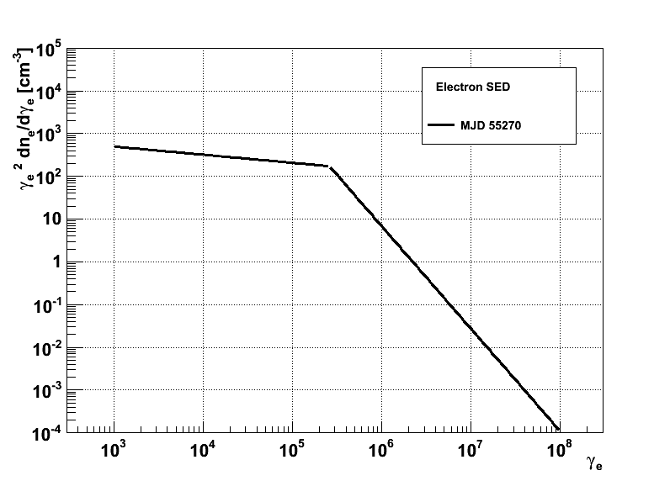
Mrk421 MW 2010_03_15 (55270)
Notes:
Fermi spectrum: because there are few photons detected by Fermi in a short time, they provide instead the region of 68% confidence level

Slide 19
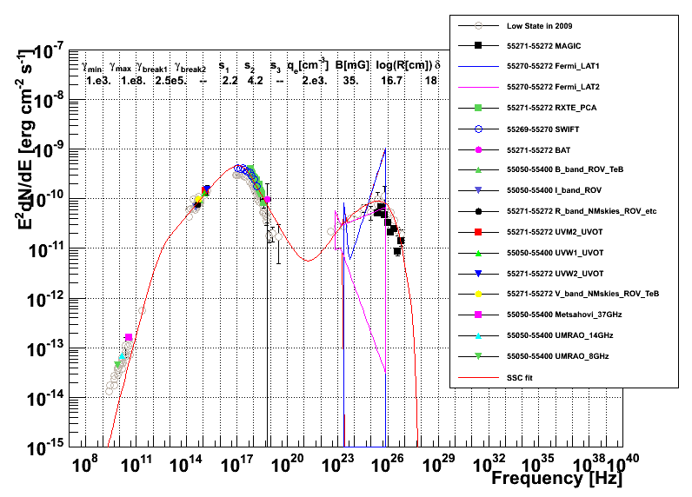

Mrk421 MW 2010_03_17 (55272)
Notes:
Fermi spectrum: because there are few photons detected by Fermi in a short time, they provide instead the region of 68% confidence level

Slide 20
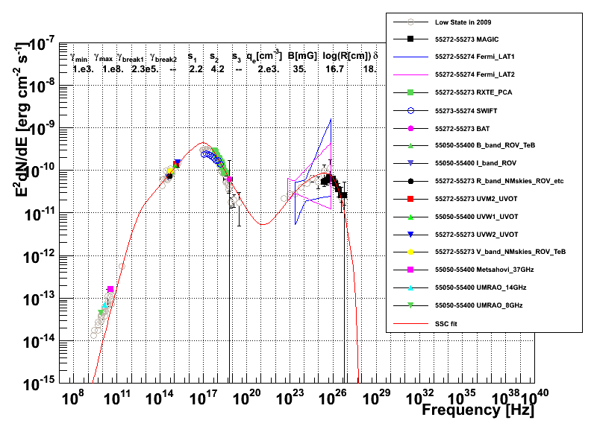

Mrk421 MW 2010_03_18 (55273)
Notes:
Fermi spectrum: because there are few photons detected by Fermi in a short time, they provide instead the region of 68% confidence level

Slide 21
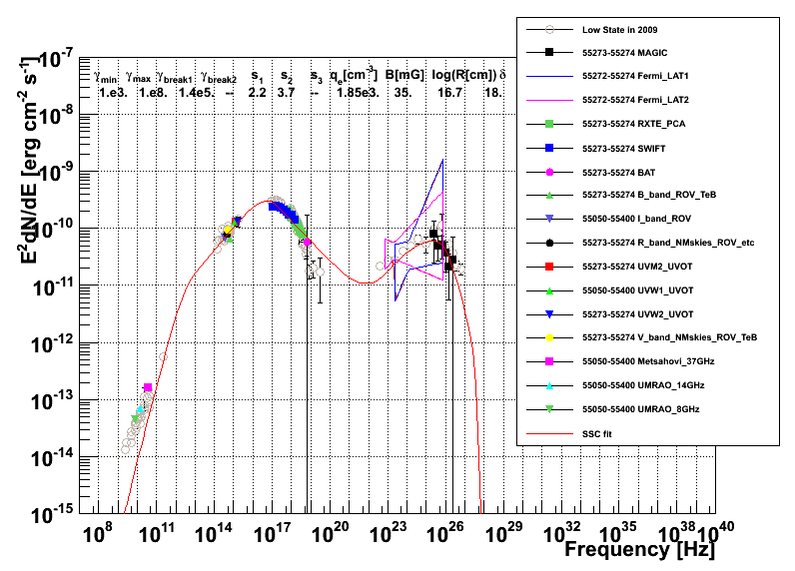
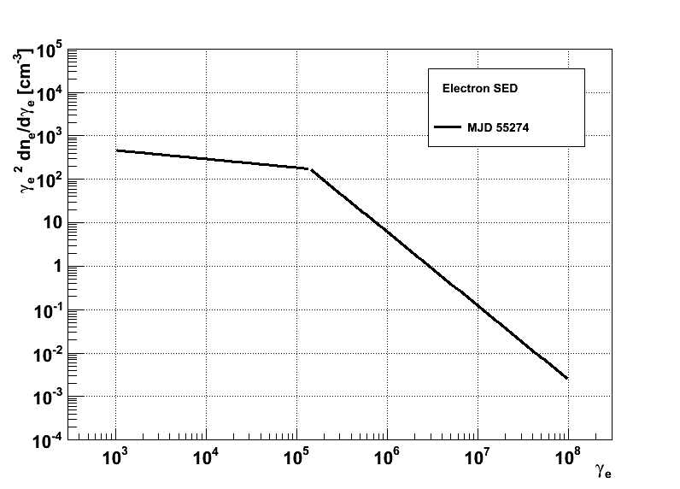
Mrk421 MW 2010_03_19 (55274)
Notes:
Fermi spectrum: because there are few photons detected by Fermi in a short time, they provide instead the region of 68% confidence level

Slide 22
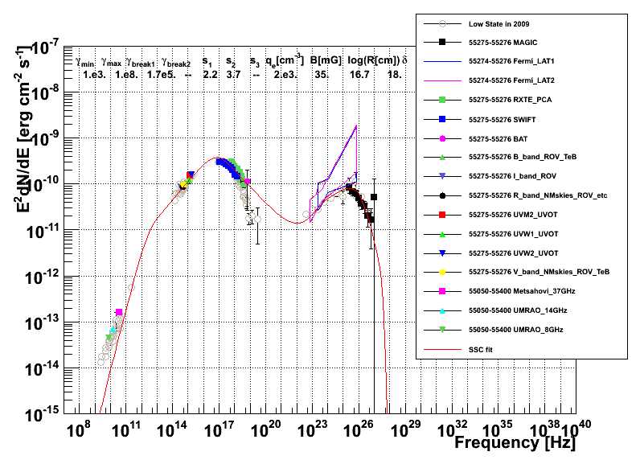
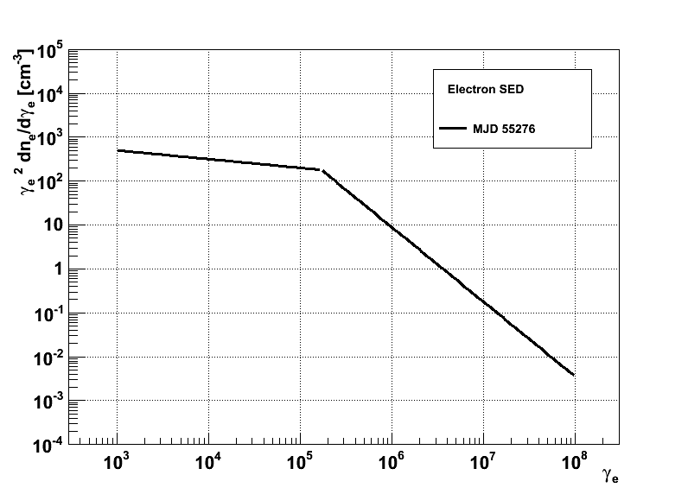
Mrk421 MW 2010_03_21 (55276)
Notes:
Fermi spectrum: because there are few photons detected by Fermi in a short time, they provide instead the region of 68% confidence level

Slide 23
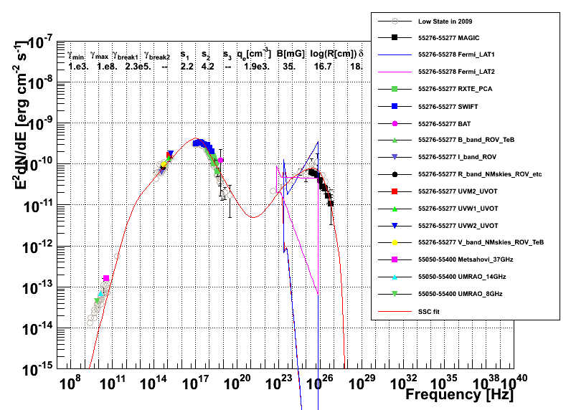

Mrk421 MW 2010_03_22 (55277)
Notes:
Fermi spectrum: because there are few photons detected by Fermi in a short time, they provide instead the region of 68% confidence level

Slide 24
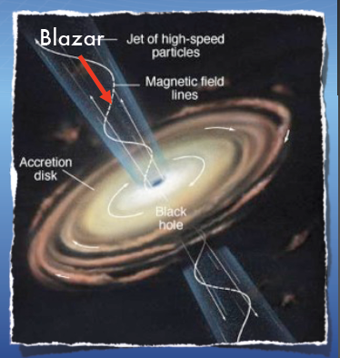
Which parameter changes during flaring acyivity?
Blob bouncing in the jet?
Magnetic field ?
Blob speed ?
Blob size?
Electron energy ?
v
B
v
B
Notes:
Go back to daily SEDs

Slide 25
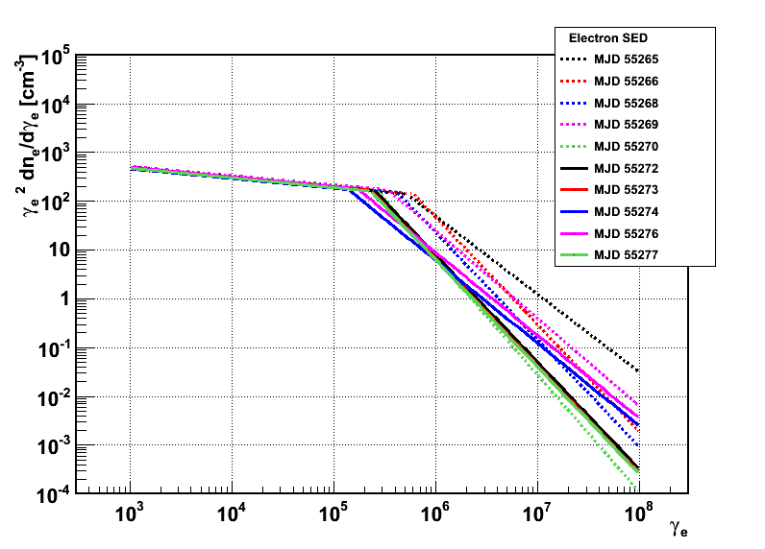
Describe Variation of Spectra with
Electron SEDs
The evolution of the SED during the flare can be explained, within the one-zone Synchrotron Self-Compton scenario, with variations in the high-energy part of the electron energy distribution, rather than the environment parameters (B,R, Doppler factor).
Fixed Parameters
1.e3.
1.e8.
35.
16.7
18.
Notes:
A scenerio

Slide 26
Conclusion
We found that the Mrk 421 flaring activity in 2010 could be explained within a one-zone Synchrotron Self-Compton Emission Model by only changing the shape of electron energy distribution

Slide 27
Backup Slides

Slide 28
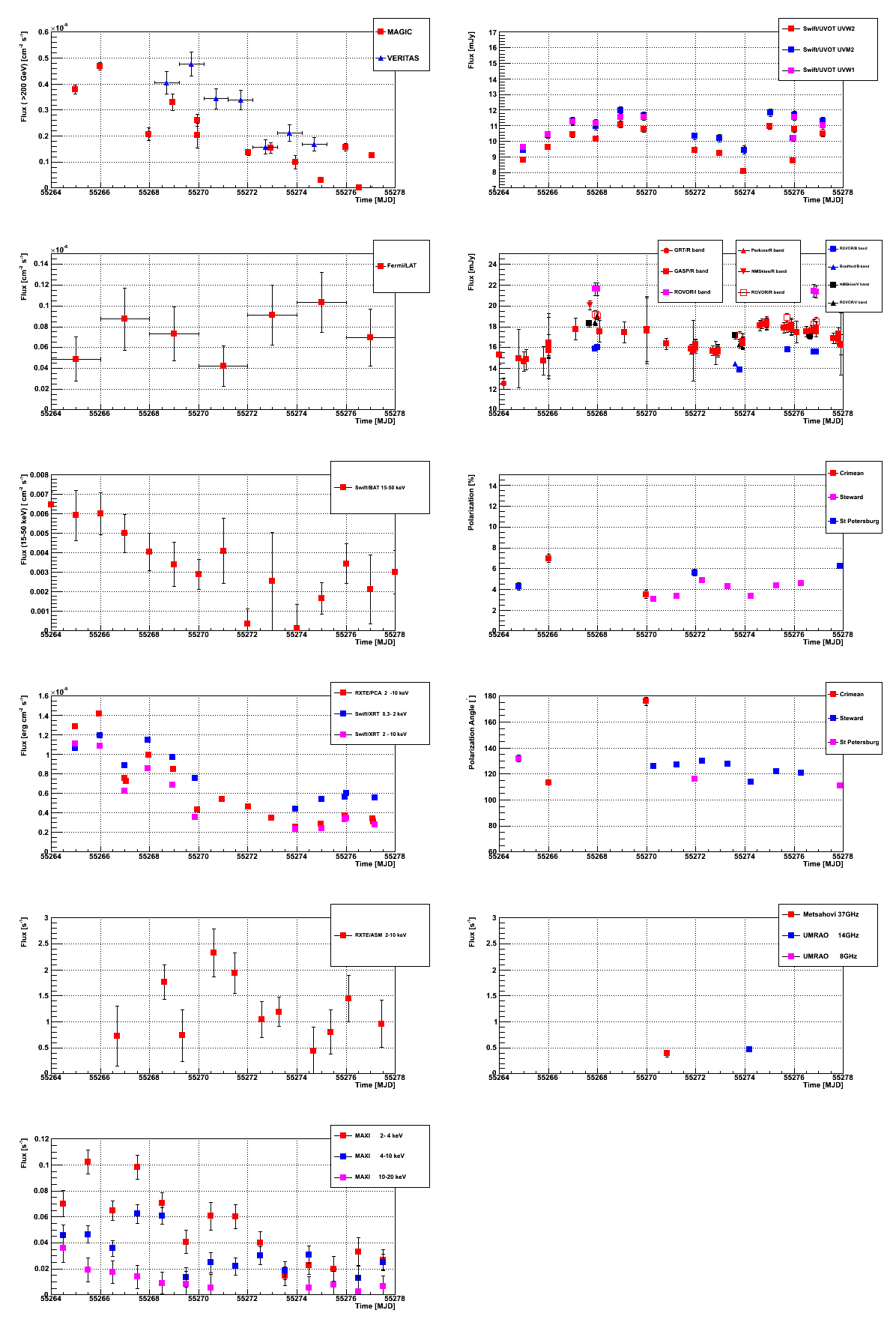
Flares are mainly driven by changes in electron number density

Slide 29
Flares are mainly driven by changes in electron number density

Slide 30

The GLAST-AGILE Support Program (GASP) was organized within the Whole Earth Blazar Telescope (WEBT: 43 radio to optical)to provide optical-to-radio long-term continuous monitoring of a list of selected gamma-ray-loud blazars during the operation of the AGILE and GLAST satellites.
AGILE (Astro‐rivelatore Gamma a Immagini LEggero) is an X-ray and Gamma ray astronomical satellite of the Italian Space Agency (ASI).

Slide 31
Mrk421 2010
MW light curves

Slide 32
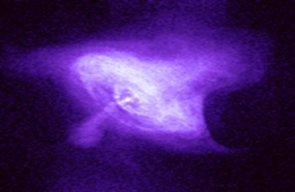
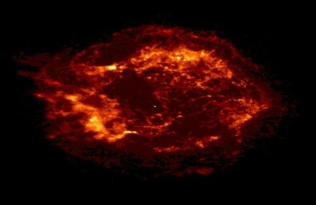
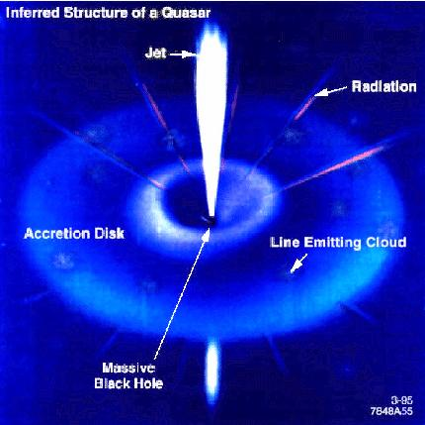
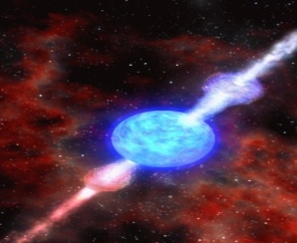
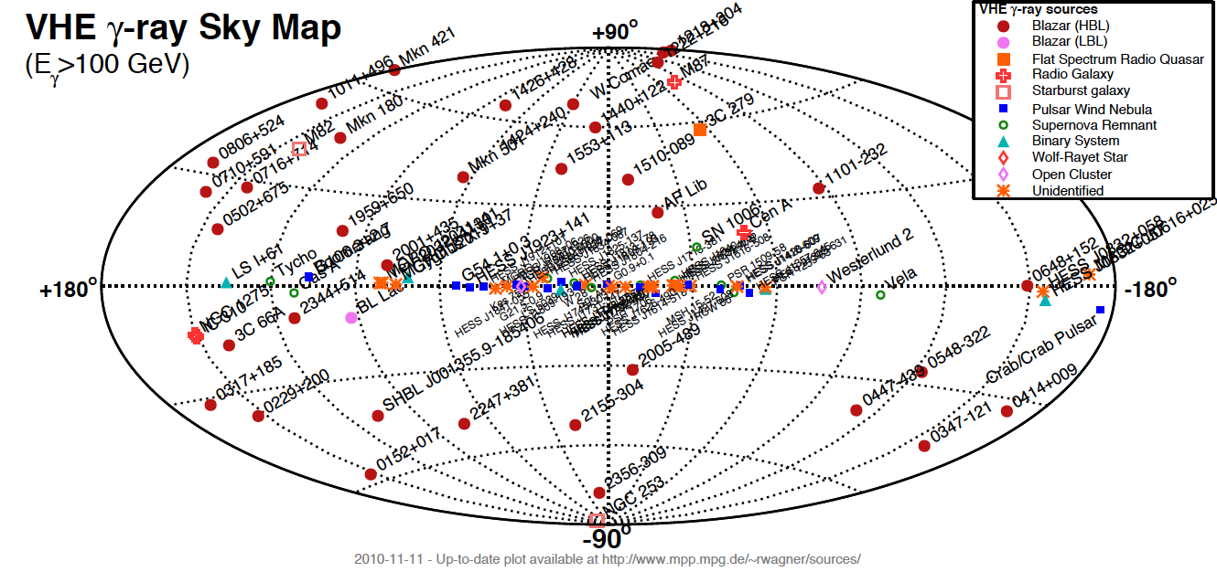
TeV Sources
extragalactic sources
Supernova Remnant
Micro quasar
X-ray binary
Gamma Ray Burst
Active Galactic Nuclei
Pulsar
Pulsar Wind Nebula
Notes:
Pulsar/Pulsar Wind Nebula, Active Galactic Nuclei, Gamma Ray Burst

Slide 33
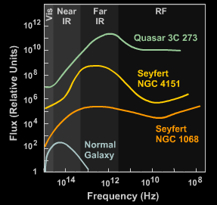
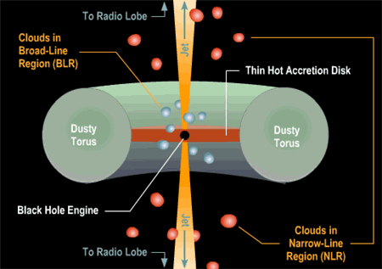
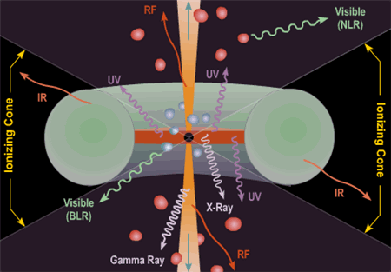
Active Galactic Nuclei(AGN) of Active Galaxies
Active Galaxy
Credits from Brooks/Cole Thomson Learning
Notes:
AGN is the very active emission regions of an active galaxy

Slide 34
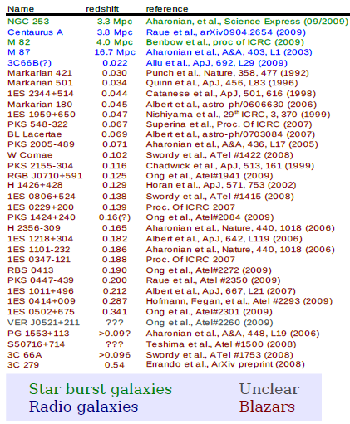
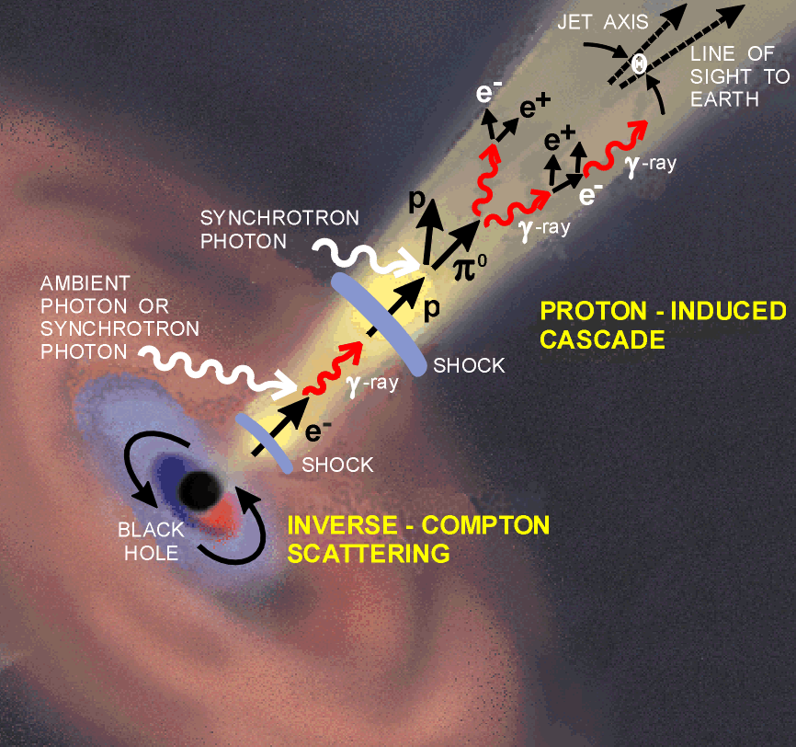
TeV Extragalactic Sources
46 TeV extragalacic sources
3 x FR-I,
2 x Starburst galaxies,
4 x FSRQs,
37 x BL Lacs
Credits from R. Wagner
FRI, FRII
(Radio Galaxies)
BL Lac, FSRQ
(Blazars)

Slide 35
Summary
1. MAGIC in its first year(2010) of stereo observation on Mrk 421 caught three TeV flares: January (~3 Crab), March (~2 Crab)
high state: TeV,GeV,X,Opt TeV,X
Mrk 421 2010 MW light curves:
Variability of (TeV, GeV, X, Opt)~(1.1, 0.2, 0.75, 0.2)
3. MAGIC stereo had 10 observation on Mrk421 in March 2010, catching a decaying flare, with fluxes of 4 observations > 1 Crab, with simultaneous spectra from Optical, SWIFT/XRT*BAT, RXTE/ASM, Fermi, MAGIC .
4. 1-zone Synchrotron Self-Compton Emission Model can describe well Mrk 421 spectrum evolution. The physical properties which changes during decaying flare might be the intrinsic characteristics of electrons, rather than the environment parameters(B,R).

