Slide 1
Calorimetry of the Future & the T3B Experiment
Pirate Lecture Session 2012
( Arrrrrrrrrrrr!!! )
Christian Soldner, Lars Weuste, Marco Szalay
Max-Planck-Institute for Physics
Young Scientist Workshop – July 25th 2012

Slide 2
Outline
Let’s hunt for the best future calorimeter
(for the future linear e+e- collider CLIC with 3TeV CM Energy)
Perfect Calorimeter
Look for the Superlative:
Bigger?
More?
Faster?

Slide 3
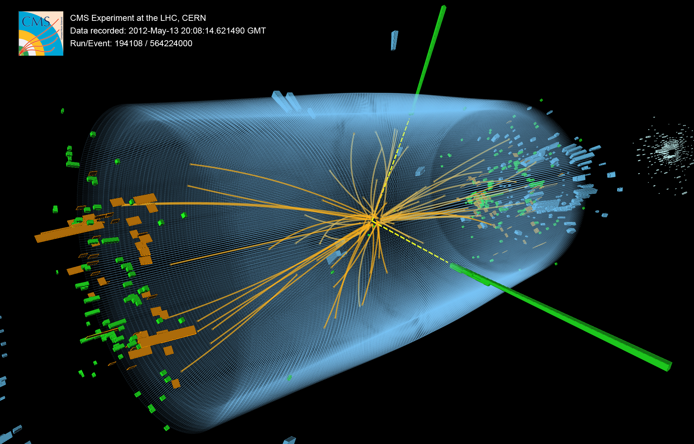
What’s a calorimeter?
At a collider:
Many particles created at collision
What is their energy? How do we measure it?
Avast! Cut ye landlubber particle in pieces and scavenge them to see how many ye get!
Force particle into a series of hard interactions: Shower
Using dense absorber material (steel, tungsten, …)
Each reaction creates secondary particles (e.g. electrons, pions)
If no energy left: Shower is stopped
➔ Number of secondaries N ∝ energy of initial particle E
Works for $e^{±},γ$ and hadrons
Statistical Error: $σ(E)∝σ(N)∝\sqrt{N}∝\sqrt{E}$
➔Resolution: ${σ\left(E\right)}/E=1/{\sqrt{E}}$
2

Slide 4
State of the Art Technology (At lhc)

Slide 5
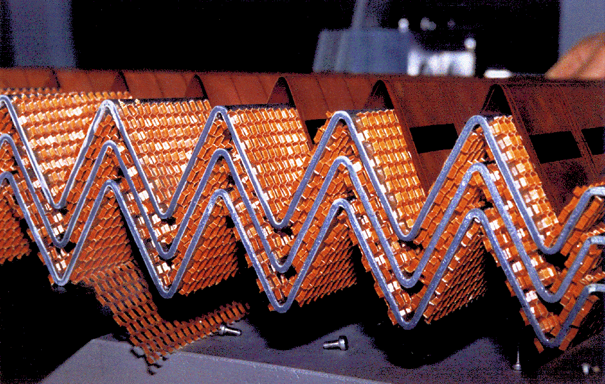
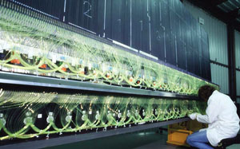
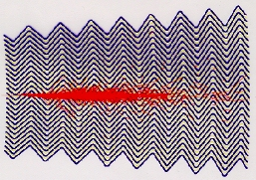
State of the Art Technology (Hadron Collider)
ATLAS: Readout:
ECAL: - Liquid Argon + Lead Absorber Plates → Cu/Kapton Electrode
HCAL: - Plastic Scintillator + Steel Absorber → Photo Multiplier Tubes
Calorimeters located outside of the Solenoid
$σ_{E}/E_{CAL}$
10%/$\sqrt{E}$
45%/$\sqrt{E}$
$$E_{JET}$$ | 45 GeV | 500 GeV
$$σ_{E}/E_{JET}$$ | 15% | 4%

Slide 6
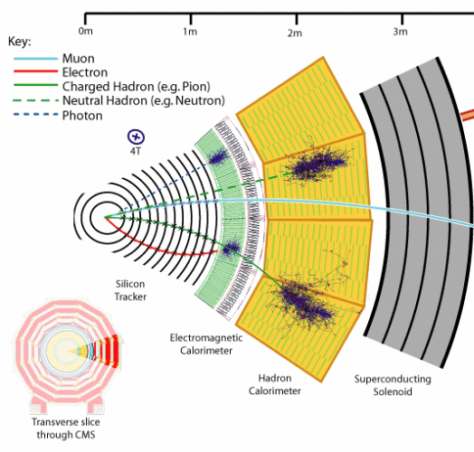
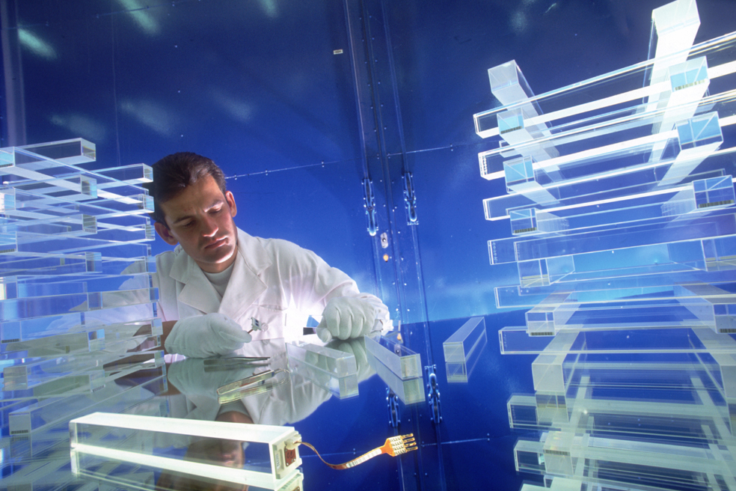
State of the Art Technology (Hadron Collider)
CMS: Readout:
Ecal: - Lead Tungstenate Crystals → Avalanche Photodiodes
HCAL: - Plastic Scintillator + Brass Absorber → Hybrid Photodiodes
Calorimeters located inside of the Solenoid
$σ_{E}/E_{CAL}$
3%/$\sqrt{E}$
100%/$\sqrt{E}$
$$E_{JET}$$ | 45 GeV | 500 GeV
$$σ_{E}/E_{JET}$$ | 19% or 12% | 5%

Slide 7
How to Design a Future Calorimeter? (for a E+E- COLLIDEr)
???

Slide 8
Big?
Let’s look for Superlatives:
Why don’t we build the biggest Calorimeter in the world?
Compare: ATLAS: 12m in beam direction, 8m diameter
Look at what’s important:
Would be nice if we could find someone to pay for it at some point!
Hermitic → leakage deteriorates the jet energy measurement
→ needed to reconstruct missing E
ρ(CAL) determines size
Atlas: ~25 $X_{0}$, ~10 $λ_{I}$
→ Bigger is not better
What about “small”?
Compare: CMS: 2.95m in diameter
Advantage: CAL fits inside the solenoid → no dead material between trackers and CAL
But: most dense material to consider: Tungsten
Steel | Tungsten | Gold
~ 8 ${g/cm}^{3}$ | ~ 19 ${g/cm}^{3}$ | ~ 19 ${g/cm}^{3}$
~ 5-10 €/kg | ~ 100 €/kg | ~ 40000 €/kg
→Let’s try that

Slide 9
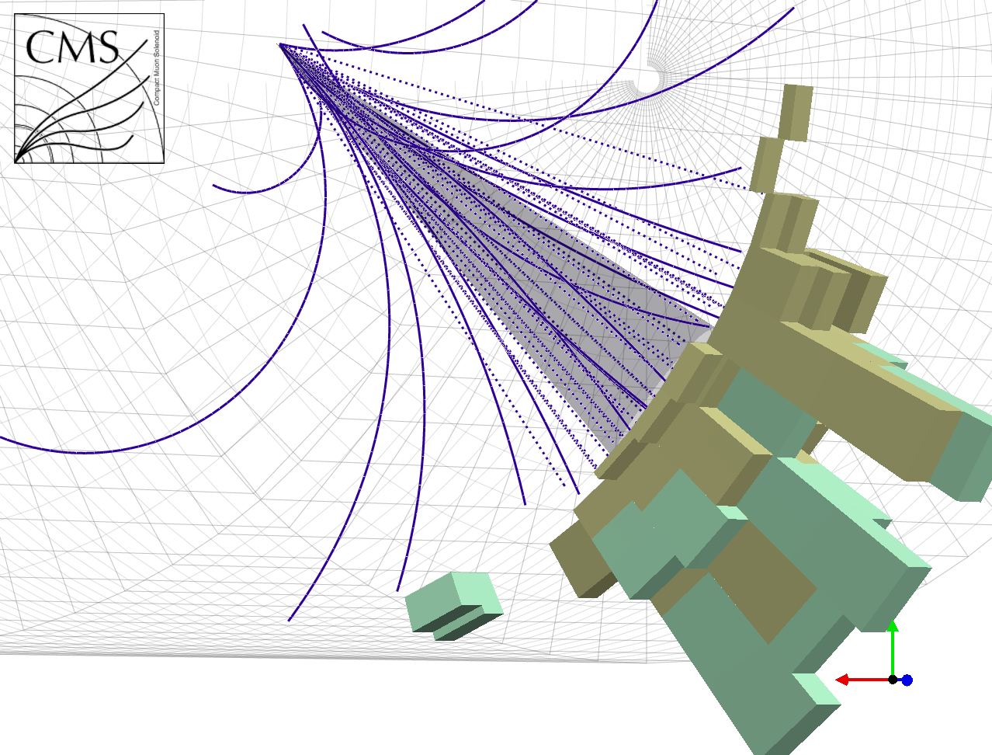
More?
How about millions of readout channels in the CAL?
Compare: ATLAS: ~10.000 in the Hcal (TileCal)
Energy depositions in Cal combined to towers
→ space requirements
→ cost efficiency
→ reduce no of readout channels (data transfer)

Slide 10
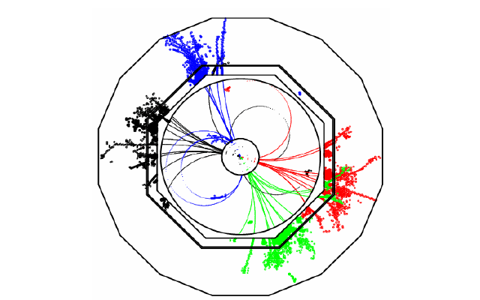
More?
How about millions of readout channels in the CAL?
Compare: ATLAS: ~10.000 in the Hcal (TileCal)
Energy depositions in Cal combined to towers
→ space requirements
→ cost efficiency
→ reduce no of readout channels (data transfer)
With say 8 million readout channels (HCAL):
Note: This just makes sense in the clean environment of a e+e- collider

Slide 11
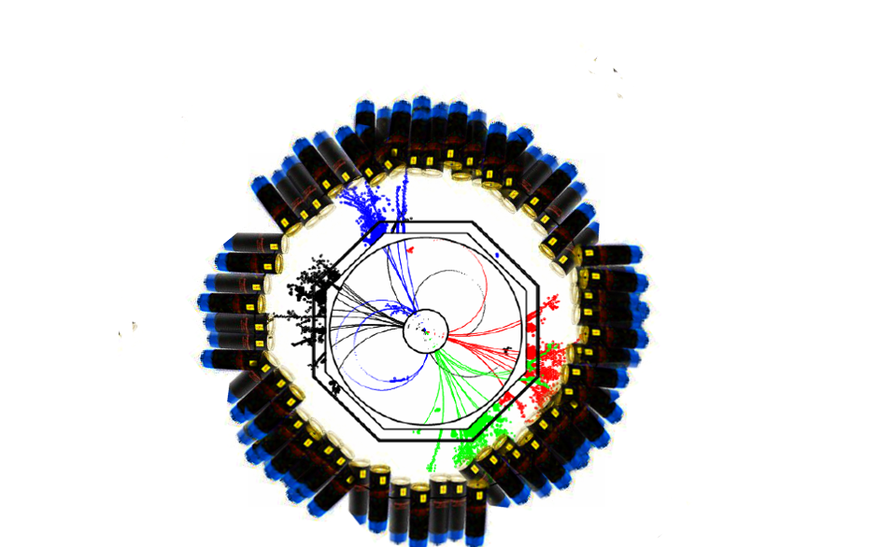
More?
How about millions of readout channels in the CAL?
Realize this with millions of PMTs? → hardly
Need to exploit
new technologies!
Use novel Silicon Photomultipliers:
Small
Insensitive to B-Fields
Low Voltage operation (~30-70V)
At last:
Photo Sensor, Scintillator Tile and Readout Electronics integrated in active layer
(other approaches: (Semi-)Digital HCAL…)

Slide 12
More?
How about millions of readout channels in the CAL?
Why did we want this again?
It certainly looks nice!
But main reason:
Try to build the best possible calorimeter
to minimize its usage
because calorimeters are bad.
Momentum measurement of tracking system better (for particles whose track is bent enough
~100GeV in case of ILD)
The Particle Flow Idea:
Reconstruct each particle in a jet in the subdetector which can provide the best energy measurement
Calorimeters need to categorize and assign energy depositions
Ultra fine segmentation and
Intelligent clustering algorithms necessary
 | Average Jet Composition(LEP)
Charged particles | 62%
Photons | 27%
Neutral Hadrons (long lived) | 10%

Slide 13
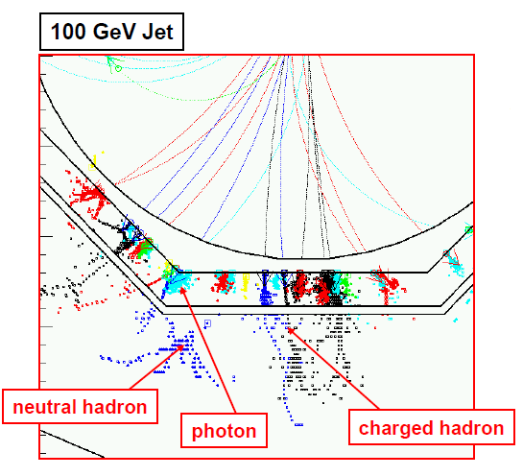
Particle Flow
Calorimeters need to categorize and assign energy depositions to incoming particles
ECAL → Photons HCAL → Neutral Hadrons
Unprecedented Jet Energy Resolution:
→ 3x better than LEP
2x better than
conventional
→ 5.2% using raw calo energy
$E_{JET}$ | $$σ_{E}/E_{JET}$$
45 GeV | 3.7%
100 GeV | 2.9%
180 GeV | 2.8%
250 GeV | 2.8%
375 GeV | 3.2%
500 GeV | 3.5%
For Jets >100GeV: JER dominated by confusion not by the Energy Res of Calorimeters!

Slide 14
Faster?
Could the calorimeter be so fast that we can observe the time development of e.g. hadronic showers?
Not directly.
Energy depositions cannot be sampled (like on an oscilloscope) → too much data
→ more later
But:
Equip every calorimeter channel with a TDC (Time to Digital Converter)
Assign a time stamp to every energy deposition
A next generation HCAL prototype is on the way equipped with such TDCs
(time resolution ~100ps)
The question is: Why should we care?
13

Slide 15
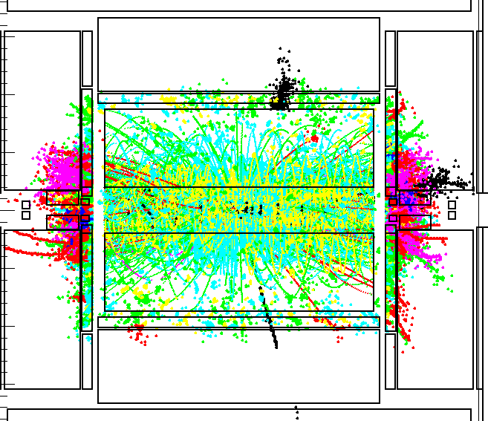
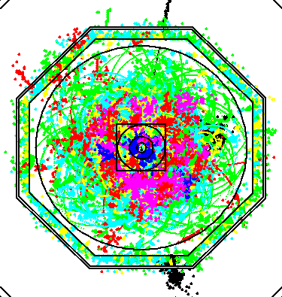
Faster?
1. Because of the design of CLIC
$$CLIC$$
CMS Energy | 3TeV
Bunch Separation | 0.5ns (25ns@LHC)
Bunch Train Length | 156ns
High rate background: γγ $→q\overline{q} →Jets$
Origin: Beam Focusing → Bremsstrahlung
Occurrence: ~13 particles/BX
Interesting Physics: << 1/Bunch Train
Clean environment of a e+e- collider?
→ Detector activity when integrating over half a bunch train
150 BXs (75 ns) in ILD-like detector
Time stamping can clean up the detector

Slide 16
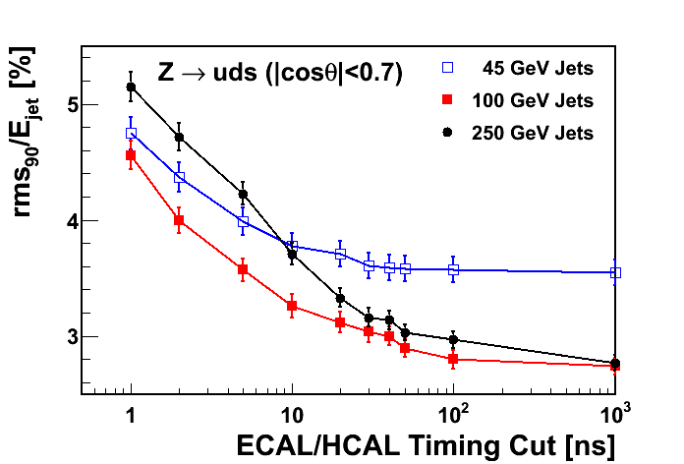
Faster?
2. Hadronic showers are not instantaneous
Process:
Heavy absorber nuclei get struck inelastically
Nucleus can be excited
Relaxation
emission of a late neutron / photon
Inelastic scattering within the active layers
Ignoring late energy depositions deteriorates the JER (like leakage)
Compromise necessary:
Good Jet Energy Resolution Efficient Background Rejection
Are those timing studies true?
→ Rely heavily on correctness of GEANT4 simulations (i.e. its physics lists)
Timing properties of hadronic showers in a tungsten calorimeter so far untested
This is where the Tungsten Timing TestBeam experiment (T3B) comes in!

Slide 17
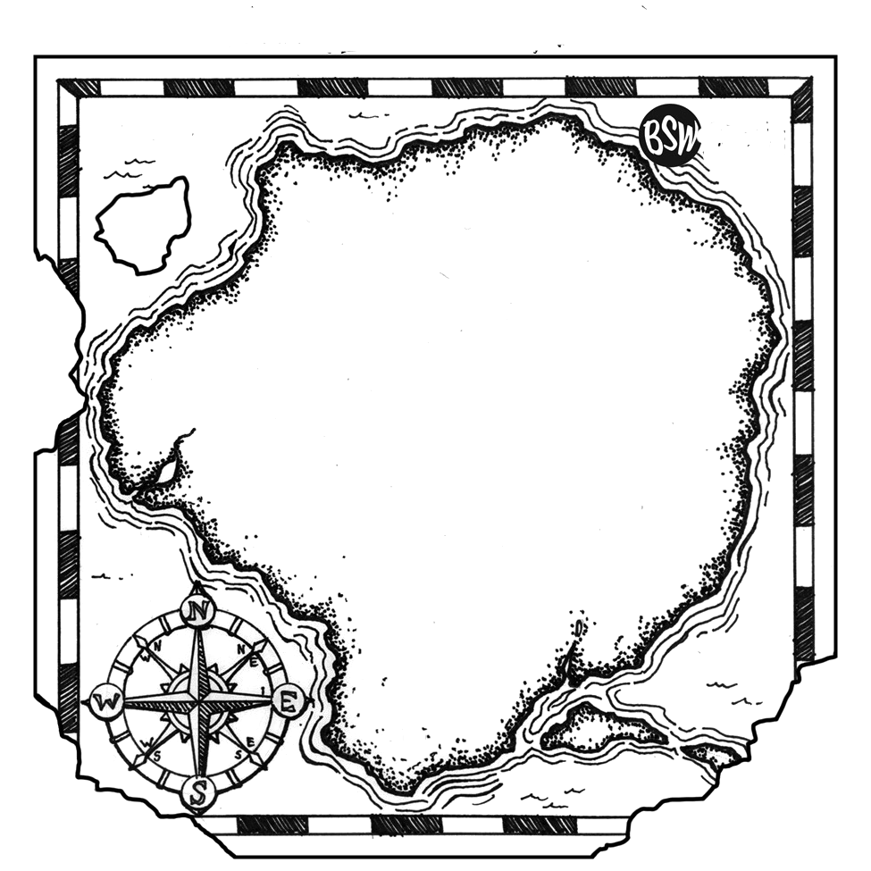
T3B
The journey to measure shower timing

Slide 18
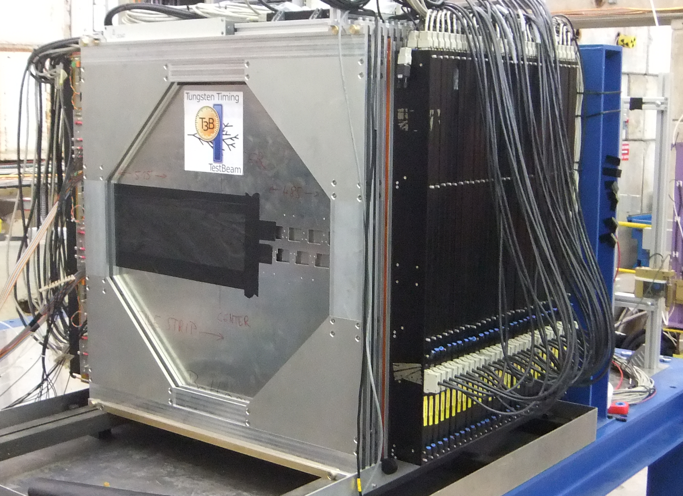
The T3B Experiment within the CALICE AHCAL
CALICE
(calorimeter for the linear collider experiment)
Prototype for a future highly granular HCAL
38 layers of scintillator and tungsten absorber
1x1x1$m^{3}$ with about 8000 channels and 5 $λ_{I}$
+ 3D reconstruction of hadronic shower shapes
- No timing information on the showers
Test Beams: PS 10/2011, SPS 6,7,9,10/2011
Absorber: Tungsten and Steel (for comparison)
Particles: Hadrons from 10 to 300 GeV
CALICE AHCAL
T3B Layer
Shower Shape of a 300GeV pion Event

Slide 19
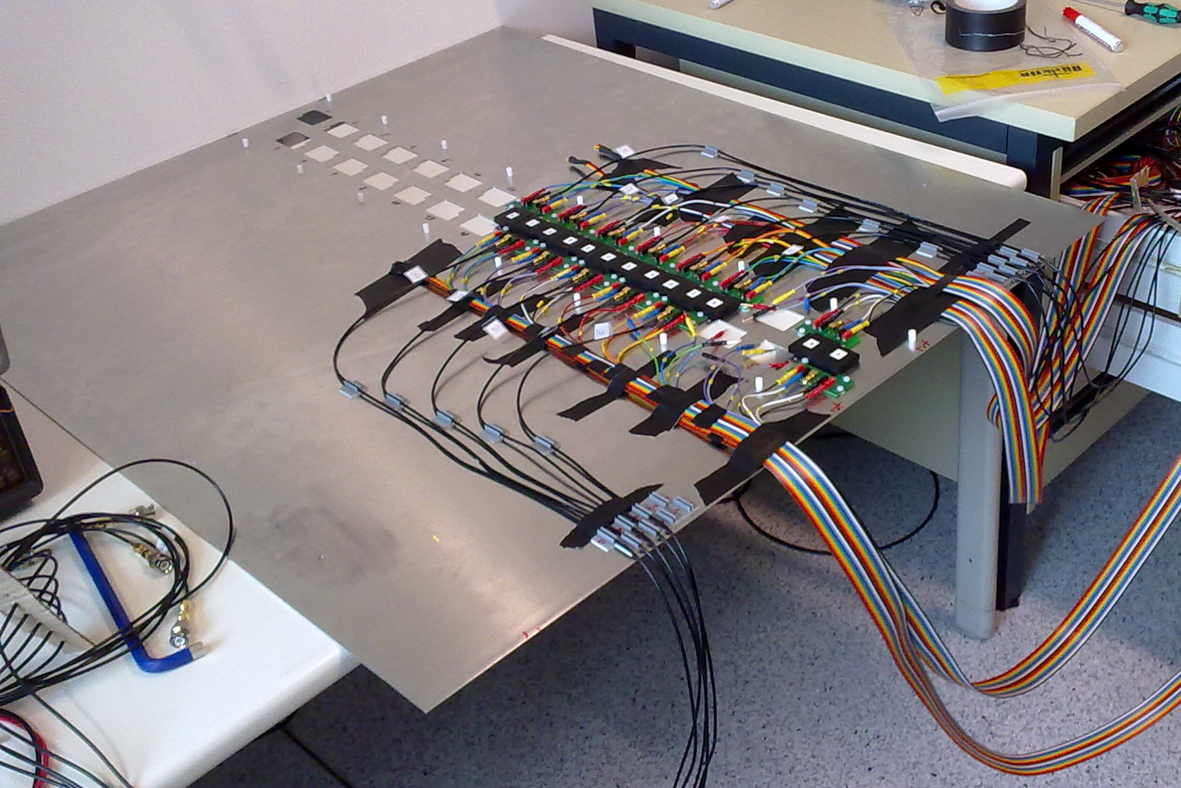
What is T3B?
What is T3B?
One layer of 15 scintillator tiles
Tile dimensions: 3 x 3 x 0.5 cm³
Light Readout by SiPMs
Data Acquisition: 4 fast USB Oscilloscopes
Setup optimized to observe the time development of hadron showers
3cm

Slide 20
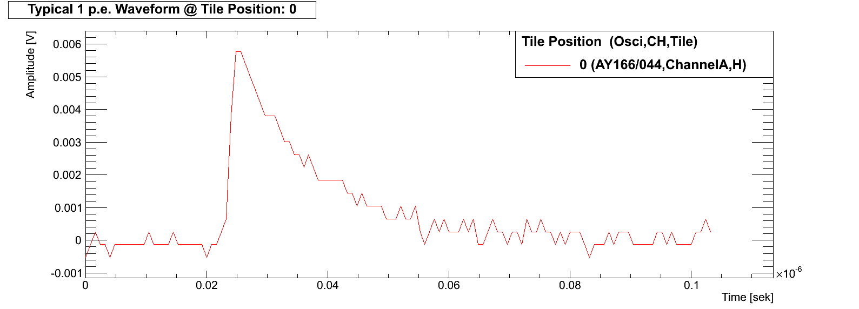
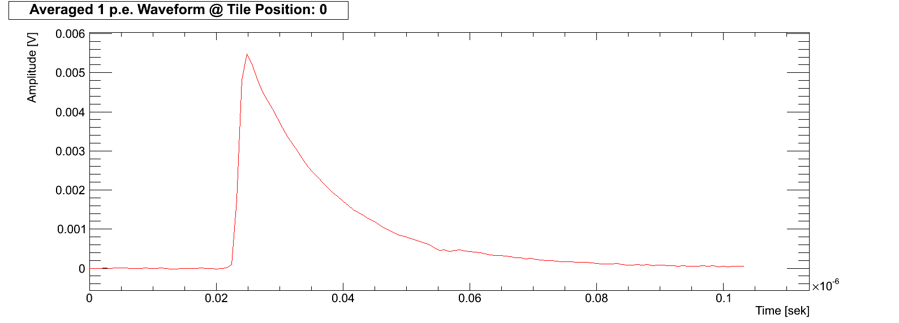
SiPMs
Typical waveform of 1 pixel firing
Average
1mm
Hamamatsu SiPM: 1600 pixels → each pixel can measure single photons
→ # fired pixels $\sim$ # measured Photons $\sim$ Energy deposition in Scintillator
19

Slide 21
Data Analysis
Waveform of Total
Acquisition window
T3B Waveforms:
Appearance of a typical event at one T3B channel → ${\text{π}}^{−}$@ 10GeV
High short energy deposition, followed by potential late Edeps

Slide 22
Novel Data Processing Method
Waveform Decomposition:
Iteratively substract 1 pixel waveform from the local maximum till nothing is left
Obtain time of energy deposition with sub-nanosecond precision
http://www.mpp.mpg.de/~soldner/WaveformDecomposition.gif

Slide 23
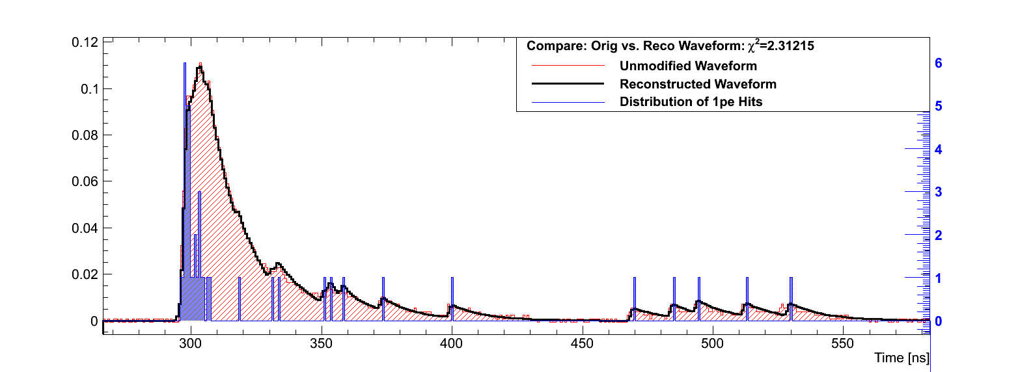
Data Analysis: Waveform Decomposition
Verify the success of the procedure:
Build up the original waveform from the 1p.e. hit histogram → good agreement

Slide 24
Data Analysis: Waveform Decomposition
Analysis of the time of first hit within the tiles of the T3B layer
The time of first hit is a good measure for the intrinsic time stamping possibilities in the calorimeter
Verify the success of the procedure:
Build up the original waveform from the 1p.e. hit histogram → good agreement

Slide 25
Data Analysis: Waveform Decomposition
Analysis of the time of hit within the tiles of the T3B layer
The time of hit is a good measure for the intrinsic timing properties of hadronic showers
Verify the success of the procedure:
Build up the original waveform from the 1p.e. hit histogram → good agreement

Slide 26
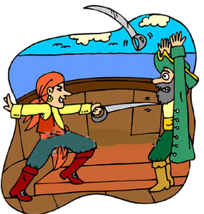
Analysis: The Time of the first Hit

Slide 27
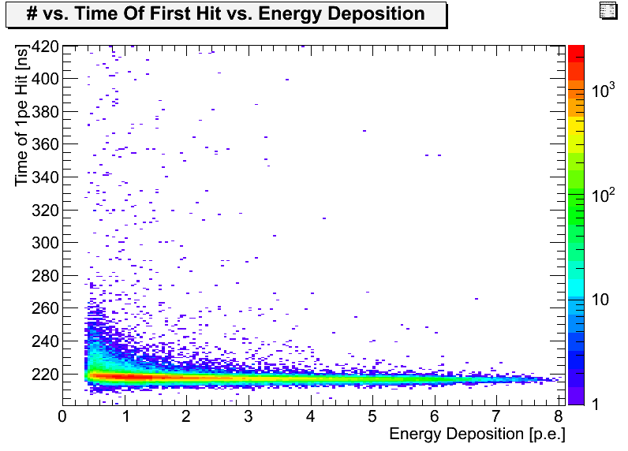
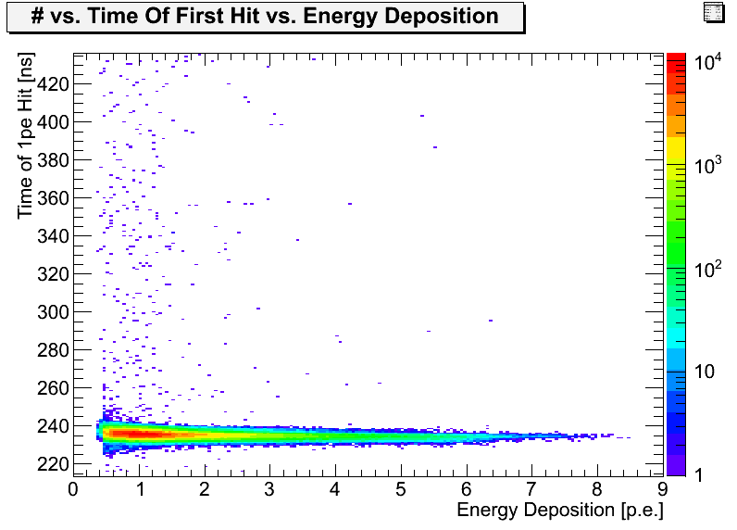
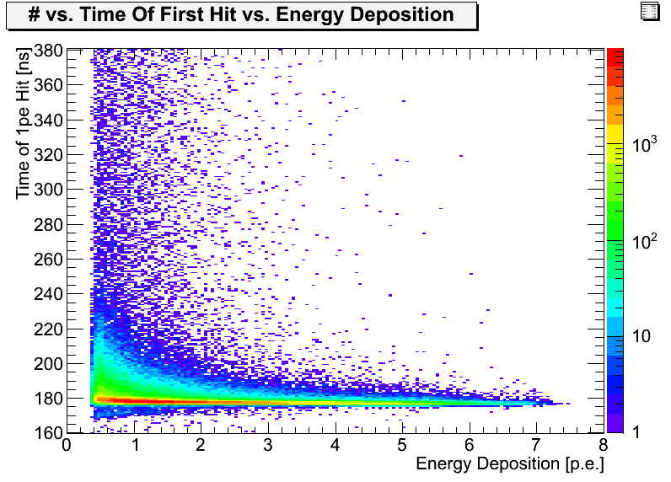
Time of First Hit
Analysis:
Consider a hit if > 8 p.e. are deposited within 9.6 ns
Take the time of the second fired SiPM Pixel as the TofH
(reduced bias through thermal darkrate → on average 1 pixel per waveform of 2.4 microsec)
Steel Data
60GeV
All Tiles
Sum the number of pixels fired within the identified hit to determine its energy deposition
[MIP]
Tungsten Data
60GeV
All Tiles
Muon Data
180GeV
All Tiles
[MIP]
[MIP]

Slide 28
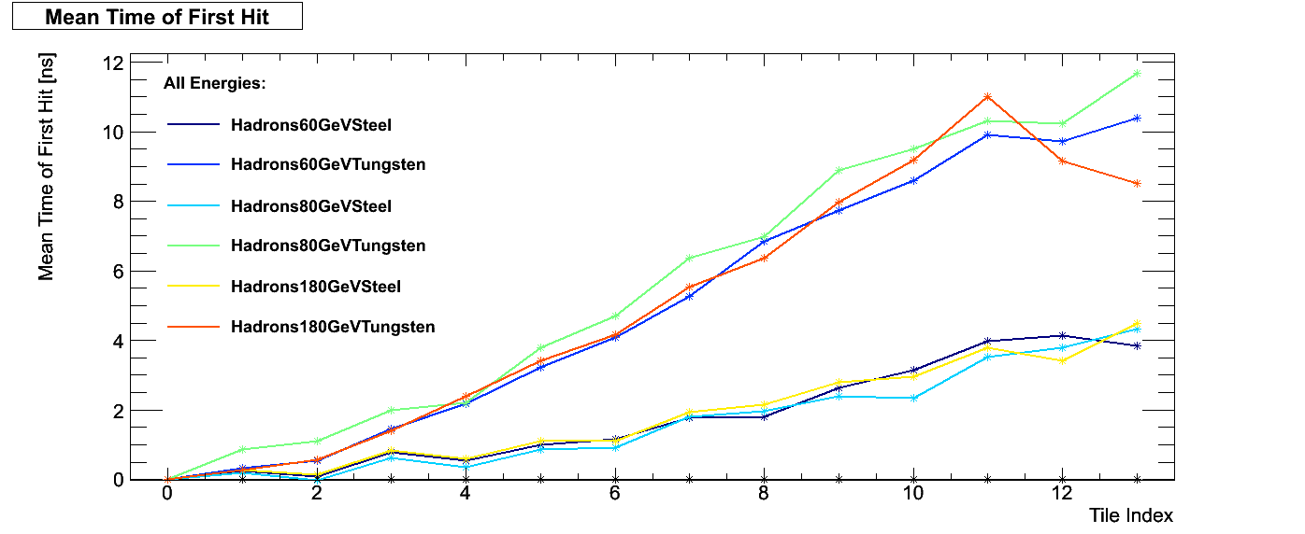
Time of First Hit
Analysis:
Consider a hit if > 8 p.e. are deposited within 9.6 ns
Take the time of the second fired SiPM Pixel as the TofH
(reduced bias through thermal darkrate → on average 1 pixel per waveform of 2.4 microsec)
Sum the number of pixels fired within the identified hit to determine its energy deposition
Striking difference between Tungsten and Steel data
Analysis of the time of first energy deposition within the tiles of the T3B layer for hadronic showers

Slide 29
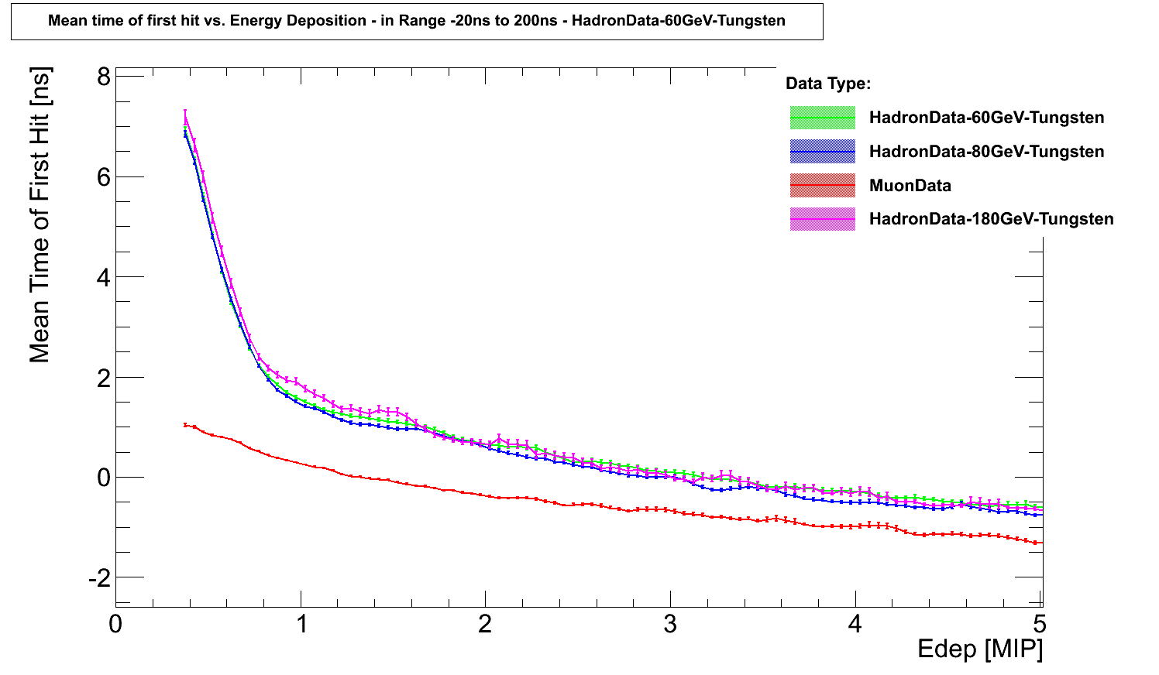
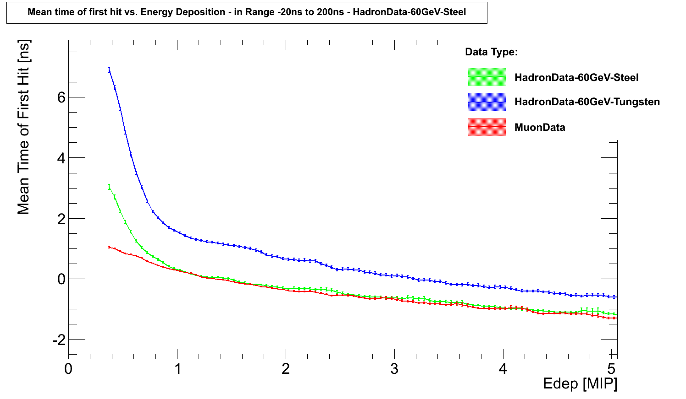
Time of First Hit
Analysis:
Consider a hit if > 8 p.e. are deposited within 9.6 ns
Take the time of the second fired SiPM Pixel as the TofH
(reduced bias through thermal darkrate → on average 1 pixel per waveform of 2.4 microsec)
Sum the number of pixels fired within the identified hit to determine its energy deposition
Determine binwise mean time of first hit:
First hit on average later for Steel and Tungsten
Steel: Late hits deposit few energy
Tungsten: Late hits can deposit few or much energy
No significant energy dependence observed

Slide 30
Analysis: The Time of the hit

Slide 31
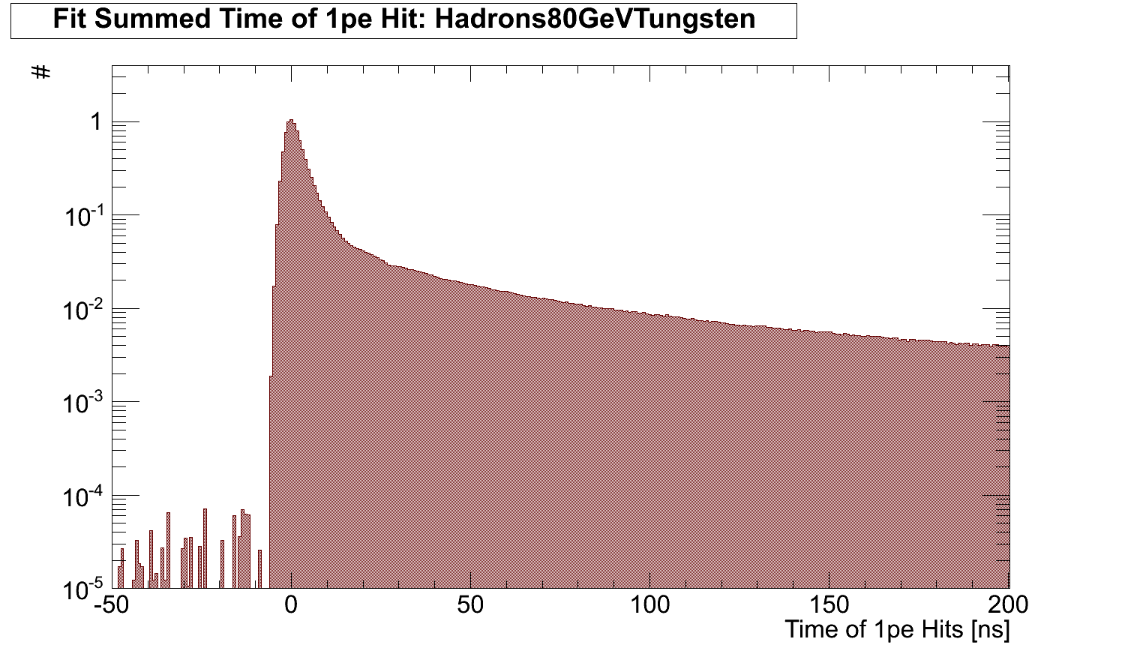
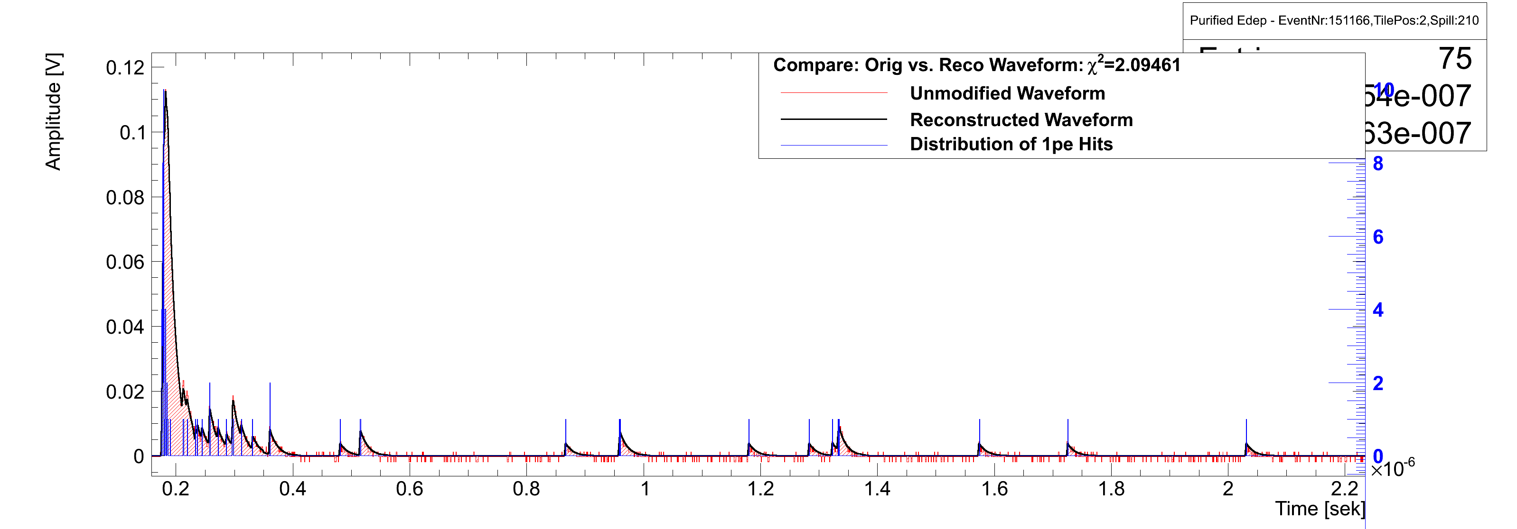
Time of Hit Analysis
Analysis Steps (All plots for Hadron Data, 60GeV, Tungsten, 4mio Events):
Fill the time of every single fired pixel into one timing histogram (per E and tile)
Correct for Detector Effects: Pedestal sub., substract SiPM afterpulsing…
Gaussian smearing → width of 1.7ns
Various late contributions
Typical T3B event for hadron data
Pedestal
Fast energy depositions

Slide 32
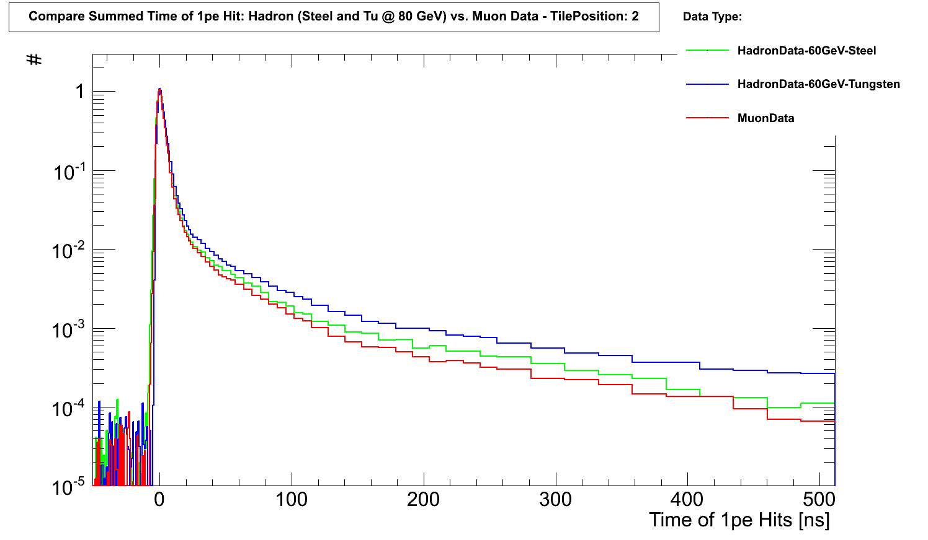
Time of Hit Analysis
Analysis Steps (All plots for Hadron Data, 60GeV, Tungsten, 4mio Events):
Fill the time of every single fired pixel into one timing histogram (per E and tile)
Correct for Detector Effects: Pedestal sub., substract SiPM afterpulsing…

Slide 33
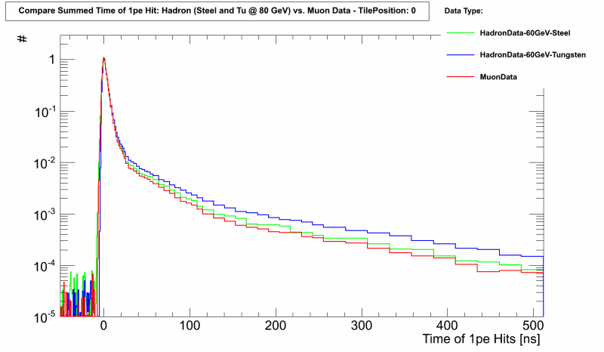
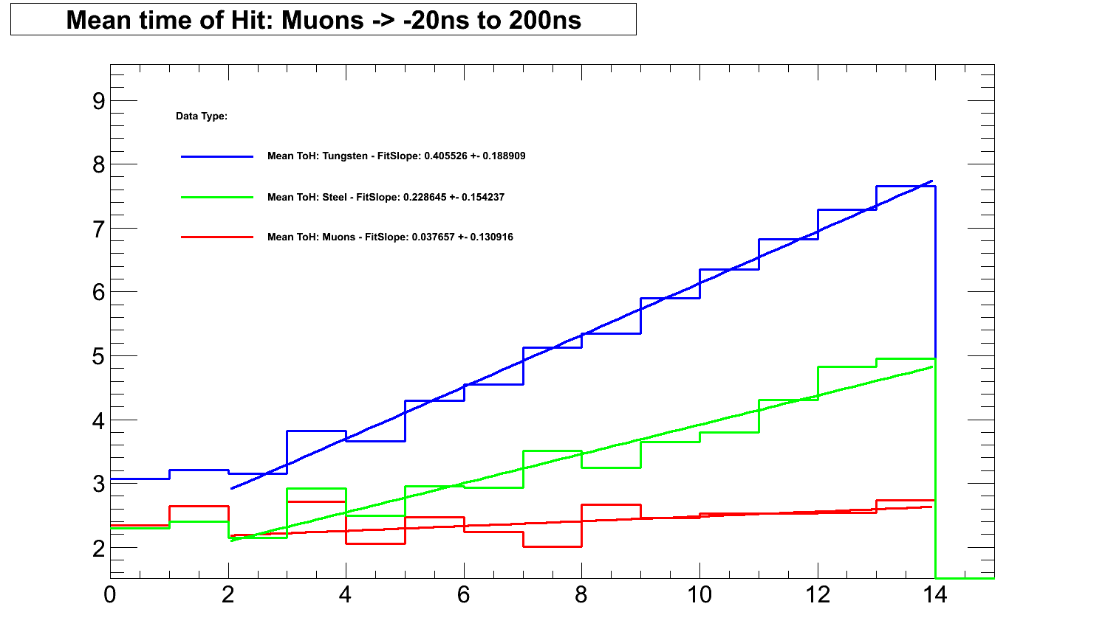
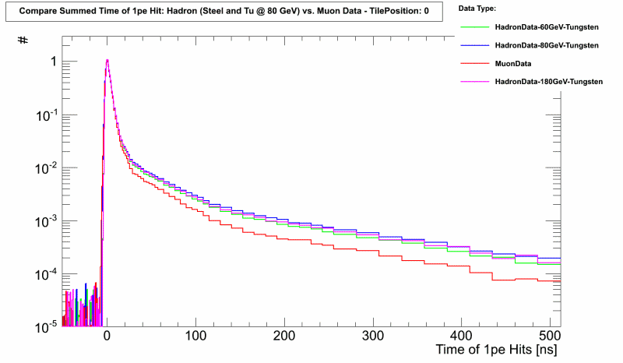
Time of Hit Analysis
Analysis Steps (All plots for Hadron Data, 60GeV, Tungsten, 4mio Events):
Fill the time of every single fired pixel into one timing histogram (per E and tile)
Correct for Detector Effects: Pedestal sub., substract SiPM afterpulsing…
Energy Scan
Tungsten Data 60,80,180GeV
→ No differences in terms of ToH
Now we can determine the
Mean Time of Hit
Mean Time of Hit [ns]
Tile Position
http://www.mpp.mpg.de/~soldner/Shinshu2012/SummedTimeOf1pe.gif
http://www.mpp.mpg.de/~soldner/Shinshu2012/SummedTimeOf1pe-EnergyScan.gif

Slide 34
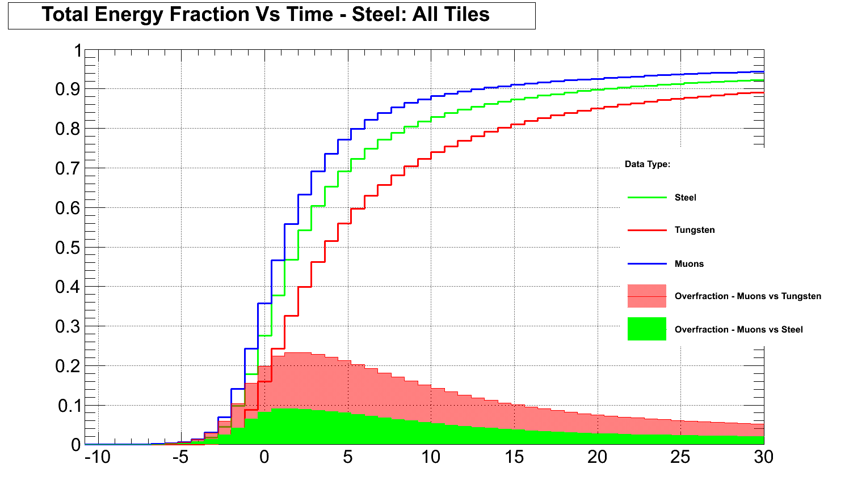
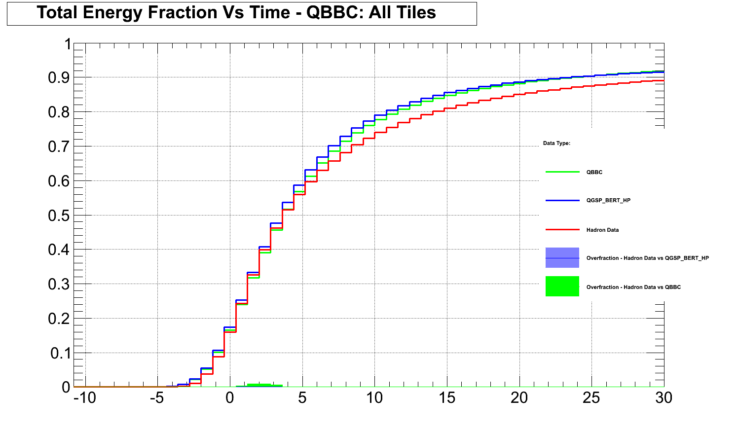
Time of Hit Analysis
Analysis Steps (All plots for Hadron Data, 60GeV, ~4mio Events):
Which fraction of the total Energy is deposited at which time?
Compare Muon, Steel And Tungsten Data
Time [ns] | Fraction Mu [T3B] | Fraction Steel [T3B] | Fraction W [T3B]
5 | 77% | 69% | 56%
10 | 88% | 83% | 74%
24.5 | 94% | 91% | 88%
Compare Hadron Data to MC for Tungsten
Edep takes longer for Tu than for Steel absorber (than for Muon data)
Monte Carlo Comp.:
High precision physics lists reproduce shower timing of Tungsten reasonably well
→ Discrepancies in late shower timing observable

Slide 35
Analysis: Recovery of the third Dimension

Slide 36
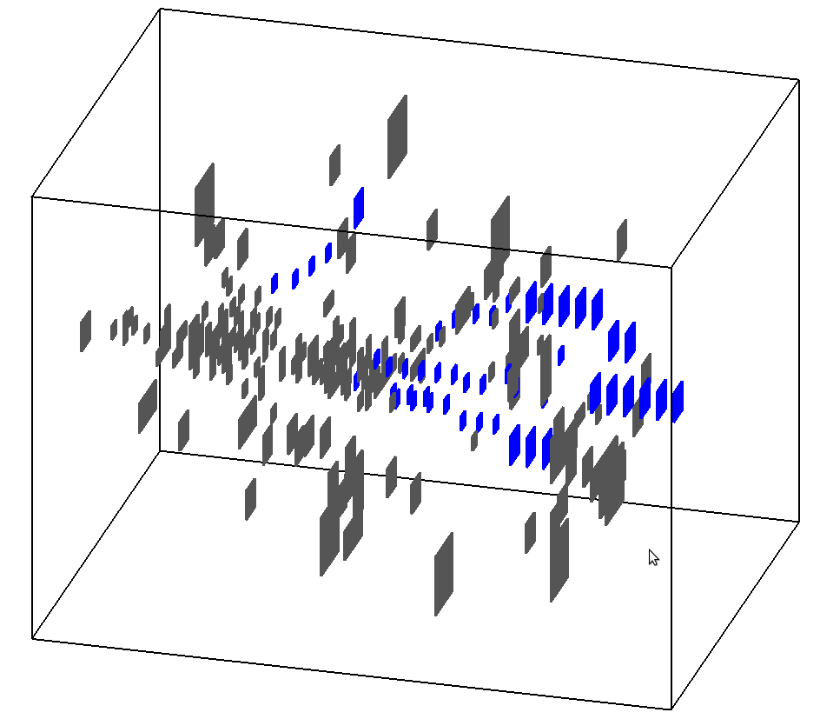
Recovery of the 3rd dimension
T3B is a single strip detector
1D: Shower center → border
One time dimension
➔ 2 dimensions
We are interested in full 4D description of hadronic showers!
Assume rotation symmetry
Recovery of 1D
But: Longitudinal component still missing
Reminder: T3B is parasitic to A-HCal
3D “imaging” calorimeter in x/y/z
Maybe 4D = 3D + 2D?
CALICE AHCAL
T3B Layer

Slide 37
Synchronisation: Calice to T3B
T3B and CALICE A-HCal use the same trigger signal
Data can be synchronized offline
First hadronic interaction
Happens in a certain depth
Can be identified in CALICE A-HCal
Ordering of T3B Hits relative to the shower start
Recovery of longitudinal dimension
Energy Depositions within Calice Scintillator Tiles
Beam Direction
T3B Tile Geometry
Eventdisplay:
Hadron Data @ 60GeV (Tungsten)
T3B Tile Geometry
Shower start relative to T3B

Slide 38
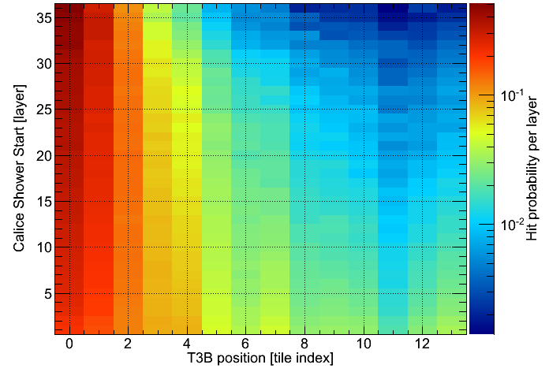
Synchronization Crosscheck: Hit probability per layer
38
A-HCal
T3B
1
T3B
1
15
38
1
A-HCal
If shower starts late, only central T3B tiles are hit
If shower starts in front of HCal, all T3B tiles are hit
➔ Sync is ok

Slide 39
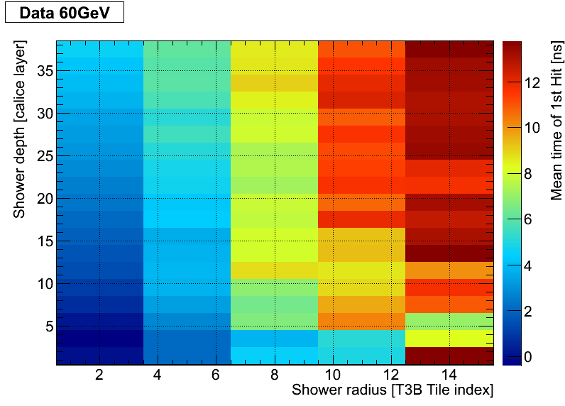
Mean time of first Hit
Mean shower development of first hits:
On shower axis: fast (few ns)
Off shower axis up to 10 ns
T3B
1
15
38
1
A-HCal
T3B can really show the average development of hadronic showers!
(by using AHCal information)
Time of Flight: ≈3.3ns
38

Slide 40
A hadronic shower in “4D”
Passing particle can be clearly seen
Response only slowly wears off

Slide 41
Summary

Slide 42
Summary
We saw how a calorimeter of the future could look like
Using the Particle Flow concept an unprecedented jet energy resolution of $\frac{σ_{E}}{E_{JET}}\sim 3−4\%$ is achievable
CALICE is a prototype of a highly granular calorimeter with 8000 channels
Testing if the performance requirements can be met
T3B is a new experiment testing the time development in hadronic showers
First results manifest that the standard GEANT4 physics list QGSP_BERT does not reproduce shower timing correctly
A high precision extension to the list is needed to fit the data
There is still a lot of potential in the taken test beam data → analysis ongoing

Slide 43
Backup

Slide 44
Results: Data vs. MC
First Robust Comparison of Data vs. MC with a timing key parameter:
Determine the mean time of first hit cell by cell
Note:
Beam axis through T3B tile 0
Tile 10 is 30cm from beam axis
Data very well reproduced with QGSP_BERT_HP
QGSP_BERT overestimates late contributions at large radii
First Data vs. MC comparison delivers valuable information:
→ The GEANT4 physics list QGSP_BERT (standard for ILC, LHC simulations) does not reproduce the timing properties of hadron showers correctly, but the High Precision extension does!

Slide 45
Summary
We presented preliminary results on the time structure of hadronic showers
Setup: Investigated π⁻ events at 10 GeV in the CALICE WHCAL at 3 lambda depth
using the T3B Timing Layer
In the presented analysis we used the time of first hit as key parameter for the time structure of hadronic showers
Data vs. MC comparison shows excellent agreement for QGSP_BERT_HP and large discrepancies for QGSP_BERT
More timing analyses from the T3B group will follow…

