Slide 1
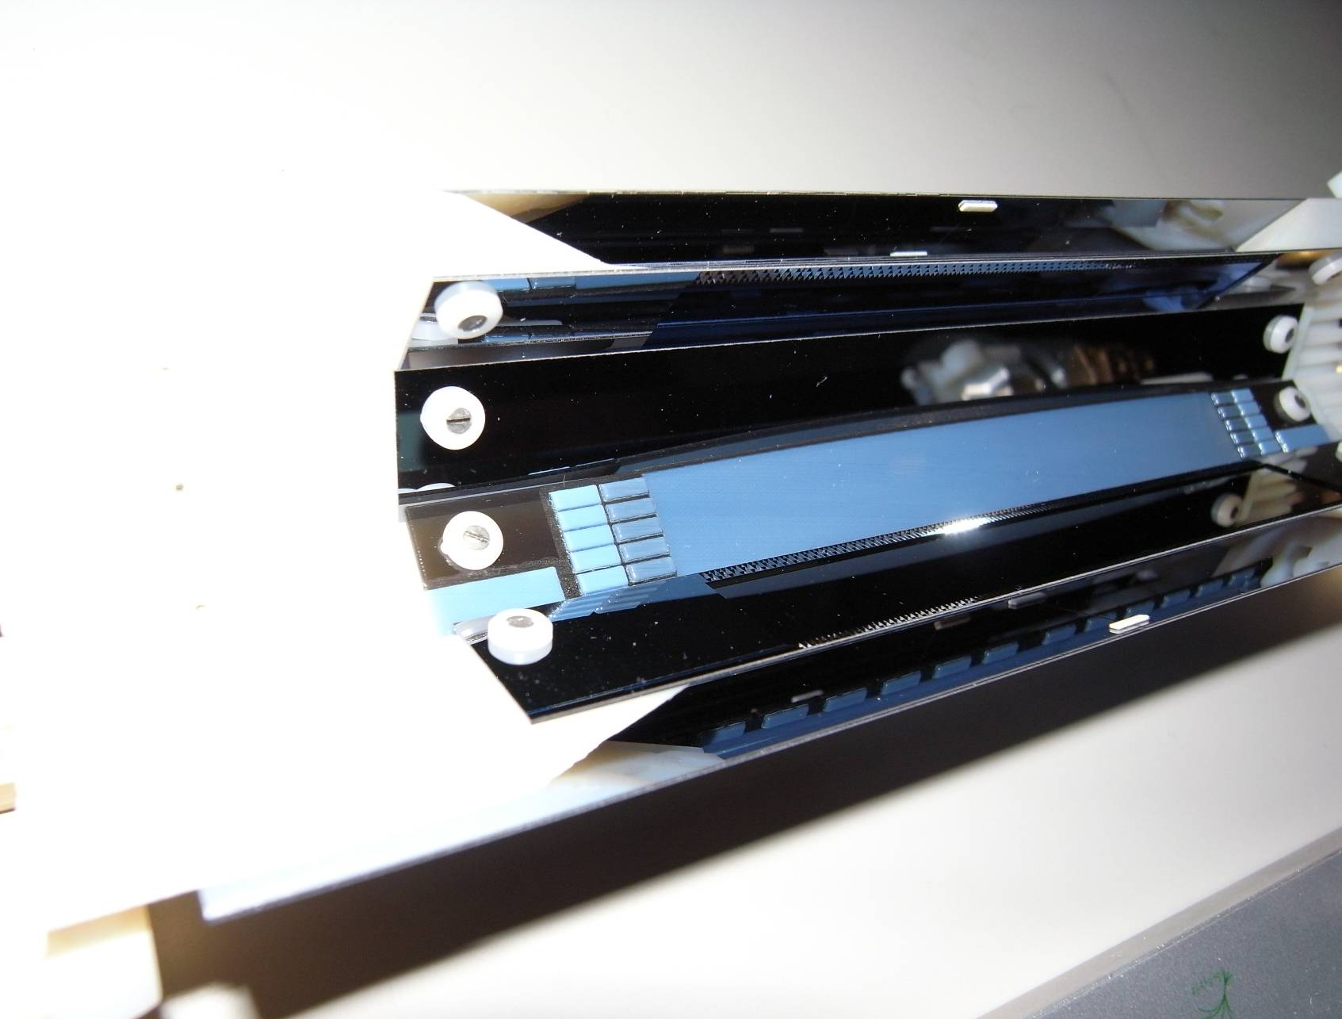
Belle & Belle II
Belle: ongoing analyses, papers
Belle II: accelerator upgrade status
Belle II detector upgrade
Activities at MPP
  DEPFET status
  Gated mode
  Mechanics & Assembly
  Cooling
Team
Director: Allen Caldwell
Project Leader: Hans-Günther Moser
Staff: Laci Andricek, Jelena Ninkovic (Minerva) ,
Christian Kiesling, Rainer Richter, Vladimir Chekelian,
Andreas Wassatsch
Postdocs: Jeremy Dalseno, Luigi Li Gioi
PhD. Students: Veronika Chobonova, Christian Koffmane, Andreas Moll, Elena Nedelkovska, kolja Prothmann, Andreas Ritter, Martin Ritter, Pit Vanhoefer,
Master Students: Fernando Abudinen,
Felix Müller, Stefan Petrovics
Sebastian Skambraks
Technical Support: Karlheinz Ackermann,…
HLL: Anastasja Plis, Martina Schnecke. ….

Slide 2
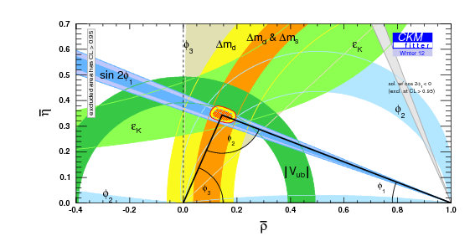
Analysis of Belle Data
Final analyses using complete Belle data set (711 fb⁻¹, 772x10⁶ B-events)
2012: 13 papers with MPP members as authors, 3 more available as preprint
Activities at MPP:
v
v
published
paper in prep.

Slide 3
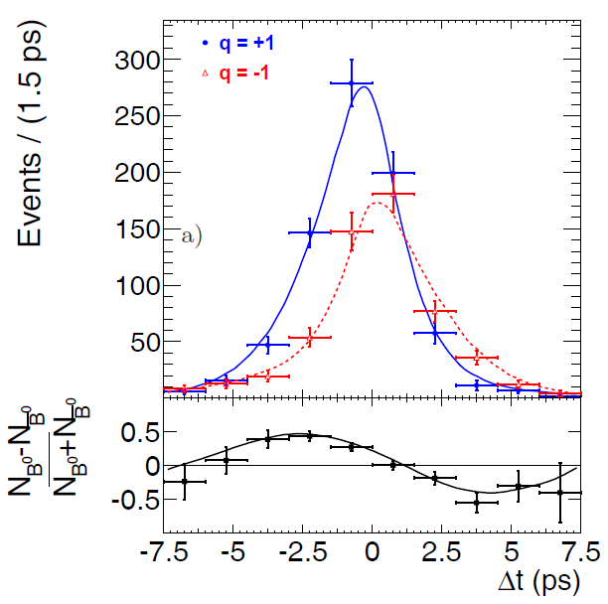
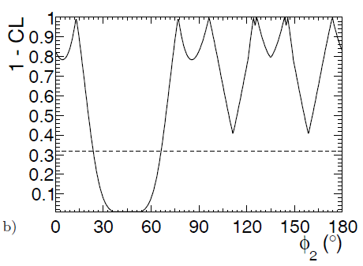
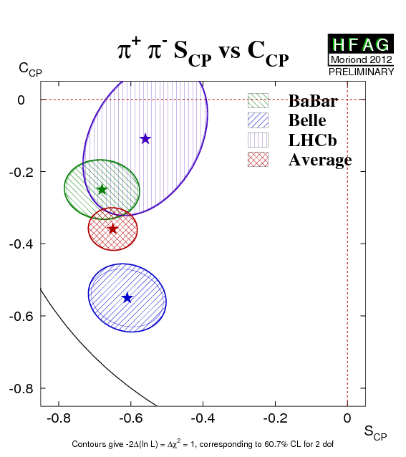
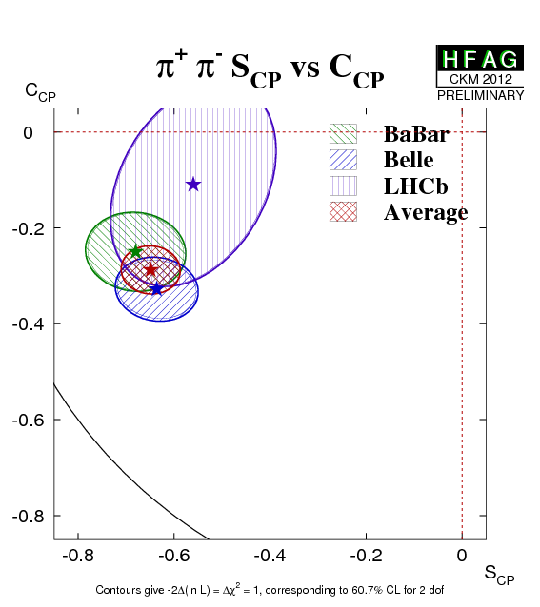
Analysis of φ₂
Decays highly suppressed -> high background level
New analysis strategy: minimize cuts, use multi-variable fit instead
=> Improve sensitivity
Excluded: 23.8° < Φ₂ < 66.8°
Kolja Prothmann
To be published

Slide 4
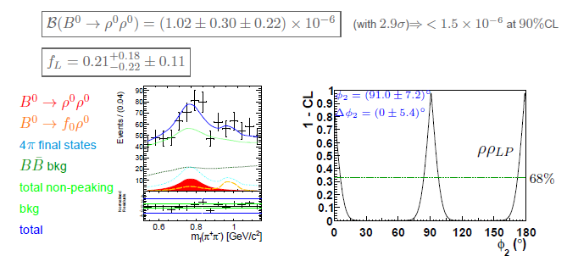
Analysis of φ₂
Tree dominated, color suppressed decay
4 pion final state, large background (0.1% signal!)
Helicity analysis to separate CP even & odd states
Extract φ₂ using isospin analysis
Pit Vanhoefer, presented at CKM2012 (Δφ2 8.4º -> 7.2º)

Slide 5

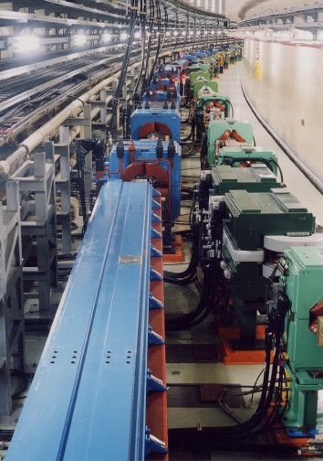

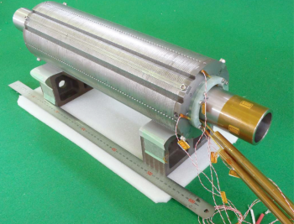
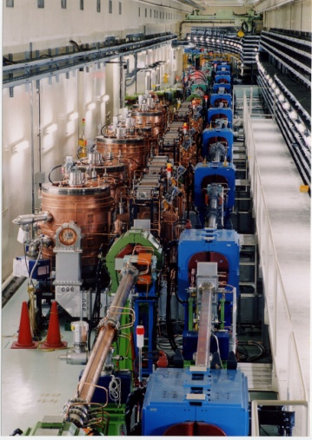


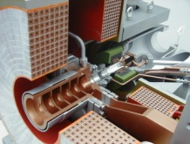

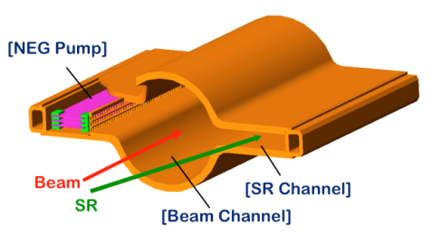
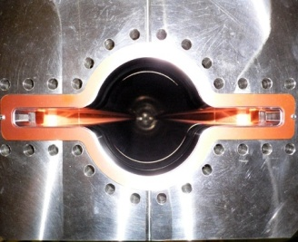
KEKB to SuperKEKB
Belle II
New IR
Colliding bunches
e- 2.6 A
New beam pipes
& bellows
New superconducting final focusing magnets near the IP
e+ 3.6 A
Reinforce RF systems for higher beam currents
Improve beam monitors and control system
e+ Damping ring
Redesign the lattice to squeeze the emittance (replace short dipoles with longer ones, increase wiggler cycles)
New positron capture section
Replace beam pipes to suppress electron cloud (TiN-coated beam pipe with antechambers)
Low emittance electron gun
To get x40 higher luminosity

Slide 6
SuperKEKB Schedule
Calendar
2010
2011
2012
2013
2014
2015
2016
2017
・・・
Japan FY
2010
2011
2012
2013
2014
2015
2016
2017
・・
Nov. 2012
Jan. 2015
SuperKEKB construction
summer 2015
Detector upgrade to Belle II
SuperKEKB operation
Belle II roll in
QCS install
Belle roll out
KEKB
operation
Dismantling KEKB
Fabrication and tests of ring components
Install and set up
Electricity and cooling facility
MR & DR buildings
DR tunnel
Upgrade Linac operation
for SuperKEKB, PF, PF-AR
Linac
Linac upgrade / operation for PF&PF-AR
6

Slide 7
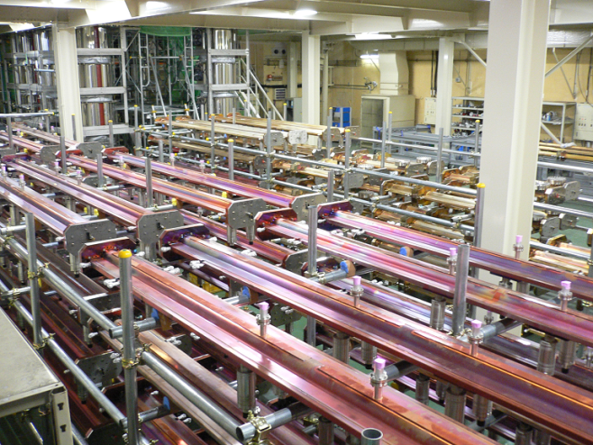
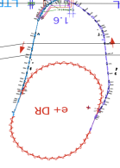
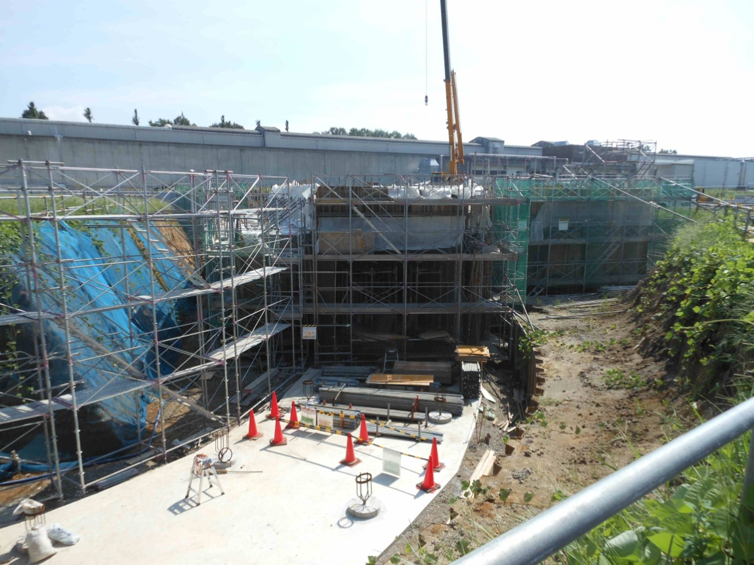
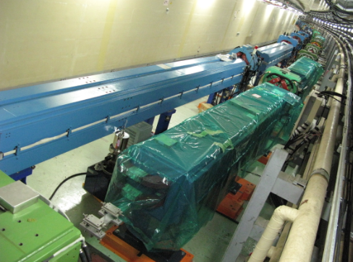
superKEKB construction
Injector Linac
e+ Damping Ring
circumference 136m
beam pipes after baking and TiN coating. They are temporary stocked until moved to tunnel
Tunnel construction for new bending ring
100 new bending pipes are installed

Slide 8
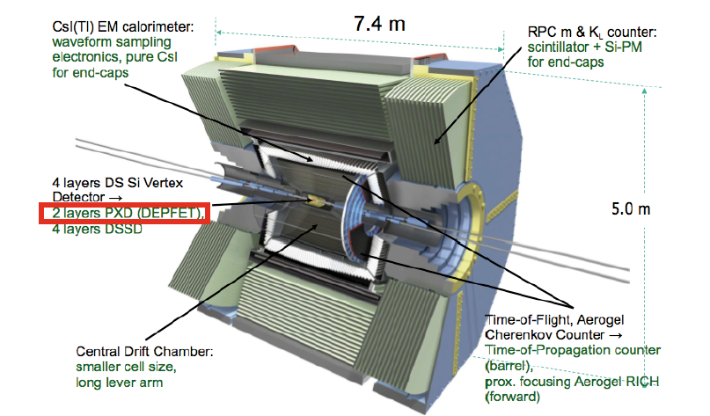
Belle II upgrade
Work on the upgrade/replacement of various sub detectors has started
Belle has been lifted and prepared for a rotation into the new position with respect to KEKB

Slide 9
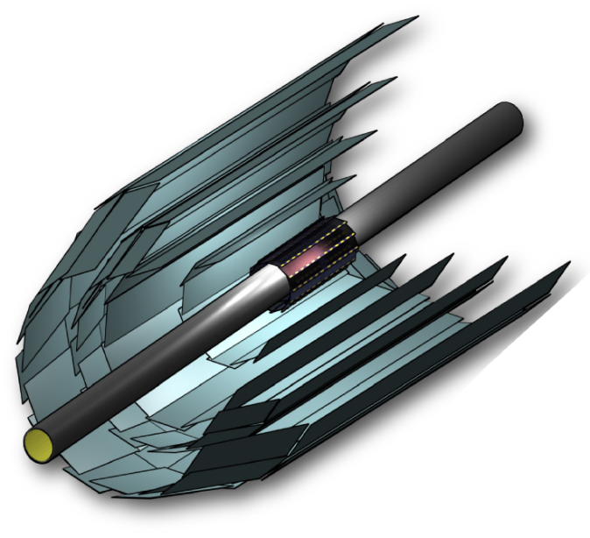
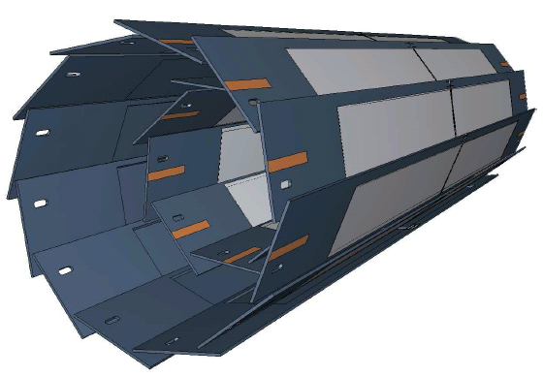
Silicon Tracking System @ Belle II
SVD: 4 layer Si strip detector (DSSD)
(R = 3.8, 8.0, 11.5, 14.0 cm)
PXD: 2 layer Si pixel detector (DEPFET technology)
(R = 1.4, 2.2 cm)
monolithic sensor
thickness 75 µm (!),
pixel size 50 x 55 µm² to 50 x 85µm² (depending on layer and z)
Significant improvement in z-vertex resolution
σ [µm]
PXD+SVD
PXD
100
Belle
50
30μm
20
Belle II
15μm
0
0.4
0.8
1.2
1.6
2.0
pβsin(θ) [GeV/c]

Slide 10
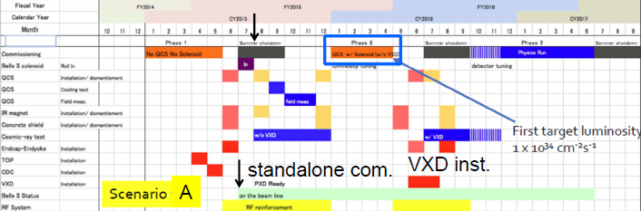
Commissioning
Preferred scenario:
SuperKEKB ready January 2015
commissioning without quads and solenoid till July 2015
commissioning with quads, solenoid & Belle II (w/o VXD) April 2016
PXD integrated with VXD standalone tests August 2015
PXD installed in Belle II summer 2016
Physics run starts end of 2016
Alternatively SuperKEKB could be commissioned with quads and w/o Belle & solenoid
No consequences for PXD delivery, but physics would be delayed by a couple of months

Slide 11
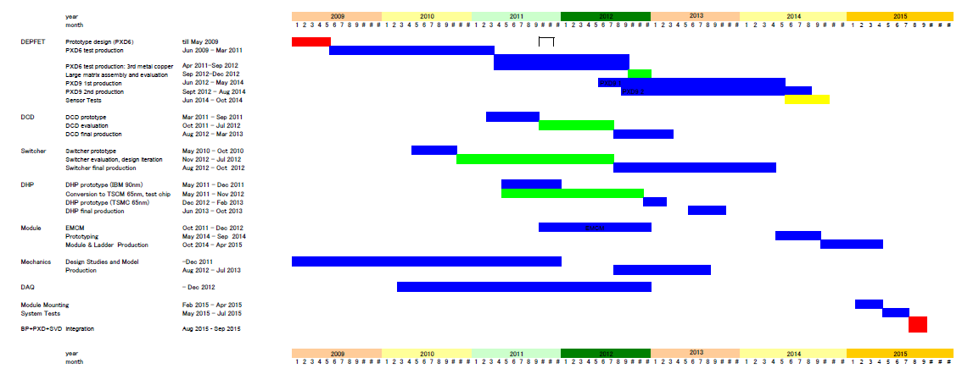
PXD Schedule
Schedule follows sensor production: first sensors available in July 2014
-> module/ladder assembly: November 2014-May 2015
-> PXD integration: March 2015-May 2015
All other tasks (ASICs, cables, power, cooling, mechanics, DAQ, slow control) will be finished
before end of 2014 (not critical)

Slide 12
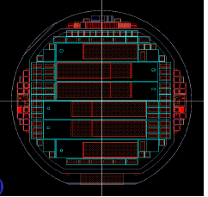
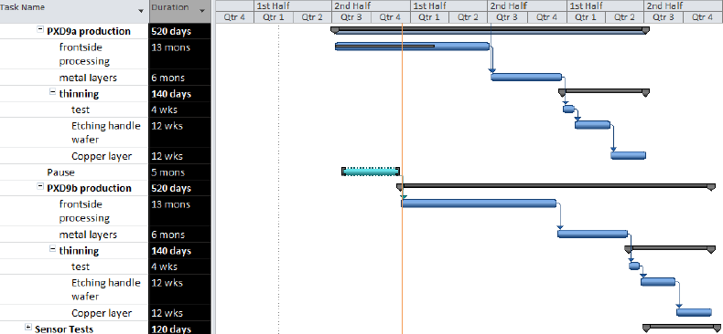
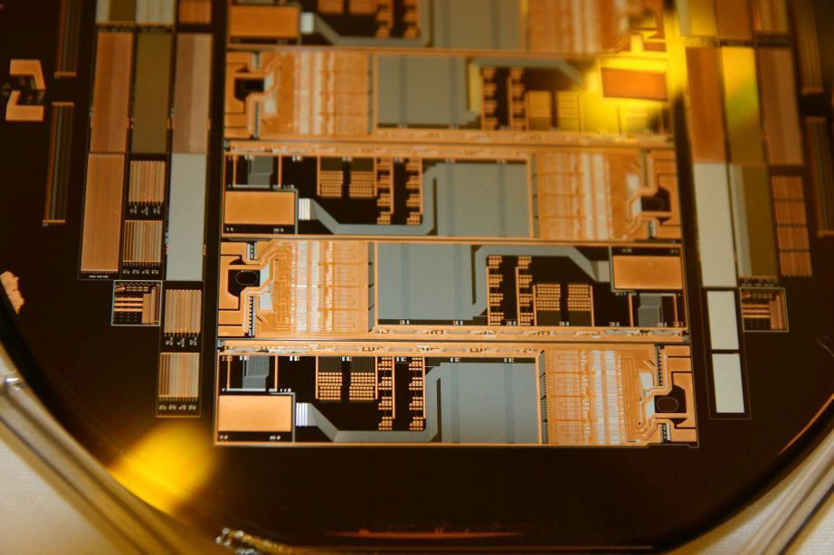
DEPFET Production
Finally we got the special SOI wafers we need in acceptable quality.
First production batch with 13 wafers started in HLL in July
one wafer has sensors for 1 inner and 2 outer ladders
Nominal processing time (including thinning): 2 years
Processing runs smoothly, ahead of schedule
Second batch with 18 wafers will follow soon
(unfortunately the engineer who should do the processing left, hire a new)
Yield requirements: 20% for outer layer
27% for inner layer
electrical dummy for electronic test
Ready, needs to be assembled and tested

Slide 13
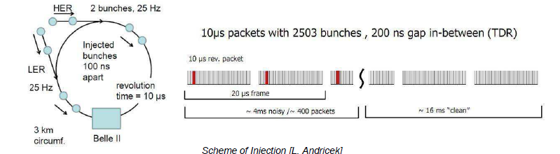
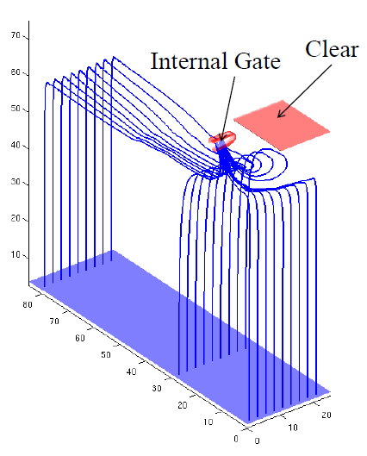
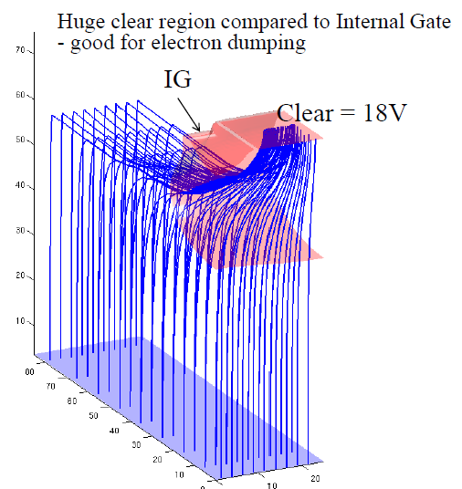
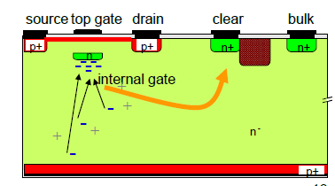
Injection Noise & Gating
Sensor filled with hits from freshly injected bunches => ~ 20% dead time
Gating : Sensor is made blind for a short time during high background (noisy bunch)
Signals detected in the clean period before are preserved
Simulations, lab tests with lasers and particle beams demonstrate feasibility of gating

Slide 14
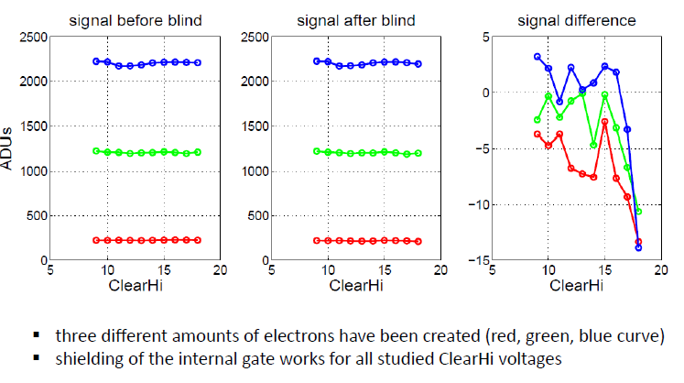
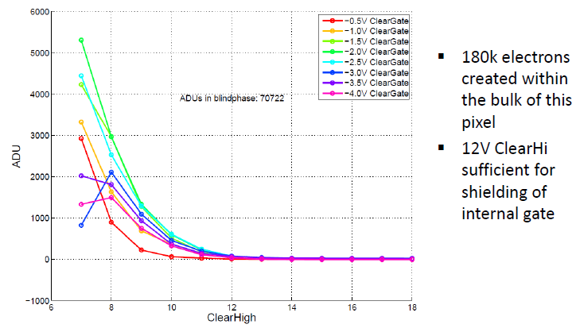
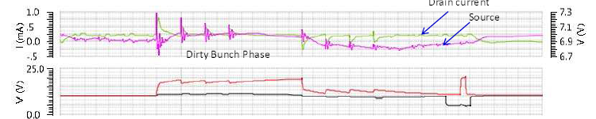
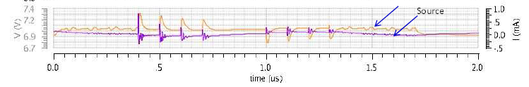

Verification with laser & beam
Efficiency of gating
Protection of a signal
Inject (using a laser) 180k electrons
(MIP: 6k electrons)
scan clear voltage
=> 12V needed for complete shield
Test storage capacity during gating
Measure injected signal before and after gate
=> No losses up to 14V clear voltage
Gating works!
No changes to DEPFET sensor needed (no interference with current production)
Some changes to ASICs needed (Switcher/DHP)
System aspects (large instant currents during gating) currently under study
Additional capacitors needed (ca. 0.01% X₀ increase of average material)
Decoupling 10nF
Decoupling 100nF

Slide 15
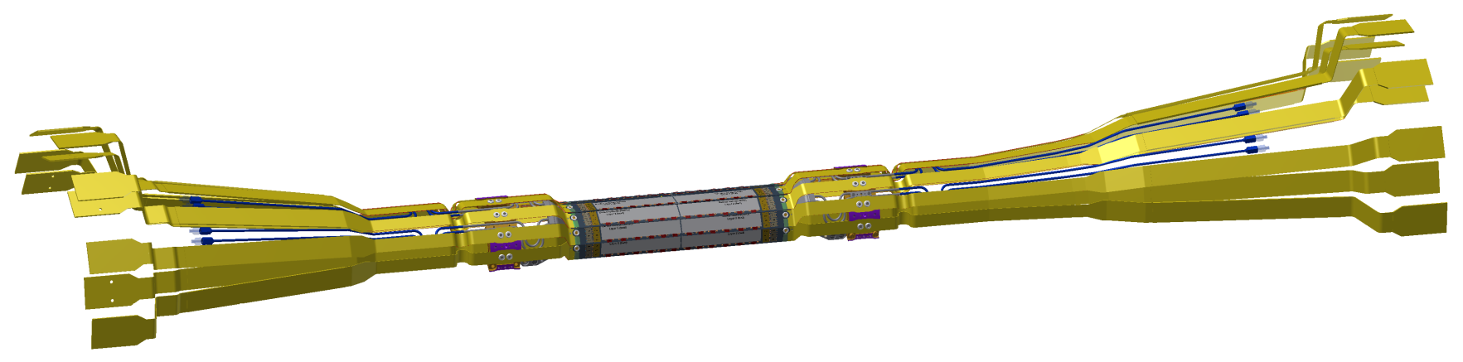

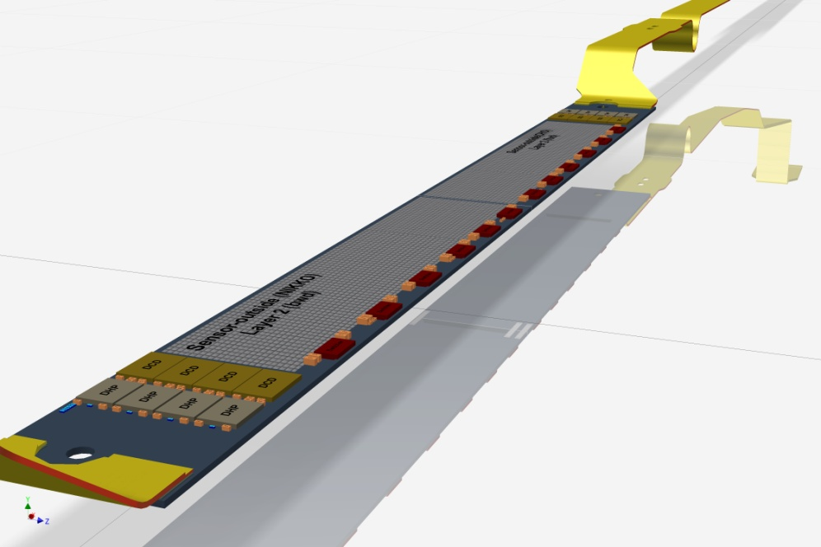
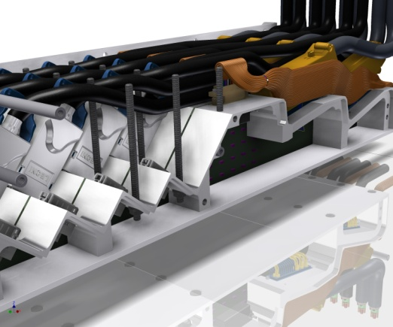
Support & Services
Mechanics workshop: Design of support & cooling structure
Complex service routing
(long Kapton tapes & CO₂ inlets)
> 1 m
Module assembly:
Gluing of two modules to a ladder
Soldering of Kapton tapes
Service routing

Slide 16
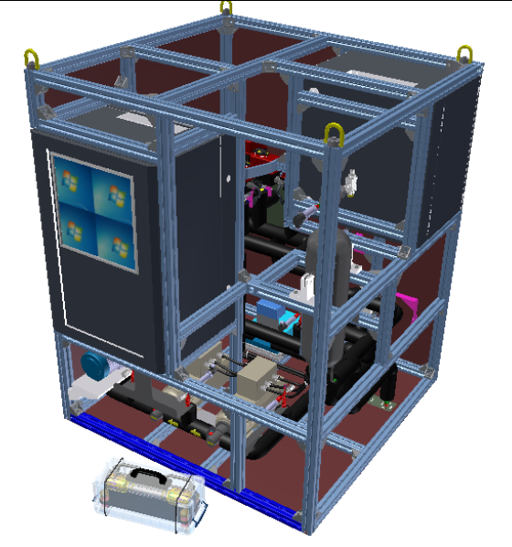
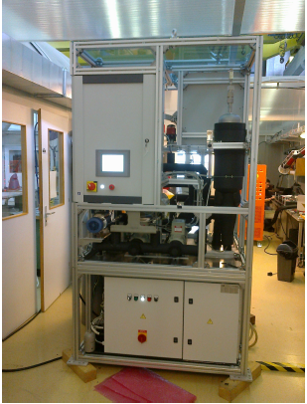
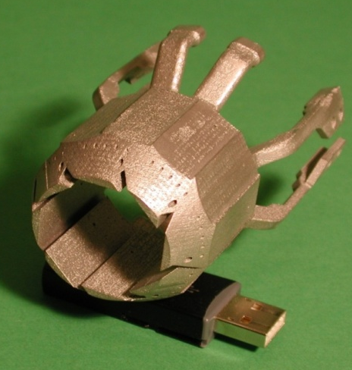
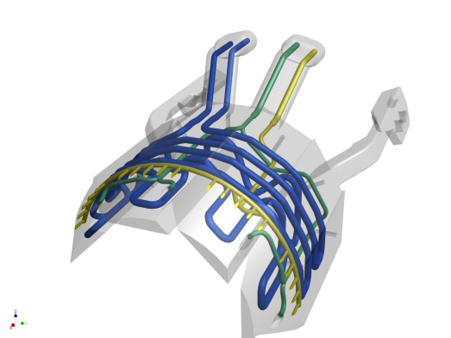
Cooling
2-phase CO₂ cooling
Common project with ATLAS (pixel)
MARCO (prototype) is being commissioned at CERN
Will be shipped to Munich in January
tested and certified
To be used for beam test in October
Main issue:
replacement of PVSS control by EPICS
IBBelle (final units) will be designed and
built in Munich
need two units for KEK
one for ATLAS IBL

Slide 17
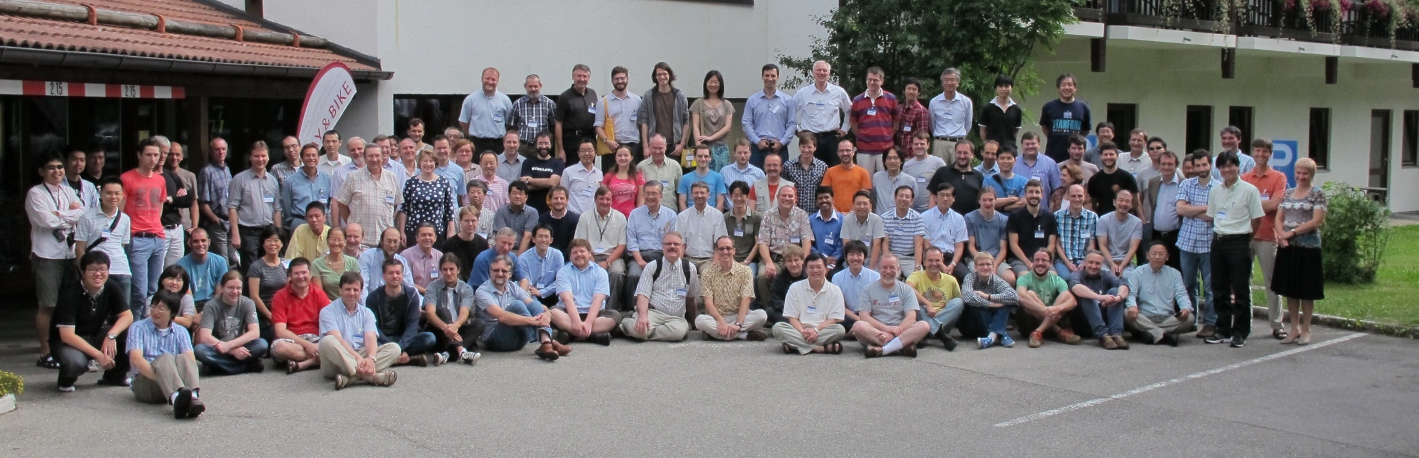
Summary
Many activities in the analysis of Belle data
could need more PhD-students (but positions limited, especially IMPRS)
Upgrade of KEKB to superKEKB and Belle to Belle II progressing well
PXD Sensor production has started and is running smoothly
batch of 13 wafers in production since July
39 of 82 steps processed
2nd batch (18 wafers) to be started asap
Other system components progressing well
Gated mode operation solves injection noise problem
Delivery date of PXD: August 2015
First data taking: End of 2016
Belle II collaboration meeting in Bad Aibling, July 2012

