Slide 1


Pulse Shape Analysis
for AGATA
    short introduction AGATA
    γ-ray tracking ingredients
    pulse shape analysis
    first results
Peter Reiter
IKP, University of Cologne
“Symposium of the Sino-german GDT Cooperation"
April 8-12, 2013
Tübingen, Germany

Slide 2
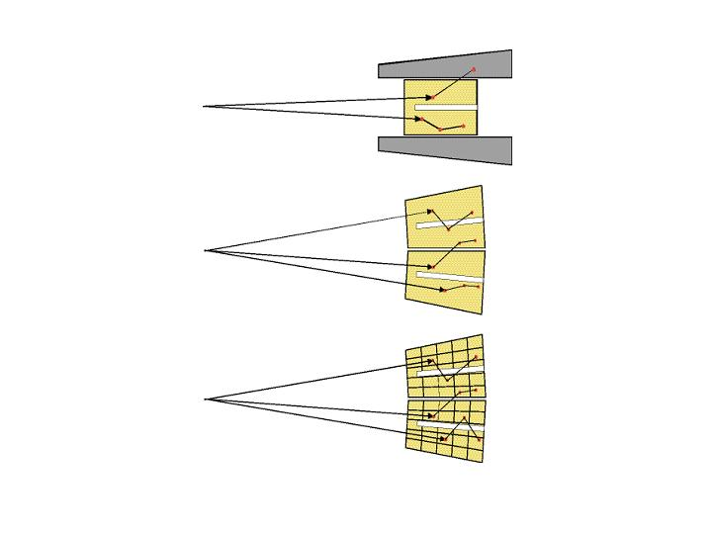
How to improve γ-detection systems
➔ Idea of γ-ray tracking
Compton Shielded Ge
large opening angle means poor energy resolution at high recoil velocity
ε_{ph} ~ 10%
N_{det} ~ 100
θ ~ 8º
Ω ~40%
Ge Sphere
too many detectors
are needed to avoid
summing effects
ε_{ph} ~ 50%
N_{det} ~ 1000
θ ~ 3º
Ge Tracking Array
Combination of:
segmented detectors
digital electronics
pulse processing
tracking the γ-rays
ε_{ph} ~ 50%
N_{det} ~ 100
Ω ~80%
θ ~ 1º

Slide 3
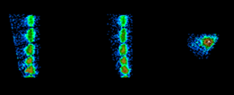
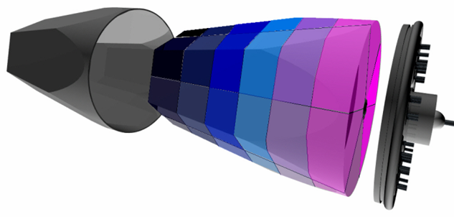
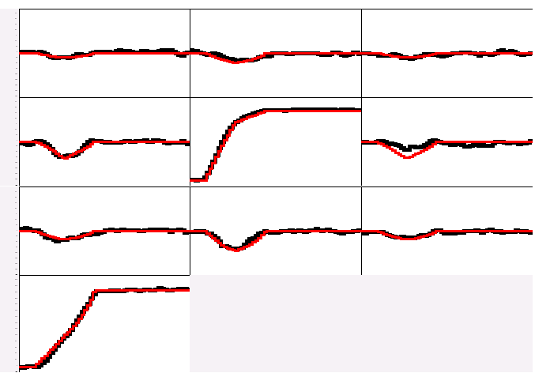
Gamma-Ray Tracking Paradigm
Large Volume Segmented Germanium Detectors
Identification of hits inside the crystal
Reconstruction of individual gammas from the hits
•
(x,y,z,E,t)_{i}
•
•
•
•
•
•
•
γ
Decomposition of signal shapes
A3
A4
A5
Digital electronics
B3
B4
B5
C3
C4
C5
Energy and direction of the gamma rays
measured
calculated
CORE

Slide 4

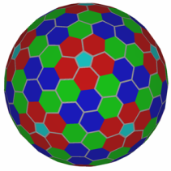













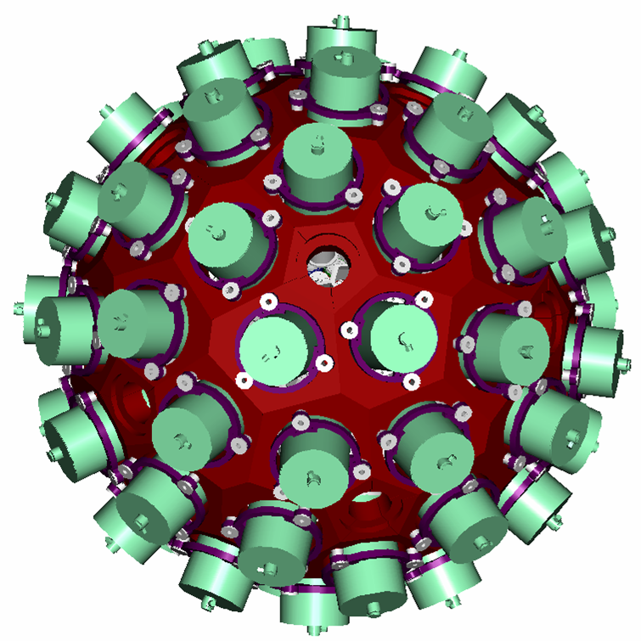
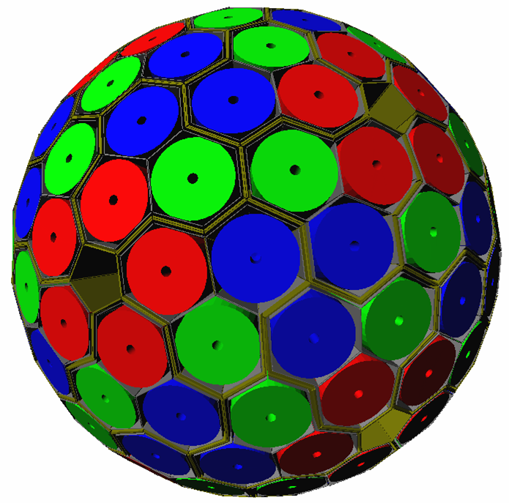
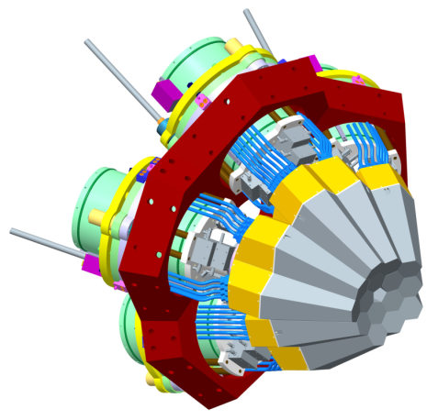
Advanced GAmma Tracking Array
180 hexagonal crystals 3 shapes
60 triple-clusters all equal
Inner radius (Ge) 23.5 cm
Amount of germanium 362 kg
Solid angle coverage 82 %
36-fold segmentation 6480 segments
Singles rate ~50 kHz
Efficiency: 43% (M_{γ}=1) 28% (M_{γ}=30)
Peak/Total: 58% (M_{γ}=1) 49% (M_{γ}=30)
New γ-ray detection method
6660 high-resolution digital electronics channels
Coupling to ancillary detectors for added selectivity

Slide 5
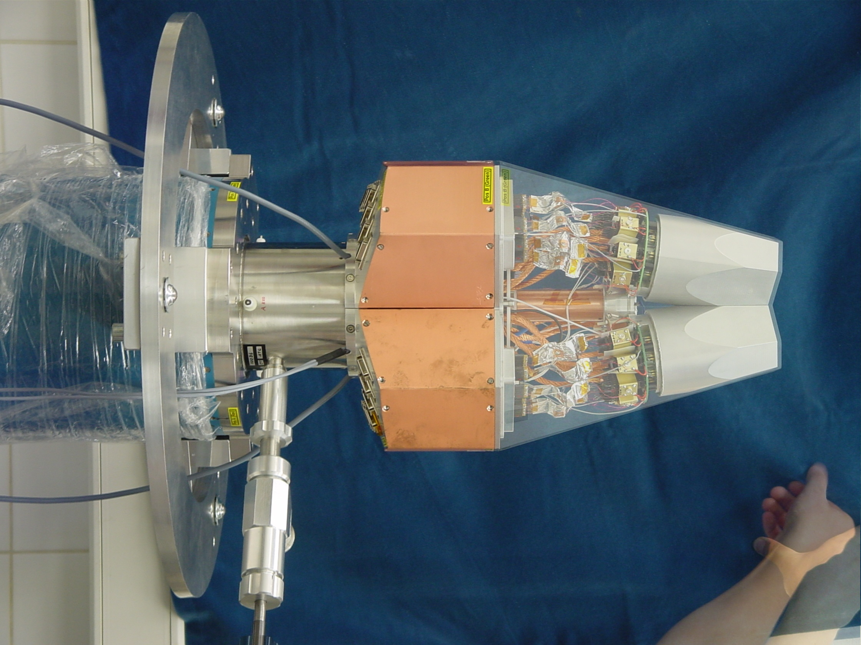
Asymmetric AGATA Triple Cryostat
- integration of 111 high resolution
spectroscopy channels
- cold FET technology for all signals
Challenges:
- mechanical precision
- LN2 consumption
- microphonics
- noise, high frequencies
- A. Wiens et al. NIM A 618 (2010) 223–233
- D. Lersch et al. NIM A 640(2011) 133-138

Slide 6
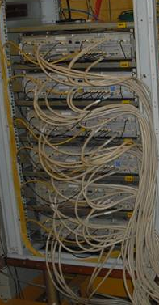
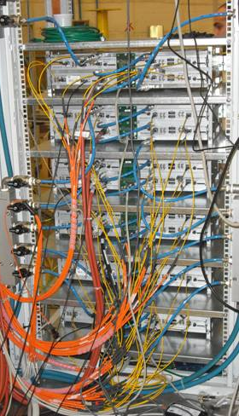
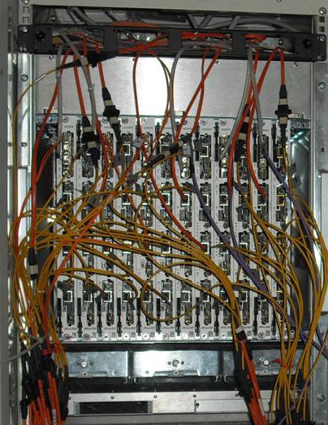
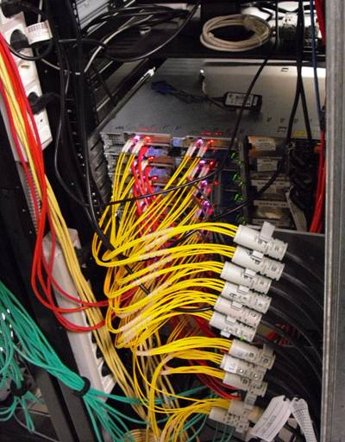
AGATA: Digital Electronics
Digitisers
in the experimental hall
Digital proc. electronics
in the users area
Computer farm
in the computing room
10 m long MDR cables
80 m long optical fibers
20 m long optical fibers
LAN to the disk servers
100Mhz, 14 bit
Synchronous &
continuous
Triggering
Energy
Trace capture
Preprocessing
PSA
Tracking
(7.6GB/s/crystal)
(10 kB/evt/crystal)
Global
Triggering
System
GTS
Clock &
Trigger validation

Slide 7
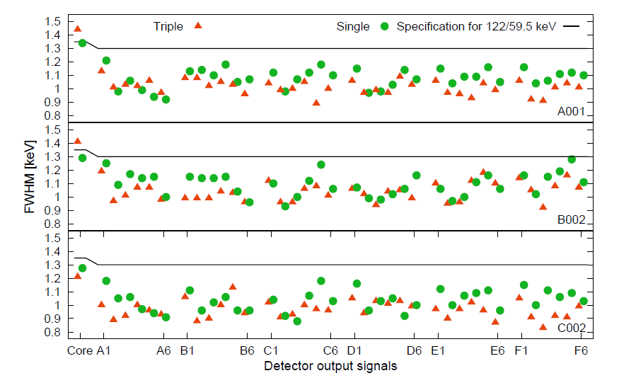
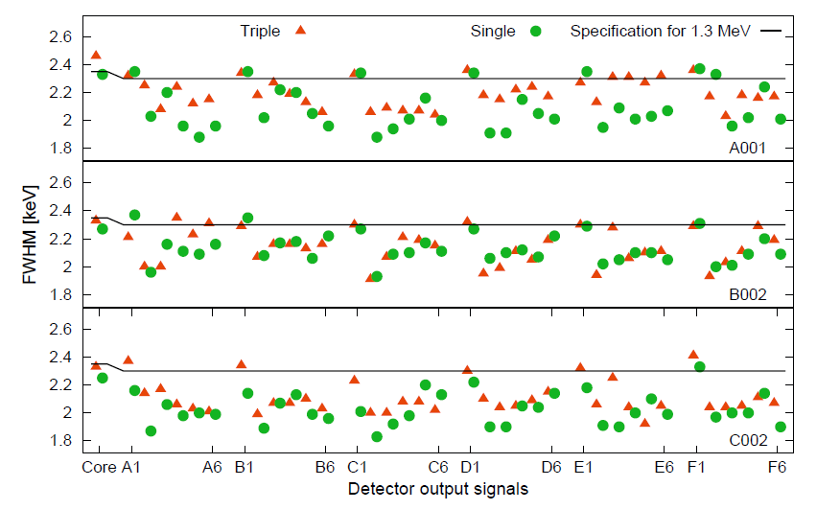
Performance: Energy resolution
@ 60 keV
@ 1333 keV
Averages of the segment resolutions
@ 60 keV :
A001: 1011 +/- 53 eV B002: 1039 +/- 70 eV C002: 965 +/- 63 eV
Averages of the segment resolutions
Measured in Köln and Legnaro
@ 1333 keV :
IKP / Legnaro
A001: 2,19 keV / 2,00 keV
B002: 2,09 keV / 1,98 keV
C002: 2,1 keV / 1,94 keV
Segment labeling

Slide 8
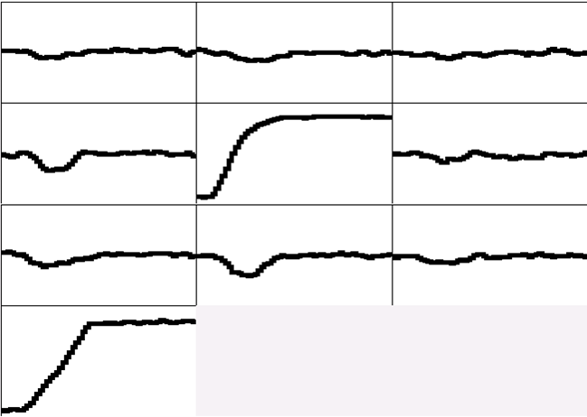
Pulse Shape Analysis concept
A3
A4
A5
B3
B4
B5
C3
C4
C5
CORE
measured
791 keV deposited in segment B4

Slide 9
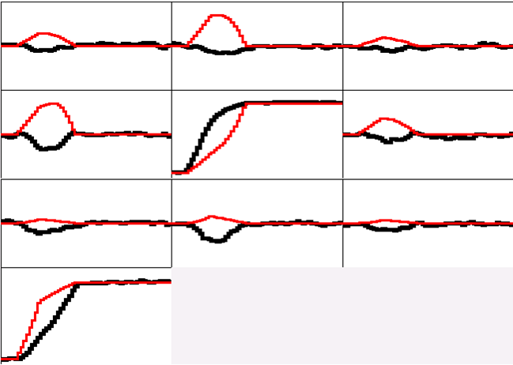
Pulse Shape Analysis concept
A3
A4
A5
B3
B4
B5
(10,10,46)
C3
C4
C5
y
CORE
C4
B4
measured
calculated
D4
A4
x
791 keV deposited in segment B4
E4
F4
z = 46 mm

Slide 10
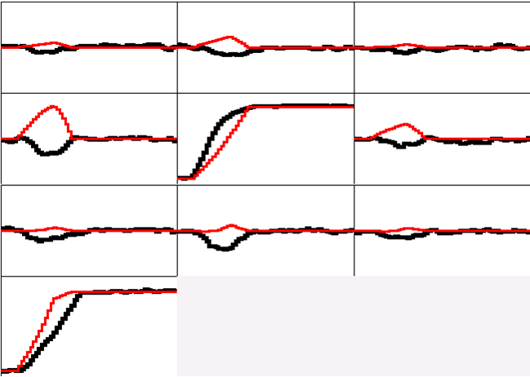
Pulse Shape Analysis concept
A3
A4
A5
B3
B4
B5
(10,15,46)
C3
C4
C5
y
CORE
C4
B4
measured
calculated
D4
A4
x
791 keV deposited in segment B4
E4
F4
z = 46 mm

Slide 11
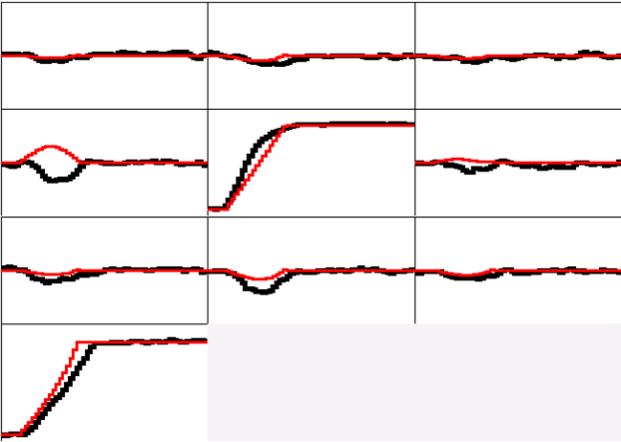
Pulse Shape Analysis concept
A3
A4
A5
B3
B4
B5
(10,20,46)
C3
C4
C5
y
CORE
C4
B4
measured
calculated
D4
A4
x
791 keV deposited in segment B4
E4
F4
z = 46 mm

Slide 12
Pulse Shape Analysis concept
A3
A4
A5
B3
B4
B5
(10,25,46)
C3
C4
C5
y
CORE
C4
B4
measured
calculated
D4
A4
x
791 keV deposited in segment B4
E4
F4
z = 46 mm

Slide 13
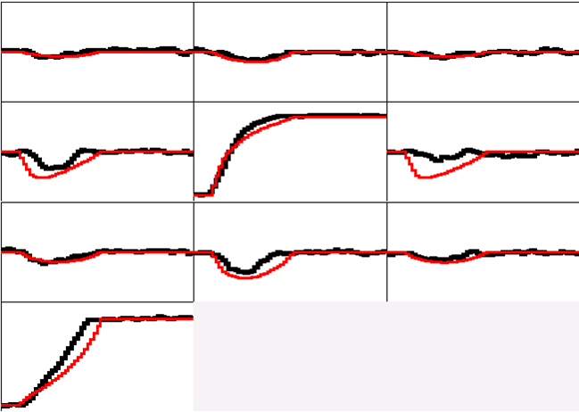
Pulse Shape Analysis concept
A3
A4
A5
B3
B4
B5
(10,30,46)
C3
C4
C5
y
CORE
C4
B4
measured
calculated
D4
A4
x
791 keV deposited in segment B4
E4
F4
z = 46 mm

Slide 14
Pulse Shape Analysis concept
A3
A4
A5
Result of
Grid Search
Algorithm
B3
B4
B5
(10,25,46)
C3
C4
C5
y
CORE
C4
B4
measured
calculated
D4
A4
x
791 keV deposited in segment B4
E4
F4
z = 46 mm

Slide 15
How to simulate detectors
Requirements:
Weighting potentials
Electrical field ↔ space charge
Anisotropic Mobility
Response of electronics
Weighting potential
for this segment
B. Bruyneel NIMA 569 (2006) 764-773
10 … 90%
B. Bruyneel NIMA 569 (2006) 774-789
Solution to
Laplace equation
1 … 9%
0.1 … 0.9%
Notes:
The characterization procedure I developed were tested on a 12-fold segmented MINIBALL detector.
To characterize such crystal, one needs to know first of all how much mirror charge is induced in each of these
Electrodes when a unit of charge is placed at a specific point in the detector.
This information is provided by the Weighting potentials.
The weigting potential for “this” segment is show here for a true coaxial detector.
These potentials can be calculated as solution of the Laplace equation,
With the boundary conditions that they have to be 1 at “this” electrode and 0 at all the other electrodes.
How to calculate the Weighting potentials is well described in litterature, so I will not disscuss this further.

Slide 16
Anisotropic charge carrier mobility
Electrons and holes have different longitudinal and tangential velocity anisotropy components.
<100>
<110>
Electrons v_{r} mainly slower near [111]
Holes v_{r} mainly faster near [100]
Tangential components 0 along symmetry axes and largest near same directions of largest v_{r} differences
see talk by I. Abt
hole trajectories
<100>
<110>
Notes:
Here you see a comparison between the electron mobility and the hole mobility:
What is plotted is a three dimensional version of the illustration given earlier (remember introduction).
The radial components are mainly slower for the electrons in the 111 direction,
while for the holes, the radial component is mainly larger along the 100 direction.
As proven earlier, along symmetry axis, the tangential component is zero.
Idem to the longitudinal anisotropy, the tangential anisotropy is again most pronounced near the 111 direction for the electrons,
And near the 100 directions for the holes.

Slide 17
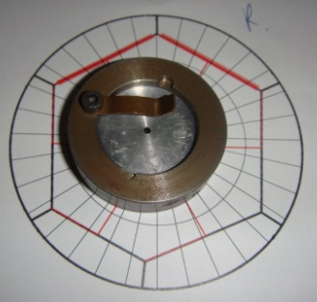
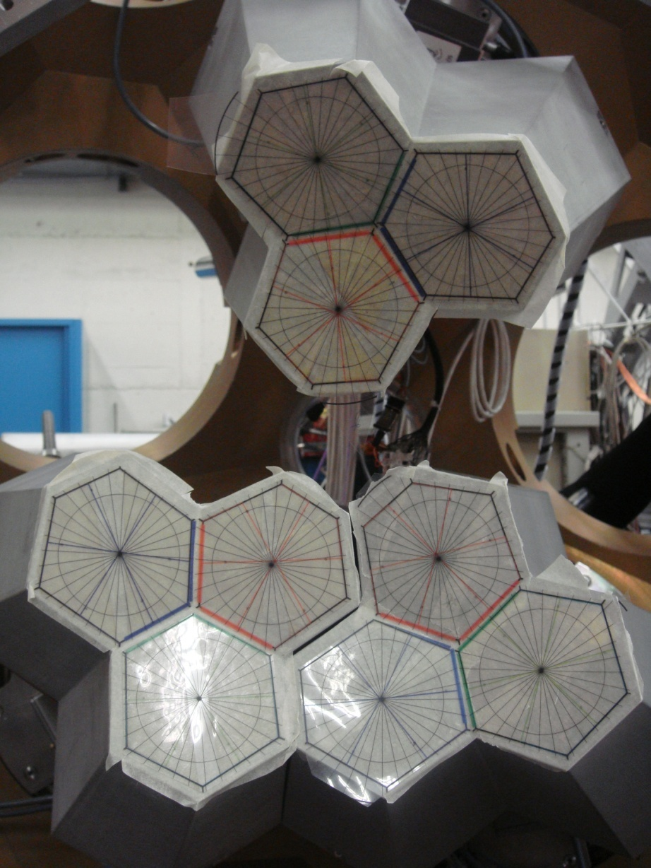
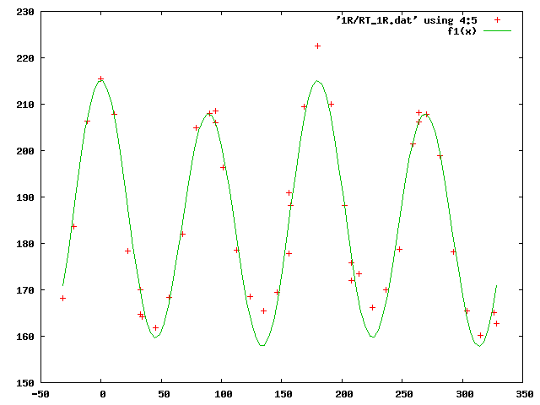
Crystal orientation
400kBq Am source +
Lead Collimator: ∅ 1.5mm X 1cm
Front Scan at ∅ 4.7cm: 300 cts/s
Fitfunction Risetime(θ) =
A.[1+R₄cos(θ- θ₄)].[1+R₂cos(θ- θ₂)]
Risetime [ns]
θ [°]

Slide 18
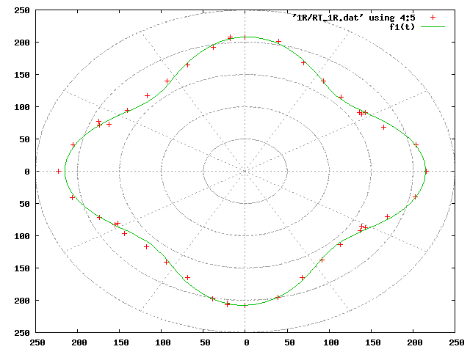
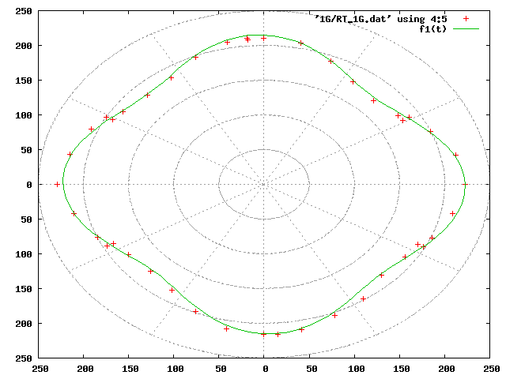
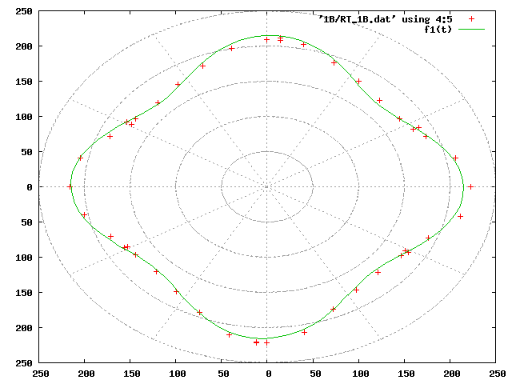
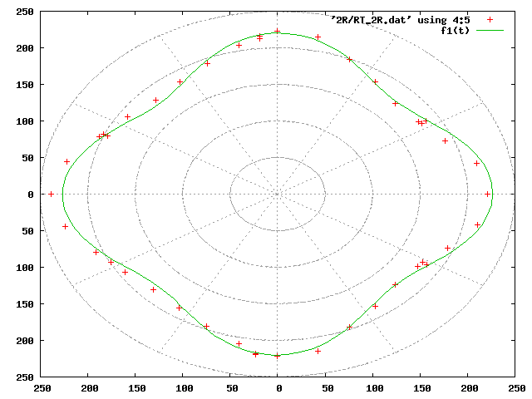
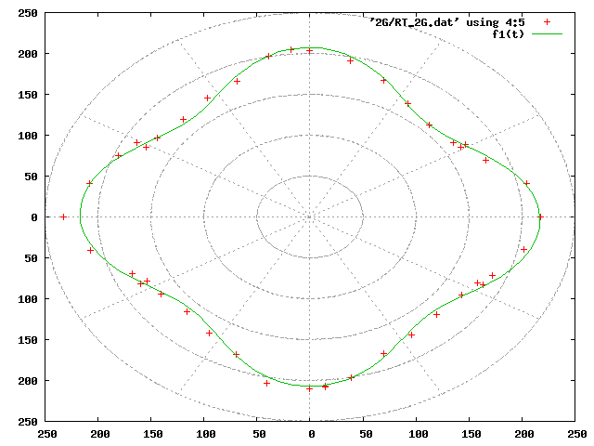
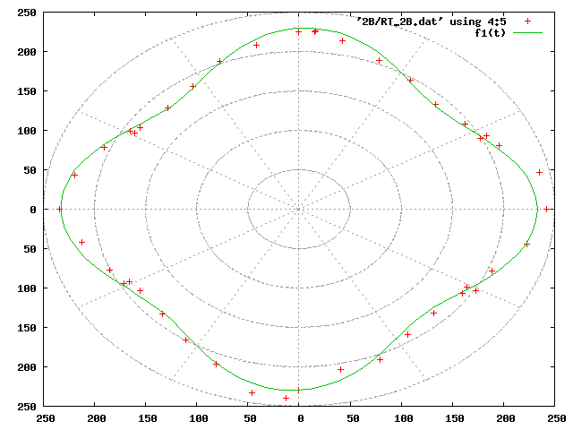
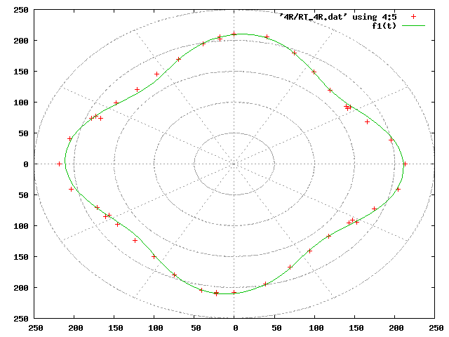

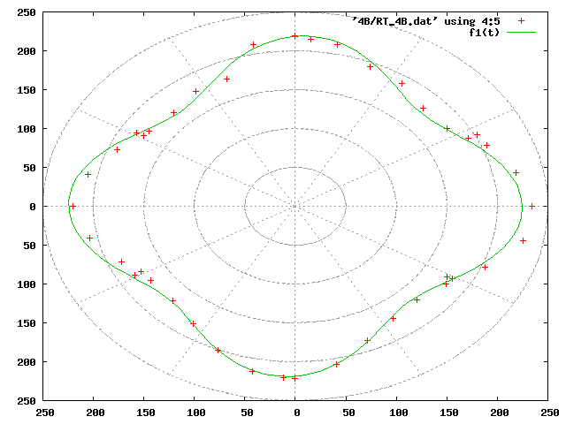
Crystal orientation
R G B
ATC1
ATC2
ATC4

Slide 19
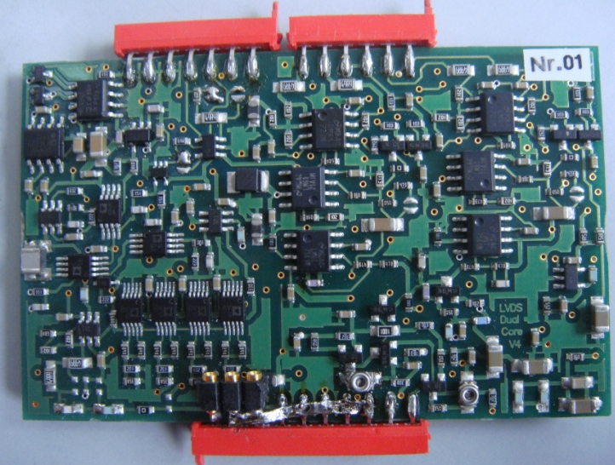
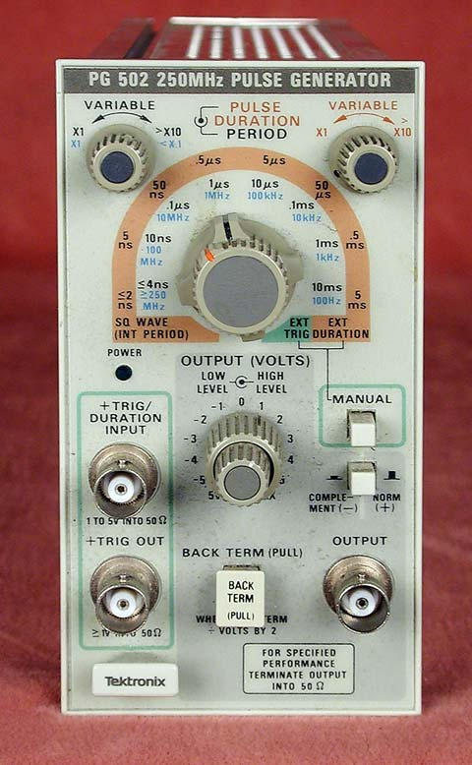
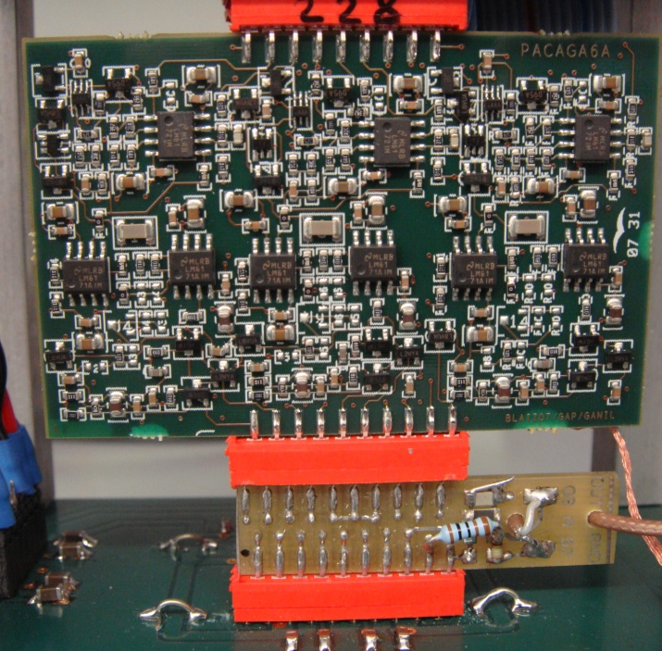
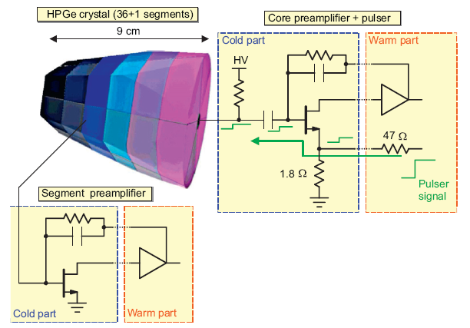
Electronics & Response
Preamps 30-35ns rise time
Core - built in progr. pulser ~ 60ns
- bypass for fast 1ns pulser
Segment pulser input (non-standard)
In
core
Rectangular wave
1ns rise time
In
seg
Responses
Capacities
Time – alignment
…

Slide 20
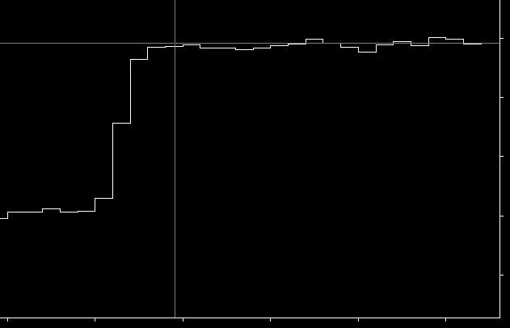
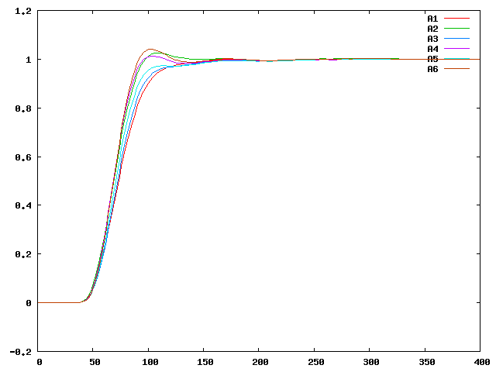
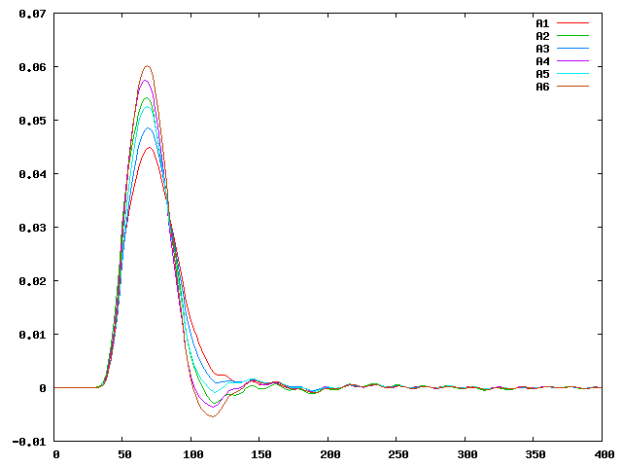
Response function
Raw data (10 ns/sample)
Averaged data
(2ns/sample)
Avg. T₁₀₋₉₀ = 43ns
Derivative of
Averaged data
…Averaging = Convolution…
Time [ns]

Slide 21
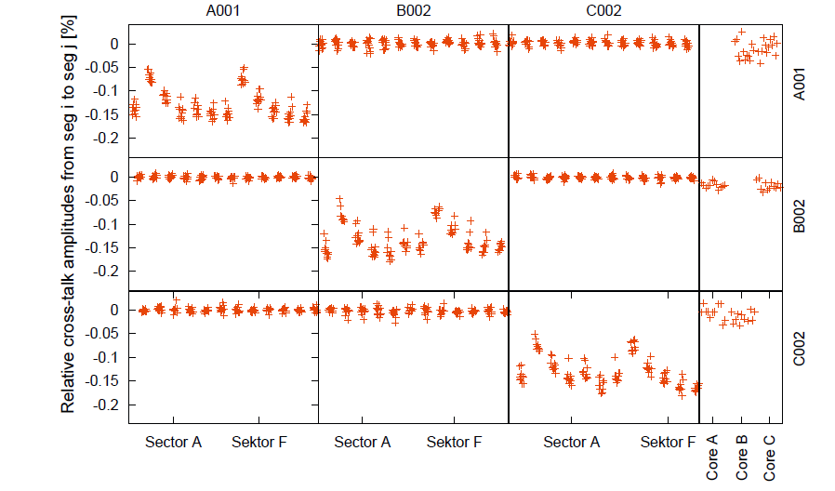
Cross talk
No crosstalk observed between detectors
Within one detector, the theoretical crosstalk limit is reached
Online cross talk correction implemented
B. Bruyneel et al., NIM A 599 (2009) 196

Slide 22
Simulated Signals
Signals after folding with the preamplifier response function and the analog filter functions (some smearing)
Full signal for each point in the detector.
experiment
Set A
Set B
Parameters from experiment

Slide 23
PSA Codes within AGATA
Search Routines
- Adaptive Grid Search (A. Venturelli, INFN Padova)
- Particle Swarm Optimization (M. Schlarb, TU Munich)
Decomposition strategy for multiple interactions:
- assuming maximum 1 hit per segment
- segments influenced by multiple hits excluded
A. Grid search:
implemented
A. Grid search:
Hit | X
 | X | Hit
Other PSA schemes
Matrix method (A. Olariu, P. Desesquelles, CSNSM Orsay)
Partial PSA information
Recursive Substraction algorithm (Fabio Crespi, INFN Milan )
[library] . [x] = [event]

Slide 24
Performance of different PSA algorithms
tests using simulated data, performance is quoted:
  relative to the grid-search algorithm for single interactions
  relative to the particle swarm algorithm for multiple interactions.
position resolution: FWHM values
Algorithm | Single interaction |  | Multiple interactions
 | CPU time (norm/GS) | Resolution (mm) | CPU time (norm/PS) | Resolution (mm)
Grid search | 1 | 2 | – | 4
Extensive GS | 2.7 | 1 | 6×10⁴ | 4
Particle swarm | 0.1 | 2 | 1 | 4
Matrix method | 6.7 | 2.4 | 10 | 10
Genetic algorithm | 330 | 1.9 | 2×10² | 8.1
Binary search | 0.06 | 1 | Not adapted | Not adapted
Recursive subtraction | Not evaluated | 3 | Not evaluated | 5
Neural network | 2 | 1.5 | Not adapted | Not adapted
Wavelets | Not evaluated | 2.3 | Not adapted | Not adapted

Slide 25
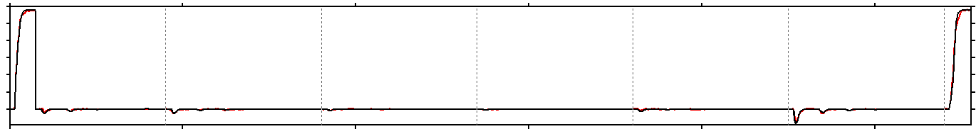
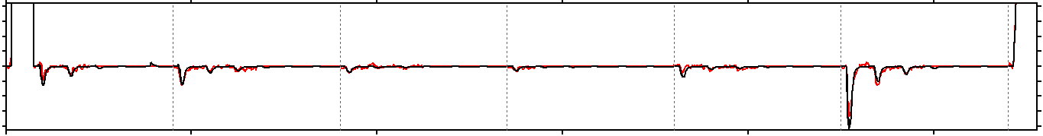
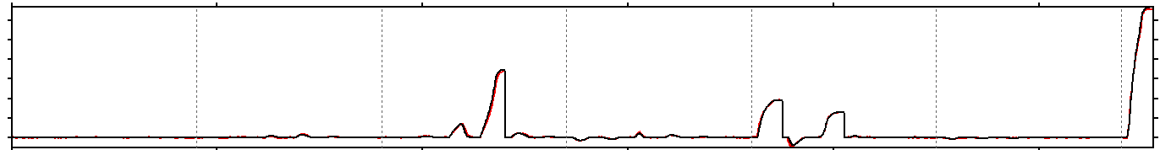
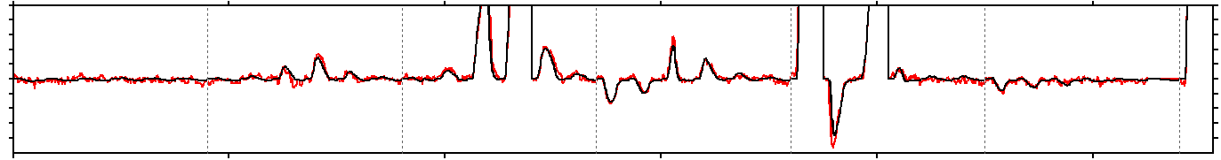
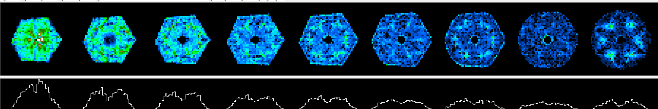
AGATA signal decomposition
Eγ = 1172 keV net-charge in A1
A B C D E F CC
Eγ = 1332 keV net-charge in C3, E1, E3

Slide 26
AGATA online
< 4 mm FWHM resolution obtained
psa online at rates > 5kHz per crystal
Notes:
26

Slide 27
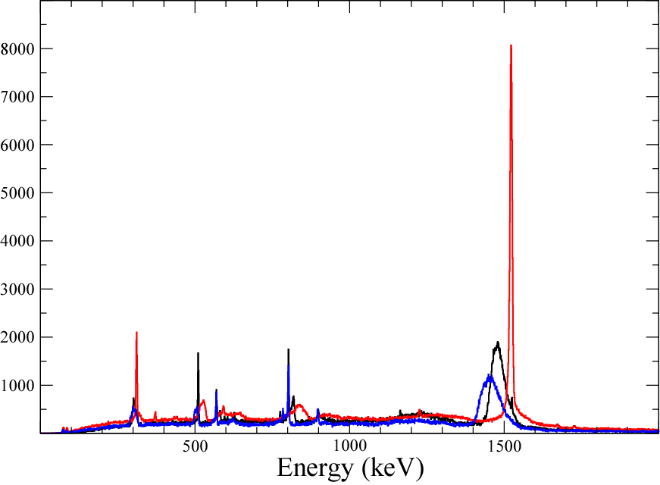
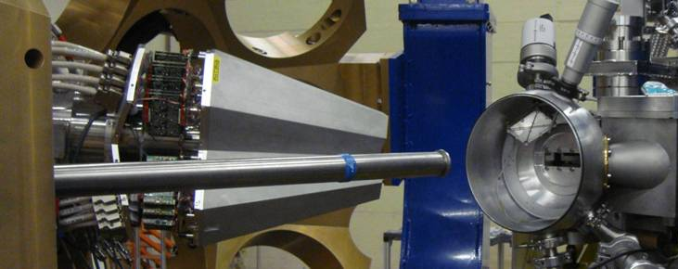
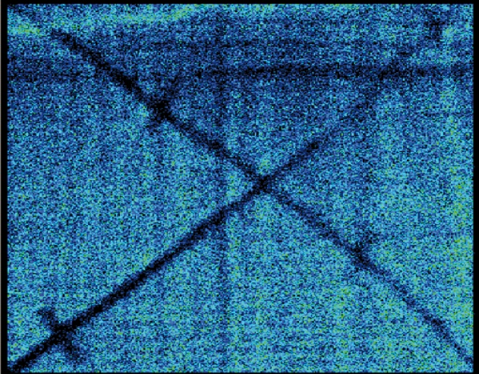
AGATA position resolution
⁴²Ca@170MeV + ²⁰⁸Pb
Kinematical coincidences
Position sensitive MCP
- Line shape without BGO
- energy resolution ΔE = 4.9 KeV corresponds to Δx < 4 mm
1524,7 keV
2⁺ - 0⁺
Uncorrected
Doppler-corrected (Ca)
Doppler-corrected (Pb)
AGATA position resolution
Δx FWHM Method
5.2 mm Doppler corr. meas. F. Recchia et al. NIM A (2009)
4.0 mm Doppler corr. meas P.-A. Söderström et al. NIM A (2011)
3.5 mm 511keV source meas M.Schlarb, et al. EPJA (2011)

Slide 28
AGATA high γ-ray energy detection
²⁴¹AmBe + Fe source to monitor gain instabilities
- ΔE/E=8⋅10⁻⁴ at 7.6 MeV
- no gain fluctuation (within 3‰), stable detectors

Slide 29
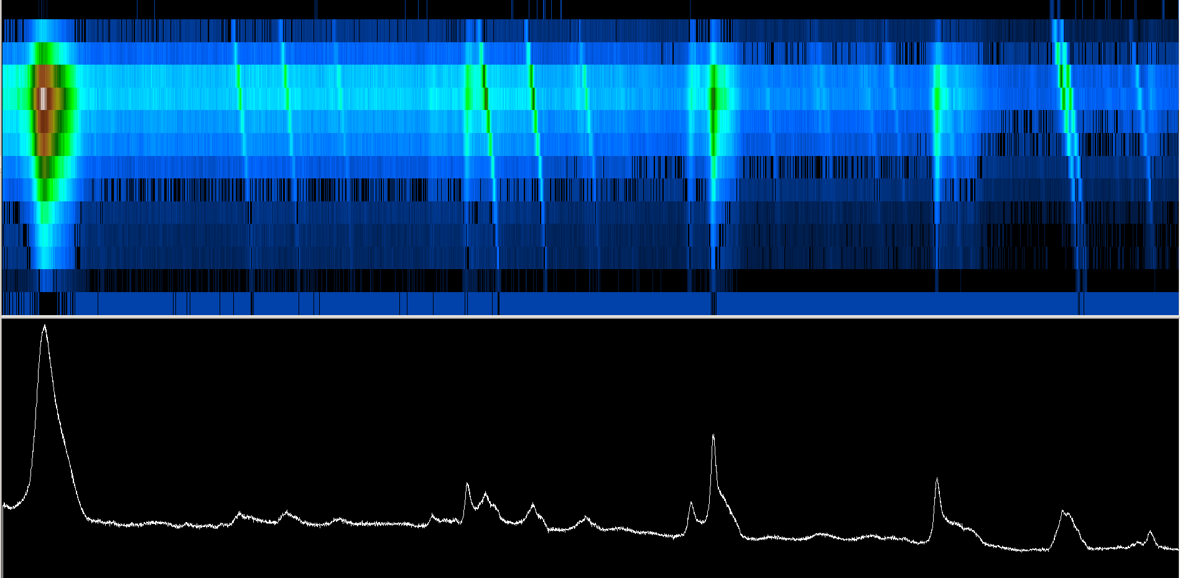
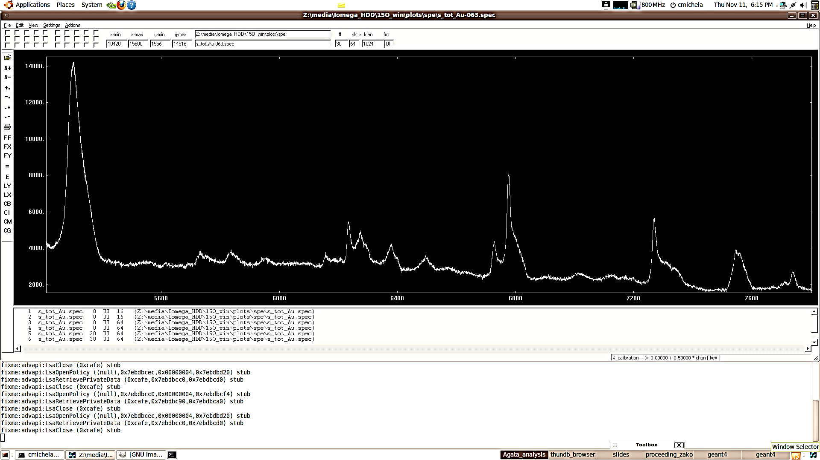
Lifetime of the 6.792MeV state in ¹⁵O
θ [deg]
151
157
163
169
175
¹⁵O
AGATA DSAM line shape sensitivity
¹⁵N
¹⁵O
¹⁵N
source
5600
6000
6400
6800
7200
7600
E
nucleon-transfer
¹⁴N
¹⁵O
¹⁴N
¹⁶O
¹⁵O
²H
n
²H
n
fusion-evaporation

Slide 30
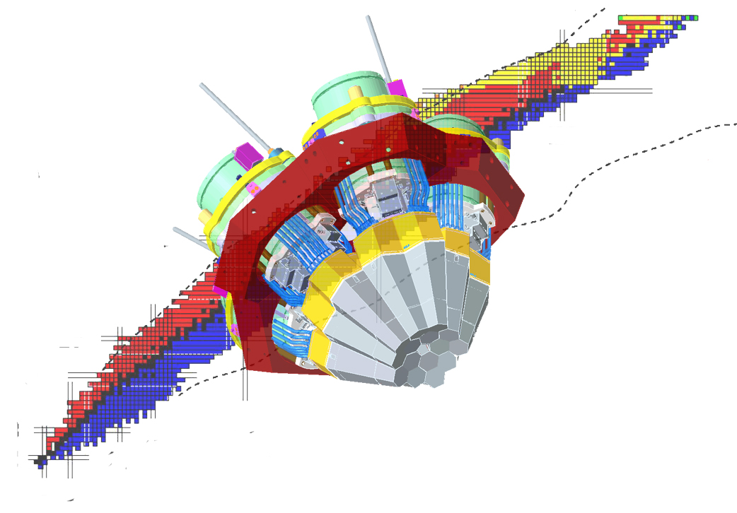

Summary
AGATA components:
  highly segmented HPGe Detectors
  digitizer & front-end electronics
  Pulse shape analysis & γ-ray tracking
Position sensitive γ-ray detection: Δx~3-4 mm
Experimental campaigns ongoing

Slide 31


Acknowledgements

Slide 32



The AGATA Collaboration
Bulgaria: Univ. Sofia
Denmark: NBI Copenhagen
Finland: Univ. Jyväskylä
France: GANIL Caen, IPN Lyon, CSNSM Orsay, IPN Orsay,
CEA-DSM-DAPNIA Saclay, IPHC Strasbourg, LPSC Grenoble
Germany: GSI Darmstadt, TU Darmstadt, Univ. zu Köln, TU München
Hungary: ATOMKI Debrecen
Italy: INFN-LNL, INFN and Univ. Padova, Milano, Firenze, Genova, Napoli
Poland: NINP and IFJ Krakow, SINS Swierk, HIL & IEP Warsaw
Romania: NIPNE & PU Bucharest
Sweden: Univ. Göteborg, Lund Univ., KTH Stockholm, Uppsala Univ.
Turkey: Univ. Ankara, Univ. Istanbul, Technical Univ. Istanbul
UK: Univ. Brighton, CLRC Daresbury, Univ. Edinburgh, Univ. Liverpool,
Univ. Manchester, Univ. West of Scotland, Univ. Surrey, Univ. York
Spain: IFIC Valencia, IEM-CSIC Madrid, LRI Univ. Salamanca
13 Countries
>40 Institutions

